Slide 1
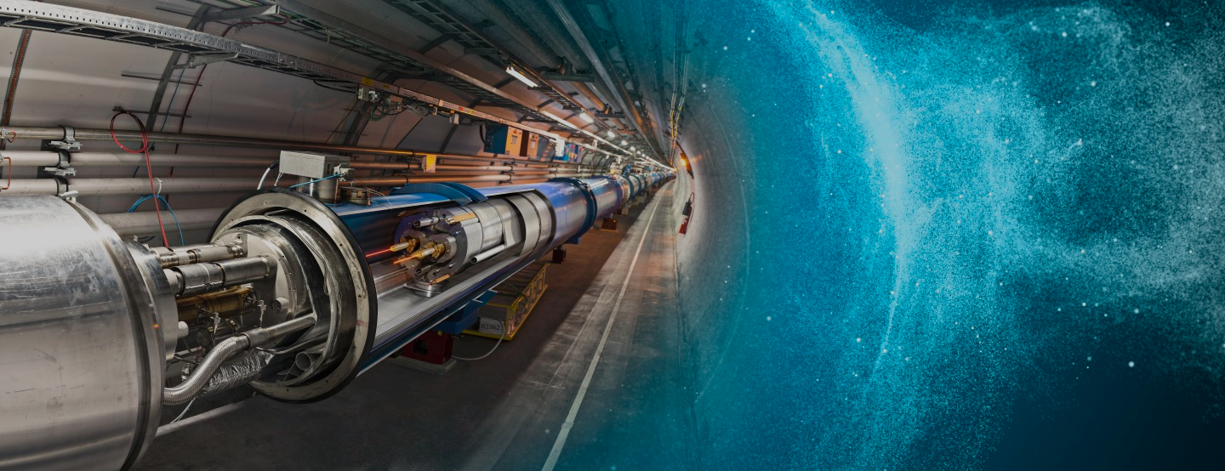

Computing at CERN
Dr Tim SMITH
International High School Teacher Programme – 2024/07/10

Slide 2
computing, n.
Pronunciation:
Brit. /kəmˈpjuːtɪŋ/ , U.S. /kəmˈpjudɪŋ/
1. The action or an instance of calculating or counting; = computation n. 1a.
2. The action or practice of using computers, esp. as a professional or expert; the activity or operation of an electronic computer; (also) = computer science n.

Slide 3
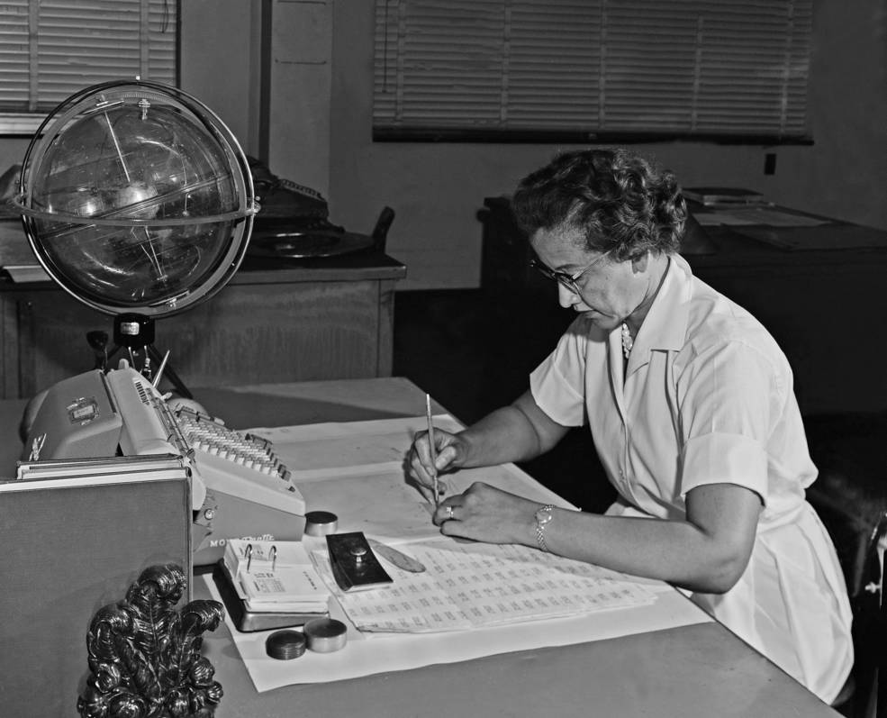
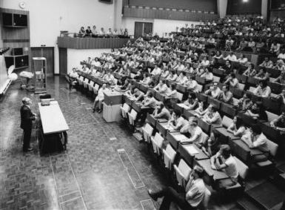
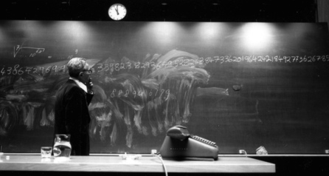
Early “Computers”
Katherine Johnson NASA
Hidden Figures!
CERN had 2 British Ladies
from National Physical Lab
Teddington (London)
Wim Klein
Calculating the 73rd root of a 500 digit number took less than 3 minutes…
Notes:
expert in doing complex calculations, using mathematical tables and interpolation methods. They had been trained at the National Physical Laboratories in Teddington (London)

Slide 4
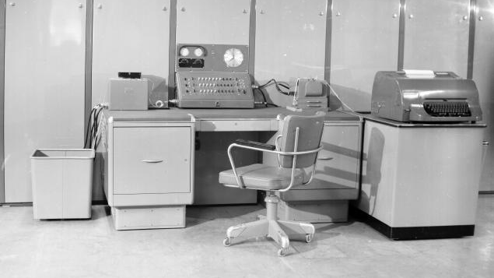
1958: The Ferranti-Mercury arrived!
“..courage to go ahead and solve problems that seemed to difficult to do otherwise..”
Notes:
Justifying words for buying such a computer from an American Physicist who had used a bianry computer already
Ferranti Ltd, Manchester!

Slide 5
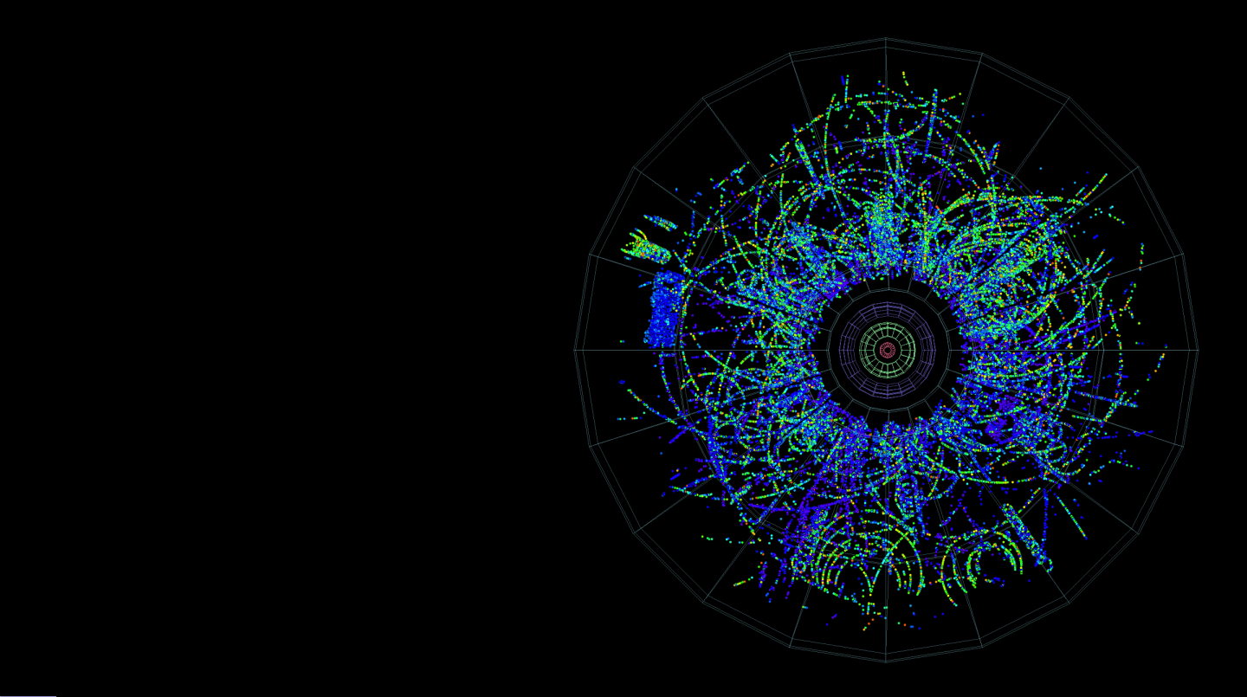
Computing
Scientific
  Compute, Storage, Network
Technical
  Design, Operation
Administrative
  HR, Finance, Projects
Desktop
Collaborative

Slide 6
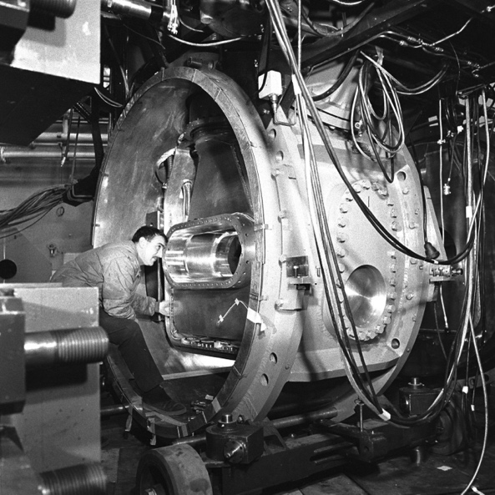
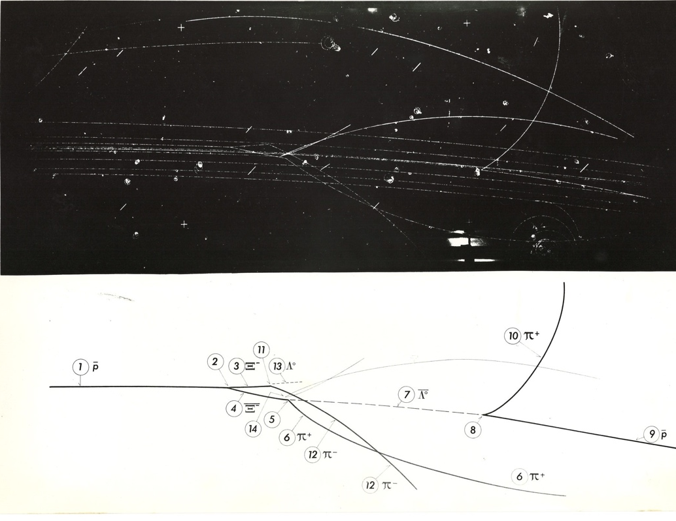
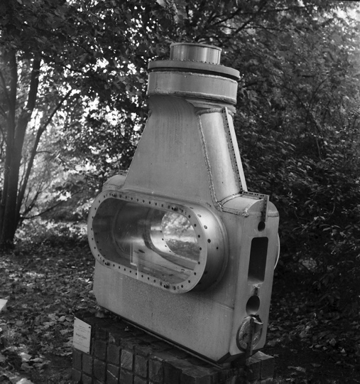
Bubble Chamber
Notes:
81cm Saclay Bubble Chamber, by R1
Superheated liquid hydrogen. Just below boiling point, just before particles piston out to reduce pressure and push into superheated metastable phase

Slide 7
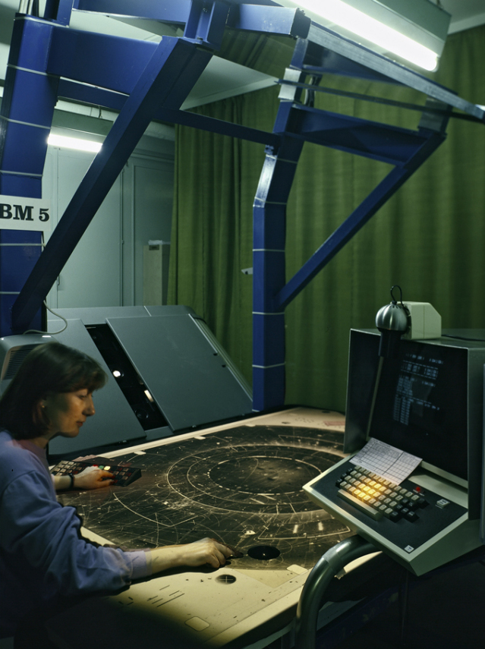
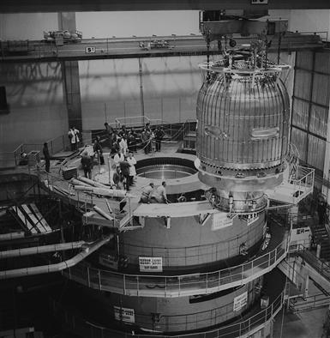
Bubble Chamber
BEBC 1973-1984
6.3 million photos
3000 km of film
Madeline Znoy
750 photos in a day!

Slide 8
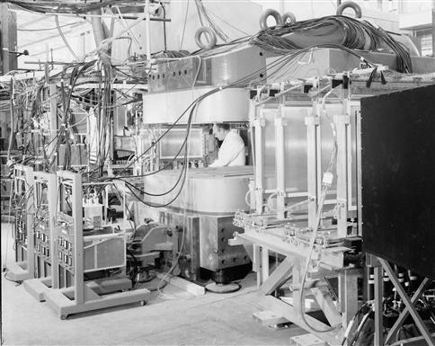
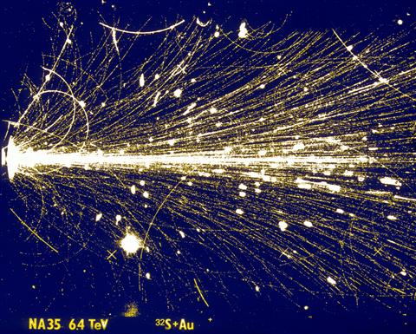
Spark Chambers
1965
Magnetostrictive readout

Slide 9
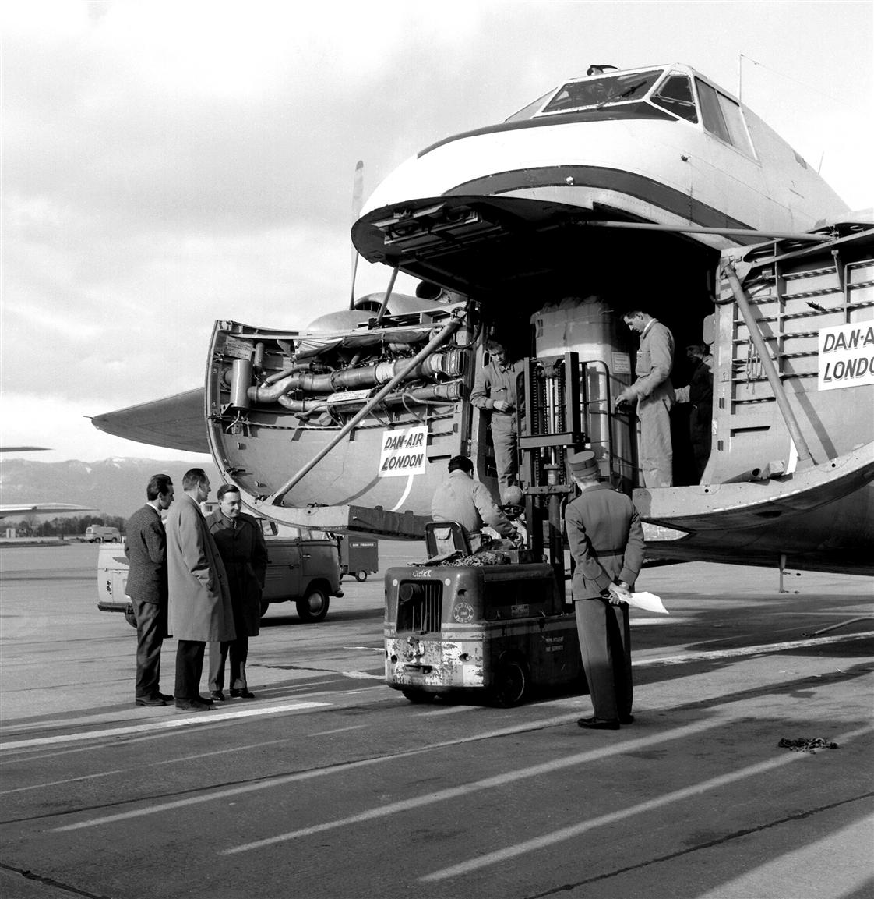
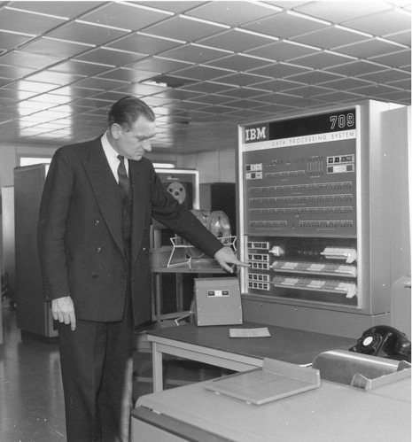
Momentous Events
1960: IBM 709 Vacuum tubes
Notes:
IBM 704 had 32kB word core store
François de Rose

Slide 10
1965: CDC 6600: #3

Slide 11
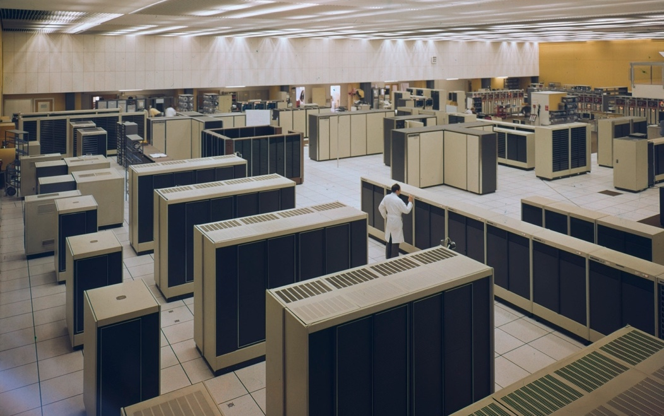
1972: New Computer Centre for a New Computer!

Slide 12
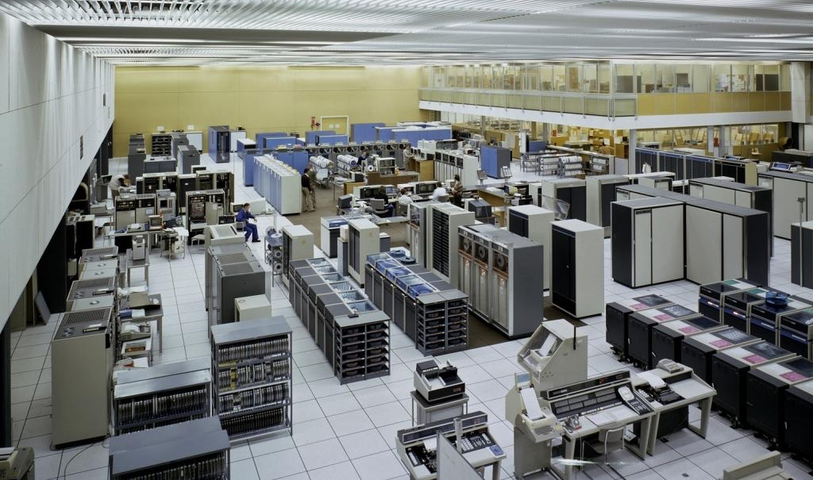
Mainframe Era
1983: 2 CDCs and an IBM 3081
Notes:
Transistors!

Slide 13
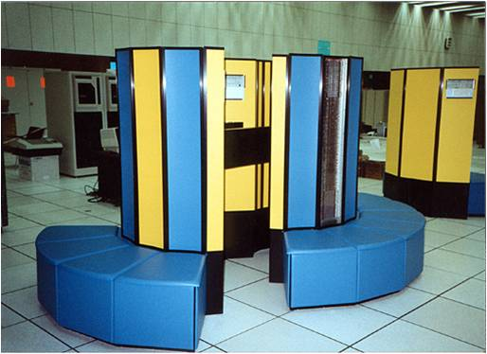
Super Computers
1988: Cray XMP

Slide 14
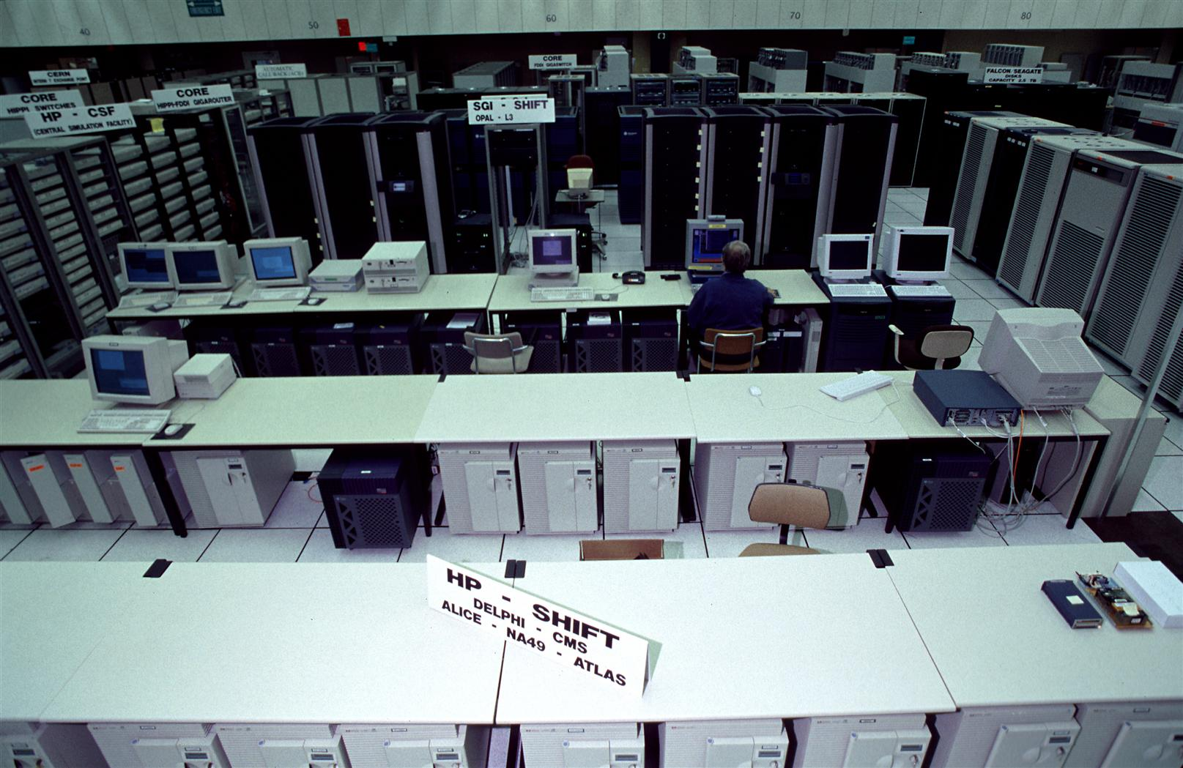




RISC Workstations
Notes:
Modular computing

Slide 15
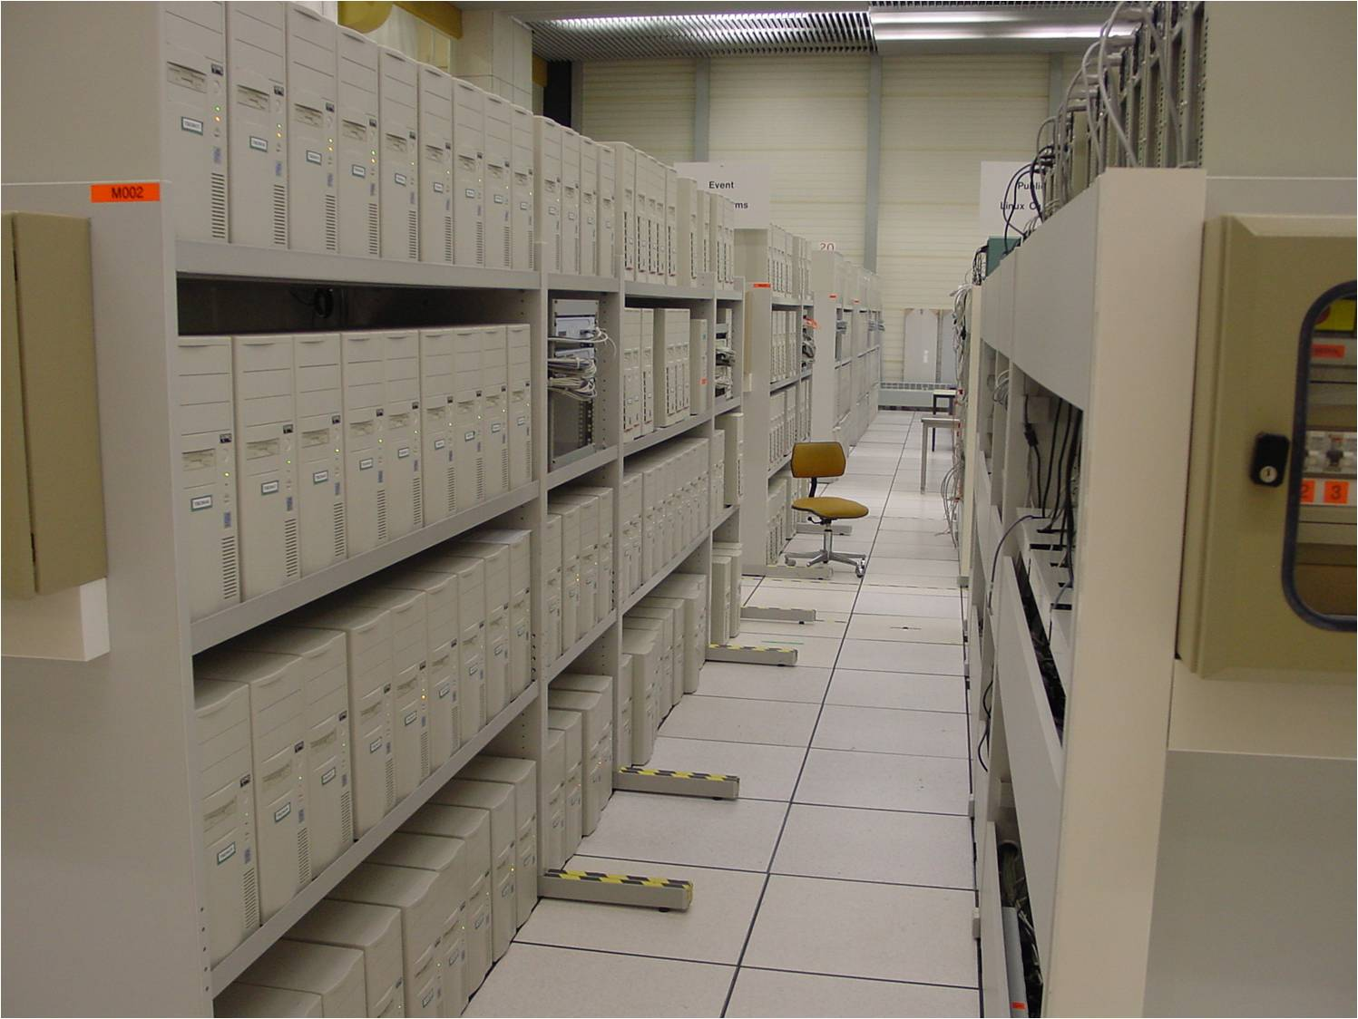
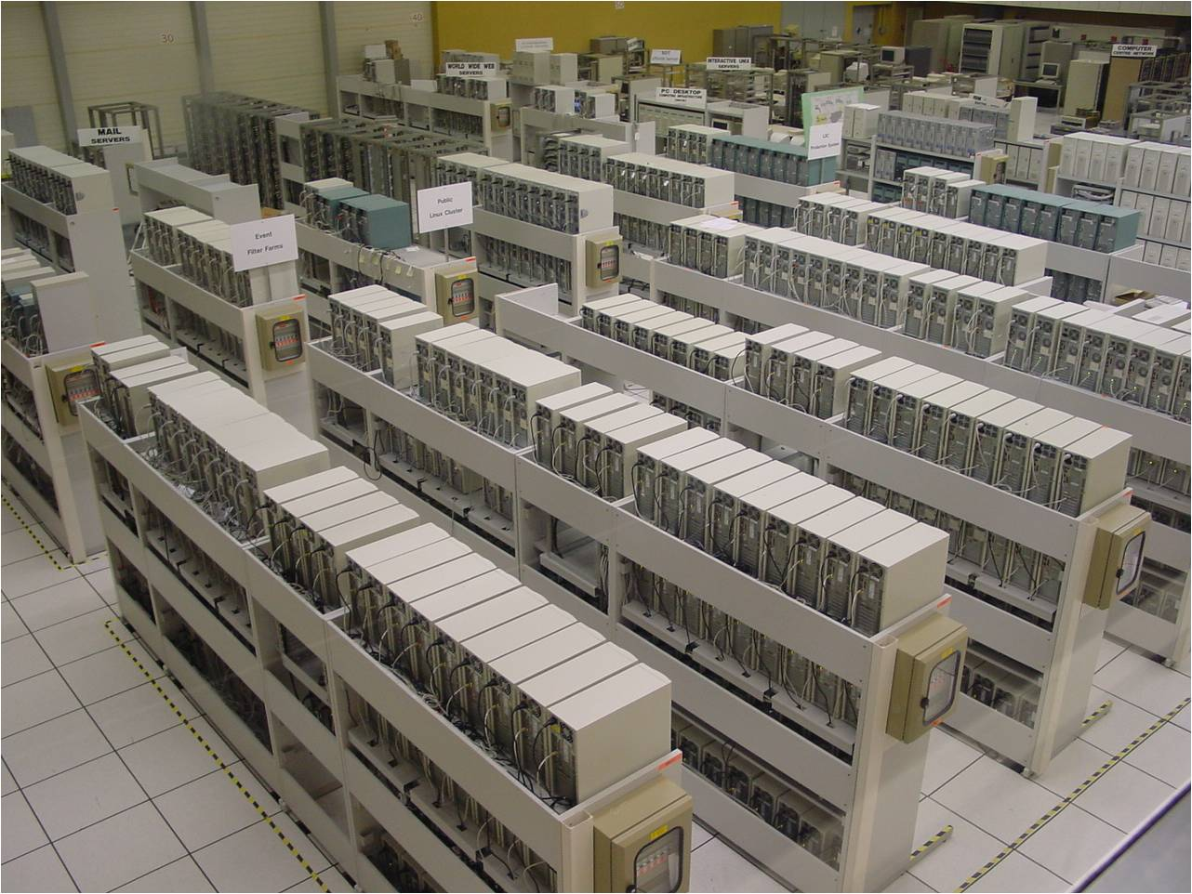
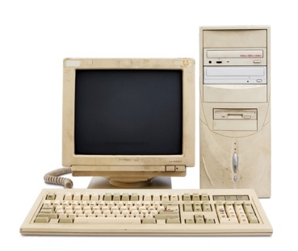

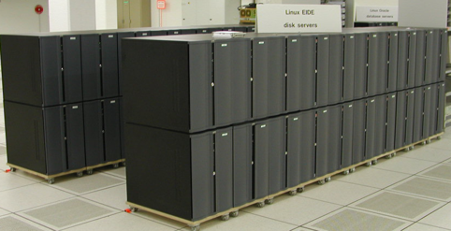
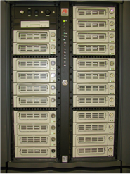
Comodity Computing

Slide 16
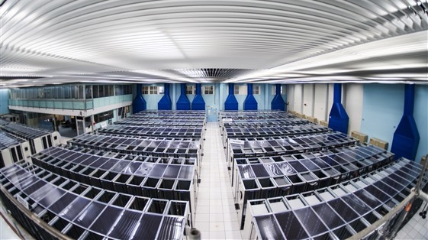
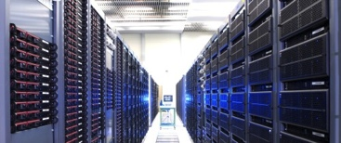
Farming in a Data Centre

Slide 17
Computing
Networking

Slide 18


Networking
Packet-switched network
1969 ARPANET
  US DoD sponsored research at US Universities
  Aim: communications network to survive a nuclear attack
  Find next best route if one node obliterated
70s and 80s proliferation
  US: NASA Science Net, CSnet, Energy Sciences Net, NSFnet
  FR: CYCLADES
  UK: Mark I, SERCnet
  Commercial: Tymnet, CompuServ, BITnet, DECnet
  Protocols: NCP, X.25 (1976), TCP/IP (1982)
  CERnet
Notes:
Telephones were circuit switched

Slide 19
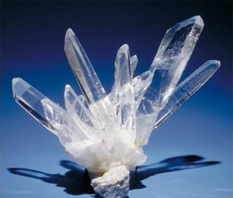

Networking
Science without borders
  1968 Data exchange across the iron curtain – to IHEP in Soviet Union
  1988 first data connection between China and scientific world – IHEP to CERN
Truly international Internet
  1989 first external TCP/IP connection
  1990 principle link US-EU from CERN
    (1.5Mb/s)
  1991 80% of the internet capacity installed in Europe for international traffic was terminated at CERN

Slide 20
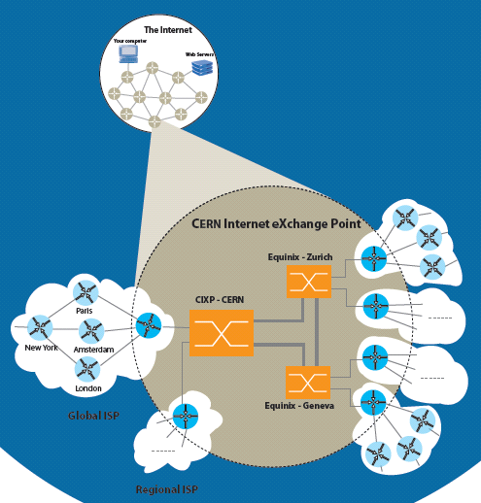
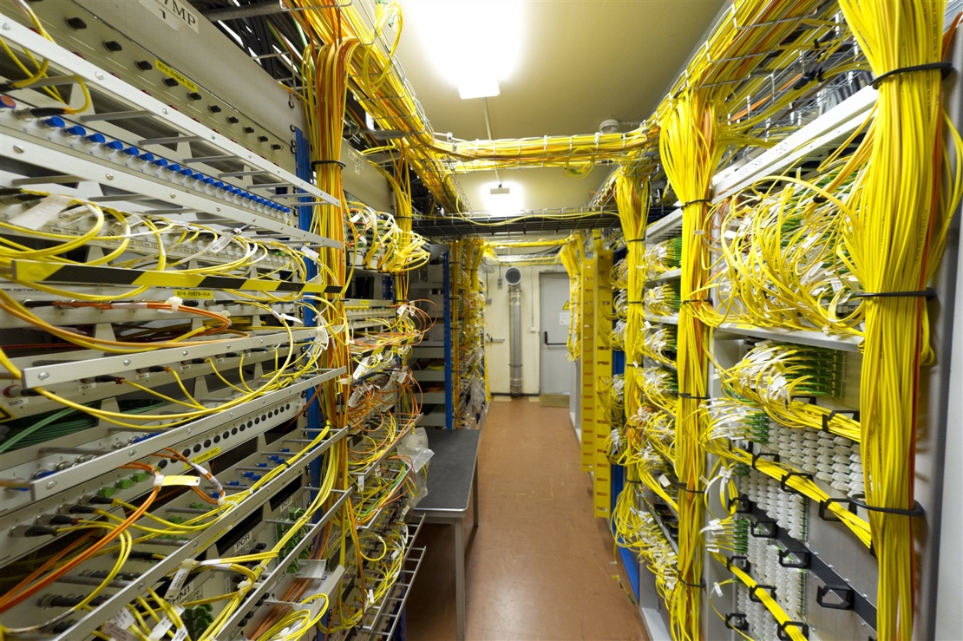
CERN Internet Exchange Point

Slide 21
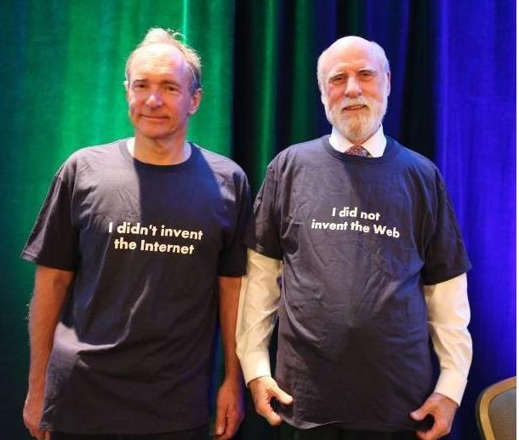
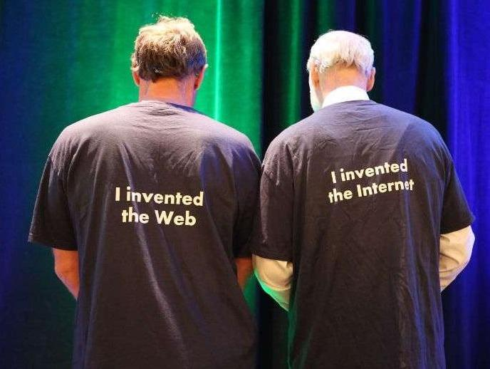
Internet … Web … Who?

Slide 22
Computing
Information Management

Slide 23
Information Management - circa 1989
Keep track of LHC project and CERN?
  Researchers turnover ~2 years
Information about CERN and its experiments
  Not hierarchical, or centrally controlled
    A multiply connected web
  Experts store locally, update independently
  Community is distributed: remote access
System to link it all together
CERN is a model in miniature of the rest of world in a few years time

Slide 24
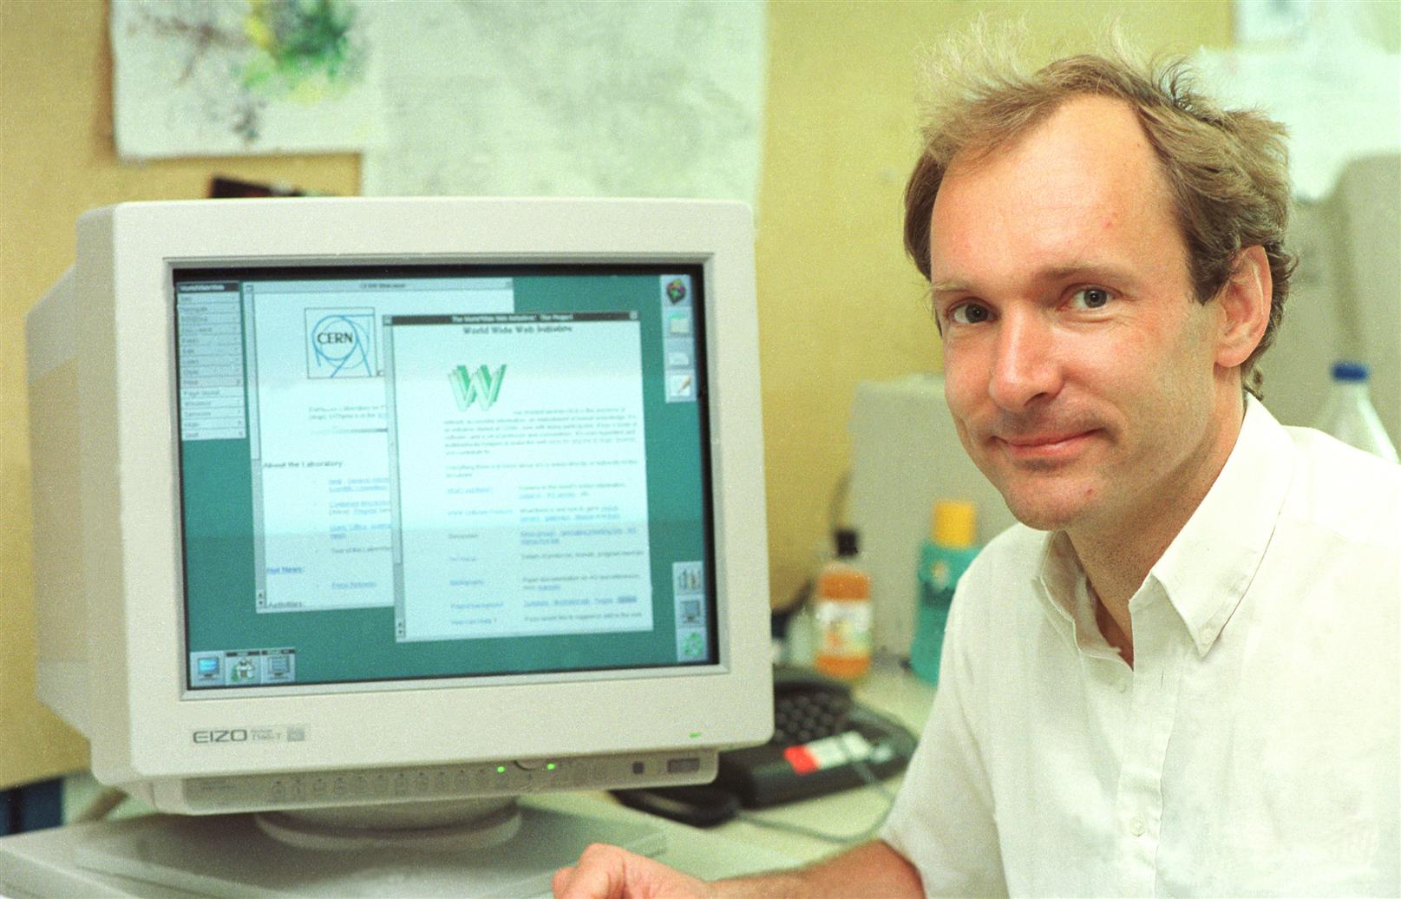
Distributed, Collaborative
©CERN https://cds.cern.ch/record/2665088

Slide 25
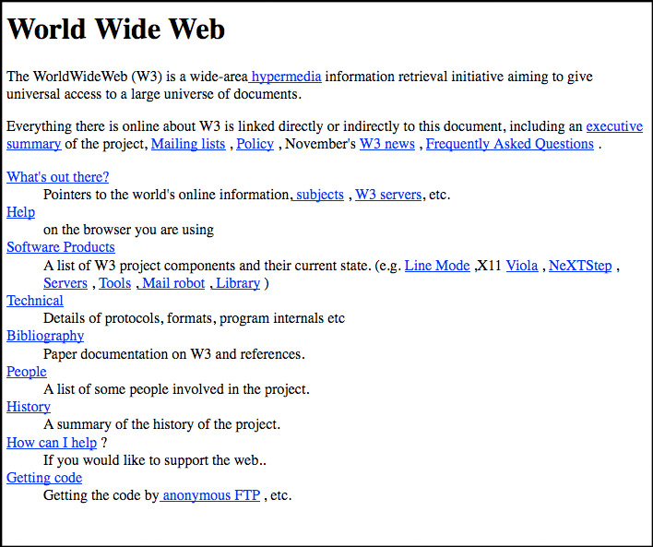

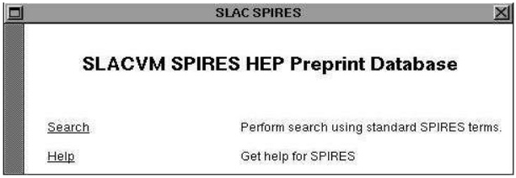
Growth of the Web
Aug 1991 went public
  Tim posted project to alt.hypertext and other internet groups
Dec 1991 First web server in US
1992 rapid expansion in HEP
  Universities and research institutes put up web servers

Slide 26
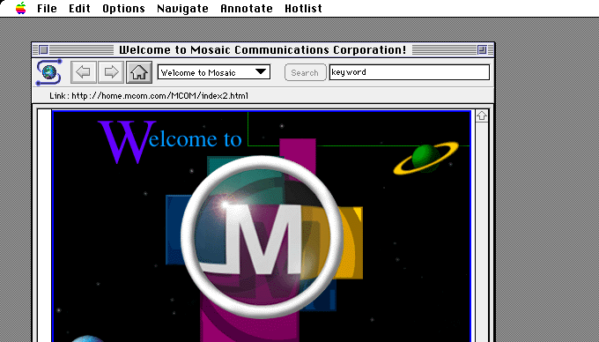

Growth of the Web
1993 rapid expansion across the world
  National Center for Supercomputing Applications (NCSA) at the University of Illinois released its Mosaic browser
Notes:
early ancestor of Mozilla Firefox

Slide 27

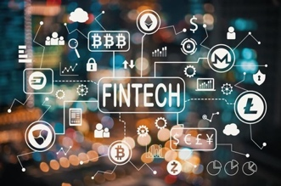
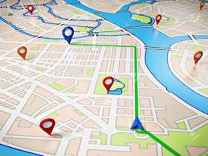

Born in Science
©CERN
Collaborative development of new tools
Universal access to information:
a human right
Theme of Concern:
monopolies as gatekeepers
steer for profit, not for humanity
©CERN https://cds.cern.ch/record/2665088
Notes:
Web went from strength to strength and has transformed society in unimaginable ways
Now seen as inconceivable to have a world without
BUT became Gateways, with monopolies as gatekeepers that steer for profit, not for humanity

Slide 28
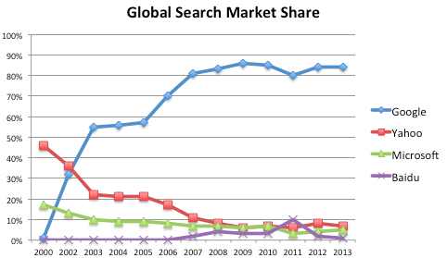
The Concentration of Power
Handful of platforms control which ideas and opinions are seen and shared
Ads
Engagement platforms
Competitive advantage from User giving data
SW creators decide fundamental issues like freedom and privacy
Which content to remove, which users to kick-off
Private Law: EULA
Weaponized
at scale
Conspiracy theories trend on social media platforms
Fake Twitter and Facebook accounts stoke social tensions
External actors interfere in elections
Notes:
As people create software, they are also making a decision about fundamental issues like freedom and privacy

Slide 29

The {Mis|Dis}Information Age
Public mistrust
Skepticism amoung government leaders
Word-of-the-Year 2018: Misinformation
  Election tampering
  Weaponization of falsity
  Surveillance capitalism
  Fake news
Word-of-the-Year 2020: Pandemic
  Vaccine distrust
  Climate Change denial
  Alternative facts
C
T
F
A
K
E

Slide 30

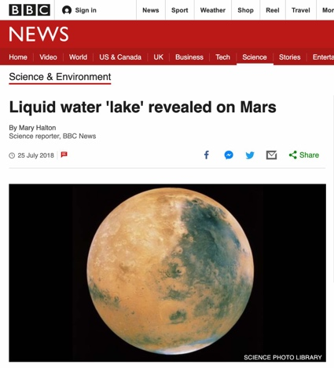
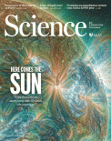
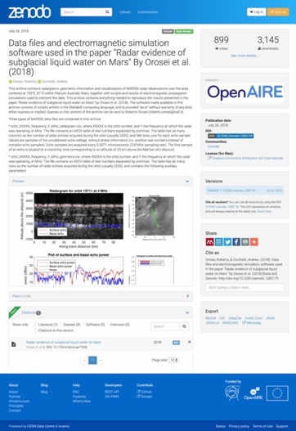
Evidence Chains
The research behind this announcement…
The data this research was based on…
The dominant theory in academia
The alternatives being discussed

Slide 31
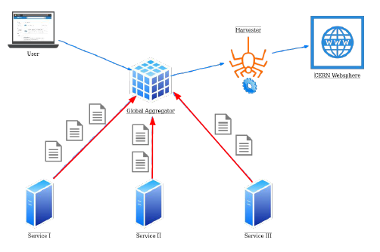
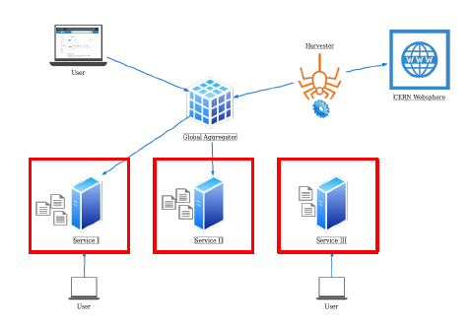


Search @ CERN
Moving from a centralized commercial Enterprise Search solution …
... to a distributed Open Source Enterprise Search solution

Slide 32
Computing
The LHC Era

Slide 33

The LHC Data Challenge
Big Data
And bigger
on the way!

Slide 34
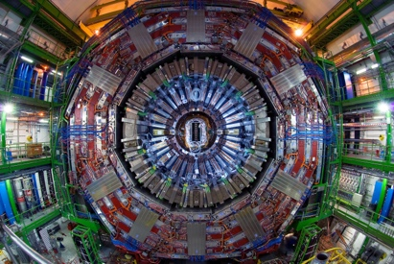
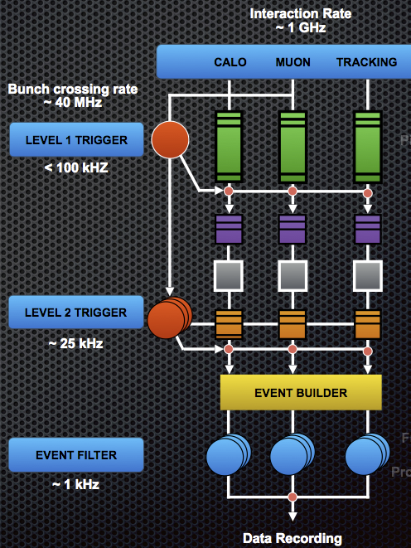
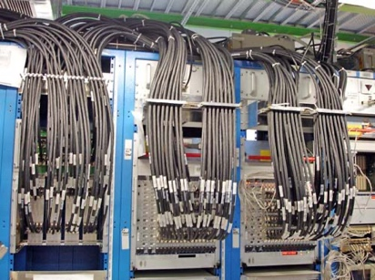
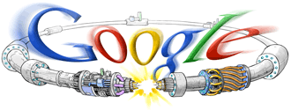
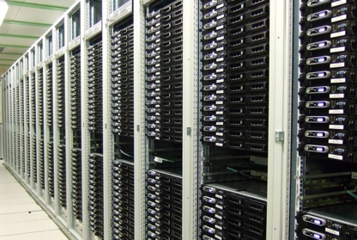
Big Data !
150 million sensors
Generating data 40 million times per second
Hardware trigger in a few microseconds
➔ Peta Bytes / sec !
Trigger
Select 100,000 per second
Software trigger in <1 second
➔ Tera Bytes / sec !
C.f: Google's computing farm handles 100,000 search queries per second
HLT / Filter
Select 100 per second
➔ Giga Bytes / sec !

Slide 35
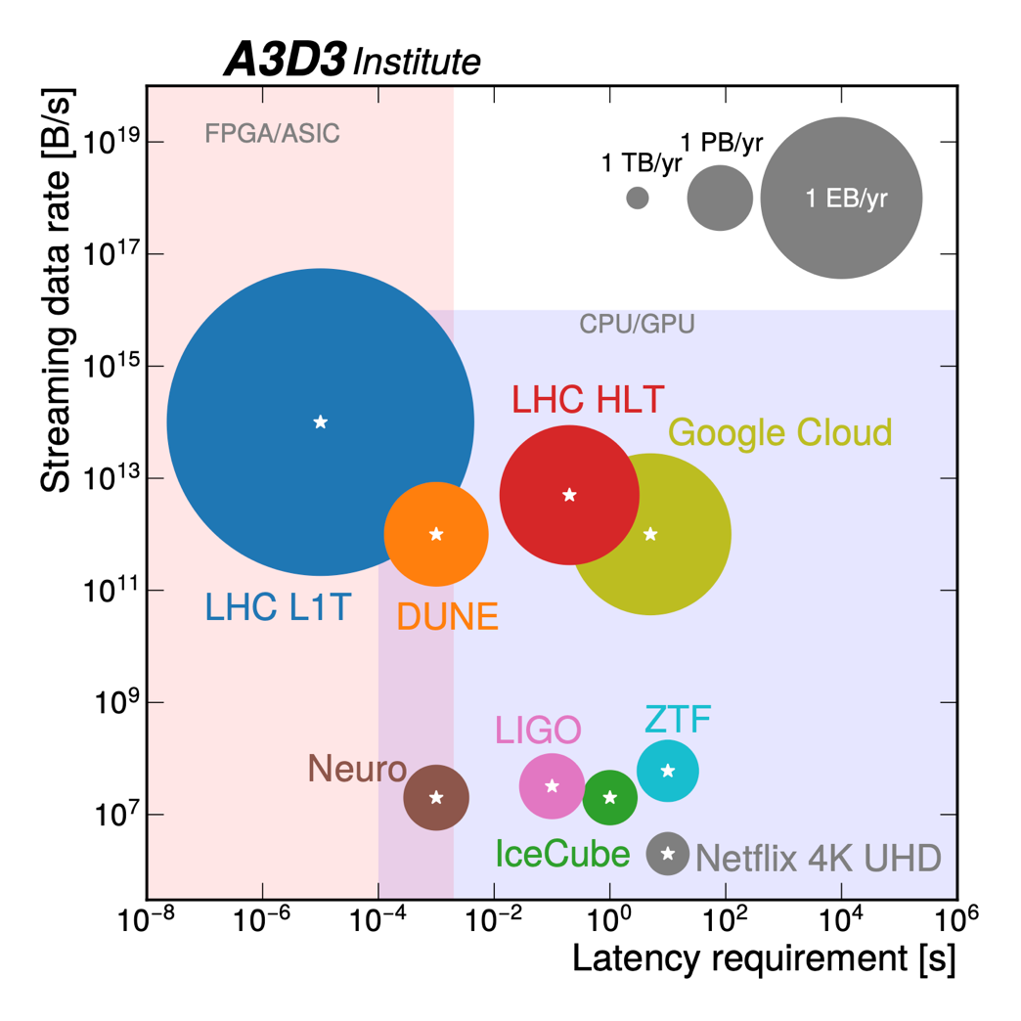
Big Data in Context

Slide 36
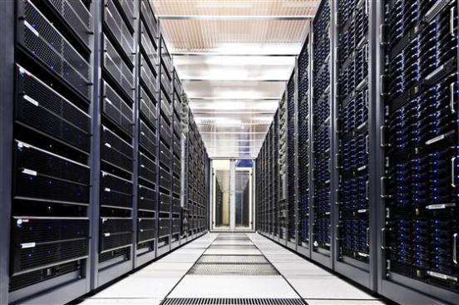







Primary Storage
8 GB/s
100,000 Disks
450,000 CPU Cores
20,000 1GB NICs
4,400 10GB NICs

Slide 37





The LHC Data Challenge
Few places can store it
Processing needs 3x CERN
HEP community distributed
  Local funding for computing
Distributed solution…
x 2 locations @ CERN
Models of Networked Analysis at Regional Centres
Notes:
Models of Networked Analysis at Regional Centres
Long before CDNs – which are different as rely on replicating small static files
Credit: Monarch Butterfly: sweetclipart.com
Credit: Cake: clker.com

Slide 38


Solution: the Grid
Use a Grid to unite computing resources of particle physics institutes around the world

Slide 39


Worldwide LHC Computing Grid
Tier-0 (CERN)
  Data recording
  Initial data reconstruction
  Data distribution
Tier-1
  Permanent storage
  Re-processing
  Analysis
Tier-2
  Simulation
  End-user analysis
Tier-2s
170 Sites
Tier-1s
13 Sites
1,400,000 Cores

Slide 40

WLCG: The Grid that Never Sleeps
500PB @ CERN
Stores, distributes, processes and analyses LHC experiments’ data
1.4 million processing cores in 170 data centres
and 42 countries
1500 Petabytes
of CERN data stored
world-wide

Slide 41

Cloud?
Cloud
On Demand
Grid
Fixed size
Dynamically provisioned & metered by e.g. Amazon, Microsoft Azure
Collaborative, run by community

Slide 42

Run-3 data taking
Record: 26 PB
in November
Data written in the CERN tape storage per month
Run-3
Run-2
Run-1
15PB 27PB

Slide 43

The LHC Data Challenge
Rate:
50 PB/y
150 PB/y
600 PB/y
Run 3
HL
LHC
Run 1
Run 2
Run 4
Run 5
Run 6
Big Data
And bigger
on the way!
Peak

Slide 44
Computing throughout the Workflow
More than half the CPU goes on simulation.
Most of the rest is reconstruction.
The remainder is analysis.

Slide 45


Where I learned to weave

Slide 46




Data Reduction / Analysis
Publication
Reduced
Reconstructed
Raw
File Size
# Files
Researchers
  T2s, T1s
Analysis Coordinators
  T1s
Production Managers
  T0, T1s

Slide 47


Slide 48



Reducing IT’s Energy Footprint: 3 lines of action
The Hardware
Procuring power efficient hardware
Extending hardware lifetime
CPU virtualisation, Disk Server densificaiton, Tape evolution
The Software
Improving software efficiency; focused C++ training courses
Innovating computing models
Using accelerators to improve efficiency of Generation & Simulation
The Data Centre
New data centre with efficient cooling and heat recovery
An optimized hardware life-cycle
ATLAS and CMS workloads: on ARM cf x86
ROOT foundation layer: less CPU, less disk hungry
Notes:
Top Right plot:
BLUE: x86_64: Single AMD EPYC 7003 series (SuperMicro) @2.3GHz
GREEN: 2*x86_64: Dual AMD EPYC 7513 series Processors (DELL) @2.6GHz
ORANGE: arm64: Single socket Ampere Altra Processor (SuperMicro)
Middle right plot:
TTree is the original ROOT format
RNTuple is the major new optimised ROOT format. Two versions are shown. Still in development, for 2024 release
(Different columns are different compression algorithms)

Slide 49
Computing
Technical

Slide 50



Design
Magnet Design
Volunteer Computing
  LHC@home
  SixTrack
    Simulates particles accelerating around the 27 km LHC to find their orbit stability

Slide 51



Operations

Slide 52
Computing
Administrative
Software

Slide 53

Administrative Information Services

Slide 54





Administrative Information Services
Applications
from the market

Slide 55







Conference, Meetings, Events...
700k events total
80k events in 2019
10k users /day
Electronic payment
Exchange Intergration
PDF conversion

Slide 56














CERN Open Data
Education
+
+
http://opendata.cern.ch
Open Storage
400 PB
Research
Notes:
What worked well:
Enterprise scale HW, Open SW PLUS experts from multiple domains
Simple interface
Audiences in mind for targeted descriptions and tools

Slide 57


Zenodo: Open Science for All

Slide 58





CERN as a host
UNOSAT
established at CERN in 2001, based on IT infrastructure
Mapping shelters in refugee camps
Flood detection
AI for Satellite Imagery Analysis
Notes:
Manually scan million pixels of satellite imagery for disaster relief
Costly
Time consuming
Limited (only 1 point per shelter)

Slide 59
Computing
Future

Slide 60


AI in HEP
Network traffic prediction
Thanks to J-R. Vlimant

Slide 61




Quantum Technology Initiative
Assess the areas of potential quantum advantage in HEP applications (QML, classification, anomaly detection, tracking)
Develop common libraries of algorithms, methods, tools; benchmark as technology evolves
Collaborate to the development of shared, hybrid classic-quantum infrastructures
Identify and develop techniques for quantum simulation in collider physics, QCD, cosmology within and beyond the SM
Co-develop quantum computing and sensing approaches by providing theoretical foundations to the identifications of the areas of interest
Develop and promote expertise in quantum sensing in low- and high-energy physics applications
Develop quantum sensing approaches with emphasis on low-energy particle physics measurements
Assess novel technologies and materials for HEP applications
Co-develop CERN technologies relevant to quantum infrastructures (time synch, frequency distribution, lasers)
Contribute to the deployment and validation of quantum infrastructures
Assess requirements and impact of quantum communication on computing applications (security, privacy)
Computing & Algorithms
Simulation & Theory
Sensing, Metrology & Materials
Communications & Networks

Slide 62
Open Quantum Institute
Pilot Phase
Global and inclusive access to quantum computing and the development of applications for the benefit of humanity

Slide 63
Take-aways
Fundamental science continues to be main inspiration for revolutionary ideas, due to revolutionary needs
Industry has well defined offer and demand. We do not. This is the key for innovation
…and innovation fosters technological advancements that percolates to society

Slide 64



Slide 65
Want to Know More?
Contact:
  Tim.Smith@cern.ch
More information:
  IT Department: http://information-technology.web.cern.ch
  The LHC Grid: http://wlcg.web.cern.ch
  Google Street view in CC:
    https://www.google.ch/maps/@46.232624,6.045747,3a,75y,162.48h,90t/data=!3m5!1e1!3m3!1sBU7JKhoaY_H9JVPFHcH8JA!2e0!3e5?hl=en
    http://lego-scavenger-hunt.web.cern.ch
  IT Archives: https://it-archives.web.cern.ch

Slide 66
Want to Follow More?
Social Media at CERN
  http://twitter.com/CERN
  http://twitter.com/CERN_FR
  http://facebook.com/cern
  http://google.com/+CERN
  http://youtube.com/CERN
  http://linkedin.com/company/cern

Slide 67
Thanks to …
Hannah Short, Lorena Lobato Pardavila, Xavier Espinal
for their suggestions & contributions

