Slide 1
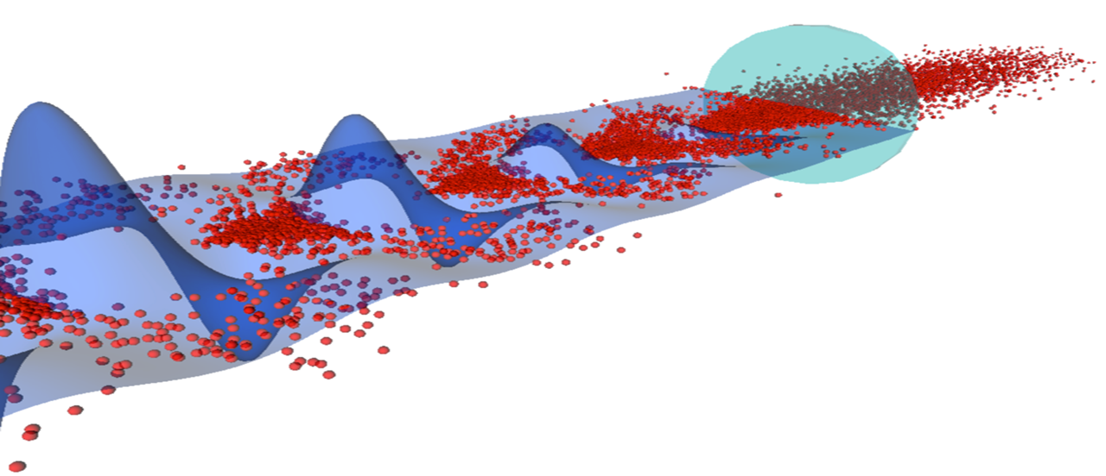

Plasma Wakefield Acceleration
AWAKE Experiment at CERN
Marlene Turner

Slide 2
Outline
What are plasma wakefields and why are they interesting?
How to accelerate charged particles using plasma wakefields?
  Underlying physics concepts, state-of-the-art results
What is the AWAKE experiment, and why is it important?
The AWAKE experimental setup
Latest AWAKE results
  Ideas and plans for the future

Slide 3

AWAKE
Advanced Proton-Driven Plasma
Wakefield Acceleration Experiment
Plasma ?
Proton-driven ?
Wakefield acceleration ?
Acceleration ?

Slide 4

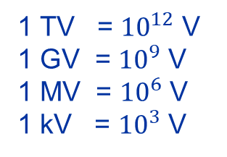
Charged Particle Acceleration
e-
Acceleration of charged particles requires an electric field
Charged particle will accelerate as long as it experiences the field
1 TV = ${10}^{12}$ V
1 GV = ${10}^{9}$ V
1 MV = ${10}^{6}$ V
1 kV = ${10}^{3}$ V
1.5V with battery length of ~3 cm → 50 V/m
To reach 1 TeV → ~20 000 million km
Distance Earth-Sun ~ 152 million km

Slide 5
Charged Particle Acceleration
Acceleration of charged particles requires an electric field
Charged particle will accelerate as long as it experiences the field
e-
Rb+
Rb+
Rb+
Rb+
Rb+
Rb+
Rb+
Rb+
Rb+
Rb+
e-
e-
e-
e-
e-
e-
e-
e-
e-
e-
e-
e-
e-
e-
e-
e-
e-
e-
Rb+
e-
Rb+
Rb+
Rb+
Rb+
Rb+
Rb+
Rb+
Rb+
Rb+
Even better:
  Field travels together with the beam
e-
e-
e-
e-
e-
e-
e-
e-
Rb+
Rb+
e-
e-
Rb+
Rb+
Rb+
Rb+
Rb+
Rb+
Rb+
Rb+
e-
e-
e-
e-
e-
e-
e-
e-
e-
e-
e-
e-
e-
e-
e-
Rb+
e-
e-
e-
e-
Rb+
Rb+
Rb+
Rb+
Rb+
e-
Rb+
Rb+
Rb+
Rb+
e-
e-
e-
e-

Slide 6
Definition of Plasma and Plasma Wakefield
Plasma
Plasma: ionised gas (4th state of matter)
  Quasi-neutrality: the overall charge of a plasma is about zero.
  Collective effects: Charged particles must be close enough together that each particle influences many nearby charged particles.
  Electrostatic interactions dominate over collisions or ordinary gas kinetics.
Rb+
Rb+
Rb+
Rb+
e-
e-
e-
e-
Rb+
e-
Rb+
Rb+
Rb+
e-
e-
e-
e-
Rb+
Rb+
Rb+
Rb+
e-
e-
e-
Rb+
e-
Rb+
Rb+
e-
Rb+
e-
e-

Slide 7
Definition of Plasma and Plasma Wakefield
Plasma
Plasma: ionised gas (4th state of matter)
  Quasi-neutrality: the overall charge of a plasma is about zero.
  Collective effects: Charged particles must be close enough together that each particle influences many nearby charged particles.
  Electrostatic interactions dominate over collisions or ordinary gas kinetics.
Rb+
Rb+
Rb+
Rb+
e-
e-
e-
e-
Rb+
e-
Rb+
Rb+
Rb+
e-
e-
e-
e-
Rb+
Rb+
Rb+
Rb+
e-
e-
e-
Rb+
e-
Rb+
Rb+
e-
Rb+
e-
e-
Plasma Wakefields
Plasma Wakefields:
  are the fields created/sustained by collective motion of plasma particles.
Rb+
Rb+
Rb+
Rb+
Rb+
Rb+
Rb+
Rb+
Rb+
Rb+
e-
e-
e-
e-
e-
e-
e-
e-
e-
e-
e-
e-
e-
e-
e-
e-
e-
e-
Rb+
e-
Rb+
Rb+
Rb+
Rb+
Rb+
Rb+
Rb+
Rb+
Rb+
e-
e-
e-
e-
e-
e-
e-
e-
Rb+
Rb+
e-
e-
Rb+
Rb+
Rb+
Rb+
Rb+
Rb+
Rb+
Rb+
Acceleration
e-
e-
e-
e-
e-
e-
e-
e-
e-
e-
e-
e-
e-
e-
e-
Rb+
e-
e-
e-
e-
Rb+
Rb+
Rb+
Rb+
Rb+
e-
Rb+
Rb+
Rb+
Rb+
e-
e-
e-
e-
e-
Electric field

Slide 8
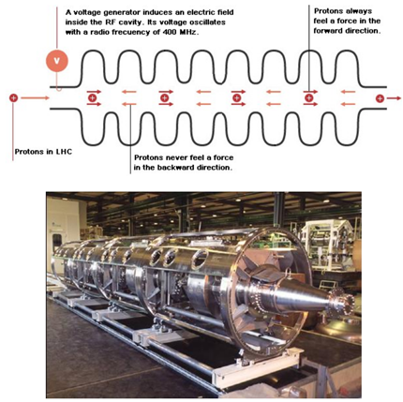
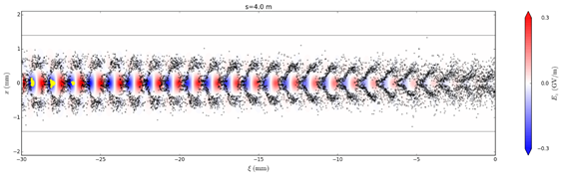
Why use Plasmas for Charged Particle Acceleration?
Conventional technology:
metallic radiofrequency (RF) cavities
New concept:
plasma wakefields acceleration
→ transient structures in plasma
~cm to m scale
~um to mm scale
LHC cavities

Slide 9
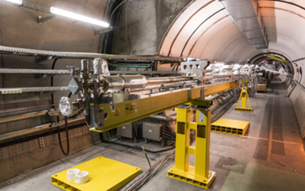
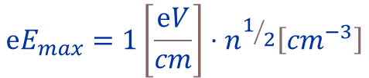
Accelerating Gradient
RF cavities
Plasma Wakefields
Limited to ~100 MV/m due to electric breakdowns (ionization).
Plasma is already ionized or “broken-down” and can
sustain electric fields ~100 GV/m.
$$ⅇE_{max}=1\left[\frac{ⅇV}{cm}\right]⋅n^{1/2}\left[{cm}^{−3}\right]$$

Slide 10
Accelerating Gradient
RF cavities
Plasma Wakefields
Limited to ~100 MV/m due to electric breakdowns (ionization).
Plasma is already ionized or “broken-down” and can
sustain electric fields ~100 GV/m.
$$ⅇE_{max}=1\left[\frac{ⅇV}{cm}\right]⋅n^{1/2}\left[{cm}^{−3}\right]$$
➔ Plasma wakefields can sustain order of magnitude higher fields
Structure exists only for a very short amount of time!

Slide 11
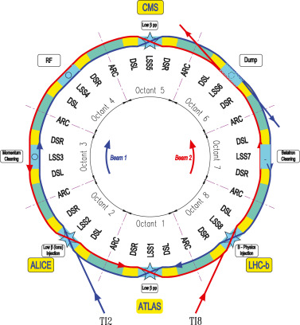
Circular and Linear Accelerators
Circular accelerators
Image from P. Arpaia et al., NIMA 985, 164652 (2021)
Advantage: beam passes accelerating section many times
Disadvantage: synchrotron radiation losses
r
LHC tunnel:
p+p+ → 14 TeV
e+e- → 209 GeV
Beam passes acceleration section multiple times.
Max. energy (E) limited by synchrotron radiation losses
∝ E⁴/(r²m⁴)

Slide 12
Synchrotron Radiation
Field left behind
Synchrotron radiation is caused by leaving part of fields behind
when the beam moves along the curve.
∝ E⁴/(r²m⁴)
v = c
v < c
Bending
radius
Mass of the particle
Particle
energy
Field lines
→ Needs to be taken into account when accelerated charged particles are deflected in the radial direction.

Slide 13
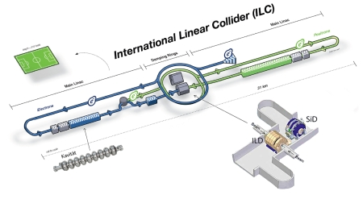
Circular and Linear Accelerators
Circular accelerators
Linear accelerators
Image from P. Arpaia et al., NIMA 985, 164652 (2021)
r
Beam passes acceleration section multiple times.
Negligible synchrotron radiation losses
Accelerator length and accelerating gradient define final beam energy.
Beam passes acceleration section multiple times.
Max. energy (E) limited by synchrotron radiation losses
∝ E⁴/(r²m⁴)
e.g. to accelerate electrons to 1 TeV (10¹² eV):
100 MeV/m x 10000 m or
100 GeV/m x 10 m

Slide 14
Let Us Repeat…
Plasma wakefields allow to accelerate charged particles with ~ 1-100 GeV/m
High gradients are important when using linear accelerators (e.g. for light particles) to minimize synchrotron radiation losses
  For linear accelerators, their length defines the final beam energy

Slide 15
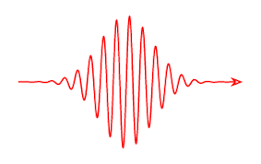
How to Create
Plasma Wakefields?
Two ingredients
Plasma
(Medium)
Relativistic charged particle beam or
Short intense laser pulse
(Energy source)
Rb+
Rb+
Rb+
Rb+
e-
e-
e-
e-
Rb+
e-
Rb+
Rb+
Rb+
e-
e-
e-
e-
Rb+
Rb+
Rb+
Rb+
e-
e-
e-
Rb+
e-
Rb+
Rb+
e-
Rb+
e-
e-

Slide 16

Image from https://revbalance.com/improving-balance-for-wakesurfing/

Slide 17
Energy Source: The Driver
Relativistic charged particle bunches or laser pulses
  → Relativistic charged particle bunches carry almost purely transverse electric fields
What we need → longitudinal electric field to accelerate charged particles
Trick:
Use plasma to convert the transverse electric field of the proton bunch into a longitudinal electric field in the plasma.
The more energy is available, the longer (distance-wise) these plasma wakefields can be sustained
v ~<c
e- bunch
Rb+
Rb+
Rb+
Rb+
e-
e-
e-
e-
Rb+
e-
Rb+
Rb+
Rb+
e-
e-
e-
e-
Rb+
Rb+
Rb+
Rb+
e-
e-
e-
Rb+
e-
Rb+
Rb+
e-
Rb+
e-
e-

Slide 18
How to Drive a Plasma Wave
Rb+
Rb+
Rb+
Rb+
Rb+
Rb+
Rb+
Rb+
Rb+
Rb+
e-
e-
e-
e-
e-
e-
e-
e-
Important to understand
Plasma electron motion is mostly transverse
Electrons do not move significantly longitudinally
Rb ions are heavy and do not move significantly on the timescale of the electrons
e-
e-
e-
e-
e-
e-
e-
e-
e-
e-
Rb+
e-
Rb+
Rb+
Rb+
Rb+
Rb+
Rb+
Rb+
Rb+
Rb+
e-
e-
e-
e-
e-
-- - - - -
e-
e-
e-
Rb+
Rb+
e-
e-
Rb+
Rb+
Rb+
Rb+
Rb+
Rb+
Rb+
Rb+
e-
e-
e-
e-
e-
e-
e-
e-
e-
e-
e-
e-
e-
e-
e-
Rb+
e-
e-
e-
e-
Rb+
Rb+
Rb+
Rb+
Rb+
e-
Rb+
Rb+
Rb+
Rb+
e-
e-
e-
e-
Rb+
Rb+
Rb+
Rb+
Rb+
Rb+
Rb+
Rb+
Rb+
Rb+
e-
e-
e-
e-
e-
e-
e-
e-
e-
e-
e-
e-
e-
e-
e-
e-
e-
e-
Rb+
e-
Rb+
Rb+
Rb+
Rb+
Rb+
Rb+
Rb+
Rb+
Rb+
e-
e-
e-
e-
e-
e-
e-
e-
Rb+
Rb+
e-
e-
Rb+
Rb+
Rb+
Rb+
Rb+
Rb+
Rb+
Rb+
e-
e-
e-
e-
e-
e-
e-
e-
e-
e-
e-
e-
e-
e-
e-
Rb+
e-
e-
e-
e-
Rb+
Rb+
Rb+
Rb+
Rb+
e-
Rb+
Rb+
Rb+
Rb+
e-
e-
e-
e-

Slide 19

How to Drive a Plasma Wave
Rb+
Rb+
Rb+
Rb+
Rb+
Rb+
Rb+
Rb+
Rb+
Rb+
e-
e-
e-
e-
e-
e-
e-
e-
Charge separation → electric field
(longitudinal and transverse)
e-
e-
e-
e-
e-
e-
e-
e-
e-
e-
Rb+
e-
Rb+
Rb+
Rb+
Rb+
Rb+
Rb+
Rb+
Rb+
Rb+
e-
e-
e-
e-
e-
e-
e-
e-
Rb+
Rb+
e-
e-
Rb+
Rb+
Rb+
Rb+
Rb+
Rb+
Rb+
Rb+
e-
e-
e-
e-
e-
e-
e-
e-
e-
e-
e-
e-
e-
e-
e-
Rb+
e-
e-
e-
e-
Rb+
Rb+
Rb+
Rb+
Rb+
e-
Rb+
Rb+
Rb+
Rb+
e-
e-
e-
e-
Rb+
Rb+
Rb+
Rb+
Rb+
Rb+
Rb+
Rb+
Rb+
Rb+
e-
e-
e-
e-
e-
e-
e-
e-
e-
e-
e-
e-
e-
e-
e-
e-
e-
Where should we place an electron bunch to be accelerated?
e-
Rb+
e-
Rb+
Rb+
Rb+
Rb+
Rb+
Rb+
Rb+
Rb+
Rb+
e-
e-
e-
e-
e-
e-
e-
e-
Rb+
Rb+
e-
e-
Rb+
Rb+
Rb+
Rb+
Rb+
Rb+
Rb+
Rb+
e-
e-
e-
e-
e-
e-
e-
e-
e-
e-
e-
e-
e-
e-
e-
Rb+
e-
e-
e-
e-
Rb+
Rb+
Rb+
Rb+
Rb+
e-
Rb+
Rb+
Rb+
Rb+
e-
e-
e-
e-

Slide 20
Plasma Wakefields
Accelerating for negatively charged particles
Decelerating for negatively charged particles
Rb+
Rb+
Rb+
Rb+
Rb+
Rb+
Rb+
Rb+
Rb+
Rb+
e-
e-
e-
e-
e-
e-
e-
e-
e-
e-
e-
e-
e-
e-
e-
e-
e-
e-
Rb+
e-
Rb+
Rb+
Rb+
Focusing for negatively charged particles
Rb+
Rb+
Rb+
Rb+
Rb+
Rb+
e-
e-
e-
e-
e-
e-
e-
e-
e-
e-
e-
e-
Rb+
e-
Rb+
Rb+
Rb+
Rb+
Rb+
Rb+
Rb+
Rb+
Rb+
e-
e-
e-
e-
e-
e-
e-
e-
e-
e-
e-
Defocusing for negatively charged particles
e-
e-
e-
e-
Rb+
e-
e-
e-
e-
Rb+
Rb+
Rb+
Rb+
Rb+
e-
Rb+
Rb+
Rb+
Rb+
e-
e-
e-
e-

Slide 21

Plasma Acts As a Transformer
Driver deposits energy, witness gains energy
Acceleration distance typically limited by either
driver
Depletion: The drive bunch/pulse running out of energy. Solution: couple in a new driver or use a more energetic driver
Dephasing: The witness bunch outruns the driver. Solution: couple in a new driver or shape the plasma density
Diffraction: Drive beam evolution. Solution: Guiding or use a more rigid driver
witness
witness
driver
witness
driver

Slide 22
Let Us Repeat…
Plasma wakefields require: plasma, energy source (driver)
  Place a particle beam (witness) to be accelerated
Plasma acts as a transformer
  Drive beam energy is transferred to the witness bunch
What limits the energy gain:
  Depletion: Driver runs out of energy
  Dephasing: Accelerating bunch outruns the driver
  Diffraction: Driver no longer intense enough

Slide 23
State-of-the-Art Results

Slide 24
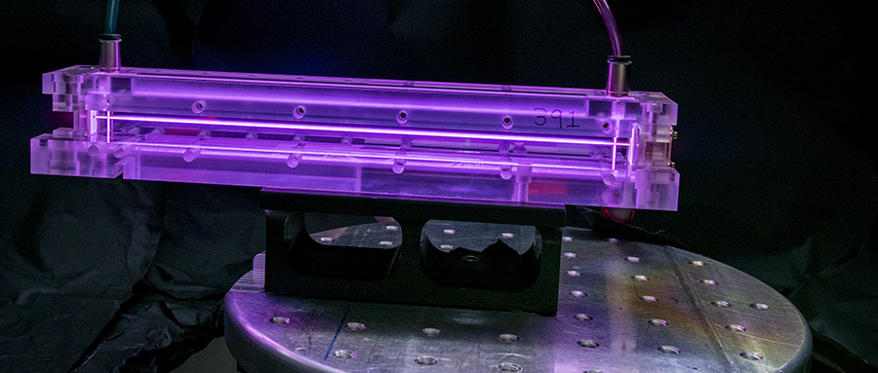
20 cm

Slide 25
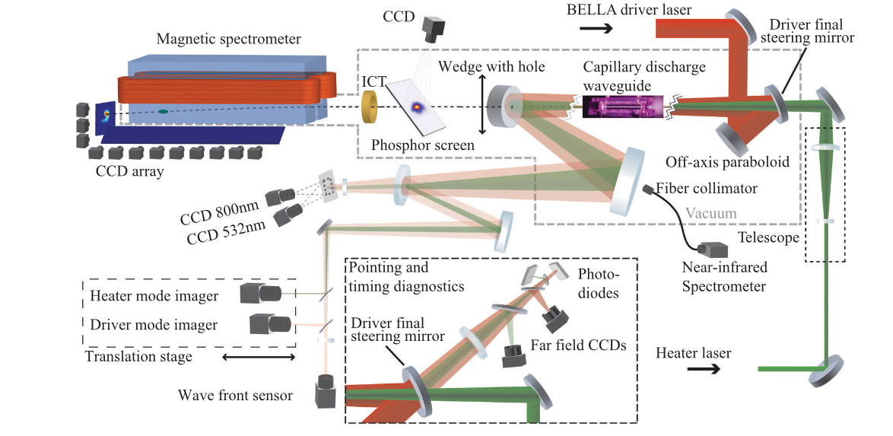
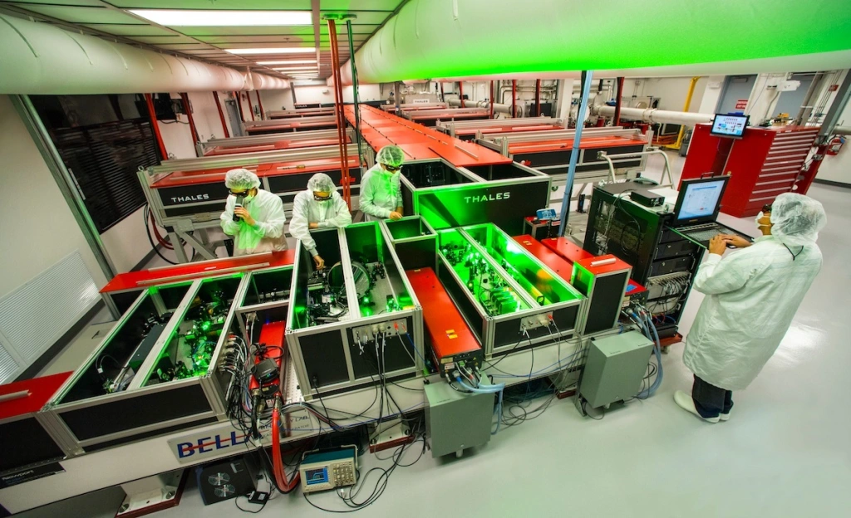
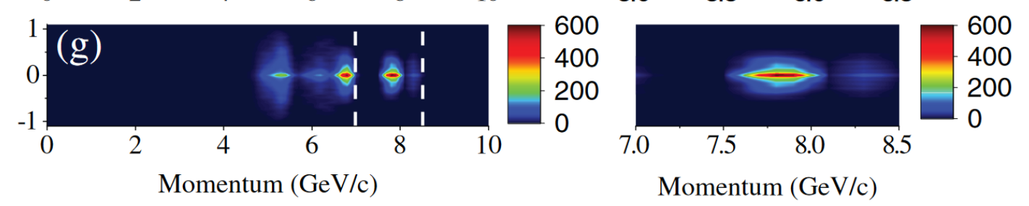
State-of-the-Art Results
BELLA (Berkeley, California)
Petawatt Laser Guiding and Electron Beam Acceleration to 8 GeV in a Laser-Heated Capillary Discharge Waveguide
A. J. Gonsalves et al., Phys. Rev. Lett. 122, 084801

Slide 26
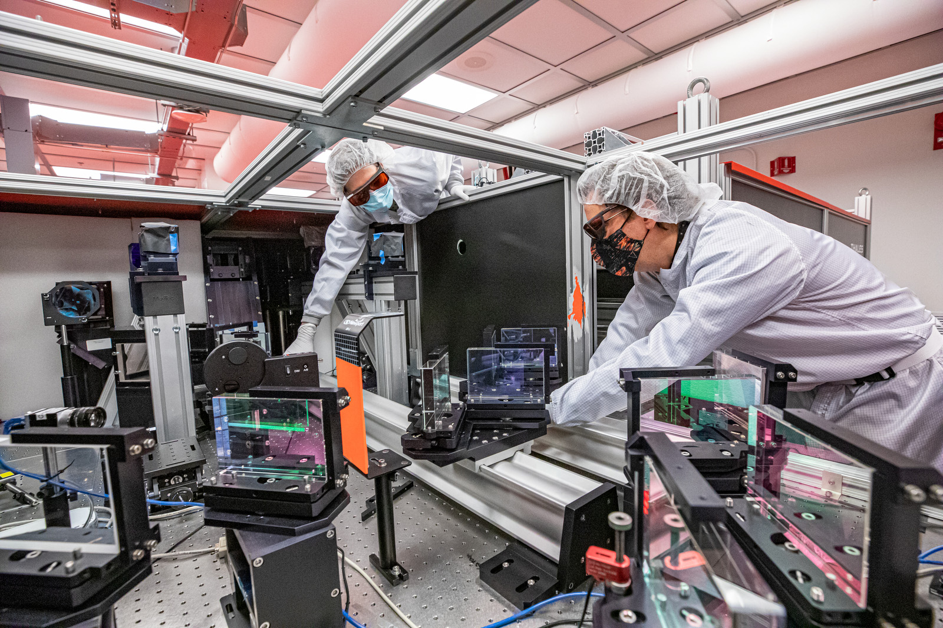

Slide 27
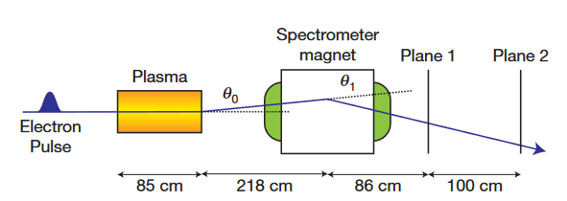
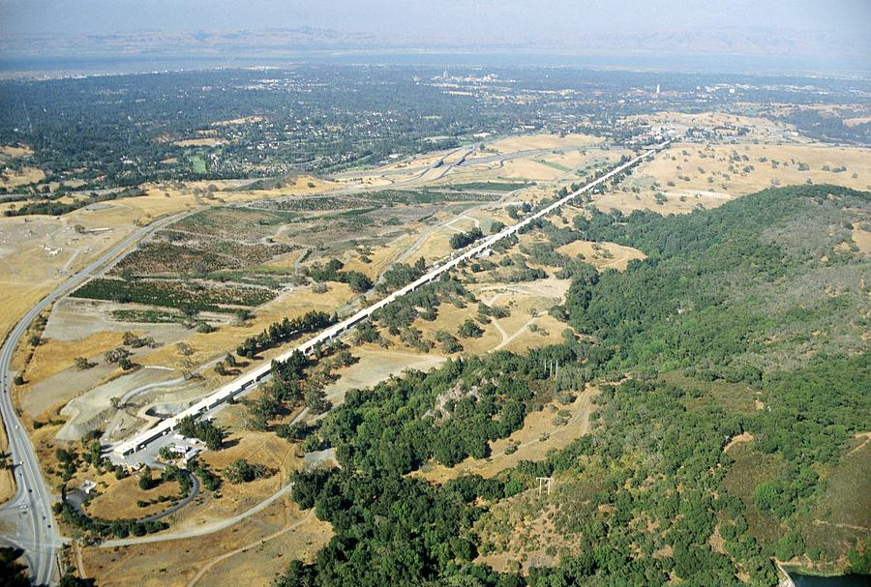
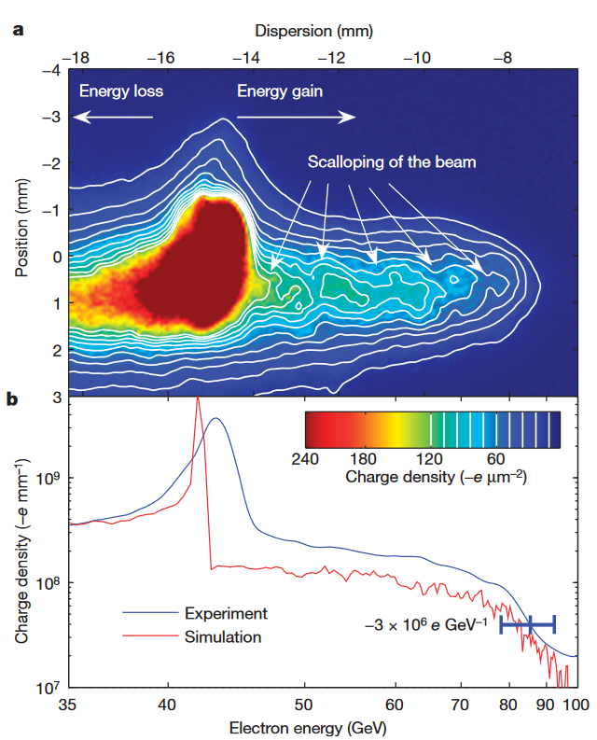
State-of-the-Art Results
SLAC (Stanford, California)
42 GeV energy gain
in 85 cm of plasma
3.2 km
Blumenfeld, I., Clayton, C., Decker, FJ. et al. Energy doubling of 42 GeV electrons in a metre-scale plasma wakefield accelerator. Nature 445, 741–744 (2007).

Slide 28
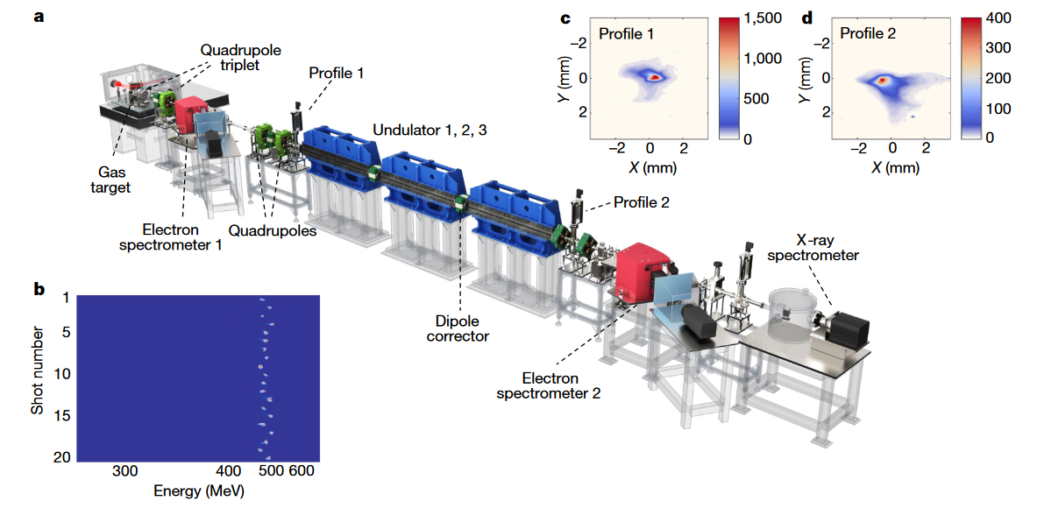
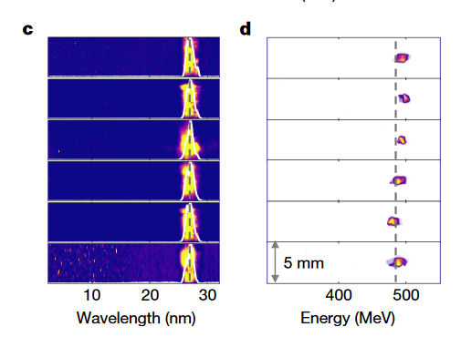
First Demonstration of a Free Electron Laser Driven by a Plasma Wakefield Accelerator
Free-electron lasing at 27 nanometres based on a laser wakefield accelerator
Wentao Wang et al., Nature volume 595, pages 516–520 (2021)

Slide 29
Let Us Repeat…
Plasma wakefields acceleration has been demonstrated experimentally:
  ~8 GeV in 20 cm of plasma
  42 GeV in 85 cm of plasma
  First laser-plasma wakefield driven free electron laser

Slide 30
The AWAKE Experiment
@CERN

Slide 31

Plasma Wakefield Physics @ CERN
CERN has very high energetic proton bunches available.
Idea: use energy stored in the proton bunches to accelerate lighter particles e.g. electrons
19 kJ
400 GeV
however, they are too long to excite wakefields

Slide 32
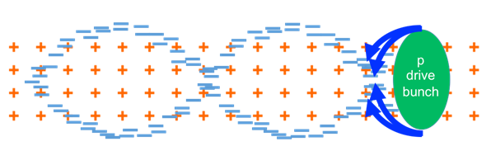
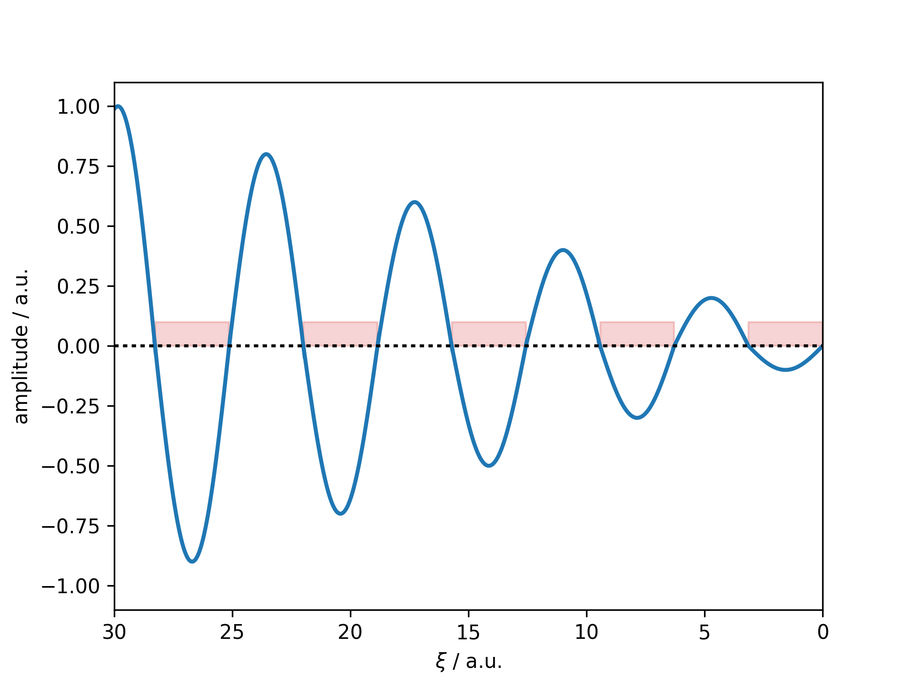
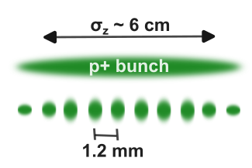
AWAKE Requires Microbunching of p⁺ Bunch
To effectively excite wakefields:
The drive bunch length has to be on the order of the plasma wavelength
For AWAKE → mm-scale bunch length
CERN SPS proton bunch length is ~6 cm
⇒ Plasma process: Self-Modulation Instability (SMI), can be seeded (SSM)
Resonant excitation
Wakefields driven resonantly to large amplitude
Self-modulation necessary to drive ~GV/m accelerating fields in 10¹⁴ cm⁻³ density plasma
(7x10¹⁴ cm⁻³)

Slide 33
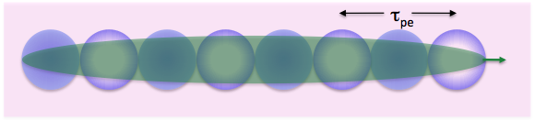
Self-Modulation Process
Long driver (p⁺), dense plasma,
σ_{t} >> 1/ω_{pe}, σ_{r} ~c/ω_{pe}
Growth mechanism:
Initial (transverse) wakefields

Slide 34
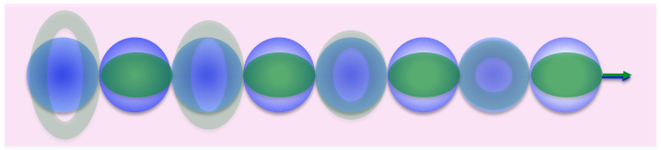
Self-Modulation Process
Long driver (p⁺), dense plasma,
σ_{t} >> 1/ω_{pe}, σ_{r} ~c/ω_{pe}
Growth mechanism:
Initial (transverse) wakefields
Self-modulation
Periodic focusing/defocusing

Slide 35

Self-Modulation Process
Long driver (p⁺), dense plasma,
σ_{t} >> 1/ω_{pe}, σ_{r} ~c/ω_{pe}
Growth mechanism:
Initial (transverse) wakefields
Self-modulation
Periodic focusing/defocusing
Self-modulated bunch
Density modulation

Slide 36
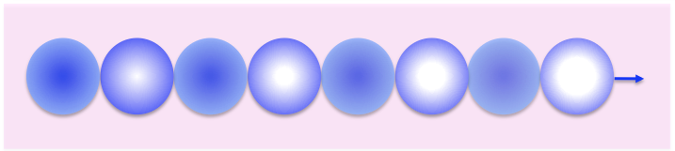
Self-Modulation Process
Long driver (p⁺), dense plasma,
σ_{t} >> 1/ω_{pe}, σ_{r} ~c/ω_{pe}
Growth mechanism:
Initial (transverse) wakefields
Self-modulation
Periodic focusing/defocusing
Self-modulated bunch
Density modulation
Plasma wakefields
Full modulation – bunch train

Slide 37
Self-Modulation Process
Long driver (p⁺), dense plasma,
σ_{t} >> 1/ω_{pe}, σ_{r} ~c/ω_{pe}
Growth mechanism:
Initial (transverse) wakefields
Self-modulation
Periodic focusing/defocusing
Self-modulated bunch
Density modulation
Plasma wakefields
Full modulation – bunch train

Slide 38
Simulation Result
Wakefield (blue)
Protons (red)
Gaussian proton beam distribution
Laser (green)
Defocused protons
Focused micro-bunch

Slide 39
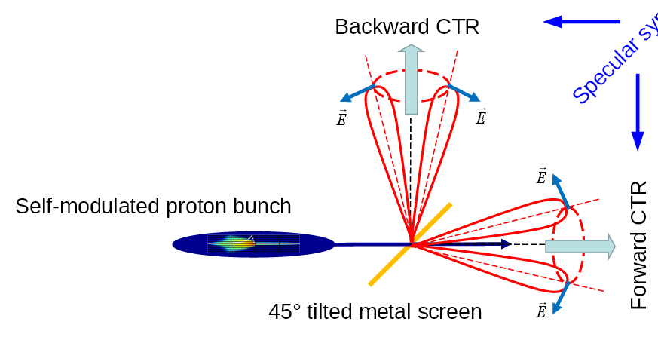
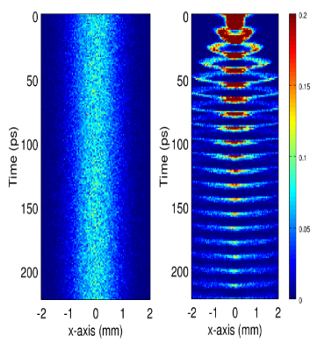
Self-Modulation Diagnostics
Streak camera measurement
No Plasma
Plasma
Foil emits waves up to the plasma wavelength of the foil including:
radiation in the optical range (OTR).
Coherent radiation (CTR) for wavelengths bigger than the structure of the micro-bunches

Slide 40
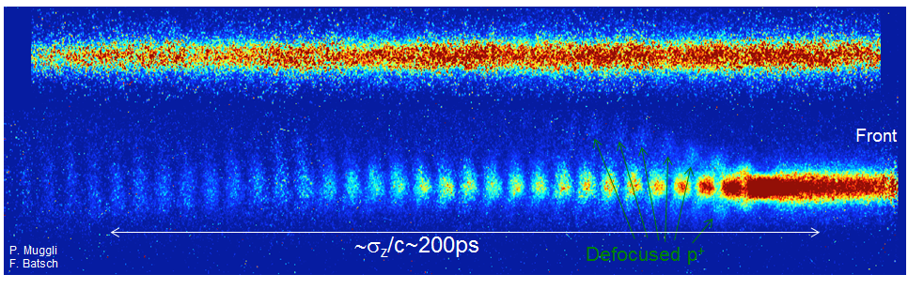
Self-Modulation Measurement Results
Plasma off:
Plasma on:
Plasma off:

Slide 41
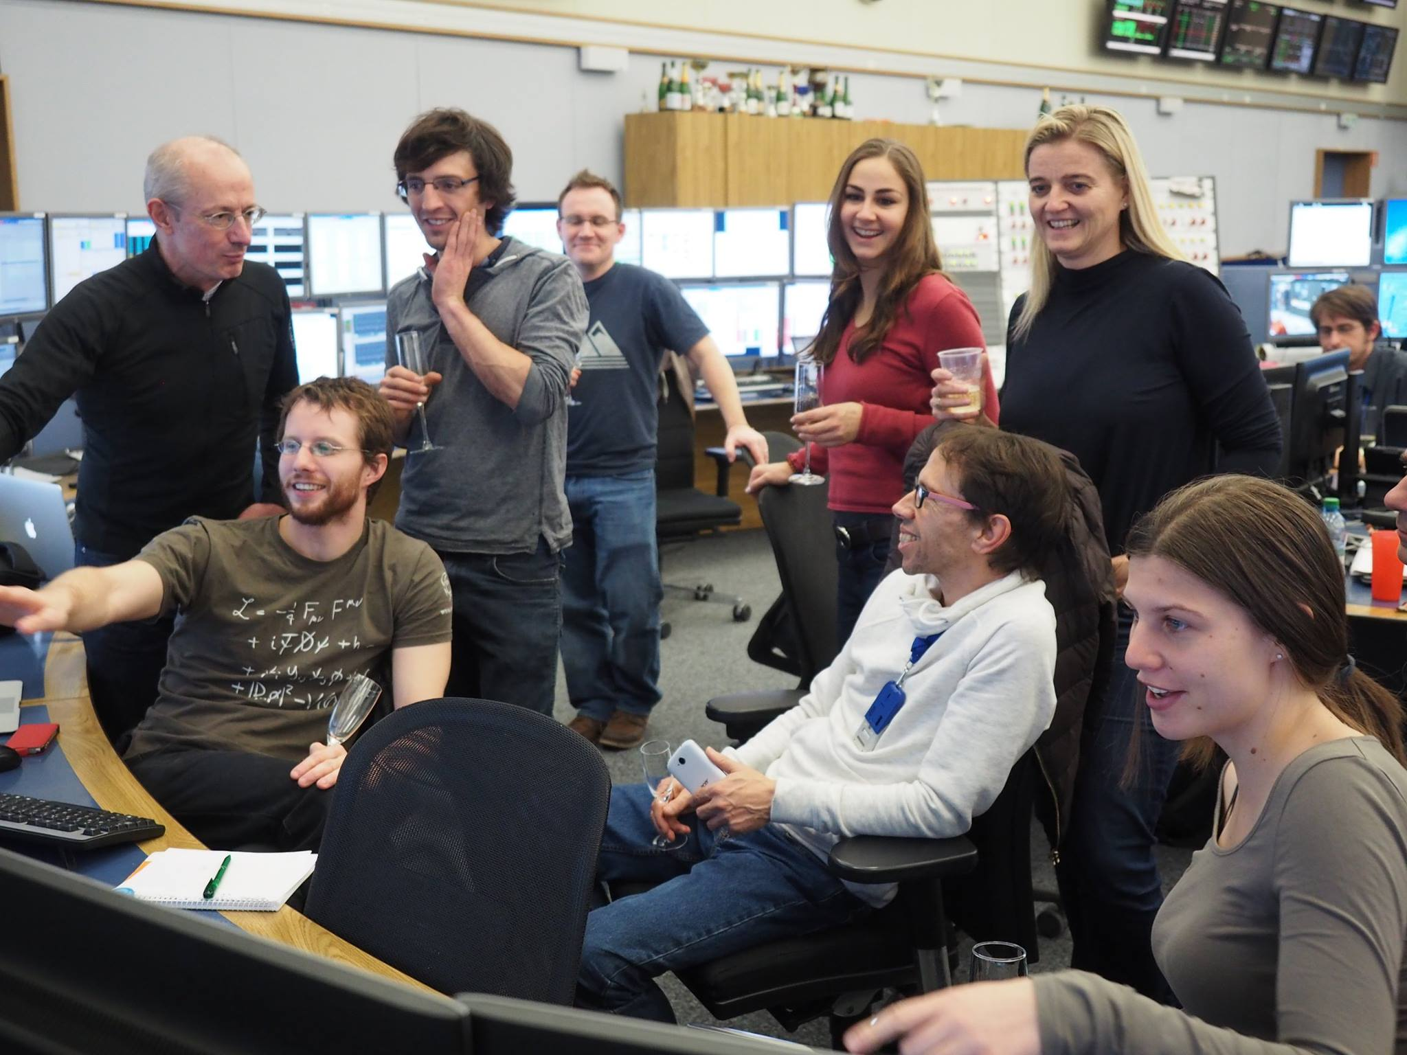
Shortly after we have observed the Seeded-Self Modulation for the first time!

Slide 42
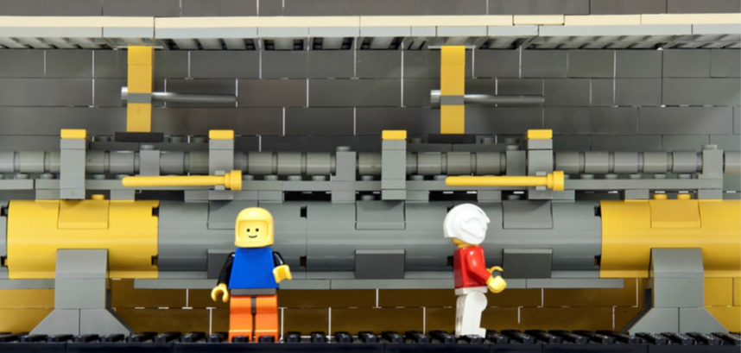
Experimental Realization @CERN
→ AWAKE Experiment
From a concept and an idea to reality !

Slide 43
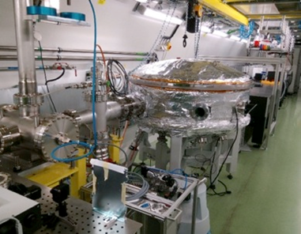
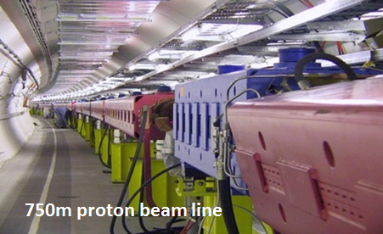
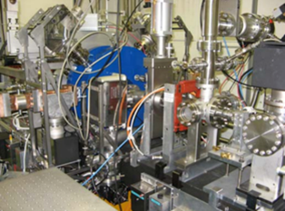
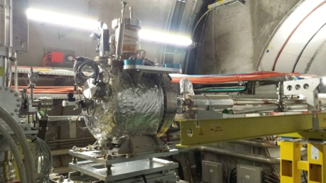
AWAKE Components
Plasma
Laser
Rubidium vapor
Drive Bunch
Proton beam (400 GeV/c)
Witness Bunch
Electron beam (10-20 MeV)
Diagnostics:
Proton
Laser
Electron

Slide 44
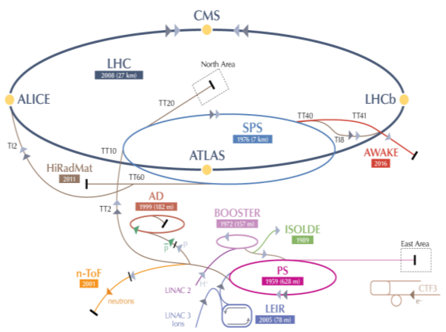
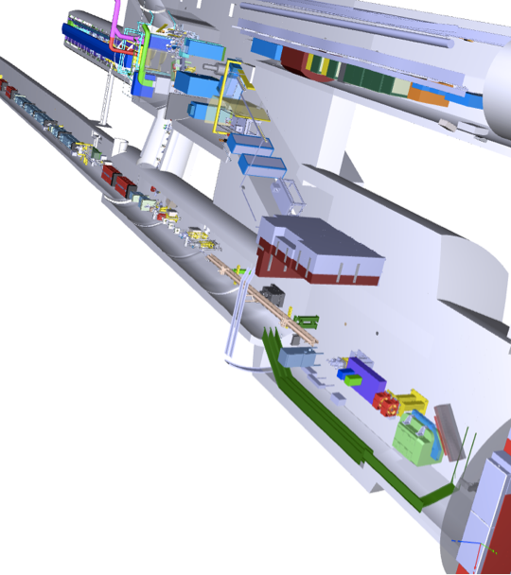
Protons Delivered by CERN SPS
Proton bunch momentum: 400 GeV/c
3x10¹¹ protons/bunch
Bunch length: σ_{z} = ~10 cm
Radial bunch size at plasma entrance: σ_{r} = 0.2 mm

Slide 45
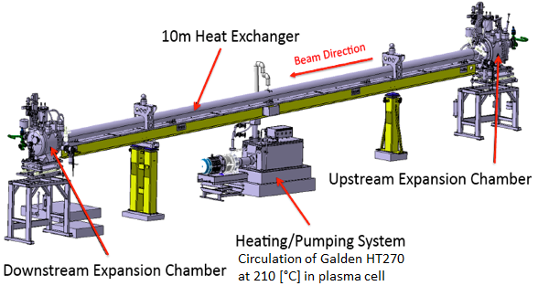
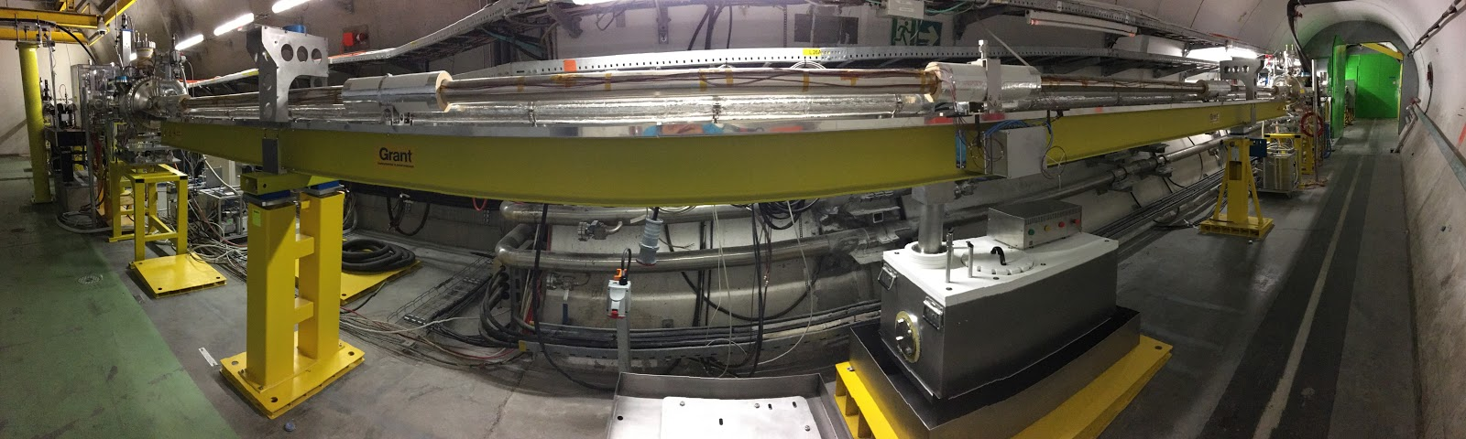
The AWAKE Plasma
Rubidium vapour cell.
The laser ionizes the outermost electron of each rubidium atom.
Desired plasma density: ~1-10x10¹⁴ electrons/cm³.

Slide 46
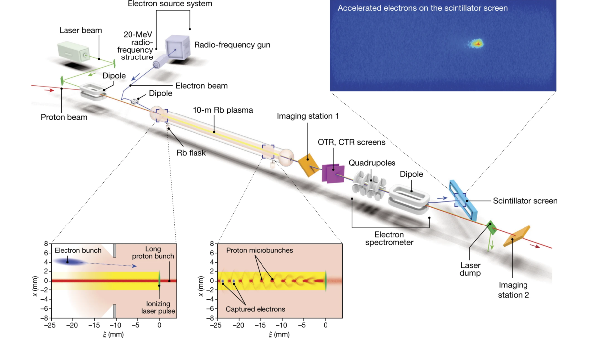

Slide 47
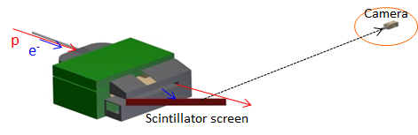
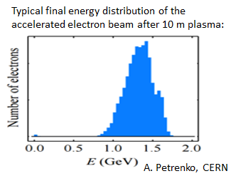
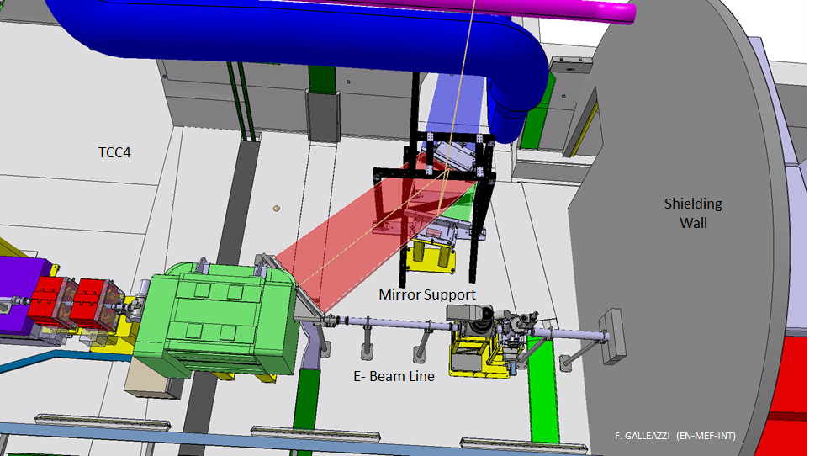
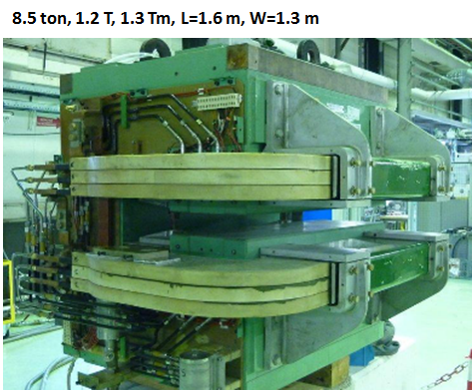
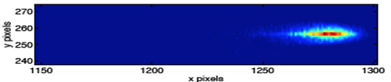
Accelerated Electron Energy Measurement
Electrons will be injected with an energy around 10-20 MeV.
Accelerated electrons are sent through a dipole magnet and deposit energy on a scintillating screen which is imaged by a camera.
Expected measurement
L. Deacon (UCL)

Slide 48
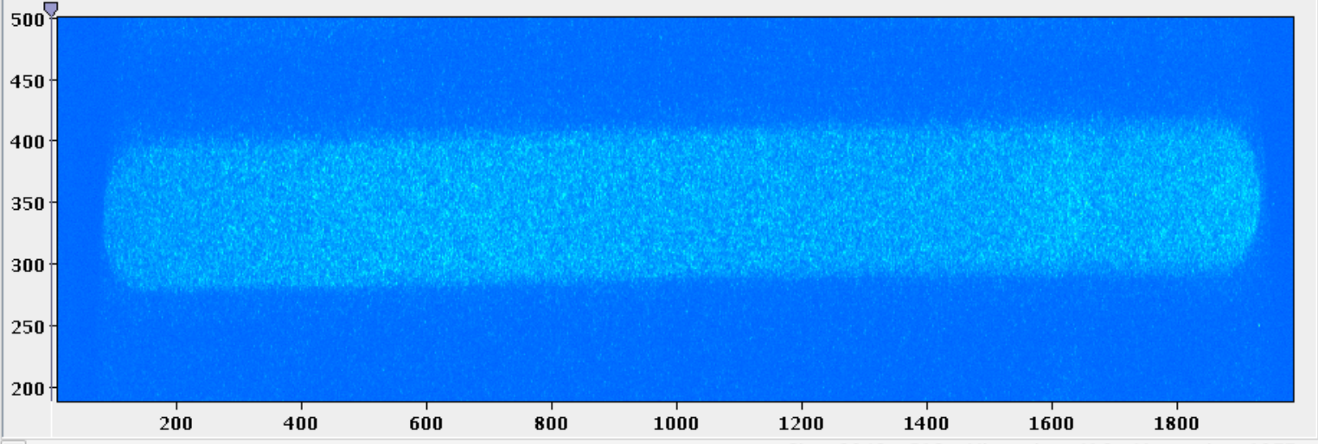
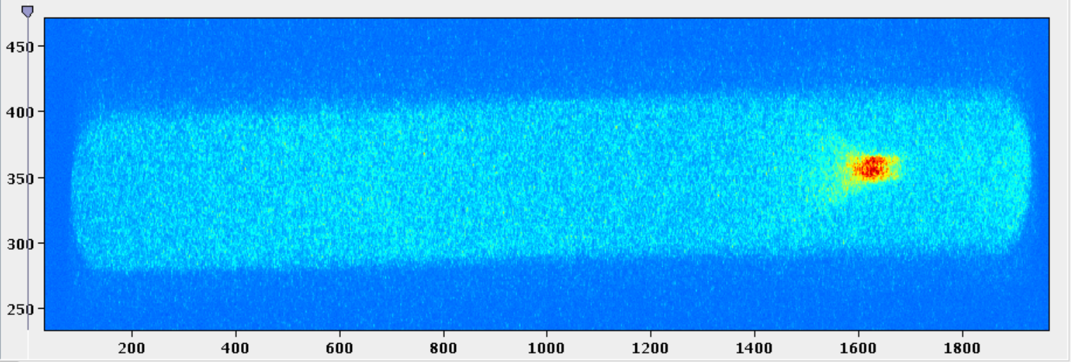
First Electron Acceleration
No electrons accelerated.
Accelerated electrons.

Slide 49
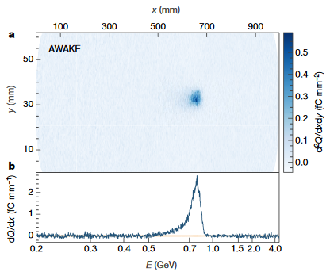
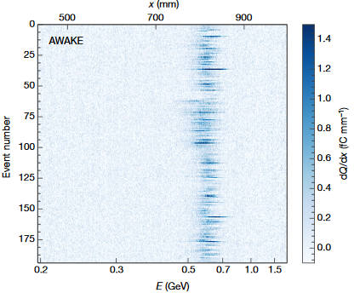
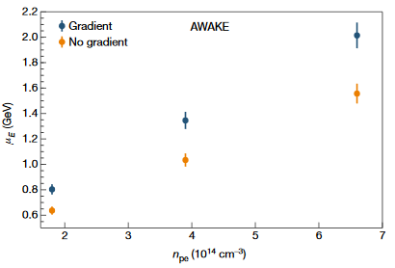
Electron Acceleration Results
AWAKE Collaboration, Nature volume 561, pages 363–367 (2018)

Slide 50
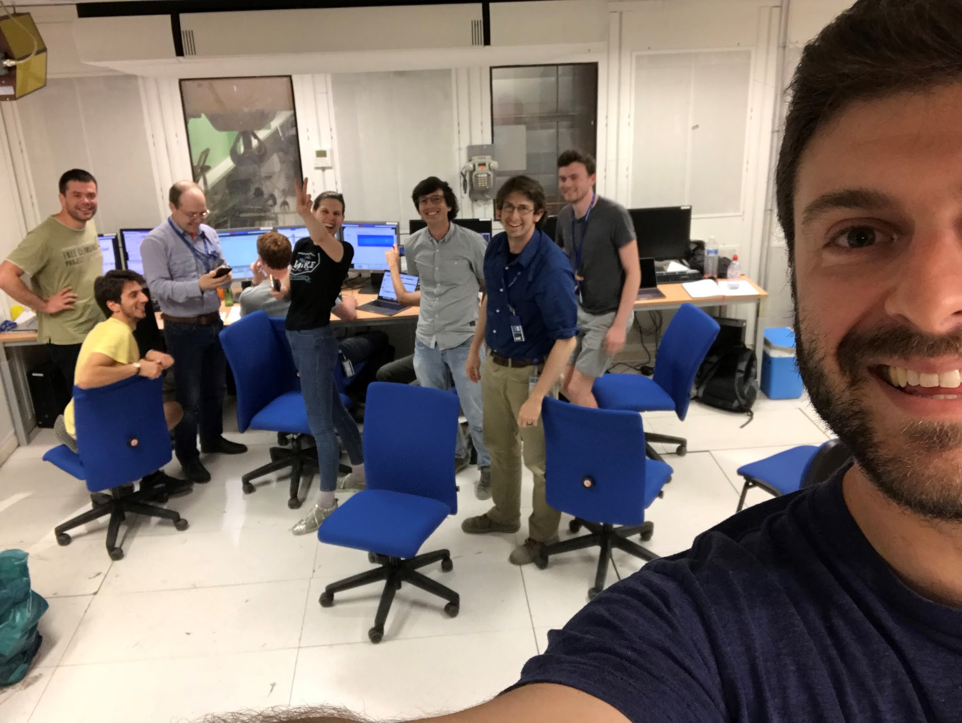
Shortly after we have observed electron acceleration for the first time!

Slide 51
Let Us Repeat…
To realize the AWAKE experiment at CERN, we need:
  Plasma (vapor source + laser)
  Proton bunch (wakefield driver)
  Electron bunch (witness – to be accelerated)
Diagnostics are key to a successful measurement
  AWAKE diagnostics include:
    Screens + Streak camera (to know beam positions and verify that SSM was successful)
    Electron spectrometer (energy of the accelerated witness bunch)

Slide 52

Most Recently: New Plasma Source Technology

Slide 53


Xe
Xe
A = 131,
Single ionisation

Slide 54

Ar
Ar
(A=40),
Single ionisation

Slide 55

He
He
(A=4),
Single ionisation

Slide 56
Motion of Ions Leads to Decoherence of Plasma Electron Motion
Rb+
e-
e-
Rb+
Rb+
Rb+
e-
e-
e-
e-
Rb+
Rb+
Rb+
Rb+
Rb+
Rb+
Rb+
Rb+
Rb+
Rb+
e-
e-
e-
e-
e-
e-
e-
e-
Rb+
Rb+
Rb+
Rb+
Rb+
Rb+
e-
e-
e-
e-
e-
e-
e-
e-
e-
e-
e-
e-
e-
e-
e-
Rb+
e-
Rb+
Rb+
Rb+
e-
Rb+
Rb+
Rb+
Rb+
Rb+
Rb+
e-
e-
e-
e-
e-
e-
e-
e-
e-
e-
e-
Rb+
e-
Rb+
Rb+
e-
e-
e-
e-
Rb+
Rb+
e-
Rb+
Rb+
e-
e-
e-
Rb+
Rb+
e-
e-
Rb+
Rb+
Rb+
Rb+
Rb+
Rb+
Rb+
Rb+
Rb+
Rb+
Rb+
e-
Rb+
e-
Rb+
e-
e-
e-
e-
e-
e-
Rb+
Rb+
e-
e-
Rb+
e-
e-
Rb+
Rb+
Rb+
Rb+
Rb+
Rb+
e-
e-
e-
e-
e-
e-
e-
e-
e-
e-
e-
e-
Rb+
e-
e-
e-
Rb+
e-
e-
Rb+
Rb+
Rb+
Rb+
e-
Rb+
Rb+
Rb+
Rb+
e-
e-
e-
e-
e-
e-
e-
e-
e-
e-
e-
e-
e-
e-
Rb+
e-
Rb+
Rb+
e-
Rb+
e-
e-
e-
Rb+
Rb+
e-
e-
e-
e-
Rb+
Rb+
Rb+

Slide 57


Experimental Observation of Motion of Ions
Simulation
Experiment

Slide 58

Now in AWAKE: New Plasma Source
Allows to adjust the plasma density along the 10 m
More stable SSM, → higher wakefield amplitudes

Slide 59


M. Bergamaschi, J. Mezger, L. Ranc

Slide 60

AWAKE until ~2030

Slide 61

First AWAKE Particle Physics Applications
Example I: Dark Matter Experiment
These experiments use the collisions of an electron beam with a fixed-target or a dump to generate the dark photon via Bremsstrahlung (electron and proton beams) or meson production.
The products of the collisions are mostly absorbed in the dump and the dark photon is searched for as a displaced vertex with two opposite charged tracks in the decay volume of the experiment.
e⁻Z →e⁻ZA′
A′ → e+e−, etc..
From Caldwell: https://arxiv.org/pdf/1812.11164.pdf

Slide 62


First AWAKE Particle Physics Applications
Example II: Electron-Proton Collisions
Collide:
  50 GeV electrons with 7 TeV LHC protons
  ~TeV electrons with 7 TeV LHC protons
Plasma-based collider design
Physics cases:
Study of the sub-structure and spin structure of the proton and photon
Determine if partons are fundamental point-like objects
Clarifying the underlying physics leading to the energy dependence of cross sections
Leptoquark production: hypothetical particles that would interact with quarks and leptons
Diagrams of neutral-current (top) and charged-current (bottom) deep-inelastic electron–proton scattering processes. Image credit: DESY.
Caldwell, A., Wing, M. VHEeP: a very high energy electron–proton collider. Eur. Phys. J. C 76, 463 (2016). https://doi.org/10.1140/epjc/s10052-016-4316-1

Slide 63
Summary and Conclusions
Plasma wakefield acceleration is a novel technique to accelerate charged particles
  Advantage: Very high accelerating gradient, compact accelerators
Proof of principle acceleration has been demonstrated
  Next step: aim for high beam quality in long plasmas→ First applications
AWAKE is an accelerator R&D experiment at CERN:
  Only proton-driven wakefield acceleration experiment worldwide
  The experiment opens a pathway towards particle physics applications
Final Goal: Design high quality & high energy electron accelerator based on acquired knowledge.

