Slide 1
Particle Detectors
Jeff Wiener
12 April 2023

Slide 2
cern.ch/identities

Slide 3
Nature of Science
Theory-laden
Empirical & inferential
Creative
Tentative
Social & cultural embeddedness

Slide 4


Higgs in a Box

Slide 5
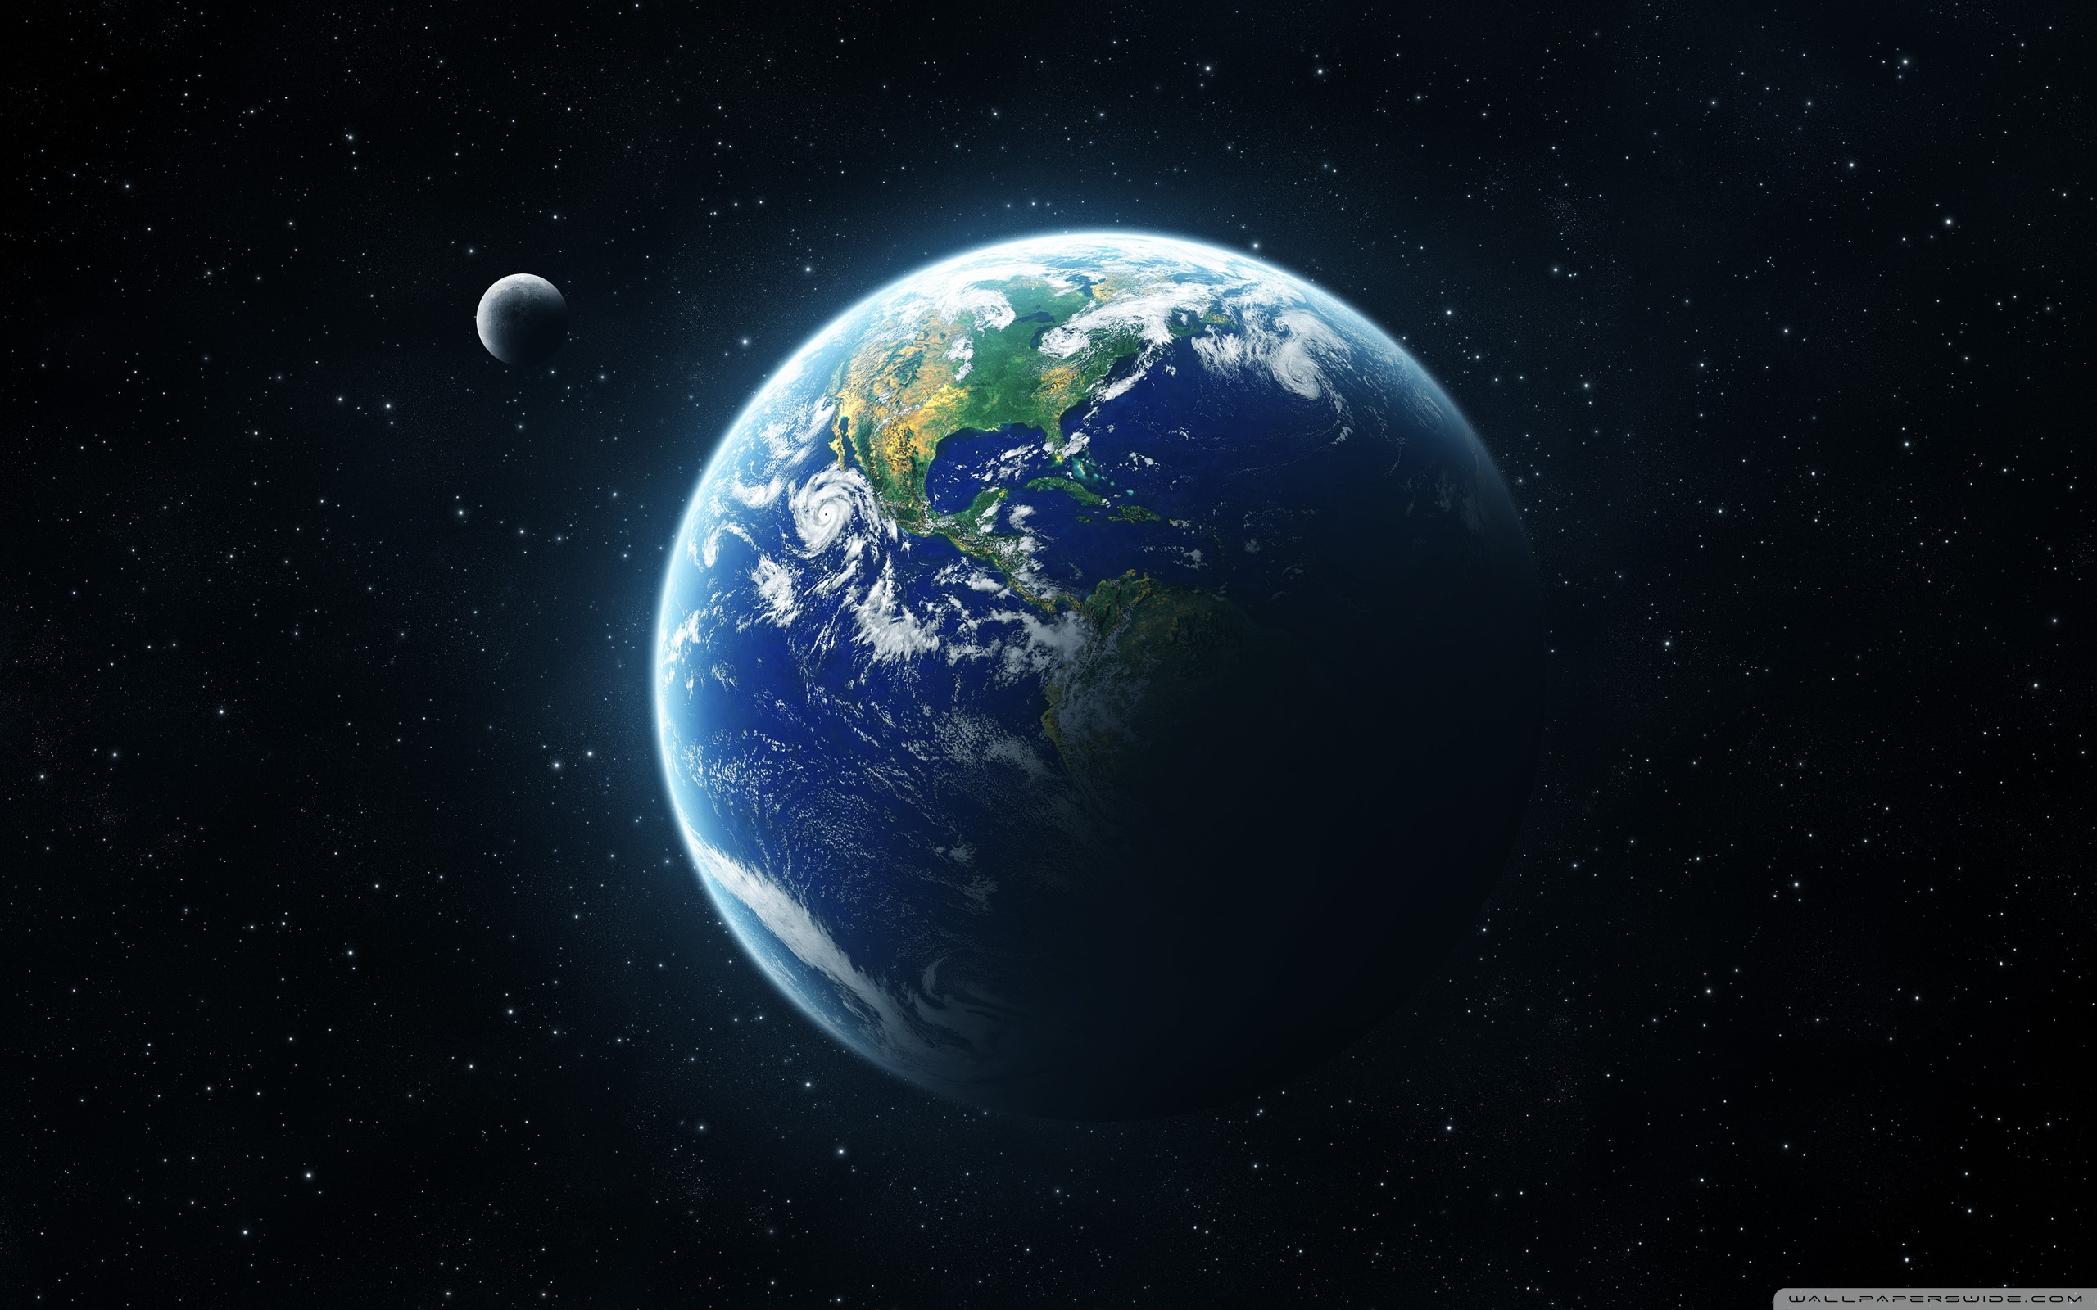

Slide 6
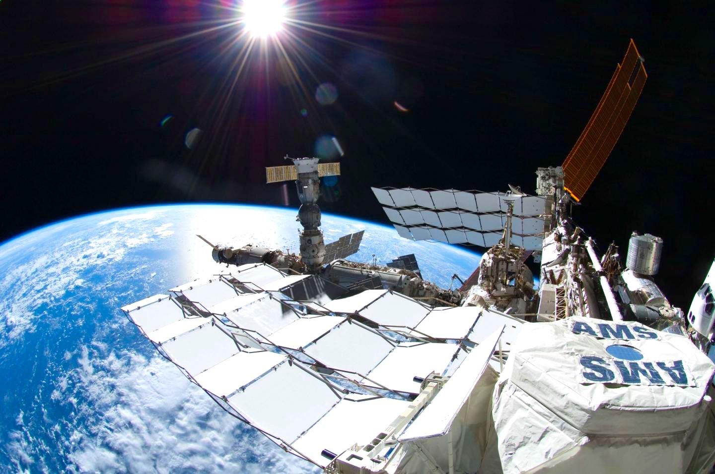

Slide 7
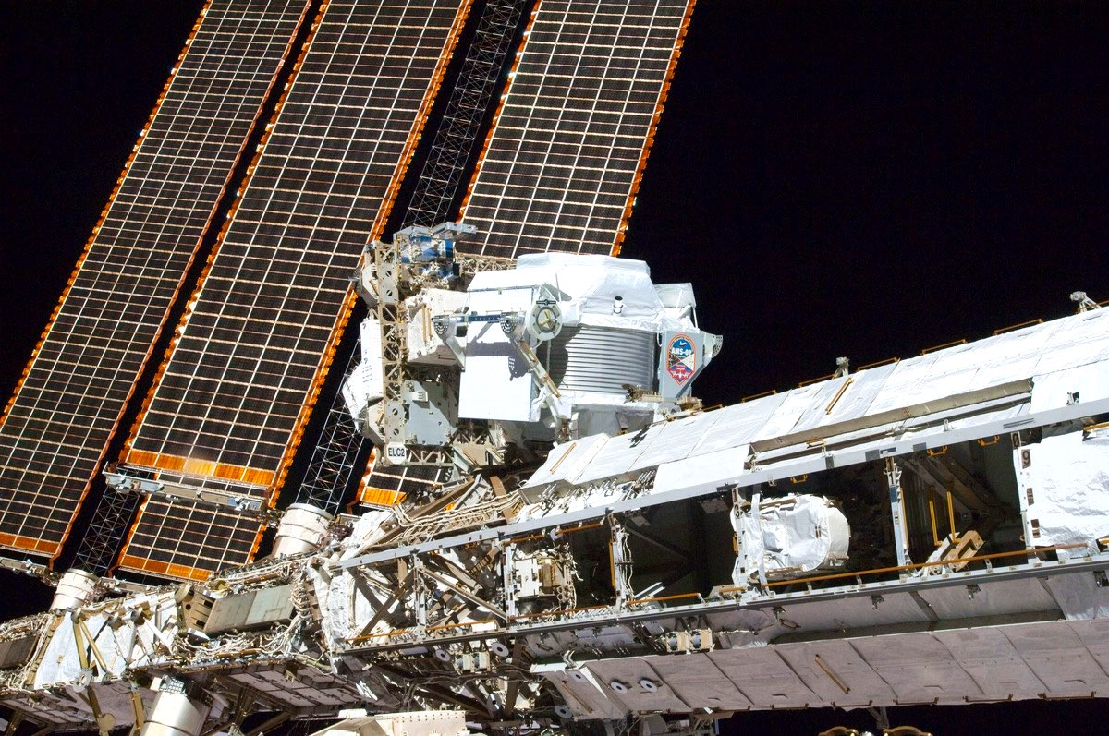

Slide 8
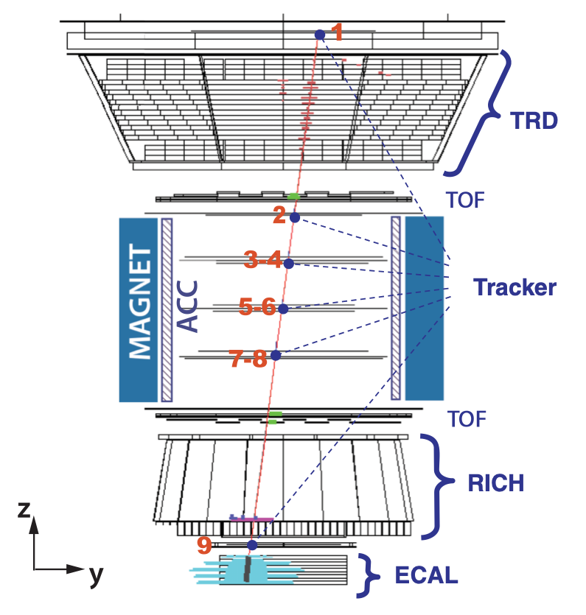

Slide 9
ams02.space

Slide 10
ams02.space

Slide 11
ams02.space

Slide 12
ams02.space

Slide 13
ams02.space

Slide 14
ams02.space

Slide 15
ams02.space

Slide 17
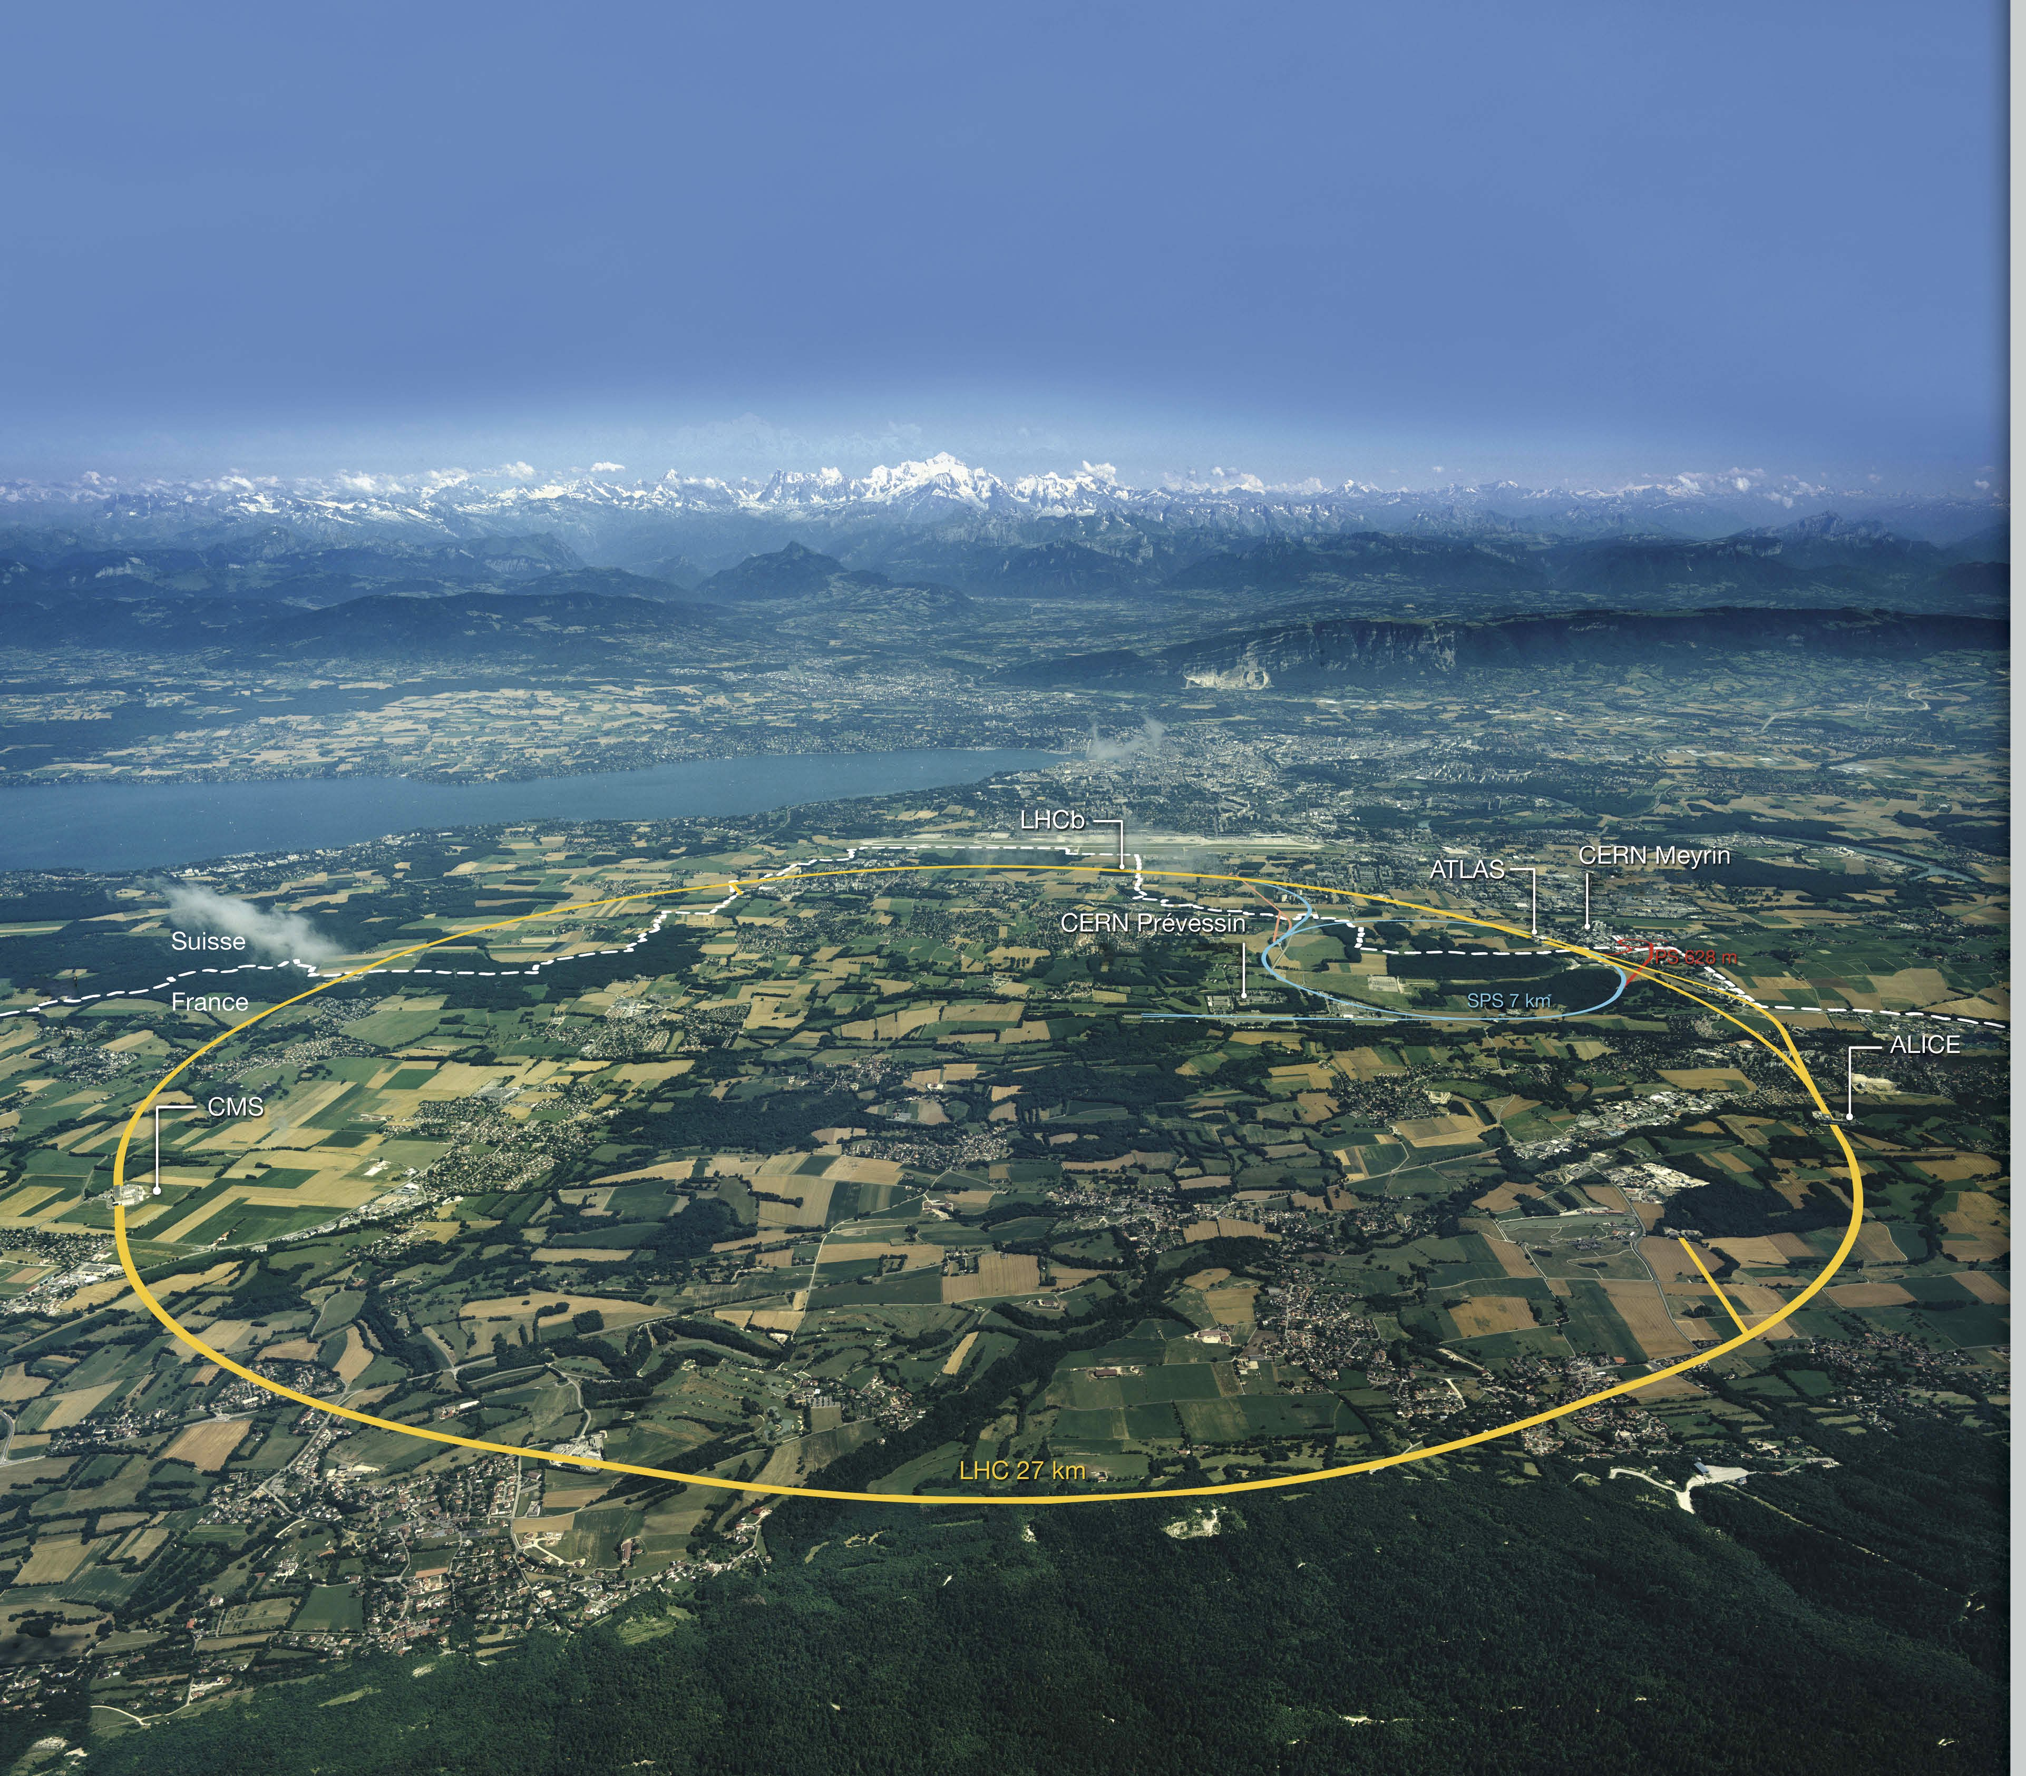

Slide 18
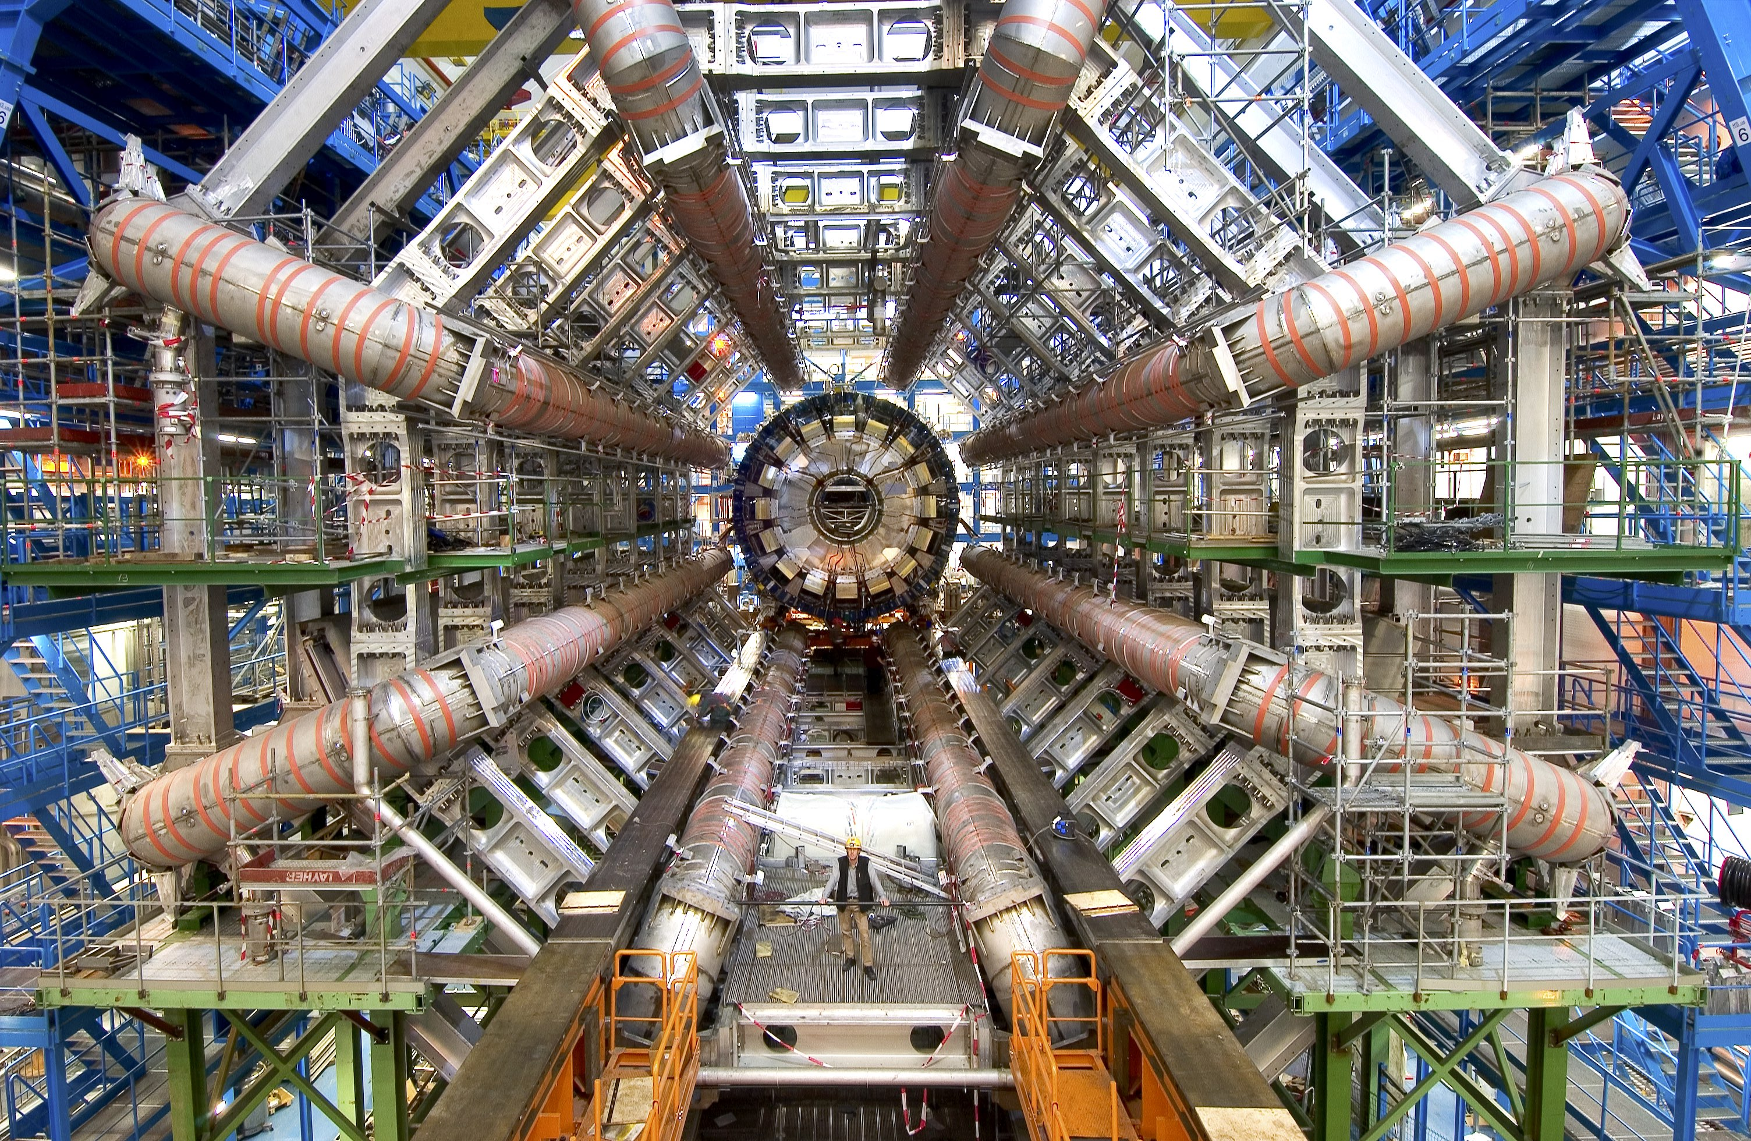

Slide 19
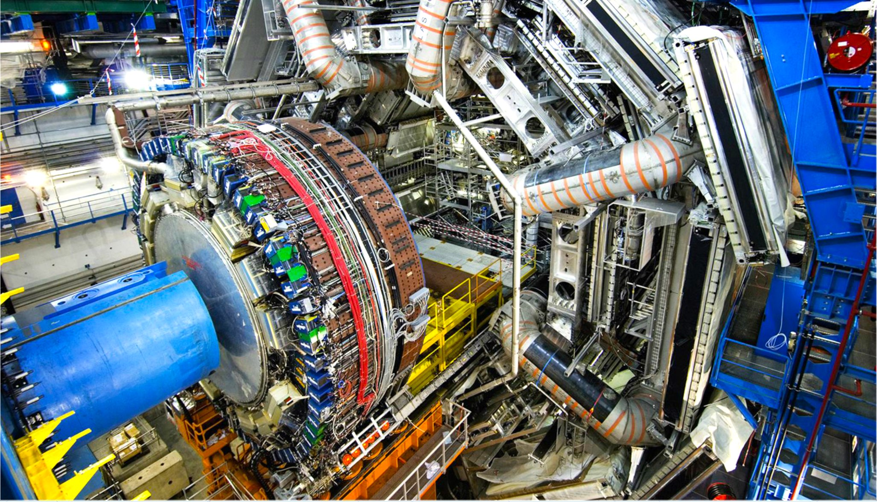

Slide 21
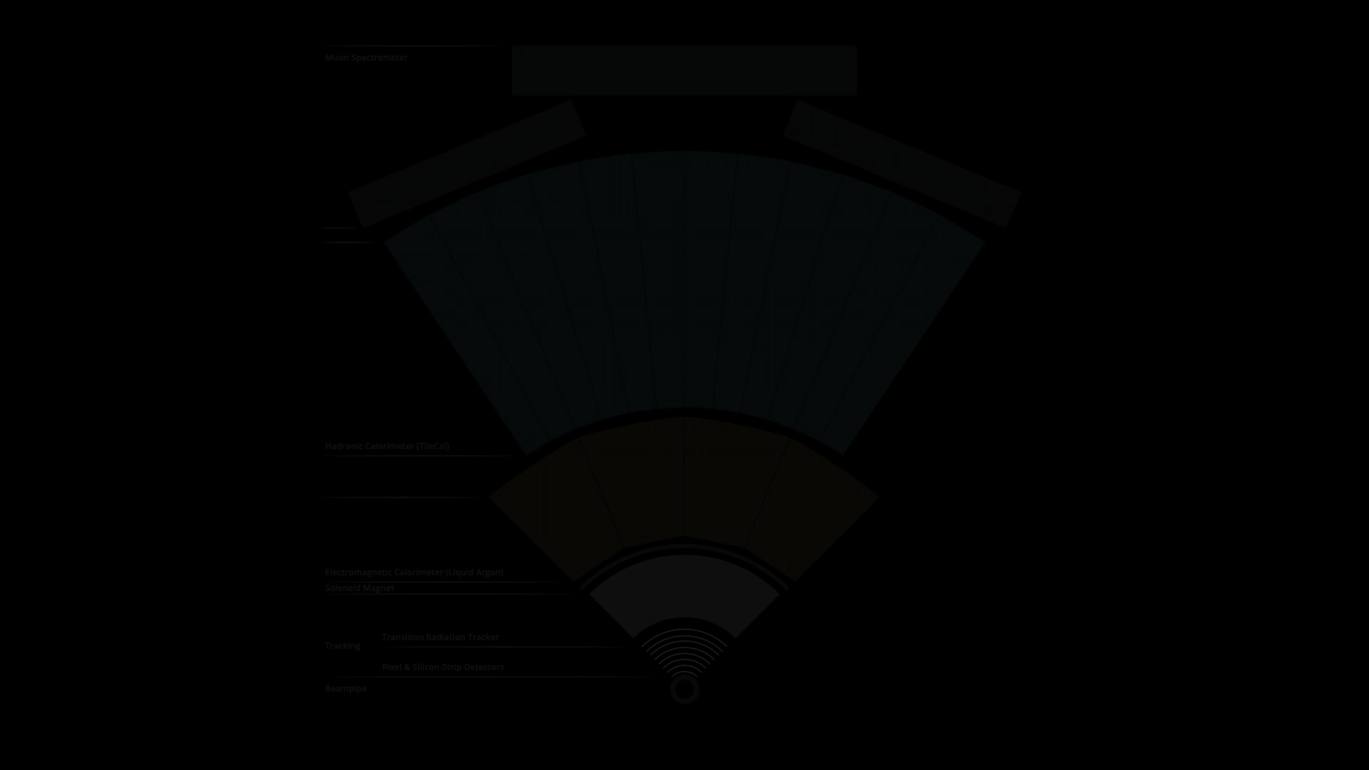

Slide 22

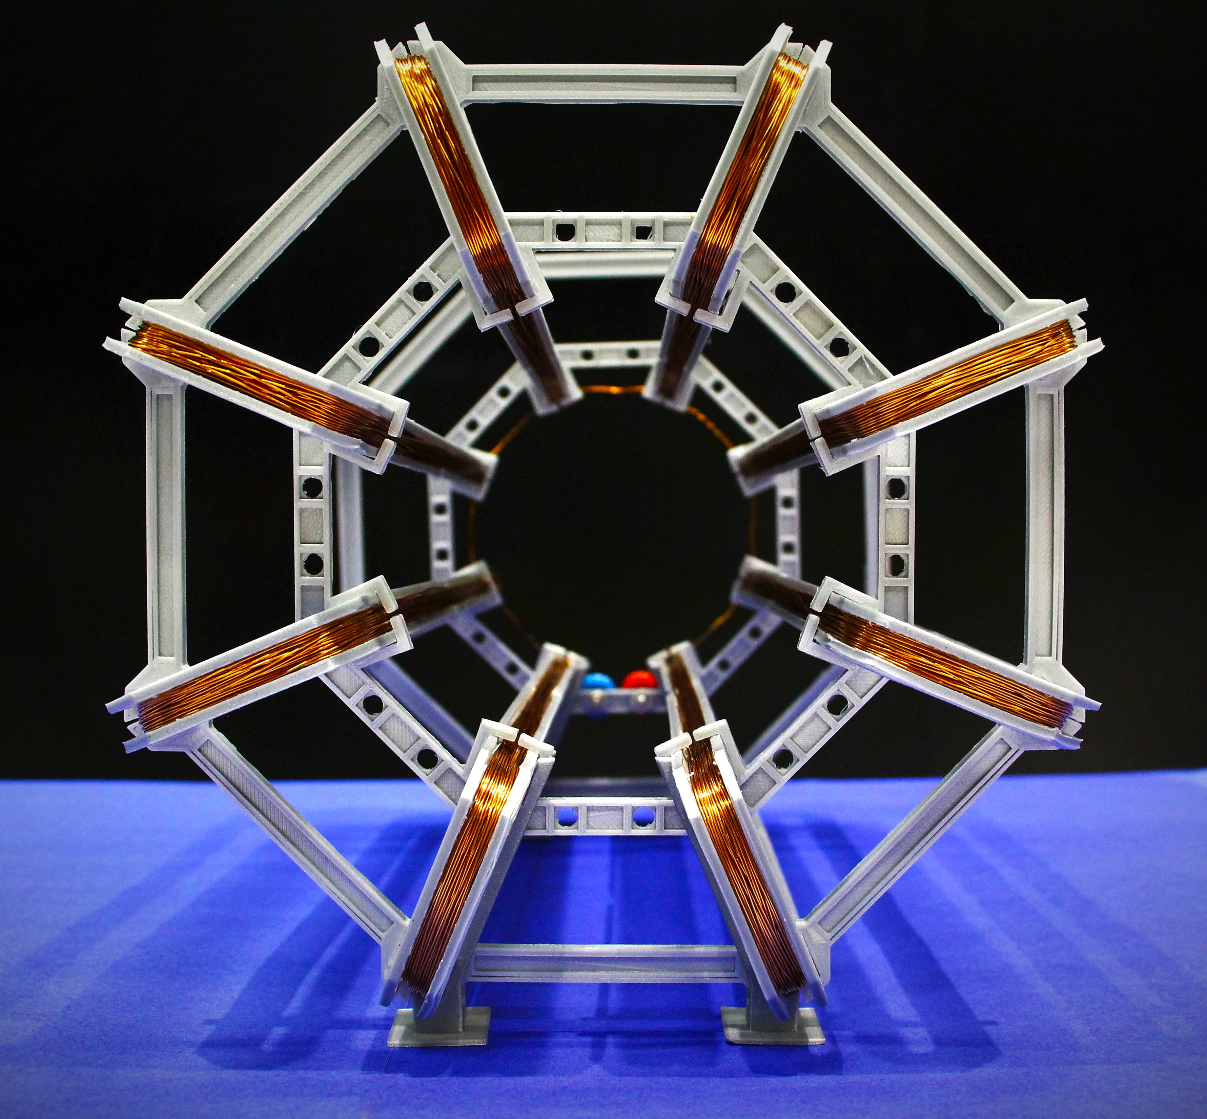
cern.ch/PER

Slide 23
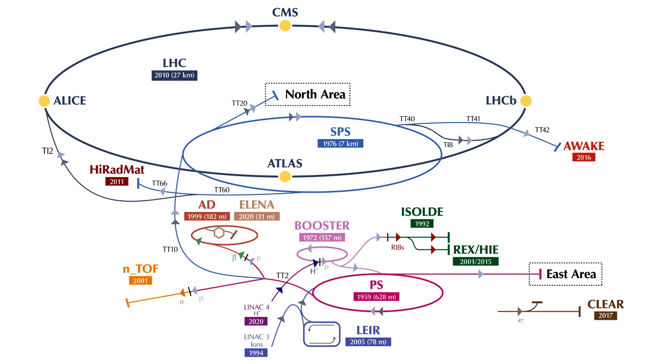

Slide 25
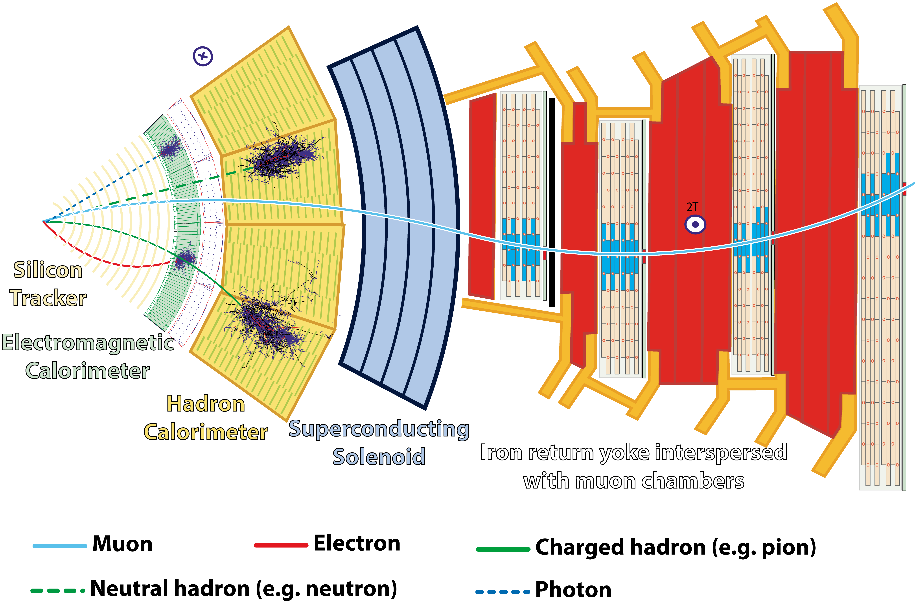

Slide 32
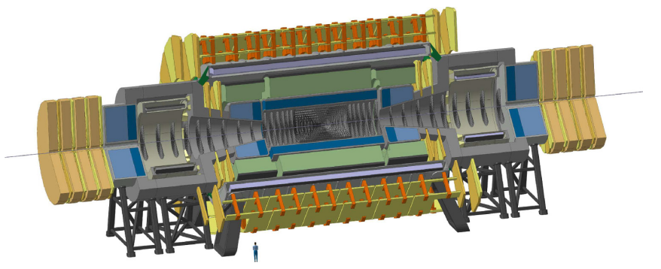

Slide 33

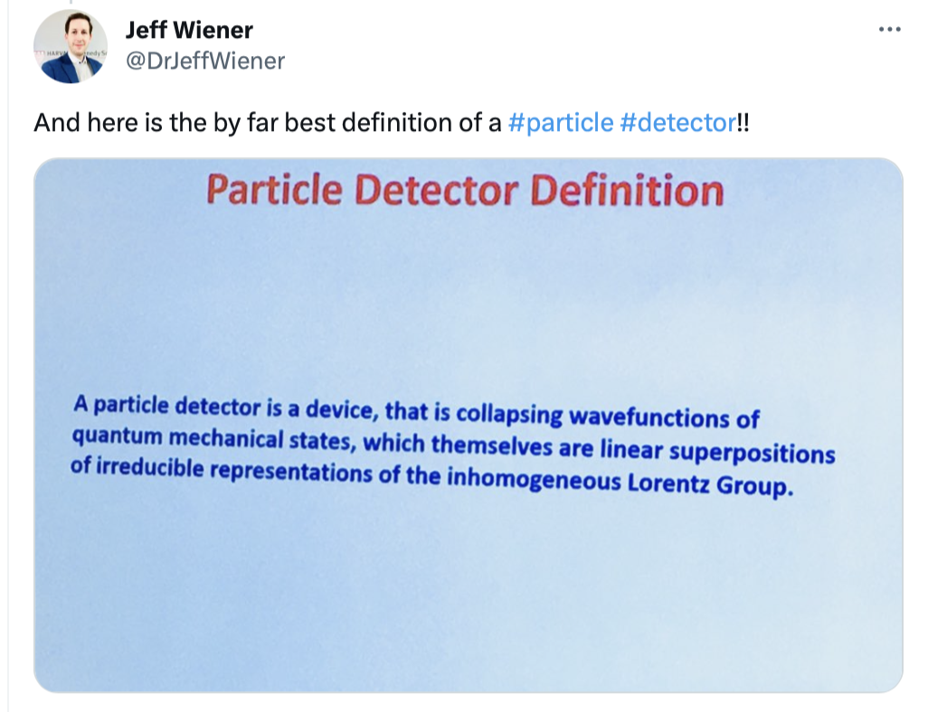
Particle Detectors in short

Slide 34
Merci bien!
Questions?
cern.ch/jeff.wiener

