Slide 1






Find the Higgs
How experimental collaboration works

Slide 2
IPPOG Exercise in Coopetition
2
Copyright © 2021 Misk All Rights Reserved.

Slide 3




Building Collaborations
9:00 - Introductions, explanation of the program and goals
9:15 – Universal Questions: Everything you always wanted to know about particle physics
9:45 - Q&A
10:00 - We split up into 5 experiments and start Masterclasses. Spokespersons have the right to hand out positions: Deputy Spokesperson, Technical Coordinator, Resource Coordinator, Physics Coordinator, Computing Coordinator, Trigger Coordinator, Outreach Coordinator, Run Coordinator, Publication Coordinator (you get the idea - everyone gets a responsibility).
10:05 – Spokespersons explain Masterclasses, collaborations carry them out and prepare presentations for the upcoming conference
11:30 – End of data taking, completion of presentations, travel to conference
11:45 - Conference (each group gets 10 mins to describe and defend their results)
12:45 - Conclusions (by the participants)

Slide 4
Spokespersons – 17 May 2022
Team 1 - Mariarosaria D'Alfonso (LHCb Experiment)
Team 2 - Despina Hatzifotiadou (ALICE Experiment)
Team 3 - Stephane Cooperstein (CMS Experiment)
Team 4 - Sonia Natale (CMS Experiment)
Team 5 - Jason Veatch (ATLAS Experiment)
Technical Coordination – Fabiola Cacciatore (IPPOG)

Slide 5
Spokespersons – 24 May 2022
Team 1 - Sonia Natale (CMS Experiment)
Team 2 - Livia Soffi (CMS Experiment)
Team 3 - Hassnae El Jarrari (ATLAS Experiment)
Team 4 - Stephane Cooperstein (CMS Experiment)
Team 5 - Jason Veatch (ATLAS Experiment)
Technical Coordination – Fabiola Cacciatore (IPPOG)

Slide 6
Spokespersons – 31 May 2022
Team 1 - Mariarosaria D'Alfonso (LHCb Experiment)
Team 2 - Despina Hatzifotiadou (ALICE Experiment)
Team 3 - Sonia Natale (CMS Experiment)
Team 4 - Hassnae El Jarrari (ATLAS Experiment)
Team 5 - Livia Soffi (CMS Experiment)
Beam Injection– Steven Goldfarb (IPPOG)

Slide 7
Spokespersons - 14 June 2022
Team 1 – Sonia Natale (CMS Experiment)
Team 2 – Jason Veach (ATLAS Experiment)
Team 3 – Shalini Epari (ATLAS Experiment)
Team 4 – Despina Hatzifotiadou (ALICE Experiment)
Team 5 – Stephane Cooperstein (CMS Experiment)
Technical Coordination – Fabiola Cacciatore (IPPOG)

Slide 8
Goals
Gain hands-on experience in particle physics research
Discover our cyclic process of Cooperation & Competition
Impress your colleagues with world-leading results
Glory, fame and a Nobel Prize
  … or at least a well-earned lunch

Slide 9
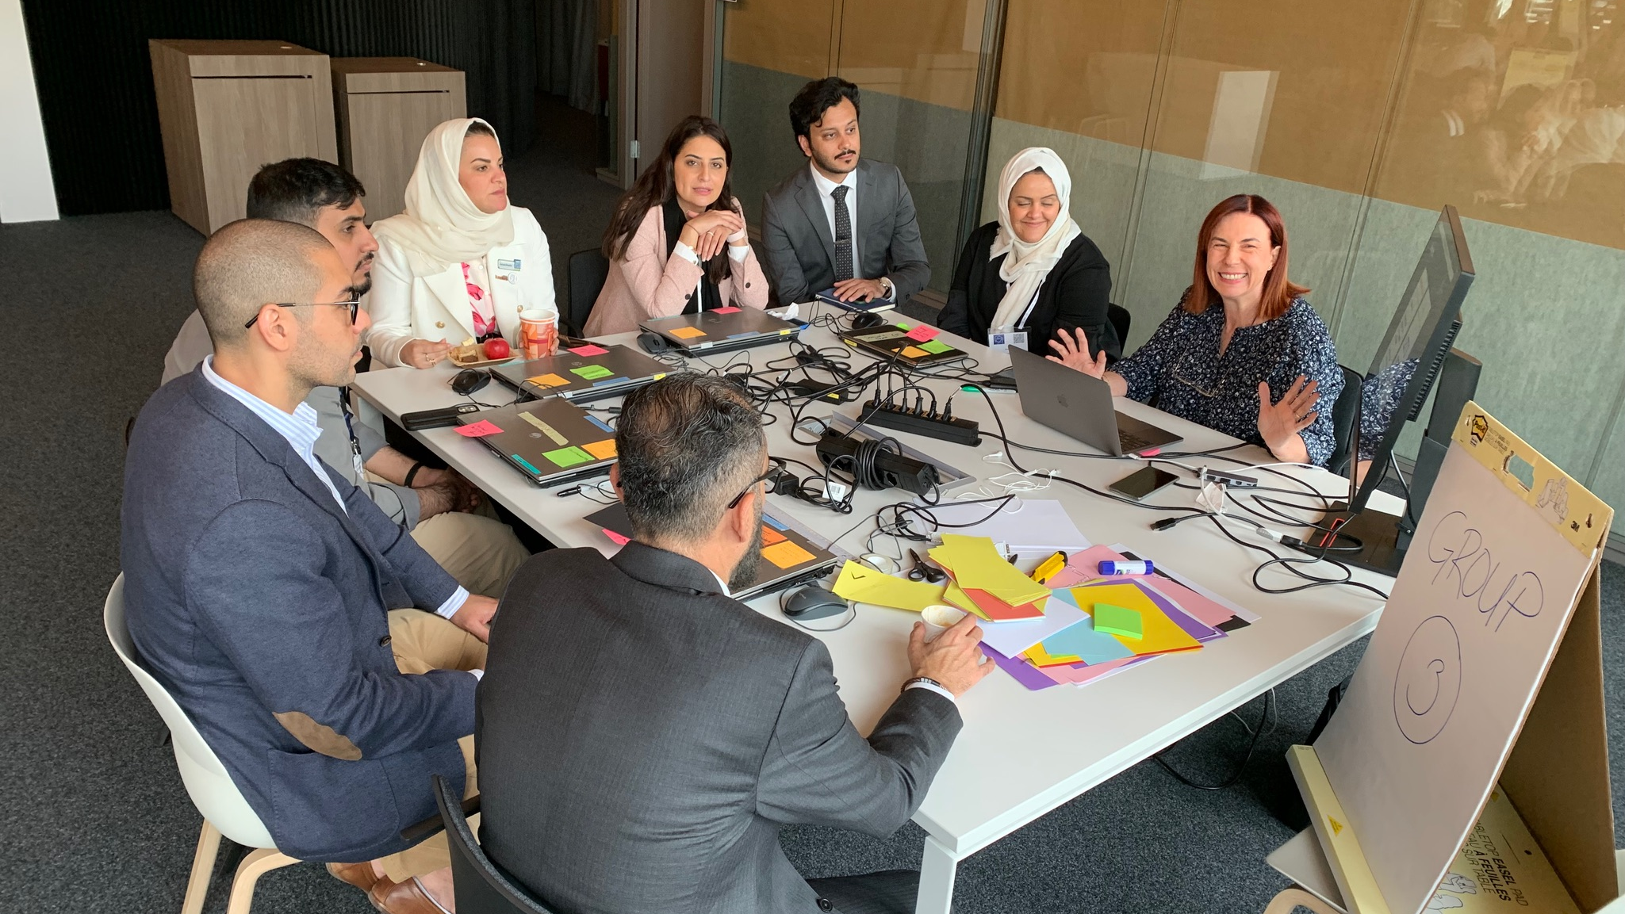

Slide 10
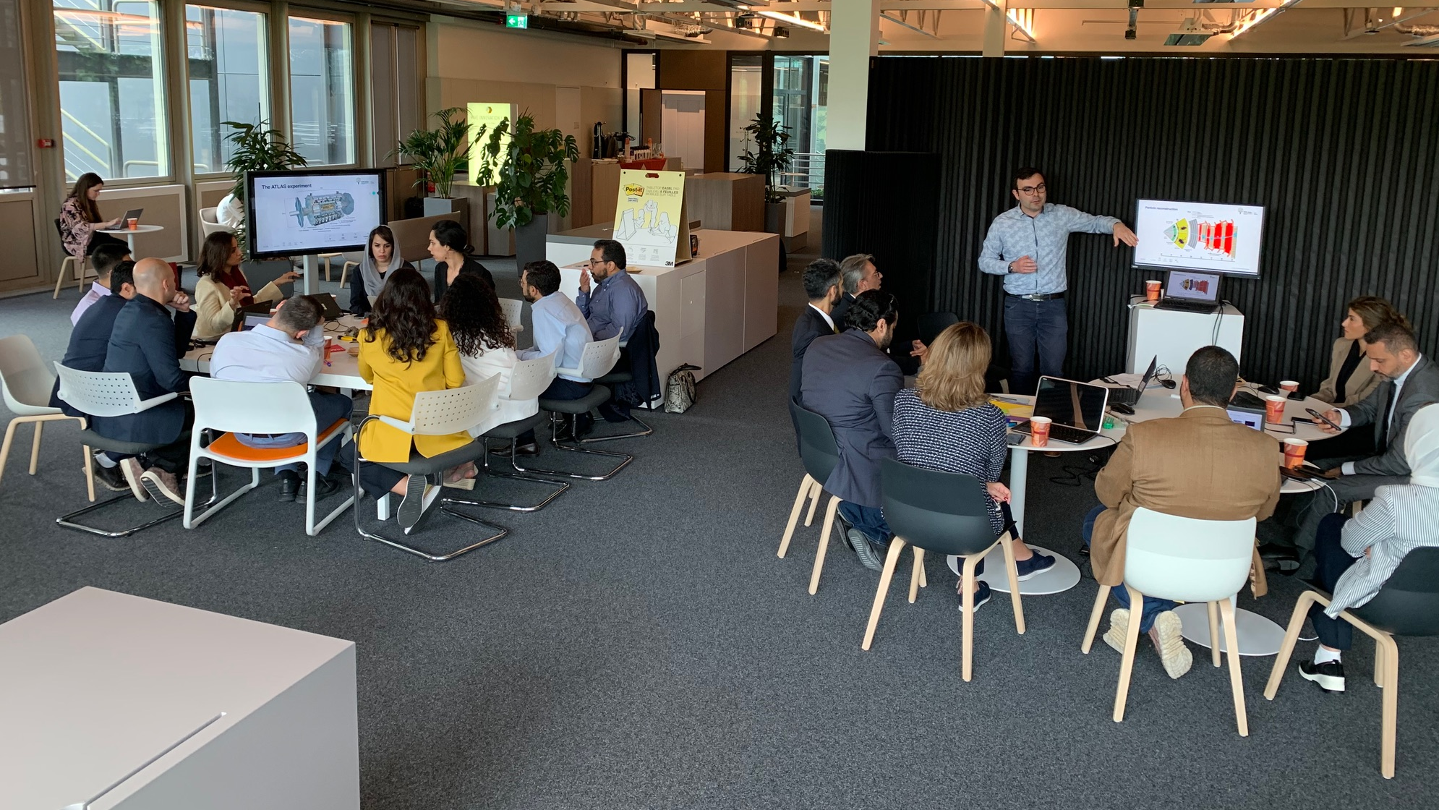

Slide 11
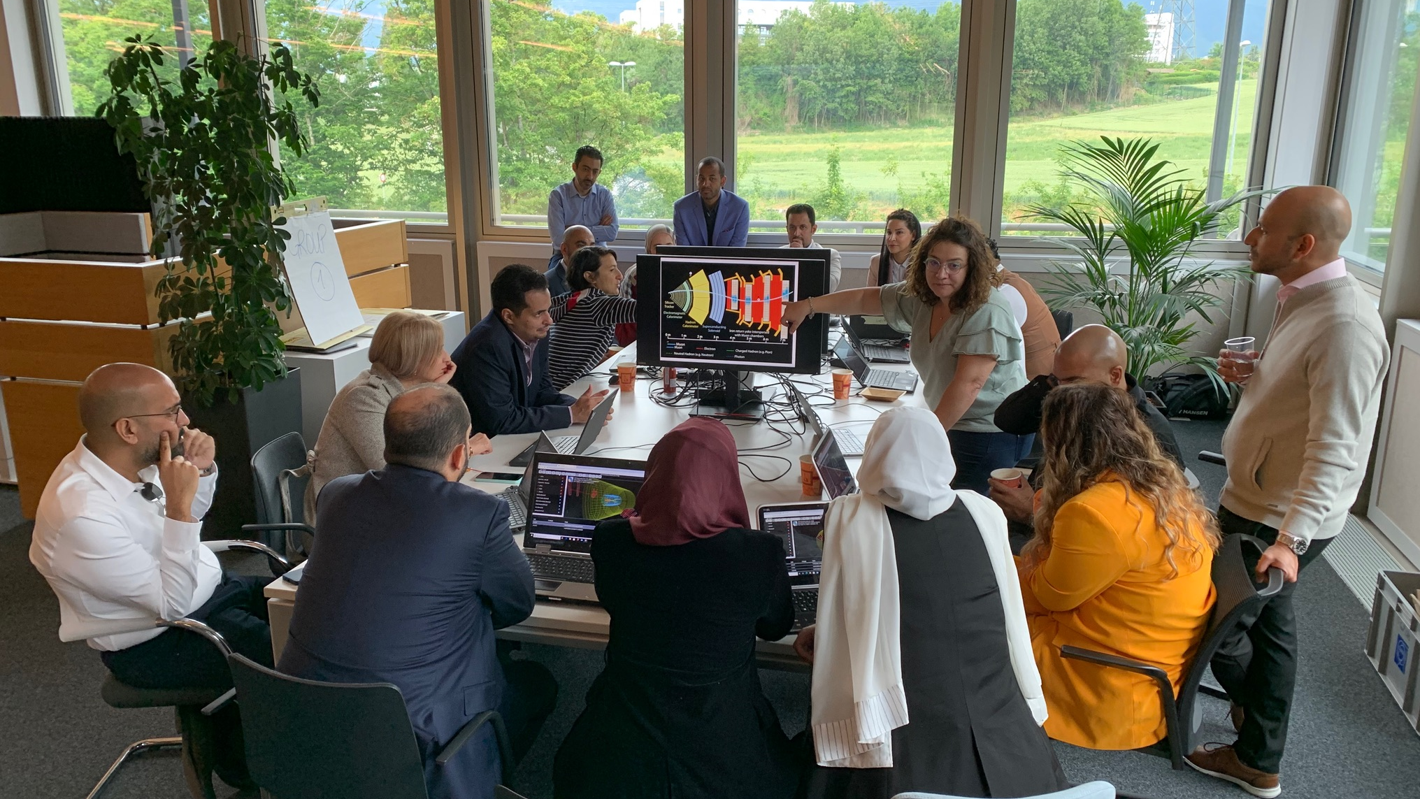

Slide 12
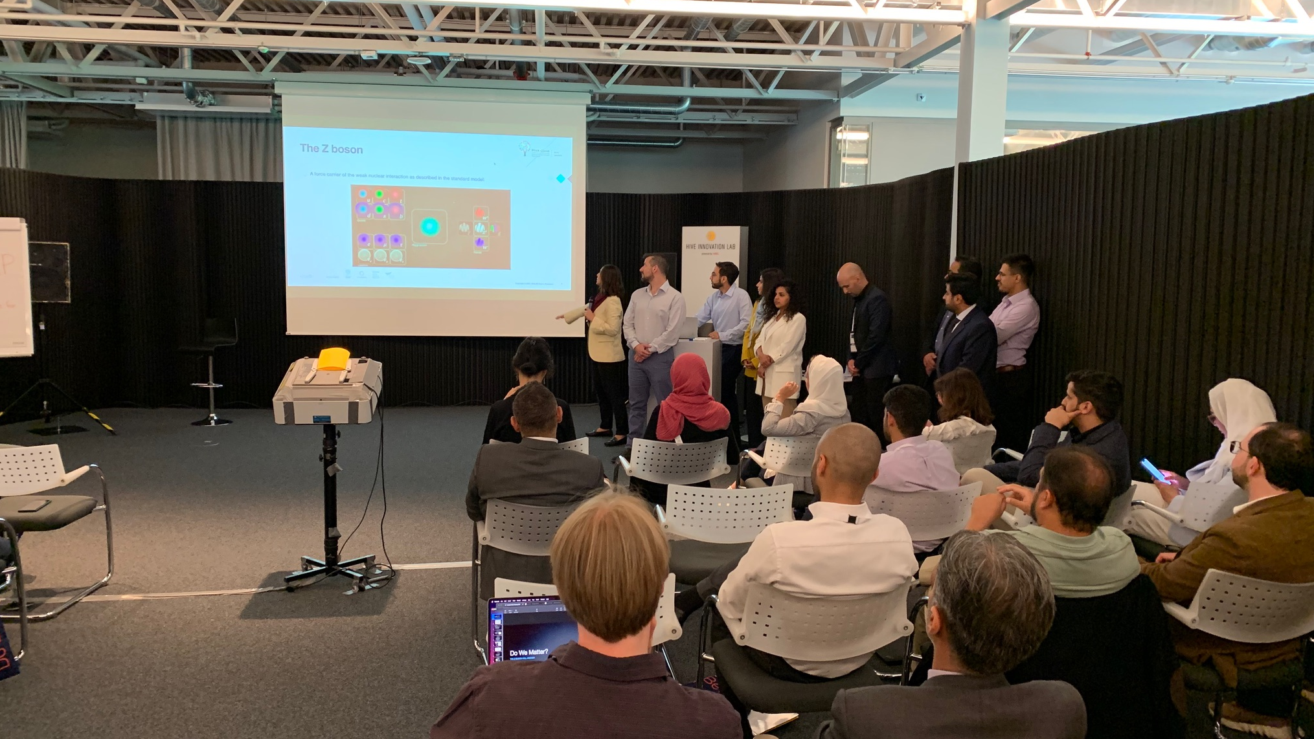

Slide 13
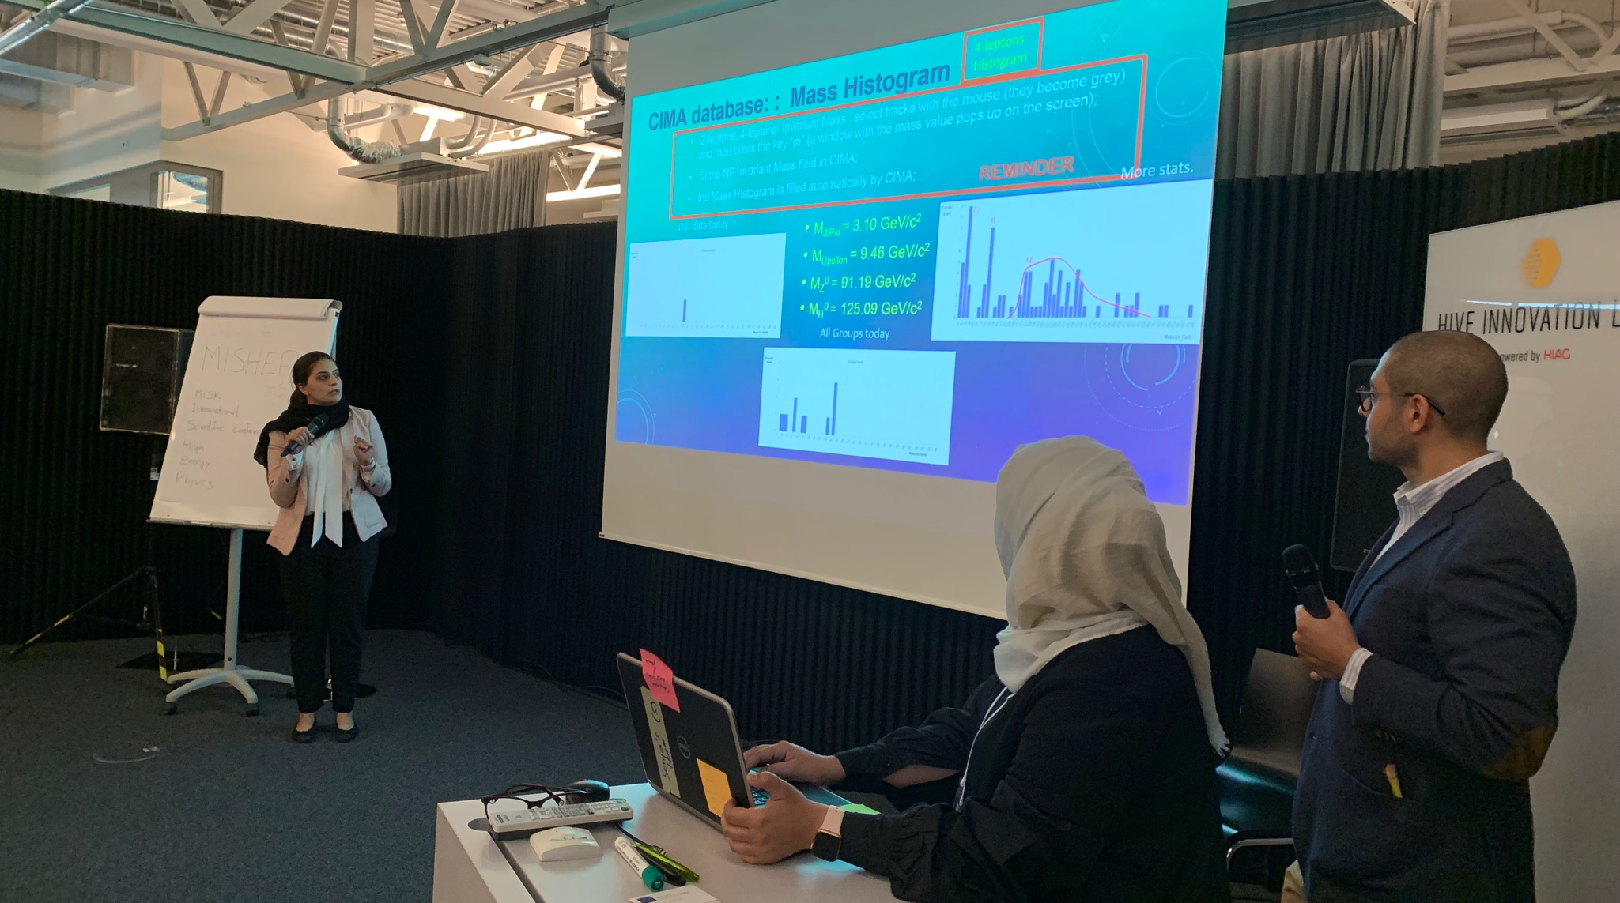

Slide 14
Lessons
Lessons learnt by students
  Particle physics is understandable
  How international collaboration works
    open minds, patience
  Truth lies in data
Lessons learnt by us
  Masterclasses teach more than particle physics
  Masterclasses work for all ages
  We should have some simplified Masterclasses on hand

