Slide 1
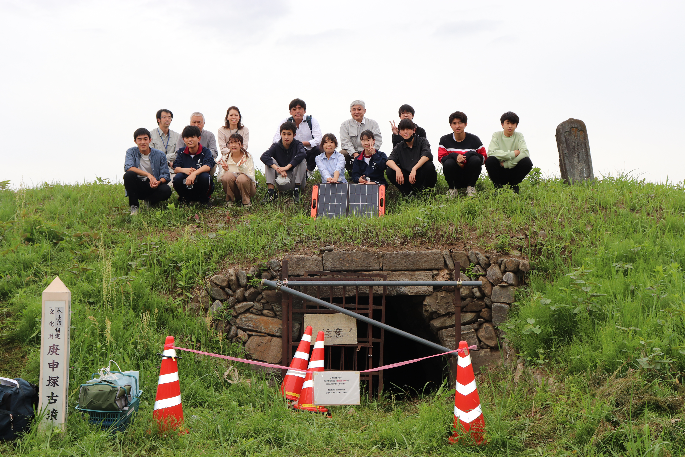

The "Fun-Q" muography project
Miki OHTSUKA (Waseda University Honjo Senior High School)

Slide 2
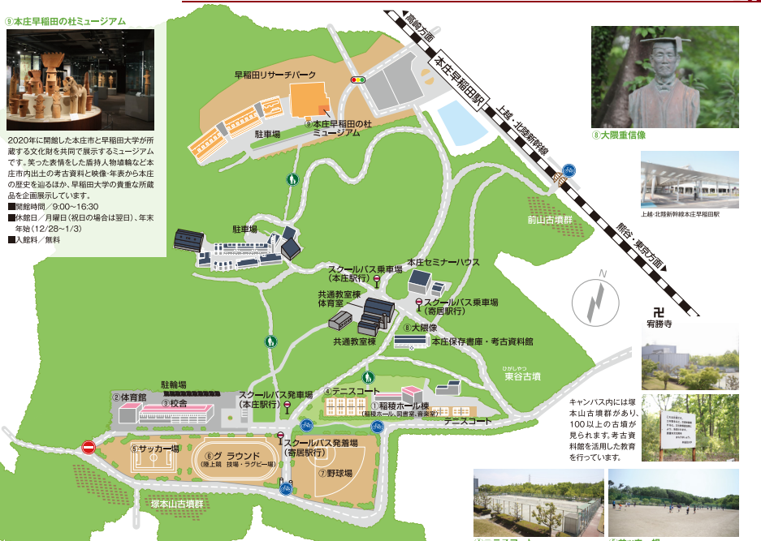
墳Q：Muography of ancient mound 2020-
Fun-Q project is muography of Japanese ancient mounds(Ko-Fun古墳) in by high school students.

Slide 3
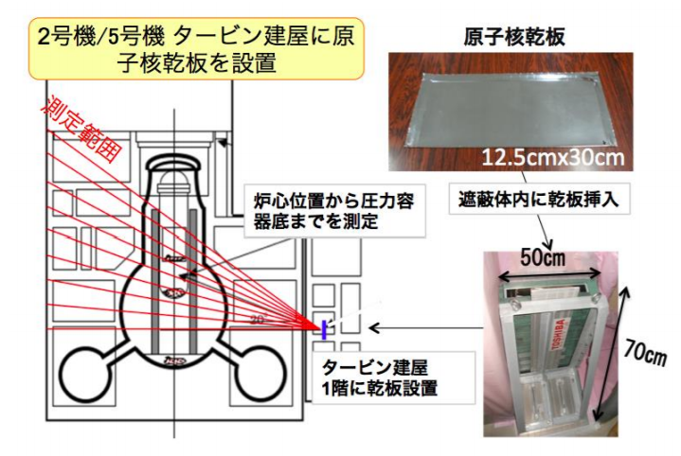
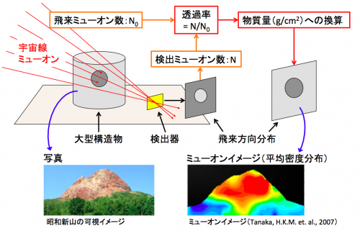
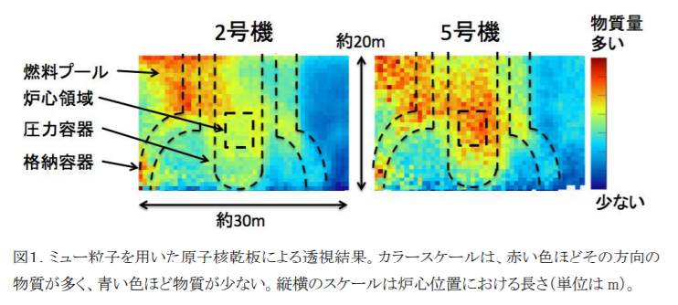
Muography
Muon tomography
Position of radioactive sourse
in Fukushima atomic plant
Magma flow inside volcano
Nagoya university

Slide 4
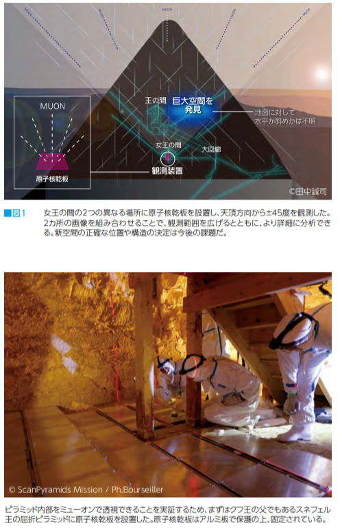
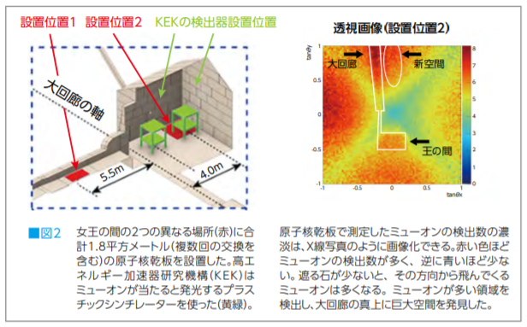
Muography and Archeology
JSTnews July 2018

Slide 5
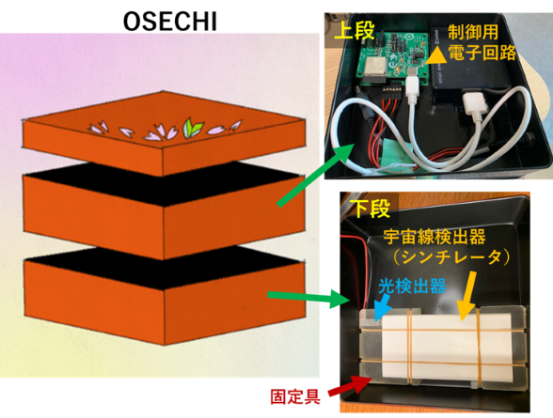
Cosmic ray detector OSECHI
(Outreach & Science Education Cosmic-ray Hunting Instrument)
Portable muon detector:
Plastic scintillator x3
+ electronics
+power supply

Slide 6
Collaboration
We have cross-disciplinary collaboration with
－high school students
(Waseda university Honjo senior high school)
－scientists(Osaka university)
－engineer(KEK)
－science communicator(KEK)
－archeologist(Waseda university)
－curtors(Honjo museum)
education
physics
archeology

Slide 7
Activity
Seninar and meeting:
detector,sensor,electronics,programing,history, archeology
Group work:
Ko-fun team:
research about Ko-fun and finding good target!
Hardware team:developing OSECHI
Software team:coding and analysis
Presentation: junior session in
geology and archeology conference
education
physics
archeology

Slide 8
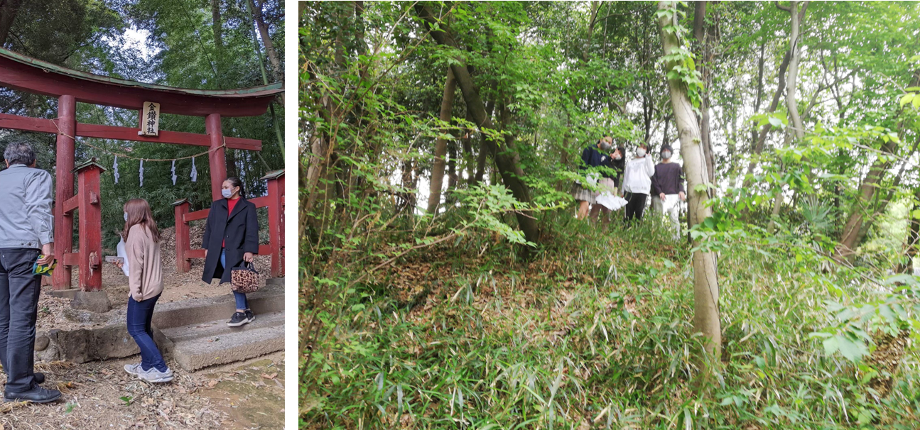
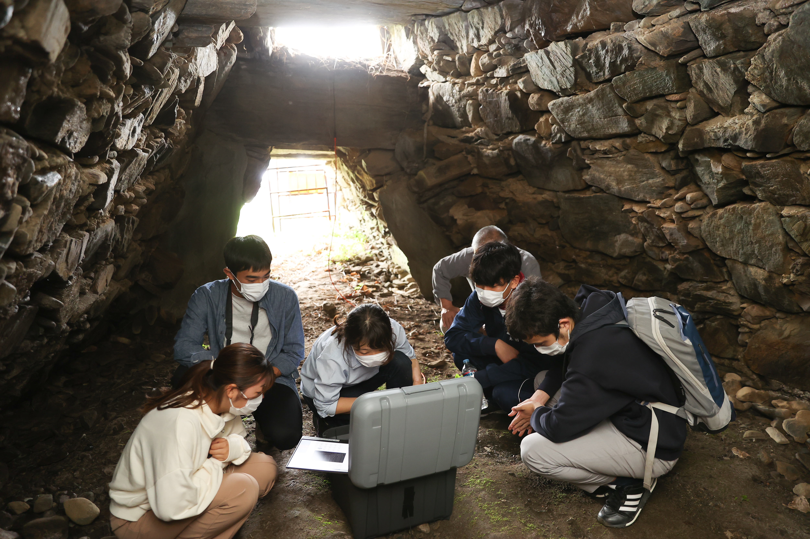
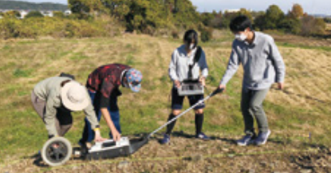
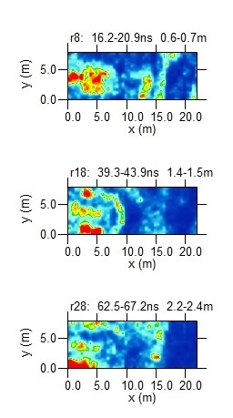
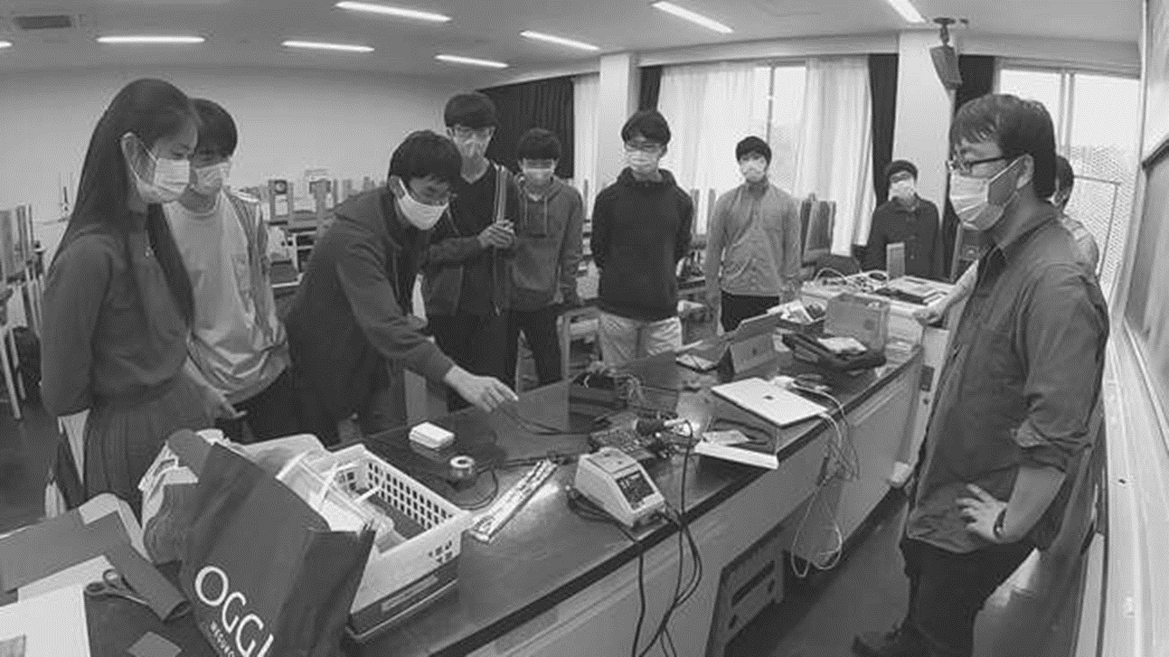
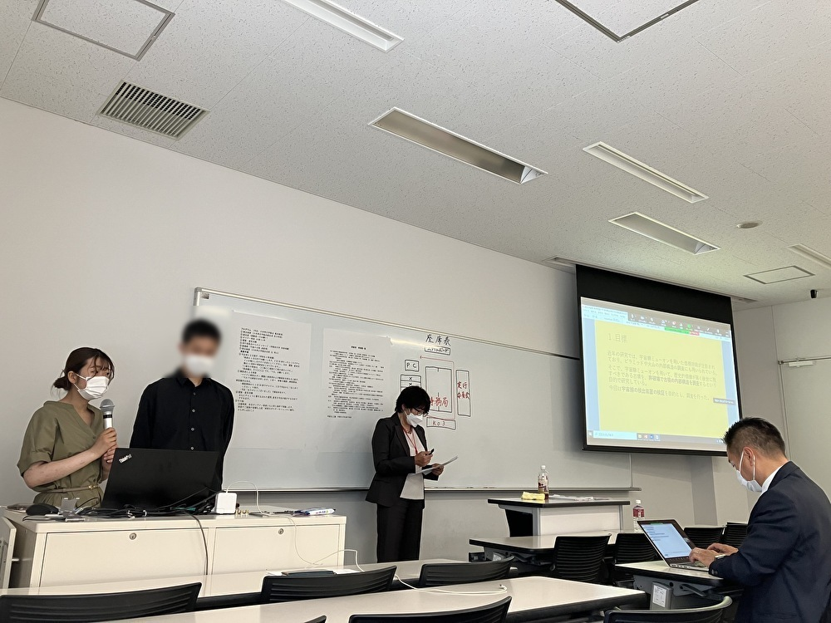
©waseda university honjo senior high school

Slide 9
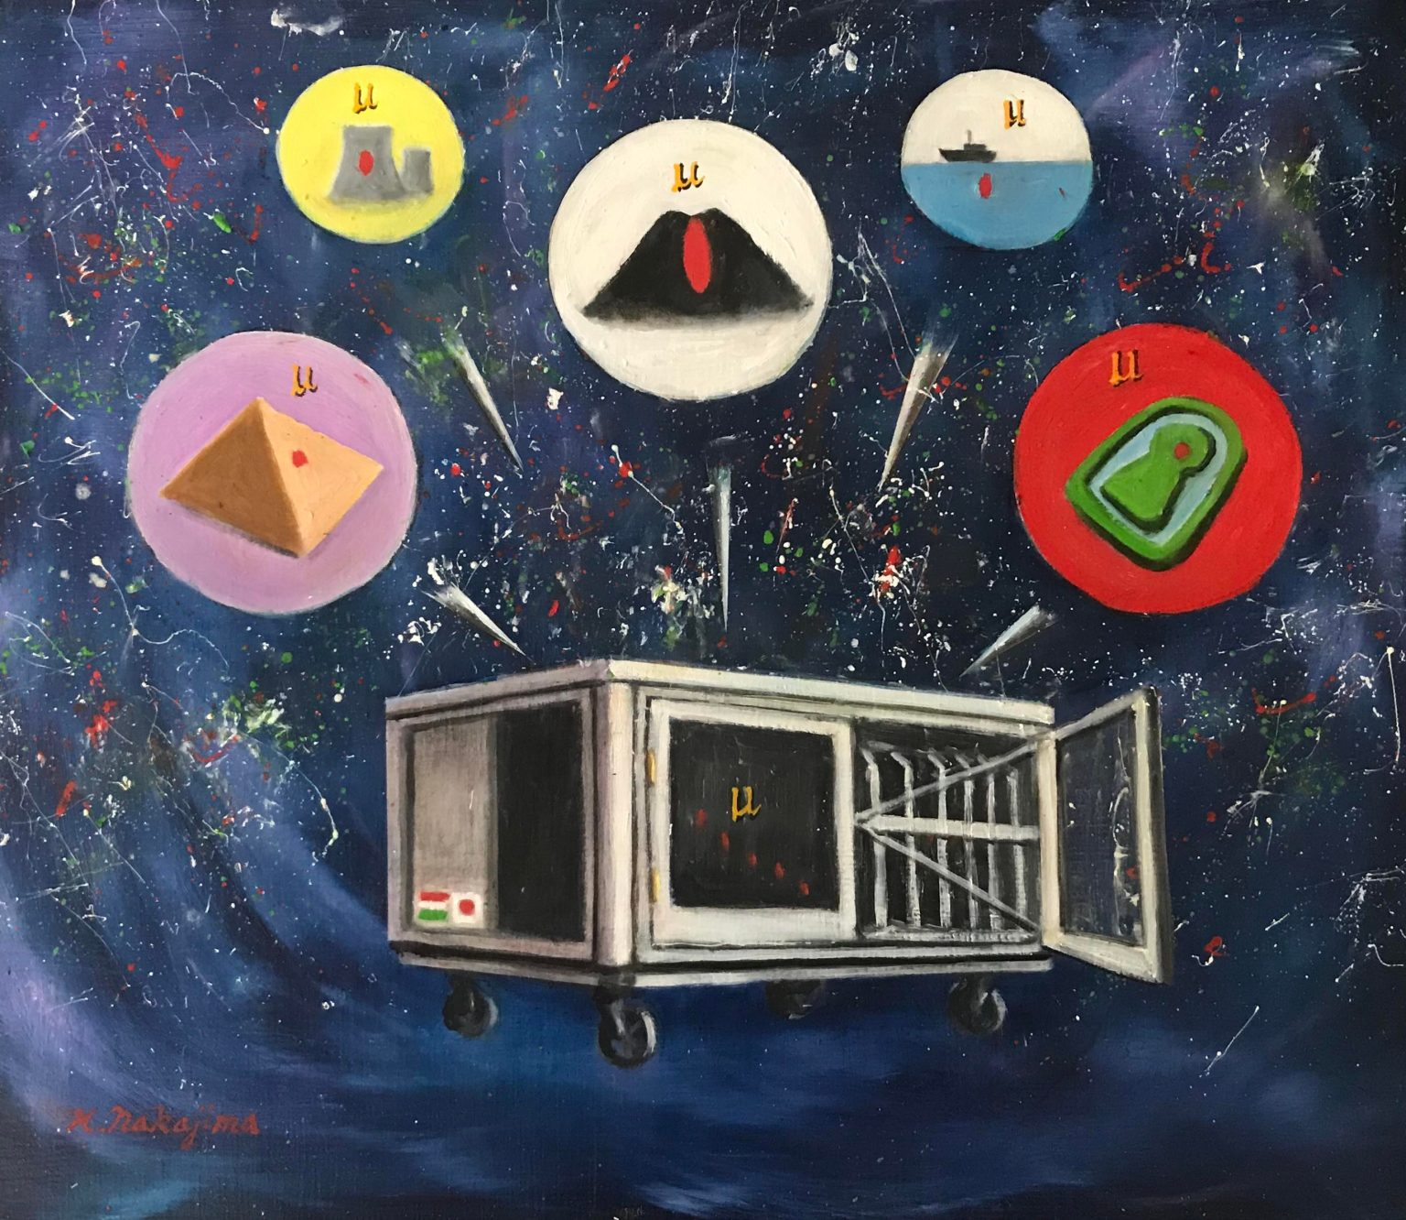
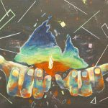
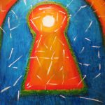

Muography art project
仁司朋花：透かす 大曽初音「見えないモノ」
https://wps.itc.kansai-u.ac.jp/ku-map/
https://www.muographix.u-tokyo.ac.jp/

Slide 10

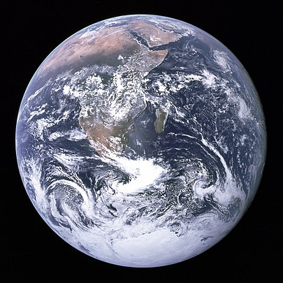
Future!
Inestigation of unknown inside structure of Ko-fun!
Collaoration all over the world!
Students connect disciplinaries!
education

Slide 11
Thank you!!
©Honjo city

Slide 12

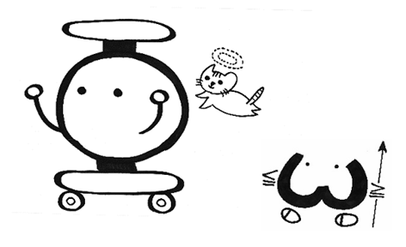
Thank you!!
MOODLE上にてアンケートの
回答よろしくお願いします！

Slide 13
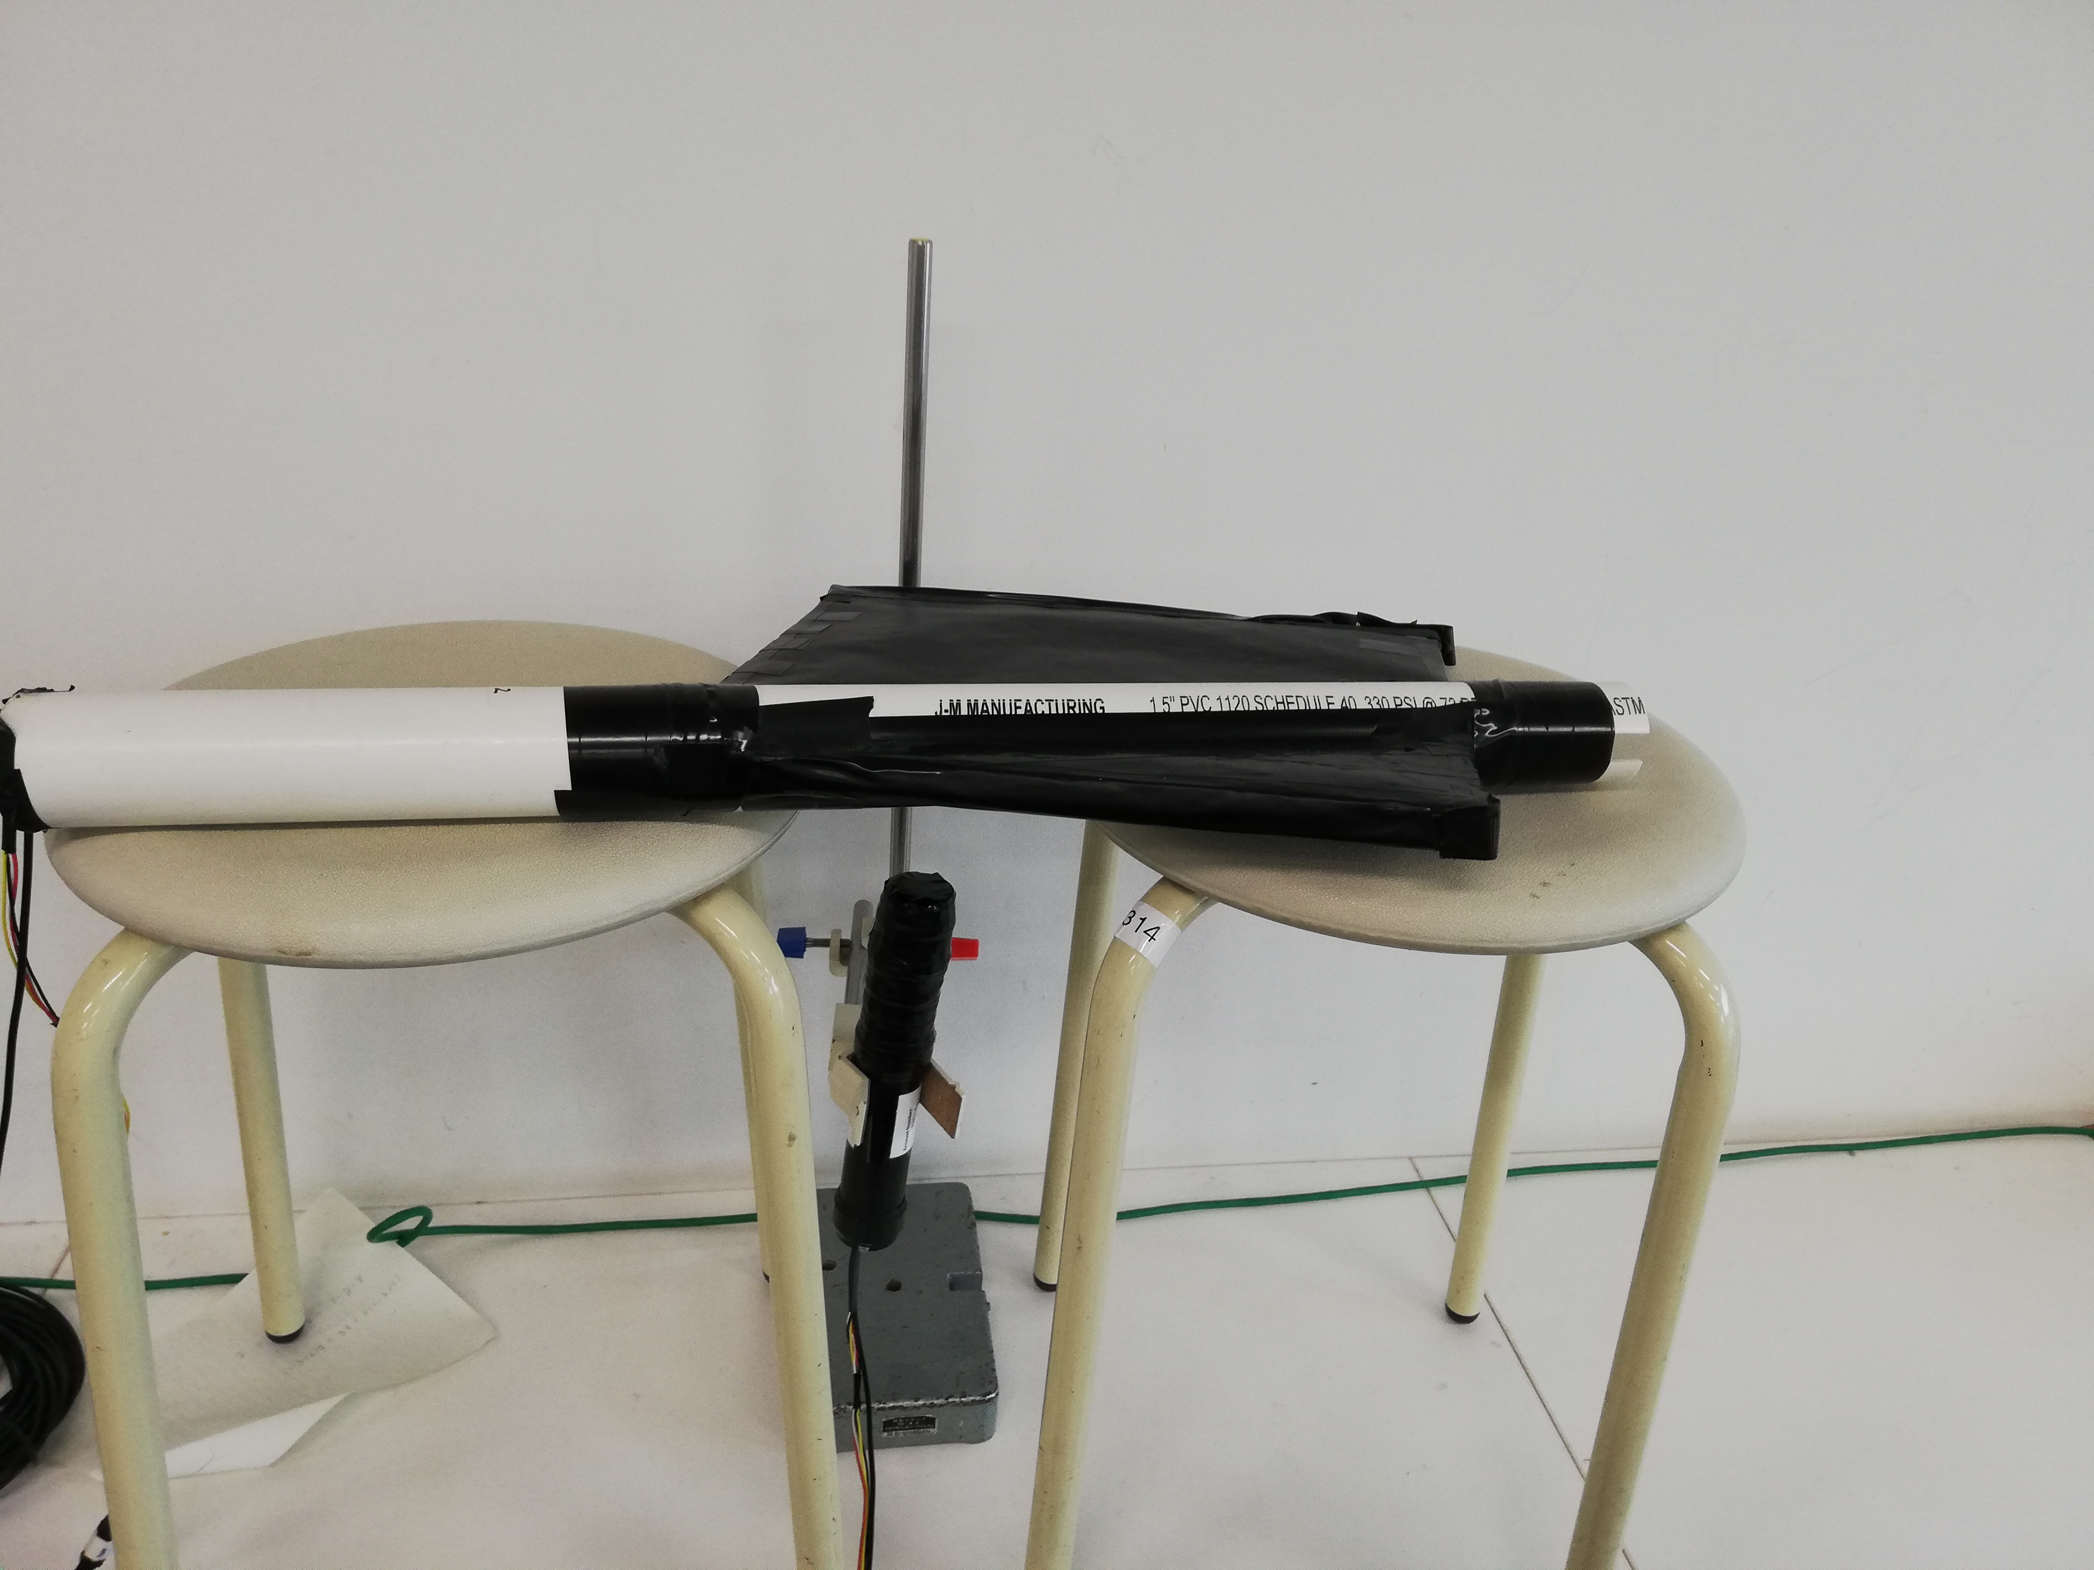
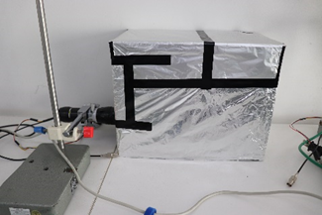
Measurement of Cherenkov light 2018-
チェレンコフ光測定

Slide 14



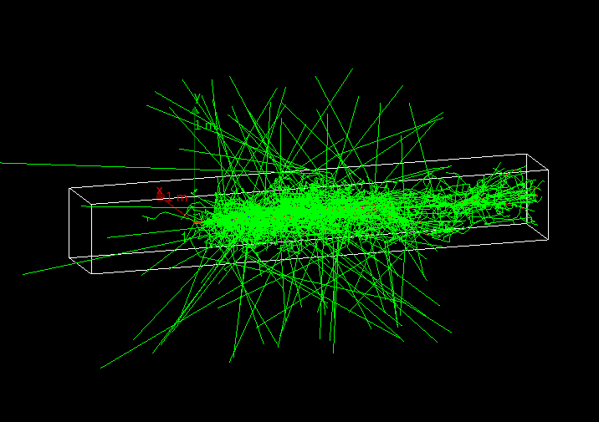
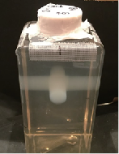
Other： Collaboration 2019-
BL4S:BEAMLINE FOR SCHOOLS (BL4S)
International physics competition for high school students from all around the world organised by CERN, the European Organization for Nuclear Research, in Geneva, Switzerland
Cancer Stop representing Argentina, Japan, Mexico
https://beamlineforschools.cern/

