Slide 1
FCC-hh – Layout and Optics for PL
Beam 2 injection and RF insertion
Gustavo Pérez Segurana

Slide 2
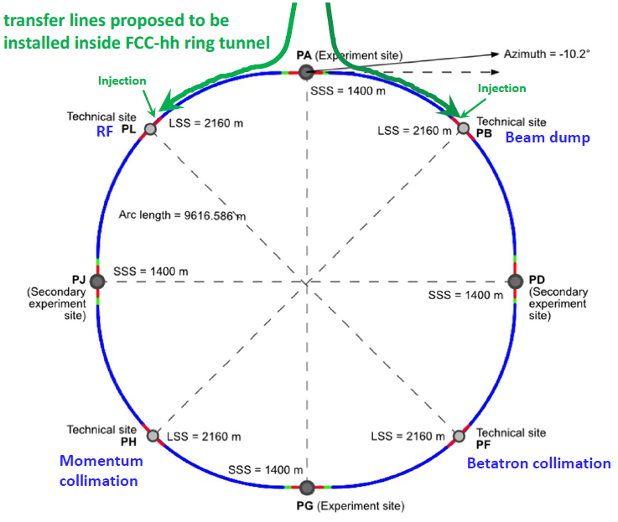
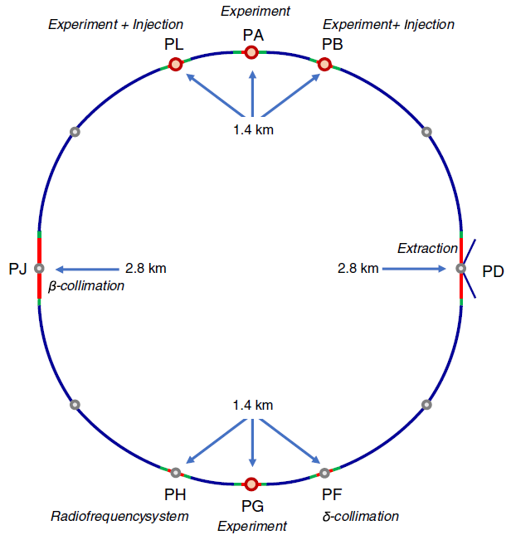
FCC layout
CDR
Current Design

Slide 3
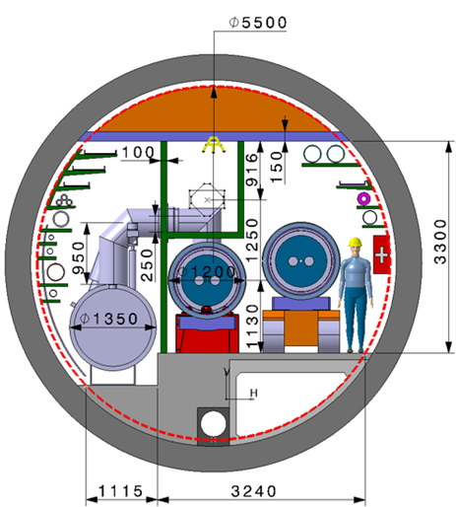
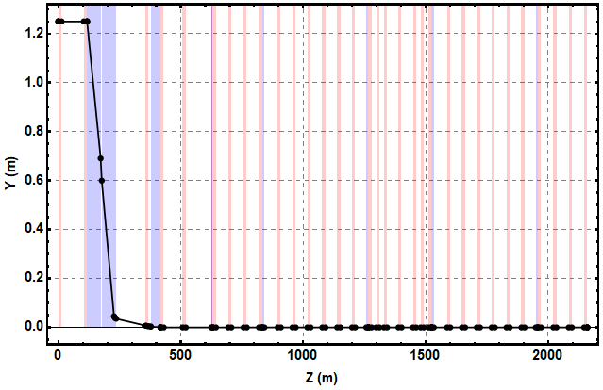
PL layout (from right)
Dipole
Quadrupole
TDI
Injection dogleg rf straight dogleg
Vertical offset between injection and circulating planes: 1.25 m
Longitudinal dimension: 2160 m

Slide 4
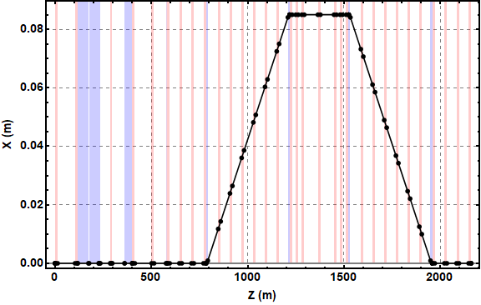
PL layout (from right)
Dipole
Quadrupole
TDI
Injection dogleg rf straight dogleg
Injection dogleg rf straight dogleg
Vertical offset between injection and circulating planes: 1.25 m
Longitudinal dimension: 2160 m
Horizontal offset for RF: 0.085 m

Slide 5
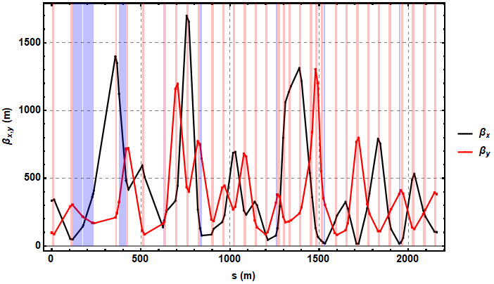
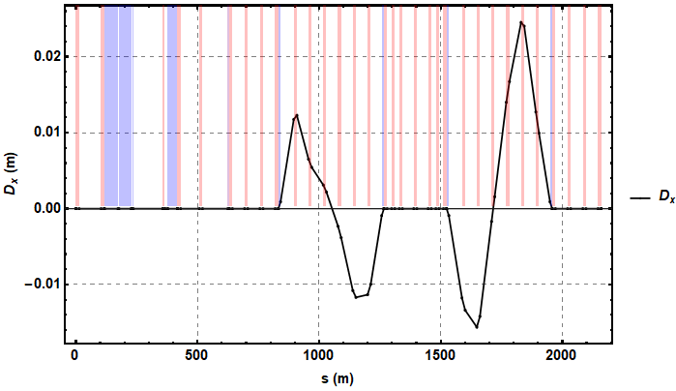
IPL layout (From right)
Strong focusing quadrupole after MSI to decrease strength requirement of MKI
Dispersion localized within rf doglegs

Slide 6
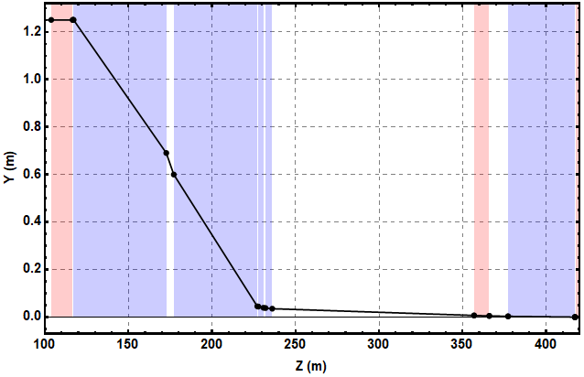
Injection geometry
mb: SBEND, l=55.48m, BField=1.2 T
msi3: SBEND, l=50.0m, BField=1.2 T
msi2: SBEND, l=3.0m, BField=1.0 T
msi1: SBEND, l=4.0m, BField=0.7 T
mki: SBEND, l=40.0m, angle=0.000166
CDR value: <0.00018
msi2
msi3
msi1
mki
mb

Slide 7
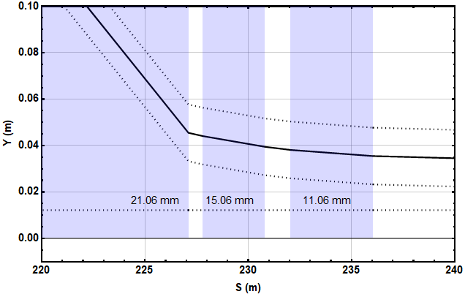
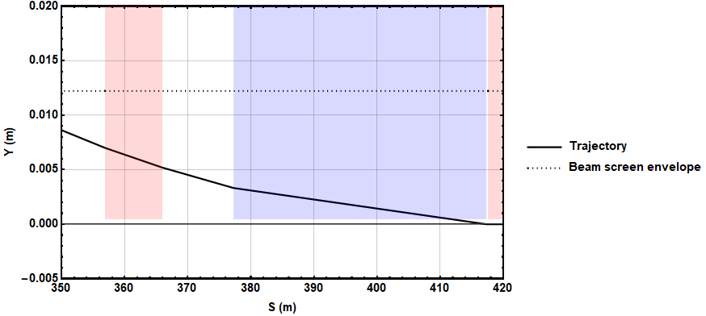
Septum and Kicker apertures
msi2
msi1
mki
msi3
 | Septum field (T) | Septum thickness (mm)
msi1 | 0.7 | > 8.0
msi2 | 1.0 | > 12.0
msi3 | 1.2 | > 18.0
Strong focusing quadrupole after MSI to decrease strength requirement of MKI.
Limited by aperture constraints.
(CDR specifications)

Slide 8
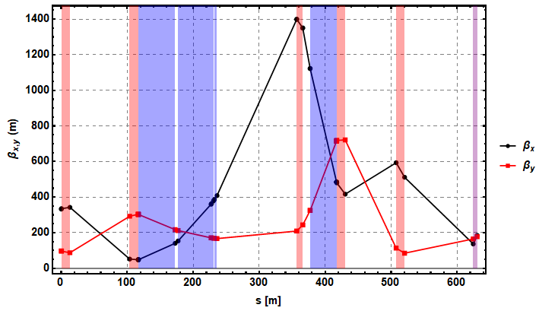
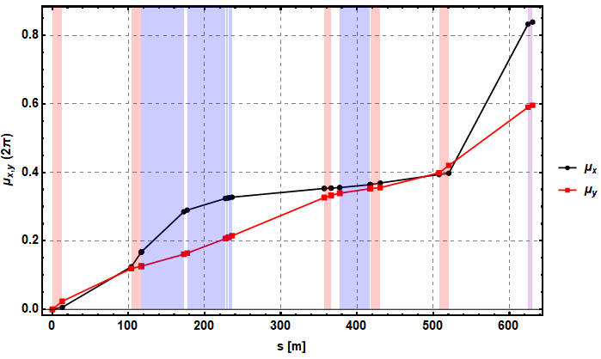
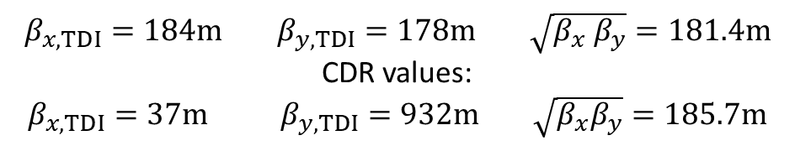
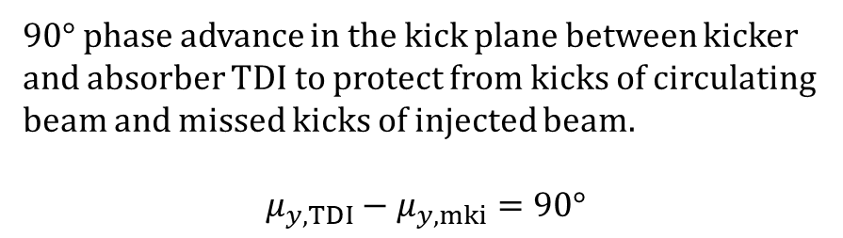
TDI
TDI
Larger $\sqrt{β_{x}β_{y}}$ at TDI reduces material stress
$90°$ phase advance in the kick plane between kicker and absorber TDI to protect from kicks of circulating beam and missed kicks of injected beam.
$$μ_{y,TDI}−μ_{y,mki}=90°$$
$β_{x,TDI}=184m$ $β_{y,TDI}=178m$ $\sqrt{β_{x} β_{y}}=181.4m$
CDR values:
$β_{x,TDI}=37m$ $β_{y,TDI}=932m$ $\sqrt{{β_{x}β}_{y}}=185.7m$
Values from: FCC-hh protection absorbers and the dump - FCC Week 2018

Slide 9
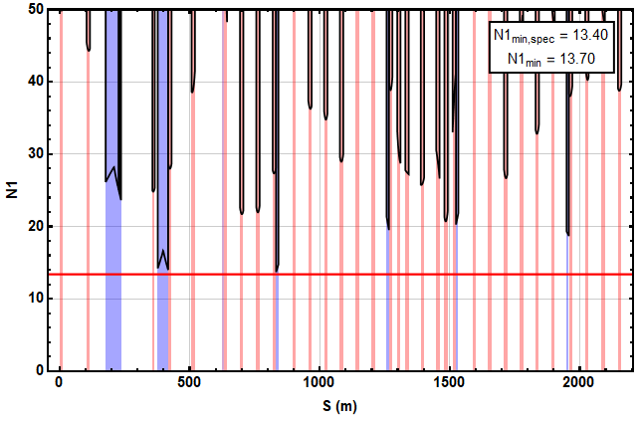
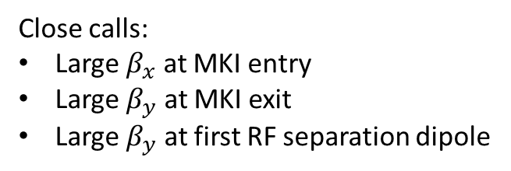
Beam aperture
Close calls:
Large $β_{x}$ at MKI entry
Large $β_{y}$ at MKI exit
Large $β_{y}$ at first RF separation dipole

Slide 10
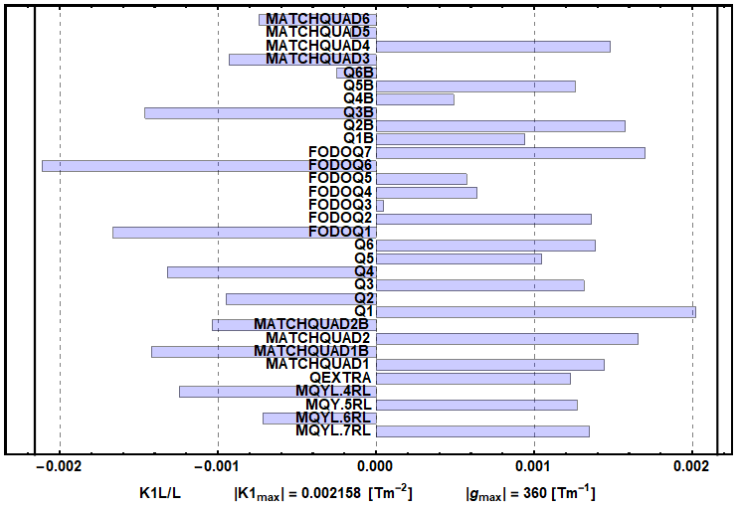

Quadrupole strengths
$∼2\%$ margin
*working names

