Slide 1
Injection and dump optics for FCC-hh mostly a recap from FCC week
W. Bartmann, FCC-hh design meeting, 15-Sept-22

Slide 2
Questions to be addressed and conclusion
Can we combine in one straight section of 2.16 km the FCC-hh injection and dump systems?
Yes … with more complicated HW, failure scenarios and operation, but no fundamental performance limit identified

Slide 3
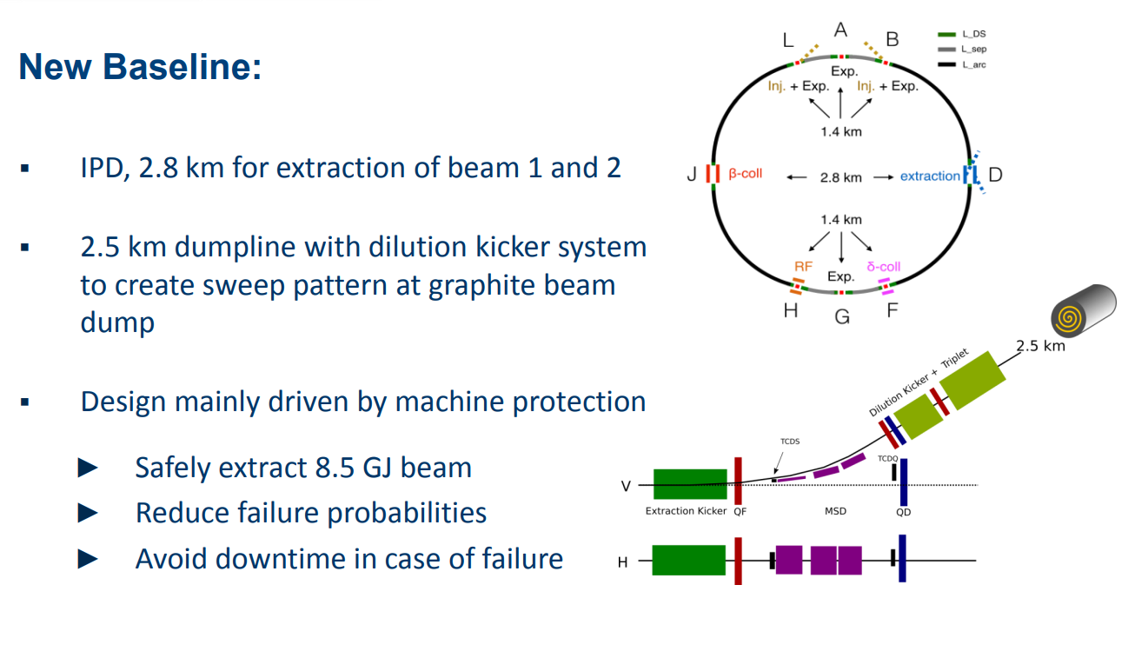
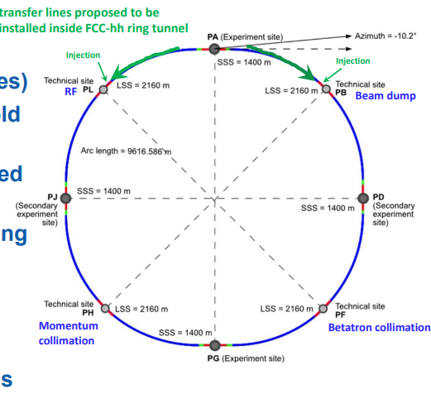
Injection/extraction – old vs new layout
OLD

Slide 4
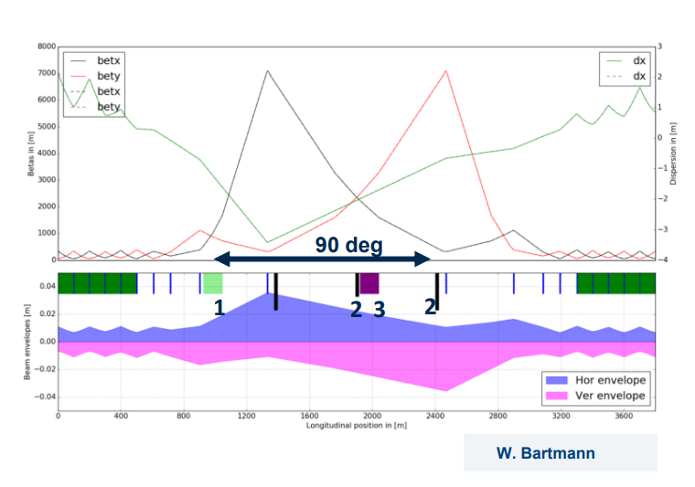
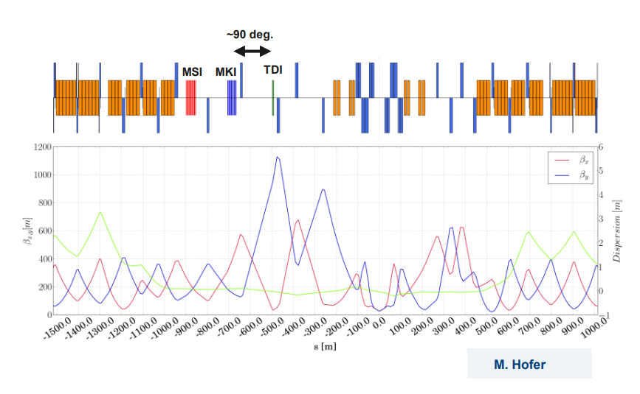
Injection/extraction – from where we started

Slide 5
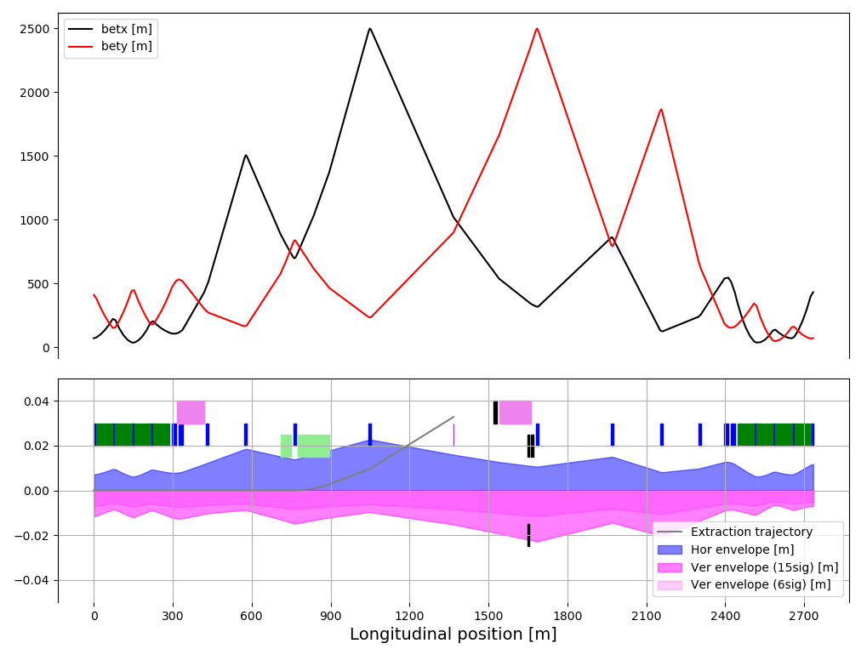
Injection and dump combined
Overlay main optics constraint of kicker-absorber = 90 deg phase
Most critical is injection failure impacting all extraction elements

Slide 6
Injection and dump combined
Kickers and absorbers for inj and extr at about same location
Move injection septum into better phase wrt kicker
  kick strength factor 1.8 reduced
  also reduces mis-kicked trajectory offset
Extraction design with HW parameters not far from CDR (aperture impacted though)
Injection failure impact
  Focussing/defocussing in right sequence → both systems in vertical
  Extra MKD clearance of 5 mm (21 cf 16 mm)
  27 mm extra at quadrupole
  MSD protection needs careful design (impact on the outside, most likely increased aperture as well)

Slide 7
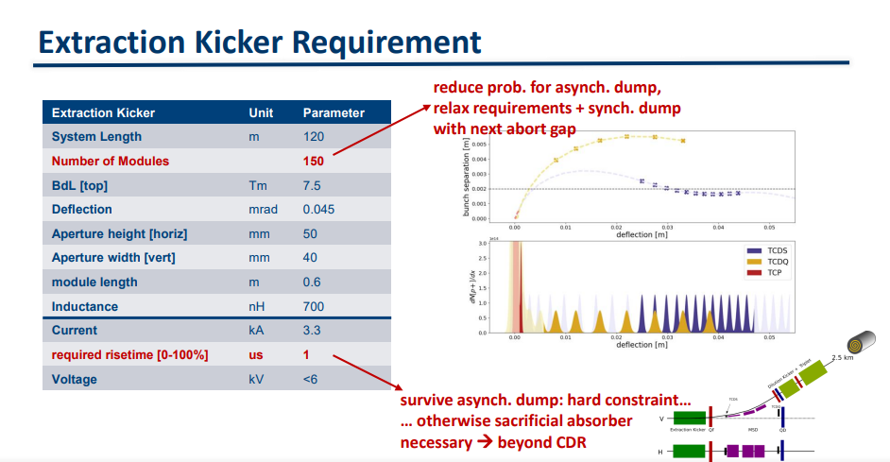
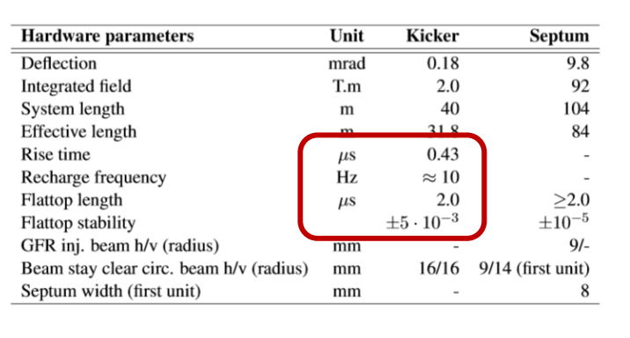
0.1 mrad kick
Similar aperture
Kick similar
~5 mm increased aperture if only 100% miskick,tbc

Slide 8
Injection/dump next
Thys’ modifications in DS have minimal impact on optics in straight → OK
Run through different failure scenarios of injection and extraction elements, incl global MP studies
Check inj HW parameters between IPB and IPL and iterate with the goal of a single type of injection HW
Update list of HW parameters and check for impact on previously chosen technologies and rough cost estimate
  Consider dilution untouched – some impact on dump line optics, envisage focusing triplet there, so room for adaptation

