Slide 1
FCC-hh ring design meeting
M. Giovannozzi

Slide 2

Outline
Introduction
Short-term goals
On-going activities:
  Transfer lines in the ring tunnel
  Optics design of FCC-hh ring
  PA31V2.0
  A dilemma
  HTS coating of beam screen
  Operating temperature of beam screen

Slide 3
Introduction
This new series of meetings is supposed to review current FCC-hh study activities and to exchange information between contributors.
It is supposed to take place every 4-6 weeks (depending on the needs).
The proposed time slot is Thursday between 2pm and 3:30 pm (to avoid clashes with TCC). The date will be selected to avoid clashes with the FCC-ee design study meeting (also on Thursday afternoons).

Slide 4
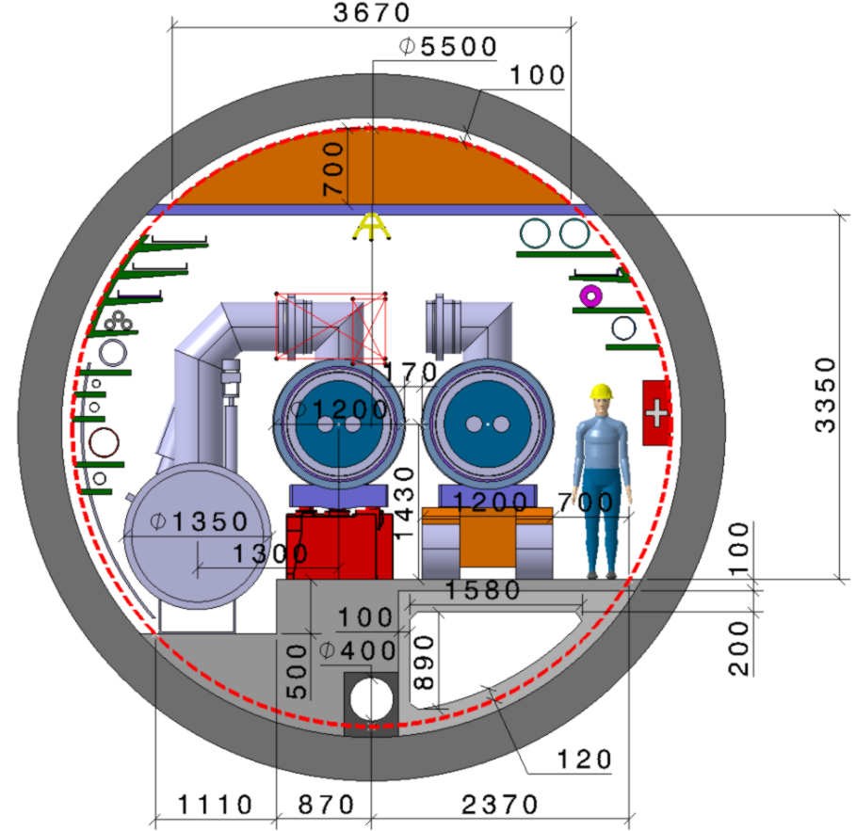
FCC-hh post-CDR ring layout
two high-luminosity experiments (A & G)
two other experiments combined with injection (D & J)
two collimation insertions
  betatron cleaning (F)
  momentum cleaning (H)
extraction insertion (B)
clean insertion with RF (L)
compatible with LHC or SPS as injector
  8-point layout
  Beam injection combined with RF and dump
  5.5 m inner diameter (under review)

Slide 5
Short-term goals
A mid-term review of the FCC study will take place the second half of 2023.
We are supposed to contribute material to a document covering the following aspects:
  Updated FCC-hh layout under the baseline scenario, including the injection lines from the LHC and/or a possible superconducting SPS
  Integration study of the FCC-hh injection lines with the FCC tunnel.
  Completion of the design of the collider optics with new designs for collimation and extraction/dump insertions
  Development of R&D plans, schedule, and deliverables for Nb3Sn, high-temperature superconducting (HTS) and hybrid magnets for FCC-hh
These aspects should be presented at the 2023 FCC Week.

Slide 6
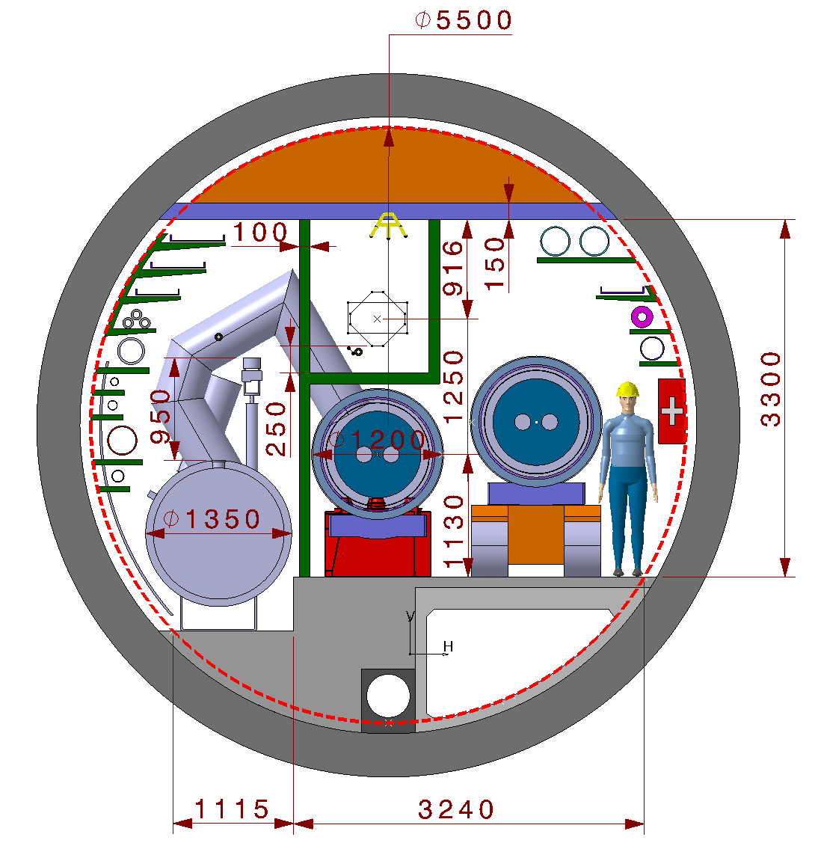
On-going activities
Transfer lines in the ring tunnel
  Attempt to change the geometry of the jumper
    Solution found, but it does not seem efficient (complex implementation for a marginal gain in transfer line height).
    It seems better to leave a gap in the magnets of the transfer line corresponding to the jumper.
  Magnet design of dipoles and quadrupoles
    Two options considered: normal-conducting and permanent magnet. Sketch of the designs available.
    The next step is the finalisation of the design and attempt a costing.
-hh ring

Slide 7
On-going activities
Optics design of FCC-hh ring
  IR design
    PB, PL: great progress made, and a design is available for merging with the latest version of the lattice (talks later).
    PF, PH: geometry of the dog-leg reviewed and implemented. Preliminary loss maps produced, activity to be pursued including the collimators in PB.
  Arcs
    Optimisation of the regular cell length.
    Analysis of dispersion suppressors.
  Alternative combined-function optics
    Study damping properties of the lattice and mitigation measures.

Slide 8
On-going activities
New layout
  The ring circumference will be shortened by 68 m for matching the harmonic number of FCC-hh and its injector.
  Placement of the new layout studied and defined by Johannes.
V1.0
  L_{cell} = 215.294 m; L_{Circ} = 91172.686 m; N_{cell} = 42;
  L_{ss} = 1400 m; L_{ss} = 2160 m;
  θ₀ = +10.75 deg; PA_{lat} = 46.2466 deg; PA_{lon} = 6.0976 deg;
V2.0
  L_{cell} = 215.294 m; L_{Circ} = 91104.686; N_{cell} = 42;
  L_{ss} = 1400 m; L_{ss} = 2143 m;
  θ₀ =+10.88 deg; PA_{lat} = 46.2467465 deg; PA_{lon} = 6.09718737 deg;
After completing the studies for the V1.0 layout, the V2.0 will be built (easy to do).

Slide 9
On-going activities
A dilemma: which beam in which aperture in PB?
  So far, no arguments found to take a decision…
HTS coating of beam screen
  Study multipoles generated by HTS layout in dipole and quadrupole external fields.
  Behaviour during a quench.
Operating temperature of the beam screen
  Launch a global review of the beam screen operating temperature in view of minimising power consumption.
    Any other activity I might have forgotten (or that we should undertake)?

Slide 10
Thank you for your attention!

