Slide 1
CW 29 – Experimental set-up: Edmundoptic lenses

Slide 2
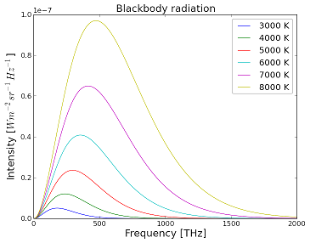
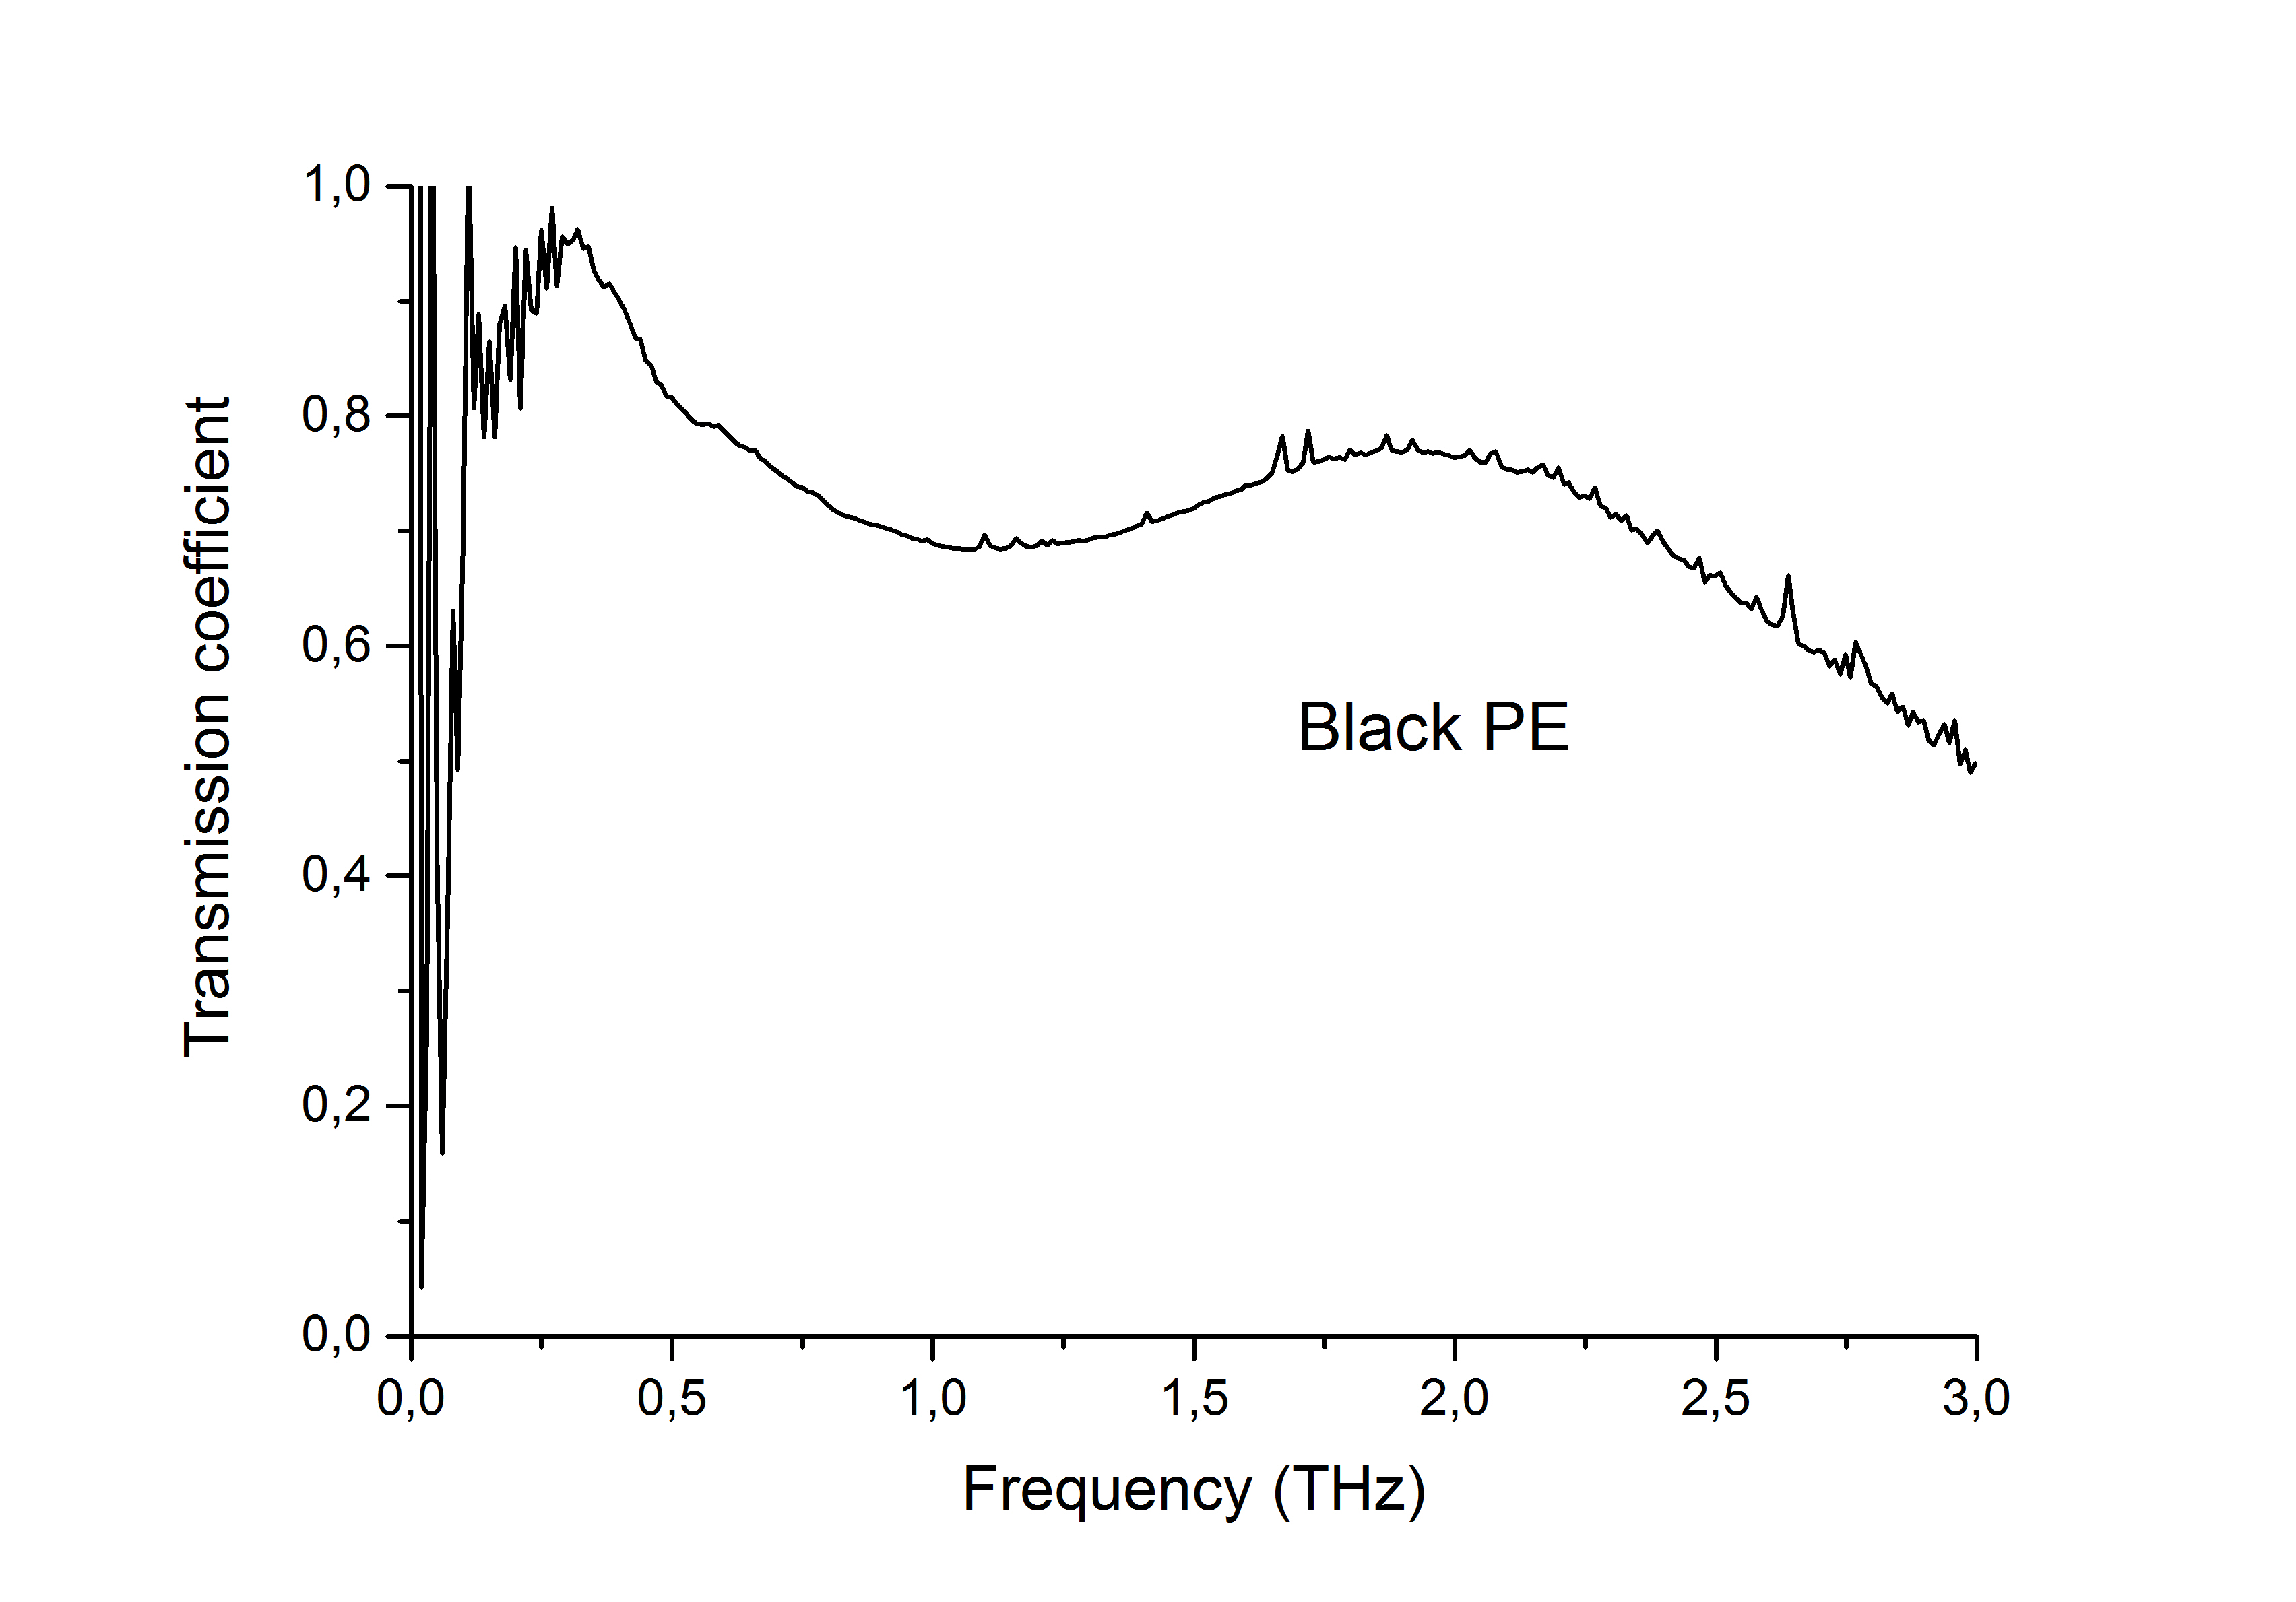
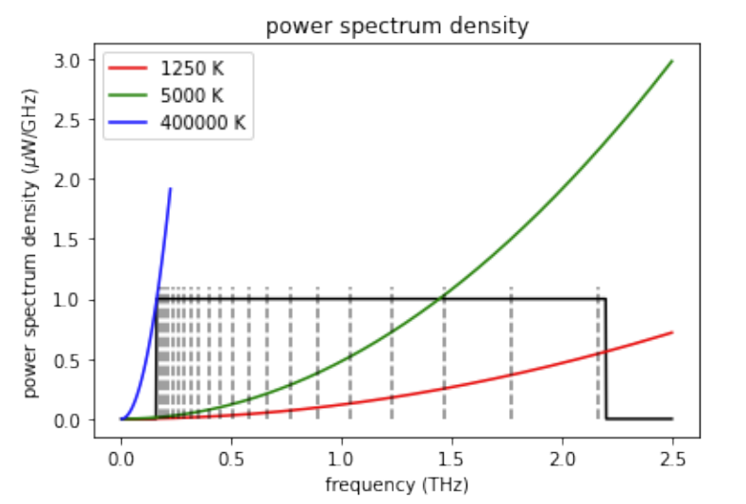
Absorption curve of a black PE

Slide 3
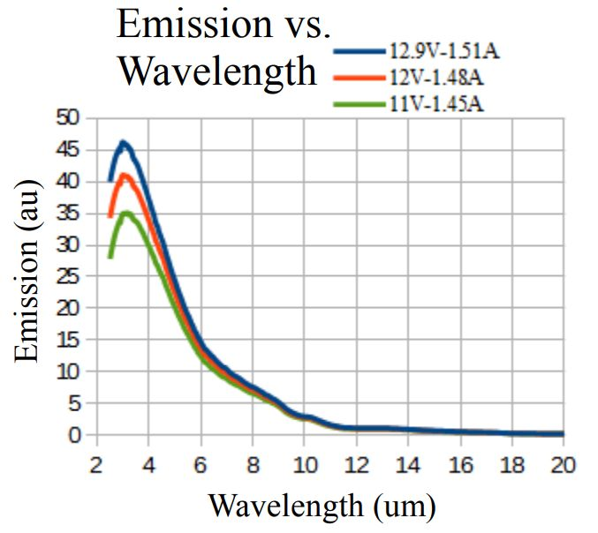
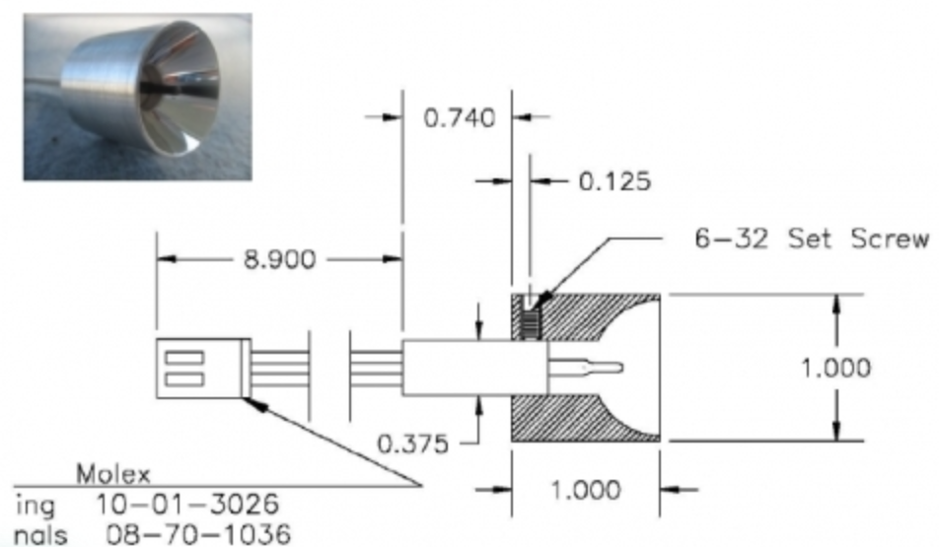
ASB-IR-18K
https://en.oceanhoodtw.com/products_detail/595.htm

Slide 4
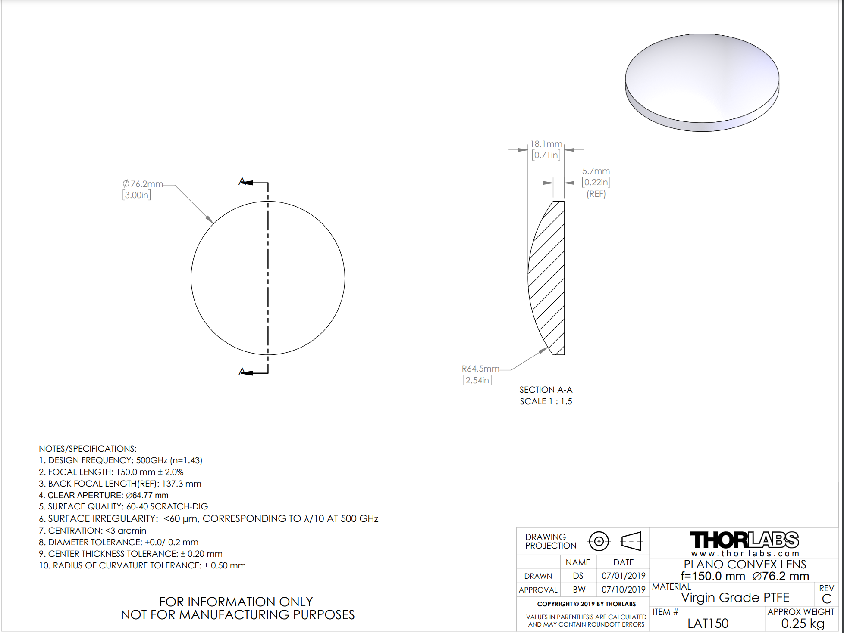
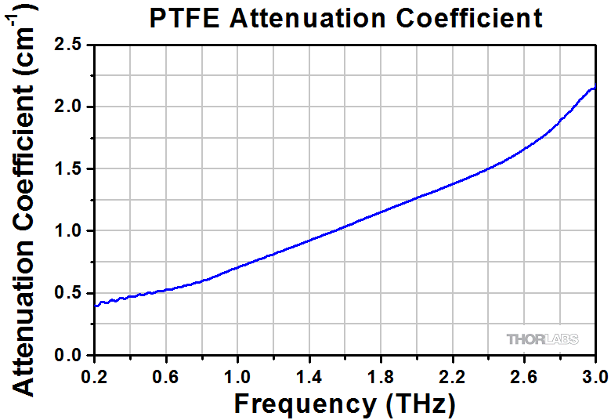
LAT150
https://www.thorlabs.com/newgrouppage9.cfm?objectgroup_id=1627
https://www.thorlabs.com/thorproduct.cfm?partnumber=LAT150

Slide 5
Magnification - telescope
Menlo Systems FL 200mm
Edmund optics

Slide 6
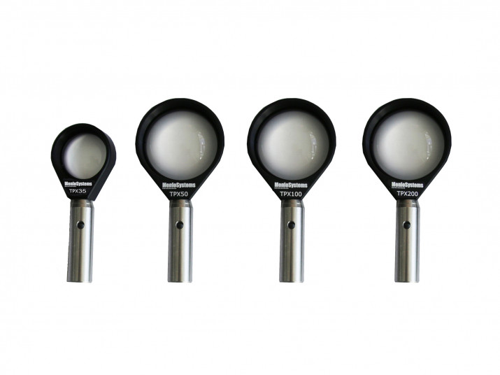
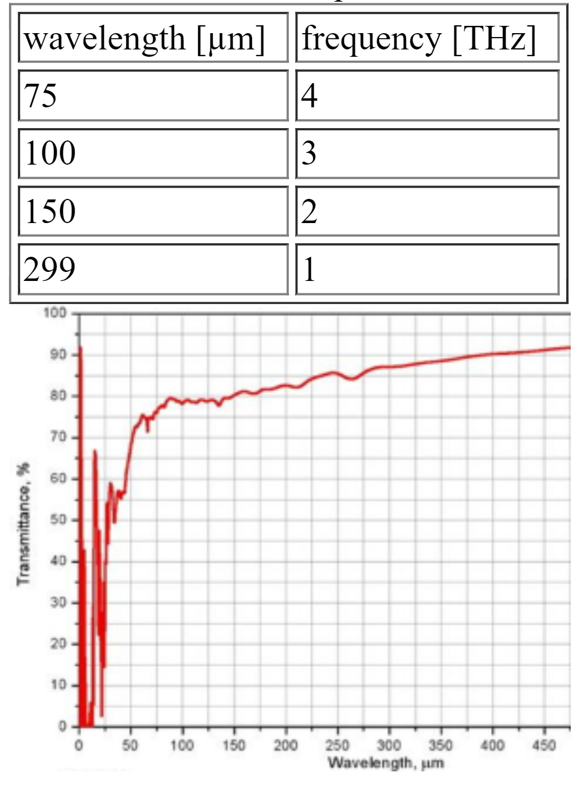
THz Lense Menlo System FL 200mm

Slide 7
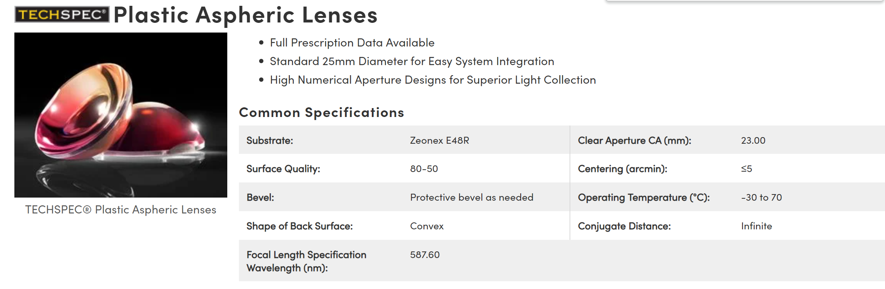
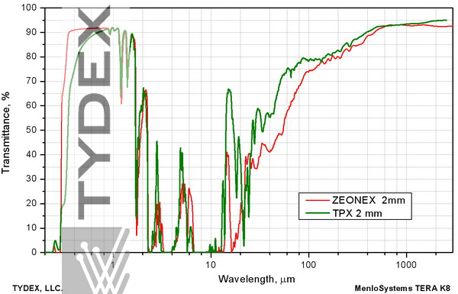
Edmund Optics Aspheric Lenses
Dia.25 EFL 17.50 Uncoated; Stock Number #66-006 Quantity: 1
Dia.25 EFL 20.00 Uncoated; Stock Number #66-007 Quantity: 1
Dia.25 EFL 30.00 Uncoated; Stock Number #66-009 Quantity: 1
Dia.25 EFL 40.00 Uncoated; Stock Number #66-010 Quantity: 1
Dia.25 EFL 50.00 Uncoated; Stock Number #66-011 Quantity: 1

Slide 8
Set Up | Distance | Power
Background noises with PE – Black Body Lamp off | - | 179µW
Black Body Lamp without PE | 23cm | 29.34mW
Black Body Lamp with PE | 23cm | 1.080mW
TPX Lense (focal length unknown) | TPX Lense: 7cm Black Body Lamp: 23cm | 291.0µW
Edmundoptics FL 50mm without PE | FL 50mm: 6cm Black Body Lamp: 23cm | 48.30mW
Edmundoptics FL 50mm with PE | FL 50mm: 6cm Black Body Lamp: 23cm | 607.0µW
Magnification without PE | FL 20mm: 6.5cm FL 50mm: 13cm Black Body Lamp: 23cm | 6.370mW
Magnification with PE | FL 20mm: 6.5cm FL 50mm: 13cm Black Body Lamp: 23cm | 359.0µW

Slide 9
Approximation

Slide 10
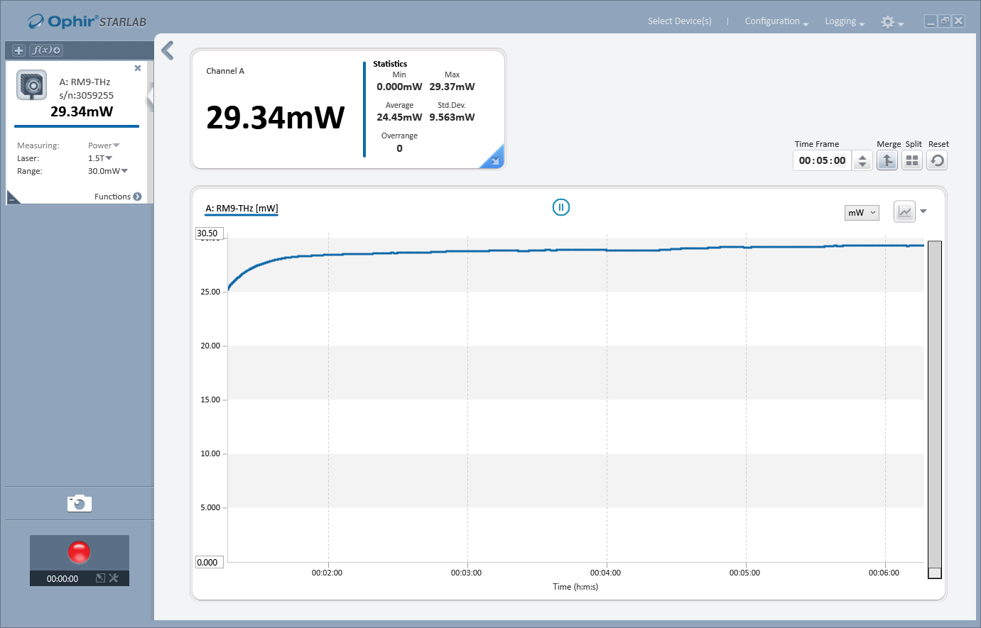
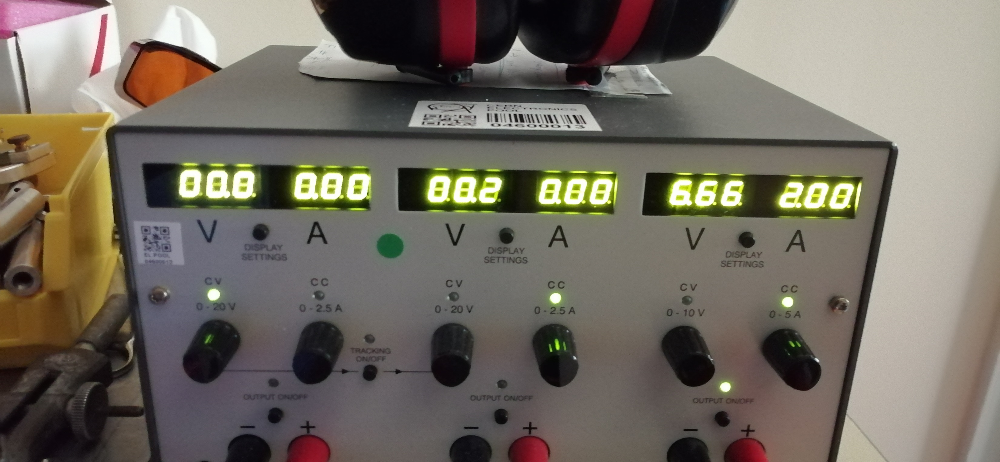

Efficiency
The power output (without PE) is 29.34mW
The output source power is calculated
$$P=U⋅I=6.66V⋅2A=13.32W$$
Efficiency $η$=$\frac{29.34e−3}{13.32}=0.22\%$

Slide 11
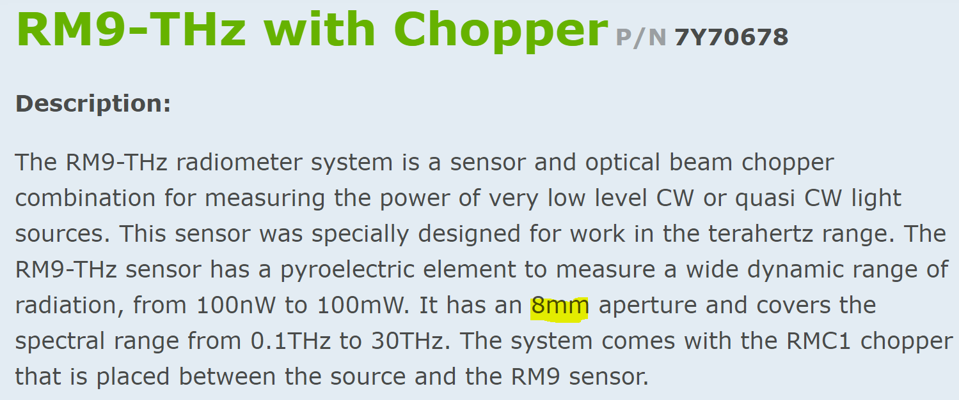
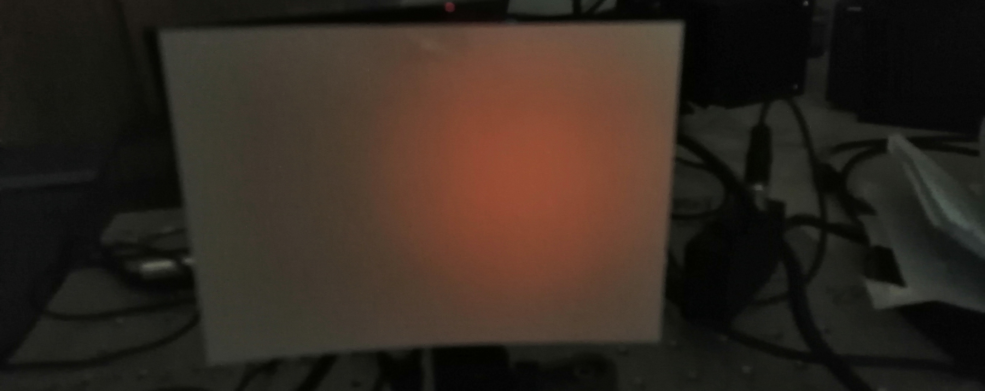

Maximum Output power through focusing
40mm radius for light spot, 4 mm sensor radius: 100x smaller spotsize
PE filter: 100x1.08mW=0.1W assuming all light is focused
PE filter+THz lens: 100x0.13mW=13mW assuming all light is focused
8cm$±$0.5cm

Slide 12
Experimental set-up

Slide 13
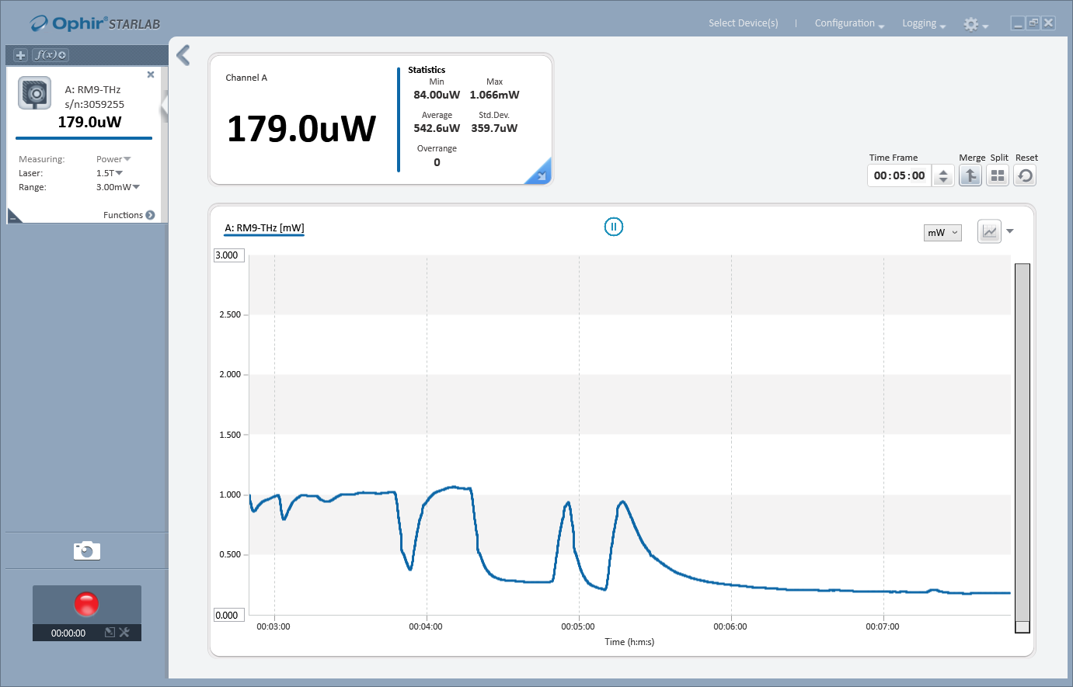
Background noises (with lights off)
With black PE

Slide 14
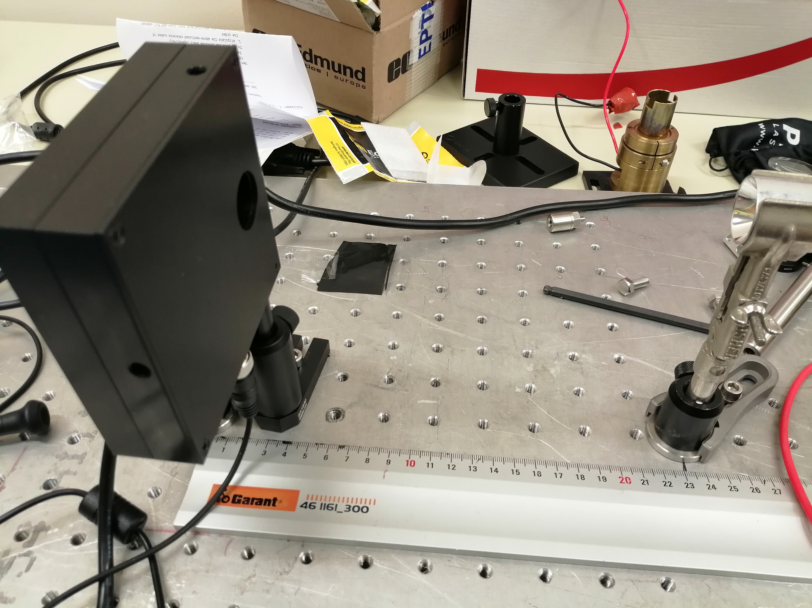
Without black PE at a distance of 23cm

Slide 15
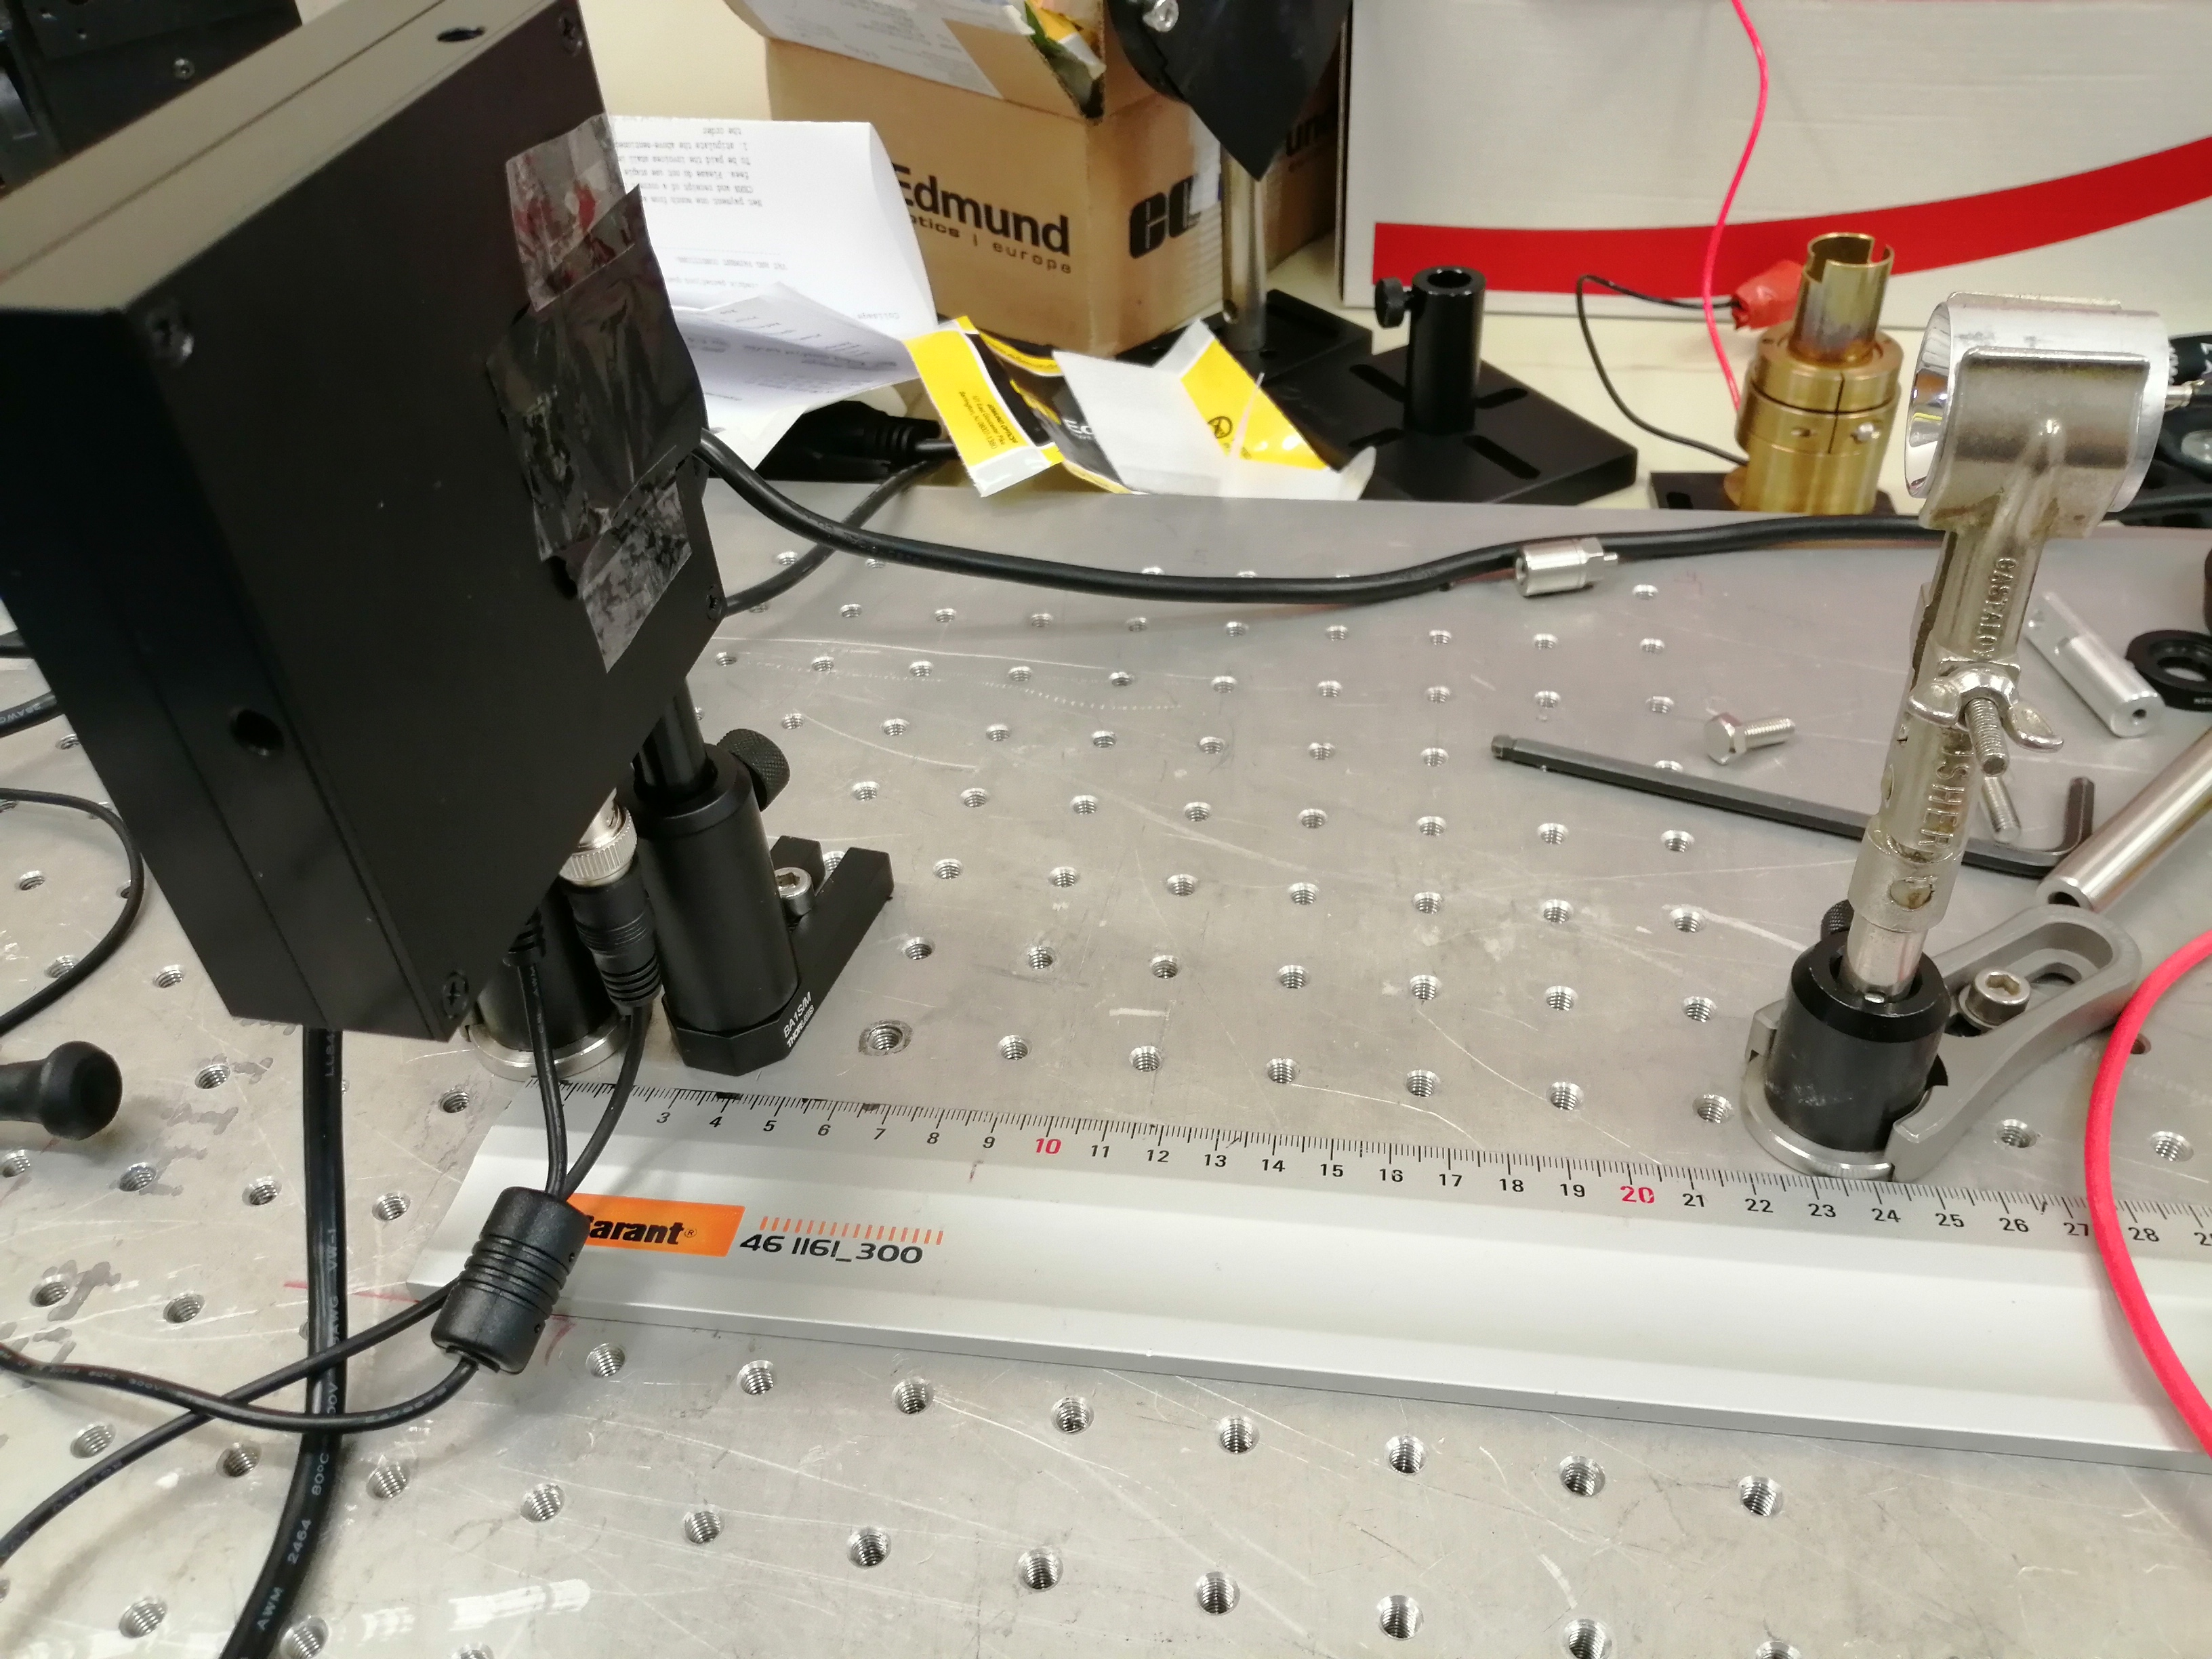
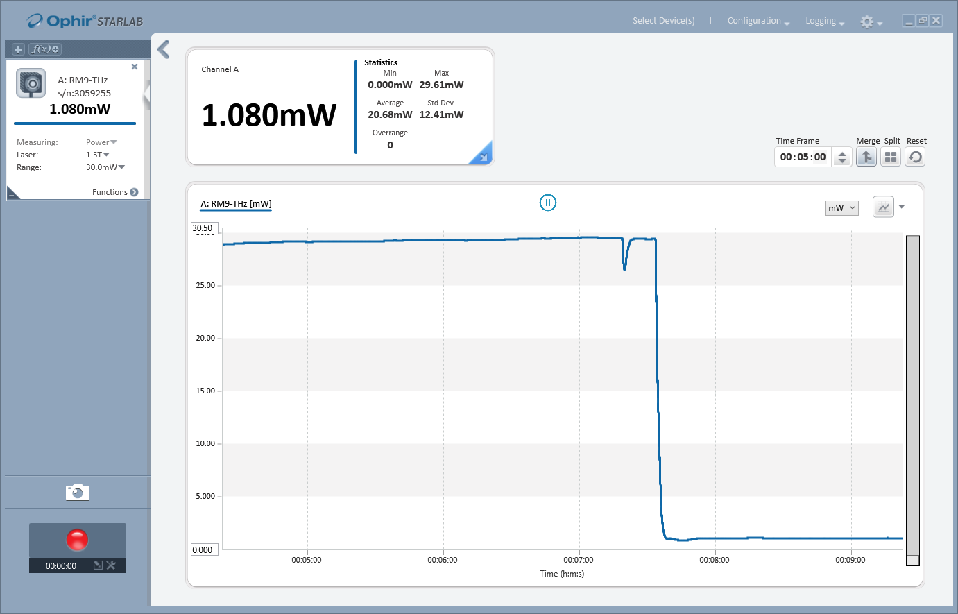
With a single black PE at a distance of 23cm

Slide 16
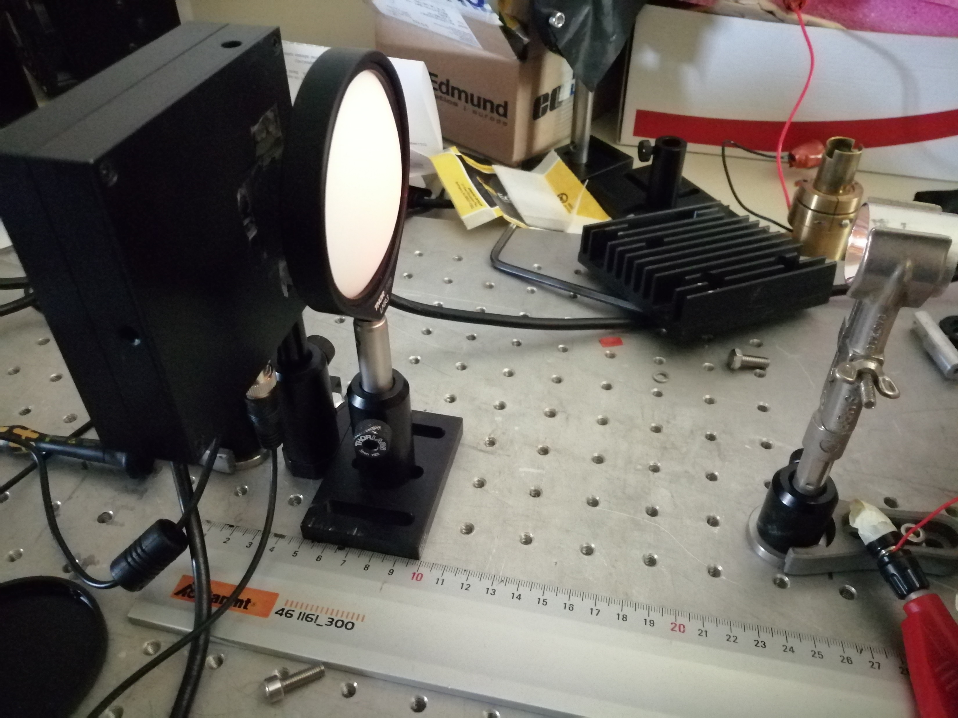
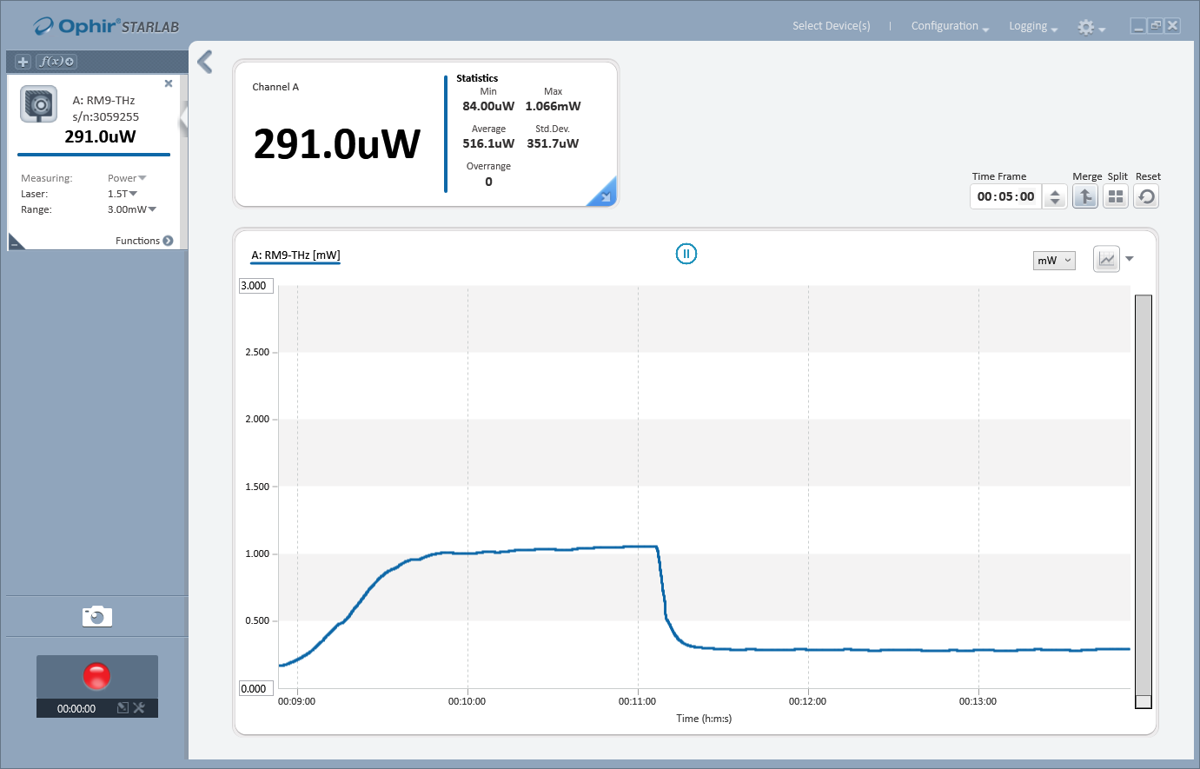
THz Lense with Thorlabs holder

Slide 17
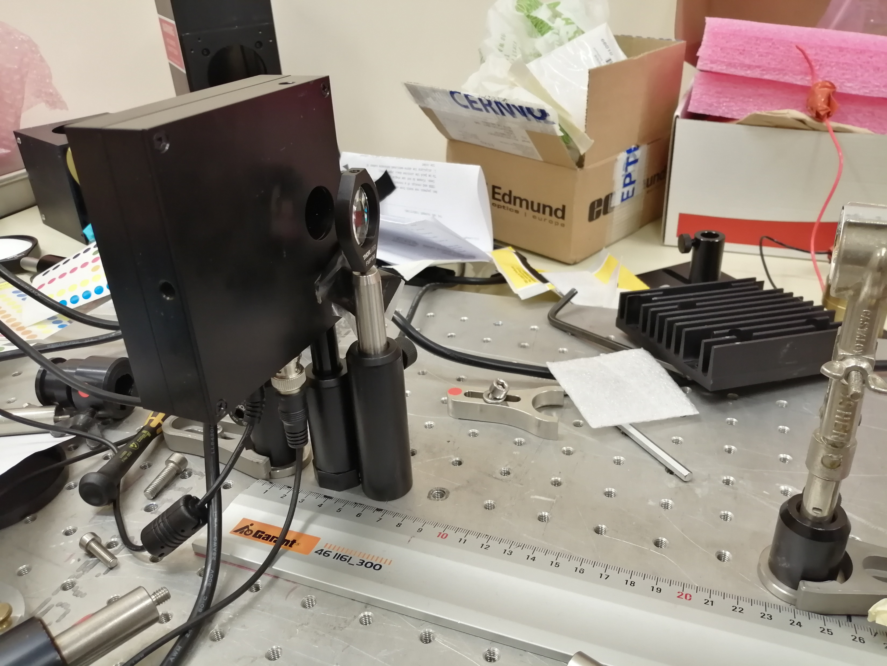
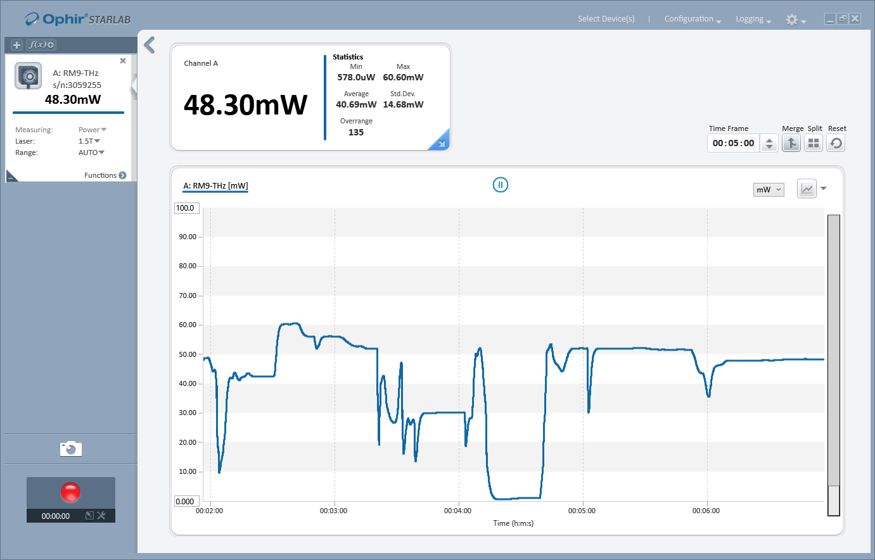
Edmundoptics FL 50mm without black PE

Slide 18
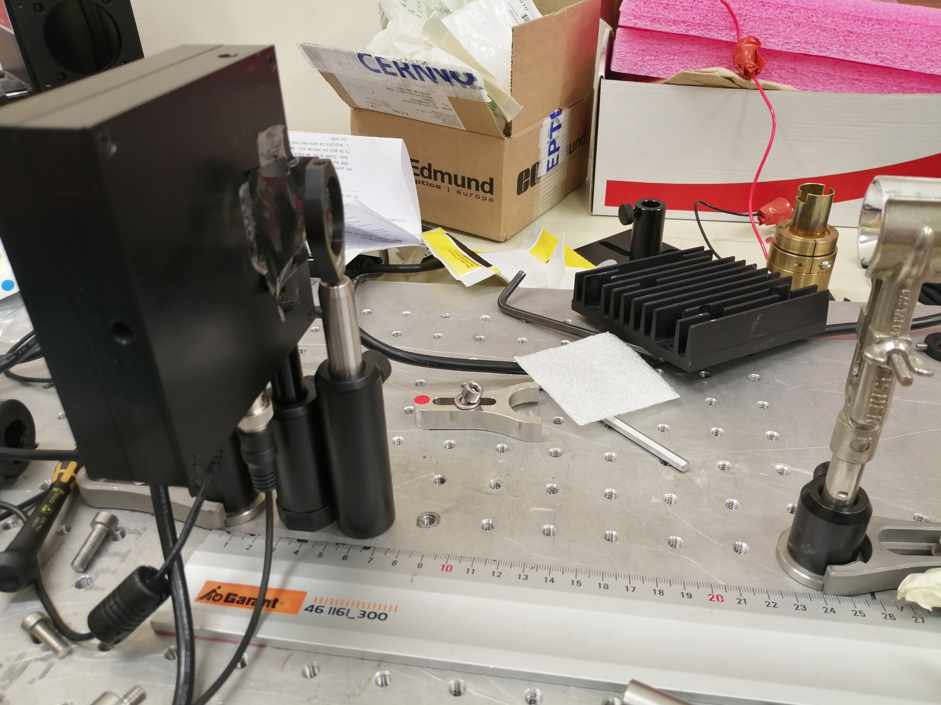
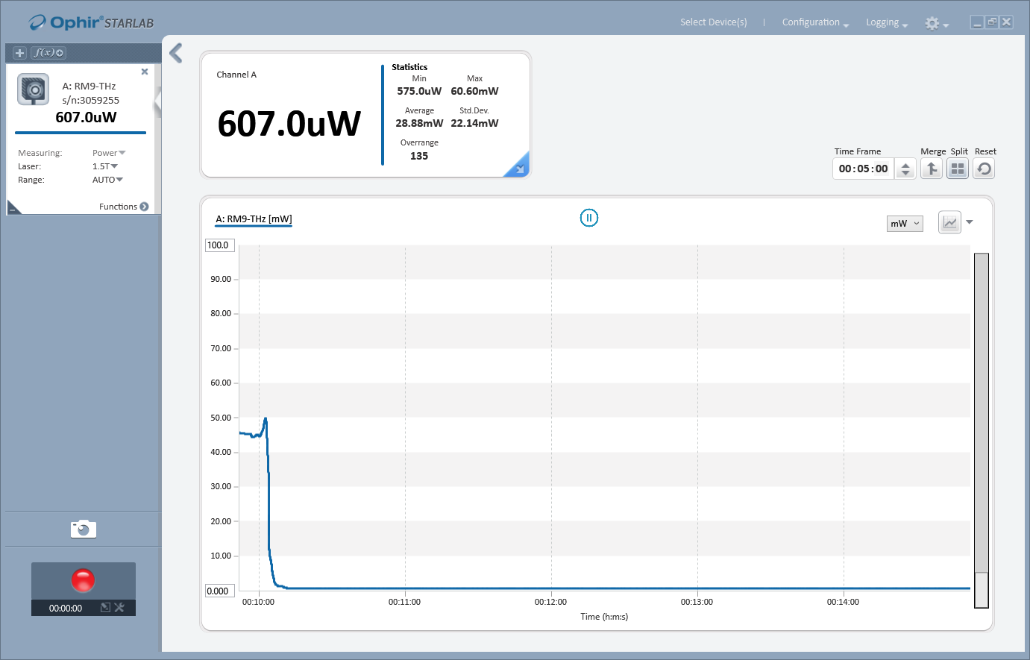
Edmundoptics FL 50mm with black PE

Slide 19
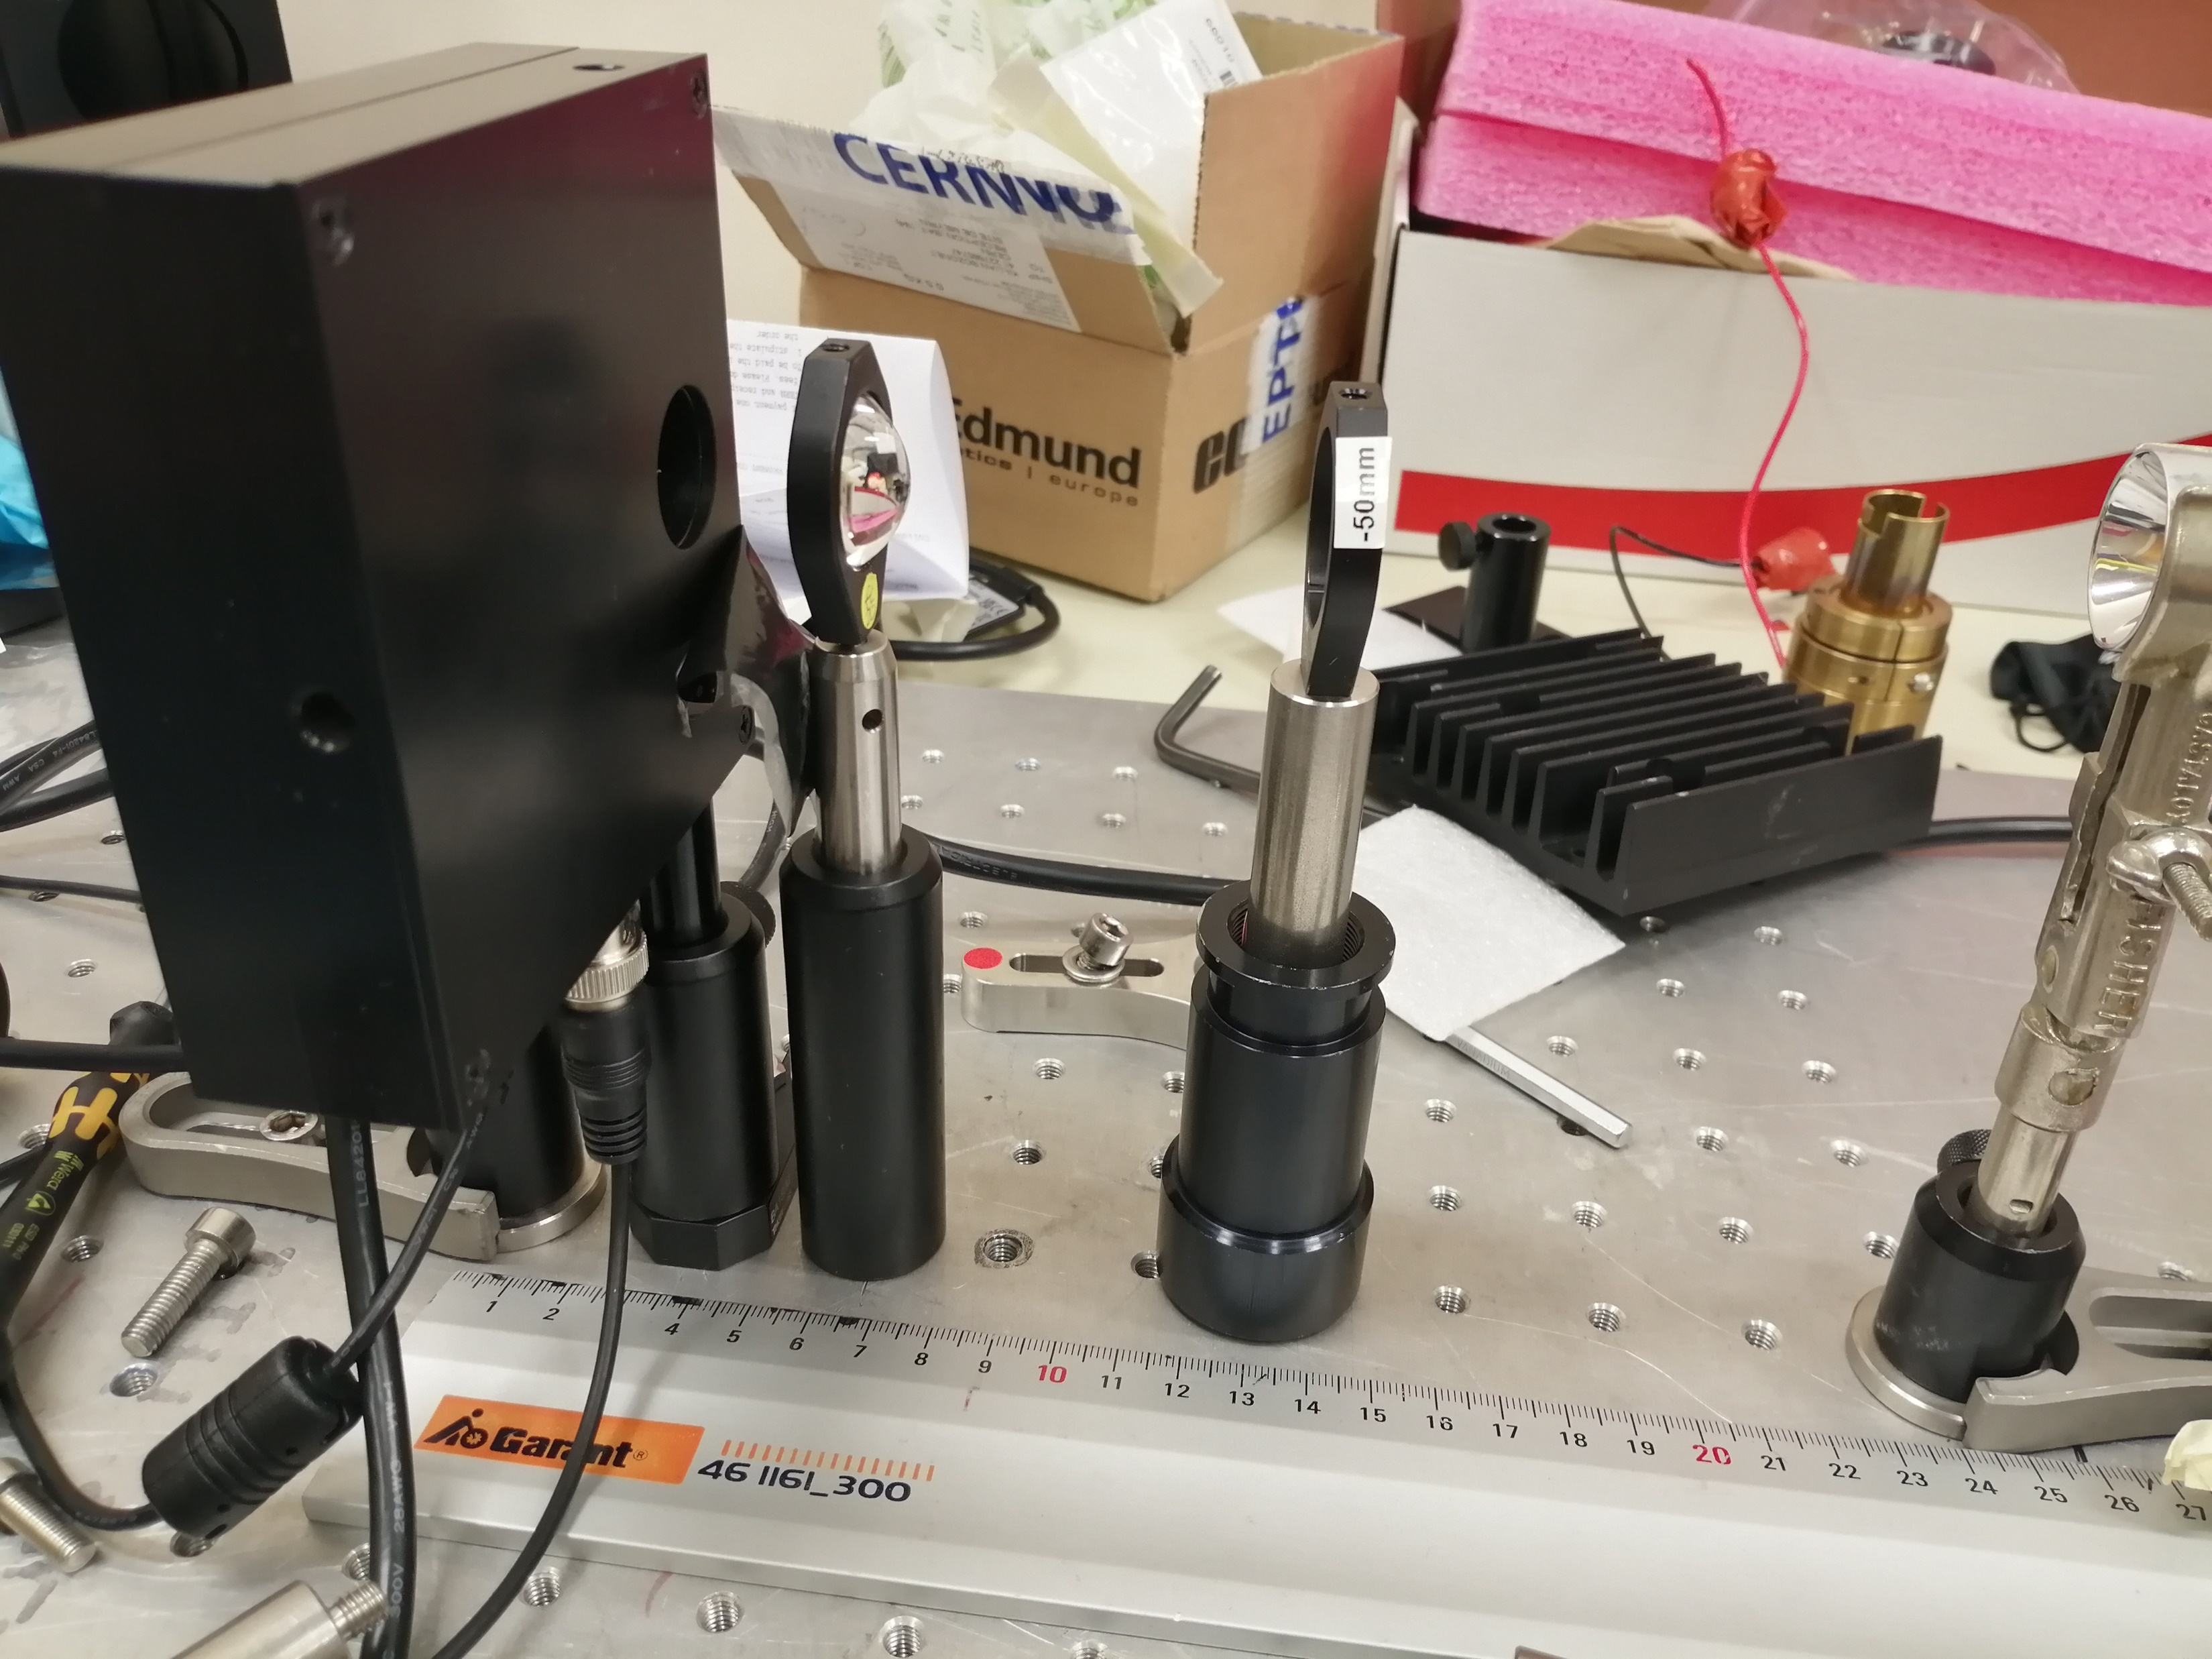
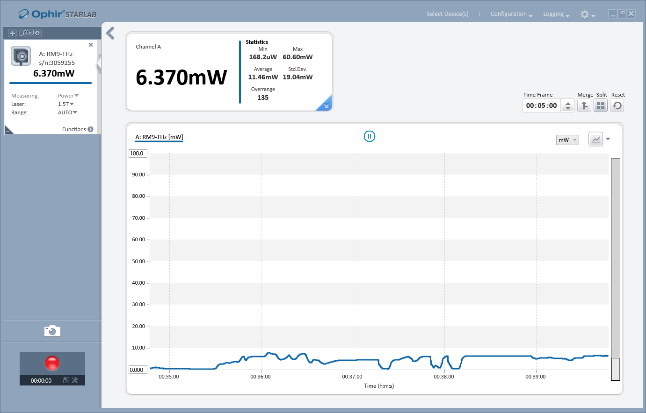
Magnification without black PE

Slide 20
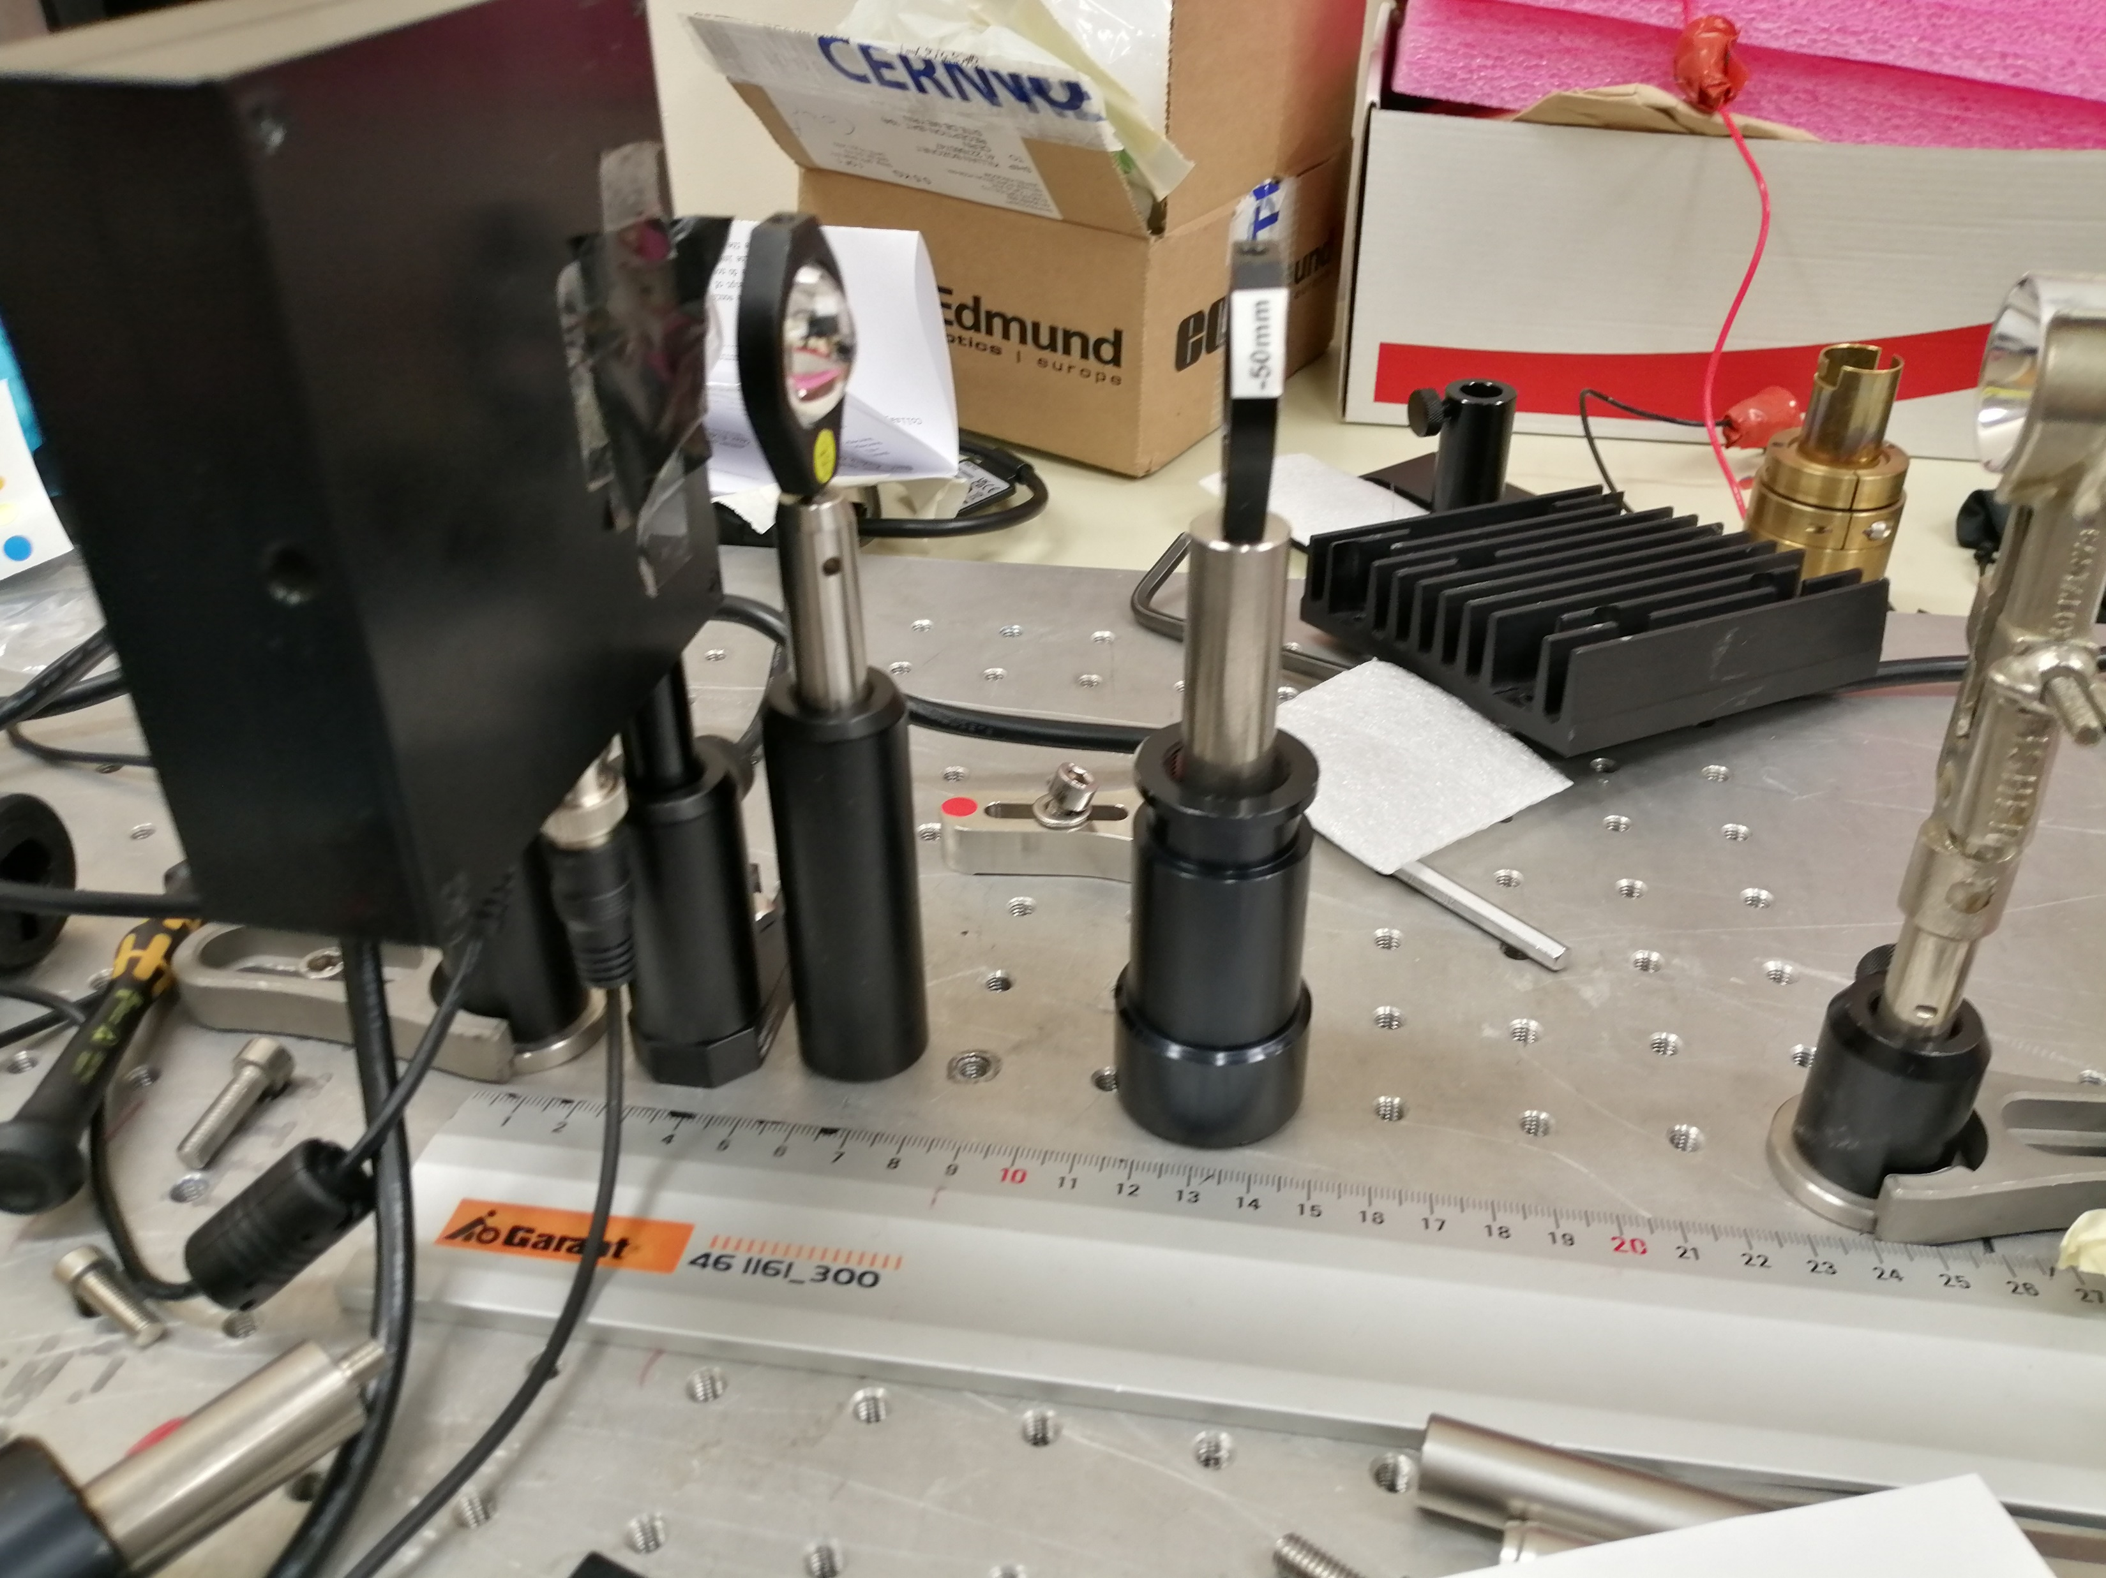

Magnification with black PE

Slide 21
Questions
What is the THz transmission for edmund optics lenses? (page 4)
Why do we lose so much power during maginification with the PE foil? (page 5)

