Slide 1
Improving the ROOT Data Analysis Framework
Julia Mathé
supervised by Enrico Guiraud and Ivan Donchev Kabadzhov
2022/09/05

Slide 2
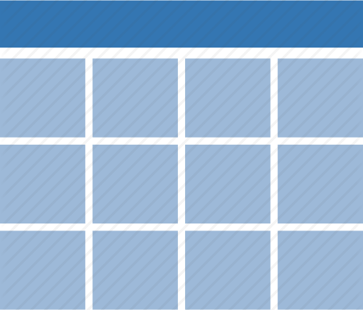
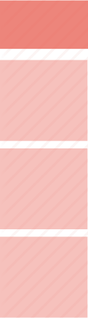

Introduction into RDataFrame
RDataFrame is a class that provides a high-level interface for HEP data analysis usecases
Basic operations for the user are Transformations and Actions
Low-level operations happen under the hood
Aggregations
Define
histograms, profiles
Datasource
px
py
pz
eta
my_px
TTree/TChain
CSV
SQLite
Apache Arrow
Numpy Arrays
new ROOT files
[1,2,3]
[2,3]
cut-flow reports
[4,5,6]
[4,6]
data reductions (mean, sum,..)
Range
Filter
[7,8,9]
any user-defined operation

Slide 3
A new feature: The RDF Progress bar
ROOT users
How long will my analysis take? At which rate are my events being processed?
Progress bar using a ProgressHelper class
  Project initiated by Stephan Hageboeck
  (Thread-safe) dataframe call-backs every n events
  Update print-out (progress bar + statistics) every m second
  Time estimation from running mean of events/sec, current event count and total number of events

Slide 4
Set up of the RDF Progress bar
Old set up
Current set up
ROOT::RDataFrame df(“Events”, “f.root”);
ROOT::RDF::ProgressHelper progress{1000};
df.DefinePerSample(“_progressbar”,
[&progress] (unsigned int slot, const ROOT::RDF::RSampleInfo & id) -> std::size_t{
progress.registerNewSample(slot, id); return progress.ComputeMaxEvents(); });
df.Count().OnPartialResultSlot(1000, [&](unsigned int slot, auto && arg){ progress(slot, arg); });
C++
C++
ROOT::RDataFrame df(“Events”, “f.root”);
ROOT::RDF::Experimental::AddProgressbar(df);

Slide 5
Systematic variations in RDataFrame
Python
nominal_hx =
df.Vary("pt", "RVecD{pt*0.9, pt*1.1}", ["down", "up"])
.Define("x", someFunc, ["pt"])
.Histo1D("x")
hx = ROOT.RDF.VariationsFor(nominal_hx)
hx["nominal"].Draw()
hx["pt:down"].Draw("SAME")
Varied columns can be used in Defines, Filters, as histogram value/weights and anything else.
Variations automatically propagate to selections, derived quantities and results.
Multi-thread and distributed execution just works.

Slide 6
A tutorial for systematic variations
Physics usecase: lepton scale factors
Lepton scale factors account for differences in MC simulations vs. real data
They vary with a lepton´s kinematics
How does the uncertainty in the lepton scale factors vary with the invariant mass of a decay mode?
Opportunity to “upcycle” the tutorial on the H → 4l decay

Slide 7
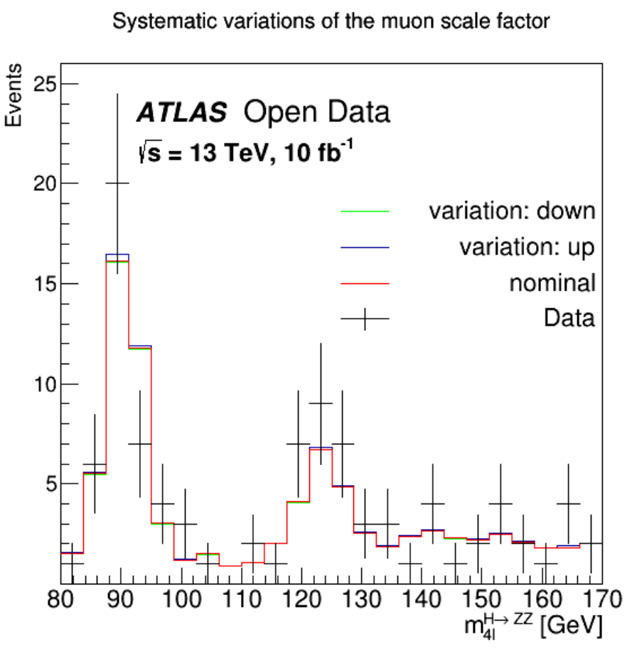
Varying the muon scale factors
Made C++ version of H → 4l
Applied systematic variations
Difficult to find muon scale factor uncertainties
  In particular: transverse momentum dependence

Slide 8
Improve RDF Sum and Means methods
RDF Sum action
Compensated summation
C++
C++
for (auto &m: summands)
sum += m;
double sum(0);
double compensation(0);
double y(0);
double t(0);
for (auto &m: summands) {
y = m – compensation;
t = sum + y;
compensation = (t – sum) – y;
sum = t;
}

Slide 9
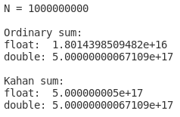
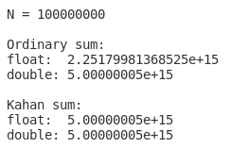
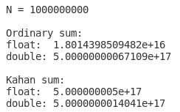
Example: Sum vs. Kahan Sum
ROOT::RDataFrame df(N);
ROOT::RDataFrame dd(N);
auto ddf = df.Define(“x”, “float(rdfentry_ + 1)”);
auto ddd = dd.Define(“x”, “double(rdfentry_ + 1)”);
C++

Slide 10

The TensorFlowCEvaluator
Why do we need this?
TensorFlow is a powerful ML and AI library
Bamboo trains their models on HEP data stored in ROOT files
User-friendly: directly evaluate a model on RDF columns
→ Integrate TensorFlowCEvaluator class from bamboo into RDataFrame
C++
df.Define(“output”, [&model] (ROOT::RVecF & x_in) {return model.evaluate(x_in); }, {“input”});

Slide 11
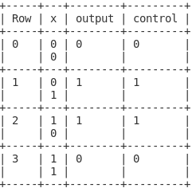
Testing the TensorFlowCEvaluator
Figure out how the bamboo TensorFlowCEvaluator works
  Reads the model’s graph
  Needs to know input and output nodes → find way to read them from any model
Make a model to be read and tested
  Save everything in a pb file
  → “Model freezing”

Slide 12
Results and Outlook
My projects & PRs:
Tutorial fixes
Progress bar
Systematic variations
Kahan Sum & Mean
TensorFlowCEvaluator
My to-do’ s:
Finalize Vary tutorial
Finalize TensorFlowCEvaluator
Improve progress bar
Feature requests for RVec
Learned a lot: ROOT, RDataFrame, GitHub, debugging, testing, C++, TensorFlow
Notes:
https://github.com/root-project/root/pull/11200#issue-1341314416
https://github.com/root-project/root/pull/11230#issue-1345908651
Branches:
https://github.com/j-mathe/root/tree/progress
https://github.com/j-mathe/root/tree/tensorflow

