Slide 1
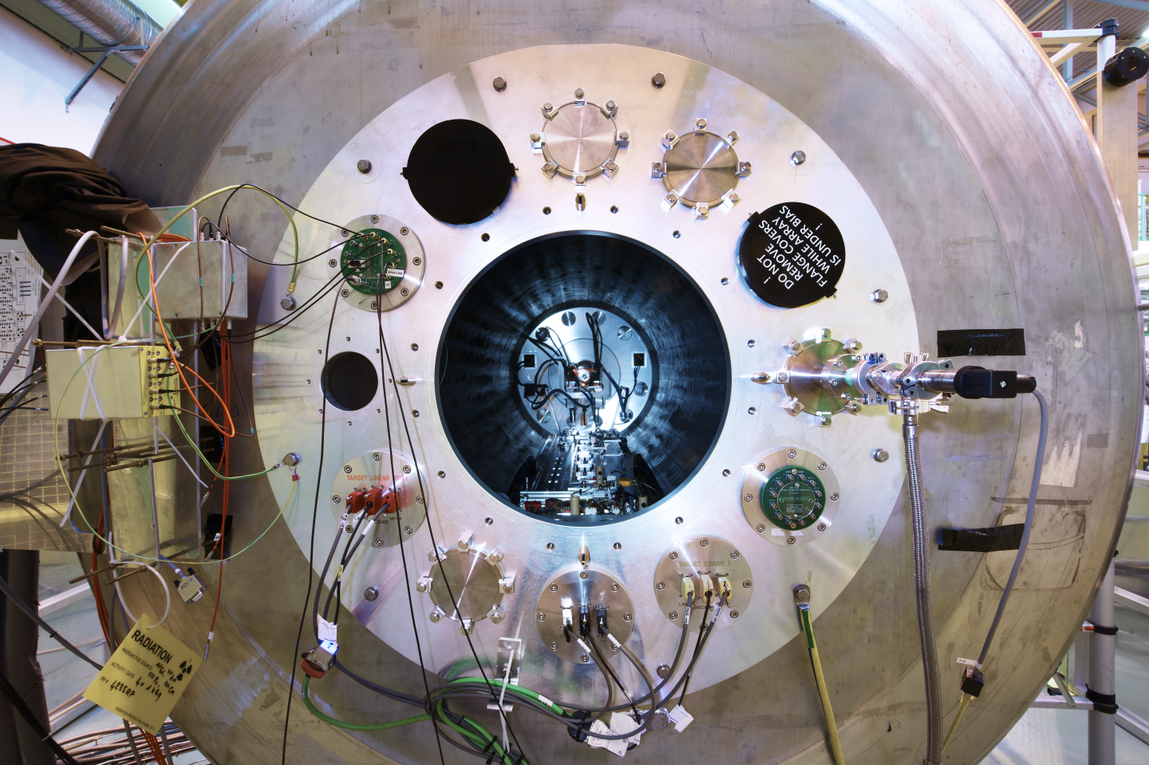

First HIE-ISOLDE physics 2022
Notes:
1

Slide 2
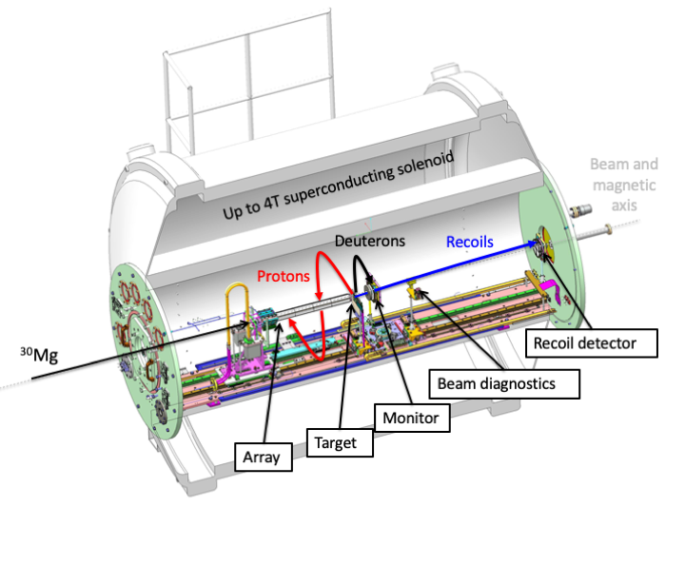
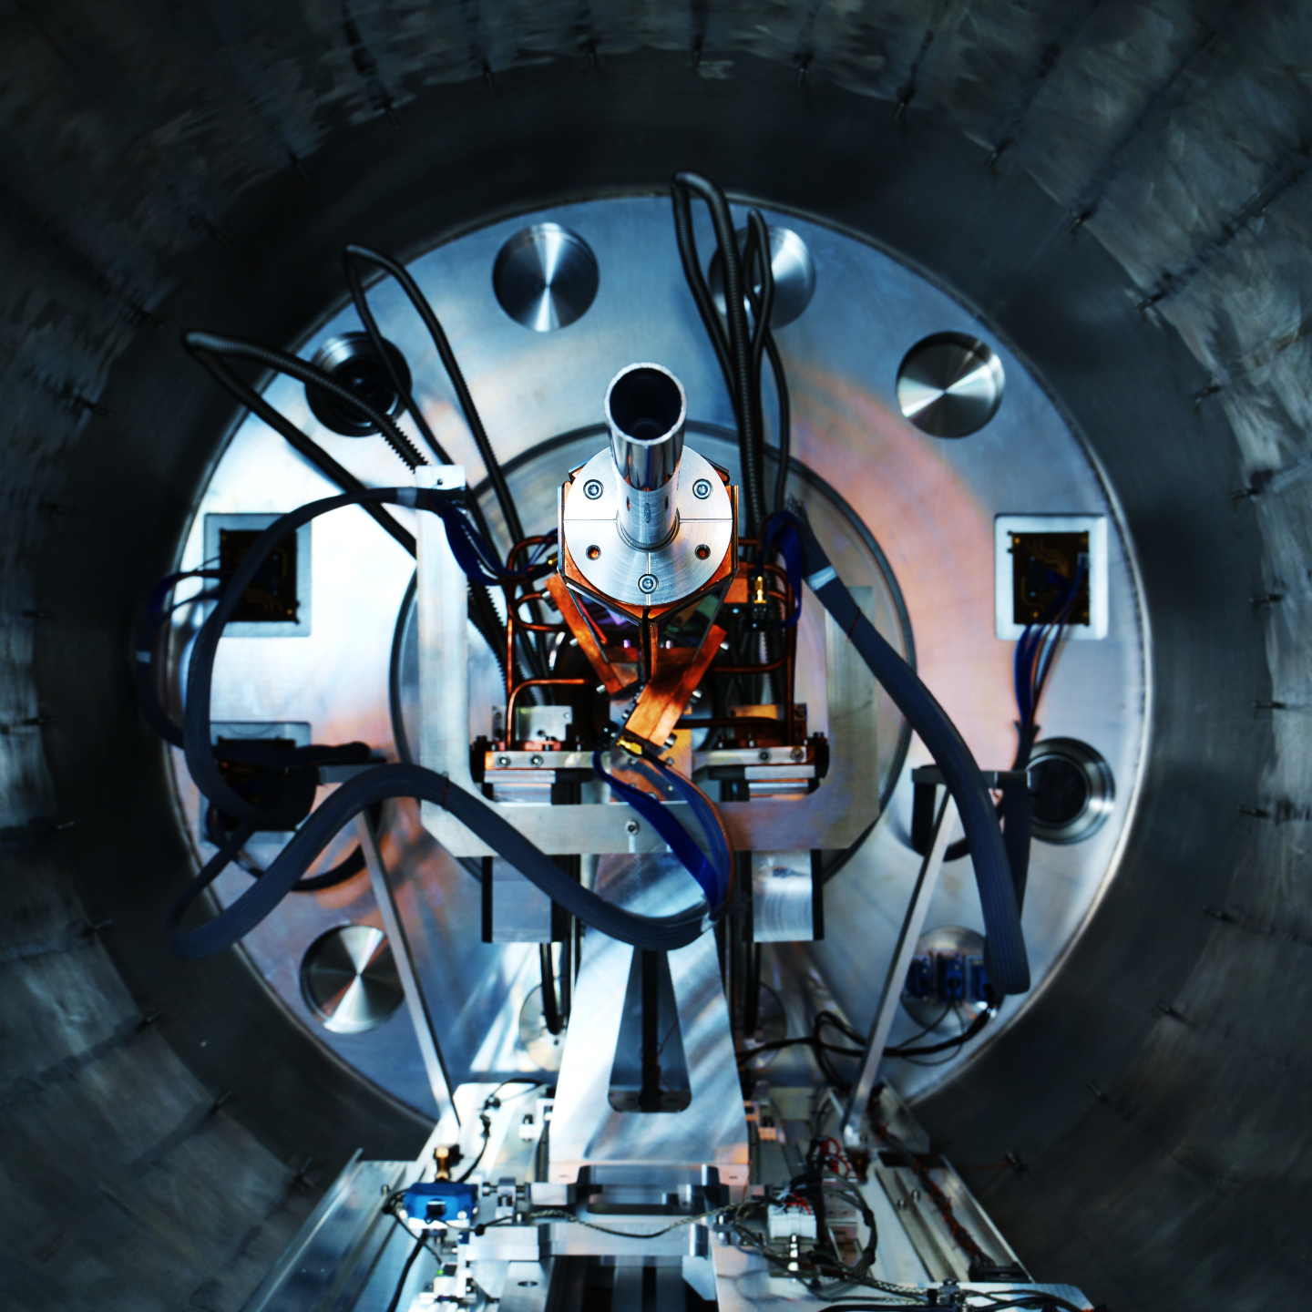
ISS configuration
Beams of ¹¹Be and ²⁷Na at 9.78 MeV/u
²⁷Na
ISS in Si-detector recoil configuration
Target-recoil distance changed between two experiments.

Slide 3
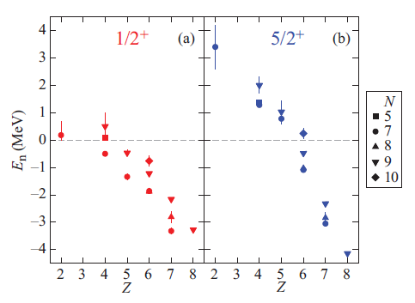
¹²Be intruder states and single-particle energies
Breakdown of conventional magic number： N=8
Isomeric state： 0₂⁺ 331(12) ns
1d_{5/2}
1p_{1/2}
2s_{1/2}
¹⁰Be
¹⁰Be
¹⁰Be
0+
2+, 3+
2-, 1-, 0-
2s_{1/2} single-particle energy
1d_{5/2} single-particle energy
1p_{1/2} single-particle energy
C. R. Hoffman et al. Phys. Rev. C 89, 061305(R) (2014)
Slide courtesy of J.Chen

Slide 4
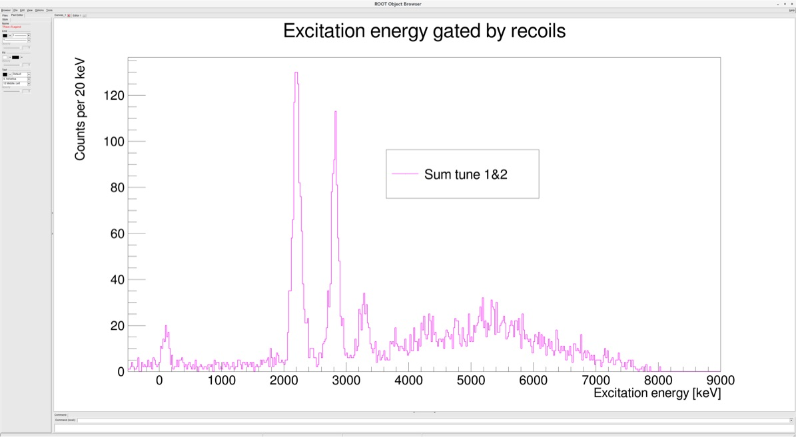
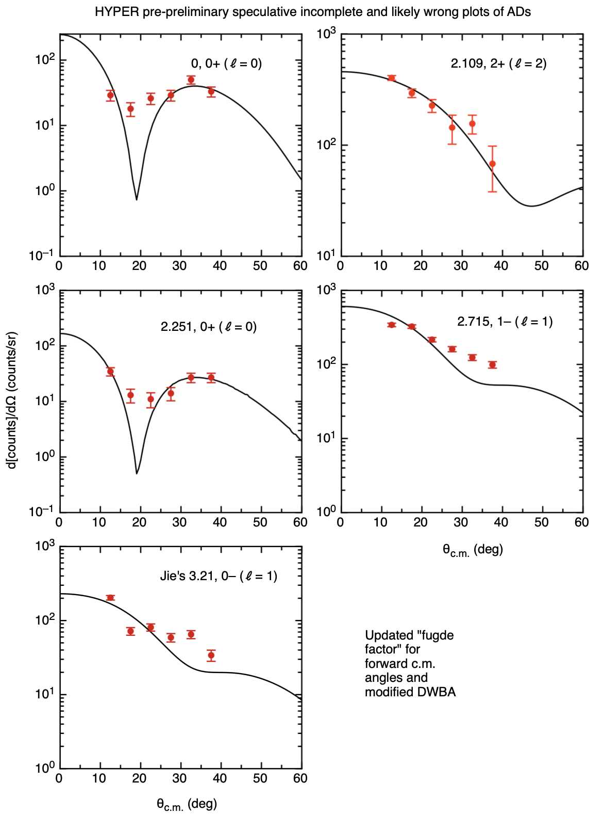
¹¹Be(d,p)¹²Be – online data
S_{n}
S_{2n}
Beam energy of 9.78 MeV/u. ~1e6pps
<10% ²²Ne contamination – use of stripper foils before XT02.
Nature of low-lying states corresponding to s₂, sd and sp configurations up to S_{2n} probed (preliminary). Strength apparent above S_{2n} as well.

Slide 5
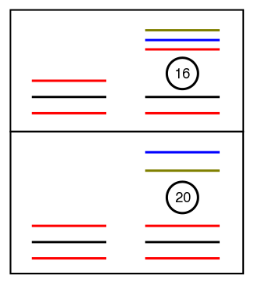
²⁷Na(d,p)²⁸Na – SP states outside N=16
In the oxygen isotopes, the N=20 shell gap has been shown to disappear with the emergence of an N=16 shell gap in ²⁴O.
This weakening shell gap also plays an important role in other regions, such as IOI
This collaboration has made previous measurements of states in ²⁹Mg (ISS) and ³⁰Al (HELIOS).
Investigated changes in single-particle centroids along N=17 and benchmarked new interactions that have been developed to better describe negative-parity intruder states near and into the IOI.
Along N=16, πd_{5/2} is emptying. Different overlaps with νd_{3/2}, νf_{7/2} and νp_{3/2} results in different monopole shifts.
Changes in ESPE’s provide details on relative strengths of interactions.
Benchmark new effective interactions.
²⁴O
Z=8
³⁰Si
p_{3/2}
f_{7/2}
d_{3/2}
s_{1/2}
Z=14
d_{5/2}
protons
neutrons

Slide 6
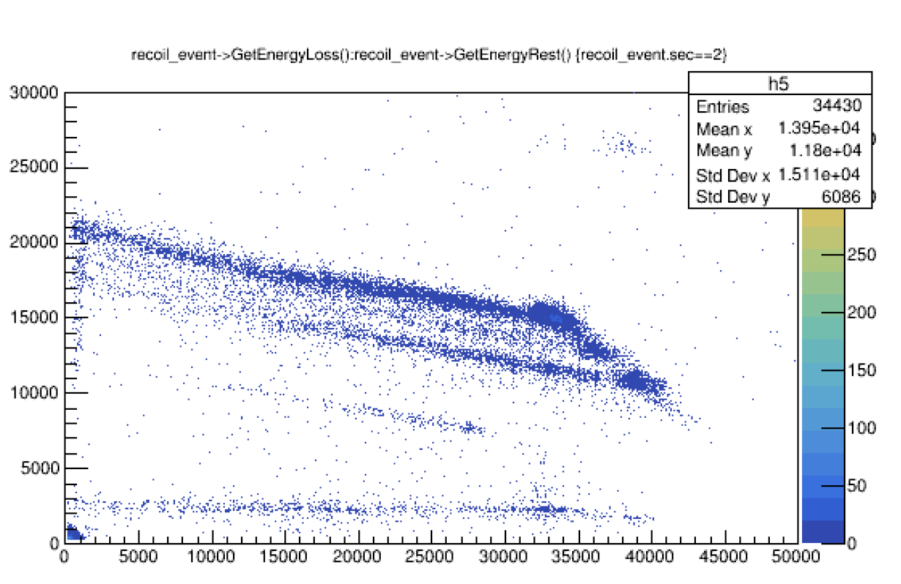
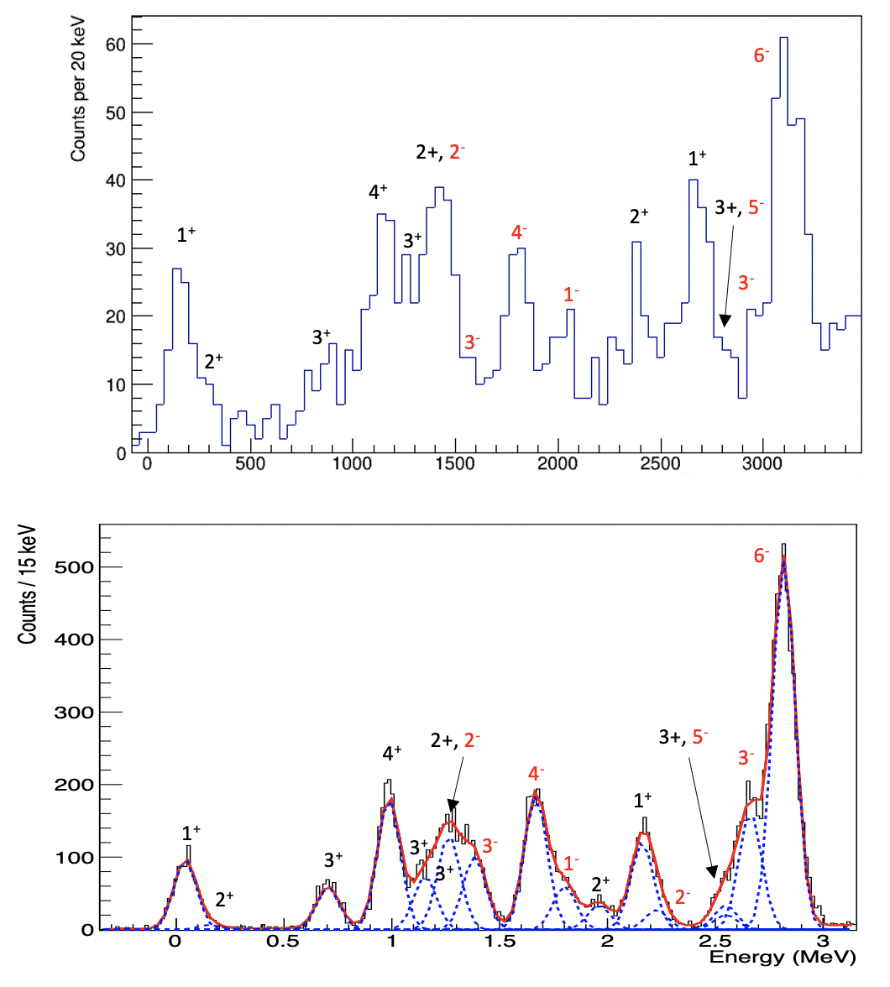
²⁷Na(d,p)²⁸Na – online data
Online data
Al
Mg
Na
Beam energy of 9.78 MeV/u. ~3e5pps
<50% ²⁷Al and 13% ²⁷Mg contamination – reaction of interest selected using recoil detectors.
Simulation based on FSU interaction

Slide 7
Thanks for the beams!

