Slide 1
EIC MDI overview
Angelika Drees, MDI system lead
(M. Valette, G. Robert-Demolaize & more)
Oct 17 2022
FCC-EIC Joint & MDI Workshop 2022

Slide 2
What is MDI?
Machine
  HSR abort
  ESR abort
  MPS
  Collimators (see Matthieu’s presentation Wednesday)
Detector
  Space requirements
  What IR do they need?
  Background (detector friends)
  Detector protection system - DPS
(more) Interfaces/Integration
  IR Magnets: Holger Witte
  Lattice design (see Scott’s presentation earlier)
  geometric constraints
  Other (vacuum, instrumentation (-> D. Gassner presentation), polarimetry, installation ….)

Slide 3
Machine

Slide 4
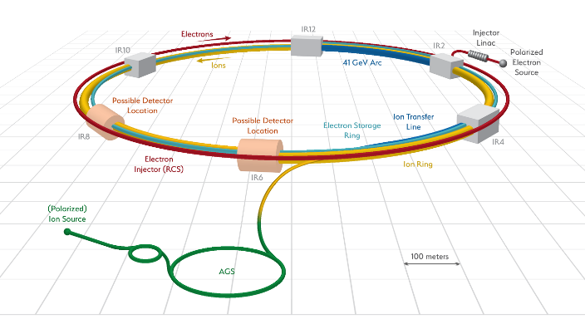
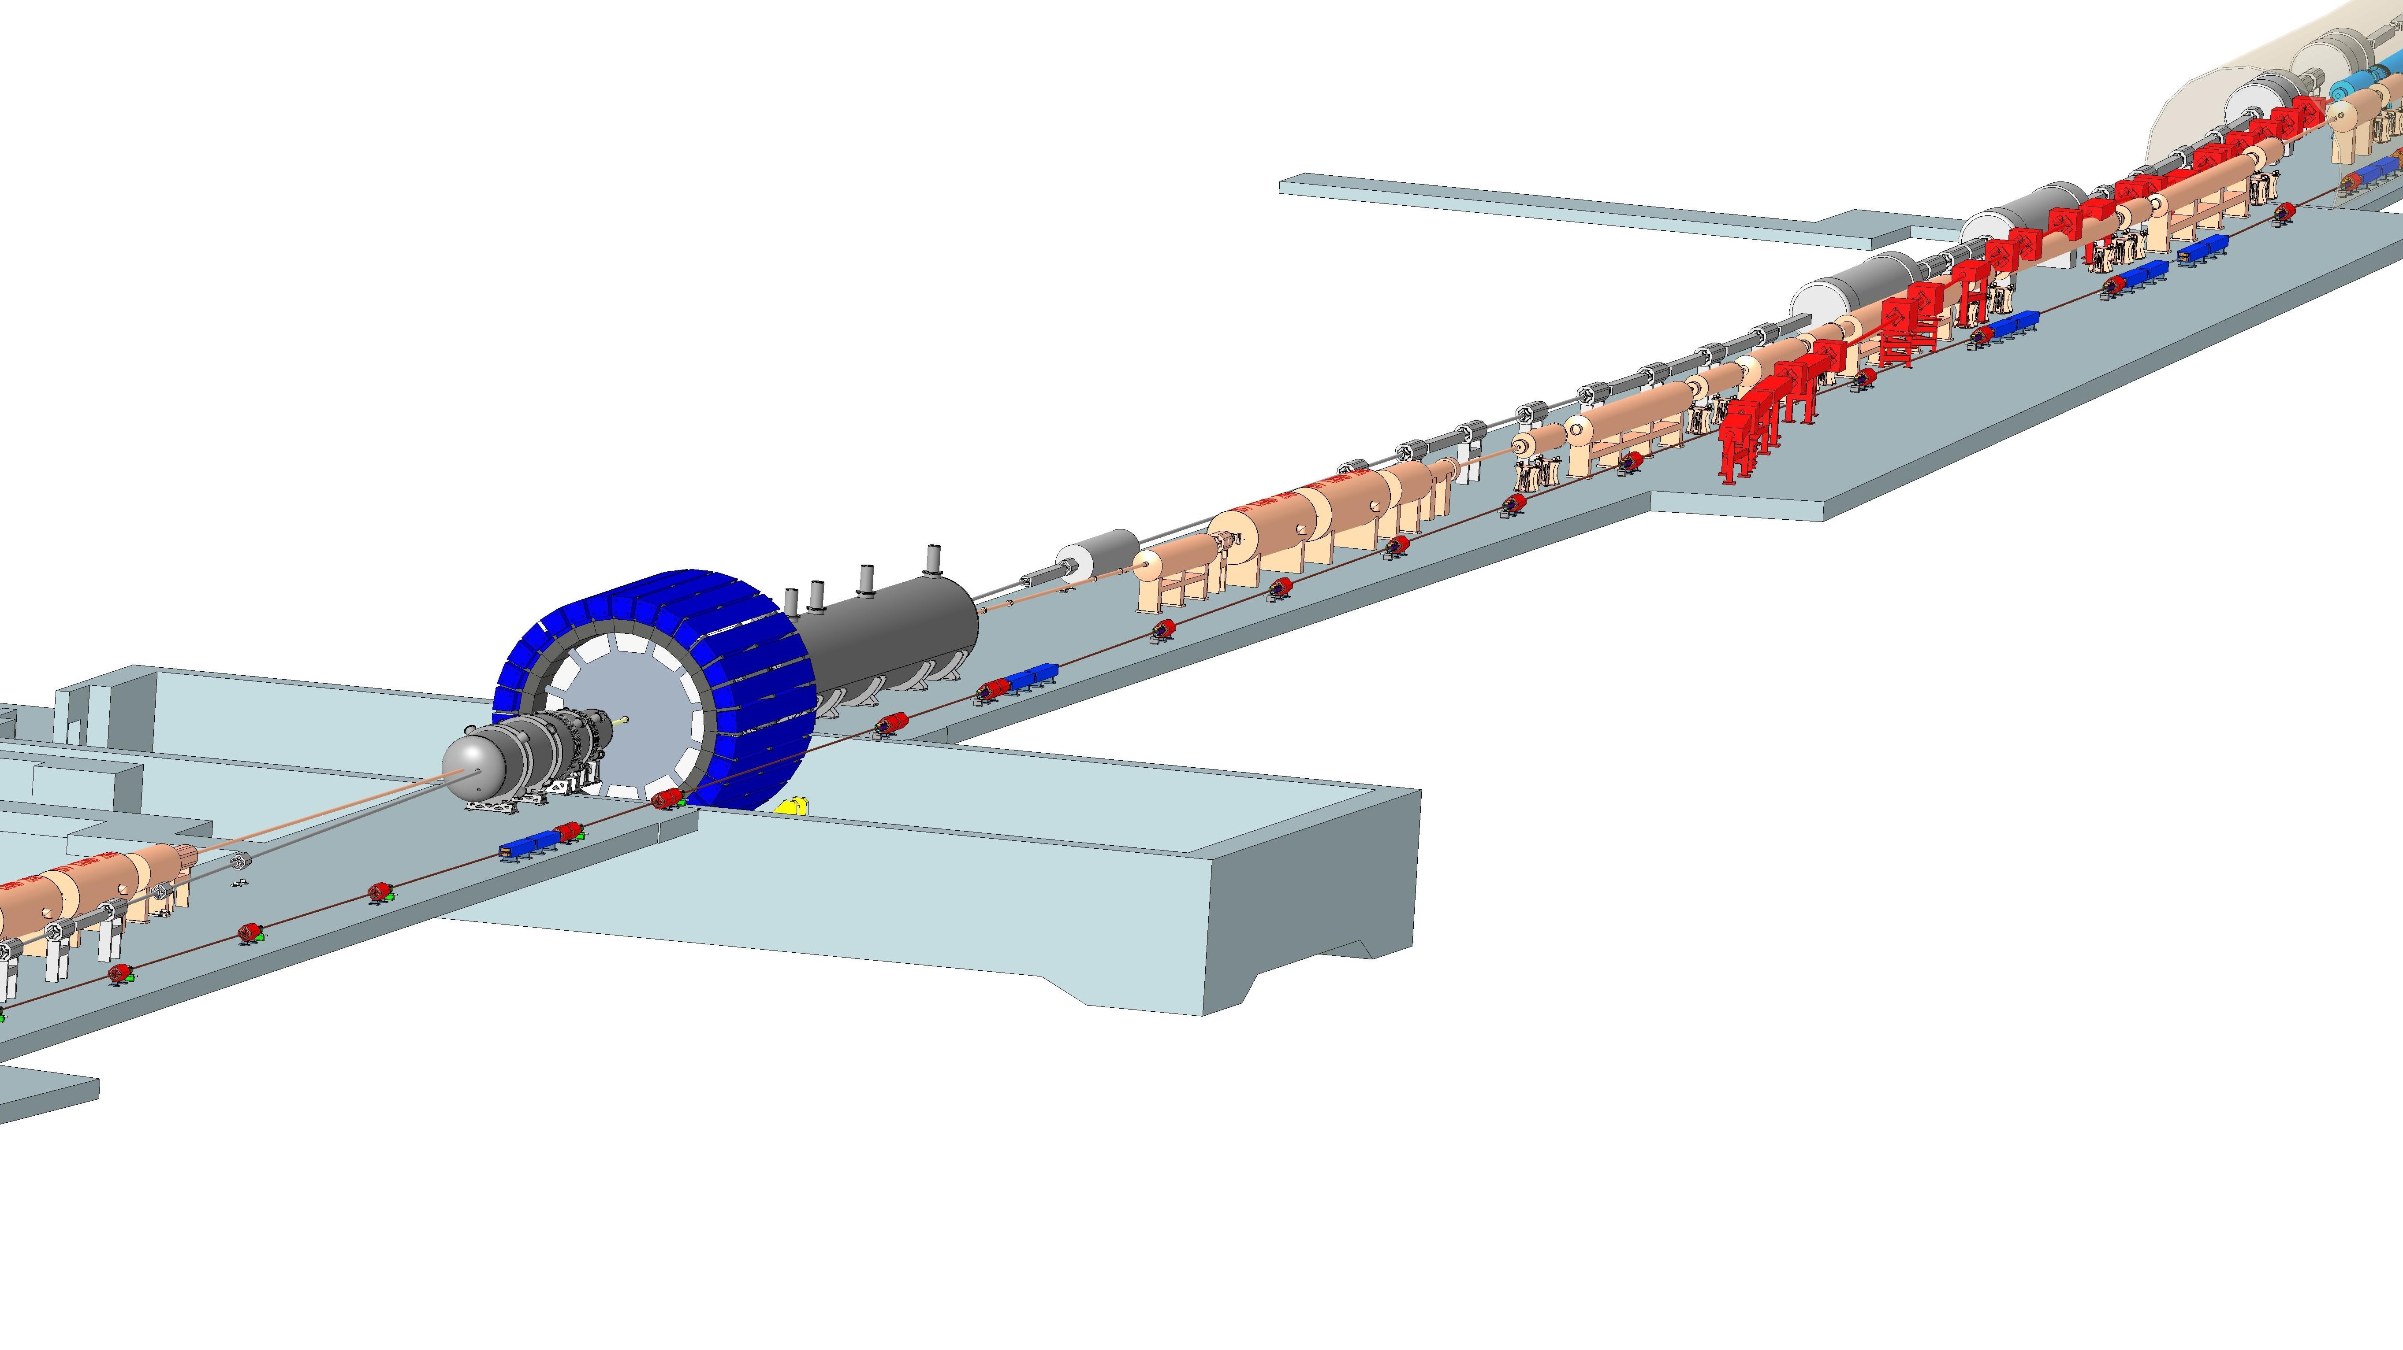
EIC Injection & aborts:
ESR injection and transfer dump, HSR collimators
HSR (RHIC) abort
ESR abort
HSR injection

Slide 5
MDI context & assumptions
The EIC will feature powerful beams
  10x the stored energy of RHIC
  2x SuperKEK-B target stored energy with 1/2 the bunches
  The e⁻ bunches will be very dense (0.5 mm²) and melt metals in case of normal impact.
radiation absorption/prevention is handled in vacuum (beam pipe design) and ESR lattice design
HSR abort is identical to RHIC yellow ring abort
ESR needs a 1-turn emergency abort to safely dump up 2.5 A beam
RCS can operate without abort but needs an“inhibit”

Slide 6
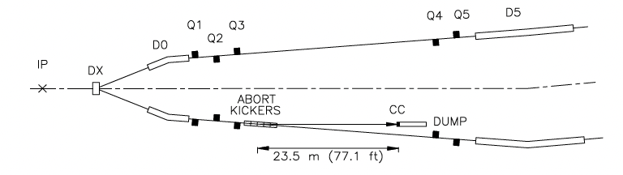
Abort system - HSR
RHIC Yellow system in IR10 with upgrade
  Window
  Water cooling
  Shielding
  Trigger solution might need a do-over

Slide 7
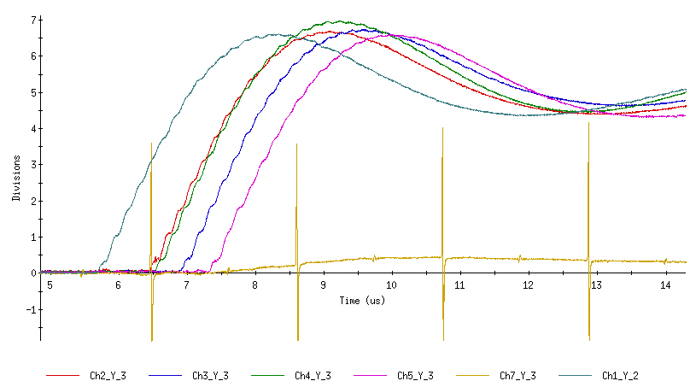
Asynchronous abort kicker discharge (“prefire”)
Cause
RHIC abort system fast switches (thyratron tubes) fire spontaneously and asynchronously (“prefires”) when operated at high energy
Effect
~10 bunches miss the dump and are steered into cold magnets (3 quench diodes lost to date) and/or into the detectors (severe damage)
PHENIX MPC
start of run
after Yellow
pre-fire 05/11/15
after Yellow
pre-fire 06/01/15
prefire
Dec 8 2021
M. Purschke

Slide 8
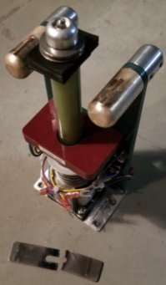
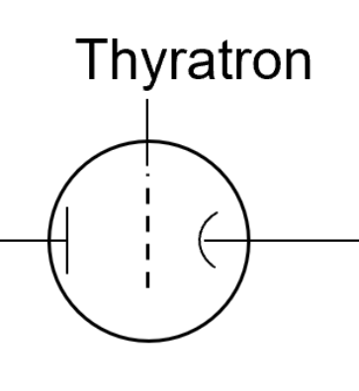
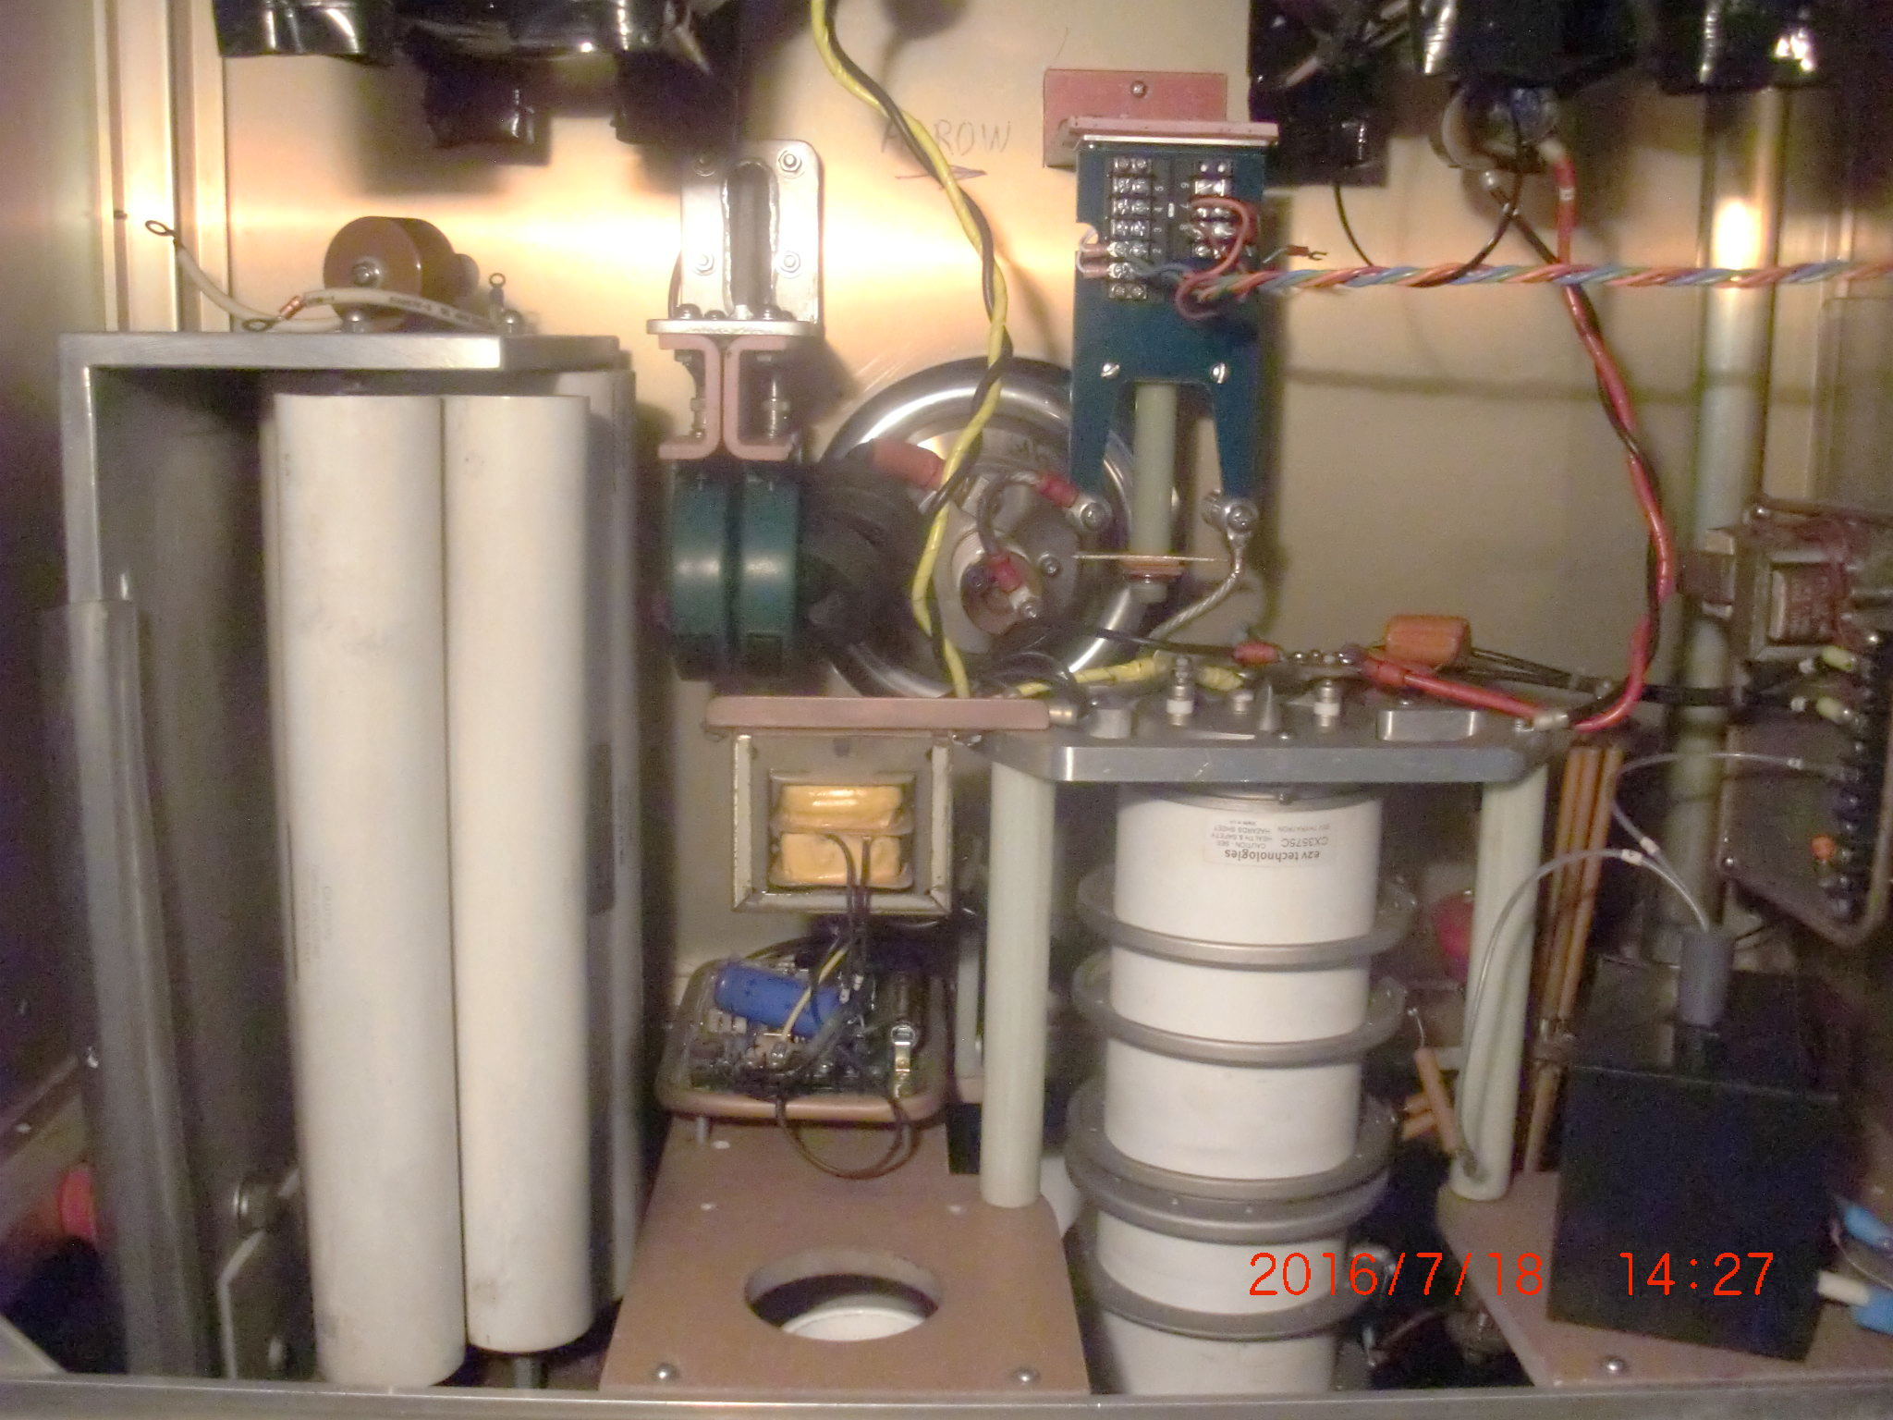
RHIC delayed abort: mechanical relays
Motivation: protect sPHENIX and RHIC SC magnets (and other accelerator components)
Solution: add mechanical relay in series to the abort thyratron tubes (completed in 2020)
  Compensate for the added time delay of 6ms (=460 turns)
  Early detection of problems ➡️ more MPS inputs (such as BPMs and PS, nested quads to be added in run 23 )
Experience:
  New MPS successfully commissioned during low energy running, some issues with monitoring
  Run 22: first complete high energy pp run with (almost) complete MPS: prefires successfully prevented
Question: is this a valid approach for the EIC?
  Solid state switches in support ‘hut’ above berm?
  Shorter instability rise-times with higher beam intensity and compatibility with delayed aborts in case alternative trigger technologies cannot be used are an ongoing study
Abort kicker switches schematic
thyratron
tube
redundant mechanical
relays (added)
PFN
abort
kicker
fast (few turns)
pre-fires
slow (460 turns)
no pre-fires
Mech. relays
closes 2nd
synchronized
closes 1st
not synchronized

Slide 9
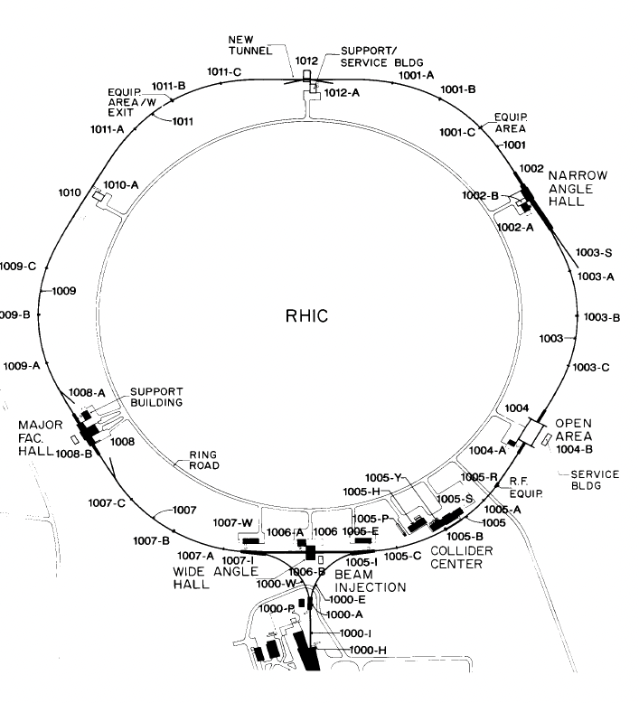
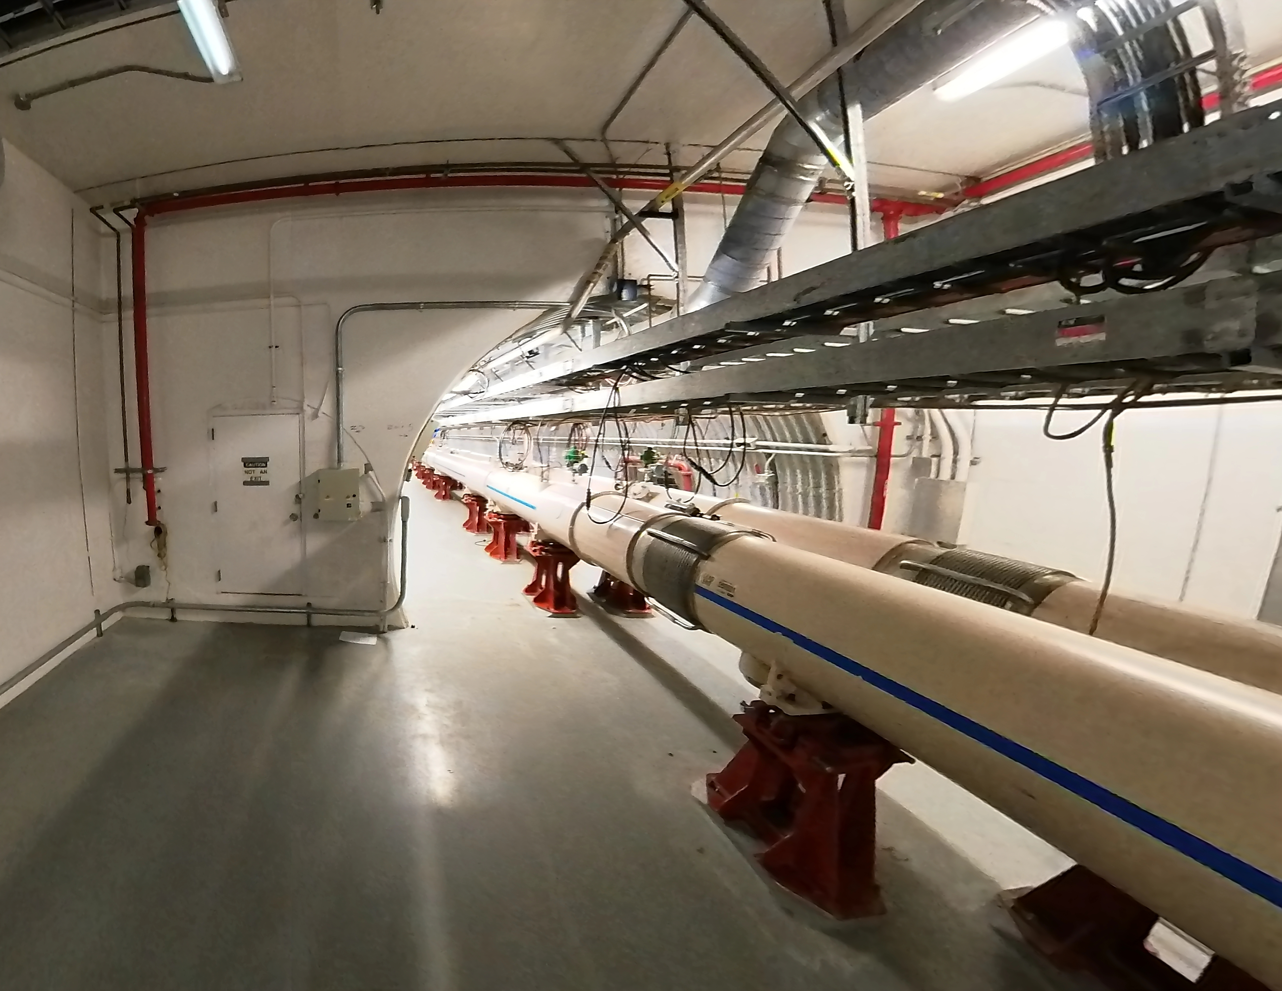
Location of the future ESR abort
The spectrometer tunnel (stub tunnel) planned for Isabelle at IR2 is suitable for our purposes.
96 meters long, 1.6 meter wide, currently empty (never used to date)
Other options are explored
Stub tunnel

Slide 10
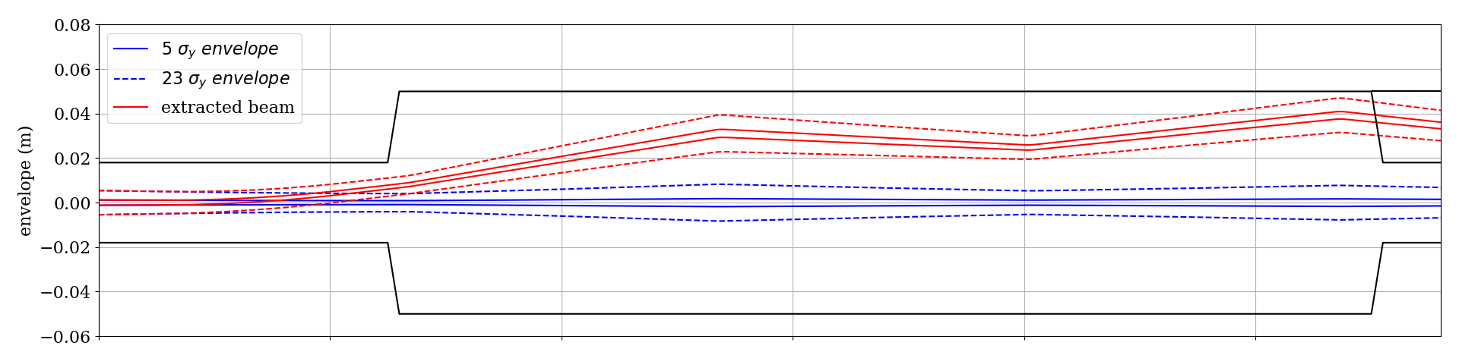
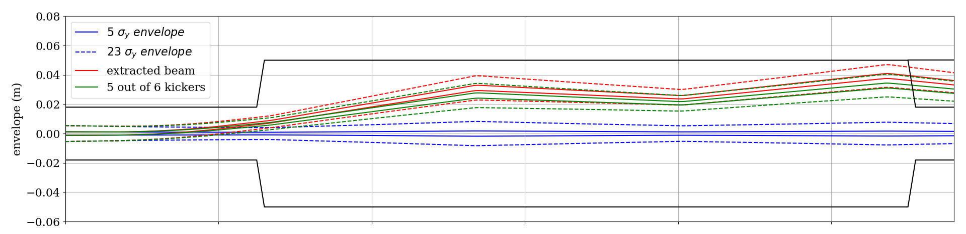
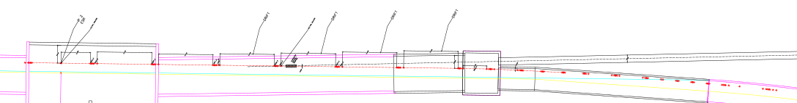
ESR abort in IR2
The unused spectrometer tunnel will allow extracting the 300-kJ beam away from other IR2 users (e-cooling, ERL, ESR, HSR, RCS)
A preliminary design requires 6 x 2-mrad vertical kickers, a 2° Lamberton magnet & a 50m-long transfer line with 6 warm quads
Side view
kickers
Lambertson magnet
Top view
Spectrometer tunnel
10
Dump block

Slide 11
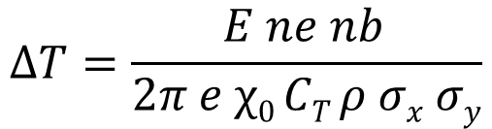
Required dilution in ESR nextraction line
Optical dilution could be enough for our purposes, the absence of sine wave kickers painting the beam on the dump reduces the complexity, cost and potential failure modes.
Heat increase from the full beam :
Assuming Carbon, which gets damaged at 1000 C°. A conservative requirement is to limit temperature increase to a factor 10 safety margin.
Roughly : ΔT < 100 K ⬄ σ_{x} σ_{y} > 5 cm² ⬄ β_{x} β_{y} > 3500 km²
I.E. : β_{x} ~ β_{y} ~ 60 km
$$∆T=\frac{E ne nb }{2π e χ0 CT ρ σx σy}$$

Slide 12
MPS logic
The HSR will take ~35 minutes to fill + ramp.
In case of an ESR abort the HSR beam can be kept while waiting for the ESR to be re-filled.
The ESR will take 10 minutes to fill.
The electrons will not survive the HSR ramp due to changing f_{rev}.
The electrons need to be dumped in case of a hadron abort, to avoid short lifetimes.
=> One way coupling of the permits :
HSR beam permit used as input for the ESR

Slide 13
Key MPS inputs
BLM
Quench Link
RF (including Crab Cavities)
Abort System
Vacuum (including Temperature)
BPMs
Power Supplies
Other/new:
  E-cooling
  Feedbacks
  Crab cavities
  Detector inputs
  ?

Slide 14
Key MPS inputs
BLM
Quench Link
RF (including Crab Cavities)
Abort System
Vacuum (including Temperature)
BPMs
Power Supplies
Based on current system with extra monitors around the experiments.
Will include bunch by bunch loss monitors at key locations (collimators, …)
Need for electron-loss specific monitors at transfer location.

Slide 15
Key MPS inputs
BLM
Quench Link
RF (including Crab Cavities)
Abort System
Vacuum (including Temperature)
BPMs
Power Supplies
Same QPS as per RHIC for Hadron arc magnets.
SBIR collaboration for ML based detection/prediction of quenches ongoing

Slide 16
Key MPS inputs
BLM
Quench Link
RF (including Crab Cavities)
Abort System
Vacuum (including Temperature)
BPMs
Power Supplies
Vacuum monitoring near the IR.
Heating of sleeves and interconnects with radially shifted beams monitored to abort the beams before a quench.

Slide 17
Key MPS inputs
BLM
Quench Link
RF (including Crab Cavities)
Abort System
Vacuum (including Temperature)
BPMs
Power Supplies
Fast BPM monitoring (turn by turn)
Individually configurable threshold for each BPM and operational mode
Amplitude, coherence, difference
Similar to RHIC system

Slide 18
Key MPS inputs
BLM
Quench Link
RF (including Crab Cavities)
Abort System
Vacuum (including Temperature)
BPMs
Power Supplies
All PS monitored :
  IP quads & dipoles
  Correctors
  mains PS
Warm switching dipoles added to the HSR will be monitored & their failures made slower (e.g. series powering).

Slide 19
Detector

Slide 20
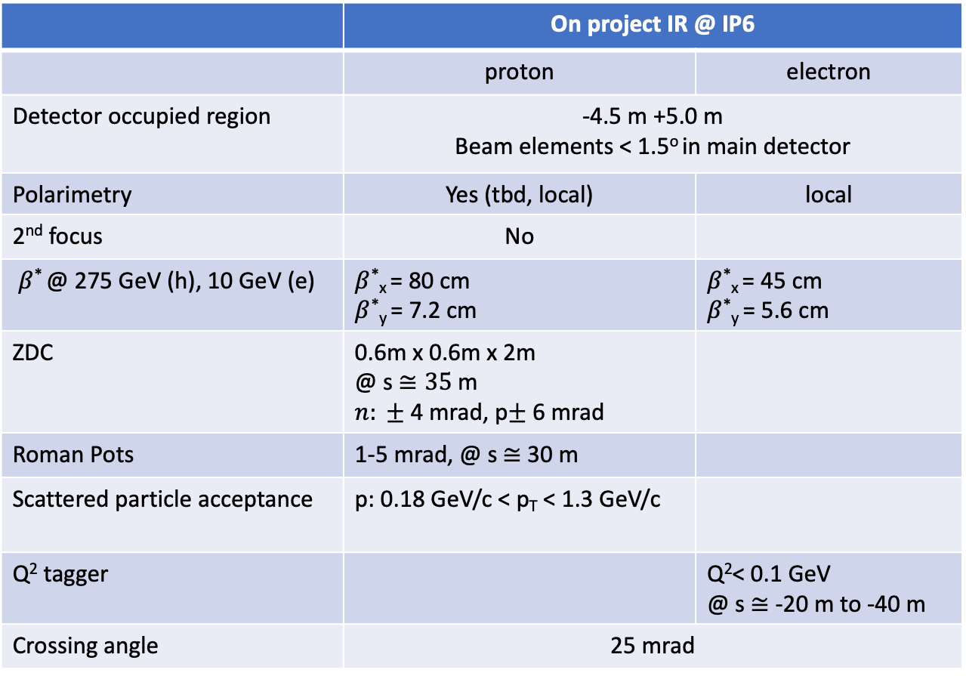
IR requirements & parameters
 | On project IR @ IP6
 | proton | electron
Detector occupied region | -4.5 m +5.0 m Beam elements < 1.5º in main detector
Polarimetry | Yes (tbd, local) | local
2nd focus | No
$β$* @ 275 GeV (h), 10 GeV (e) | $β$*_{x} = 80 cm $β$*_{y} = 7.2 cm | $β$*_{x} = 45 cm $β$*_{y} = 5.6 cm
ZDC | 0.6m x 0.6m x 2m @ s $≅35$m $n: ±$ 4 mrad, p$±$ 6 mrad
Roman Pots | 1-5 mrad, @ s$≅$ 30 m
Scattered particle acceptance | p: 0.18 GeV/c < p_{T} < 1.3 GeV/c
Q² tagger |  | Q²< 0.1 GeV @ s $≅$ -20 m to -40 m
Crossing angle | 25 mrad

Slide 21
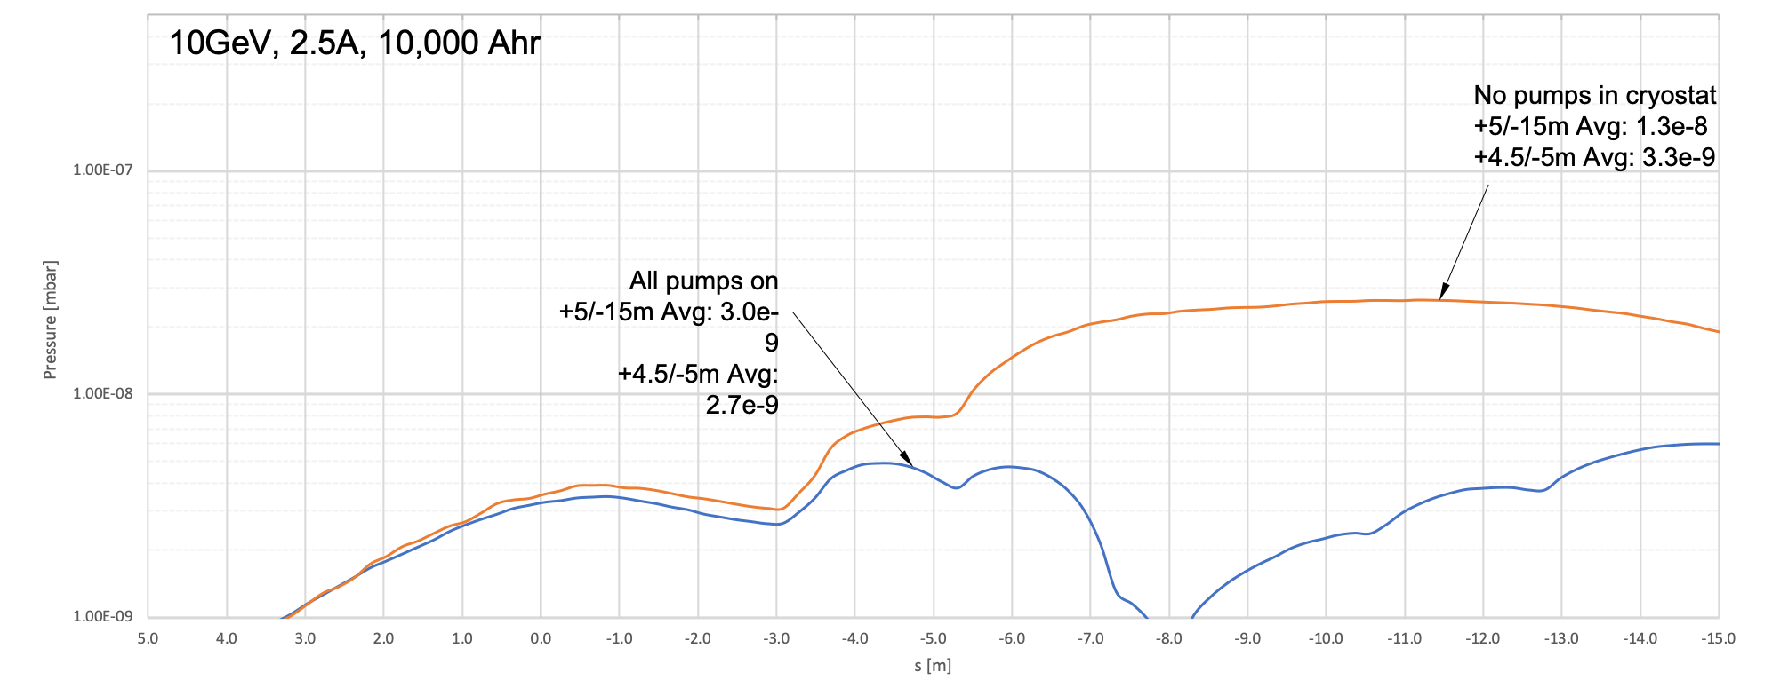
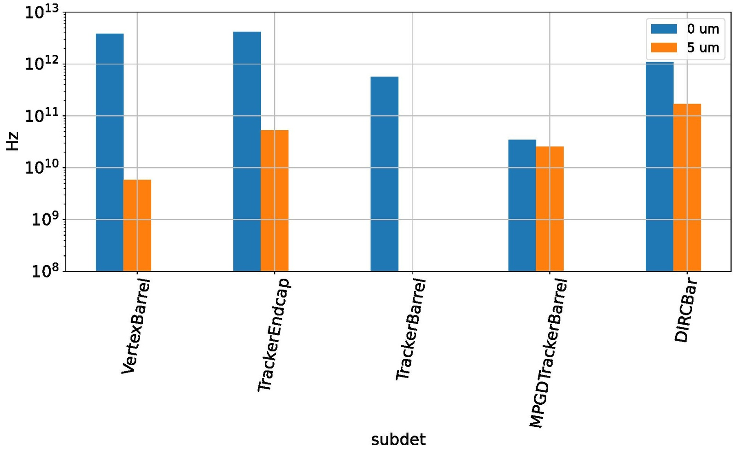
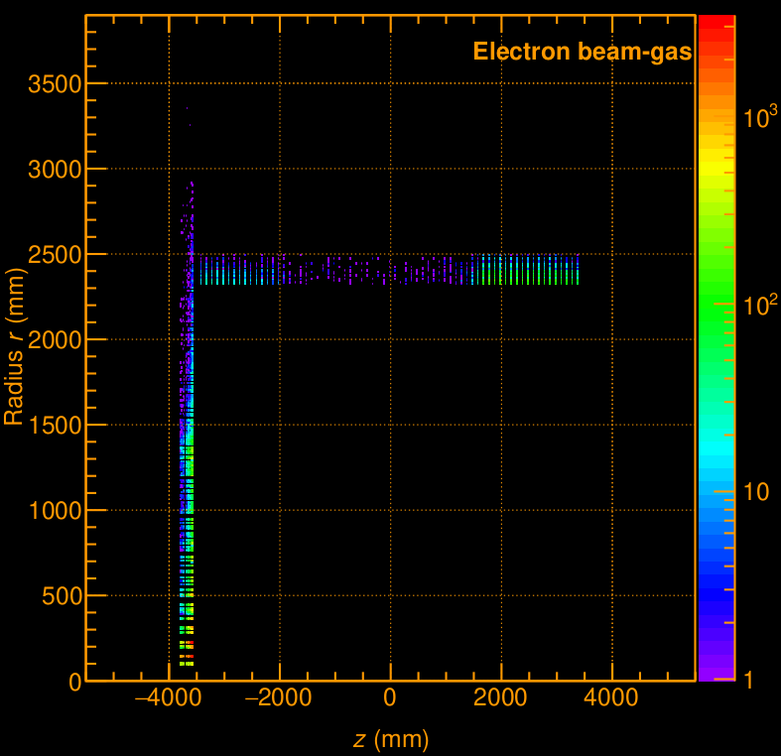
Machine-Detector Interface
Detailed assessment of beam vacuum, pump layout in the forward and rear cryostats and synchrotron radiation
Studies on beam induced detector backgrounds
hadron beam:
background during injection and ramp → collimators
beam gas interactions p/A + H²_{restgas}
  detailed GEANT simulations including detector responses
  current levels are tolerable
electron beam:
background due to de-excitation of beam if bunches are replaced
  collimated injected beam (6 σ) well inside aperture limits 13.5/23 σ
beam gas interactions: e_{Beam} + H²_{restgas} → e’ + γ + H²_{restgas}
  detailed GEANT simulations including detector responses
  current levels are tolerable
All background sources have been identified.
Tools are developed to track the impact of design changes on the backgrounds
in the detector.
Distribution in ECals

Slide 22
Detector D(M)PS inputs
  Magnets are already part of the permit system @ RHIC (main solenoid + compensation magnets)
  Low level trigger on backgrounds & energy deposited on vertex detector
  Roman pots (position, vacuum, …)
  Other?

Slide 23
More Interfaces

Slide 24
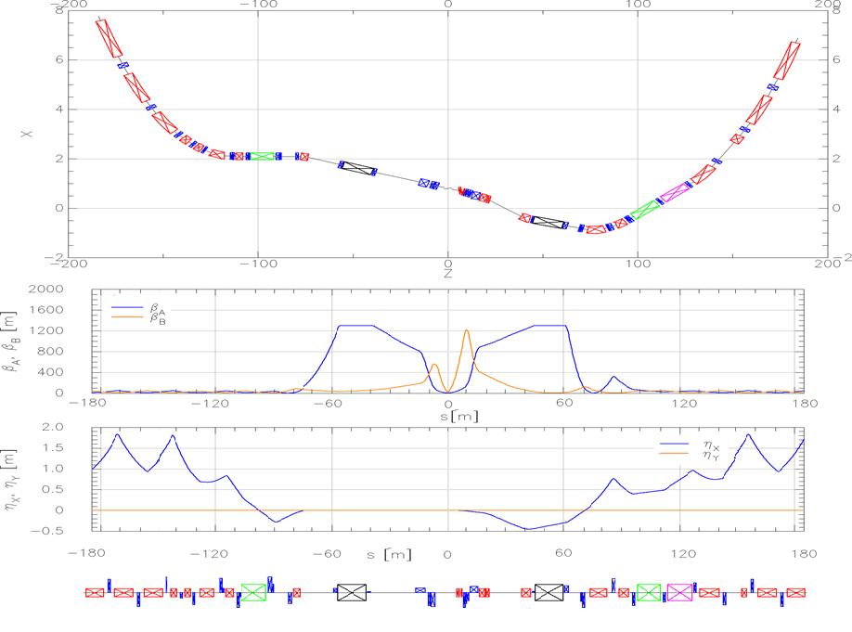
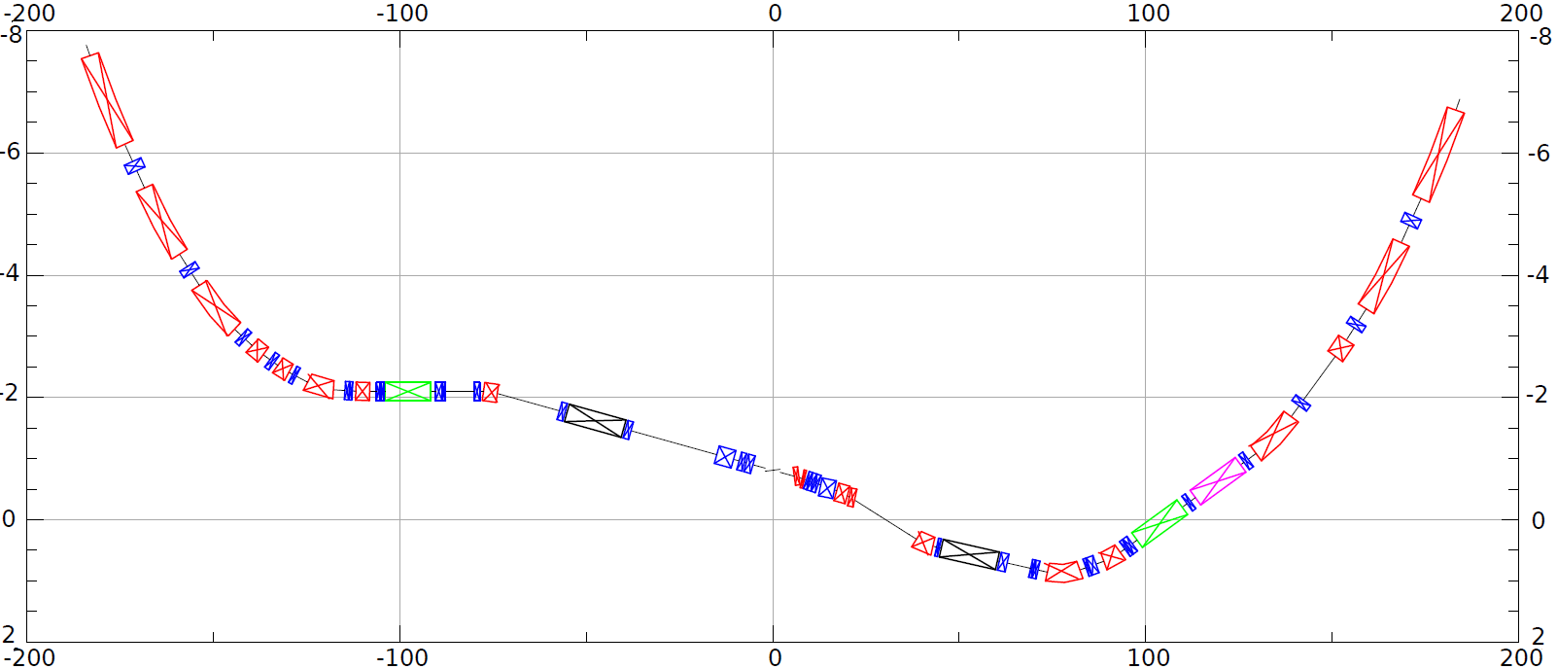
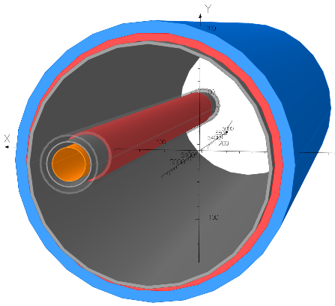
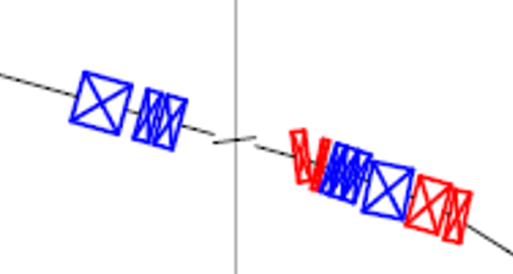
HSR layout in IR6
Forward and rear hadron lattice matched into RHIC
  Snake at correct angle
  Beta fct. 1300m at crab cavities
    Hor. phase advance 90º
  Matching Magnets
    Mostly repurposed RHIC magnets
    few additional magnets required (some SC)
    Some need re-cryostating
h
HSR Arc
Crab–in
Crab –out
HSR Arc
Spin
Rotator
Snake
matching
Off momentum Detectors
Spin Rotator
ESR Lumi-Monitor
matching
Approximate ESR path
Zero Deg Calorimeter
Detector region
B0pF spectrometer
Nov 2021 layout
3 Dipoles and 3 Quadrupoles in one shared cryostat
(Much) more detail in S. Berg’s presentation

Slide 25
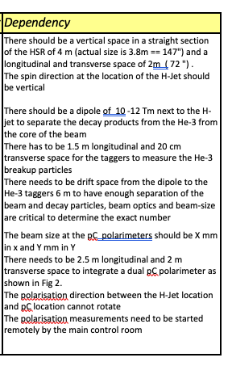
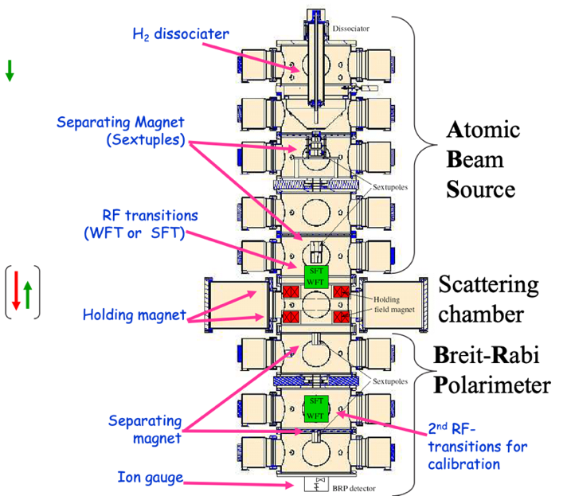
Polarimetry
Hjet
  relocation from IR12 (RHIC) to IR4 (EIC)
pC
  Relocation with Hjet
Local polarimetry: IR6
He3 polarimeter:
  New location, needs dipole
Beam
level

Slide 26
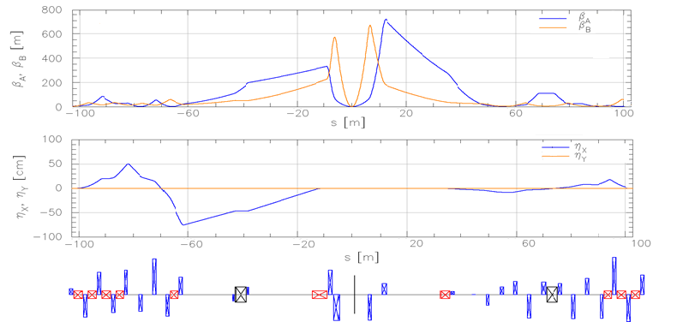
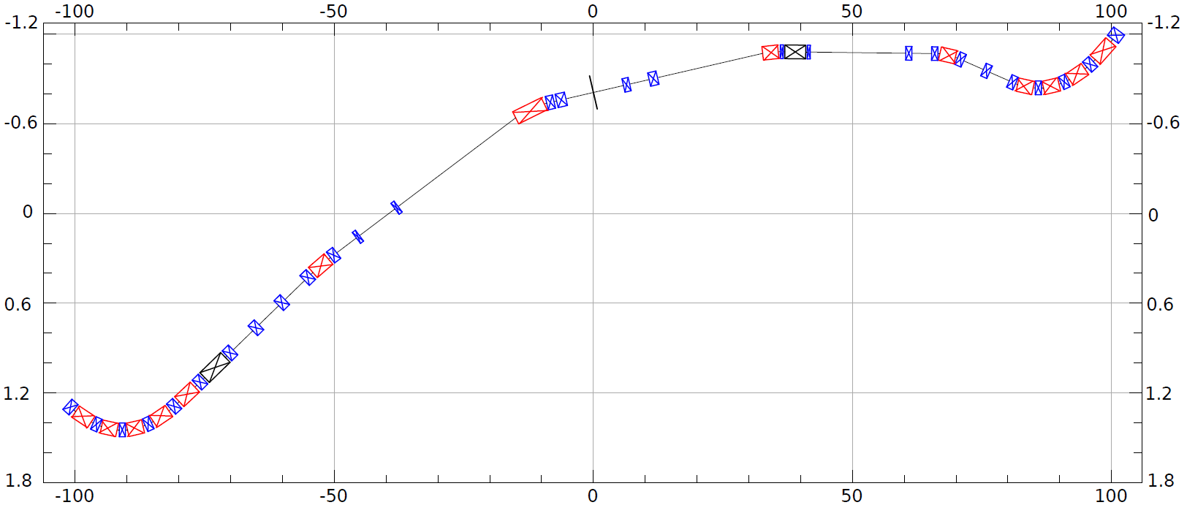
ESR layout in IR6
Design to:
Provide room for detector components
Mitigate synchrotron radiation issues
Provide longitudinal spin (new spin rotators)
Match into the arcs
Provide conditions for crabbing
Allow 3 rings and beam elements
e
~130m
Spin Rotation Solenoids
6GeV
Crab –in
IP Focusing
18GeV
Lumi-Monitor
B2eR
~130m
Spin Rotation Solenoids
E-taggers
Polarimeter Laser
Detector region
Longitudinal spin
B1eF
Crabbed beam.
(Much) more detail in S. Berg’s presentation
Crab–out

Slide 27
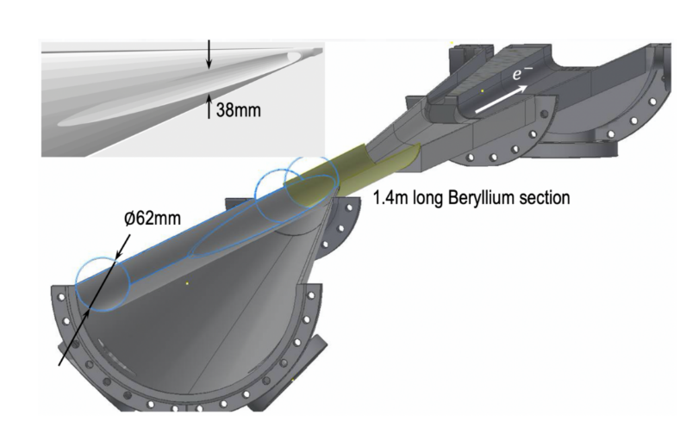


Central Vacuum Chamber
Real part of long. Impedance
(minimized for exp. detector)
Hadrons
Loss factor k_{loss} = 2.2mV/pC
Bunch length σ_{s} = 12mm
Total power loss = 262W (was 10 kW!)
I_{avg} = 2.48A, N = 660, T_{o} = 12.79µs
Loss factor k_{loss} = 0.2mV/pC
Bunch length σ_{s} = 24mm
Total power loss = 30W
I_{avg} = 2.48A, N = 660, T_{o} = 12.79µs
Small diameter, thin walled Be in center region.
Smooth tapers and transitions to limit energy deposited by beam in trapped modes (wakes).
Considering HOM absorbers
$$P_{loss}=\frac{k_{loss}I_{av}^{2}T_{0}}{M}$$
Courtesy Charles Hetzel

Slide 28
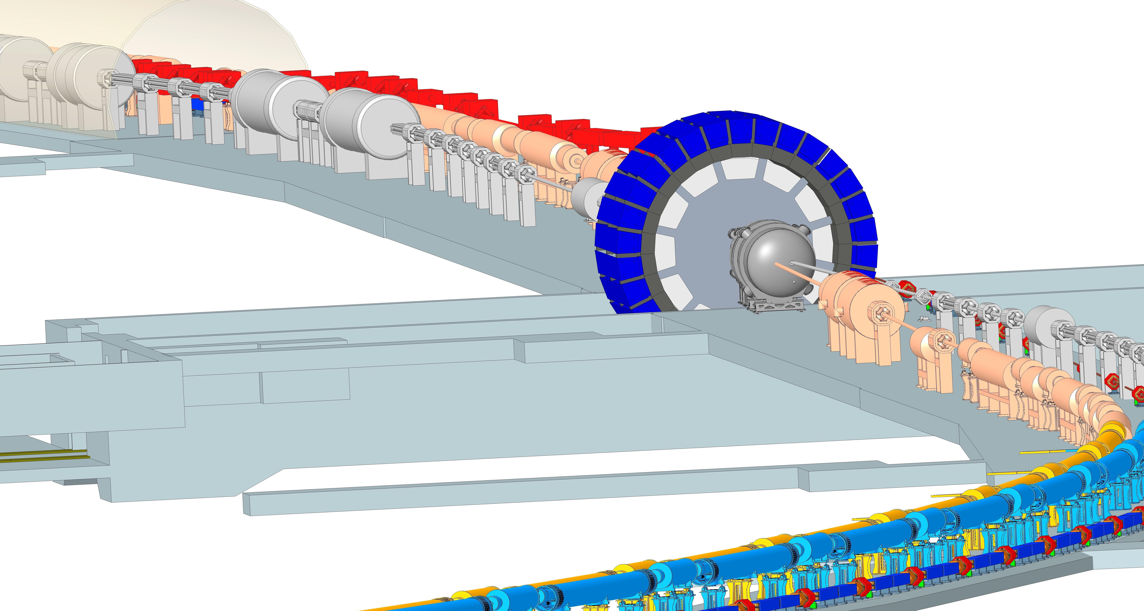
Existing tunnel and infrastructure
Sector 5
HSR
RCS
Sector 6
Cortesy: K. Hamdi,
D. Holmes
RHIC blue arc

Slide 29
Conclusions
ESR abort
  Needed. Conceptual layout complete
HSR abort
  Needs upgrades.
  Determine if mechanical relays can be used.
    Delayed aborts “R&D”: RHIC runs 2023-25
  Alternatives exist
Detector & other
  Polarimetry, ZDCs, lumi monitors, roman pots, vacuum chamber …
  Collaborative efforts, in progress
MPS concept evolving
  Adjusting to EIC beams and configuration
More work ahead

