Slide 1

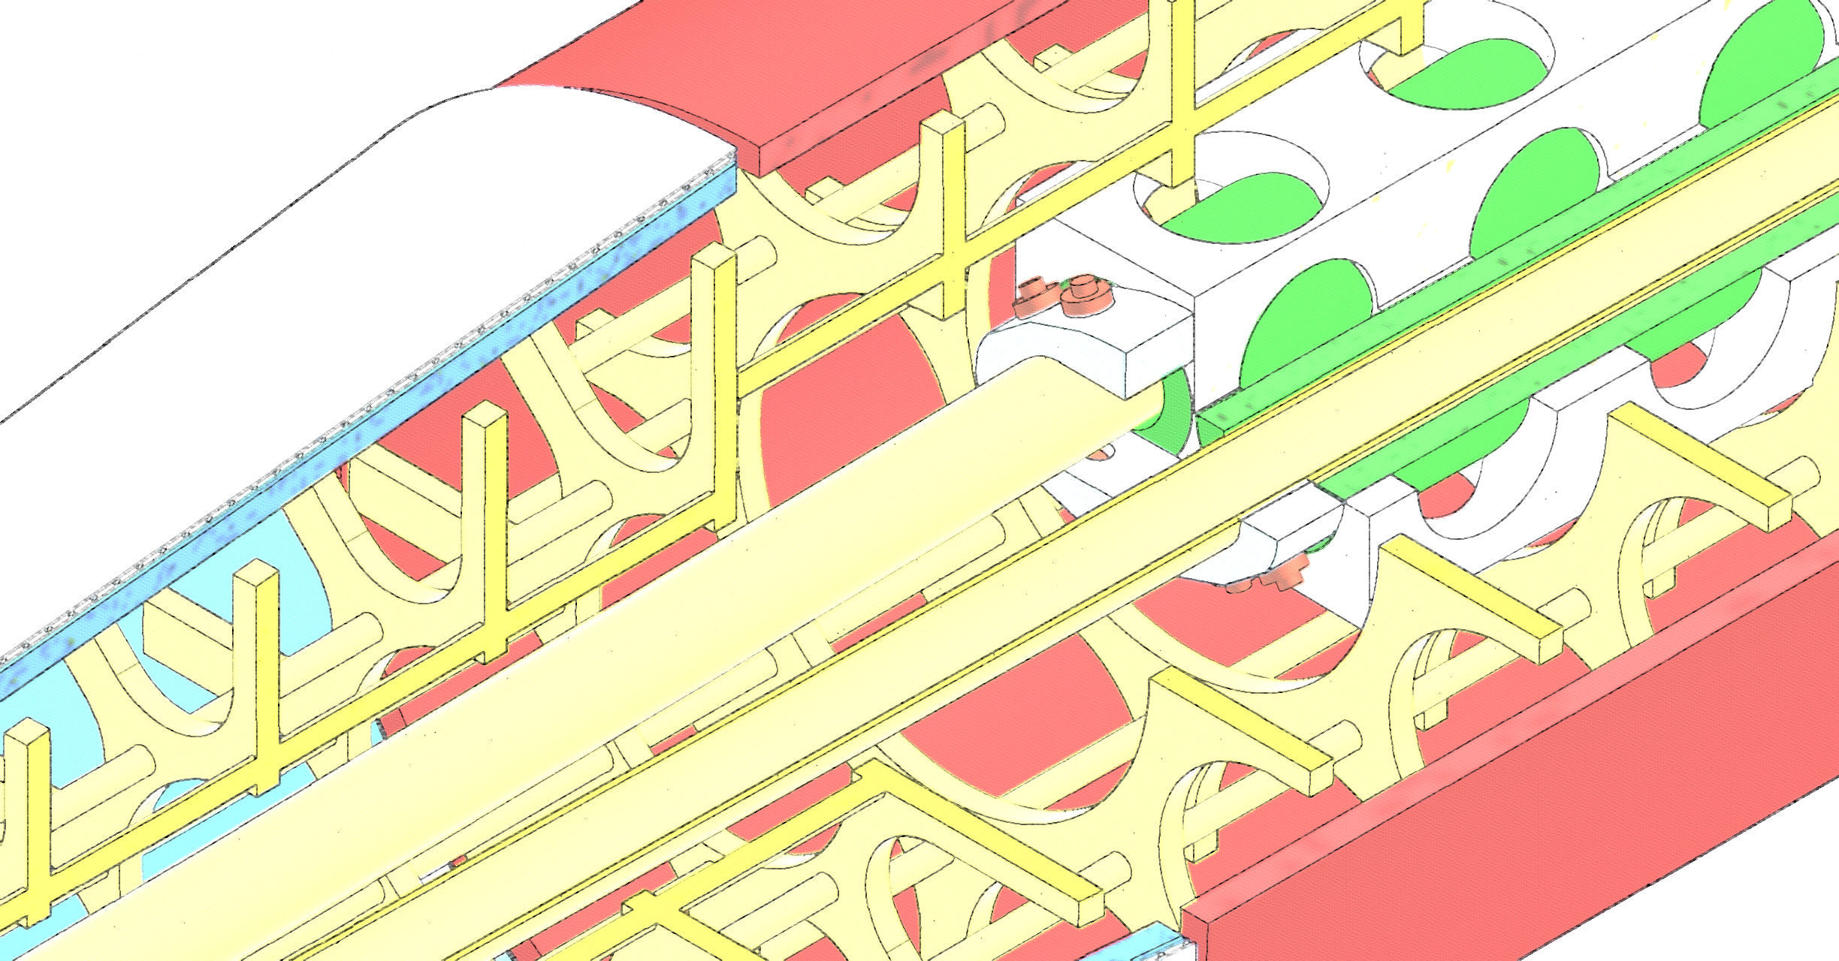


FCC-ee CCT Quadrupole Design and Plans
M. Koratzinos
FCC-EIC Joint & MDI Workshop 2022
18/10/2022

Slide 2
Previously
Please see “FCCIS WP2 Workshop 2021” on 03/12/2021 for a near-identical presentation

Slide 3
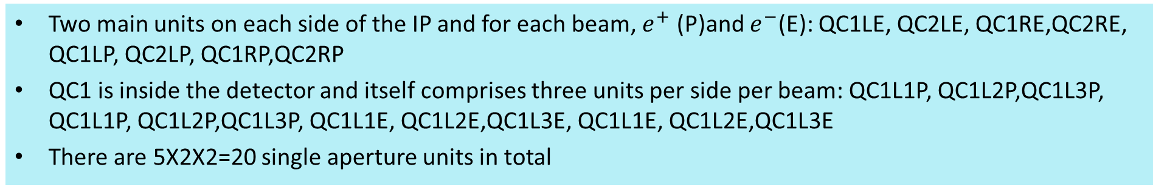
Final focus quadrupoles
Two main units on each side of the IP and for each beam, $e^{+}$ (P)and $e^{−}$(E): QC1LE, QC2LE, QC1RE,QC2RE, QC1LP, QC2LP, QC1RP,QC2RP
QC1 is inside the detector and itself comprises three units per side per beam: QC1L1P, QC1L2P,QC1L3P, QC1L1P, QC1L2P,QC1L3P, QC1L1E, QC1L2E,QC1L3E, QC1L1E, QC1L2E,QC1L3E
There are 5X2X2=20 single aperture units in total
From the FCC CDR update 13/12/2019, Katsunobu Oide
Optics design is such that E and P quads have the same strength
Maximum strength is 100T/m
The most difficult element is QC1L1, the closest to the beam and where the E and P quads are closer together
 | Start position (m) | Length (m) | B’ @Z (T/m) | B’ @W (T/m) | B’ @ H (T/m) | B’ @ tt (T/m)
QC2L2 | -8.44 | 1.25 | 25.05 | 43.82 | 61.30 | 69.50
QC2L1 | -7.11 | 1.25 | -0.18 | 0.00 | 7.32 | 56.85
QC1L3 | -5.56 | 1.25 | -19.35 | -34.38 | -53.08 | -99.98
QC1L2 | -4.23 | 1.25 | -18.57 | -32.94 | -53.07 | -99.98
QC1L1.1 | -2.9 | 0.7 | -40.95 | -70.00 | -99.71 | -95.39
QC1L1.2 | 2.2 | 0.7 | -40.95 | -70.00 | -99.71 | -95.39
QC1R2 | 2.98 | 1.25 | -25.44 | -37.25 | -51.94 | -100.00
QC1R3 | 4.31 | 1.25 | -19.54 | -39.51 | -53.65 | -91.87
QC2R1 | 5.86 | 1.25 | 14.64 | 16.85 | -2.65 | 37.19
QC2R2 | 7.19 | 1.25 | 19.50 | 44.32 | 67.52 | 94.43
The updated parameters are rather different for QC1L1: its length is now 70cm from 120cm

Slide 4
Main challenges
Lack of space: 66mm between the two beams at QC1L1. Quads are at an angle so crosstalk varies along the length
Required field quality: better than 10⁻⁴ and of O(10⁻⁵)
Need to eliminate crosstalk between the two quadrupoles
  The beam pipe inner diameter is 30mm
  The beam pipe is warm, so we need vacuum insulation and cooling/heating for the beam pipe
  The minimum size of the thickness of the double layer beam-pipe with the cooling liquid flowing in-between is 3mm
  We are then leaving 2mm for vacuum and a heat shield
  ➔ aperture of FF quads is 40mm
  ➔ space left for former, conductor, yoke = 13mm
  ➔ it would be very difficult to fit an iron yoke with reasonable thickness to eliminate crosstalk

Slide 5
Choice of technology for QC1L1
There is only one technology we have identified that can tackle those challenges: a CCT iron-free design
A CCT design can compensate for the crosstalk between quadrupoles even in the case that crosstalk changes every centimetre: see M. Koratzinos et al.1709.08444 [physics.acc-ph] Published in: IEEE Trans.Appl.Supercond. 28 (2018) 3, 4007305
A CCT design can also compensate for edge effects ensuring excellent field quality locally at every point of the magnet. This is important since the optics functions vary wildly close to the IP

Slide 6
CCT accelerator magnets
A CCT (Canted Cosine Theta) is a type of accelerator magnet where the multipole mix is a local attribute of a magnet. (One can trivially design a magnet which is a dipole on one side and a quadrupole in the other.)
The QC1L1 magnets are NOT quadrupoles. They are quads minus the field due to the other aperture. But together they make two nearly perfect quadrupoles
Other important advantages of CCTs:
  Cheap to make – from the magnet design program to CAD to CNC machine with no manual interventions
  Easy to make – no pre-stress! Stress management is trivial in CCTs
  Fast to make – few steps, no expensive equipment
  Excellent field quality – please see further
Conventional
CCT

Slide 7
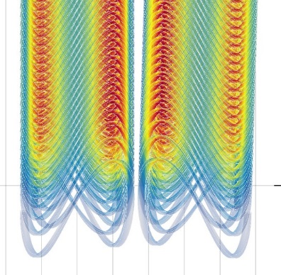
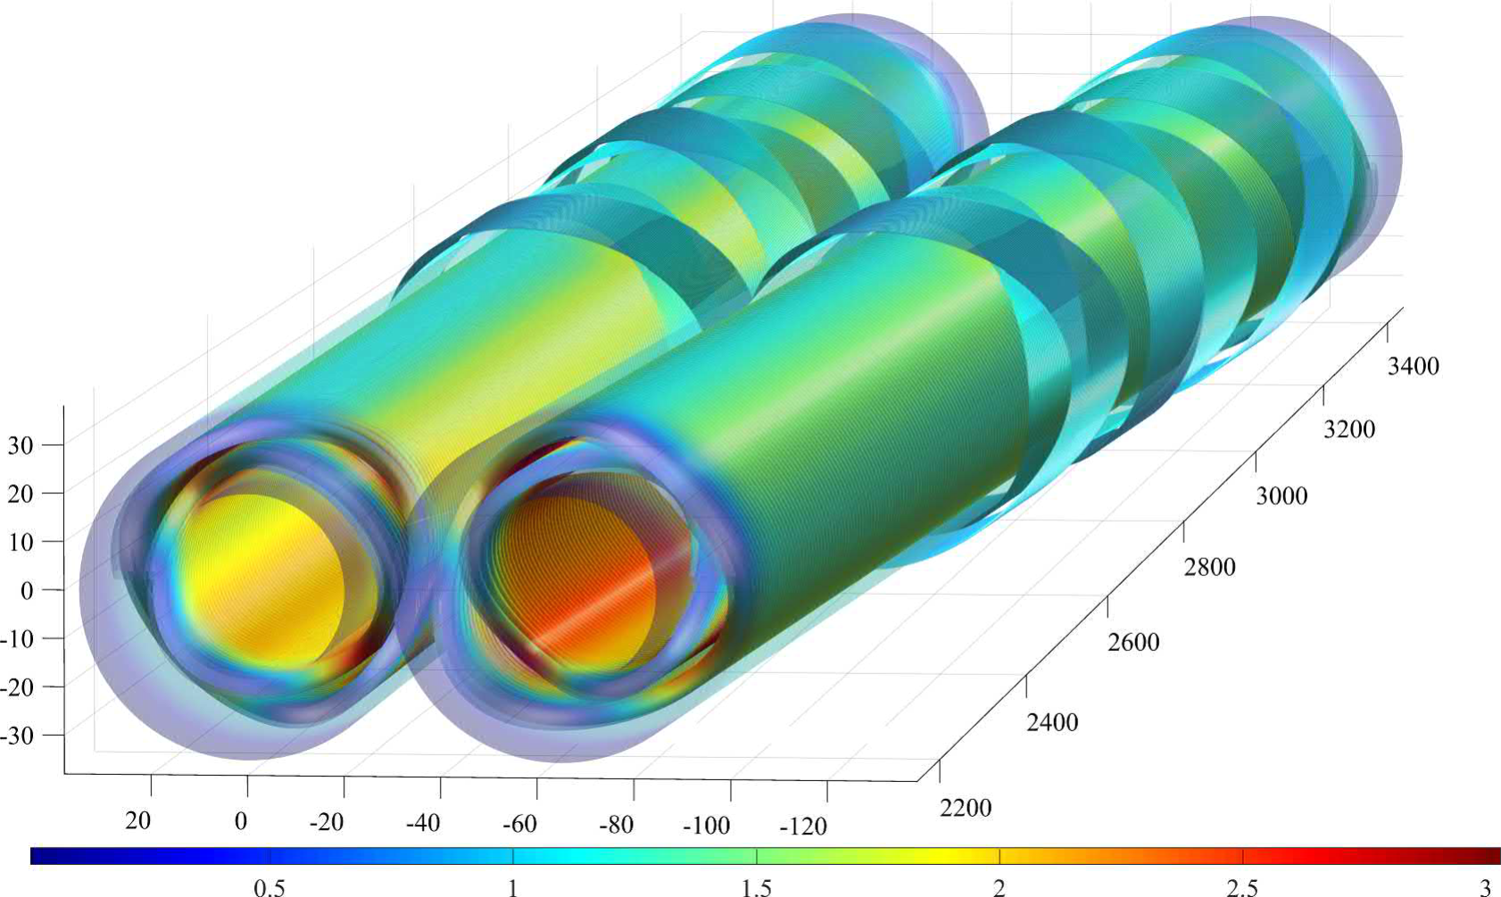
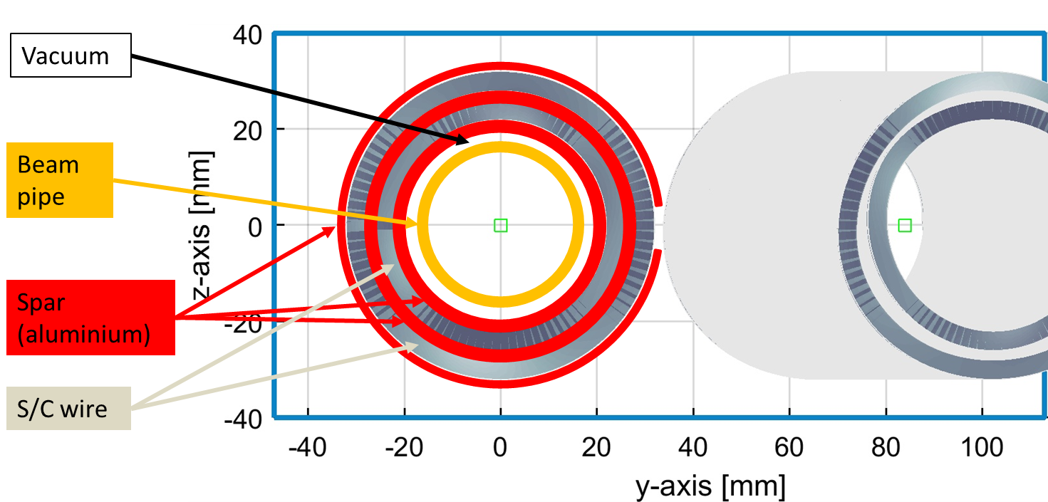
QC1L1
QC1L1 is the first and most demanding pair of quadrupoles of the final focus system of FCC-ee
Iron-free design
Inner bore: 40mm (diameter)
Fits outside the warm water-cooled beam pipe of inner diameter 30mm

Slide 8
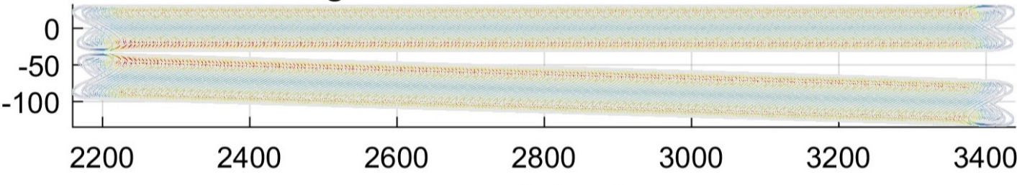
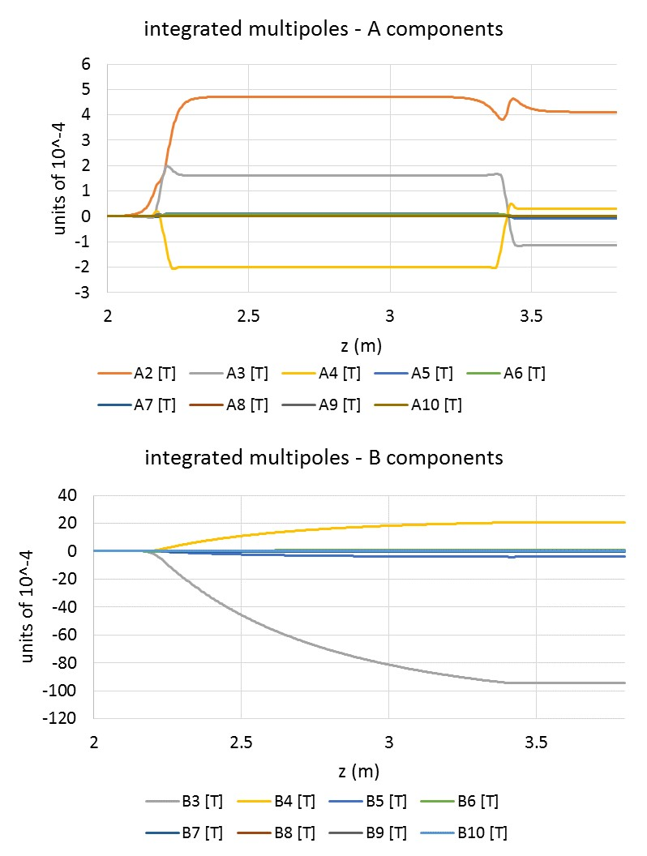
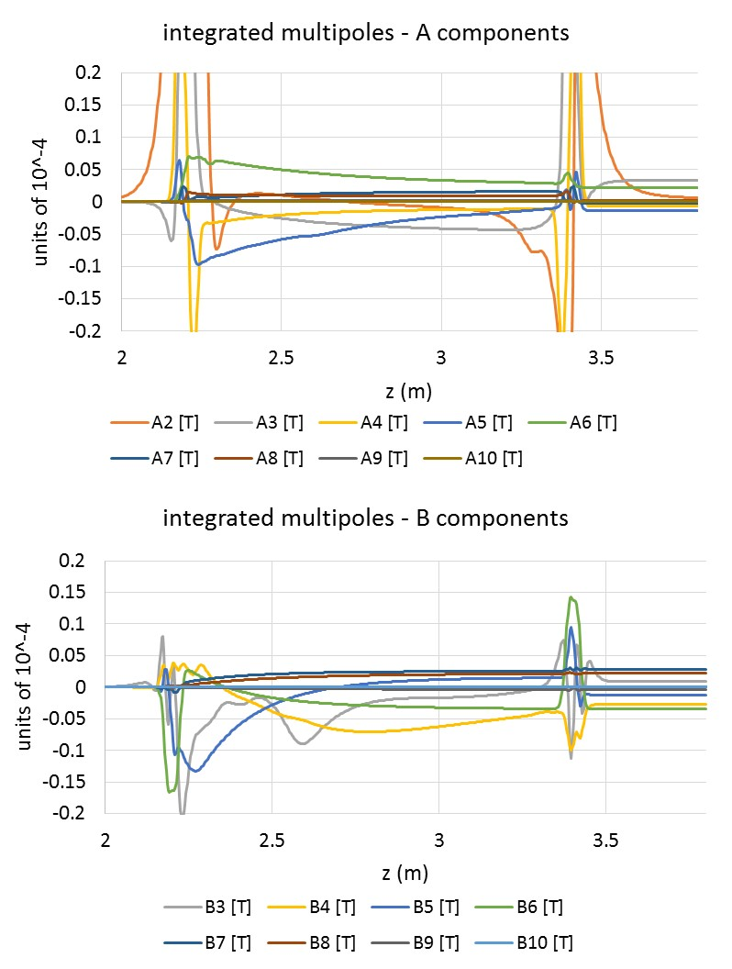
Crosstalk compensation
QC1L1 quadrupole:
length = 1200mm
Aperture: 40mm
distance at tip: 66mm
angle 30mrad
powered together
Before compensation
After compensation
After compensation: all multipoles are under 0.1 units (limited by alignment errors, not included here)

Slide 9
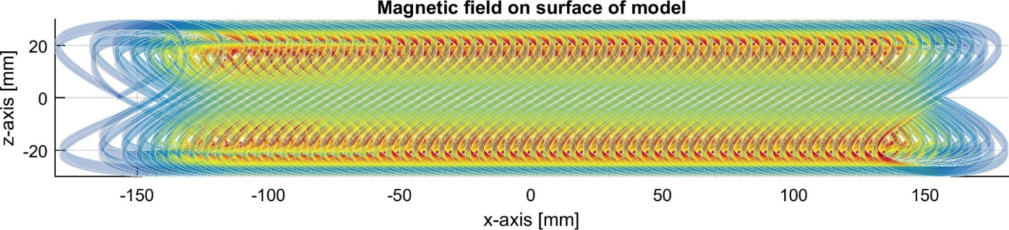
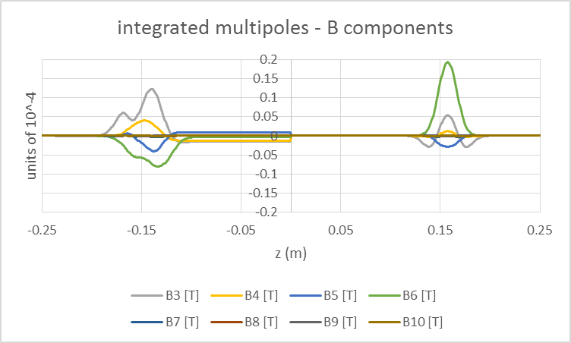
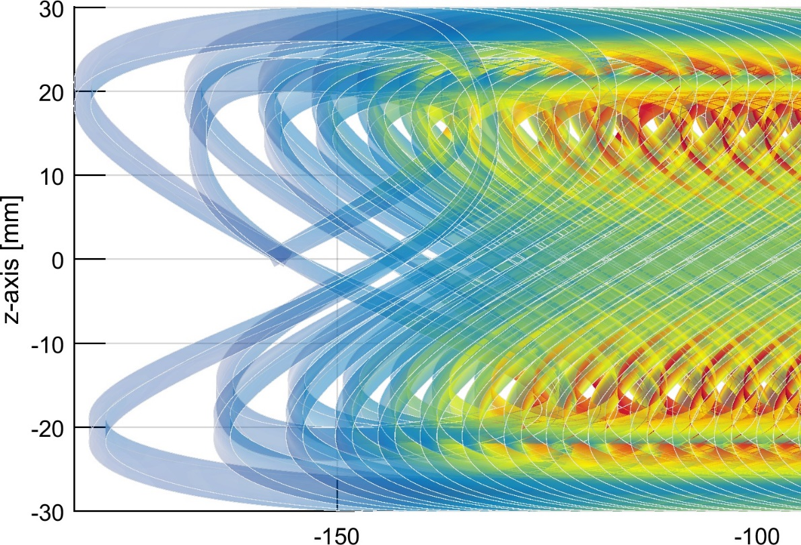
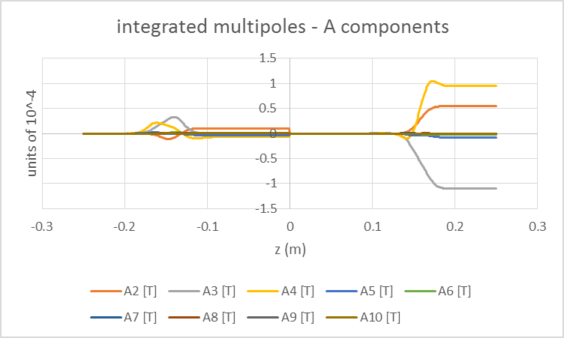
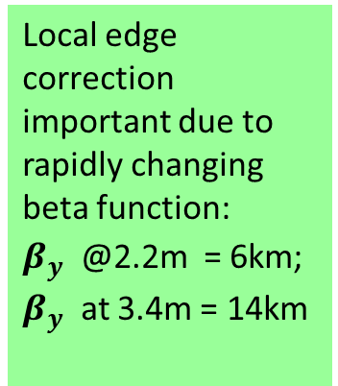
The FF quadrupole – local edge compensation
corrected
uncorrected
Local edge correction important due to rapidly changing beta function:
$β_{y}^{}$ @2.2m = 6km; $β_{y}^{}$ at 3.4m = 14km
Magnet field quality is excellent throughout
The first two turns of the quadrupole contain, apart from the B2 component, all the necessary components to nullify the edge effects.
9

Slide 10
Why prototype?
Although it works very well on paper, we need to test it in practice
The first prototype is a single aperture magnet. So how can we test the crosstalk performance?
The specific prototype employs a technique similar to the crosstalk compensation: edge correction
One end of the magnet is corrected for local multipoles, which are present on every accelerator magnet design
Exactly the same technique and tools are used for the crosstalk compensation of a double aperture design. ➔ If the edge correction works as expected, so will the crosstalk compensation

Slide 11
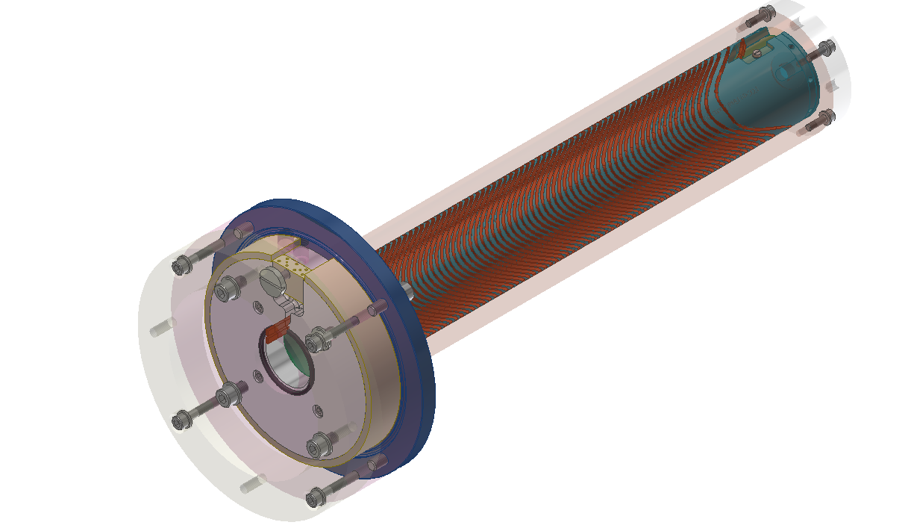
The FCC-ee Final Focus Quadrupole prototype
Single aperture
43cm long
With edge correction on one side

Slide 12
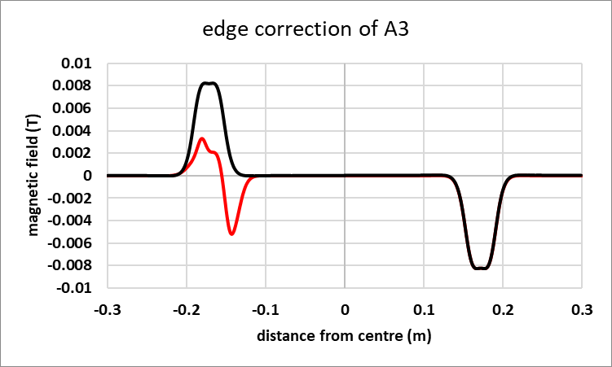
Local edge correction
By design, a CCT magnet has all integral multipoles vanish (with the exception of the main one).
However, the skew (A) components of the magnetic field compensate only because they have opposite signs at the entry and exit of the magnet.
QC1L1 sits in an area of rapidly-changing optics functions: the change of beam size between the entry and exit of the magnet is a factor of ~2. ➔ a local correction is needed
Example: correction of A3 component, one side only. In red: corrected; in black: uncorrected
M. Koratzinos et al.1709.08444 [physics.acc-ph]

Slide 13
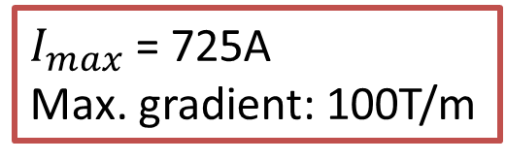
QC1L1 and the prototype
The first FCC-ee Final Focus prototype is a single-aperture version of QC1L1, with identical aperture (40mm) but one-third of the length (26% of the quadrupole strength).
It has asymmetric edges
QC1L1_electron
Prototype
QC1L1_positron
1200mm
$I_{max}$ = 725A
Max. gradient: 100T/m
400mm

Slide 14
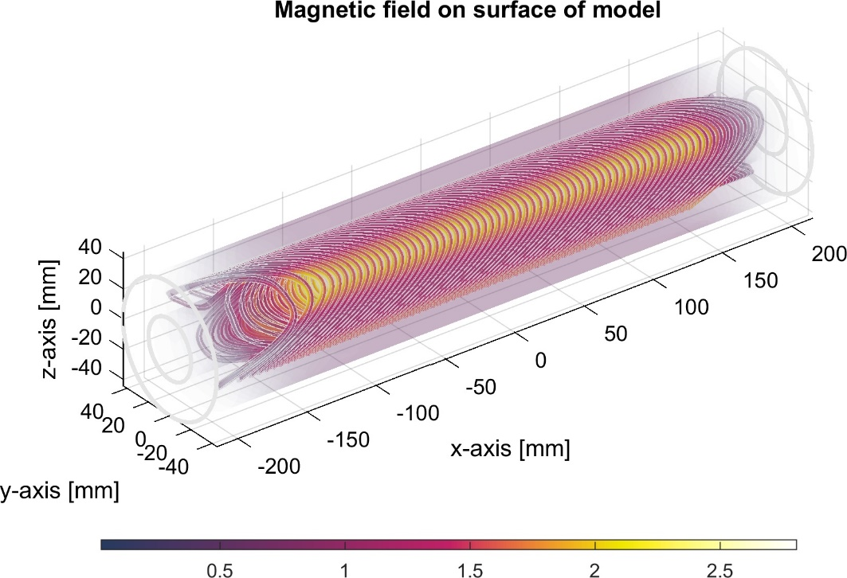
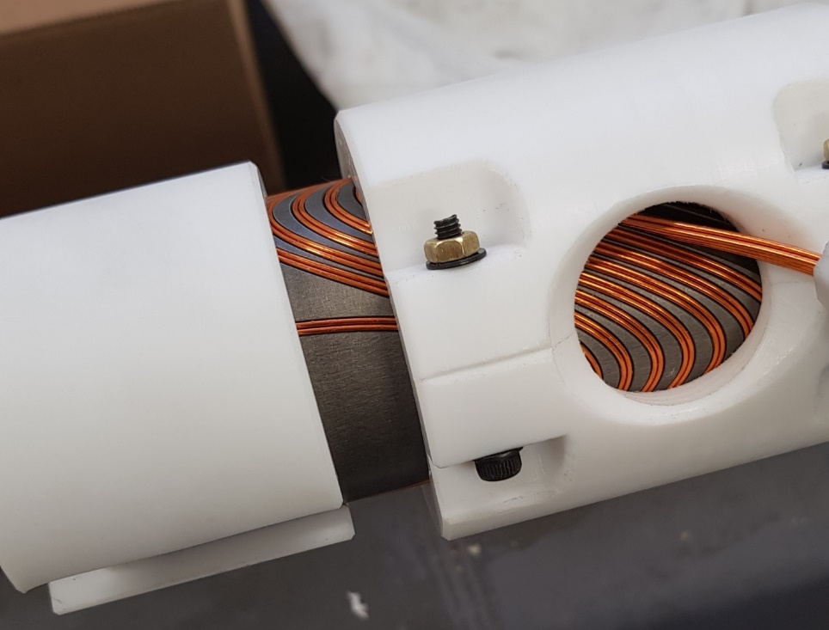
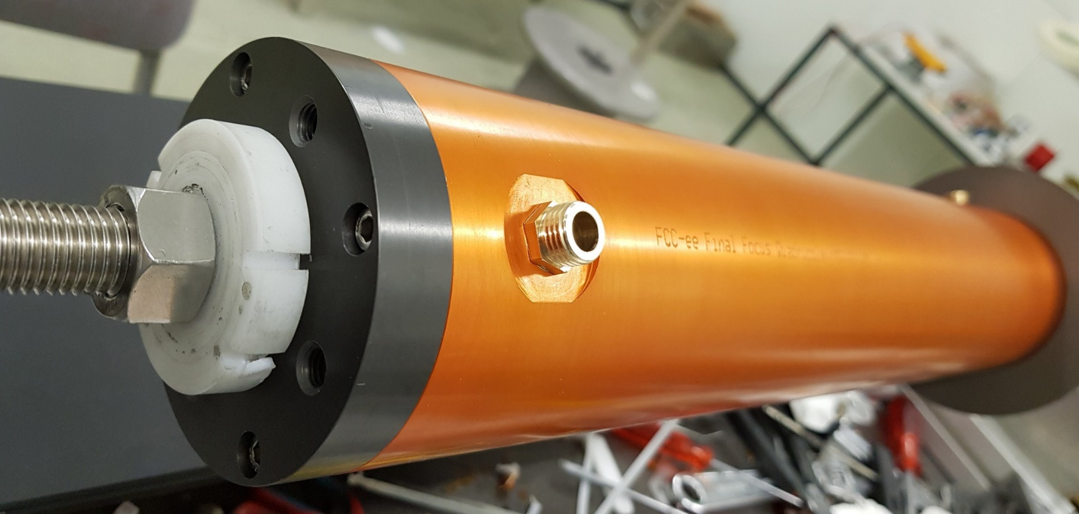
Design, manufacture and winding

Slide 15
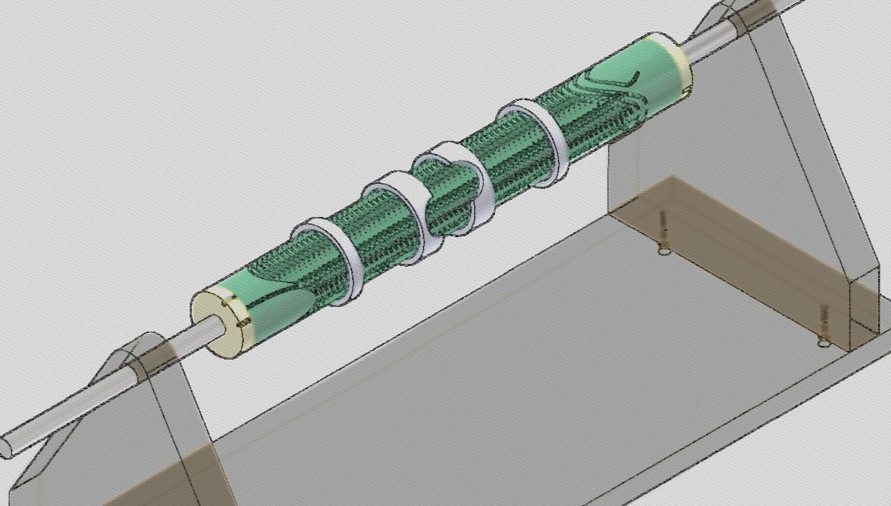
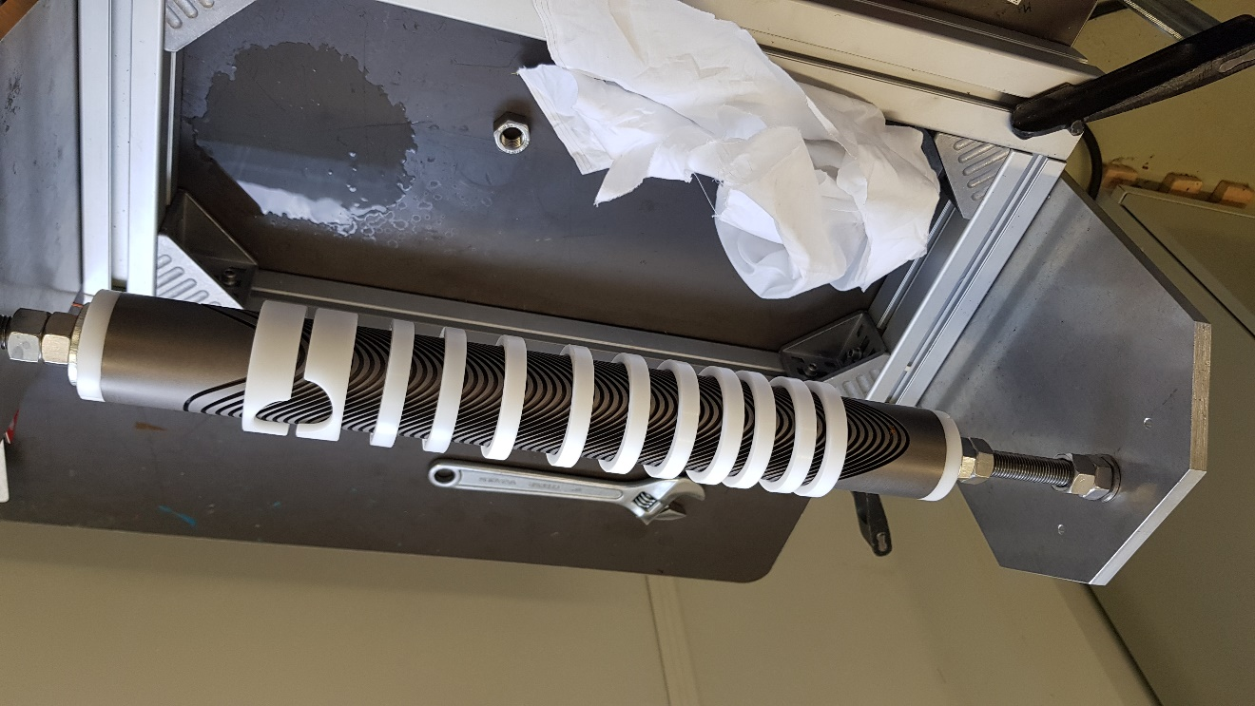
Winding
Was done in-house on a purpose built winding table
Pre-stressing the conductor was not necessary

Slide 16
Testing at warm
The first magnetic quality tests were performed at warm
A rotating coil arrangement was used:
  The magnet is powered with a current of 5 A (0.7% of maximum current) at room temperature
  We measure the magnetic flux as the coil is rotated.
  Each measurement is averaged over 100 revolutions
  Then the data is post-processed to calculate the first 15 multipoles.
  Then current is reversed and another (100-revolution) measurement is taken
  The final numbers are the average over the two polarities – This eliminates the contribution due to the earth’s magnetic field and any other static fields.
All measurements made at a radius of 10mm
Rotating coil length: 200mm (194mm active), width 35mm
The rotating coil can be moved to measure the (integrated) field at different areas of the magnet: the middle, the corrected side and the uncorrected side

Slide 17
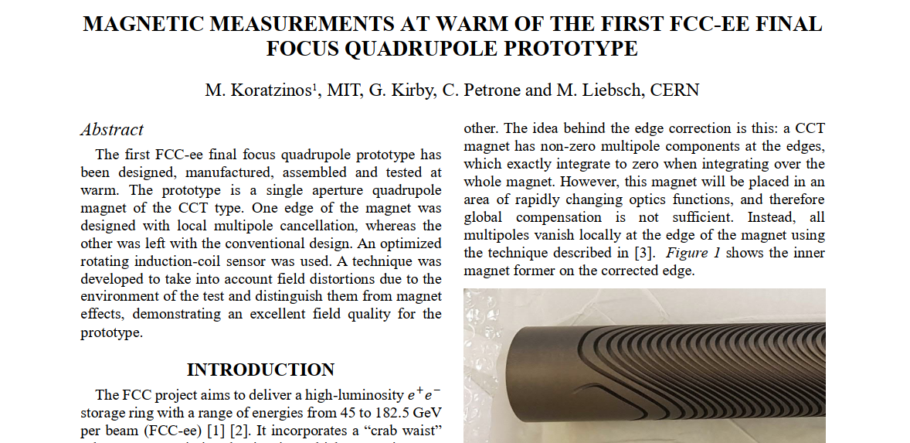
IPAC21 paper
arXiv:2105.13230 [physics.acc-ph]

Slide 18
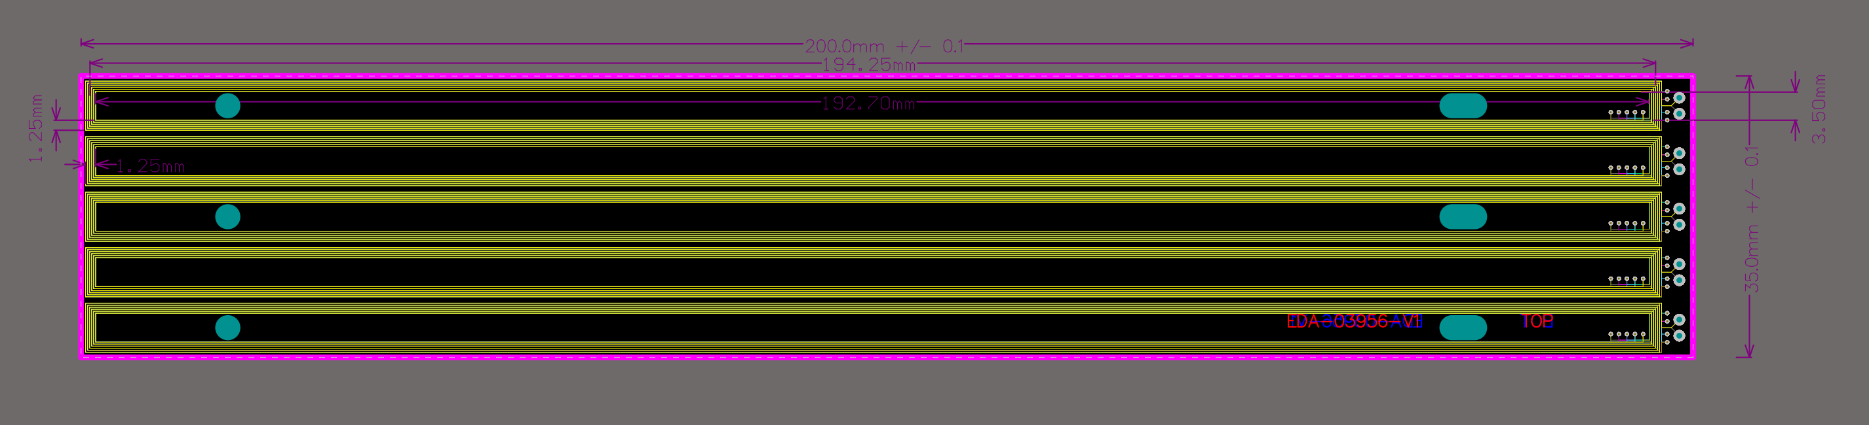
The rotating coil
Length is 200mm nominal, 194.25 mm active, width is 35mm, split in five individual coils
For the quadrupole magnet, the individual coils are combined in such a way, that the coil is immune to the B2 field component, which is the dominant one, to be able to see errors in higher multipoles
For the transfer function measurement, the coil is combined linearly

Slide 19
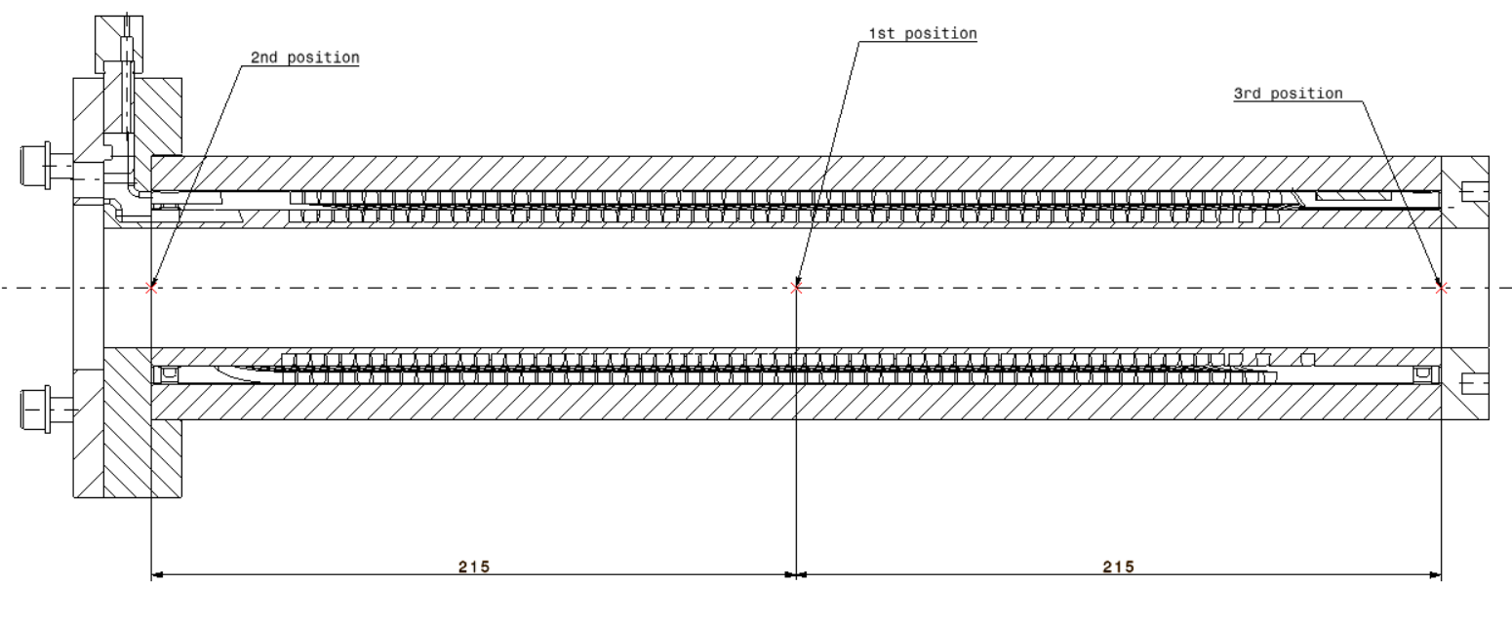
Testing arrangement
1st measurement:
Centre
Rotating probe
Three rotating coil measurements at the middle, at the uncorrected edge and at the corrected edge

Slide 20
Testing arrangement
2nd measurement:
Uncorrected side
Three rotating coil measurements at the middle, at the uncorrected edge and at the corrected edge

Slide 21
Testing arrangement
3rd measurement:
Corrected side
Three rotating coil measurements at the middle, at the uncorrected edge and at the corrected edge

Slide 22
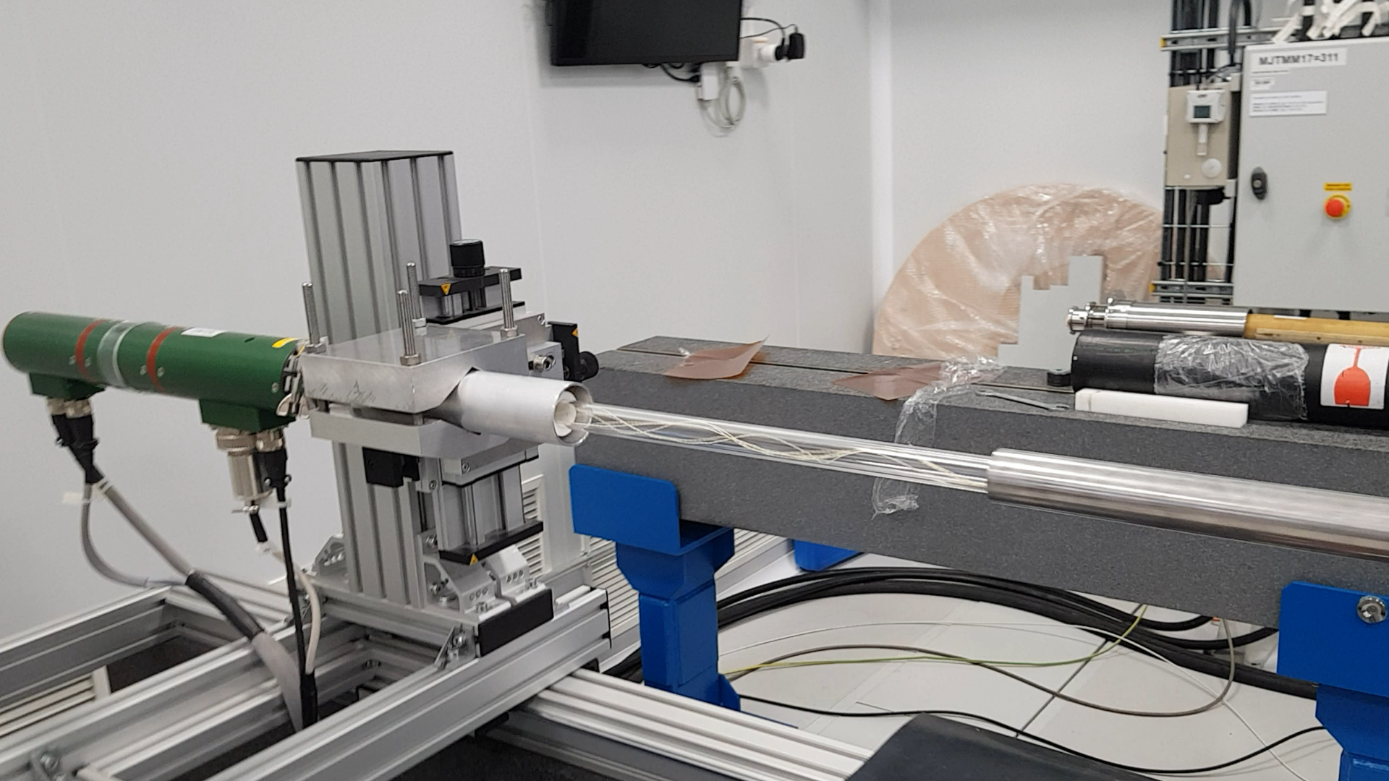
Measurement video

Slide 23
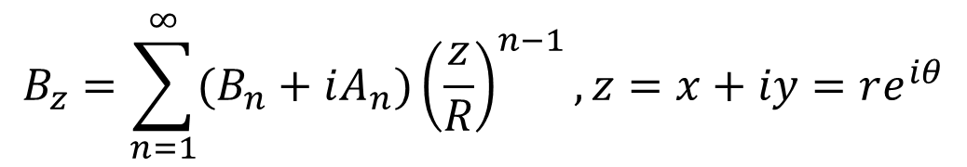
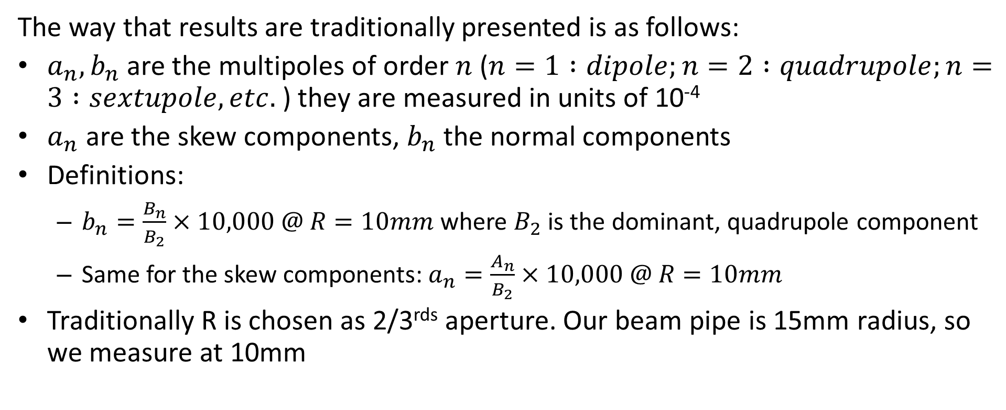
Nomenclature
$$B_{z}=\sum_{n=1}^{∞}{(B_{n}+iA_{n}){\left(\frac{z}{R}\right)}^{n−1},z=x+iy=re^{iθ}}$$
Magnetic field of accelerator magnet:
The way that results are traditionally presented is as follows:
$a_{n},b_{n}$are the multipoles of order $n$ ($n=1 :dipole;n=2 :quadrupole;n=3 :sextupole, etc.$ ) they are measured in units of 10⁻⁴
$a_{n}$ are the skew components, $b_{n}$ the normal components
Definitions:
  $b_{n}=\frac{B_{n}}{B_{2}}×10,000 @ R=10mm$ where $B_{2}$is the dominant, quadrupole component
  Same for the skew components: $a_{n}=\frac{A_{n}}{B_{2}}×10,000 @ R=10mm$
Traditionally R is chosen as 2/3^{rds} aperture. Our beam pipe is 15mm radius, so we measure at 10mm

Slide 24
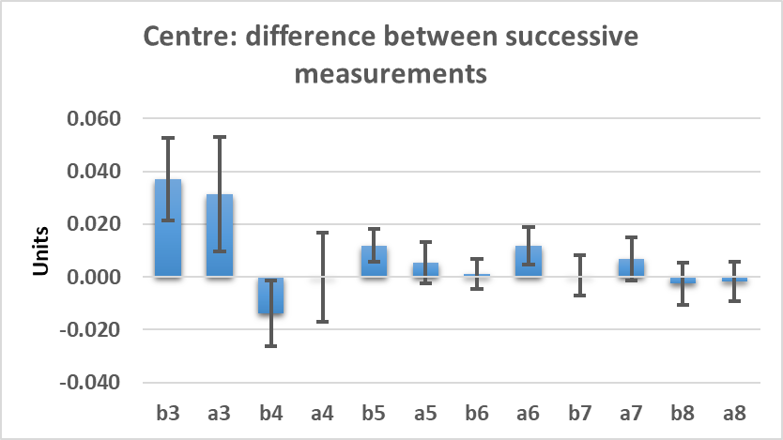
Repeatability of measurements
The first test is the (short-term) reproducibility of measurements: The plot shows two successive measurements. Repeatability is excellent, within 0.04 units or better
➔ The sensitivity of the method is at the ~0.02 unit level
Difference between successive measurements compared to the expected error of the measurement.
The error is taken from the RMS spread of the 200 revolutions comprising each measurement divided by SQRT(200)
Carlo Petrone

Slide 25
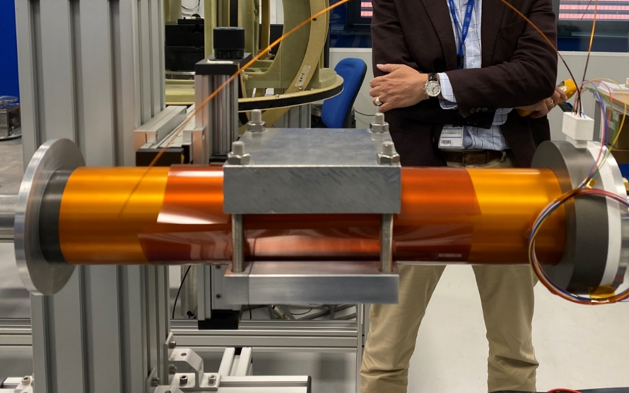
Centre measurement
We need to make sure that whatever we measure is due to the magnet and not its environment
Although the mechanical clamping of the magnet is with aluminium claws, we have also used stainless steel high-strength bolts
At this level of precision, we need to guard against these bolts distorting the field and therefore introducing multipoles
Do not forget that we are dealing with 10⁻⁵ effects

Slide 26
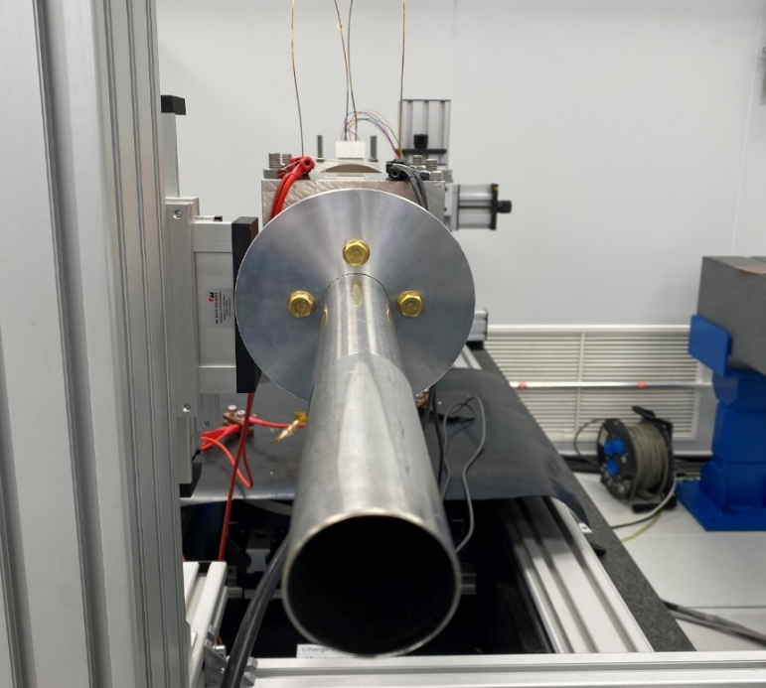
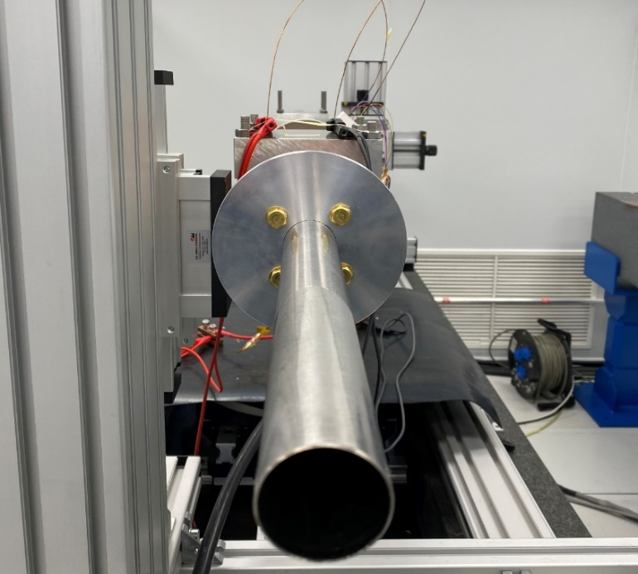
A strategy for measuring the pure magnet components
We decided to take two measurements: one with the magnet in its proper position and the second where the magnet is rotated by ~45 degrees. (suggested by Glyn Kirby, CERN)
The multipole errors due to the magnet should rotate with the magnet, but the errors due to the environment should not
We then have two measurements and two unknowns
Original position
rotated position
φ
In our case, φ was measured to be 41.87 degrees

Slide 27
Rotated/original measurements
 | b3 | a3 | b4 | a4 | b5 | a5 | b6 | a6 | b7 | a7 | b8 | a8
Original data (units) | -0.22 | 0.32 | 0.53 | 0.54 | -0.16 | -0.03 | 0.64 | -0.12 | 0.03 | 0.00 | 0.00 | -0.03
Rotated data (units) | 0.08 | 0.43 | 0.49 | 0.66 | -0.16 | -0.03 | 0.65 | -0.11 | 0.03 | 0.00 | 0.00 | -0.03
If a multipole component comes from the magnet and not from the environment, it is expected to change under this rotation.
Example:
Rotate by 42 degrees:
b3
magnet
b3
environment
42°×3=126°
total
a3
a3
Vector rotates by (rotation angle) × n

Slide 28
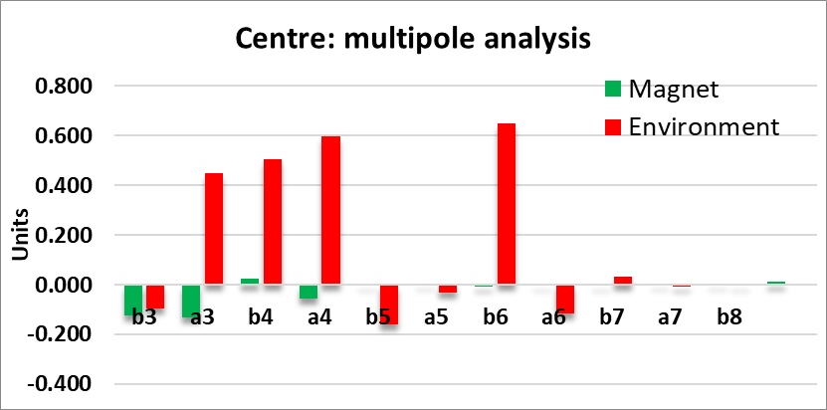
Results
 |  | b3 | a3 | b4 | a4 | b5 | a5 | b6 | a6 | b7 | a7 | b8 | a8
Raw measurements | original | -0.22 | 0.318 | 0.531 | 0.538 | -0.162 | -0.031 | 0.642 | -0.118 | 0.031 | -0.004 | -0.002 | -0.029
 | rotated | 0.083 | 0.427 | 0.494 | 0.656 | -0.159 | -0.034 | 0.65 | -0.105 | 0.033 | -0.005 | 0.003 | -0.03
Analysis | magnet | -0.124 | -0.133 | 0.025 | -0.057 | -0.001 | 0.002 | -0.009 | -0.004 | 0.000 | 0.003 | 0.002 | 0.011
 | environment | -0.097 | 0.45 | 0.506 | 0.595 | -0.161 | -0.033 | 0.651 | -0.114 | 0.031 | -0.006 | -0.003 | -0.04
A big chunk of the measured multipoles can be attributed to the environment

Slide 29
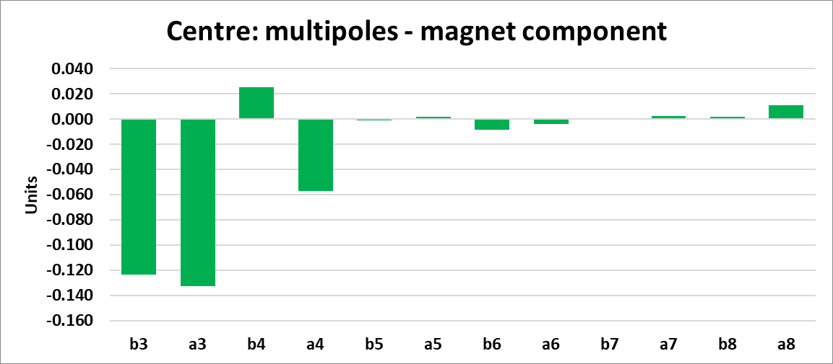
Results - centre
All multipoles are below 0.15 units and only b3, a3 is above 0.10 units. (this is barely above the sensitivity of the method)

Slide 30
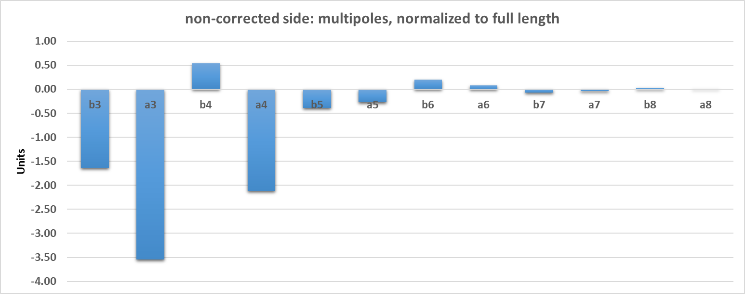
Field quality at the edge, without correction
@10mm radius
For this measurement we do not have rotated data
Multipoles calculated up to B15, A15, but are all zero
Carlo Petrone
3.5 units in A3, 2 units in A4
The normalization is to the full length of QC1L1 (1200mm)

Slide 31
Field quality at the edge, with correction
Here there is a minor correction due to the fact that the probe was not centred along the magnetic edge of the magnet, so in the ideal case, we do not expect to have measured zero multipoles
@10mm radius
Multipoles, corrected side (units 10⁻⁴ )
order | B components | A components
3 | 0.06 (expected 0.00) | -0.08 (expected 0.00)
4 | 0.11 (expected 0.00) | -0.04(expected -0.03)
5 | -0.01(expected 0.00) | 0.00 (expected 0.00)
6 | 0.04 (expected 0.01) | 0.00 (expected 0.00)
7 | 0.00 (expected 0.00) | 0.00 (expected 0.00)
8 | 0.00 (expected 0.00) | 0.00 (expected 0.00)
For this measurement we do not have rotated data, real magnet errors might be smaller
Multipoles calculated up to B15, A15, but are all zero
The normalization is to the full length of QC1L1 (1200mm)

Slide 32
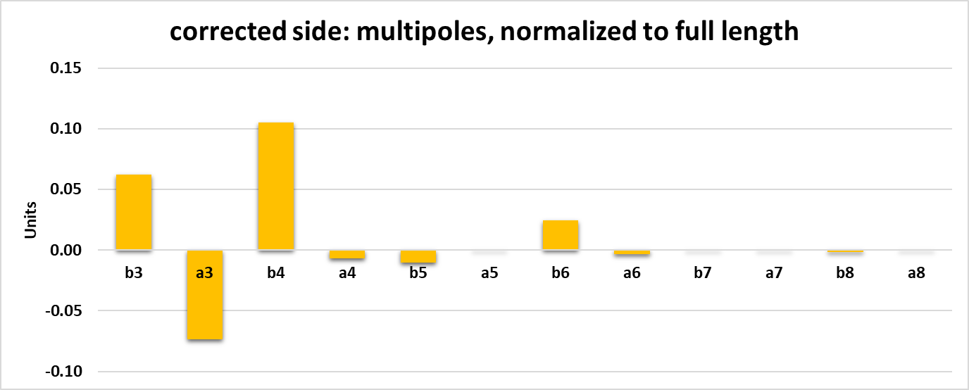
Field quality at the edge, with correction
@10mm radius
For this measurement we do not have rotated data, real magnet errors might be smaller
Carlo Petrone
Multipoles calculated up to B15, A15, but are all zero
0.1 units maximum. An excellent result.
The normalization is to the full length of QC1L1 (1200mm)

Slide 33
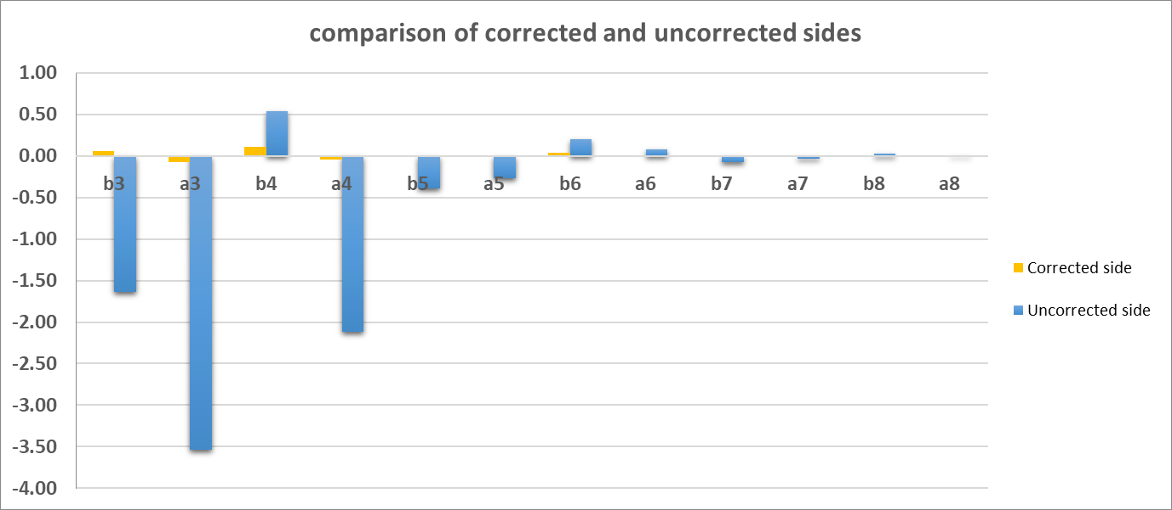
Field quality at the edge, comparison
Corrected side has edge effects that are 0.1 units or less
Reduction by a factor ~50!
For both plots, the normalization is to the full length of QC1L1 (1200mm)
Carlo Petrone
Edge correction really works!

Slide 34
Next steps
Testing the magnet at cold
  [Without impregnation – there is not enough data on impregnation-free magnet performance –optional]
  With impregnation (wax or beeswax) – better mechanical characteristics at cryogenic temperatures (cracking) and possible to remove and dismantle
Development of a double aperture prototype.
  We can check the full crosstalk compensation
  Design the support mechanics
  Can perform vibration studies
  (it might be considered a luxury, however)

Slide 35
Frequently Asked Questions
Why don’t we design an HTS FF quadrupole?
  Well, the question of field quality due to screening currents for HTS tapes has not been settled yet. But it will be settled when we test the new HTS sextupole demonstrator next year
  The question of winding HTS tape on a CCT former has been addressed and there is a solution that does not suffer from important field uality issues. Again, this idea will be checked with the above-mentioned demonstrator.
  If field quality problems are not an issue, we should proceed with an HTS design that will be cheaper to cool and has superior quench behaviour.

Slide 36
Conclusions
The first FCC-ee final focus prototype has been designed, manufactured and the first tests at warm are available (IPAC paper arXiv:2105.13230 ).
Field quality is excellent.
All multipoles in the middle of the magnet are 0.15 units or less, approaching the accuracy of the method. These are real measurements, not simulation!
The novel technique of locally correcting each edge for edge effects is working beautifully → this gives us confidence that the crosstalk compensation will also work.
All multipoles of the corrected edge contribute 0.1 units or less. ➔ this is a “perfect edge” magnet.
The CCT technique is very well suited for the final focus quadrupoles of FCC-ee (and also CEPC, SuperKEKb, …).

Slide 37
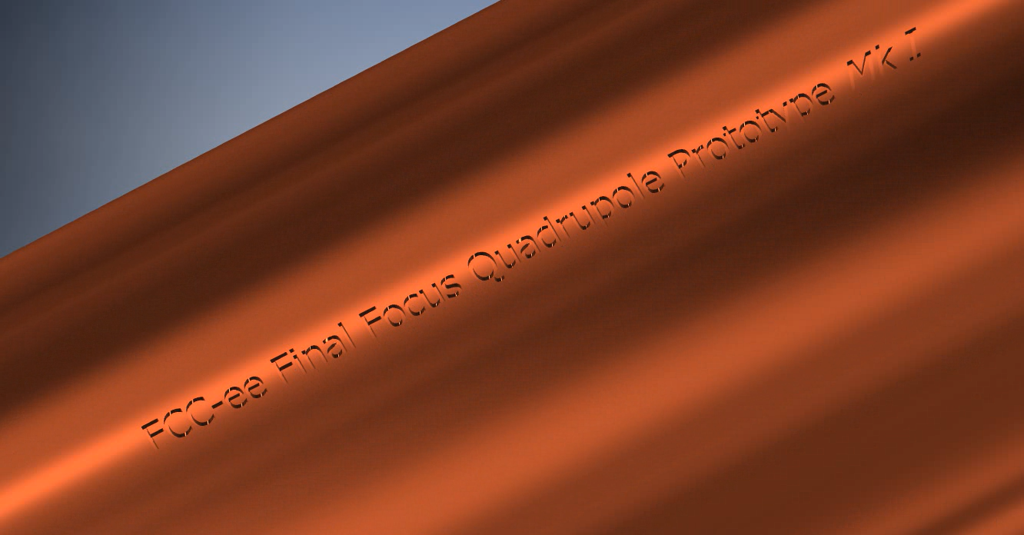
Promotional video - assembly
(done directly from Inventor, not an “artist’s impression”)

