Slide 1
EIC IR Beam Instrumentation Considerations
FCC-EIC Joint & MDI Workshop
David Gassner
October 18, 2022

Slide 2
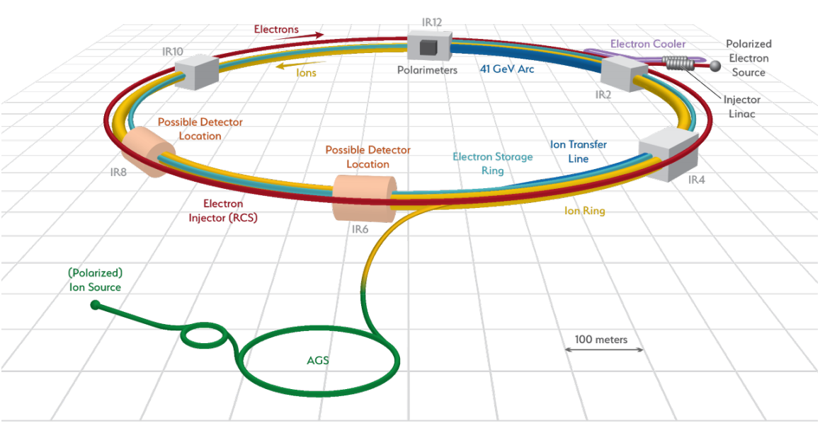
Outline
IR Introduction & status
  Electron beam transport
  Hadron beam transport
IR Beam Instrumentation
  Beam position monitors
    Electron
    Hadrons
  Beam loss monitors
  Orbit feedback at the IP
  Crabbing angle monitors
  Large angle beamstrahlung monitor
Summary

Slide 3
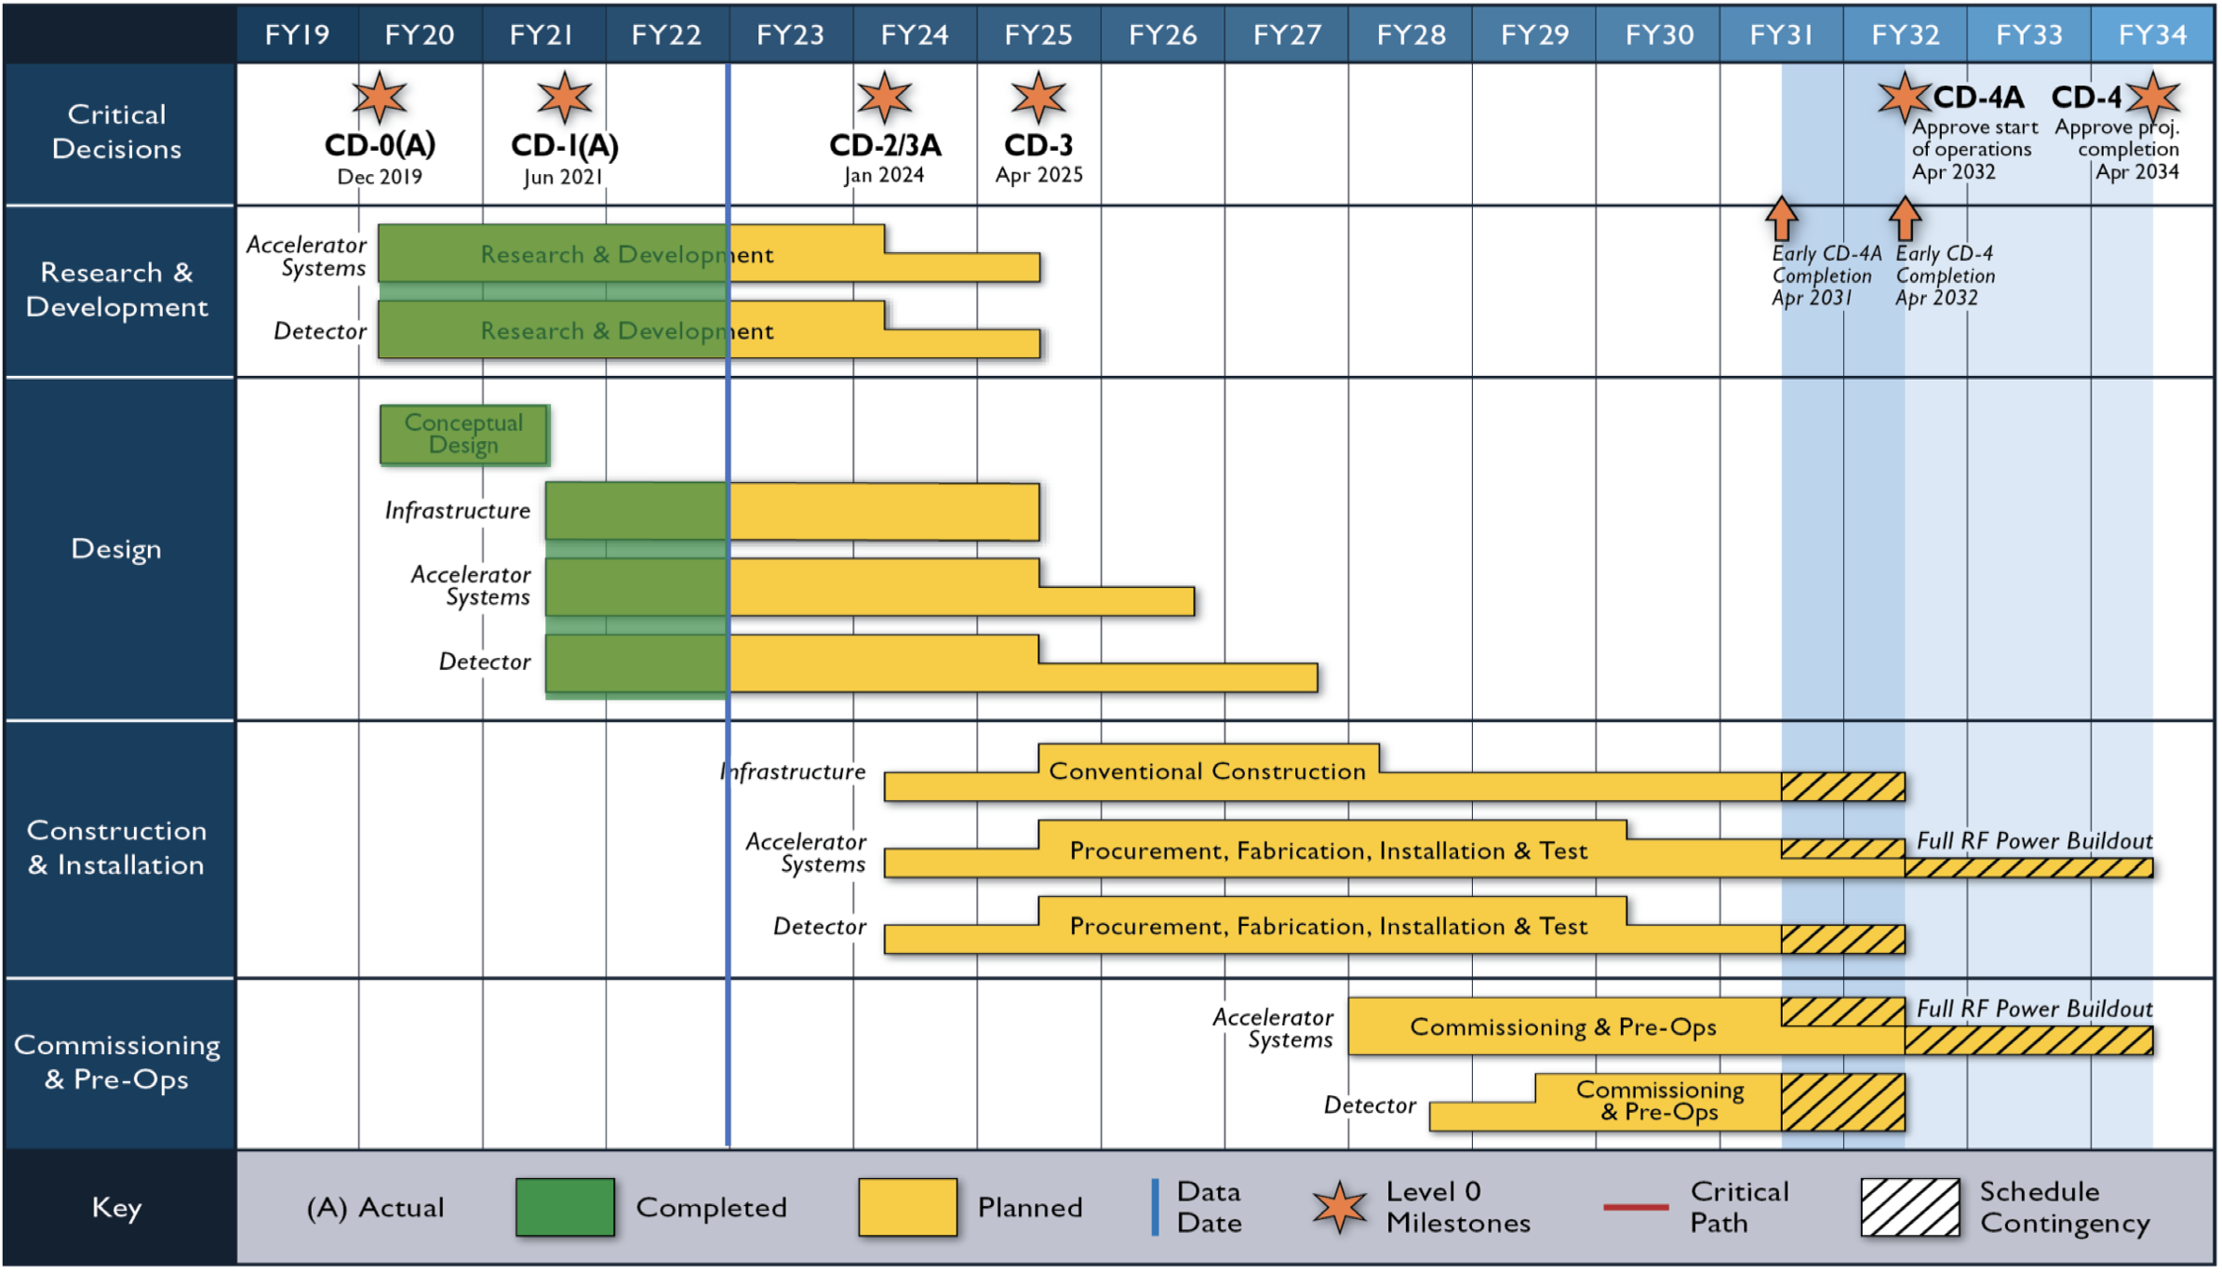
IR Instrumentation Introduction
Present status
  Conceptual design phase
  IR instrumentation details can be better defined after other larger system (lattice, magnet, cryostats) designs are more mature
  Gathering IR machine parameters
  Working on defining performance requirements
  Improving cost estimates
  Developing the schedule
  Instrument simulations underway (CST, Ansys, GdfidL, etc..)
Schedule
  CD1 in June ‘21
  CD2 planned Jan ’24, cost and schedule well developed
  CD3 planned April ’25, construction start, IR designs continue
  IR Beam instrumentation (BPMs) ready to install 2029
  Start IR beam commissioning 2031

Slide 4
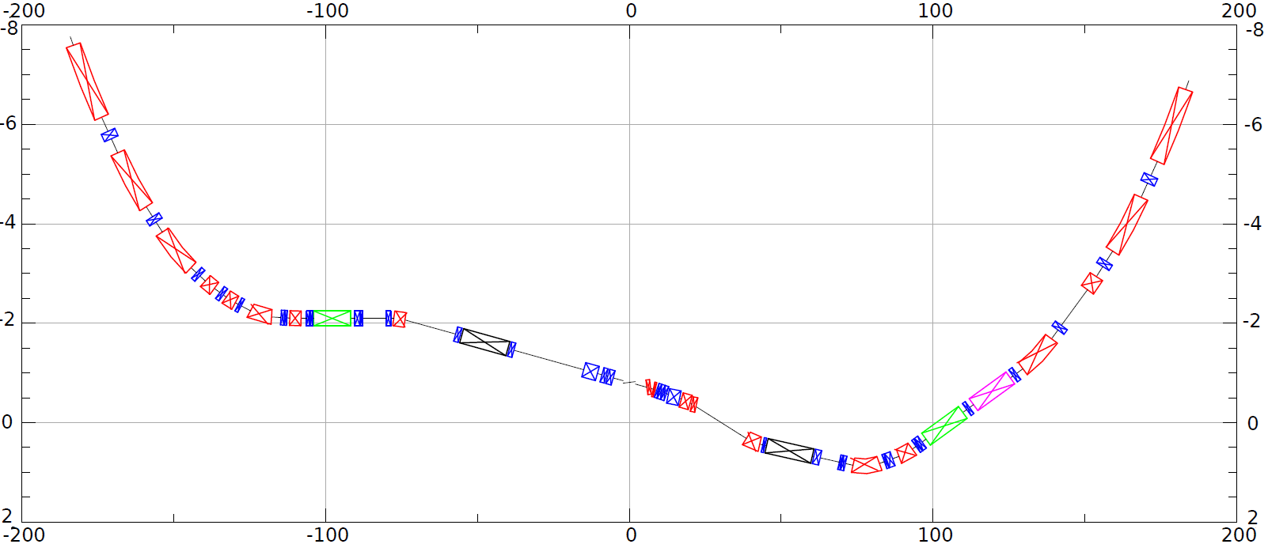
Hadron transport through IR6
The EIC IR is defined as +/- 130 meters from the IP
Zero-degree calorimeter not covered in this talk as this is included in the Detector Group scope.
Forward and rear hadron lattice matched into Hadron Storage Ring
h
HSR Arc
Crab–in
HSR Arc
Crab –out
Spin
Rotator
Snake
Off momentum Detectors
Spin Rotator
matching
ESR Lumi-Monitor
matching
Approximate ESR path
Zero Deg Calorimeter
Detector region
transport diagram from A. Drees

Slide 5
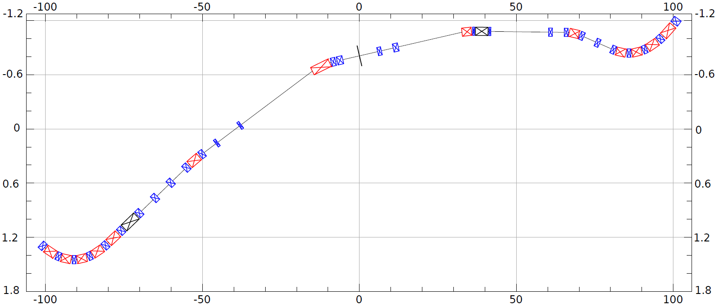
Electron transport layout in IR6
Details about the polarimeter, Lumi-monitor and E-taggers are not covered in this talk as they are included in the Detector Group scope.
e⁻
~130m
Spin Rotation Solenoids
Crab – in
IP Focusing
Lumi-Monitor
~130m
Spin Rotation Solenoids
E-taggers
Polarimeter Laser
Detector region
Crabbed beam.
Crab – out
transport diagram from A. Drees

Slide 6
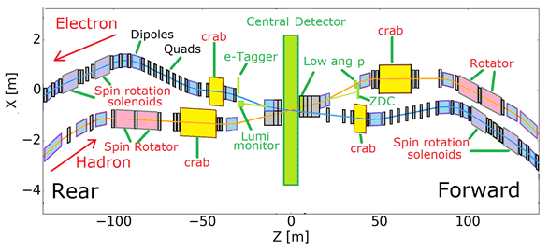
Interaction Region BPMs
Button BPM pick-ups, designs underway
Total = 78 in conceptual baseline
Cover 2 beamlines (e & ions), +/- 130 m
Some IR hadron cold magnets will be reused from elsewhere in RHIC, new button BPMs
EIC IR layout for illustration only

Slide 7
Interaction region BPM Pick-ups design status
IR BPMs far from the IP are similar to those in the electron and hadron storage rings
Near IR BPMs are considered in the pre-conceptual phase
  Gathering machine parameters as they become available
    Developing performance requirements
    Beamline layouts, mechanical constraints
  Design challenges
    Variety of IR BPM apertures are larger than those in the storage rings
    Hadron operations with large radial offsets
    BPMs inside cryostats near the IP
      Tight space constraints
      Challenging signal path routing
      Very limited access for service/repairs if needed

Slide 8
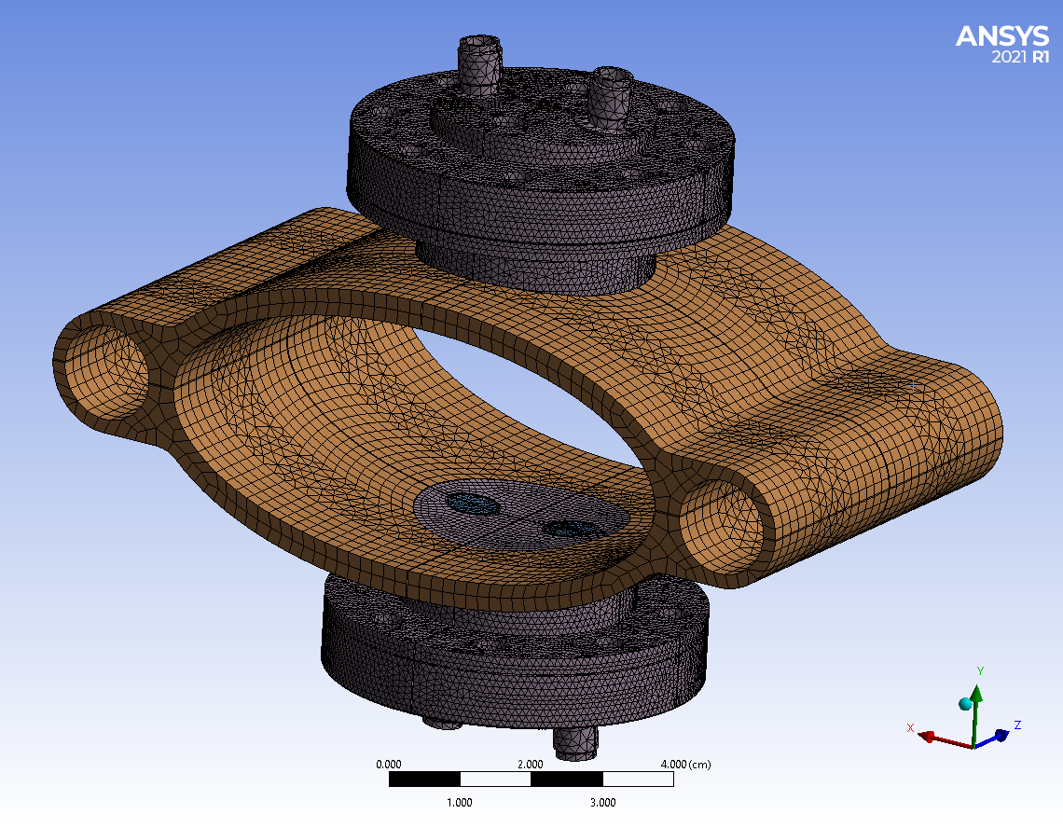
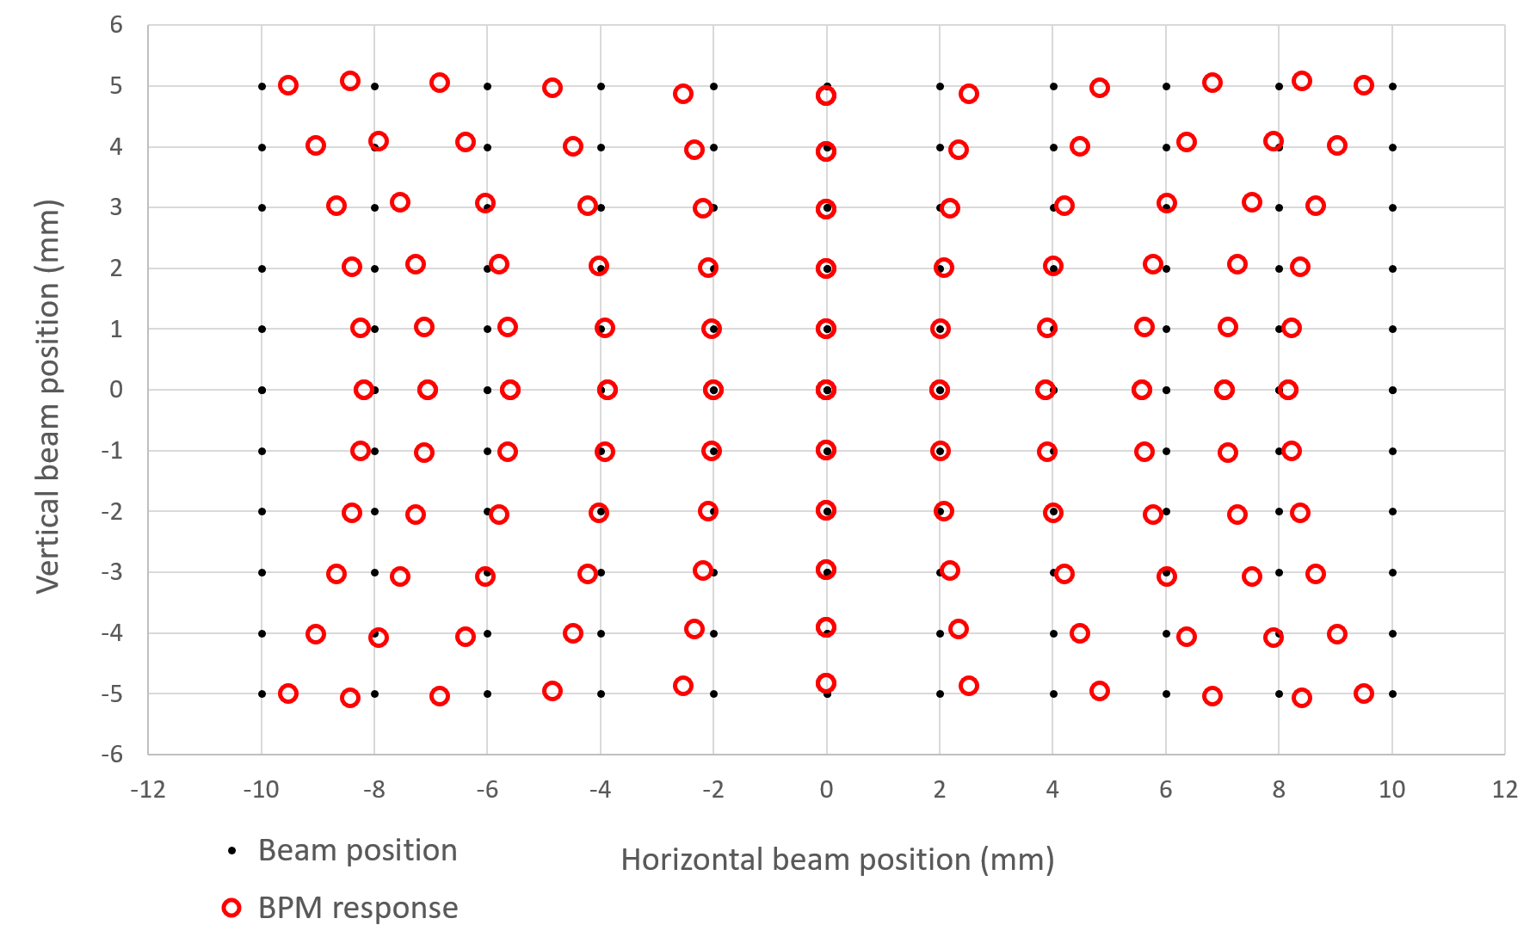
Electron Storage Ring BPM Pick-up design
Warm ESR BPM pick-up design is underway, CST & Ansys simulations
  Reviewing signal response, impedance, energy deposition, etc..
Example: electron storage ring beam parameters for 10 GeV:
  Bunch charge range = 27.5 nC
  Bunch length (RMS) = 7 mm
  Bunch spacing = 10.95 ns (1,160 bunches)
  Beam current = 2.5 Amps
For the above parameters, preliminary results look OK
  each dual button BPM assembly heat load is ~5 W
  Max temp is button surface at 68°C (copper coated moly button)
  Impedance characteristics look good
36 X 80 mm
aperture
Water cooling channels
The expected range of ESR beam positions to be measured is +/-10mm H, +/- 5mm V.
Non-linearities will be compensated using FPGA-based lookup table interpolations.
J. Bellon
S. Bellavia
A. Blednykh
C. Hetzel
P. Thieberger
Pin cushion distortion plot

Slide 9
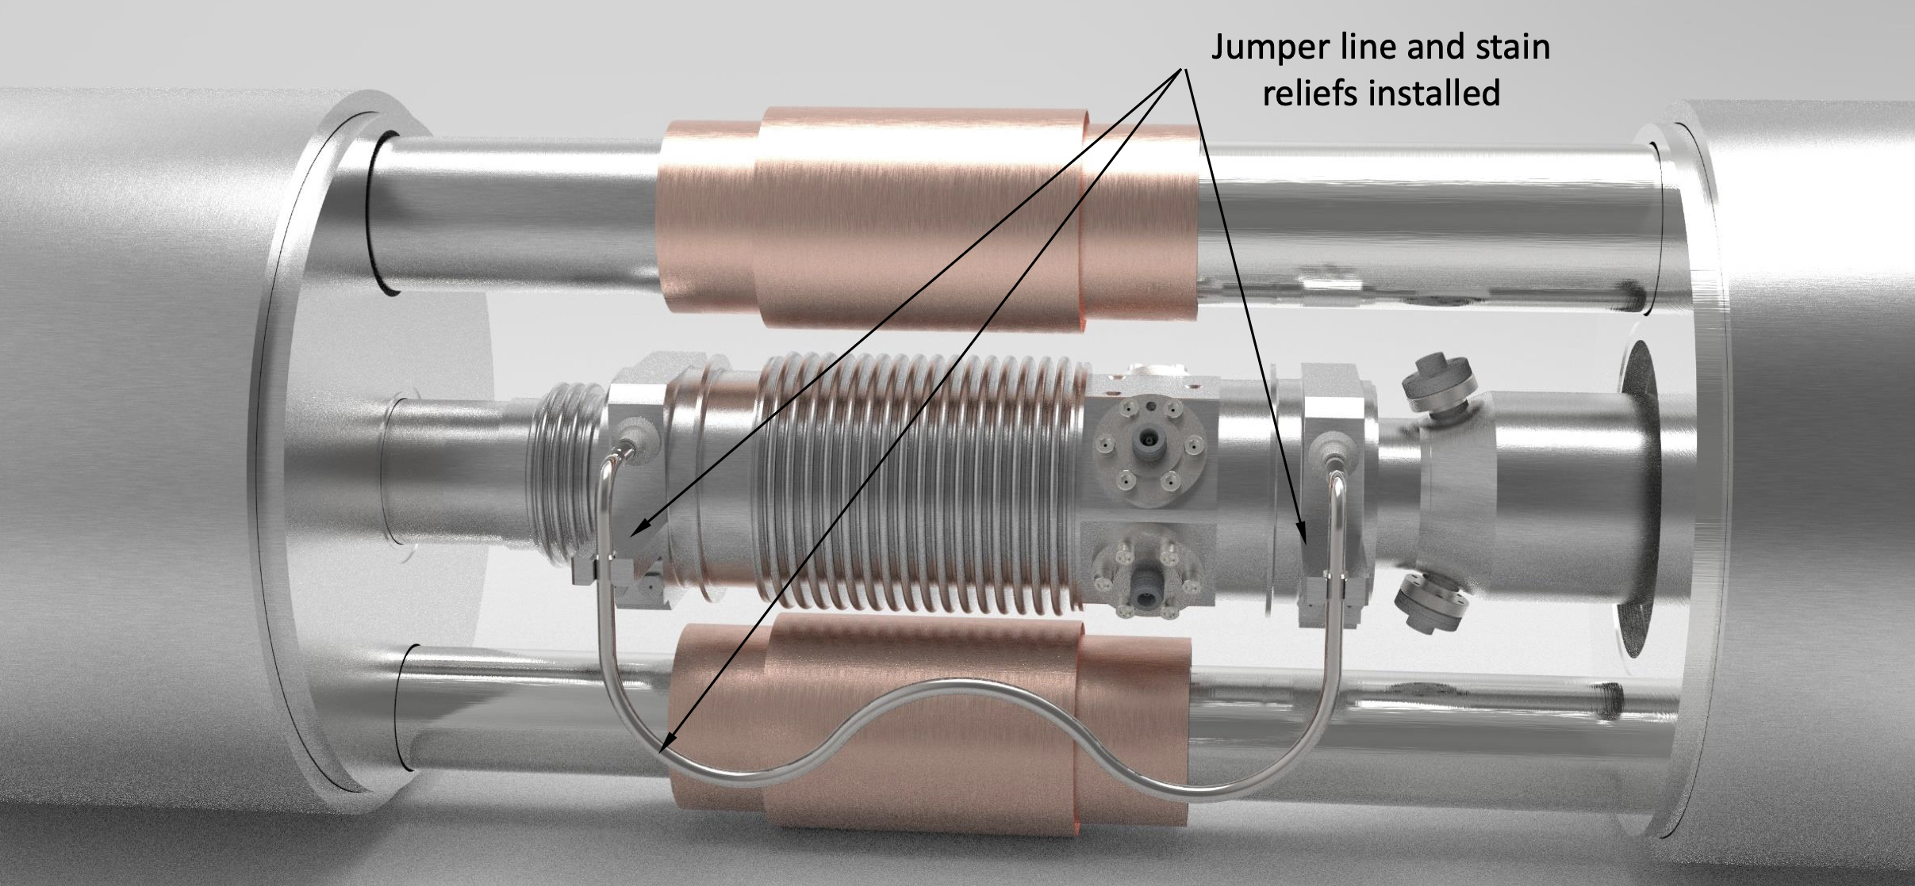
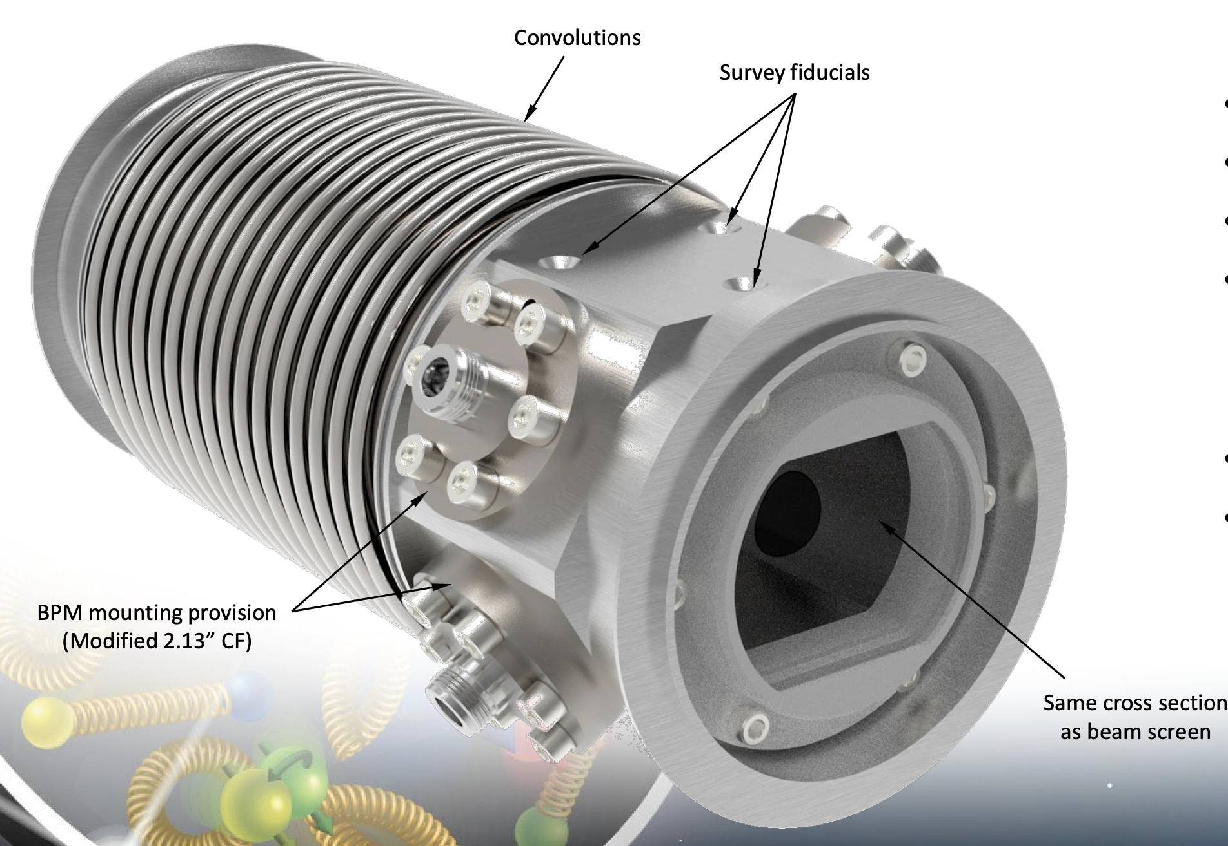
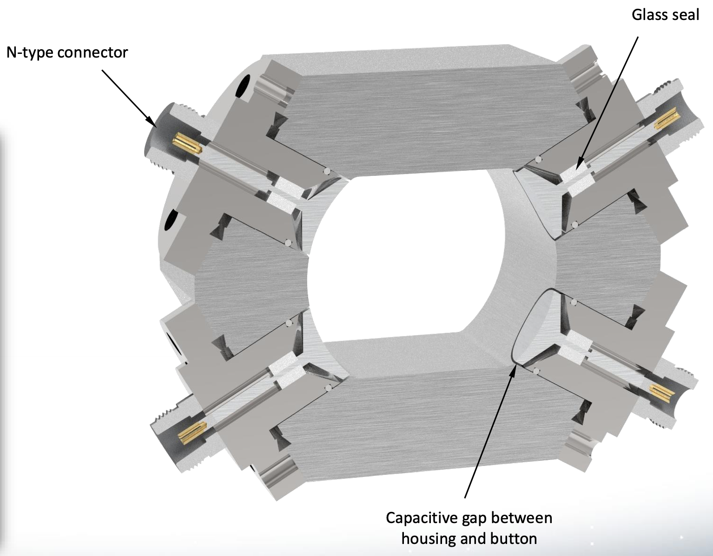
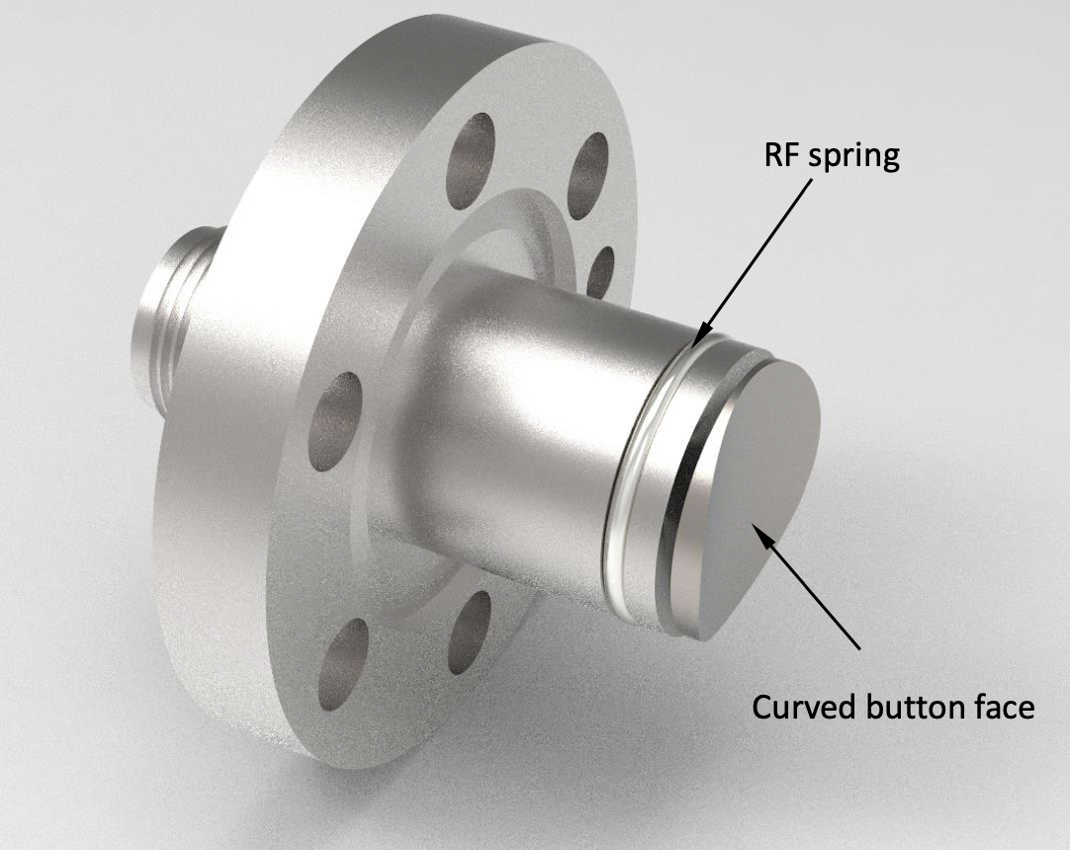
Hadron Storage Ring cryo-button BPM Pick-up
The new cryo-BPM design considerations:
  Aperture 50 x 64 mm (same as adjacent beam sleeve)
  Operations with large (+/-20 mm) radial offset at store
  Power deposition on the buttons is not excessive
  Signal levels to meet performance requirements (20 um resolution, average over 1 second during store)
  Dynamic range of ~ 85 dB;
    long 125 cm RMS, 5 nC gold pilot bunches at injection
    short 6 cm RMS, 30 nC bunches during store with large radial offset.
HSR cryo-BPM pick-up design is underway, CST & Ansys simulations
HSR beam parameters for 275 GeV (most challenging for BPM):
  Bunch charge = 30.5 nC
  Bunch length (RMS) = 6 cm
  Bunch period = 40 ns, 290 bunches
  Beam current = 0.69 Amps
  Radial shift = 20 mm
For the above parameters, preliminary simulation results look promising
  Impedance characteristics look good (matched to beam sleeve)
Conceptual design of the HSR bellows/interconnect/BPM
with cryo-cooled vacuum chamber sleeve bypass
HSR BPM cross section
20 mm diameter button
Pics courtesy of Charlie Hetzel

Slide 10
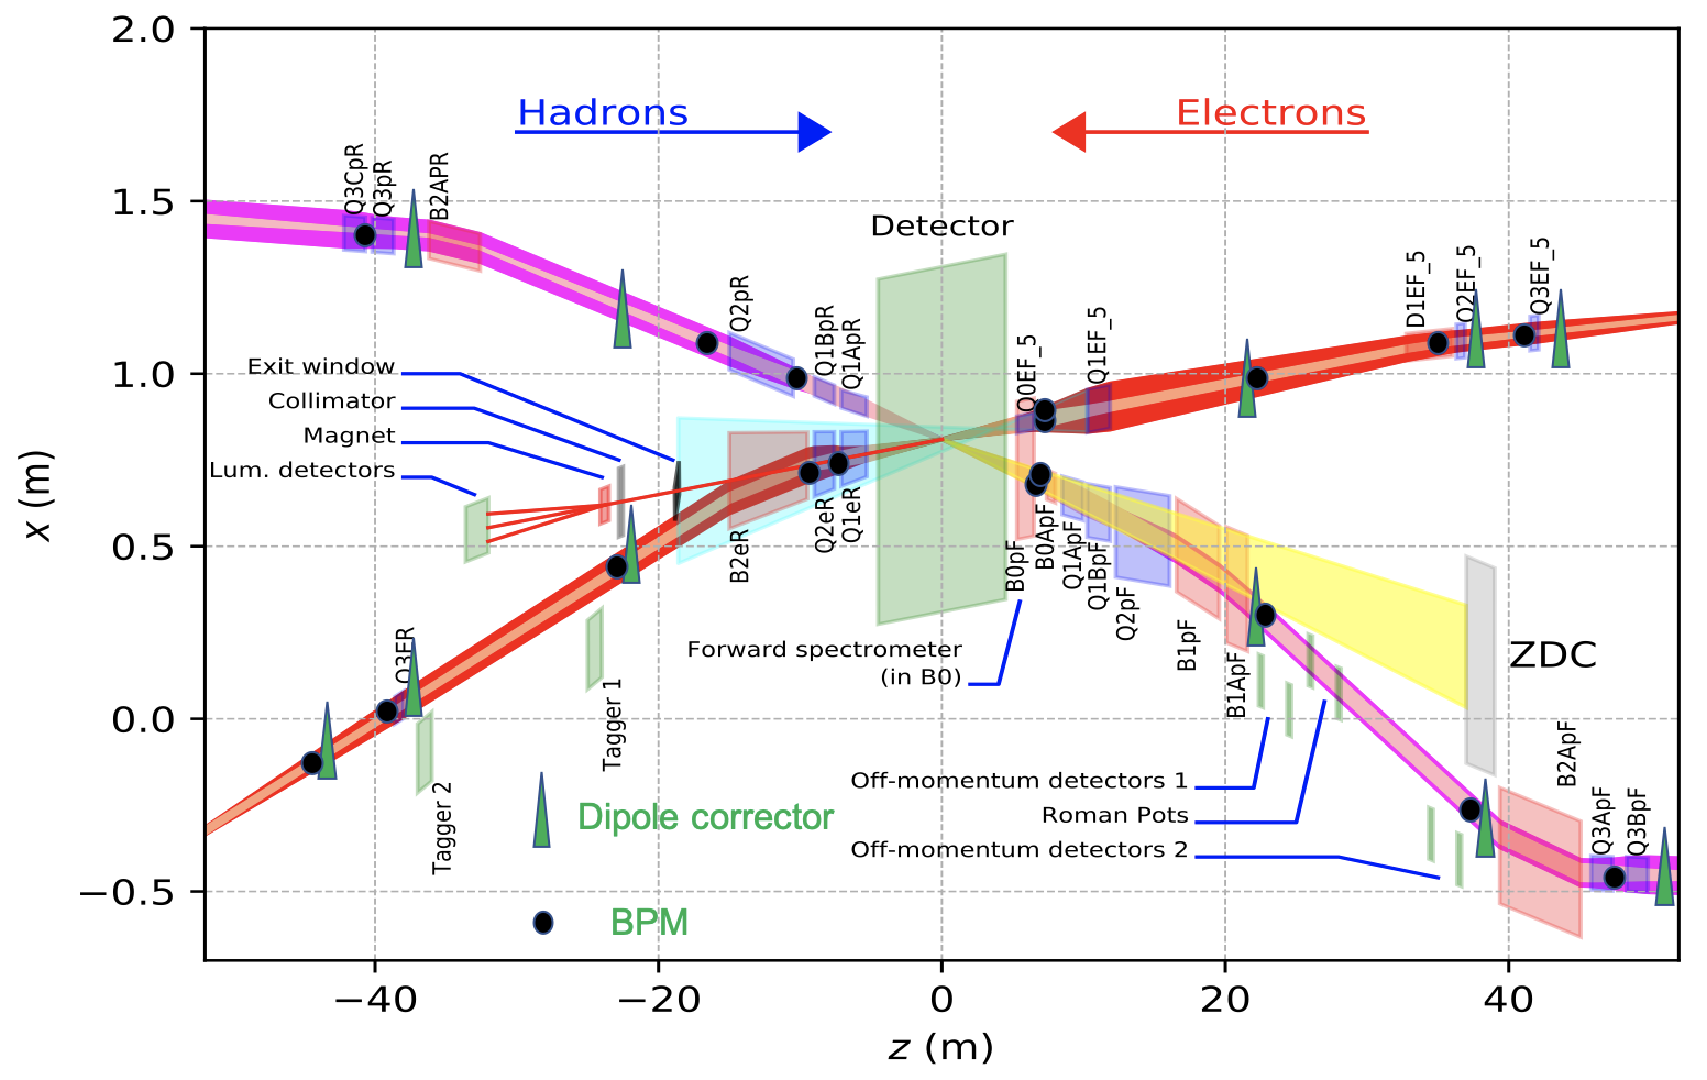
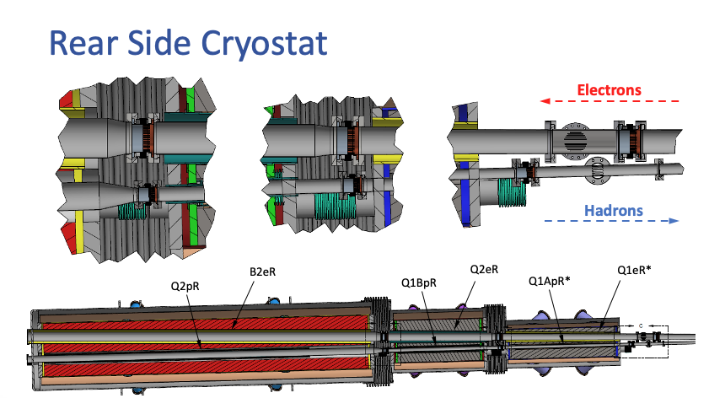
Near interaction region electron BPM Pick-ups
Large diameter e-BPM pick-ups in the electron forward and rear region present challenge for 1 um average resolution position measurements. For comparison: ESR BPMs: 18 mm radius (1.4” diameter).
Forward region
Q0eF5 (~7 m from IP) 27 mm radius (2.1” diameter) in cryostat
(~22 m from IP) 63 mm radius (5” diameter)
Q2eF5 (35m from IP) 50 mm radius (4” diameter)
Q3eF5 (42 m from IP) 50 mm radius (4” diameter)
Rear region
Q1eR (~7.3 m from IP) 56 mm radius (4.4” diameter) in cryostat
Q2eR (~9.3 m from IP) 64 mm radius (5” diameter) in cryostat
DS of B2eR (22m from IP) 80 mm radius (6.3” diameter)
Q3eR (38 m from IP) 80 mm radius (6.3” diameter)
Q2eR
BPM
Q1eR
BPM

Slide 11
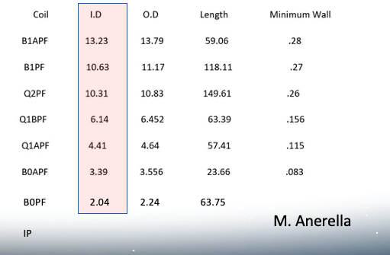
Near interaction Region hadron BPM Pick-ups
Hadron beam transports in the IR, near the IP, are not fully designed yet
The BPM near B1ApF will have ~13” aperture (pick-up design & measurement challenge)
There will be an energy dependent radial offset in the IR hadron BPMs, similar to the offsets in HSR
After IR hadron transport designs are more mature, simulations will be done to determine remaining BPM and corrector locations
B0ApF (~7 m from IP) 27 mm radius (2.1” diameter) in cryostat
B1ApF (~22 m from IP) 167 mm radius (13.2” diameter)
Hadron forward beamline ID’s can be large. All are expected to be round; dimensions are in inches.
B1ApF BPM
Dual plane BPM
Crab tilt BPM,
horiz button pair

Slide 12
ESR & IR Orbit correction simulations
Chuyu Liu
11 Correctors and 18 BPMs have been placed in the IR layout. Presently working on orbit correction scripts for electron beam transport through the IP.
The preliminary electron correction results are promising, which implies the placement of electron correctors and BPMs in the IR, is reasonable.
The next step is to run multiple correction simulations with random seeds. Check the residual orbit against the available IR aperture. Identify possible synchrotron radiation fan scraping points.
Eventually move on to the hadron orbit correction simulations

Slide 13
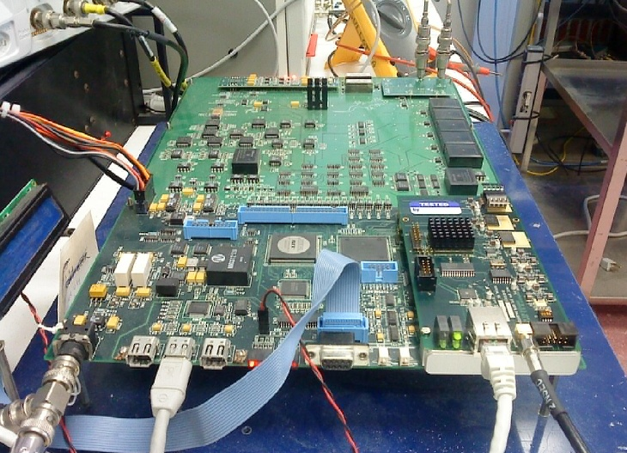
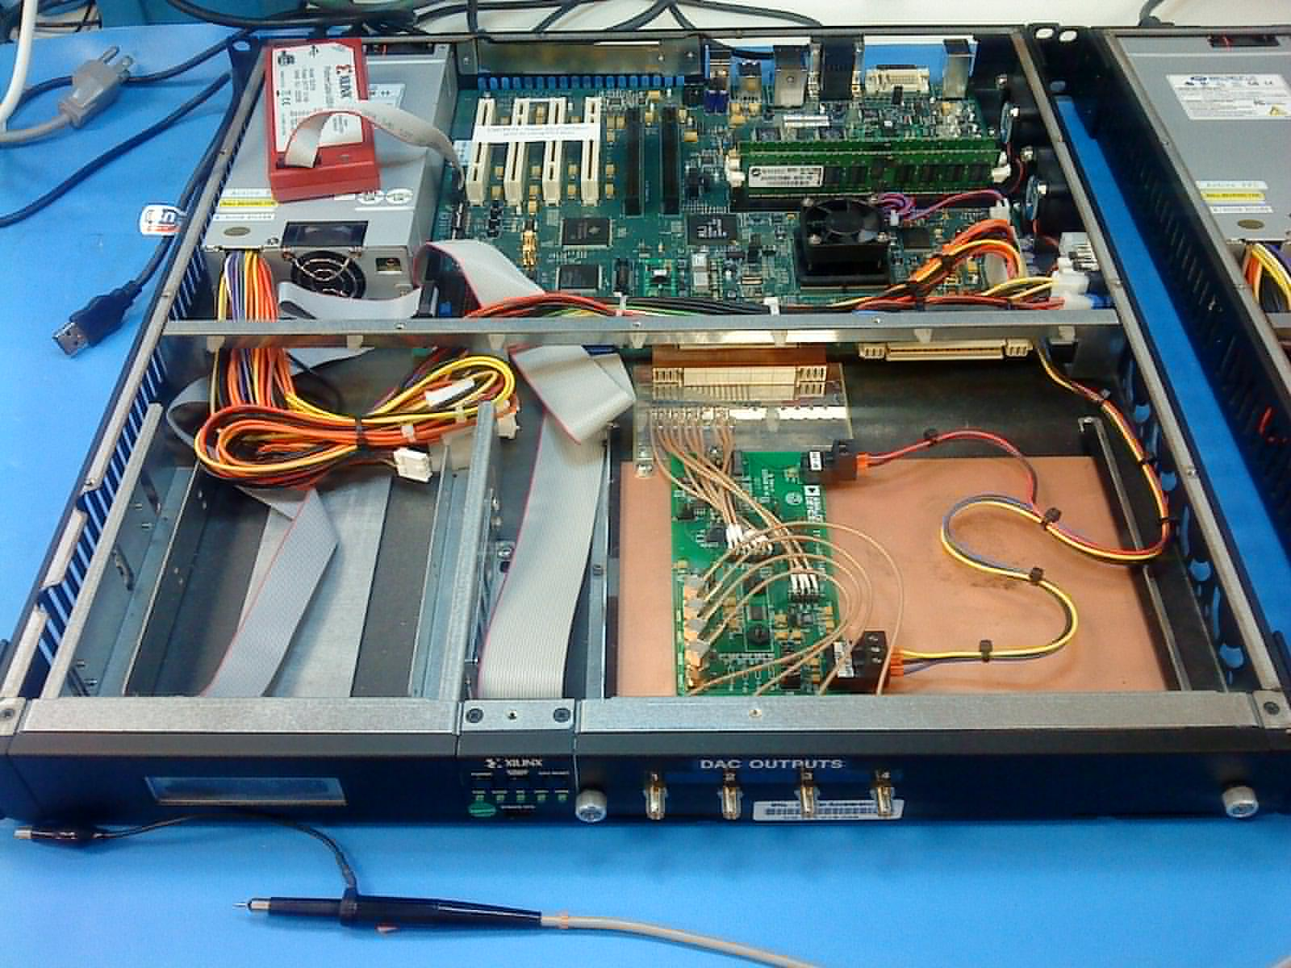
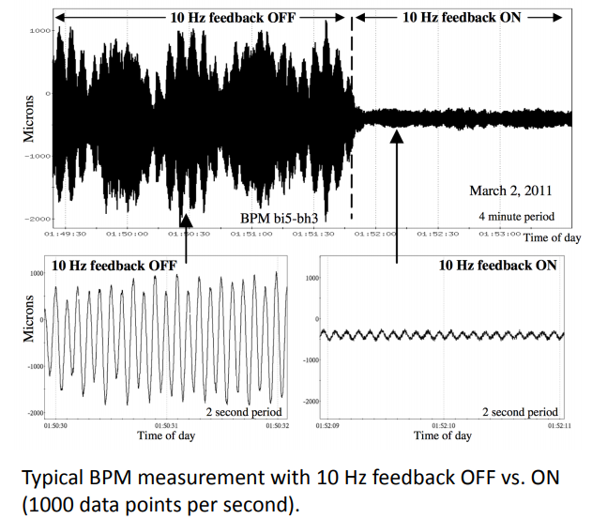
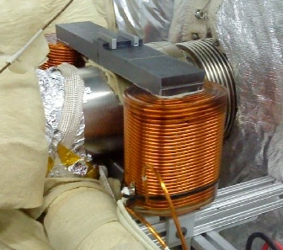
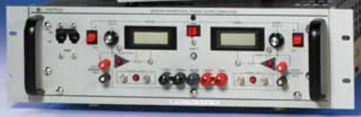
IR Orbit feedback
Compensation for modulated beam-beam offsets at the IP due to mechanical
vibration of IR magnets at frequency range of 2 to 30 Hz.
The baseline has 16 sets of orbit correction magnets and power supplies.
Design based on principle demonstrated at existing RHIC 10 Hz feedback system.
  12 electron, dipole steering magnets (8V + 4H)
  4 hadron, dipole steering magnets
RHIC Example
RHIC Orbit Feedback Off vs. On
IR
BPMs
RHIC BPM IFE board
with daughter card
Digital to analog converter
Electronics, Xilinx ML-510
Kepco BOP-36-12M
Magnet Power Supply
Steel laminated core
magnet installed in RHIC

Slide 14
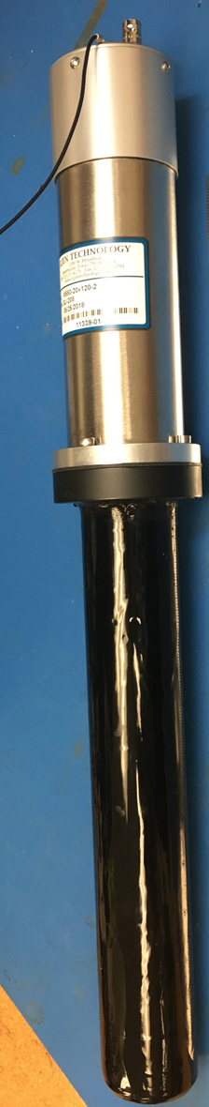
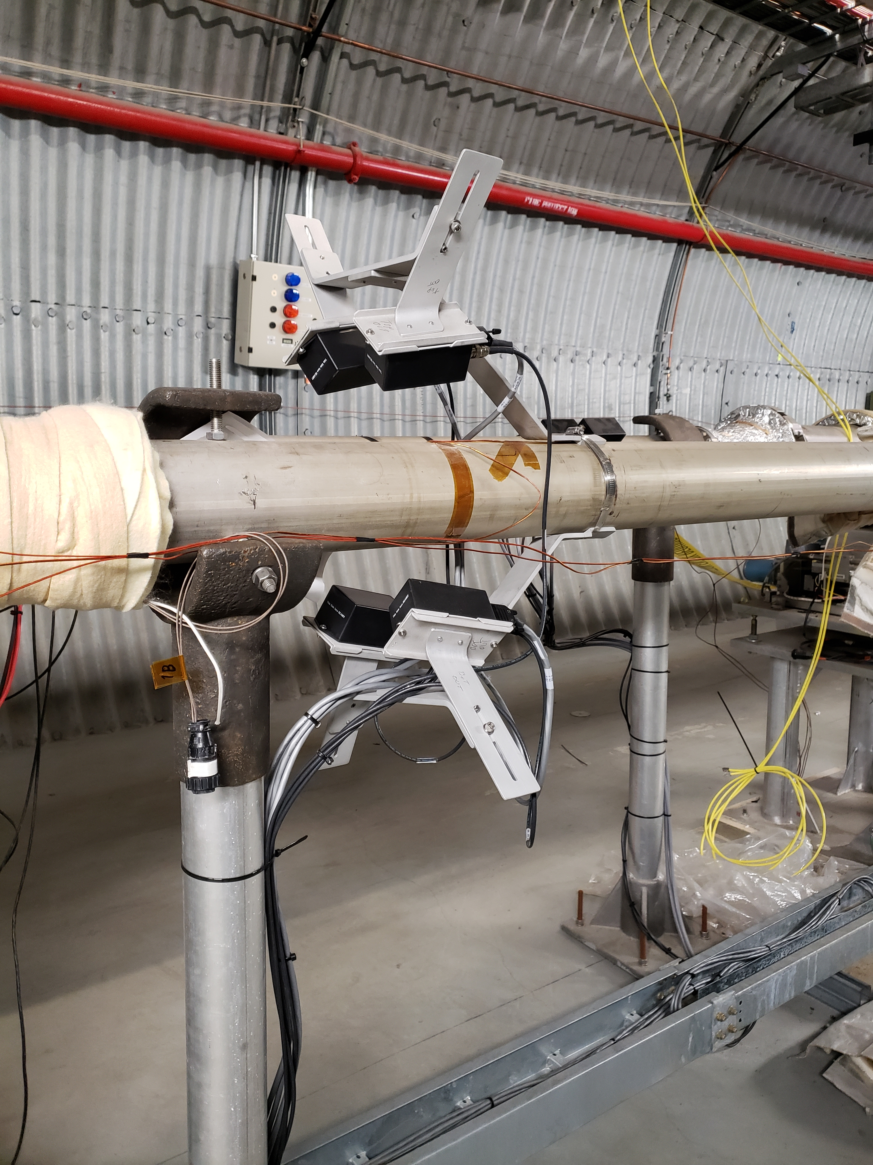
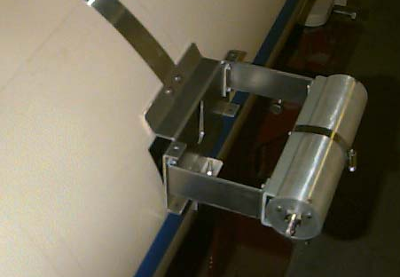
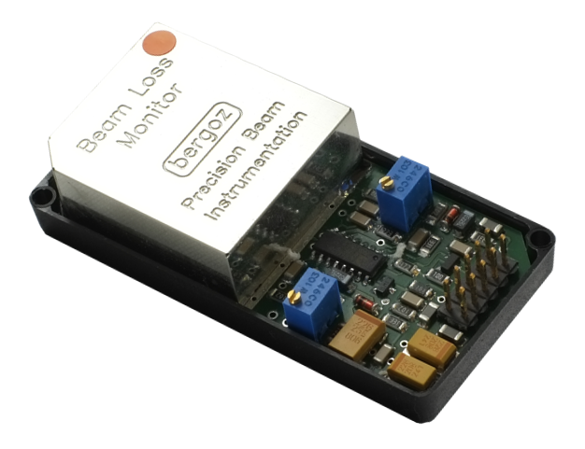
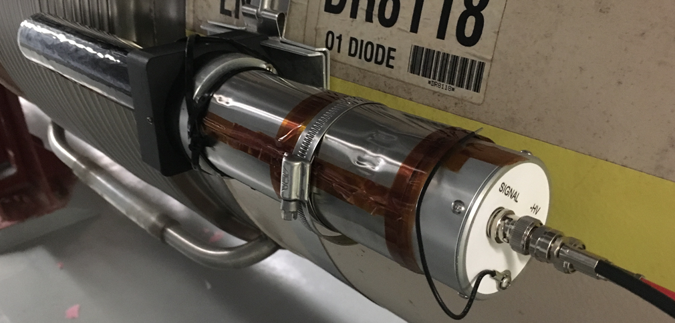
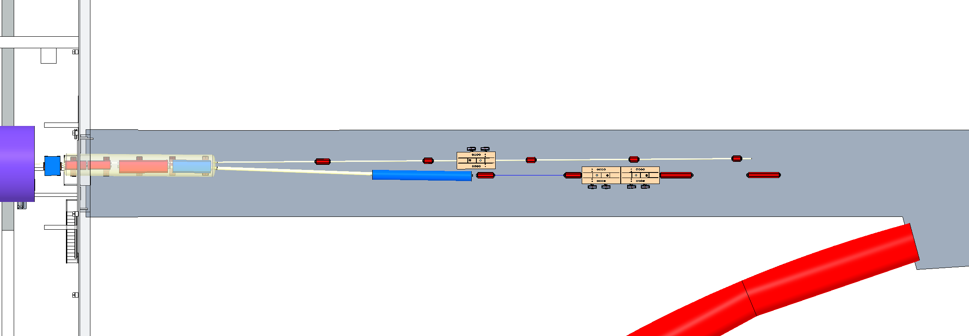
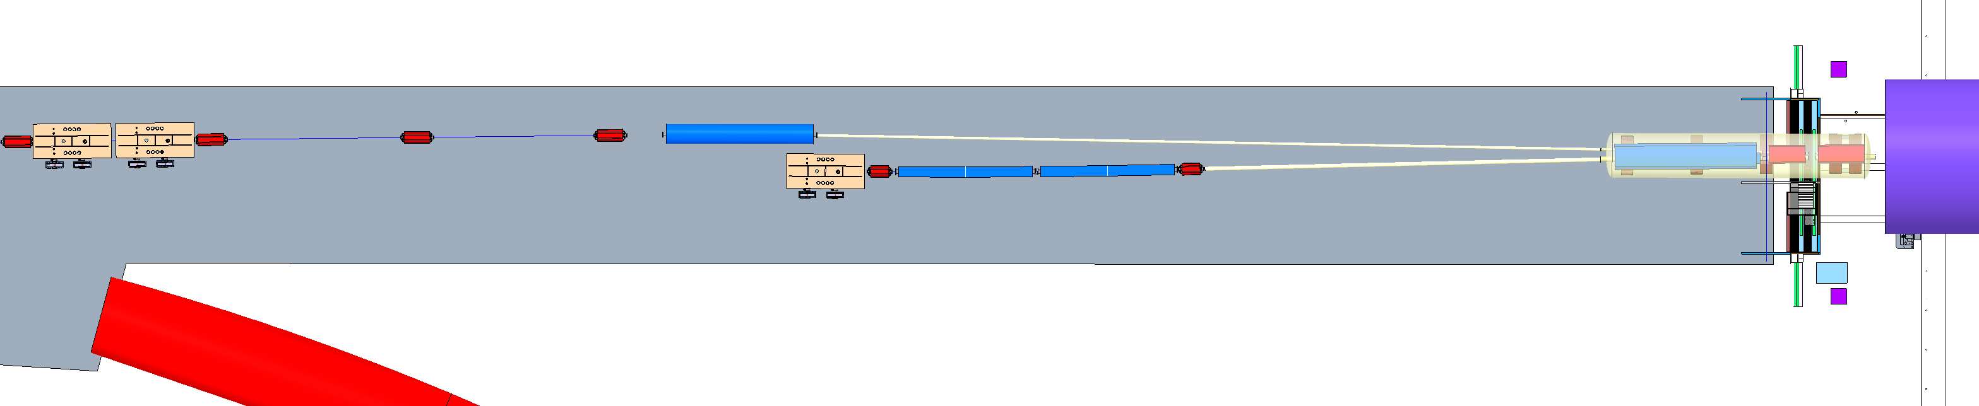
IR Beam Loss Monitors
Provide protection against unexpected sudden beam loss, input to MPS & beam abort system
Plan to do beam loss simulations to determine IR loss locations, detector locations
Several types of detectors in the baseline:
  10 RHIC style BLM ion chambers on each side of IR (20)
  10 Pin Diode style Bergoz BLMs on each side of IR (20)
  2 Paddle Scint/PMTs on each side of the detector (4) measure background level
RHIC style BLM Ion Chamber
Bergoz Pin Diode BLMs
Scint/PMT BLMs
Hadron Crab Cavities
electron Beamline
Hadron Beamline
Rear SC Magnet
System
Forward SC Magnet
System
electron Beamline
Detector
Hadron Beamline
e-Storage Crab Cavity
Hadron Crab Cavities

Slide 15
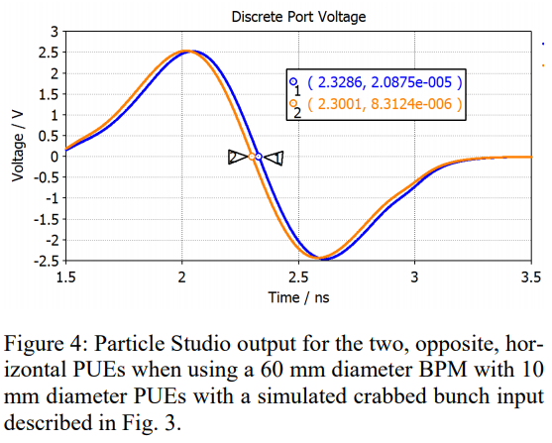
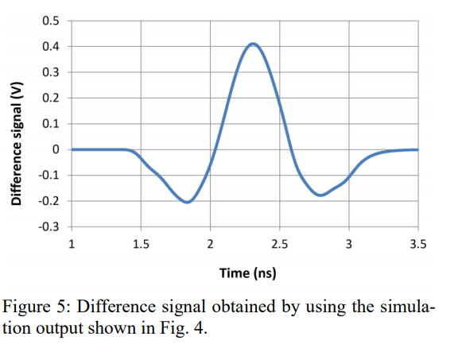
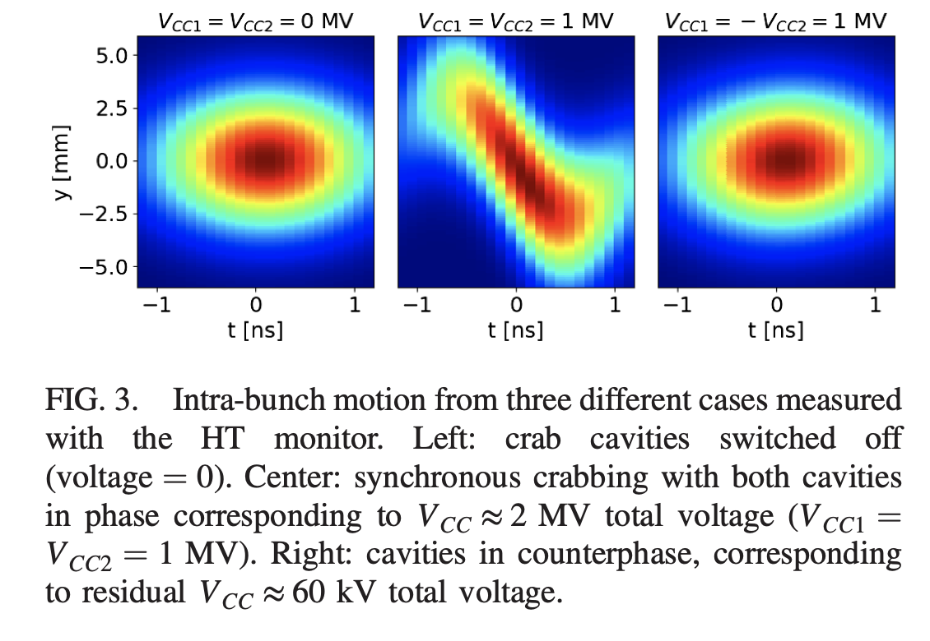
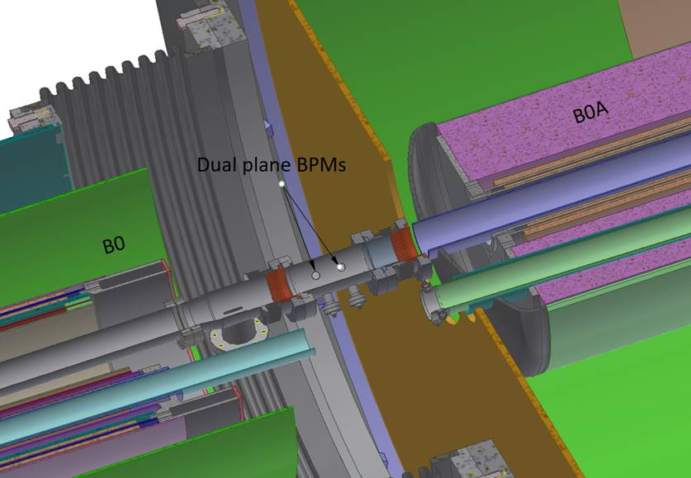
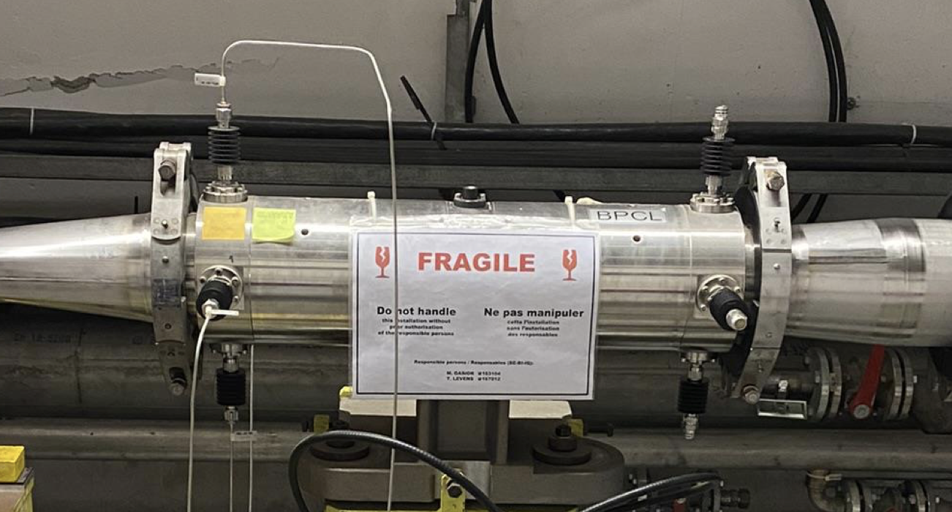
Hadron Crabbing Angle Measurements
et
Crabbing angle near IP determined by different degrees of BPM signal distortion depending on the tilt angle, the zero-crossing time difference is approximately proportional to the tilt angle.
A Head-tail monitor (stripline pick-up) will be installed in the HSR somewhere outside of the IR that can measure hadron crabbing angle with the de-crabbing cavity turned off.
Successful test at the SPS:
Concept by P. Thieberger
IPAC2018-WEPAF018
Concept has not demonstrated yet.
Due to sensitivity to long cable thermal effects, considering using a fast differential signal splitter in reverse, as combiner, close to the BPM
In the space between B0pF and B0ApF the horizontal BPM buttons should see the maximum tilting of the bunch, (crabbing angle 12.5 mrad.) Bending magnets and drifts behave alike with respect to crab rotations.
Proposed location between B0pF & B0ApF
SPS 60 cm strip-line
R. Calaga et al. PRAB 24 062001, June 2021

Slide 16
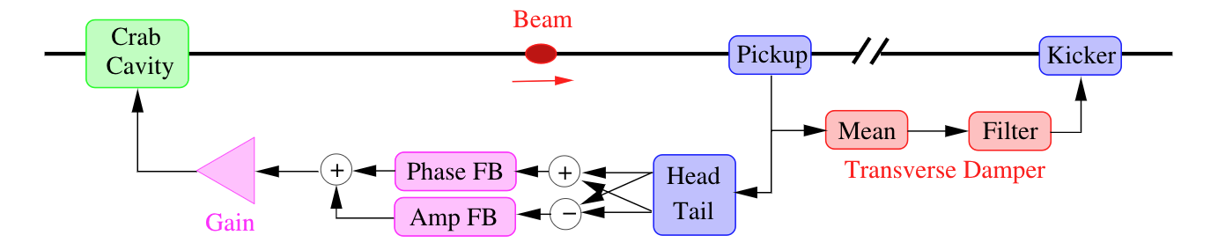
Hadron Crabbing Angle - Residual Measurement
Need crabbing angle residual (noise) measurement, located someplace away from the IR
  Purpose is to reduce emittance growth
  A dedicated feedback system could mitigate crab cavity noise effects. A similar system is planned for the HL-LHC.
  The bunch head and tail position would be extracted from the pickup signal. The head/tail ∆ and Σ estimate the bunch tilt and offset (amplitude and phase noise respectively).
  Themis Mastoridis has conducted simulations of such a system for the EIC HSR to study its potential performance and limitations.
  The performance of the system will greatly depend on the pickup precision, location, and additional technical specifications (signal processing/equalization, longitudinal motion effect, etc).
  The pick-up resolution needed for EIC HSR: TBD
  Type of pick-up under discussion (electro-optical?), considering multiple pickups.
T. Mastoridis, K. Smith, et al.

Slide 17
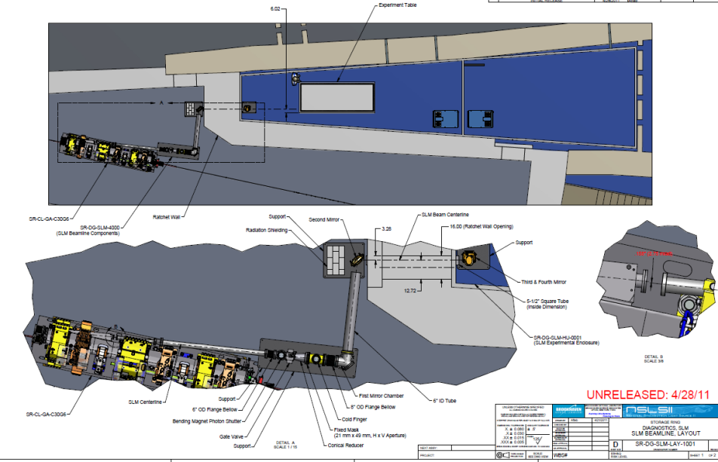
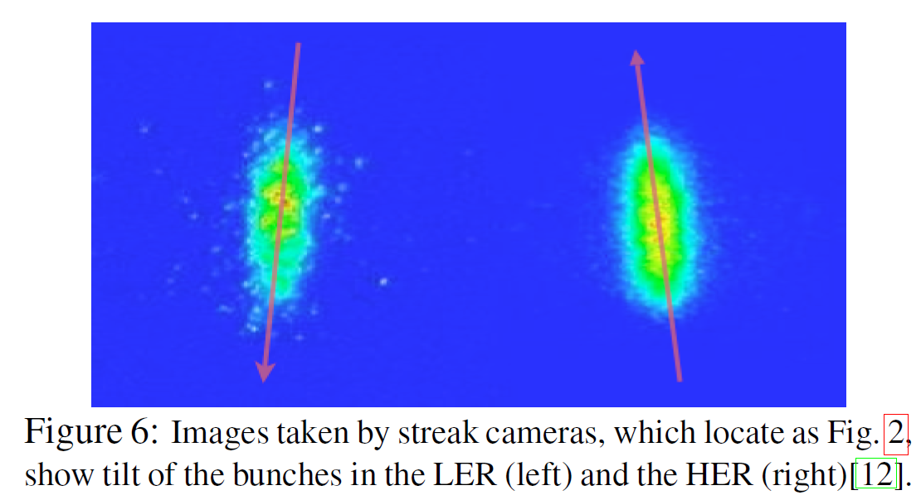
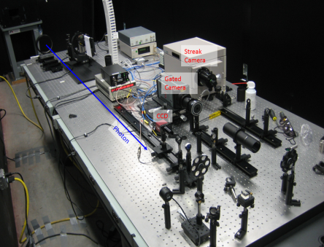
Electron Crabbing Angle Measurements
Electron Crabbing angle can be directly measured using a synchrotron light monitor with streak camera at a location TBD in the electron Storage Ring. Principle was demonstrated KEKB. Challenge is that this has not been done at BNL, different parameters at EIC.
A cooled mirror will direct the visible portion of synchrotron radiation to an enclosed light transport, then to an optical table in a service building.
Operational strategy for the measurement:
Since there is no room for an SLM in the IR, the electron crabbing angle cannot be directly measured in the IR during operations. It can be measured elsewhere in the ESR during a studies mode.
With the crabbing cavity turned on, and the decrabbing cavity turned off, the crab tilted beam will precess around the ring. A SLM will be located in the ESR lattice (away from the IR) at a location chosen with a large angle to optimize the measurement.
ESR synchrotron light monitor design
generally based on NSLS-II SLM
NSLS-II Synchrotron Light Monitor layout
When the decrabbing cavity is turned on (during normal operations), there should be no residual electron crabbing angle outside of the IR.
Working with NSLS-II colleagues to determine electron bunch crabbing angle measurement capability using ESR lattice and beam parameters.
Crab cavity bunch tilt angles measured at KEKB
NSLS-II Optical table with Streak camera
Longitudinal
Horizontal
Compensation of the Crossing Angle with Crab Cavities at KEKB, Abe et al, 2007
17

Slide 18
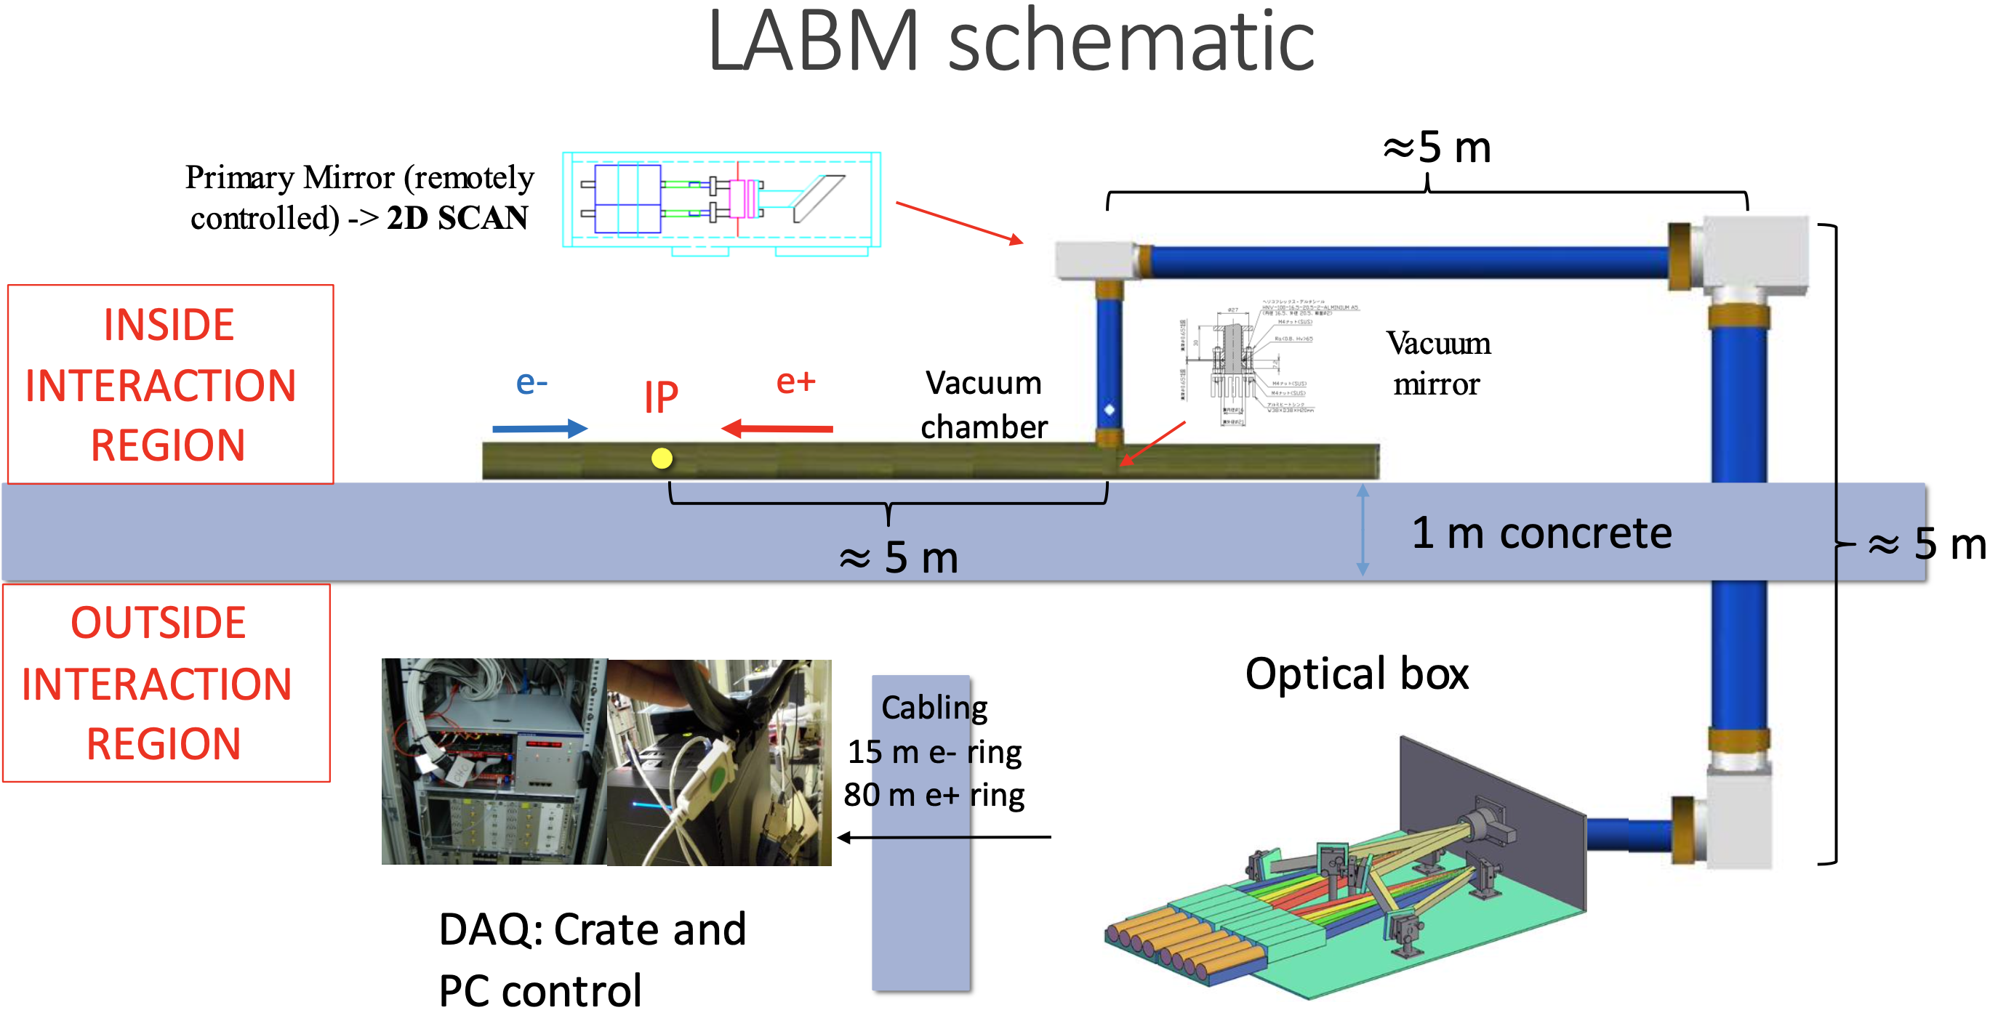
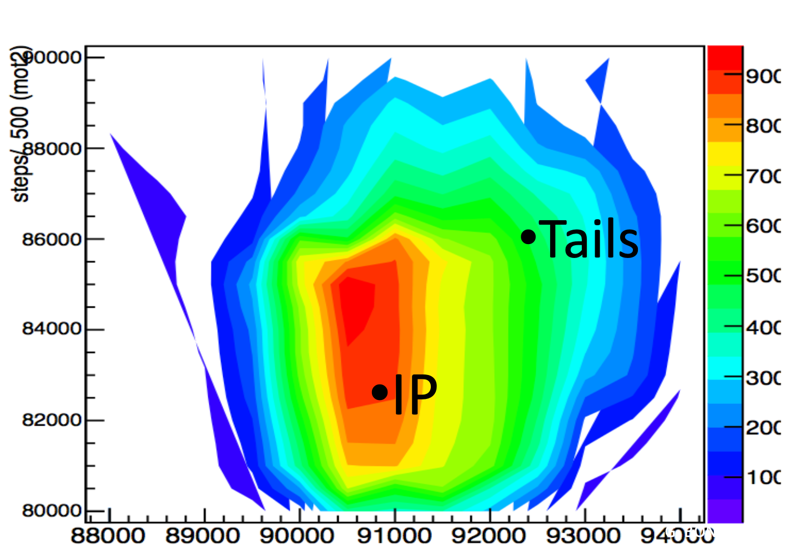
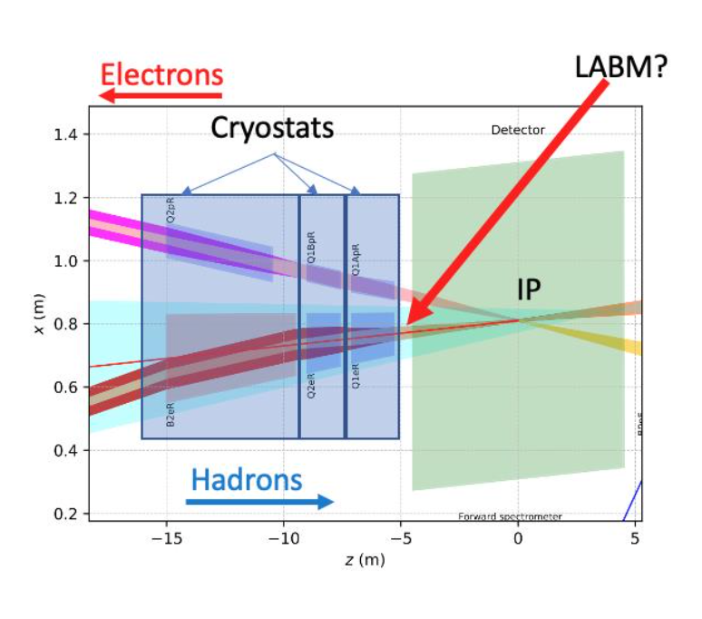
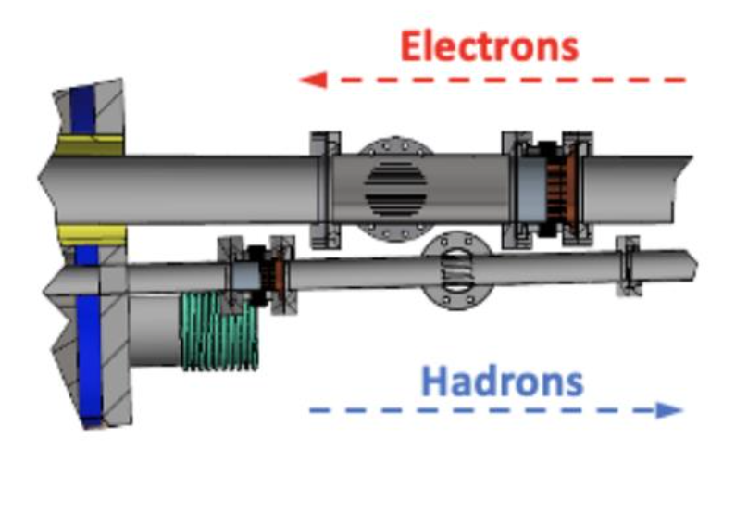
Large Angle Beamstrahlung Monitor (under consideration)
Demonstrated at CESR and SuperKEKB:
G. BONVICINI, S. DI CARLO
SuperKEKB
LABM light extraction principle
LABM heat map image
Electron
Ion Collider
A single-sided LABM is proposed to be installed near (~ 5 m) the EIC IP to measure rates produced by the electron beam.
  (A large angle beamstrahlung monitor for EIC, 2020 NIMA 164656)
Visible light collected at "large angles" (~ 6 mrad for EIC) by small mirrors integrated into the top and bottom of the beampipe, reflect the light through view ports to processing electronics.
A variety of beam parameter measurements using radiation emitted by the collisions at the IP.
  beam size, aspect ratios, offsets, bunch length
The plan looking forward is to create 3D models of the mirror/viewport chamber and do CST simulations to check impedance, and other logistical installation considerations.
warm beamline
space
available for
LABM mirrors
and windows

Slide 19
Summary
Have IR instrumentation systems functional requirements
Working on detailing individual system performance requirements
Beam position monitors:
Many of IR BPMs (far from the IP) will be similar to those used in the ESR & HSR, designs are underway
Final IR BPM quantity and locations TBD
BPM pick-ups near the IP will need special design attention, different from the ring BPMs
Radial offsets and large beam pipe apertures present measurement challenges
BPMs inside cryostats present mechanical engineering challenges
Beam loss monitors:
Variety of loss detector types are in the baseline
Plan to do IR loss simulations to determine detector types at specific locations
IR orbit correction method planned is similar what was proven at RHIC
Use BPM measurements and corrector magnets
Crab tilt angles measured by:
Hadrons: Dedicated BPM pick-up near IP, and head-tail monitor in Hadron Storage Ring away from the IR
Electrons: Synchrotron light monitor in ESR, away from the IR
Large angle beamstrahlung monitor – under consideration for EIC

Slide 20
Acknowledgements
EIC instrumentation team at BNL
Bel Bacha
Gabriele Bassi
Jonathan Bellon
Will Bergan
Mike Blaskiewicz
Alexei Beldnykh
Peter Braunius
Chris Degen
Lenny De Santo
Angelika Drees
Syed Hafeez
Charlie Hetzel
Doug Holmes
Rob Hulsart
Chuyu Liu
Frederic Micolon
Michiko Minty
Rob Michnoff
Christoph Montag
Peter Oddo
Danny Padrazo
Matt Paniccia
John Pomaro
Medani Sangroula
John Skaritka
Julio Renta
Peter Thieberger
Vadim Ptitsyn
Vahid Ranjbar
Matthieu Valette
Silvia Verdu Andres
Erdong Wang
Ferdinand Willeke
Holger Witte
Thank you for your attention!

Slide 21
ESR BPM Resolution Requirements
Gassner/Montag 21Mar22
Can expect similar requirements for most of the IR electron BPMs
The BPMs close to the IP may need special requirements
ESR BPM Measurement Mode | Required Resolution (σ) Horiz Vert |  | Allowable drift Horiz Vert |  | Bunch Intensity
Pilot bunch, single turn | 100 μm | 100 μm | 50 μm | 50 μm | (2 nC) 1.25x10¹⁰ e⁻
Pilot bunch, 10³ turns, averaged | 30 μm | 30 μm | 30 μm | 30 μm | (2 nC) 1.25x10¹⁰ e⁻
Newly injected refill bunch * (with 289 or 1159 existing bunches)
New bunch position measurement for first 20 BPMs (low charge) | 50 μm | 10 μm | 10 μm | 10 μm | (2 nC) 1.25x10¹⁰ e⁻
New bunch position measurement for first 20 BPMs (high charge) | 10 μm | 5 μm | 5 μm | 5 μm | (10 - 28 nC) 6.25x10¹⁰ e⁻ to 1.75x10¹¹ e⁻
Stored 290 or 1160 bunches
Bunch-by-bunch position measurement not required
Turn-by-turn, (low charge) | 30 μm | 30 μm | 30 μm | 30 μm | (2 nC) 1.25x10¹⁰ e⁻
Turn-by-turn, (high charge) | 10 μm | 10 μm | 10 μm | 10 μm | (10 - 28 nC) 6.25x10¹⁰ e⁻ to 1.75x10¹¹ e⁻
10³ turns, averaged | 5 μm | 5 μm | 5 μm | 5 μm | (10 - 28 nC) 6.25x10¹⁰ e⁻ to 1.75x10¹¹ e⁻
1 second average (78k turns) | 1 μm | 1 μm | 1 μm | 1 μm | (10 - 28 nC) 6.25x10¹⁰ e⁻ to 1.75x10¹¹ e⁻
Feedback systems
Transverse bunch-by-bunch (one special BPM), 1 mm meas. range | 3 μm | TBD | TBD | TBD | (10 - 28 nC) 6.25x10¹⁰ e⁻ to 1.75x10¹¹ e⁻
Longi bunch-by-bunch (one special BPM), phase measurement | TBD | TBD | TBD | TBD | (10 - 28 nC) 6.25x10¹⁰ e⁻ to 1.75x10¹¹ e⁻
*Note: EIC CDR p 758, ch 6.9.3: To monitor and fine tune injection matching, four BPMs (two each at dispersive and non-dispersive locations) will be used to monitor betatron and synchrotron oscillations of the first injected bunch.
“I would think a single turn would be sufficient, and if this capability is a substantial cost driver we could restrict it to the first 20 BPMs downstream of the injection point.” CM 9Nov20 email
Allowable Drift: this is related to how much the position measurement can change due to outside influences (cable and rack temperature, etc…) , assuming the beam does not drift

Slide 22
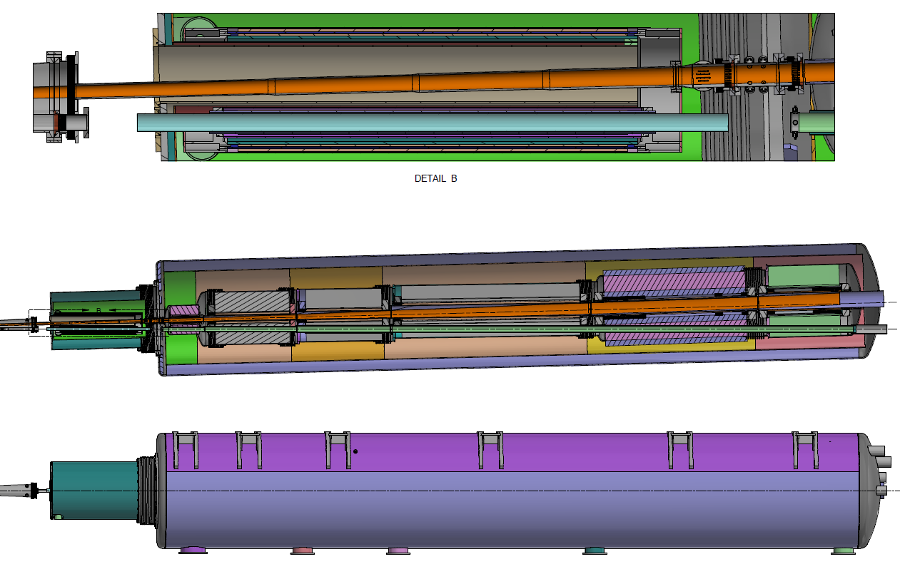
Relatively large radial offsets in the hadron BPMs near the IP also present challenge for quality measurements, performance requirements TBD.
Forward Side Cryostat (~17 m length)
+/- 1.3GeV
Atmosphere
BPMs
Hadrons
Electrons
Q0eF
B0pF
BPM
Q2pF
B1pF
B1ApF
B0ApF
Q1ApF
Q1BpF
B0pF
Q0eF
Q1eF

Slide 23
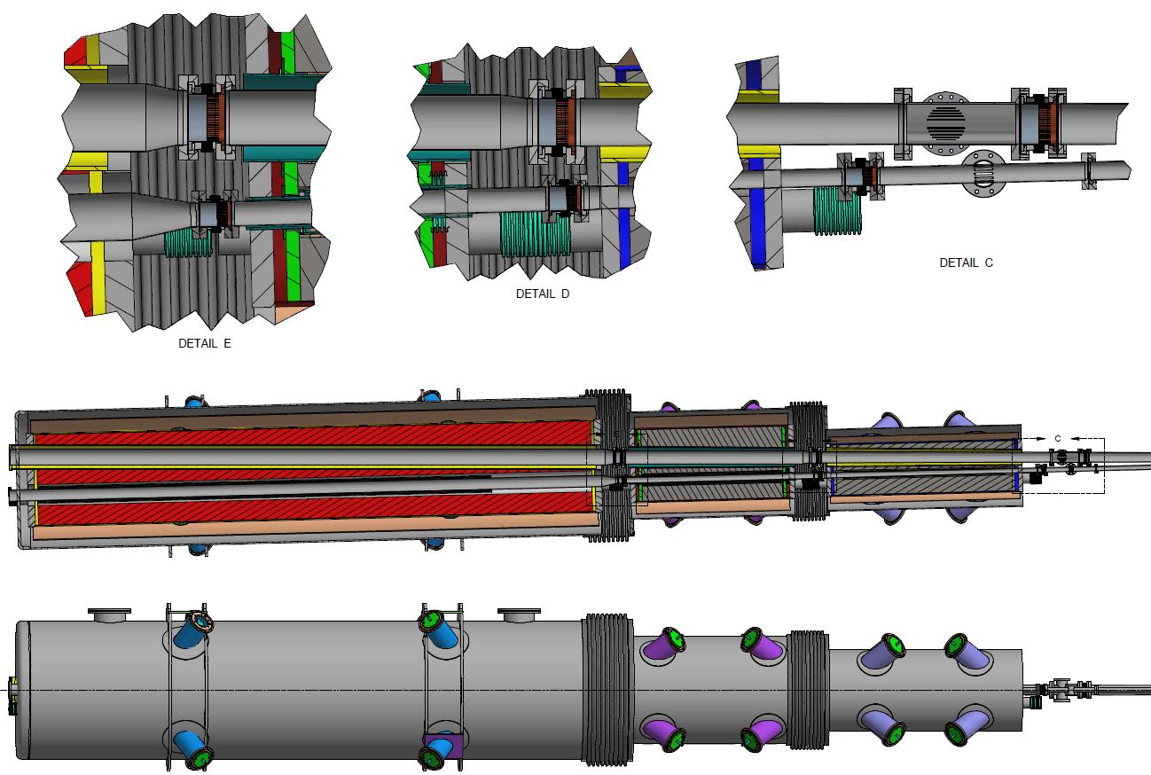
Rear Side Cryostat (~12 m length)
Electrons
Hadrons
B2eR
Q2eR
Q1eR*
Q2pR
Q1BpR
Q1ApR*
*Tapered beam pipe

