Slide 1
SuperKEKB collimator design
FCC-EIC Joint & MDI Workshop 2022
2022-10-19
Collimator Design
KEK Accelerator Laboratory
KEKB Vacuum Group
T. Ishibashi and S. Terui

Slide 2
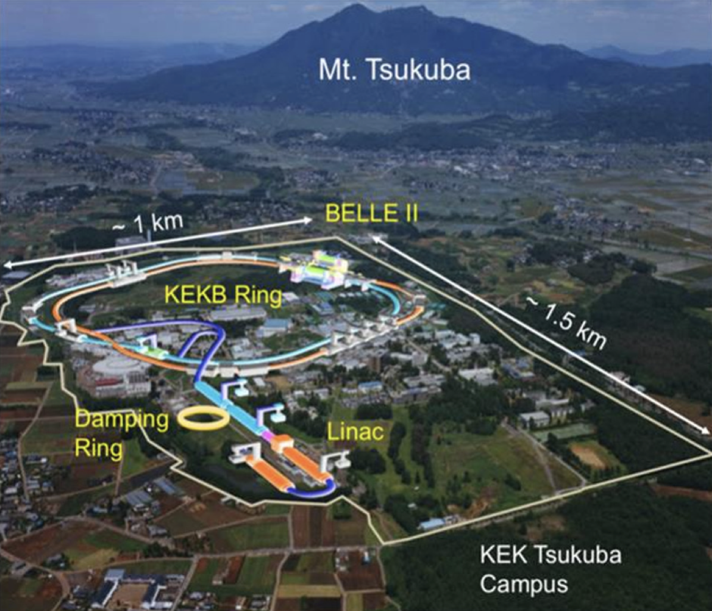
Introduction - SuperKEKB
Aerial photo of KEK Tsukuba Campus
Upgrade project of KEKB B-factory located at KEK Tsukuba campus.
SuperKEKB accelerator is an electron-positron collider and has about 3 km in the circumferential length.
The commissioning of the SuperKEKB started on 2016.

Slide 3
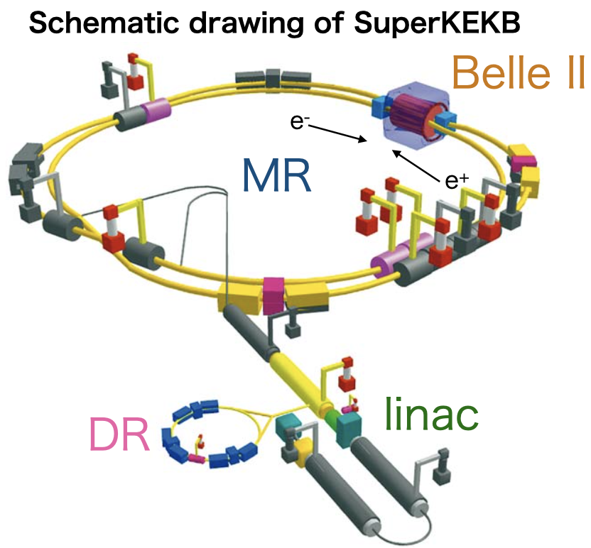
Introduction - SuperKEKB
Main components of SuperKEKB
Linac
  Length: ~700 m
  Provide electron or positron beams to 4-ring
    SuperKEKB HER, LER
    PF (Photon Factory): 2.5 GeV
    PF-AR (Photon Factory Advanced Ring): 6.5/5 GeV
DR (Damping Ring, positron)
  Circumferential length: ~136 m
  Energy: 1.1 GeV, 71 mA (design)
MR (Main Ring)
  Circumferential length: ~3016 m
  HER (High Energy Ring, electron): 7 GeV, 2.6 A (design)
  LER (Low Energy Ring, positron): 4 GeV, 3.6 A (design)
Belle II (particle detector complex)
The achieved peak luminosity is ~4.7×10³⁴ cm⁻² s⁻¹ with 1.4 A in LER and 1.1 A in HER when the stored bunch number is 2249 during 2022 spring run, and this is the world record.

Slide 4
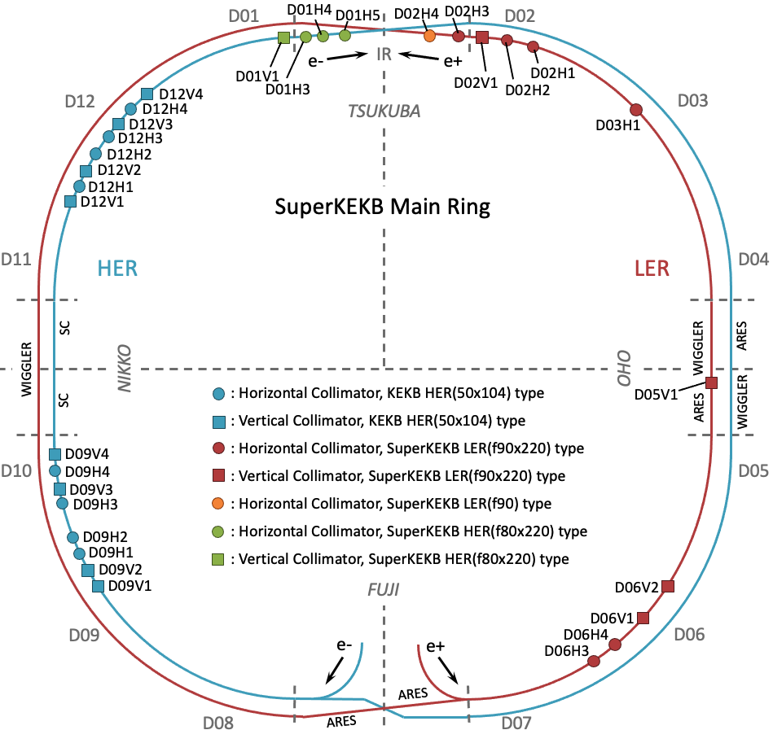
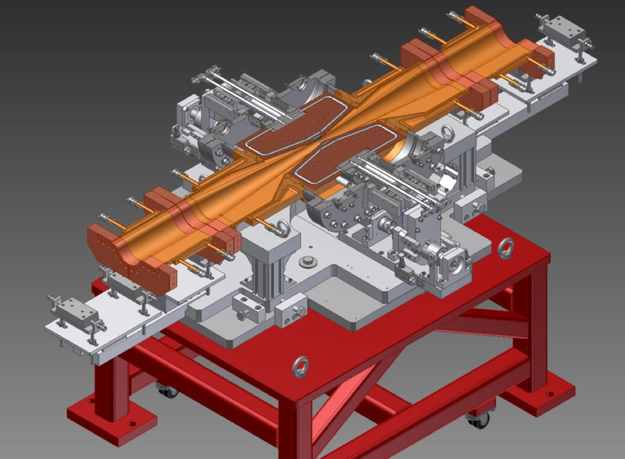
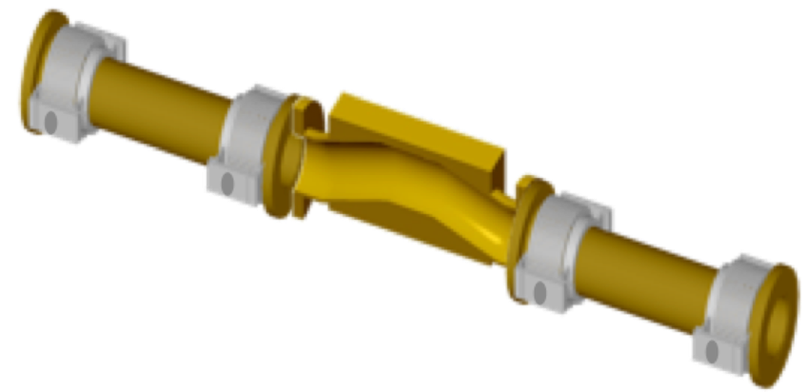
Beam collimators in SuperKEKB
Beam collimators are used to suppress backgrounds in the Belle II detector and to protect accelerator components from beams out of control.
There are two types of collimators in SuperKEKB MR.
  KEKB type: Tapered chamber itself approaches the beam. The tip is made of Cu coated titanium.
  SuperKEKB type: A chamber has two movable jaws, and they approaches the beam.
In HER, 8 horizontal and 8 vertical KEKB type collimators have been reused at the same location as KEKB era. 3-horizontal and 1 vertical SuperKEKB type collimators have been installed in Tsukuba straight section.
In LER, 7 horizontal and 4 vertical SuperKEKB type collimators have been installed.
KEKB type
SuperKEKB type
[Y. Suetsugu et al., NIM A 513, 465 (2003)]
[T. Ishibashi et al., PRAB 23, 053501 (2020)]
Location of collimators in MR (after Long Shutdown-1)

Slide 5
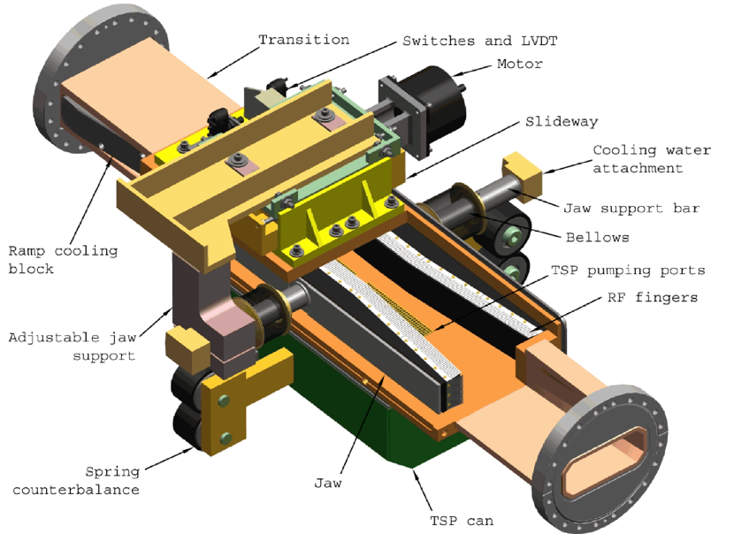
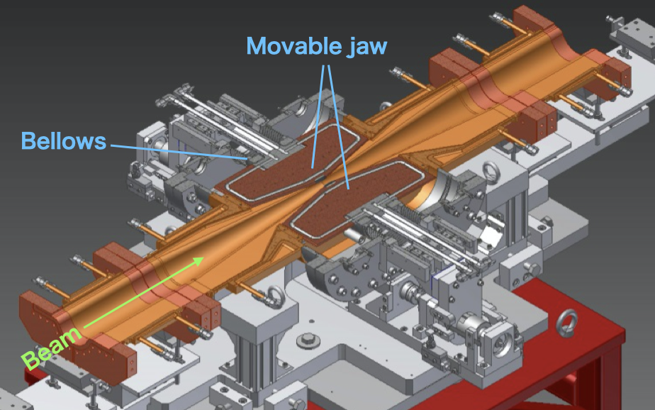
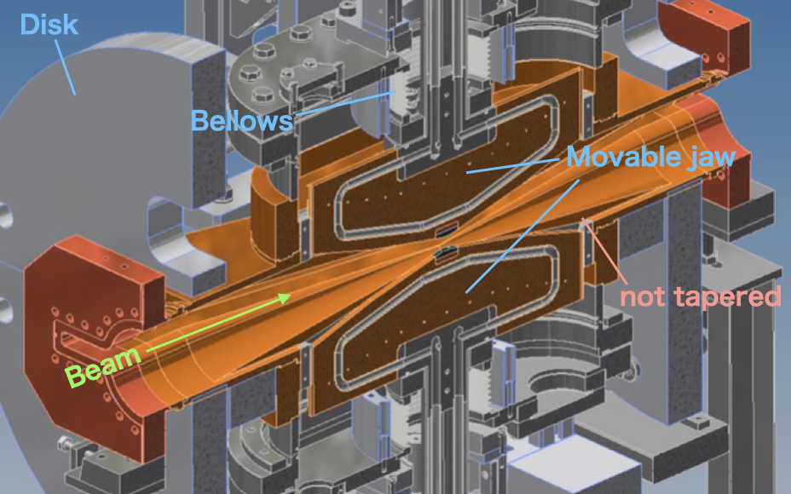
Design of SuperKEKB type collimator
We referenced movable collimators for PEP-II in SLAC for the basic design of the SuperKEKB type.
A collimator chamber has two movable jaws, which are placed the horizontal/vertical direction.
The geometry was optimized using optimizers in CST studio to minimize the impedance.
Part of the movable jaws is hidden inside the antechambers (or antechamber like structure).
  The beam doesn't see gaps or protrusions between the movable jaw and chamber. The excitation of the trapped modes around them can be avoided.
  Similar level of the impedance with shorter collimator length. Compact and simple structure.
The chamber is also tapered to the center of the collimator in order to avoid excitation of trapped-modes.
Materials at the tip of the jaws are tungsten (1st ver.), tantalum (2nd ver.), carbon (low-Z, special ver.), and hybrid (C+Ta, special ver.).
Collimator in PEP-II
Horizontal direction
Vertical direction
[S. DeBarger et al., SLAC-PUB-11752]
SuperKEKB type collimator
5

Slide 6
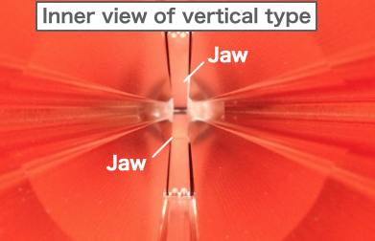
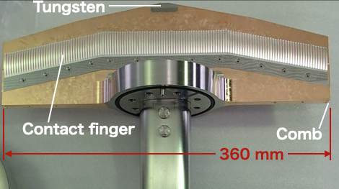
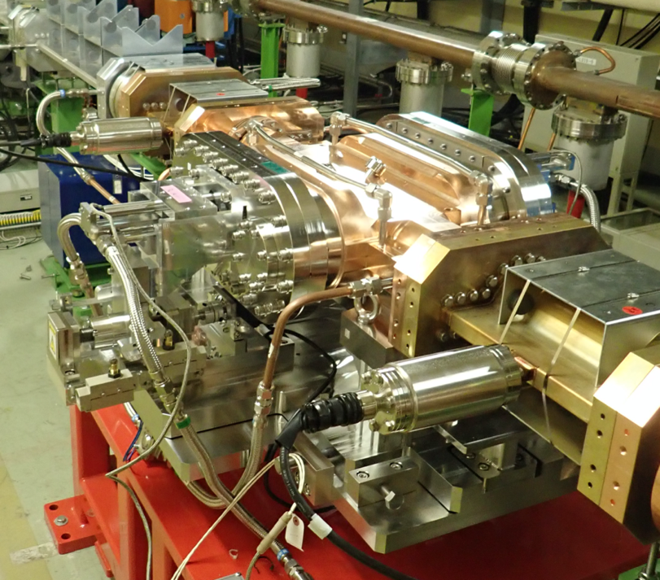
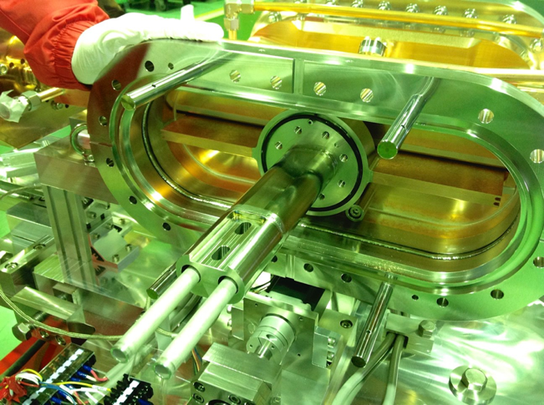
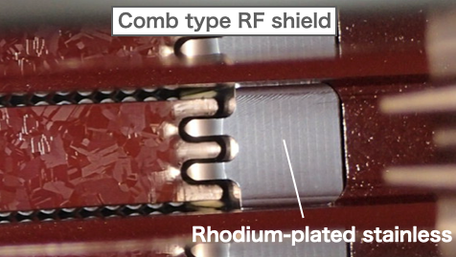
Design (RF-shield)
There are cavity structures where the jaws are inserted in the chamber, and it’s necessary to prevent the intrusion of RF excited by the beam.
Contact finger-type RF shield is attached on the side wall of each jaw.
  The fingers are made of silver-plated INCONEL.
  The contact surface on the chamber is made of rhodium-plated stainless steel.
Contact-less comb-type RF shield is adopted between the longitudinal end of the jaw and the facing surface on the chamber.
Jaw with RF-shield
6

Slide 7
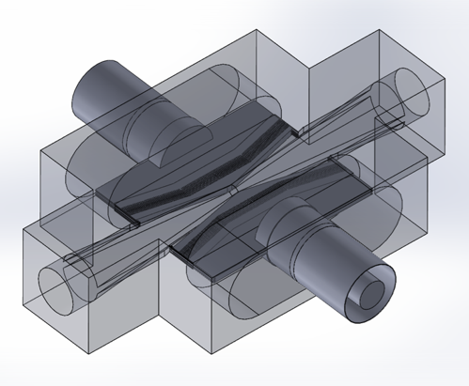
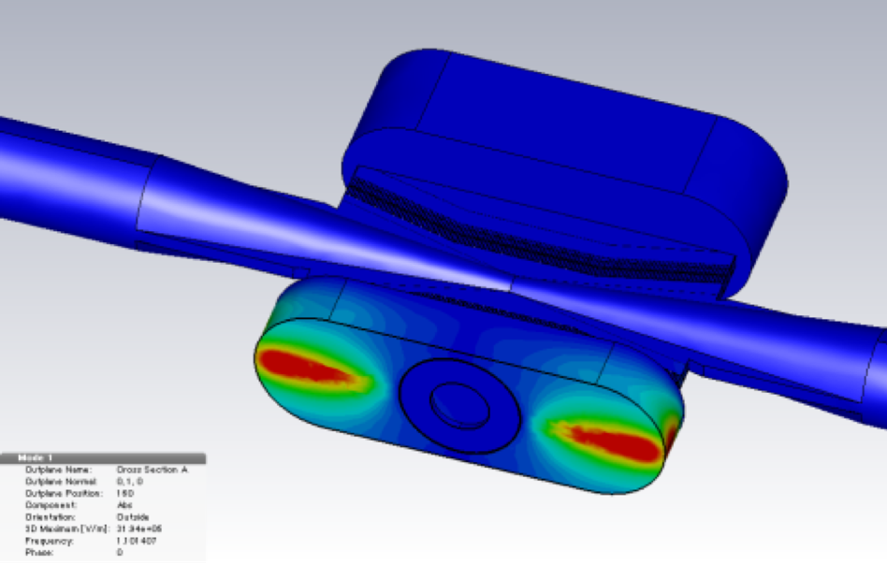
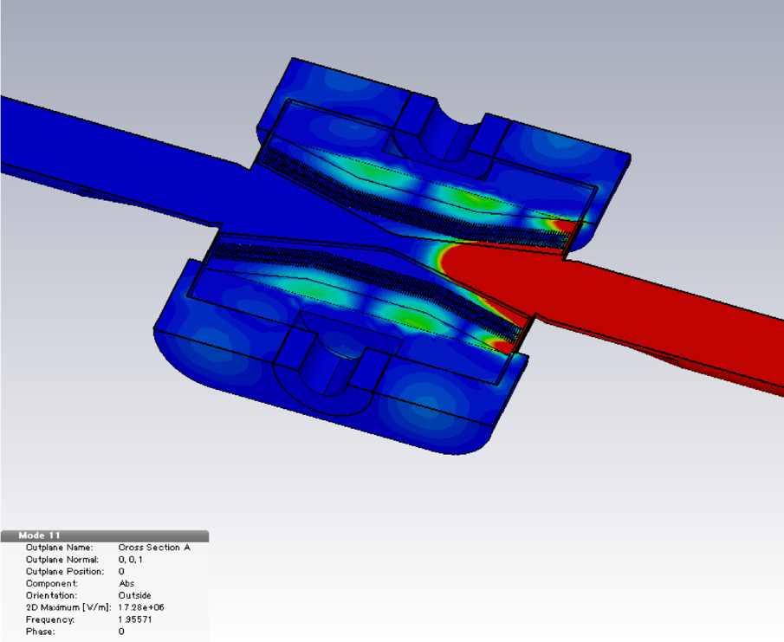
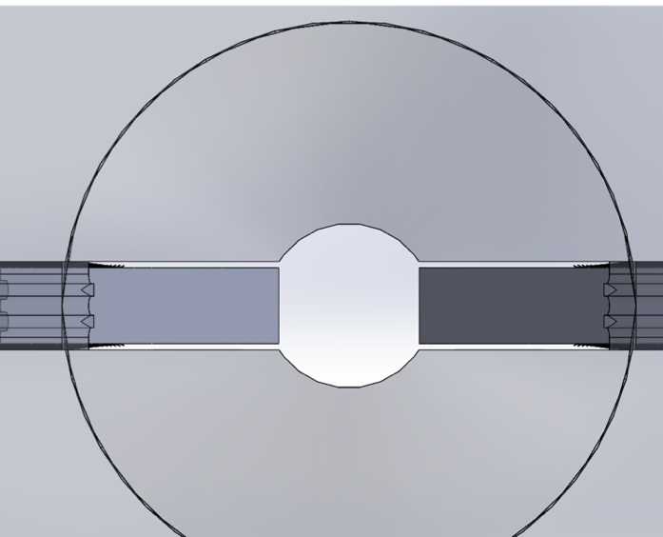
Design (RF-property)
We estimated effectivity of the RF shields using Eigen-mode solver in CST Studio.
The maximum electric field strength in the beam channel is 1.7x10⁷ V m⁻¹, and 10 V m⁻¹ in a gap between the jaw and the chamber wall.
RF in the beam channel is intruded into the chamber placed the jaw. However, the coupling between the beam channel and the chamber is small.
Simulation model in CST Studio
E-field strength in jaw’s chamber
(1.1014 GHz)
E-field strength in beam channel
(TE₁₁₁: 1.9557 GHz)
7

Slide 8
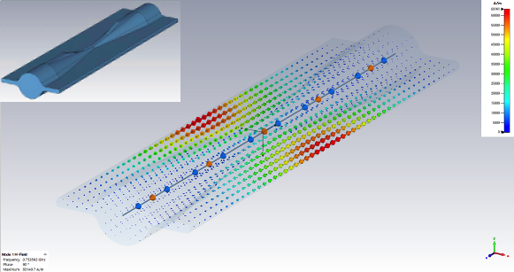
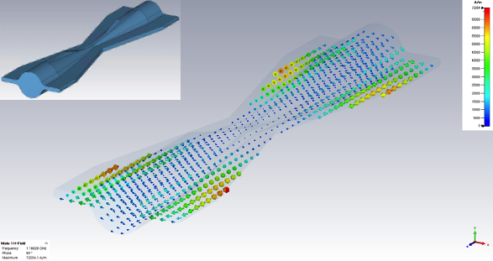
Design (RF-property)
Trapped modes are exited around the jaws in the vertical collimator in a straight shaped beam pipe.
The excitation of that is avoided by means of tapering the inside of the antechambers to the center of the collimator.
Straight chamber (0.7536 GHz)
Tapered chamber (1.1683 GHz)
8

Slide 9
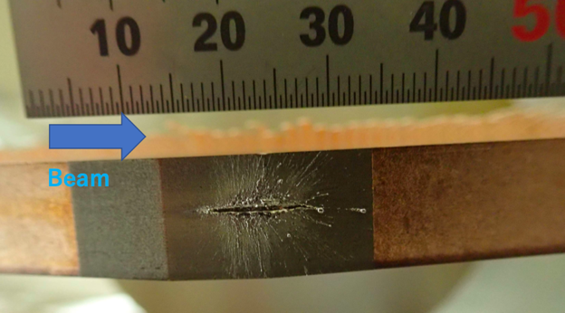
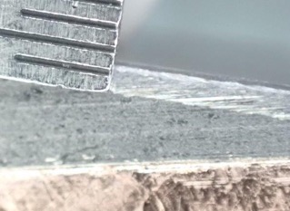
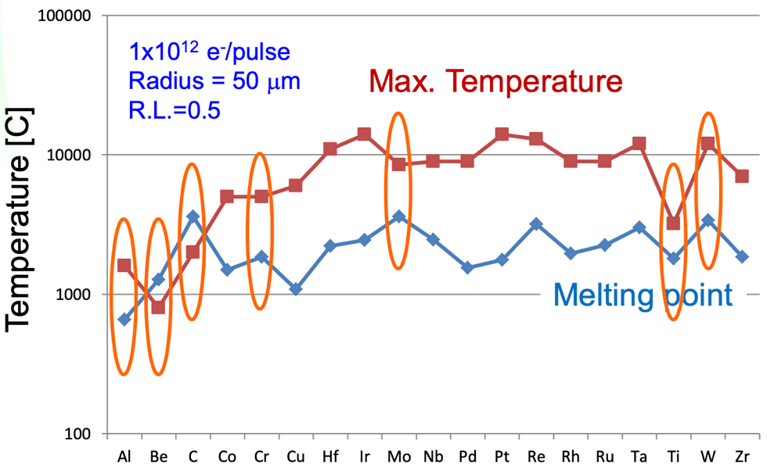
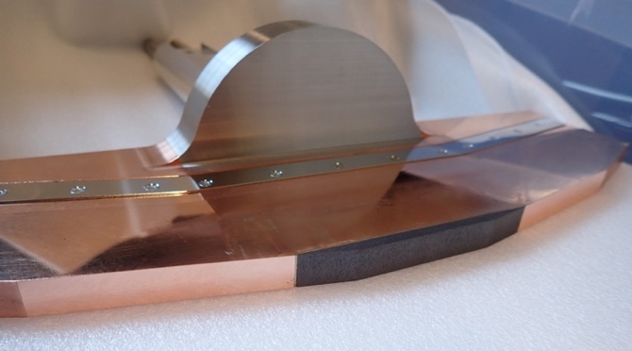
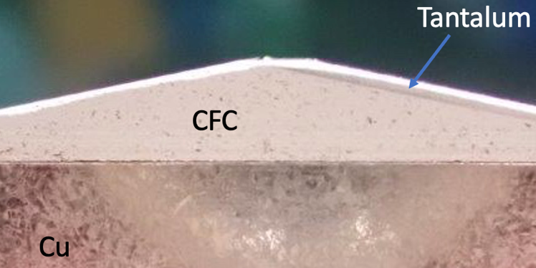
Design (tip-material)
Note that any materials should melt if high current beams hit the tip.
  3.6 A → 2.25×10¹⁴ e⁻/pulse; 225 times higher than the simulation
We had used tungsten for the default material. However, it was found that if it was damaged by the beam hit, it become embrittled and generate a lot of radioactive dusts.
Tantalum has been used as a default material now (less likely to generate radioactive dusts).
A special type of jaws named low-Z/carbon made from carbon fiber reinforced carbon (CFC) was developed for a more robust collimator, but the impedance problem arose and was removed (low electric conductivity and longer radiation length).
A special type of jaws named hybrid made from CFC and Ta was developed for the robust collimator. This jaw has been used without being damaged. If a high beam current induced in, it will break, and we don't know what state it will be in if it breaks.
Damaged jaw
Hybrid jaw (CFC+Ta)
Tantalum
Maximum temperature for various materials simulated by EGS4 [T. Sanami]. 1×10¹² e⁻/pulse is equivalent to 16 mA.
CFC
Cu coating
Cu
Carbon jaw
9

Slide 10
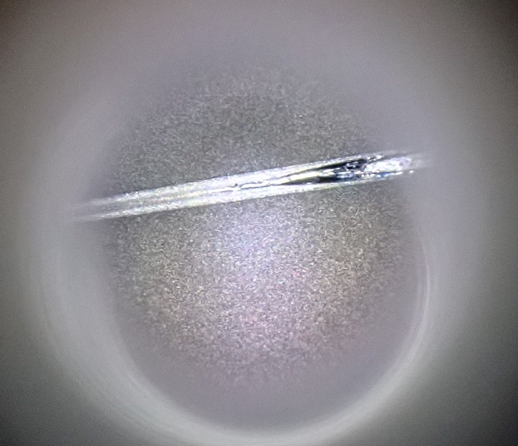
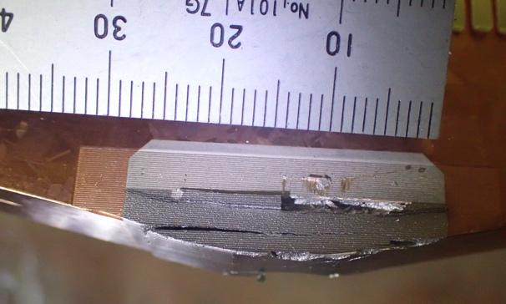
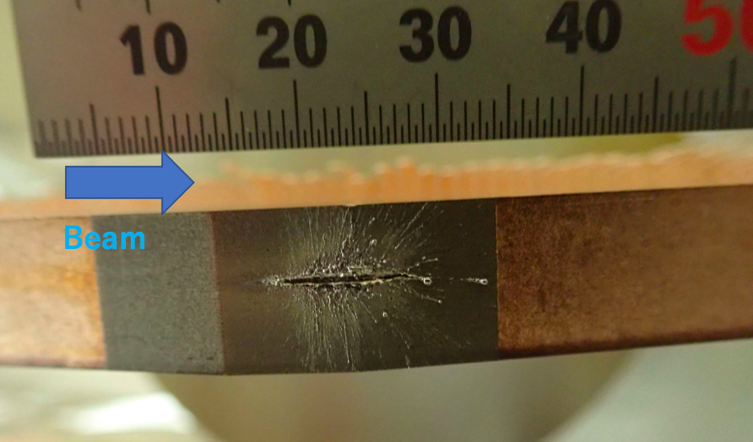
Major Issue (damage)
The collimators have been frequently damaged due to beam hits.
The source of beam instability that causes damage to the vertical collimators is still unknown (sudden beam loss).
On the other hand, there are damaged events for known reasons, and that is the damage to a horizontal collimator (D06H3) caused by accidental-firings of injection kickers in LER.
Damaged tip of D09V1 (KEKB type) in HER due to the sudden beam loss
Damaged jaw of D06H3 in LER due to the accidental-firings
Damaged jaw of D02V1 in LER due to the sudden beam loss

Slide 11
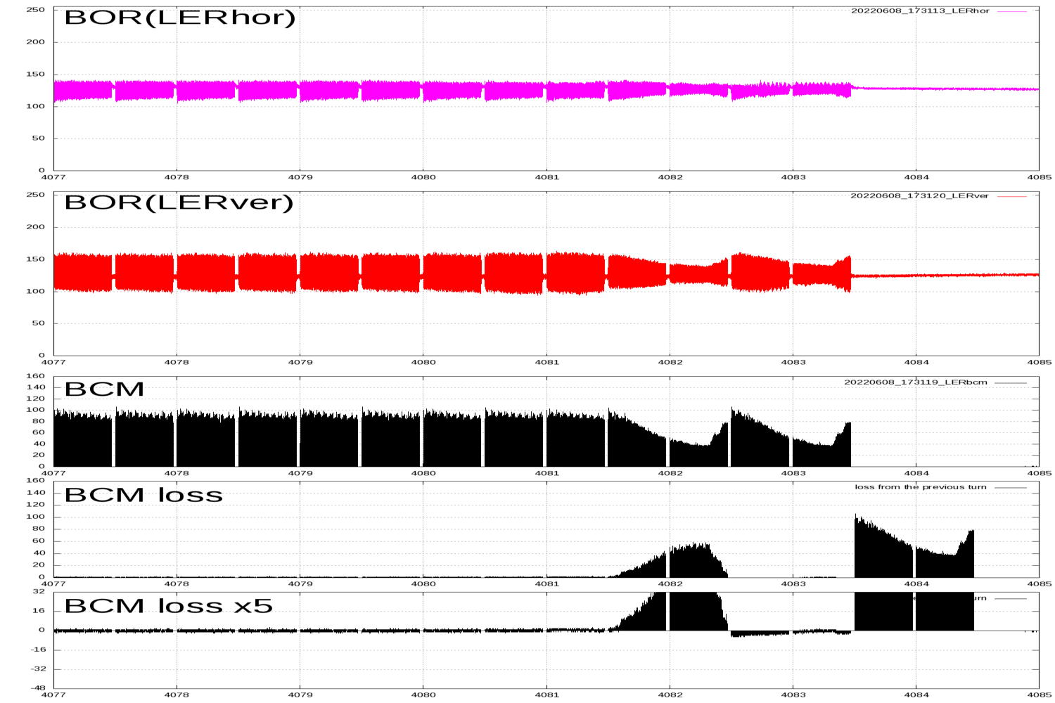
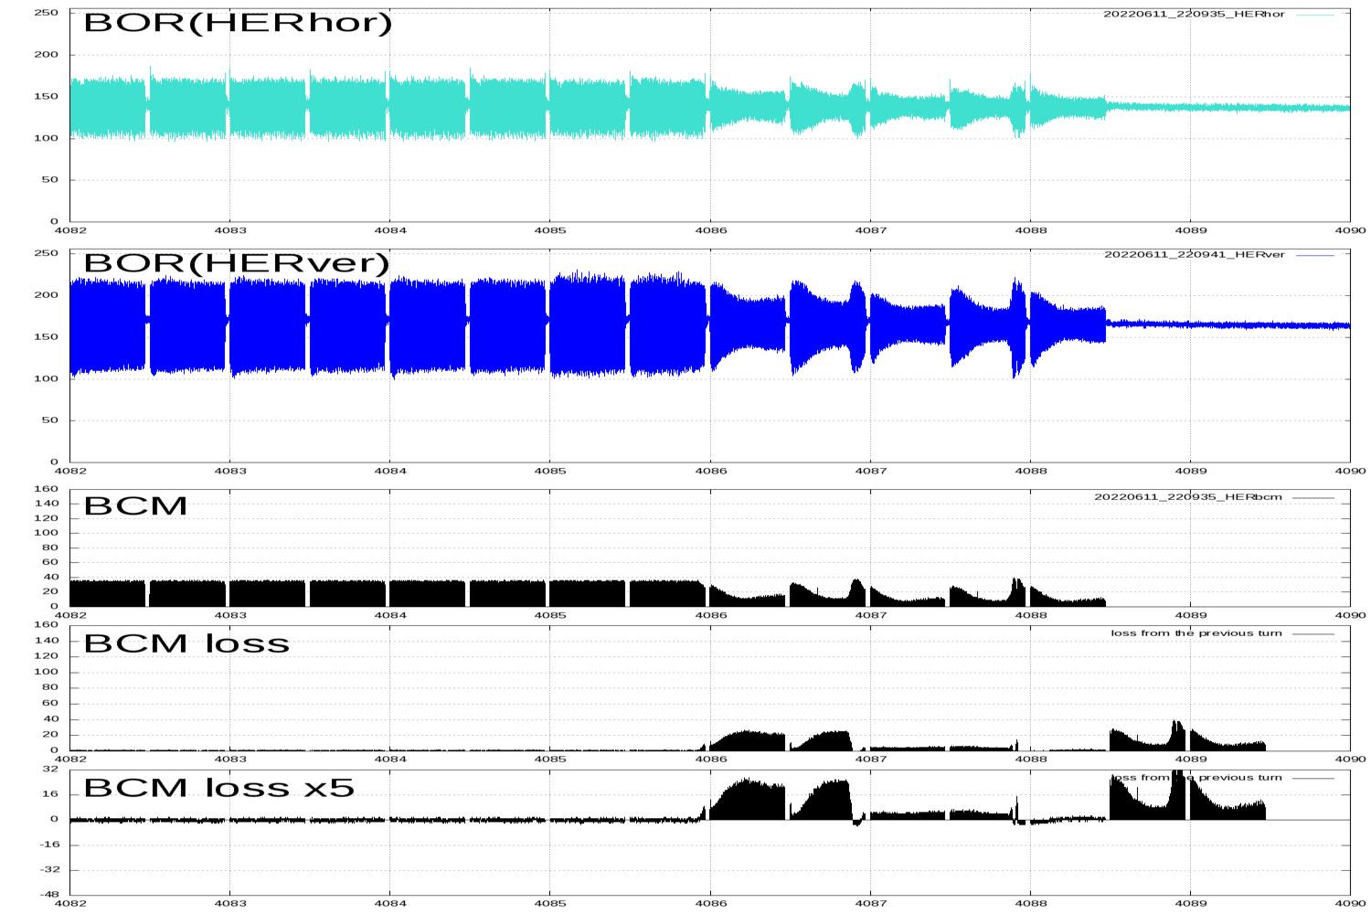
Major Issue (damage – sudden beam loss)
Sudden beam loss has occurred within approximately 2-turn (~20 μs) before the beam abort.
Beam orbit displacements in horizontal and vertical direction has been observe (H. Fukuma and S. Terui).
No increase in the beam size has been observed by a fast beam size monitor (G. Mitsuka).
This beam loss has never happened in single beam operation (because the short operation time with single beam?).
It is more common in LER, but has also occurred in HER.
Candidates of the cause [kick-off meeting of ITF sudden beam loss working group, https://kds.kek.jp/event/43499/]:
  X-abort, dust, fire-ball in collimators, electron cloud in vertical collimators, accidental-firings in abort kicker…
1st train
2nd train
a turn
Bunch oscillation recorder (BOR) and bunch current monitor (BCM), BOR signal is proportional to (bunch displacement)×(bunch intensity).

Slide 12
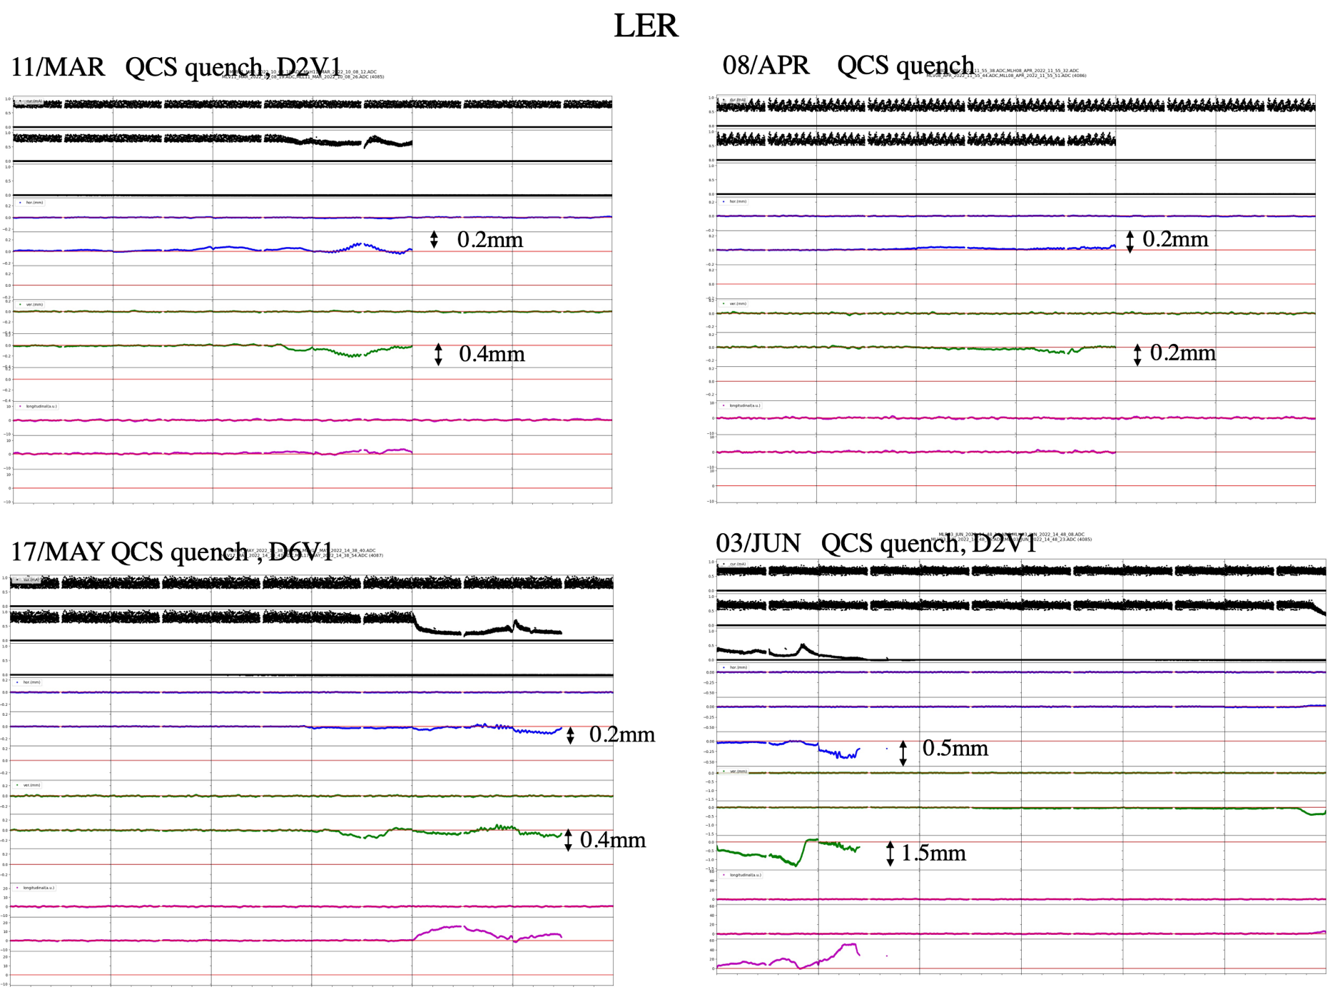
Major Issue (damage – sudden beam loss)
Beam orbit displacements in horizontal and vertical direction has been observed.
Current [mA]
[H. Fukuma]
Horizontal [mm]
Vertical [mm]
Longitudinal [a.u.]

Slide 13
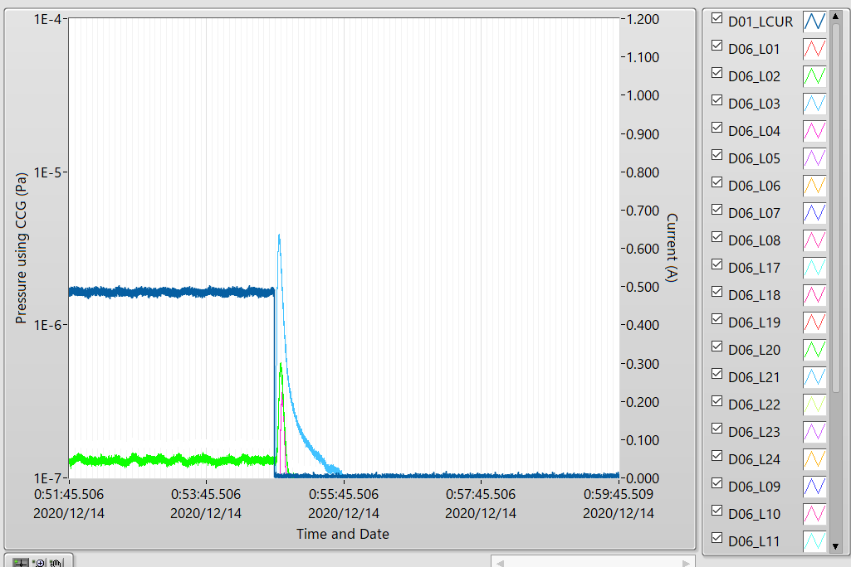
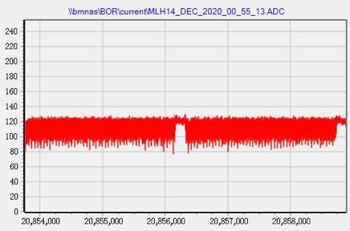
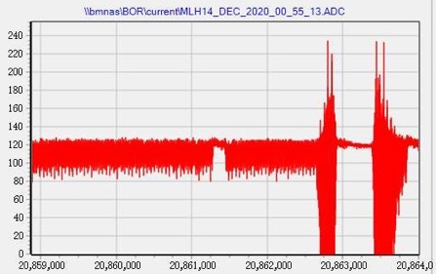
Major Issue (damage – accidental firings)
Accidental firings of injection kickers have happened in LER.
(example) 2020-12-14 0:55, beam abort (VXD diamond) with pressure burst at D06H3.
  LER: 480 mA, HER: 449.9 mA
  A part of the bunches was suddenly kicked by an accidental firing of the injection kickers.
  Tips of D06H3 were seriously damaged by the beam hit.
In the current system, we cannot make the probability of the accidental firing zero, so some horizontal collimators in each ring has been used to protect the components against the accidentally kicked beams.
As countermeasures against this,
  Carbon jaws will be installed in D06H3 and used as a spoiler of the crazy beams.
  D06H1 will move to D06H4 and used as an absorber of crazy beams due to accidental firings of injection kickers.
LER beam current and pressure near D06H3 collimator
BOR(H)
next turn
[S. Terui]
LER current
CCG D06_L03
1st train
2nd train
kicker accidental-fire

Slide 14
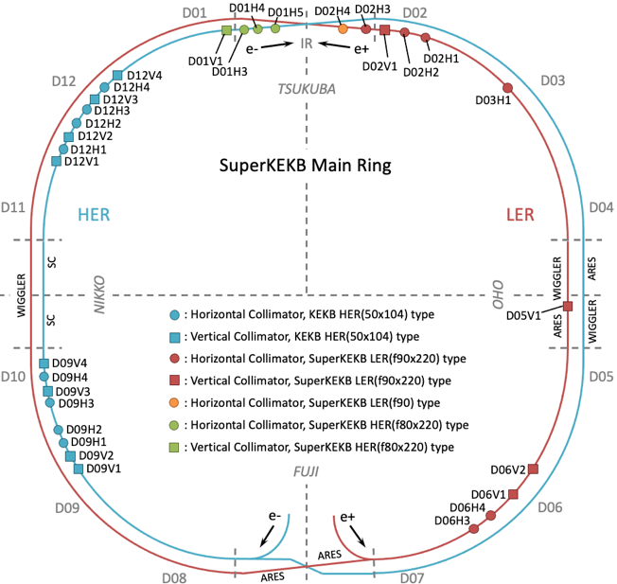
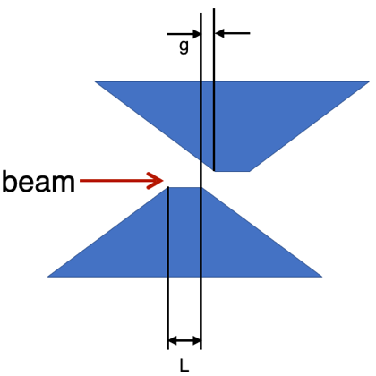
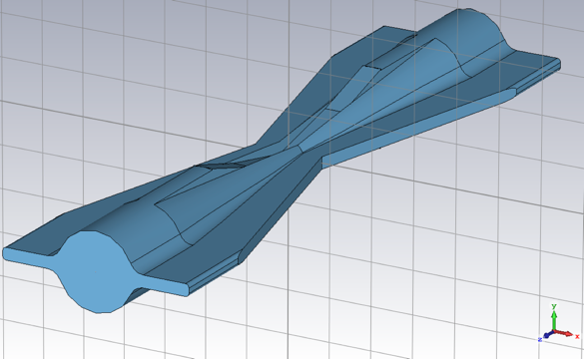
Summary and plans
The SuperKEKB type collimators have been working well up to the beam current of approximately ~1.46 A in LER without any abnormal temperature rise and electric discharge.
These collimators have been indispensable for the Belle II and SuperKEKB operation.
Collimators have been frequently damaged due to
  accidental firings of injection kickers in LER,
  sudden beam loss in the both rings.
We’re developing new jaws made from Ti or MoGr for a more robust collimator in terms of the beam hits.
  We are developing jaws that are hard to damage or have little effect on the background even if they are damaged.
  Even if these are realized, they are only tentative measures, because any materials should melt if high current beam hit the jaw. It is essential to eliminate sources that causes the crazy beam (sudden beam losses and accidental-firings in injection kickers), ideally.
In addition, several ideas have been proposed t make the collimator system more robust.
  very short length tip (~1 mm) with high-Z material (shielding performance decrease)
  alternate jaws (impedance increase and trapped mode)
  wider jaws (impedance increase)
  operation of double D02V1 in tandem (trapped mode)
  vertical collimator at downstream of IP, that is D01 for example
  (): cons
alternate jaws
wider jaws

Slide 15
Thank you for your attention.

Slide 16
Back-ups

Slide 17
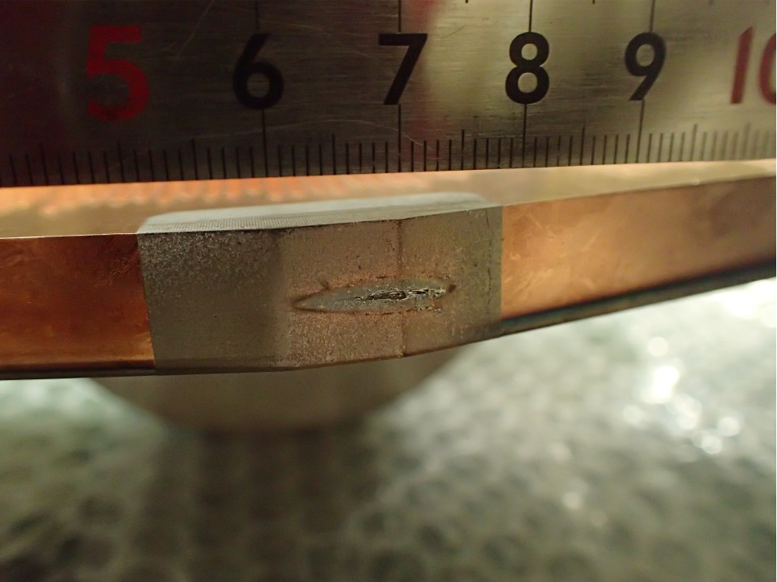
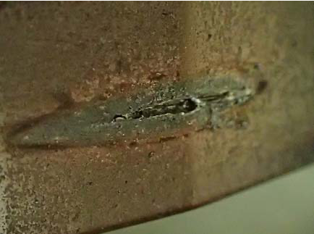
Damage of Cu coated Ta jaw

Slide 18
Impedance (vertical beam size blow-ups in LER)
In single-beam operation (no collision) in LER:
Vertical beam size blow-ups have been observed at ~1.0 mA/bunch, and the threshold of this instability depends on the aperture setting of the vertical collimators, tuning of the vertical bunch-by-bunch feedback and so on.
ITF TMCI working group (contact person: Mauro Migliorati, sub-contact person: me) had worked to find countermeasures against this and investigation of the mechanism through simulations and machine studies.
  ITF TMCI working group: https://kds.kek.jp/category/2247/
  ITF meetings: https://kds.kek.jp/category/2322/
A peak around ν_{y}-ν_{s} appears when the blow-ups occur (so we’ve called this “-1 mode instability in the group).
Tune surveys indicate that this instability is not derived from a stop band of ν_{y}-ν_{x}-2ν_{s}=N.
The dipole oscillation due to the -1 mode instability is spontaneously damped.
  The growth time is 3.5 ms to 8 ms.
The 0- and -1-mode seem to be coupled at around ~2.0 mA (ordinary TMCI) from a linear regression in a measurement.
We’ve found some effective countermeasures to the -1 mode instability.
  Tuning of the vertical bunch-by-bunch feedback (BxB FB),
  Increase the vertical tune,
  Increase the vertical chromaticity,
  Reducing the impedance in the vertical direction by opening vertical collimators.
The forth point is one of motivations to construct a non-linear collimator (talked on the last meeting by Y. Funakoshi, https://kds.kek.jp/event/42211/), and we’ve decided to construct it.
This instability can be reproduced by simulation using transverse wake and high gain multi-tap feedback [K. Ohmi, “Impedance and instability studies at SuperKEKB”, eeFACT2022].

Slide 19
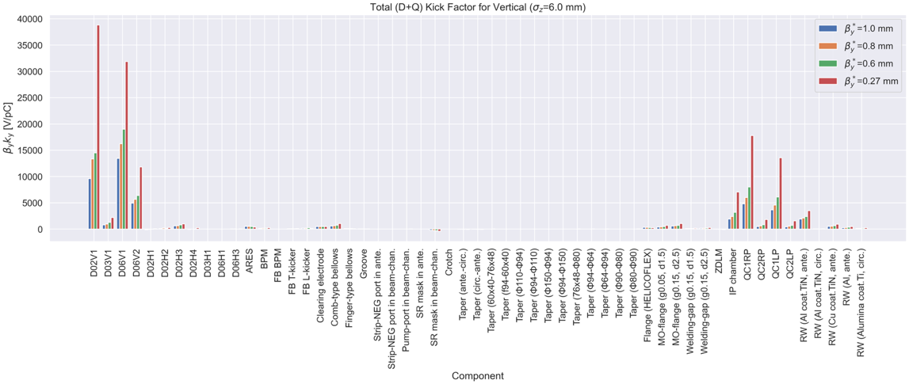
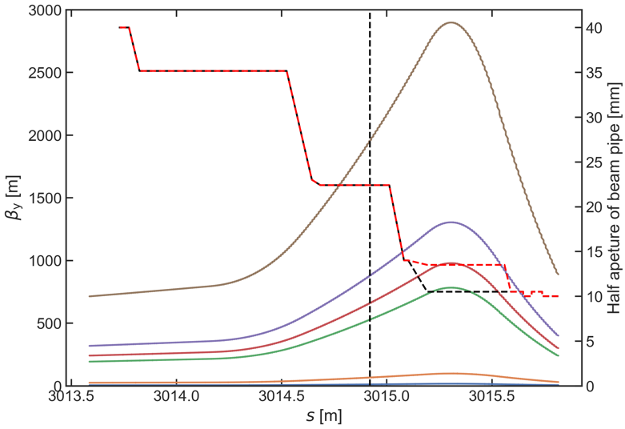
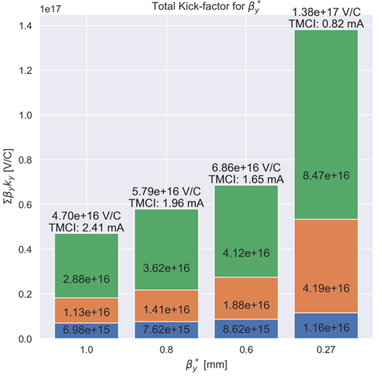

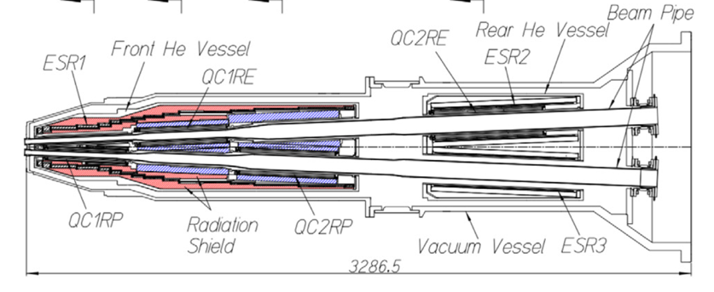
Impedance budgeting in LER
Half aperture of a QCS beam-pipe and vertical beta-function with each vertical beta-function at the interaction point as a function of the longitudinal location.
D06V1
Vertical collimators
Schematic drawing of QCS cryostat
Interaction region
$$I_{th}= \frac{4πν_{s}(E/e)}{T_{0}\sum_{i}{β_{y,i}k_{y, i}}}$$
$ν_{s}=0.022, E/e=4$ GV, $T_{0}=$ 1e-5 s
[N. Ohuchi et al., Nucl. Instrum. Methods Phys. Res.A, 1021, 165930 (2022)]
The collimator setting is based on that in physics run during 2021c with β_{y}* = 1.0 mm.
  β_{y}*: vertical beta function at the interaction point, QCS: final focusing superconducting magnets
The main vertical impedance sources are the vertical collimators and beam-pipes in the interaction region.
The reason why the kick factor in IR increases with squeezing β_{y}* is the β_{y} becomes bigger and bigger with the squeezing.
The calculated threshold of transverse mode coupling instability is 0.82 mA/bunch for β_{y}* = 0.27 mm, and this can limit the current in the future.

Slide 20
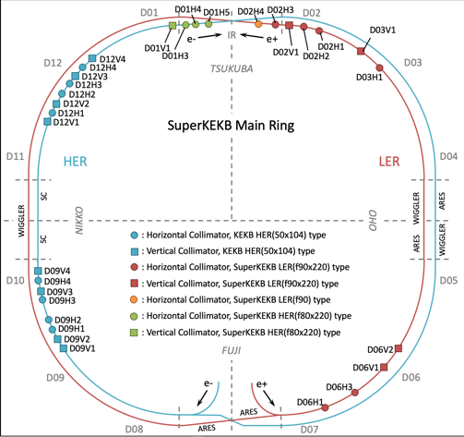
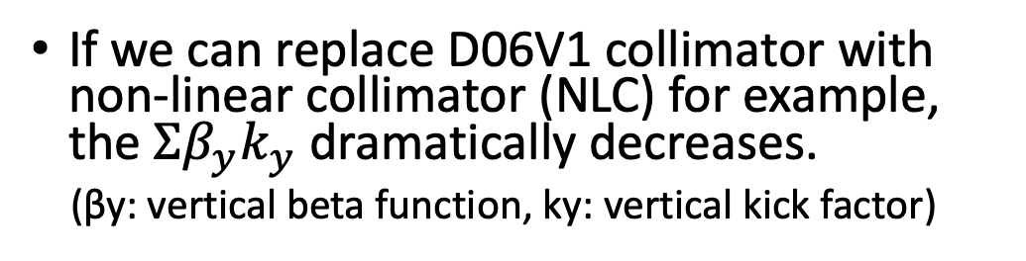
Impedance - non-linear collimator
Present collimator setting (2021ab)
  D06V1: primary collimator: most tightly closed and suppresses the injection BG.
  D02V1: second collimator: closest vertical collimator to IP and very important to suppress BG
  D06V2, D03V1: backup: not so tightly closed. D03V1 can be used for a backup of D02V1.
If we can replace D06V1 collimator with non-linear collimator (NLC) for example, the $Σβ_{y}k_{y}$ dramatically decreases.
(βy: vertical beta function, ky: vertical kick factor)
D05V1
(non-linear collimator)

Slide 21
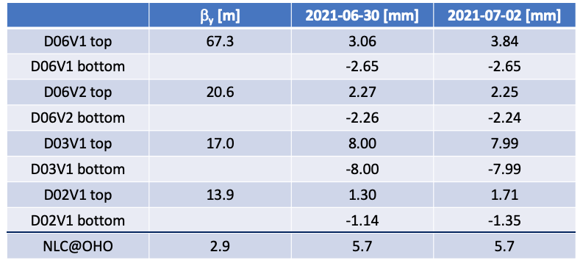
Impedance - non-linear collimator
Collimator setting (half-aperture) during physics run in 2021b (βy*=1 mm)
The β_{y} at the D06V1 is large, and the aperture is narrow.
The β_{y} at the NLC is small, and the aperture is wide.
→ We could dramatically decrease the $Σβ_{y}k_{y}$ if we can replace D06V1 with NLC.

