Slide 1

FCC-ee Collective Effects
Emanuela Carideo
M. Migliorati, F. Zimmermann, M. Zobov, D.Quartullo, Y.Zhang, M.Behtouei, B.Spataro
FCCIS – The Future Circular Collider Innovation Study. This INFRADEV Research and Innovation Action project receives funding from the European Union’s H2020 Framework Programme under grant agreement no. 951754. The information herein only reflects the views of its authors and the European Commission is not responsible for any use that may be made of the information.

Slide 2
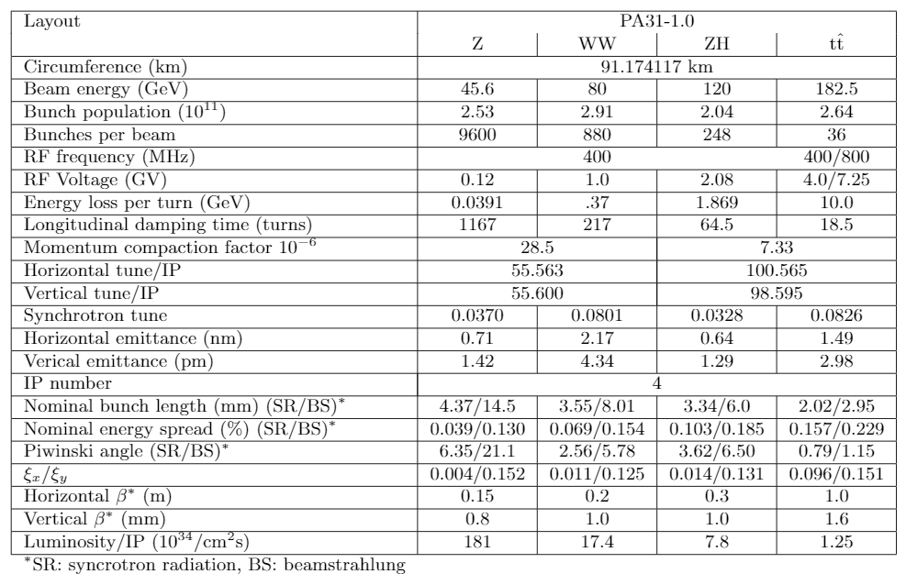

FCC-ee main parameters

Slide 3
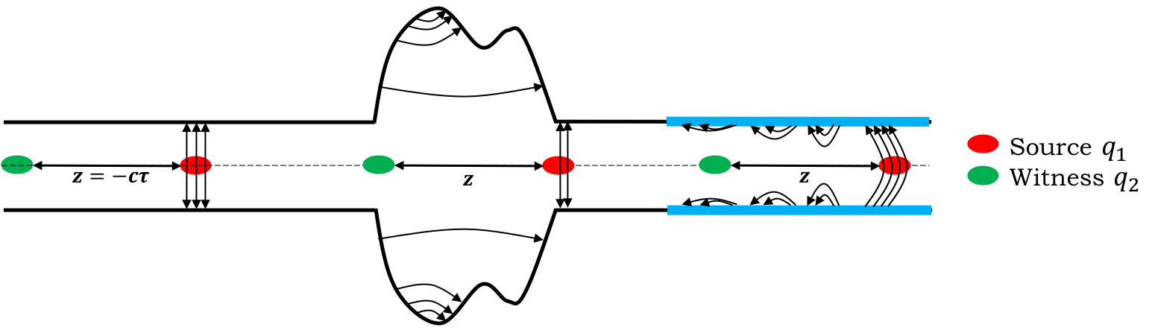
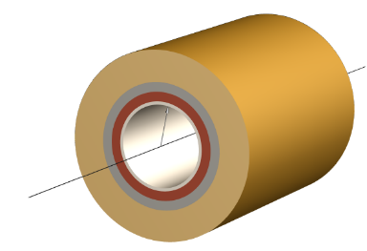
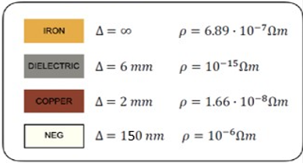
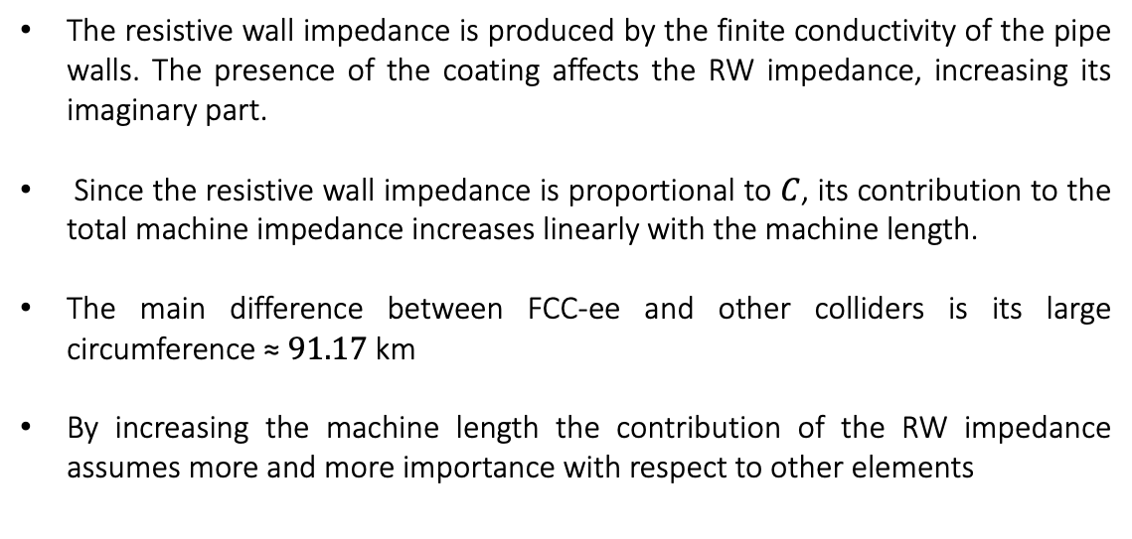
Resistive wall
The interaction of the beam with the environment can produce wakefields (impedances in the frequency domain) that induce instabilities
      The resistive wall impedance is produced by the finite conductivity of the pipe walls. The presence of the coating affects the RW impedance, increasing its imaginary part.
      Since the resistive wall impedance is proportional to $C$, its contribution to the total machine impedance increases linearly with the machine length.
      The main difference between FCC-ee and other colliders is its large circumference ≈ $91.17$ km
      By increasing the machine length the contribution of the RW impedance assumes more and more importance with respect to other elements
35mm
      In FCC-ee, RW represents the main source of wakefields

Slide 4
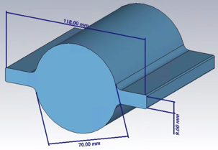
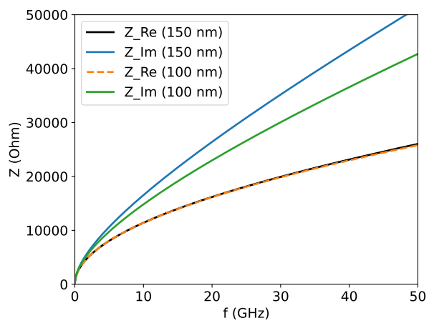
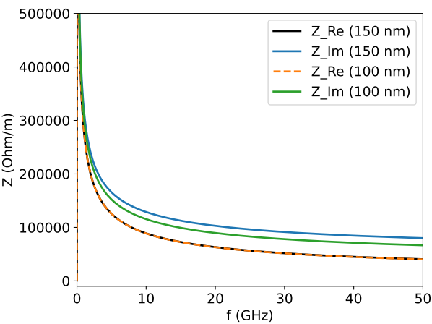
NEG coating is needed to mitigate the electron cloud build-up in the positron machine and for pumping reasons in both rings.
IW2D results for a circular pipe. We estimated a factor 1.1 for winglets contribution
Longitudinal Impedance
Transverse Impedance

Slide 5
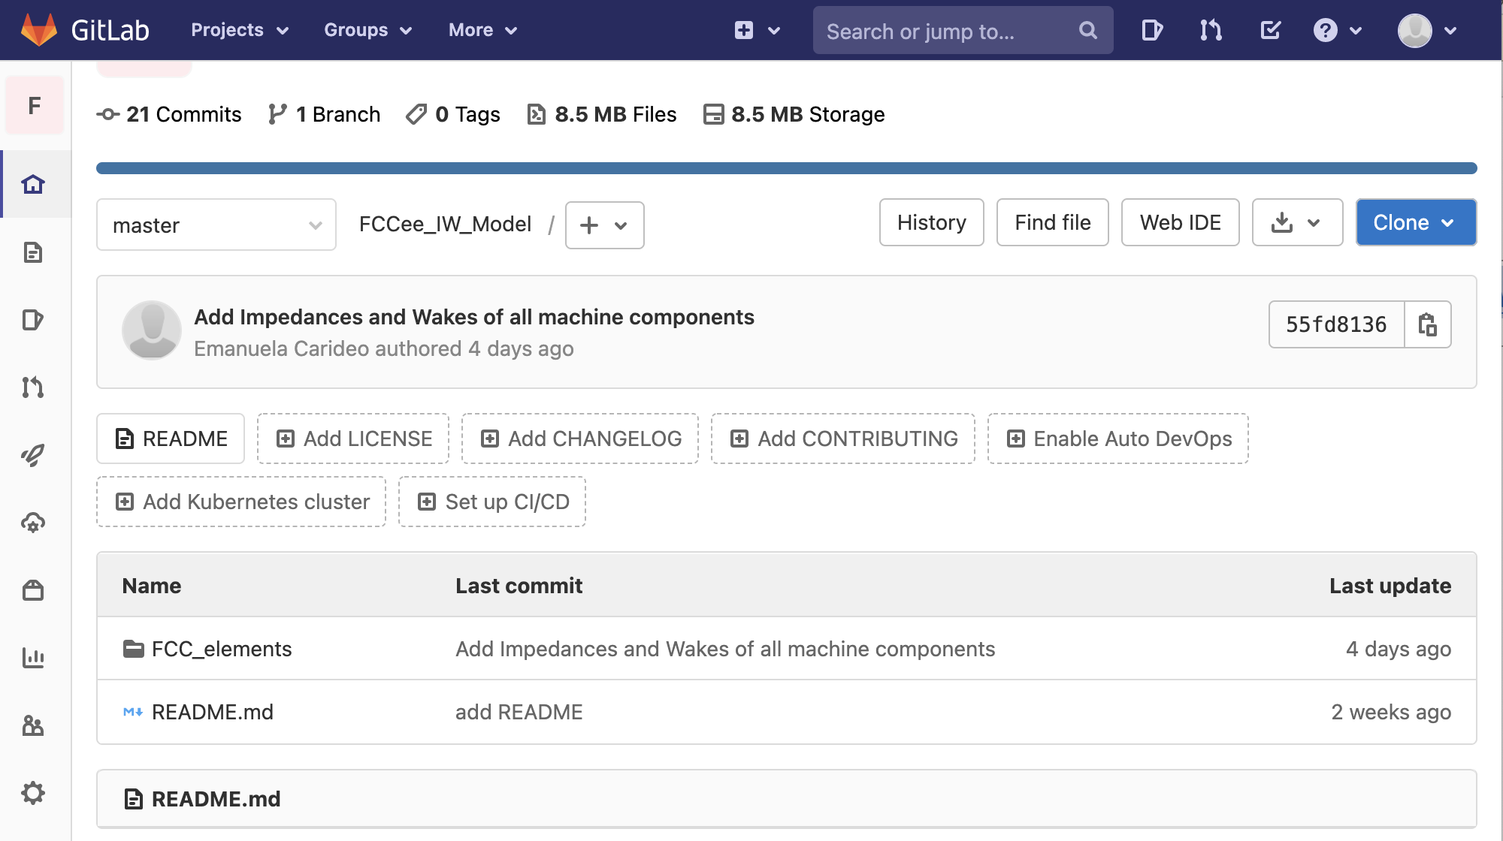
Wake and impedance repository for FCC-ee: https://gitlab.cern.ch/ecarideo/FCCee_IW_Model
A repository, or Git project, encompasses the entire collection of files and folders associated with a project. Working in repositories keeps development projects organized and organized and protected.
The Repository also provides more opportunities for project transparency and collaboration, working together to build the best possible final product.
How is it developed?
In this folder there are some of FCC-ee components and for each machine components the calculated impedance and wake

Slide 6
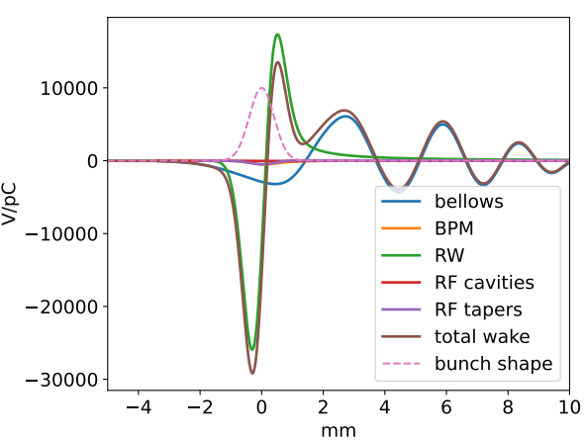
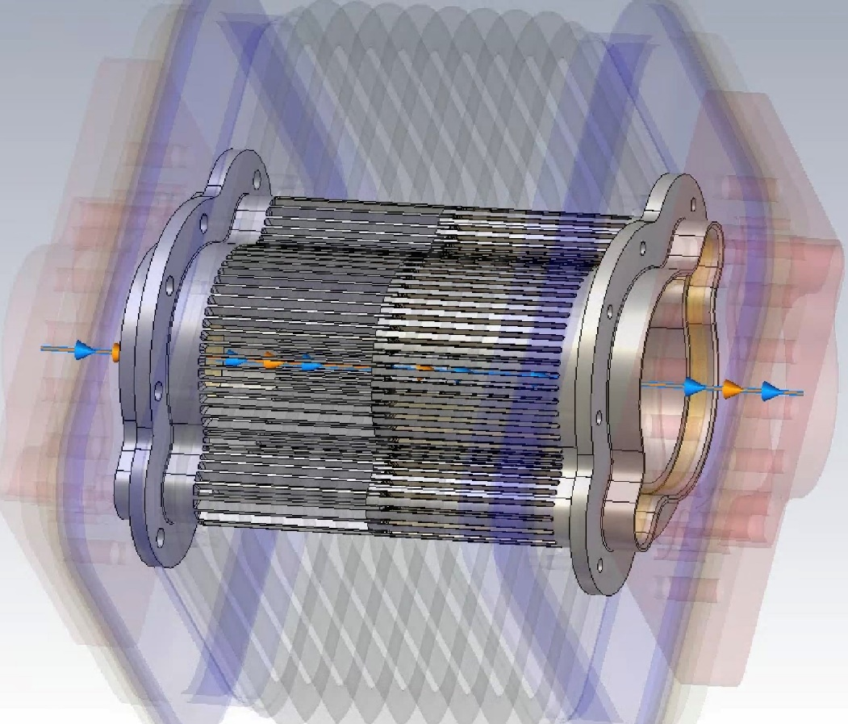
Impedance Sources: CST and IW2D simulations
Longitudinal wake potentials for a Gaussian bunch with nominal bunch length, 4.37 mm, due to the main FCC-ee components, evaluated so far.
The bellows represent the second highest impedance source. We have used an upper estimate of 20000 bellows
How did we do these simulations?

Slide 7
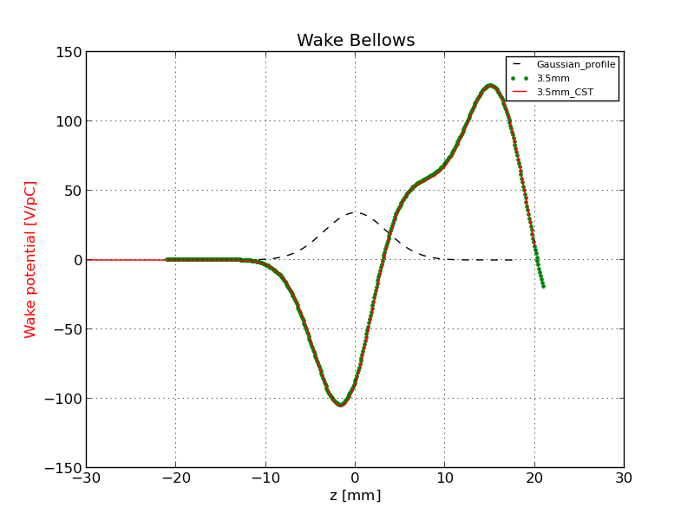
Method to calculate the Wake Potential by software simulation
Comparison of the wake potential of 3.5 mm bunch length between PyHT and CST: Bellows
Wake potential for a Bellow of a 3.5 mm Gaussian bunch obtained directly by CST (red curve) and with the convolution by using the wake potential of 0.4 mm Gaussian bunch (green dots).

Slide 8
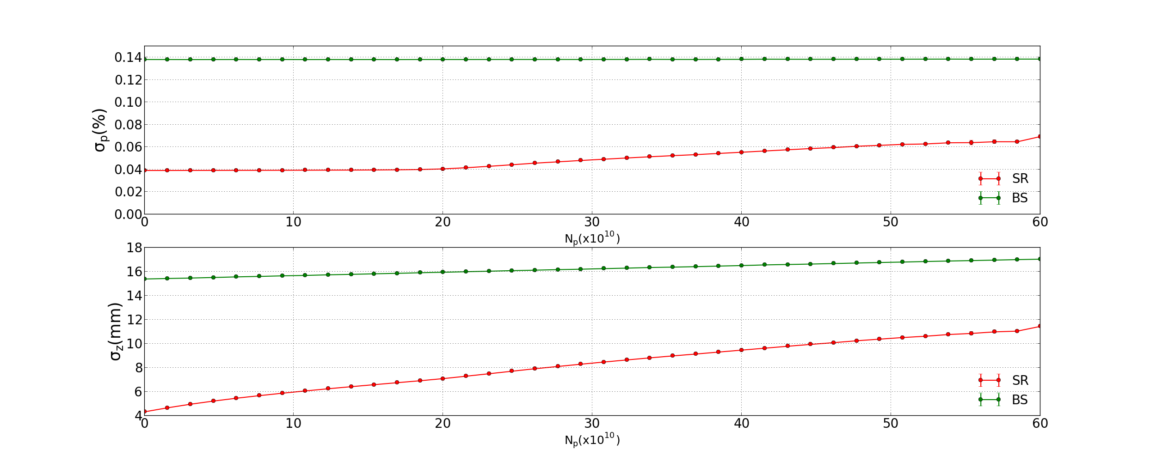
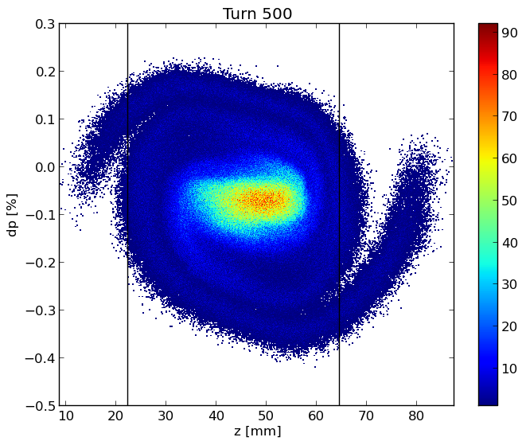
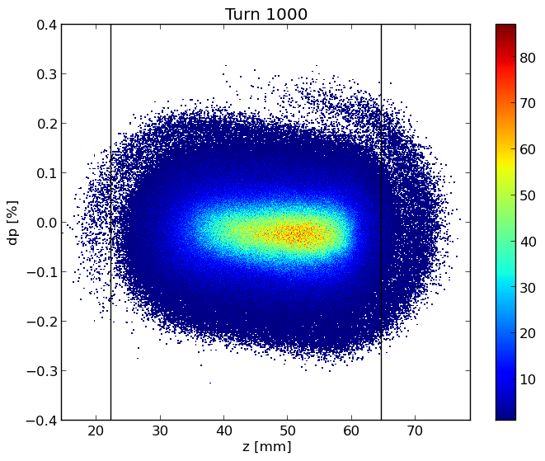
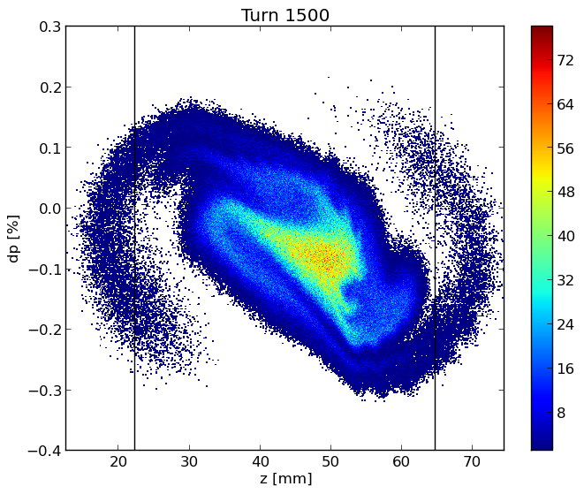
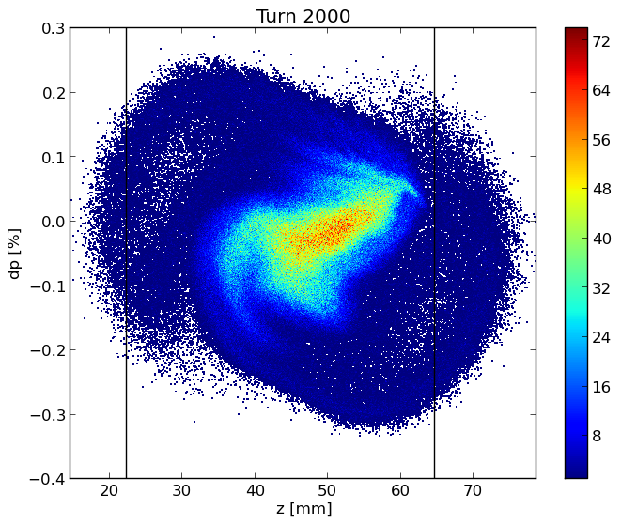
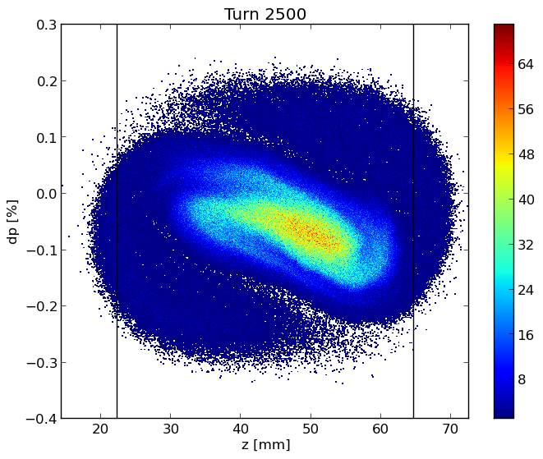
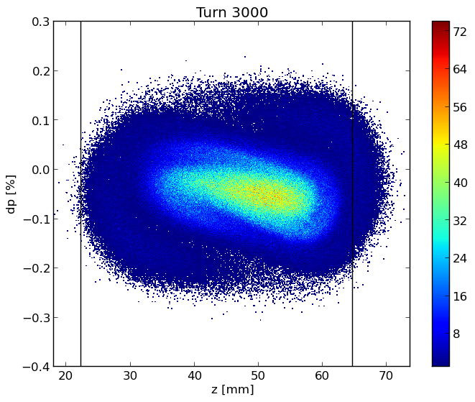
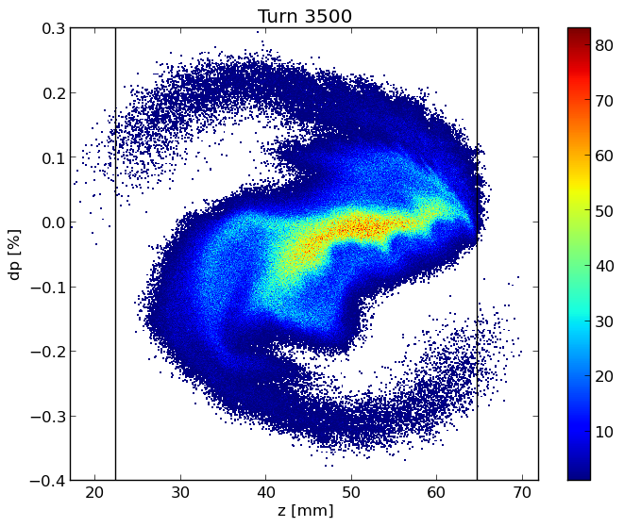
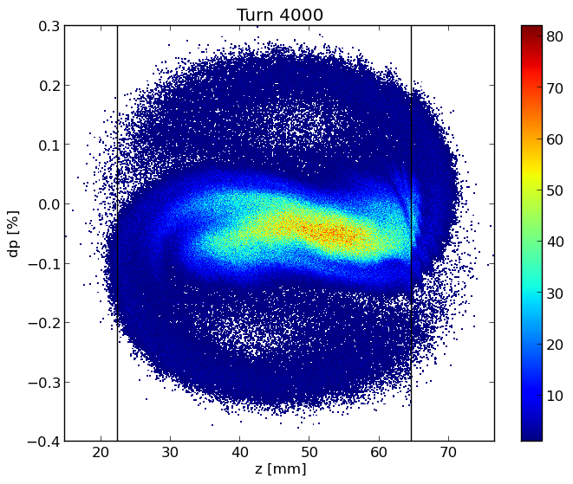
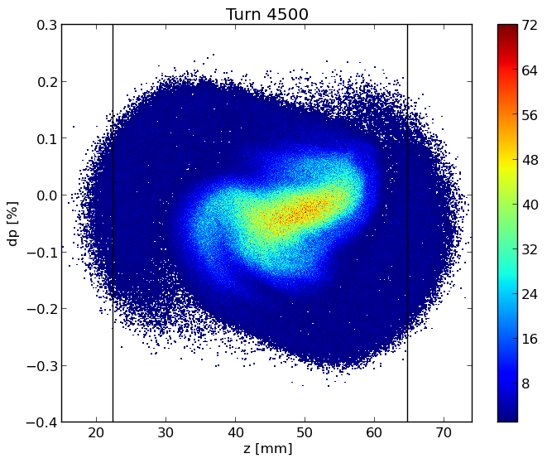
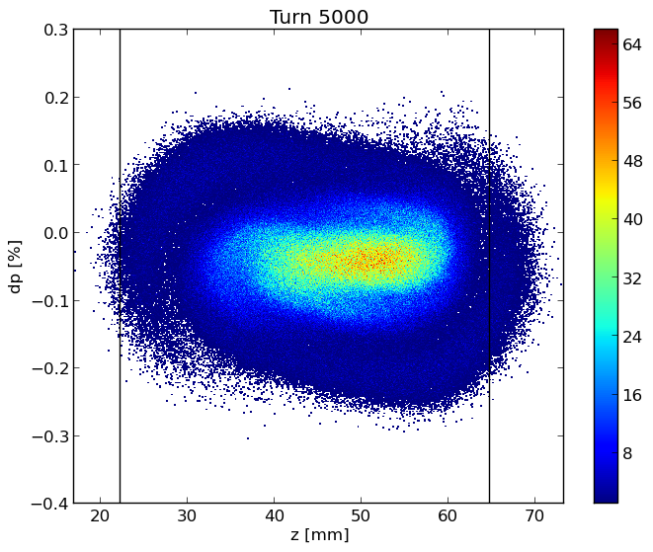
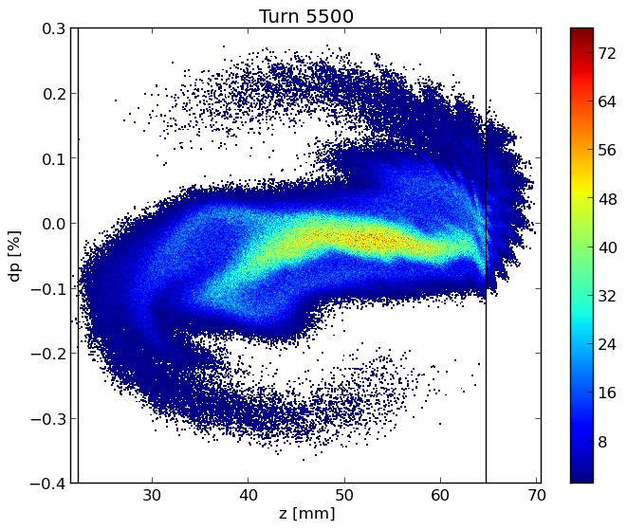
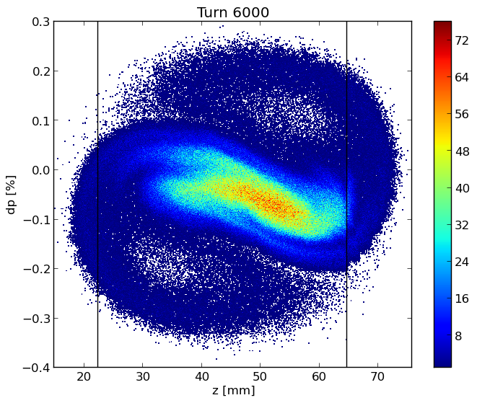
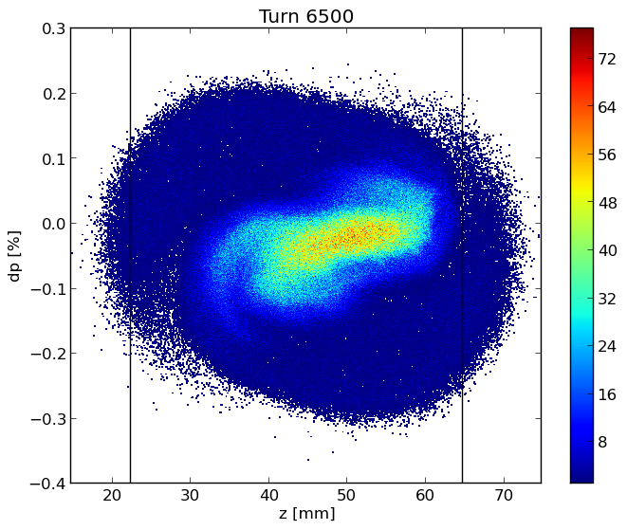
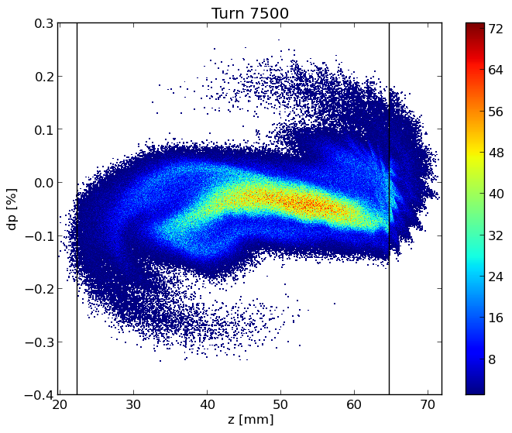
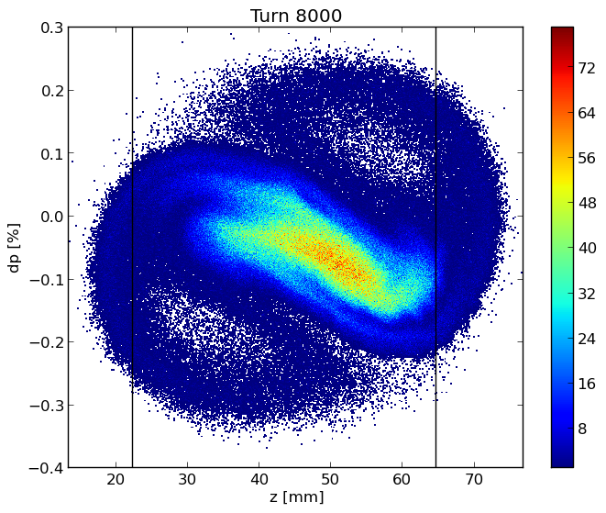
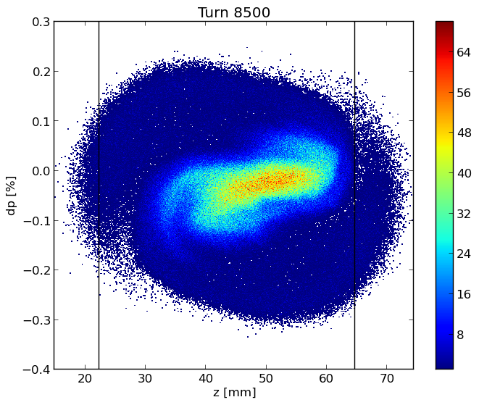
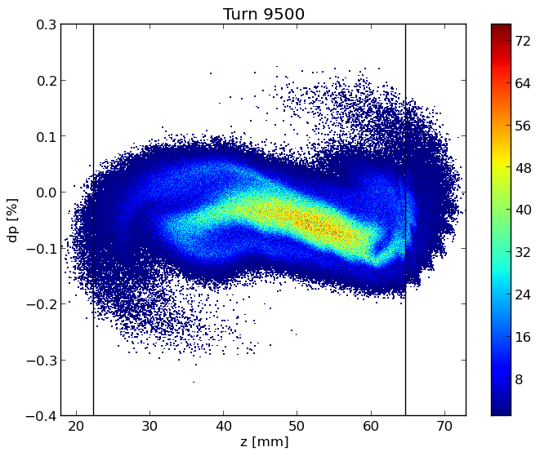
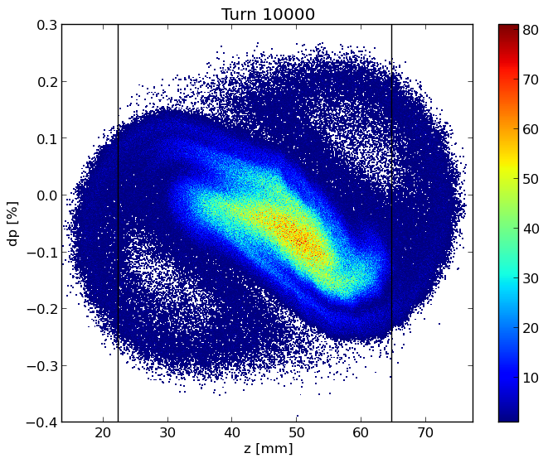
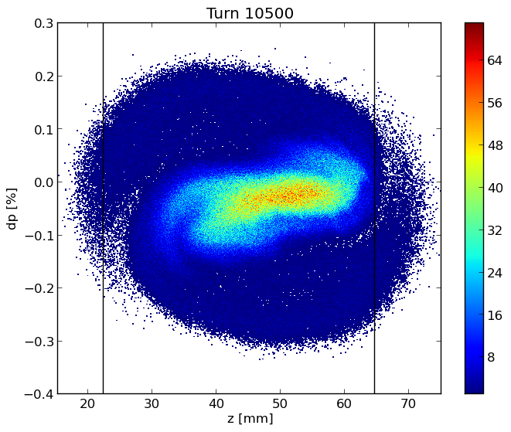
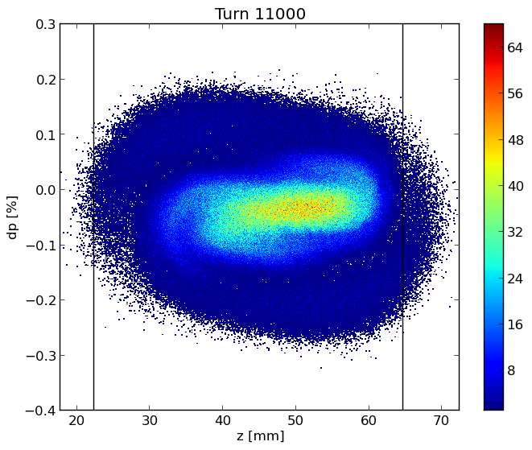
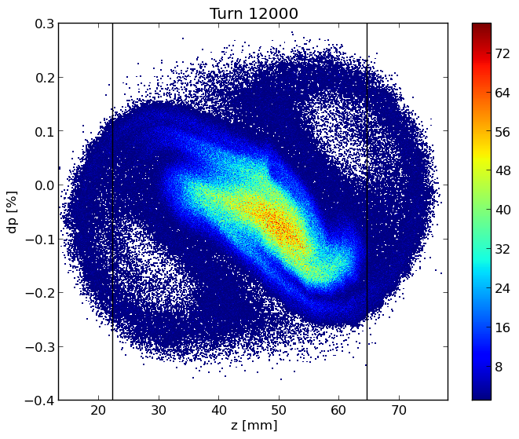

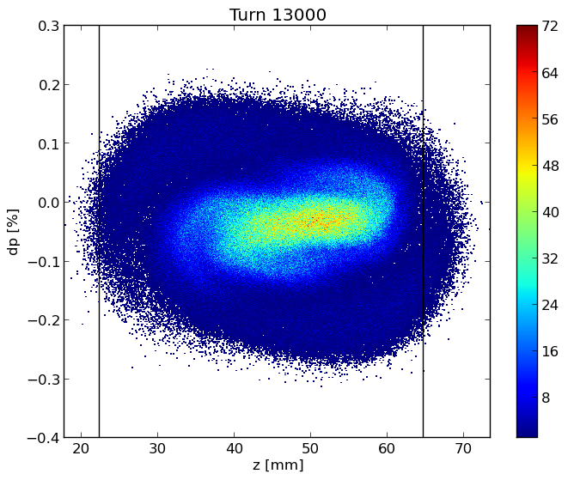
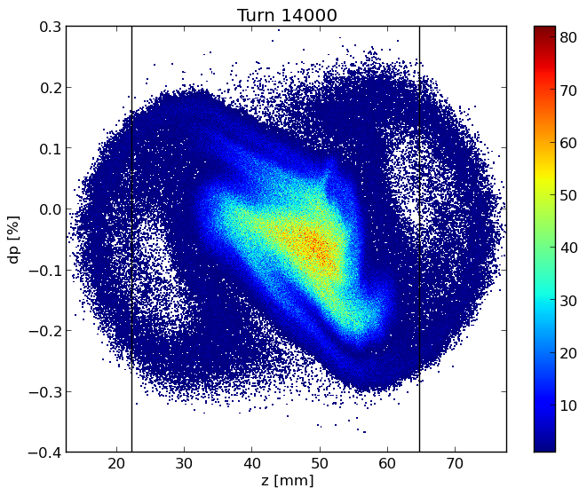
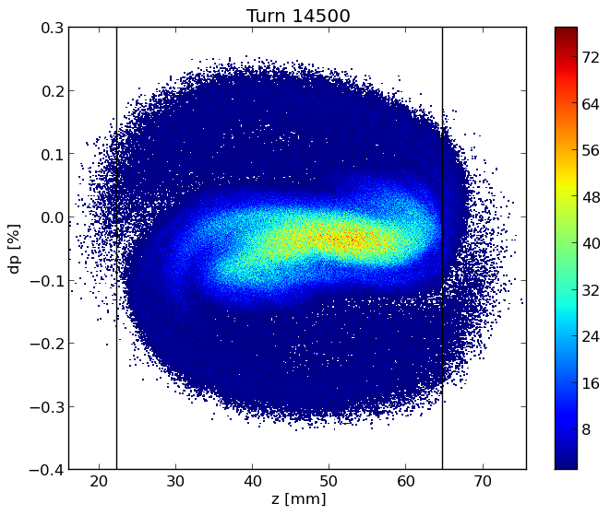
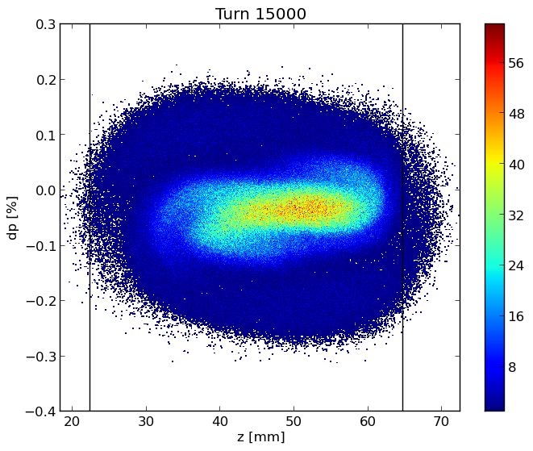
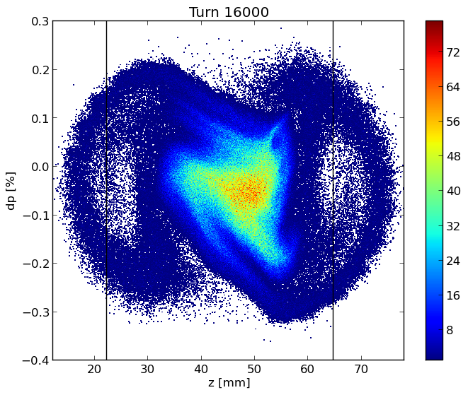
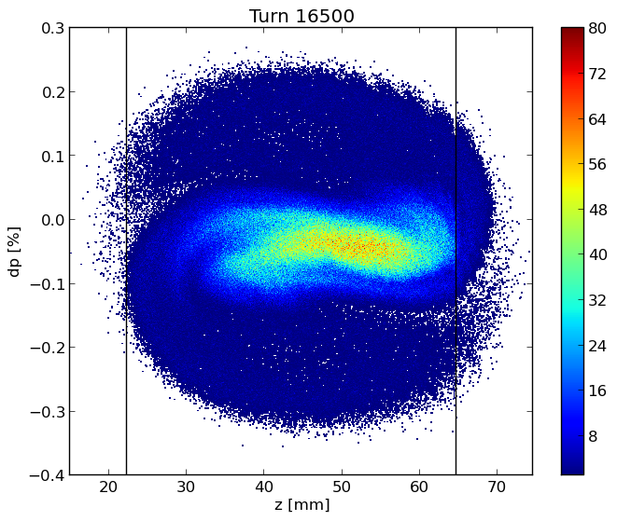

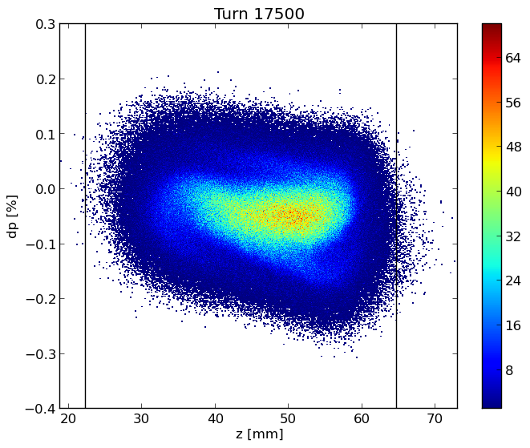
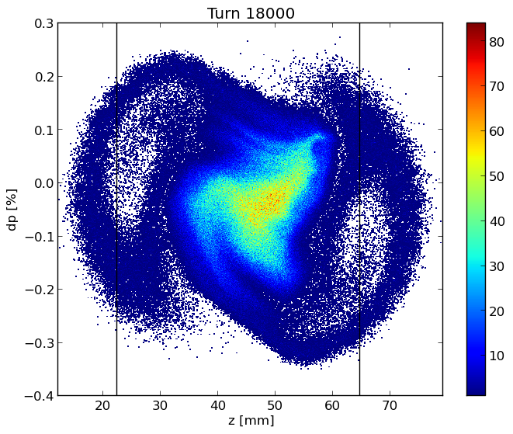
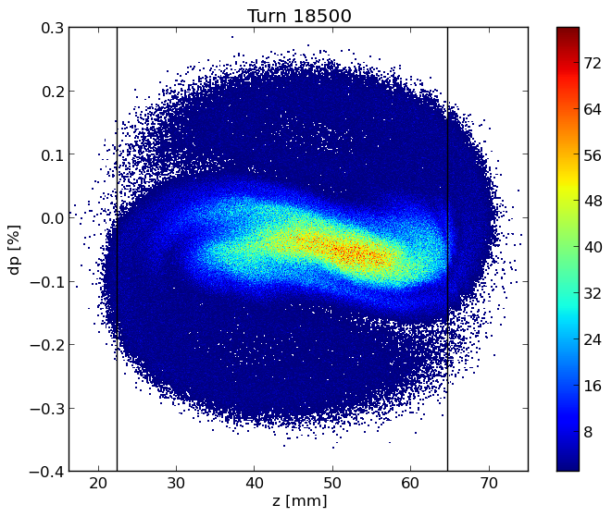
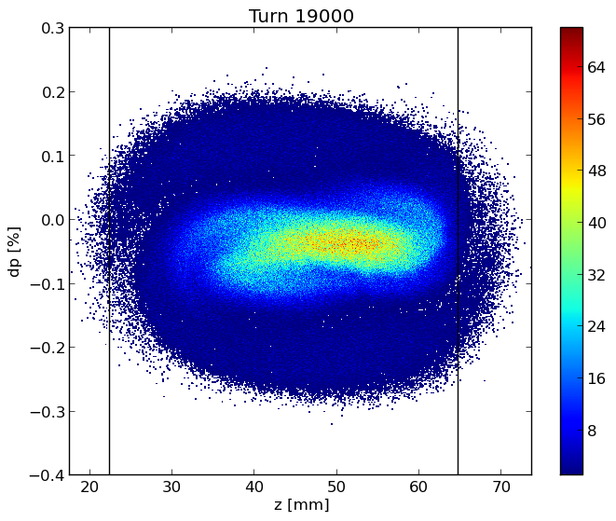
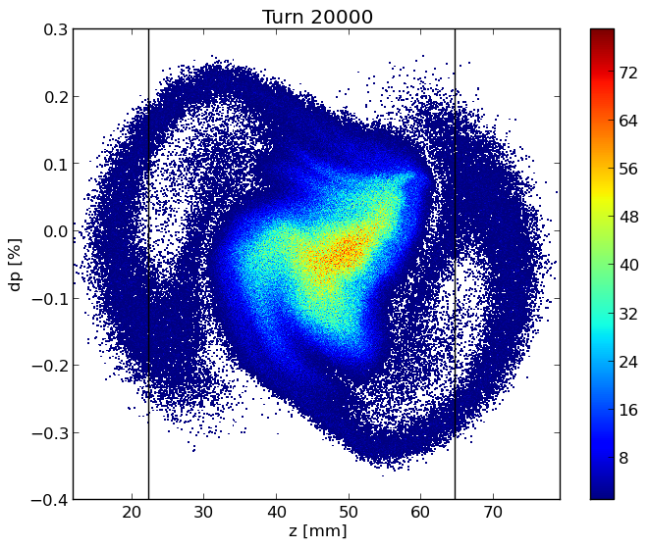
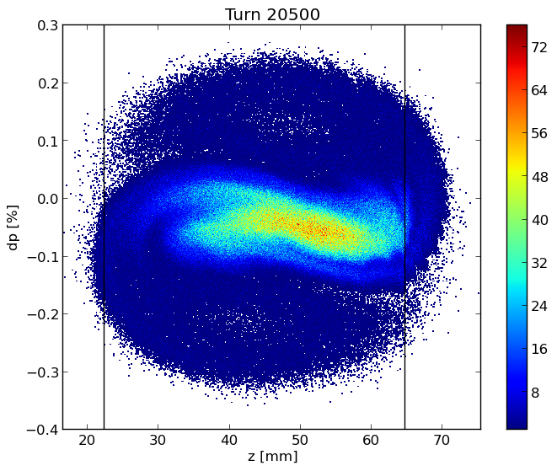
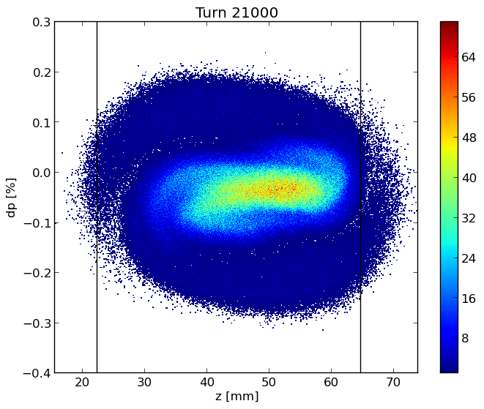
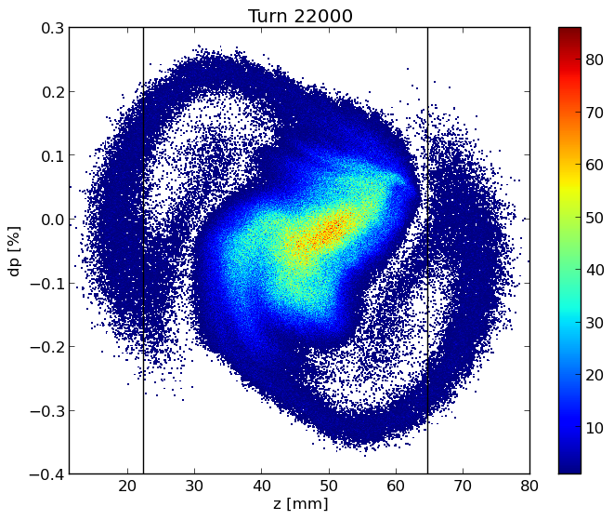
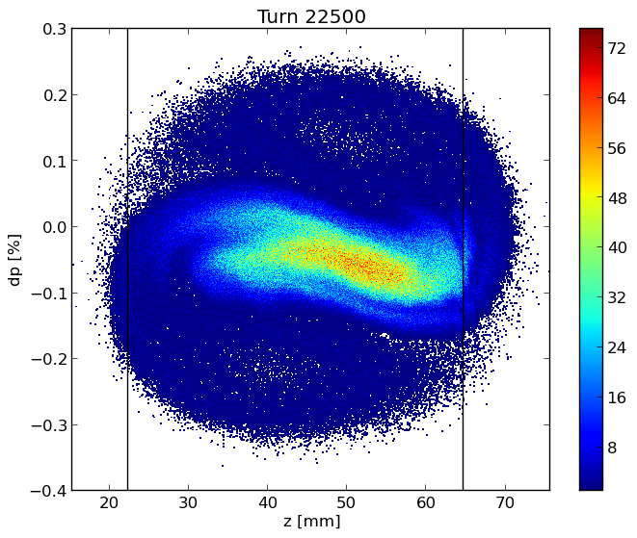
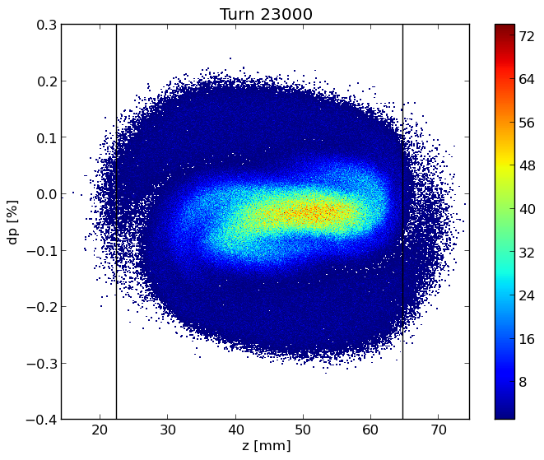













Longitudinal dynamics
Longitudinal phase space
Bunch length (bottom) and RMS energy spread (top) as a function of bunch population in the case with (BS) and without (SR) beamstrahlung, which is considered here independent of the longitudinal impedance.

Slide 9


Bunch length and energy spread for considered cases
The transverse impedance almost does not affect the longitudinal dynamics

Slide 10


Transverse Dynamics
SR: Bunch length of 4.37 mm
The TMCI, Transverse Mode Coupling Instability,
occurs when the frequencies of two neighboring coherent oscillation modes merge together. Above the transverse instability threshold the bunch is lost and this makes the TMCI very dangerous for the beam.
On the top, real part of the frequency shift of the first coherent oscillation modes as a function of the bunch population without beamstrahlung, by considering only the transverse wakefield.
On the right, real part of the coherent tune shift as a function of intensity considering both longitudinal and transverse wakefield, by using PyHEADTAIL.

Slide 11
TMCI: longitudinal and transverse wake with a bunch length of 14.5 mm (BS)

Slide 12


Variable Chromaticity:
Dependence of the TMCI from the Chromaticity
On the left, real part of the frequency shift of the first coherent oscillation modes as a function of the bunch population without beamstrahlung, so considering a bunch length of 4.37mm and a value of Chromaticity of +5
On the right, real part of the frequency shift of the first coherent oscillation modes as a function of the bunch population without beamstrahlung, so considering a bunch length of 4.37mm and a value of Chromaticity of -5:
the 0-mode is unstable and a feedback system is necessary

Slide 13





TCBI and feedback system
Transverse Coupled Bunch Instability (TCBI)
$$\frac{1}{τ_{μ,⊥}}=−\frac{ecI}{4πEQ_{β}}\sum_{q}{Re\left[Z_{⊥}\left(ω_{q}\right)\right]G_{⊥}\left(\frac{σ_{z}}{c}ω_{q}^{′}\right)}$$
$$Re\left[Z_{⊥}\left(ω_{q}\right)\right]=\operatorname{sgn}\left(ω\right)\frac{C}{2πb^{3}}\sqrt{\frac{2Z_{0}c}{σ_{c}\left|ω\right|}}$$
where
$$ω_{q}=\left(qM+μ+Q_{β}\right)ω_{0}$$
$$ω_{q}^{′}=ω_{q}+ξ\frac{ω_{β}}{η}$$
The most dangerous mode is that closest to the origin (with negative frequency)
Rise time of about 6 revolution turns
A robust feedback is required for the instability suppression!

Slide 14

TMCI and feedback system
In SuperKEKB the transverse feedback was one important source of the ‘-1’ mode instability which limited the machine to reach the nominal intensity. Its damping time is around 100 turns, that is about 1000 1/s.
What is the effect of feedback in FCC-ee that needs about the same damping time, but this corresponds to only few turns?
Is the TMCI perturbed by the feedback? And what about the longitudinal effect of the wake?
A robust feedback is required for the instability suppression!
Introduction
[…] However, a resistive transverse damper also destabilizes the single-bunch motion below the transverse mode coupling instability intensity threshold (for zero chromaticity), introducing a new kind of instability, which has been called ITSR instability (for imaginary tune split and repulsion). […]

Slide 15


ITSR instability: Imaginary Tune Split and Repulsion
Only Transverse wakefield, resistive feedback, 10 turns damping time
$$N_{p}=16×{10}^{10}$$
$$N_{p}=18×{10}^{10}$$

Slide 16

ITSR instability: Imaginary Tune Split and Repulsion
Long. + Transverse wakefield, resistive feedback, 10 turns damping time
$$N_{p}=34×{10}^{10}$$
The spread in the synchrotron tune due to the longitudinal wakefield helps to mitigate the ITSR instability

Slide 17

ITSR instability: Imaginary Tune Split and Repulsion
Long. + Transverse wakefield, resistive feedback, 4 turns damping time
Beamstrahlung reduces the effect of the longitudinal wakefield which, on its turn, has a beneficial effect on the TMCI with a resistive transverse damper. What happens if both effects are present?
$$N_{p}=46×{10}^{10}$$

Slide 18
Challenges and Future Plan
Continue the work for the evaluation, reduction and optimization of the impedances of the main machine elements (e. g. collimators system), and also for implementing the FCC-ee repository.
Continue to investigate on the beam-beam effect, longitudinal and transverse coupling impedance
Continue to investigate diversified mitigation techniques: feedback system (resistive + reactive), chromaticity, …
Split the machine into segments, each one having its own longitudinal wake, transverse wake weighted by the local beta function, RF system (which is not evenly distributed along the machine), …
Study the effects of possible transverse localized impedances (in particular for the collimation system)
Use a more realistic transverse lattice
Other effects: electron could, (also multi-bunch), ion instabilities …

Slide 19
Thanks for your attention!

Slide 20
Back-up Slides

Slide 21

Updated FCC-ee impedance model: 20000 Bellows
We initially considered a number of 8000 Bellows
BUT
85% of arcs (~ 79 km)
Every arc is 8m long
X2 because we have another bellow before any quadrupole
12000-13000 but to be sure we are performing our calculations considering up to 20000 bellows

Slide 22

Method to calculate the Wake Potential by software simulation: Resistive Wall
Real and imaginary part of the resistive wall impedance calculated by using the code IW2D
Wake potential of a 0.4 mm Gaussian bunch convoluted with the nominal bunch length and compared with the wake potential obtained directly from the convolution of the wakefield with the 3.5 mm Gaussian bunch.

Slide 23

Comparison of the wake potential of 3.5 mm bunch length between PyHT and CST: BPMs

Slide 24

Comparison of the wake potential of 3.5 mm bunch length between PyHT and CST: RF Cavities

Slide 25

Comparison of the wake potential of 3.5 mm bunch length between PyHT and CST: RF double tapers
3.5 mm
3.5_ABCI

Slide 26


New Wakes with new machine parameters :
Longitudinal RW with 150nm of coating plus the Bellows without neglected the perturbation introduced by the lateral winglets used to place synchrotron radiation absorbers
https://indico.cern.ch/event/995850/contributions/4401571/attachments/2275135/3864813/FCCweek.pdf

Slide 27

Longitudinal dynamics: OLD machine parameters
Bunch length (bottom) and RMS energy spread (top) as a function of bunch population in the case with (BS) and without (SR) beamstrahlung, which is considered here independent of the longitudinal impedance.

Slide 28


Bunch length and energy spread
(old machine parameters)

Slide 29
Transverse Dynamics
The TMCI occurs when the frequencies of two neighbouring coherent oscillation modes merge together. Above the transverse instability threshold the bunch is lost and this makes the TMCI very dangerous for the beam.
In addition to simulations with the tracking code, the TMCI threshold has been also evaluated with the analytic Vlasov solver DELPHI
On the top, real part of the frequency shift of the first coherent oscillation modes as a function of the bunch population without beamstrahlung, by considering only the RW impedance produced by a NEG film with 150 nm thickness given by IW2D.
On the right, real part of the coherent tune shift as a function of intensity considering the longitudinal resistive wall wakefield, by using PyHEADTAIL.

Slide 30

TMCI
Without longitudinal resistive wall wakefield
Considering the longitudinal resistive wall wakefield

Slide 31




Transverse RW for a beam length of 12.1mm:
TMCI analysis
Transverse wake: PyHT vs Delphi
Considering the longitudinal wakefield
Without longitudinal wakefield
Longitudinal wake

Slide 32
TMCI: longitudinal wake (on the right) and transverse wake (on the left) with a bunch length of 14.5 mm

Slide 33
New evaluation of the impedances using different NEG coating : 100 nm 150 nm and 200 nm

Slide 34


Longitudinal dynamics

Slide 35
TMCI analyzes using wake with different NEGs : 100nm, 150 nm and 200 nm
On the letf the plot of the TMCI considering a wake with 100nm of NEG and a beam length of 3.5mm
On the right the plot of the TMCI considering a wake with 100nm of NEG and a beam length of 12.1mm

Slide 36


TMCI analyzes using wake with different NEGs :
100nm, 150 nm and 200 nm
On the letf the plot of the TMCI considering a wake with 150nm of NEG and a beam length of 3.5mm
On the right the plot of the TMCI considering a wake with 150nm of NEG and a beam length of 12.1mm

Slide 37


TMCI analyzes using wake with different NEGs : 100nm,150 nm and 200 nm
On the letf the plot of the TMCI considering a wake with 200nm of NEG and a beam length of 3.5mm
On the right the plot of the TMCI considering a wake with 200nm of NEG and a beam length of 12.1mm

