Slide 1


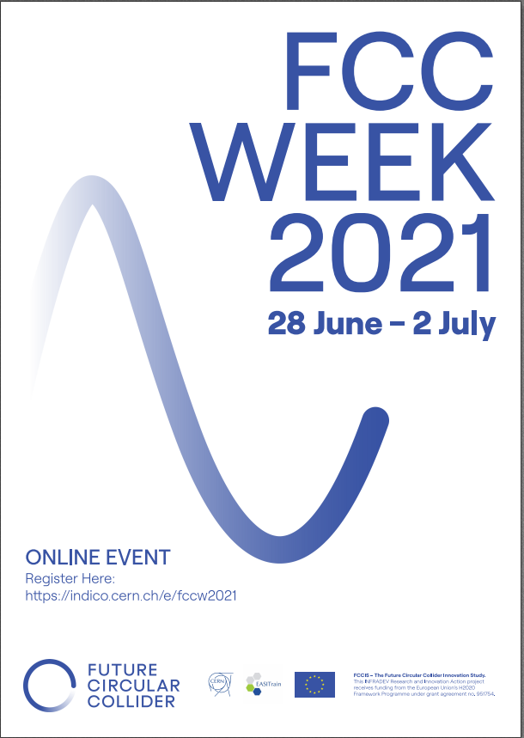
Optics tuning and orbit correction studies for FCC-ee
Tessa Charles ^{1,2}, Bernhard Holzer ³, Michael Hofer ³, Katsunobu Oide ^{3,4}, Dmitry Shatilov, Frank Zimmermann ³
Rogelio Tomas ³, Leon Van Riesen-Haupt ⁵, and the entire FCC-ee optics team
1. University of Liverpool; 2. Cockcroft Institute; 3. CERN; 4. KEK; 5. EPFL
FCCIS – The Future Circular Collider Innovation Study. This INFRADEV Research and Innovation Action project receives funding from the European Union’s H2020 Framework Programme under grant agreement no. 951754.

Slide 2
Natural chromaticities for a range of low emittance storage rings
CEPC workshop 2021
Tessa Charles
Many thanks to:
Rohan Dowd (AS), Masamitsu Aiba (PSI), Katsunobu Oide (KEK), Thorsten Hellert (ALS), Ilya Agapov (DESY), Pedro Fernandes Tavares (MAX IV), Kent Wooton (APS), Bastian Härer (KIT), Liu Lin (LNLS), Simone Di Mitri (Elettra), Jeff Corbett (SLAC), Bernhard Holzer (CERN), Ian Martin (Diamond), David Amorim (SOLEIL)
Notes:
Here we compare FCC-ee to other low emittance SR around the world, including a number of existing and planned upgrades.
You can see that FCC-ee is pushing towards low emittance whilst battling high chromaticity.

Slide 3
Context
“Given the size of the FCC-ee, we will not be able to perform standard alignment and to use standard techniques in such a machine: we will need alignment sensors at least for the girders of the arcs quadrupoles and sextupoles. So applying a factor 2 on tolerances should not increase the cost by two.” - H. Mainaud Durand
“[Increasing the alignment tolerances will ...] increase the cost of the positioning system, but it must be compared with the total cost of the collider. If the total cost increases by a few percent, and the luminosity by fifty, then it probably makes sense.” - D Shatilov
- FCC-ee tuning & alignment mini-workshop 11 & 12 May 2022
Notes:
Currently no existing solutions are directly applicable for the alignment of the FCC-ee:

Slide 4

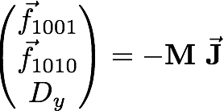
Correction tools
Orbit correction:
  MICADO & SVD from MAD-X
    Hor. corrector at each QF, Vert. corrector at each QD
  1598 vertical correctors / 1590 horizontal correctors
    BPM at each quadrupole
  1598 BPMs vertical / 1590 BPMs horizontal
Vertical dispersion and orbit:
  Orbit Dispersion Free Steering (DFS)
Linear coupling:
  Coupling resonant driving terms (RDT)
    1 skew at each sextupole
Beta beating correction & Horizontal dispersion via Response Matrix:
  Rematching of the phase advance at the BPMs
    1 trim quadrupole at each sextupole

Slide 5
Tuning simulations
Tuning simulation
File generation
Lattice initialisation
Corrections
as sextupole strength increase
Final corrections
Analysis

Slide 6
Tuning simulation
File generation
x 100
Lattice initialisation
Corrections
as sextupole strength increase
Final corrections
Analysis
Inputs:
MAD-X template file
Errors values (yaml file)
Bash template
(for HT condor submission)
Python simulation configuration
(specify number of seeds [default 100])
generates
100 madx files,
100 bash files, and,
1 HT condor submission file

Slide 7
Tuning simulation
File generation
Lattice initialisation
Corrections
as sextupole strength increase
Final corrections
Analysis
Correction macros defined
Insert bpms, correctors, skew quads, trim quads.
Beam energy = 1 GeV; radiation = off;
VOLTCA1 = 0.0; VOLTCA2 = 0.0;
Sextupoles turned off
Introduce field errors
Beta beating correction (Python)
Introduce arc misalignments
Girder misalignments (Python)
Add BPM roll angle (rotation of coordinate system before and after BPM) (Python)
Corrections applied:
  tune re-matched
  orbit correction
  beta-beat correction (Python)
  coupling correction (Python)
Introduce IR misalignments
Further correction:
tune re-matched, orbit correction, beta-beat correction, and coupling and
dispersion correction

Slide 8
Tuning simulation
File generation
Lattice initialisation
Corrections
as sextupole strength increase
Final corrections
Analysis
Sextupoles set to 10% of their design strength
  Orbit correction
  Combined coupling and dispersion correction (Python)
  Beta-beating correction applied (Python)
  Sextupole strengths increased by 10%
Constant checking of the tunes and orbit avoids running into resonances, or failure to find the closed orbit.
Iterated over many times.

Slide 9
Tuning simulation
File generation
Lattice initialisation
Corrections
as sextupole strength increase
Final corrections
Analysis
Final correction (at 100% design sextupole strength)
  Additional coupling, dispersion and beta-beating correction applied.
  Step through corrections until beta beating threshold is reached.
  Vary SV cut off values
  Chromaticity correction
Lattice sequence saved.
Lattice sequence file, error tfs file, copied to eos.

Slide 10
Misalignments and field errors
Tessa Charles
  Misalignments are randomly distributed via a Gaussian distribution, truncated at 2.5 sigma.
  This table is not the final set of tolerances.
Notes:
This table summarises the current set of misalignments. That’s not to say that this wont’ change. This talk is an update on going work.
\begin{table}[htb!]
\centering
\begin{tabular}{p{3cm}ccccccc}
\hline
Type & $\Delta$X & $\Delta$Y & $\Delta$PSI & $\Delta$S & $\Delta$DTHETA & $\Delta$DPHI & Field Errors\\
& ($\mu$m) & ($\mu$m) & ($\mu$rad) & ($\mu$m) & ($\mu$rad) & ($\mu$rad) & \\
\vspace{.1cm} \\
\hline
Arc quadrupole* & 50 & 50 & 300 & 150 & 100 & 100 & $\Delta k /k = 2 \times 10^{-4}$\\
Arc sextupoles* & 50 & 50 & 300 & 150 & 100 & 100 & $\Delta k /k = 2 \times 10^{-4}$\\
\hline
Dipoles & 1000 & 1000 & 300 & 1000 & 0 & 0 & $\Delta B /B = 2 \times 10^{-4}$\\
\hline
Girders & 150 & 150 & - & 1000 & - & - \\
\hline
IR quadrupole & 100 & 100 & 250 & 250 & 100 & 100 & $\Delta k /k = 2 \times 10^{-4}$\\
IR sextupoles & 100 & 100 & 250 & 250 & 100 & 100 & $\Delta k /k = 2 \times 10^{-4}$\\
\hline
\end{tabular}
\end{table}

Slide 11
Assigning girder misalignments
Tessa Charles
sextupoles/ quadrupoles
girder
girder
(not to scale)
dipole
dipole
  - 2 independent DX and DY misalignments for each end of the girder, and which can be used to calculate DTHETA and DPHI.
Notes:
And actually we have misalignments on top of misalignments. Within the arcs, we have sextpoles and quadrupoels on a girder.

Slide 12
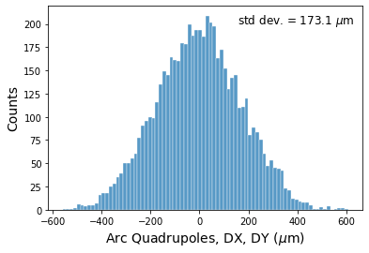
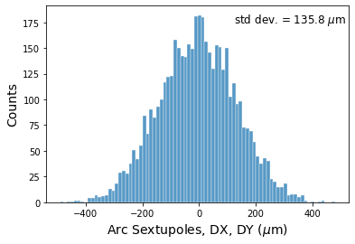
Misalignments and field errors
Tessa Charles
  Misalignments are randomly distributed via a Gaussian distribution, truncated at 2.5 sigma.
  This table is not the final set of tolerances.
  Distributions of arc quadrupoles and sextupoles, total DX and DX misalignments:
Notes:
This table summarises the current set of misalignments. That’s not to say that this wont’ change. This talk is an update on going work.
\begin{table}[htb!]
\centering
\begin{tabular}{p{3cm}ccccccc}
\hline
Type & $\Delta$X & $\Delta$Y & $\Delta$PSI & $\Delta$S & $\Delta$DTHETA & $\Delta$DPHI & Field Errors\\
& ($\mu$m) & ($\mu$m) & ($\mu$rad) & ($\mu$m) & ($\mu$rad) & ($\mu$rad) & \\
\vspace{.1cm} \\
\hline
Arc quadrupole* & 50 & 50 & 300 & 150 & 100 & 100 & $\Delta k /k = 2 \times 10^{-4}$\\
Arc sextupoles* & 50 & 50 & 300 & 150 & 100 & 100 & $\Delta k /k = 2 \times 10^{-4}$\\
\hline
Dipoles & 1000 & 1000 & 300 & 1000 & 0 & 0 & $\Delta B /B = 2 \times 10^{-4}$\\
\hline
Girders & 150 & 150 & - & 1000 & - & - \\
\hline
IR quadrupole & 100 & 100 & 250 & 250 & 100 & 100 & $\Delta k /k = 2 \times 10^{-4}$\\
IR sextupoles & 100 & 100 & 250 & 250 & 100 & 100 & $\Delta k /k = 2 \times 10^{-4}$\\
\hline
\end{tabular}
\end{table}

Slide 13
RESULTS

Slide 14
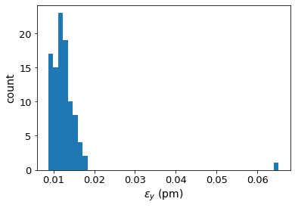
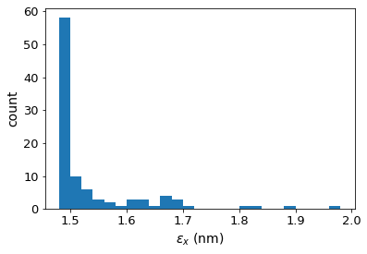
ttbar (182.5 GeV) 4IP lattice,
after correction strategy:
FCC-ee emittance tuning results
without BPM errors and without chromaticity correction
RMS misalignment and field errors tolerances:
Important to note:
BPM errors not included.
Radiation not included in correctors and trim and skew quads.

Slide 15
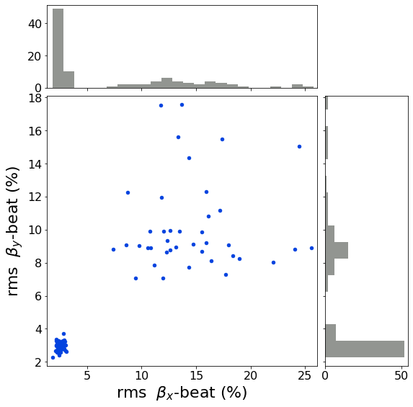
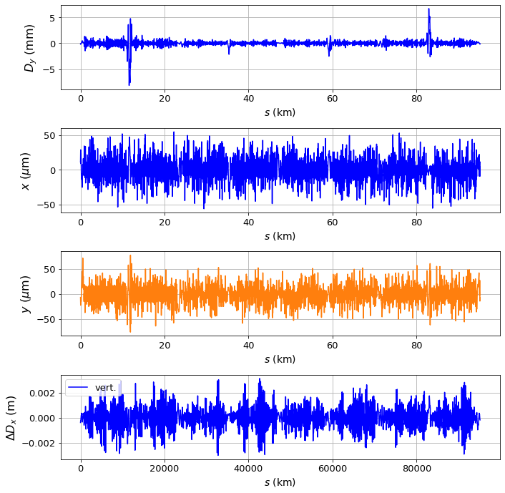
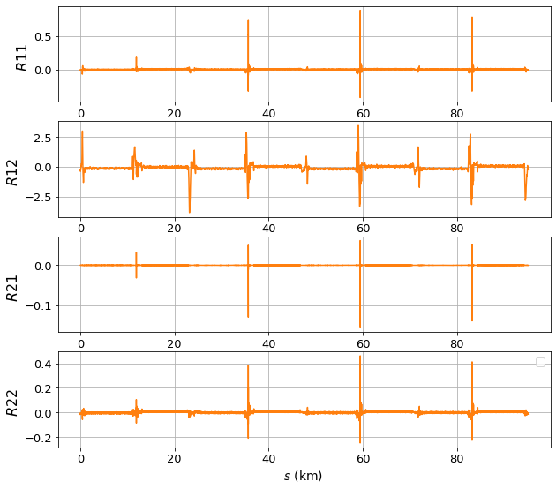
Tessa Charles
After corrections, ttbar 4 IP lattice:
Notes:
Need to develop and model
IR optics tuning knobs

Slide 16
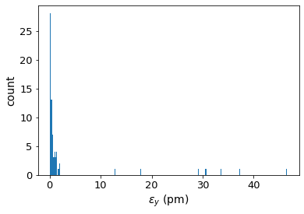
Chromaticity correction added
No chromaticity correction:
Chromaticity correction:
Large proportion of seeds start to fail

Slide 17
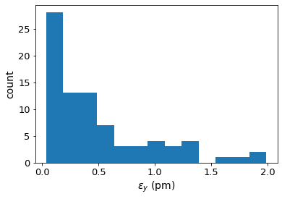
Chromaticity correction added
No chromaticity correction:
Chromaticity correction:
Highest 8 emittances removed, to better view lower end of distribution.

Slide 18
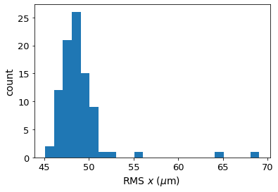
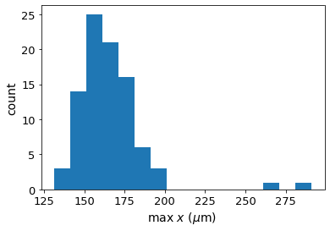
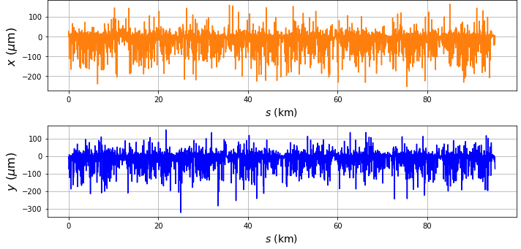
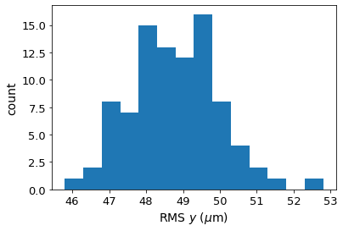
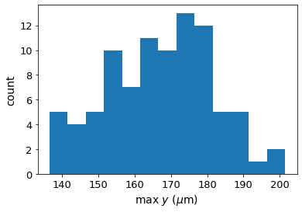
Tessa Charles
Adding chromaticity correction
Chromaticity correction corrects chromaticity well, but increases coupling.
Applying additional coupling correction changes the chromaticity -> An iterative procedure is necessary.
RMS horizontal orbit and max orbit distortion, after corrections (without BPM errors):
Notes:
Why does this happen? Chromaticity corr changes sextupole strengths.
Improved orbit correction would help, but it’s already good.

Slide 19
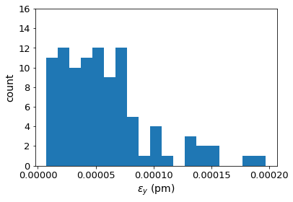
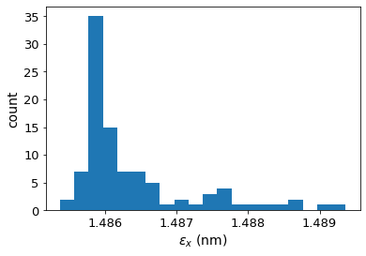
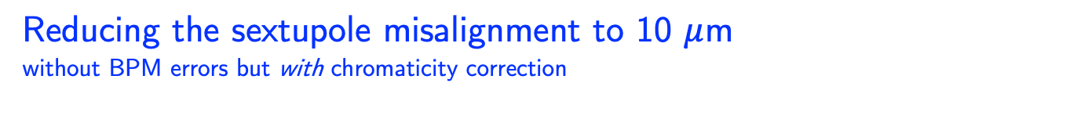
Reducing the sextupole misalignment to 10 $μ$m
without BPM errors but with chromaticity correction
ttbar (182.5 GeV) 4IP lattice,
after correction strategy:
RMS misalignment and field errors tolerances:
Important to note:
BPM errors not included.
Radiation not included in correctors and trim and skew quads.
Notes:
$\epsilon_{x, \textrm{median}} = 1.487$ nm rad \\
% $\epsilon_{y, \textrm{median}} = 5\times10^{-5}$ pm rad
%$\frac{\epsilon_{y}}{\epsilon_{x}} = 0.011$ $\%$ \\

Slide 20
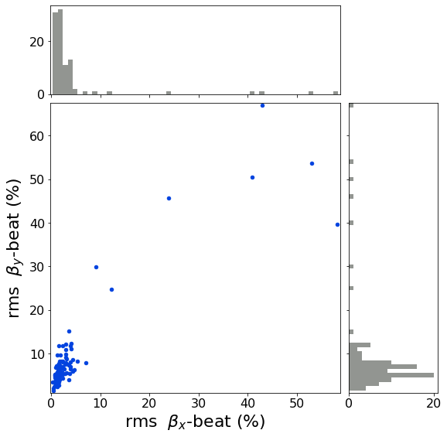
Reducing the sextupole misalignment to 10 $μ$m
without BPM errors but with chromaticity correction
ttbar (182.5 GeV) 4IP lattice,
after correction strategy:
RMS misalignment and field errors tolerances:
Important to note:
BPM errors not included.
Radiation not included in correctors and trim and skew quads.
Notes:
$\epsilon_{x, \textrm{median}} = 1.487$ nm rad \\
% $\epsilon_{y, \textrm{median}} = 5\times10^{-5}$ pm rad
%$\frac{\epsilon_{y}}{\epsilon_{x}} = 0.011$ $\%$ \\

Slide 21
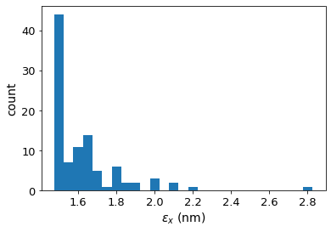
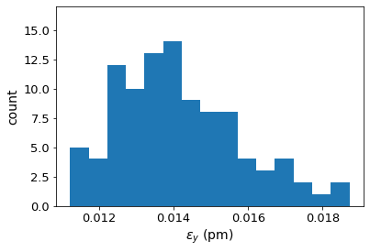
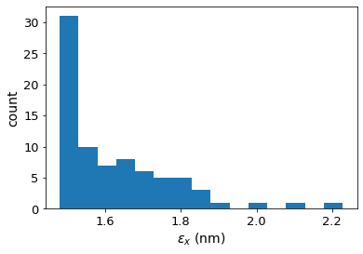
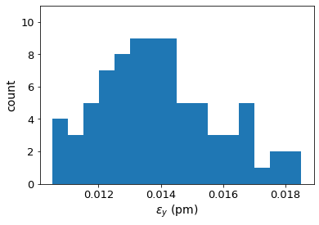
without dipole b2 & b3 errors:
Emittance Tuning with Dipole b2 and b3 Errors
without BPM errors but without chromaticity correction
Systematic errors applied of: b2 = -4e-4, b3 = 2e-4.
(b2 errors change sign as beams exchange apertures.)
All other misalignments and field errors, as per latest first table of on slide 12.
Conclusion: Systematic dipole b2 and b3 errors can be handled by correction algorithm.
B2 and b3 errors caused simulation to take longer and 19 seeds to exceed time limit.
with dipole b2 & b3 errors:
Thanks to Jeremie Bauche for the values of b2 and b3 errors.
Thanks to Cristobal Garcia for identifying dipole element patter.
Notes:
$\epsilon_{x, \textrm{median}} = 1.487$ nm rad \\
% $\epsilon_{y, \textrm{median}} = 5\times10^{-5}$ pm rad
%$\frac{\epsilon_{y}}{\epsilon_{x}} = 0.011$ $\%$ \\

Slide 22


Tessa Charles
22
Summary
The correction algorithms developed in this context represent a powerful correction tools and lead to successful convergence for a large majority of the applied errors seeds. And, most importantly, the lead to values of coupling and emittances that lie within the requirements of the machine design. For a standard set of misalignments, the final median vertical emittance achieved is 0.332 pm rad and horizontal emittance of 1.497 nm rad. However, the reduced DA needs dedicated investigation.
Reduction in sextupole misalignment (or rather improved orbit through sextupoles), which could be implemented through placing sextupoles on movers, presents a promising option towards restoring DA.
This work is ongoing.

Slide 23
Thank you for your attention.

