Slide 1


FCC-ee Synchrotron Radiation Collimators and Masks
K.D.J. André for the MDI study group

Slide 2
Outline
FCC-ee lattice, aperture profile, masks and collimators
Direct hits from the last dipole
Masks and collimators
  tt mode
  Z mode
  W and H modes
Summary and outlook
 | Beam Energy | Beam Current | H Beam Emittance | V Beam Emittance | β*_{x,y} [mm]
@ Z | 45.6 GeV | 1280 mA | 0.71 nm | 1.42 pm | 100/0.8
@ W | 80.0 GeV | 135.0 mA | 2.16 nm | 4.32 pm | 200/1.0
@ H | 120.0 GeV | 26.7 mA | 0.64 nm | 1.29 pm | 300/1.0
@ tt | 182.5 GeV | 5.0 mA | 1.49 nm | 2.98 pm | 1000/1.6
Table ref

Slide 3
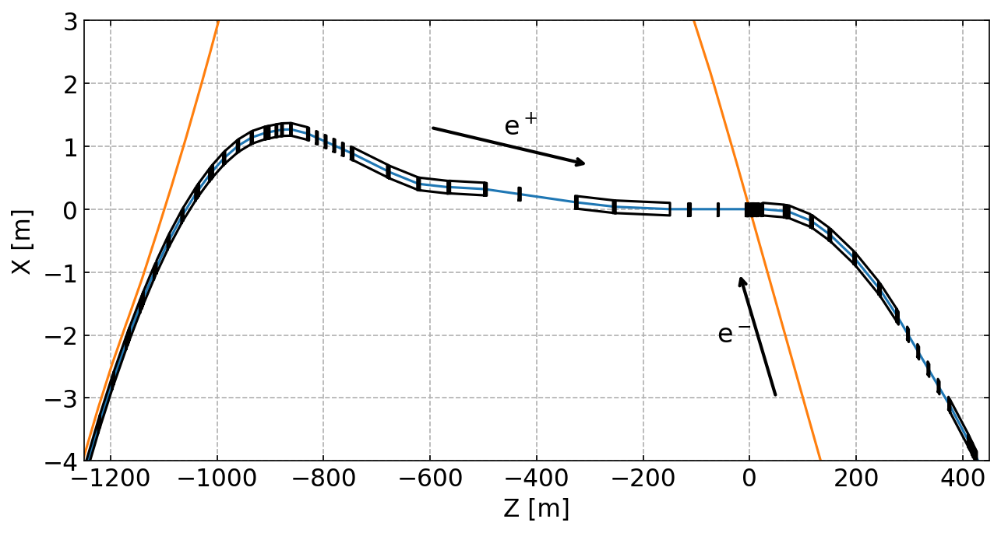
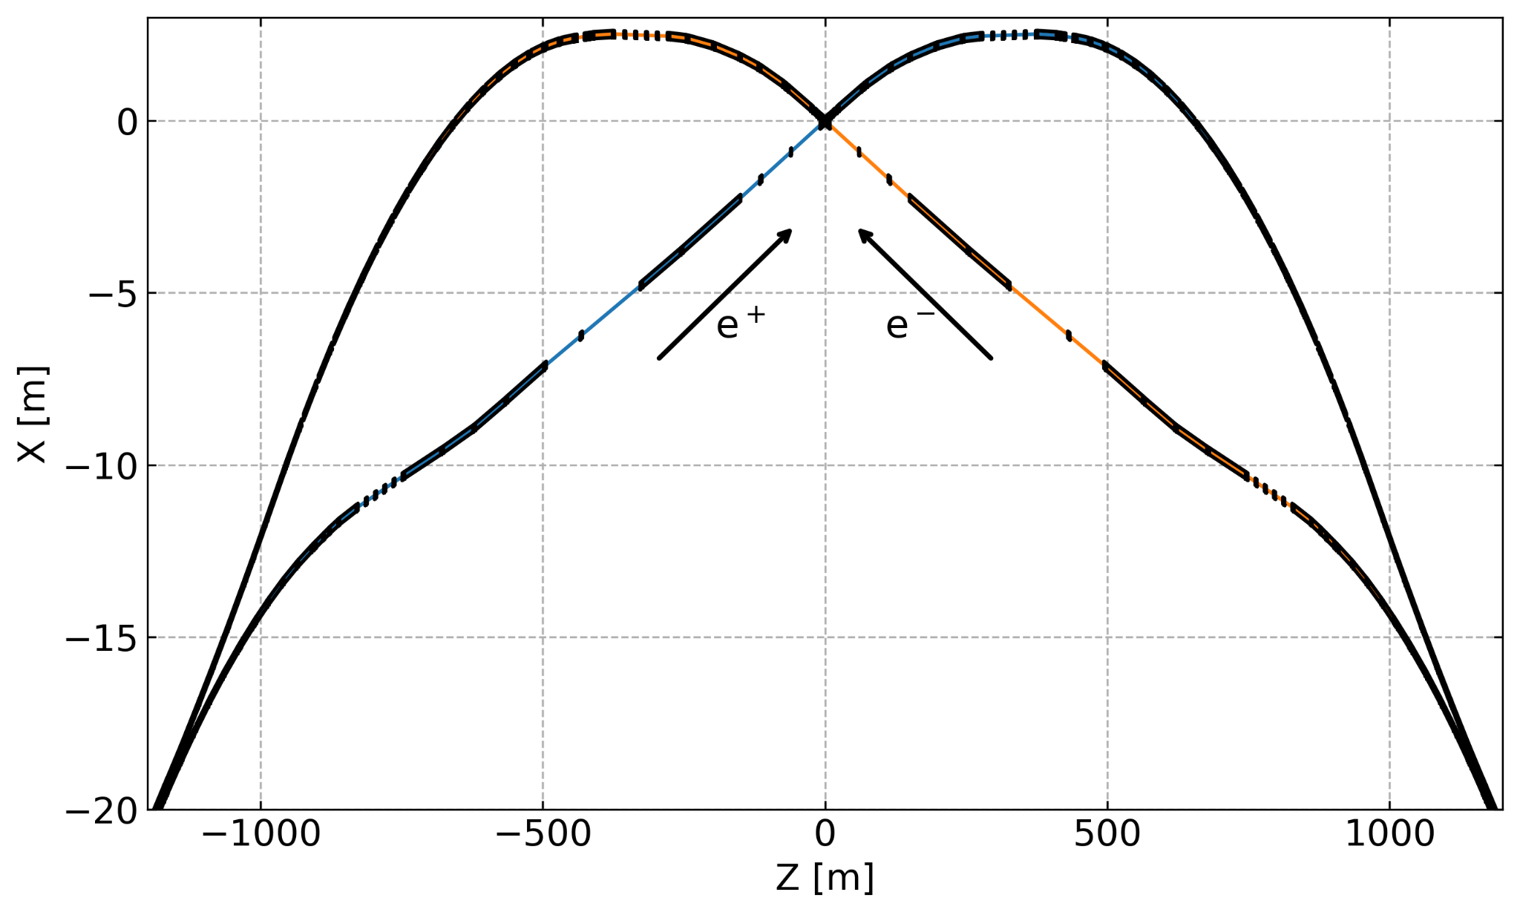
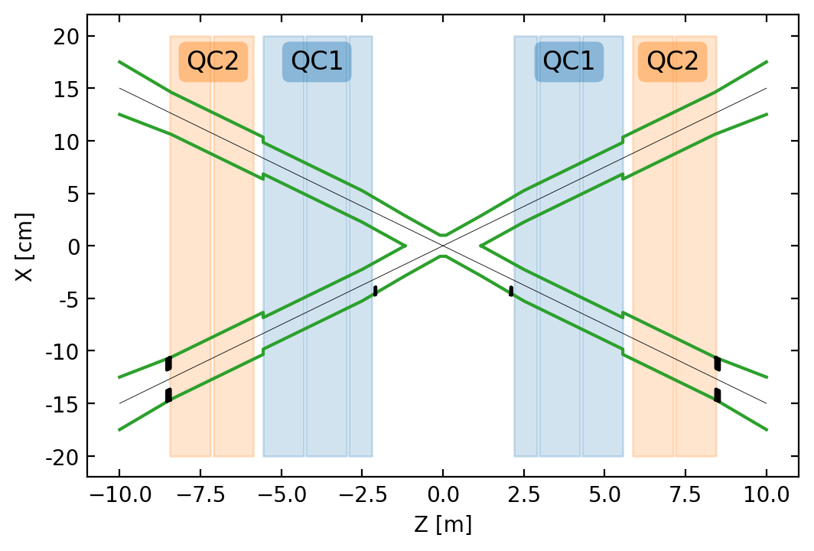
FCC-ee lattice | 4 IPs
The studies focus on the section from s=-800m to 100m around the IP and specifically on the photon hits in the detector region.
There is a 30 mrad crossing angle at the IP.
The lattice design upstream the IP is based on weak dipoles and long straight sections. BC1L and BWL dipoles have critical energies below 100 keV and are located further than 150m from the IP.

Slide 4
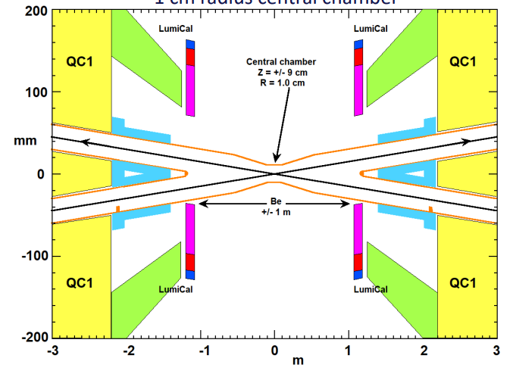
FCC-ee lattice | Masks and collimators
QT1L
BP ⌀ 70 mm
PQC2LE
BP ⌀ 40 mm
COL ⌀ 20 mm
MSK.QC2L
BP ⌀ 40 mm
MSK ⌀ 30 mm
MSK.QC1L
BP ⌀ 30 mm
CC
BP ⌀ 20 mm
PQC2RE
BP ⌀ 40 mm
e+
y
x
IP
s
The central beam pipe radius is 10mm over 18cm along the Z axis. Due to the 30mrad crossing angle the central chamber is 1.35mm closer to the beam center.
Masks: s=-2.12m with 9mm horizontal aperture, s=-5.58m with 15mm aperture radius.
Collimators: after BWL (s=-144m), after QC3L (s=-112m), after QT1L (s=-39.7m) shields the aperture reduction downstream from (⌀ 70→ ⌀ 40), at PQC2LE (s=-8.4m) shields the aperture reduction downstream at MSK.QC2L (⌀ 40→ ⌀ 30).

Slide 5
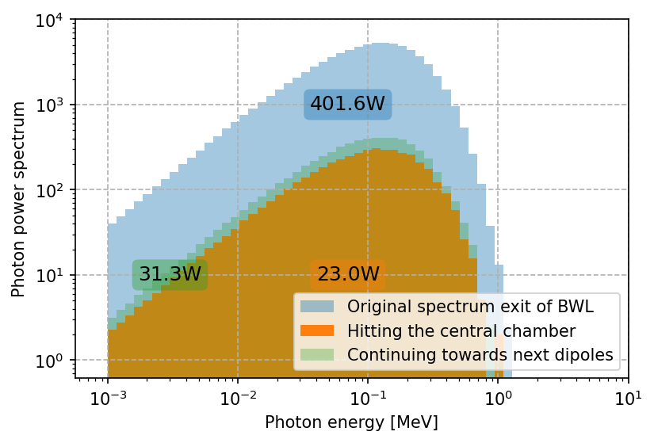
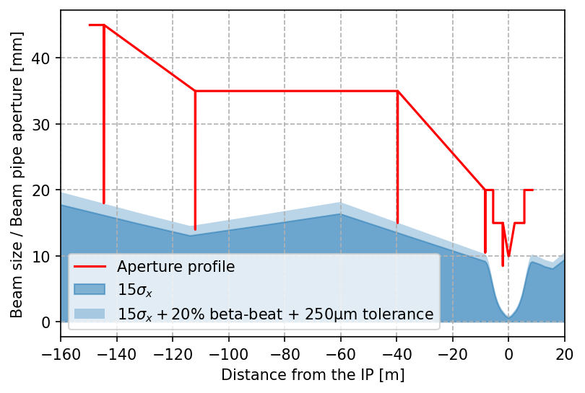
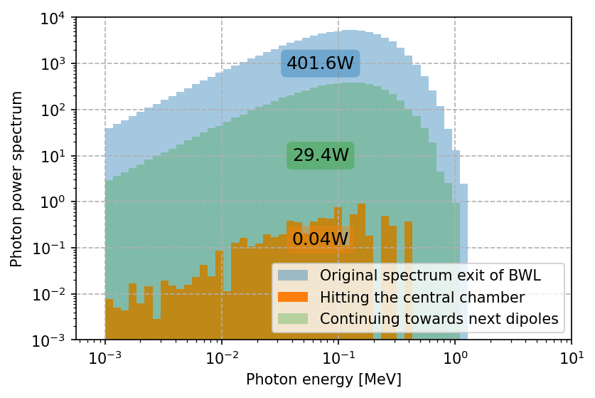
Synchrotron radiation power deposition from BWL (last dipole before the IP)
Unshielded study
Mitigation method
Shielded study
A total of 23W is deposited in the CC region and 347W are distributed along the beam line before the IP.
31W continue towards BC1R-BC3R.
Study of the SR from the last dipole, tracked past the IP to record the photon hits and confine them at specific locations as well as possible.
Power spectrum of the photons hitting the beam pipe or continuing towards the dipoles BC1R-BC3R.

Slide 6
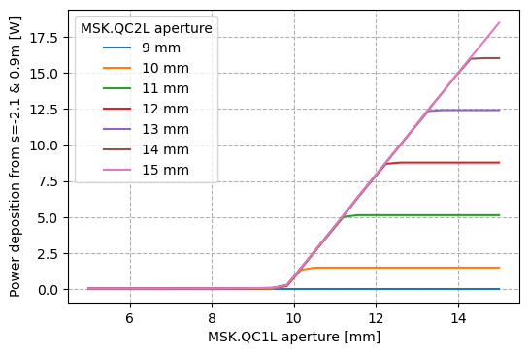
Synchrotron radiation power deposition
No crossing angle included
Using only two masks, it is possible to reduce to some mW the power deposited in the CC. A radial aperture of 9mm of the mask between QC1L and QC2L is sufficient to shield the CC but it would go below the protection of the vertical primary collimator hence the second mask is mandatory.
Conclusion: MSK.QC2L has a 15mm radial aperture and absorbs 18W and MSK.QC1L is opened at 9.5mm and absorbs 19W.

Slide 7
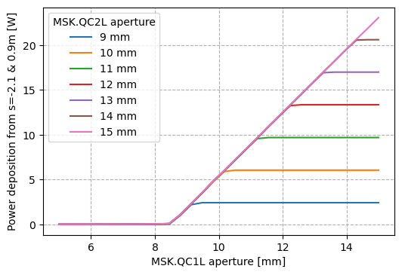
Synchrotron radiation power deposition
Central chamber
15mrad crossing angle included
e⁺
e⁺
e⁻
The 15mrad crossing angle reduces the aperture by 1.35mm at both ends of the CC (13.5%). The minimal aperture of MSK.QC1L becomes 8.5mm instead of 9.5mm. Besides, an aperture of 9mm for MSK.QC2L can not replace MSK.QC1L.
Conclusion: MSK.QC2L has a 15mm radial aperture and absorbs 18W and MSK.QC1L is opened at 8.5mm and absorbs 23W.

Slide 8
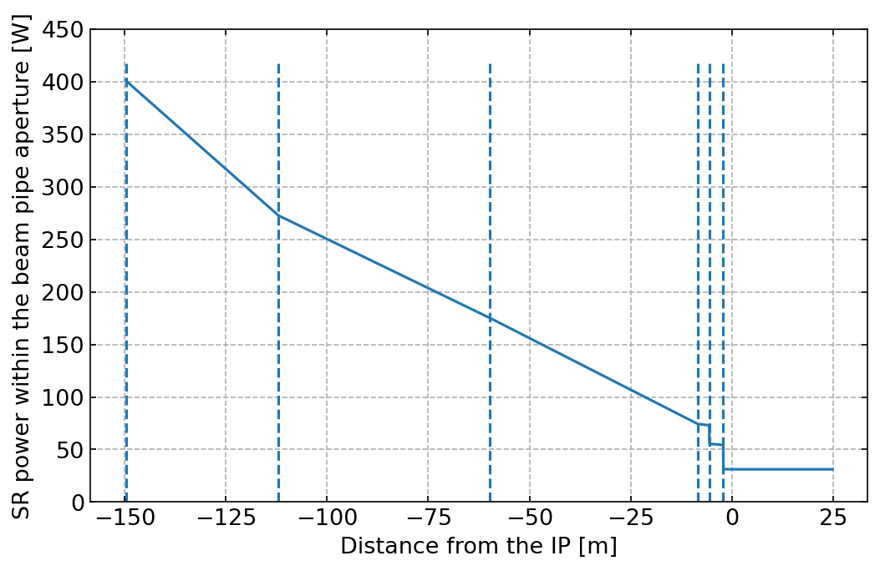
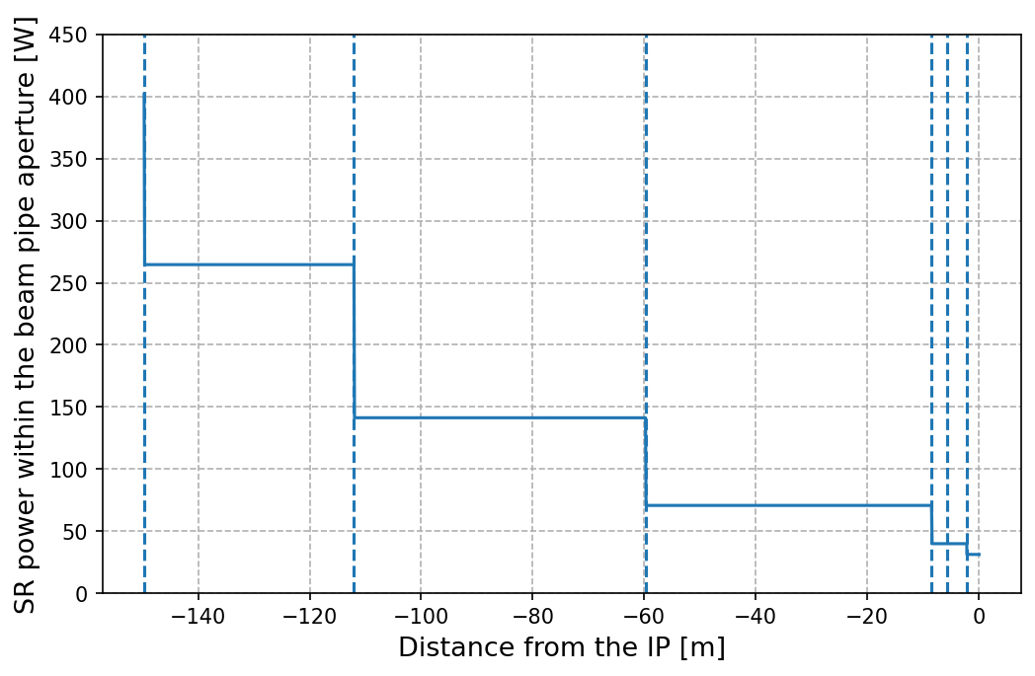
Synchrotron radiation collimation scheme
Continuous loss from the exit of BWL (s=-150m) to the mask MSK.QC2L (s=-5.56m).
The placement of collimator confines the losses and protects the thin beam pipe through which SR could damage the detector and/or SC FF magnets.

Slide 9
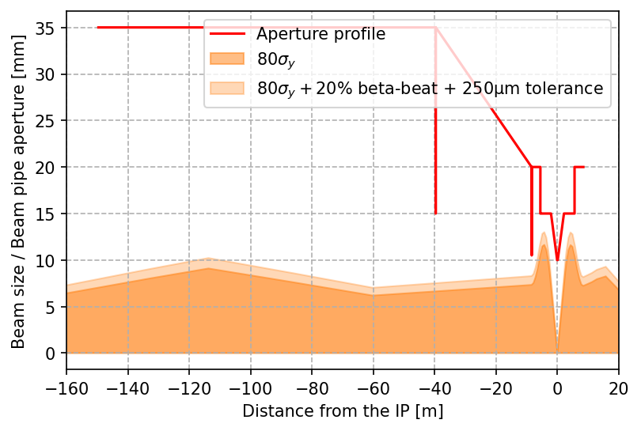
Synchrotron radiation collimation
at the tt mode
Primary and secondary collimators
Name | nsigma | half-gap [m] | plane
tcp.h.b1 | 15.0 | 0.013802 | H
tcs.h.b1 | 17.0 | 0.011591 | H
tcp.v.b1 | 80.0 | 0.002466 | V
tcs.v.b1 | 89.5 | 0.001840 | V
The collimators have been adjusted to have a minimum of 15 σ_{x} horizontal aperture and 80 σ_{y} vertical aperture.

Slide 10
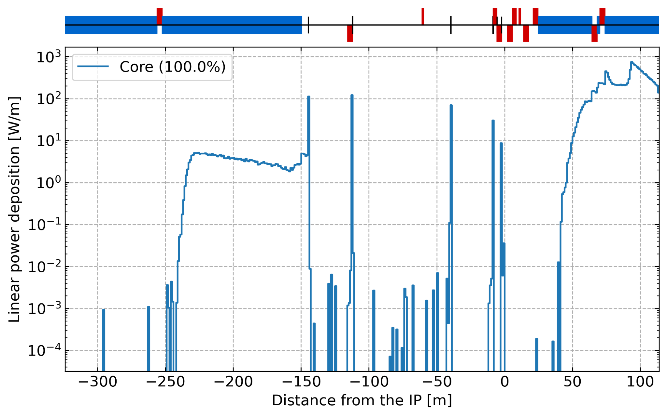
Synchrotron radiation collimation
at the tt mode
Name | s [m] | nsigma | half-gap [m] | plane
bwl.h | -144.692 | 16.7 | 0.018 | H
qc3l.h | -112.054 | 16.1 | 0.014 | H
qt1l.h | -39.747 | 16.7 | 0.015 | H
qt1l.v | -39.647 | 180.9 | 0.015 | V
pqc2le.h | -8.64 | 18.0 | 0.011 | H
pqc2le.v | -8.54 | 120.0 | 0.011 | V
msk.qc2l | -5.56 | 43.5/113 | R = 0.015 | Radial
msk.qc1l | -2.12 | 93.9 | 0.0085* | H
COLL.BWL is 10cm of tungsten absorbing 124W
COLL.QC3L is 10cm of tungsten absorbing 124W
COLL.QT1L is 10cm of tungsten absorbing 70W
COLL.PQC2LE is 10cm of tungsten absorbing 25W
MSK.QC2L is 2cm of tungsten absorbing 0.1mW
MSK.QC1L is 2cm of tungsten absorbing 10W
Simulations made with a Gaussian positron beam. i.e. no specific tail distributions considered yet and without the synchrotron radiation from the solenoid

Slide 11
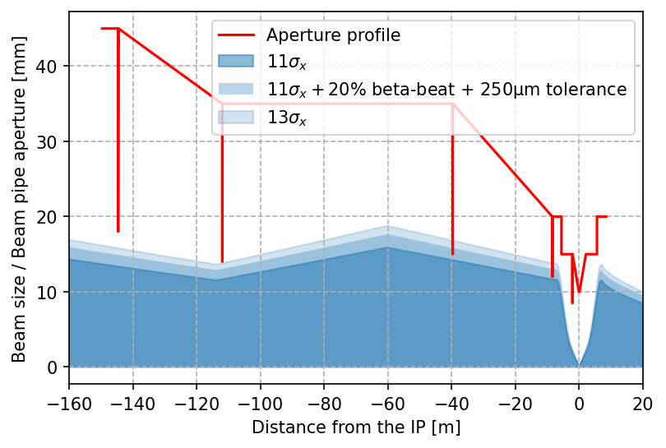
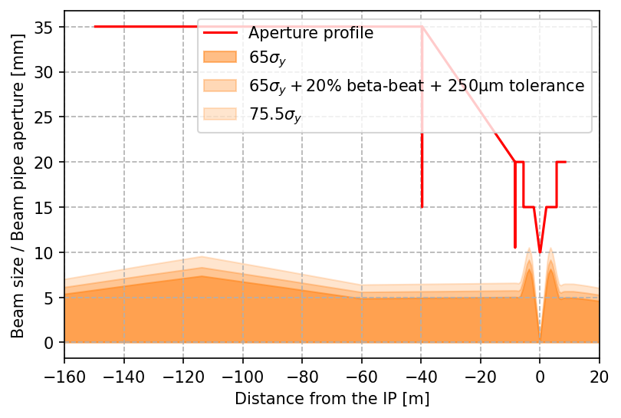
Synchrotron radiation collimation
at the Z mode
Primary and secondary collimators
Name | nsigma | half-gap [m] | plane
tcp.h.b1 | 11.0 | 0.005504 | H
tcs.h.b1 | 13.0 | 0.004162 | H
tcp.v.b1 | 65.0 | 0.002332 | V
tcs.v.b1 | 75.5 | 0.002030 | V
The closest collimator to the IP must be opened to 12mm w.r.t. 11mm for the tt mode in order to be above 11 σ_{x} horizontally. Vertically the SR collimators are opened above the secondary collimators.

Slide 12
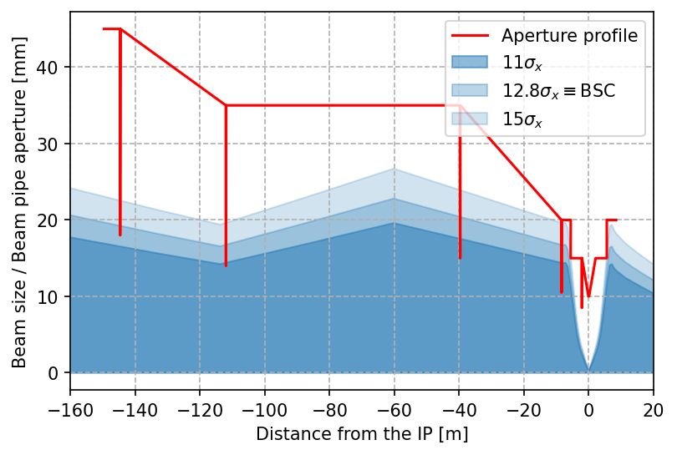
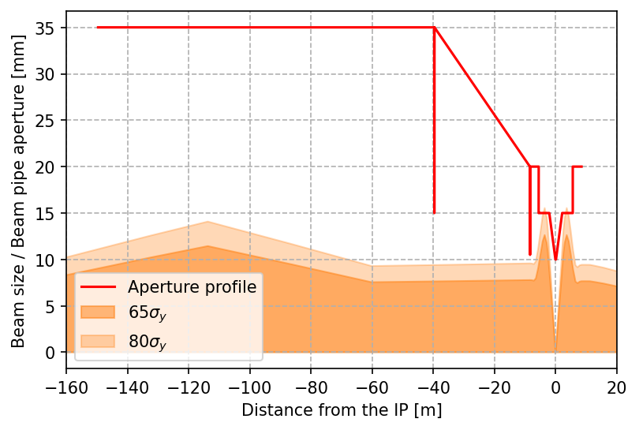
Synchrotron radiation collimation at the W mode
Estimation of the synchrotron radiation collimator apertures based on the latest beam stay clear studies (ref). Due to the larger transverse emittance, the SR collimators would probably be inside the primary and/or secondary collimator settings.

Slide 13
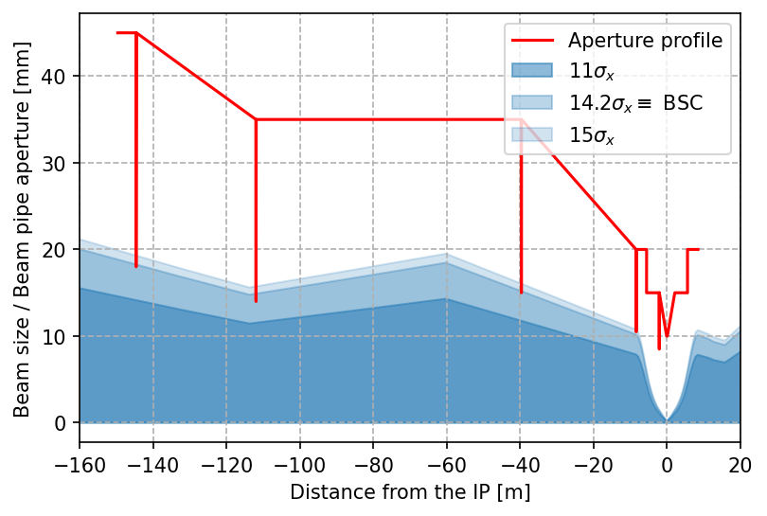
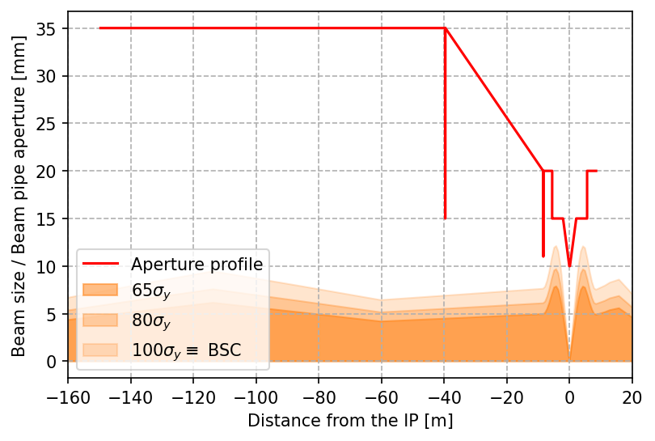
Synchrotron radiation collimation at the H mode
Estimation of the synchrotron radiation collimator apertures based on the latest beam stay clear studies (ref). Again, the synchrotron radiation collimators could be inside the primary/secondary collimator settings.

Slide 14
Summary:
The interaction region lattices for the 4 operation modes have been implemented in BDSIM with the solenoid field map and without the installation of the CAD design of the central beam pipe.
The central beam pipe can be efficiently shielded with collimators and masks from the synchrotron radiation emitted in the last dipole BWL.
The initial synchrotron radiation collimator settings have been designed for the Z and tt operation modes with the objective of being above the primary collimators, if possible above the secondary collimators as well.
Next steps:
Add the synchrotron radiation collimators to the collimator hierarchy and iterate regarding their positions and apertures. (A. Abramov).
Include tail distribution to the SR collimation studies
Study the influence of misalignments, tolerances, and top-up injection on the SR collimation.

