Slide 1

Prototyping of IR Technological Details - requirements, costs and schedule
FCC-EIC Joint & MDI Workshop 2022
Luigi Pellegrino
(Manuela Boscolo, Luigi Pellegrino, Giancarlo Sensolini, Stefano Lauciani, Alexander Novokhatski, Francesco Fransesini)

Slide 2

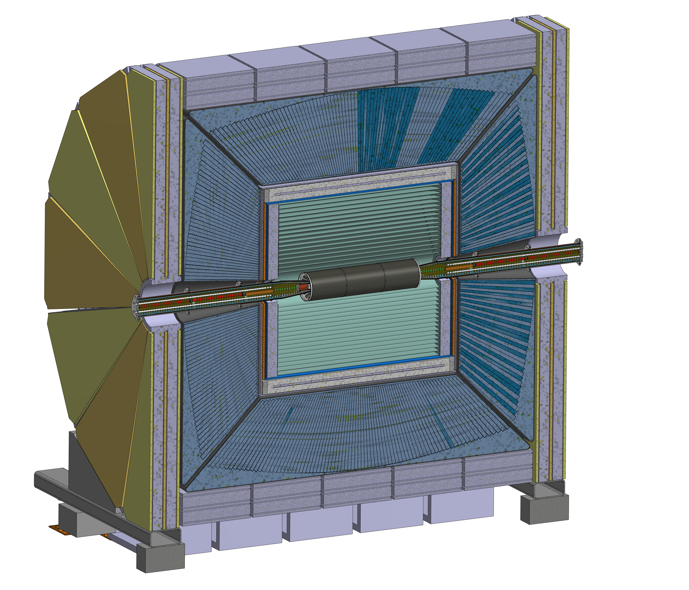
The IR inside Detector
FCC-EIC Joint & MDI Workshop 2022

Slide 3
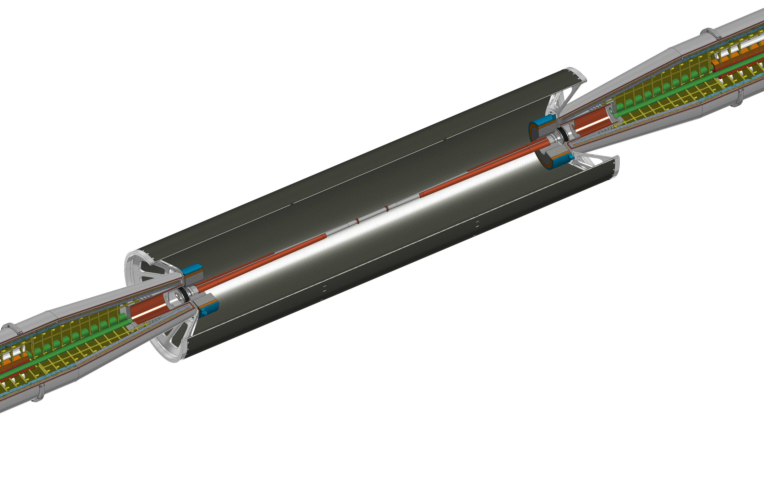
FCC-EIC Joint & MDI Workshop 2022
The Interaction Region current design – central zone partial detail

Slide 4
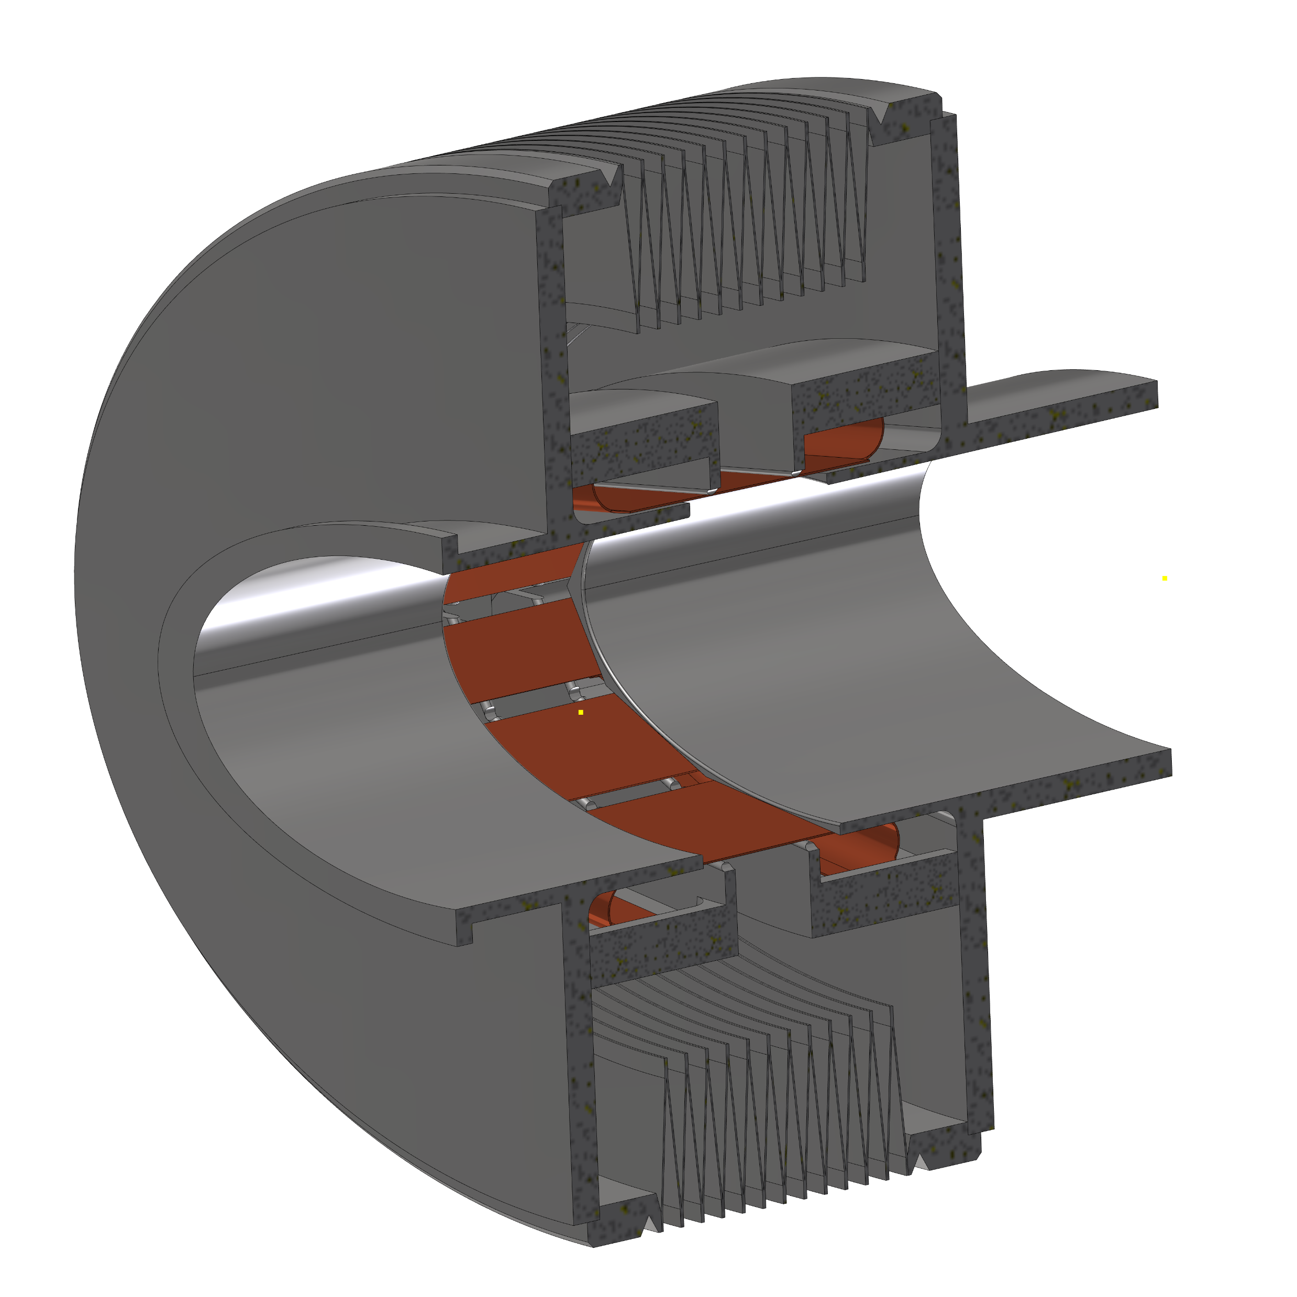
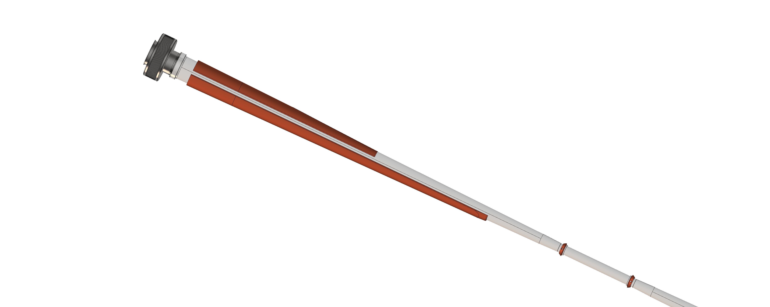
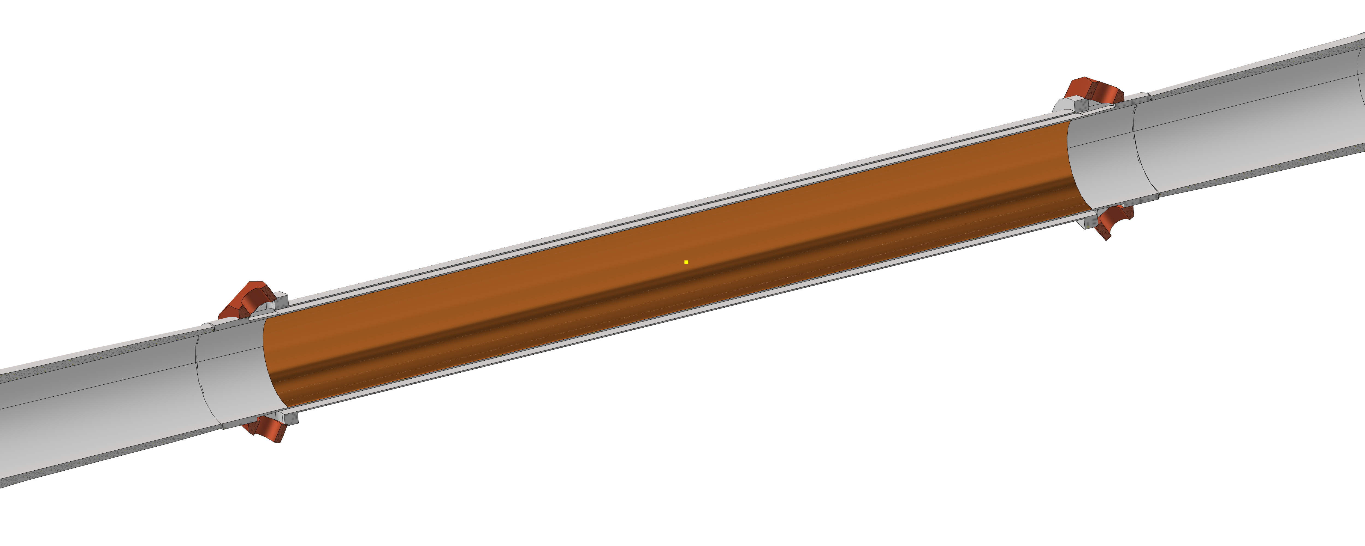
Points to further investigate (see next slides)
FCC-EIC Joint & MDI Workshop 2022
4
2
3
1

Slide 5
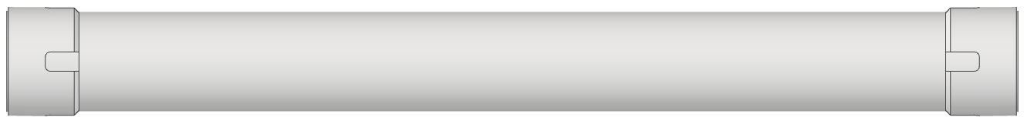
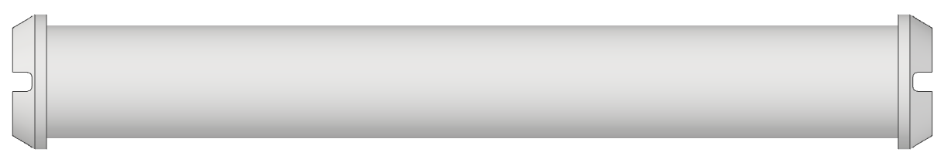
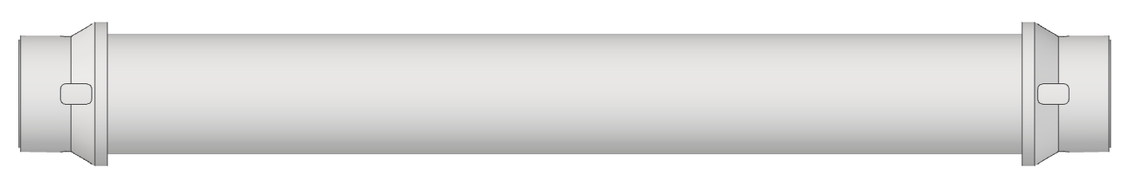
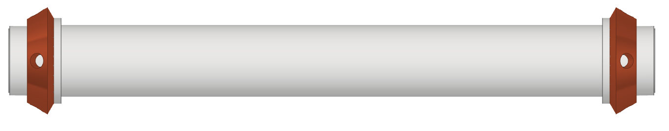
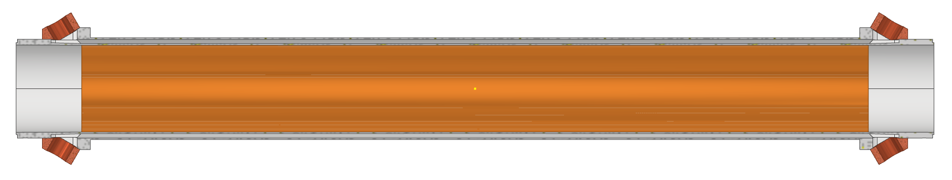
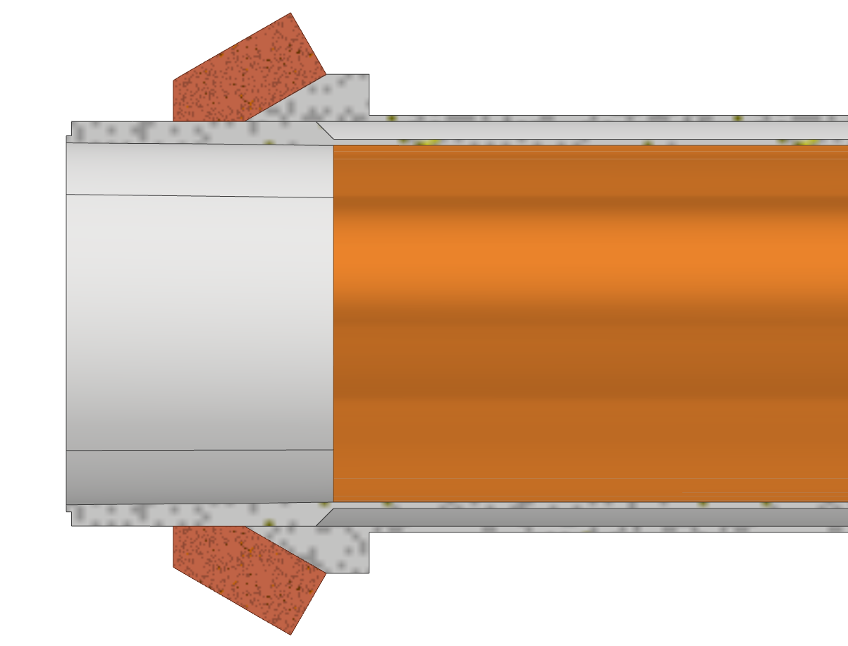
1. Central chamber
FCC-EIC Joint & MDI Workshop 2022
1.1 Assembly concept check
1.2 paraffin cooling effectiveness
1.3 thin chamber accuracy of fabrication and strength
1.4 Thick copper deposition thermal interface and tightness

Slide 6
2. Elliptical bellow
FCC-EIC Joint & MDI Workshop 2022
2.1 fabrication issues due to the shape
2.2 thermal/electrical contact effectiveness
2.3 AlBeMet/SS transition

Slide 7
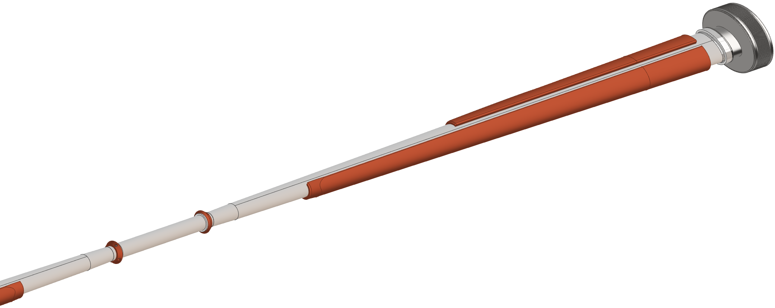
3. Trapezoidal chamber with asymmetric cooling
FCC-EIC Joint & MDI Workshop 2022
  3.1 chamber fabrication (transitions from elliptical section, accuracy of the shape) and strength;
  3.2 thick copper deposition over an elliptical shape with embedded channels;
  3.3 tightness of the channels and thermal contact between deposited copper and AlBeMet.
Bellow
Cooling
Trapezoidal chamber
IP
Central chamber

Slide 8
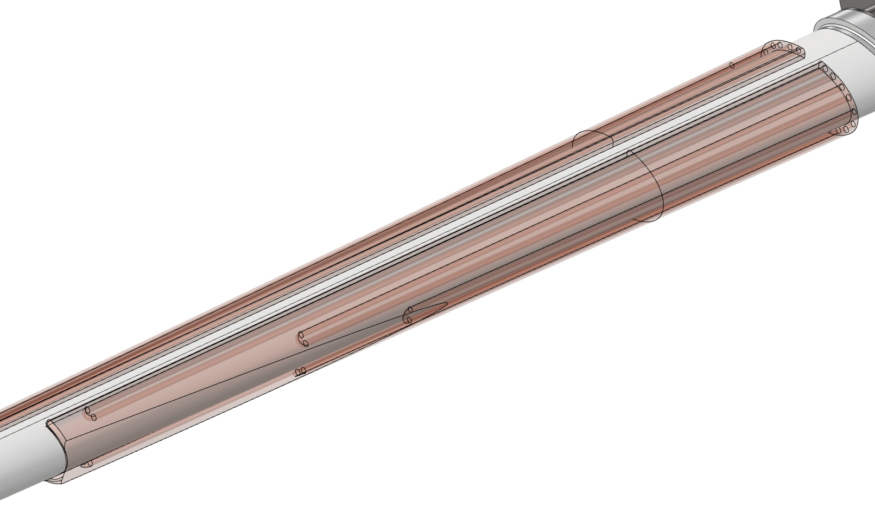
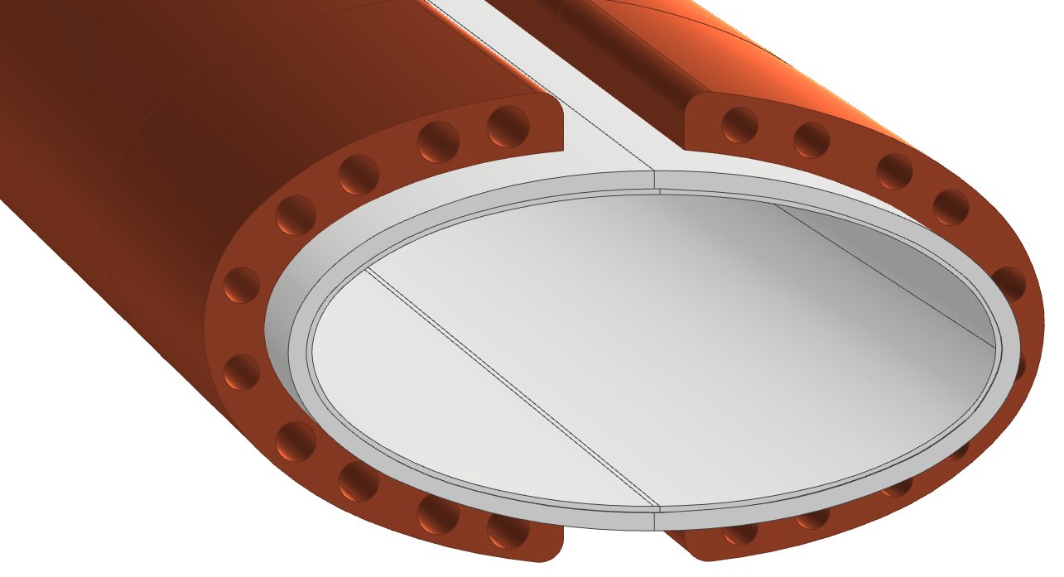
Cooling channels details
FCC-EIC Joint & MDI Workshop 2022
Cooling channels

Slide 9
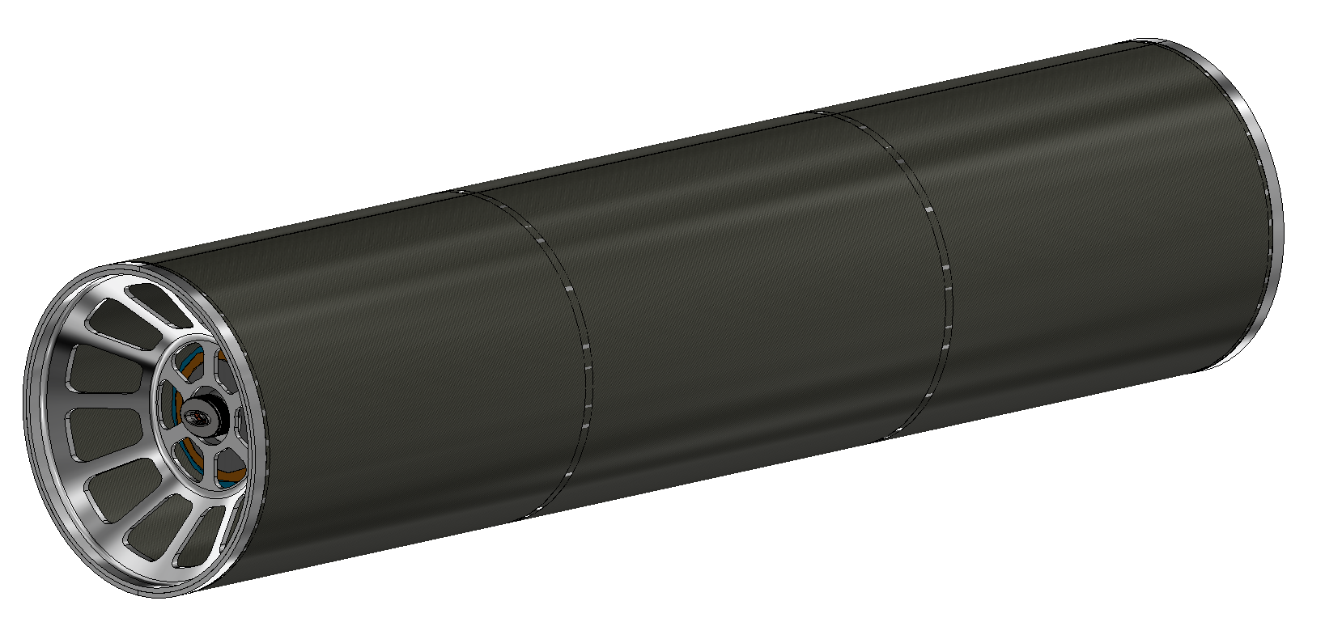
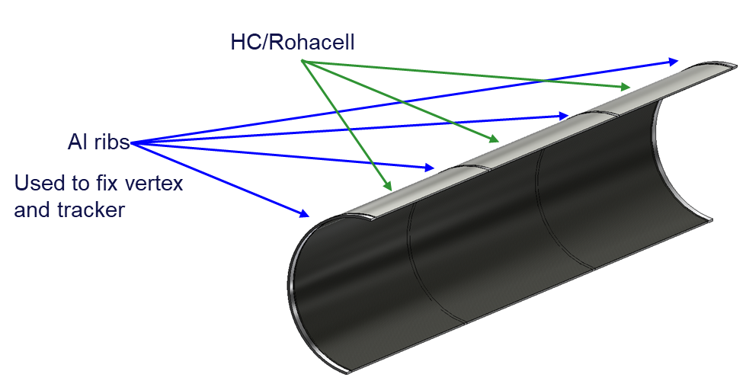
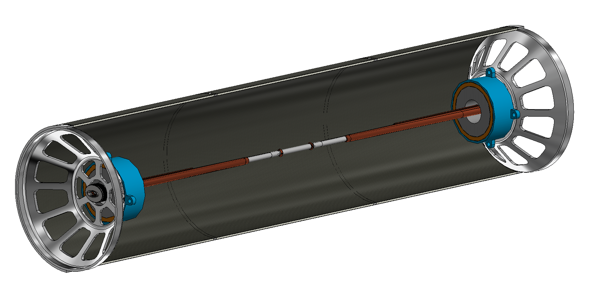
4. Carbon fiber cylinder lightweight rigid structure
FCC-EIC Joint & MDI Workshop 2022
4.1 Fiber carbon composite fabrication technology,
4.2 shape accuracy and rigidity of the structure,
4.3 insertion of the reinforcements for anchoring LumiCal and Vertex.
Half Cylinder
Al Flanges

Slide 10
Prototyping rationale -1 mechanical design and fabrication
FCC-EIC Joint & MDI Workshop 2022
FCC Collaboration meeting-03/12/2021
Some prototyping is necessary to check the feasibility of the proposed technological solutions, in addition to the FEM simulations (see F. Fransesini presentation, this workshop).
If the technical feasibility isn’t proved at a good degree, if it isn’t enough reliable, the design has to be reconsidered. The impact on the general assembly could not be negligible.
The simulations cover most general issues and have the great advantage that could be parametric and easily adapted to changes in the configuration.
But, actually, not all the technical details could be fully simulated, and in some cases we would need experimental tests.
We recommend to proceed first with small and cost-effective partial prototypes focused on these details.
Take in account that each prototype needs an effort not only on the design for the fabrication, but even on the design of the test procedure (e.g.: test setup, environment, instrumentation…).
A well designed test is always essential.

Slide 11
Prototyping rationale – 2 further stages
FCC-EIC Joint & MDI Workshop 2022
FCC Collaboration meeting-03/12/2021
Assembly procedures
General assemblying issues could be then best explored by virtual assembly, so to have more freedom w.r.t. a real, full scale, mock-up. At this early stage of definition, any change could be quickly embedded in the general assembly, and a parametric study on some dimensions as well as different options could be included.
Routing of piping and cables, interferences, mounting clearances, line of sight for laser alignment and many others could be addressed this way.
Other test issues
The same concepts above holds for other kind of mechanical tests (i.e. accuracy of positioning system, vibration issues…), mainly where the details are so important. Part of the work could be done by simulations, but in these cases experimental tests could start at a more advanced design stage (i.e. when the supporting structure would be outlined). I would ask the opinion of the collegues involved on these topics.
(Disclaimer: magnetic and cryogenic design and test issues are not included in this presentation)

Slide 12
Prototypes scope - summary
FCC-EIC Joint & MDI Workshop 2022
FCC Collaboration meeting-03/12/2021
1. Central IP chamber:
  1.1 double thin chamber precision and strength, as well as assembly procedure;
  1.2 paraffin cooling effectiveness;
  1.3 Thick copper deposition over AlBeMet 162 thermal interface and tightness.
2. Bellow
  2.1 fabrication, assembly procedure and EBW (electron beam welding) over an elliptical shape.
  2.2 thermal/electrical contact effectiveness
  2.3 AlBeMet/SS transition
3. Trapezoidal chamber
  3.1 chamber fabrication (transitions from elliptical section, accuracy of the shape) and strength;
  3.2 thick copper deposition over an elliptical shape with embedded channels;
  3.3 tightness of the channels and thermal contact between deposited copper and AlBeMet.
4. Carbon fiber cylinder lightweight rigid structure
  4.1 Fiber carbon composite fabrication technology,
  4.2 shape accuracy and rigidity of the structure,
  4.3 insertion of the reinforcements for anchoring LumiCal and Vertex;

Slide 13
Prototypes costs and timeschedule
FCC-EIC Joint & MDI Workshop 2022
FCC Collaboration meeting-03/12/2021
PROTOTYPES #1 TO 3
Overall cost in the order of magnitude of 100 k€, split in three separate contracts.
Feasibility in 8 months from the financing, included the detailed design.
PROTOTYPE #4
A further design activity is necessary to include all the interface with the other components.
A better definition of these interfaces as well as sensible advances on the engineering of the components is a critical issues and is mandatory.
As a consequence, the cost and the time have yet to be defined.
VIRTUAL PROTOTYPING AND ASSEMBLYING
Software cost, time, manpower or outsourcing: To be evaluated.
A worthwhile investment for the near future of the design.

Slide 14
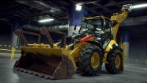
Virtual assembly: if it works for the industry, why not for the research? (link to a demonstration video clip)
FCC-EIC Joint & MDI Workshop 2022

Slide 15
Thank you for your attention
Contact: Luigi.Pellegrino@lnf.infn.it

Slide 16
SPARE SLIDES

Slide 17

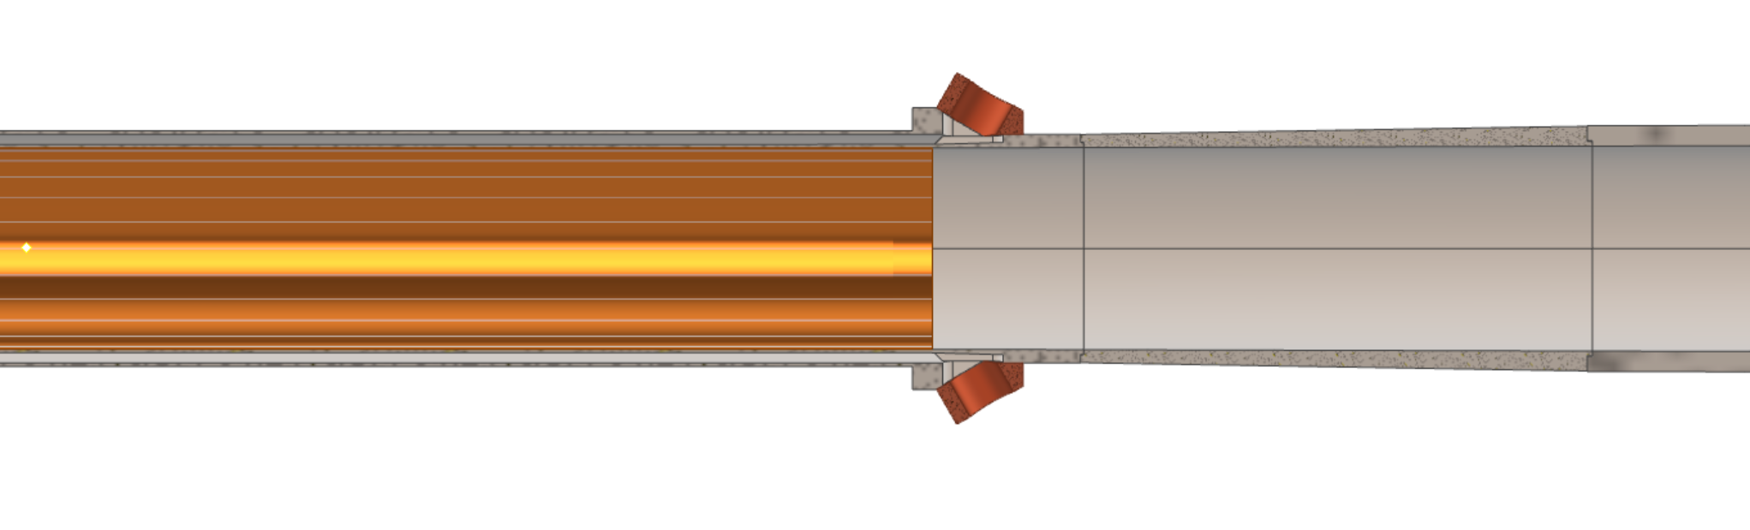
FCC-EIC Joint & MDI Workshop 2022
Details of the chamber
0,35 mm
1 mm
0,35 mm
1,5 mm
2 mm
90 mm
105 mm
155 mm

