Slide 1

IR Engineering: Thermal and Structural Issues
CERN, 26th of October 2022
1st FCC-EIC Joint Workshop and the 4th FCC-ee MDI Workshop
Speakers: Francesco Fransesini
Manuela Boscolo, Luigi Pellegrino, Giancarlo Sensolini, Stefano Lauciani, Alexander Novokhatski, Francesco Fransesini

Slide 2

Outline
CERN, 26th of October 2022
1st FCC-EIC Joint Workshop and the 4th FCC-ee MDI Workshop
The presentation concerns:
Thermo-structural calculation: comparison between beam and no-beam condition
Thermal calculation due to the wake field: issues and progress
Study of the influence of the VTX detector first layer weight over the chamber
Issues for the integration between vertex detector and chamber
Structural analysis of the Carbon fiber cylinder

Slide 3
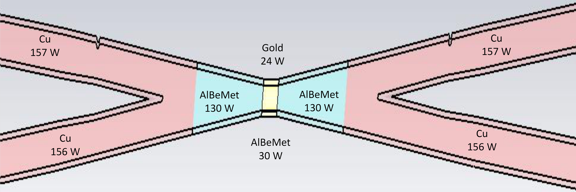
FEA analysis of the chamber
CERN, 26th of October 2022
1st FCC-EIC Joint Workshop and the 4th FCC-ee MDI Workshop
It is necessary to consider every thermo-structural aspect using a detailed model
FEA (Ansys)
Temperature distribution along the pipe
Start of the cooling over the trapezoidal chamber
Paraffin flow
Flow rate: 0,015 kg/s
Section:68,17 mm²
Velocity: 0,3 m/s
Inlet temperature: 18°C
Convective coefficient: 900 W/m²K
Water flow (20 different channel)
Flow rate: 0,0019 kg/s
Section: 9,62 mm²
Velocity: 0,2 m/s
Inlet temperature: 18°C
Convective coefficient: 1200 W/m²K
Heat load :
54 W central
130 W AlBeMet162 for each part
Thanks to Alexander Novokhatski
A. Novokhatski 04/11/22

Slide 4
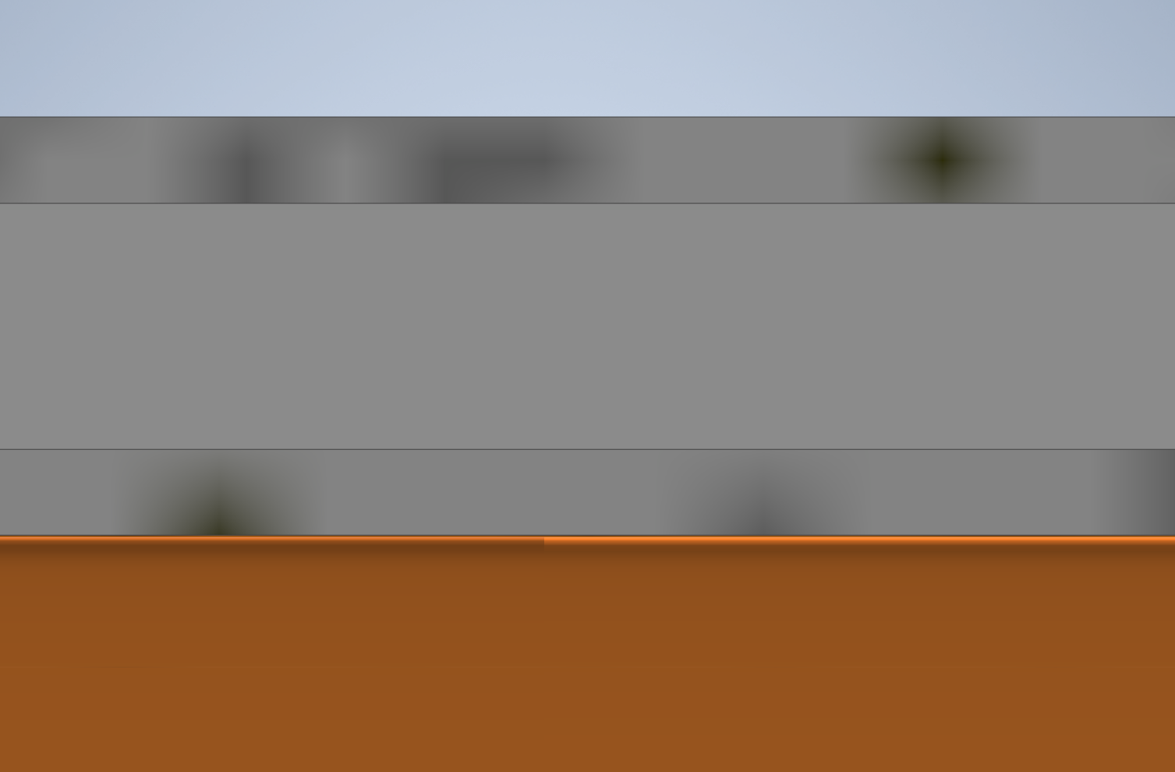
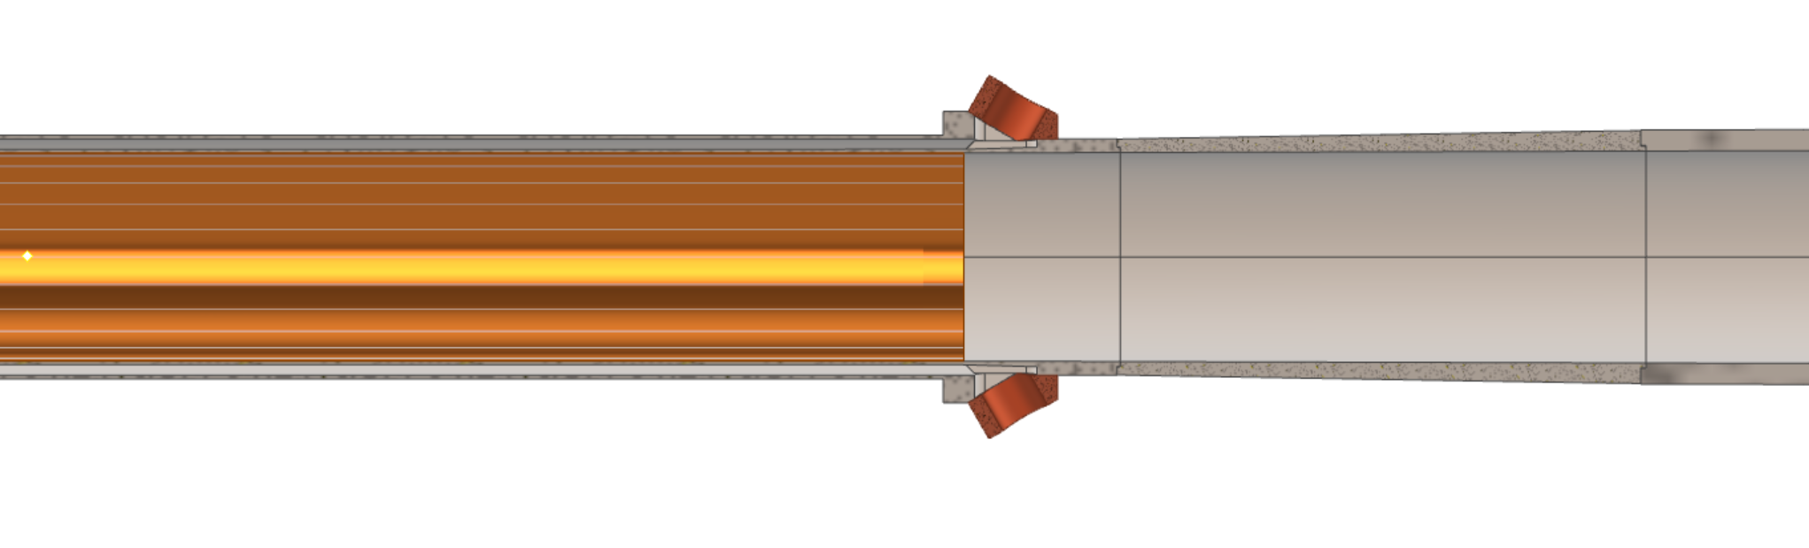
CERN, 26th of October 2022
1st FCC-EIC Joint Workshop and the 4th FCC-ee MDI Workshop
Thickness of the chamber
0,35 mm
Uniform thickness of the trapezoidal chamber set at 2 mm
1 mm
0,35 mm
1,5 mm
2 mm
90 mm
105 mm
155 mm

Slide 5
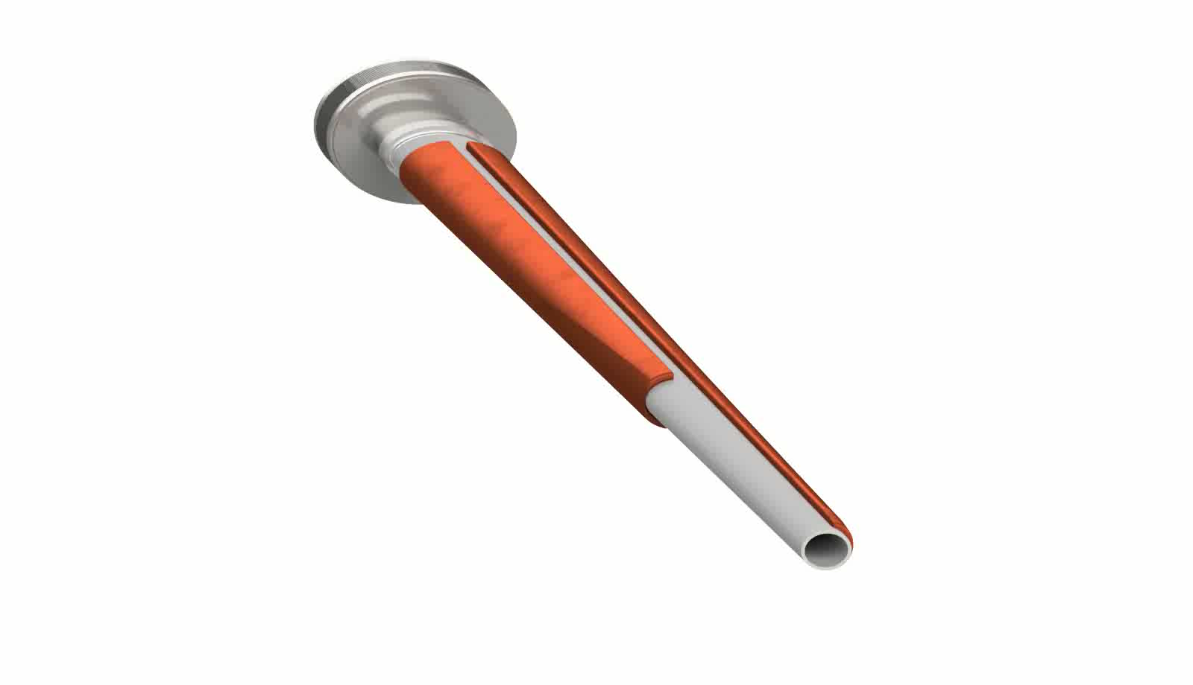
Cooling
CERN, 26th of October 2022
1st FCC-EIC Joint Workshop and the 4th FCC-ee MDI Workshop
To assure the structural thickness of the cooling channels walls and to create the structure less massive possible, the channels start at different distance from the IP, creating the following design.
This solution creates an asymmetric behavior but still effective.

Slide 6
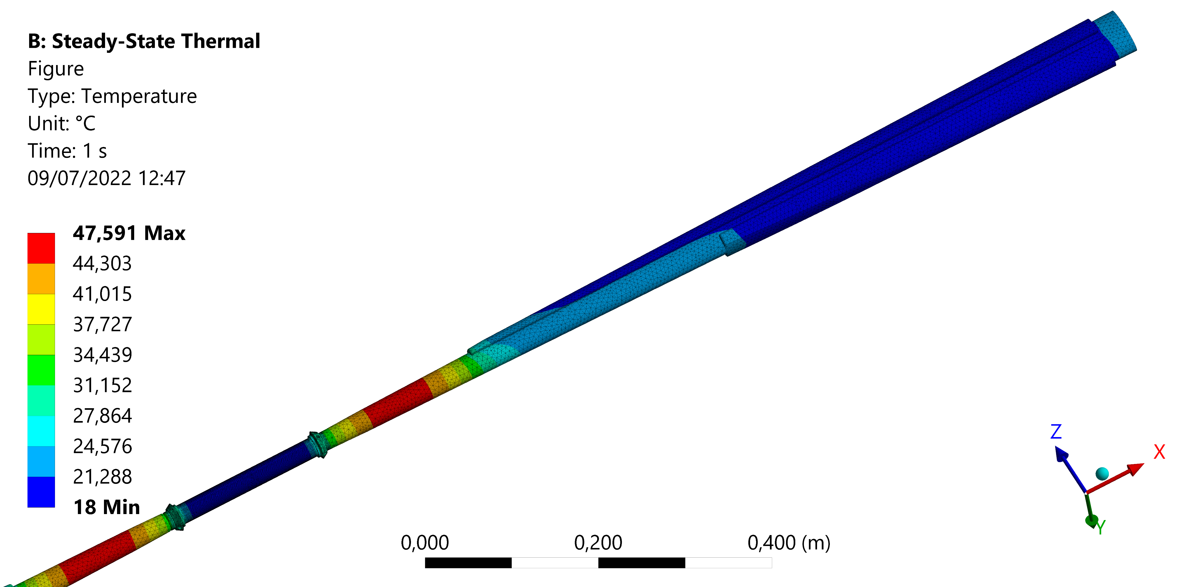
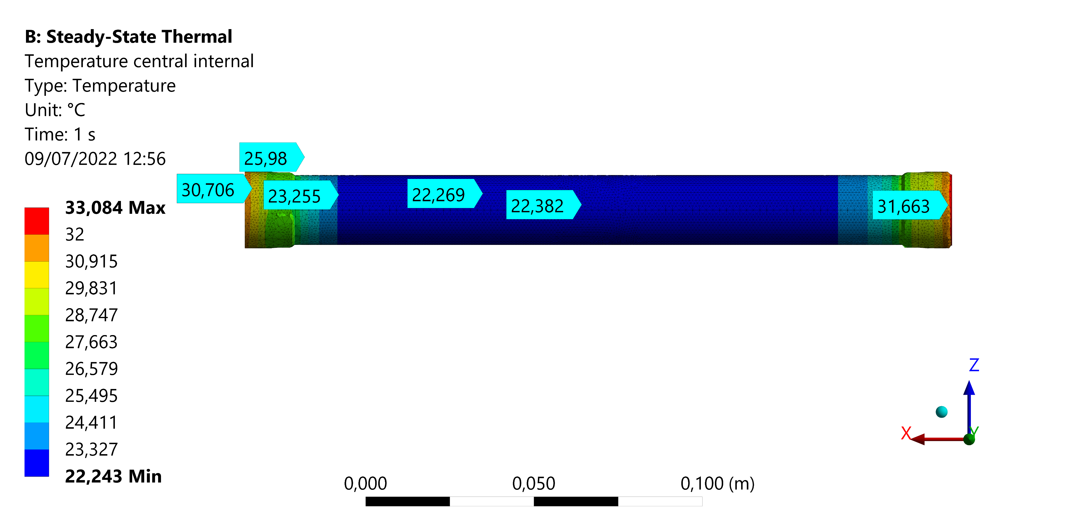
CERN, 26th of October 2022
1st FCC-EIC Joint Workshop and the 4th FCC-ee MDI Workshop
Hypothesis:
Perfect thermal contact between the materials
Results:
 | Trapezoidal chamber | Central chamber
Coolant | Water | Paraffin
Maximum chamber temperature [°C] | 47,6 | 33,1
T_out coolant [°C] | 20,5 | 20,1

Slide 7
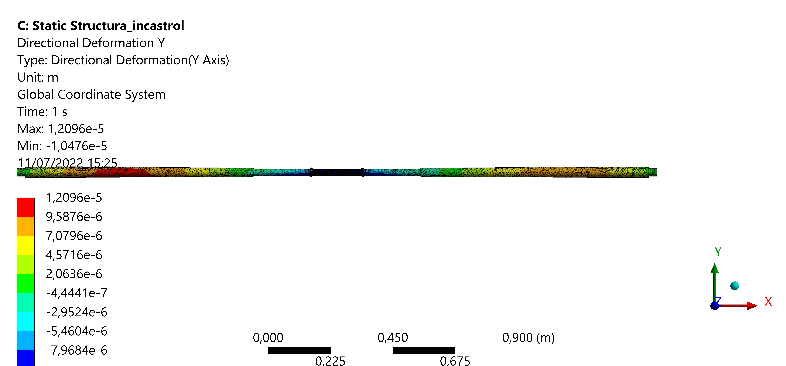
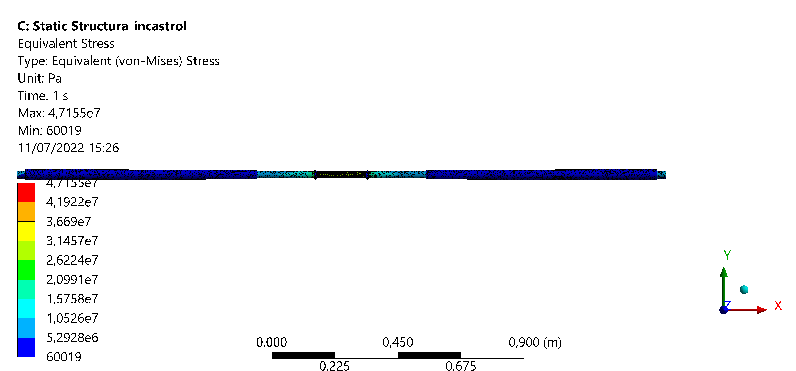
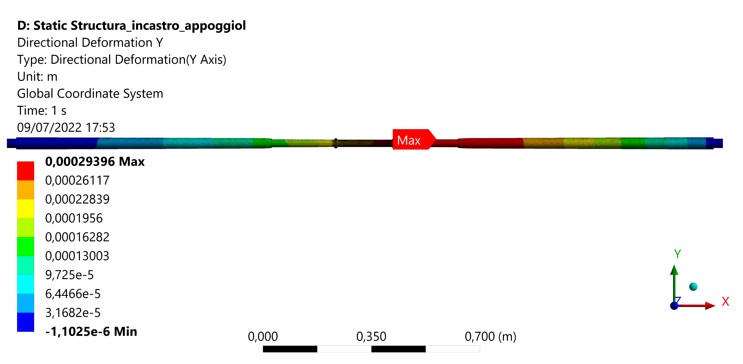
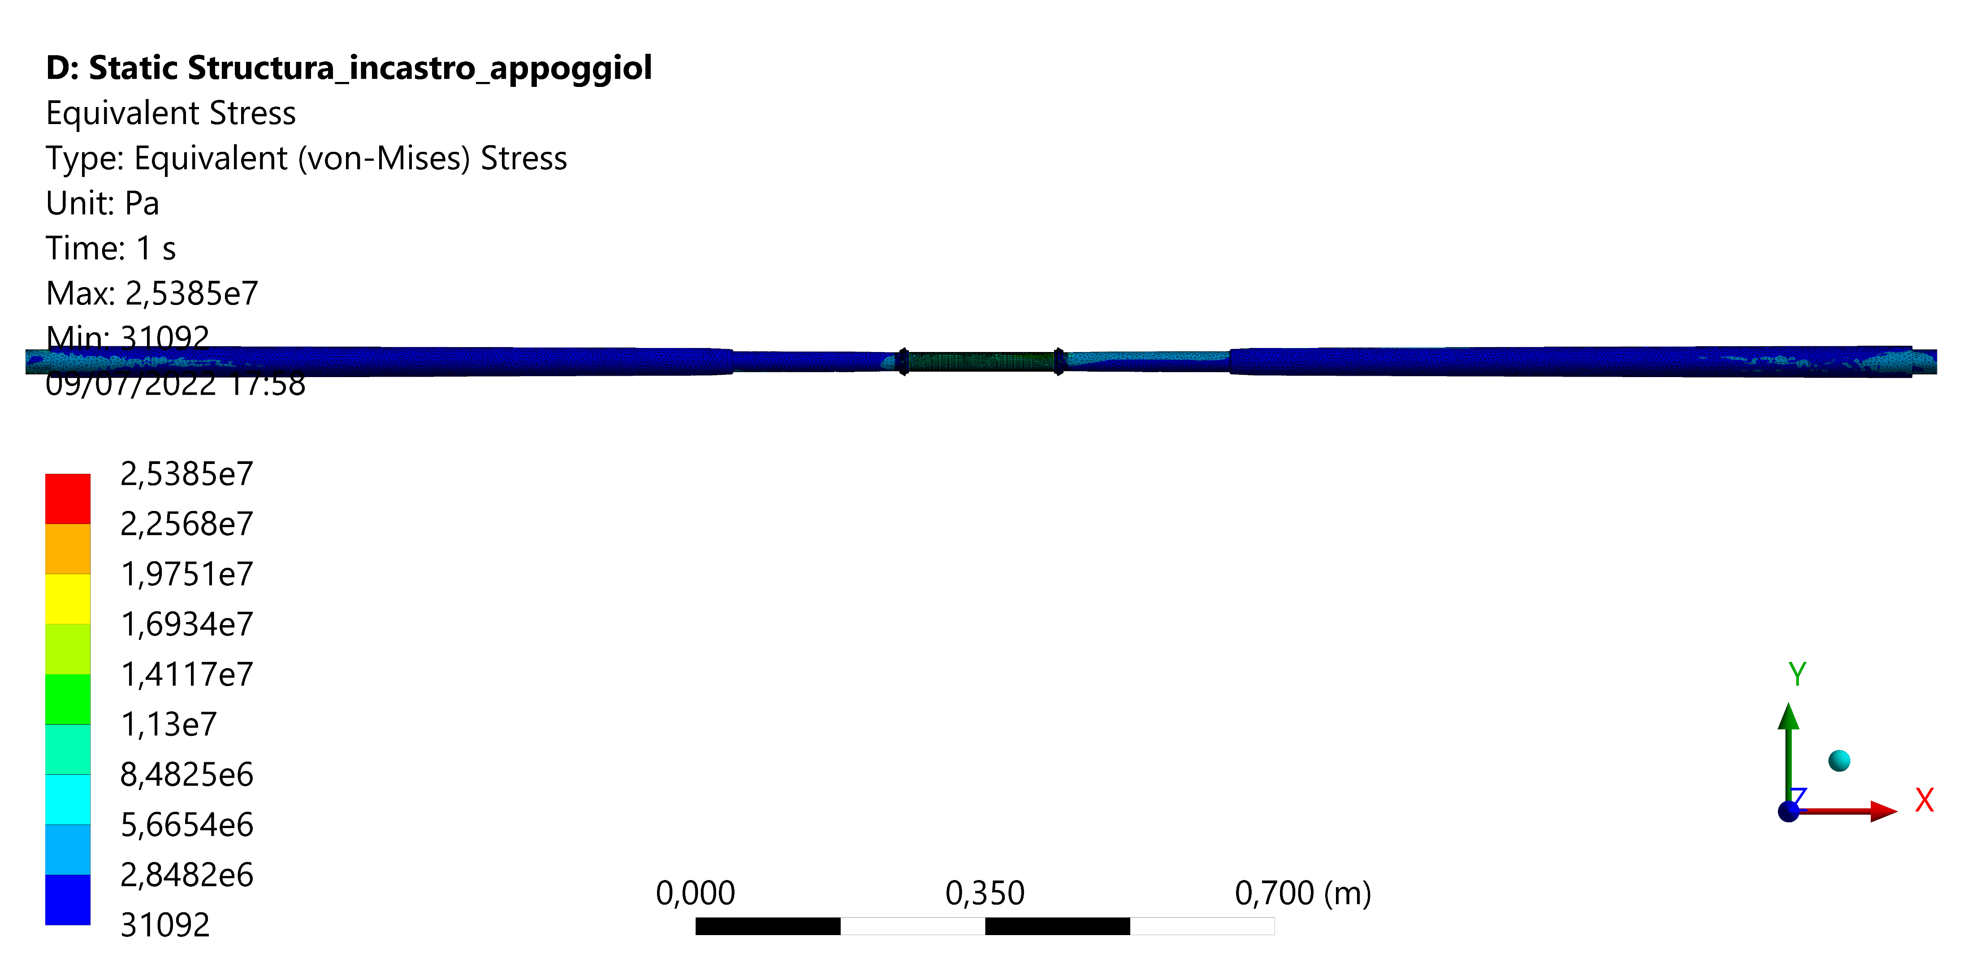
CERN, 26th of October 2022
1st FCC-EIC Joint Workshop and the 4th FCC-ee MDI Workshop
Fixed ended
Cantilevered, simply supported
Case | Maximum stress Von Mises | Maximum displacement
Fixed ended | 46 MPa | 0,01 mm
Cantilevered, simply supported | 25 MPa | 0,3 mm
The stresses and displacement are acceptable, but the buckling study of the central chamber is ongoing.

Slide 8
Study of the influence of the VTX detector first layer weight over the chamber
CERN, 26th of October 2022
1st FCC-EIC Joint Workshop and the 4th FCC-ee MDI Workshop
To understand the behavior of the chamber under a load due to the weight of the VTX first layers, is useful to create a table.
This table is created performing a Parametric design with Ansys, augmenting the weight of the layers and evaluating the central chamber stress and strain.
Configuration | VTX load [kg] | Maximum stress [Mpa] | Maximum displacement [mm] | Safety factor
1 | 0,5 | 46,8 | 9,56E-02 | 5,9
2 | 1,0 | 47,4 | 1,15E-01 | 5,7
3 | 2,0 | 48,4 | 1,47E-01 | 5,3
4 | 3,0 | 49,4 | 1,80E-01 | 5,0
5 | 4,0 | 50,0 | 2,03E-01 | 4,8
6 | 5,0 | 50,7 | 2,27E-01 | 4,5
7 | 6,0 | 51,6 | 2,62E-01 | 4,3

Slide 9


CERN, 26th of October 2022
1st FCC-EIC Joint Workshop and the 4th FCC-ee MDI Workshop
Comparison between beam and no-beam condition (1)
It is necessary to study the behavior of the system over the two-operative condition: the one with the beam running and the other without the beam (many thanks to M. Sullivan for highlighting that) .
The characteristics are the following:
Characteristic | BEAM | NO BEAM
Earth gravity
Constraint
Cooling
Heat load due to the wake field
Services load (foreseen for next study)
Vertex detector load

Slide 10
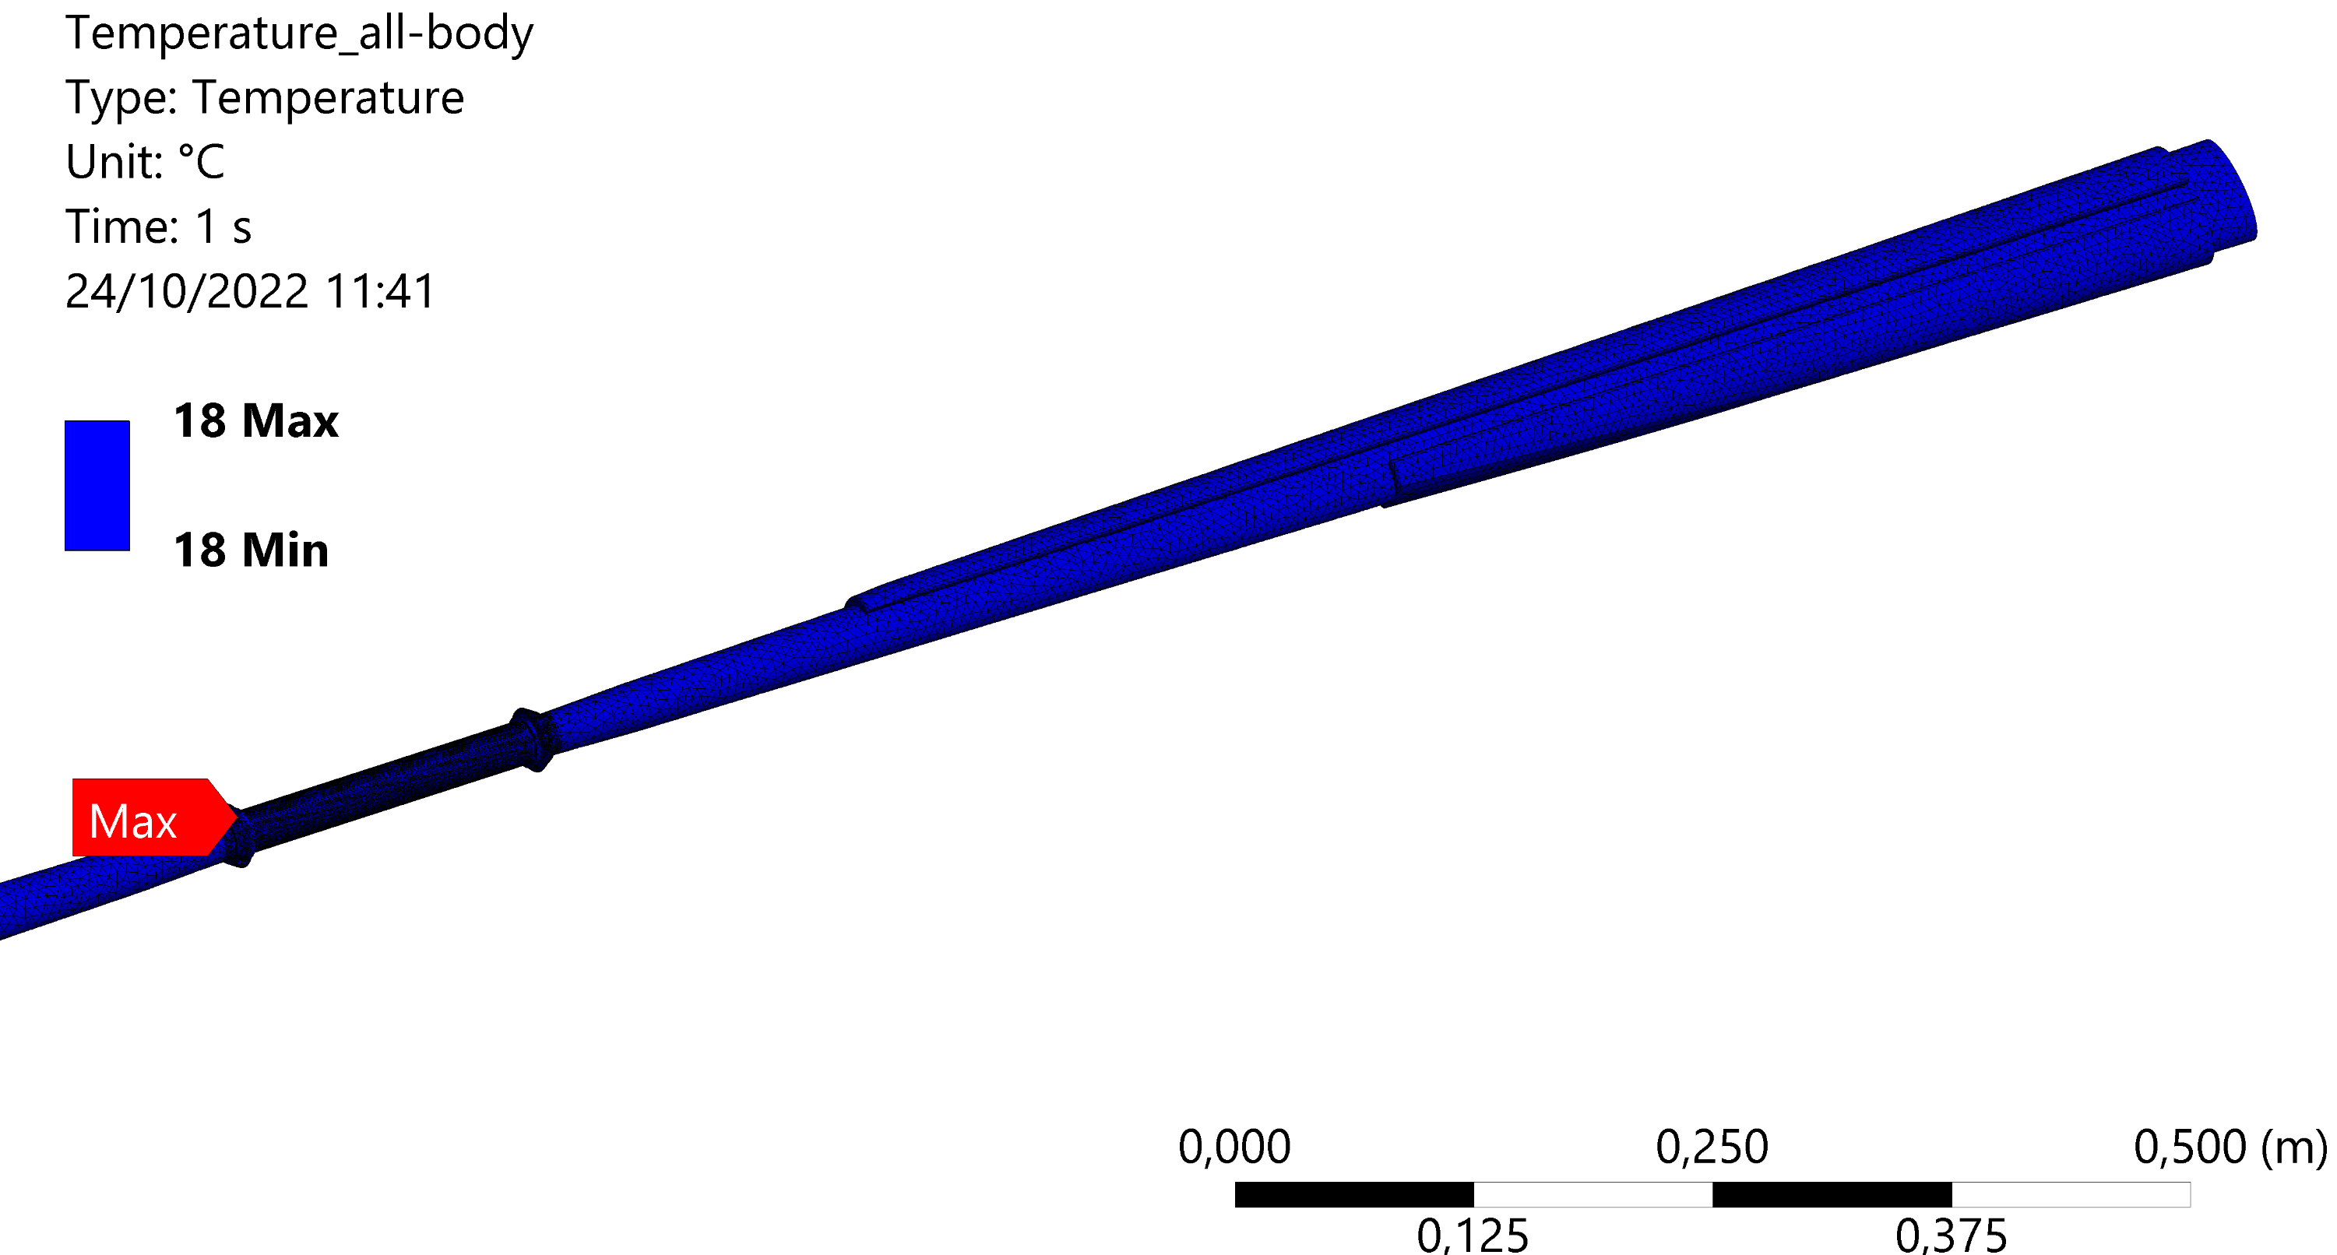
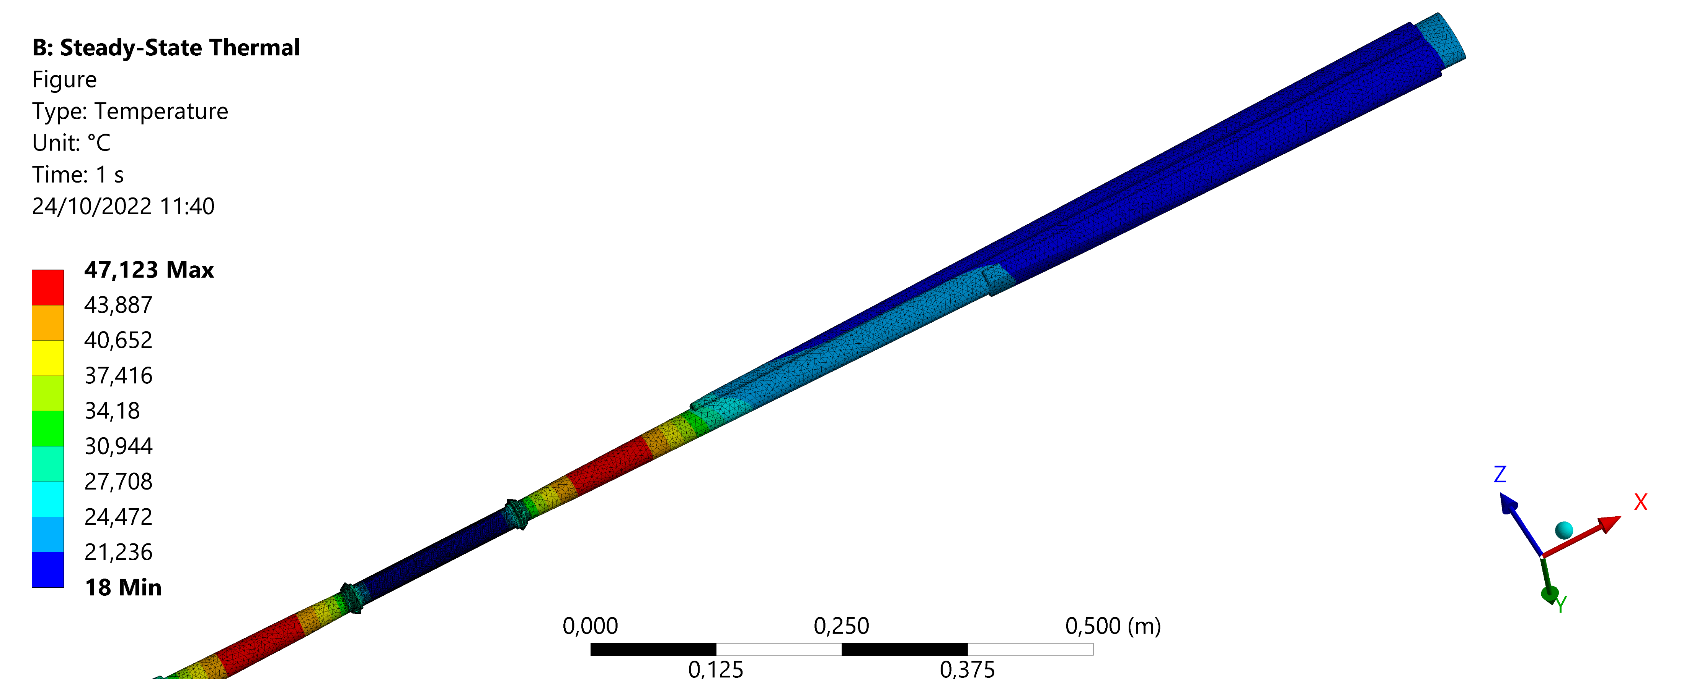
CERN, 26th of October 2022
1st FCC-EIC Joint Workshop and the 4th FCC-ee MDI Workshop
Comparison between beam and no-beam condition (2)
In term of displacement and stress, without the heat load (no beam) the cooling keep the temperature at steady state about 18 °C, the temperature of the coolant at the inlet. The hall temperature is set at 22°, so the structure is under contraction, in contrast to the beam condition where the temperature is higher of 22°C causing an expansion of the structure.
BEAM
NO BEAM

Slide 11
CERN, 26th of October 2022
1st FCC-EIC Joint Workshop and the 4th FCC-ee MDI Workshop
Comparison between beam and no-beam condition (3)
Von Mises stress [MPa]
 |  | Trapezoidal SX (always fixed side) | Trapezoidal DX | Central IN | Central EX
BEAM | Fixed ends | 22,07 | 21,86 | 46,8 | 38,9
 | Fixed+displ | 14,65 | 10,63 | 9,69 | 17
NO BEAM | Fixed ends | 36,7 | 37 | 69,26 | 68,1
 | Fixed+displ | 27,6 | 20,1 | 12,7 | 9,82
Results
Maximum displacement [mm]
 |  | X | Y
BEAM | Fixed ends | 0,031 | 0,07
 | Fixed+displ | 0,1 | 0,29
NO BEAM | Fixed ends | 0,033 | 0,055
 | Fixed+displ | 0,13 | 0,3
 |  | Trapezoidal SX (always fixed side) | Trapezoidal DX | Central IN | Central EX
BEAM | Fixed ends | C | C | C | C
 | Fixed+ displ | E | C | E | C
NO BEAM | Fixed ends | E | E | E | E
 | Fixed+ displ | E | C | C | C
Contraction and expansion state
C = Contraction
E = expansion

Slide 12
CERN, 26th of October 2022
1st FCC-EIC Joint Workshop and the 4th FCC-ee MDI Workshop
Comparison between beam and no-beam condition (4) Conclusion
Both condition are allowable in term of stress and strain
The different behavior in term of contraction and expansion is highly important for the sizing of the bellow (stroke, dimension).
The study of the two condition influences the analysis of the position of the first vertex detector layer attached to the chamber.
Future step
Upload the analysis using the last Alexander Novokhatski calculation ( presented on Monday the 24th)

Slide 13
Thermal calculation due to the wake field: issues and progress (1)
CERN, 26th of October 2022
1st FCC-EIC Joint Workshop and the 4th FCC-ee MDI Workshop
This work has been started with Alexander Novokhatski and is currently in progress.
To calculate the thermal contribution is necessary to progress step by step and create simplified models, compatible with CST requirement and needs.
The chamber model is less complicated than the bellows, in fact for the last one it has been necessary a process of simplification of the edges, geometry and features.

Slide 14
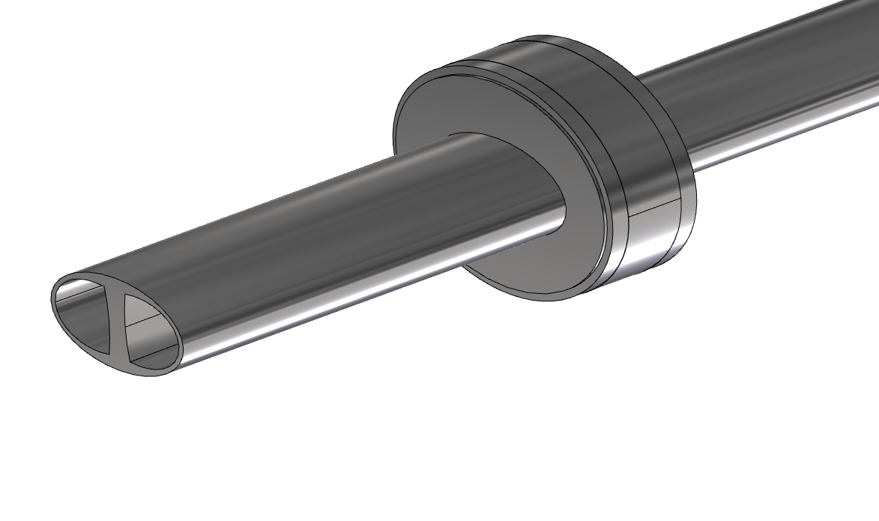
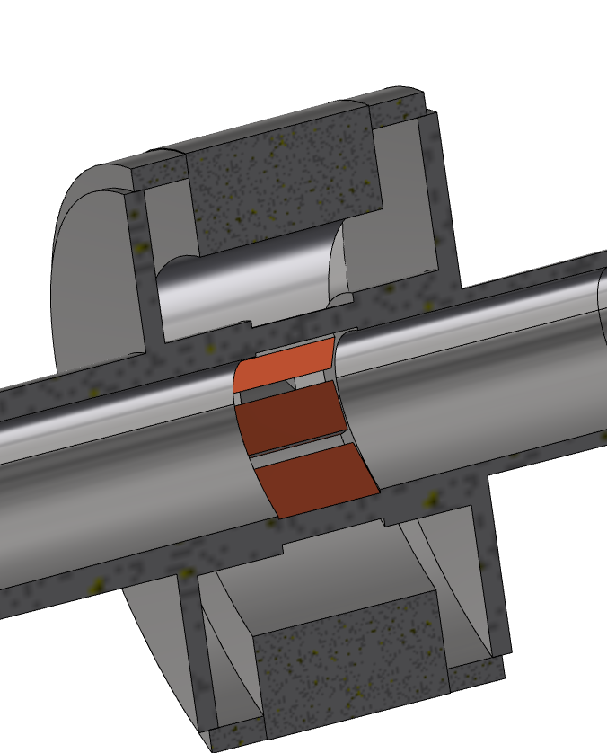
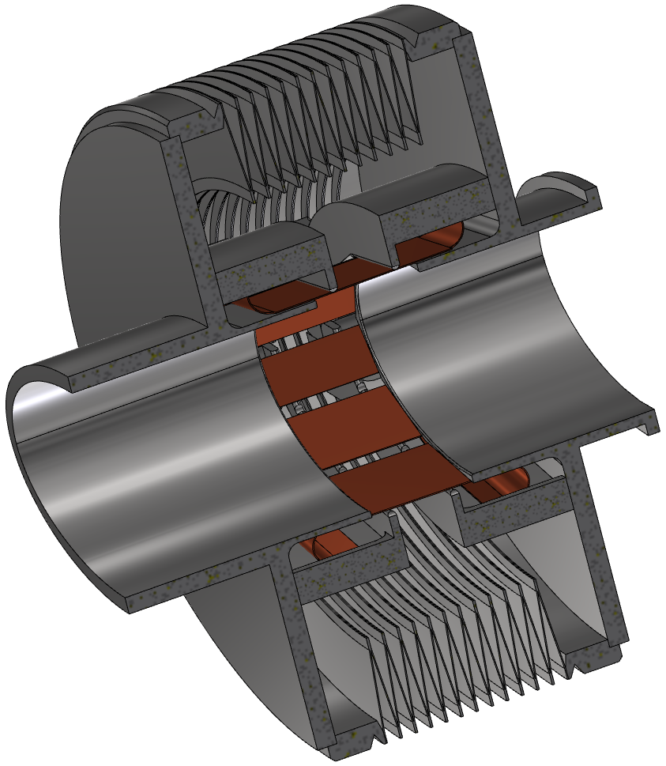
Thermal calculation due to the wake field: issues and progress (2)
CERN, 26th of October 2022
1st FCC-EIC Joint Workshop and the 4th FCC-ee MDI Workshop
Simplification of springs and fingers
Simplification of edge: every edge bigger than 1 mm
No compenetrating body

Slide 15
Issues for the integration between vertex detector and chamber (1)
CERN, 26th of October 2022
1st FCC-EIC Joint Workshop and the 4th FCC-ee MDI Workshop
A collaboration with INFN-Pisa on tracker and vertex of IDEA detector has been started, and after some iterations a new proposal for the central chamber design has been created.
This solution fit with the vertex detector first layer and its support.
The focus was to create the space for the layer, according to the geometry, the weight and the geometry of the chamber.

Slide 16
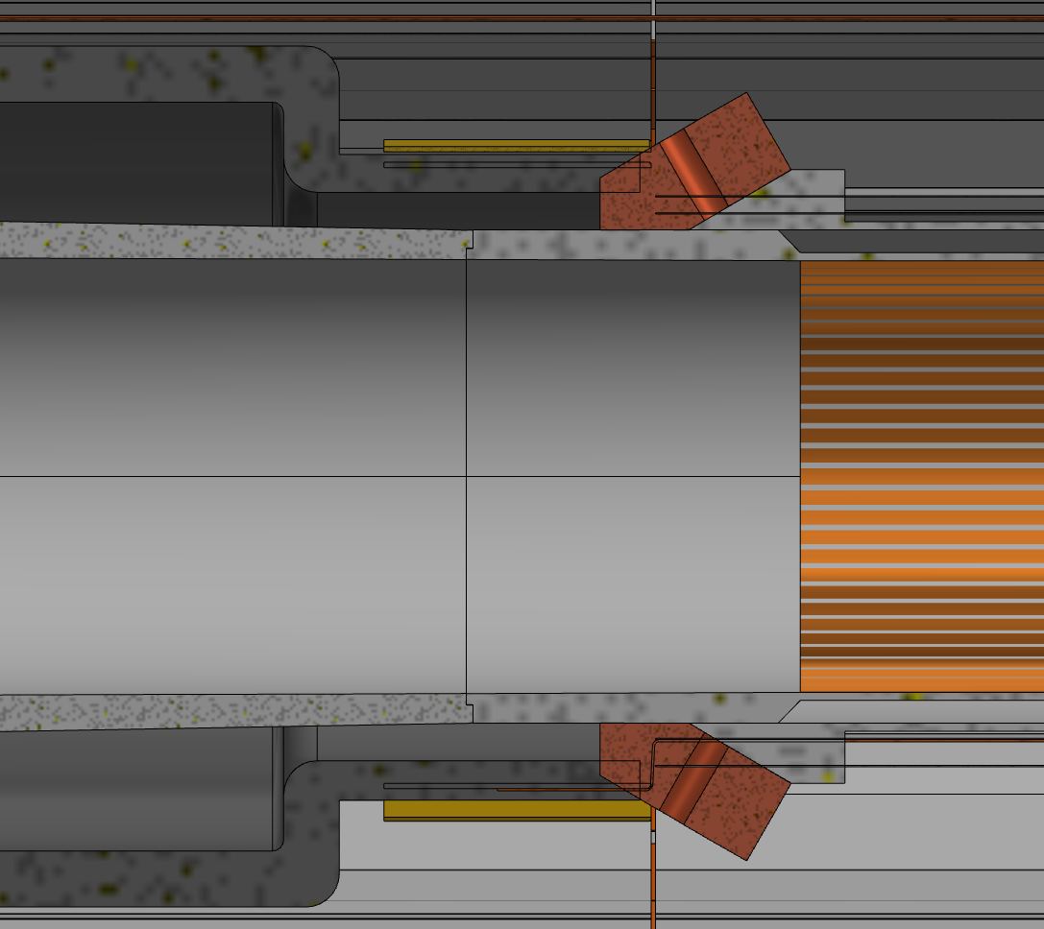
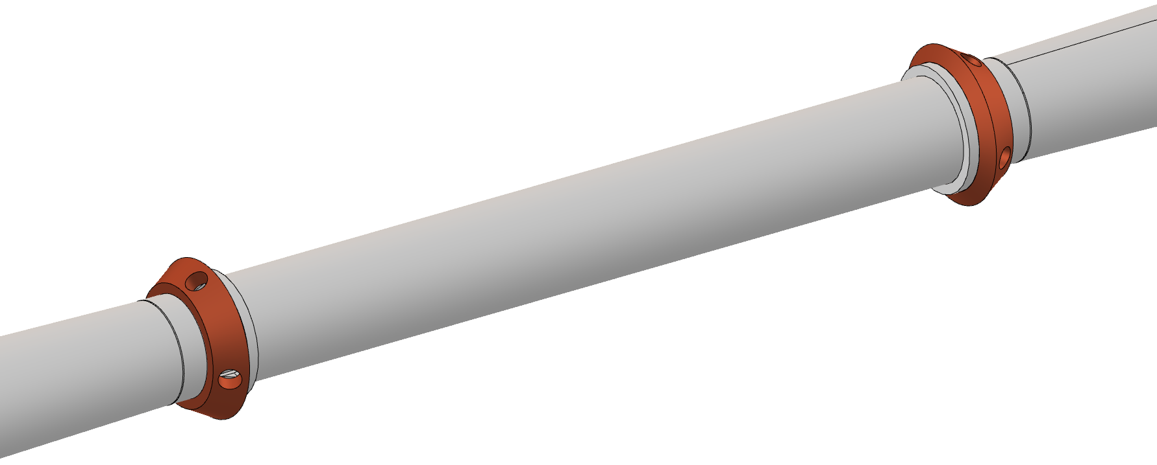
Issues for the integration between vertex detector and chamber (2)
CERN, 26th of October 2022
1st FCC-EIC Joint Workshop and the 4th FCC-ee MDI Workshop
Problems:
Compenetration between inlet/outlet and the chamber
No space to arrange the first layer

Slide 17
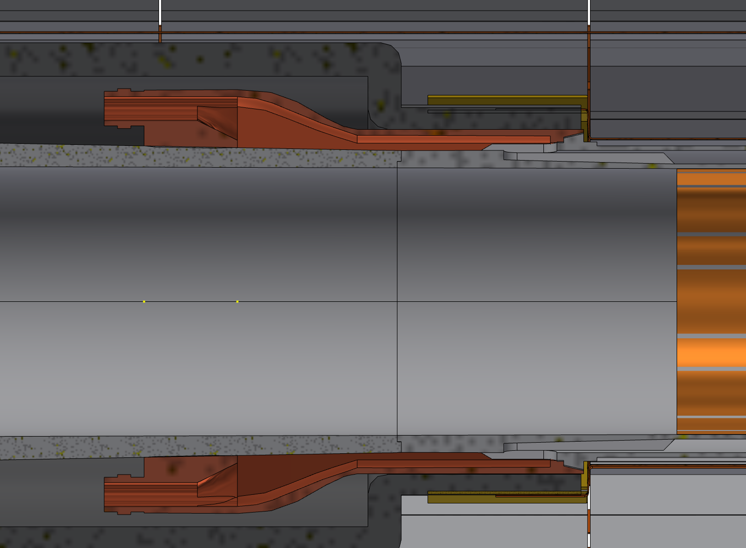
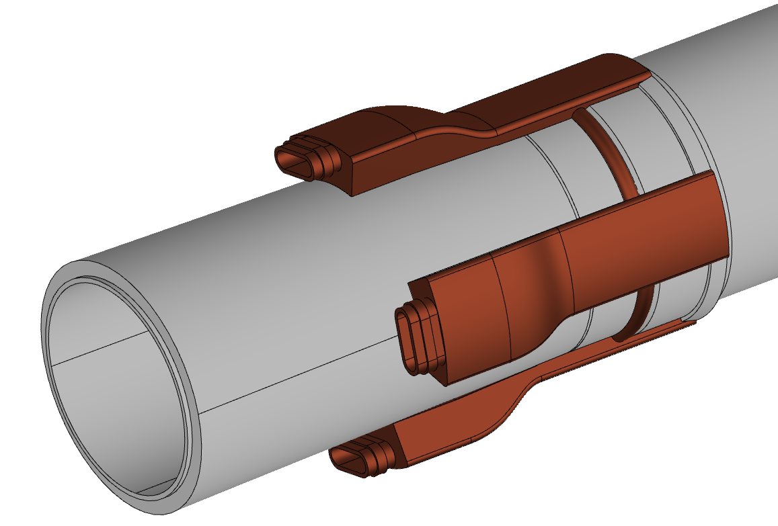
Issues for the integration between vertex detector and chamber (3)
CERN, 26th of October 2022
1st FCC-EIC Joint Workshop and the 4th FCC-ee MDI Workshop
Solution:
move forward inlet and outlet creating a longer channel; inlet and outlet into the first cavity of the vertex detector support.
4 different channel instead of massive one, to reduce the copper
1st layer vertex detector
Central chamber
Inlet/outlet

Slide 18
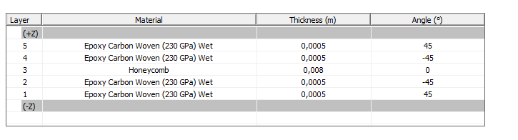
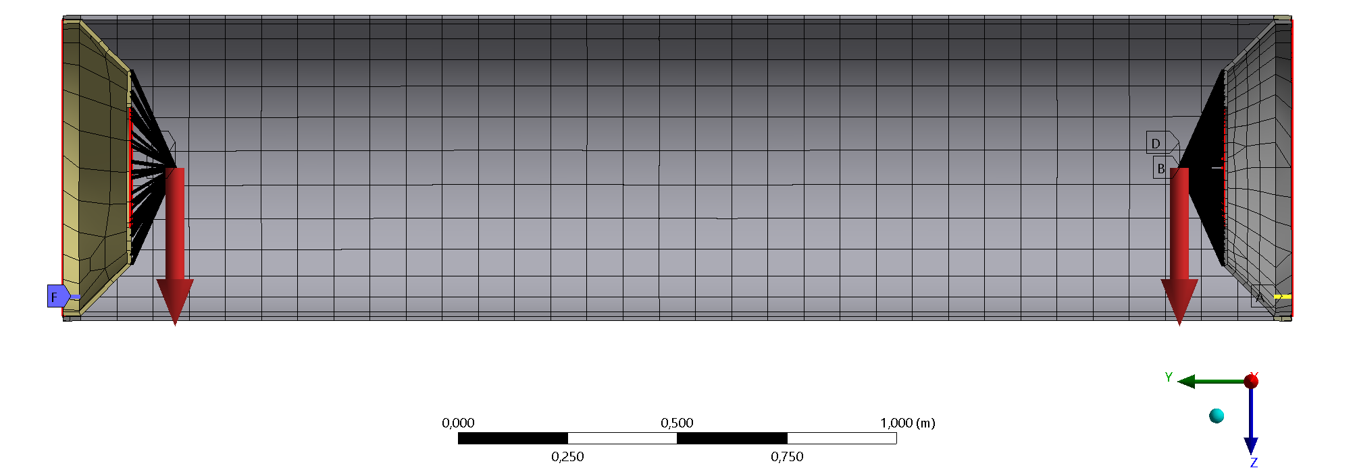
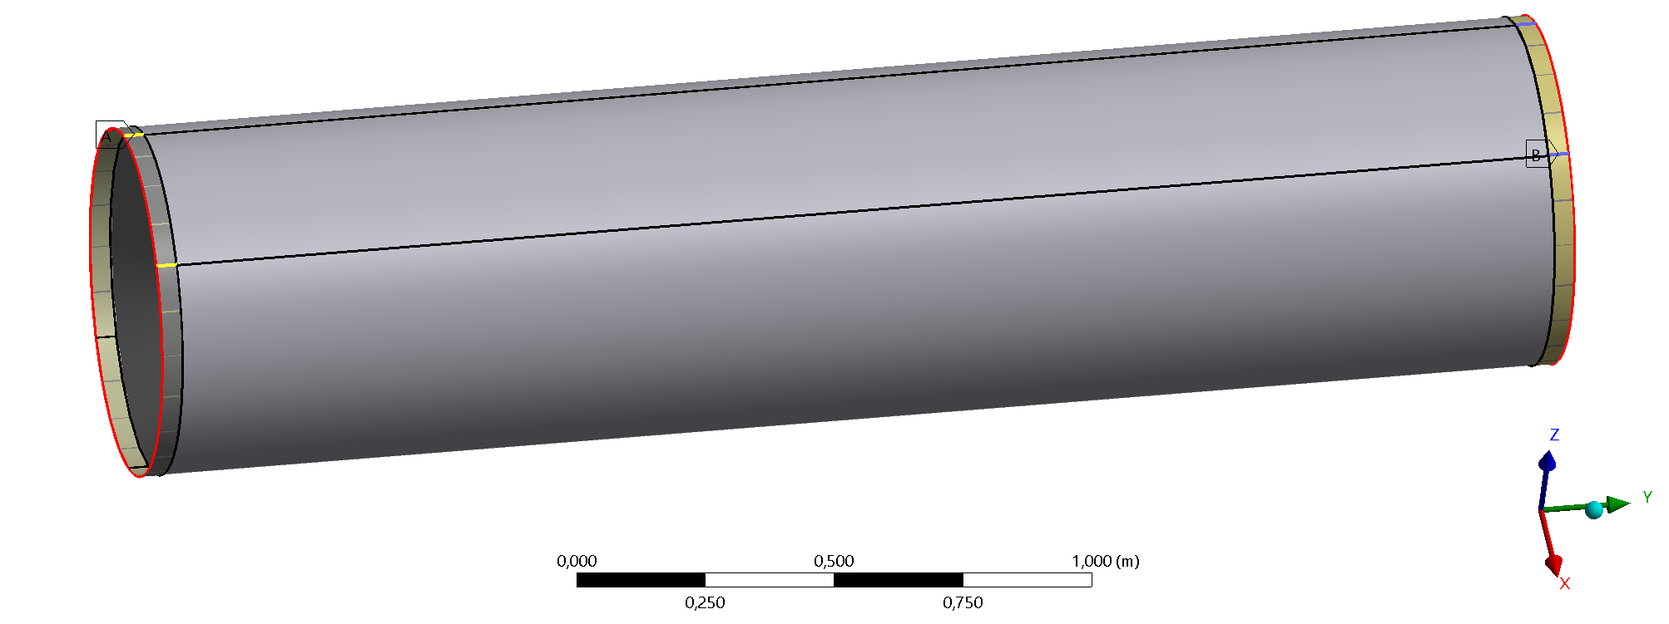
Preliminary simulation on supporting Cylinder (1)
CERN, 26th of October 2022
1st FCC-EIC Joint Workshop and the 4th FCC-ee MDI Workshop
Materials
Cylinder structure (10mm)
1mm CF
8mm HC
1mm CF
Flanges:
10mm Aluminium
2)
1)
Cylinder structure (7mm)
1mm CF
5mm HC
1mm CF
Flanges:
10mm Aluminium
Loads
70 Kg on each flanges
Constraints
Simply supported in order to simulate rail supports
Free to move in longitudinal direction
Fixed
CF=carbon fiber
HC=honeycomb

Slide 19
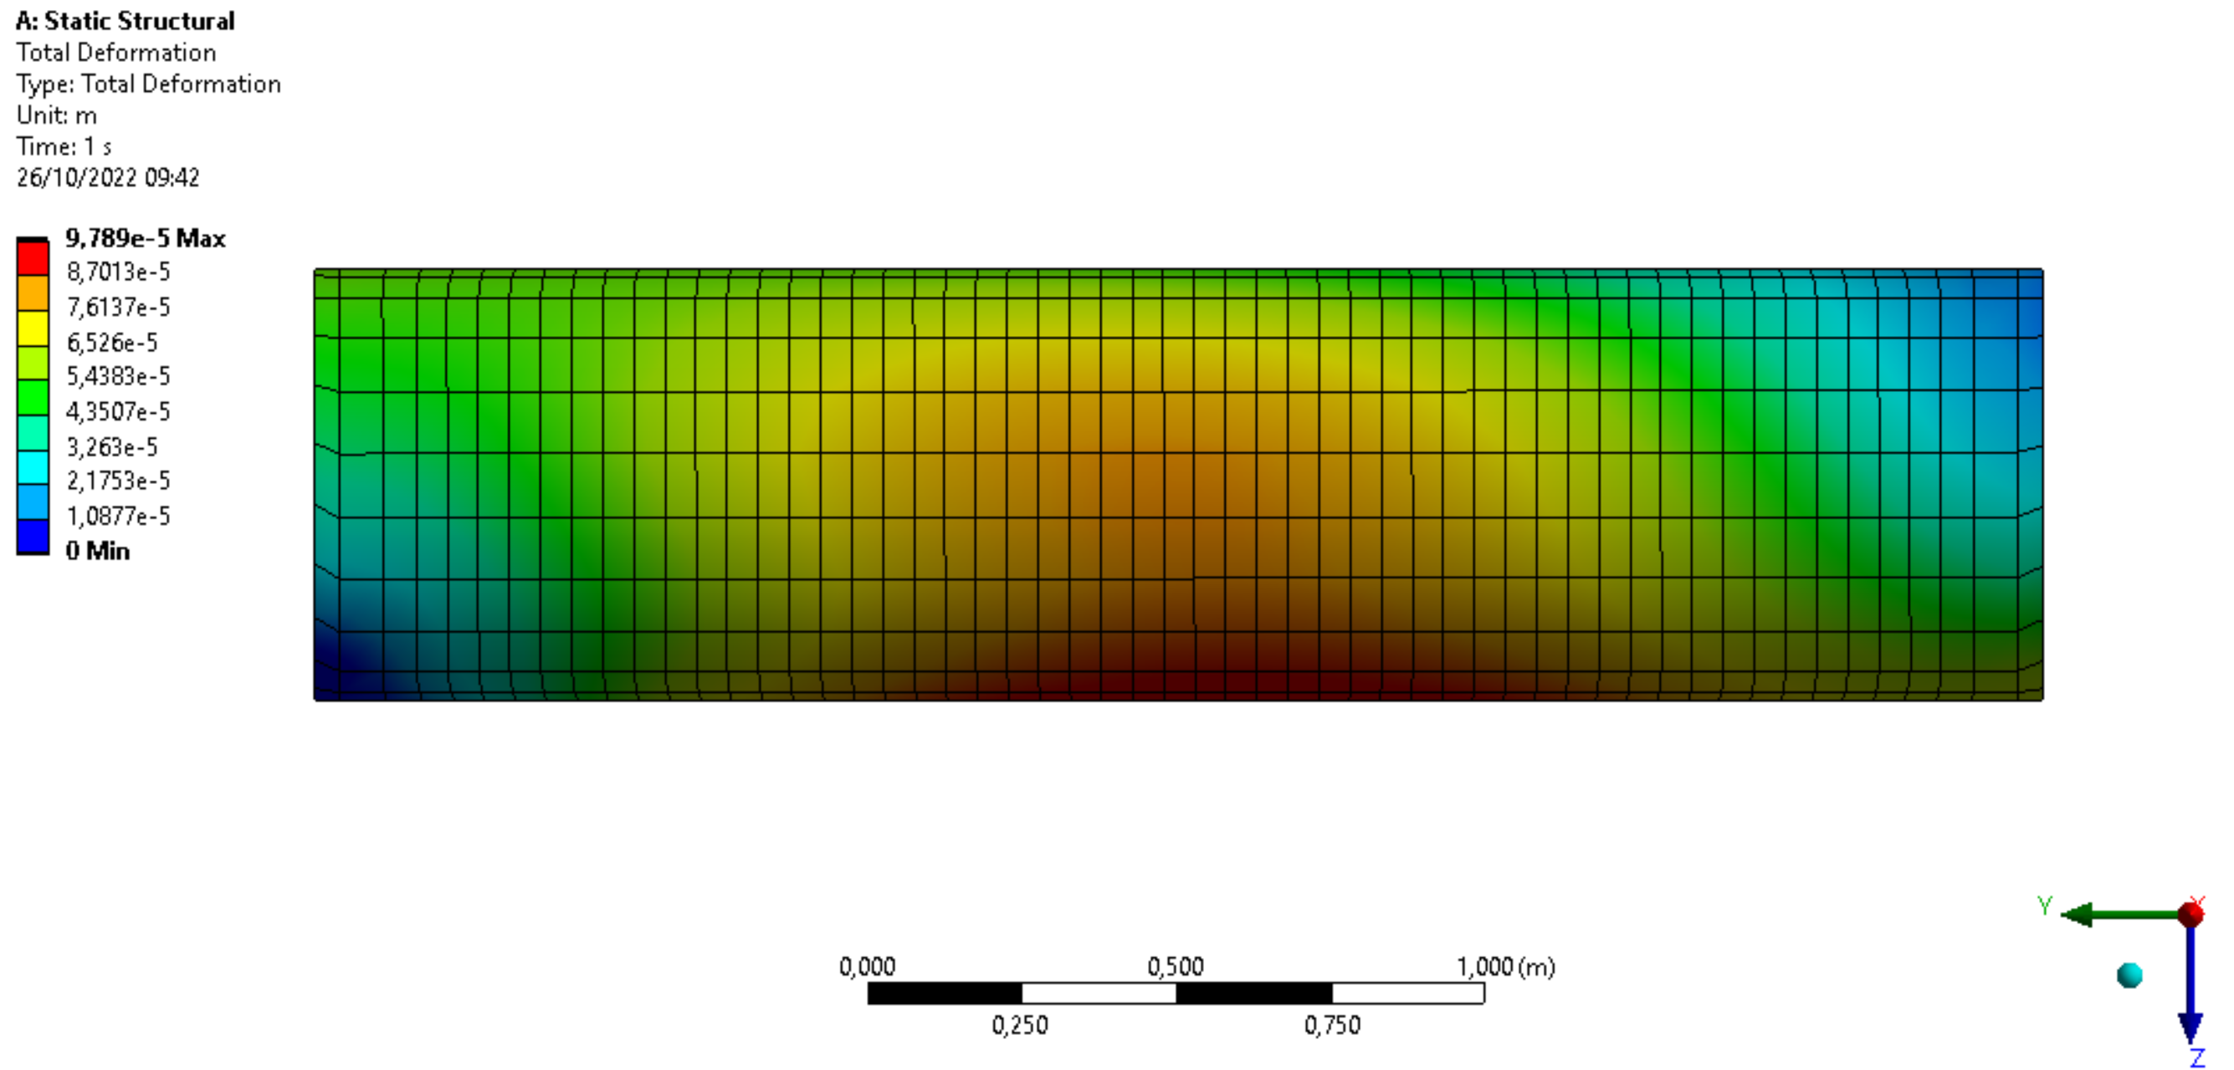
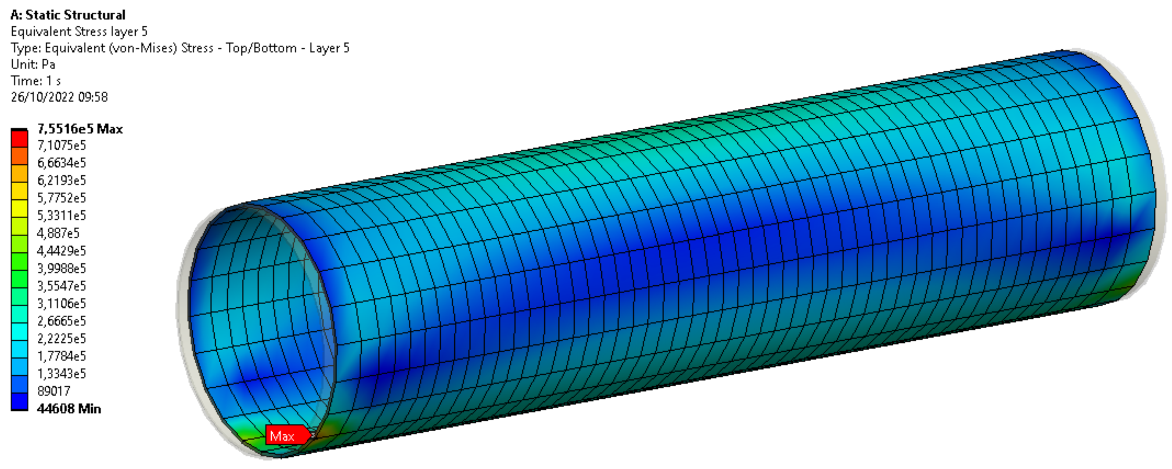
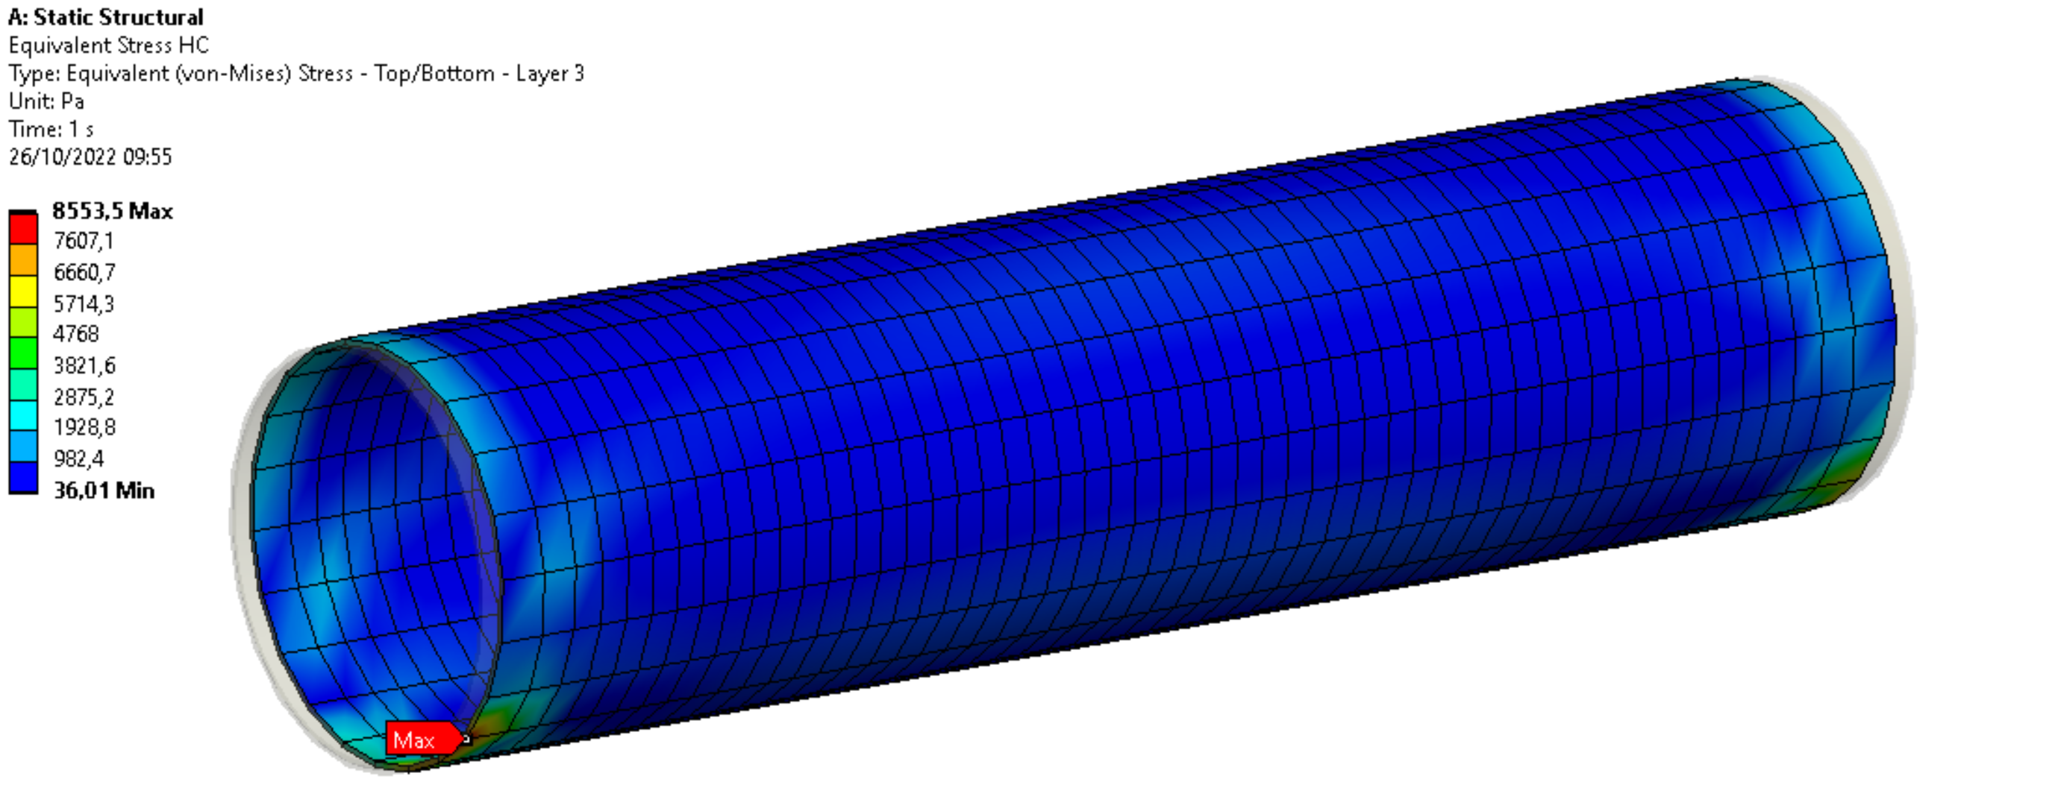
Results
CERN, 26th of October 2022
1st FCC-EIC Joint Workshop and the 4th FCC-ee MDI Workshop
Deformation
Stress on CF
Stress on HC [MPa]
 | Maximum deformation [mm] | Maximum stress on CF [MPa] Layer 1 | Maximum stress on HC [MPa] Layer 3 | First failure stress for CF [Mpa]
8mm HC | 0,098 | 0,7 | 0,085 | 275
5mm HC | 0,11 | 0,7 | 0,094 | 275

Slide 20
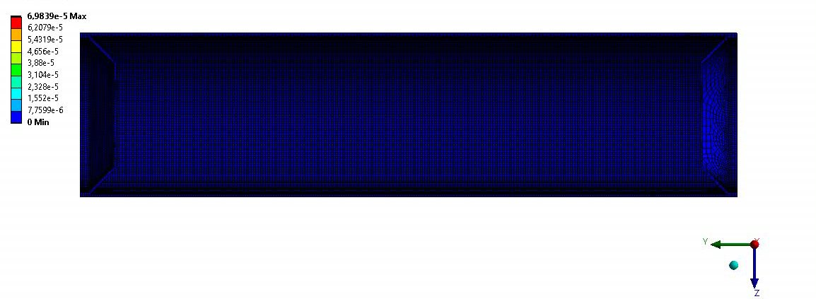
CERN, 26th of October 2022
1st FCC-EIC Joint Workshop and the 4th FCC-ee MDI Workshop
It is very important to evaluate the flanges rotation due to the weight especially for the components’ alignment.
 | Maximum rotation x [deg*10^-3 (mrad) ]
 | Flange Left | Flange Right
8mm HC | -4,68 (0,082) | 4,9 (0,086)
5mm HC | -4,63 (0,081) | 4,8 (0,084)
Displacement multiplied by 1000 factor

Slide 21
CERN, 26th of October 2022
1st FCC-EIC Joint Workshop and the 4th FCC-ee MDI Workshop
Conclusion and future steps
The current structure (chamber, cylinder) can assure a good stiffness, maintaining stress and strain low.
The thermal simulation is quite preliminary but still effective. In the next future we are going to update the thermal load with Alexander calculation, then we intend to built a prototype to test the system.
The design compatible with last update of INFN-Pisa VTX will require a new analysis, but we do not expect sensible variation in term of stress and strain.
The cylinder analysis will be updated following the progress of the IR design.

Slide 22
Thank you for your attention
CERN, 26th of October 2022
1st FCC-EIC Joint Workshop and the 4th FCC-ee MDI Workshop
Contact: francesco.fransesini@lnf.infn.it

