Slide 1
Integral Archive
A new brand of science-oriented Science Archives at ESAC Science Data Centre
Mónica Fernández, RHEA Group for ESA
ESA ESAC
31/10/2022
Notes:
Hello everybody! I'd like to thank to the Cern comittee for inviting me this Conference.
Let me introduce myself quickly.
My name is Monica Fernandez, and after several years working in domains like telephony or logistics, I arrived to ESAC, located in Madrid, more than 15 years ago to participate in the implementation of the ESA Science Archives. My. current position is coordinating the Observatory sub-area.
In this presentation I’ll talk about the long path between the first archive, published in 1998, and the latest ones, specifically the Integral Archive, still to be released publicly on 2025. We’ll describe this evolution, stressing the balance between their two main drivers: technology and associated science. We’ll see how important is being up-to-date using the latest technologies to get meaningful and maintainable tools.

Slide 2
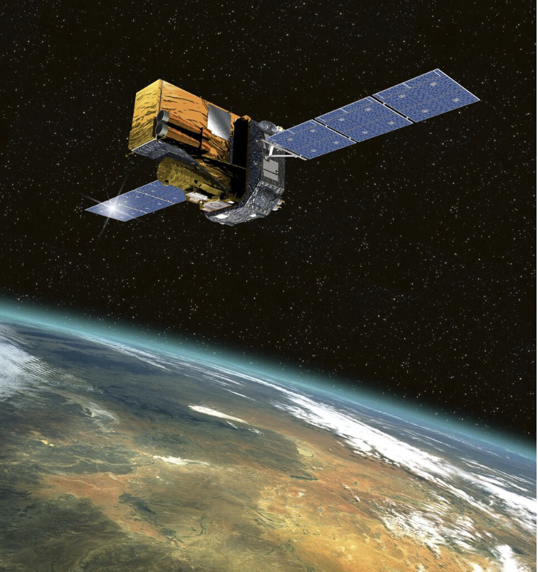
Integral mission: a bit of context
ESA’s International Gamma-Ray Astrophysics Laboratory, launched on October 2002 (still in operations)
First observatory that observes simultaneously objects in gamma rays, X-rays and visible light
Mission targets:
  Galactic black holes, neutron stars, white dwarfs
  Active galactic nuclei at heart of distant galaxies
  Gamma-ray bursts and violent explosions
  Supernova explosions
Heavy science payload (2 tonnes): large area detectors & huge shield
  2 gamma-ray instruments: Imager (IBIS) & Spectrometer (SPI)
  2 monitors: X-ray monitor (JEM-X) & Optical camera (OMC)
3 days high elliptical orbit around Earth, shorter after 2015 to ensure re-entry
Planned mission end date: 2029
Notes:
Let’s start our trip talking a little bit about the mission.
Integral is an ESA international mission with contributions of Russia (Proton rocket) and the NASA deep space ground stations. It was launched in 2002. At that time it was the most advanced Gamma-Ray laboratory ever created, allowing astronomers to understand how matter behaves in extreme conditions.
It is still in operations, expected to end in 2024, post-operations will last until 2029. It was the first spacecraft that can observe celestial objects simultaneously in gamma rays, x rays and visible light with the main goal of tracking violent events across the Universe. IN the slide we can see the mission targets:
Galactic black holes, neutron stars, white dwarfs
Active galactic nuclei at heart of distant galaxies
Gamma-ray bursts and violent explosions
Supernova explosions
The INTEGRAL payload is the heaviest science payload ever placed by ESA at the time it was launched.Why? because the detectors have a large area and a huge shield that protects them from background radiation. It has 4 coaligned instruments:
2 gamma-ray: a camera and a spectrometer
2 monitors: an X-RAY and an optical camera
The mission has a high elliptical orbit around the Earth of 3 days that guarantees long periods of observation away from Earth radiation belts. Though it was reduced in 2015 (approaching the spacecraft to Earth surface) to enlarge the spacecraft life until 2029.

Slide 3
Scientific Archive: definition
Final mission data repository
  Different types of data: images and mosaics, spectra and time series, catalogues and online analysis tools
  Different users/different privileges: scientific community, PI team and observers, science operations team
Data is stored in powerful servers: ingested regularly
Metadata is saved in open source DB
Data and metadata is made available to the public through:
  Standard Internet browsers (Firefox, Chrome…)
  Command line interface
  Search, preview, select and download
  Public after a proprietary period
Facilitates the data exploitation: interactive, plots, interconnectivity, Astroquery, Datalabs…
Notes:
Since we are talking about implementing science archives let’s continue with a few words about what a science archive is. They can be considered the final repository of the products originated by the different missions. Their main aim is not only keeping the data but being a complete tool to distribute and exploit the mission products.
They serve the needs of both professional astrophysicists and also of the general public.
Data products are regularly ingested through automatic processes (we call ingestors) and metadata is stored in open sources databases (Postgresql, Greenplum)
The most basic capabilities any archive should offer are data and metadata retrievals via standard browsers or shell scripts, but on top on this, plenty of additional tools belong now to the core of the archives like:
interactive plots
interconnectivity with external applications via SAMP protocol
Python Astroquery modules
Integration with Datalabs: platform that allows an efficient exploitation of the science products.

Slide 4
Science Archives Incubator: ESAC Science Data Centre
ISO: first science archive in ESAC in 1998!
ESAC is the default ESAC location for scientific archives and VO activities
ESDC (ESAC Science Data Centre):
    Design, develop and maintain all the scientific archives to enable maximum scientific exploitation of ESA space science data
    Optimize personnel resources and expertise
    Ensure long term data preservation
State of the art technology in continuous improvement: need to adapt to the trend
First generation
1998 - 2006
Second
2006 -2011
Third
2011 – 2019
Forth
2019 -
Notes:
But, who is behind the archives?
As I’ve said in my introduction it was not until 1998 that ESA published the first archive for the ISO mission, being ESAC the default ESA location for scientific archives and VO activities.
ESAC Science Data Center (ESDC) is a team of software engineers and scientists in charge of those archives, re-using the manpower, software and technology. On top of this, it is key for the team to ensure the long term data preservation, once the missions are completed.
The challenge is important: Science Archives must support different missions (Planetary, solar, astronomy…), different types of data and different user communities with a common architecture and branding.
Along these years the team tried to follow the latest technologies resulting in different generations of archives.

Slide 5
ESDC: Archives evolution - architecture
 | First Generation 1998 - 2006 | Second 2006- 2011 | Third 2011 - 2019 | Forth 2019 -
Client Layer | Java applet: AWT | Java webStart Swing Jgoodies Infonode | Java: GWT | Javascript: Angular
Server Layer | In-house Java server | Open source Java Server | Open source Java Server | Open source Java Server (IVOA protocols)
Ingestor | Java standalone application |  |  | Apache Camel
Data Layer/ Persistence | Sybase, Oracle | Postgresql, Hibernate, Ehcache |  | Greenplum
-- |  |  |  | UX Design
Notes:
This table summarizes the architecture details of those generations, showing the team commitment with the state of the art technology
. From the bottom to the top we can see that
We started using commercial databases like Oracle or Sybase to move to Postgresql in the second generation because of multiple reasons:
A it is Open Source database we reduce costs
It is community driven, this ensures that bugs are fixed without delay. it has been around for more than 20 years
And on top of this, It is reliable, scalable and secure system
Nevertheless, when missions like Euclid or PLATO appeared, a simple postgresql database seemed to be not enough and Greenplum has been selected as the best approach to manage large amounts of data. The strategy of Greenplum is distributing this data and the processing workload across several servers.
The ingestors, responsible for storing data and metadata,have evolved from being standalone Java applications to be based on Apache Camel integration framework. It is based on Spring and its component-driven approach allows the scalability and the reduction of the boilerplate code making the apps easy to maintain.
In the server layer no big technological changes have occurred along the different archives generations: An open source Java server based on sevlets handles the communication between client and data layers. Nevertheless the team is more focused now in the implementation of standard protocols defined within the international alliances like the IVOA . For instance, all our archives have implemented the TAP service (table access protocol), that supports the ADQL query language and is able to expose the database schemas to any client application.
Finally we can see the significative evolution of the Client Layer:
The first archives were Java Desktop applications because web technology was no enough advanced at that moment to support the user requirements
to overcome performance issues and software requirements in the client machine the Applets were replaced by Java Web Start technology in the next archives family.
But a big step forward was made in the third generation by adopting the Google Web Toolkit framework. The web technology had evolved significantly and presented a lot of advantages like simplicity of use, audience reach, device support, etc and once we took the decision of using this framework the number of access to our archives had increased dramatically.
After a deep analysis in 2019 the team concluded that Angular framework fitted the ESDC needs, so we started using that Javascript tool for the new Archives and considering the migration of some of the old ones. We’ll describe more in detail the reasons behind this decision in one of the next slides.

Slide 6
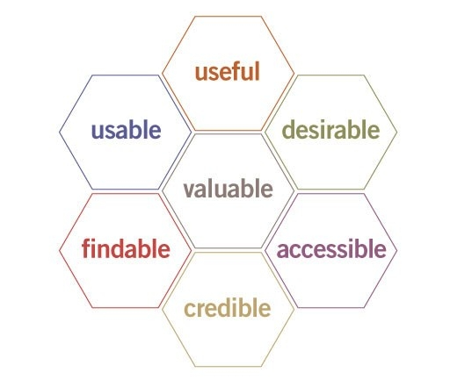
One step forward in ESDC: UX design
Term “UX design” invented by Don Norman in 1995: User Experience Design
Goal: provide meaningful experiences to the application users
Key to distinguish between UX and UI and usability: UX is a broader concept
  UI concerns to the product interface
  Usability is a UI quality attribute
Involves the entire process of acquiring and integrating the product, covering why, what and how:
  Why: user’s motivations for adopting a product
  What: functionality
  How: design of the functionality in the most high-quality way
Notes:
Another step forward in the archive maturing came when the team started to use the UX design paradigm. A term invented by Don Norman in 1995 to define the process to build products focused on the quality of the user experience.
It is key to distinguish the total user experience from the User Interface, though the UI is an extremely important part of the design and we dedicate special care to it.
Important as well to separate UX and usability, that is a quality attribute of the UI that assesses how easy is an user interface to use.
UX is a broader term: it involves the design of the entire process of acquiring and designing the product covering three important questions in the following order:
Why: the users’ motivations to accept a product, it can be because of the utility of the product or the image associated to the ownership of that product
What: it addresses what can be done with the product, its functionality
How: covers the design of the functionality.

Slide 7
UX design in ISLA: why, what, how
Why
  Different and meaningful approach to exploit the Integral Science
What
  Having an efficient and intuitive Integral science archive
How
  Replace old forms-based Science Archives by Science Portals focused on specific scientific topics
  Adding smart search engine (google like form)
  Collaborate with mission scientists to design a science oriented archive
  Use the ESA branding
  Responsiveness
  Balance: up to date on technology trends & long term applications => Angular framework
Notes:
Applying the paradigm in Integral was a collaborative activity between the ESDC Scientists and Software Engineers.
The first task was finding reasons a potential Integral Archive user would have to access to the app and the following answers appeared:
Having a different a meaningful approach to exploit Integral data.
With this goal in mind the second step was defining what is the product about, in this case is an efficient and intuitive science archive for the Integral mission products
Finally we put on the table the strategy to get the objective:
The most important change has been the replacement of the web forms by Science Portals, sections dedicated to specific scientific topics, accessible from the entire application. This does not mean that the forms have disappeared. They are not a central tool any more, but a simple mechanism to refine the searches.
Including a sophisticated search engine that exposes the database content in the most intuitive way.
Increasing the collaboration between scientists and engineers to create a meaningful and usable product.
Using the ESA brand, not only because we are implementing ESA archives, but as well because of the important benefits of Branding:
customer recognition
customer loyalty
consistency
credibility
Putting special care in having a responsive app: It is basically the ability of a website to adapt to the size of any device screen ensuring that all content looks fine.
Adopting Angular as UI framework. As we have seen in an earlier slide appropriate technological solutions are key in building robust and usable applications. Let’s see the reasons behind this decision in the next slide..

Slide 8
ISLA UX design How: Angular Framework
Selected among the three most popular JavaScript frameworks/tools: Angular vs React vs Vue
  It is a complete framework: very convenient for large teams like ESDC
  Developed by Google with LTS
  Based on Typescript
  Follow Model-View-Controller (MVC) paradigm
  Large developers community
  Scalable
ESDC UI applications:
  Large applications: Angular is scalable
  Similar in their core: Angular is modular (reusability)
  Pretty large team: Angular is a framework
  ESDC has a strong background in OO language (Java): Angular is based on TypeScript
Notes:
A couple of years ago we made deep analysis of the more used UI technologies and concluded that JAvascipt should be the way to go... for several reasons like
*it provides faster user experiences since the code is running in the browser, avoiding multiple calls to the server
it has brought user interactivity to the web
it provides good responsive web design
JS is easy to learn, having a big community
And within the most popular frameworks, Angular was considered the most appropriated for the team for reasons like:
It is a complete framework, that defines a complete project structure. Very convenient for large teams
Google is behind, with a long-term support.
Based on typescript, that provides static type checking, contributing to build a more robust apps.
It follows the MVC (model-view-controller) paradigm that works better for complex apps
Large community of developers
Scalable because of its modular development nature.
All these characteristics made it convenient for the essence of ESDC since
All the science archives are large and Angular is highly scalable
Angular is modular allowing re-usability between applications
Using frameworks like angular instead libraries is the better approach for large software teams
We have a strong background in object oriented languages, so we’ll not have any difficulty in adopting typescript.

Slide 9
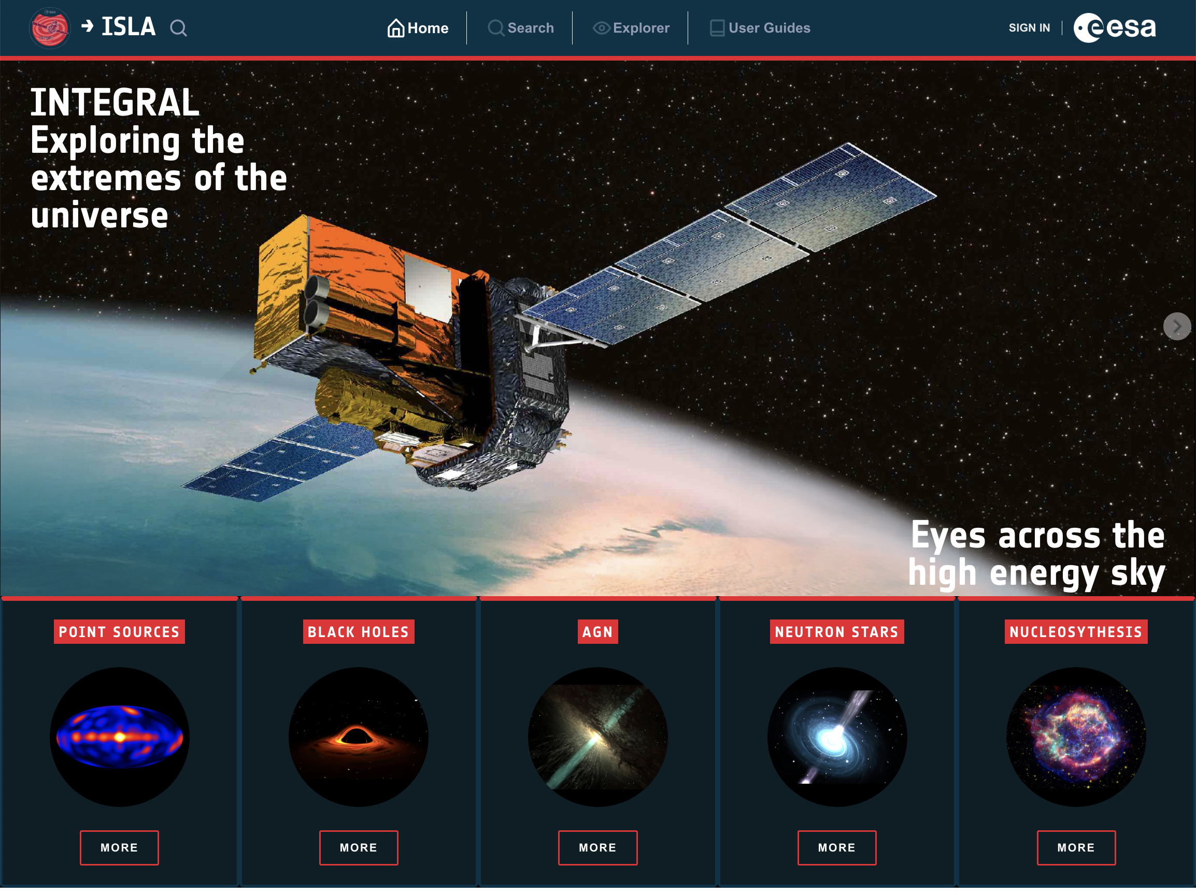
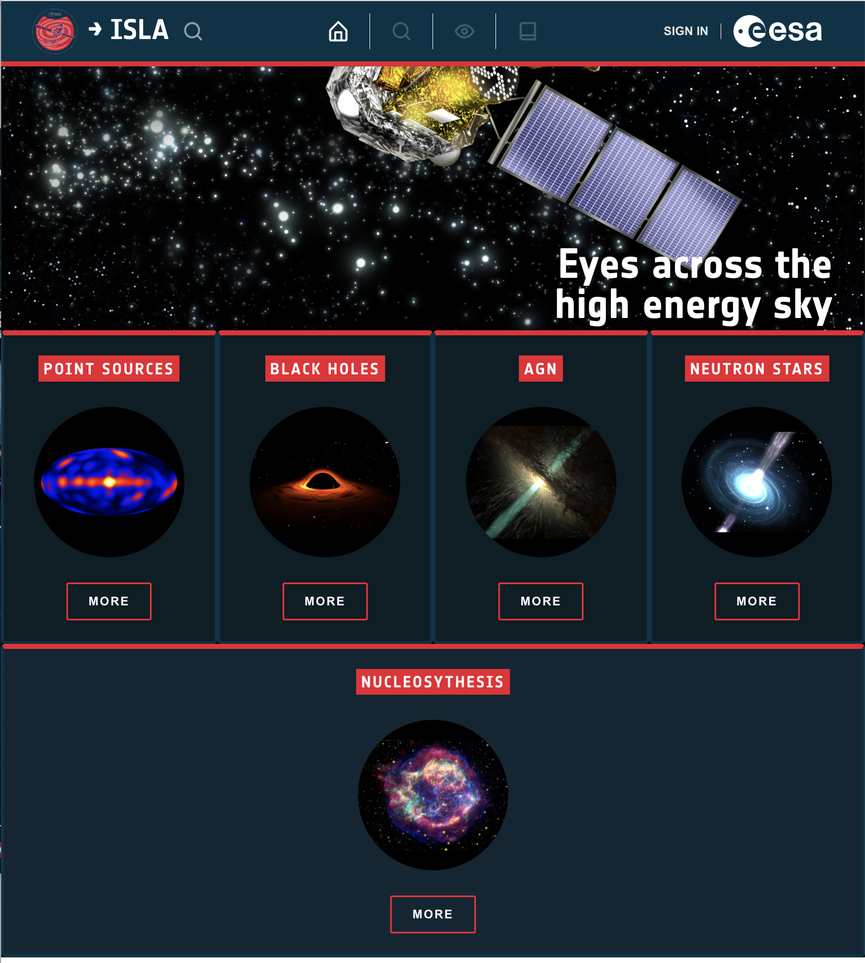
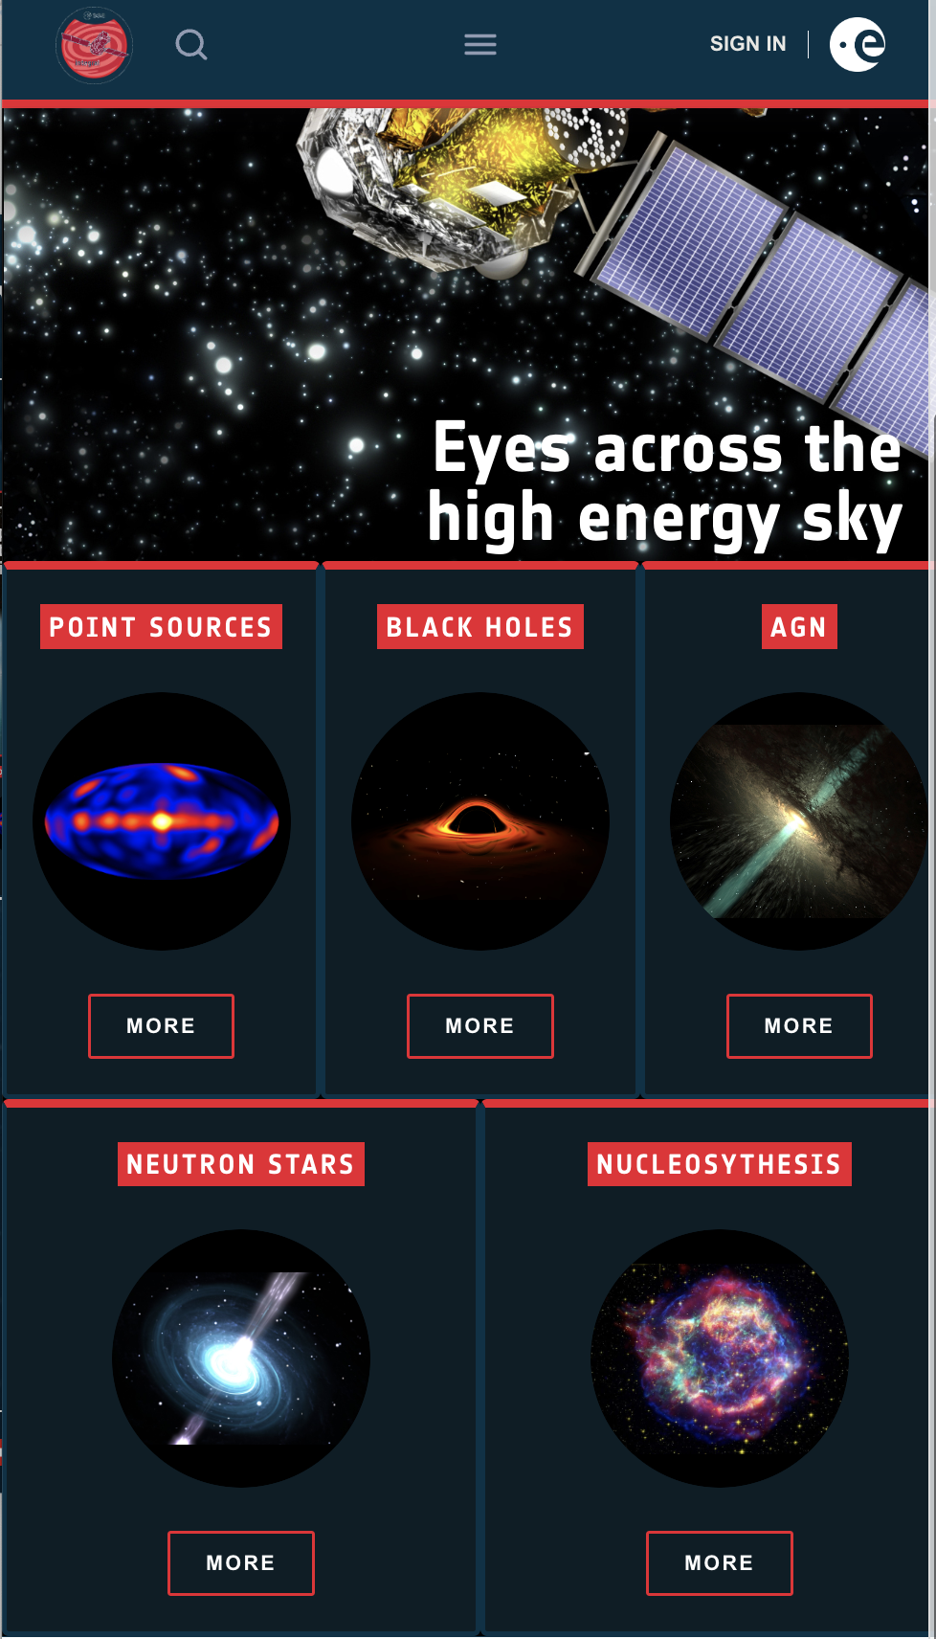
The result: ISLA
Notes:
The last slides have been the preparation for the current one.
The Integral Science Archive has been the first archive using Angular and that has followed strongly the principles of the UX design paradigm.
The UI is organized in five Science Portals, covering 5 important topics of Integral Science: Point Sources, Black HOles, AGN, Neutron Stars and Nucleosynthesis. As you can see in the slide the look and feel is pure ESA branding where the responsiveness has been one of the usability aspects we cared of much.

Slide 10
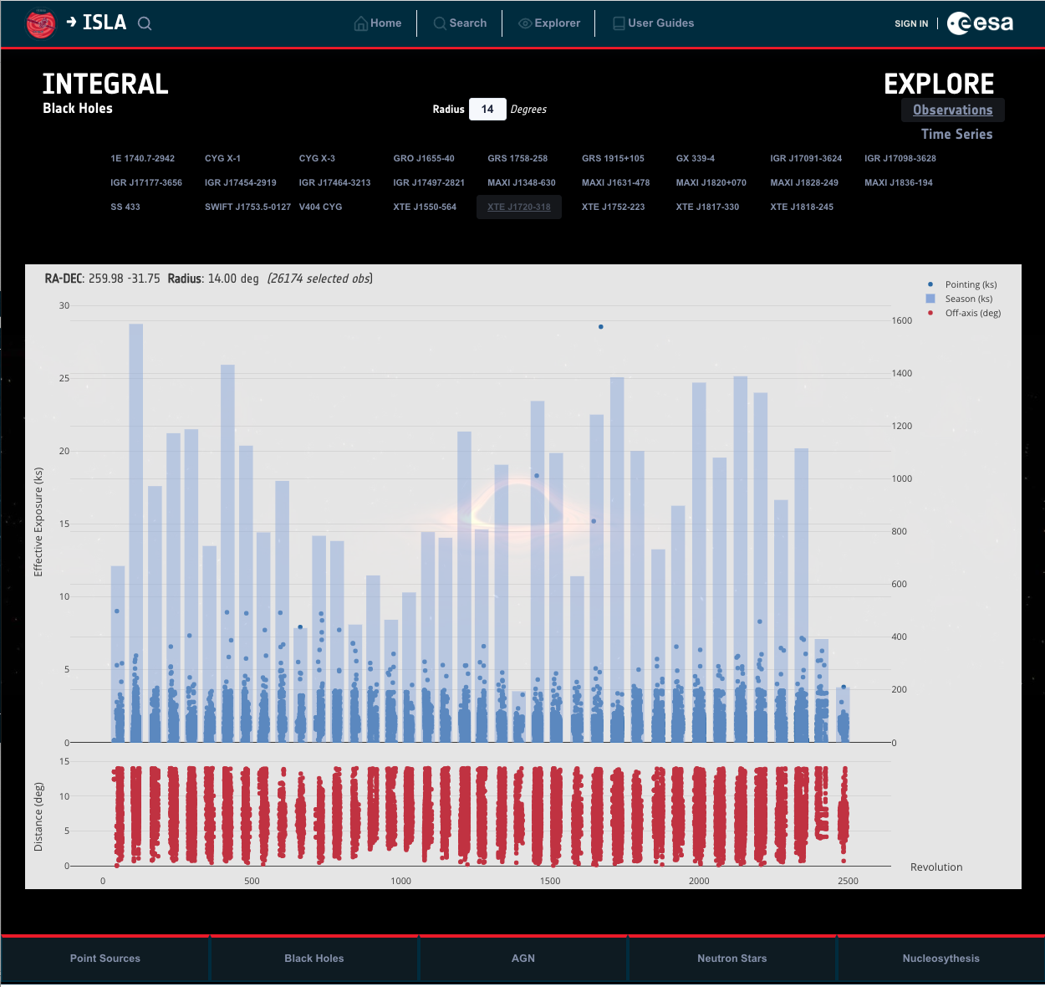
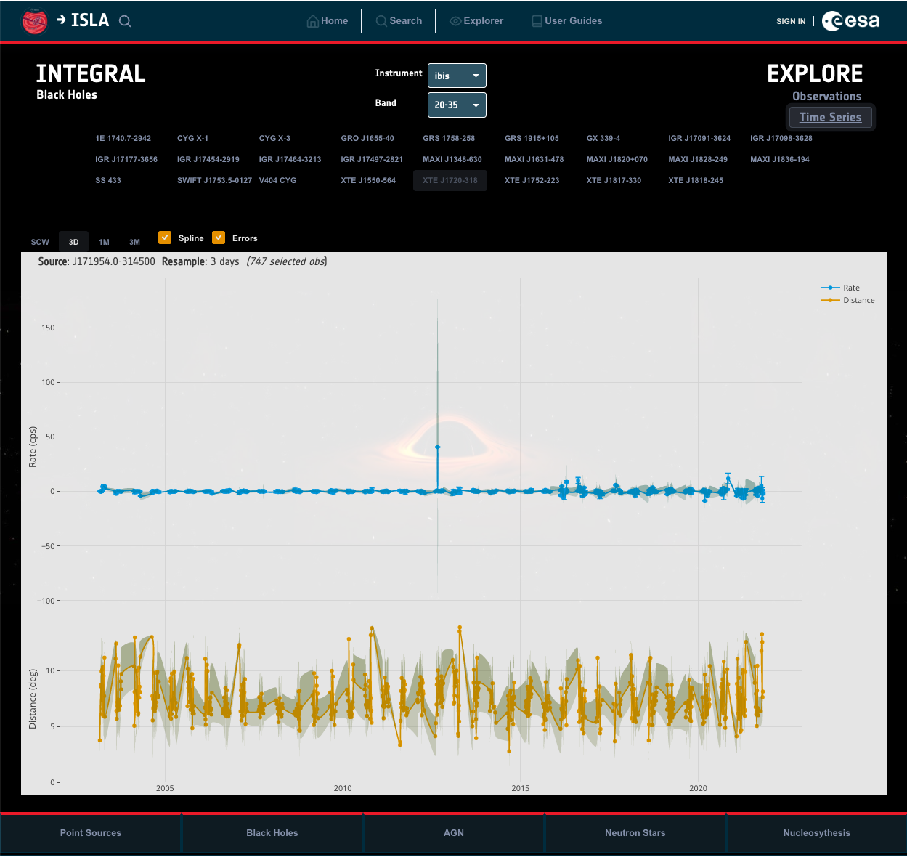
Science Portals: Black Holes
One of the mission targets
  Wide field of view (30 by 30 degrees)
  Observations of up to 3 full days
  High sensitivity (above 20 keV)
Centralised access of the Black Holes observed by Integral
in the past 20 years
Capabilities:
  All the observed Black Holes are explicitly exposed
  Effective Exposure plot
  Timeseries graphs corresponding to the different instrument
  energy bands
    Optional down sampling
Notes:
The first Science Portal is devoted to the Black Holes because they are among the most important sources that populate the high-energy sky. It was one of the mission targets because…
its unique combination of instruments sensitive to X-rays and gamma-rays
a very wide field of view of 30◦ by 30◦ (900 square degrees);
the ability to perform long uninterrupted observations of up to 3 full days;
a high sensitivity above 20 keV (kei electron volts)
In this portal the access to the BH is centralized. All the observed BHs are explicitly exposed and for any of them we offer two type of plots:
The effective exposure per revolution and the average per season, together with the distance to the region center.
The timeseries corresponding to all the energy bands of the three instruments: IBIS, JEM-X and OMC.

Slide 11
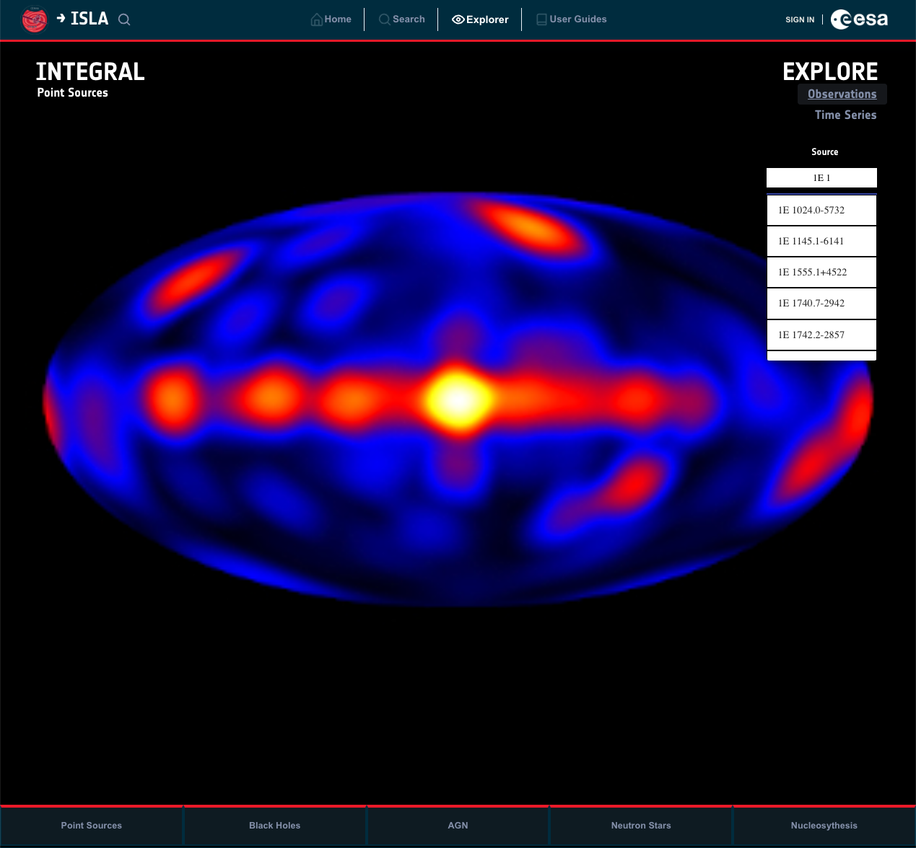
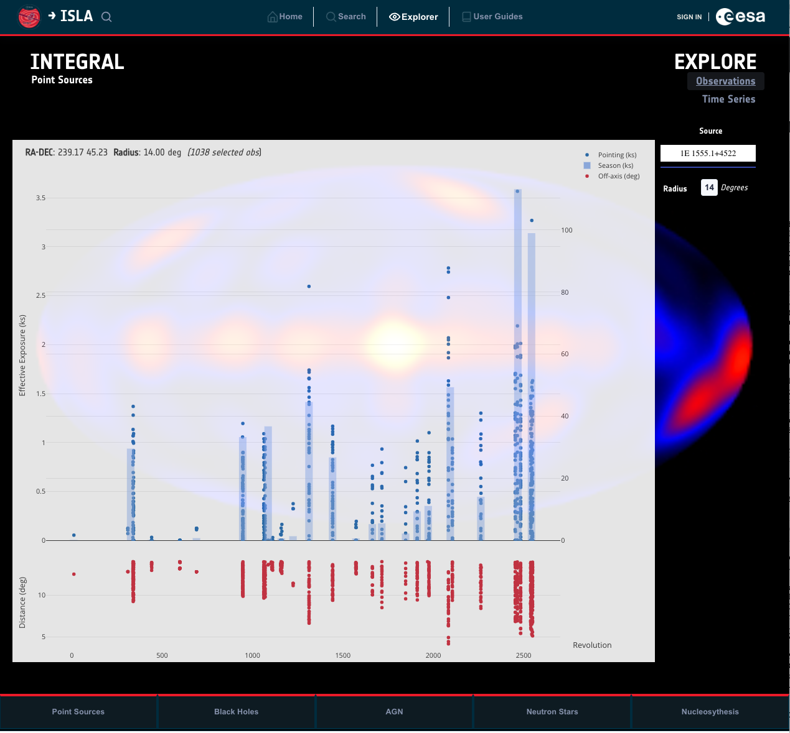
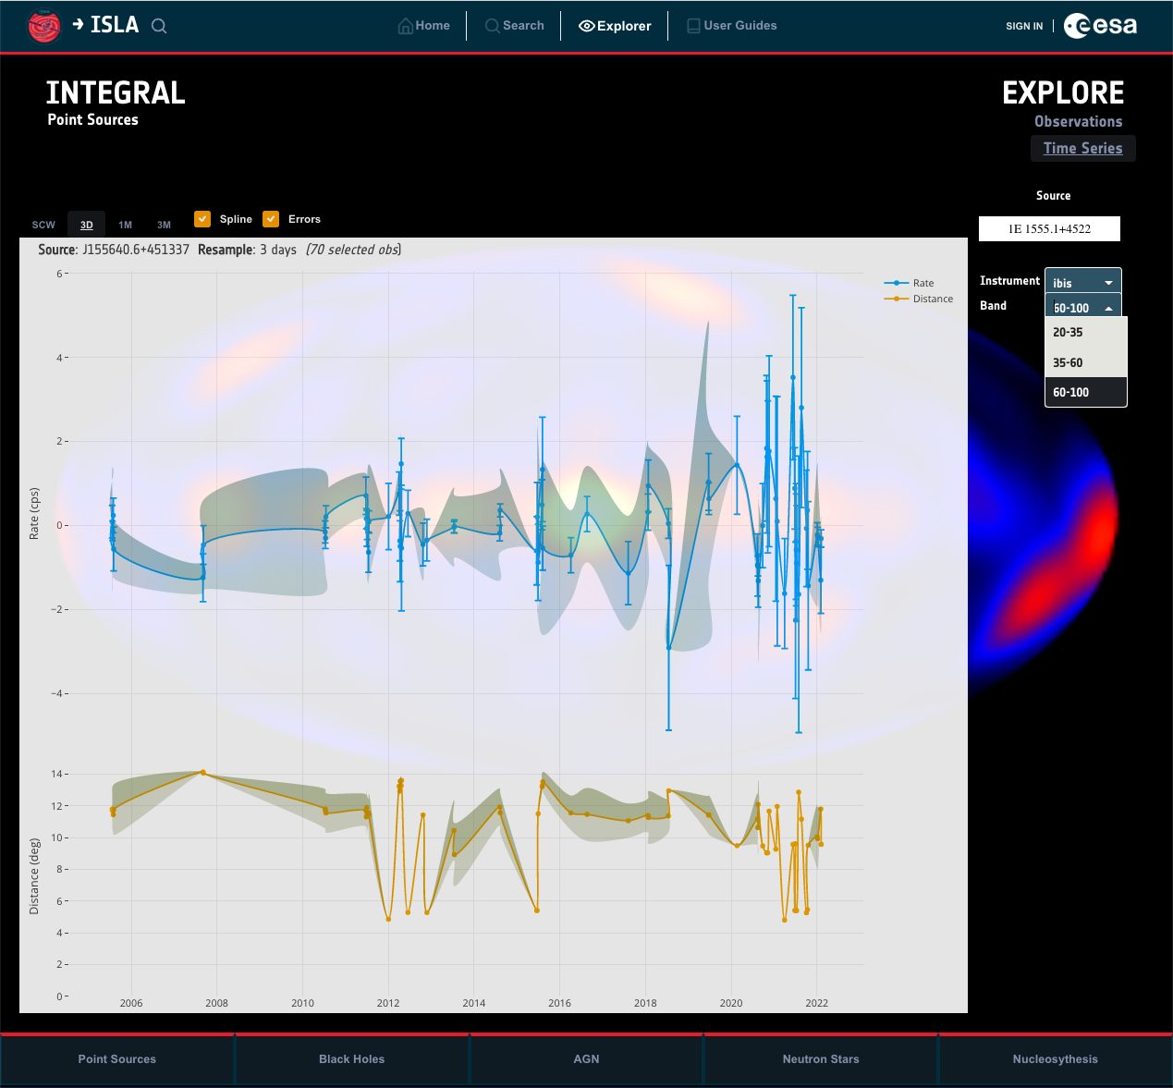
Science Portals: High Energy Point Sources
Portal for quick and easy exploration of point sources detected by INTEGRAL
Identifiers are SIMBAD compliant
Last version contains 2410 sources
Science Portal capabilities:
  Autocomplete source search
  Display effective exposure timeline of observations, time series, spectra
  All instruments: IBIS, JEM-X, SPI, and OMC
Notes:
The second portal is devoted to the Integral reference source catalogue, that contains all high-energy sources.
Their identifiers are SIMBAD compliant. Several catalogues versions have been created in the last years, the last catalogue contains about 2410 sources.
FInding the sources in the section is very easy thanks to an autocomplete search field. Like in the black hole portal we offer two types of plots: the effective exposure and the timeseries.
Though I did not mention this in the Black Hole portal, the first step to show any product/data in the UI is ingesting the proper information in our database and file repository. Automatic processes are implemented that are in charge of ingesting any available product left in the staging area with a format agreed with the Archive SCientist (collected in a ICD document)

Slide 12
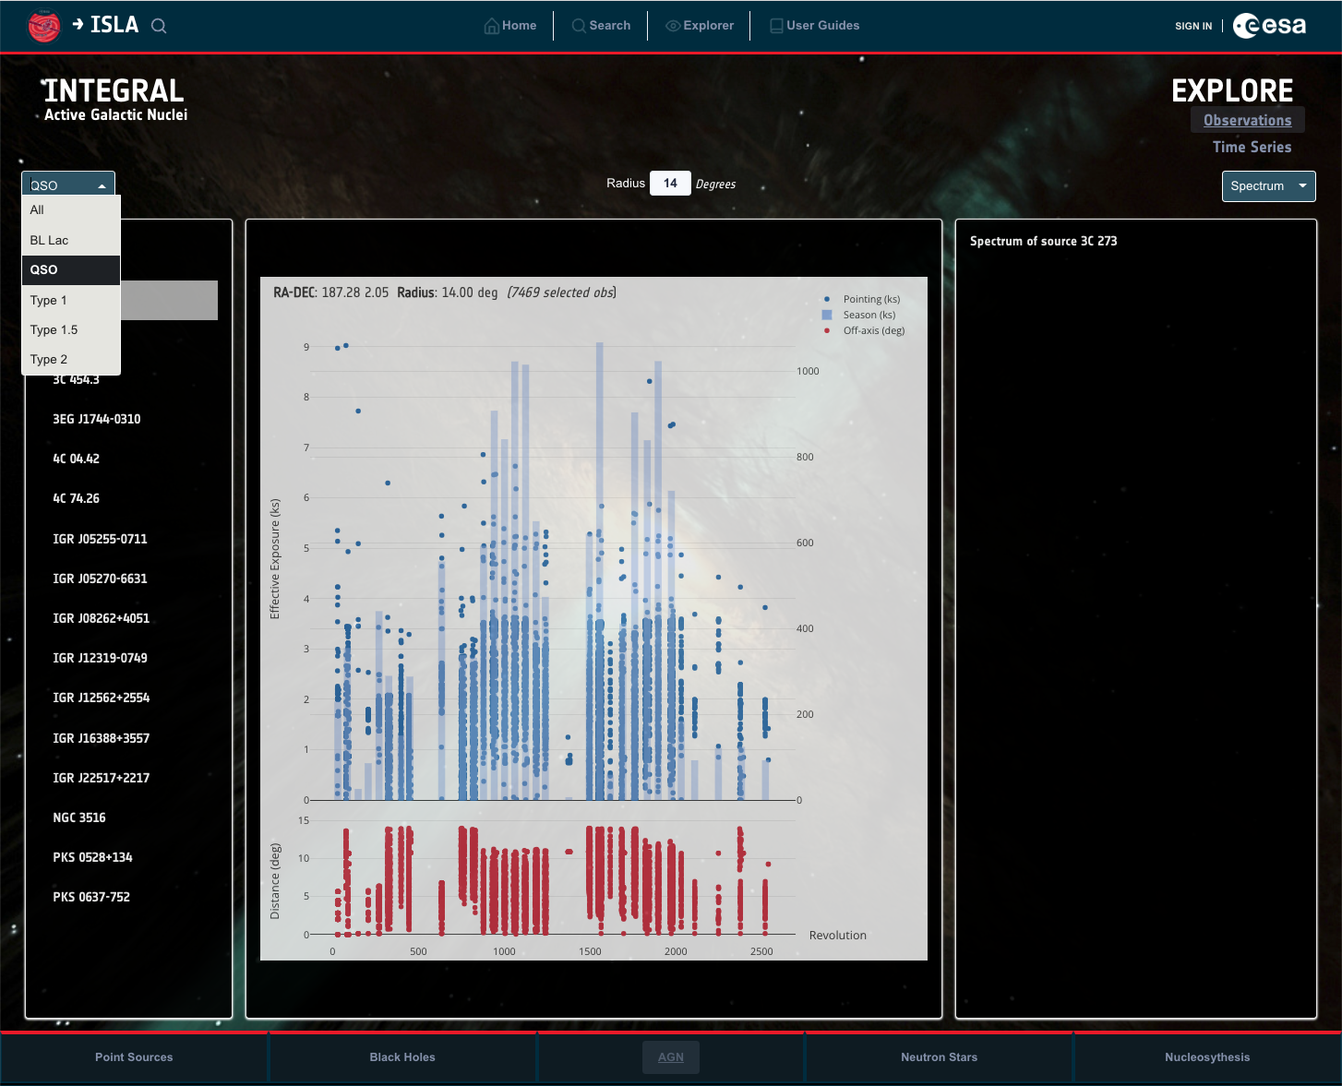
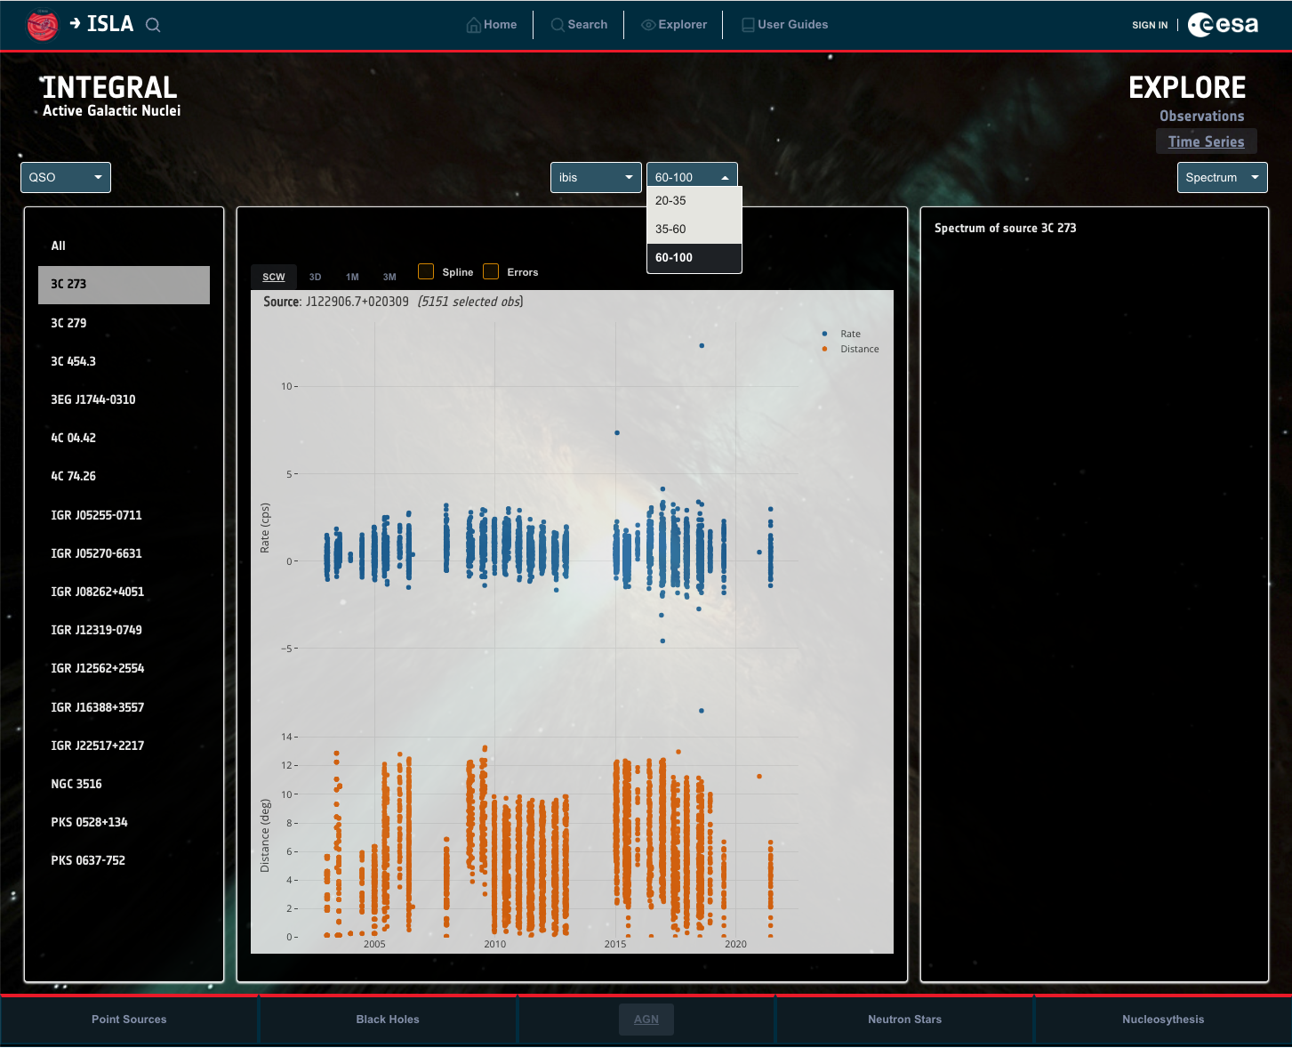
Science Portals: AGN, Pulsars, Nucleosynthesis
AGN (Active Galactic Nuclei) – under construction
  Selection based on AGN type
  Display of observations, time series, spectra
  AGN-specific products for population studies
    Average spectra
    LogN – LogS (number per luminosity bin)
    Comparison of individual to population
Pulsars (planned)
  High resolution products:
    periodograms
    Phasograms (folded time series and pulse profile)
    time resolved spectra
Nucleosynthesis (planned)
Notes:
The third portal is dedicated to Active Galacit Nuclei (AGN), that can be defined as an extremely bright region of a galaxy emitting a huge radiation produced by a supermassive black hole. These are the most luminous persistent sources of the electromagnetic radiation of the universe, and they can be used to discover distant objects, hence the importance of having a dedicated space in the archive.
This section groups the sources in families and like the other portals it is possible to request plottings of observations, time series or spectra by a simple click on the selected AGN source. On top of this and to help in population studies some AGN-specific products will be added like
average spectra
LogN -LogS that represents the luminosity
Two more portals will be implemented in the coming months: one dedicated to pulsars, spherical and compact objects about the size of a large city but containing more mass than the sun. They are useful to find exoplanets or gravitational waves. The plan is including high resolution products like periodograms, phasograms or time resolved spectra.
The last portal is still to be designed…

Slide 13
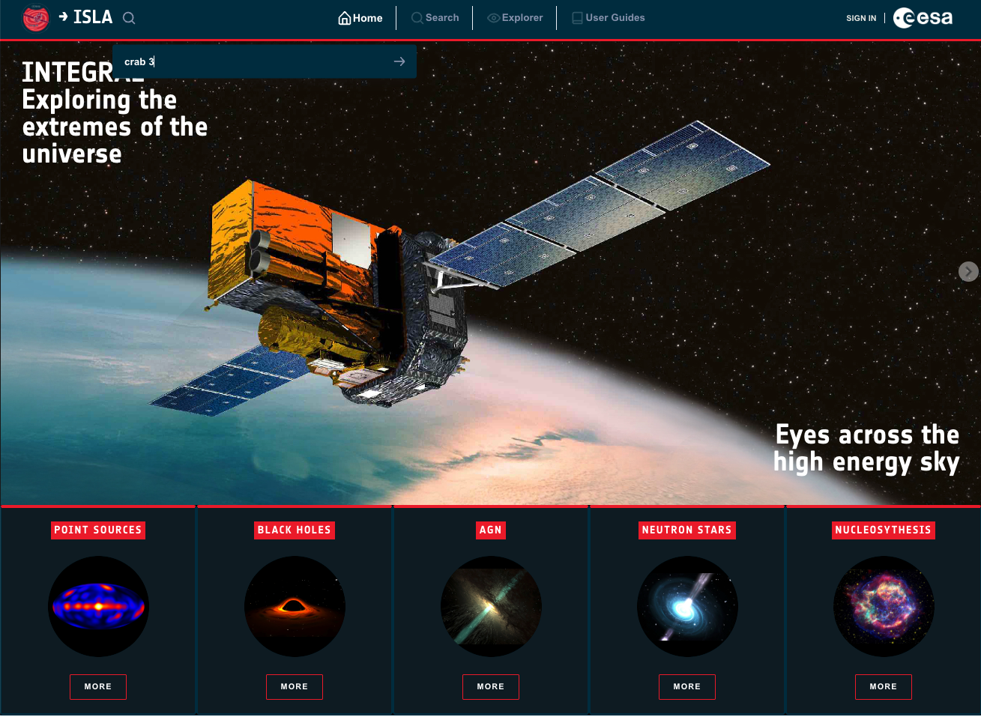
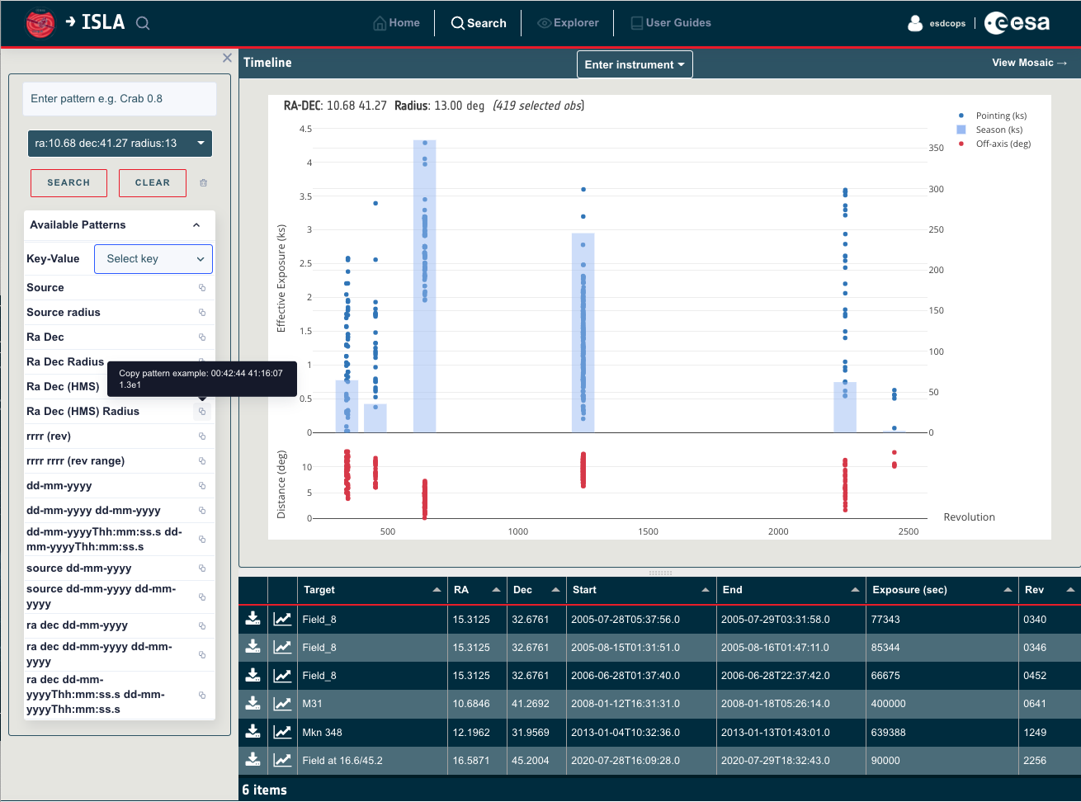
Improving user experience: smart search tool
Quick search in the home page
Smart google-like search based on a sophisticated grammar
  Many input patterns
  Regular expressions approach discarded: difficult to maintain and escalate
  Solution:
    Consider the input filters as formal language and define a grammar
    Use ANTLR (Another Tool for Language Recognition)
Tabulator JavaScript library to show the results
  Fast render
  Extensive features set: filtering, sorting,
  Interactive tables
  New releases almost every month
Notes:
At this point it is clear that this presentation is about to describe all the capabilities that make the usage of the Integral Science Archive a meaningful experience. That’s the reason why I’d like to talk a little bit about the search capability and the results display:
There is an autocomplete search, google-like that allows quick searches from the whole application.
We have implemented a Smart search engine that accepts multiple input patterns. THough the first approach was using regular expressions to process those patterns it was discarded because of the difficulties to maintain and escalate. The final solution was considering the filters as a formal language and creating a grammar using ANTLR (antler). ANTLR4 is a tool for language recognition that takes a grammar as input and generates lexers and parsers that build parse trees.
A Javascript widget called Tabulator is used to show the results in tabular format. This is a very versatile library with a lot of features that allow a high table customization. Its main advantage is the fast data rendering thanks to the Virtual DOM rendering, which allows thousands of rows to be processed without performance overhead by rendering only the visible rows.

Slide 14
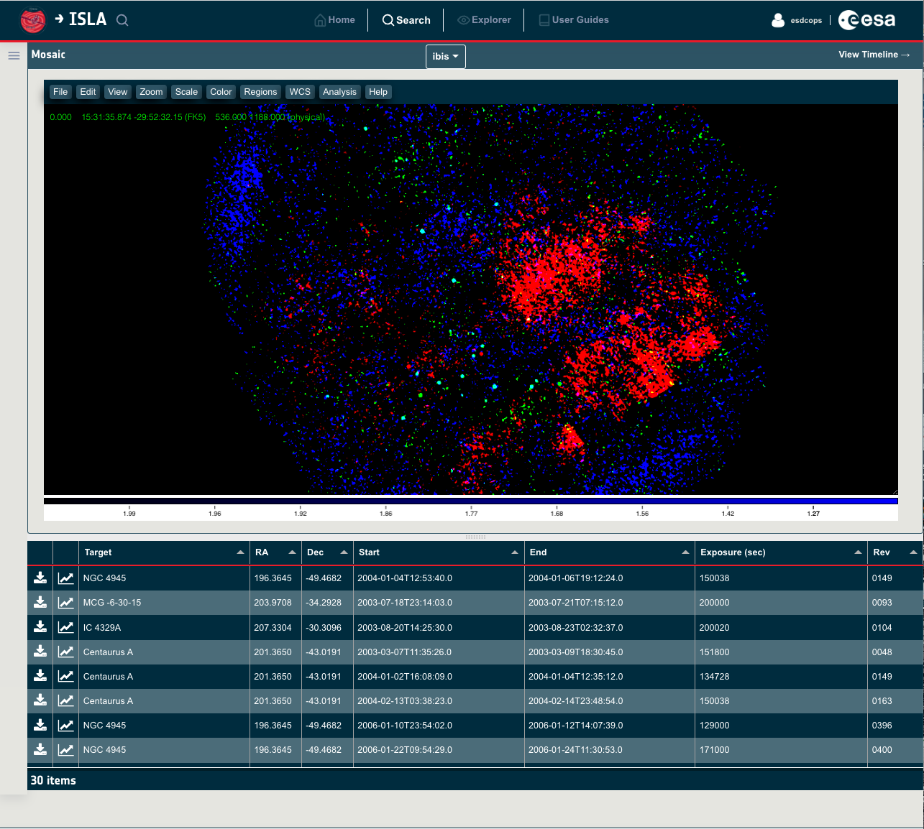
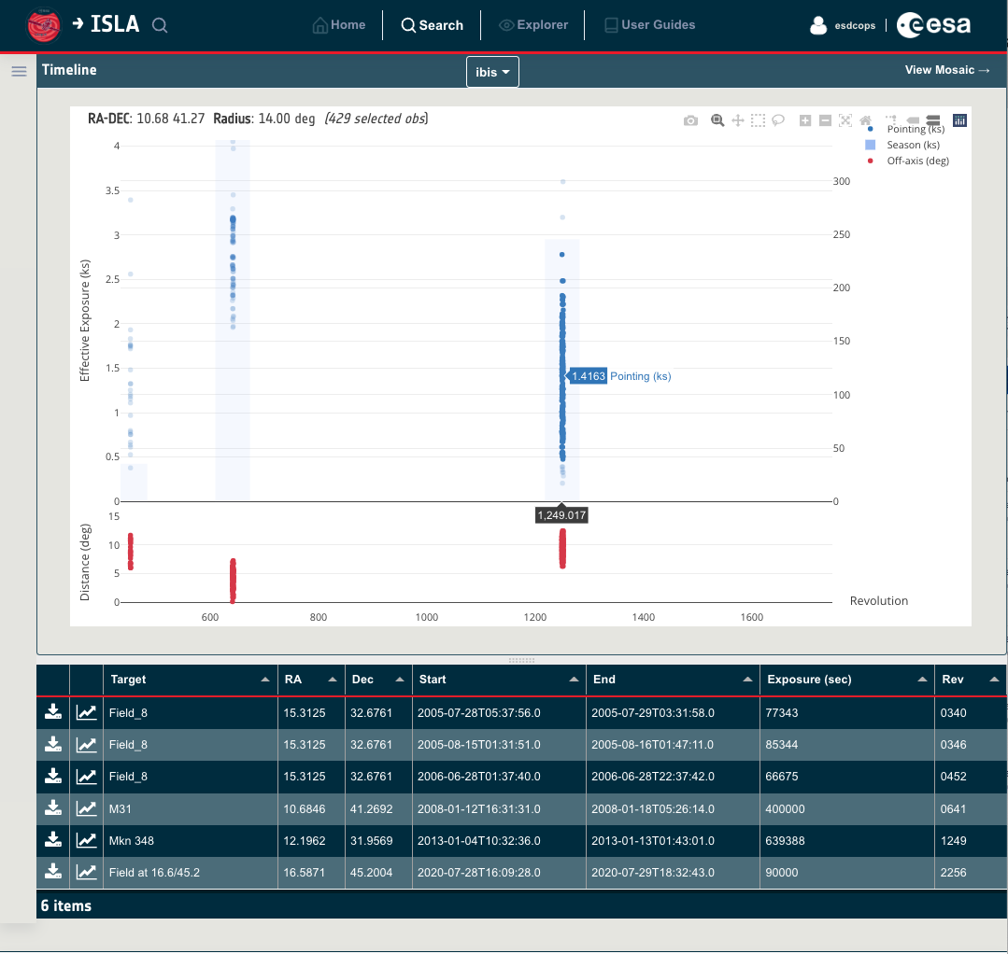
Scientific display tools: JS9 & Plotly
JS9 : Astronomical visualization tool fully integrated
JS9 is the DS9 successor
Display and merge the three energy bands of Integral mosaics
Idisplay canvas and a menubar full of useful capabilities:
zoom, pane, colomap, WCS….
        Plotly: standalone Javascript data visualization library
        Default ISLA display tool
        Built on top of d3.js and WebGL
        Versatile: over 40 chart types, including 3D charts, statistical and SVG maps
        Big community
        Continuous releases
        …
Notes:
In parallel to the metadata displayed in tabular format ISLA puts special care in presenting the data as meaningful scientific graphs. When used correctly they can consolidate large amounts of data to help identify patterns and relationships.
Two libraries haven been selected to create those graphs:
JS9 is an astronomical image display built in Javascript. It is the DS9 successor, that was the ‘de facto standard desktop image display’ for more than 30 years. It is composed of an image display canvas and a menubar containing useful functionalities: zoom, pane, scale, colomap, etc. It is used to display the three-band RGB images of the Integral mosaics for the whole sky.
To be able to quickly show a mosaic associated to a source, we have precomputed mosaics covering the entire sky. In the Search panel we only need to perform a search based on coordinates or target and the backend will get the closest mosaics to the entered target.
The rest of the Integral plots use Plotly Javascript library:
Timelines of the observations that contain a specific source in the field of view
Timeseries (based on the science windows images for each observation)
Spectra…
Plotly is an Open source graphing library, built on top of d3 and WebGL, that allows the creation of interactive charts. It is really versatile with more than 40 types of charts. It has big community and their continuous releases show its constant evolution.

Slide 15
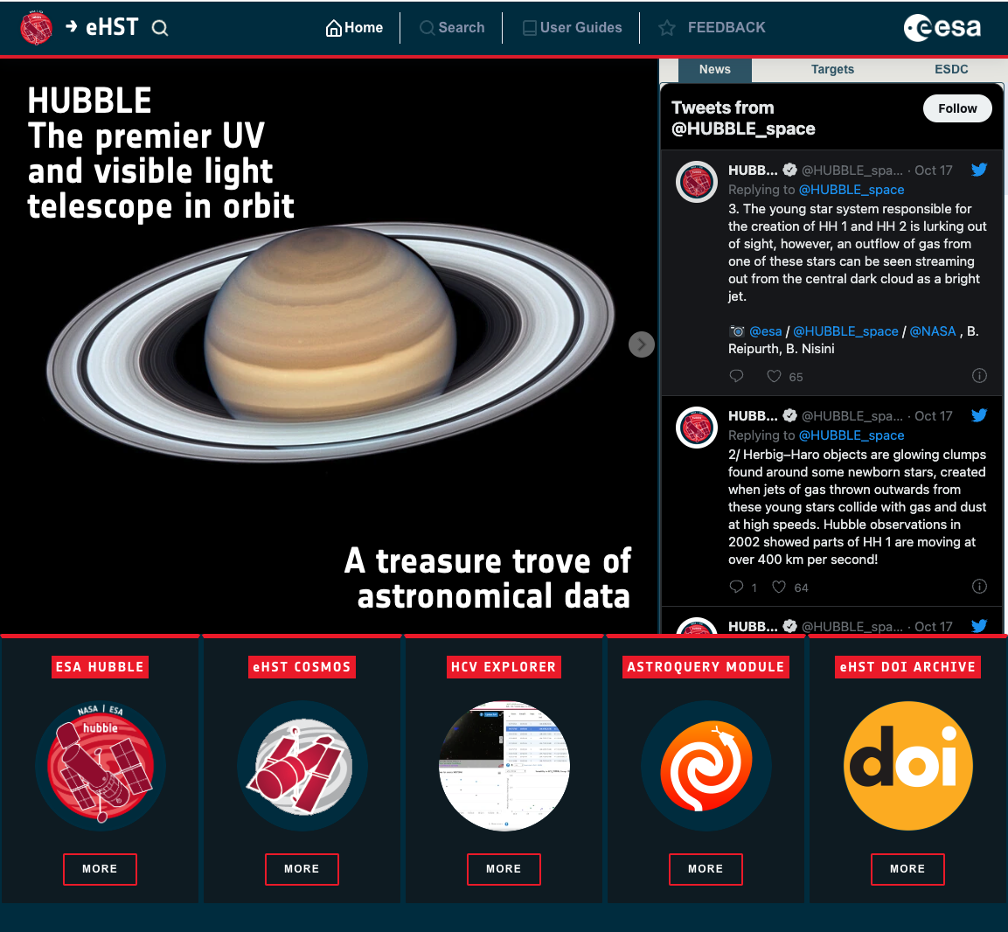
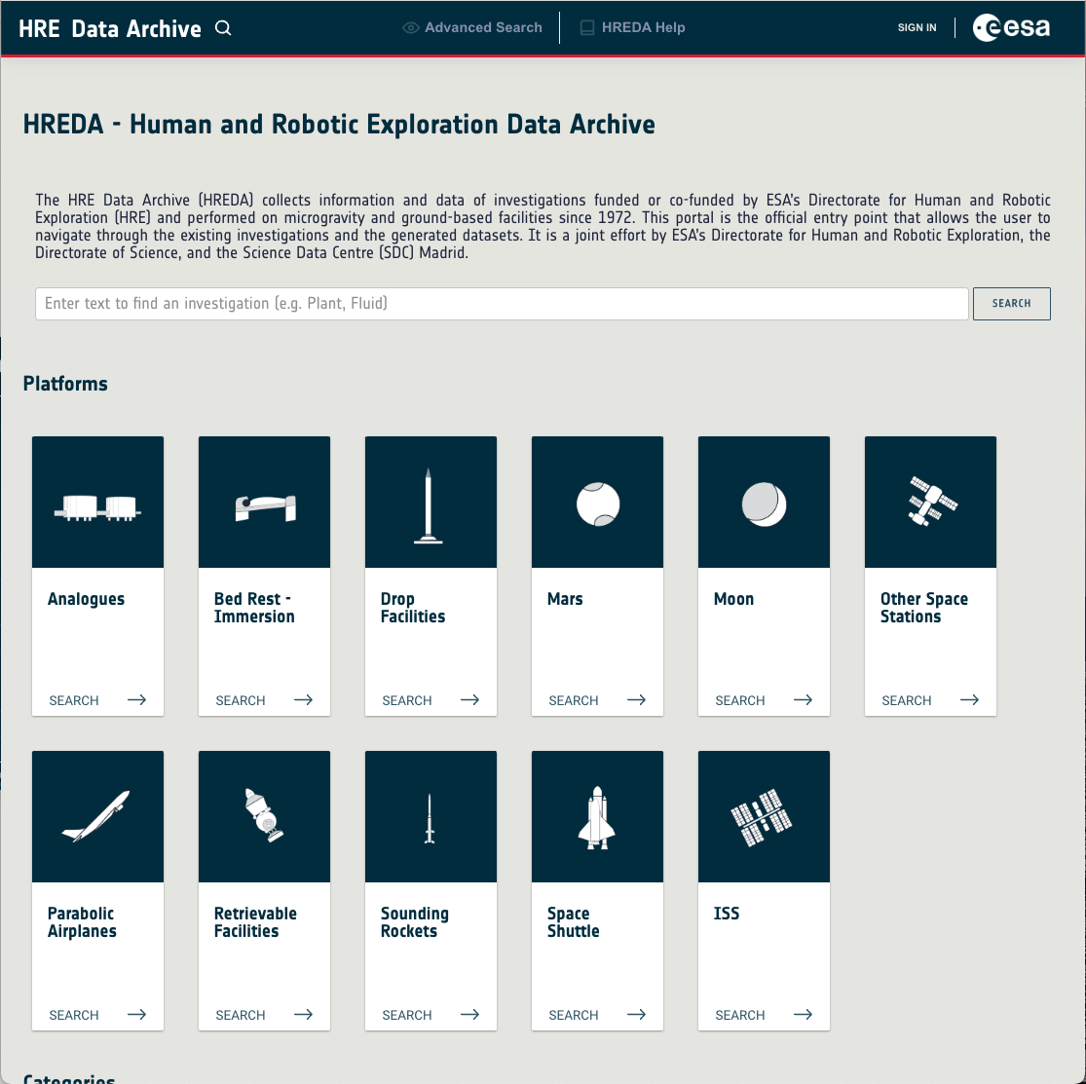
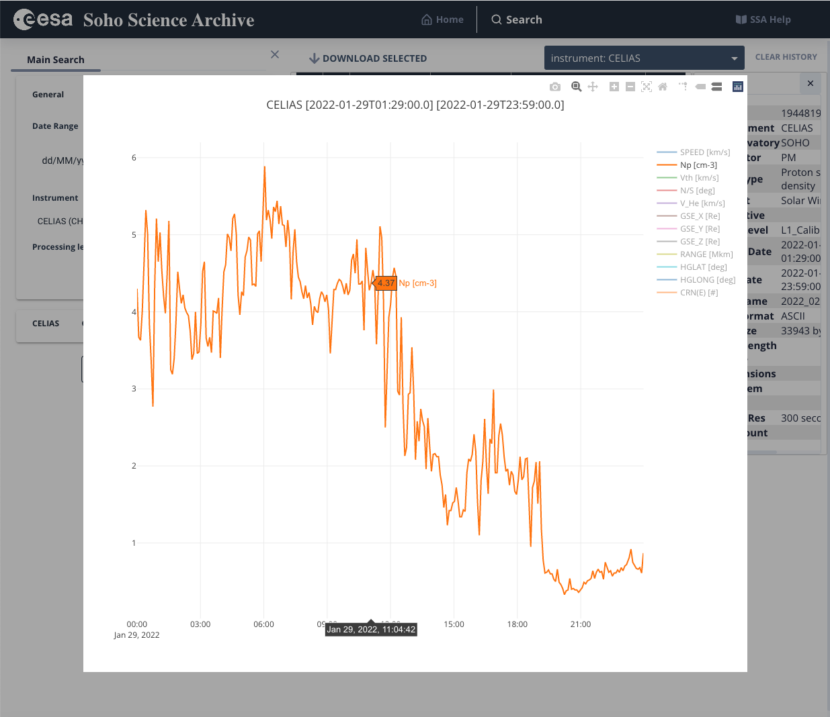
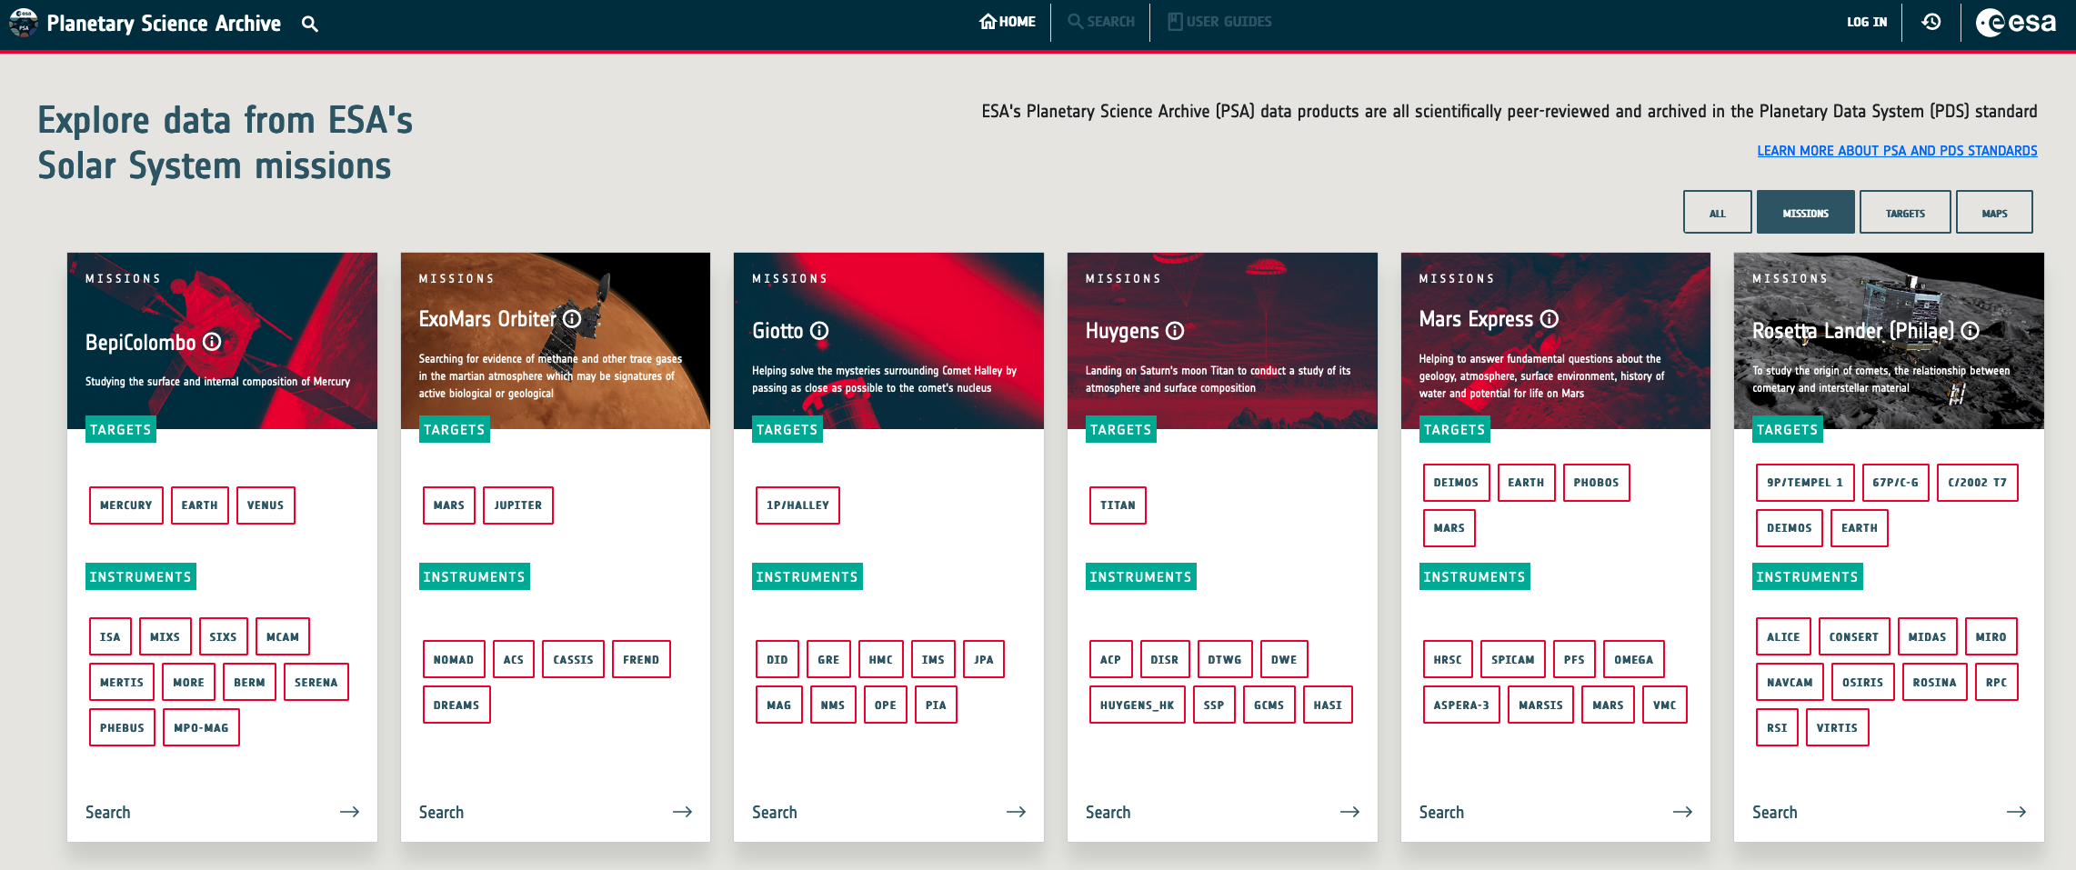
ISLA: pioneering the next ESDC step
Truly pioneer
  Science-oriented
  UX paradigm
  Angular framework
  Smart search
Reusability is a MUST
Increase team efficiency
Coming soon:
  JWST
  XMM
  PSA
  …
Hubble
Human and Robotics
Exploration Data Archive
Soho
Planetary Science Archive
Notes:
Finally, and before the conclusions I’d like to emphasize that ISLA has taken the lead in adopting some of the improvements covered in this talk,
-like using Angular,
-replacing the archives forms-based approach by Science Portals or
implementing smart search.
These kinds of initiatives are key in the evolution of the Archives and it is the first step in the birth of a new generation of archives.

Slide 16
Conclusions
Science Archives are the final mission data repository
  Maximum scientific exploitation
  Long-term preservation data
ESDC: Science Archives incubator
  Up-to-date on technology trends
  Several generation of archives
Integral Science Archive: truly pioneer
  Science-oriented
  UX design paradigm
  Angular,
  Smart search
Inspiration for other archives: HST, Soho, PSA, JWST…
Thanks!!
Notes:
Let's conclude the talk with a quick summary:
we have seen that ESDC is a group of scientists and engineers working together to implement the Science Archives. This important tool enables a maximum scientific data exploitation and an efficient long-term data preservation by reusing software and knowledge.
We have seen that the commitment of the team with the latest technologies result in several generations of archives, with the unique goal of improving the user experience.
We have made a tour along the ESDC history, starting with ISO in 1998 and ending with the hero of this talk, the Integral Science Archive, that is a real pioneer in several aspects like:
Putting special effort to engaging the mission scientists to develop a science-oriented archive
Following the UX design paradigm to get the best user experience as possible
Selecting the Angular framework to implement the client layer to develop a highly performant and usable application
--> we plan to release this archive at the end of the next year, unless something unexpected happens.
Finally we’ve seen how ISLA has inspired other archives like HST, Soho or HREDA, though this list does not end here: PSA, JWST or XMM will come soon.

