Slide 1
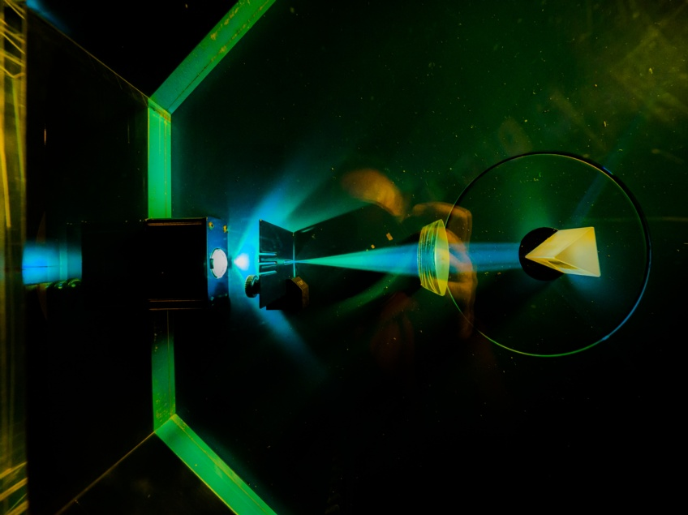


FAIR data and Net Zero: exploring the interactions
Dr Gabin Kayumbi*, Simon Lambert, Dr Brian Matthews
Scientific Computing Department, Rutherford Appleton Laboratory
(STFC-UKRI)
Image © STFC Alan Ford
Notes:
To edit the background image, select ‘Format’ from the PowerPoint menu and ‘Slide Background’ from the drop-down menu. Within the new list of options that appears on the right of the screen, select the ‘File’ button under ‘Insert picture from’ and select your image from your file browser. Remember to delete the image credit if using your own image.

Slide 2
FAIR data and Net Zero: exploring the interactions
Net
Zero
FAIR
data
Outline
Context of our study
  Environment: Net Zero
  Data management: FAIR
Scope and aim
Methodology
Framework
Conclusions and future work
Image © STFC Alan Ford

Slide 3
FAIR data and Net Zero: exploring the interactions
Outline
Momentum on Environment
  Reduction of carbon emissions
  Attain Net Zero
Impact of ICT
  Power consumption
  Manufacturing
  Disposal of equipment
UKRI
  Roadmap DRIs towards Net Zero
Net
Zero
FAIR
data
FAIR data
  Findable
  Accessible
  Interoperable
  Reusable
Research Data sharing
    Knowledge discovery
    Advance science
    Web of FAIR data & services
Image © STFC Alan Ford

Slide 4
FAIR data and Net Zero: exploring the interactions
Outline
Momentum on Environment
  Reduction of carbon emissions
  Attain Net Zero
Impact of ICT
  Power consumption
  Manufacturing
  Disposal of equipment
UKRI
  Roadmap DRIs towards Net Zero
Net
Zero
FAIR
data
FAIR data
  Findable
  Accessible
  Interoperable
  Reusable
Research Data sharing
    Knowledge discovery
    Advance science
    Web of FAIR data & services
Image © STFC Alan Ford
WIDESPREAD UPTAKE OF FAIR DATA ON DRIs CARBON FOOTPRINT ?

Slide 5
Net
Zero
FAIR
data
FAIR data and Net Zero: exploring the interactions
Scope and Aims
Impact of ICT
  Computing
  Data centres
  Data transfer
  Services
Impact of FAIR data
  Data reuse
  Return on investment (finance)
  Scientific innovation
  Time
Image © STFC Alan Ford
Gap : impact of FAIR in environmental terms

Slide 6
Net
Zero
FAIR
data
FAIR data and Net Zero: exploring the interactions
Scope and Aims: two strands
Net Zero
ARINZRIT
FAIRsFAIR
Image © STFC Alan Ford
Gap : impact of FAIR in environmental terms

Slide 7
FAIR data and Net Zero: exploring the interactions
Gap: impact of FAIR in environmental terms
Challenge
  Difficult analysis of interactions
  Complex systems
    problems , uncertainties
Net
Zero
FAIR
data
Difficult questions !
  MWh, tonnes of CO2 saved by FAIR?
  Single repository vs ecosystem? (scope unclear)
  What if FAIR data not available? Interplay speculative
  Many factors impossible to quantify
Image © STFC Alan Ford

Slide 8
FAIR data and Net Zero: exploring the interactions
Gap: impact of FAIR in environmental terms
Challenge
  Difficult analysis of interactions
  Complex systems
    problems , uncertainties
Net
Zero
FAIR
data
How factors at play influence each other?
Energy proportionality
Avoidance of resource proliferation
Image © STFC Alan Ford

Slide 9
FAIR data and Net Zero: exploring the interactions
Methodology
Model system of processes
  FAIR processes and activities
  Energy consumption
  ICT resources
Net
Zero
FAIR
data
Look at processes as part of a dynamic system
Energy proportionality
Avoidance of resource proliferation
Image © STFC Alan Ford

Slide 10
FAIR data and Net Zero: exploring the interactions
Methodology
FAIR processes : Data storage – Data management
  Long term preservation; FAIR-oriented curation; trusted repositories
  Metadata creation; PIDs;
  Data reuse; Data sharing; Data Quality (assurance); Data integration, Data transfer
Net
Zero
FAIR
data
Look at processes as part of a dynamic system
  Positive/negative influence
Energy proportionality
Avoidance of resource proliferation
Image © STFC Alan Ford

Slide 11
FAIR data and Net Zero: exploring the interactions
Methodology
FAIR processes : Data storage – Data management
  Long term preservation; FAIR-oriented curation; trusted repositories
  Metadata creation; PIDs;
  Data reuse; Data sharing; Data Quality (assurance); Data integration, Data transfer
Net
Zero
FAIR
data
Look at processes as part of a dynamic system
  Positively / negatively influencing each other
    Research data: initiator of dynamic system
    Carbon emission: final resulting impact
Energy proportionality
Avoidance of resource proliferation
Look at processes as part of a dynamic system
  Positive/negative influence
Energy proportionality
Avoidance of resource proliferation
Image © STFC Alan Ford

Slide 12
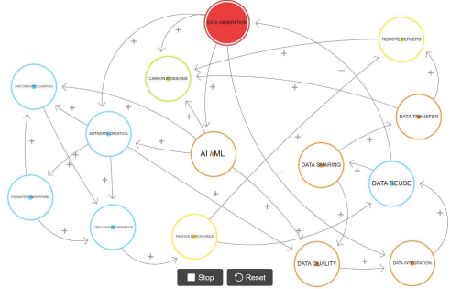
FAIR data and Net Zero: exploring the interactions
Net
Zero
FAIR
data
Framework using Causal Diagram Loops (CLD)
CLD
  System thinking
  Qualitative – Quantitative systems mapping methods
  Modelling relationships between entities of a dynamic system in a qualitative way without quantifying the influences
Image © STFC Alan Ford

Slide 13
FAIR data and Net Zero: exploring the interactions
Net
Zero
FAIR
data
Framework using Causal Diagram Loops (CLD)
CLD
  CLDs are built by representing nodes as FAIR processes and data activities identified in previous works
  free software Loopy4
Image © STFC Alan Ford
https://ncase.me/loopy/

Slide 14
Image © STFC Alan Ford

Slide 15
CAUSAL LOOP DIAGRAM : FAIR - NETZERO
http://bit.ly/3FOuuj5
Image © STFC Alan Ford

Slide 16
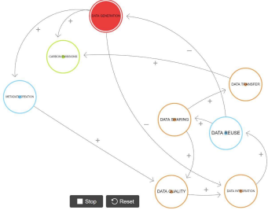
FAIR data and Net Zero: exploring the interactions
Net
Zero
FAIR
data
Framework using Causal Diagram Loops (CLD)
Balancing loop
Image © STFC Alan Ford

Slide 17
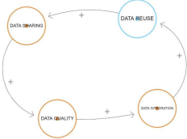
FAIR data and Net Zero: exploring the interactions
Net
Zero
FAIR
data
Framework using Causal Diagram Loops (CLD)
Reinforcing loop
Image © STFC Alan Ford

Slide 18
FAIR data and Net Zero: exploring the interactions
Net
Zero
FAIR
data
Conclusion and Future Work
Sustainable FAIR processes requires critically examining the underlying assumptions and activities shaping current practices
Work in progress:
  Define the full extension of the framework
    More mediating factors between nodes
    Variation over time
    Long/short –term of influences
    Metrics to express energy proportionality, resource proliferation
Image © STFC Alan Ford

Slide 19







Science and Technology Facilities Council
@STFC_matters
Science and Technology Facilities Council

