Slide 1
AVHRR Curation Project - Keeping 40 years of European AVHRR-LAC data alive
Stefan Wunderle¹, Mirko Albani², Christoph Neuhaus¹, Iolanda Maggio³, Sergio Folco³
¹Oeschger Centre for Climate Change Research
Institute of Geography
University of Bern
²ESA – European Space Agency
³Rhea Group for ESA

Slide 2
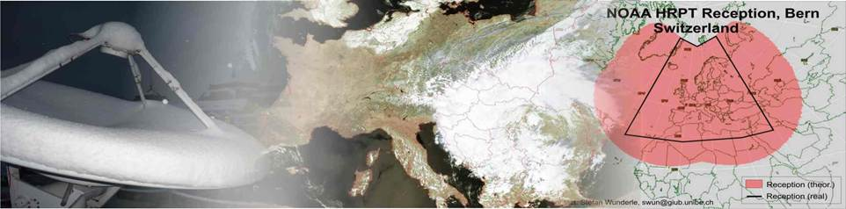
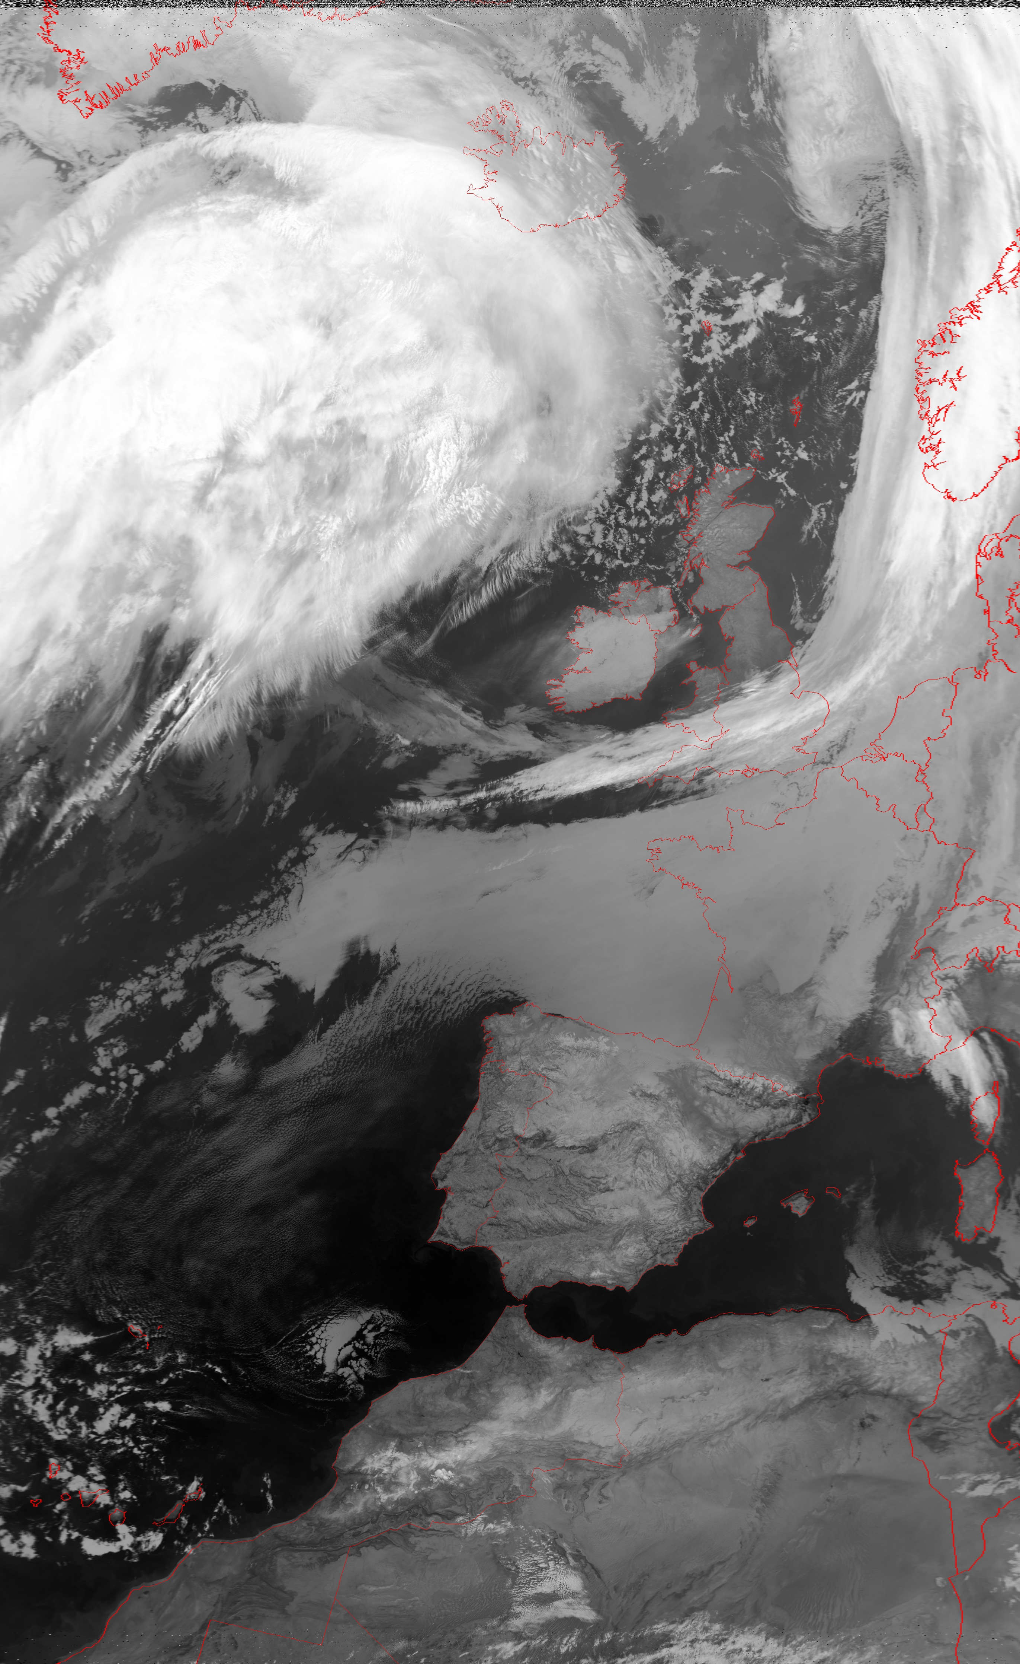
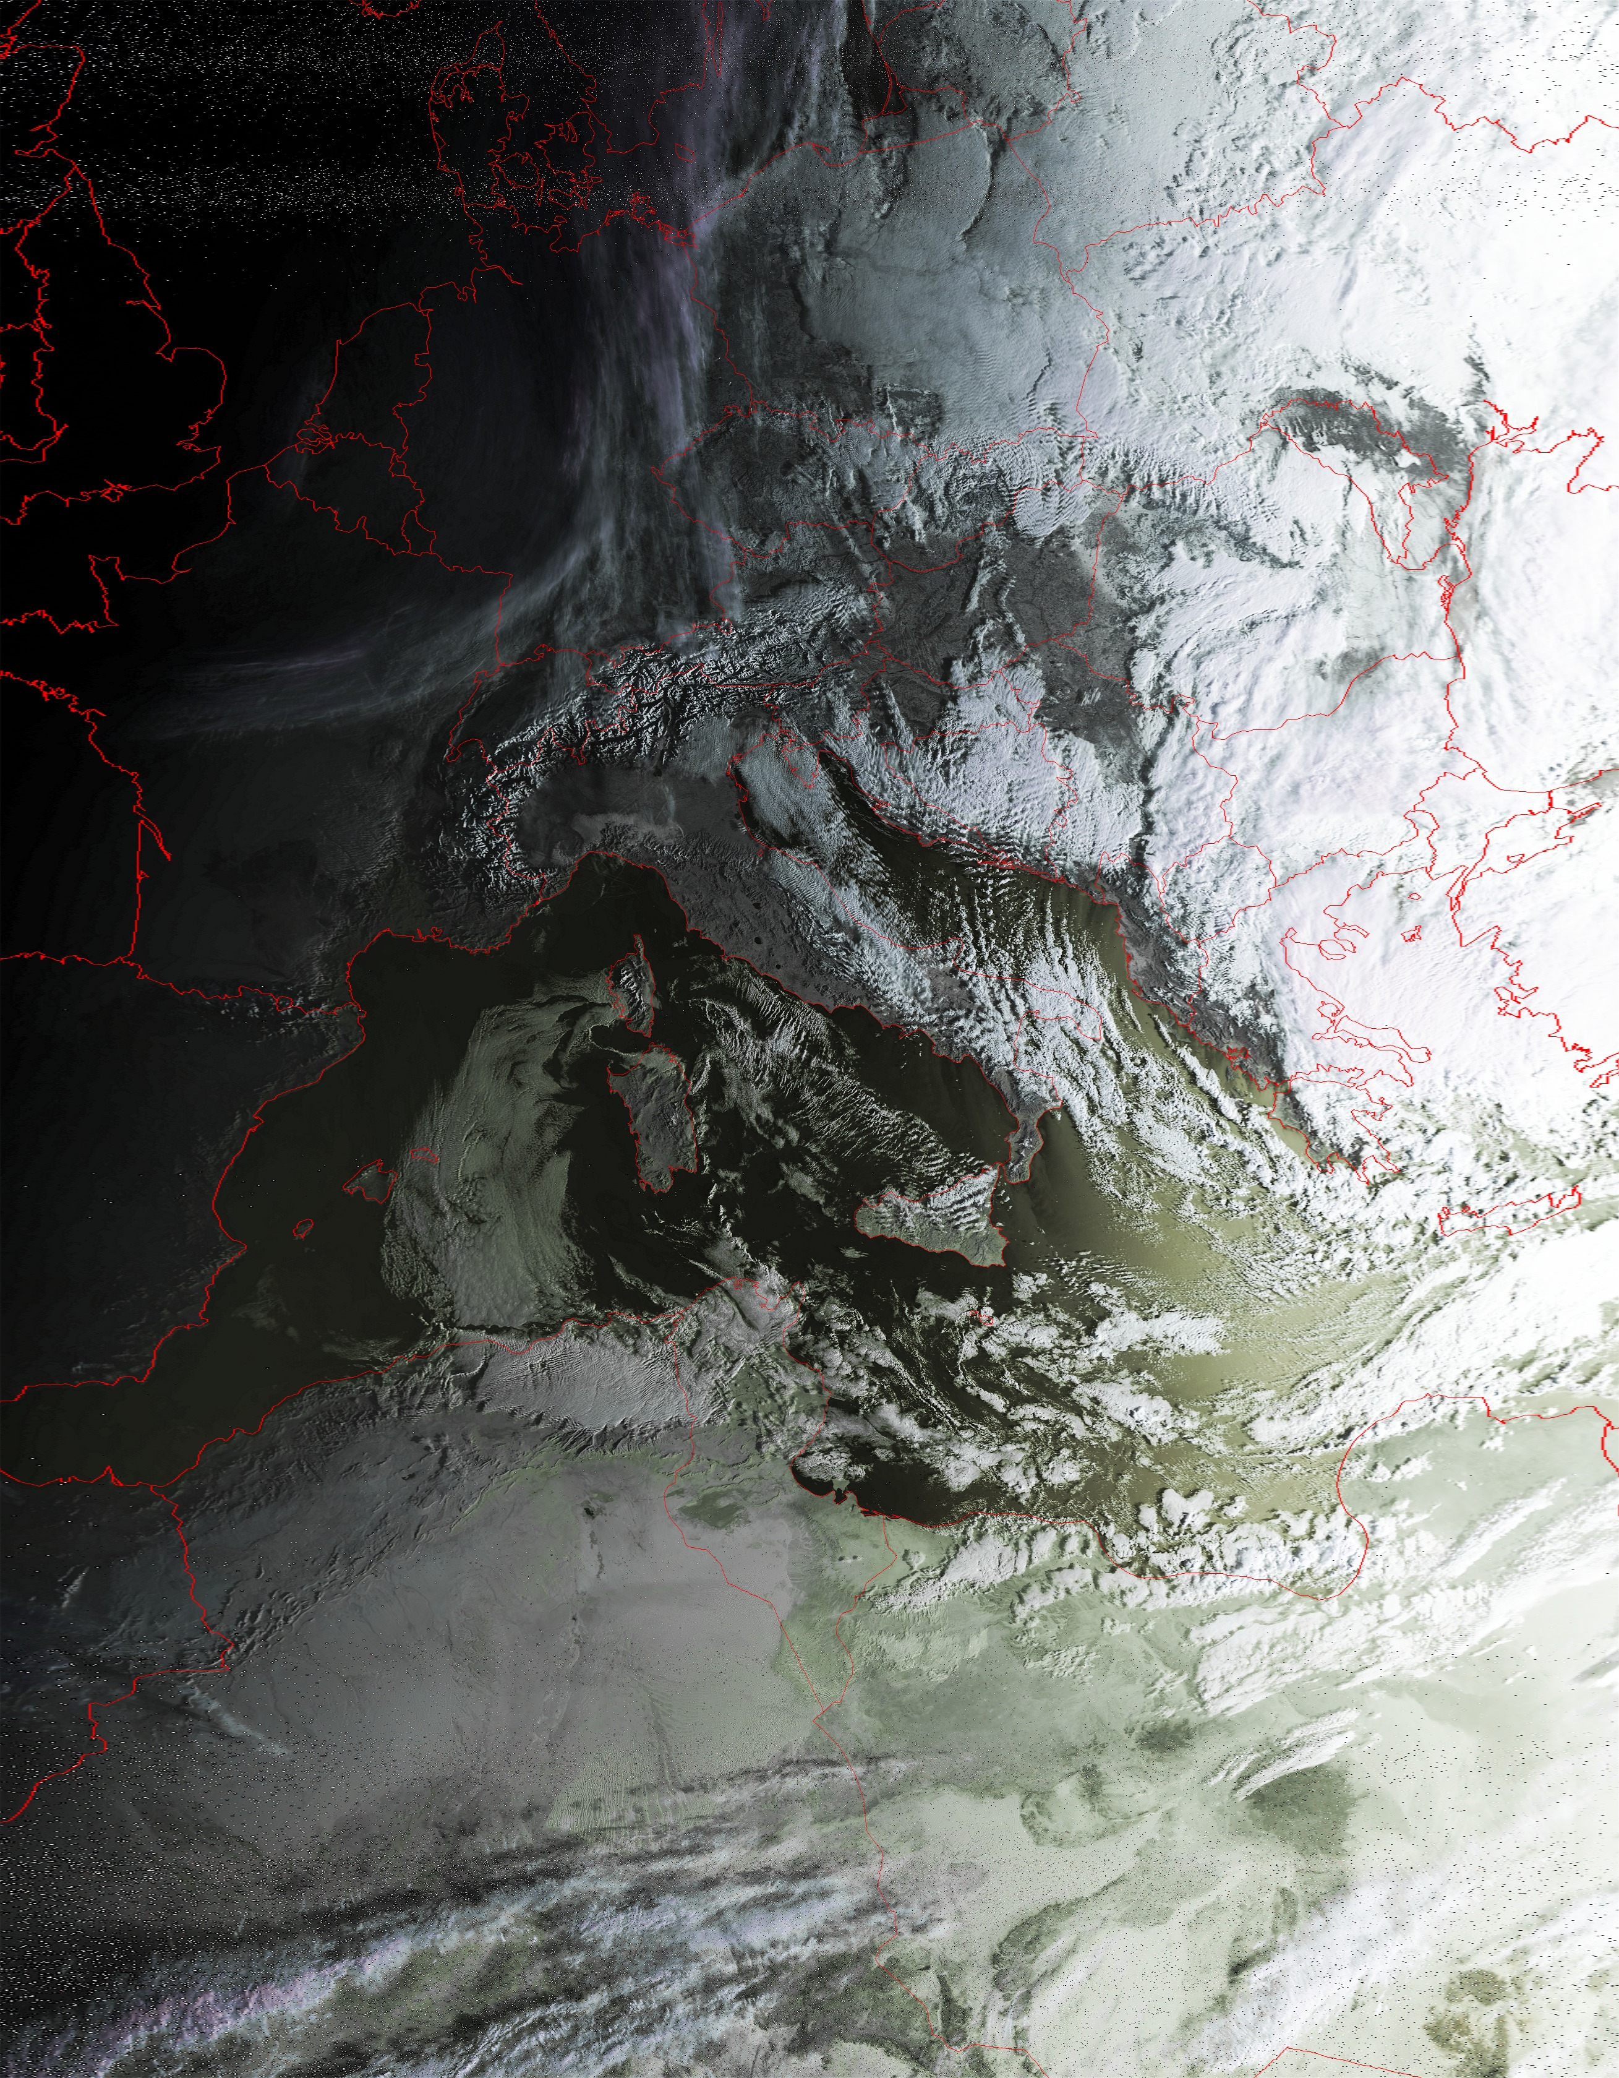
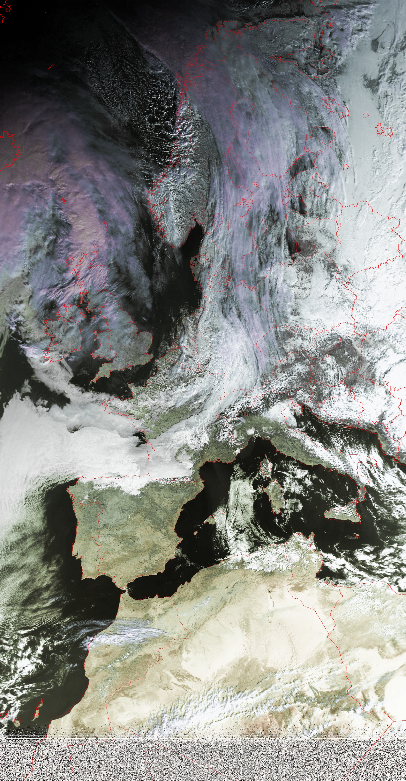
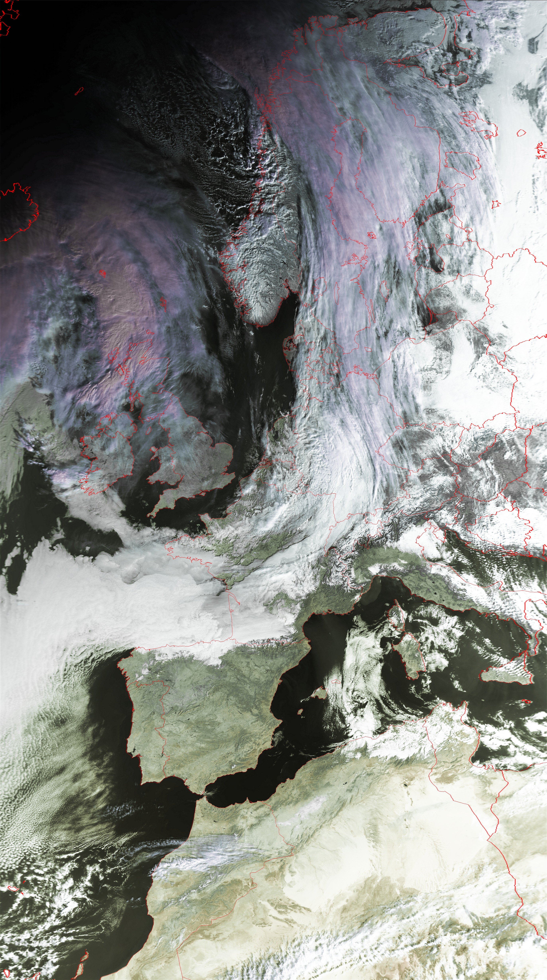
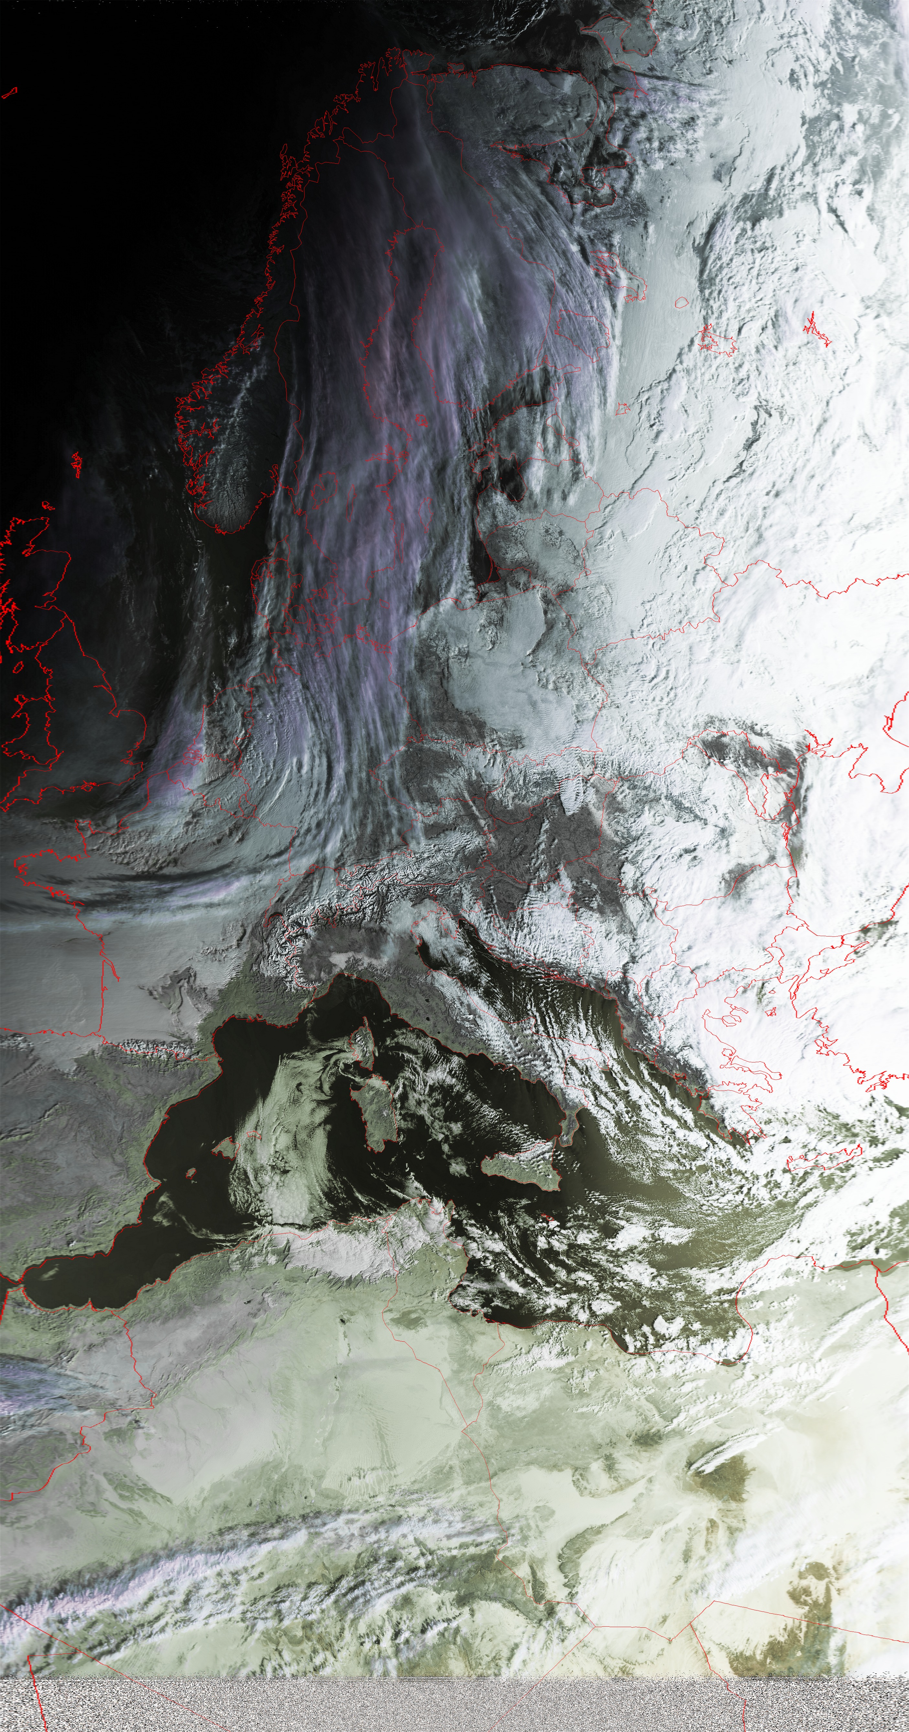
10-11 overflights in 24h; archived and processed at our facilities.
05. February 2023

Slide 3
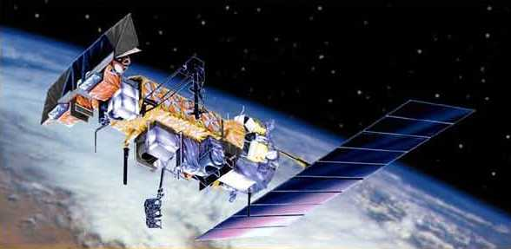
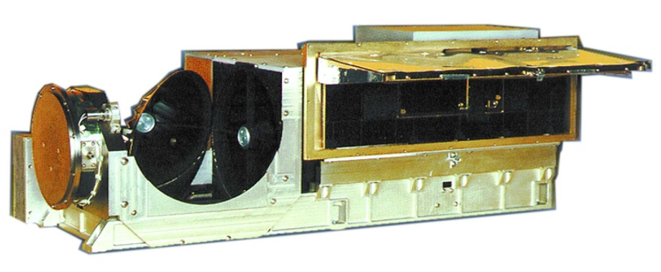
AVHRR – Advanced Very High Resolution Radiometer (1980 – ca. 2027)
NOAA-satellites (1980 – ca. 2024)
MetOp-satellites (2006 – ca. 2027)
AVHRR: 30cm x 36cm x 80cm (32 kg)
AVHRR/3 Channel Characteristics (since 1998)
Channel Number | Resolution at Nadir | Wavelength (um) | Typical Use
1 | 1.09 km | 0.58 - 0.68 | Daytime cloud and surface mapping
2 | 1.09 km | 0.725 - 1.00 | Land-water boundaries
3A | 1.09 km | 1.58 - 1.64 | Snow and ice detection
3B | 1.09 km | 3.55 - 3.93 | Night cloud mapping, sea surface temperature
4 | 1.09 km | 10.30 - 11.30 | Night cloud mapping, sea surface temperature
5 | 1.09 km | 11.50 - 12.50 | Sea surface temperature

Slide 4
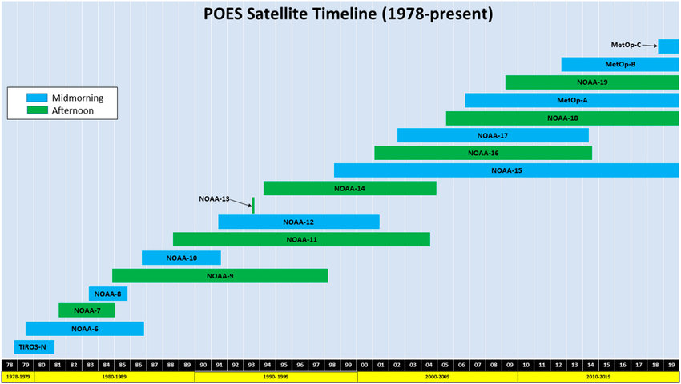
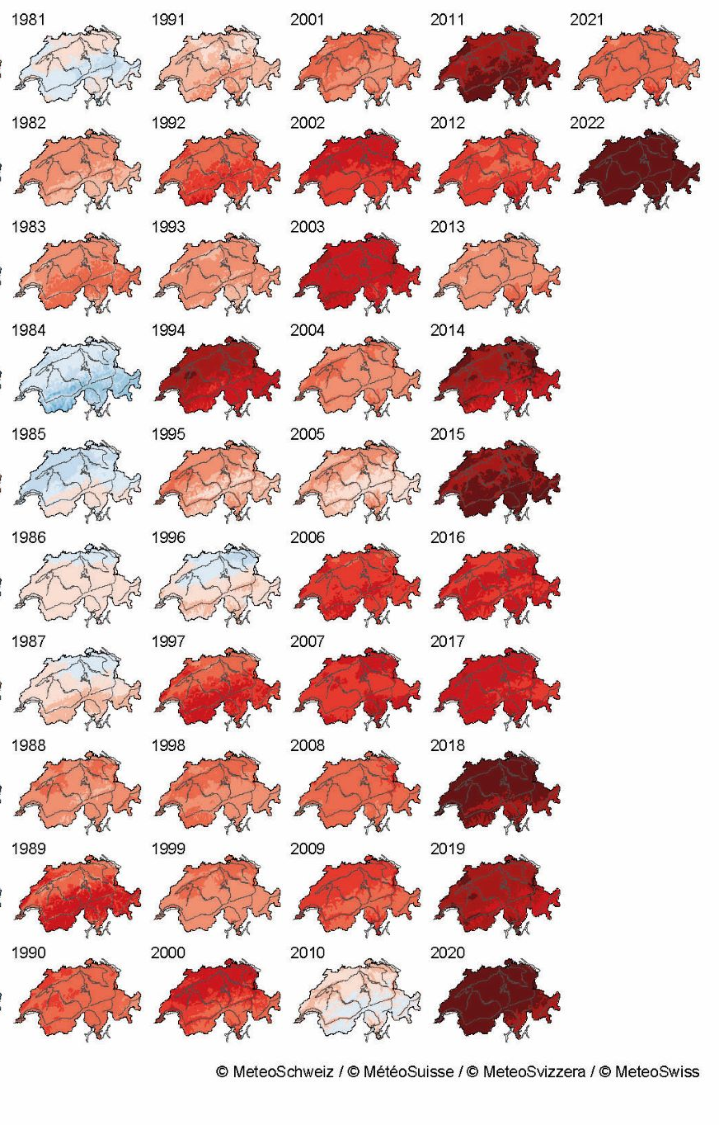
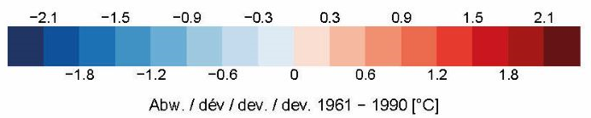
Unique Time Series of more than 40 years based on similar AVHRR sensor to support climate change studies
Kalluri et al. 2019

Slide 5
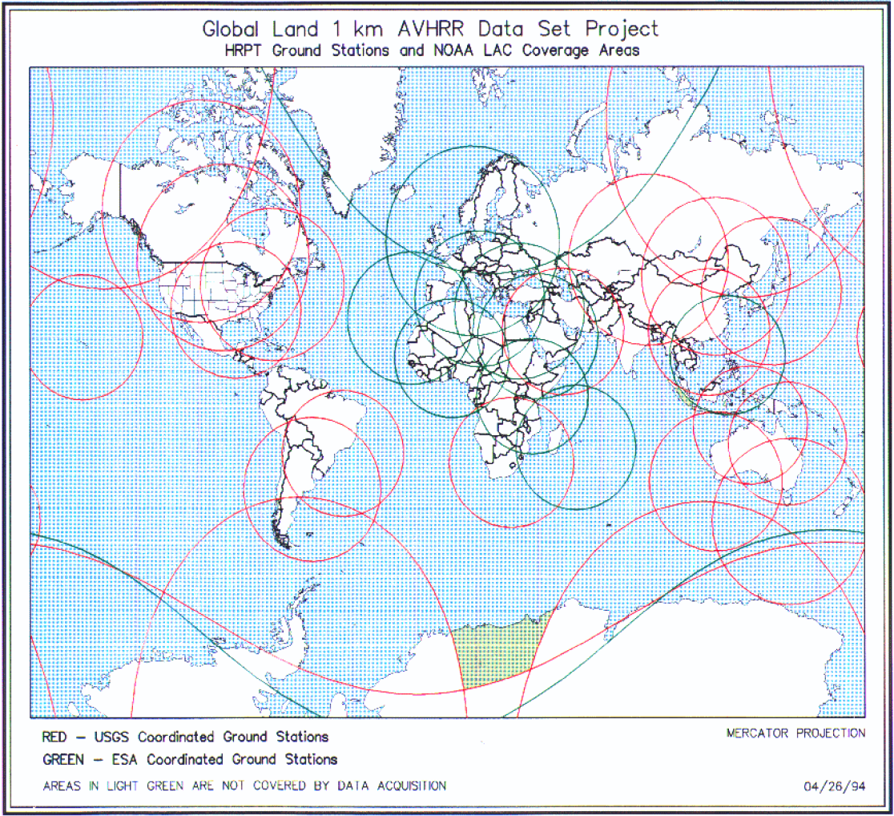
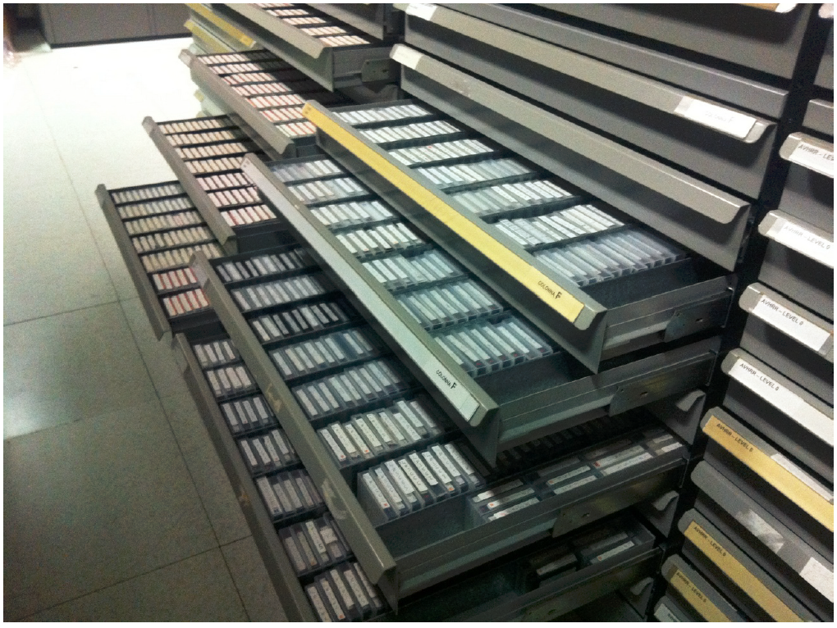
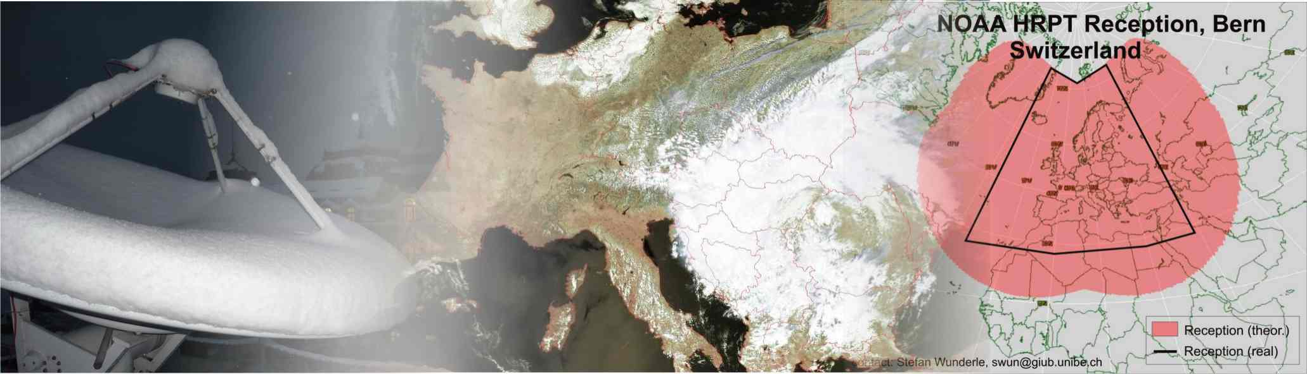
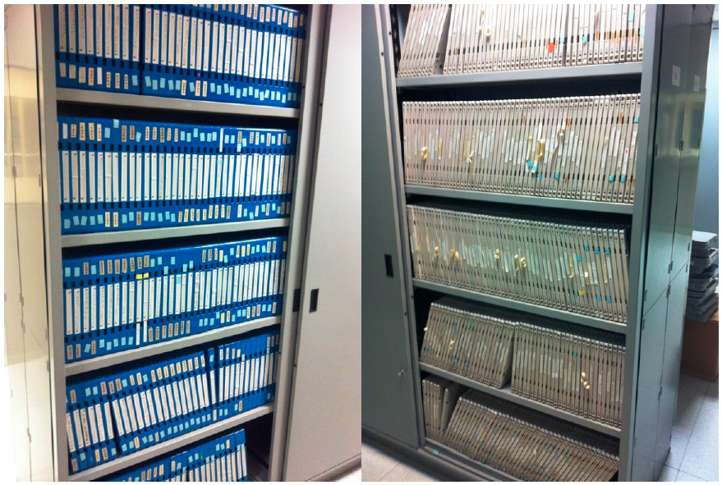
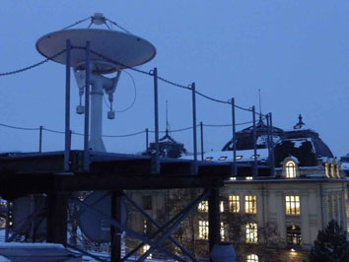
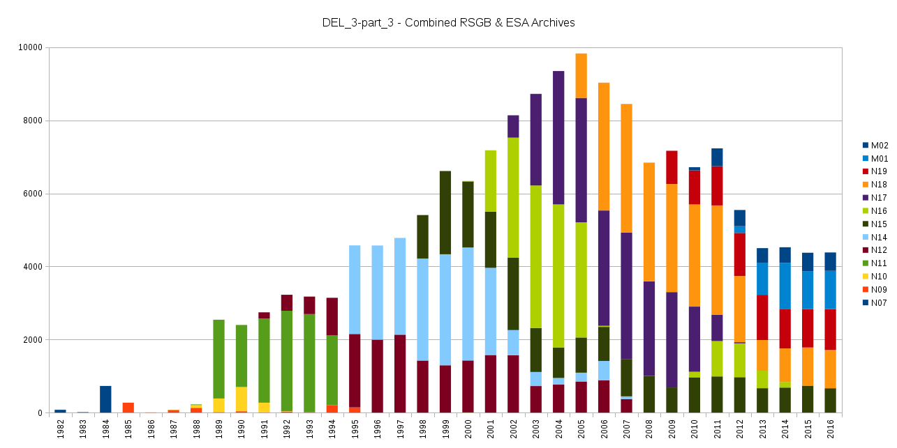
Motivation for the co-operation:
ESA Heritage Mission Team and University of Bern
Heritage program for third party missions
Support climate change initiative and other projects related to climate change studies
UniBern – long tradition of AVHRR reception and processing
We see the need to make historical data accessible to the public and keep the data alive for an unlimited time.
AVHRR data archived on optical disks and magnetic tapes in ESRIN

Slide 6
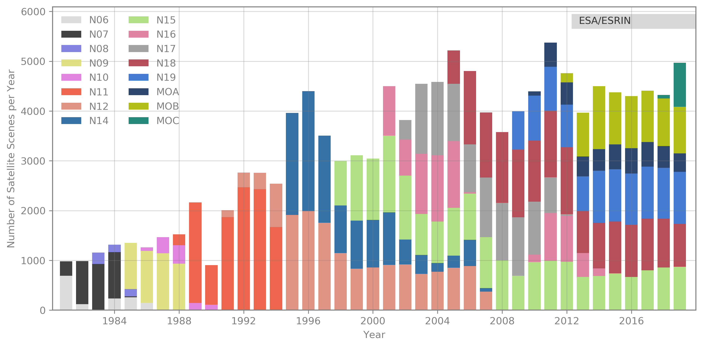
European 1-km AVHRR archive hosted at ESA includes data from University of Bern, Dundee Satellite Receiving Station and ESA holdings. Period: 1981 - 2020
Two-ten overpasses per day.
Dataset consists of more than 250.000 data products harmonized and consolidated through a dedicated ESA project (Heritage Space Programme).
All accessible free of charge via ESA dissemination services.
Archived for unlimited time by ESA.
Processing to Level-1c planned.

Slide 7
Procedure to compile an open accessible AVHRR data set via ESA dissemination service
WP_1: Inventory and gaps identification of AVHRR UniBe data incl. ESA data holdings
WP_2: Consolidation procedure and reprocessing definition; development of software to re-format the different flavors of archived AVHRR data and fill the meta file.
WP_3: AVHRR Master data set consolidation and reprocessing at UniBe Linux Cluster; transfer of software and scripts to ESA for own re-processing.
WP_4: AVHRR European Master data set validation (test of readability, check of consistency of all files in EO-SIP)
WP_5: Consolidation of AVHRR preserved data set composition
WP_6: Transfer of all re-processed AVHRR data in level 1b (1981 – 2020) to ESA to be included in EARTH ONLINE.

Slide 8
EO-SIP package (Earth Observation – Submission Information Package)
EO-SIP package structure, content and metadata attributes for the AVHRR products in scope, in line with the ESA Next Generation Multi-Mission PDGS Infrastructure, to be used for archiving and dissemination.
AVHRR EO-SIP
EO Product
Metadata Report
1 1
1
0..1
Quality Report (1)
SIP Information File (1)
Browse Image

Slide 9
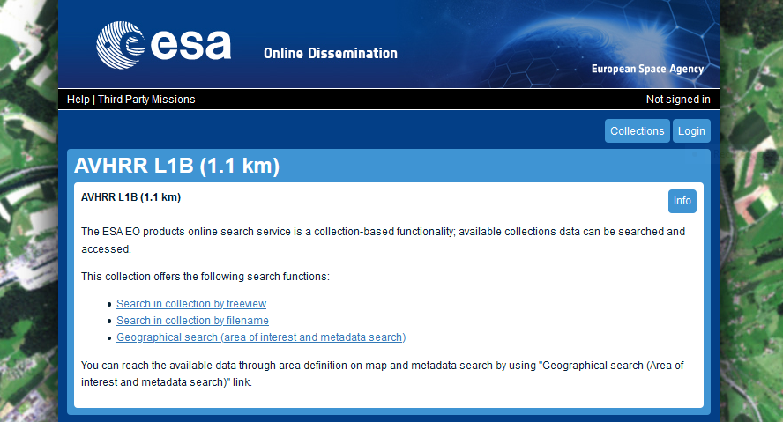
ESA Online Dissemination – AVHRR L1B data
https://tpm-ds.eo.esa.int/oads/access/collection/NOAA_AVHRR_L1B_LAC

Slide 10
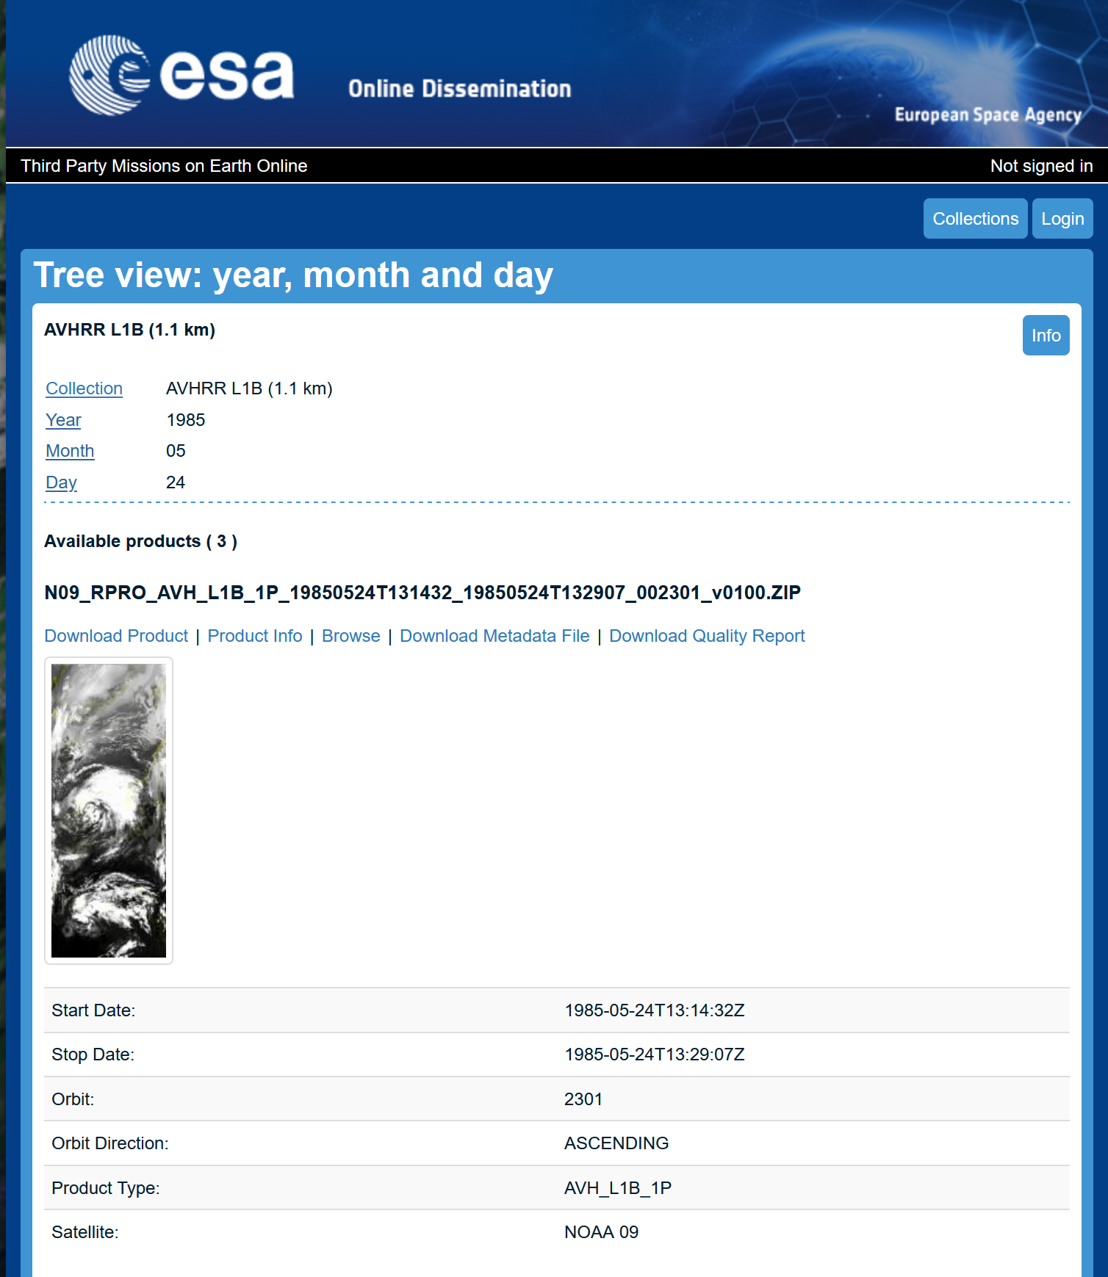
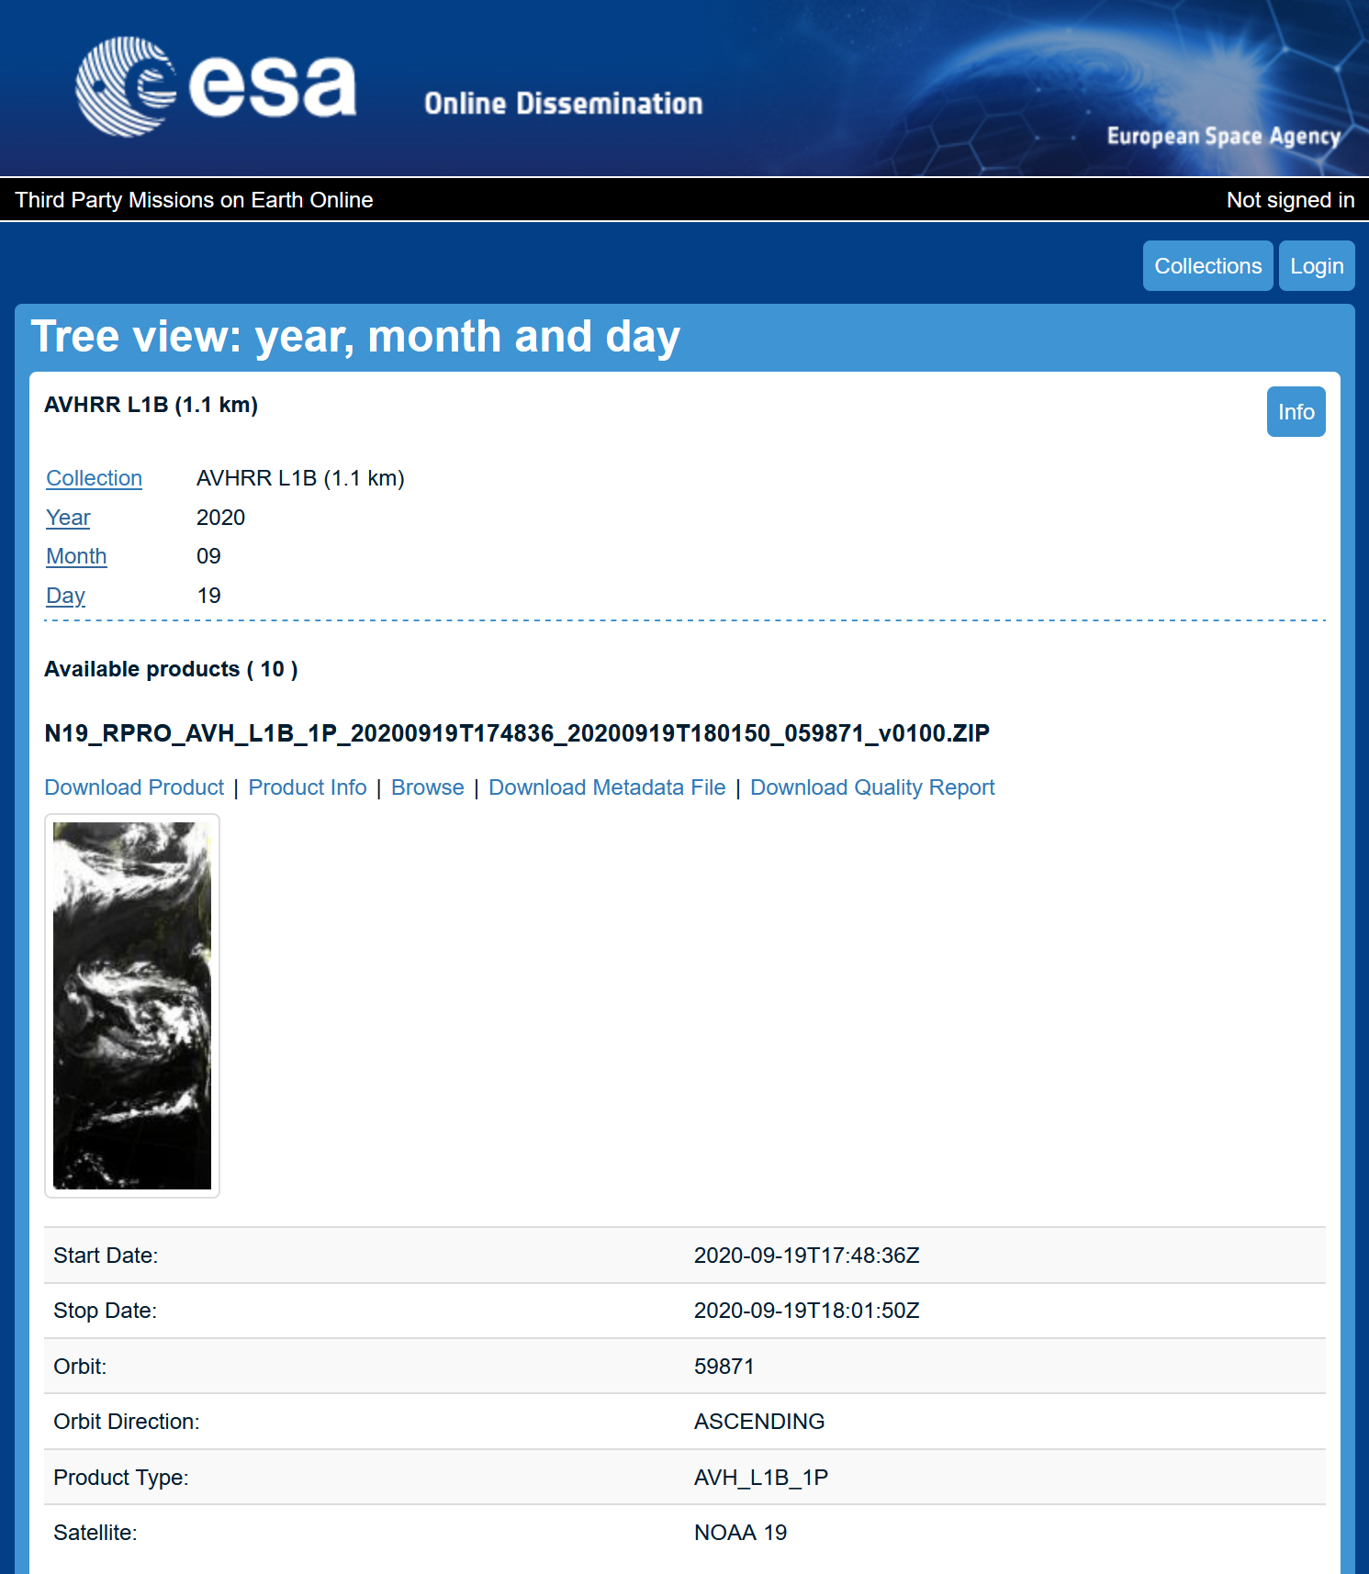

Slide 11

Essential Climate Variables (GCOS / GOOS)
Global Climate Observing System: established by the international science community to measure how the climate system is changing
A set of Essential Climate Variables were defined, that should be monitored systematically
  Atmosphere
  Ocean
  Terrestrial
Environmental satellites play a significant role in this effort

Slide 12
A few examples of the developments and operational services developed by University of Bern
Pre-processing of AVHRR data; calibration and geocoding/ orthorectification
Aerosol Optical Depth (AVHRR)
Probability Cloud Mask (PCM)
Albedo, Vegetation Dynamic, Fire
Snow Cover Fraction (AVHRR)
Lake Surface Water Temperature (AVHRR)
Atmosphere
Land

Slide 13
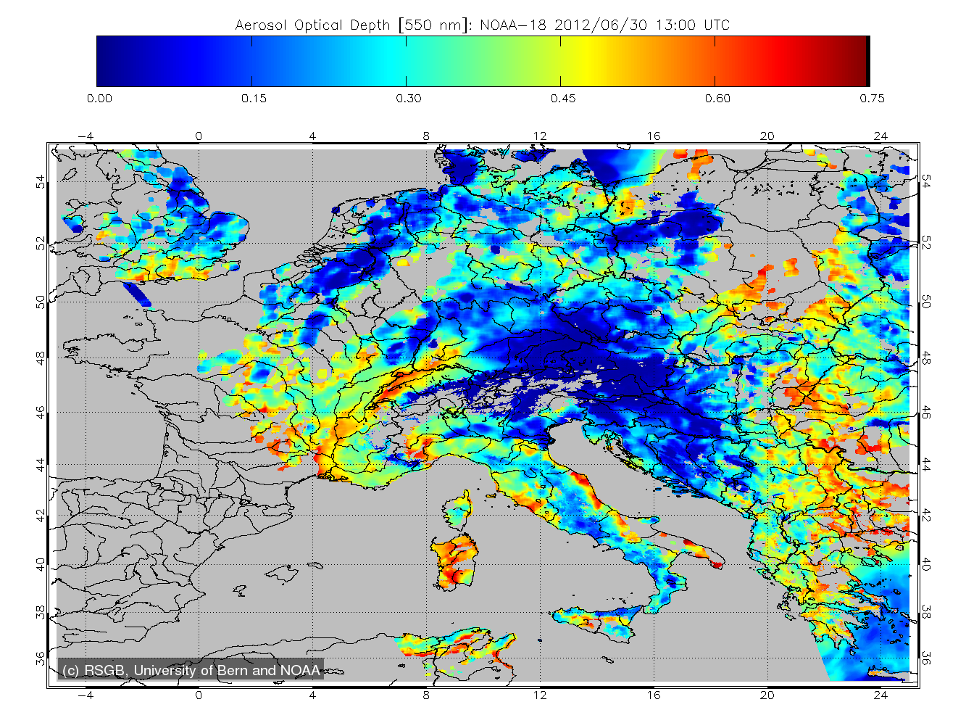
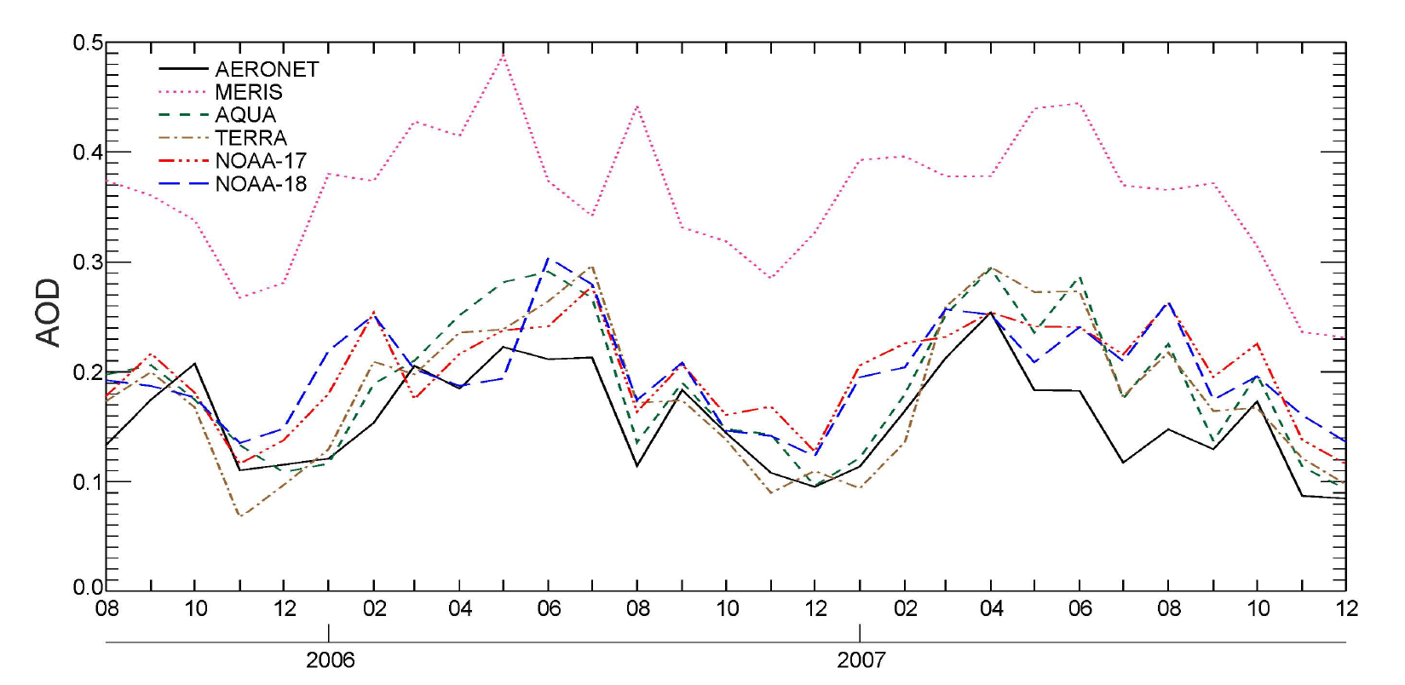
Aerosol Optical Depth (AOD) derived from AVHRR
Riffler, Michael; Popp, Christoph; Hauser, Adrian; Fontana, Fabio; Wunderle, Stefan (2010). Validation of a modified AVHRR aerosol optical depth retrieval algorithm over Central Europe. Atmospheric Measurement Techniques (AMT), 3(5), pp. 1255-1270

Slide 14
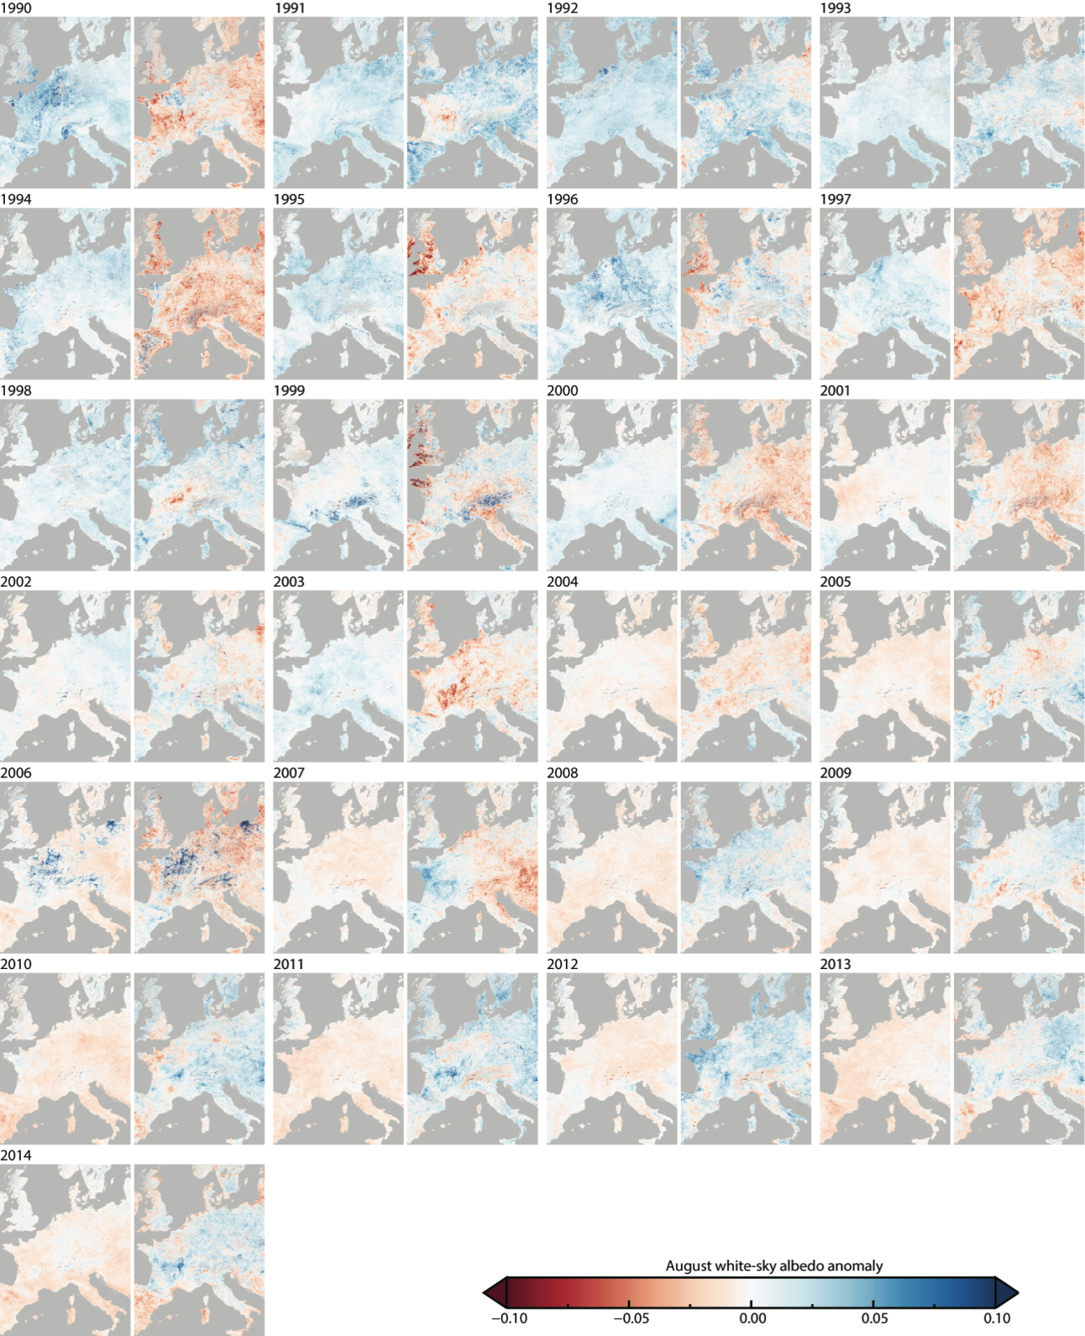
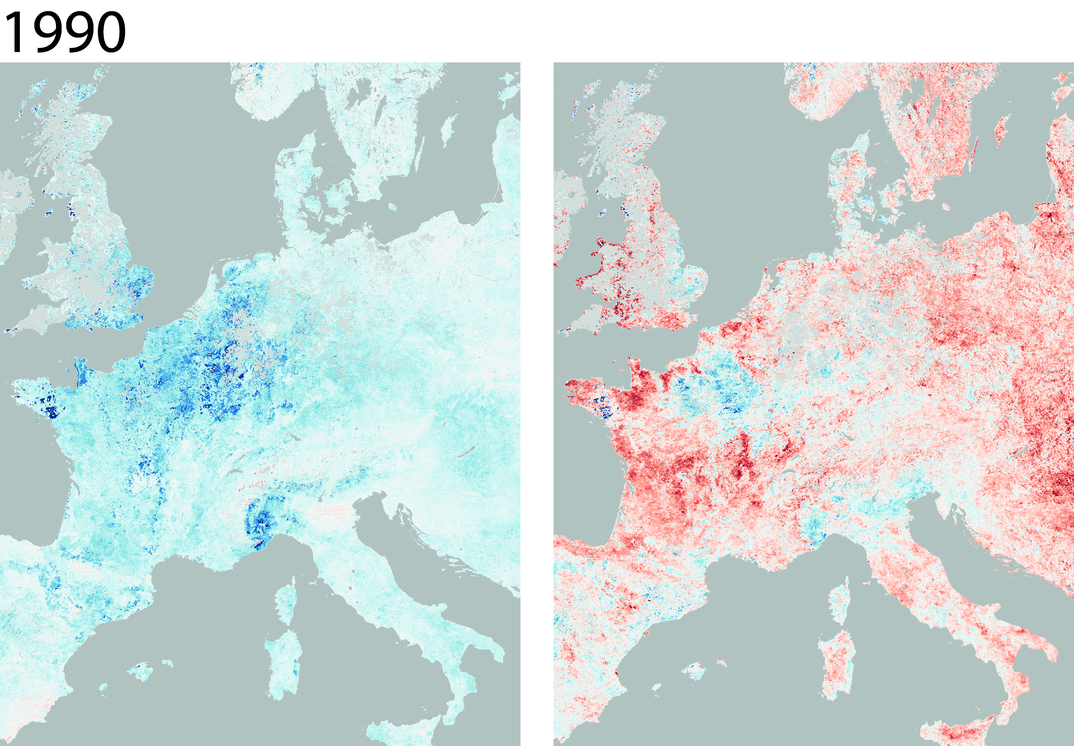
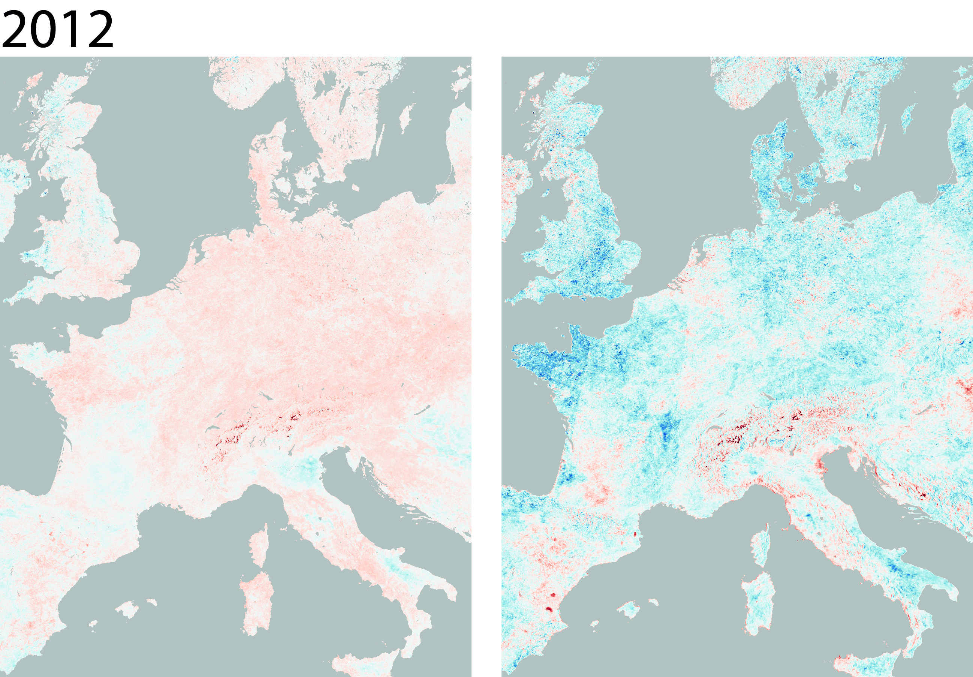
Albedo 1990 - 2014
annual August white-sky albedo anomalies
VIS (left) and NIR (right)
Sütterlin, Melanie; Stöckli, R.; Schaaf, C. B.; Wunderle, S. (2016). Albedo climatology for European land surfaces retrieved from AVHRR data (1990-2014) and its spatial and temporal analysis from green-up to vegetation senescence. Journal of Geophysical Research: Atmospheres, 121(14), pp. 8156-8171.

Slide 15
Lake Surface Water Temperature LSWT
derived from AVHRR
Lieberherr, Gian; Wunderle, Stefan (2018). Lake Surface Water Temperature Derived from 35 Years of AVHRR Sensor Data for European Lakes.
Remote sensing, 10(7),

Slide 16
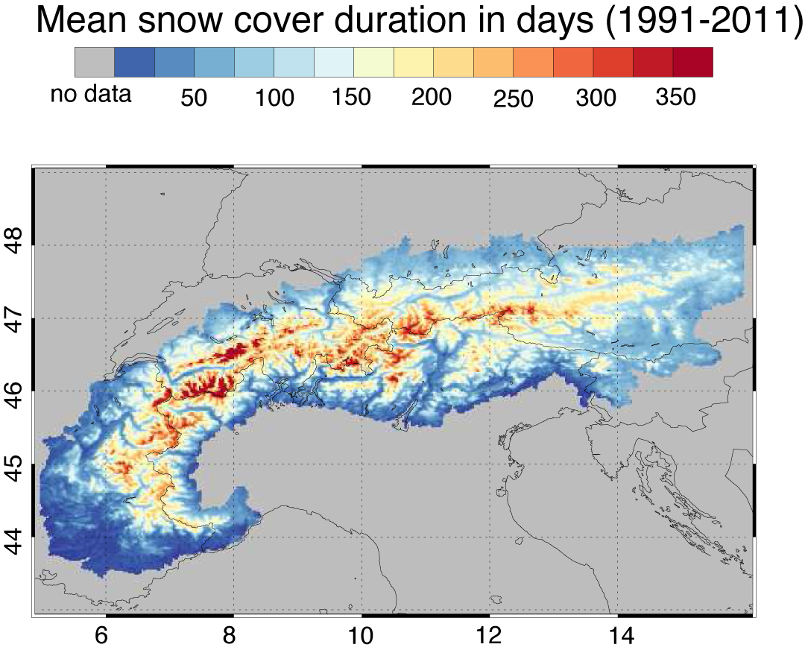
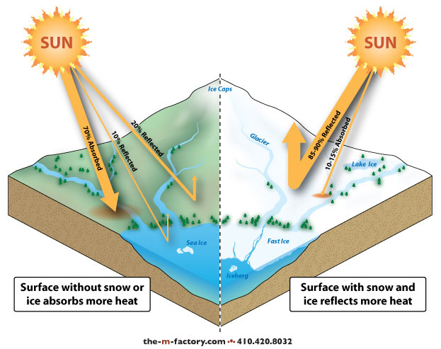
Snow covered Area (SCA) based on AVHRR LAC data (1982 – 2017)
Snow cover reflects approx. 80% of incoming solar radiation. High relevance for our climate
Hüsler, F., T.Jonas, M.Riffler, J.P.Musial, S. Wunderle (2014): A satellite-based snow cover
climatology (1985 -2011) for the European Alps derived from AVHRR data. The Cryosphere, 8, 73-90

Slide 17

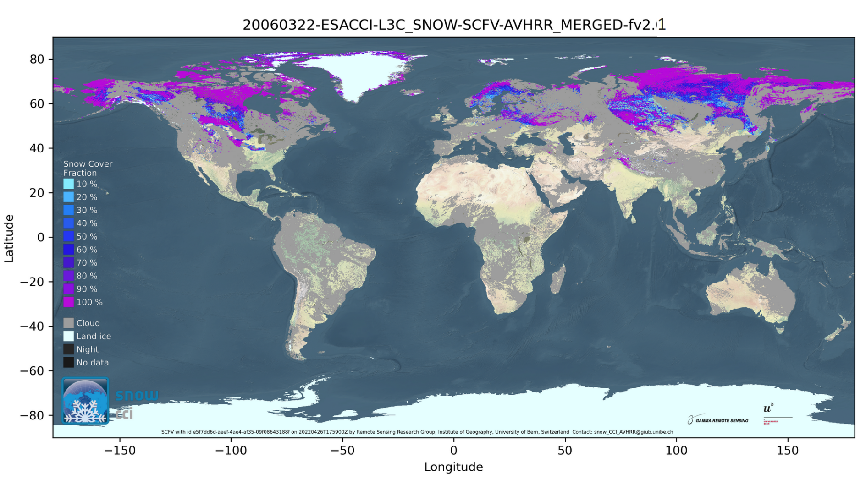
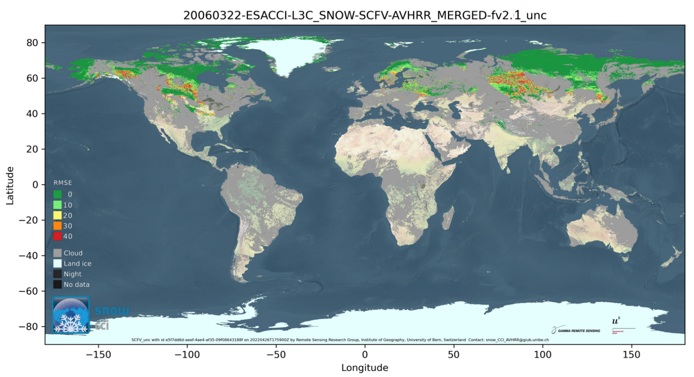
AVHRR Snow Cover Fraction (global) by University of Bern
Aim: consistent SCFV/SCFG (1978 – 2023)
Data source:
  AVHRR GAC, reprocessed by EUMETSAT
  Morning and afternoon passes
  CLARA-A3 daily composites from CM SAF
Retrieval scheme:
  NDSI, Scamod and tailored thresholds
  spatial and temporal adapted transmissivity based on NDVI
  Cloud probability based on CLARA-A3
Right: SCFV and uncertainty (20060322) based on AVHRR GAC

Slide 18
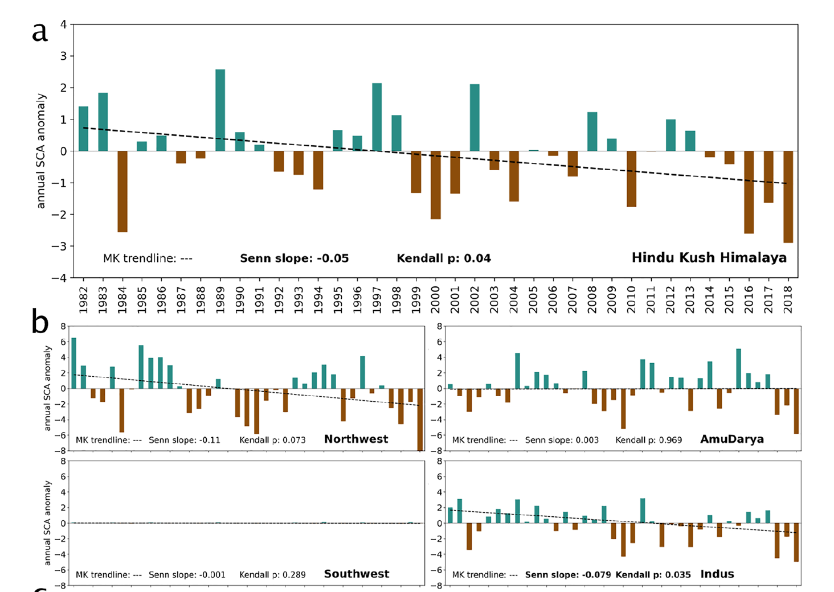
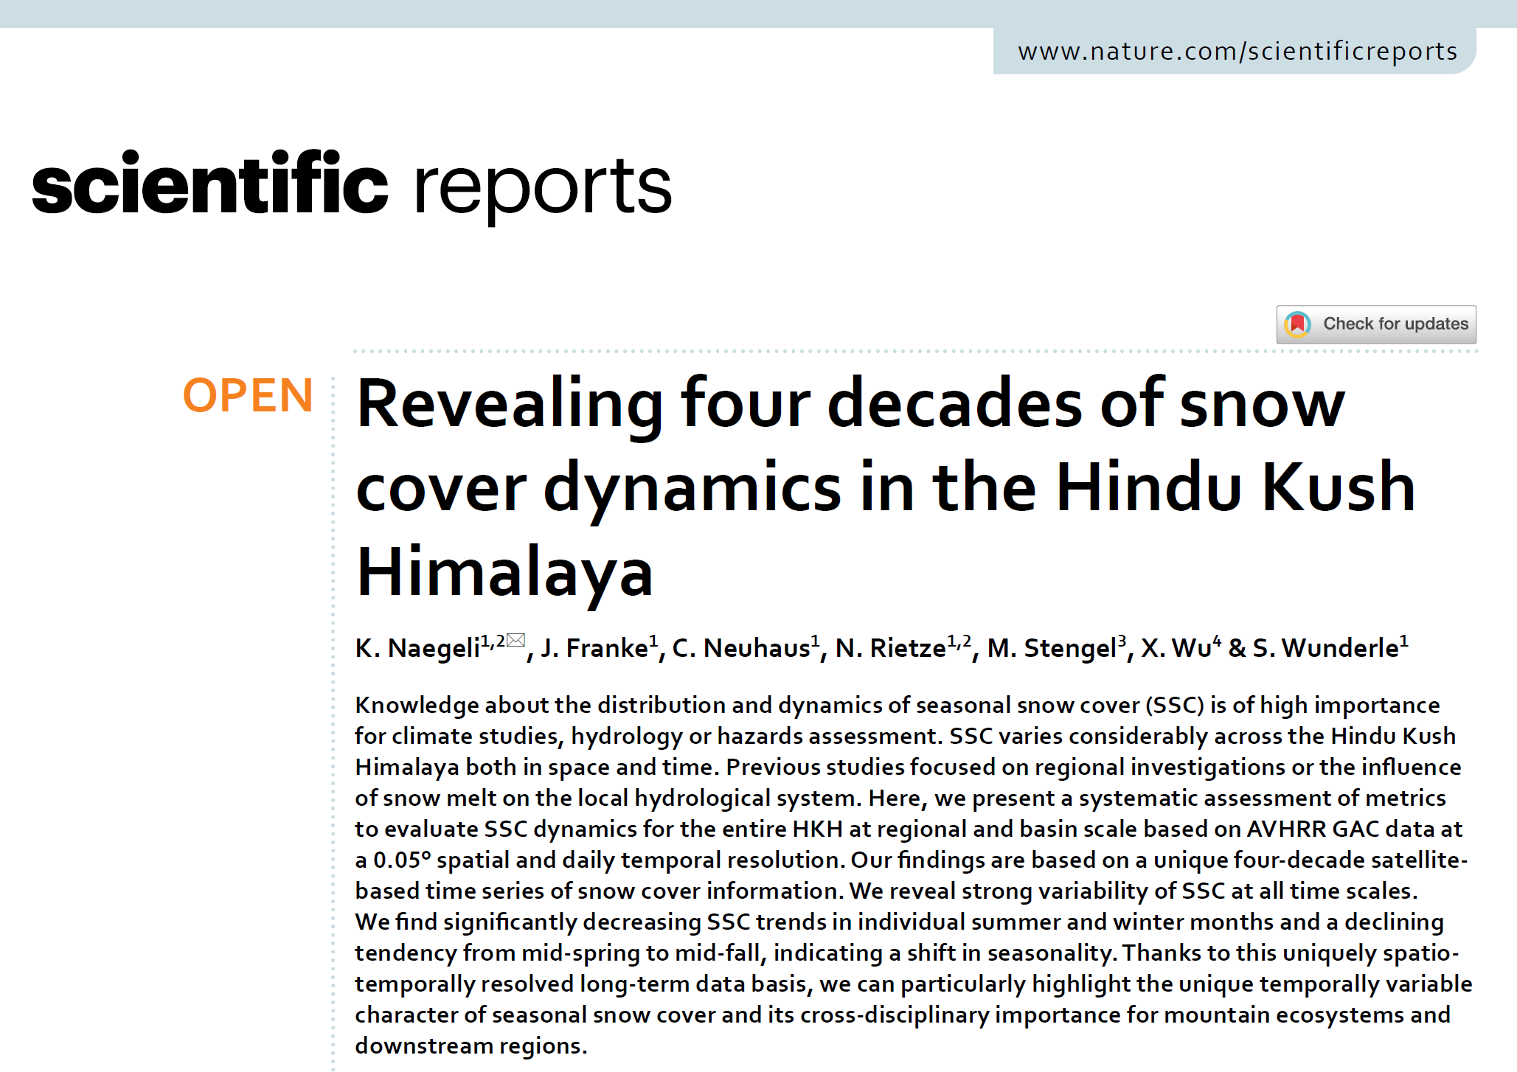
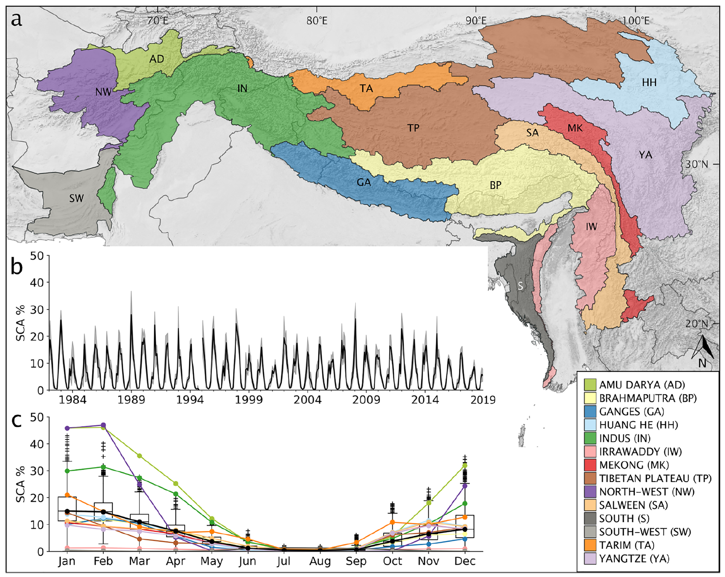
Research based on global AVHRR data (4 x 4km) from 1982 - 2018
Naegeli et al. 2022: https://www.nature.com/articles/s41598-022-17575-4.pdf

Slide 19
Summary and Outlook
Summary
  A homogenous and consolidated AVHRR LAC time series (1981 – 2020) is now available via ESA dissemination service.
  More than 250.000 AVHRR data (level 1b) covering Europe are ready to be used
  Approx. 55.000 CEOS Sharp-1 segments were rescued, re-processed in a consistent way (EO-SIP) and are accessible via ESA dissemination service, too.
  Software and processing procedure developed at University of Bern is installed and tested at ESA facilities.
  Next step is the generation of Level 1c data (calibrated and geocoded, in NetCDF format) for a better service to support communities without the needed expertise in AVHRR processing.

Slide 20
Outlook
Filling of AVHRR level1b archive with LAC data until the end of AVHRR sensor (NOAA, MetOp) approx. 2027
Integrate global AVHRR LAC data of the pre-MODIS era (e.g. 1992 – 1999; more than 30.000 data sets); start rescue activities for local archives around the world.
On the way to a FCDR:
  include Sentinel-3 and other medium resolution satellite data
  Apply best practice for uncertainty characteristics (e.g. FIDUCEO)
Data Usage:
  Open and free availability of AVHRR data will support any study
  Provide Access-Ready-Data (ARD) for user, climate modelling community (CMUG)
  Climate Observations and Monitoring for Policy Action Support from Space;

