Slide 1

The Analyst’s Notebook: Providing Context for Landed Operations and Adding Value to Mission Archives
Tom Stein Feng Zhou
tstein@wustl.edu feng.zhou@wustl.edu
PDS Geosciences Node
Washington University in St. Louis
PV2023: Adding value (to) and preserving Scientific & Technical data
2023-0502

Slide 2
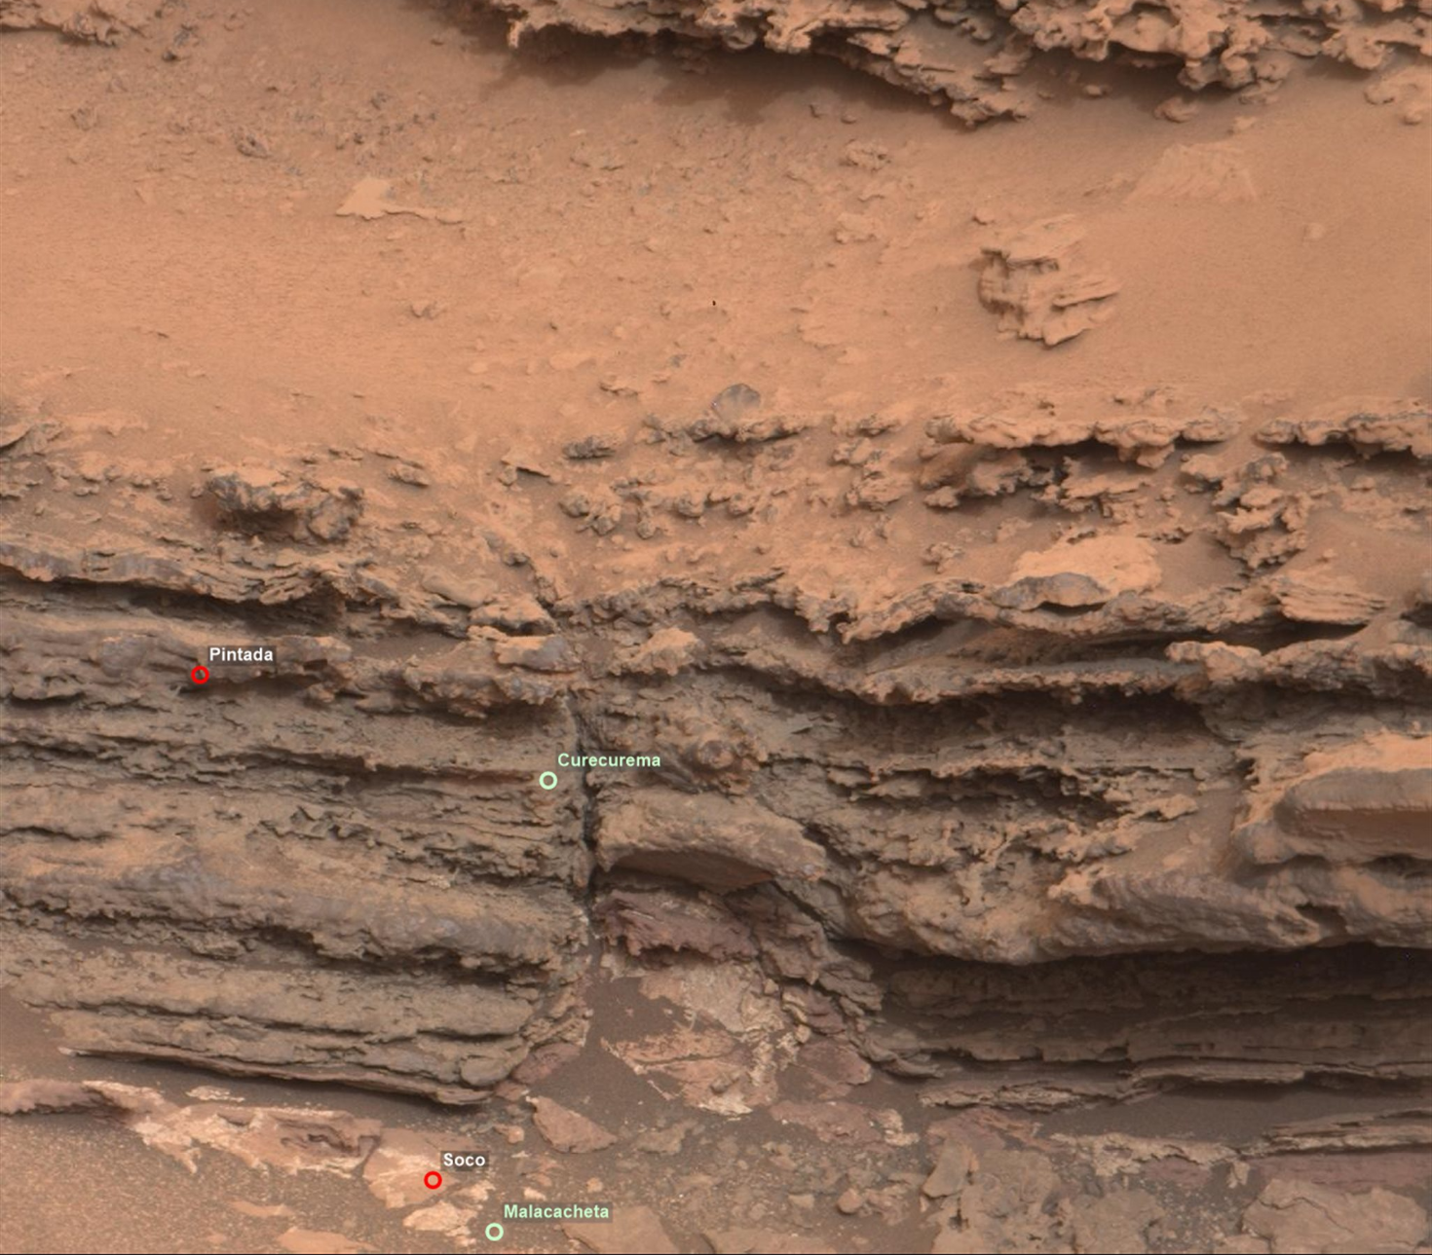
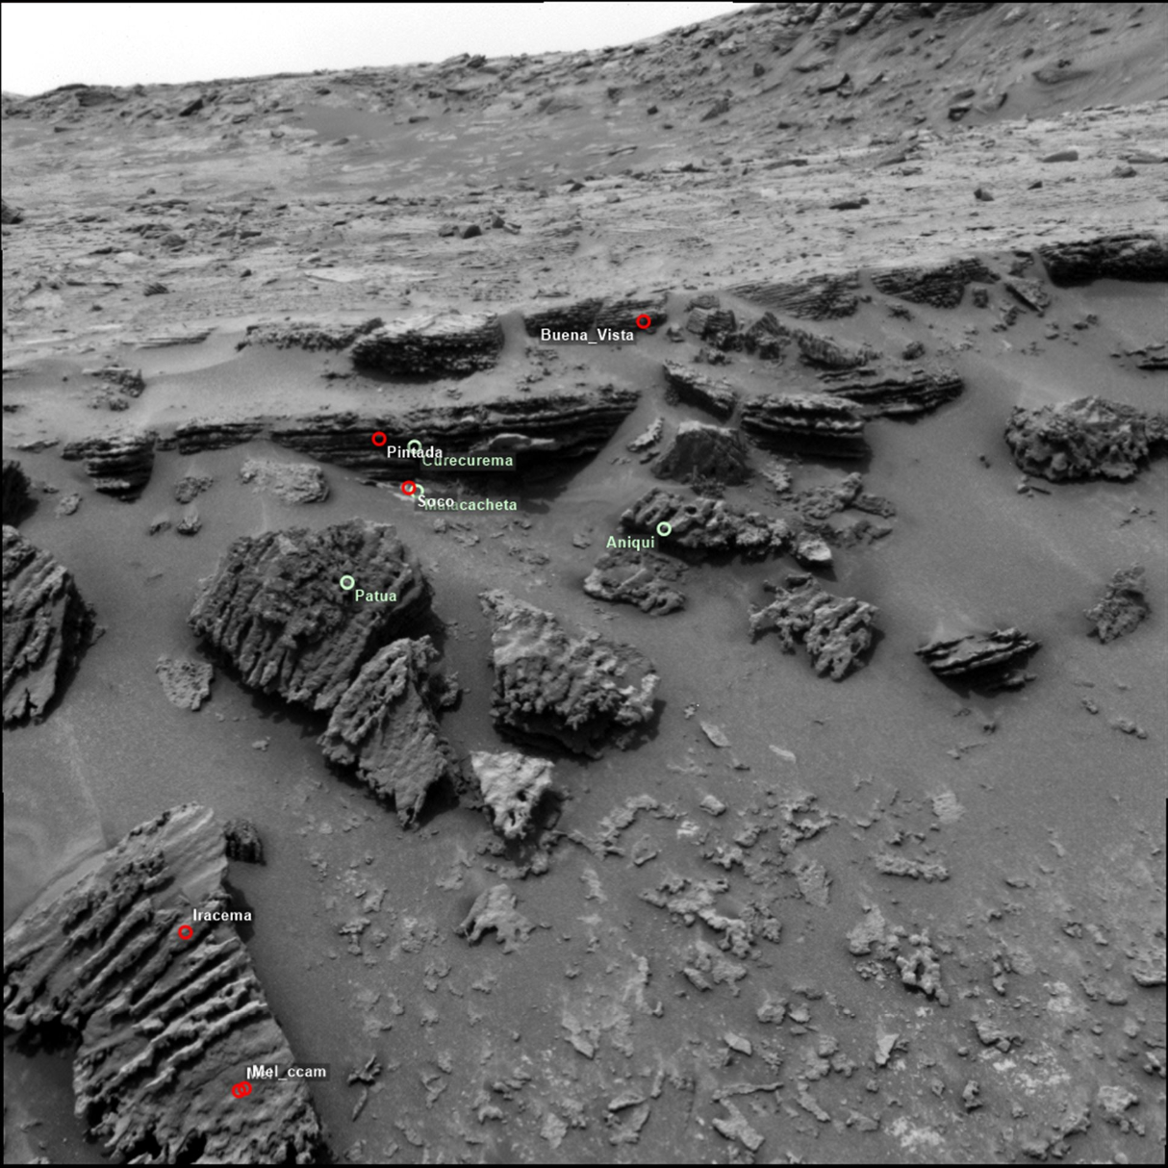
Planetary data archives of surface missions contain data from numerous hosted instruments. Because of the nondeterministic nature of surface missions, it is not possible to assess the data without understanding the context in which they were collected.

Slide 3
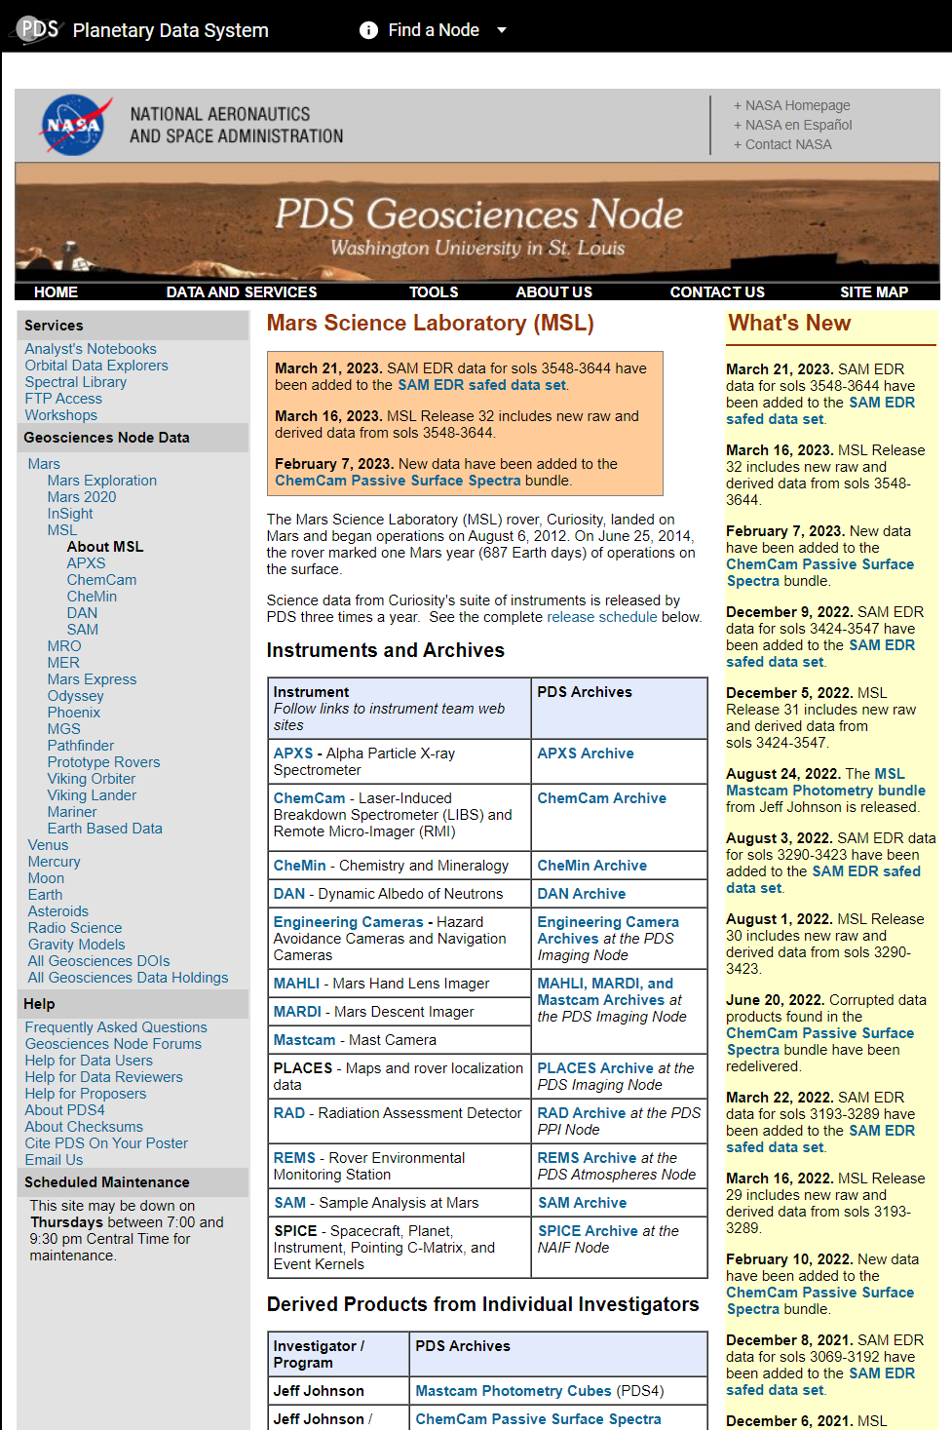
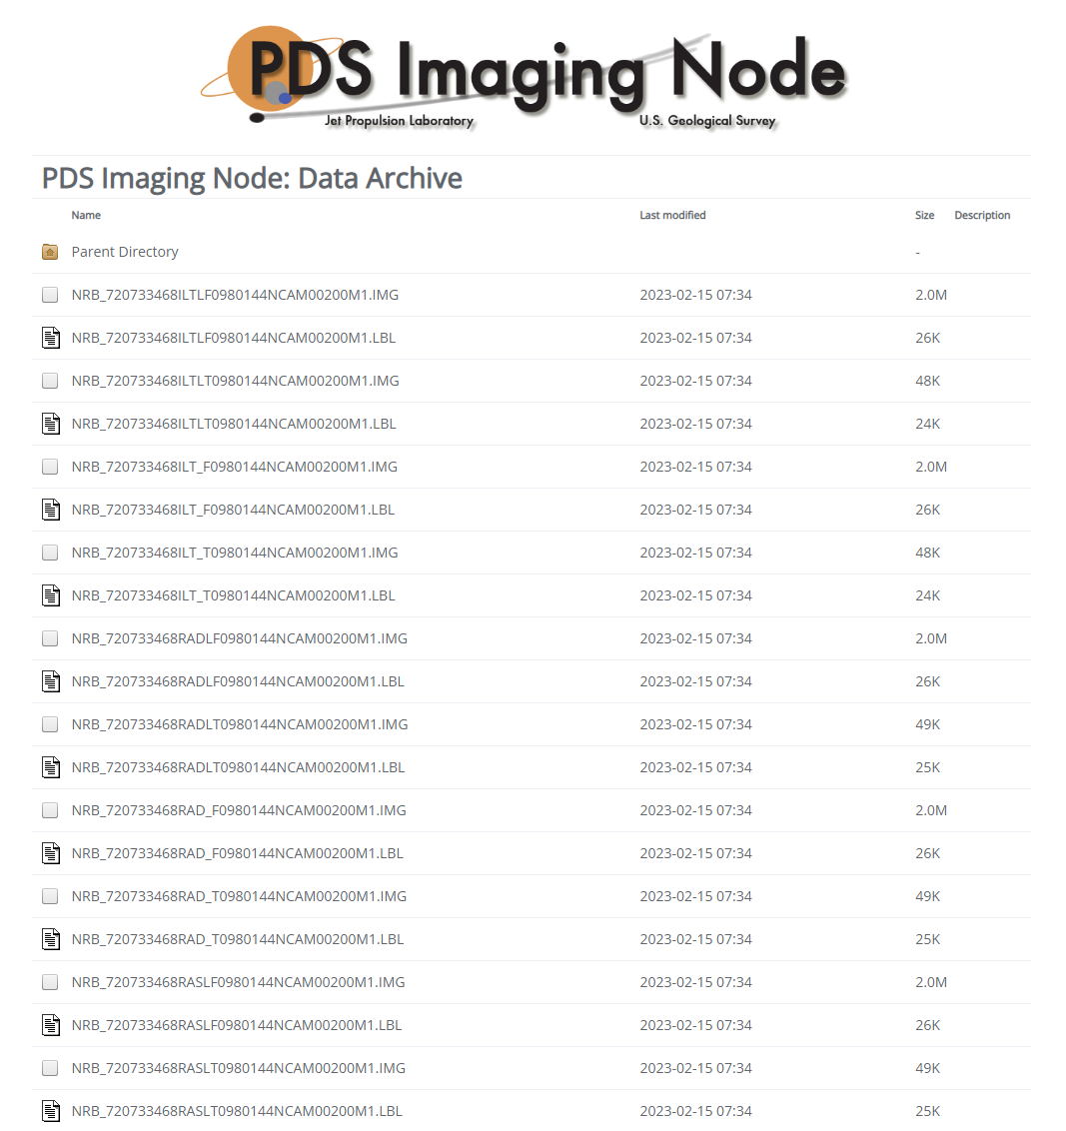
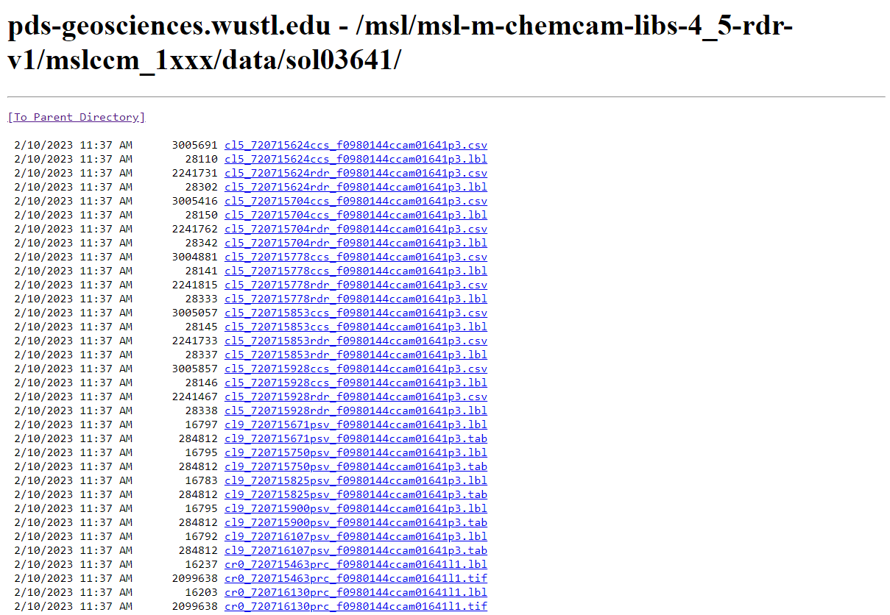
Data discovery

Slide 4
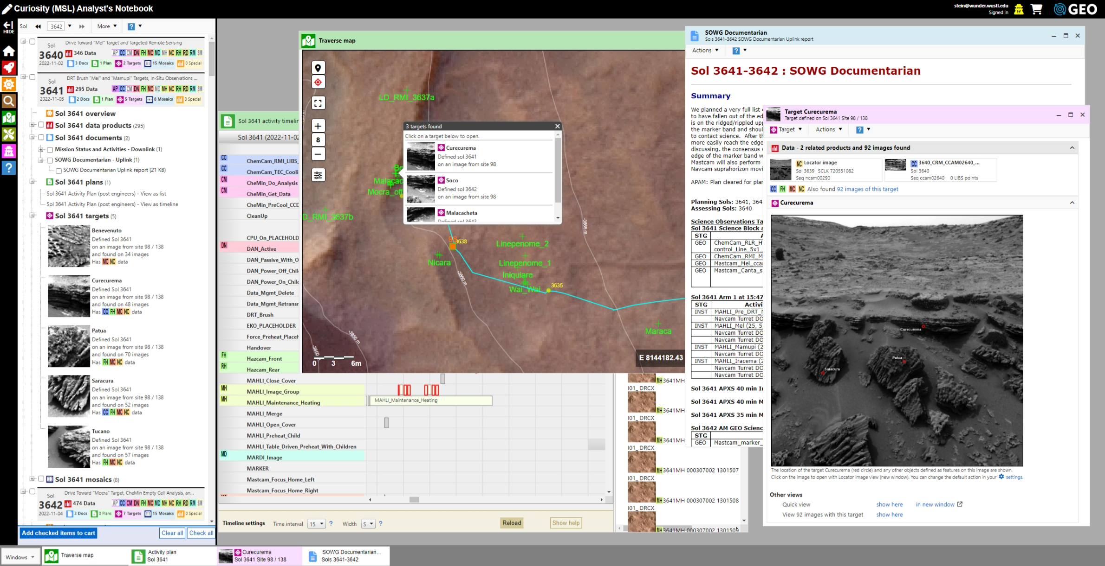
Analyst’s Notebook
The Analyst’s Notebook supports data discoverability and access for landed missions by integrating sequence information, engineering and science data, observation planning and targeting, and documentation into a web-based application.
Updated commensurate with scheduled public archive releases.
InSight release 17 | 30 Jun 2023
Mars 2020 release 7 | 27 Jul 2023
MSL release 33 | 01 Aug 2023
Sample screen shot
from Curiosity Analyst’s Notebook
https://an.rsl.wustl.edu

Slide 5

Adding value to the PDS archives
Standard PDS Release
Additional data and tools in the Notebook
Archived Data
- Standard EDR and RDR data products
Documentation
- Software Interface Specification
- Spacecraft and instrument reports
Calibration Data
- Calibration reports and data
Special Products
- Additional products of interest
- Science team supplemental products
Documentation
- Daily operations reports
- Science team reports
- Historical reports
Resources
- Historical mission overview
- Science paper references
- Links to additional resources
Value Added Elements
Suite of tools and data representations that enhance archive use
- Faceted search
- Interactive maps
- Image measurement
- Integrated plans / timeline
- Data transformation
- Cross instrument data browsing
- Context mosaics
Planetary data archives are enhanced by incorporating higher order products and external resources into the AN.
Notes:
The Notebook is more than data from the PDS archive. It includes additional information from the science team:
Sol documents
Targets
Activity plans
Traverse locations
There are also value added elements provided by the Notebook:
Interactive maps
Context mosaics
Data, document, and target search
Literature references

Slide 6
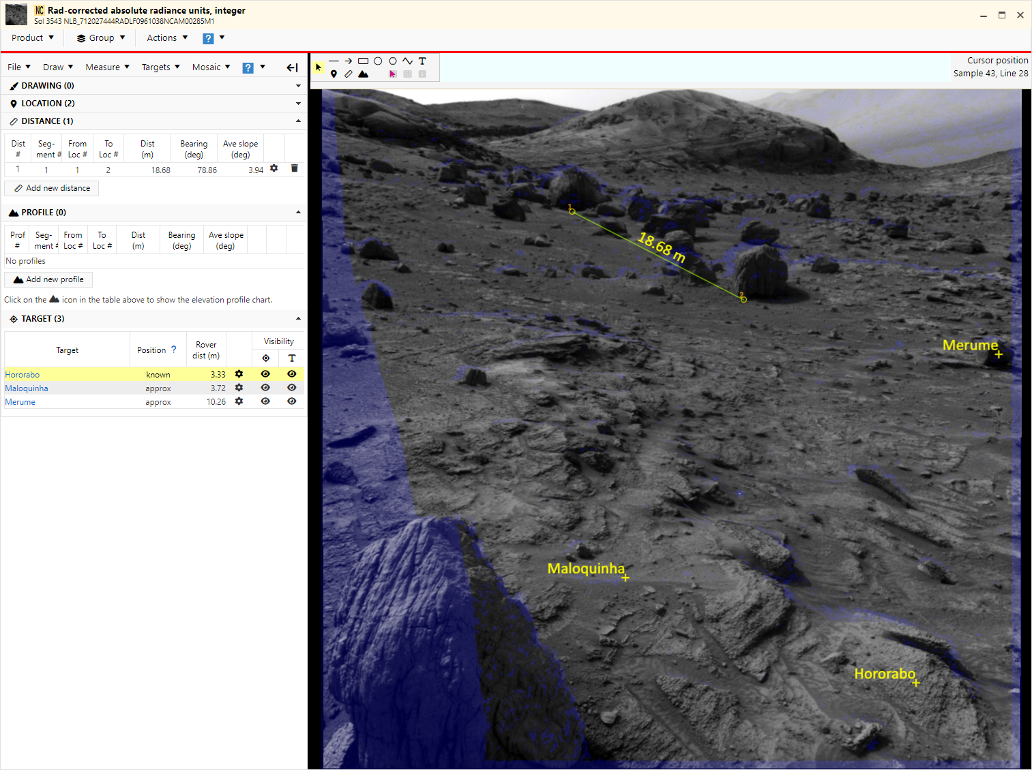
Measurement tools
Drawing
Line, arrow, rectangle, ellipse, polygon, polyline, and text.
Location
Find a location from known coordinates
  Provide (x, y) or (x, y, z) values in Site, Rover, or Local frame.
  Provide map coordinates as easting and northing.
Location metadata
  Image pixel coordinate
  Ground location in local, rover, or site frame
  Distance from rover frame origin
  Azimuth and elevation relative to head frame.
Distance
Between two points or along a polyline.
Elevation profile
Between two points or along polyline.
Measurements use archive XYZ products.

Slide 7
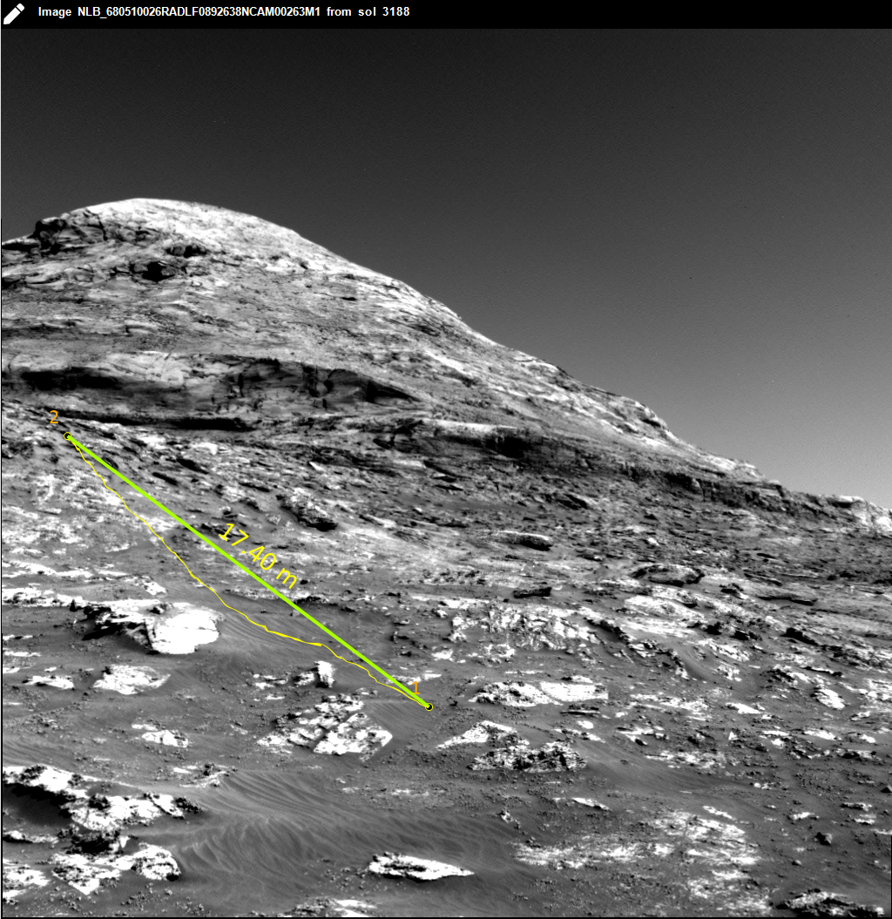
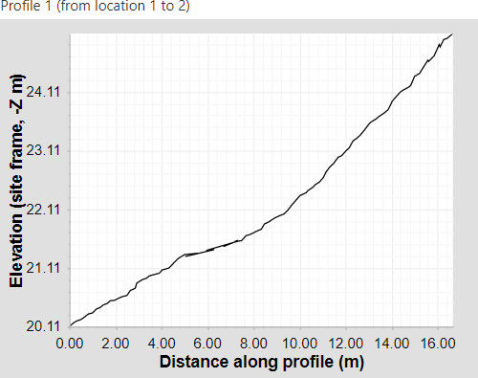
Profile tool
Elevation profile between two points or along polyline.
Elevations calculated along a path as if it were "dropped on the ground" between the two points.
  The profile is not simply the elevation values of the image pixels under the straight line drawn on the image.

Slide 8
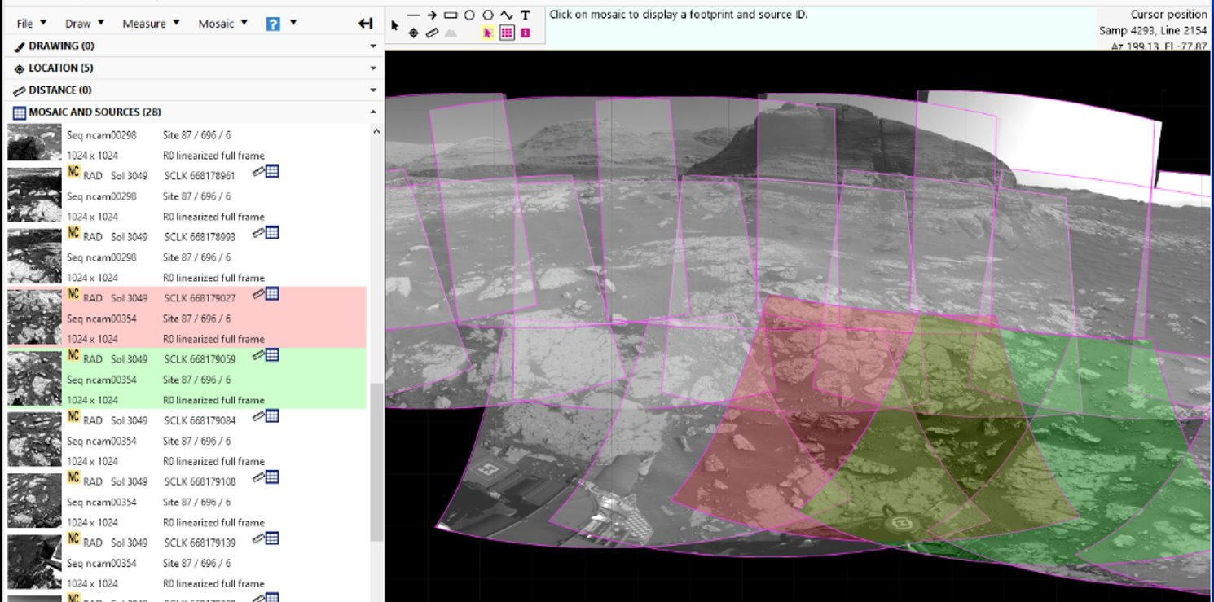
Working with mosaics
Location and distance tools are available for mosaics made from source frames with XYZ data.
Footprint overlays show boundaries and help identify source frames.

Slide 9
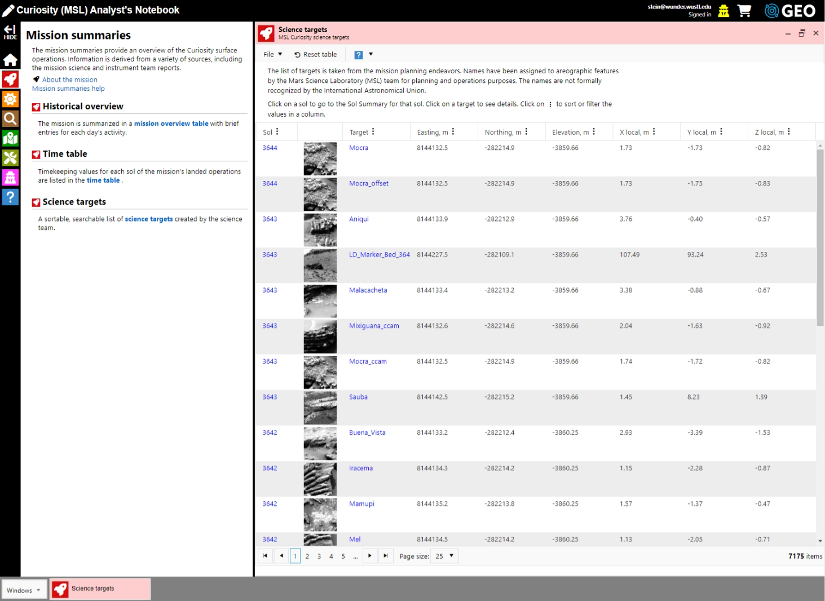
Science targets table

Slide 10
Science target links

Slide 11
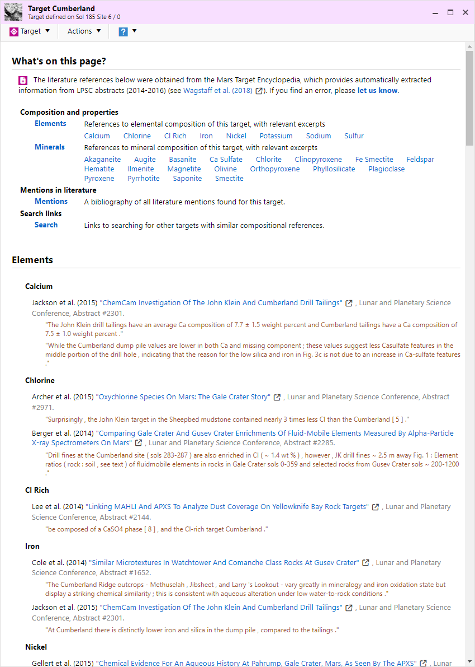
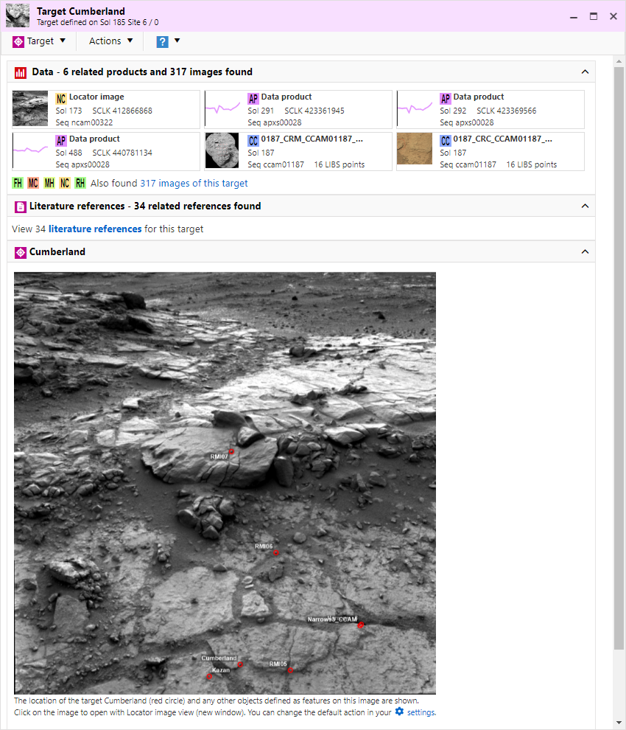
Mars Target Encyclopedia (MTE)
The MTE is a reference database containing compositional information about targets extracted from publications.
The AN incorporates MTE for Curiosity Rover and Phoenix Lander. An update for Spirit and Opportunity Rover targets is pending.

Slide 12
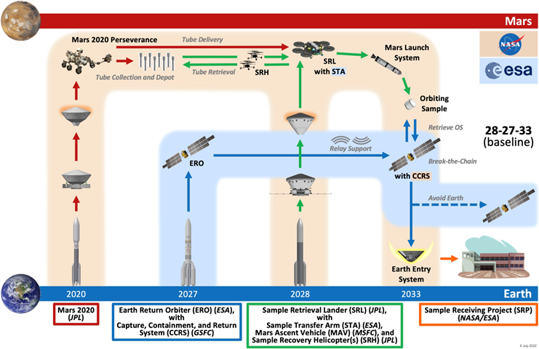
Mars Sample Return program
Capture and archive operations data and contextual information
  acquired after sample acquisition (Mars 2020)
  during operations (MSR program and other MSR projects).
Incorporate sample collection information into Analyst’s Notebook with interoperability to JSC curations.

Slide 13
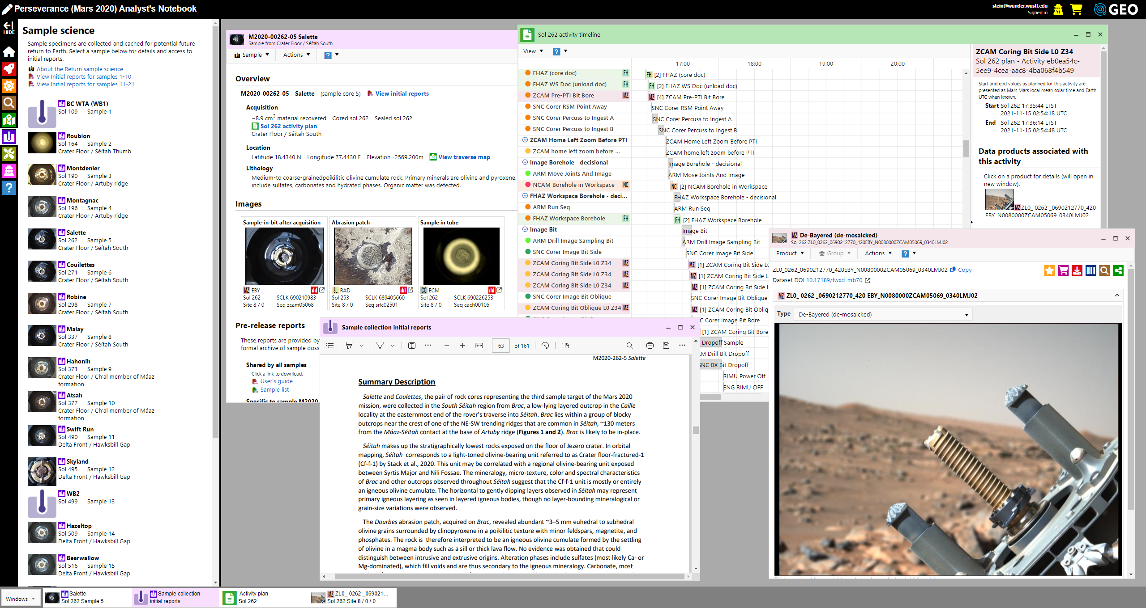
Mars 2020 sample science

Slide 14
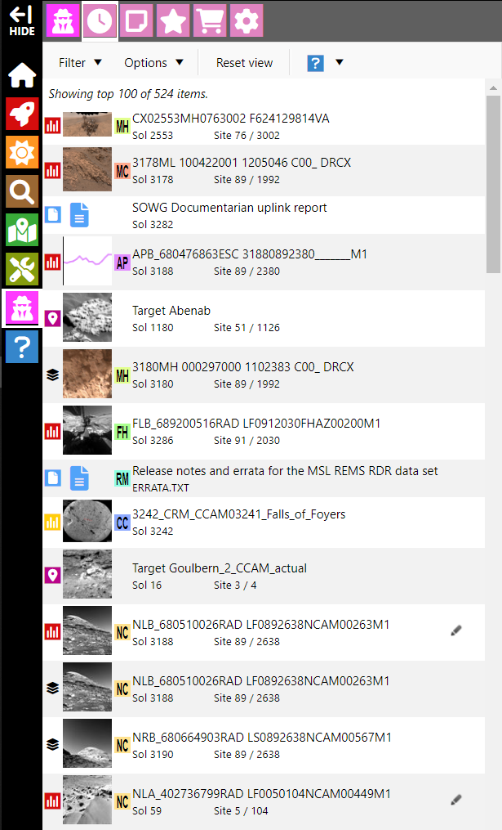

User history
Annotations (drawing and measurement elements) are saved when created.
Annotations are loaded automatically when the image is subsequently opened in image viewer.
  User must be signed in with optional account.
Annotated images are identified in the user history by the icon.

Slide 15
Team version for Curiosity rover
Developed by the PDS Geosciences Node in collaboration with the MSL science team.
Available to the team during landed operations as a non-mission critical tool.
Content (data, plans, traverse data, and support documents) are ingested daily.
Assists with data validation.

Slide 16
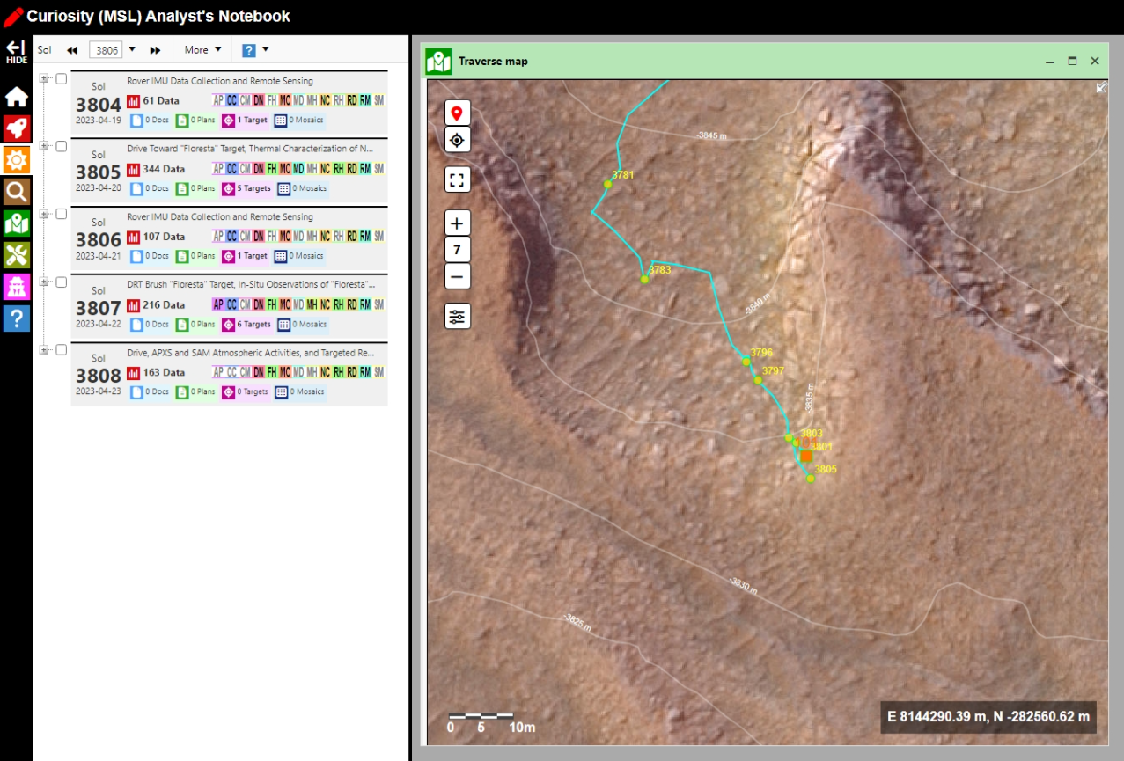
Team Notebook for Curiosity rover
Developed by the PDS Geosciences Node in collaboration with the MSL science team.
Available to the team during landed operations as a non-mission critical tool.
Content (data, plans, traverse data, and support documents) are ingested daily.
Assists with data validation.

Slide 17
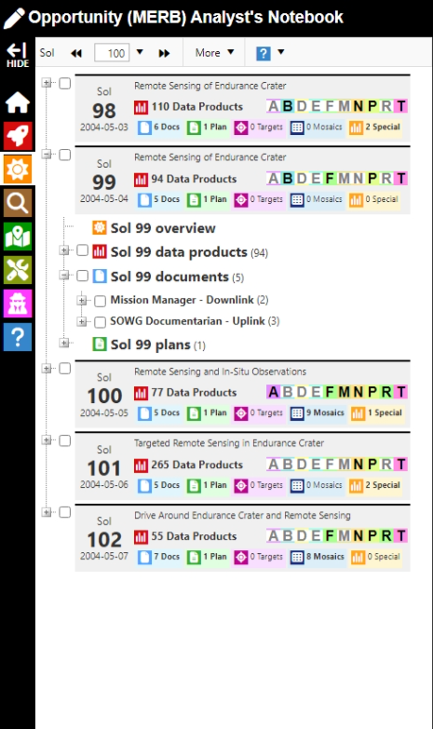
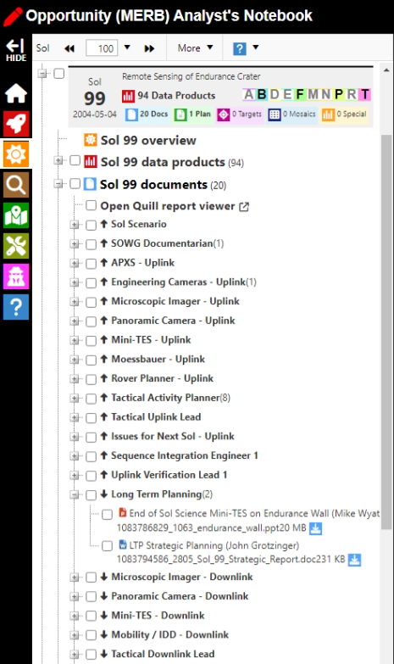
Team Notebook – completed missions
Contents of Public and Team versions are identical with limited exceptions.
Available to team-identified collaborators.
Team-only content may be released to others by agreement.
Goal is to maintain important non-archive components for long term.

Slide 18
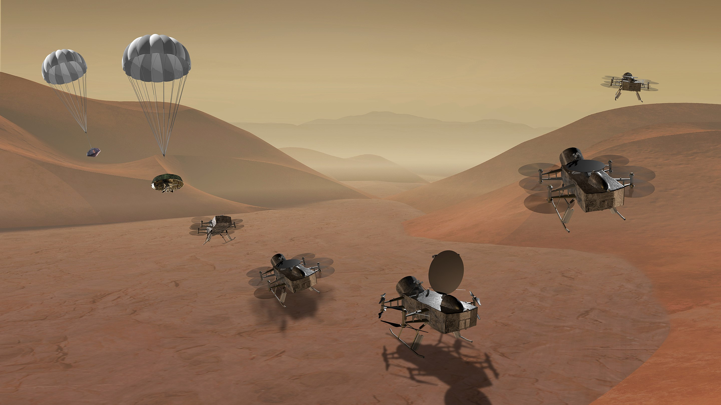
Dragonfly
Development of Analyst’s Notebook to support landed science of the Dragonfly mission during operations.

Slide 19

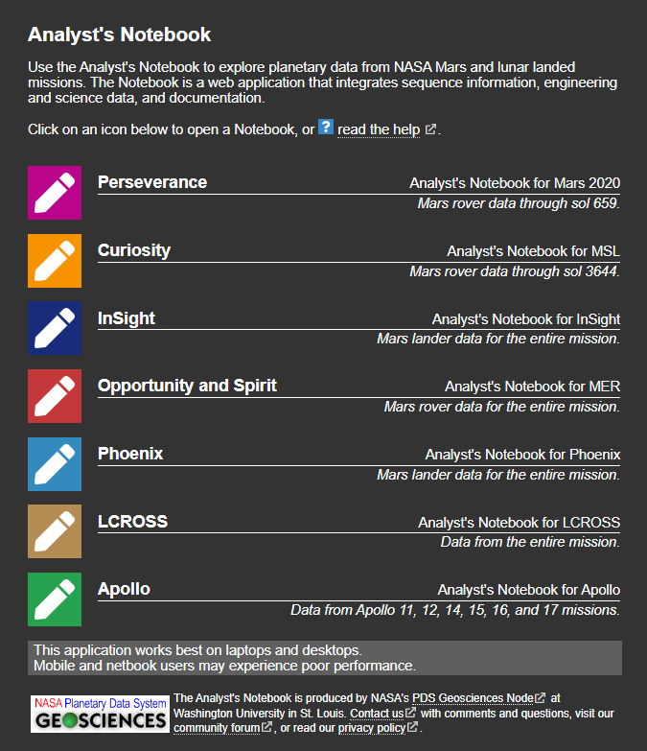
an.rsl.wustl.edu
PDS Analyst’s Notebook
  https://an.rsl.wustl.edu/
Notebook online help
  https://an.rsl.wustl.edu/help
Email
  Tom Stein, tstein@wustl.edu
  Feng Zhou, feng.zhou@wustl.edu
The Analyst’s Notebook is developed under funding provided by NASA to the PDS Geosciences Node. Cooperation by mission science teams is greatly appreciated.
Additional input provided by the PDS Atmospheres, Imaging, and PPI Nodes, as well as by professional and citizen scientists from around the world.
Notes:
Thank you for your attention.

Slide 20
