Slide 1
ESA Data Discovery Portal
Christophe.Arviset@esa.int
ESA, Directorate of Science
PV @ CERN, 03/05/2023

Slide 2
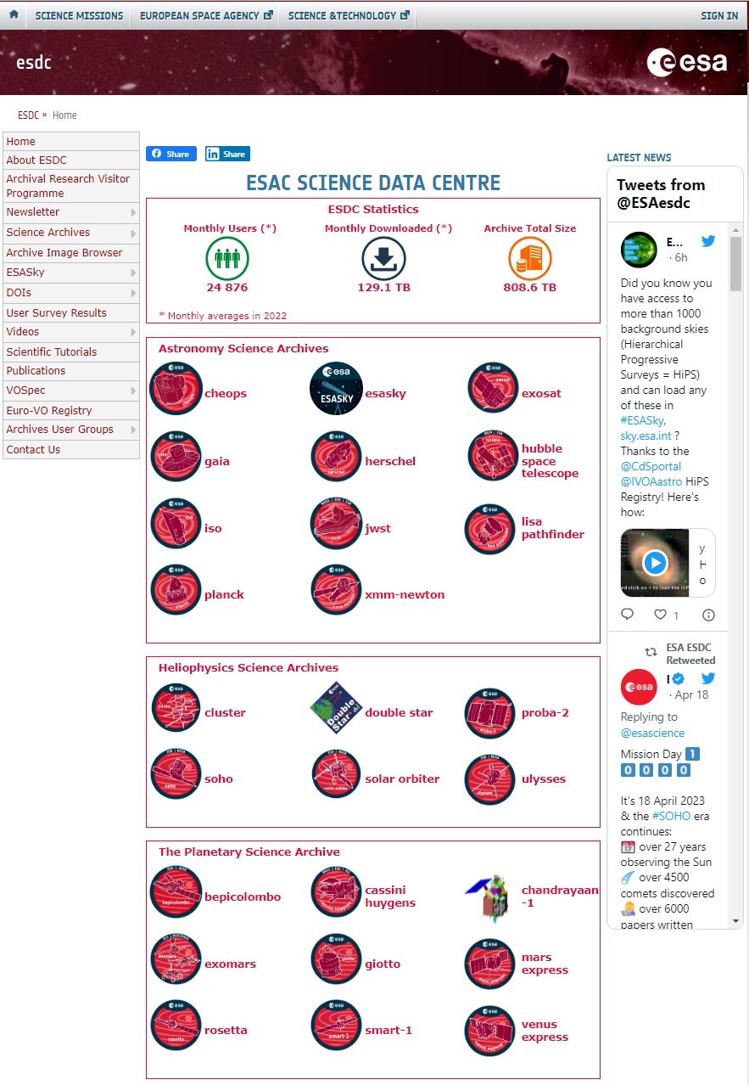
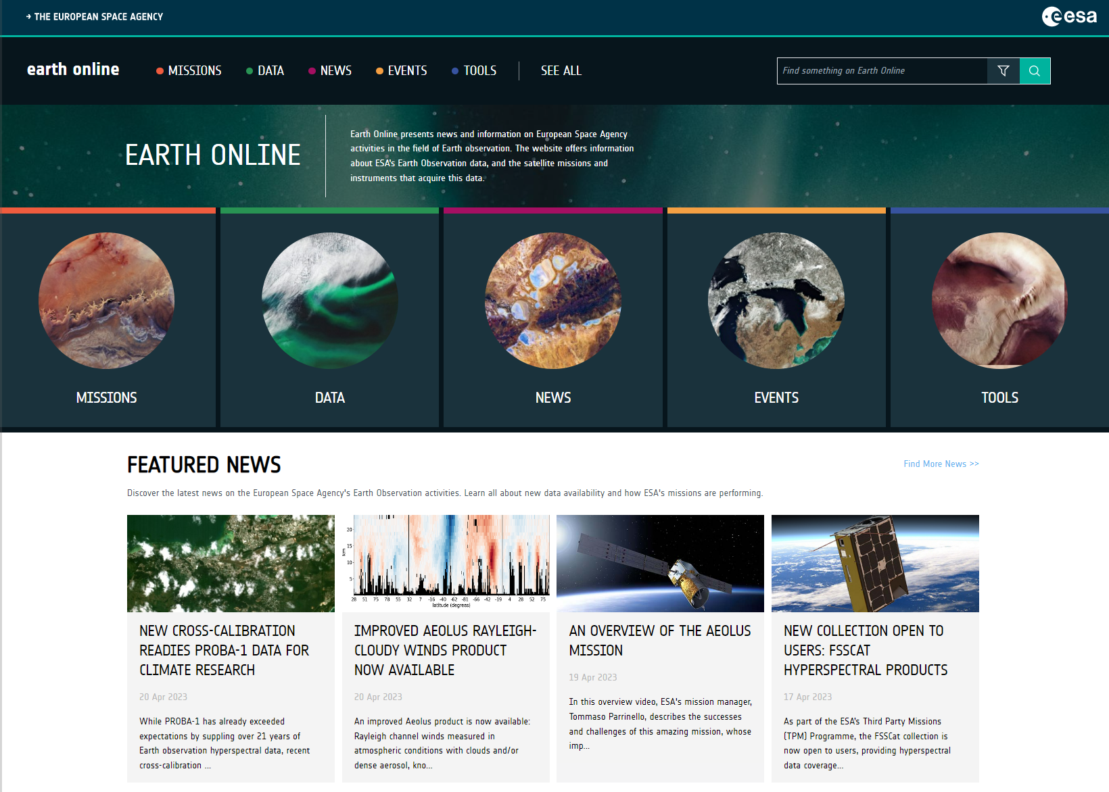
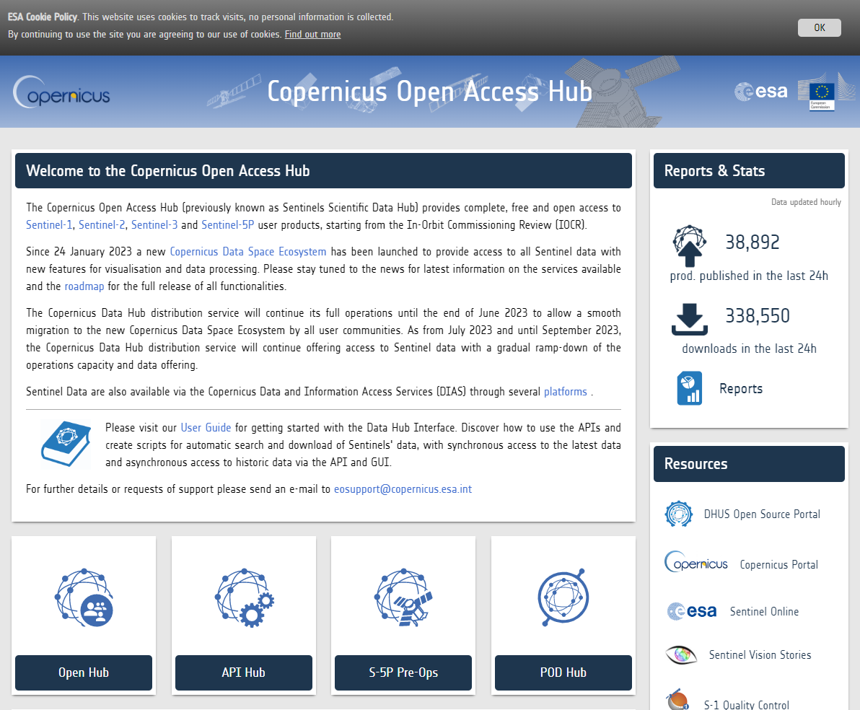
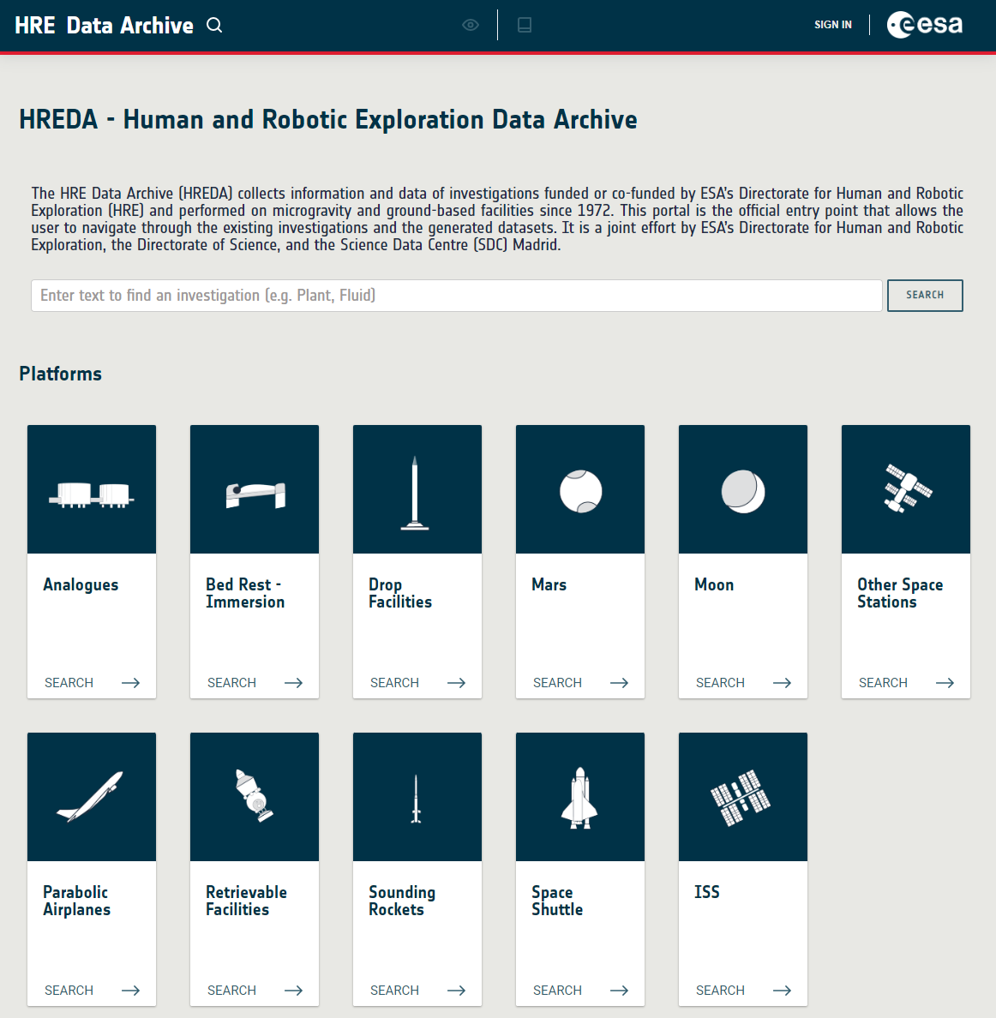
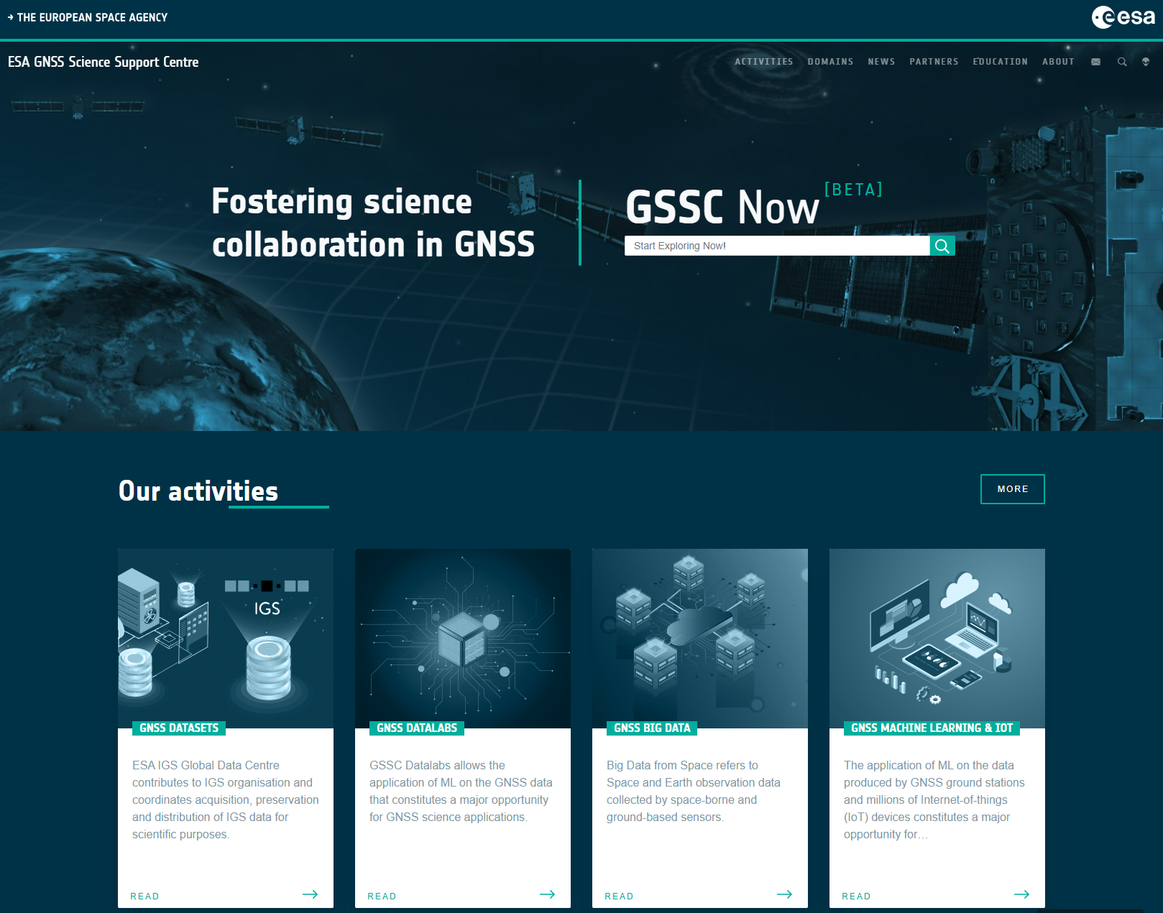
Science Data Archives at ESA

Slide 3
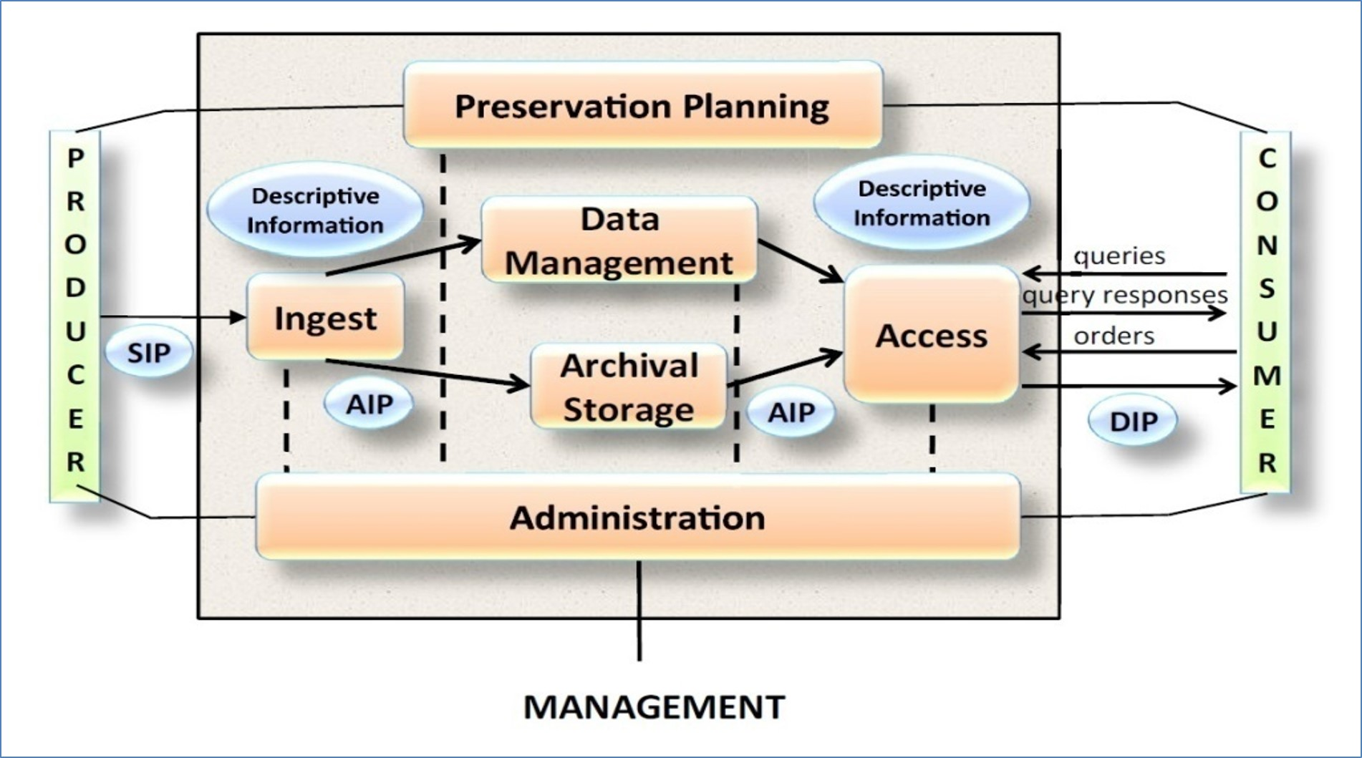

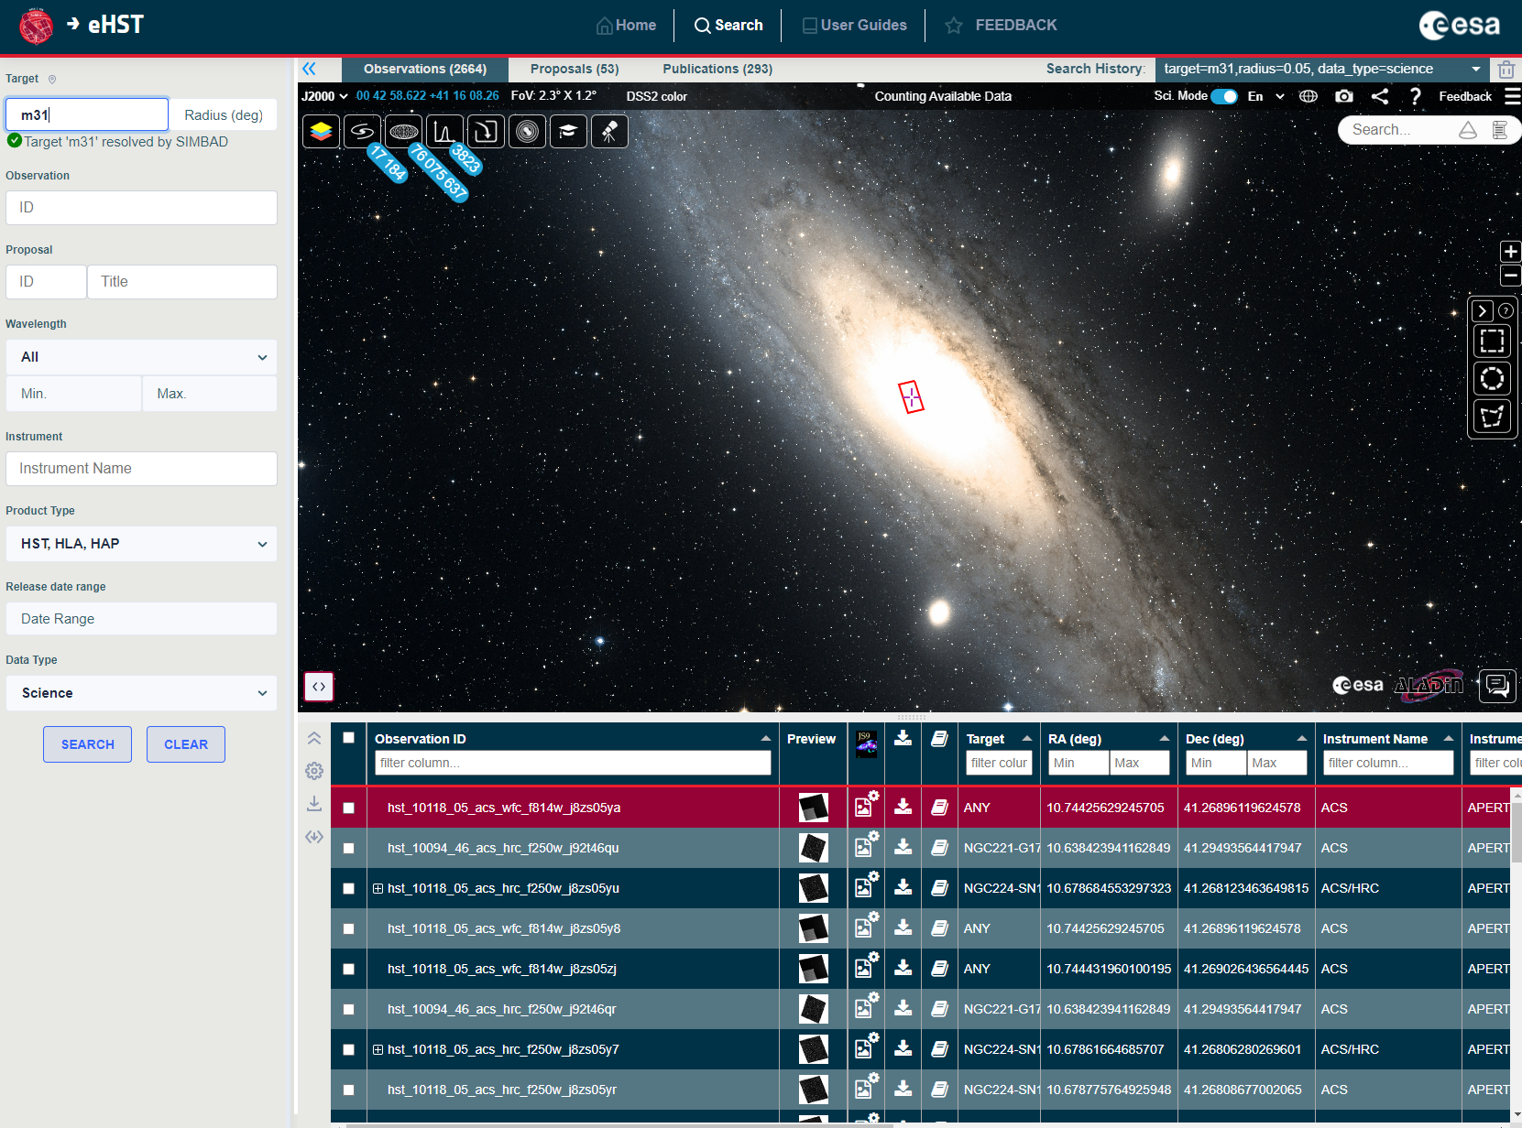
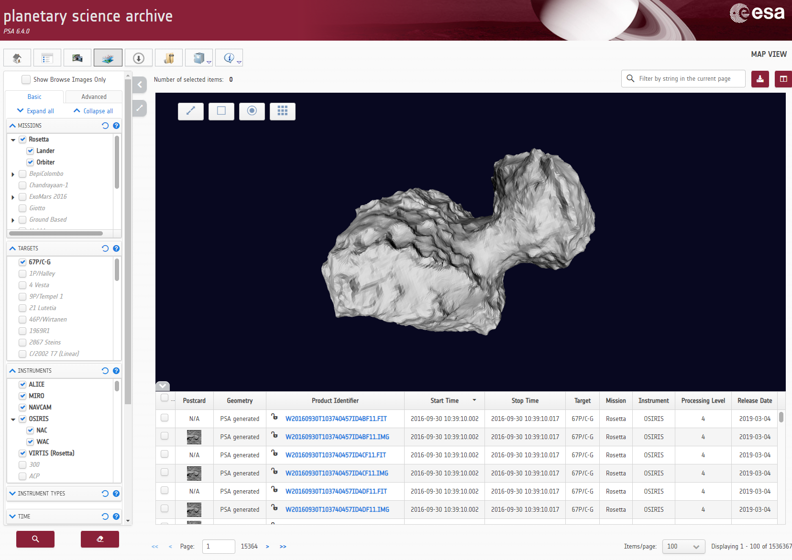
Science Data Archives are more than JBOD*
Complete data management system as per OAIS
Implement FAIR principles
Interoperable with other external services
Powerful and user friendly GUI
Simple and complex searches
Data Visualization
Scriptable interfaces
Query and download
Link to data analysis tools
*Just a bunch of disks

Slide 4
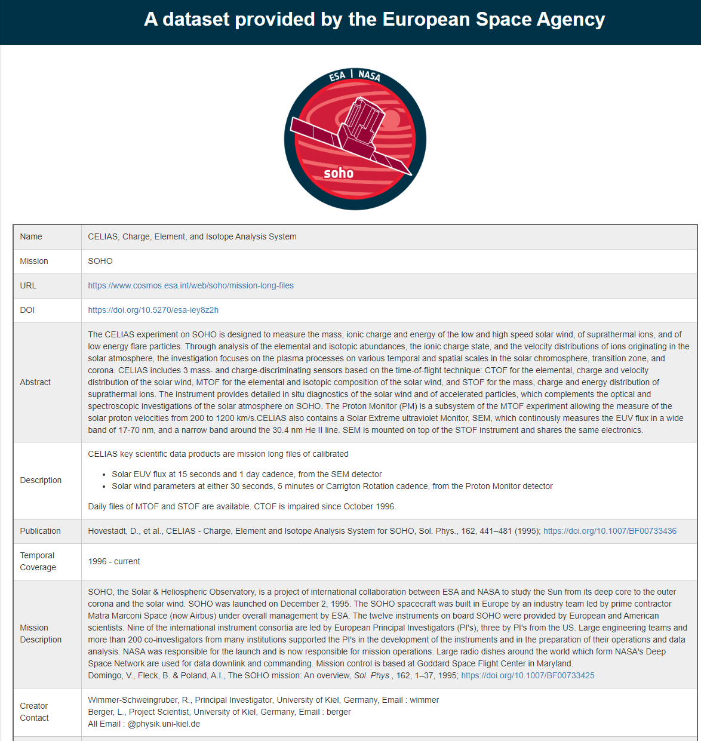
Defining DOIs for every ESA dataset
DOI is a persistent and unique resource identifier pointing to a landing page that provides a description and a download link for the particular dataset
Define a common set of metadata for all ESA Datasets, regardless of the scientific discipline
DOIs defined through CrossRef and now through DataCite DataCite
Common Metadata
Dataset name | Dataset Description
Mission name and description | Dataset version
Instrument | Publishing date
Scientific domain | Publisher and associated information
Temporal coverage | Credit and citation Guidelines
Link to the actual data

Slide 5
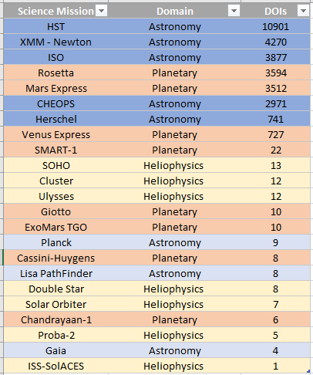
Granularity level for DOI assignment – space science
Minting DOIs depends on the way data is organized for each mission type
Astronomy survey missions (e.g. Gaia, Planck, …)
Catalogue of astronomical objects, cosmology maps
A few DOIs required
Astronomy observatory mission (e.g. HST, XMM – Newton, Herschel)
Proposal for a particular scientific topic resulting in many observations
A few thousands of DOIs
Planetary missions (e.g. Rosetta, Mars Express, BepiColombo)
Dataset for an instrument for a particular mission phase
A few thousands of DOIs
Heliophysics missions (e.g. SOHO, Solar Orbiter, Cluster)
1 DOI for each experiment throughout all mission lifetime
A few tens of DOIs
Around 30.000 DOIs

Slide 6
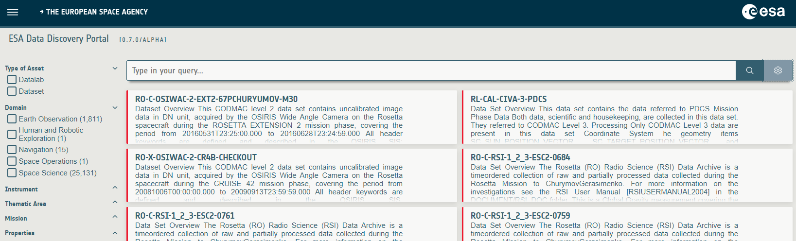
ESA Data Discovery Portal – data.esa.int

Slide 7
ESA Data Discovery Portal – main concepts
Common Portal for all ESA datasets from all disciplines
Drill down your search through faceted search criteria selection
Not an actual data archive
Does not actually archive datasets (but only common metadata)
Does not supersede the existing mission data archives
Provides link to the corresponding mission data archive for dataset download
Domain, Thematic area, Mission, Instrument
Simple Search Interface
ESA branding, homogenous description of ESA datasets through DOI (data.esa.int/asset/<reference>)
(In progress) Provides access to tools / software available to analyse the datasets (datalabs)

Slide 8
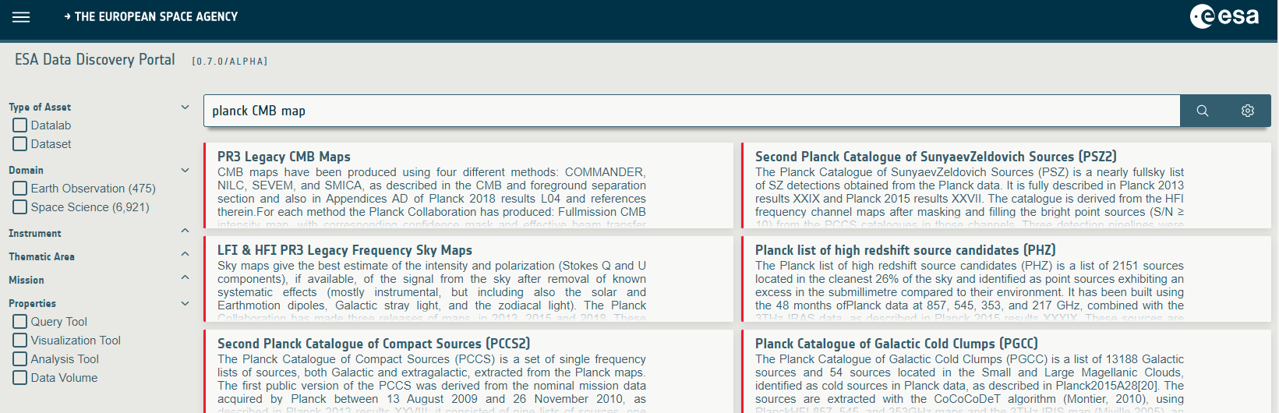
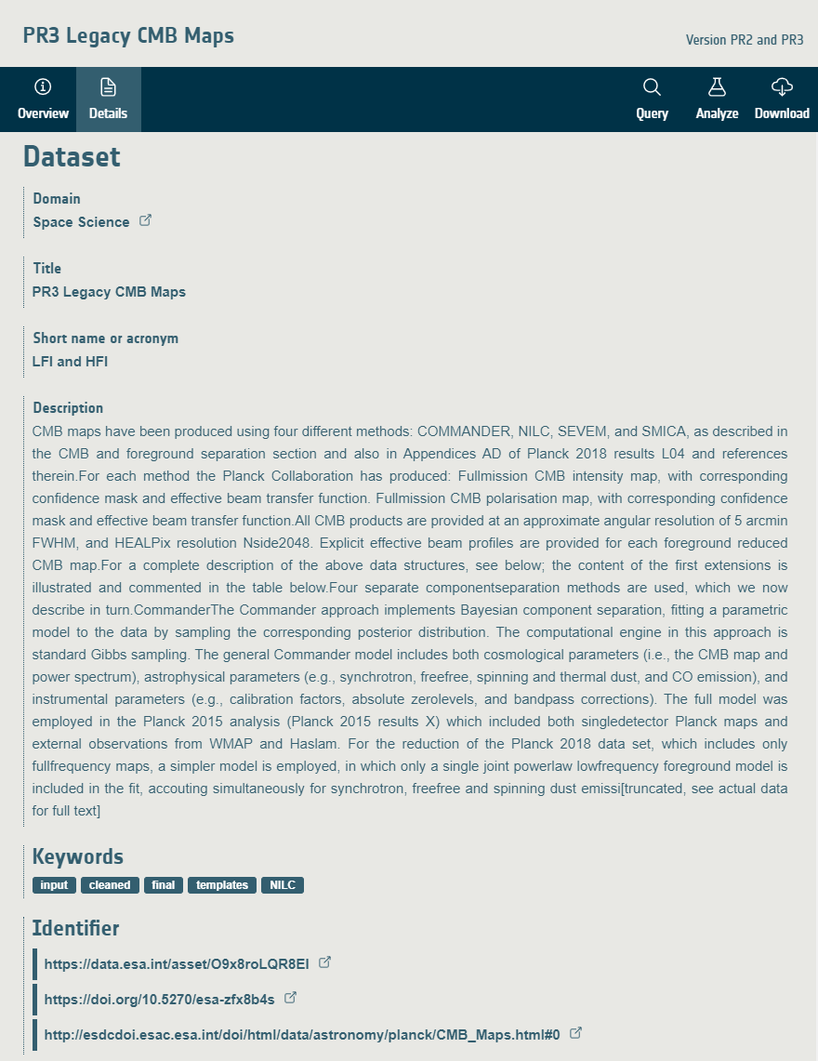
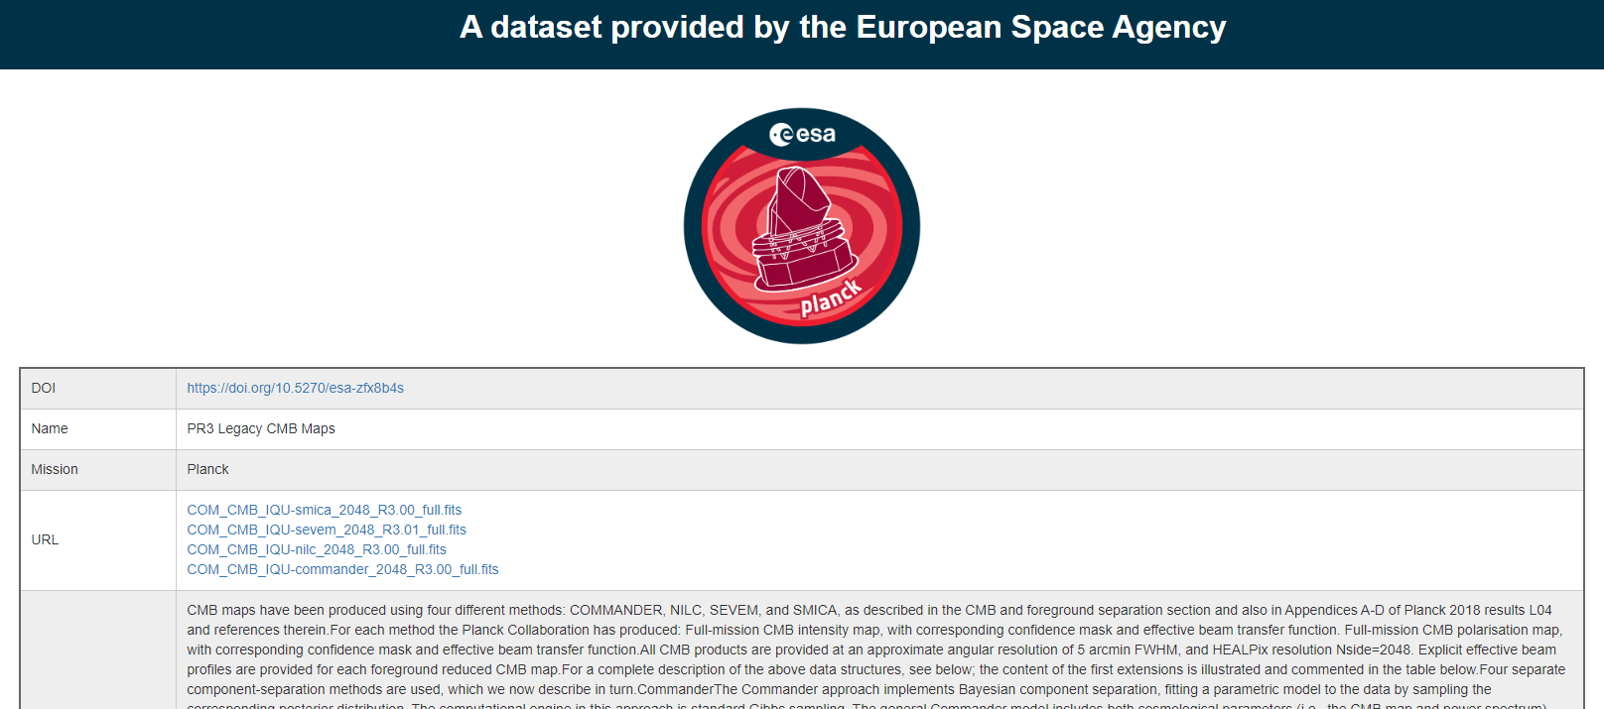
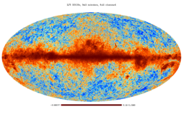
From ESA Data Discovery Portal to Dataset download
Dataset DOI landing page
Dataset Download

Slide 9
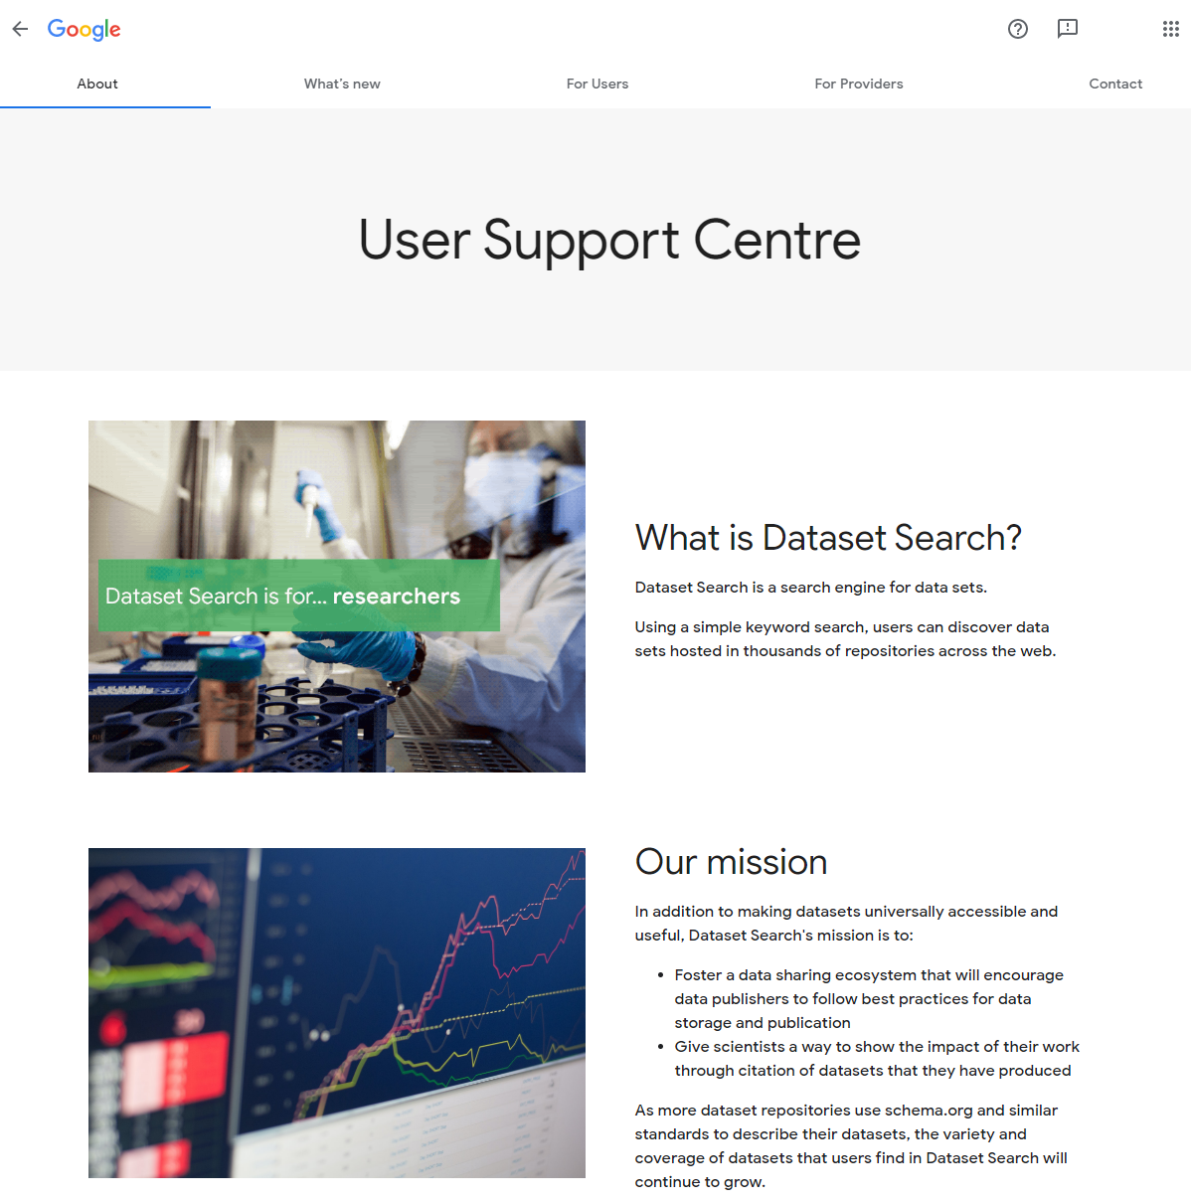
Google Dataset Search - https://datasetsearch.research.google.com/
Released in September 2018, targeting
Open data and open science
Researchers, data geeks/scientists/journalists, students, …
25M datasets referenced
All datasets referenced through schema.org vocabulary
Not clear if really to be used by scientific community which is probably better served through our mission data archives
But ESA datasets need to be properly referenced in Google to ensure access to correct and quality data
When minting DOI for ESA Dataset, add creation of schema.org for it (as great overlap with DOI metadata)
=> ESA Datasets then get referenced into Google Dataset Search

Slide 10
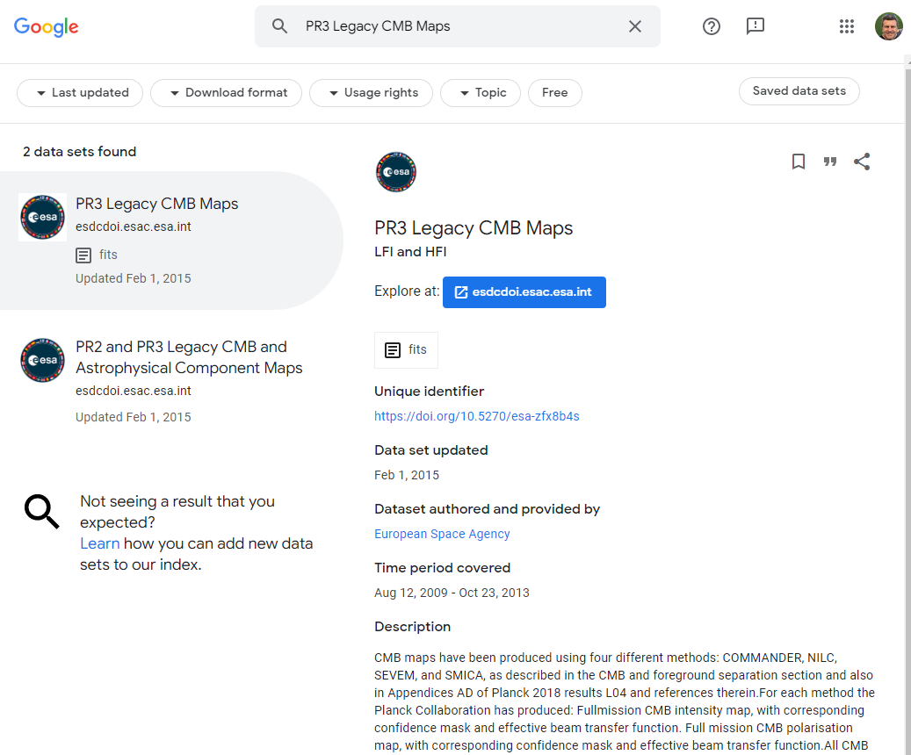
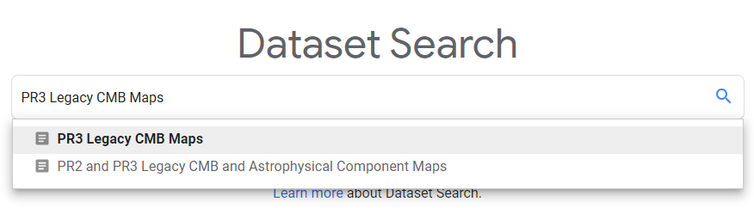


From Google Dataset Search to ESA dataset download
Dataset DOI landing page
Dataset Download

Slide 11
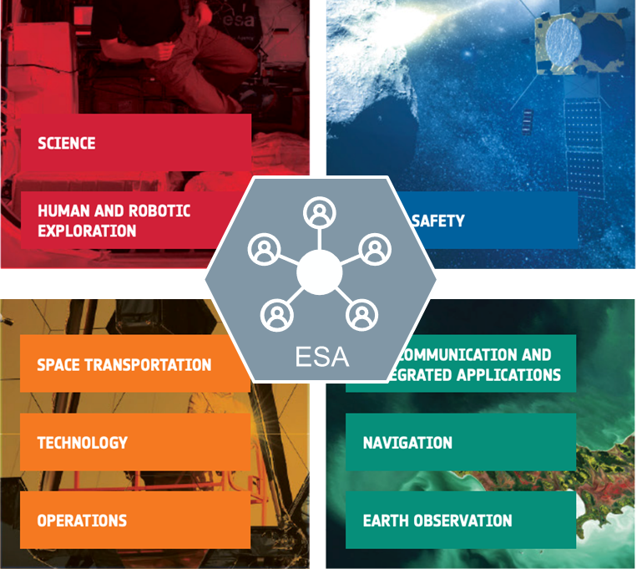
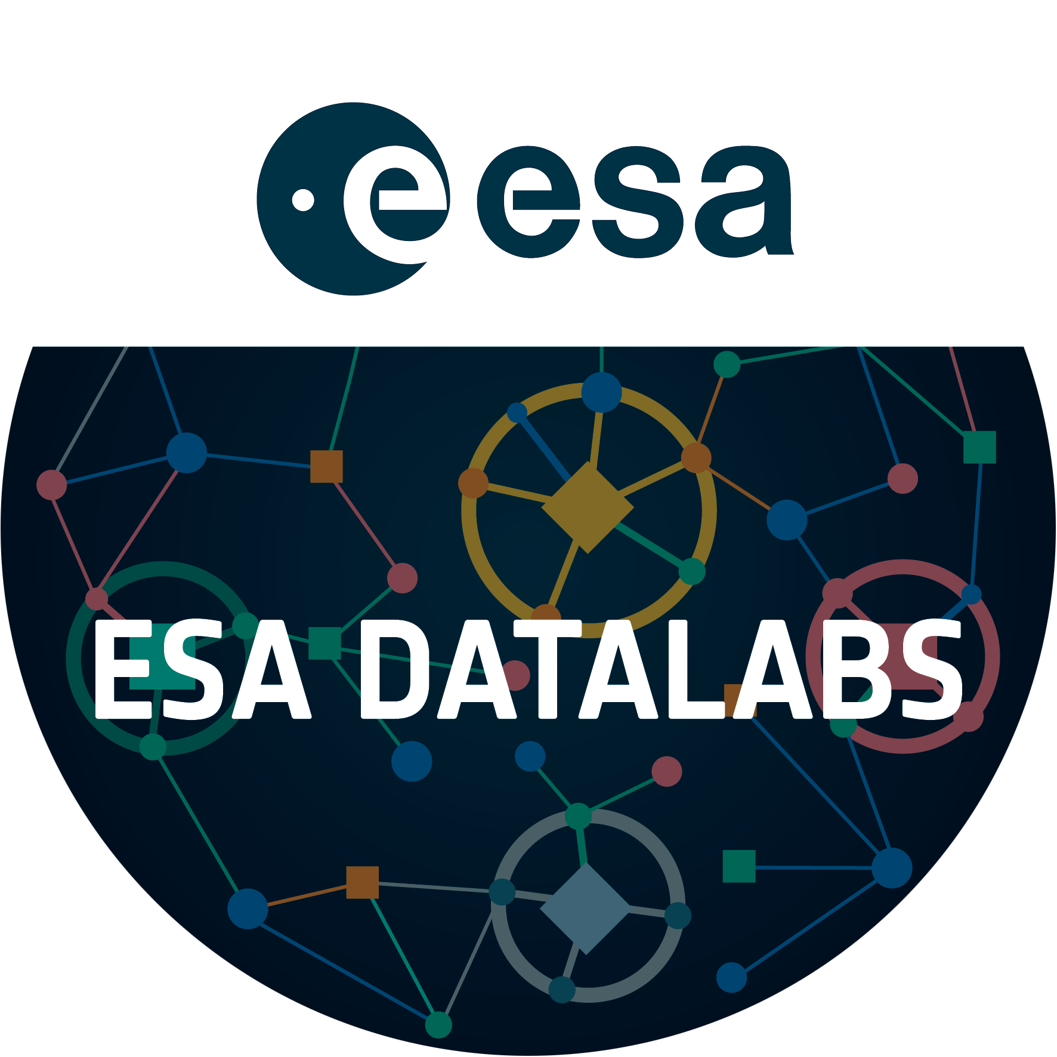
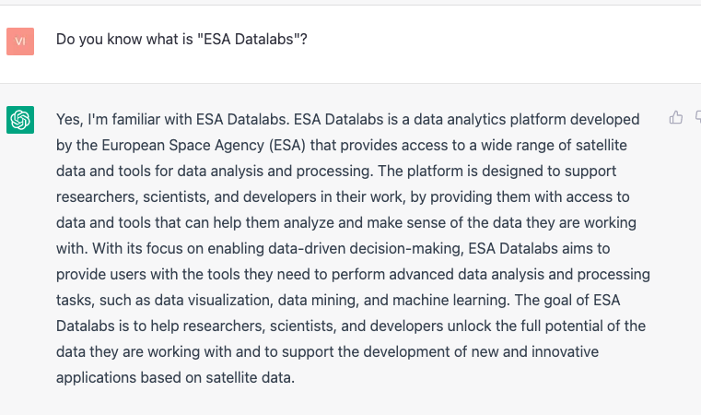

ESA Datalabs – datalabs.esa.int
Multi-Domain and Multi-Mission Digital Platform
ESA Science Exploitation Platform
Science Data available for researchers to work on it, made easy
Increase Science Operations Efficiency
Reusable for fast implementation of Scientific Processing Pipelines
Reusable for fast implementation of Scientific Analysis and Visualisation Tools
Collaboration and Open Science
Share complex processing tools and data with your team
Share your contributions with the community in ESA Datalabs Science AppStore
ChatGPT

Slide 12

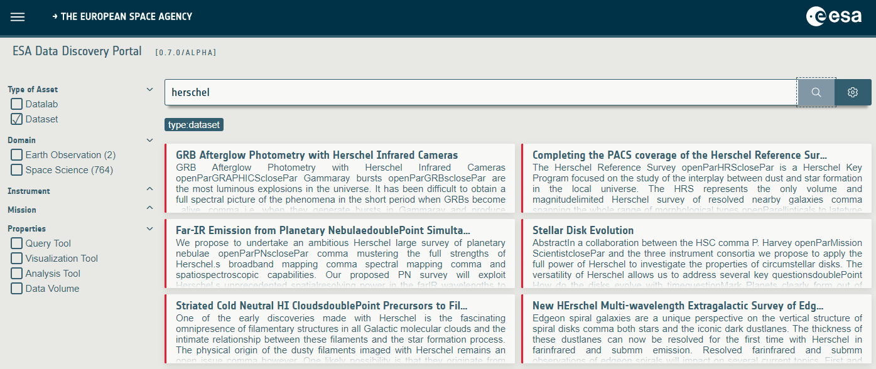
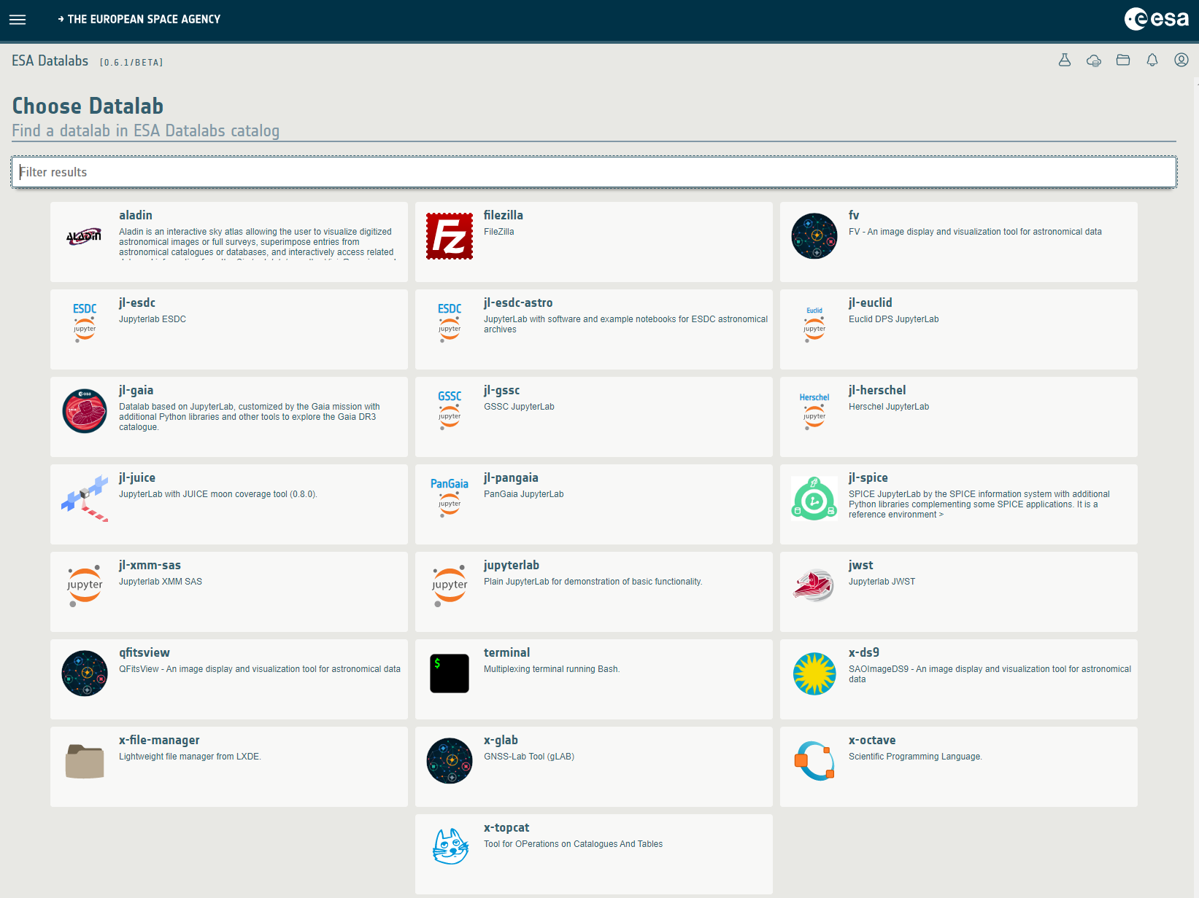
From ESA Data Discovery Portal to ESA Datalabs
Search for Tools associated with data
Launch it directly into ESA Datalabs platform
Data will automatically be loaded into your datalab
Start analysing the data

Slide 13
Conclusions and next steps
ESA Data Discovery Portal (data.esa.int)
Offers a unified entry point to all ESA datasets from all ESA directorates
Is complementary to the existing ESA data archives where data resides
DOI minted for all ESA datasets
Common metadata description for all
Granularity depends on type of mission
Almost complete for Space and Earth Science, in progress for other disciplines
ESA Data Discovery Portal expands to ESA Datalabs science exploitation platform
From the data to the visualization / analysis tools

