Slide 1
EO Metadata Mapping to STAC
PV 2023: Ensuring Long-Term Preservation and Adding Value to Scientific and Technical Data
2023-05-03 Christoph Reck*, J. Eberle, T. Heinen, M. Kunze, F. Feckler, J. Meyer-Arnek

Slide 2
PV 2023 : EO Data Mapping to STAC
Presentation Overview
Earth-Observation Products Metadata Standards
  EOP
  STAC
Metadata Extraction Tool
Conclusion

Slide 3
Metadata Standards
Short History
1997 JRC INFEO – z39.50 ASN-1 binary encoding
2000 ESA MUIS Multi-Mission User Information Services - binary encoding
2001 OGC WMS Web Map Service
2003 ISO 19115 Geographic information : Metadata
2004 OGC CSW 2.0 Catalogue Service for the Web
2006 OGC EOP EO Products Extension Package for ebRIM
(ISO/TS 15000-3) Profile of CSW 2.0
2008 HDF5 and NetCDF4 from UCAR and NASA

Slide 4
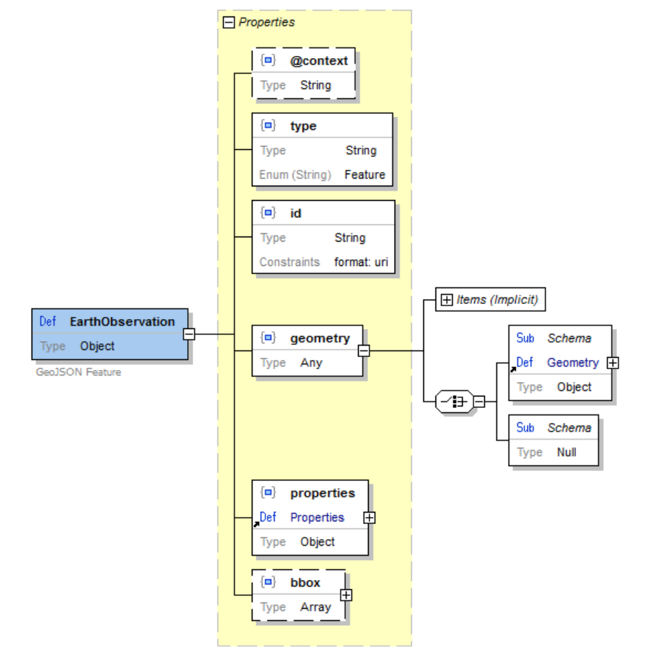
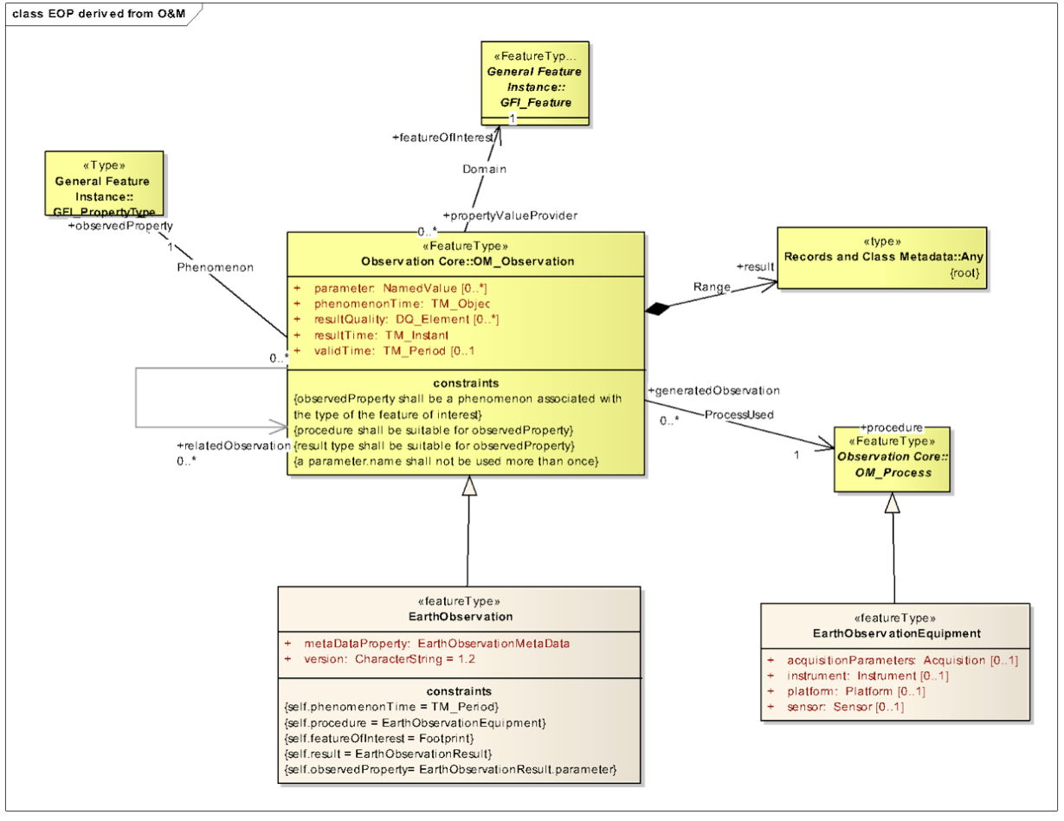
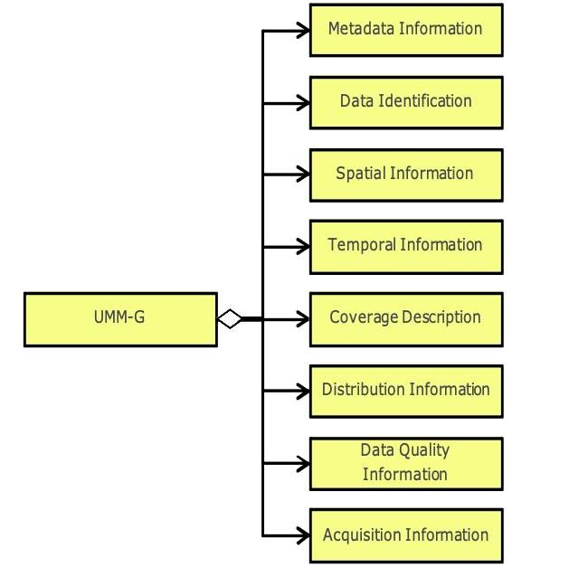
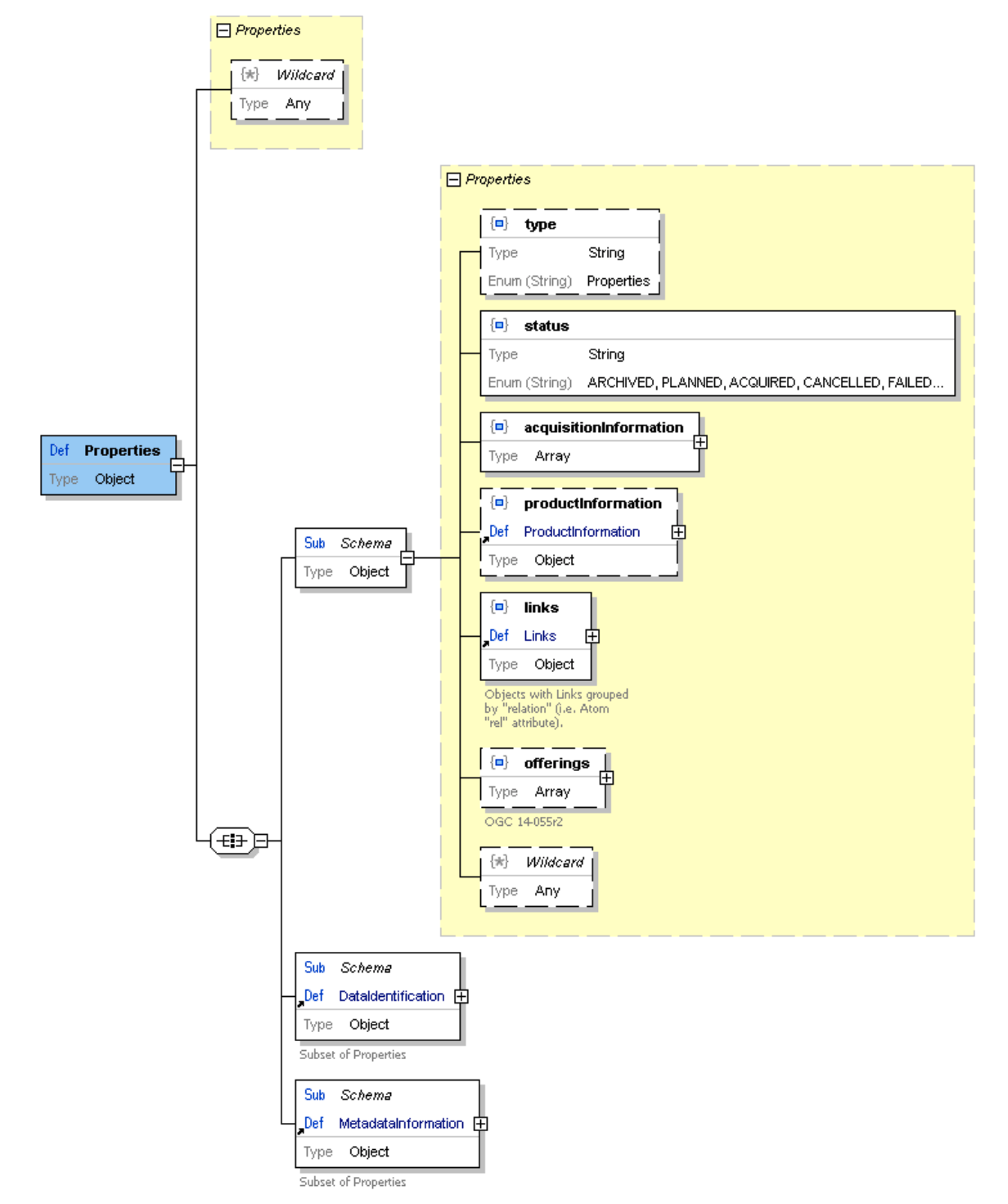
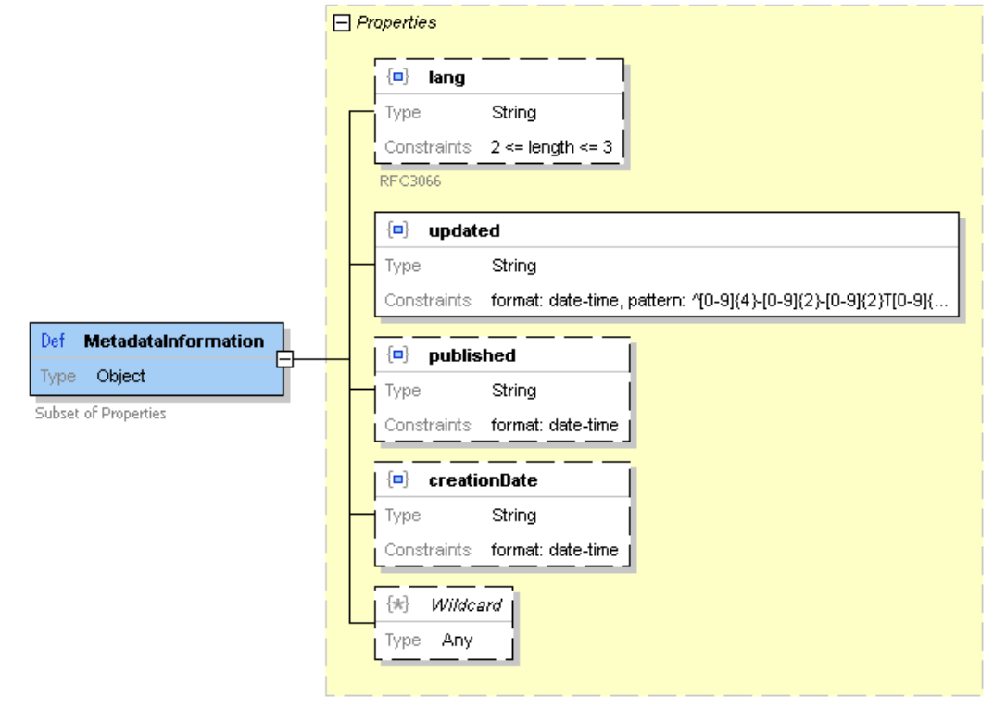
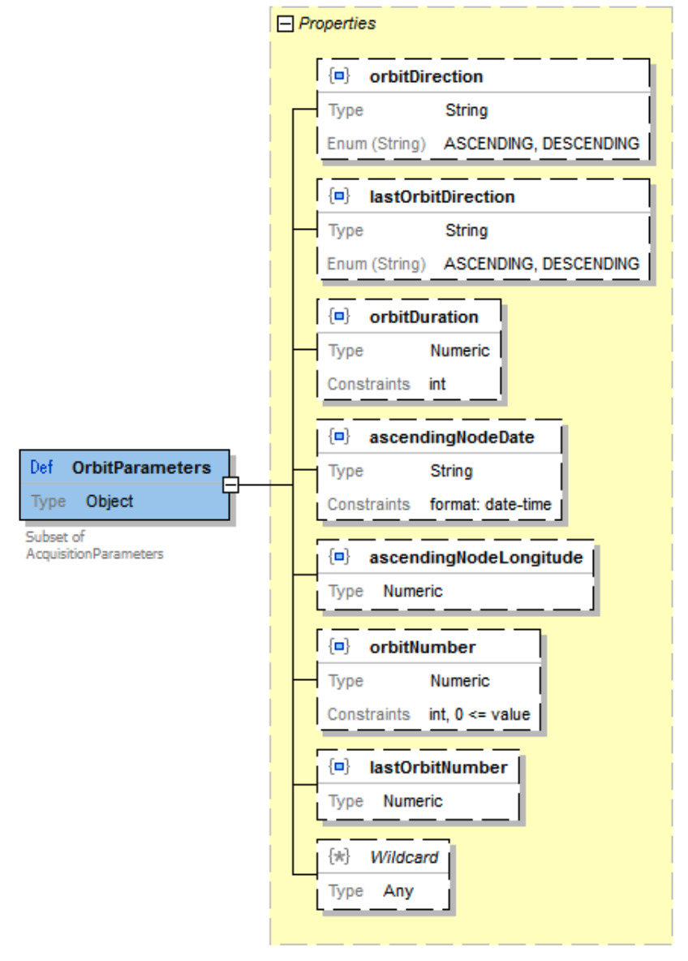
Earth-Observation Products Metadata Standard
The EOP standard has 14 years of evolution:
OGC 06-131 EO Products Extension Package for ebRIM
OGC 10-157 Earth Observation Metadata profile of Observations & Measurements
OGC 13-026 OpenSearch Extension for Earth Observation
OGC 17-003 EO Dataset Metadata GeoJSON(-LD) Encoding Standard
Covers common metadata fields for optical, SAR, atmospheric, limb and synthesis EO products.
As most standards documents – no real overview – see the many facets next →
https://docs.ogc.org/is/17-003r2/17-003r2.html
Notes:
Distributed figures depict only parts of the whole, e.g. the figures on the right are extracts from OGC 17‑003

Slide 5
Earth-Observation Products Metadata Standard
DLR has extracted the complete specification structure into one table →
This provides a basis for implementations of harmonized catalogue metadata for different EO mission products.
https://github.com/dlr-eoc/EOmetadataTool/blob/main/OGC17-003-OSEO-Attributes-Specification.md?plain=1
…

Slide 6
STAC – SpatioTemporal Asset Catalog
2017 https://stacspec.org/
The STAC specification is a “common language to describe geospatial information”
The STAC Specification consists of 4 semi-independent parts
  STAC Item a single spatiotemporal asset as GeoJSON feature + datetime + links.
  STAC Catalog is a simple, flexible JSON file of links that provides a structure to organize and browse STAC Items.
  STAC Collection is an extension STAC Catalog with extents, license, keywords, providers, etc. that describe STAC Items that fall within the Collection.
  STAC API defines RESTful endpoint to search STAC Items, specified in OpenAPI, following OGC's WFS 3.
STAC was from the beginning is self-describing, linked and extensible

Slide 7
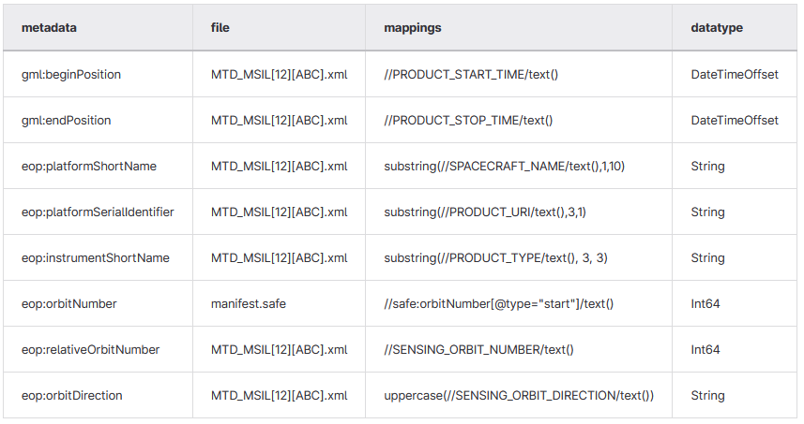
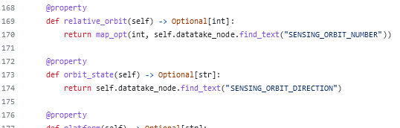
EO Metadata Extraction Tool
EO Data Products come in different packaging formats as
  Flat or structured directories
  ZIP, tar, gzip
  GeoTIFF
  NetCDF4
  Mostly with the metadata somewhere inside.
Instead of coding an extraction for every satellite mission and EO product type, we need a simple tool to extract and format the metadata.
The tool is configured with a CSV table specifying
  metadata attribute name
  source filename of each metadata value
  XPath to extract the value
  Capability of handling the different file and packaging formats
https://github.com/dlr-eoc/EOmetadataTool
https://github.com/stactools-packages/sentinel2/blob/main/src/stactools/sentinel2/product_metadata.py

Slide 8
EO Metadata Extraction Tool: example template and output
Template (abbreviated)
{
"type": "Feature",
"stac_version": "1.0.0",
{%- set metadata = extract(filename, 'mappings/TSX.csv') %}
{%- set sha256sum = sha256sum(filename) %}
{%- set md5sum = md5sum(filename) %}
{% set size = filesize(filename) %}
"id": "{{ metadata.id }}",
"geometry": {
"type": "Polygon",
"coordinates": {{ metadata.coordinates }}
},
"properties": {
"version": "1",
"title": "{{ metadata.title }}",
"datetime": "{{ metadata.datetime }}",
"start_datetime": "{{ metadata.start_datetime }}",
"end_datetime": "{{ metadata.end_datetime }}",
...
"sat:orbit_state": "{{ metadata['sat:orbit_state'] }}",
"sat:absolute_orbit": {{ metadata['sat:absolute_orbit'] }},
"sat:relative_orbit": {{ metadata['sat:relative_orbit'] }},
"sat:anx_datetime": "{{ metadata['sat:anx_datetime'] }}",
"tsx:beam": "{{ metadata['tsx:beam'] }}",
"tsx:polarisationMode": "{{ metadata['tsx:polarisationMode'] }}",
"sar:instrument_mode": "{{ metadata['sar:instrument_mode'] }}",
STAC Output (rendered in browser)

Slide 9
EO Metadata Extraction Tool: API examples
Dump of extracted metadata from a SAFE.zip package
  extract.py --scene S1A_IW_GRDH_1SDV_20220621T075323_20220621T075348_043758_053961_0000.SAFE.zip \
  --mapping src/metadata_extract/mappings/S1_L1L2.csv
Format the metadata using a jinja2 template
(tool self-discovers sentinel-1, 2 or 3 product types and selects extraction mapping and output template)
metadata_extract.py --scene S2A_MSIL1C_20230216T044851_N0509_R076_T46UEU_20230216T00000.SAFE.zip
Mappings for S5p L2 and L3 are also included, but requires using --mapping and --template parameters
  extract.py --scene S5P_OFFL_L2__O3_____20200303T013547_20200303T031717_12367_01_010107_20200306T053811.nc
  --mapping S5P_TROPOMI_L2.csv
  --template s5p_l2_stack.j2
API
  from metadata_extract.extract import extract
  ...
  metadata = extract(scene, csv_file)
  ...
  template = env.get_template(args.template)
  template.render(metadata)

Slide 10
Conclusion
EOP Metadata Specification provides a harmonized profile for common EO product types
EO Metadata Extract tool allows simple extraction and output formatting configuration
https://github.com/dlr-eoc/EOmetadataTool
Usable for common EO data packaging formats: ZIP, tar, gzip, NetCDF4
Open Source with Apache 2.0 licensing model
Used as part of DLR's EOC Geoservice:
  STAC Service: https://geoservice.dlr.de/eoc/ogc/stac/v1/
  OpenSearch EO: https://geoservice.dlr.de/eoc/oseo/search
Future:
  STAC mappings for further datasets
  JSON and GeoTIFF support
  code refactoring to be used as a stac-util
  documentation updates
  more test cases

Slide 11
Imprint
Topic: EO Metadata Mapping to STAC
PV2023 Conference – Ensuring Long-Term Preservation and Adding Value to Scientific and Technical Data
Date: 2023-05-03
Author: Christoph Reck
Institute: German Remote Sensing Data Center (DFD)
DLR Oberpfaffenhofen, Germany
Image credits: All images “DLR (CC BY-NC-ND 3.0)” unless otherwise stated
URL: https://github.com/dlr-eoc/EOmetadataTool

