Slide 1


Bringing the data closer to users with UX and SEO
PV 2023
3rd May 2023

Slide 2



















Problem
FACTS
RESOURCES
INSIGHTS
DETAILS
FIGURES
STATS
ARCHIVES
DATA
RECORDS
CONTENT
EVIDENCE
INFORMATION
RESEARCH
DOCUMENTATION
MATERIALS
03/05/2023
PV 2023 | Bringing data closer to users with SEO and UX

Slide 3


Problem
FACTS
RESOURCES
INSIGHTS
DETAILS
FIGURES
STATS
ARCHIVES
a lot of
DATA
RECORDS
OPPORTUNITIES
CHALLENGES
CONTENT
EVIDENCE
INFORMATION
RESEARCH
DOCUMENTATION
MATERIALS
03/05/2023
PV 2023 | Bringing data closer to users with SEO and UX

Slide 4
Challenge
How to spread the information and reach everyone needing it?
How to suggest the correct data for users who search for it?
How to help potential users find the data easily?
03/05/2023
PV 2023 | Bringing data closer to users with SEO and UX

Slide 5

Challenge
03/05/2023
PV 2023 | Bringing data closer to users with SEO and UX

Slide 6
Challenge
earth online
eoPortal
news and information about
ESA’s Earth Observation data
knowledge and resources related to
Earth Observation satellite missions
03/05/2023
PV 2023 | Bringing data closer to users with SEO and UX

Slide 7


Goals
earth online
eoPortal
Goal 1 | Acquisition
Increase the visibility of websites
Goal 2 | User engagement
Increase user traffic
03/05/2023
PV 2023 | Bringing data closer to users with SEO and UX

Slide 8


Solution
SEO
UX
Search Engine Optimization
User Experience
03/05/2023
PV 2023 | Bringing data closer to users with SEO and UX

Slide 9

Solution | SEO
Keyword research
Titles and summaries
Meta descriptions
Tags
Images descriptions
Lists
Internal links
Outdated links cleanup
On-page SEO
Off-page SEO
Toxic backlinks elimination
URL Simplification
Structured content (Schema.org)
Technical SEO
03/05/2023
PV 2023 | Bringing data closer to users with SEO and UX

Slide 10
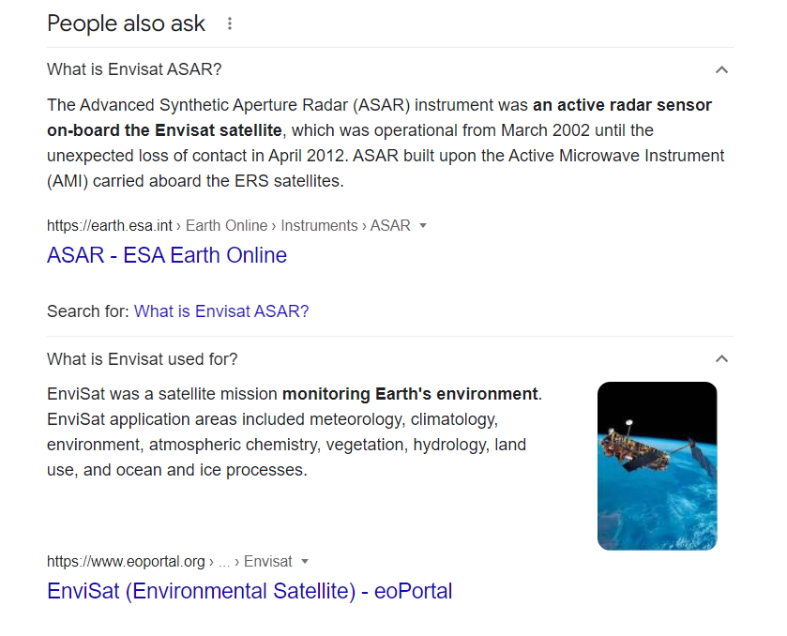
Solution | SEO: structured content
03/05/2023
PV 2023 | Bringing data closer to users with SEO and UX

Slide 11
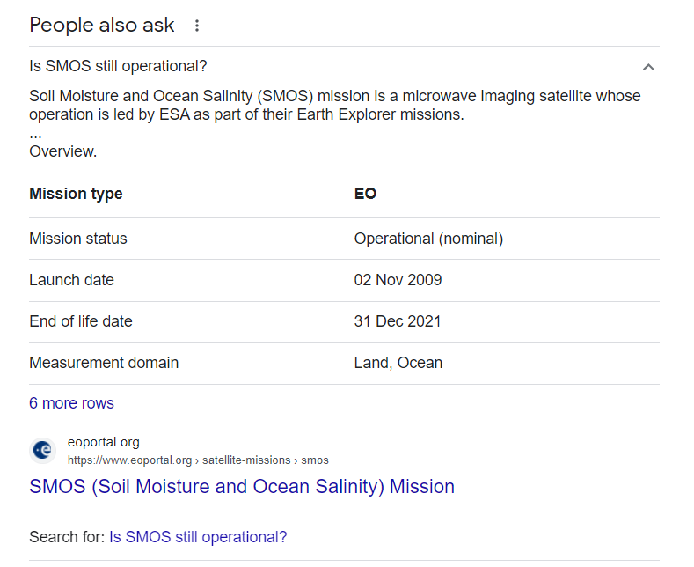
Solution | SEO: structured content
03/05/2023
PV 2023 | Bringing data closer to users with SEO and UX

Slide 12
Solution | UX
Behaviour
Patterns
Exit pages
Time spent on pages
Traffic analysis
Homepage redesign
General landing pages
Specialised landing pages
Suggested content
Internal navigation
Tables of content
Content readability
Responsiveness
New functionalities
03/05/2023
PV 2023 | Bringing data closer to users with SEO and UX

Slide 13
Implementation
toxic backlinks elimination
September 2021
toxic backlinks elimination
August 2022
earth online
1st website redesign
December 2020
2nd website redesign
January 2022
2020
2021
2022
eoPortal
August 2022
website redesign
03/05/2023
PV 2023 | Bringing data closer to users with SEO and UX

Slide 14


Results | Tools
Goal 1 | Acquisition
Increase the visibility of websites
Goal 2 | User engagement
Increase user traffic
03/05/2023
PV 2023 | Bringing data closer to users with SEO and UX

Slide 15
Results | Acquisition: Earth Online
03/05/2023
PV 2023 | Bringing data closer to users with SEO and UX

Slide 16
Results | Acquisition: eoPortal
03/05/2023
PV 2023 | Bringing data closer to users with SEO and UX

Slide 17
Results | User engagement: Earth Online
03/05/2023
PV 2023 | Bringing data closer to users with SEO and UX

Slide 18
Results | User engagement: Earth Online
03/05/2023
PV 2023 | Bringing data closer to users with SEO and UX

Slide 19
Results | User engagement
Bounce rate
03/05/2023
PV 2023 | Bringing data closer to users with SEO and UX

Slide 20

Results
Goal 1 | Acquisition
Increase the visibility of websites
Higher ranks on the SERP brought more new users to the websites from search engines.
Goal 2 | User engagement
Increase user traffic
Better functionalities allowed users to explore the websites more efficiently and increased the traffic on the website.
03/05/2023
PV 2023 | Bringing data closer to users with SEO and UX

Slide 21

Thank you for attention!
pfilipkowski@eversis.com
office@eversis.com

