Slide 1
Utilizing Monitoring and Reporting Techniques in data processing systems to improve the value adding of data
Johanna Senft, Henrike Barkmann, Sven Stönner, Max Wegner

Slide 2
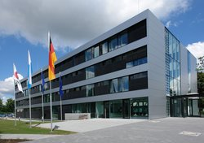
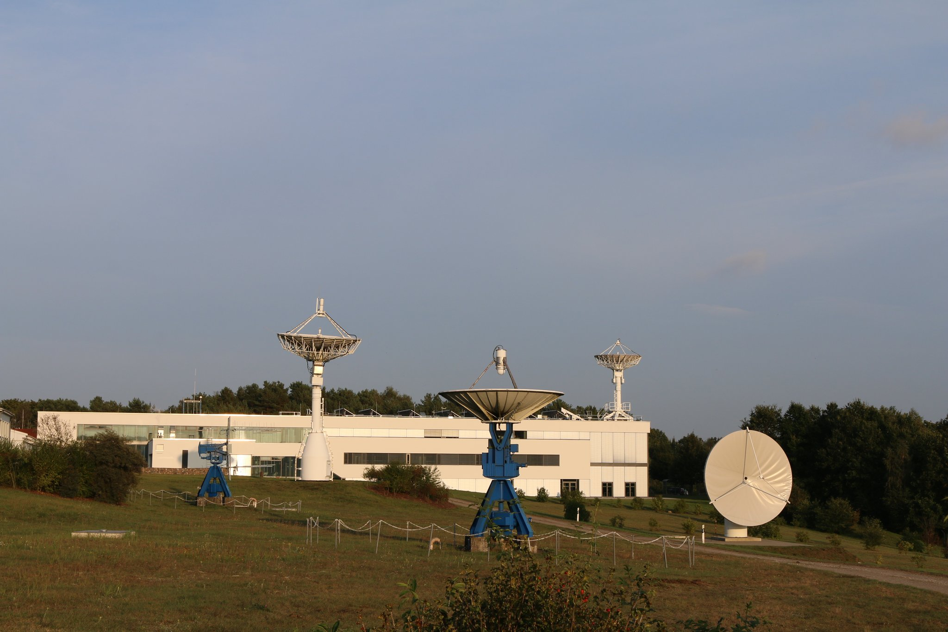
Introduction
DLR‘s Remote Sensing Data Center (DFD) processes daily
→ more than 20 TB of remote sensing data
→ using more than 70 processing chains.
Processing chains Input data of is of varying quality
→ it may be degraded by external and internal influences.
DFD’s Monitoring & Reporting System is needed to ensure:
→ reliable data processing,
→ adequate performance,
→ effective operation,
→ and stable resource usage.
DLR Remote Sensing Data Center, Oberpfaffenhofen
DLR Remote Sensing Data Center, Neustrelitz
Notes:
Personal introduction:
As Researcher of DLR‘s Remote Sensing Data Center. I am working in the field of Monitoring and Reporting.
The DFD is located in Oberpfaffenhofen (Bavaria) and in Neustrelitz (Mecklenburg-Vorpommern).
The DFD handles remote sensing data, using more than 70 processing chains with daily more than 20 TB of data.
Processing chains input data is of varying quality as it may be degrated by internal and external influences
Therefore the DFD’s Monitoring & Reporting System is needed to ensure
→ reliable data processing,
→ adequate performance,
→ effective operation,
→ and stable resource usage

Slide 3
Agenda
Section I : IMPC and IMPC data process
Section II: DFD’s Monitoring & Reporting System (DFD M&R)
Section III: Use cases
Section IV: Observation Discussion; Conclusion
Utilizing Monitoring and Reporting Techniques in data processing systems to improve the value adding of data
Notes:
In the paper contribution to the PV conference, we
Describe and discuss the application of the DFD M&R to a selected part of the Ionosphere Monitoring and Prediction Center (the IMPC) processing chain the (IMPC-ROTI).
Asses DFD M&R benefits and limitations
Provide an overview of future developments
But at first the presentation of the Ionosphere Monitoring and Prediction Center (the IMPC) and DFD‘s Monitoring & Reporting System (DFD M&R) is usefull for the unterstanding of the context.

Slide 4
Section I: The IMPC / IMPC data process
Ionospheric disturbances affect the performance of space-based communication, navigation and remote sensing. They degrade the accuracy of Global Navigation Satellite Systems (GNSS) i.e. GPS or Galileo.
Notes:
Ionospheric disturbances affect the performance of space-based communication, navigation and remote sensing. They degrade the accuracy of Global Navigation Satellite Systems (GNSS) i.e. GPS or Galileo.

Slide 5
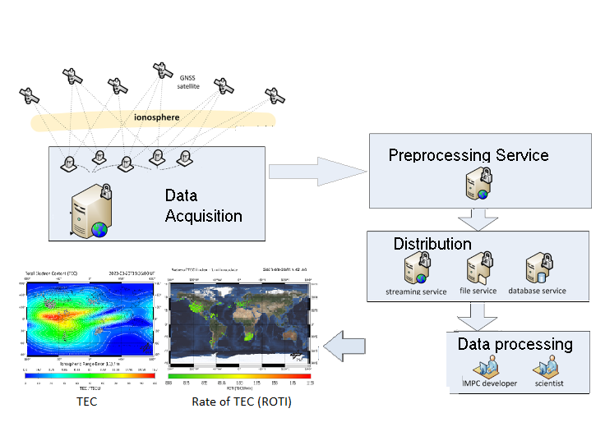
Section I: The IMPC / IMPC data process
Ionospheric disturbances affect the performance of space-based communication, navigation and remote sensing. They degrade the accuracy of Global Navigation Satellite Systems (GNSS) i.e. GPS or Galileo.
IMPC-ROTI
Scientific
Processor
Notes:
Therefore the Ionosphere Monitoring and Prediction Center (the IMPC)
permanently monitors the electron density and its structure in the ionosphere-plasmasphere system, using ground and space-based antennas.
This data is used by several IMPC Scientific Processors to develop IMPC products
products such as the Total Electron Content Maps (IMPC-TEC) – which displays the number of electrons per square meter - or the Rate of Change of TEC index

Slide 6
Section I: The IMPC / IMPC data process
Ionospheric disturbances affect the performance of space-based communication, navigation and remote sensing. They degrade the accuracy of Global Navigation Satellite Systems (GNSS) i.e. GPS or Galileo.
Daily more than 50 GiB ionosphere data are processed and archived
Including 2888 ROTI, 288 TEC products
1588 products for GNSS users
IMPC-ROTI
Scientific
Processor
Notes:
Daily more than 50 GB of ionosphere data are processed and archived
Including more than 2888 ROTI products and 288 TEC products
More than 1500 products are processed for GNSS users

Slide 7
Section I: The IMPC / IMPC data process
System architecture
IMPC-ROTI Processing Chain
Kubernetes Cluster
Control node
Worker node
Worker node
Worker node
Argo
Workflow
Create pods
ROTI
ROTI
ROTI
ROTI
ROTI
Data Collection Agent
Telegraf
Data Collection Agent
Telegraf
Data Collection Agent
Telegraf
Data Collection Agent
Telegraf
DLR‘s DFD Monitoring and Reporting
Data Collection Agent
Telegraf
Database
InfluxDB
Monitoring Visualization
Grafana
Reporting
ReportServer
Notes:
The IMPC-ROTI scientific processor is built as a Kubernetes Cluster with a monitoring data collecting agent (Telegraf) inside each node.
The monitoring and reporting components (InfluxDB, Grafana, Reporting System) lie outside the cluster.
Specifically for this case study, the configured Kubernetes cluster uses
three controller-nodes . The controller-nodes include the API service, the cluster state and a scheduler
three or more worker-nodes.. The worker-nodes are used to run any kind of container-based workload
Inside Kubernetes, the Argo-Workflow engine is used and runs as a container-deployed service.
Argo-Workflow is an open-source container-native workflow engine for orchestrating parallel jobs on Kubernetes.
A workflow defines the sequential or parallel execution of a set of distinct steps. -→ of the IMPC-ROTI processing chain (as seen in the next slide)
The Argo-Workflow runs one container for each workflow step. More specifically, it creates the container description based on the workflow definition, then passes it to Kubernetes for orchestration and scheduling.

Slide 8
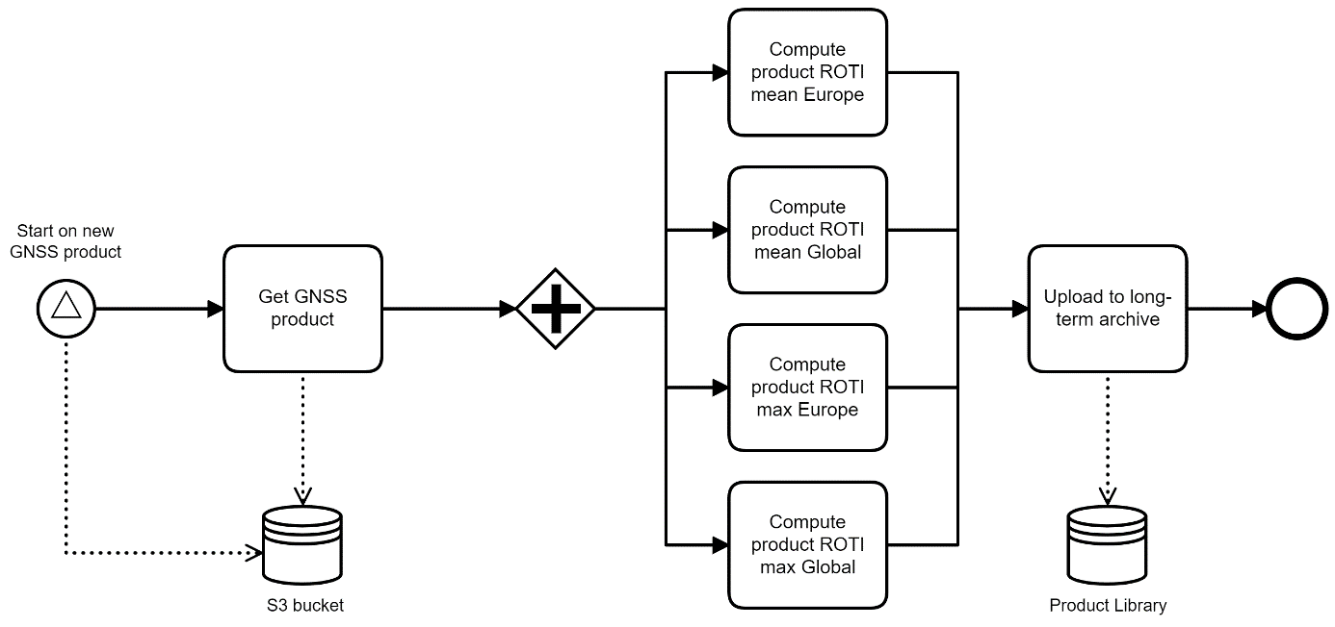
Section I: The IMPC / IMPC data process
IMPC-ROTI Scientific processor - workflow chain
Consists of five key steps:
Notes:
The IMPC-ROTI scientific processor chain - used in this case study - consist of five key steps:
read data from a data source;
transform data;
generate additional information;
transfer data into a long-term archive;
upload data to a remote data sink.
The Argo-Workflow runs one container for each workflow step. More specifically, it creates the container description based on the workflow definition, then passes it to Kubernetes for orchestration and scheduling.

Slide 9
Section I: The IMPC / IMPC data process
IMPC-ROTI Scientific processor - workflow chain
Consists of five key steps:
Read data from datasource
Notes:
The IMPC-ROTI scientific processor chain - used in this case study - consist of five key steps:
read data from a data source;
transform data;
generate additional information;
transfer data into a long-term archive;
upload data to a remote data sink.
The Argo-Workflow runs one container for each workflow step. More specifically, it creates the container description based on the workflow definition, then passes it to Kubernetes for orchestration and scheduling.

Slide 10
Section I: The IMPC / IMPC data process
IMPC-ROTI Scientific processor - workflow chain
Consists of five key steps:
Read data from datasource
Transform data
Generate additional information
Notes:
The IMPC-ROTI scientific processor chain - used in this case study - consist of five key steps:
read data from a data source;
transform data;
generate additional information;
transfer data into a long-term archive;
upload data to a remote data sink.
The Argo-Workflow runs one container for each workflow step. More specifically, it creates the container description based on the workflow definition, then passes it to Kubernetes for orchestration and scheduling.

Slide 11
Section I: The IMPC / IMPC data process
IMPC-ROTI Scientific processor - workflow chain
Consists of five key steps:
Read data from datasource
Transform data
Generate additional information
Transfer data into a long-term archive
Upload data to a remote data sink.
Notes:
The IMPC-ROTI scientific processor chain - used in this case study - consist of five key steps:
read data from a data source;
transform data;
generate additional information;
transfer data into a long-term archive;
upload data to a remote data sink.
The Argo-Workflow runs one container for each workflow step. More specifically, it creates the container description based on the workflow definition, then passes it to Kubernetes for orchestration and scheduling.

Slide 12
Section I: The IMPC / IMPC data process
Processing chains are vulnerable to errors
Core problems
Extensive usage of processing capacity
System overload
Notes:
Let’s take a look to a particular processing chain
Processing chains are vulnerable to errors
There are several key core problems as
system overload

Slide 13
Section I: The IMPC / IMPC data process
Processing chains are vulnerable to errors
Core problems
Extensive usage of processing capacity
System overload
Introducing new processing products
Performance decrease
Notes:
Let’s take a look to a particular processing chain
Processing chains are vulnerable to errors
There are several key core problems as
system overload

Slide 14
Section I: The IMPC / IMPC data process
Processing chains are vulnerable to errors
Core problems
Extensive usage of processing capacity
System overload
Introducing new processing products
Performance decrease
Malfunction of processing steps
Bottlenecks - processing workflow
Notes:
Let’s take a look to a particular processing chain
Processing chains are vulnerable to errors
There are several key core problems as
system overload

Slide 15
Section I: The IMPC / IMPC data process
Processing chains are vulnerable to errors
Core problems
Extensive usage of processing capacity
System overload
Introducing new processing products
Performance decrease
Malfunction of processing steps
Bottlenecks - processing workflow
Disfunction between system components
Instable system inter-operation
Notes:
Let’s take a look to a particular processing chain
Processing chains are vulnerable to errors
There are several key core problems as
system overload

Slide 16
Section I: The IMPC / IMPC data process
Processing chains are vulnerable to errors
Core problems
Extensive usage of processing capacity
System overload
Introducing new processing products
Performance decrease
Malfunction of processing steps
Bottlenecks - processing workflow
Disfunction between system components
Instable system inter-operation
Requires Monitoring and Reporting to ensure:
  well-functioning
  performance
  overall data quality
Notes:
Let’s take a look to a particular processing chain
Processing chains are vulnerable to errors
There are several key core problems as
system overload

Slide 17
Agenda
Section I : IMPC and IMPC data process
Section II: DFD’s Monitoring & Reporting System (DFD M&R)
Section III: Use cases
Section IV: Observation Discussion; Conclusion
Utilizing Monitoring and Reporting Techniques in data processing systems to improve the value adding of data
Notes:
After introducing the IMPC the next step is the presentation of DFD‘s Monitoring & Reporting System

Slide 18
Section II: DFD’s Monitoring & Reporting System (DFD M&R)
Collecting and transformig data
Telegraf
Service based agent
Uses plugins for input and output metrics.
Notes:
The DFD‘s Monitoring & Reporting Systems consists of four steps:
Step 1: Data collection and transformation
This step is performed by using Telegraf
Telegraf is a service based agend, based on a plugin concept for input and output metrics.
So that a variety of systems and applications can be connected in order to collect the metrics needed. And send them – as output - to other systems for example databases

Slide 19
Section II: DFD’s Monitoring & Reporting System (DFD M&R)
Collecting and transformig data
Saving in database
Telegraf
Service based agent
Uses plugins for input and output metrics.
InfluxDB
Time series database system.
Notes:
The DFD‘s Monitoring & Reporting Systems consists of four steps:
Step 2: Saving in database
After collecting the input metrics, Telegraf saves them directly in a InfluxDB
InfluxDB is a time series database system especially made for data that can be evaluated as a time-series.

Slide 20
Section II: DFD’s Monitoring & Reporting System (DFD M&R)
Collecting and transformig data
Saving in database
Visualization of database data
Telegraf
Service based agent
Uses plugins for input and output metrics.
InfluxDB
Time series database system.
Grafana
Visualization platform
for querying, exploring and analyzing,
metrics, logs and traces.
Notes:
The DFD‘s Monitoring & Reporting Systems consists of four steps:
Step 3: Visualization of database data
This is done using Grafana
Grafana is an open-source visualization platform for querying, exploring and analyzing, metrics, logs and traces wherever they are stored. Connected to various data sources,
Grafana offers tools to visualize the stored time-series into meaningful graphs.

Slide 21
Section II: DFD’s Monitoring & Reporting System (DFD M&R)
Collecting and transformig data
Saving in database
Visualization of database data
Reporting statistics and visualizations
Telegraf
Service based agent
Uses plugins for input and output metrics.
InfluxDB
Time series database system.
Grafana
Visualization platform
for querying, exploring and analyzing,
metrics, logs and traces.
ReportServer
Business Intelligence Suite platform
Notes:
The DFD‘s Monitoring & Reporting Systems consists of four steps:
Step 4: Reporting statistics and visualizations
DFD M&R uses an additional tool – ReportServer.
The ReportServer is a Business Intelligence Suite platform, provided in a basis version as open-source software.
After the introduction of the DFD’s Monitoring & Reporting concept, the next step is to apply these to the IMPC scientific processor (IMPC-ROTI)

Slide 22
Section II: DFD’s Monitoring & Reporting System (DFD M&R)
Collecting and transformig data
Saving in database
Visualization of database data
Reporting statistics and visualizations
Telegraf
Service based agent
Uses plugins for input and output metrics.
InfluxDB
Time series database system.
Grafana
Visualization platform
for querying, exploring and analyzing,
metrics, logs and traces.
ReportServer
Business Intelligence Suite platform
Application IMPC-ROTI
Collects:
system metrics,
Kubernetes metrics
Argo-WF metrics
Saves metrics directly in Database
Notes:
In Step 1:
Telegraf collects system metrics, Kubernetes metrics, Argo-Workflow metrics and saves these metrics directly in the InfluxDB

Slide 23
Section II: DFD’s Monitoring & Reporting System (DFD M&R)
Collecting and transformig data
Saving in database
Visualization of database data
Reporting statistics and visualizations
Telegraf
Service based agent
Uses plugins for input and output metrics.
InfluxDB
Time series database system.
Grafana
Visualization platform
for querying, exploring and analyzing,
metrics, logs and traces.
ReportServer
Business Intelligence Suite platform
Application IMPC-ROTI
Collects:
system metrics,
Kubernetes metrics
Argo-WF metrics
Saves metrics directly in Database
Application IMPC-ROTI
Configured with one bucket
containing all received data
Notes:
Step 2: The InfluxDB is configured with one bucket containing all received data (specifical in this case-study)

Slide 24
Section II: DFD’s Monitoring & Reporting System (DFD M&R)
Collecting and transformig data
Saving in database
Visualization of database data
Reporting statistics and visualizations
Telegraf
Service based agent
Uses plugins for input and output metrics.
InfluxDB
Time series database system.
Grafana
Visualization platform for querying, exploring and analyzing, metrics, logs and traces.
ReportServer
Business Intelligence Suite platform
Application IMPC-ROTI
Collects:
system metrics,
Kubernetes metrics
Argo-WF metrics
Saves metrics directly in Database
Application IMPC-ROTI
Configured with one bucket
containing all received data
Application IMPC-ROTI
Displays collected data in an operator friendly manner
Quick Overview Dashboard
WF Status Dashboard
Used Components Dashboard
Kubernetes Dashboard
Notes:
Step 3: Grafana displays the collected data in in an operator friendly manner, so that the operator can understand the current state of the system and the workflows running within.
The DFD M&R results in four dashboards, where each dashboard is made up of multiple panels:
The Quick Overview Dashboard
the Workflow Status Dashboard
the Used Components Dashboard
the Kubernetes Dashboard.

Slide 25
Section II: DFD’s Monitoring & Reporting System (DFD M&R)
Collecting and transformig data
Saving in database
Visualization of database data
Reporting statistics and visualizations
Telegraf
Service based agent
Uses plugins for input and output metrics.
InfluxDB
Time series database system.
Grafana
Visualization platform for querying, exploring and analyzing, metrics, logs and traces.
ReportServer
Business Intelligence Suite platform
Application IMPC-ROTI
Collects:
system metrics,
Kubernetes metrics
Argo-WF metrics
Saves metrics directly in Database
Application IMPC-ROTI
Configured with one bucket
containing all received data
Application IMPC-ROTI
Displays collected data in an operator friendly manner
Quick Overview Dashboard
WF Status Dashboard
Used Components Dashboard
Kubernetes Dashboard
Application IMPC-ROTI
Compiles reports by querying Influx-DB:
System Usage Report
System Error Report
Resources Report
Notes:
Step 4: Reporting
Reports of the IMPC-ROTI scientific processor are accessible from the DLR DFD’s ReportServer.
The reports are designed to report about the identified core problems discussed before.
The reports are addressed to operators, developers, and project leaders.
Therefore, three major reports have been established.
The system usage report
The system error report
The resources report

Slide 26
Agenda
Section I : IMPC and IMPC data process
Section II: DFD’s Monitoring & Reporting System (DFD M&R)
Section III: Use cases
Section IV: Observation Discussion; Conclusion
Utilizing Monitoring and Reporting Techniques in data processing systems to improve the value adding of data
Notes:
Now after the introduction of the DFD‘s Monitoring and Reporting System and it‘s application to the a specific part of the IMPC processing chain, the IMPC-ROTI scientific processor, the next usefull is to solve the core problems and the use cases of IMPC-ROTI scientific processor.

Slide 27
Section III: Use cases:
System overload
Notes:
One core problem for the IMPC-ROTI scientific processor is the recognition of system overload caused by extensive system usage by competitive users.

Slide 28
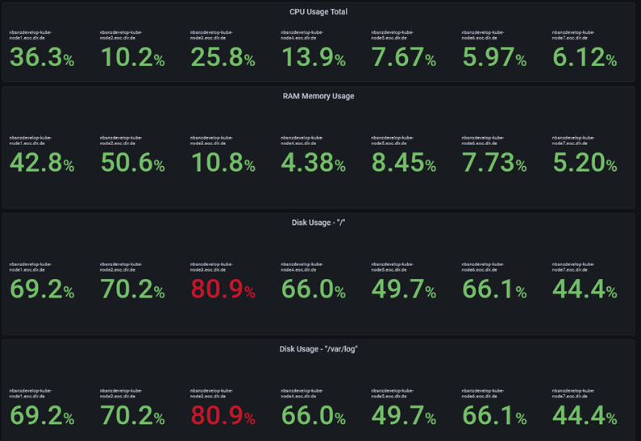
Section III: Use cases:
System overload
CPU Usage
Notes:
One core problem for the IMPC-ROTI scientific processor is the recognition of system overload caused by extensive system usage by competitive users.
Therefore in Grafana a set of the dashboards shows the
CPU-Usage

Slide 29
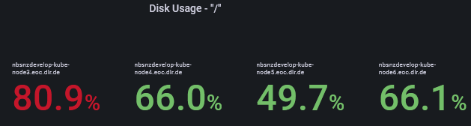
Section III: Use cases:
System overload
CPU Usage
Disk Usage
Notes:
One core problem for the IMPC-ROTI scientific processor is the recognition of system overload caused by extensive system usage by competitive users.
Therefore in Grafana a set of the dashboards shows the
CPU-Usage
Disk Usage.

Slide 30
Section III: Use cases:
System overload
CPU Usage
Disk Usage
RAM Memory Usage
Notes:
One core problem for the IMPC-ROTI scientific processor is the recognition of system overload caused by extensive system usage by competitive users.
Therefore in Grafana a set of the dashboards shows the
CPU-Usage
Disk Usage.
RAM Memory Usage

Slide 31
Section III: Use cases:
System overload
CPU Usage
Disk Usage
RAM Memory Usage
Operator alarms
System crash can be averted
Reporting: system usage, ressources report
Notes:
alarm situations are highlighted in red to instantly alert the operator
alarm situations are immediately reported to operators via E-Mail
Doing so : a potential system overload can easily be noticed and thus a system crash be averted
The status of system load
is daily reported by the system usage report
And monthly by the ressources report

Slide 32
Section III: Use Cases:
Performance - decrease
Notes:
Another core problem of the IMPC-ROTI scientific processor arises during the introduction and deployment of new product computing steps inside the IMPC-Roti scientific processor

Slide 33
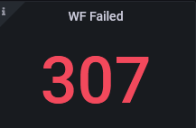
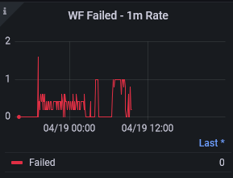
Section III: Use Cases:
Performance - decrease
Workflow Errors
Notes:
Another core problem of the IMPC-ROTI scientific processor arises during the introduction and deployment of new product computing steps inside the IMPC-Roti scientific processor
an increase of erroneous Workflows is displayed, so that the operator can immediately recognize when errors are caused by the new computing steps.

Slide 34
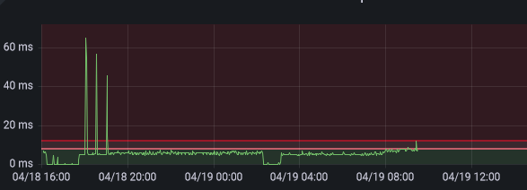
Section III: Use Cases:
Performance - decrease
Workflow Errors
Workflow Duration of operation
Notes:
Another core problem of the IMPC-ROTI scientific processor arises during the introduction and deployment of new product computing steps inside the IMPC-Roti scientific processor
Introducing new computing steps can also impact the Workflow duration of operation.
There, operators can easily set the threshold for the durations of operations to an appropriate value, ensuring full customization and control

Slide 35
Section III: Use Cases:
Performance - decrease
Workflow Errors
Workflow Duration of operation
Operator alarms
Recognize performance problems caused by new processing products
Reporting: system error, ressources report
Notes:
Again
alarm situations are highlighted in red to instantly alert the operator
alarm situations are immediately reported to operators via E-Mail
Doing so : the operator can immediately recognize when errors are caused by the new computing steps.
Performance problems
are daily reported by the system error report
and monthly by the ressources report

Slide 36
Section III: Use cases:
Bottlenecks - processing workflow
Notes:
Another core problem is the recognition of bottlenecks inside the processing workflow

Slide 37
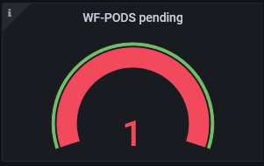
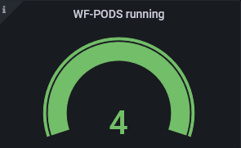
Section III: Use cases:
Bottlenecks - processing workflow
Workflow - pods state
Notes:
Another core problem is the detection of bottlenecks inside the processing workflow
Workflow pods (components) state, offers a good oveview

Slide 38
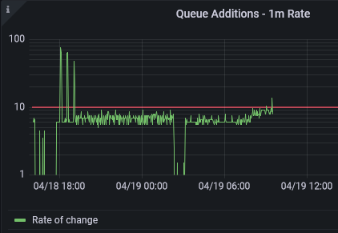
Section III: Use cases:
Bottlenecks - processing workflow
Workflow - pods state
Addition to WF - Queue
Notes:
Another core problem is the detection of bottlenecks inside the processing workflow
Addition to the Workflow Queue shows the amount of data waiting inside to be handled by the processing worklow

Slide 39
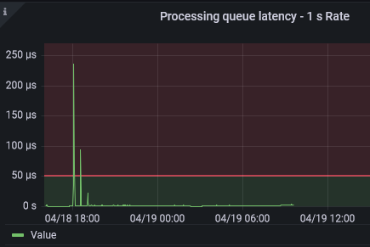
Section III: Use cases:
Bottlenecks - processing workflow
Workflow - pods state
Addition to WF - Queue
WF-Queue Latency
Notes:
Another core problem is the detection of bottlenecks inside the processing workflow
The workflow latency can be seen showing how long it takes to process a product

Slide 40
Section III: Use cases:
Bottlenecks - processing workflow
Workflow - pods state
Addition to WF - Queue
WF-Queue Latency
Operator alarms
Bottlenecks are identified quickly
Reporting: system error, system usage, ressources report
Notes:
Again
alarm situations are highlighted in red to instantly alert the operator
alarm situations are immediately reported to operators via E-Mail
Doing so : the operator can immediately recognize bottlenecks can be immediately and take actions to solve them
Bottleneck problems
are daily reported by the system error report and system usage report
and monthly by the ressources report

Slide 41
Section III: Use cases:
Instable system inter-operation
Notes:
Another identified core problem is a stable system inter-operation inside the Kubernetes Cluster

Slide 42
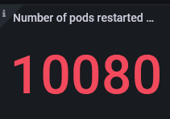
Section III: Use cases:
Instable system inter-operation
Number of pods restarted by Kubernetes
Notes:
Another identified core problem is a stable system inter-operation inside the Kubernetes Cluster.
This can be done by monitoring the number of pods restarted by Kubernetes

Slide 43
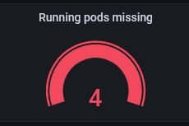
Section III: Use cases:
Instable system inter-operation
Number of pods restarted by Kubernetes
Missing pods in Argo-WF terminated by Kubernetes
Notes:
Another identified core problem is a stable system inter-operation inside the Kubernetes Cluster.
This can be done by monitoring “loose ends”, there are missing pods by the internal Argo Workflow, terminated by Kubernetes

Slide 44
Section III: Use cases:
Instable system inter-operation
Number of pods restarted by Kubernetes
Missing pods in Argo-WF terminated by Kubernetes
Operator alarms
Provide a stable operation between system components
Reporting: system error, system usage, ressources report
Notes:
Again
alarm situations are highlighted in red to instantly alert the operator
alarm situations are immediately reported to operators via E-Mail
Doing so : the operator can immediately recognize instable system inter-operation can be immediately and take actions to solve them
System inter-operation problems
are daily reported by the system error report and system usage report
and monthly by the ressources report

Slide 45
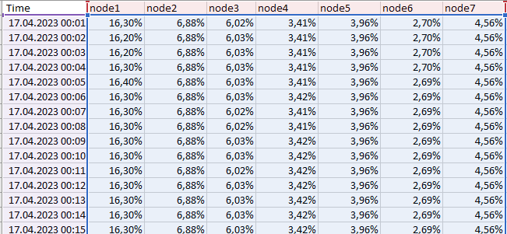
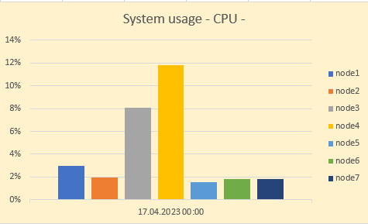
Section III: Use cases:
Reports
System Usage Report
CPU- , Memory-, Disk-Usage
Designed for operators
Notes:
Now let‘s take a quick look to the configured report
The System Usage Report ….

Slide 46
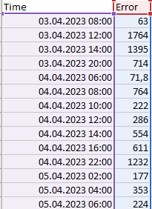
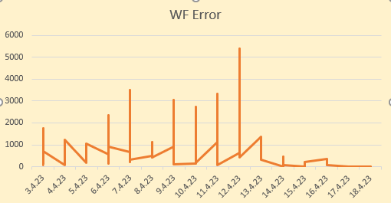
Section III: Use cases:
Reports
System Usage Report
CPU- , Memory-, Disk-Usage
Designed for operators
System Error Report
Occured failures and errors
Designed for developers
Notes:
The system error report

Slide 47
Section III: Use cases:
Reports
System Usage Report
CPU- , Memory-, Disk-Usage
Designed for operators
System Error Report
Occured failures and errors
Designed for developers
Ressources Report
Used ressources
Good future planning instrument for introduction of new products
Designed for project leaders, system and software developer
Notes:
The ressources report

Slide 48
Agenda
Section I : IMPC and IMPC data process
Section II: DFD’s Monitoring & Reporting System (DFD M&R)
Section III: Use cases
Section IV: Observation Discussion; Conclusion
Utilizing Monitoring and Reporting Techniques in data processing systems to improve the value adding of data
Notes:
After the presentation how the specifical use cases can be monitored and reported. Now it is the time to discuss benefits and drawbacks specific to the IMPC-ROTI scientific processor
and discuss their implications beyond this case study.

Slide 49
Section IV: Observation, Discussion
Benefits
By impeding system overload
By increasing system stability
By improving system performance
By detecting bottleneck

Slide 50
Section IV: Observation, Discussion
Benefits
By impeding system overload
By increasing system stability
By improving system performance
By detecting bottleneck
Increased system reliability
Faster troubleshooting
Data throughput optimization
Reduced operation efforts
Improved data consistency
Improved data quality
Reliable planning information

Slide 51
Section IV: Observation, Discussion
Drawbacks
monitoring complex systems
creates a large amount of data
strain the system load,
strain the application capacity,
strain the data traffic,
are memory consuming

Slide 52
Section IV: Observation, Discussion
Drawbacks
monitoring complex systems
creates a large amount of data
strain the system load,
strain the application capacity,
strain the data traffic,
are memory consuming
Slow down the entire system
Reducing data quality
Worst-case lead to system crash

Slide 53

Section IV: Observation, Discussion
Drawbacks
monitoring complex systems
creates a large amount of data
strain the system load,
strain the application capacity,
strain the data traffic,
are memory consuming
Carefully consider
The amount of collected monitoring metrics
The retention policy of stored data
The data cardinality in databases
Slow down the entire system
Reducing data quality
Worst-case lead to system crash

Slide 54
Section IV: Observation, Discussion
Outlook - future development
Introduction of user defined Custom Metrics; specific for each application.
Monitor Log-Errors by introduction of log-shipment and log-files analyzing
Extension of DFD M&R procedures to components outside the Kubernetes Cluster

Slide 55
Section IV: Conclusion
Application of DFD M&R to a complex data processing system
can improve essentially all data processing chains.
Careful configuration and implementation is paramount to the successful use of the DLR DFD Monitoring and Reporting System.

