Slide 1







STAC for CEDA - Developing a scalable, standards-based search system
Rhys Evans, Sam Pepler, Ag Stephens,
Mahir Rahman, Richard Smith

Slide 2
CEDA (Centre for Environmental Data Analysis)
Who are CEDA?
Part of UKRI
Facilitate research in atmospheric and Earth observation
The CEDA Archive
  Long term data store
JASMIN
  Data intensive supercomputer
Notes:
We’re part of UK Research and Innovation which is a public body that manages funding for science and research projects
Our role is to facilitate atmospheric and Earth observation research
We do that through two services
The ceda archive which is a long term large scale data store
And JASMIN
Which is home to the archive and our services
As well as providing compute for data analysis

Slide 3
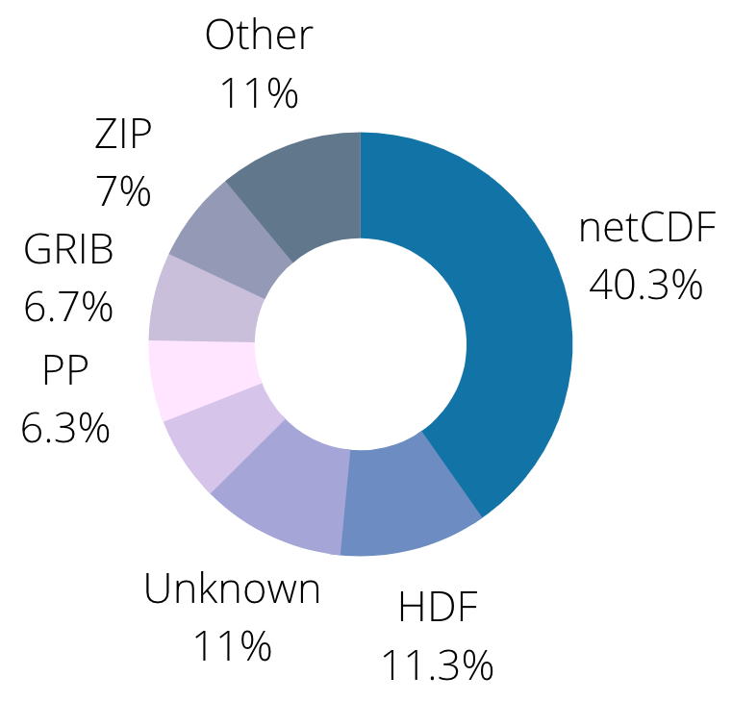
Motivation
The CEDA Archive
Large scale
  > 20 PB of data
  > 350 million files
  > 200,000 files a day
Highly Heterogeneous
  Different sources
  Different storage types
  Different formats
Notes:
The motivation behind looking at STAC was how our users can find relevant data in our archive
The ceda archive has over 20 petabytes of data spread over 350 million files
And this is continuously getting added to by 100 of 1000s of files a day
We receive this data from a range of different sources
Different projects and institutions which use different instruments
They also have different opinions on how they want their data stored

Slide 4
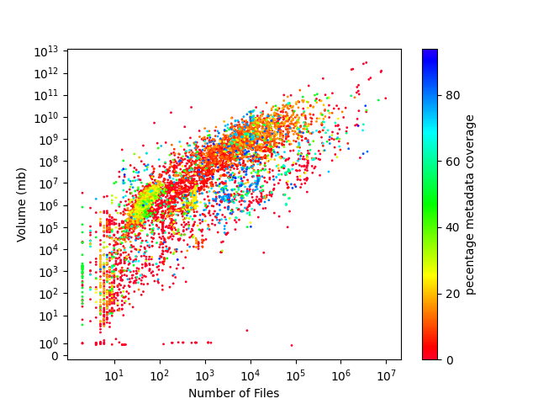
PreSTAC search
General search
Catalogue
File Based Index
  Basic file level information
  Metadata from the most common formats
    Only 48% coverage
Notes:
We’ve successfully implemented several search services already
our main search service is the CEDA catalogue
On file ingestion file level information is extracted
and for some of the more common formats some metadata is extracted
However as this has to run for all the files in the archive the methods of extraction are not very specific
This means that only 48% of files have extra metadata extracted
There are several reasons why data isn’t extracted
The file is missing
Its external
Isn’t a common format
We do susudise this with hand written metadata but it’s not feasible to do this for the whole archive

Slide 5
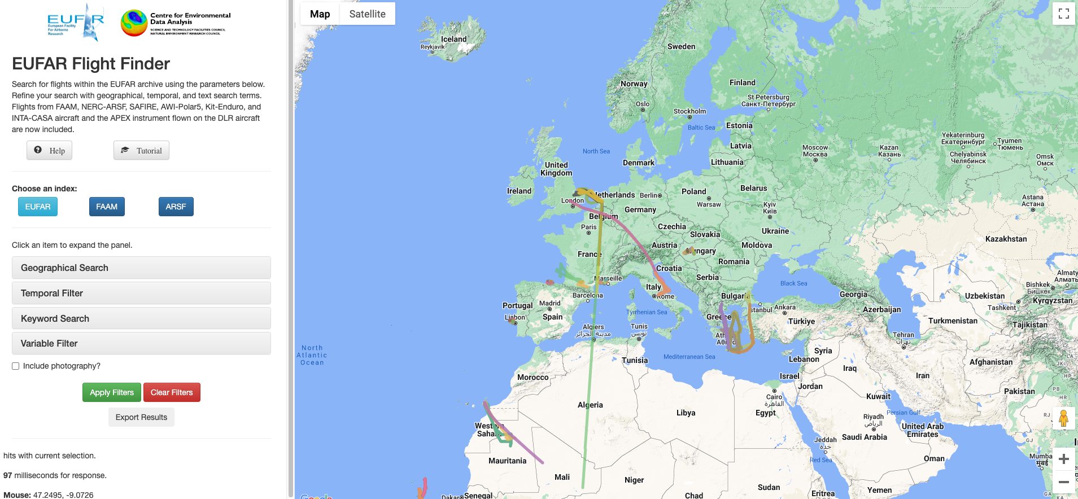
PreSTAC search
Specific search
EUFAR Flight Finder
Focus on a specific area of archive
  More homogeneous
  Rich metadata
Only for a section of the archive
Notes:
We have also developed project that are specific to one area of the archive
Because they’re on a specific area the data is more homogenous
This allows us to write more specific extractions
Which means we can create more novel search services
You can search on spatial information and see the flight paths

Slide 6
What do we want?
Develop a search tool which allows users to perform faceted and free-text
search to find the relevant data for their use-case, taking into account the
heterogeneity of the data.
It needs to
Allow low level search of all items (granules)
Provide faceted and free-text search
Handle heterogeneous data
Work at scale
Work with different domains/vocabularies
Notes:
What we wanted from this project was something that could meet both needs
Allow for a general faceted and free text search
And allow for enough detail that we can produce novel search services
To do that it will need to work at the scale and with the variety of data of the archive

Slide 7
Shared Problem
We think this problem is common among data providers with heterogeneous data. Wanted to use an existing standard to enable more collaboration.
SpatioTemporal Asset Catalog:
Developed with the Earth Observation community
Community project
Reusable solution
Existing tools and extensions
Notes:
We don’t think we’re unique
So wanted to see if there was an existing standard that we could use
We found STAC Spatio Temporal Asset Catalog which seemed like it could be a good fit
As it had been principally designed for the Earth Observation community

Slide 8
STAC
Designed to be minimalistic with the core specification requiring only space and time on a latitude, longitude grid in standard Julian calendar.
Features:
Extension of GeoJSON
Minimum specification for Geospatial data
Extensible
  Ecosystem of tools and extensions
  Can write your own extensions
STAC community
Notes:
What we liked about STAC was that the standard was minimalistic
The only requirements were a space and time
And this can then be extended with a variety of extensions
Finally it had an active community

Slide 9
STAC for CEDA
STAC:
Asset
  file representing information about the earth in a certain space and time
Item
  an atomic collection of inseparable data and metadata
Collection
  a structure to organise and browse Items
CEDA:
Asset
  a file within the archive
Item
  group of files that are meaning to a user (depends on the collection)
Collection
  group of items with a shared vocabulary
Notes:
STAC has 3 levels
Asset that represents a file
Item an atomic set of inseparable files
Collection a group of items or other collections that gives the catalog structure
One thing to note is that collections can be nested

Slide 10
Extracting Metadata
We needed a way to extract the necessary metadata to create the Assets, Items, and Collections required for the STAC catalog.
Requirements:
Fast
  Match data ingestion
Flexible
  Cope with heterogeneous data
  Extract collection specific facets
Scaleable
  Work across the archive
Notes:
The first task was generating the meta data for our catalog
This had a lot of the same requirements for the project
It had to work at scale
Had to be flexible to the data
Had to be fast enough that it could keep up with ingestion

Slide 11
STAC Generator
STAC Generator
Collection Describer
Plugin Architecture
Generator
Inputs
Outputs
Extraction methods
  ID
  Facets
{
generator: ...
inputs: [...]
outputs: [...]
}
BADC
{
paths: [...]
asset: {...}
item: {...}
collection: {...}
}
ID Extraction Methods
FAAM
Hash
Default
CMIP6
Inputs
Generators
Outputs
File System
Item
Rabbit MQ
Object Store
Asset
Collection
JSON
Intake ESM
CSV
text file
Extraction Methods
Intake ESM
Rabbit MQ
regex
Posix stats
JSON file
Standard out
Elasticsearch
Elasticsearch
Object store stats
Elasticsearch
header
xml
default
Notes:
What we’ve produce is the stac generator
So we didn’t have to have a generator for each part of the archive
So we’ve used a plugin architecture which allows you to configure the plugins for the use case
And to allow for allow for collection specific extractions it’s split across two congifs

Slide 12
Generator Configuration
STAC Generator
Collection Describer
{
generator: asset
inputs:
- name: file_system
path: /badc/cmip6/data
outputs:
- name: elasticsearch
connection_kwargs:
hosts: ["es9.ceda.ac.uk:9200"]
use_ssl: false
verify_certs: false
ssl_show_warn: false
index:
name: stac-assets
}
{
generator: ...
inputs: [...]
outputs: [...]
}
BADC
{
paths: [...]
asset: {...}
item: {...}
collection: {...}
}
ID Extraction Methods
FAAM
Hash
Default
CMIP6
Inputs
Generators
Outputs
File System
Item
Rabbit MQ
Object Store
Asset
Collection
JSON
Intake ESM
CSV
text file
Extraction Methods
Intake ESM
Rabbit MQ
regex
Posix stats
JSON file
Standard out
Elasticsearch
Elasticsearch
Object store stats
Elasticsearch
header
xml
default
Notes:
The first is the generator configuration
Which specifies the type of STAC object that will be created
And the input plugin which defines where the generator will scan
And the output plugin which defines where the generated data should be stored
These are both lists so you can input and output from and to multiple places

Slide 13
Collection Descriptions
{
paths:
- /badc/cmip6/data/
asset:
id:
method: hash
terms:
- uri
extraction_methods:
- method: default
inputs:
defaults:
general_data_type: climate models
permitted_use:
- academic
- educational
- method: regex
inputs:
regex: '^(?P<mip_era>[^_]+)_(?P<table_id>[^_]+)_(?P<source_id>[^_]+)_
(?P<experiment_id>[^_]+)_r(?P<activity_id>\d*)i(?P<institution_id>\d*)'
- method: os_stats
item:
id:
method: hash
terms:
- mip_era
- activity_id
- institution_id
- table_id
extraction_methods:
- method: elasticsearch
inputs:
list:
- mip_era
- activity_id
- institution_id
- table_id
collection:
id:
method: default
value: cmip6
extraction_methods:
- method: elasticsearch
inputs:
list:
- mip_era
- activity_id
- institution_id
- table_id
}
STAC Generator
Collection Describer
{
generator: ...
inputs: [...]
outputs: [...]
}
BADC
{
paths: [...]
asset: {...}
item: {...}
collection: {...}
}
ID Extraction Methods
FAAM
Hash
Default
CMIP6
Inputs
Generators
Outputs
File System
Item
Rabbit MQ
Object Store
Asset
Collection
JSON
Intake ESM
CSV
text file
Extraction Methods
Intake ESM
Rabbit MQ
regex
Posix stats
JSON file
Standard out
Elasticsearch
Elasticsearch
Object store stats
Elasticsearch
header
xml
default
Notes:
The second configuration comes from the collection description
In this it states a list of paths which it’s applicable too
We can write multiple collection descriptions for different paths
The collection describer using information from the input will pick the most relevant description to use
And then for each STAC level
A list of extraction methods specifying how to extract the metadata
The method of ID creation
The hash method lets you choose a list of facets which are combined and then hashed to form the ID
Which allows for items to be created in novel ways and specific to the collection

Slide 14
Scanning the archive
{
paths:
- /badc
asset:
id:
method: hash
terms:
- uri
extraction_methods:
- method: default
inputs:
defaults:
inspire_theme: Meteorological geographical features
gemet_topic:
- climatology
- meteorology
- atmosphere
- method: path_parts
- method: os_stats
item:
id:
method: hash
terms:
- _dir1
- _dir2
extraction_methods:
- method: elasticsearch
inputs:
list:
- general_data_type
- inspire_theme
- gemet_topic
- permitted_use
- _dir[1-9][0-9]
collection:
id:
method: default
value: badc
extraction_methods:
- method: elasticsearch
inputs:
list:
- general_data_type
- inspire_theme
- gemet_topic
}
Reason
Scale of the archive
Breadth of the archive
Method
“All The Other Data” Collection description
Used batch compute
Run in series
  Assets → Items → Collections
Notes:
To test if STAC and the STAC Generator were viable we needed to test it at the scale of the archive
This meant scanning the archive
We got together with our data curators to write a set of collection descriptions
We came up with around 10
with one being pointed at the top level directory to sweep up all the other data
Initially this only extracted file and directory metadata
We ran this in series so generated all the assets then items then collections
We ran this on JASMINs batch compute called LOTUS

Slide 15
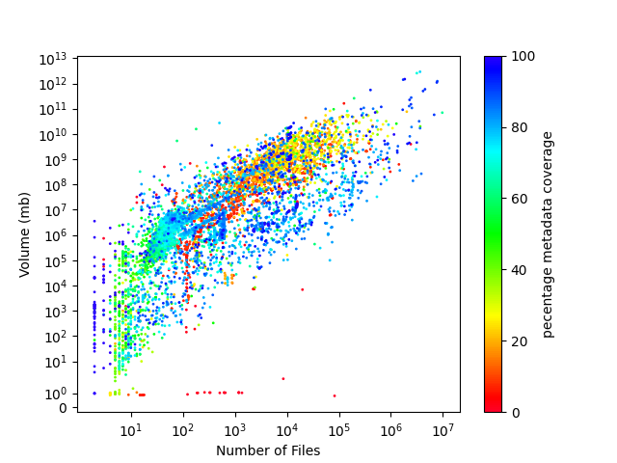
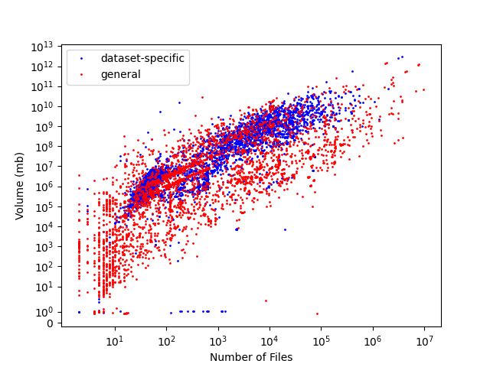
Scanning the archive
Result
Took
  50 nodes
  ~ 2 weeks
Generated
  ~ 325 million assets
  ~ 4 million items
  10 collections
Properties
  100% have basic
  12% have dataset specific
Notes:
We ran this across 50 nodes and it took around 2 weeks to generate the full catalog
We managed to generate 325 million assets, 4 million items and 10 collections
There were some files still missing
We ran this quick and dirty so we’re not sure why these were skipped over
Could be an error in one of the collection descriptions
But we did have a hardware issue at the time
But all the files we did generate did have a minimum of file and directory information
Doesn’t yet meet the catalog as only 12% had dataset specific

Slide 16

Scanning the archive
Next steps
Iterative approach
Expand ATOD
  Add Extraction Methods
Chop up ATOD
  Add Collection Descriptions
  Reduce coverage of ATOD
  Allows specific extraction
https://api.stac.ceda.ac.uk/asset/search?limit=1
{
"type": "FeatureCollection",
"features": [
{
"type": "Feature",
"stac_version": "1.0.0",
"stac_extensions": [],
"asset_id": "bb43f6a3d9c1c298b2b48d388315a026",
"roles": [],
"item": "00ee2018d58a8d25ce7c28eefa3a348b",
"bbox": null,
"properties": {
"_dir7": "IPF_v2",
"_dir6": "m",
"_dir9": "05",
"extension": ".zip",
"_dir8": "2018",
"_dir10": "26",
"inspire_theme": "orthoimagery",
"_dir1": "neodc",
"_dir3": "data",
"uri": "/neodc/sentinel1b/data/EW/L1_GRD/m/IPF_v2/2018/05/26/S1B_EW_GRDM_1SDH_20180526T022500_20180526T022600_011086_014527_5CF2.zip",
"_dir2": "sentinel1b",
"_dir5": "L1_GRD",
"_dir4": "EW",
"collection_id": "neodc",
"filename": "S1B_EW_GRDM_1SDH_20180526T022500_20180526T022600_011086_014527_5CF2.zip",
"gemet_topic": "environment",
"modified_time": "2018-06-26T10:21:09",
"size": 244845430,
"catagories": [
"data"
],
"magic_number": "application/zip"
},
"links": [...],
"context": {
"returned": 1,
"limit": 1,
"matched": 323492562
}
}
Notes:
We see this as an iterative process
And there are two ways in which we can extract more information
Extending ATOD to have more extraction methods
Slice off archive areas into their own collection descriptions
Which would allow for specific metadata extraction

Slide 17
Continuous integration
Asset
Ingest
FBI
STAC stocktake
Rabbit
Elasticsearch
Item
STAC stocktake
Rabbit
Elasticsearch
Collection
STAC stocktake
Rabbit
Elasticsearch
CEDA Ingest
RabbitMQ
STAC Generator
Asset
Queue
Asset
Generator
FBI
STAC Stocktake
Item
Queue
Item
Generator
Elasticsearch
Collection
Queue
Collection
Generator
Notes:
We didn’t want to have to run this everytime a new file was added to the archive
We created the STAC Stocktake which will scan the FBI and find any new files
Adds messages onto a queue that is then read by an instance of the STAC generator to create the Assets
The Stocktake will also scan the asset for any missing items
And similarly it scans the items for any new collections that need to be generated

Slide 18
STAC Generator
STAC Generator
Collection Describer
What we’ve found
Highly configurable
  Different workflow
  Collection specific
Work at scale
  Fast enough
{
generator: ...
inputs: [...]
outputs: [...]
}
{
paths: [...]
asset: {...}
item: {...}
collection: {...}
}
ID Extraction Methods
BADC
FAAM
Hash
Default
CMIP6
Inputs
Generators
Outputs
File System
Item
Rabbit MQ
Object Store
Asset
Collection
JSON
Intake ESM
CSV
text file
Extraction Methods
Intake ESM
Rabbit MQ
regex
Posix stats
JSON file
Standard out
Elasticsearch
Elasticsearch
Object store stats
Elasticsearch
header
xml
default
Notes:
We think these experiments have shown that the STAC Generator can be used on heterogeneous data
We think there are some performance gains to be had
But it’s fast enough that it can be used at the scale of the archive

Slide 19
STAC API
Follows the same principles of the STAC standards, with a basic set of core functions and then a set of extensions so it can adapt to different domains.
Requirements:
Based on OGC API
Core
  ‘/’ - Landing page
  ‘/search’ - Search items
Extensions
  Sort
  Transactions
  Filter
  More …
Notes:
We also needed to make this data available to be searched on
STAC has a specification for its API
And this follows the same basic principles of the STAC Framework
Simple core that defines the landing and item search pages
And then extensions on top
Also as STAC was based on GeoJSON the API is based on Open Geospatial Consortium API
Meaning if you’re following STAC you’re also following OGC

Slide 20
https://api.stac.ceda.ac.uk
STAC API
{
"type": "Catalog",
"id": "stac-fastapi",
"title": "CEDA STAC API",
"description": "This is an experimental STAC API server.\n
The content is subject to change the and there is no guarantee surrounding its uptime.\n",
"stac_version": "1.0.0",
"conformsTo": [
"http://www.opengis.net/spec/ogcapi-features-1/1.0/conf/core",
"https://api.stacspec.org/v1.0.0-beta.4/core",
"https://api.stacspec.org/v1.0.0-beta.4/item-search",
"https://api.stacspec.org/v1.0.0-beta.2/item-search#free-text-search",
...
],
"links": [
{
"rel": "self",
"type": "application/json",
"href": "https://api.stac.ceda.ac.uk/"
},
{
"rel": "root",
"type": "application/json",
"href": "https://api.stac.ceda.ac.uk/"
},
{
"rel": "data",
"type": "application/json",
"href": "https://api.stac.ceda.ac.uk/collections"
},
{
"rel": "conformance",
"type": "application/json",
"title": "STAC/WFS3 conformance classes implemented by this server",
"href": "https://api.stac.ceda.ac.uk/conformance"
},
{
"rel": "search",
"type": "application/geo+json",
"title": "STAC search",
"href": "https://api.stac.ceda.ac.uk/search",
"method": "GET"
},
...
]
}
Elasticsearch backend:
Based on STAC FastAPI
https://github.com/cedadev/stac-fastapi-elasticsearch
CEDA extensions:
Free-text search
https://github.com/cedadev/stac-freetext-search
context-collection
https://github.com/cedadev/stac-context-collections
Multi-level search
https://github.com/cedadev/stac-asset-search
Notes:
When we started the project the API backend only worked with Postgres
as we were using Elasticsearch this meant we had to create our own backend
We’ve followed the API specification for the core and several of the existing extensions
There was some functionality that didn’t already exist
So we’ve developed several extensions

Slide 21
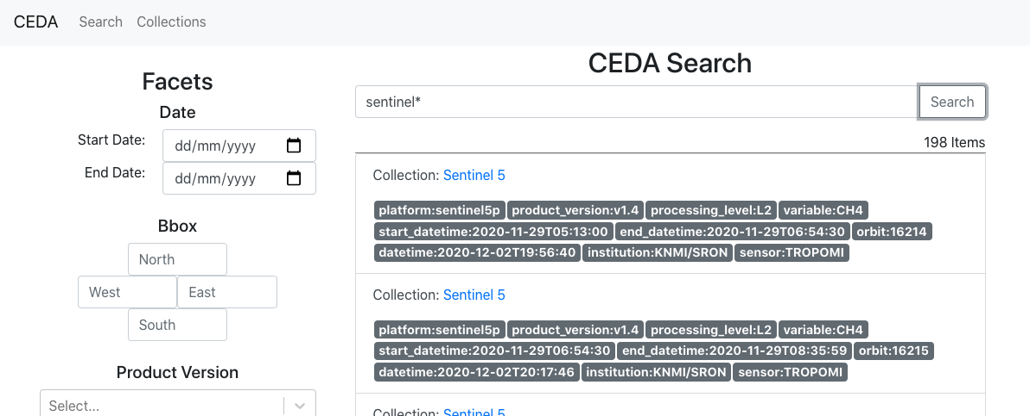
User interface
Web:
No existing tools
https://github.com/cedadev/stac-ui
https://stac.ceda.ac.uk
Notes:
It was a similar story for the user interfaces
There was no existing that met all of our needs
Specifically our extensions and free text
So we’ve created a basic react app

Slide 22
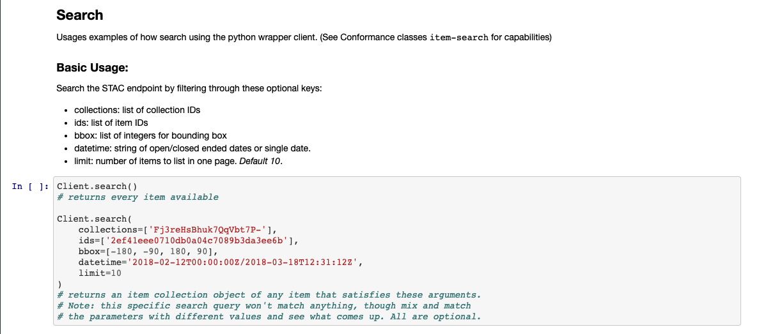
Clients
Python:
Extension of pystac
https://github.com/cedadev/pystac-client
Wrapper for ESGF
https://github.com/cedadev/esgf-stac-client
Notes:
Finally, we’ve extended the pystac client to include our extensions
And as part of our work to see if STAC can be a replacement for the Earth System Grid Federation’s search services
We’ve developed a wrapper to pystac bring it closer to what ESGF users would expect from the current service

Slide 23
Conclusion
Question | Answer
Can STAC be used as a general model for environmental data search? | ✔
Can we generate the metadata required for STAC? | ✔
Are we able to quickly search on the generated metadata? | ✔
Does STAC have all the functionality we need? | ❌
Can we extend STAC to meet our requirements? | ✔
Do we need layers in our framework? | ?
Could Temporal and Spatial information be optional? | ?
Can we use STAC extensions for specific parts of our archive? | ?
Do we need Asset Search? | ?

Slide 24

Thank you!
JASMIN: support@jasmin.ac.uk
CEDA: support@ceda.ac.uk
Twitter - @cedanews
Website - www.ceda.ac.uk

