Slide 1
A data-centric platform for scientific support to EU policies
Chiara Chiarelli, Davide De Marchi, Ilias Ioannou, Pieter Kempeneers, Tomas Kliment, Pierre Soille, Roberto Ugolotti
Joint Research Centre
Geneve, 04/05/2023

Slide 2
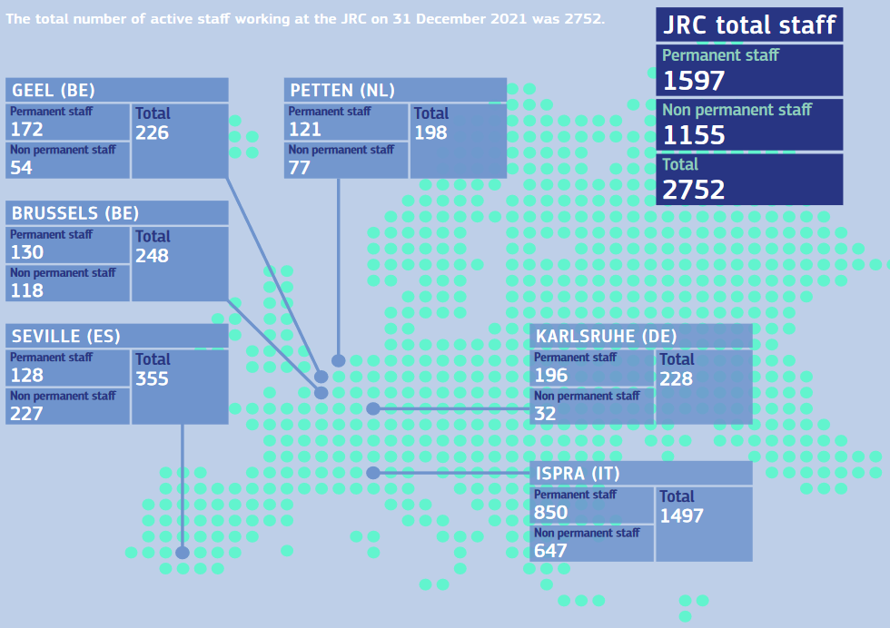
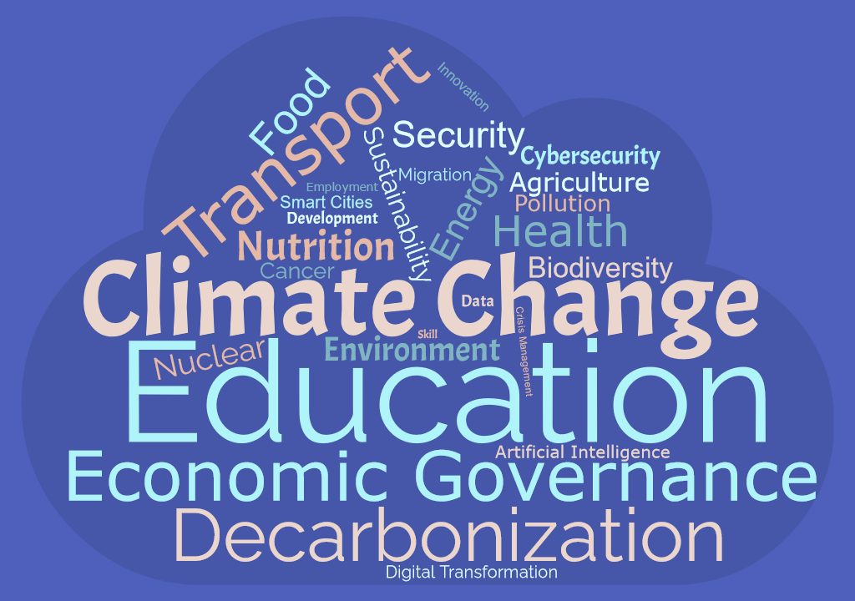
Joint Research Centre
The role of the Joint Research Centre (JRC) of the European Commission is to provide independent, evidence-based science and knowledge, supporting European Union (EU) policies to positively impact society.

Slide 3
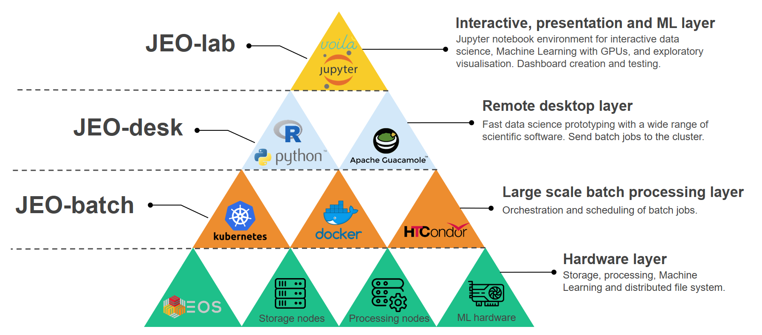
Big Data Analytics Platform
The JRC Big Data Analytics Platform is a cloud platform that provides data, environments, and software to JRC researchers, all in a single place.

Slide 4
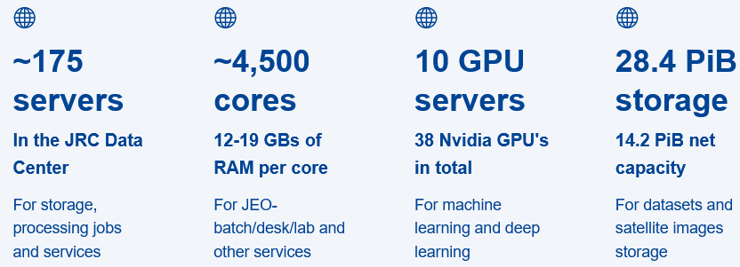
Big Data Analytics Platform
The JRC Big Data Analytics Platform is a cloud platform that provides data, environments, and software to JRC researchers, all in a single place.

Slide 5
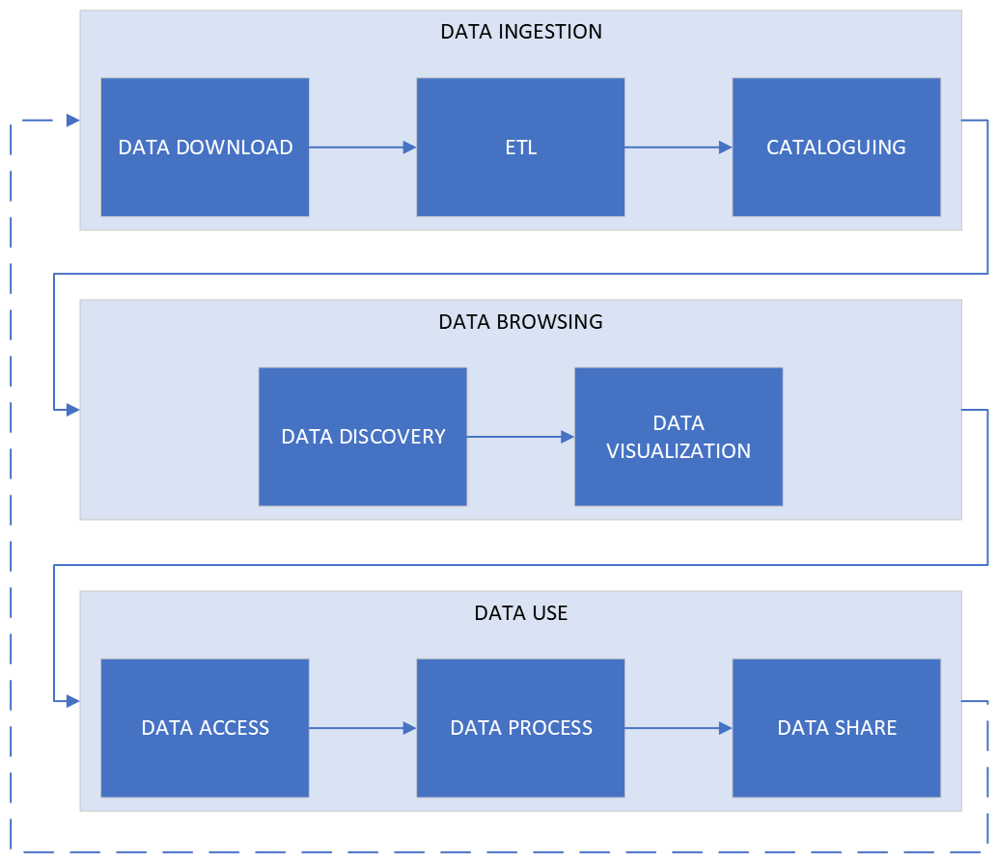
A Data Story in BDAP

Slide 6
A Data Story in BDAP – Data Ingestion

Slide 7
Some numbers
> 400 collections
> 100 providers
> 20 domains
> 20 million of metadata records
> 10 PB of data

Slide 8






Data Download

Slide 9
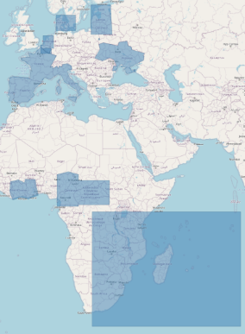
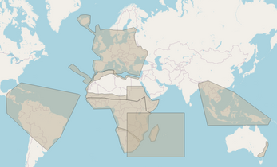
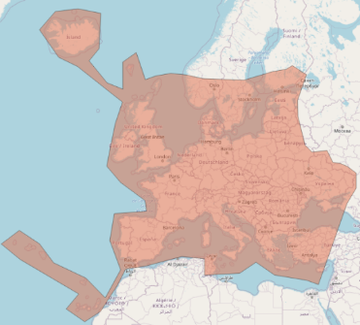
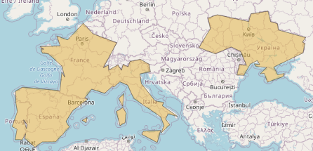
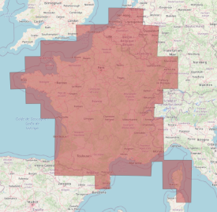
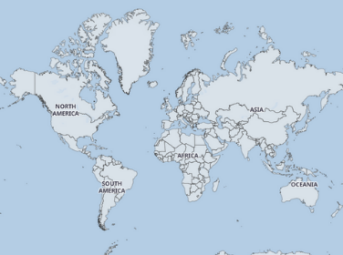
Main Systematic Downloads
Sentinel-1 GRD
Sentinel-1 SLC
Sentinel-2 L1C and L2A
NASA HLS L30 and S30
Sentinel-3 OL2LRR + OL2WRR and Sentinel-5P: global

Slide 10
Quality Checks
Completeness
Accuracy
Consistency
Validity
Uniqueness
Integrity

Slide 11


Cataloguing

Slide 12
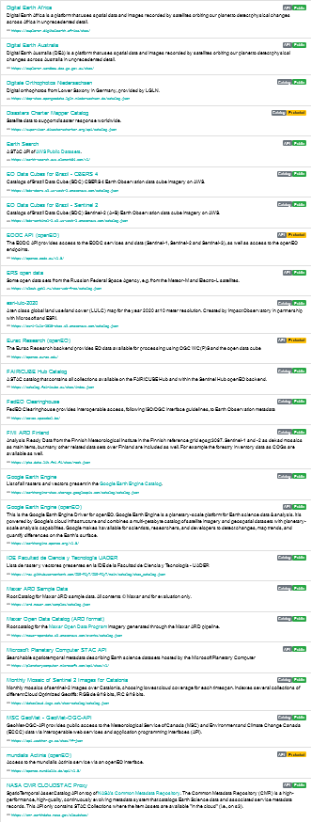
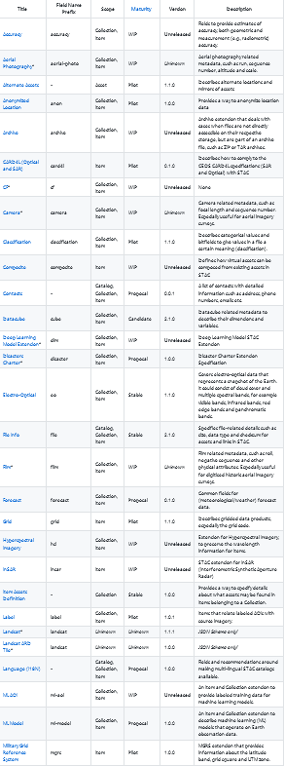
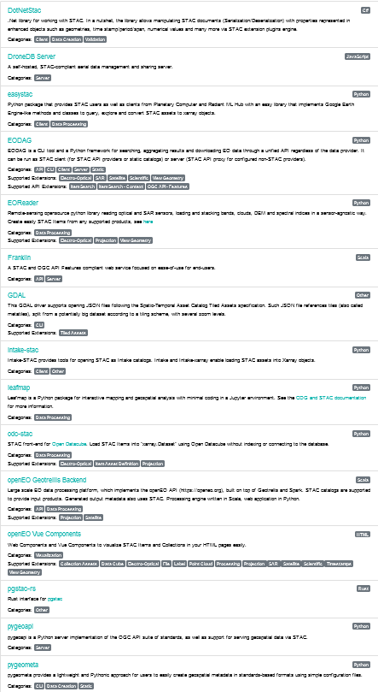
Cataloguing
Each download is associated with a metadata entry
STAC (SpatioTemporal Asset Catalogs) format
Widely accepted and used by OS community
Geospatial Information (but not limited to)
Modular/Easy to extend
Ecosystem of libraries, tools, and clients
Elasticsearch

Slide 13
A Data Story in BDAP – Data Browsing

Slide 14

Data Discovery
API

Slide 15
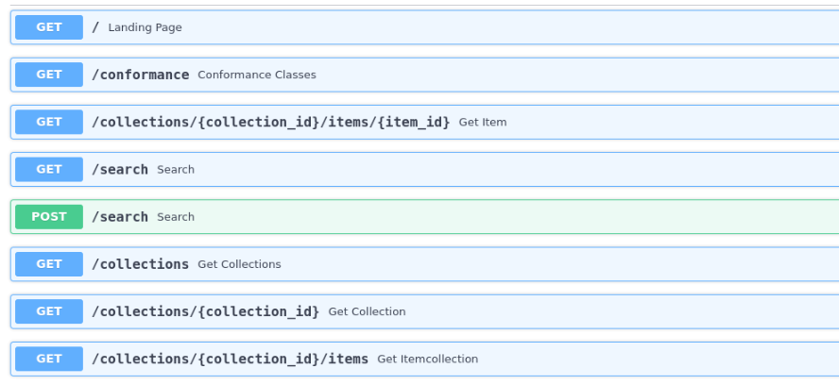
REST APIs
Following STAC API V1.0.0 RC.1 specifications.

Slide 16
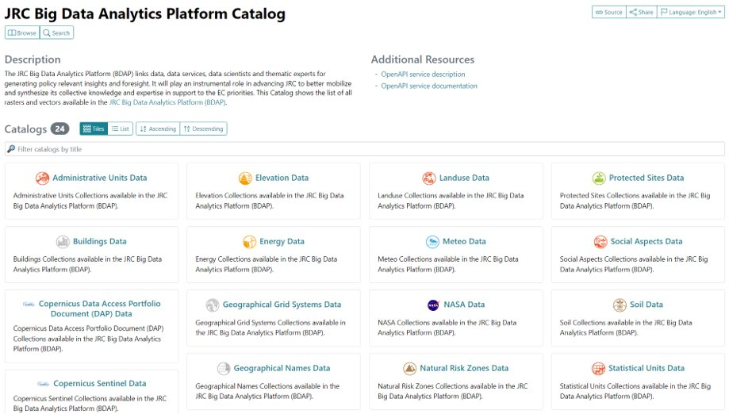
BDAP Data Catalog
JRC Big Data Analytics Platform Catalog

Slide 17
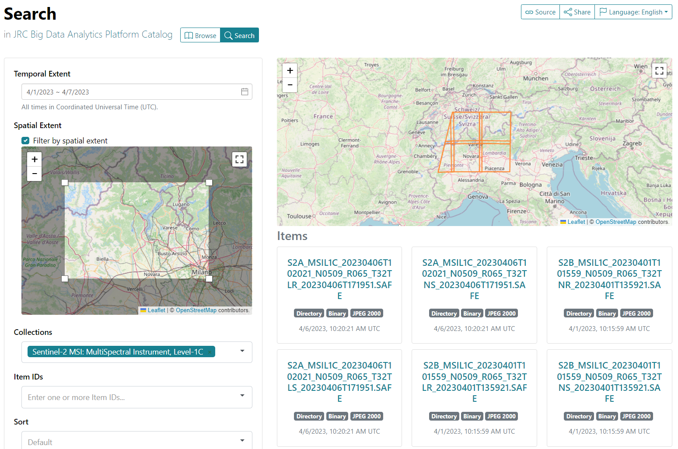
BDAP Data Catalog - Search

Slide 18
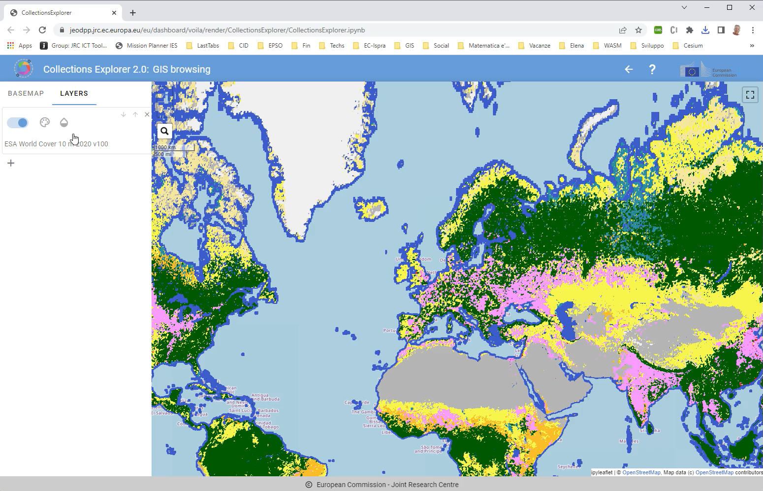
BDAP Collections Explorer

Slide 19
A Data Story in BDAP – Data Use

Slide 20
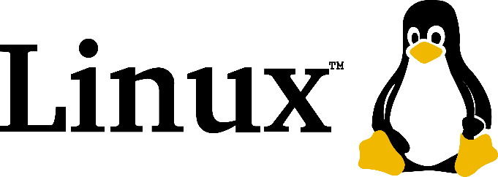
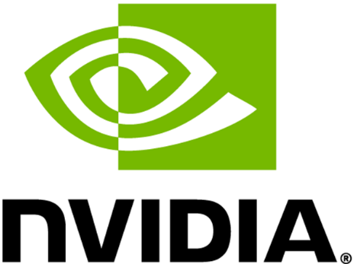
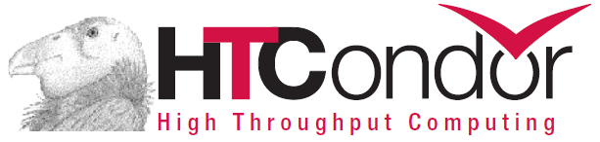
BDAP Development Environment

Slide 21


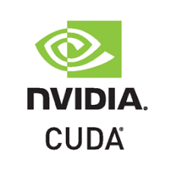
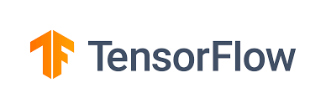


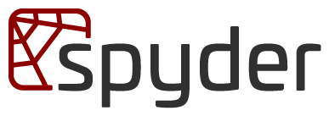
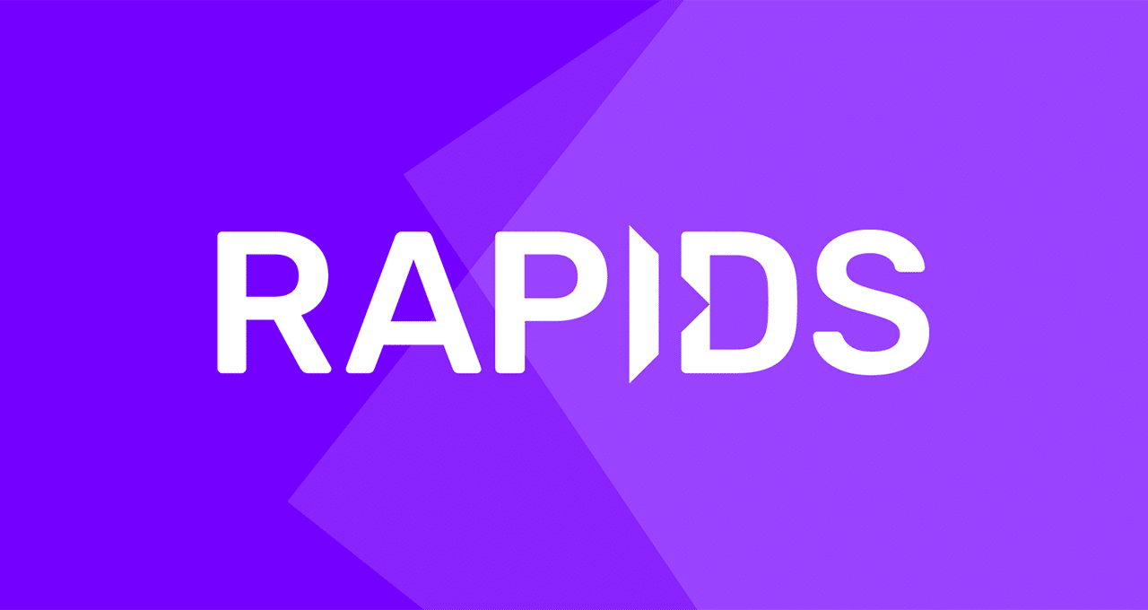




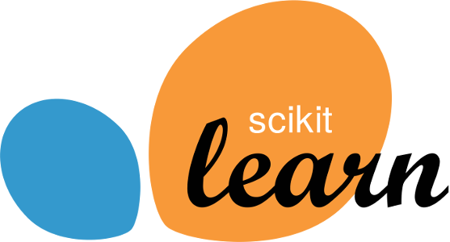
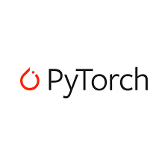





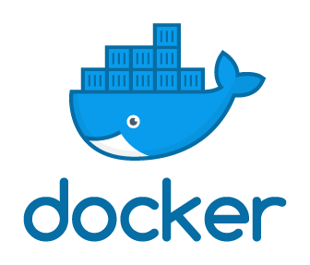
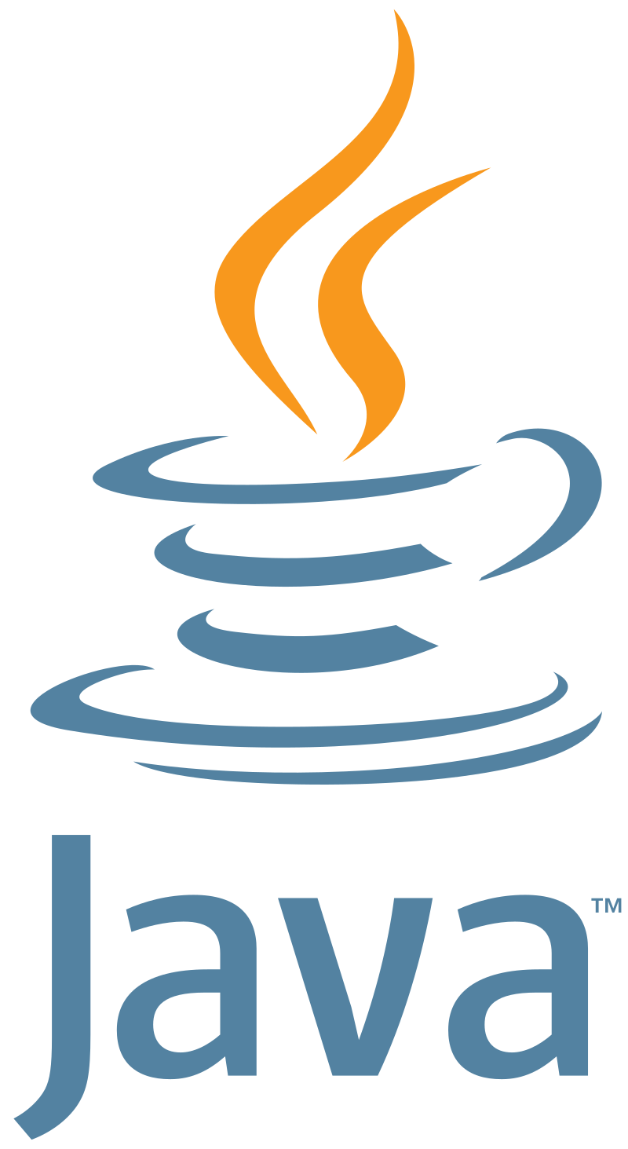



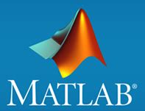


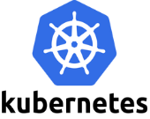


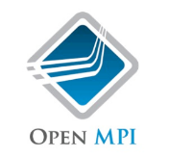

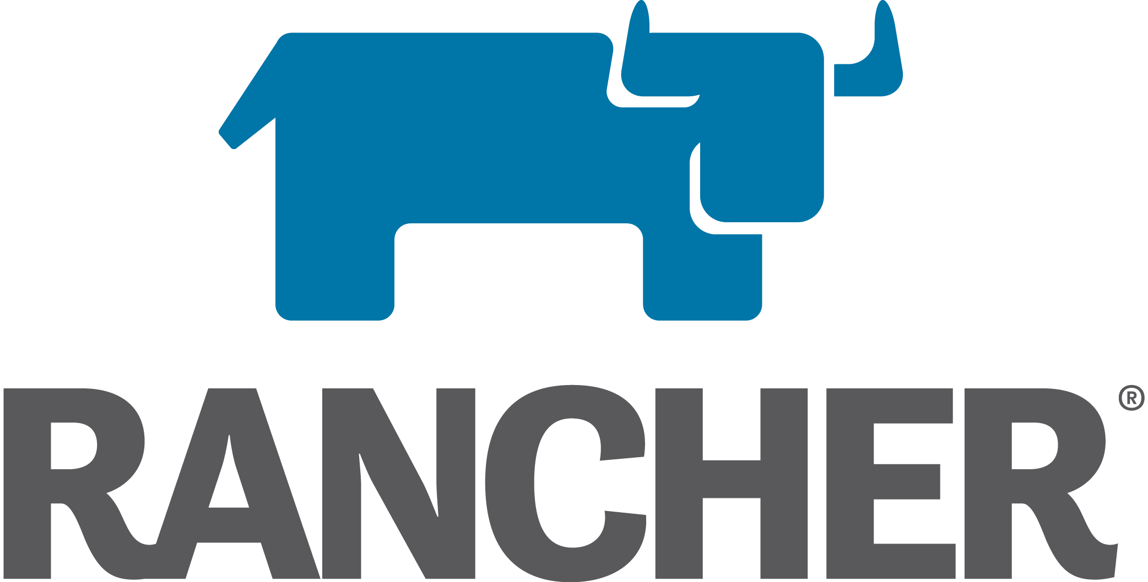
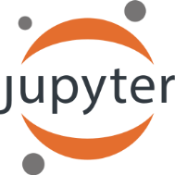
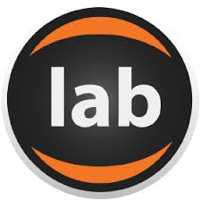
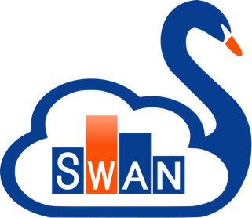



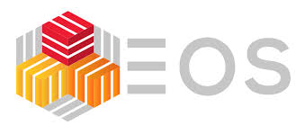

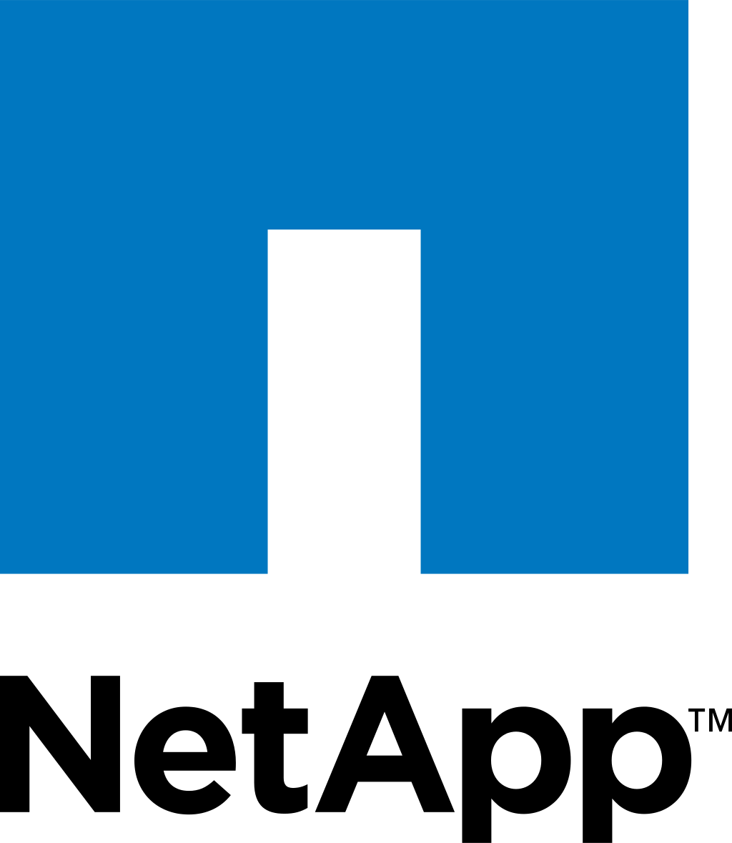
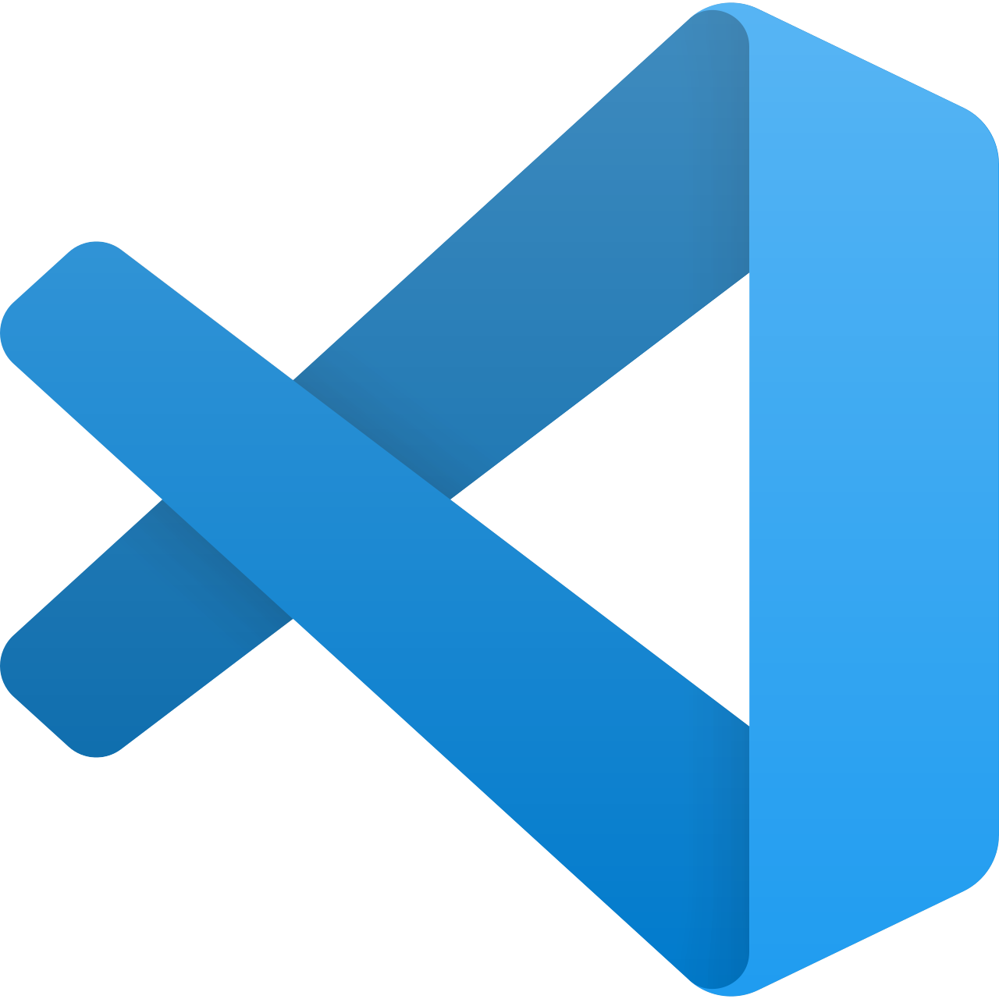



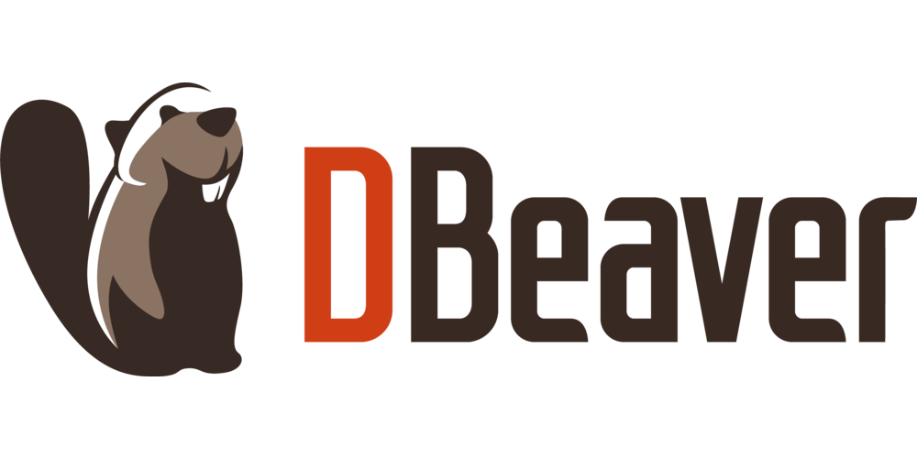
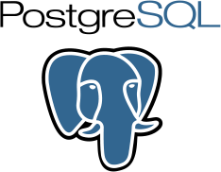
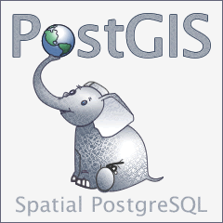









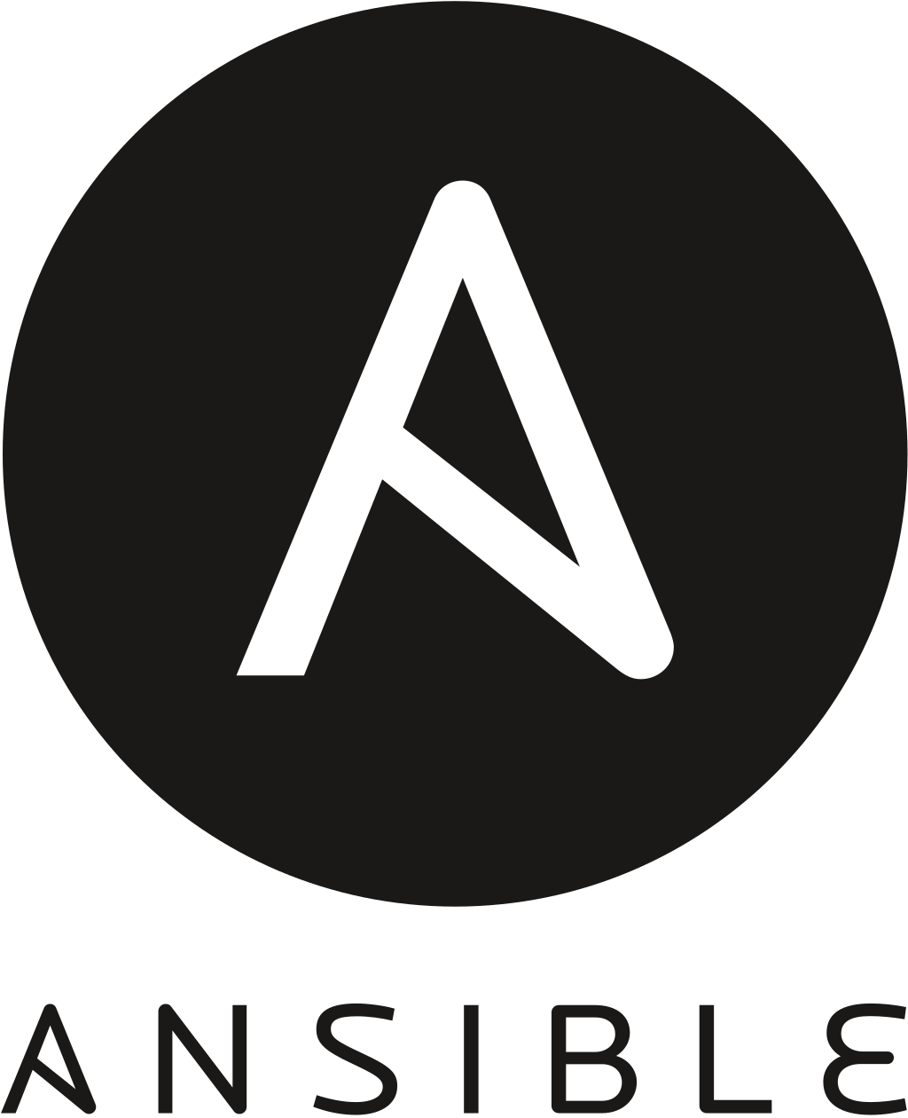


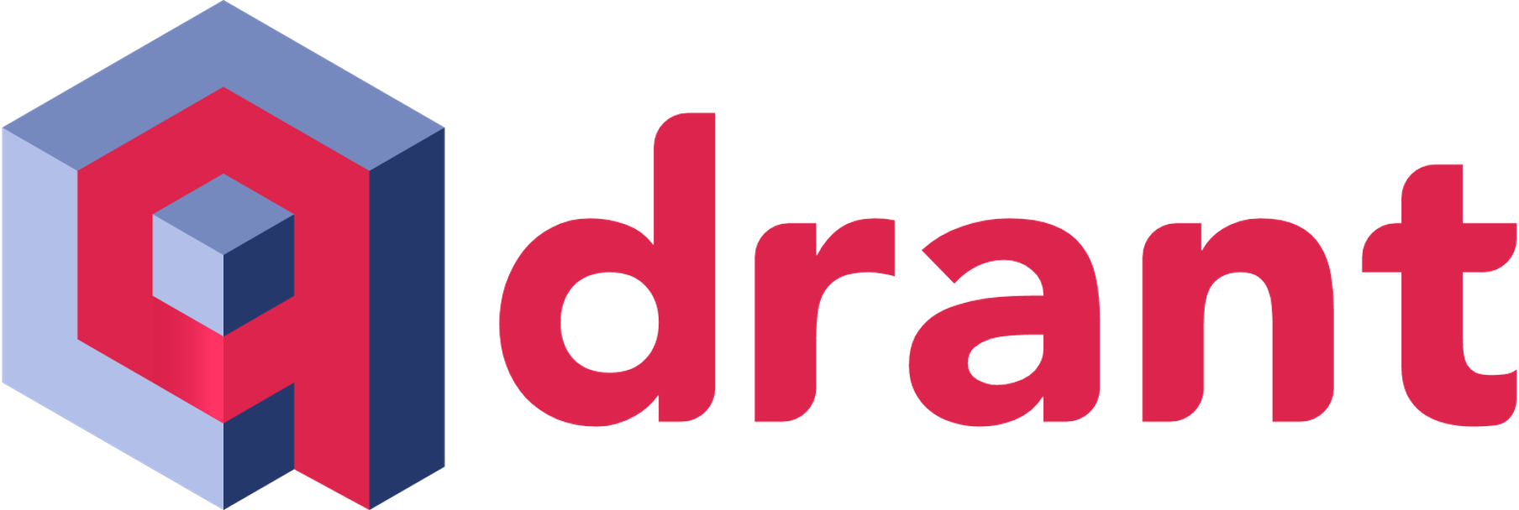



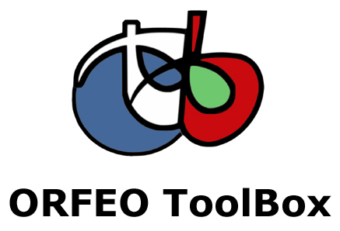

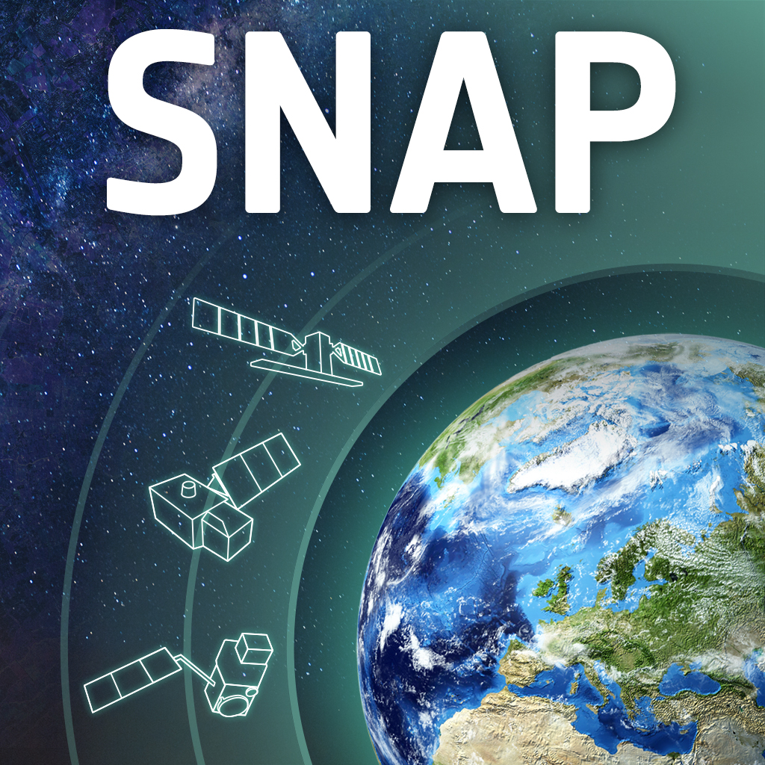
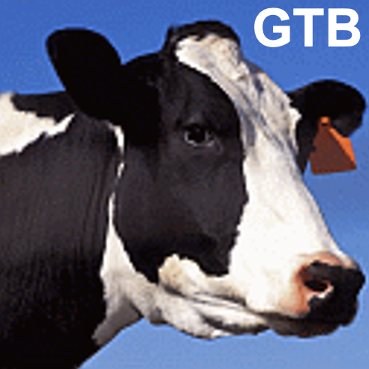



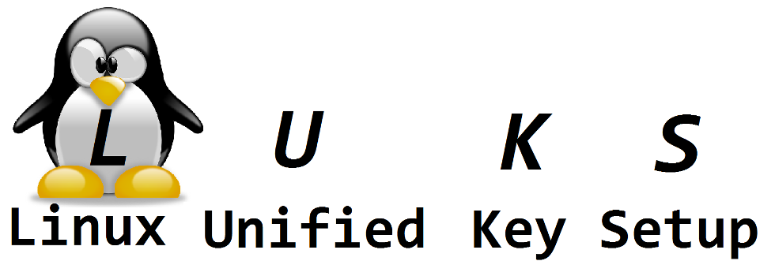






BDAP software landscape
Operating systems & virtualization
Data science languages & IDEs
AI & Machine Learning
HTC/HPC & Workflow engines
Storage & file sharing
Database engines, clients, and tools
Monitoring & Automation
Web-desktop for data science
Geospatial software applications
Search engine & web frameworks/servers
Notes:
The stack is ordered by categories: OS & Virtualisation/Containerisation, Storage & File sharing & transfer, Remote Desktop, Data science programming/development environments, Monitoring, Automation, ML, HTC/HPC/Worflows, Database management, WSIG/search, and GIS software + Knime.
All but Matlab and IDL are open-source software.

Slide 22
Conclusions – How BDAP adds value to data?
Combine different sources of data
Quality checks on data
Based on open-source and widely used standards
Integrated environment + data

Slide 23
A data-centric platform for scientific support to EU policies
Chiara Chiarelli, Davide De Marchi, Ilias Ioannou, Pieter Kempeneers, Tomas Kliment, Pierre Soille, Roberto Ugolotti
Joint Research Centre
Geneve, 04/05/2023

