Slide 1
Trustworthy Preservation and Access Metadata
Using Distributed Ledger Technology (DLT)
PV2023 Conference 2–4 May 2023, CERN
Notes:
In this video we give an overview of the technical aspects of the PROHUB project
The acronym PROHUB stands for „Protecting Oral Histories Using Blockchain“
This recording was done on the 9th of January 2023
The project has received funding from the European Commission's „Connecting Europe Facility“ programme

Slide 2
overview
Concept, Principles, and Use Case
Stakeholder and Collections
eArchiving Use Case
Managing and Persisting Resource Access Information
Blockchain-verifiable Resource Access Metadata
Notes:
We give an overview about the motivation, concepts, principles, and main use case of PROHUB
We explain who the stakeholder is and what type of collections we use to demonstrate the PROHUB implementation
We introduce an eArchiving Use Case for packaging collection data and show how we manage and persist resource access information
And, finally, we introduce the concept of blockchain-verifiable resource access authorisation metadata

Slide 3
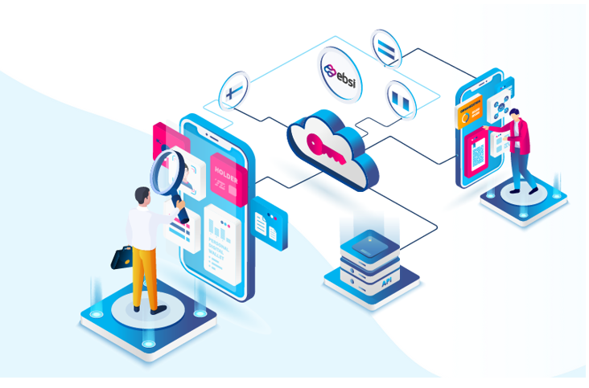
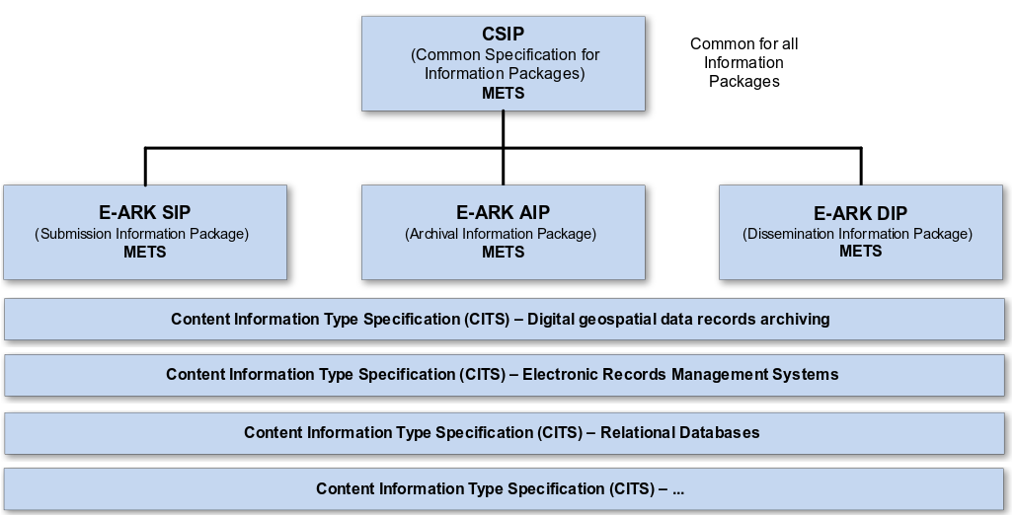
E-ARK standards & European blockchain service infrastructure
eArchiving (E-ARK Standards)
European Blockchain Service Infrastructure
Cooperation & Synergies
Notes:
From a technical perspective the goal of PROHUB is to demonstrate the benefit of and synergies between the European eArchiving initiative and the Blockchain Service infrastructure.
The eArchiving initiative provides standards and tools for digital archiving and the European Blockchain service Infrastructure provides APIs which allow using the European blockchain services

Slide 4
NIOD‘s Collections
The NIOD Institute for War, Holocaust and Genocide Studies provided several collections to test the concept of E-ARK/EBSI based access mechanisms.
  Archive 244 European Diaries and Egodocuments
    Diaries reporting stories of pain and loss, fear and hunger and moments of levity while facing greatest misery.
  Archive 250D Concentration Camps and Prisons
    Personal accounts of former prisoners of concentration camps.
  Archive 250K Concentration Camps outside the Netherlands.
    Records by private persons, interest groups of former inmates and organizations with the task to determine the fate of missing persons.
  Archive 817 Ravensbrück Women's Concentration Camp
    The collection includes personal Statements of former prisoners of Ravensbrück.
Notes:
The NIOD Institute for War, Holocaust and Genocide Studies is the stakeholder of the project and provided collections to test PROHUB‘s archiving and access implementation
The collections include personal reports and accounts of people who suffered during World War II
The material is considered sensitive and therefore secure control mechanisms are required to ensure safe archiving and access processes.

Slide 5
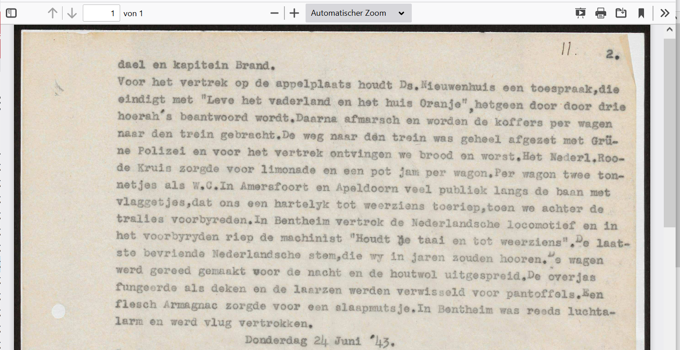
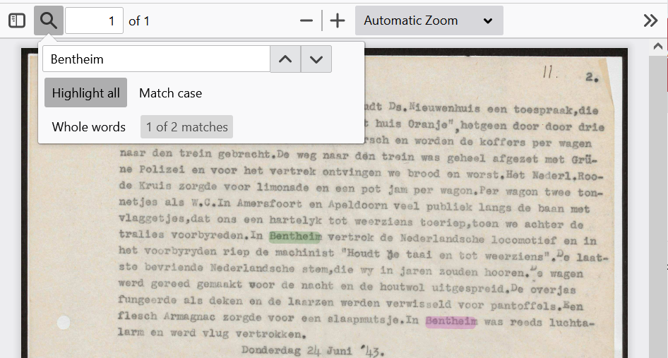
Master/dissemination representation
MASTER Image Representation
Searchable PDF Representation
Notes:
Technically, the eArchiving initiative defines standards for packaging the collections
Each information package has so called „representations“ which allow storing the collection items in different formats
Here we have a JPEG master representation and an OCR PDF representation. The second representation is derived from the first one by applying Optical Character Recognition to extract the full-text from the image

Slide 6
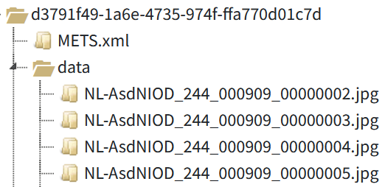
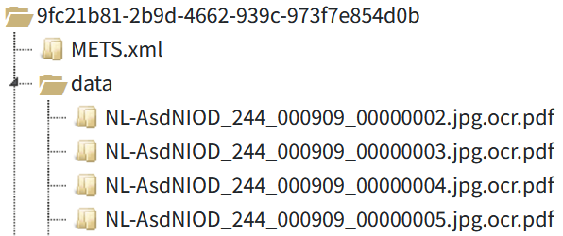
Master/dissemination representation
Master Image Representation
Searchable PDF Representation
Master Image Representation
Master Image Representation
AGGREGATED
Searchable PDF Representation
Searchable PDF Representation
Searchable PDF Representation
SIP
AIP
DIP
Notes:
The eArchiving standards allow organising the data and defining processes for:
creating information packages which are submitted to the archive (the SIPs),
Information packages which are stored in the archive (the AIPs),
And, finally, the Information packages created for dissemination purposes (the DIPs)
In this case the DIP contains an aggregated searchable PDF file which bundles all searchable PDF pages available in the AIP

Slide 7
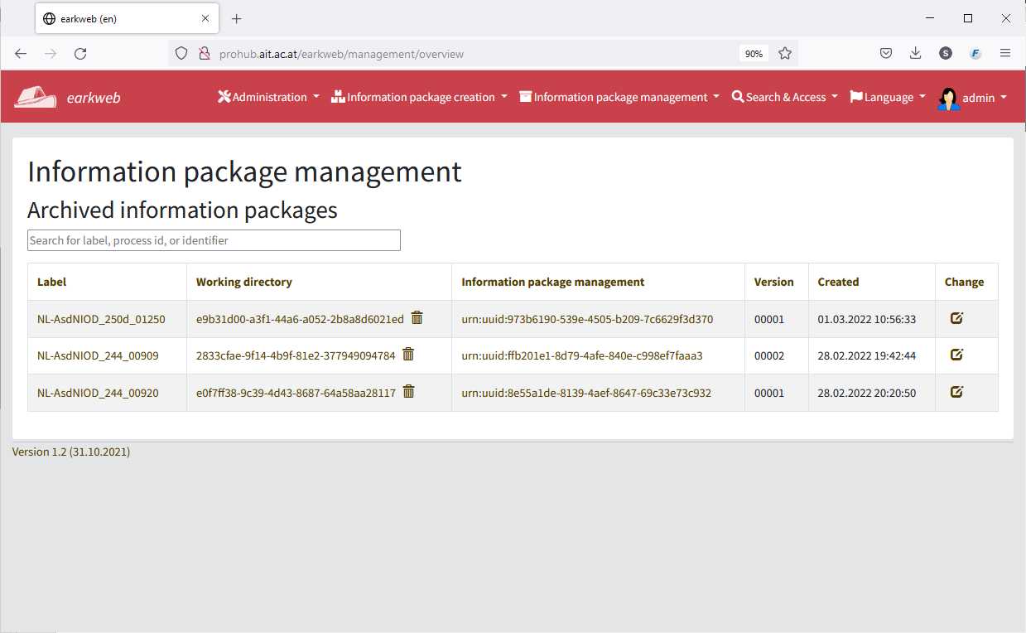
E-ARK repository refrence implementation
Notes:
PROHUB uses the E-ARK repository reference implementation to ingest and store information packages.

Slide 8

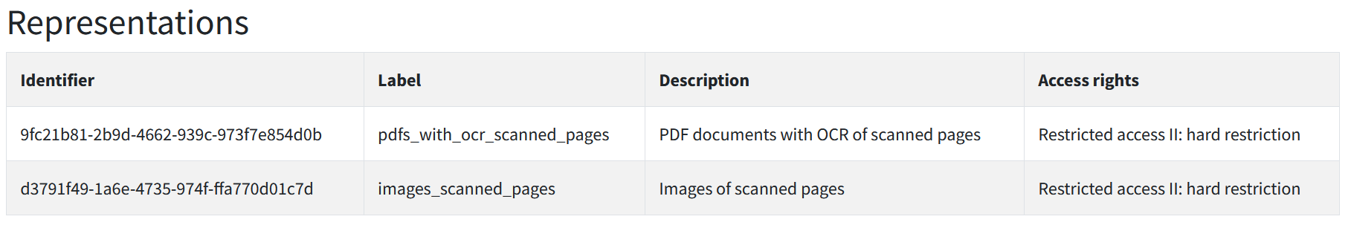
Notes:
An information package stands for the „intellectual entity“ and bundles representations, in this case below there are two representations, one is
the representation with the searchable PDF pages
And the other one contains the images of scanned document pages

Slide 9
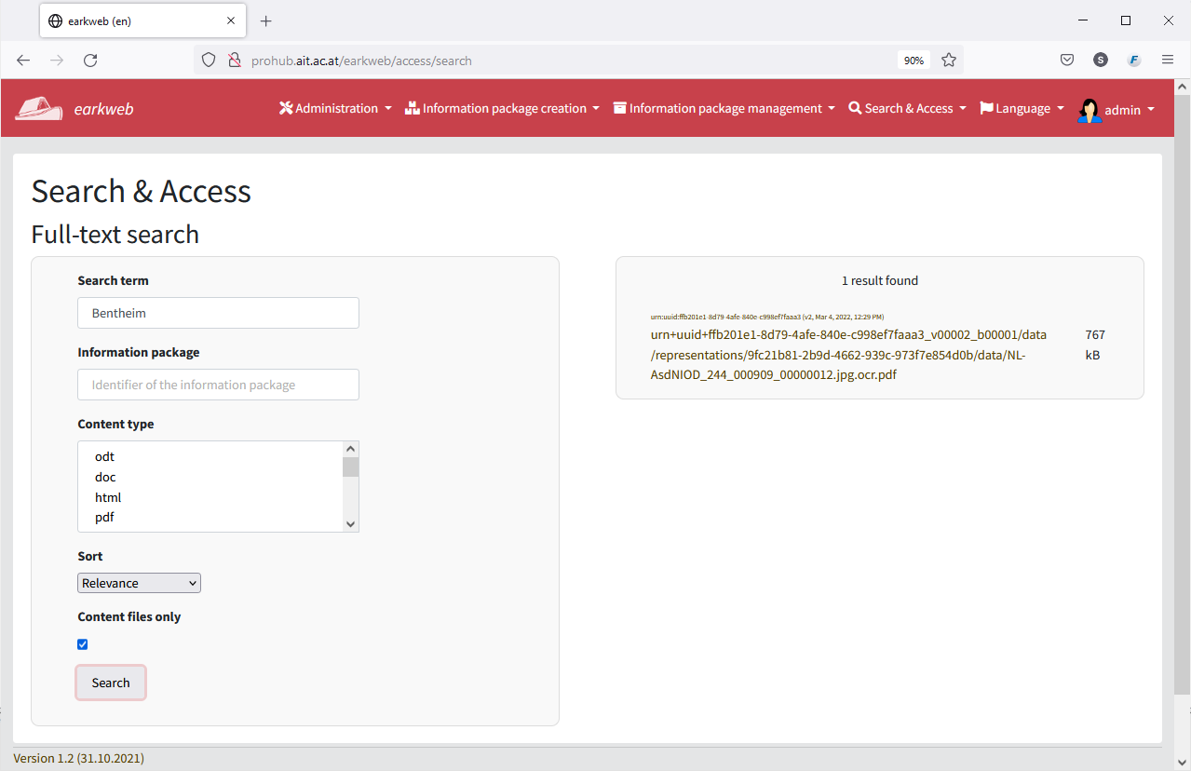
Search
Notes:
To demonstrate access to collection items it is possible to perform metadata and full text search for text documents.
In this example we search for the location „Bentheim“ which returns one PDF file match – one of the document images which includes a plain text layer.

Slide 10
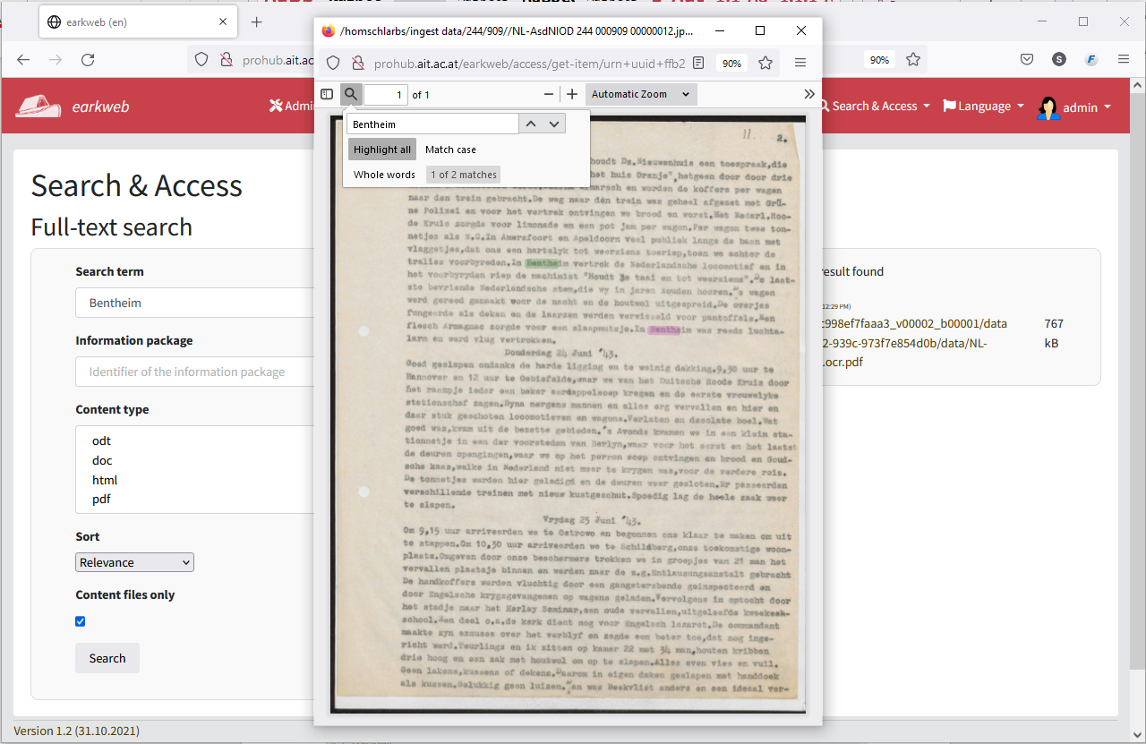
Search
Notes:
We can display the document of the search result and the matches of the term „Bentheim“ are highlighted in the document

Slide 11


A basic authorisation model
Is the applicant allowed to use the discovery service?
Is it allowed to apply search and retrieval tools to allow finding the resource?
Does the resource contain sensitive data?
Discovery Service
Applicant
Resource
Is the applicant allowed to access and use the resource?
If yes, under which conditions?
Notes:
So far so good. The repository allows full-text indexing and searching for documents containing specific search terms.
However, when dealing with sensitive material, the question is which of the documents may actually be full-text-indexed and who is allowed to access them.
In PROHUB there are three types of authorizations
An applicant may be authorised to use a discovery service
A discovery service may be authorised to index a resource
And an applicant may be authorised to access a resource
Usually, this kind of information is configured in the repository using the system-specific application logic.

Slide 12

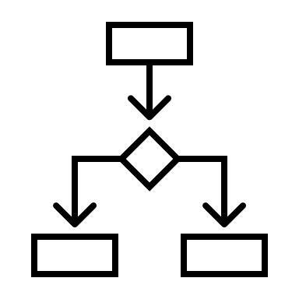
System migration - still often like this
System migration
Repository System A
Repository System B
DIP
SIP
Archival Data
Archival Data
Notes:
We argue that there is need for a system-independent, standards-based storage of resource access rights
This can be illustrated using the example of system migration
Pemissions to apply a specific category of tools
Applicants/researchers with access rights
If access related metadata and permissions are not persisted in a standardised way, they need to be redefined in the new system (labour-intensive, time-consuming).

Slide 13
And not like this?
System migration
Repository System A
Repository System B
Archival Data
The amount of data is growing at a fast pace! Moving data will become more and more difficult!
Notes:
We argue that there is need for a system-independent, standards-based storage of resource access rights
This can be illustrated using the example of system migration
Pemissions to apply a specific category of tools
Applicants/researchers with access rights
If access related metadata and permissions are not persisted in a standardised way, they need to be redefined in the new system (labour-intensive, time-consuming).

Slide 14
Motivation
Why do we want to include authorisation metadata in the information package?
Problem: Re-configuring authorization settings in a new system is labour-intensive and time-consuming.
Approach: Authorization metadata and licenses remain valid after system migration – signatures, and licenses are interpreted by the new system
Notes:
We argue that there is a need to persist resource access authorisation metadata in a system-independent and standards-based form
This need can be illustrated using the example of system migration
[explain diagram]
This is when an organisation at some point decides to replace their Repository System A by a new Repository System B.
Ideally, the archival data would not need to be modified for that purpose, but in reality, this operation usually requires retransforming the archived data into a SIP format which is understood by the new system (but that's another story, which we won't go into now …)
The problem we are focusing here on is that [problem]
The PROHUB approach that we propose is that … [approach]

Slide 15







requirements
It must be possible to define rights statements on information package, representation, or file level.
It must be possible to define rights statements related to the application of software agents enabling information retrieval, such as Optical Character Recognition (OCR) or full-text indexing software, for example.
It must be possible to define rights statements regarding information applicants.
Notes:
Related to the resource access authorisation use case PROHUB has identified a couple of requirements:
First, …, second, …, and, third, …

Slide 16
Requirement 1: Object levels
premis:object
urn:example:niod:244.909
premis:objectCategory= intellectual entity
Notes:
In line with recommendations of the eArchiving initiative we use PREMIS metadata for recording events and rights related to digital objects

Slide 17
Requirement 1: Object levels
premis:object
urn:example:niod:244.909
premis:objectCategory= intellectual entity
represents
represents
premis:object
premis:object
urn:example:niod:244.909.1
is derived from
urn:example:niod:244.909.2
premis:objectCategory= representation
premis:objectCategory= representation
PREMIS Objects for the information package, representation, or file level can be defined and therefore rights statements can relate to the objects at these levels.
Notes:
We start by defining an object which stands for the intellectual entity, so for the information package as a whole
We then introduce a second object which as the „master image representation“
A third object is the „searchable PDF representation“
Finally we express the fact, that the second representation was derived from the first one.
In summary, using premis we can create objects for all levels, down to the file level and thereby relate rights statements to these levels

Slide 18







Requirement 2: software agents
Tools performing or enabling search and retrieval
Information Extraction
Search & Retrieval
Optical Character Recognition (OCR)
Metadata editing/extraction tools
Full-text indexing
Notes:
Regarding requirement 2 a software taxonomy allows grouping software agents so that rights statements can be assigned …
To a specific software, such as Tesseract OCR,
To the group of Optical Character Recognition software,
To the group of „Information Extraction“ tools,
Or at the highest level in this example, to the group of „Tools performing or enabling search and retrieval”

Slide 19
Requirement 2: software agents
premis:object
urn:example:niod:244.909
premis:objectCategory= intellectual entity
represents
represents
premis:object
premis:object
urn:example:niod:244.909.1
is derived from
urn:example:niod:244.909.2
premis:objectCategory= representation
premis:objectCategory= representation
Is allowed to be be applied to
premis:agent
Tools performing or enabling search and retrieval
Notes:
We are then able to relate a rights statement to any of these levels in the software taxonomy
In this example we take the most generic level of the „Tools performing or enabling search and retrieval“
And define that this group is „Is allowed to be applied to“ the representation created for dissemination purposes (this representation could contain anonymised content or where specific parts have been blacked out)
If an internal policy states that applying the search and retrieval tools is only allowed if this is explicitly stated in the metadata, it can be demanded from the repository system provider to consider these metadata and enforce them.

Slide 20
Requirement 3: applicant
premis:object
urn:example:niod:244.909
premis:objectCategory= intellectual entity
represents
represents
premis:object
premis:object
urn:example:niod:244.909.1
is derived from
urn:example:niod:244.909.2
premis:objectCategory= representation
premis:objectCategory= representation
License agreement is stored as part of the information package
Is allowed to access/use
premis:agent
https://orcid.org/0000-0002-1825-0097
Notes:
The 3rd requirement is analogue to the 2nd one with the only difference that the agent is a person or researcher requesting access to the resource
In this case the License agreement is stored as part of the information package and the event of the license agreement conclusion is recorded

Slide 21


Blockchain object registration and license agreement process
Register dissemination
object
Create text license document
Provider assigns license
Applicant accepts license
Provider approves request
MASTER
ACCESS
Ressource
Provider
Applicant
Provider
Notes:
The events of the of the license agreement conclusion consist of a sequence of steps which are
Recorded in PREMIS metadata
And registered in the blockchain in form of transactions
The steps are to:
…

Slide 22
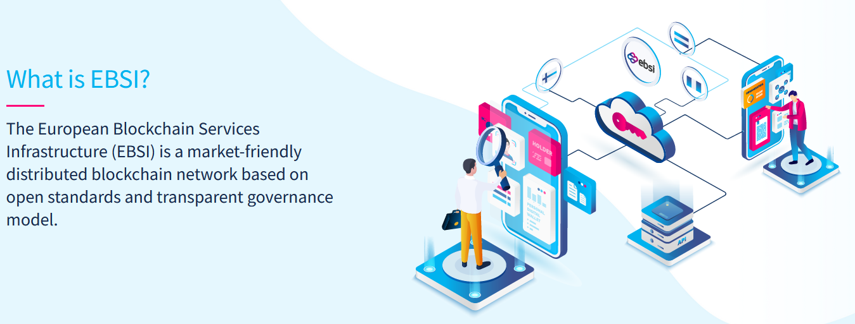
European Blockchain Services Infrastructure (EBSI)
Source: https://ec.europa.eu/digital-building-blocks/wikis/display/EBSI/What+is+ebsi
Notes:
PROHUB uses the European Blockchain Services Infrastructure (EBSI)
To store metadata about events in the blockchain, we are using the EBSI Timestamp API
Basically, this API allows storing timestamped hash on the blockchain and retrieve if for validation

Slide 23
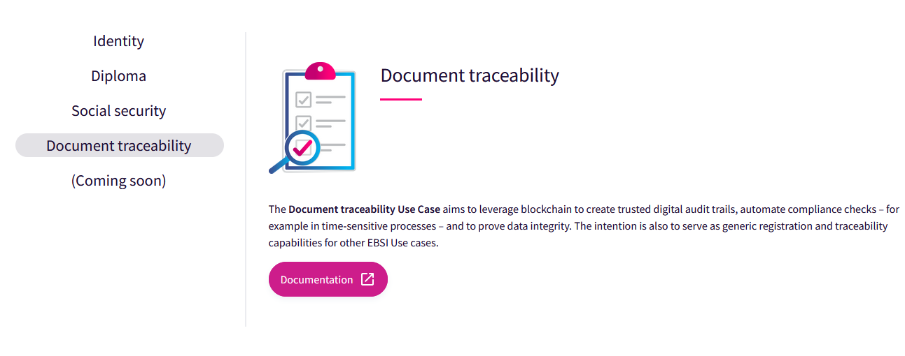
EBSI Use Cases
Source: https://ec.europa.eu/digital-building-blocks/wikis/display/EBSI/Use+cases
Notes:
EBSI defines a series of use cases to support verifying credentials, tracking & tracing, trusted data exchange, and more
Especially relevant for PROHUB is the so called Notary Use case which in EBSI terms falls into the category of „Document traceability“

Slide 24


Blockchain notary
Fingerprint (hash) of document(s) and optionally signatures is stored
  impossible to derive the original document from the hash value only
Transaction stores the hash value with a timestamp when it was performed
The hash value may represent a single document or multiple documents
Documents may be signed or hashed together with signature files
Proof of existence and (optionally) proof of authenticity
Hash
Transaction
Timeline
Notes:
The key aspects of the Blockchain Notary use case are the following …
Only a fingerprint (or technically: a hash) of the document is stored ; it is impossible to derive original document from the hash value only
A transaction stores the hash value with a timestamp when it was performed
The hash value may represent a single document or multiple documents
Documents may be signed or hashed together with signature files
The information in the Blockchain serves as a proof of existence and (optionally) proof of authenticity

Slide 25


Blockchain backed metadata
Blockchain
Metadata
Metadata
Event metadata records are registered in the blockchain
Metadata can be validated against blockchain registry
Integrity and authenticity
Protection against manipulation
}
of resource access and authorization metadata
Notes:
With the help of EBSI, metadata events persisted in PREMIS can be registered in the blockchain
This allows then validating PREMIS metadata against the blockchain registry
The benefit of this kind of blockchain validated metadata is that:
The Integrity and authenticity of resource access and authorization metadata is ensured.
And the protection against manipulation is guaranteed.

Slide 26
Prototype implementation
Prototype published at:
  https://github.com/E-ARK-Software/blockchain-notary-poc

Slide 27
Thank you!
SVEN SCHLARB
Scientist
Data Science & Artificial Intelligence
Center for Digital Safety & Security
AIT Austrian Institute of Technology GmbH
Giefinggasse 4 | 1210 Vienna | Austria
sven.schlarb@ait.ac.at
Notes:
This was our short introduction into the PROHUB project
More information can be found on the website prohub dot ait dot ac dot ait
Thank you for listening! Good buye!

