Slide 1
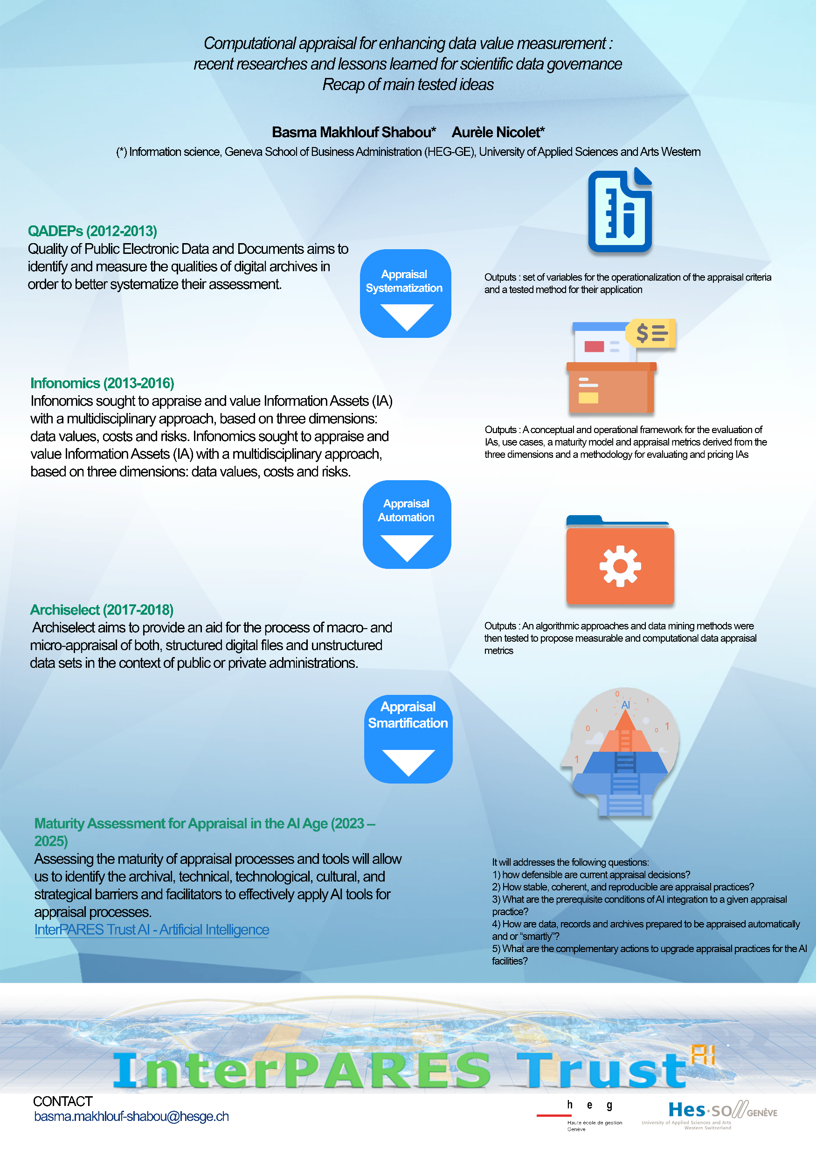
#0184
Computational appraisal for enhancing data value measurement: recent researches and lessons learned for scientific data governance Recap of main tested ideas
Basma Makhlouf Shabou, Aurèle Nicolet

