Slide 1
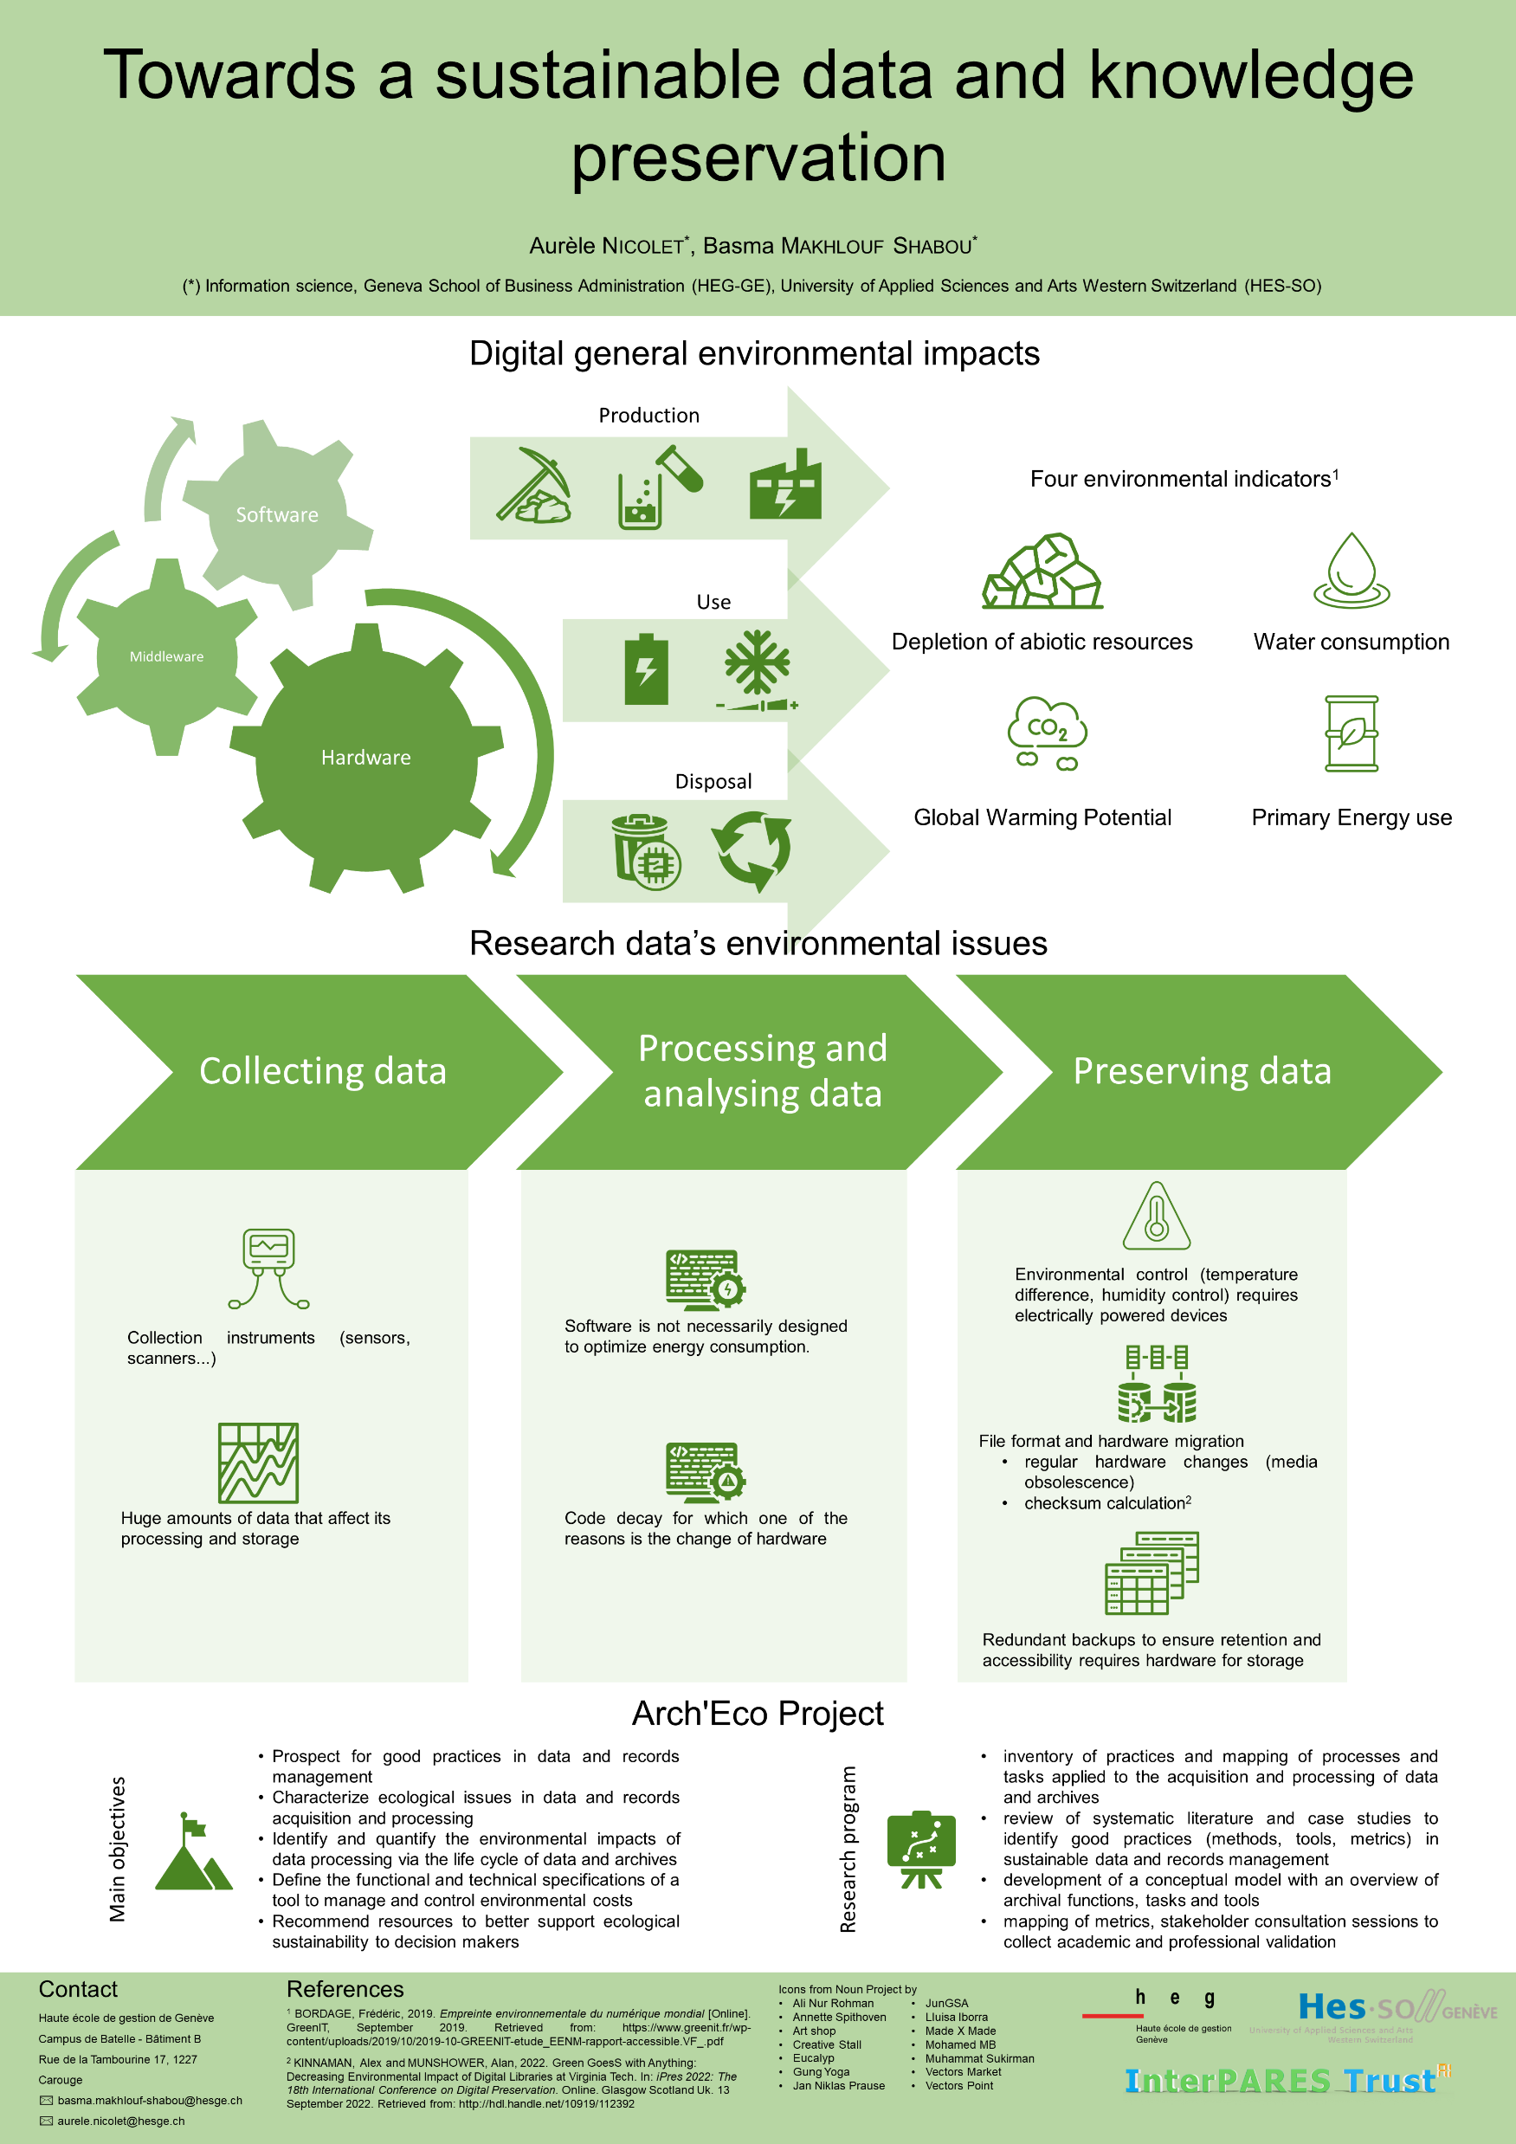
#4705
Towards a sustainable data and knowledge
preservation
Aurèle Nicolet , Basma Makhlouf Shabou

