Slide 1

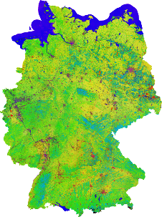

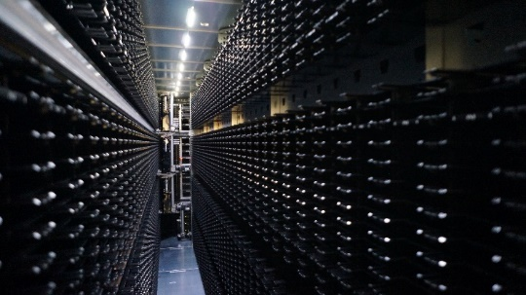
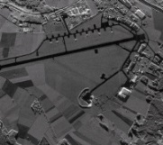
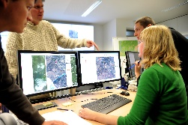

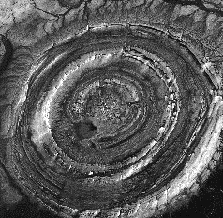

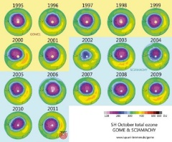

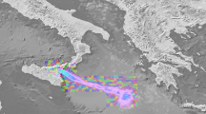
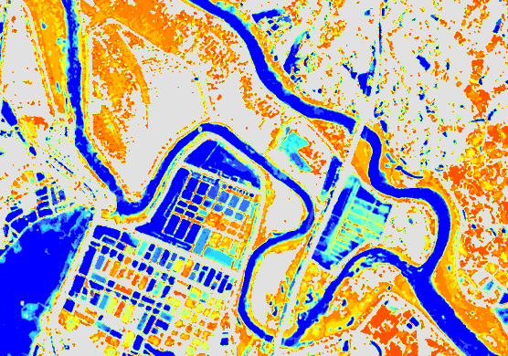
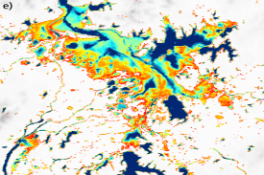


Getting out the Data – Fighting the Latency Dragon
Charlotte Wehn, German Aerospace Center DLR
We‘ve got all this data in our archive
We‘ve got great ideas to use it
We‘ve got the (processing) power
But tape is slowing us down
Can‘t we do anything about it ?
Yes we can - and we did!
Check out my poster and find out how!

