Slide 1

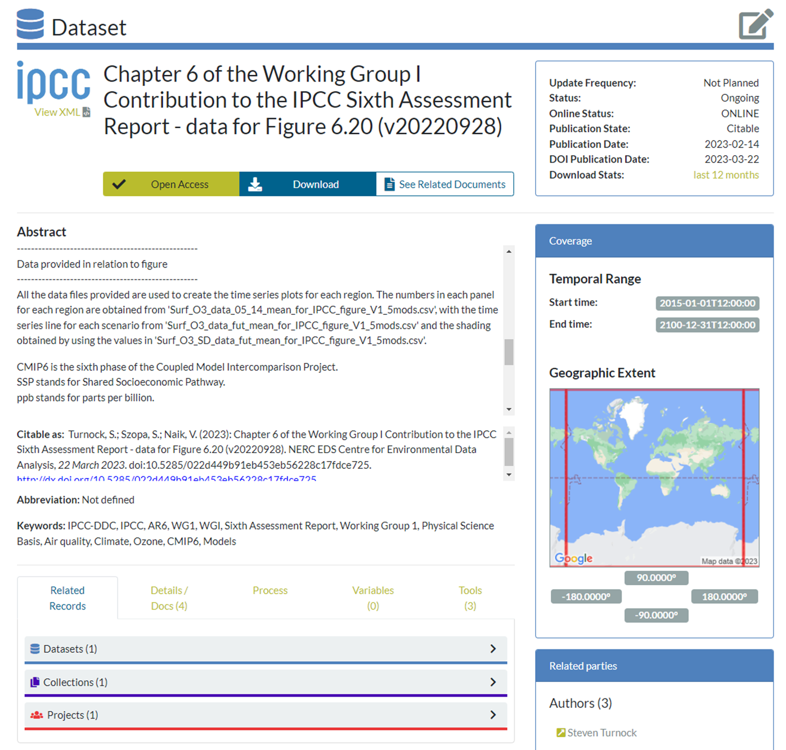
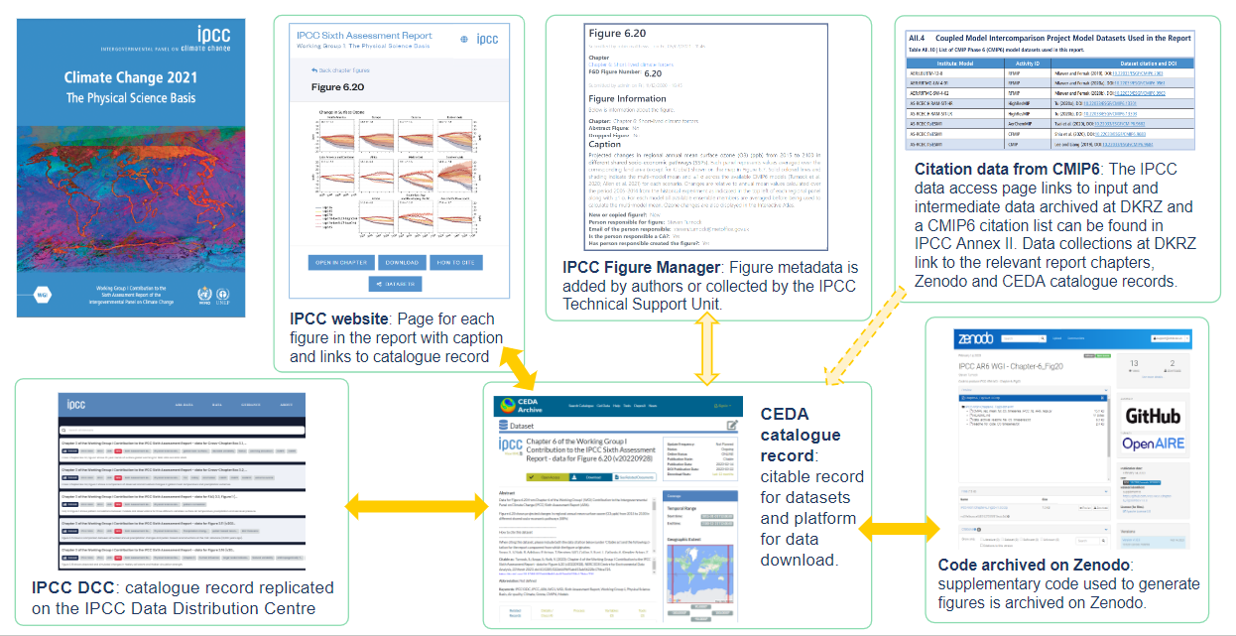
Making IPCC Data FAIR
The reality of implementing FAIR principles in the IPCC context to support open science and provide a citable platform to acknowledge the work of authors.
Find out how the catalogue record is FAIR!
Molly MacRae, Emily Anderson, Diego Cammarano, Charlotte Pascoe, Anna Pirani, Lina Sitz, Martina Stockhause
Come and find out about our: Data Publication Ecosystem, Workflow of Data, FAIR implementation, Decision Making Trees and Recommendations for AR7

