Slide 1
Minute Madness poster session schedule
Pilar de Teodoro (recording submitted) | Enabling data discovery in big datasets
Petiton Julien (recording submitted) | Using the REGARDS Framework for the renewal of the CNES archive system
Kajal Haria | ERS-1/2 SAR and ENVISAT ASAR CEOS-ARD NRB Product Development Project
Benjamin Branch (no poster submitted) | Workforce data curation training with AI considerations in Federated Data Repositories by netcdf-empowered community informatics at OKD edge site
Poppy Townsend | Scoping Net Zero Research Computing
Di Xian (no poster submitted) | Fengyun meteorological satellite global observation and applications
Molly MacRae | Implementing FAIR principles in the IPCC context to support open science and provide a citable platform to acknowledge the work of authors.
Charlotte Wehn | Getting Out The Data - Fighting The Latency Dragon
David Giaretta | Preserving an endangered society: the case of Maldives
David Giaretta | Developing an OAIS based Interoperability Framework
Aurèle Nicolet | Towards a sustainable data and knowledge preservation
Adithya Thaduri (no poster submitted) | Data standardization and integration for maintenance of Critical Infrastructure
Baptiste Cecconi (no poster submitted) | TFCat (Time-Frequency Catalogue): JSON Implementation and Python library
Zhe Xu (no poster submitted) | Design and Implementation of FENGYUN Meteorological Satellite Archive Data Migration Mission
Liv Toonen | CryoSat Ice Baseline-E: Operational & Reprocessed Data Quality Control
Joey Mukherjee | Converting a Traditional Space Science Operations Center to a Cloud-Based Architecture
David Giaretta | Petabyte scale, OAIS/ISO 16363 conformant archive
Jordi Andilla (no poster submitted) | Data structure and long-term preservation of sequential images from optical microscopy
Bernard Pruin | In-Situ and IoT data inventorisation in support of earth observation data analysis
Fay Done | Adding Value to ESA Heritage and Third-Party Mission Archived Datasets via Reprocessing: ATSR and ALOS
Aurèle Nicolet | Computational appraisal for enhancing data value discovery: recent researches and lessons learned for scientific data governance
Deborah Agarwal | Focusing on Scalable Citations to Improve Data Usability and FAIRness
Marcelo Garcia (remote) | Developing a Prototype of Library Dataset supporting Services

Slide 2
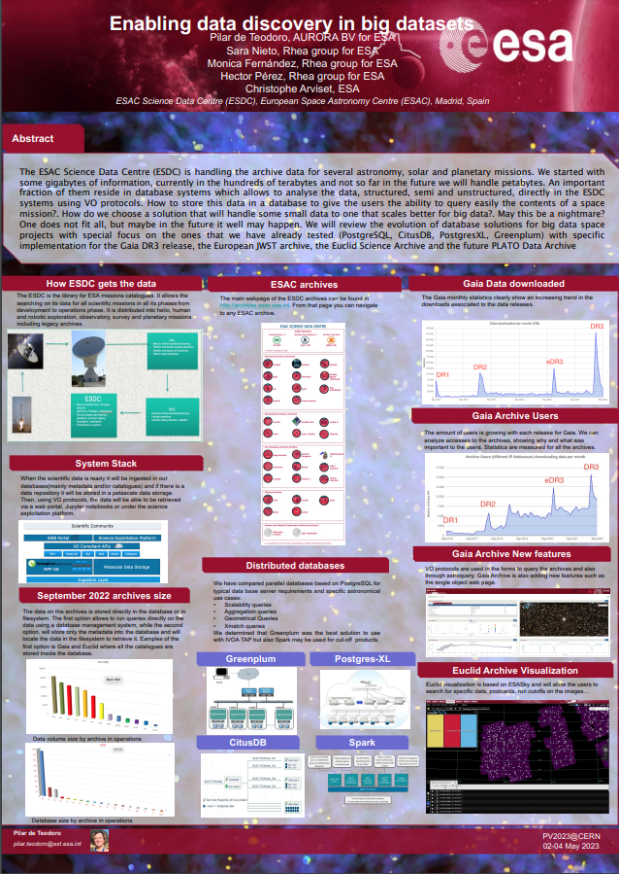


Slide 3
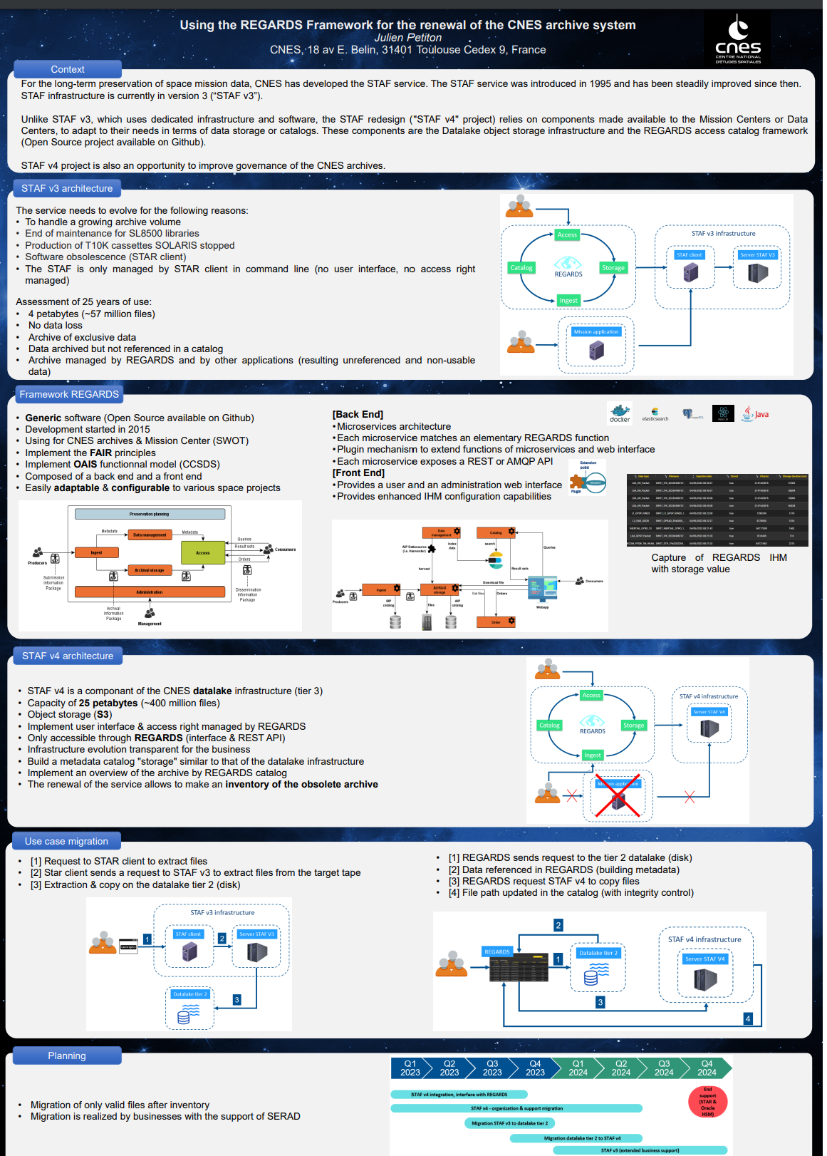


Slide 4



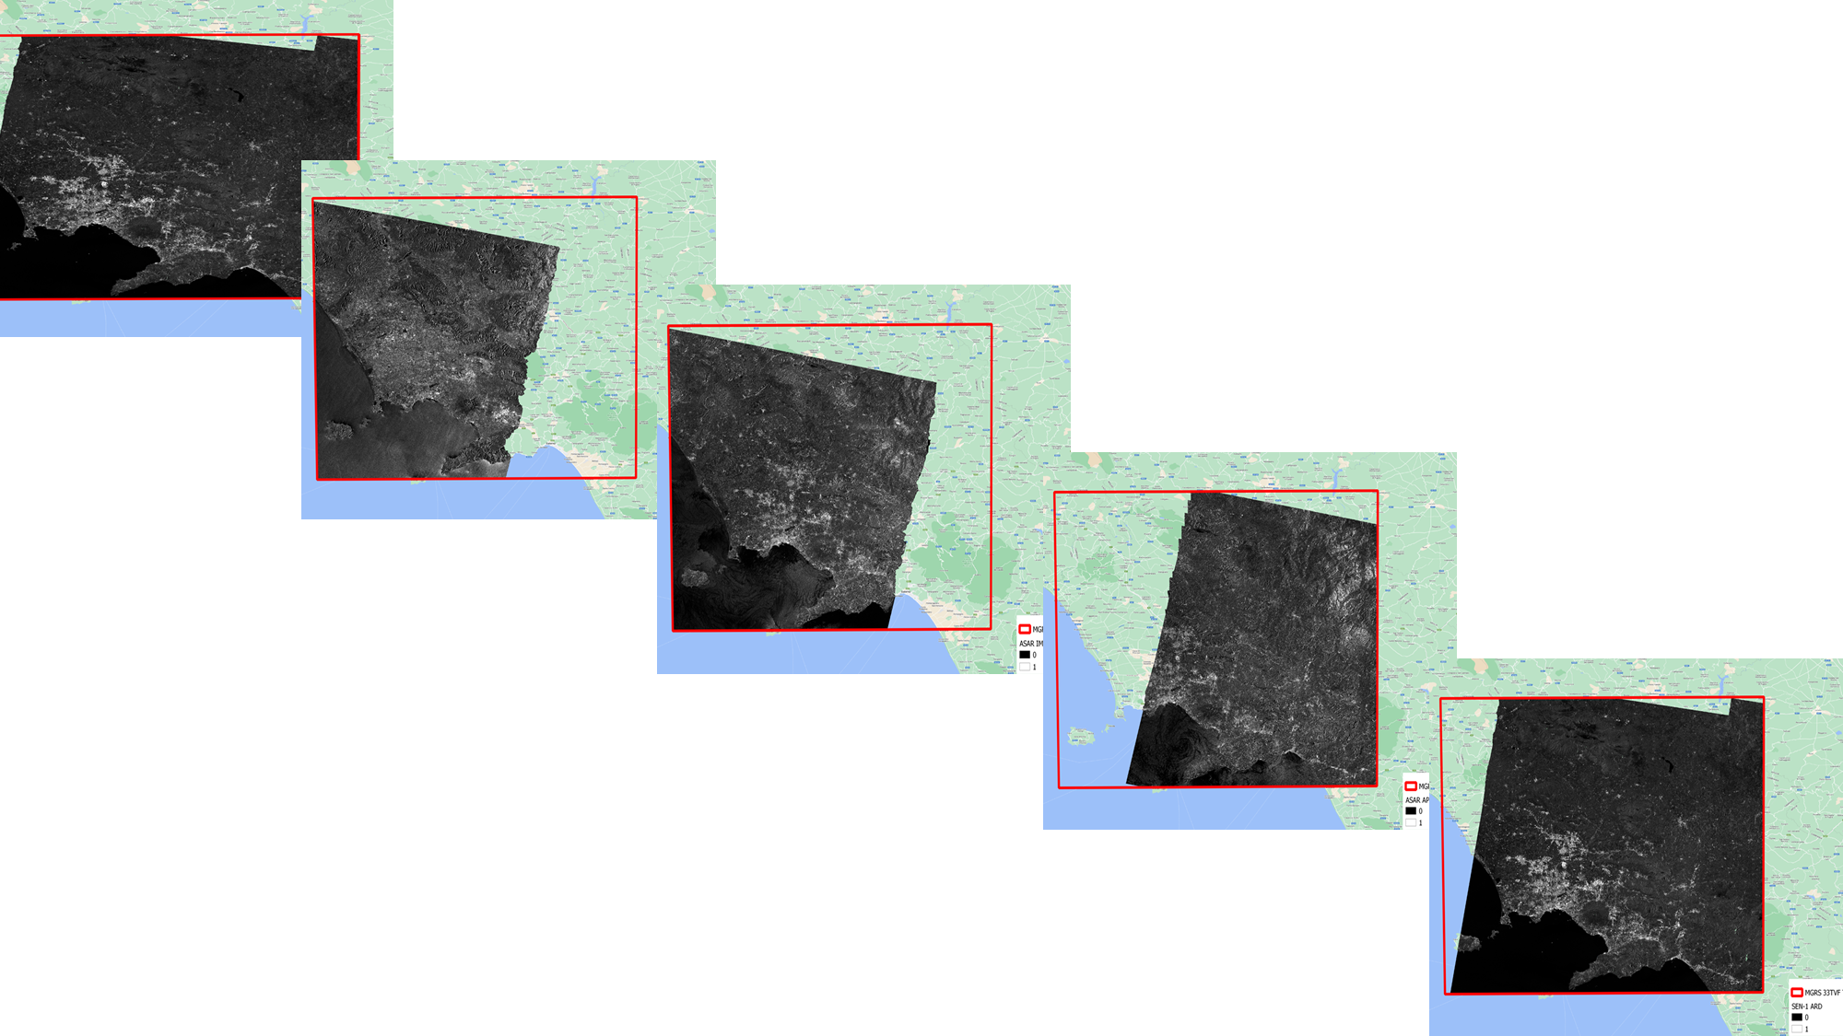


ERS-1/2 SAR and ENVISAT ASAR CEOS-ARD NRB Product Development Project
This project fulfils the needs of ESA’s Heritage Space Programme to generate a CEOS-ARD SAR product aligned to Sentinel-1 and Sentinel-2 ARD outputs, for the historic ERS-1/2 and ENVISAT missions.
Baseline specification:
CEOS-ARD specification for SAR Normalised Radar Backscatter (NRB) PFS v5.5
Current status:
Builds Upon: PyroSAR and SNAP
DEM: EEA-10 / GLO-30 or GLO-90
RTC: Flattening Gamma: Radiometric Terrain Correction for SAR Imagery
Gridding: Aligned to MGRS, geometry of each tile read from a Sentinel-2 reference KML file
CEOS Requirement Traceability:
  30/30 Threshold requirements (100% compliance)
  7/14 Target requirements (50% compliance)
Development approach:
Closely follows Sentinel-1 approach to support:
Immediate analysis and facilitation of data use
Interoperability
Cloud computation capability
Open science compliance
Kajal Haria⁽¹⁾, Michael Williams⁽¹⁾, Garin Smith⁽¹⁾, Ricardo Noguera⁽¹⁾, Clément Albinet⁽²⁾, Mirko Albani⁽²⁾, Antonio Valentino⁽³⁾, Sabrina Pinori⁽⁴⁾
⁽¹⁾Telespazio UK (TPZ UK), UK; ⁽²⁾ European Space Agency (ESA)/ESRIN, Italy; ⁽³⁾ RHEA Group, Italy, ⁽⁴⁾ Serco, Italy

Slide 5
Workforce data curation training with AI considerations in Federated Data Repositories by netcdf-empowered community informatics at OKD edge site
Benjamin Branch

Slide 6
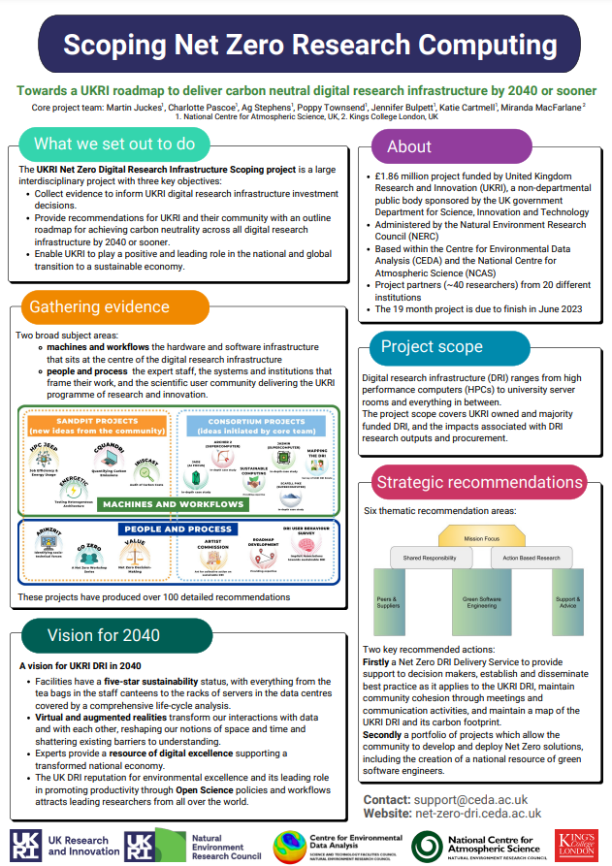

Slide 7
Fengyun meteorological satellite global observation and applications
Di Xian

Slide 8

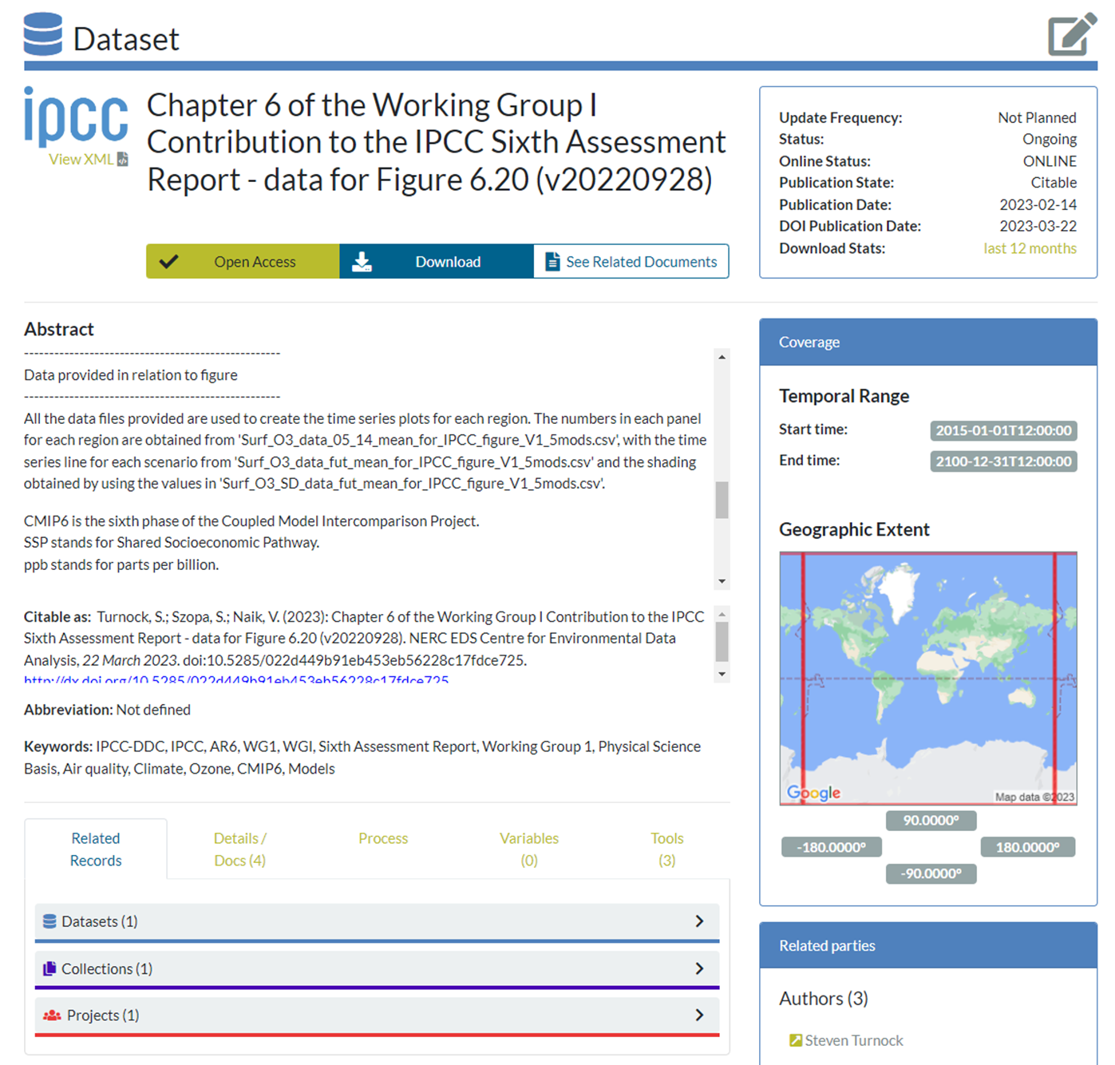
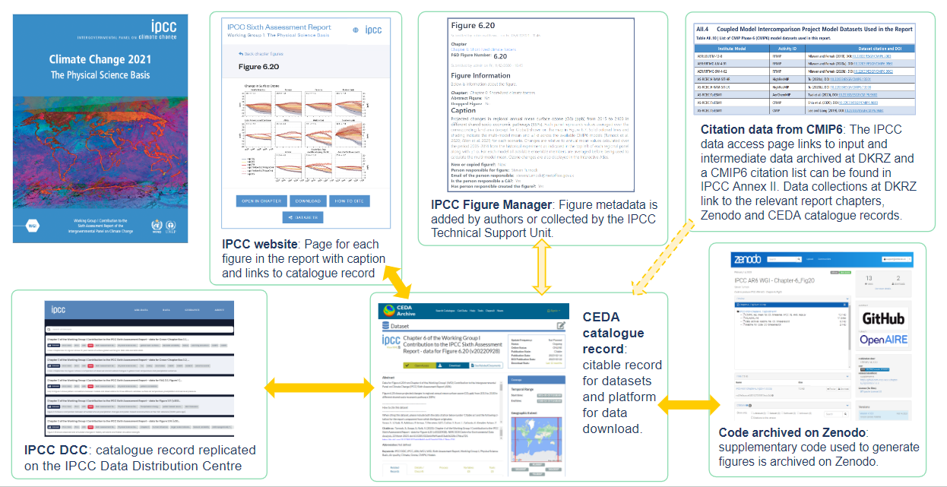
Making IPCC Data FAIR
The reality of implementing FAIR principles in the IPCC context to support open science and provide a citable platform to acknowledge the work of authors.
Find out how the catalogue record is FAIR!
Molly MacRae, Emily Anderson, Diego Cammarano, Charlotte Pascoe, Anna Pirani, Lina Sitz, Martina Stockhause
Come and find out about our: Data Publication Ecosystem, Workflow of Data, FAIR implementation, Decision Making Trees and Recommendations for AR7

Slide 9
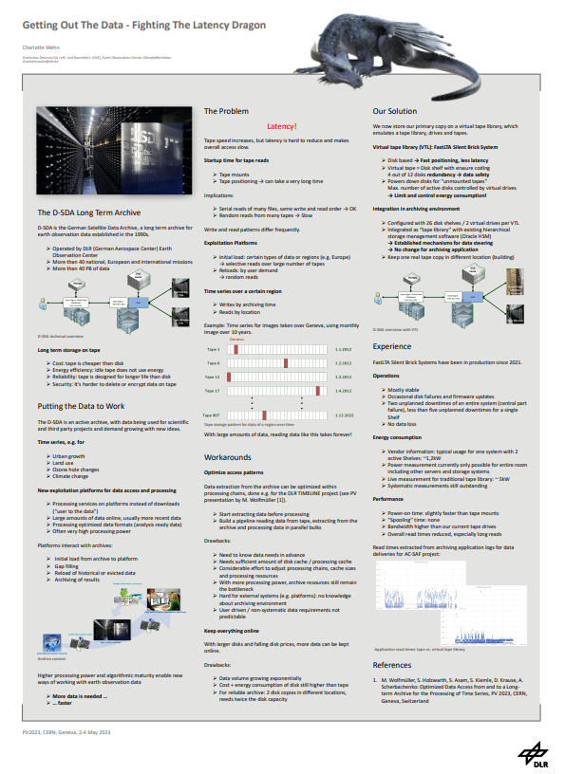

Slide 10


Slide 11
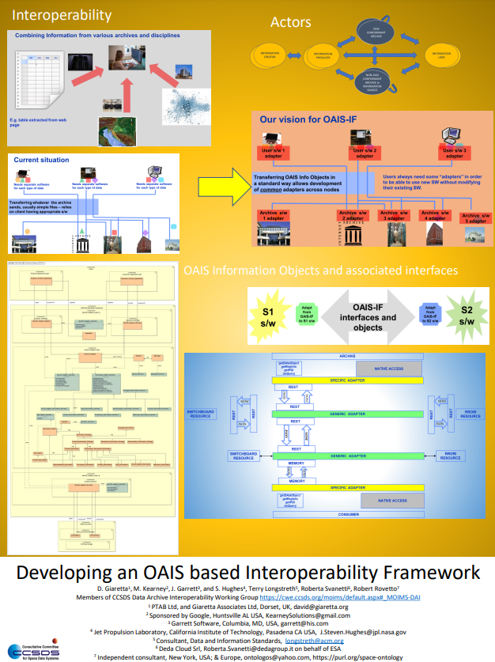

Slide 12
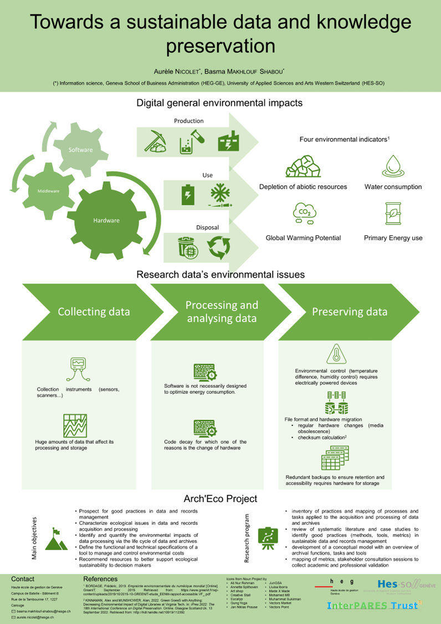

Slide 13
Data standardization and integration for maintenance of Critical Infrastructure
Adithya Thaduri

Slide 14
TFCat (Time-Frequency Catalogue): JSON Implementation and Python library
Baptiste Cecconi

Slide 15
Design and Implementation of FENGYUN Meteorological Satellite Archive Data Migration Mission
Zhe Xu

Slide 16
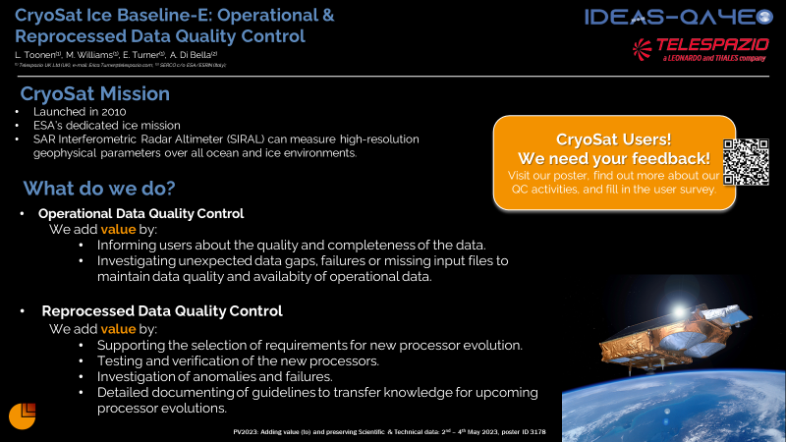

Slide 17
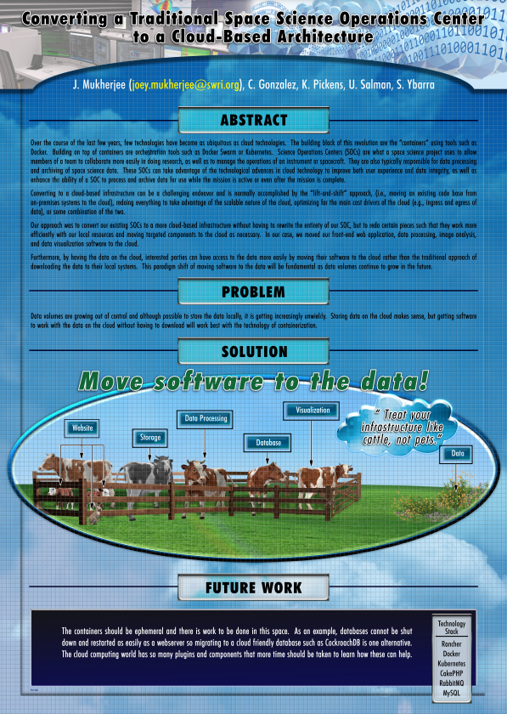

Slide 18
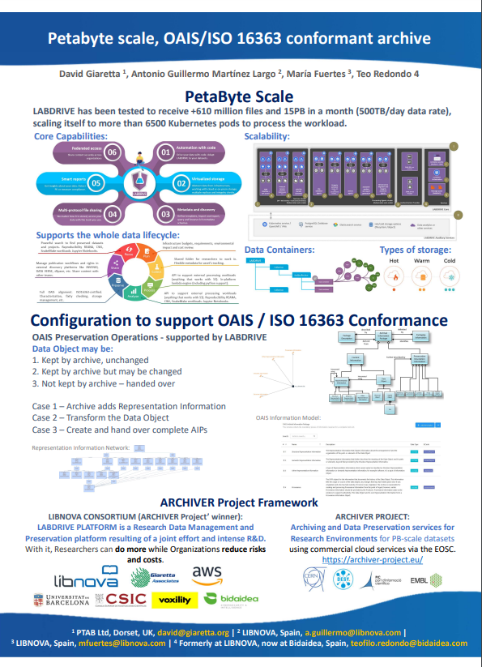

Slide 19
Data structure and long-term preservation of sequential images from optical microscopy
Jordi Andilla

Slide 20
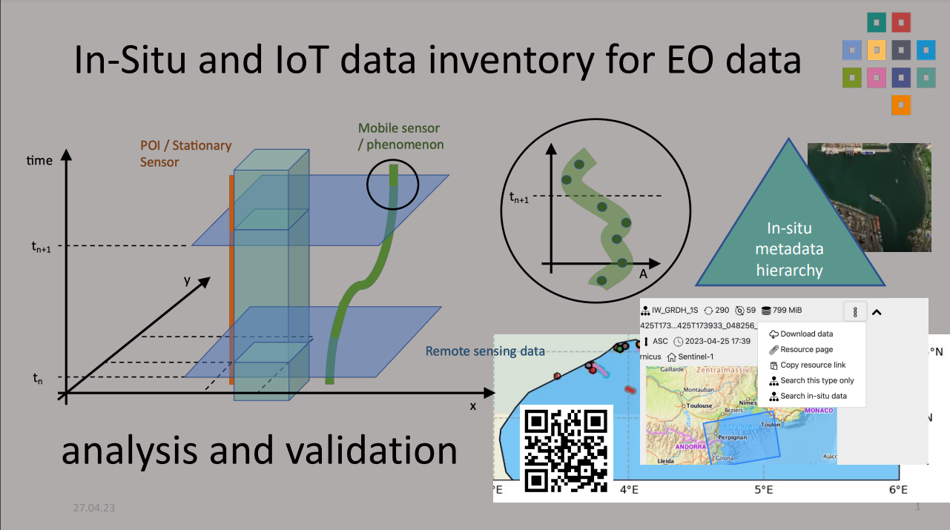

Slide 21
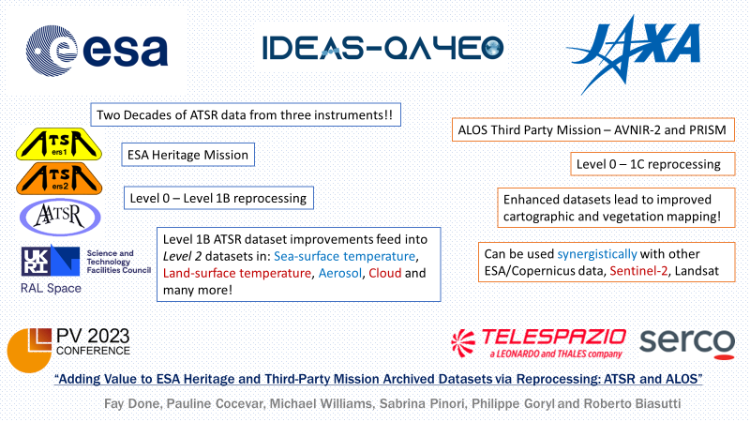

Slide 22
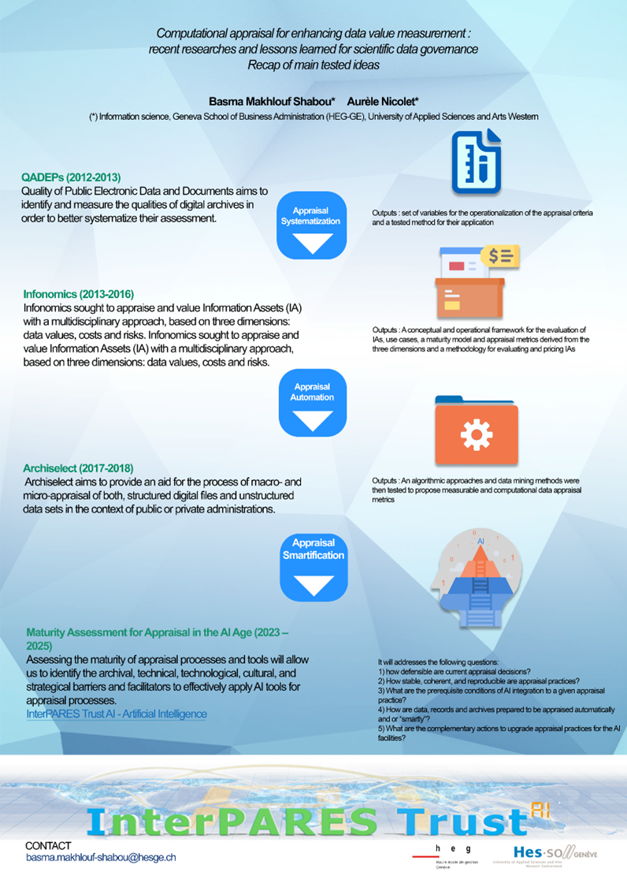

Slide 23
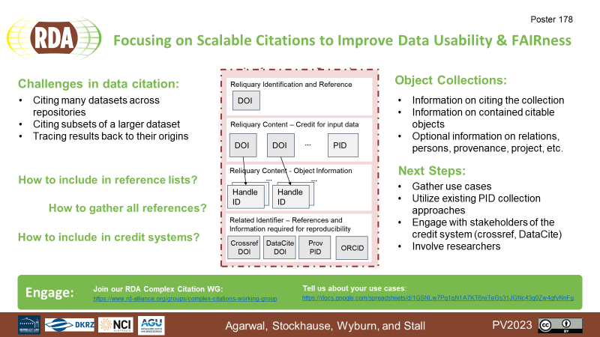

Slide 24
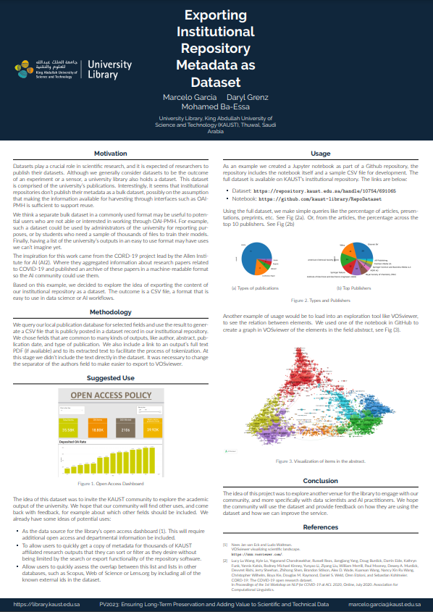
Notes:
Remote

