Slide 1

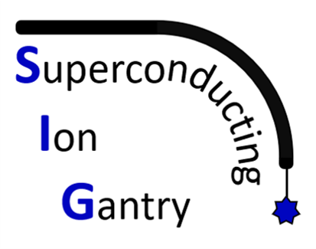
Update on SIG WP2
Marco Prioli on behalf of INFN - LASA
Sept. 2022

Slide 2
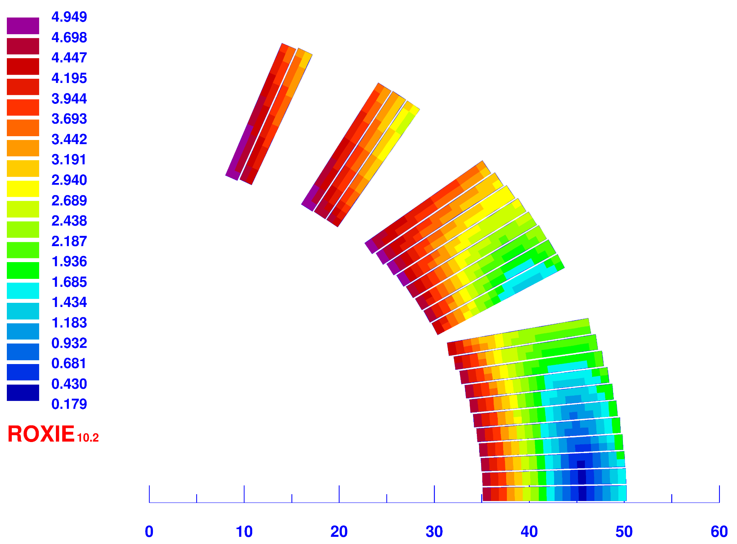
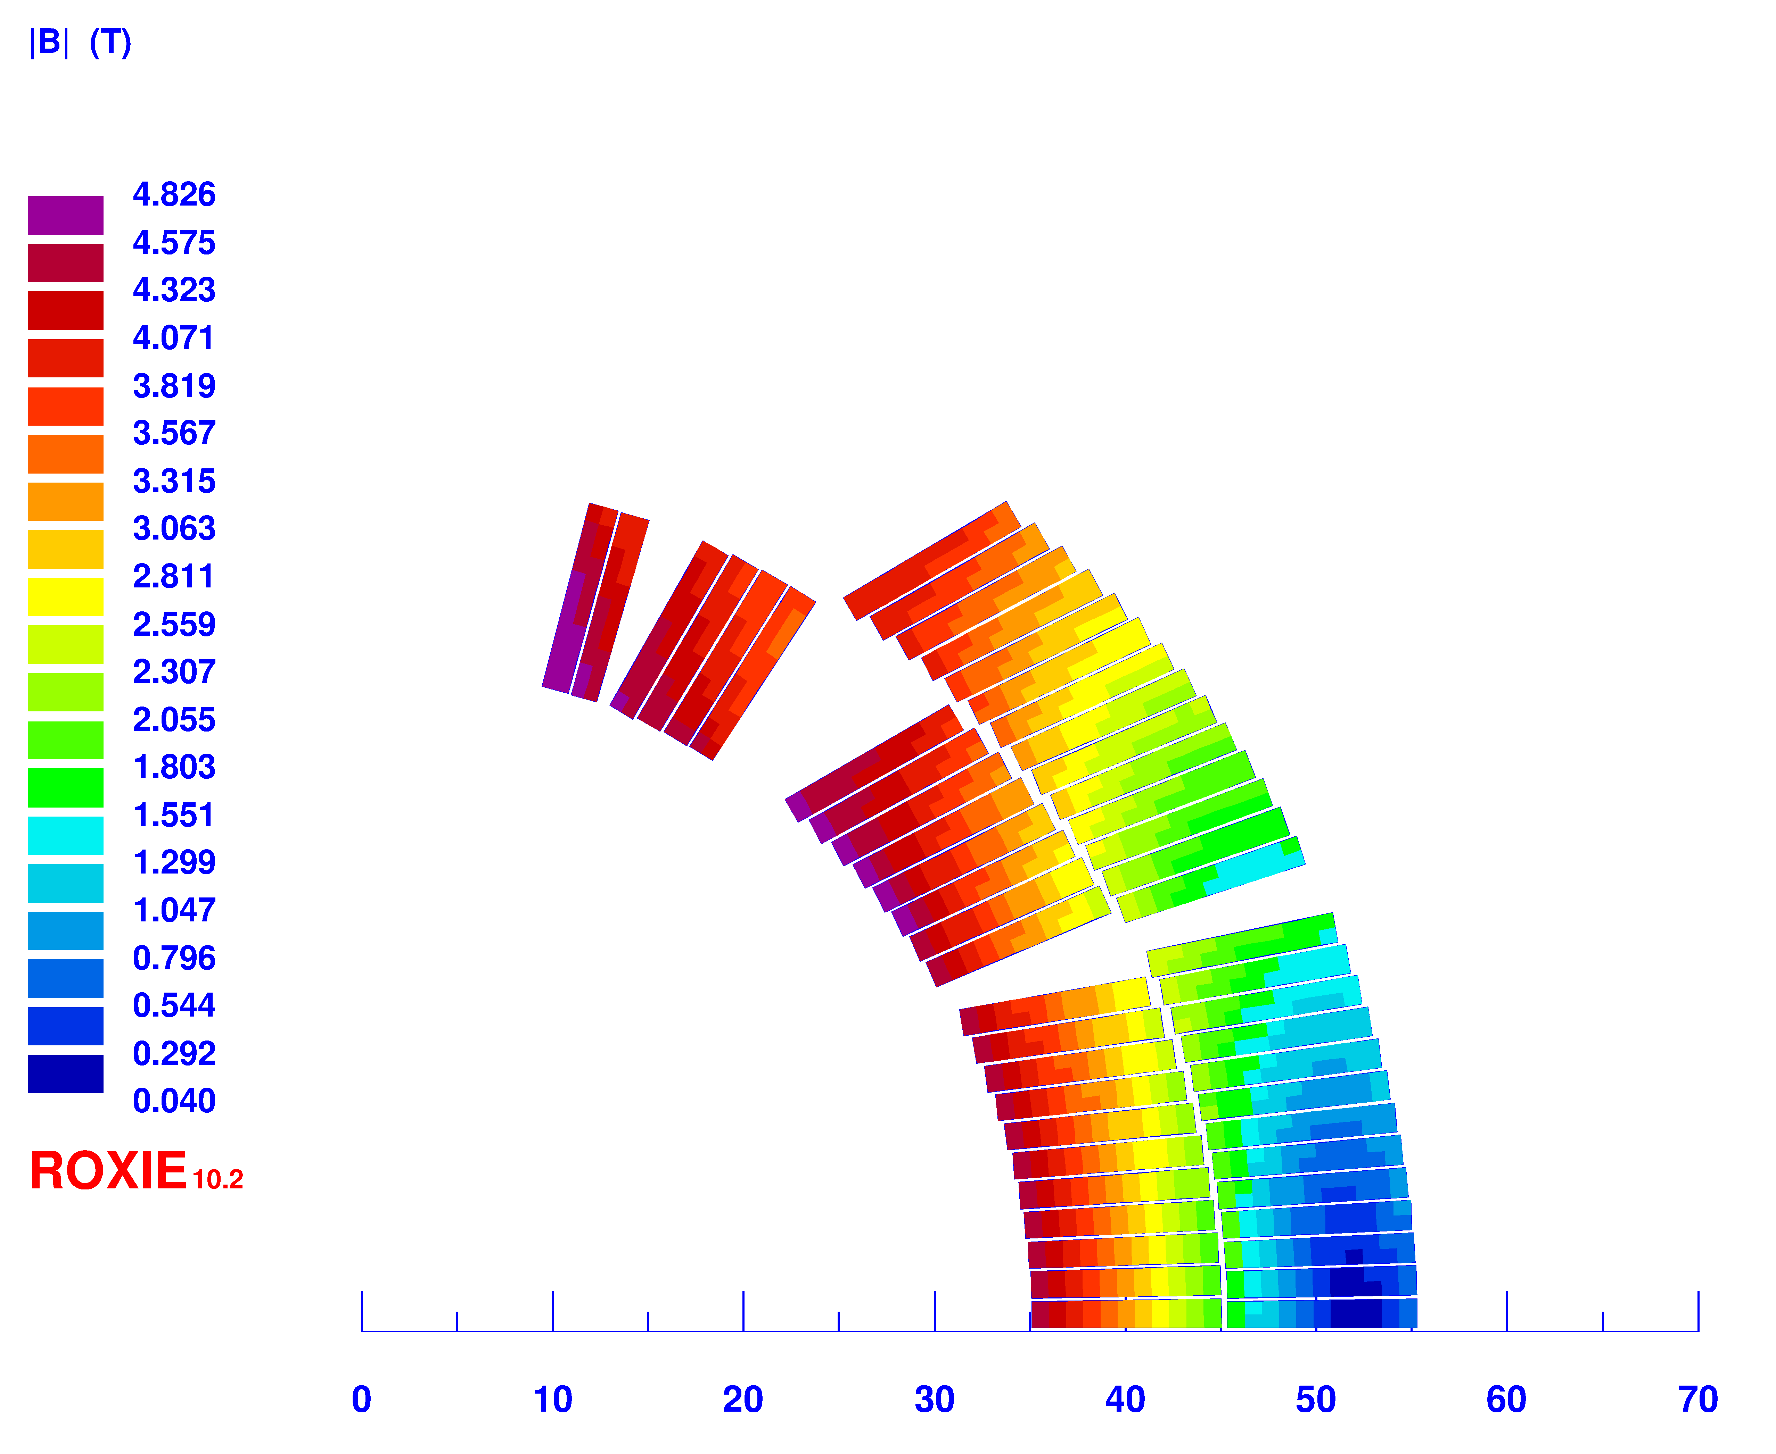
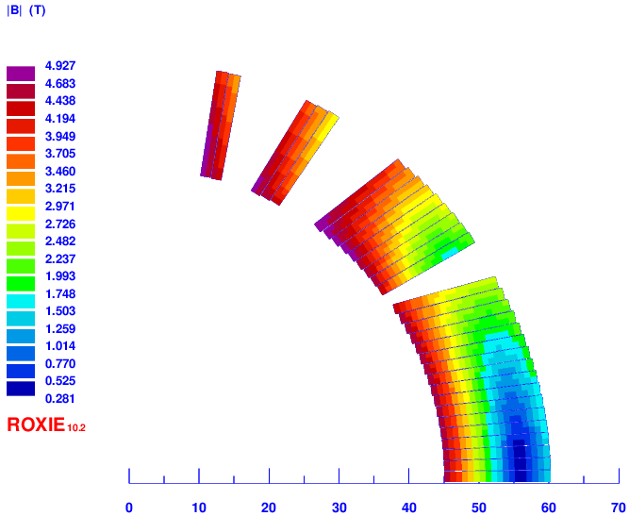
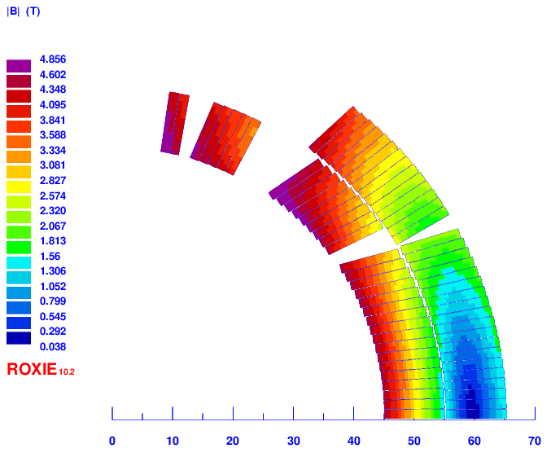
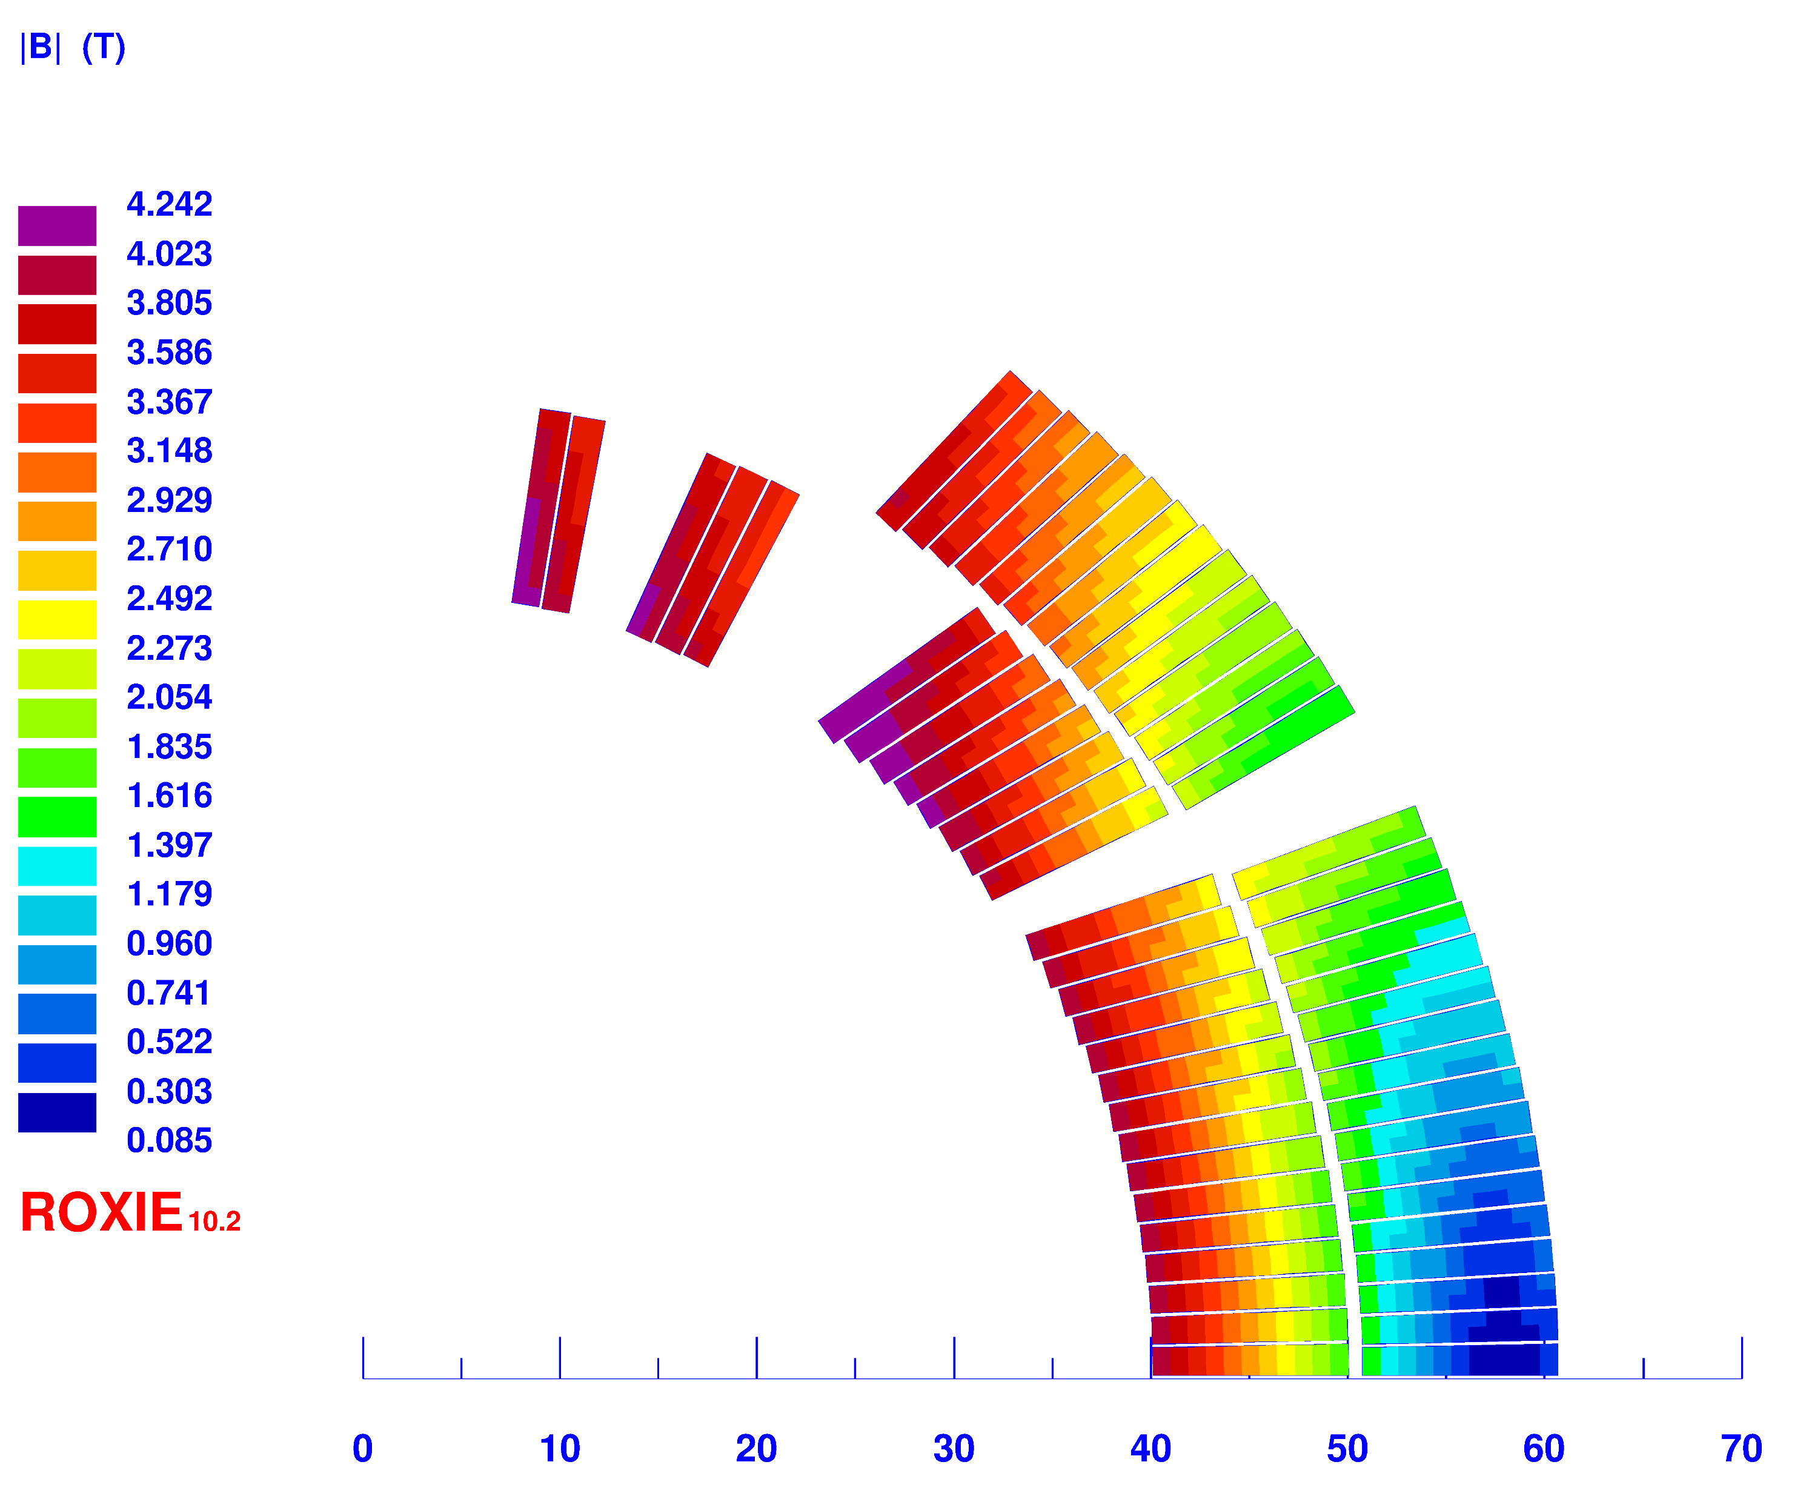
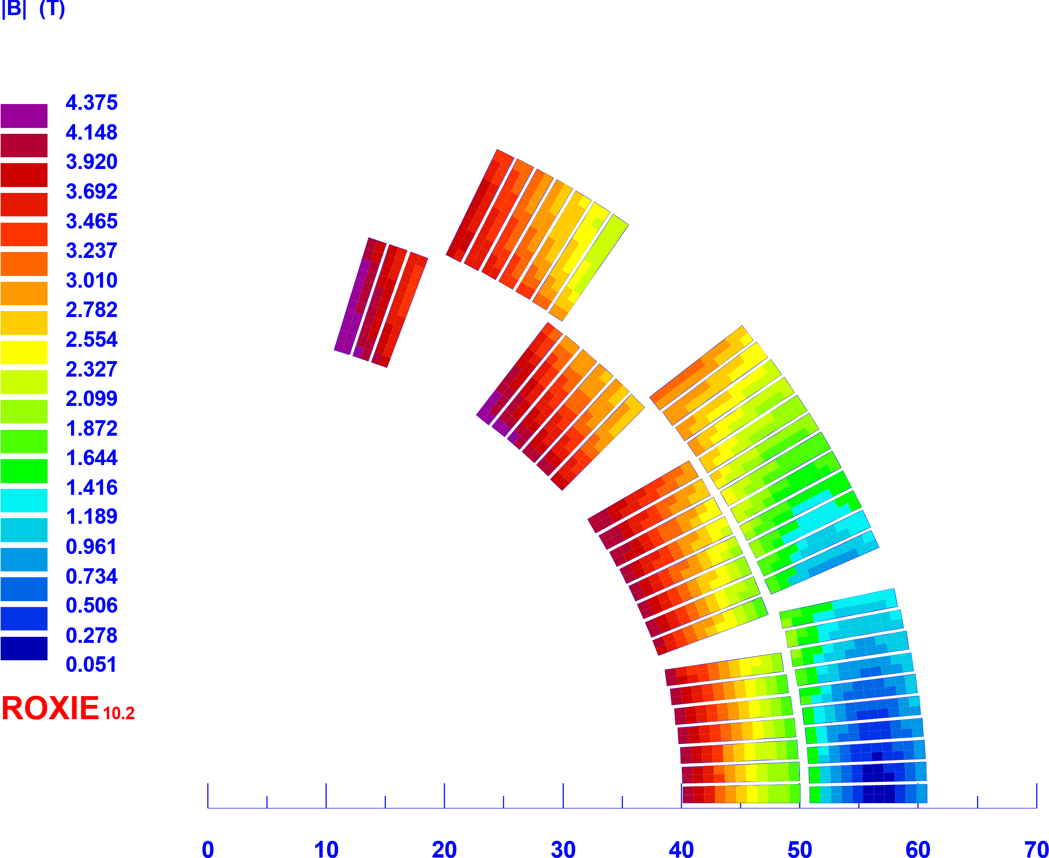
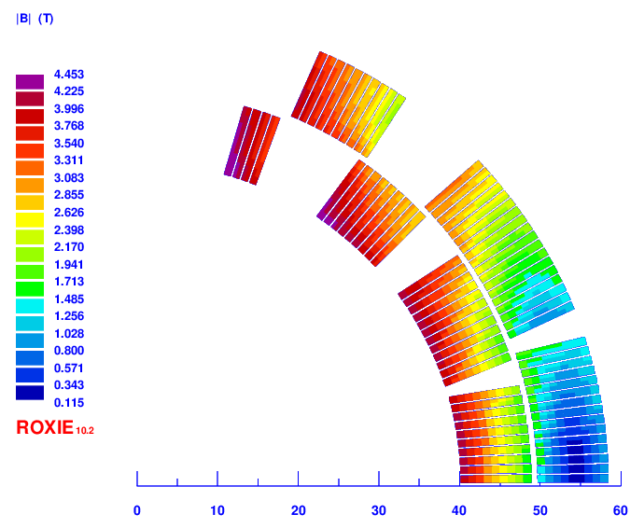

1 layer
2 layers
Retrospection
Ap. 70 mm
Starting from the SIGRUM experience, we explored the parameter space for the magnet design
Aperture: 70 – 90 mm
One / two layers
Bore dipole field: 4.5 – 4 T
Two different cables
Optimal cable positions
No gradient vs small and high gradient
4.5 T, Discorap cable
Ap. 90 mm
Ap. 80 mm, 4T

Slide 3
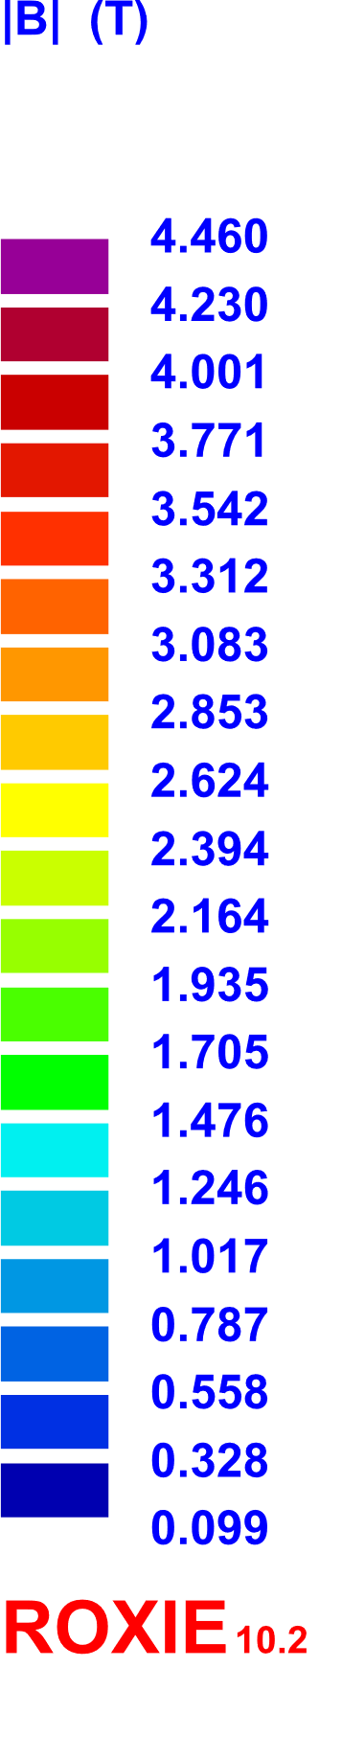
Present magnet parameters
Result of the exploration
Agreement of the collaboration on the main magnet parameters:
  Pure dipolar field: 4 T
  Aperture: 80 mm
  Curvature radius: 1.65 m
  Angular sector: 30° (l=0.9 m) for the demonstrator
  45° (l=1.3 m) for the final magnet
  Reduction of the ramp rate for the demonstrator:
  0.4 → 0.15 T/s since cable not optimized for low-loss
  (see next slide)
Baseline

Slide 4
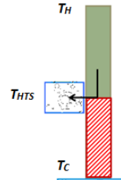

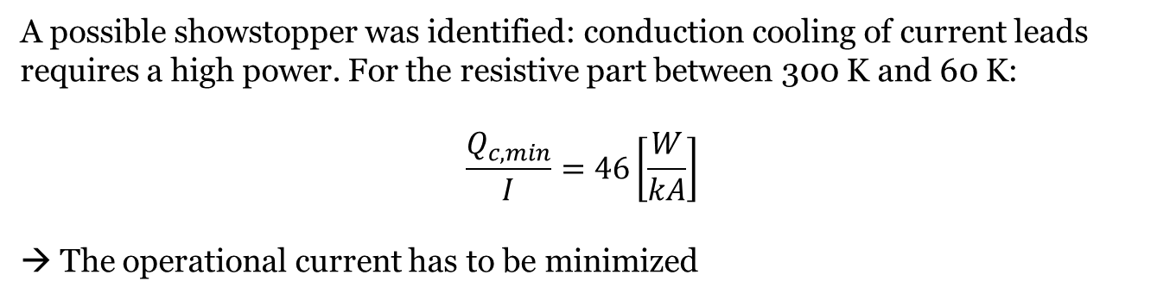
Cable comparison
300 K
A possible showstopper was identified: conduction cooling of current leads requires a high power. For the resistive part between 300 K and 60 K:
$$\frac{Q_{c,min}}{I}=46\left[\frac{W}{kA}\right]$$
→ The operational current has to be minimized
60 K
HTS
Cable | Discorap III gen. | CERN LHC05
Strand diameter [mm] | 0.821 | 0.48
Operational Temperature [K] | 5 | 5
Operational Current [A] | 4195 | 2790
CL cooling power [W] | 2 x 193 | 2 x 128
Margin on Load Line [%] | 28.1 | 21.9
Temperature Margin [K] | 1.49 | 1
Inner Layer Turns | 24 | 35
Outer Layer Turns | 29 | 43
4.7 K
Cable | Operational current (kA) | Max. dB/dt (AC loss)
Discorap III gen. | 4.2 | 0.4
CERN LHC05 | 2.8 | 0.15
Future ad-hoc | 2.8 | 0.4

Slide 5
Baseline
Present Baseline
Baseline
Backup
Cable | LHC05 | Discorap III
Strand diameter [mm] | 0.48 | 0.821
Iron yoke inner radius [mm] (distance from coil) | 75 (16.4) | 77.3 (16.4)
Iron yoke outer radius [mm] | 170 | 170
Operational Temperature [K] | 5 | 5
Operational Current [A] | 2790 | 4195
Bore field [T] | 4 | 4
Peak Field [T] | 4.46 | 4.376
Margin on Load Line [%] | 21.9 | 28.1
Temperature Margin [K] | 1 | 1.49
Inner Layer Turns | 35 | 24
Outer Layer Turns | 43 | 29
Field Quality | b7=-2units | b5 = -3.4 units b7 = -2.83 units b9 =1.48 units
Backup

Slide 6
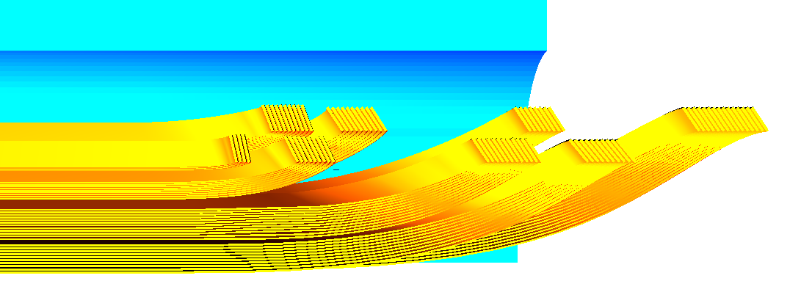
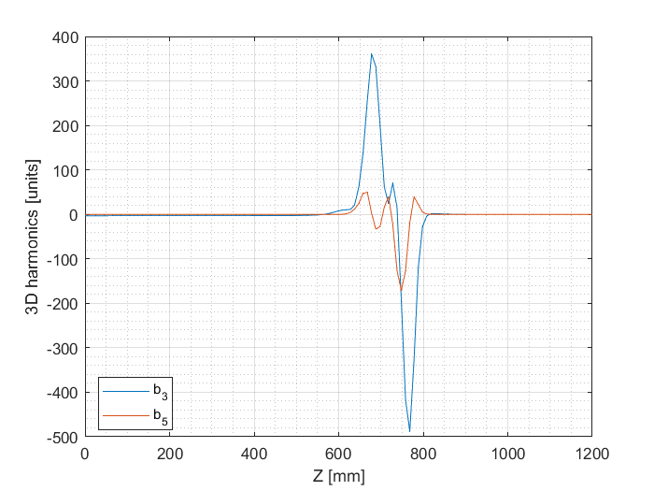
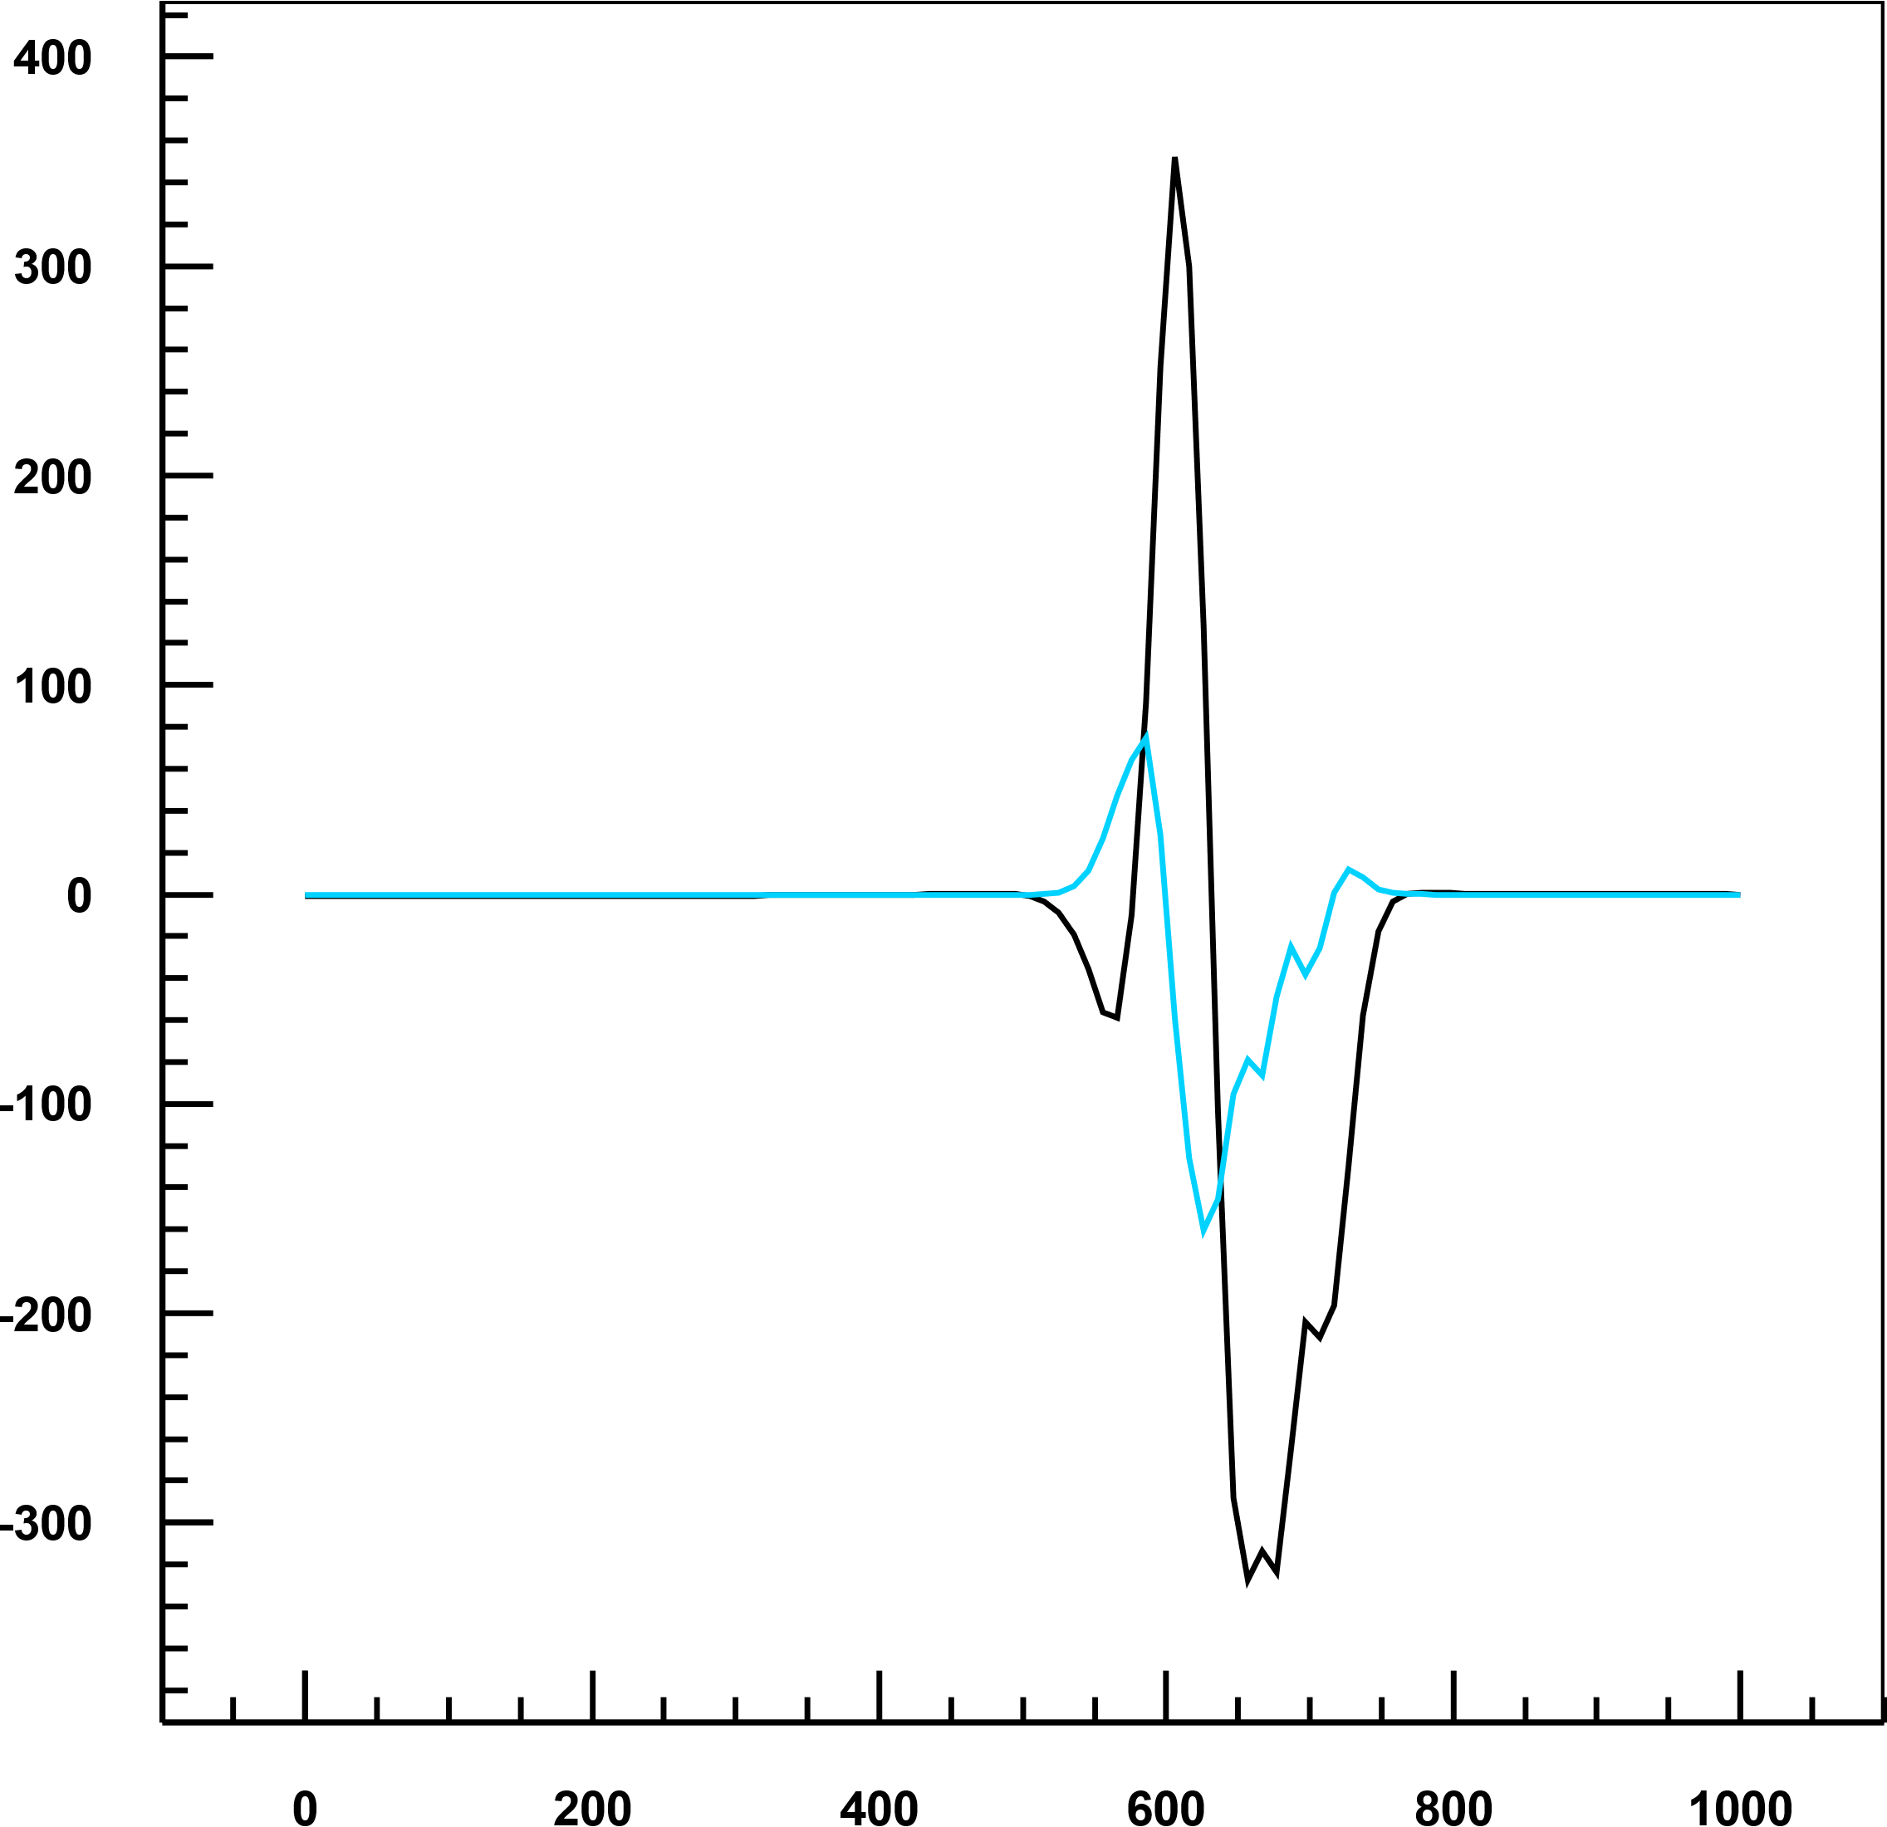
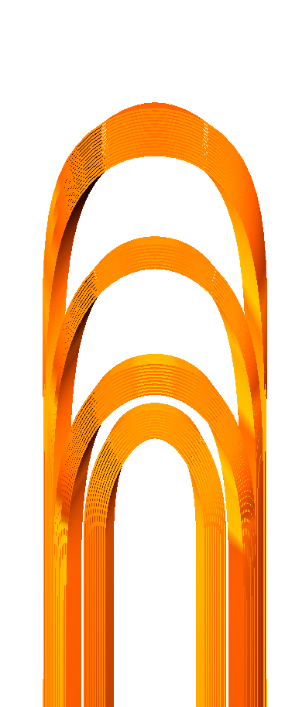

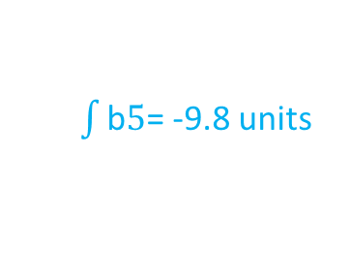
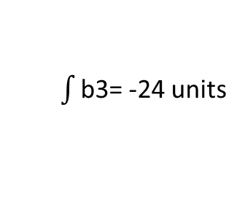
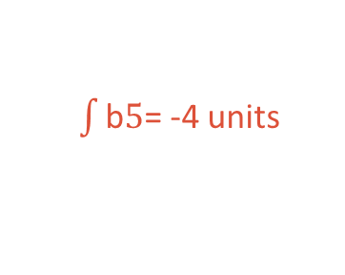
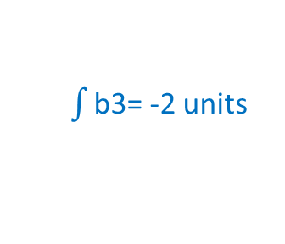
667.82 mm
Coil end optimization
3D PF= 4.576 T
Preliminary
5
1
6a
2
6b
3
$\int{\text{b}\text{3}}$= -24 units
$\int{\text{b}\text{3}}$= -2 units
7
4
$\int{\text{b}5}$= -9.8 units
$\int{\text{b}5}$= -4 units
578 mm
604 mm
668 mm
738 mm
620 mm
697 mm
675 mm
597 mm

Slide 7
Demonstrator vs final magnet for gantry
  Pure dipolar field: 4 T
  Aperture: 80 mm
  Curvature radius: 1.65 m
  Cross section
Demonstrator
Magnet for gantry
  30 ° (l=0.9 m)
  0.15 T/s with LHC05 cable
  45 ° (l=1.3 m)
  0.4 T/s with cable optimized for low-loss

Slide 8
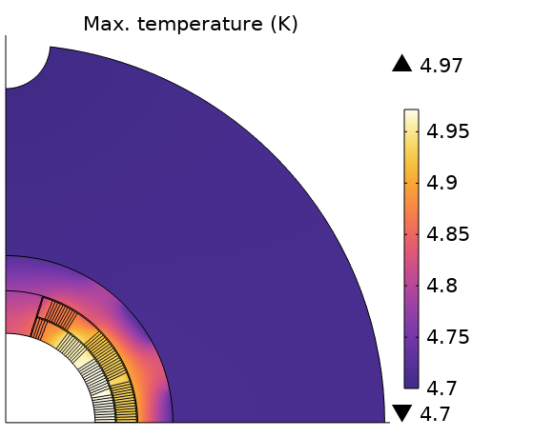
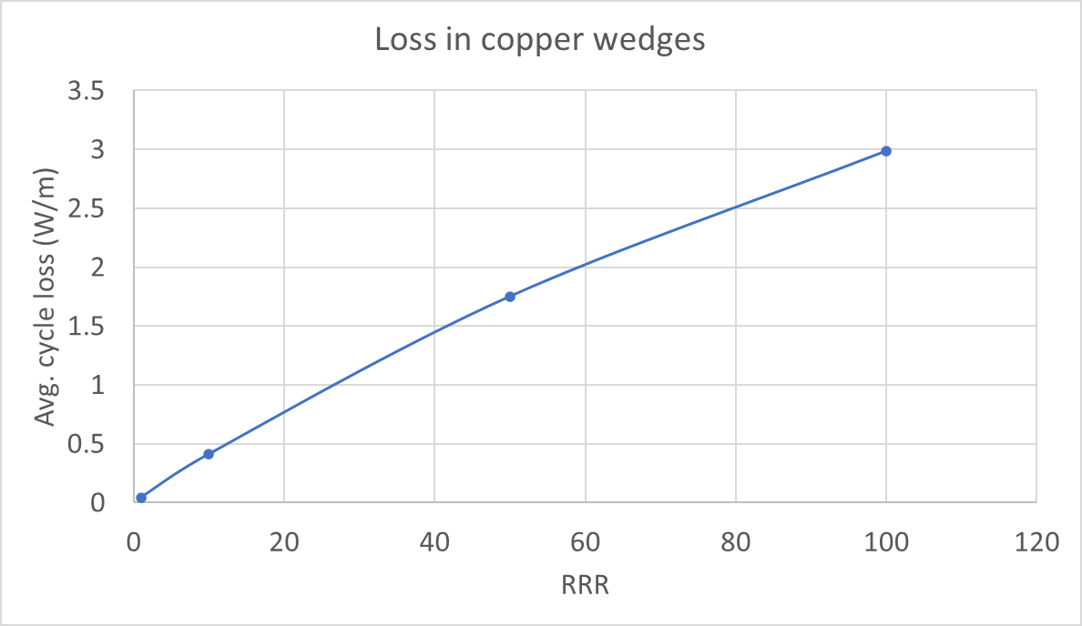

Thermal Study
Field ramp-rate (T/s) | Cable | Qpers (W/m) | Qifcc (W/m) | Qiscc(W/m) | Qtot (W/m)
0.4 | Low loss | 0.80 | 0.14 | 0.07 | 1.01
0.4 | LHC05 | 1.59 | 2.59 | 0.13 | 4.32
0.15 | LHC05 | 0.60 | 0.36 | 0.02 | 0.98
$$\dot{B}=0.4 T/s$$
 | Straight part | Int. l = 1.1 m (45°) | Ends
Conductor loss | 1 W/m | 1.1 W | 0.18 W*
Iron hyst | 0.32 W/m | 0.35 W | 0.14 W*
Eddy current | 0.37 W/m* | 0.41 W* | 0.41 W*
Total |  | 1.9 W | 0.7 W
* Scaled from Discorap
2.6 W @ 5 K
2.6 W * 1.5 = 4 W @ 5 K

Slide 9
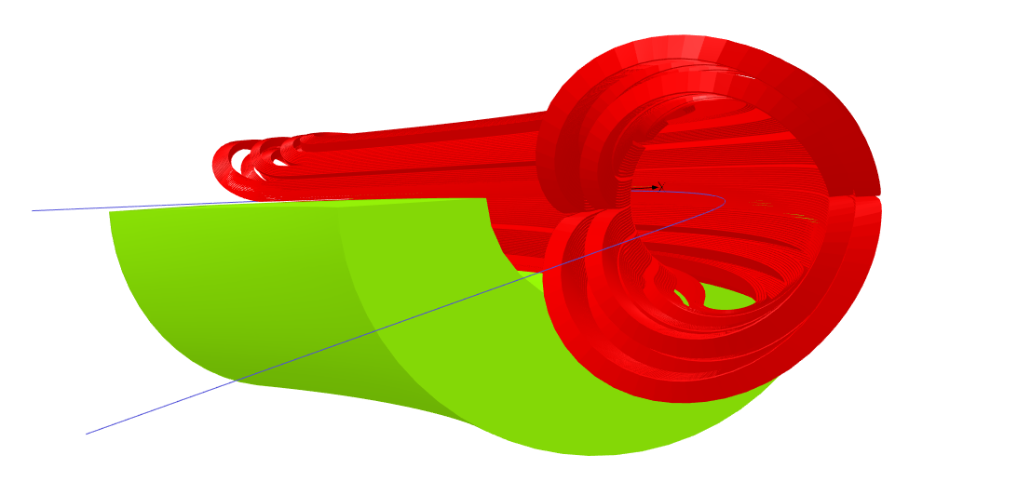
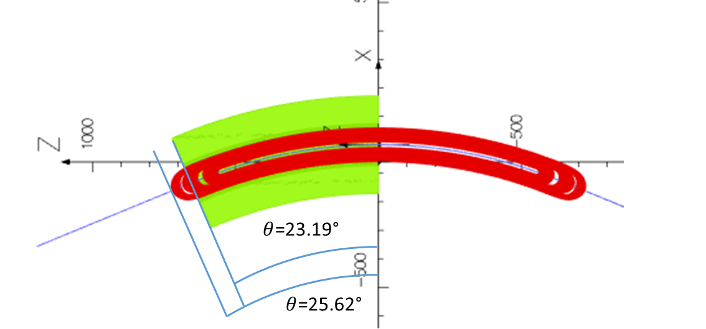
Size and mass for 45°
Inner yoke radius: 75 mm
Outer yoke radius: 170 mm
Cable length (1 pole): 250 m
 | Mass (kg)
Coil | 2x15
(cu wedges) | 2x7.5
SS collar (16.4 mm) | 100
Iron yoke | 800
Total (magnet only) | ~ 1 ton

Slide 10
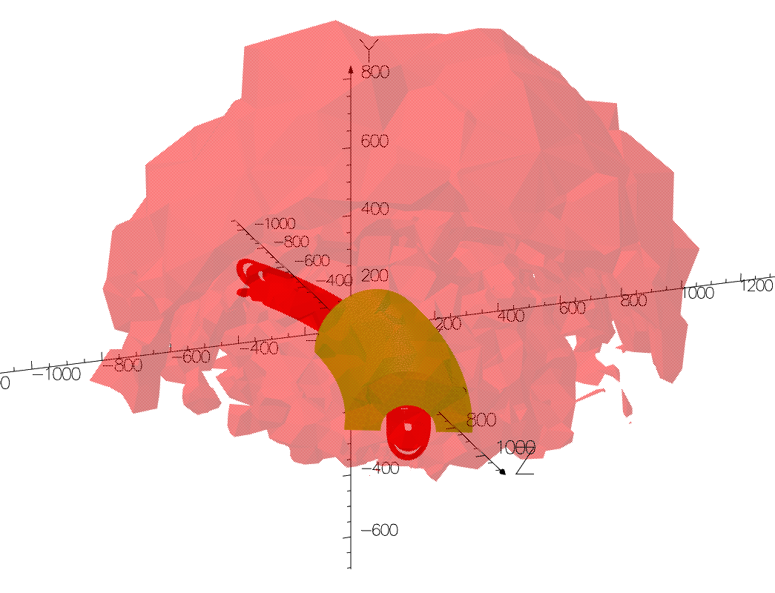
Fringe field
Distance from origin @ 0,5 mT [m] | Bx<0.8, By<1, Bz<1.1
Fringe field @ 2 m [mT] | <0.3
Within the law limits

Slide 11
Next steps
Complete the addendum to the four-party agreement dedicated to SIG
Finalize the conceptual design by the end of this year
Need feedback from the mechanical design
Working group started led by INFN Genova
Winding trials, first half of 2023
Complete the installation of the winding machine @ LASA
Procure components and tooling (CERN support?)
Procure insulated copper cable

Slide 12
Thank You for listening!

