Slide 1
Heat Load Estimation and Dry Cooling Scheme Proposal for Sigrum update 07. Sept. 2022
Torsten Koettig, Rob van Weelderen,
with inputs from Patricia Tavares Coutinho Borges De Sousa and Aleksandra Onufrena (CERN)

Slide 2
Content
Heat load estimation, updated
Dry cooling scheme
R&D options
Open points to address

Slide 3
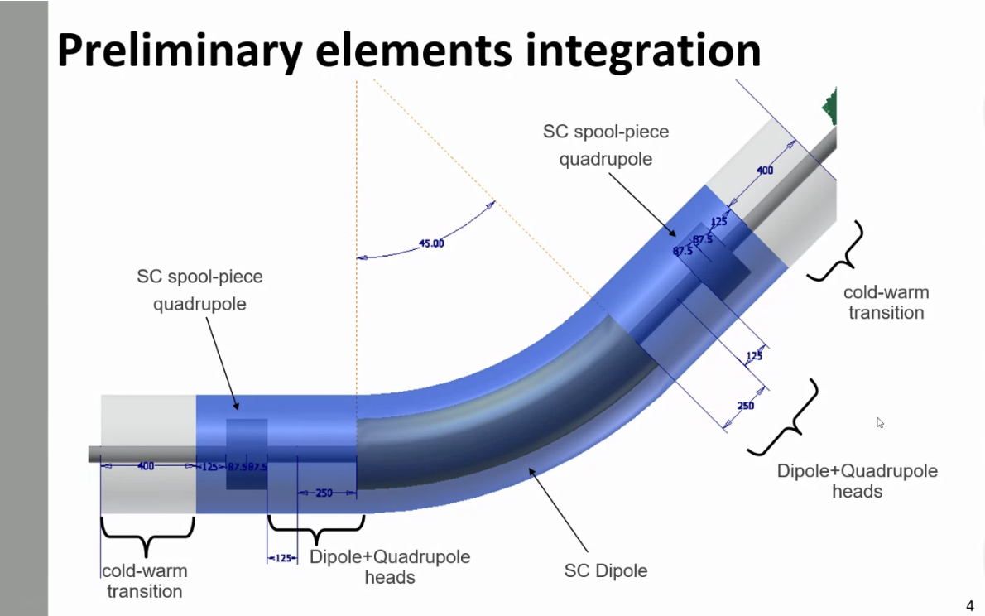
Heat loads at 4.7 K and 60 K
Parameters:
1 Dipole + 1 pair CL 2.5 kA (Dry + HTS)
2 Quadrupoles + 2 pairs CL 350 A (Dry + HTS)
Supports in G10, 30 cm, 15 cm heat intercept @ 60 K
Cold warm trans. 1.8 W rad. + conduction in material
60 K thermal shield and CL intercept
30 layer MLI @ 60 K
10 layer MLI at 4.7 K
5 W heat load on cold mass (Mikko)

Slide 4
Heat loads at 4.7 K and 60 K
Parameters:
1 Dipole + 1 pair CL 2.5 kA (Dry + HTS)
2 Quadrupoles + 2 pairs CL 350 A (Dry + HTS)
Supports in G10, 30 cm, 15 cm heat intercept @ 60 K
Cold warm trans. 1.8 W rad. + conduction
60 K thermal shield and CL intercept
30 layer MLI @ 60 K
10 layer MLI at 4.7 K
5 W heat load on cold mass (Mikko)
+2

Slide 5
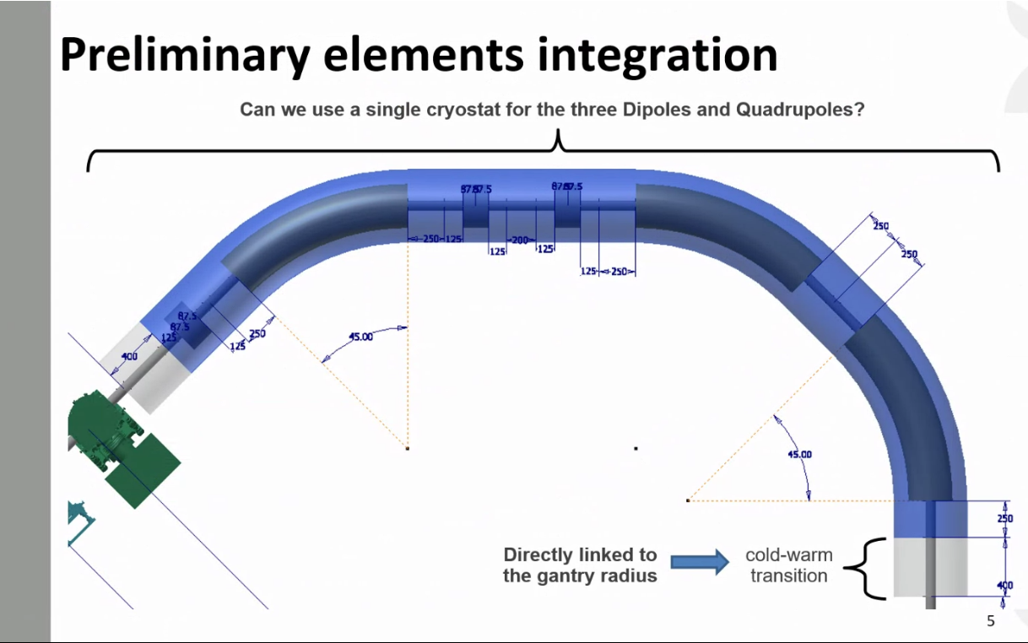
Heat loads at 4.7 K and 60 K
Parameters:
One common cryostat
3 Dipoles + 1 pair CL 2.5 kA (Dry + HTS)
3 Quadrupoles + 3 pairs CL 350 A (Dry + HTS)
Supports in G10, 30 cm, 15 cm heat intercept @ 60 K
Cold warm trans. 1.8 W rad. + conduction in material
60 K thermal shield and CL intercept
30 layer MLI @ 60 K
10 layer MLI at 4.7 K
5 W heat load on cold mass per dipole (Mikko)

Slide 6
Heat loads at 4.7 K and 60 K
Parameters:
One common cryostat
3 Dipoles + 1 pair CL 2.5 kA (Dry + HTS)
3 Quadrupoles + 3 pairs CL 350 A (Dry + HTS)
Supports in G10, 30 cm, 15 cm heat intercept @ 60 K
Cold warm trans. 1.8 W rad. + conduction
60 K thermal shield and CL intercept
30 layer MLI @ 60 K
10 layer MLI at 4.7 K
5 W heat load on cold mass per dipole (Mikko)
+2

Slide 7
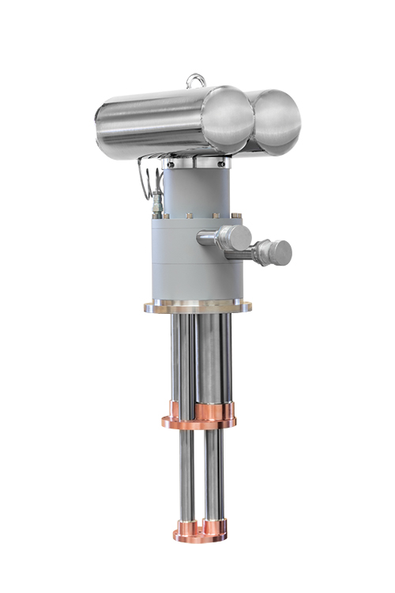
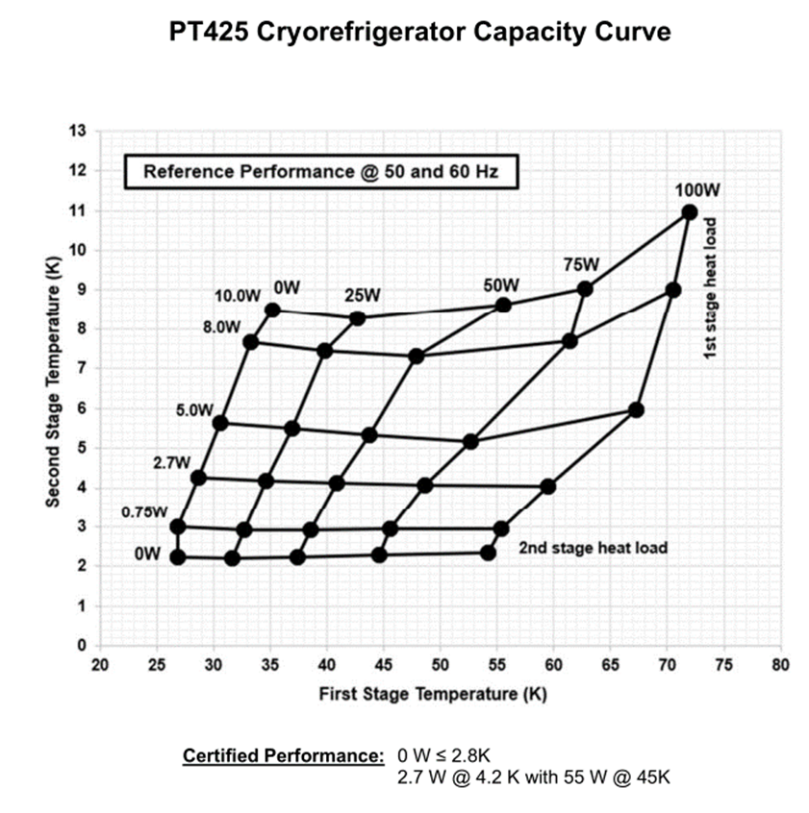
Cooling comparison
Two-stage Pulse Tube Refrigerators vs. He cryoplant
Updated version
+4
It needs:
a dedicated cryocooler- satellite box (incl. 2 add. PTR) + distribution system
electrical insulators for the CL!

Slide 8
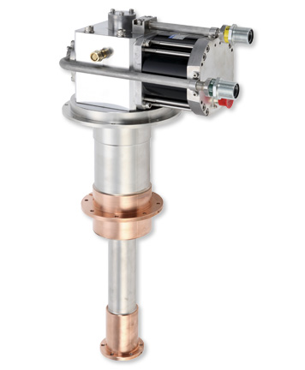
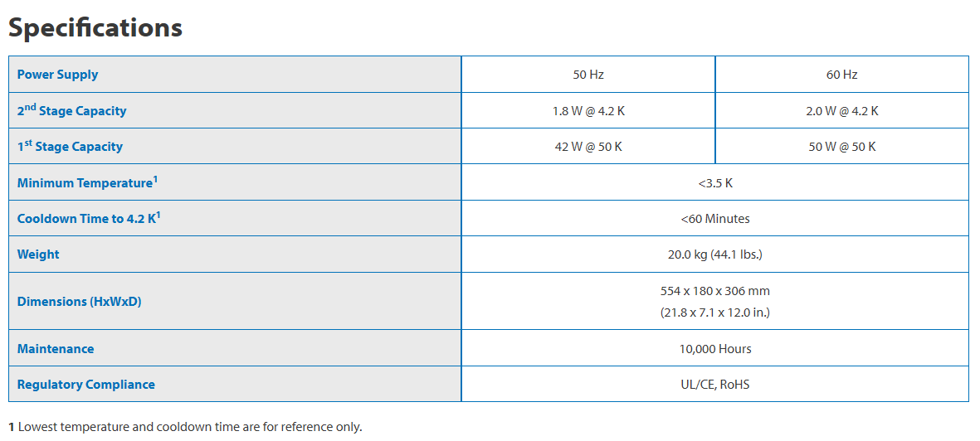
Cooling comparison
Two-stage GM Cryocooler vs. He cryoplant
+7 GM
Sumitomo GM RDE-418D4 4K Cryocooler
Is there an option to reduce the number of PTC?

Slide 9
Remote cooling circuit options
Cryolab at CERN, Sumitomo Ind.

Slide 10
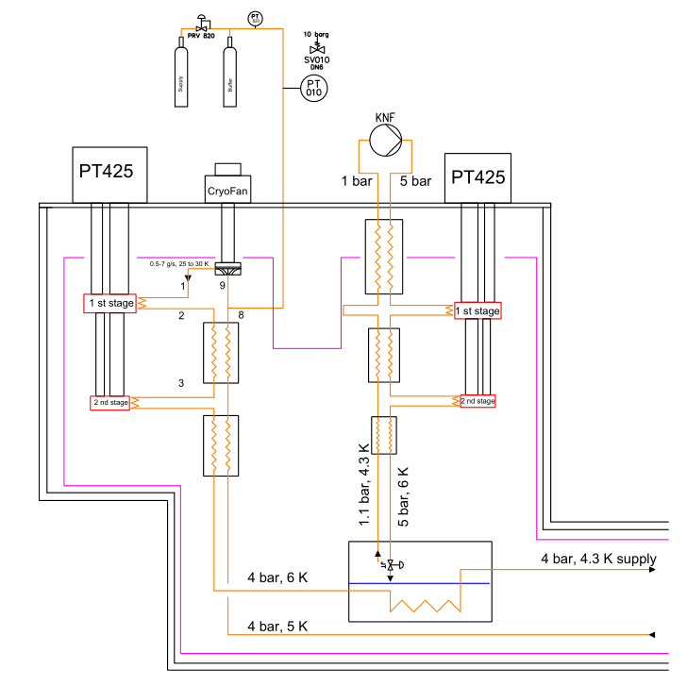
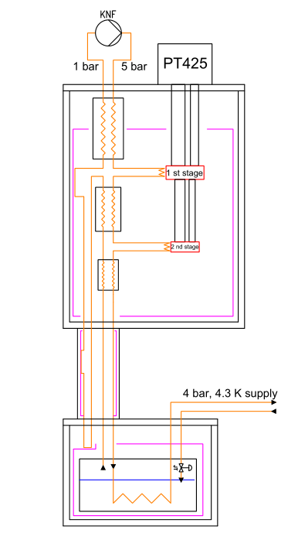
Application to Sigrum
Subcooled 4 bar cooling loop – high Q
Subcooled 4 bar cooling loop
Pushing the limits is one of our current R&D topics in the Cryolab
3-4 x

Slide 11
Application to Sigrum
Subcooled 4 bar cooling loop – high Q
Source: Introduction of GM – JT cooling system, A. Euler, Sumitomo
10 W @ 4.2 K! boosted Cryocooler system
3 compressors and 1x two stage, 1 single stage one He circulation J-T system
3-4 x

Slide 12
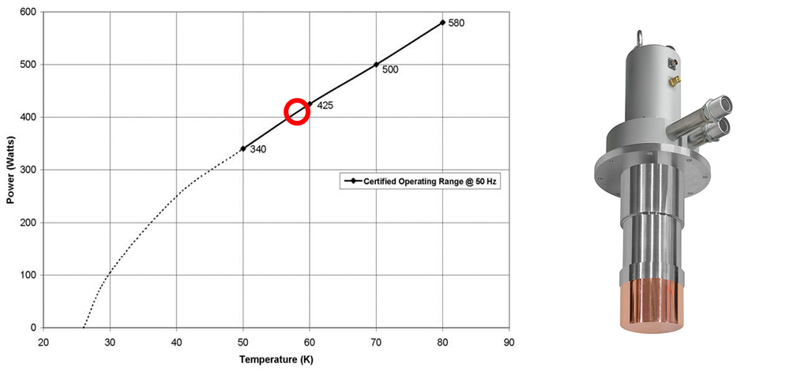
Summary
Can we refine the heat loads?
Study of the thermal interface to the cold mass at T< 4.7 K
Thermal gradients along the cooling channel and perpendicular
Quadrupoles, heat load, cold-warm transitions => can we make orifices?
Rotation angle of the gantry => feedthroughs, which are rotating, cold and leak-tight for ±180°?
Options to cool the prototype, in LHe and then dry (incl. the cooling tube already)
Cooldown with LN2 or some large single stage GMs?
Remote cooling R&D will proceed in the Cryolab

