Slide 1

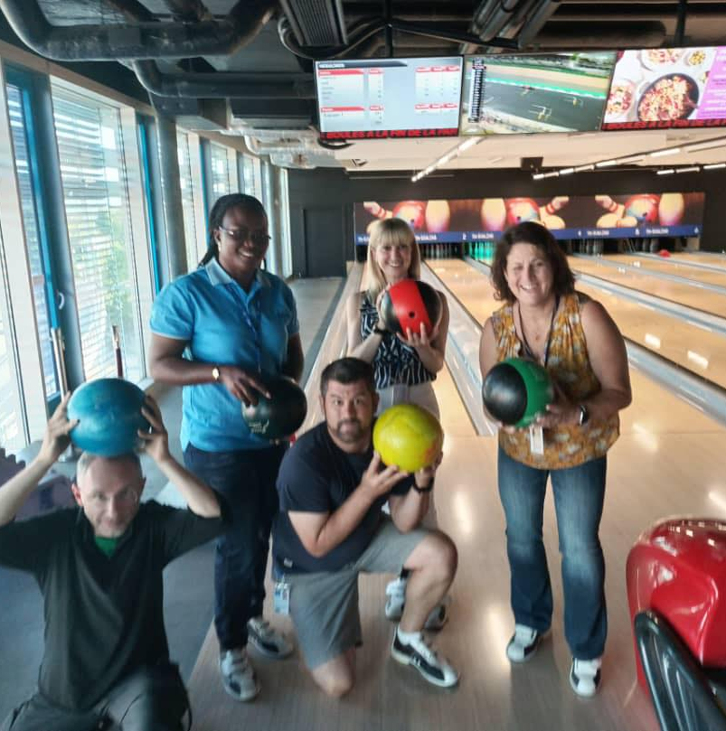
Particles Accelerators
By Stephanie Mireille Beyalla¹, Matt Dodds², Carmen Hernandez³, Luca Marinatto⁴, Janice Valletta⁵.
Government Bilingual High School of Mengang, Mengang, Cameroon
Farrer Memorial Agricultural High School, Tamworth, NSW Australia
Creixen Terrassa, Terrassa, Barcelona, Spain
Liceo Scientifico “G. MARINELLI”, Udine, Italy
Capuchino High School, California, USA

Slide 2
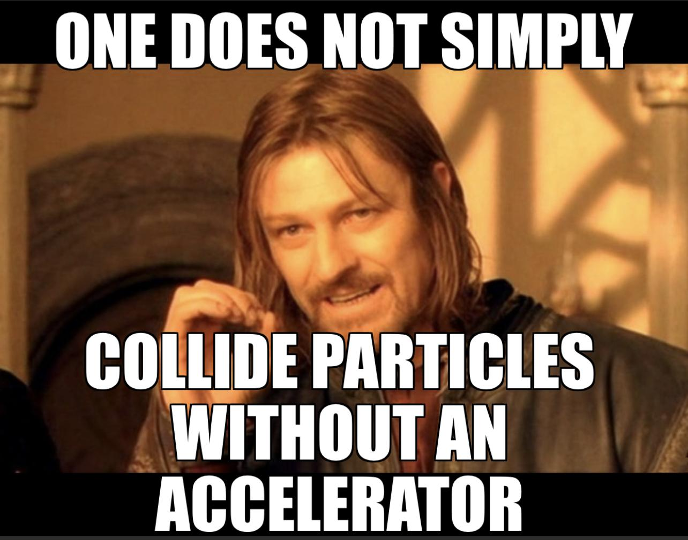

Slide 3
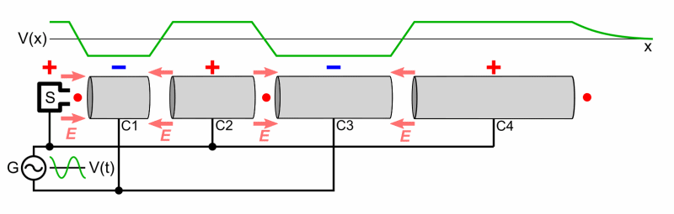
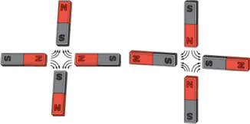
What we want our students to know
-Accelerators
Generate high speed beams of “particles” using electric fields, bending and focusing them using magnetic fields.
Used to answer fundamental questions about nature.
Can be applied to medical applications.

Slide 4
So you want to build a particle accelerator…
Materials
Particle source (e.g. electron, protons, lead nuclei)
Vacuum chamber
Radio Frequency Cavity
Magnets to bend or focus

Slide 5

Student misconceptions
Accelerators only speed up electrons
Accelerate particles one by one
Electric field used is static
You can make a black hole with an accelerator
This has nothing to do with my life
https://tenor.com/xrBx.gif

Slide 6
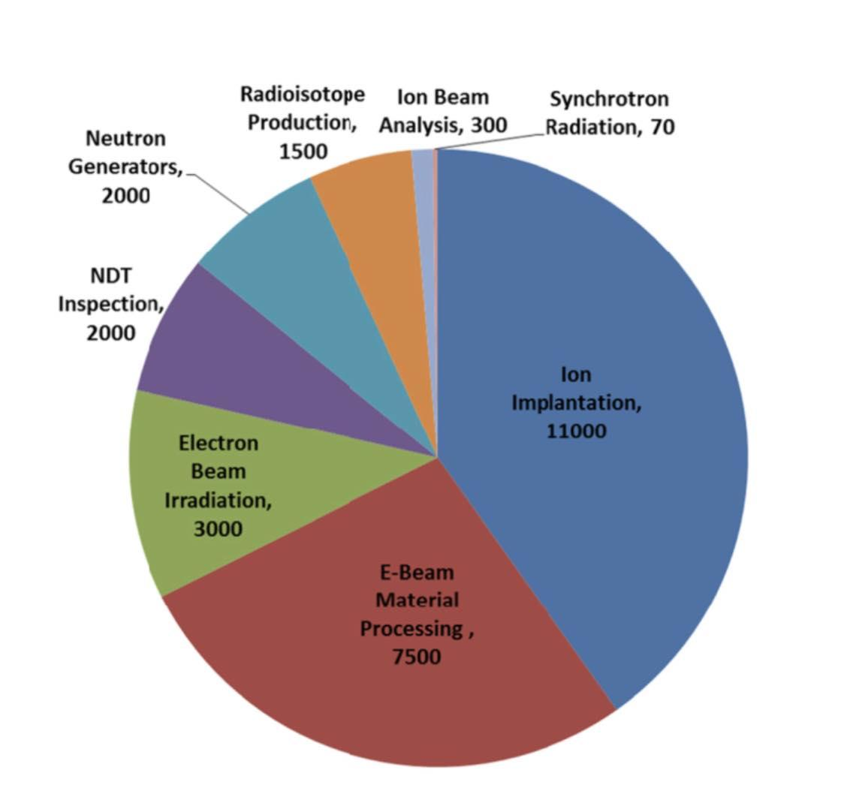
Your life is full of accelerators
Isabel Alonso

Slide 7
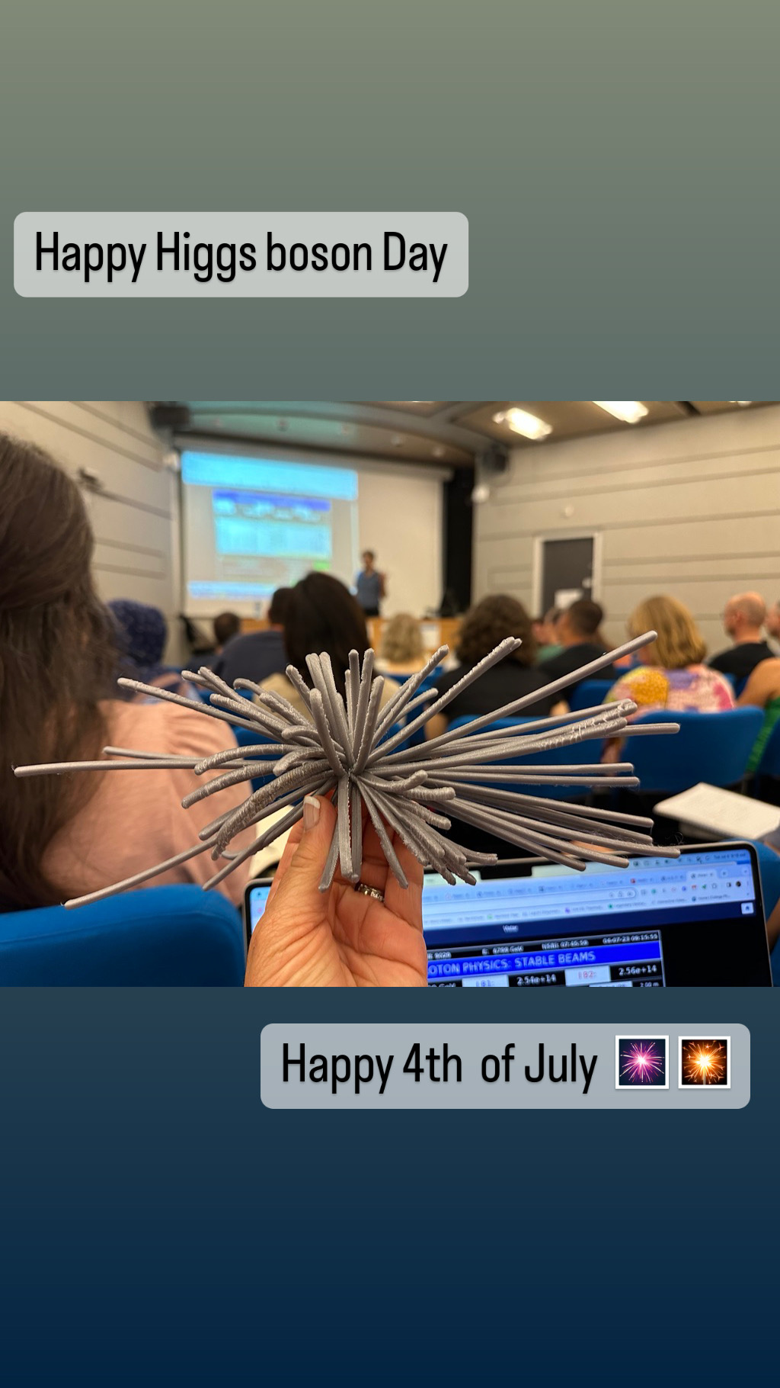
Pedagogical approaches
Adding Context:
Why are they important

Slide 8
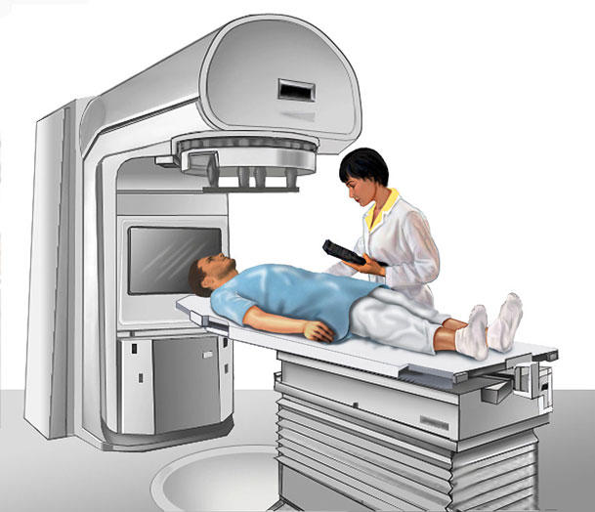
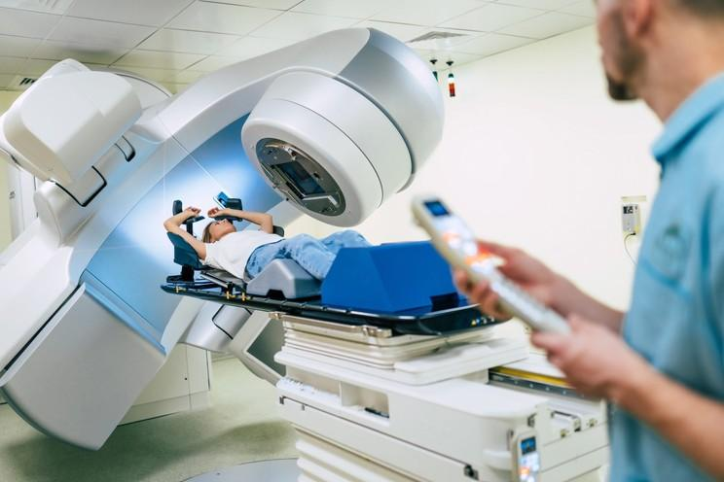
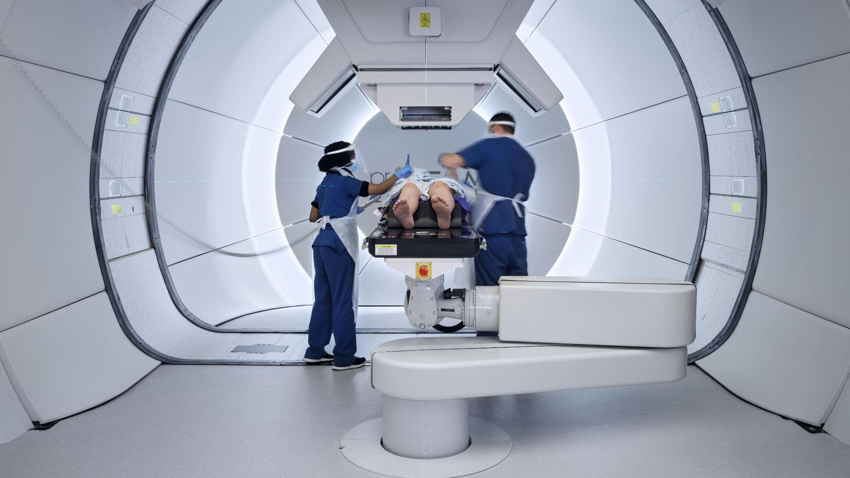
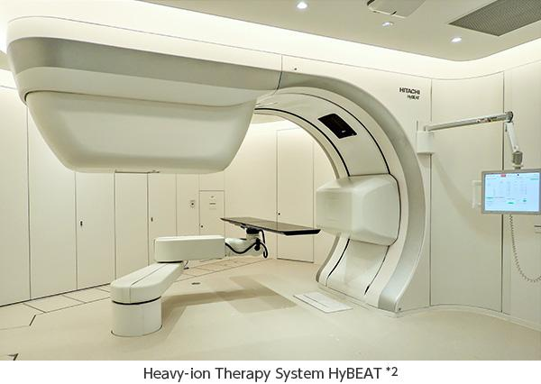
Medical Applications - Based
RADIOTHERAPY
  External Beam radiotherapy b. Stereotactic radiosurgery
PROTON THERAPY 3. HEAVY ION THERAPY

Slide 9
Based RADIOTHERAPY
A.- EXTERNAL BEAM RADIOTHERAPY
Utilizes external radiation beams
Effective for treating various types of cancers
Precise targeting of tumors while minimizing damage to surrounding tissues
B.- STEREOTACTIC RADIOSURGERY
-Non-invasive treatment option
-Delivers high doses of radiation to small, well-defined tumors.
- Commonly used for brain tumors and other localized lesions.

Slide 10
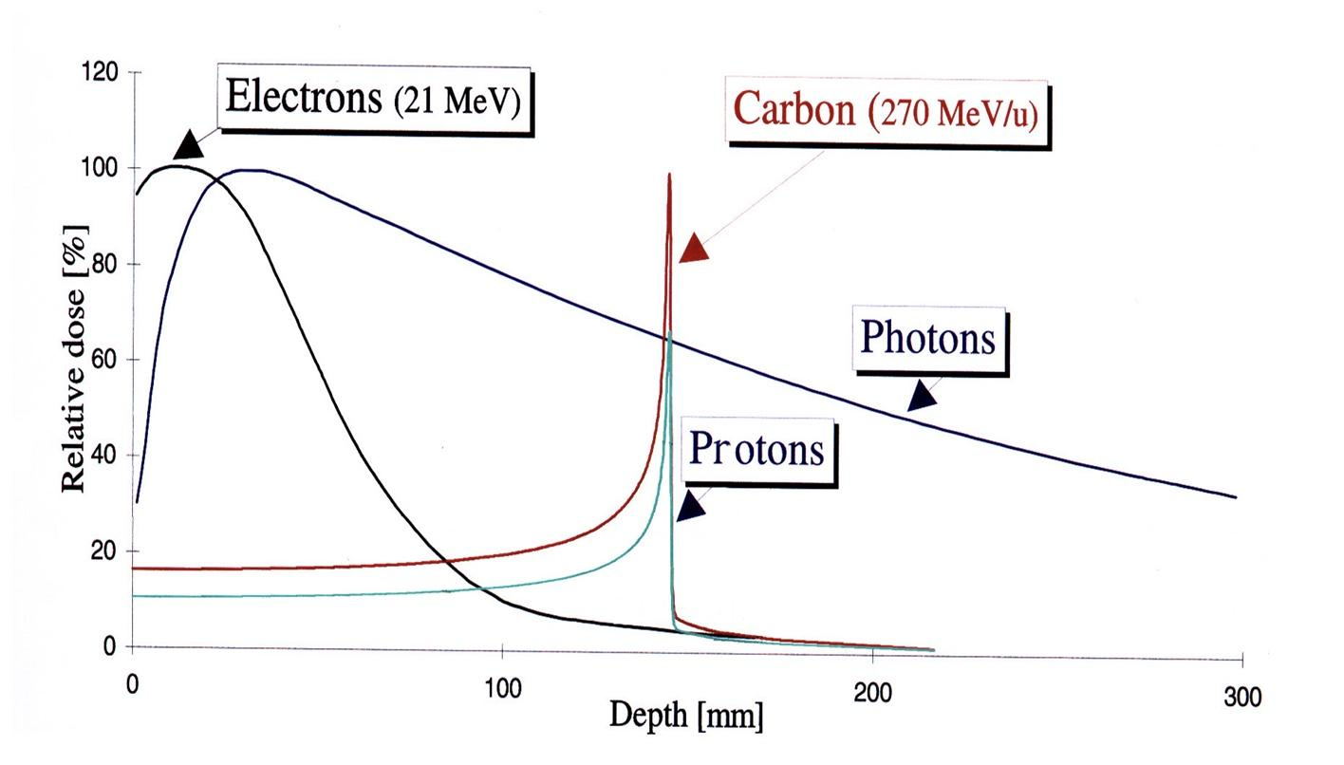
Based Proton Therapy
Uses protons instead of conventional X-rays
Precise and targeted treatment with minimal impact on healthy tissues
Effective for tumors near critical structures and in pediatric cases

Slide 11
Based Heavy Ion Therapy
Utilizes heavy Ions like Carbon or Helium
Enhanced precision and effectiveness in treating resistant tumors
Particularly beneficial for deep-seated tumors and radioresistant cancers

Slide 12
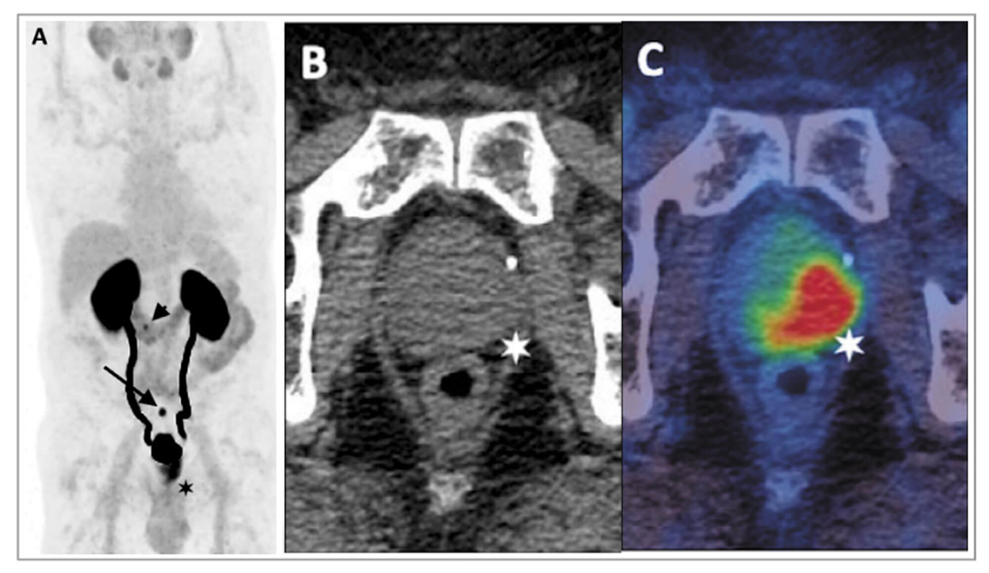
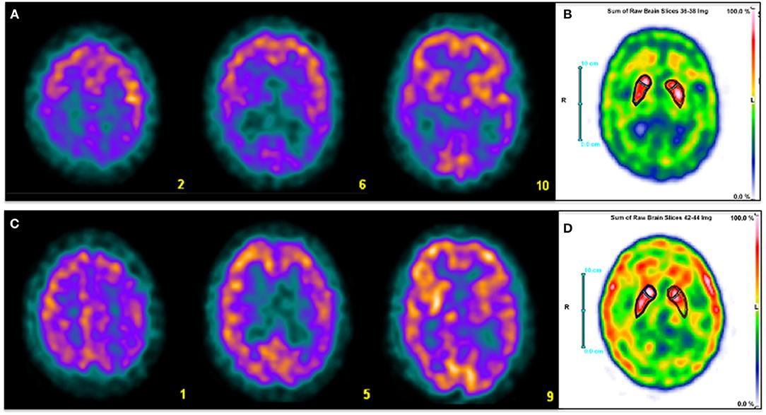
Medical Imaging with Particle Accelerators
  Positron Emission Tomography (PET) *1
  Single Photon Emission Computed Tomography (SPECT) *2
  Advantages of PET, SPECT with particle accelerators: Offers valuable diagnostic tool with improved sensitivity, resolution and qualification capabilities

Slide 13
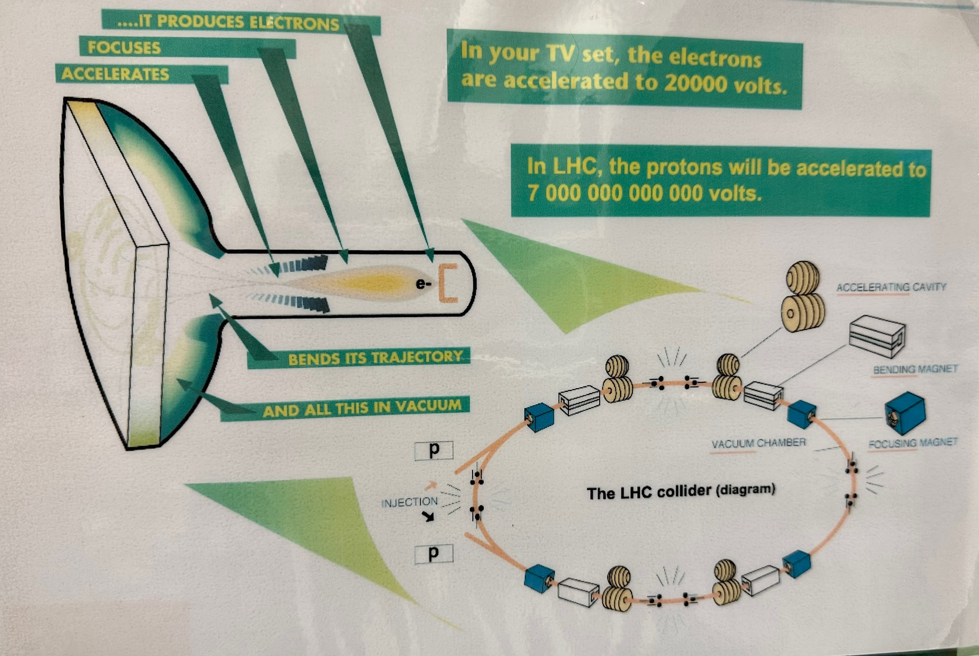
Pedagogical approaches to understanding the steps need to accelerate particles

Slide 14
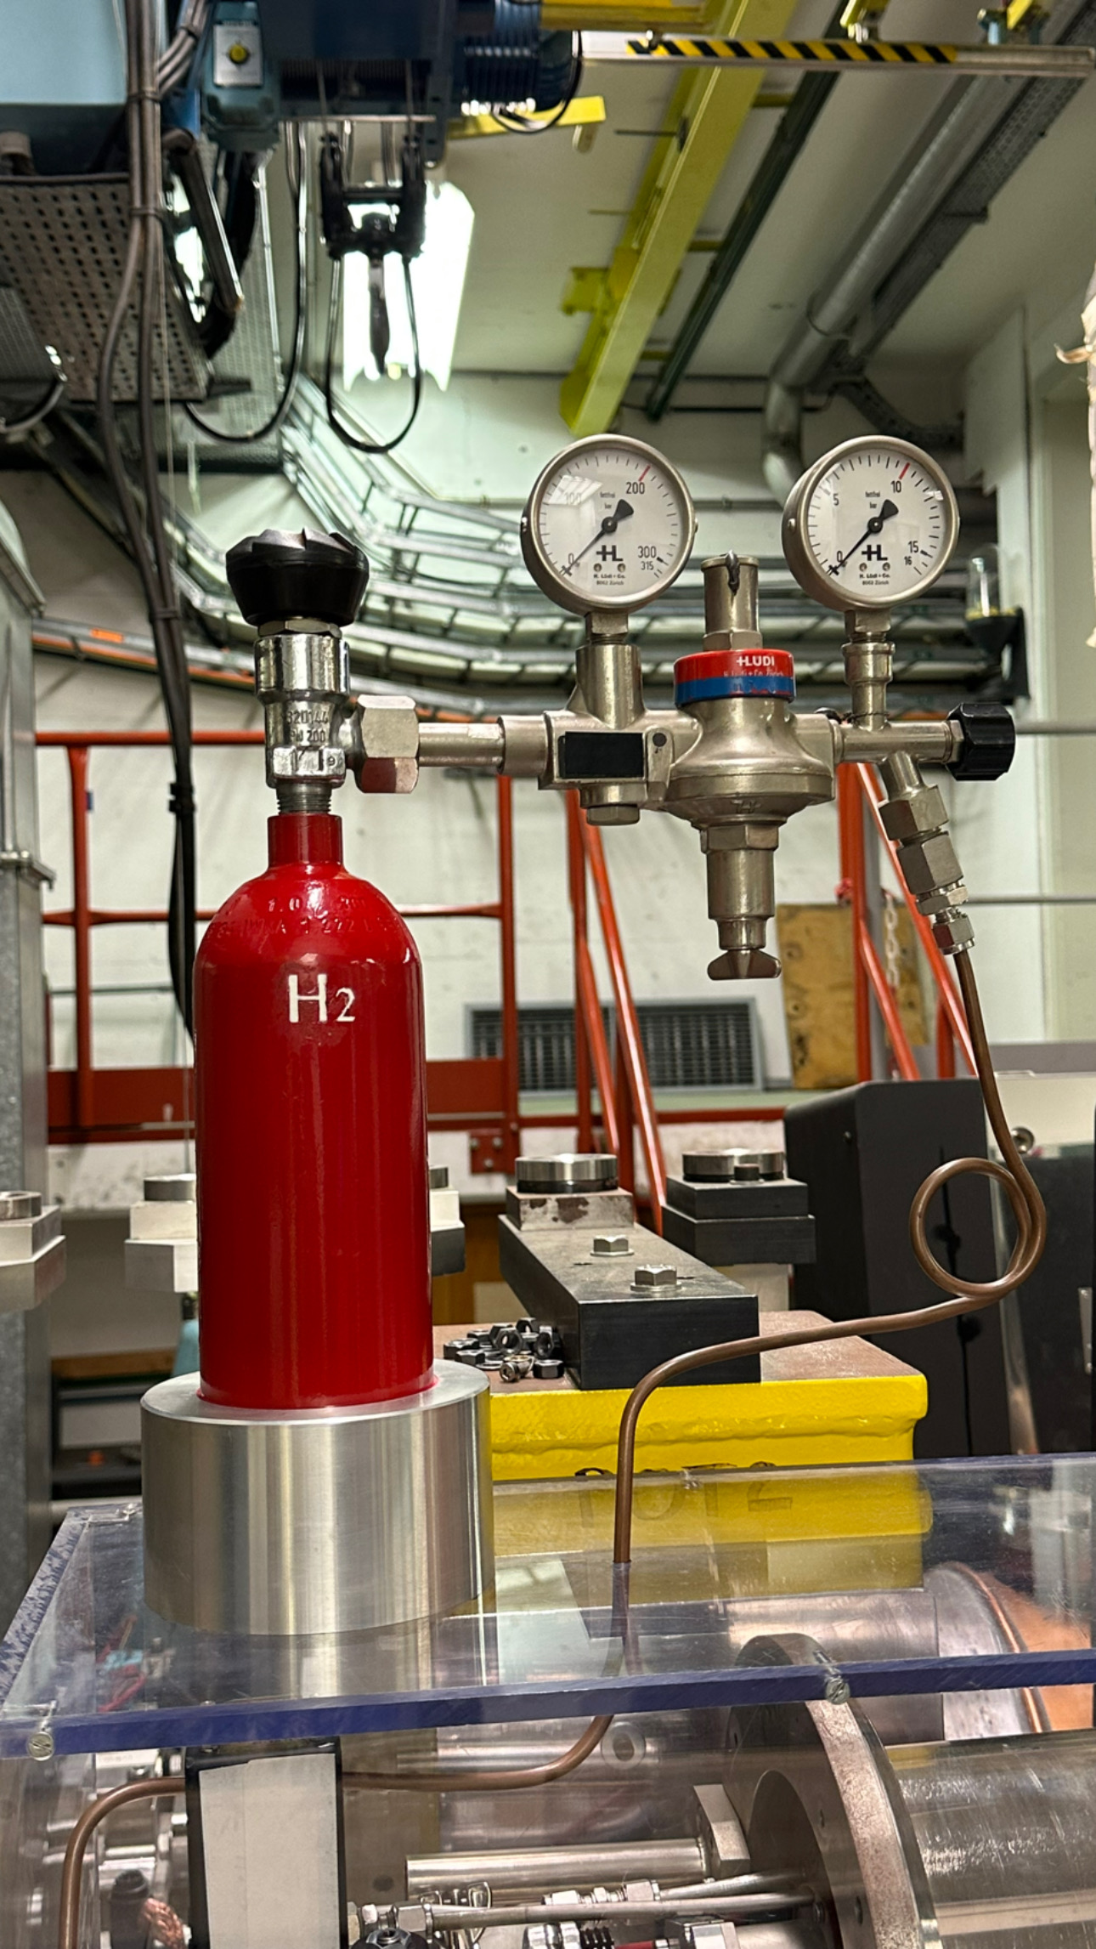
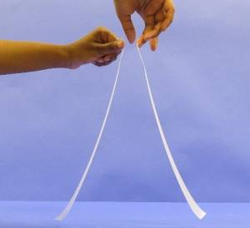
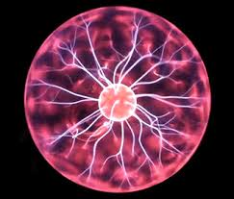
Step 1 -Generate particles
Notes:
You can relate the first

Slide 15
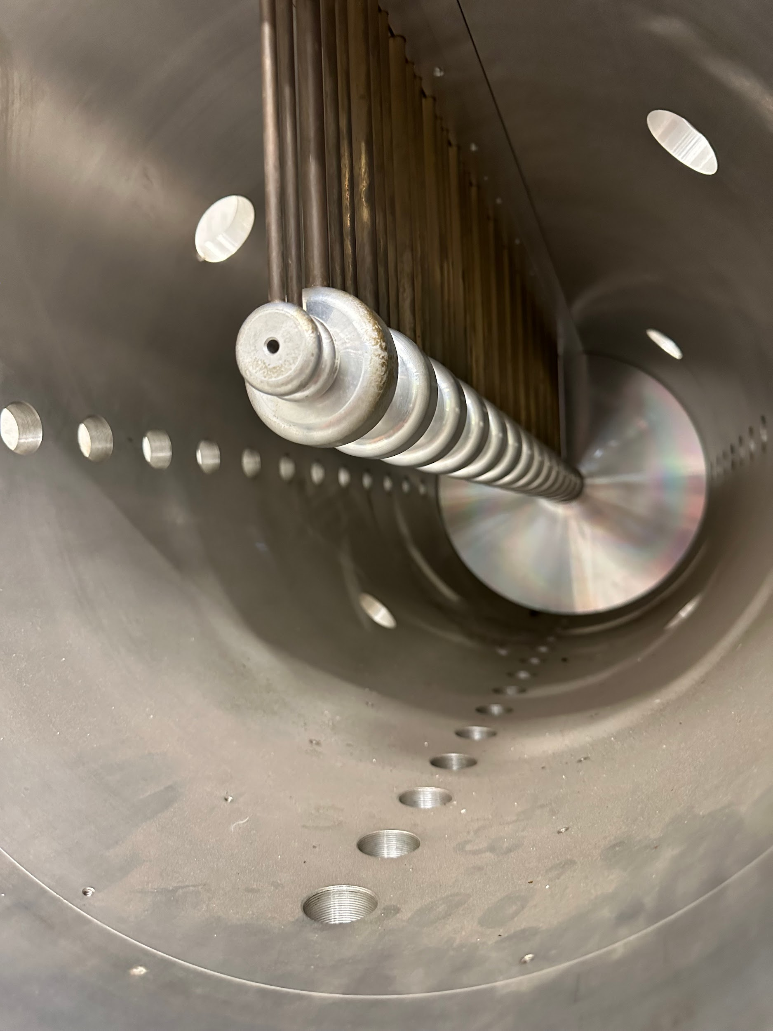
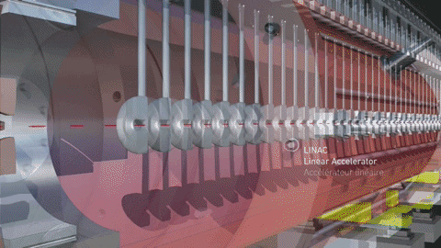
Step 2: Accelerating charged particles in an radiofrequency cavities
Notes:
Of course the field is changing - you did watch the movie right?

Slide 16
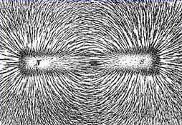
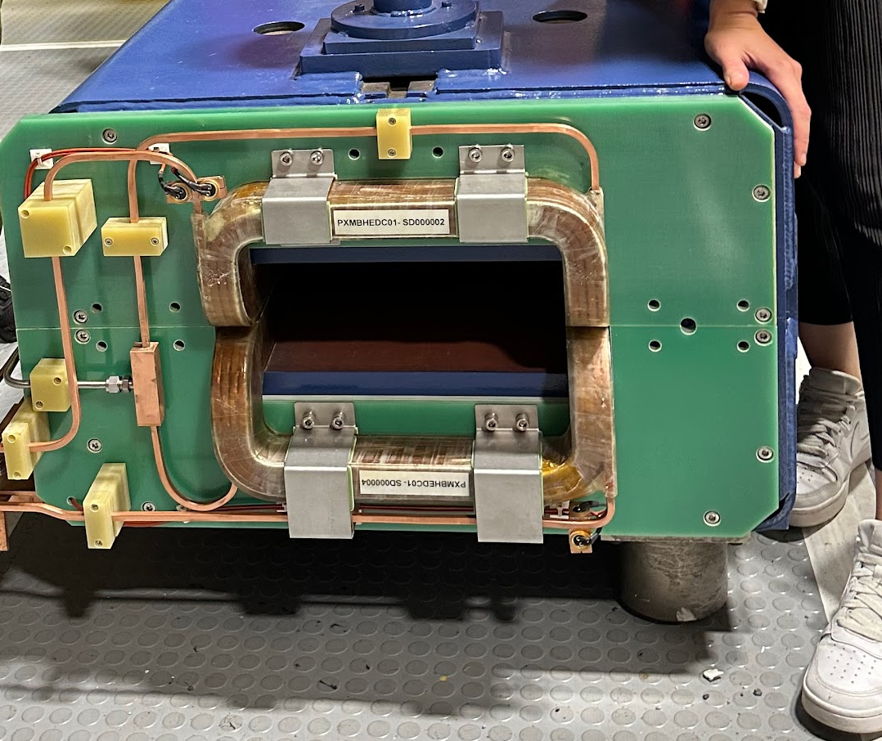
Visualizing Magnetic fields
Most high students are familiar with visualizing magnetic field lines using a bar magnet and iron filings

Slide 17
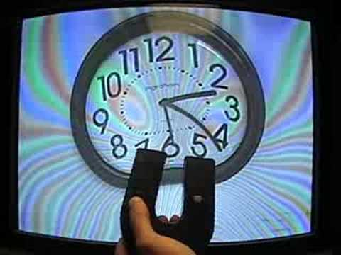
Step 3: Beams of charged particles bent with magnets
Students can observe that the path of charged particles can be changed in a magnetic field
Older CRTs produced images by firing electron guns (red, blue, and green) through the television body onto the back of the screen.

Slide 18
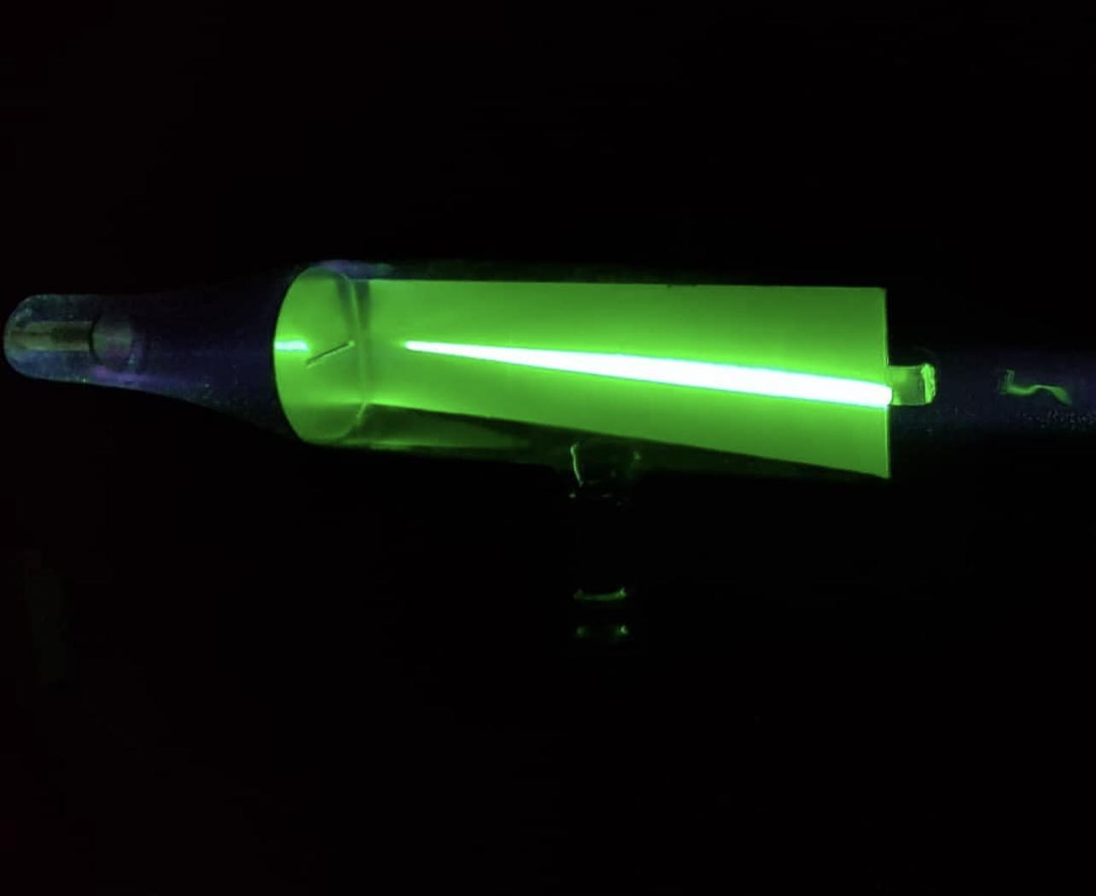
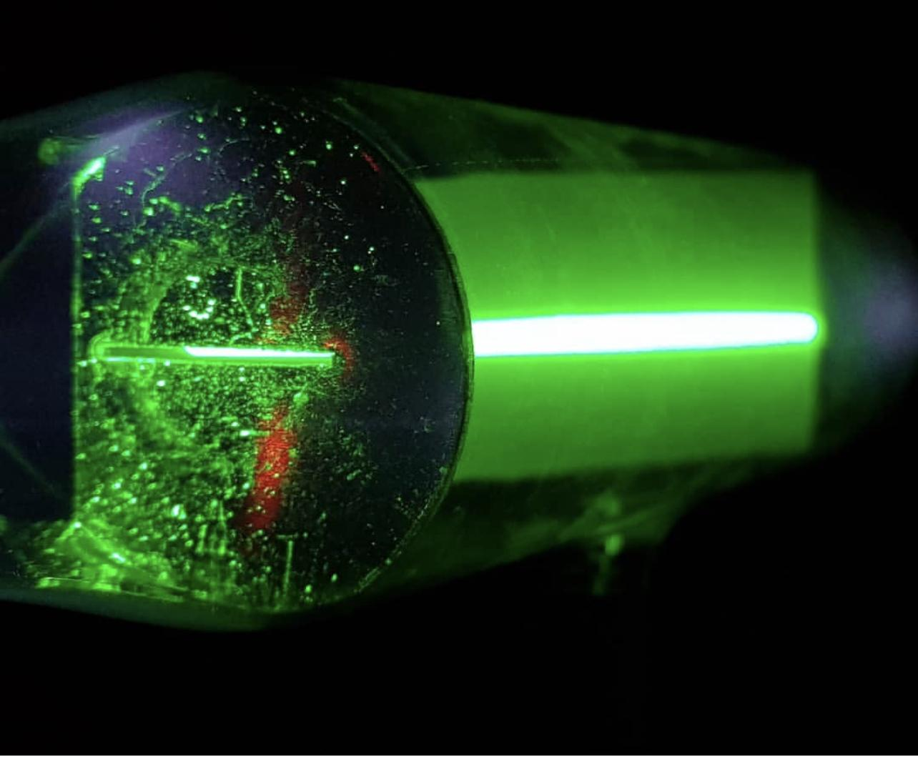
Can use a Cathode Ray Tube as a live demo
A Cathode Ray Tube is a particle accelerator.
It uses a high voltage power supply to accelerate particles ~ electrons

Slide 19
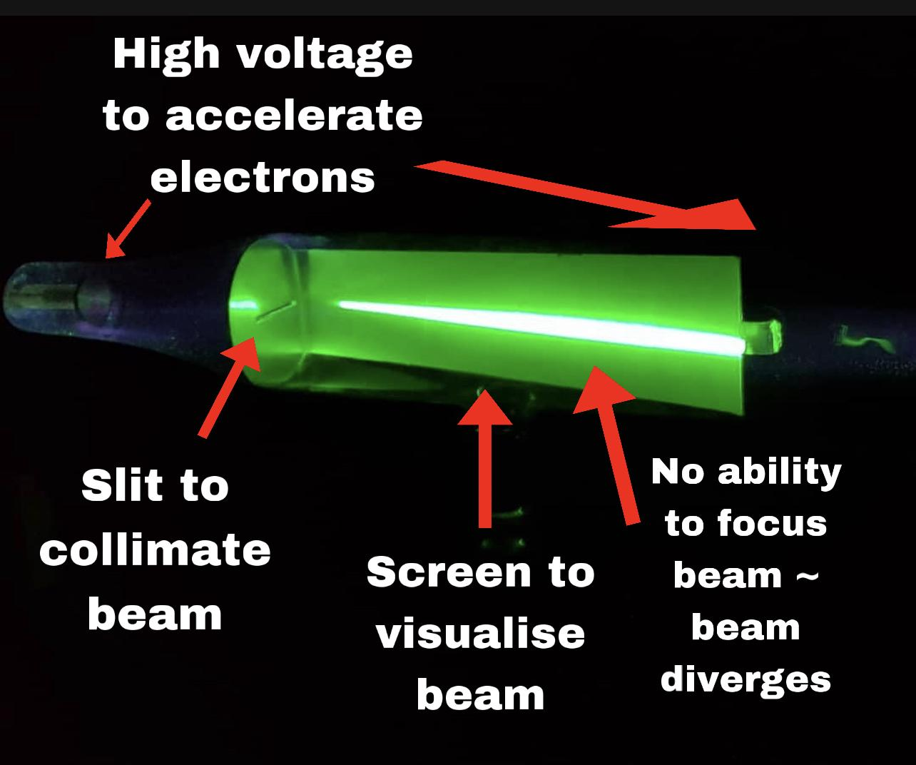
Notes:
As you can see, a cathode ray tube with a phosphorescent screen can be used to introduce Particle Accelerators. There are various components that students can identify and relate to the LHC. Firstly there is a high voltage in order to accelerate particles, which in this case are electrons.The basic components of an accelerator are present.
A source of particles
Vacuum vessel
High Voltage Power Supply
Phosphorescent Screen
The students can then be asked to think about the purpose of the slit which is to collimate the beam. Secondly students be asked what is the purpose of the screen which is to visualise the beam and allow us to detect the particles. A subtle characteristic is that the beam diverges and is not focussed.

Slide 20
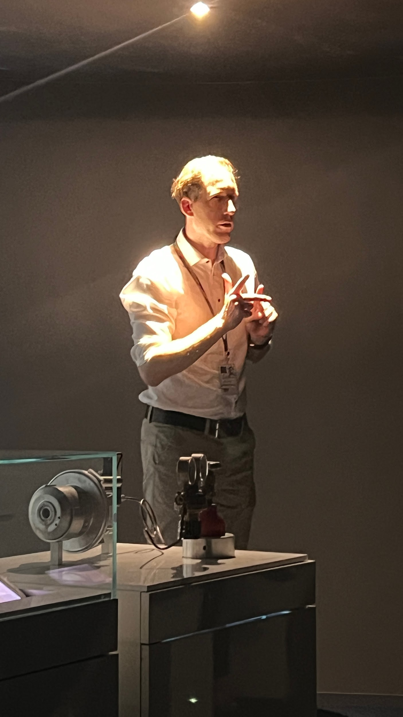
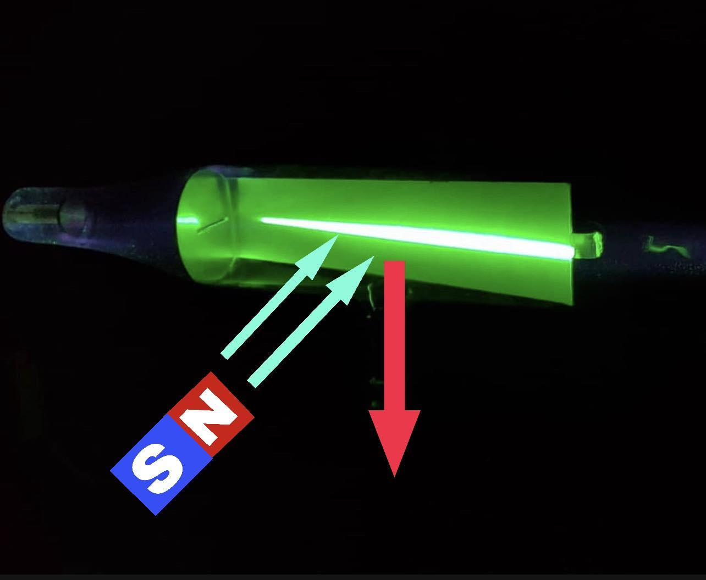
The Right Hand Rule - Lorentz Force

Slide 21
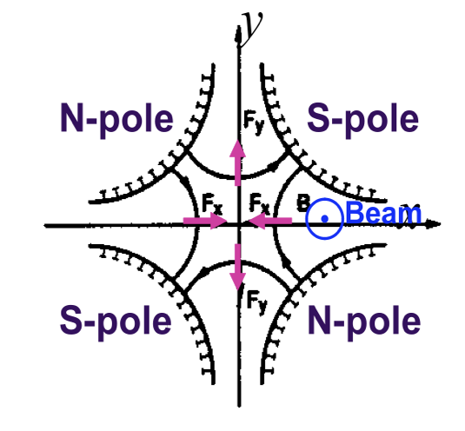
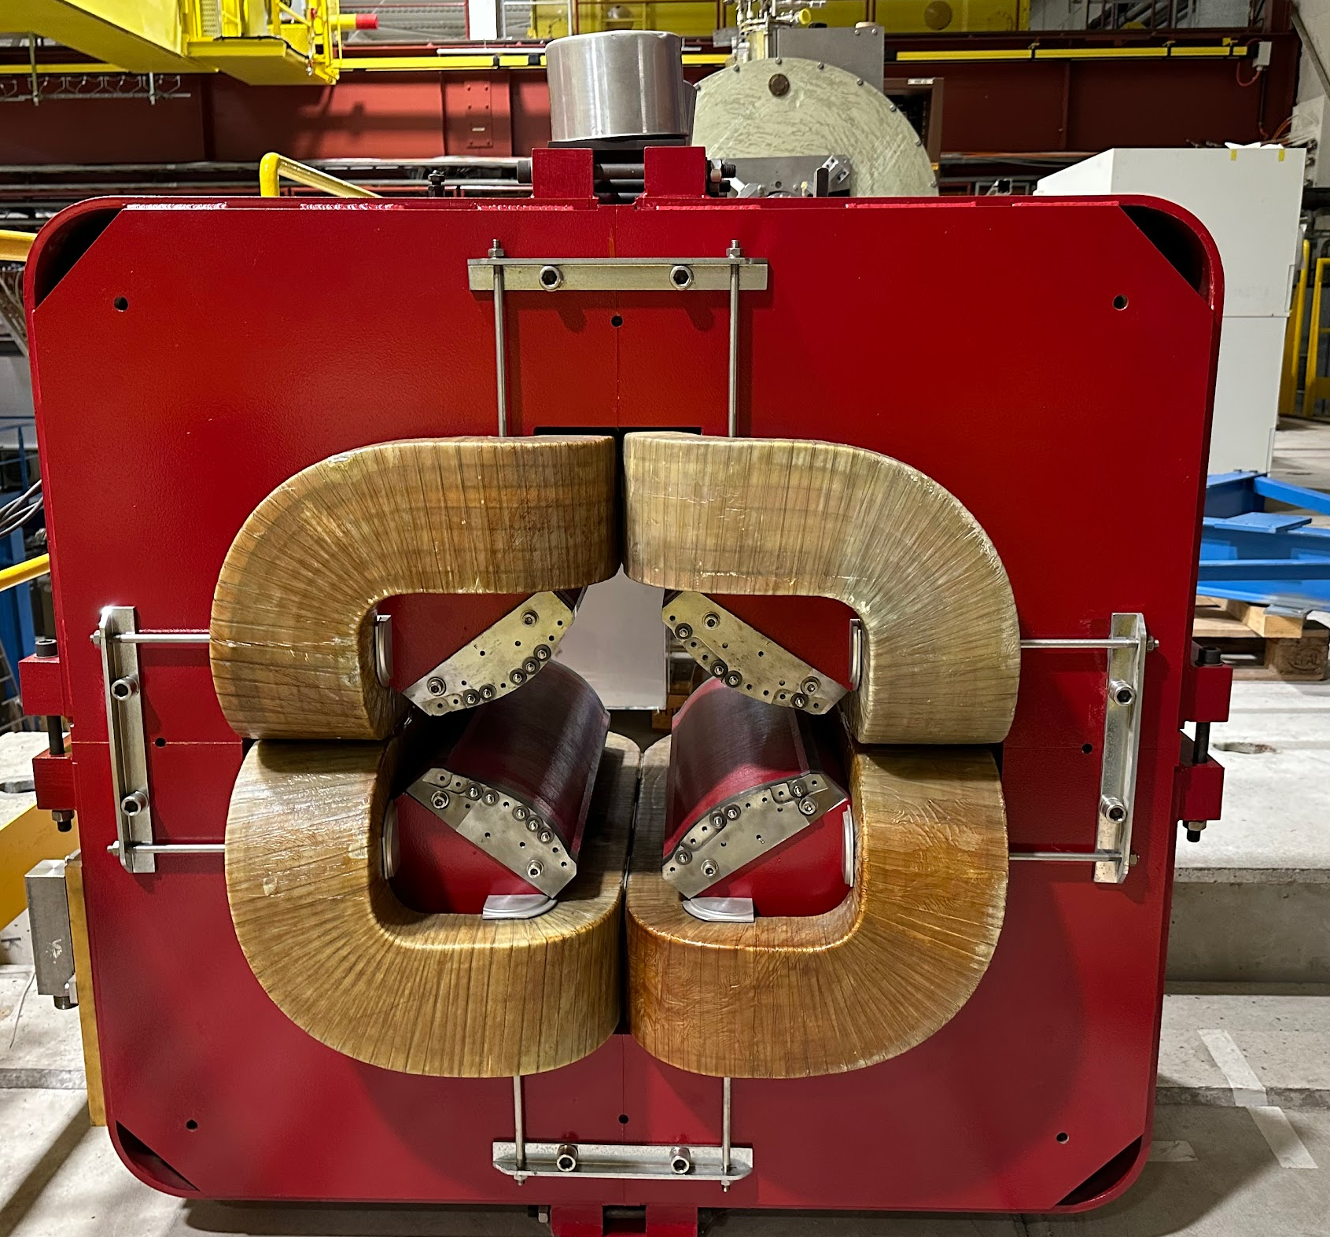
Step 4: Magnet lattice focuses beam

Slide 22
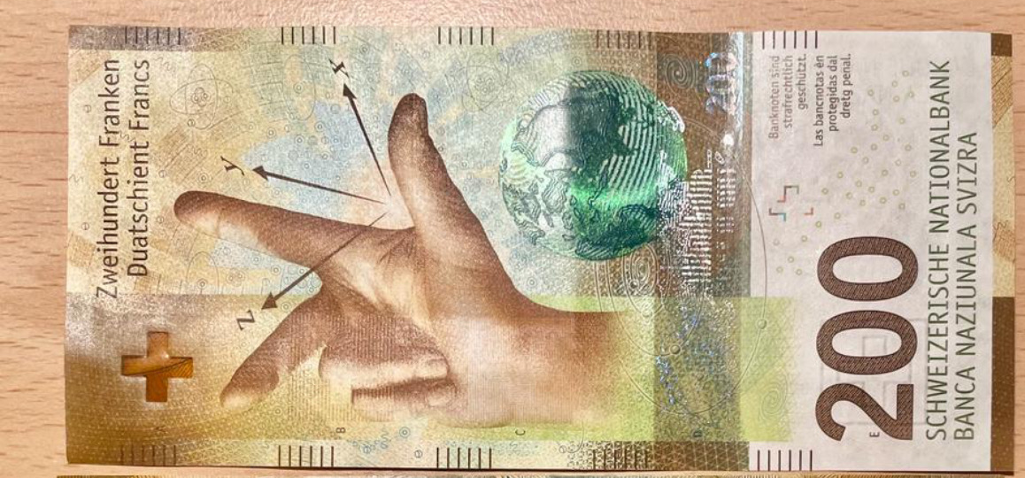
Pedagogical approaches
Support their understanding with mathematical representations

Slide 23
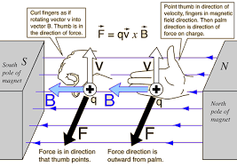
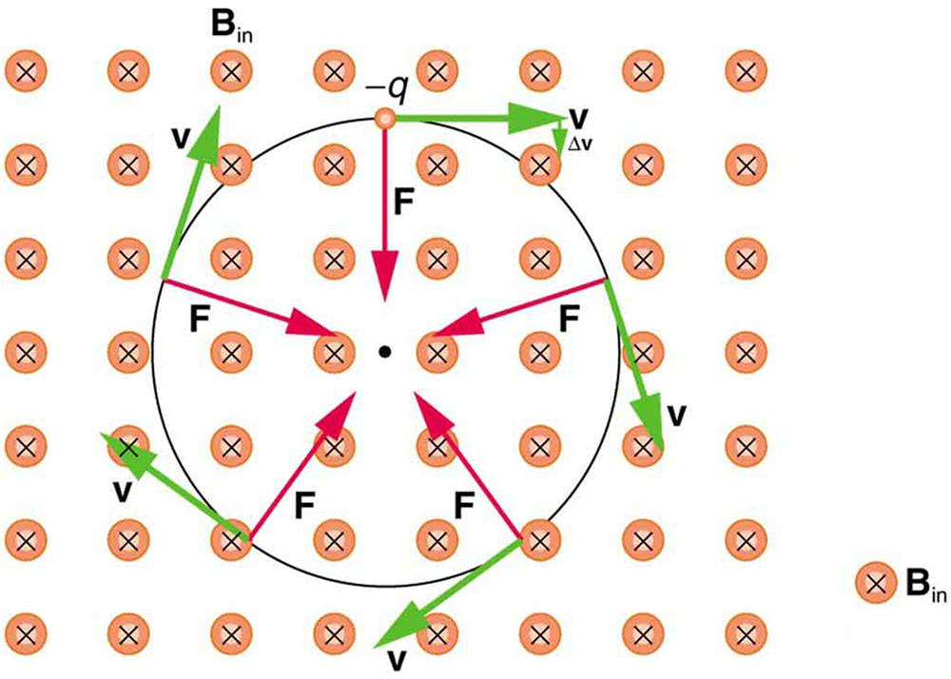
Mathematics that would help our students (If we must)
Lorentz force acts as a centripetal force:
qvB=mv²
r

Slide 24

Pedagogical approaches
Kinesthetic learning

Slide 25
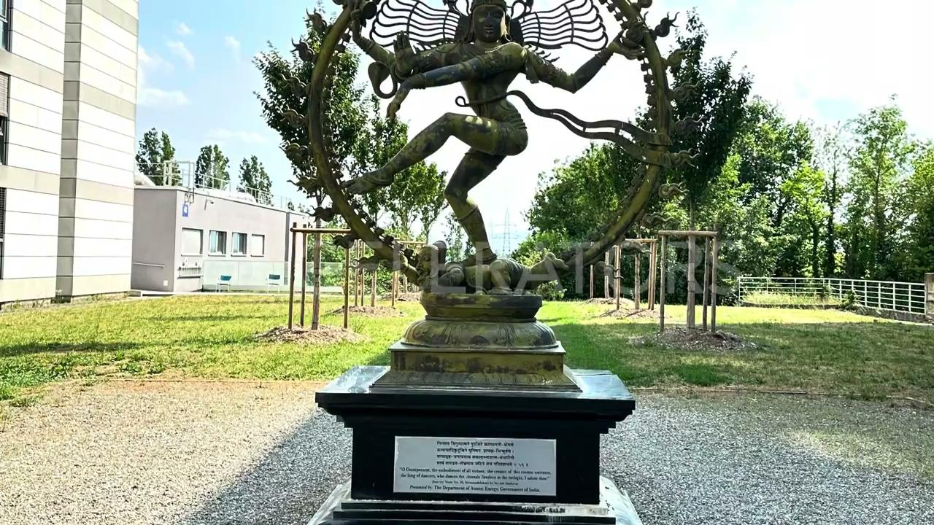

Slide 26
Resources
https://www.youtube.com/watch?v=pQhbhpU9Wrg
https://onlinestores.factoryoutlets2023.com/category?name=plasma%20ball%20gif
https://www.facebook.com/actitoutlessons/
http://hyperphysics.phy-astr.gsu.edu/hbase/electric/elefie.html
Introduction to particle accelerators S. Gilardoni SY/STI, simone.gilardoni@cern.ch
pictures from physics website. We are so sorry
Pictures (slides from 8 to 12): https://drive.google.com/file/d/1ve1EJ5l5yO-C8ej38EArDR5hduiBoBaW/view?usp=drive_link ;https://drive.google.com/file/d/1vbgiJpOg7Peglp20LcphHGML9g-3xqTQ/view?usp=drive_link; https://drive.google.com/file/d/1vbb_bP25pCp-Ng5qXZqDJtY-Ihlr06tR/view?usp=drive_link; https://drive.google.com/file/d/1vVhJTIohWQMvLJiX3LGOKjR0ZWvdGE8f/view?usp=drive_link; https://drive.google.com/file/d/1vNwrjCcmKSucTRg9mjd0dAOizAbie8c2/view?usp=drive_link

Slide 27

Free templates for all your presentation needs
For PowerPoint and Google Slides
100% free for personal or commercial use
Ready to use, professional and customizable
Blow your audience away with attractive visuals

