Slide 1
Status w31 2022
Fredrik PG

Slide 2
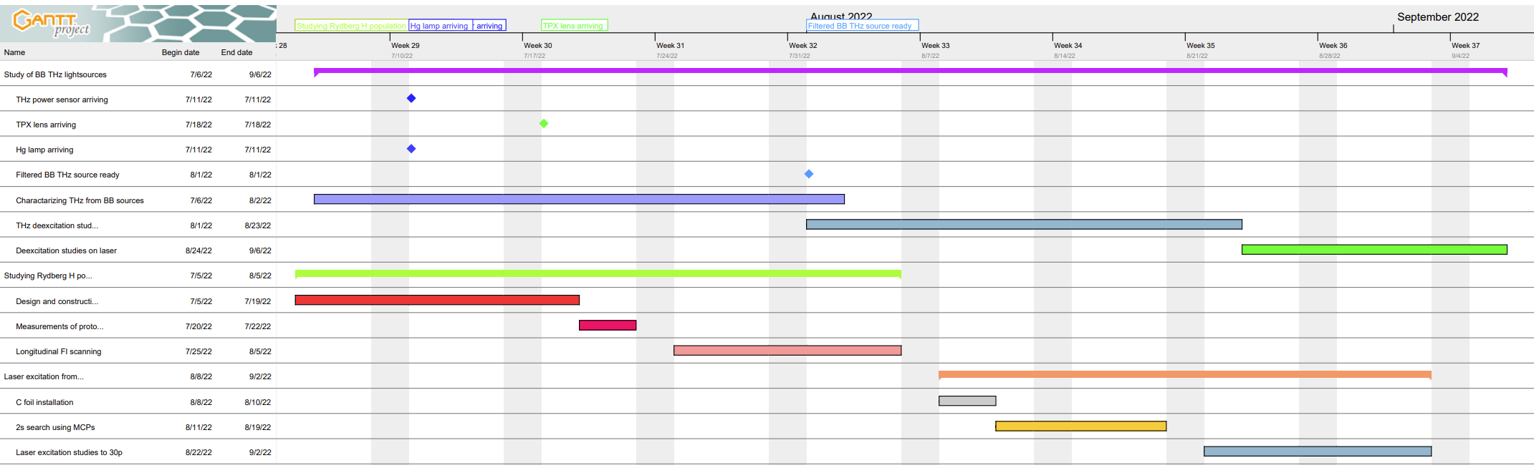
Timeline
Milestones achieved:
TPX lens arrived
Pulsed proton source characterized
C foil installed in chamber
Milestones remaining:
Hg,Cd,Na lamps not arrived
but they have been shipped
MCP feedthroughs still missing.

Slide 3
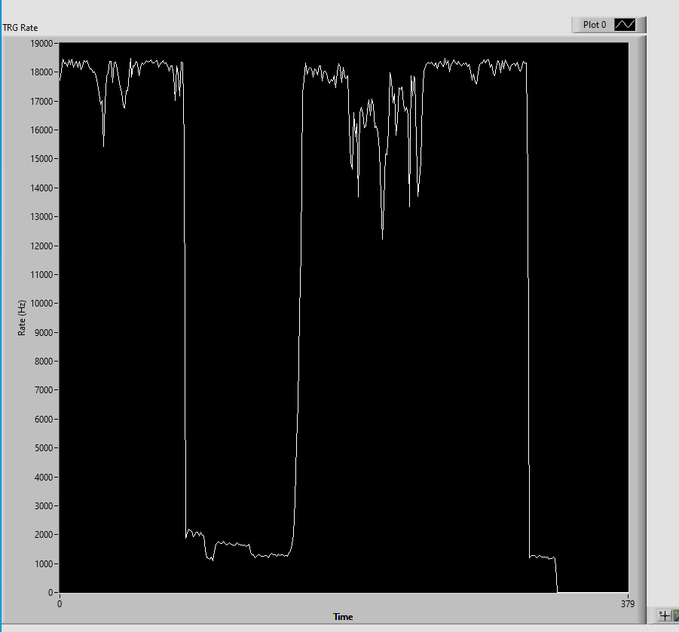
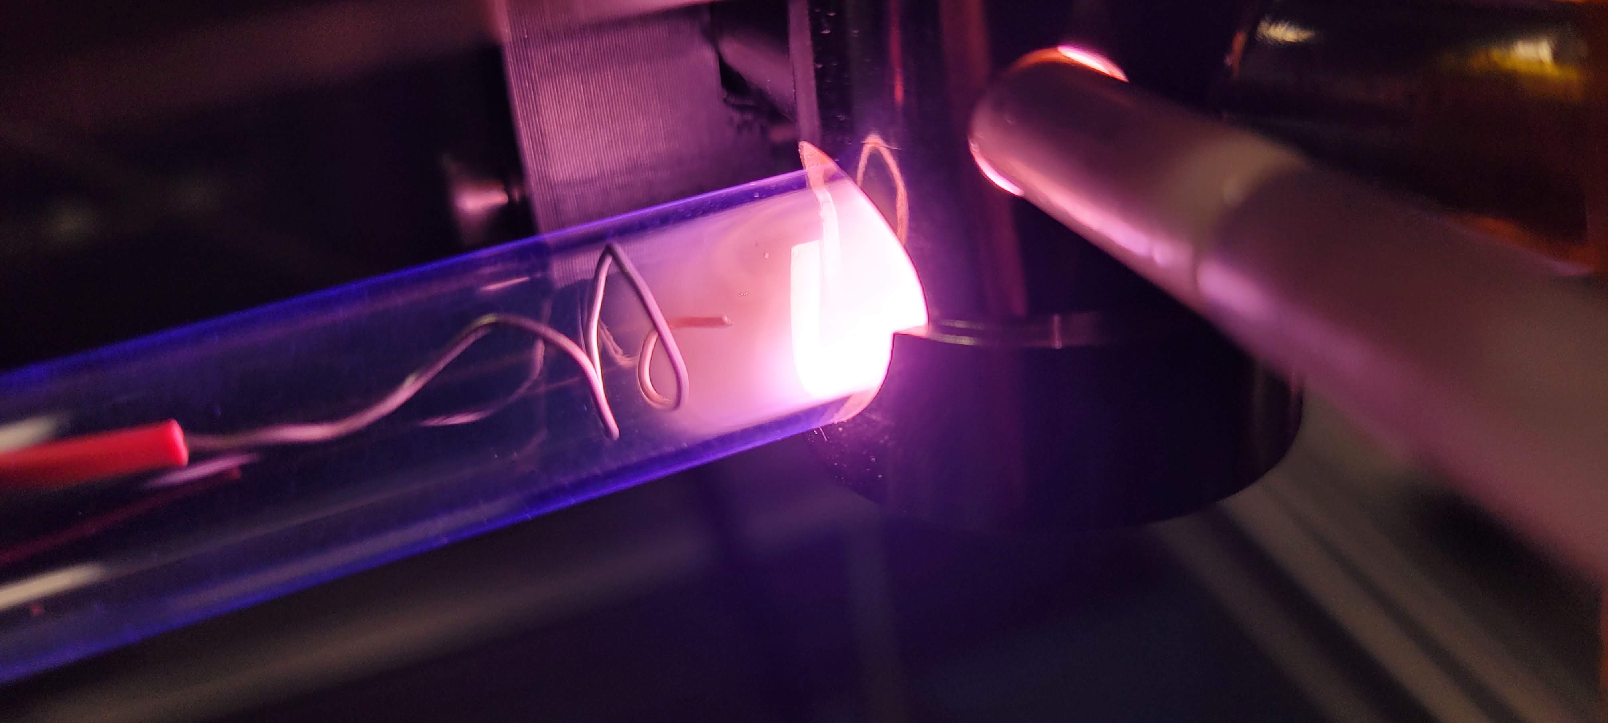
A simple proton source
Electrode placed near plasma and biased to +0 to +5kV.
5mA, 0-20kV Heinzinger power supply acquired
SHV feedthrough borrowed from MIRACLES
Stable proton beam observed from 200V to 5kV
Beam on
def off
MCP
Deflector
FI
+5kV
Protons
def on
plasma off
Powersupply tripping at 300uA

Slide 4
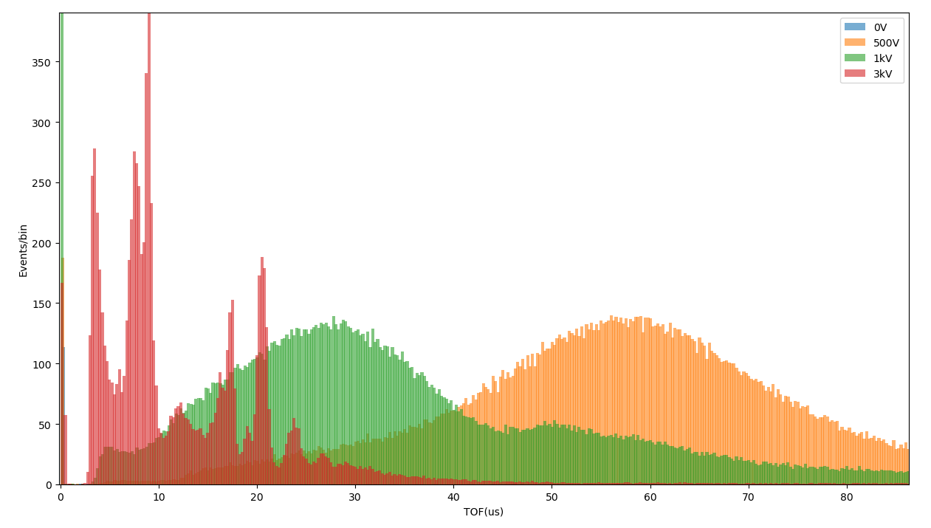
TOF of pulsed proton source, at different bias voltages
0.3 mbar plasma pressure
Temp of plasma

Slide 5
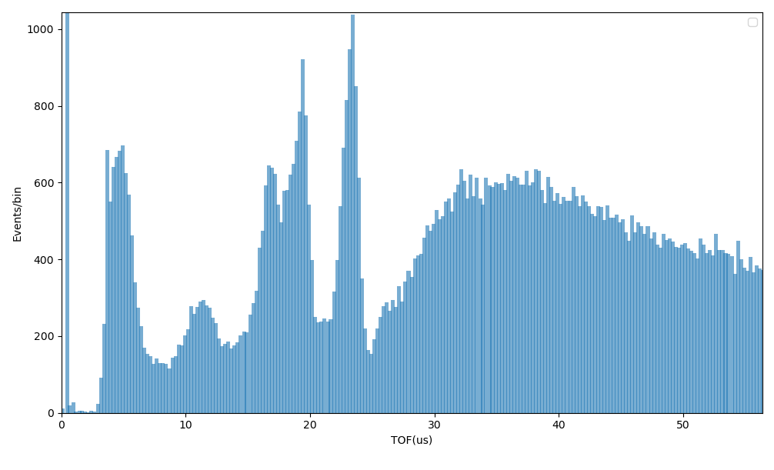
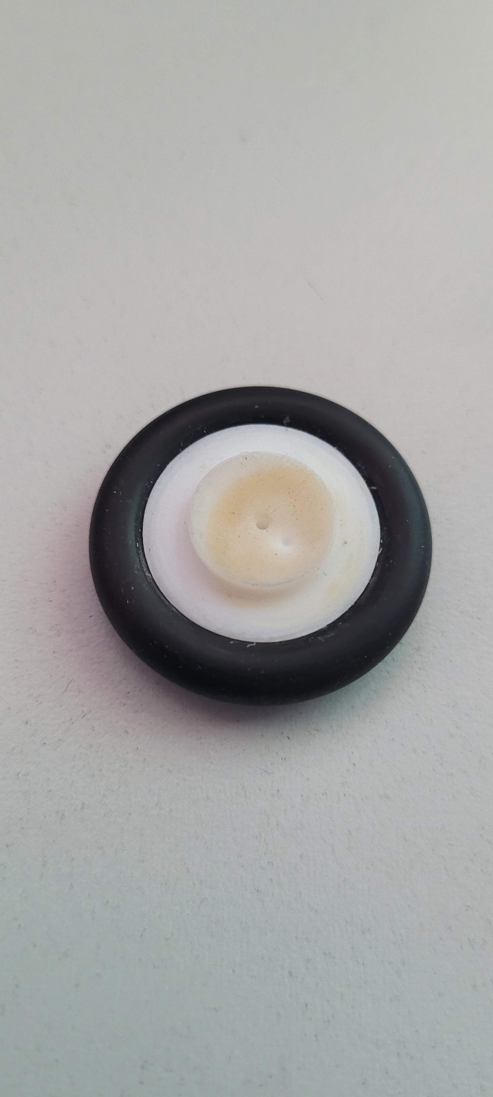
What are these peaks?
3us -> 270eV protons
23us
10us, 270eV 12 amu
16us, 270eV 30 amu
19us, 270eV 44 amu
23us, 270eV 65 amu
19us
3us
16us
Hole caused by beam?
10us

Slide 6
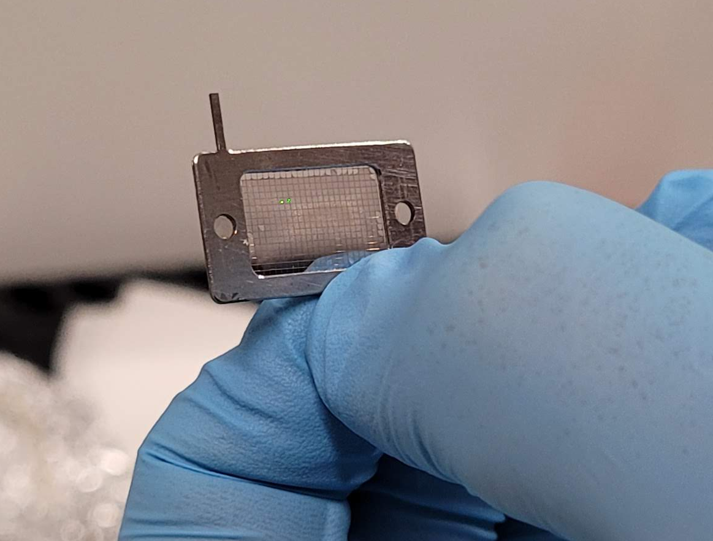
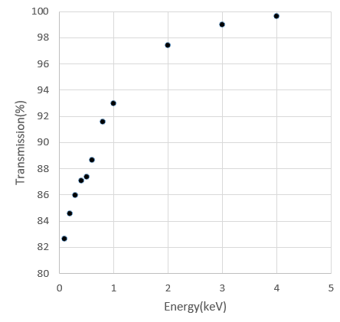
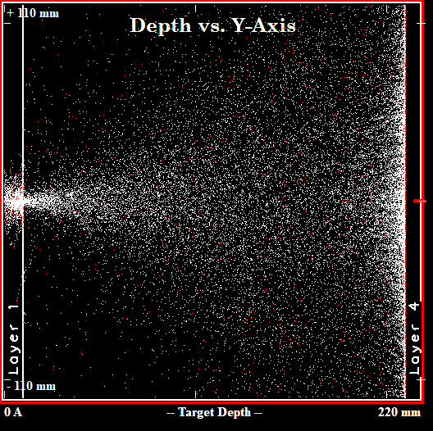
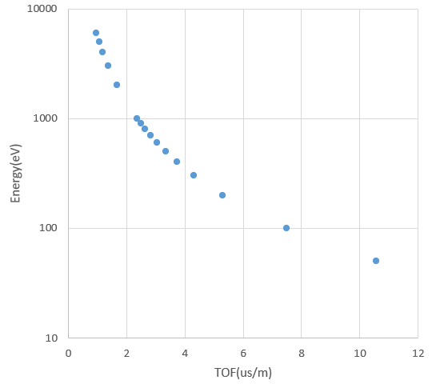
Transmission through 12nm thick C-foil
Beam energy TOF
Transmission through 12nm foil
200 eV p+ beam
Example: With 200V we expect 85% transmission with a beam energy of 185(25) eV resulting in 5.5us/m TOF

Slide 7
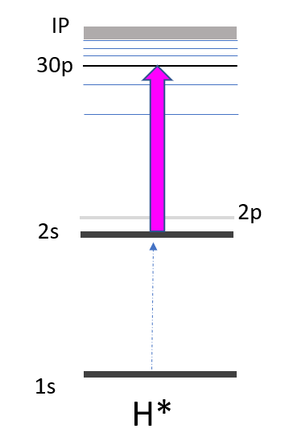
H(2s) production using C-foil
For testing laser excitation to Rydberg states we can use the C foil with a 200eV proton beam.
Unfortunately the TOF will be too short for any Deexcitation studies..
MCP
C-foil
-10V
Grid
-50V
+200 V
H(2s)
H*
H+
H*
+3000V
+50V
0V
0V
0V
2.5us
366 nm
Stable proton beam observed

Slide 8
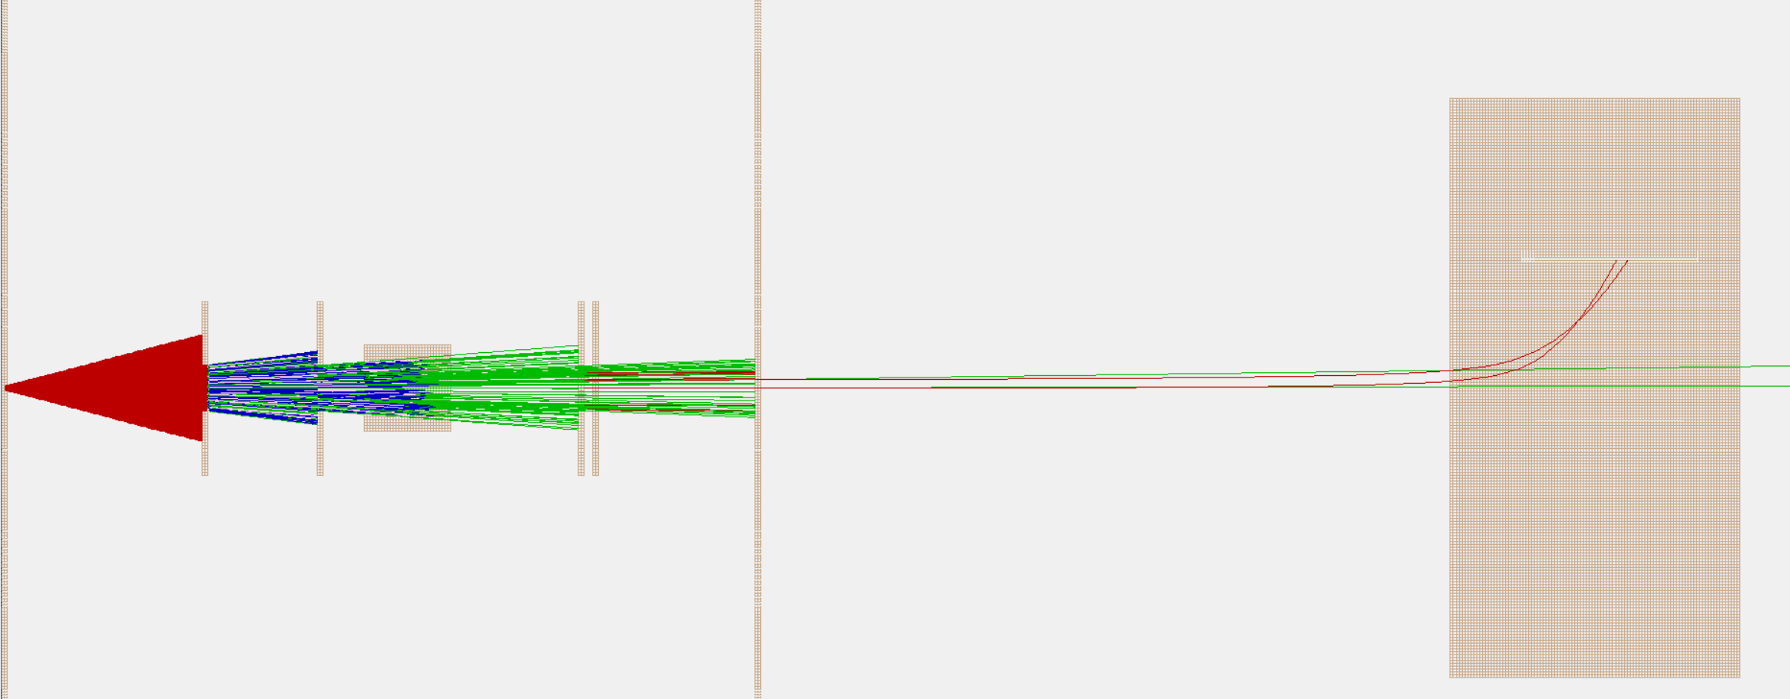
SIMION simulation of setup
12cm
300eV
+50V
0V
0V
+3000V
Detector for 2s detection?
OBS: Ions field ionized have a TOF of roughly 1.2us
while ions not produced in FI region have a TOF of 3us.
This could be used for discrimination.

Slide 9
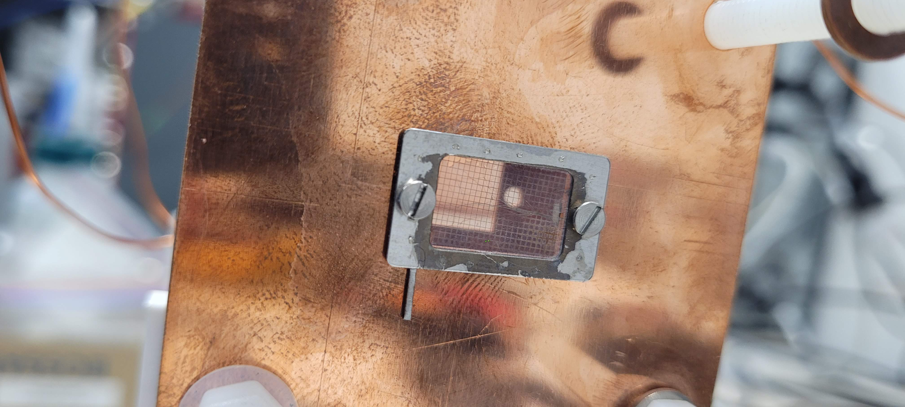
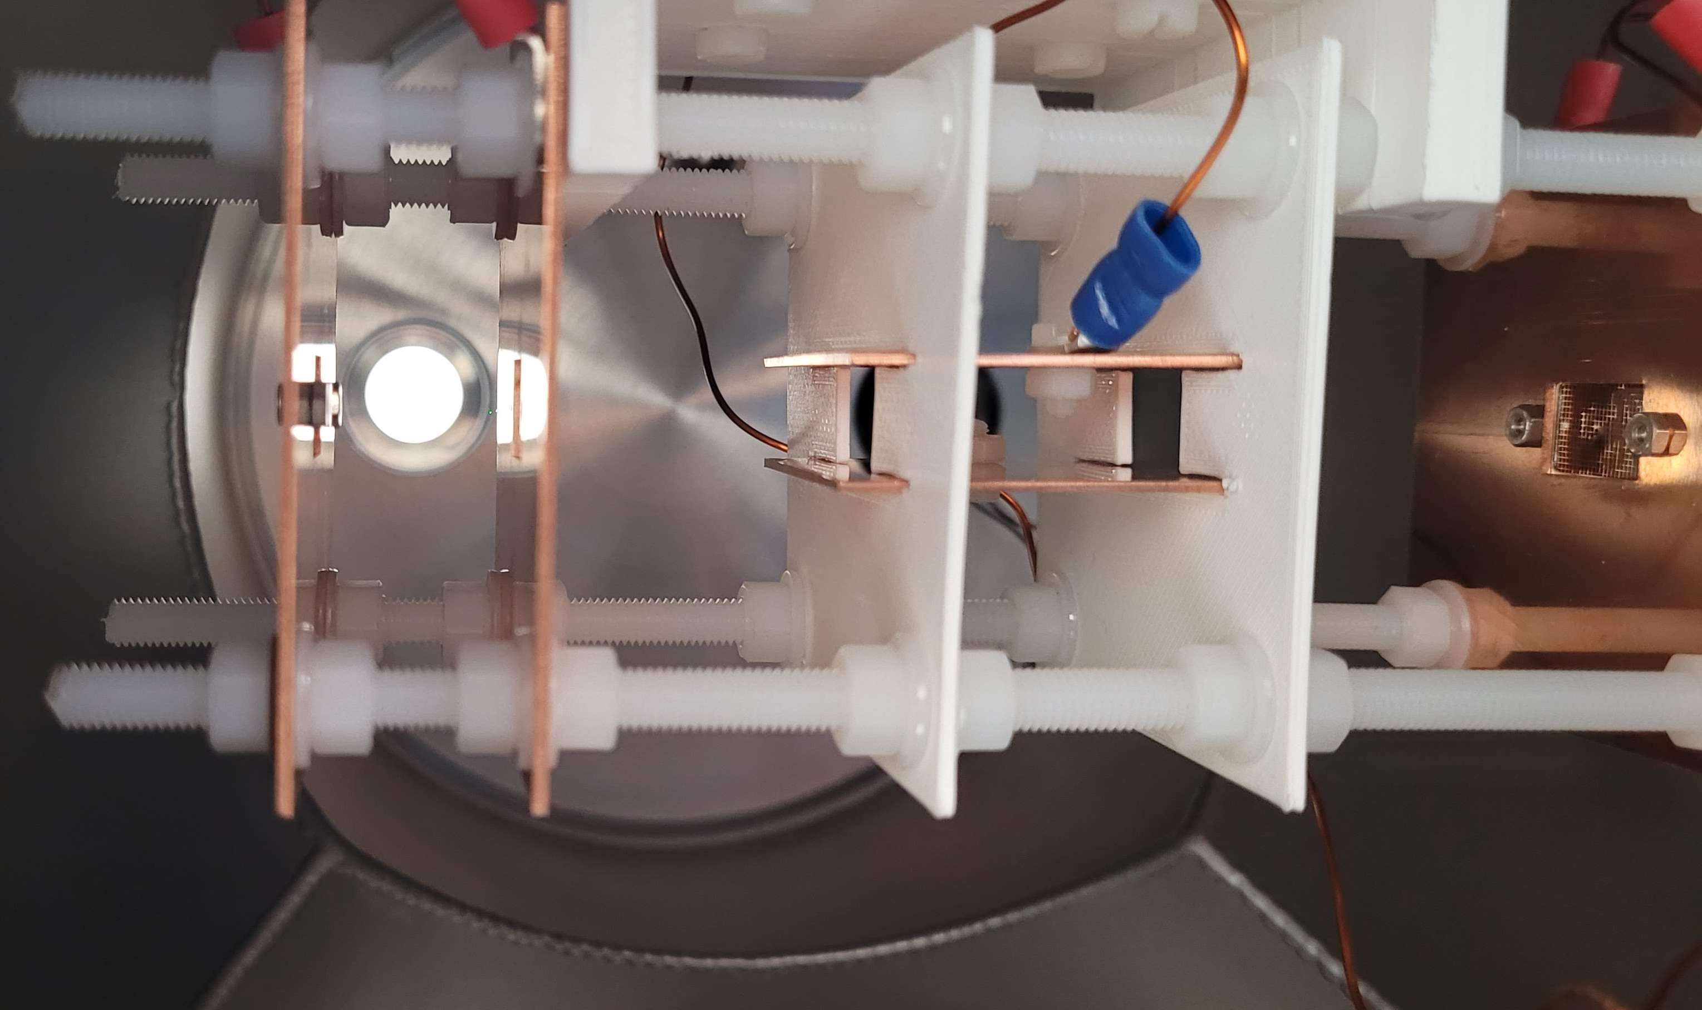
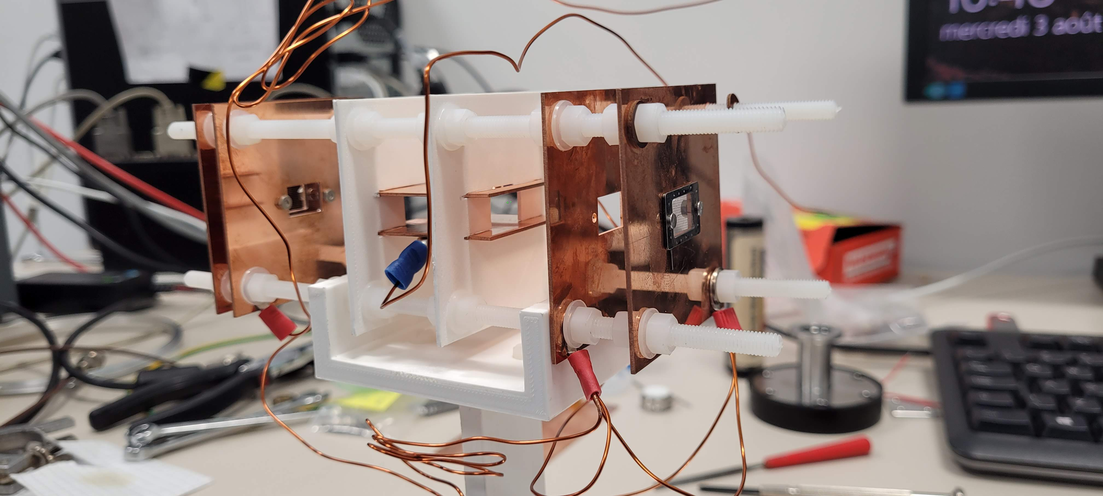
Installation of foil (ongoing)
C foil
Study TOF after installation of foil at different beam energies.
Excitation region:
FI region
Ion beam filtering

Slide 10
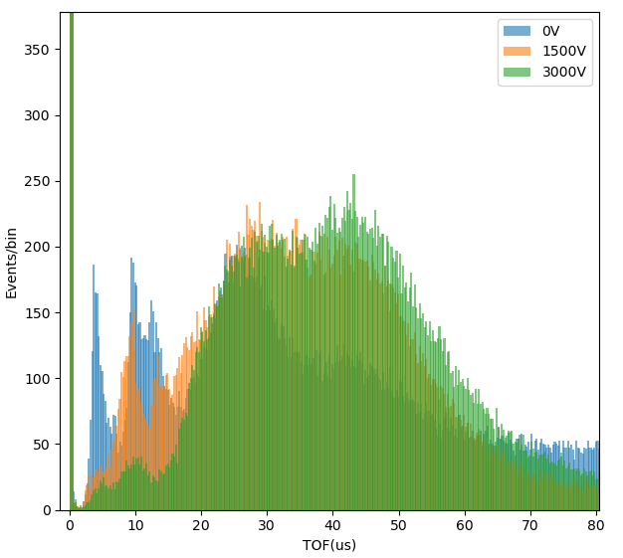
Voltage applied on Longitudinal FI electrodes
0.3mbar plasma pressure biased at +3kV
Fast protons are filtered when increasing voltage on FI

Slide 11
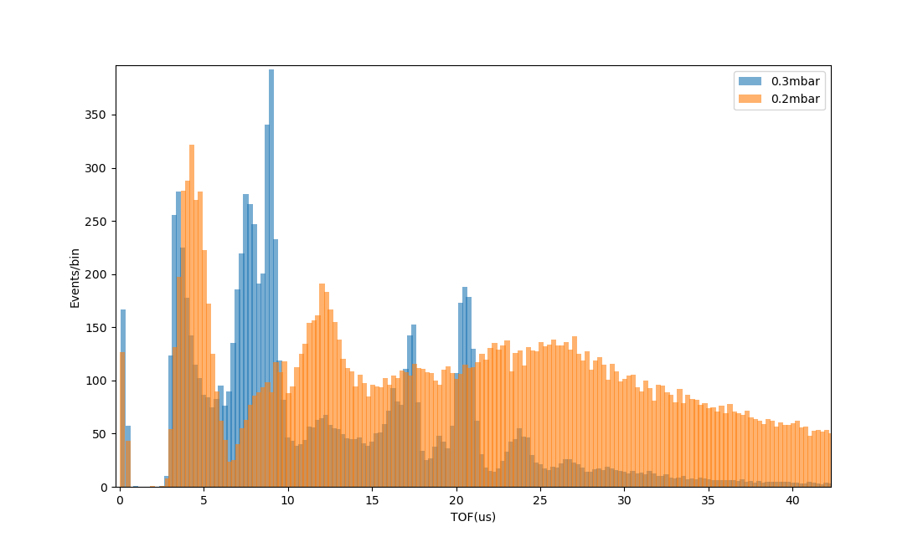
At 3kV voltge compared.

Slide 12
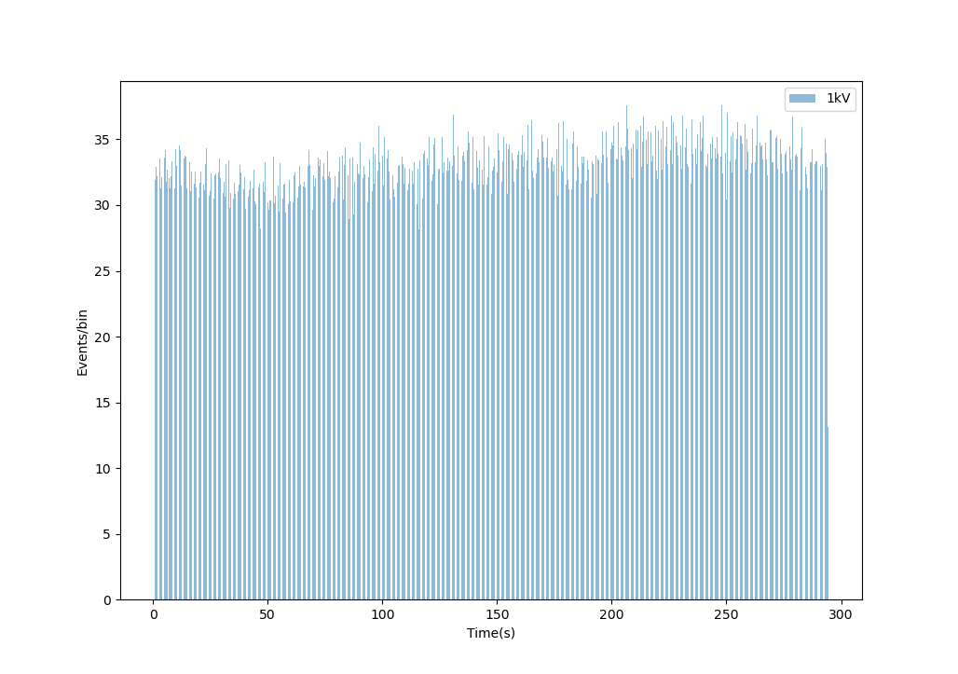
Stability of source

