Slide 1
CW 31 – Roadmap and Transmission
Presenter Name
Date

Slide 2
Roadmap
1.Experimental Measurements
1.2 PE with Lenses Transmission
2.Simulation of theoretical Data Set
2.1 PE Transmission
2.2 Lenses Transmission
3.Comparision
2.3 Black Body Radiation
1.1 PE Transmission
1.3 Power/Area over Distance
4. Telescope

Slide 3
1.1 PE Transmission

Slide 4
1.2 PE with Lenses Transmission

Slide 5
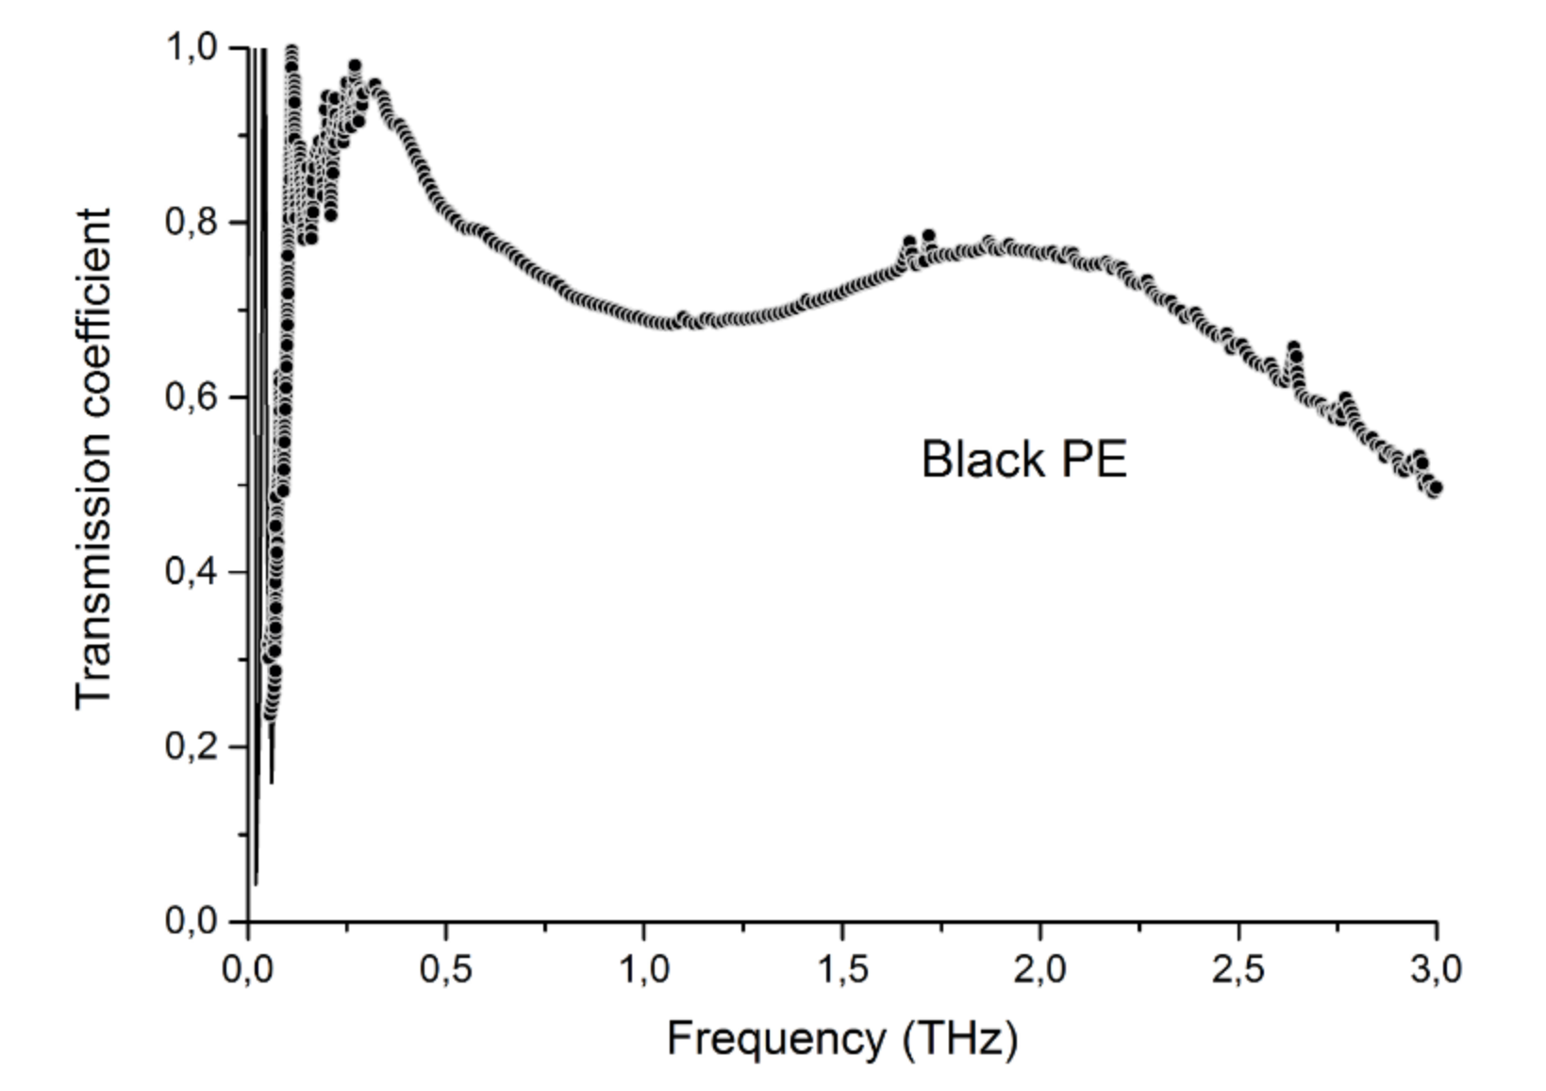
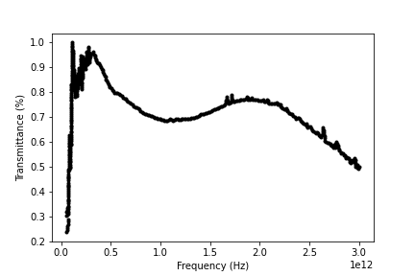
2.1 PE Transmission
https://automeris.io/WebPlotDigitizer/

Slide 6
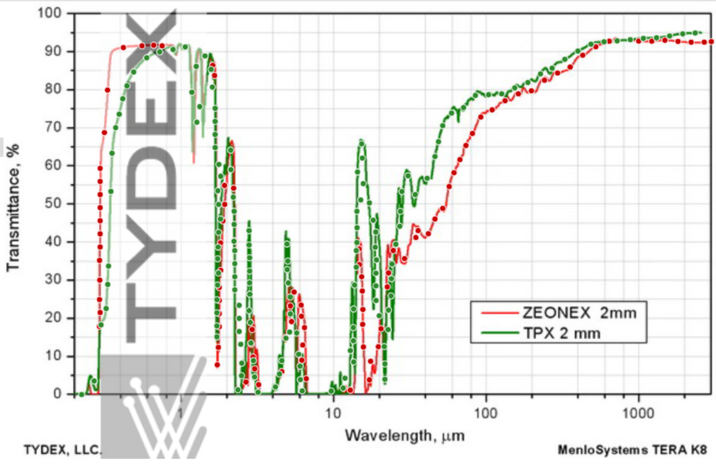
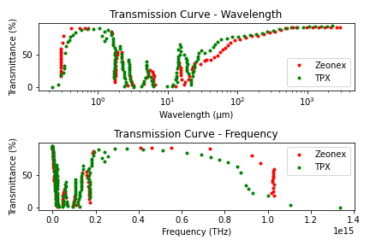
2.2 Lenses Transmission

Slide 7
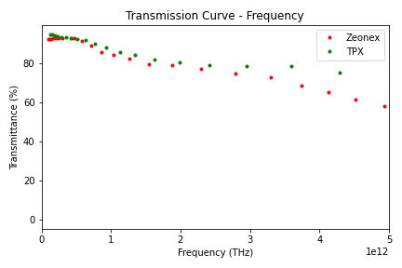
2.2 Lenses Transmission

Slide 8
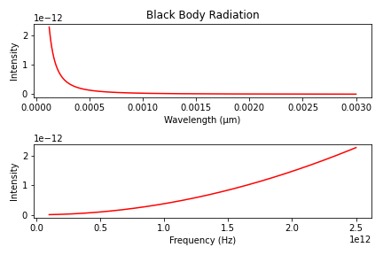

2.3 Black Body Radiation
Planck‘s law of black body radiation:
$$B(f,T)=2 ⋅h⋅\frac{f^{3}}{c^{2}}⋅\frac{1}{e^{h⋅\frac{f}{kT}}−1}$$

Slide 9
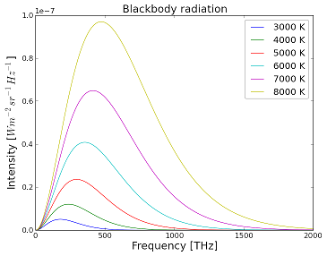



3.Simulation of theoretical Data Set
$$I_{m}\left(f\right)=I_{BlackBody}⋅T_{PE}⋅T_{TPX,Zeonex}$$

Slide 10
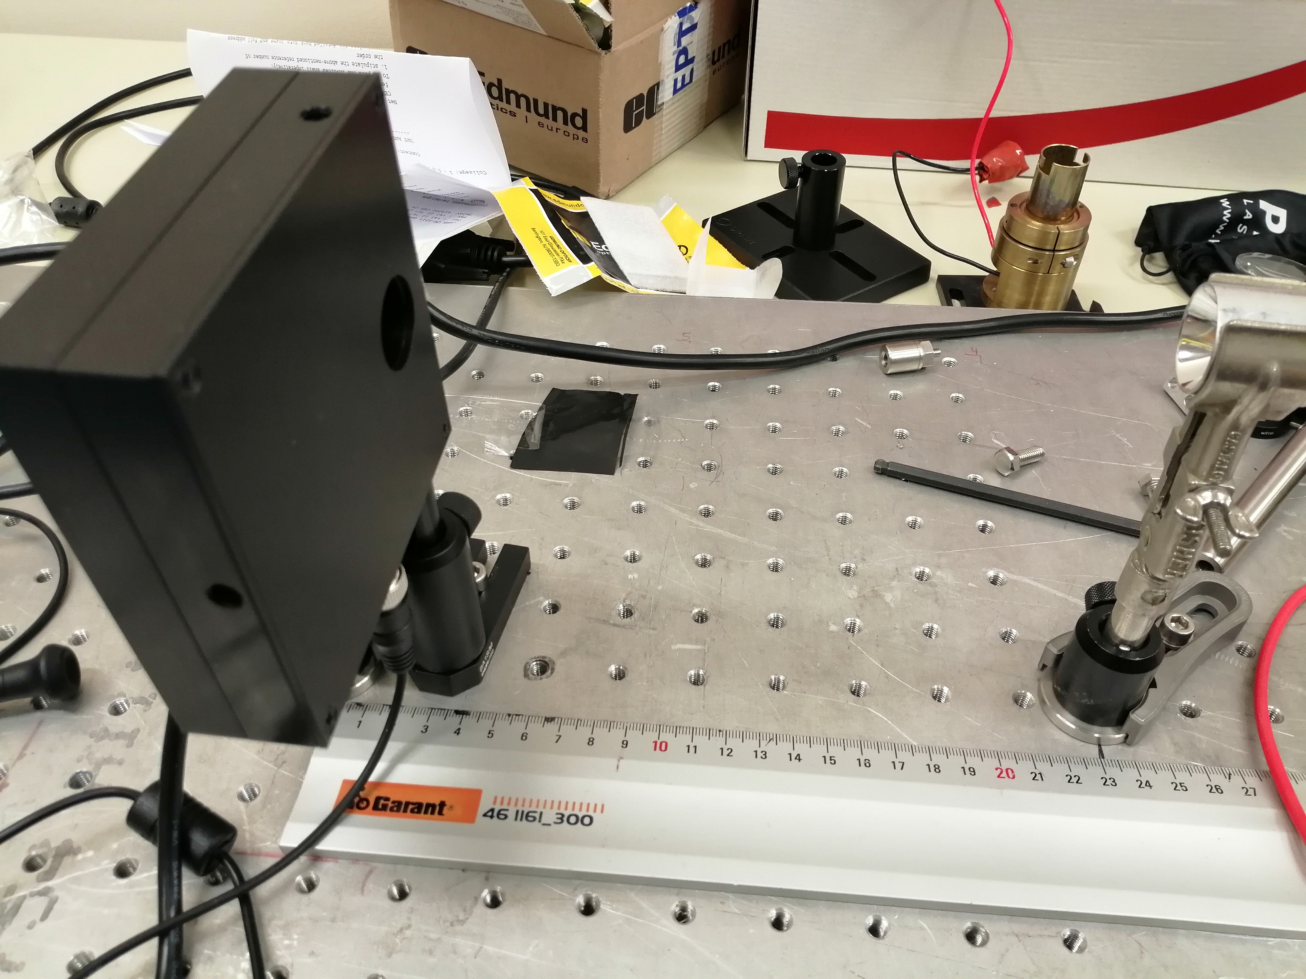
3.Comparison
$$I_{m,theo}\left(f\right)=I_{Planck}⋅T_{PE}⋅T_{TPX,Zeonex}$$
VS
$$I_{m,exp}\left(f\right)=I_{ASB−IR−12K}⋅T_{2PE}⋅T_{TPX,Zeonex}$$

Slide 11
TO DO
Ask JF PE Transmission for higher THz up to 5 THz or more
Measure Lamps charateristics->Power/Area over Distance
Finish Simulation for the Intensity output
Compare experimental Data with simulation
Building telescope

