Slide 1
Cosmic Anomalies?
Ned Wright

Slide 2

Two and a half Facts
Peter Scheuer (1963)*: “There are only two & a half facts in cosmology:
The sky is dark at night.
The galaxies are receding from each other as expected in a uniform expansion.
The contents of the Universe have probably changed as the Universe grows older.”
* In Longair, 1993, QJRAS, 34, 157

Slide 3
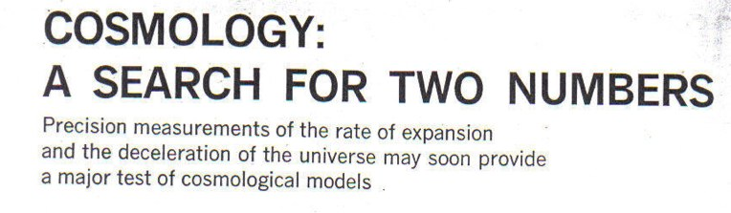
Sandage, Feb 1970, Physics Today
H_{o} = 49 to 130 km/sec/Mpc
  Sandage not yet hard over on 50
q_{o} = 1.2 ± 0.4
  Notes not close to -1 for SS
  Also not close to true -0.5 to -0.6

Slide 4

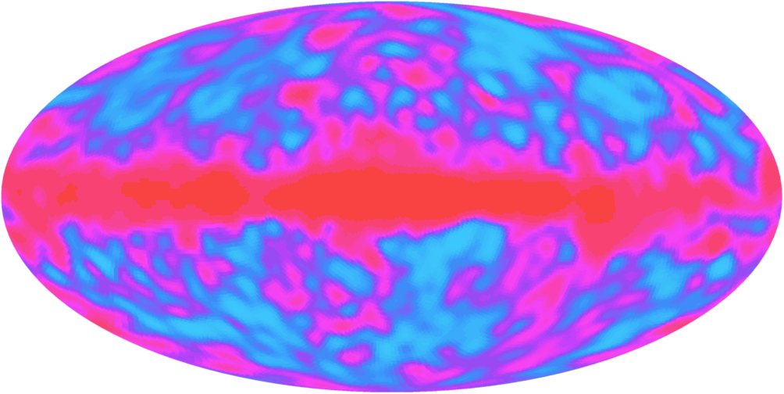
A Big Media Splash in 1992:
25 April 1992
Prof. Stephen Hawking of Cambridge University, not usually noted for overstatement, said: “It is the discovery of the century, if not of all time.”

Slide 5
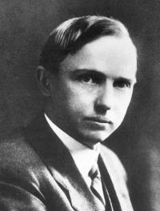
Harlow Shapley
“A hypothesis or theory is clear, decisive, and positive, but it is believed by no one but the man who created it.
Experimental findings, on the other hand, are messy, inexact things, which are believed by everyone except the man who did the work.”

Slide 6
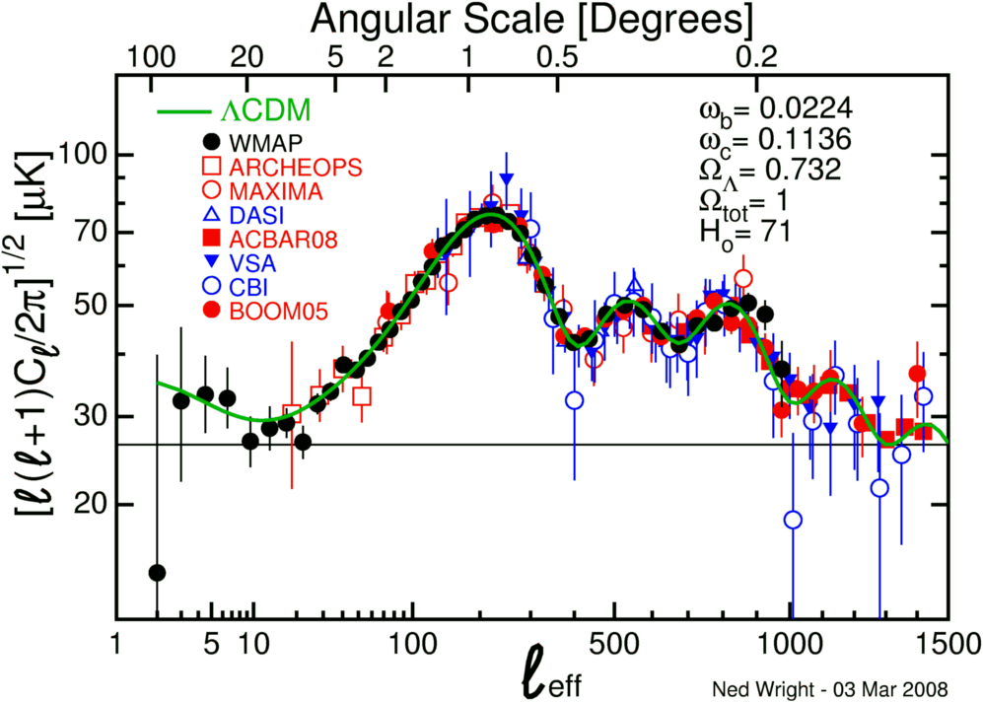

Slide 7
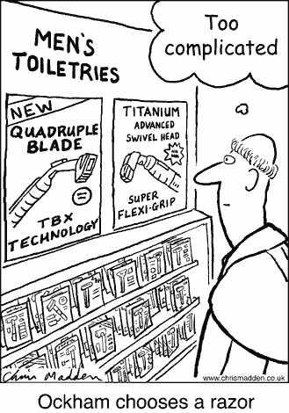
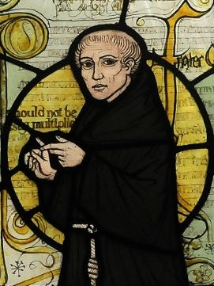
Ockham’s Razor

Slide 8
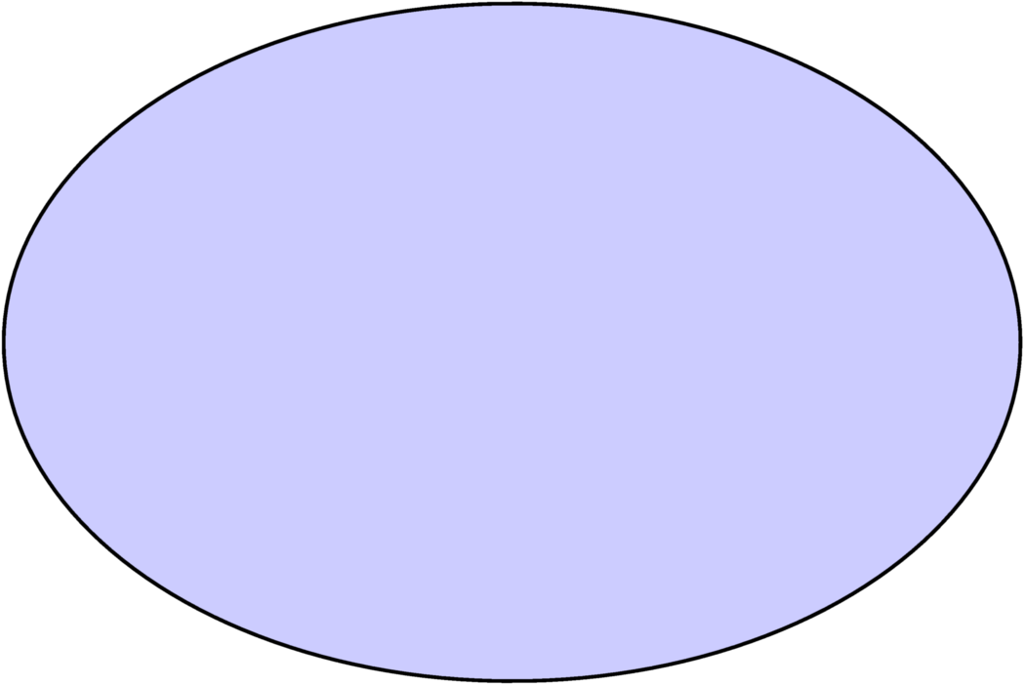
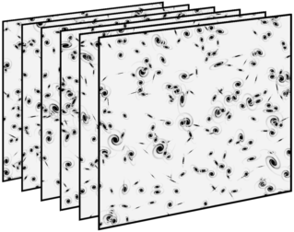
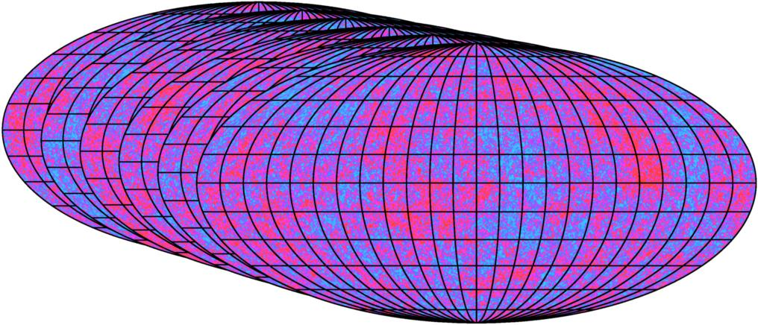
Set of All Random Processes
A cosmological model is a prescription for generating an ensemble of Universes. Each element of the ensemble describes a different realization of a random process.

Slide 9
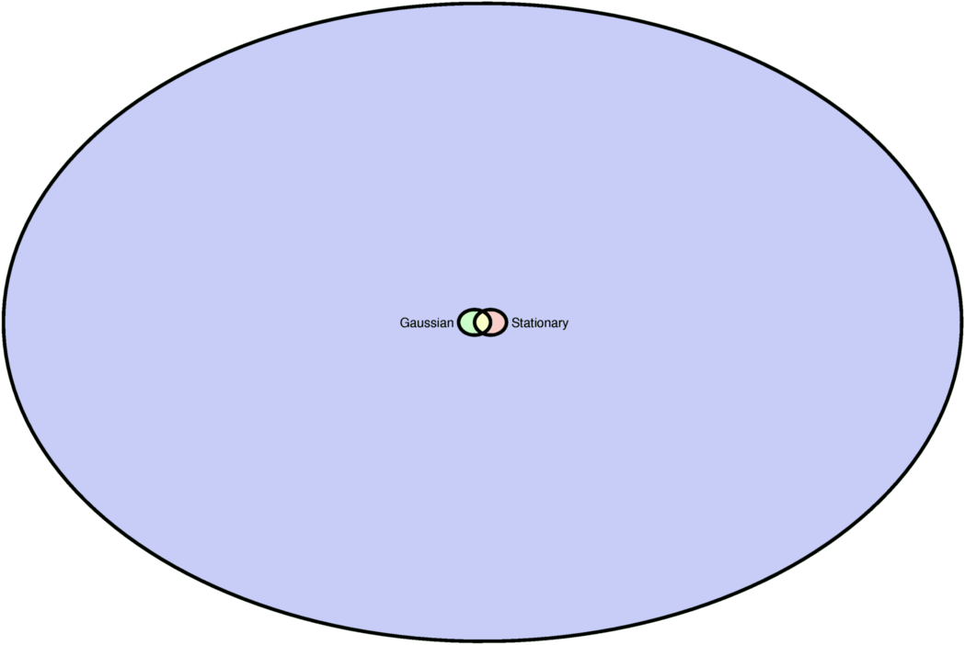
Small Subsets of All Models
Gaussian and/or stationary random processes

Slide 10
Gaussian models
The one point distribution function is Gaussian for all locations.
The two point distribution function is Gaussian.
The three point distribution function is Gaussian [and derivable from the two point function].
[…]

Slide 11
Stationary Models
The one point distribution function is independent of the location.
The two point distribution function depends only on the (vector) separation.
ISOTROPIC models: the distribution functions are invariant when the set of points is rotated.
Stationary & isotropic models satisfy the Cosmological Principle.

Slide 12
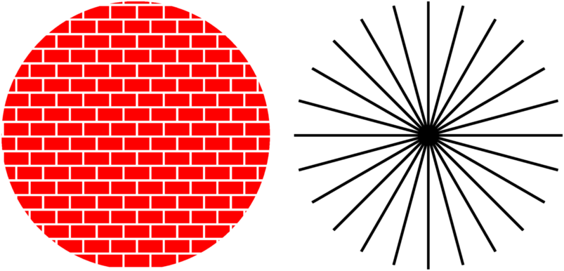
The Cosmological Principle
The Universe is homogeneous and isotropic
Not isotropic
Not homogeneous

Slide 13
Large Scale Effects
The CMB quadrupole is low compared to ΛCDM.
The octupole and quadrupole appear to be roughly aligned.
There is the infamous “dark spot”.

Slide 14
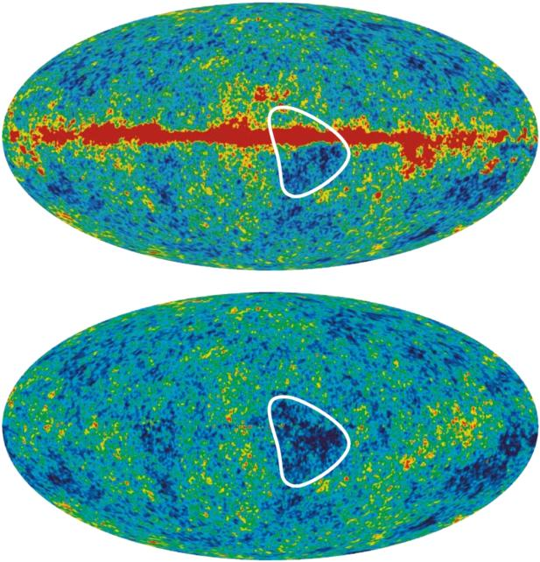
Look at the (W)MAP
Fig of Bennett etal, arXiv:1001:4758
This huge dark spot at the GC is not “the” dark spot.

Slide 15
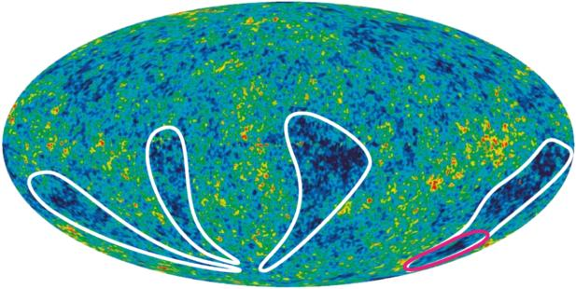
Cold Fingers of God
The red line outlines “the” dark spot.
Better called the “dark fingernail” of God

Slide 16
The Infamous “Dark Spot”
Proposed by Cruz et al., astro-ph/0405341, “Detection of a non-Gaussian Spot in WMAP”
  Of course it makes no sense to talk about “a non-Gaussian spot”: one has to show that the underlying random process is non-Gaussian. If I choose a value from N(0,1), say 1.37, then the observed pdf is δ(T-1.37) which is non-Gaussian but the underlying process is Gaussian.

Slide 17
Large Search Space
15 different circular Mexican hat wavelet sizes were used.
For each size, the whole sky was searched for outliers.
  A fair estimate for the number of cases searched has to be > 10⁵.
Claim that (l,b) = (209,-57) is a 4.7σ cold spot with a 5º scale (8.75º FWHM).
But exp(-½×4.7²) is > 10⁻⁵, so where’s the beef?

Slide 18

A Real Anomaly
``Imprints of a Primordial Preferred Direction on the Microwave Background’’
  Ackerman, Carroll & Wise, astro-ph/0701357
Assumed that the 3D power spectrum is not isotropic:
Then assumed g(k) is a constant g*. Estimated g*~10⁻⁵ might be possible.

Slide 19
Search in WMAP data
``Bayesian analysis of sparse anisotropic universe models and application to the 5-yr WMAP data’’.
  Groeneboom & Eriksen, arXiv:0807.2242.
They found a significant effect with g* ~ 0.12
  10,000 times too big but who’s counting.
Then with more data, Groeneboom, Ackerman, Wehus & Eriksen (arXiv:0911.0150) found a 9σ effect! But the preferred axis now very close to the ecliptic poles.
Conclusion: a systematic error in the WMAP maps due to ellipticity of the beams.
Remembering Shapley, always look for systematic errors.

Slide 20
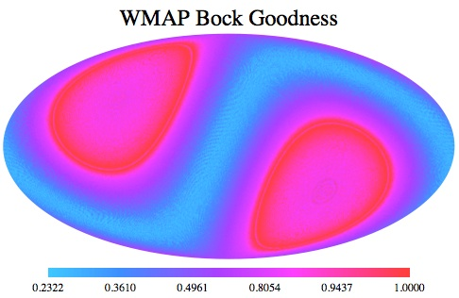
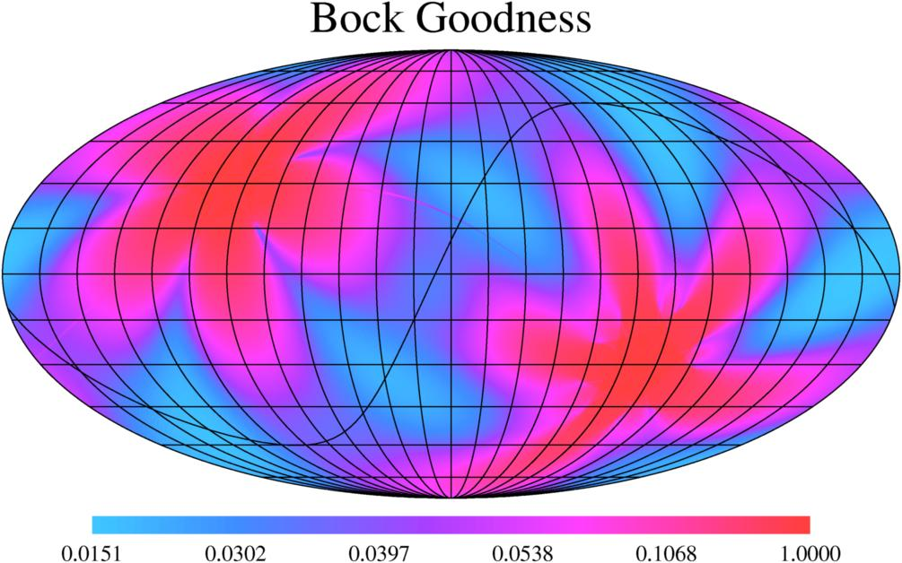
Bock Goodness
It is best to observe the sky in all possible orientations. COBE did this well, WMAP did OK but Planck used a very limited range of scan angles.
Quantify using Bock Goodness:1-(<sin(2θ)>²+<cos(2θ)>²)
Median: WMAP 0.65, Planck 0.047

Slide 21
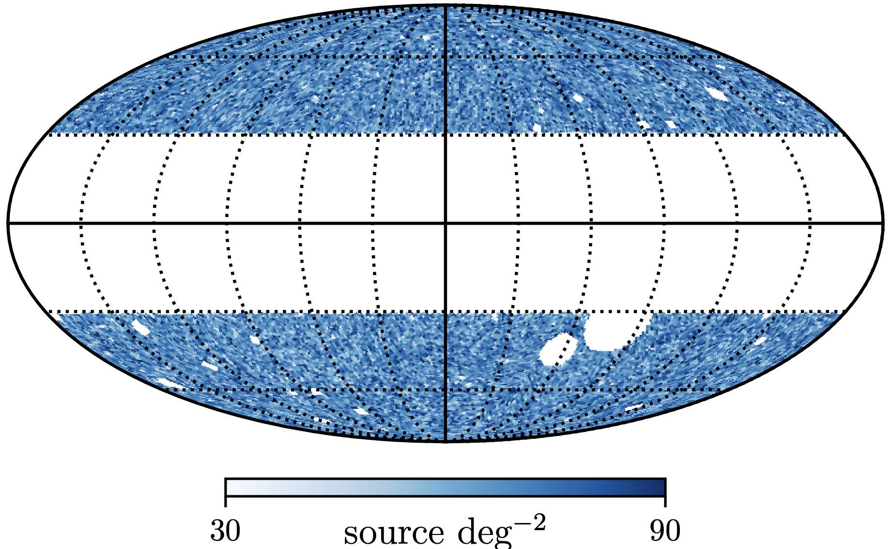
Quasar Number Count Dipole
Large samples of “quasars” have been constructed using WISE colors: W1-W2 > 0.8 and W2 < 16.4 (Vega). (Secrest etal arxiv:2009.14828)
|b| > 30 and other masks for bright sources
Dipole of resulting map is too big for Compton-Getting effect.

Slide 22
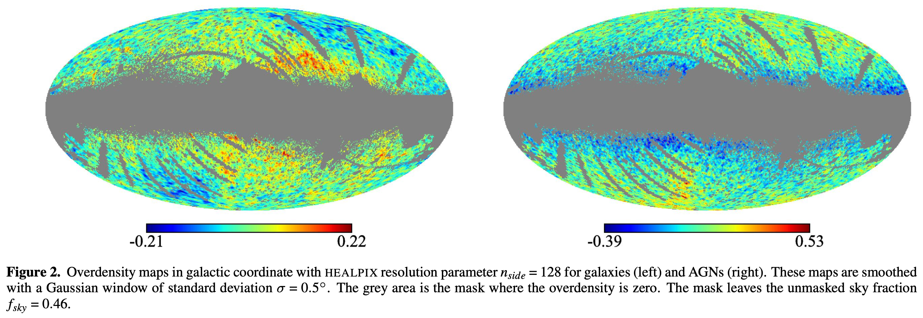
I too have struggled to use WISE number counts for cosmology
Measurement of the Integrated Sachs-Wolfe Effect Using the AllWISE Data Release, Shajib & Wright, arxiv:1604:03939
Luckily only needed intermediate angular scales
Consistent with ΛCDM

Slide 23
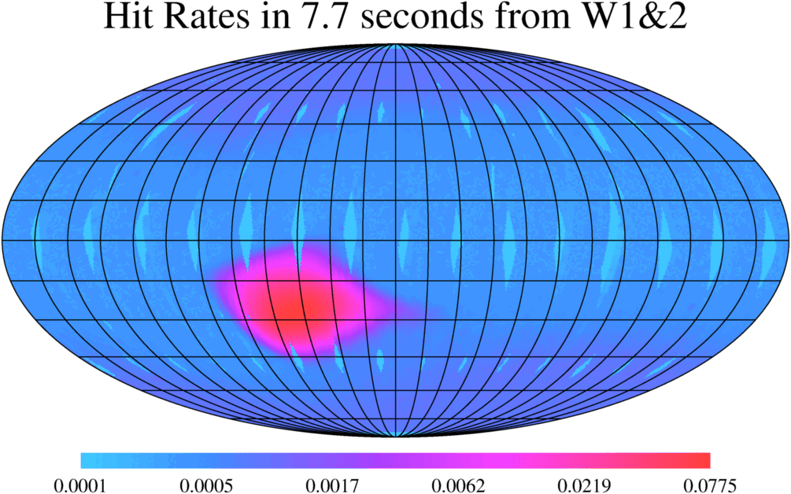

WISE Made NO Attempt at Uniform Sky Coverage
What could make a confounding pattern in the counts? Here are two effects:
  The scan density is 7% larger around aphelion (July) than perihelion (Jan) due to the eccentricity of the Earth’s orbit.
  There is a South Atlantic Anomaly but no North Atlantic Anomaly
Notes:
Dipole points to 9 h, where the Sun is around August
Excess would be anti-Sunward so around February

Slide 24
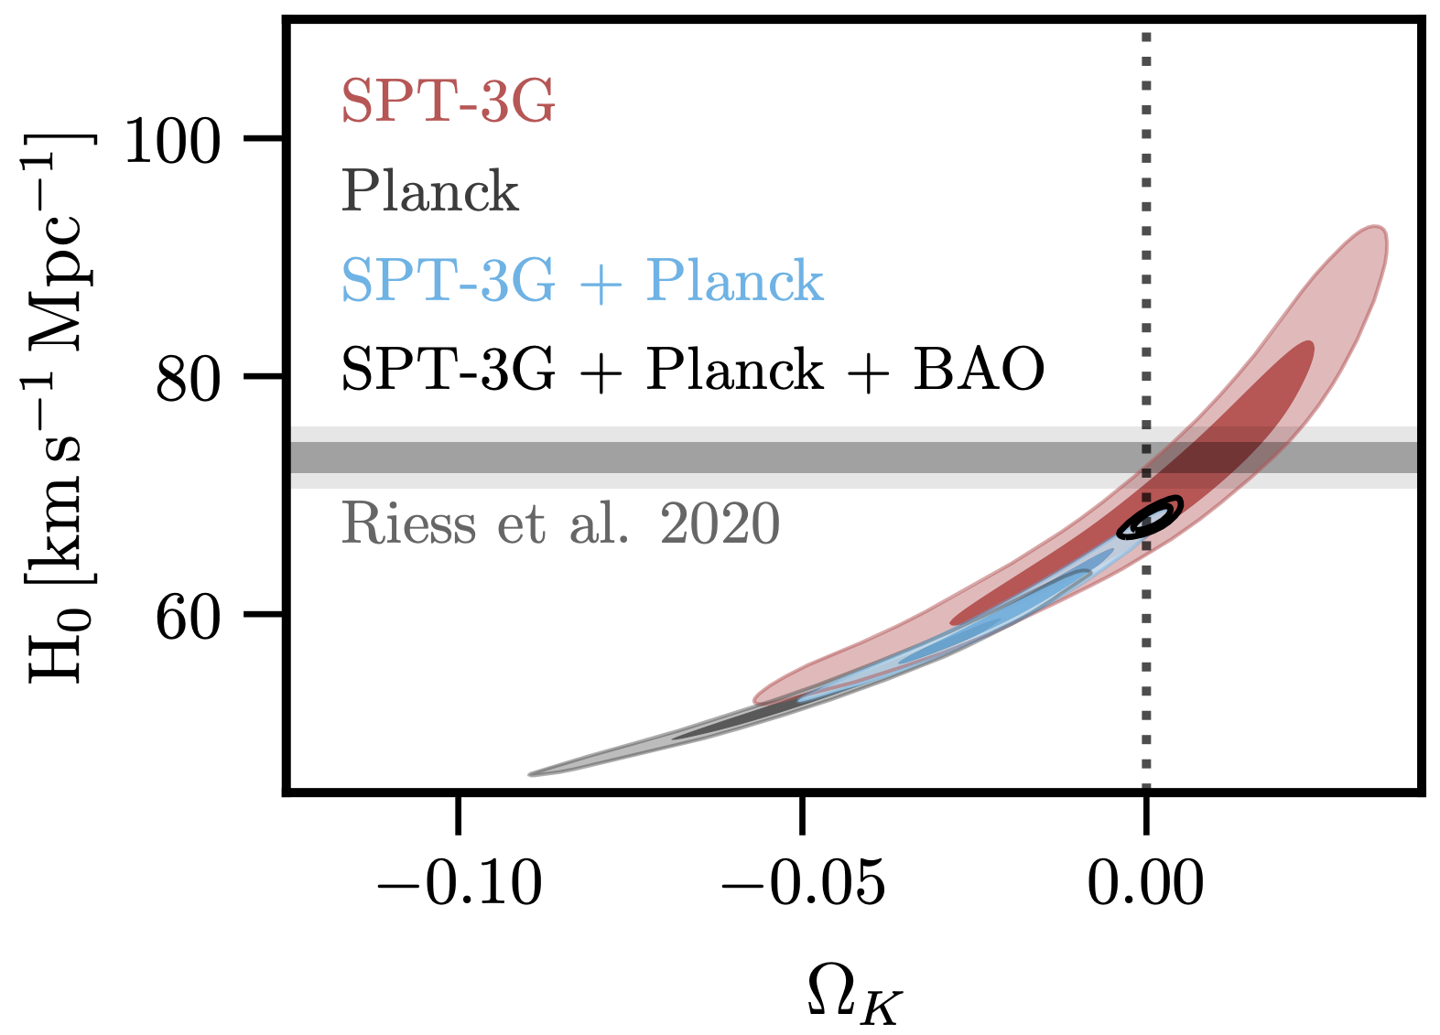
Is Space Flat?
Planck slightly favors a closed space with a very low H₀.
The South Pole Telescope is OK with flat space.
Combining CMB with BAO, flat space is good and H₀ is higher.
Fig 5 from Balkenhol arxiv:2103.13618

Slide 25
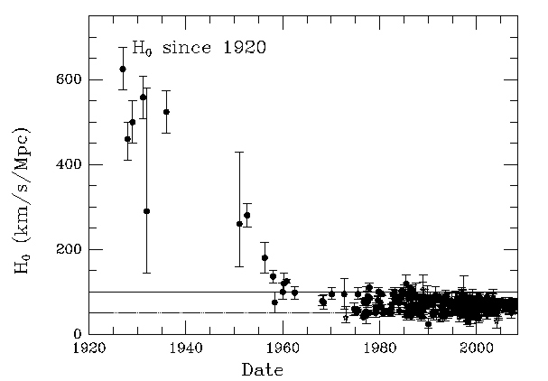
Hubble “Constant” is H(t)
Looks like the Universe formed in 1920 and dark energy dominates after 1965
Figure credit: John Huchra

Slide 26
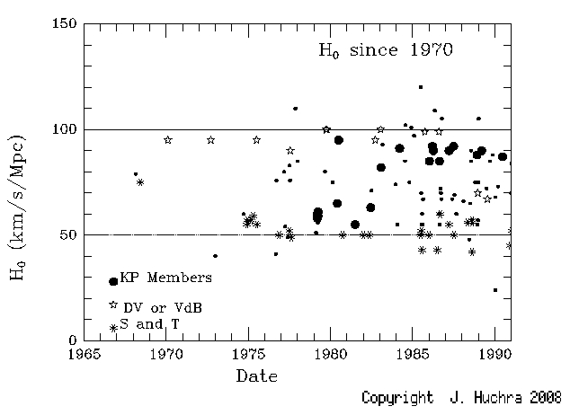
Past Hubble Tension
Remember H₀ = 100h? I do

Slide 27
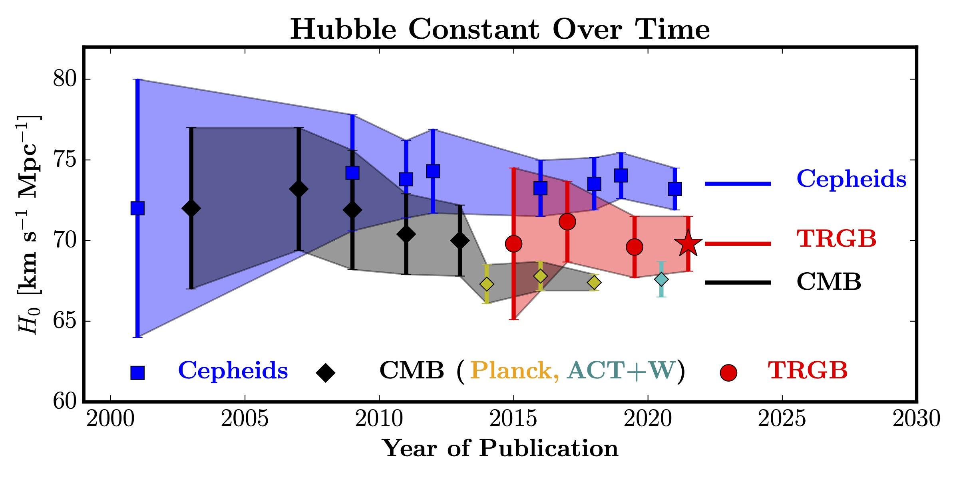
Current Hubble Tension
Old 50 vs 100, 5 sigma; New 68 vs 73, 5 sigma
Credit: Wendy Freedman arxiv: 2106.15656

Slide 28
My Conclusion
Cosmology is now data rich.
With lots of data, outliers are inevitable.
The 6 parameter Lambda-CDM model is still an adequate fit.
Tensions are to be expected with a large number of number of data sets. They are worth tracking but hardly worth a press release.

