Slide 1


Measuring the properties of dark matter with galaxy-scale strong gravitational lenses
Anna Nierenberg
University of California, Merced

Slide 2
Overview
Gravitational lensing-dark matter connection
Overview of techniques
Recent Results
Future Prospects

Slide 3
Different dark matter models <-> different dark matter halos
Cold Dark Matter e.g. WIMP
Warm Dark Matter – e.g. Sterile Neutrino
Credit: Lovell et al. 2014

Slide 4
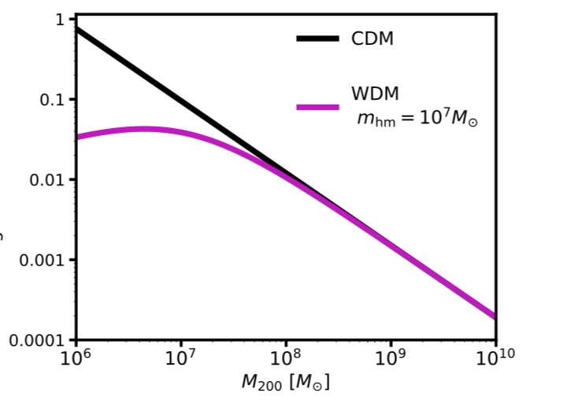
Different halo Mass Functions
Cold Dark Matter e.g. WIMP
Warm Dark Matter – e.g. Sterile Neutrino
Projected Number/kpc²
Half mode mass characteristic cutoff scale
Credit: Lovell et al. 2014
Halo Mass (M☉)

Slide 5
Different halo Density Profiles
Cold Dark Matter e.g. WIMP
Warm Dark Matter – e.g. Sterile Neutrino
Log [Concentration]
Credit: Lovell et al. 2014
Macciò et al. 2013
10 12 14
Notes:
1 keV WDM

Slide 6
A huge space of dark matter models to explore
Weakly Interacting Massive Particles (WIMPs)
Sterile Neutrinos
Axions
Primordial black holes – (Massive Compact Halo Objects) explain LIGO detections, seeds for supermassive black holes.
Self-interacting dark matter
….
Schive et al. 2014

Slide 7
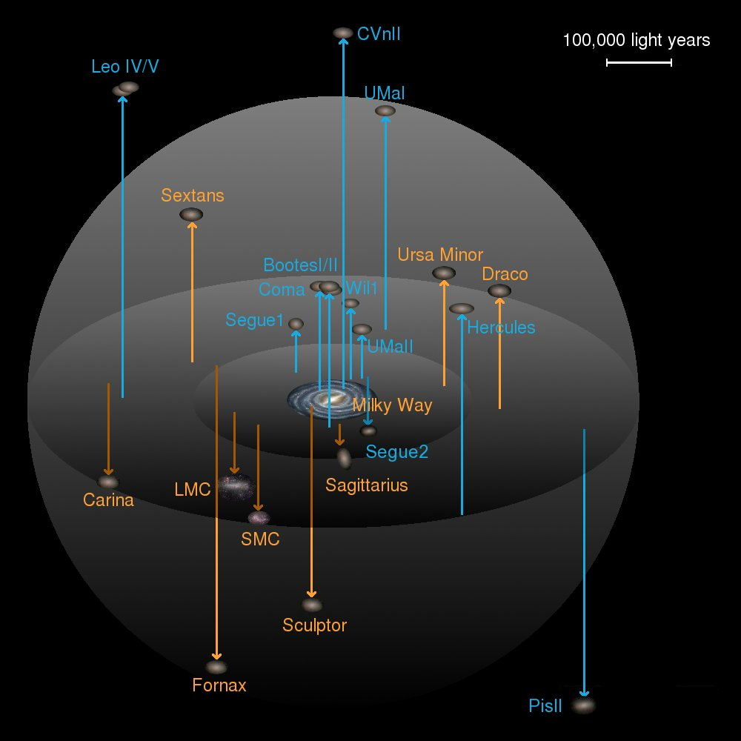
Dark matter structure measurements traditionally rely on galaxies as tracers
Cold Dark Matter Prediction
Observed Milky Way Structure
Credit: Lovell et al. 2014
Credit: J.T.A de Jong
Galaxies are collections of stars, which we believe to be embedded in a dark matter halos, so there are two solutions:
There are a large number of halos below some mass scale which do not contain enough gas or stars for us to see (almost certainly true)
Dark matter doesn’t form structure on small scales

Slide 8
Goal: Detecting halos in the dark regime
Credit: Strigari 2008

Slide 9
Gravitational lensing-dark matter connection
Vegetti et al. 2010

Slide 10
Strong lenses have multiple images of the same background source
Vegetti et al. 2010

Slide 11
Gravitational lensing is sensitive to perturbations by dark matter halos
Low-mass perturbers cause deflections and magnifications
Vegetti et al. 2010

Slide 12
Gravitational lensing is sensitive to perturbations by dark matter halos
Low-mass perturbers cause deflections and magnifications
Deflection ∝
first derivative
Magnification ∝ second derivative
Gravitational Potential

Slide 13
We detect perturbations as deviations from the single deflector model.
~10⁹ (M☉) halo detected, not visible in imaging
Vegetti et al. 2012
See also Minor et al. 2022 for an analysis of concentration

Slide 14
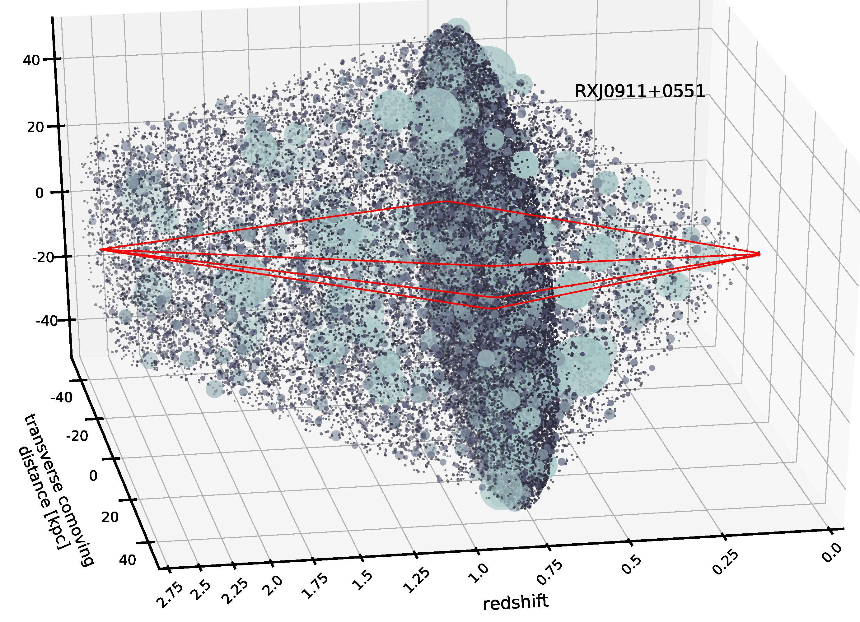
Strength of using lensing to measure dark matter
No dependence on halos containing baryons (could be completely dark)
Measure low-mass halo properties at a range of cosmological distances and environments
Simulation from pyhalo Gilman et al. 2022

Slide 15
Types of Background Sources
Resolved (Galaxies)
  current sensitivities to ~10⁸ M⦿ halos, main signal from deflections. (a.k.a. gravitational imaging)
Unresolved (narrow-line emission, some radio)
  current sensitivities to ~10^{6.5} M⦿ halos main signal from magnification (a.k.a. flux ratio anomalies)
Fundamentally the same process, different sensitivity regimes

Slide 16
Results from resolved source lensing – individual subhalo detection

Slide 17
Results from resolved galaxy sources – individual detection 34 lenses
Half mode mass < 10¹² M⦿ (2σ)
Ritondale et al. 2017

Slide 18
Results from combining with other probes
Enzi et al. 2021
Combining results with Ly-alpha and MW satellites yields stronger constraints
Half mode mass < 3x10⁷ M⦿ (2σ)

Slide 19
Resolved source-multiple detections (power spectrum)
He et al. 2022
With higher resolution we expect multiple detections per lens
Dark matter convergence
Image residuals w.r.t smooth model

Slide 20
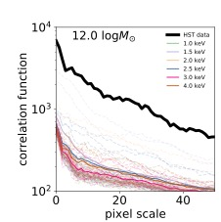
Quantify via a residual power spectrum
Birrer et al. 2017
Half mode mass < 10⁹ (2σ) M⦿
Caveat: does not include line of sight structure
See also forecasting work by Hezaveh et al. (2014), Cyr-Racine et al. (2019)

Slide 21
Forecast power spectrum forecast with line-of-sight structure- 50 lenses HST single orbit
Truth ~ 10⁷ M⦿
Truth ~ 10⁹ M⦿
Forecast sensitivity
< 10^{8.2} M⦿ (2σ)
He et al. 2022

Slide 22
Forecast for varying lens samples, using ML
Wagner-Carena 2023 (assume CDM, measure subhalo mass function normalization).

Slide 23
Unresolved sources
Credit: STSCI, GO-15177, 13732 PI Nierenberg

Slide 24
Signal of a perturbation in an unresolved source
Observed lens
Best 1 halo model fit

Slide 25
Signal of a perturbation in an unresolved source
Observed lens
Perturbation needs to be localized and small scale – positions unperturbed
Best 1 halo model fit

Slide 26
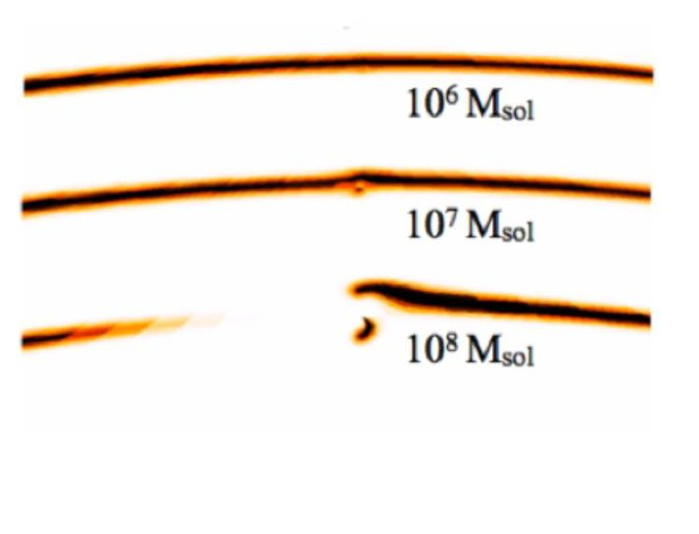
Signal of a perturbation in an unresolved source
Observed lens
Best 1 halo model fit
Same Physics!

Slide 27
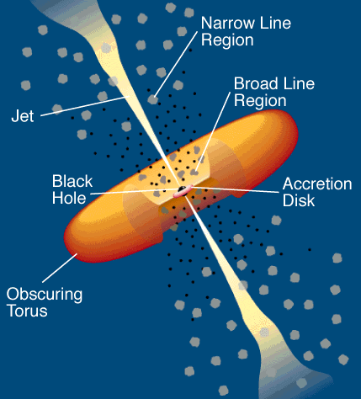
Unresolved source types
Quasar radio emission (traditional, e.g. Dalal and Kochanek 2002), very rare
Quasar narrow-line emission detected in virtually all quasars
Quasar cold torus
Caveat: Cannot use quasar accretion disk, is affected by lensing by stars.

Slide 28
Restrict to non-disk deflectors
Choose only lenses with elliptical deflectors
Marginalize over a broad range of macromodel parameters
Quantify effects of asymmetry in deep images of elliptical galaxies (Gilman et al. 2016, Hsueh et al. 2016)
Hsueh et al. 2017

Slide 29
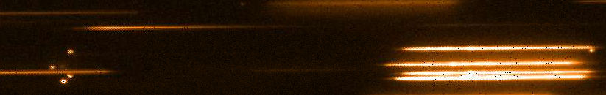
Narrow-line flux ratios measured with HST grism and Keck-OSIRIS
HST-GO 13732 and 15177 PI: Nierenberg
Flux Ratios: Nierenberg et al. 2017, 2020
Keck OSIRIS, Nierenberg et al. 2014

Slide 30
Results from a sample of 8 lenses
The model
The mass function of halos bound to the main lens
The spatial distribution of halos bound to the main lens
The mass function of halos outside of the main lens
The mass concentration relation of the subhalos
Unknown finite source size’
Face on magnification view of all dark matter perturbations
Gilman, Birrer, Nierenberg et al., 2020 a
CDM
WDM

Slide 31

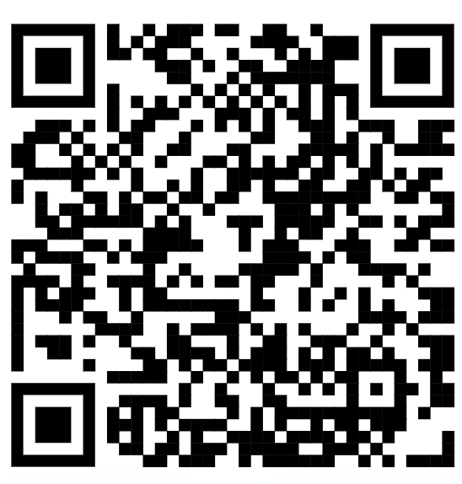
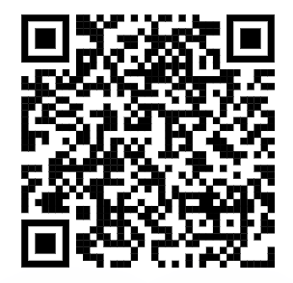
All software is open source and publicly available on github
Lenstronomy: All data analysis and gravitational lensing calculations. (Birrer and Amara 2018, Birrer et al. 2021)
PyHalo: Generates populations of dark matter halos and profiles along the line of sight and in the main lens. (Gilman et al. 2022)

Slide 32
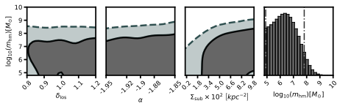
NL Flux Ratios Results from 8 lenses
2$σ$ m_{half mode}<10^{7.8}, M_{DM} > 5.2 keV (thermal relic)
Gilman, et al. 2020a
C.f. consistent results also from Hsueh et al. 2020 with radio loud quads

Slide 33
Measuring the halo mass function where majority of halos are dark
Est. transition to majority of halos dark

Slide 34

Combining results with MW satellites
One of the strongest measurements to date
2$σ$ m_{half mode}<10⁷
Nadler et al. 2021
Notes:
One of our major uncertainties is the normalization of the subhalo mass function, scaling the MW satellite population provides one way to reduce that uncertainty
Combination better than either method individually

Slide 35
Many more aspects of dark matter are now being explored

Slide 36
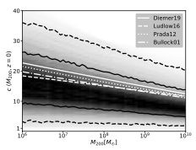
Mass-concentration relation results with 11 lenses
Traditional measurements
Assuming CDM
Gilman et al. 2020b
Coe 2010

Slide 37
4 Different sterile neutrino models
95% confidence interval to the left of dashed lines
Zelko et al. 2022 different WDM scenarios
Notes:
GUT scale scenario (KTY) keV Miracle Model (KTY) Higgs Production Mechanism (PK) and the single particle neutrino oscillation production mechanism. Only lower limits are there, 2 sigma is 4.6, 2.1, 11, and 34 KeV respectively. Case 1 and case 2 assume either the average background density of the universe does or does not contain baryons. Some of the limits on the left depend on lepton asymmetry

Slide 38
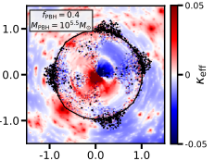
Primordial Black Holes
Dike et al. 2022

Slide 39
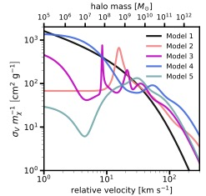
Self-interacting dark matter
Tidal stripping leads to run-away collapse of dark matter subhalos 100 cm²/g at velocities below 30 km/s strongly ruled out. (Gilman et al. 2022)
Notes:
These are resonant SIDM, which have resonances at particular velocities.

Slide 40
“Fuzzy” Dark Matter
Laroche et al. 2022
Powell et al. 2023
Notes:
We account for the suppression of the halo mass function and concentration–mass relation predicted by ULDM theories, and the wave-like fluctuations in the host halo density profile, calibrating the model for the wave interference against numerical simulations of galactic-scale haloes. We show that the granular structure of halo density profiles, in particular, the amplitude of the fluctuations, significantly impacts image flux ratios, and therefore inferences on the particle mass derived from these data. Repeating the analysis and omitting fluctuations associated with the wave interference effects, we obtain relative likelihoods of CDM to ULDM with a particle mass in the same ranges of 98:1, 48:1, 26:1, and 18:1, highlighting the significant perturbation to image flux ratio.
Constraints from 11 lenses on the particle mass mψ and the fluctu- ation amplitude Afluc, with no haloes included in the lens model. Fluctuation amplitudes log10(Afluc)>−1.5andlightparticlesmψ <10−21.5eVareruled out because they impart too much perturbation to image flux ratios (see also Fig. 6). On the other hand, fluctuation amplitudes log10(Afluc) < −3.0 and moremassive particles mψ >10−20eV are ruled out because the fluctuations are strongly suppressed in this regime.
Powell -> not including line of sight subhalos rule out Psi less than 4*10^-21 at 20:1 odds

Slide 41
Tying the measurement back to the primordial power spectrum
Gilman et al. 2022

Slide 42
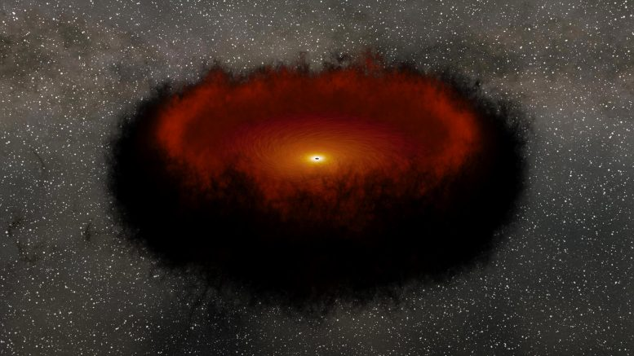
Coming soon, the quasar cold torus flux with the James Webb Space Telescope
Simulation from Caltech/JPL, based on Yang et al 2020
~Cold Torus
~Narrow line
Small source sensitive to INDIVIDUAL 10⁷ M⦿ perturbers
Notes:
The cold torus is a compact region emits in the rest-frame mid-IR (requires JWST)
Benefits relative to NL- very bright, and can be measured with just a few broad bands of JWST imaging (no spectroscopy required) – fewer systematics with deblending spectral features
Intrinsically smaller than NL, so sensitive to lower mass halos

Slide 43
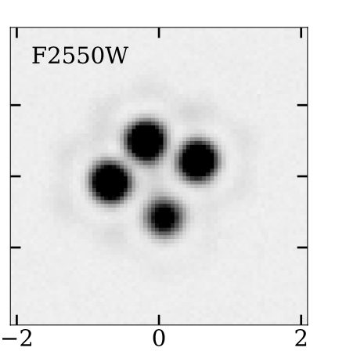
Forecast constraints with JWST- 38.4 hours to observe 31 lenses in Cycle 1
Simulated JWST MIRI image
JWST-GO-02046, PI Nierenberg

Slide 44
Forecast constraints with JWST- 38.4 hours to observe 31 lenses in Cycle 1
We will detect completely dark halos if they exist
Simulated JWST MIRI image
JWST-GO-02046, PI Nierenberg

Slide 45
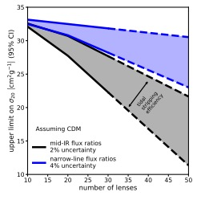
Some other forecasts with JWST:
SIDM: Gilman et al. 2021
Also we will detect or rule out 50% mixed warm/dark matter (Keeley et al. 2022, see talk tomorrow!)

Slide 46
The future…
Continuous improvement of lens models
New data
New lenses

Slide 47
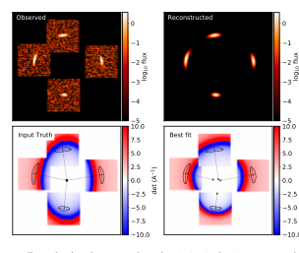
Host galaxy modelling for stronger constraint on macromodel
High sensitivity of narrow-line magnification with large-scale constraint from arcs
Birrer 2021

Slide 48
Future prospects for unresolved source lensing
Hundreds of new lenses will be discovered in upcoming surveys (LSST, Euclid, Roman~ mid 2020s)
Improved flux precision with next generation instruments and observatories
LSST
Oguri and Marshall 2010

Slide 49
Development of next generation detectors
Liger is an upgrade to the current IFS on Keck
NL lensing was one of three main science goals highlighted in recent MSIP funding proposal
Status: Advanced to stage 3 NSF MSRI-2, now up to NSF site visit.

Slide 50
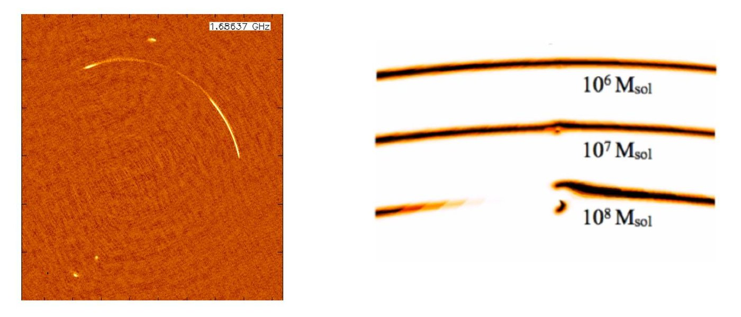
Future prospects for gravitational imaging- single detection- higher spatial resolution
VLBI imaging of radio jets
Next generation AO
EELTs
Simulated VLBI detection
Vegetti

Slide 51
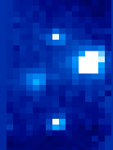
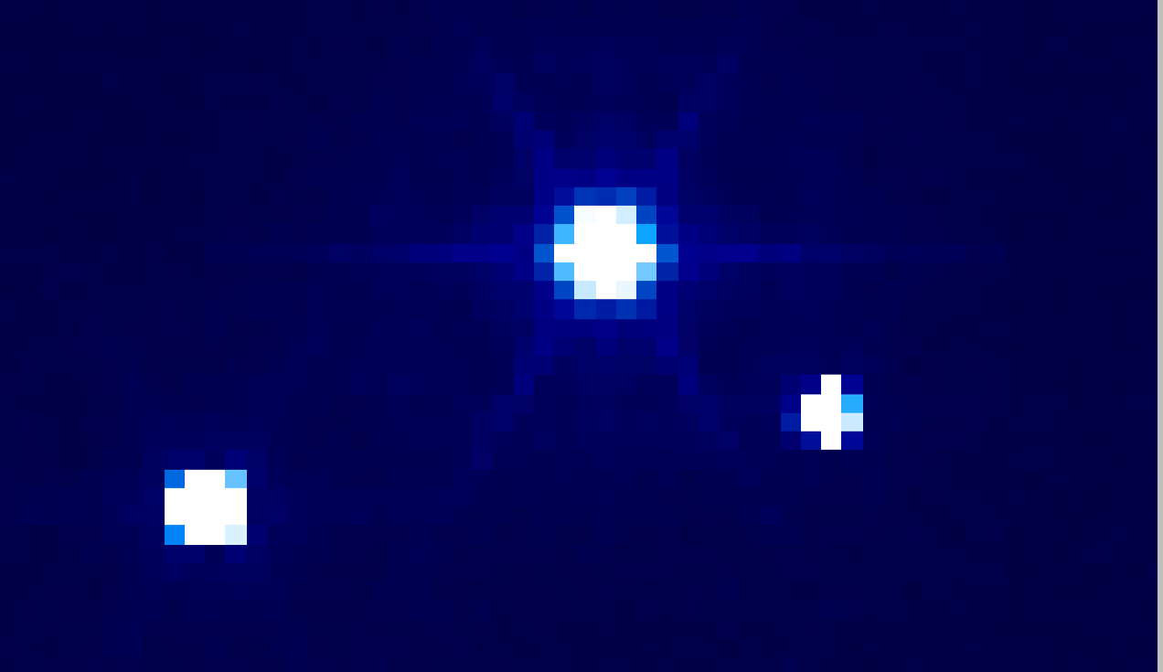
Development of next generation detectors
IRIS is the OSIRIS analog in development for TMT
OSIRIS Kbb 100 mas, 900s
IRIS K 50 mas, 10s
IRIS Simulation courtesy of Nils-Erik Rundquist (UCSD)

Slide 52
Conclusions
Galaxy-scale strong gravitational lensing provides a rich variety of tests of dark matter models
Constraints on WDM models from galaxy-scale lenses are among the tightest we have
Future surveys will enable us to push these methods into new regimes

