Slide 1
The Third Direct Detection Talk
(title amended on Slide 7)
Prisca Cushman
University of Minnesota
14th UCLA Symposium on Dark Matter
Los Angeles, CA March 29 – April 1 2023

Slide 2
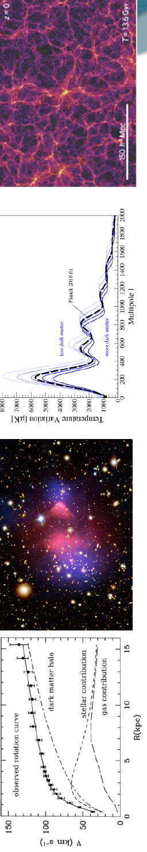
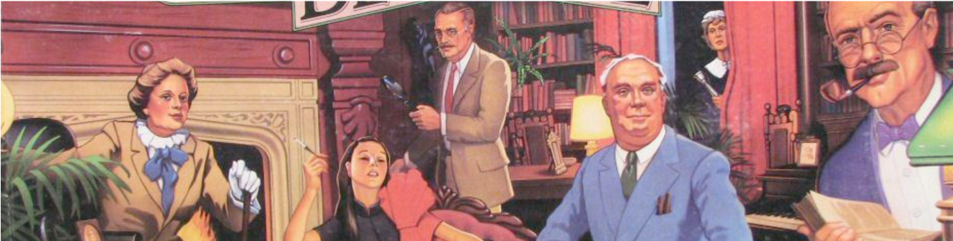
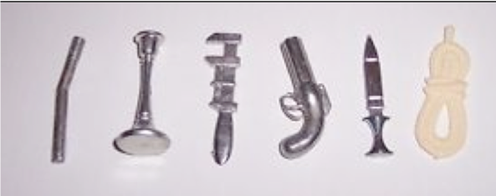
Direct Detection is like playing CLUE
We have a well-established crime scene
But we don’t know who did it
nor what weapons they have in their arsenal

Slide 3
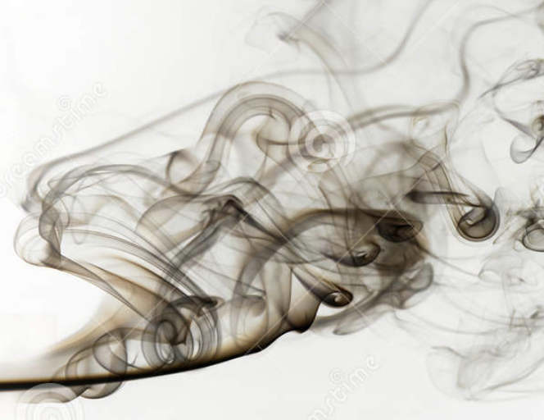
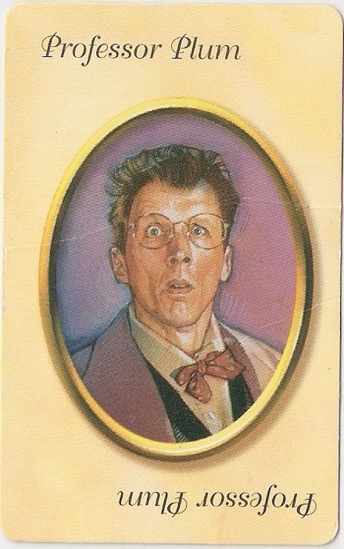
Prime Suspect:
Weakly Interacting Massive Particle
The WIMP
in the Cosmos with the …
Gravity
E&M
Strong
Weak
The Weak Interaction is allowed and provides the right relic density with a simple thermal equilibrium model in the early Universe. But no smoking gun yet.

Slide 4
The Prime Suspect is still on the loose!
But his hideout is well-known
and currently staked out.
But here is where I am
having some trouble
with the title assigned by the
conference organizers:
“Direct Detection without Noble Gases”
Weak

Slide 5
That covers all the
rest of the rooms
and other suspects

Slide 6
That covers all the
rest of the rooms
and other suspects
and plenty of new interactions
Heavy Mediator
Light Mediator
?
?

Slide 7
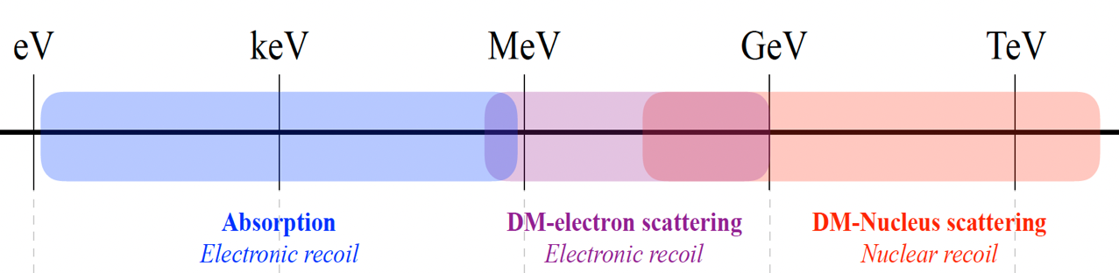
2017 Cosmic Visions mapped DM mass to generic coupling
?
?
Weak

Slide 8
Direct Detection without Noble Gases
of Particle DM
Liquids
>
below a TeV
And I will cede CCDs and (most) sub-GeV dark matter to Rouven who speaks next
?
?
Weak

Slide 9
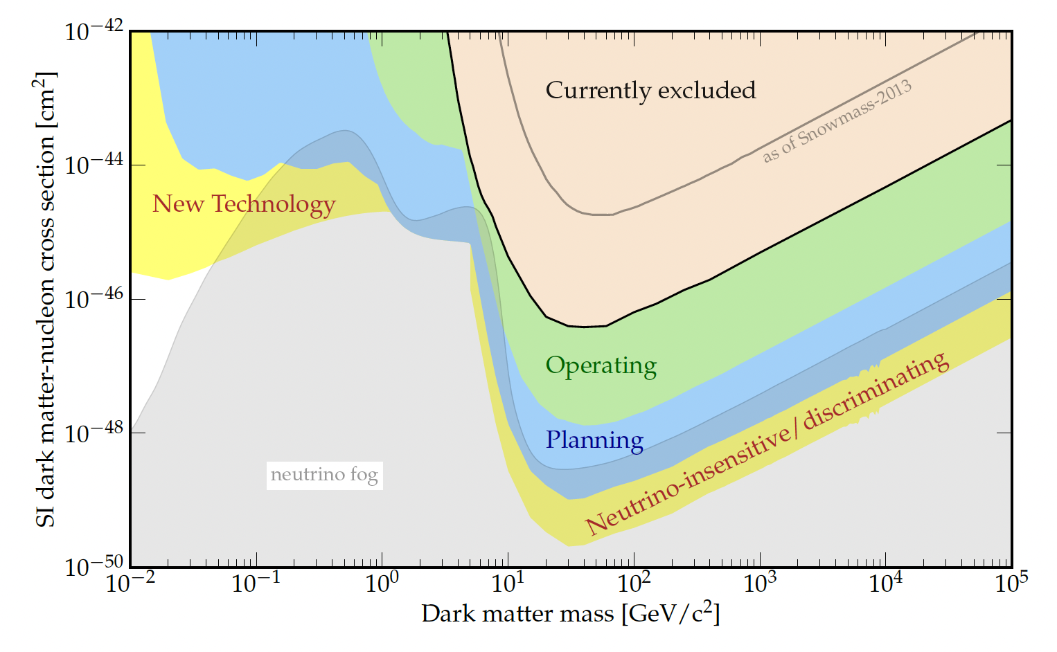
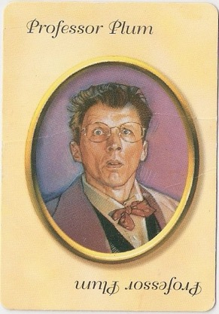
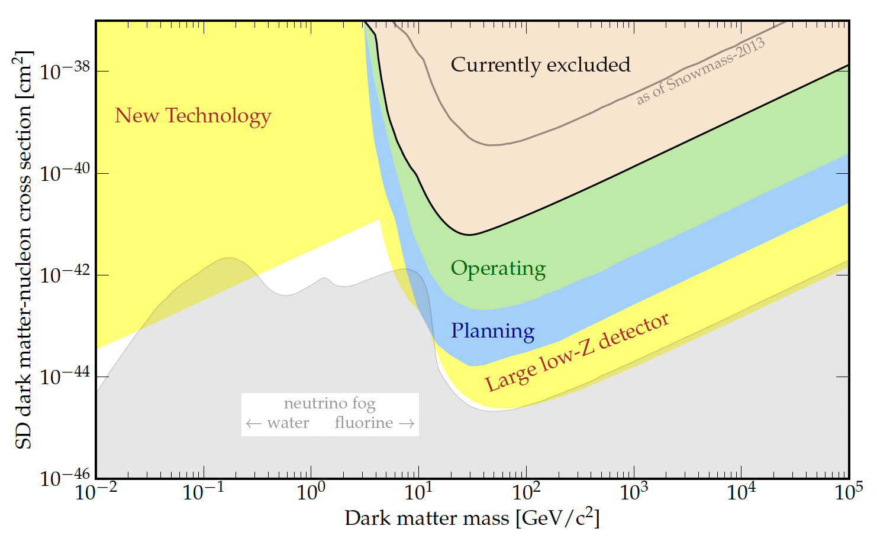
Nuclear Recoiling Dark Matter Future – Snowmass View
Neon
Spin-independent searches will reach the neutrino fog by mid-century
LXe TPCs will then probe atmospheric neutrinos
LAr (TPCs and Scintillating bubble chambers) probe solar ν
Solid state bolometers spawn
  small phonon-only (TES readout of LHe, Al₂O₃, Ga As, Si)
  and voltage-assisted phonon amplification (Ge, Si…)
Charge-only devices (CCDs and HPGe) cut a swath
Along with gas proportional chambers with light noble gas
Si, LHe,
Al₂O₃,
Ga As
Ge,CaWO₄
with large overlap
Argon
Xenon
Spin-dependent phase space is wide-open at lower masses
but technology to probe deep at 10 – 100 GeV/c² is well-developed
σ_{SD} reach can’t take advantage of the coherent A² enhancement
One experiment proves dark matter interacts with SM particles
with force(s) other than gravity
Multiple experiments not only confirm the detection,
They are essential to probing the nature of the interaction.

Slide 10
Snowmass gave us a new mantra: Delve deep and Search wide
Experimental Strategy for the next 20 years
Noble Liquids continue to look for the prime suspect: Large exposure, good NR discrimination
Solid State
Phonons + SuperCDMS, EDELWEISS, CRESST. Target lower mass DM with excellent NR discrimination.
Tension: Max exposure + NR discrimination… or … Low threshold (small crystals, NTL amplification)
Phonon only: Remove charge noise and expand your choice of target (TESSERACT)
Charge only: DAMIC, SENSEI CCDs. Sub-GeV ER dark matter, single electron sensitivity
CDEX Point-contact Ge detectors.
Can you make a 0νββ detector with low enough threshold to do a light DM search?
Annual Modulation Program NaI crystal arrays with very low background and stable conditions
Bubble chambers: Insensitive to electron-recoil DM ➔ the best discrimination possible
PICO program: Freon (and other fluorocarbons) gives access to spin-dependent NR interactions.
Nucleation Threshold determined by T, P ➔ no energy information except by tuning conditions
SBC (Scintillating bubble chambers) Use scintillation of noble liquids to measure the energy event-by-event.
Current plan with LAr ➔ go for the ~ 1GeV NR, no spin-dependence. Target CEνNS as well as DM
Gas Detectors: Light DM mass: e.g. NEWS-G spherical proportional chamber with Ne + CH₄
Probe below the neutrino fog with directional information (e.g. CYGNUS)
Technology is advanced, but exposure is challenging.

Slide 11
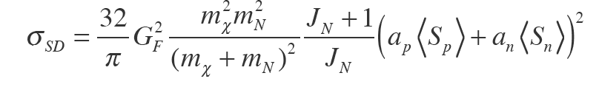
Summary of Spin-dependent target opportunities
Couples to net nuclear spin J_{N}
neutron coupling
proton coupling
⁷³Ge (7.73%) <S_{n}> = .46
²⁹Si (4.68%) <S_{n}> = .13
¹⁷O (0.037%) <S_{n}> =.5
CDMS,EDELWEISS
⁷Li (92.4%) <S_{p}>=.5
CRESST(LiAlO₂ , Li₂MoO₄)
DAMIC/SENSEI, CDMS
¹²⁷I (100%) <S_{p}>= .31
²³Na (100%) <S_{p}>= .25
¹³³Cs (100%) <S_{p}>= − .37
NaI (and CsI)
DAMA, SABRE, ANAIS,
COSINE-100, COSINUS
CRESST (CaWO₄)
¹²⁹Xe (26%) <S_{n}>= .33
¹³¹Xe (21%) <S_{n}>= − .27
LXe TPCs
¹H (100%) <S_{p}> = .5
Snowball (H₂O)
proton & neutron coupling
¹⁹F (% depends on fluorocarbon)
<S_{n}> = −.11 <S_{p}>=.44
PICO (CF₃I, C₃F₈ )
⁶Li (7.6%)
<S_{n}> = .472 <S_{p}>= .472
CRESST (LiAlO₂ , Li₂MoO₄)

Slide 12
Nuclear Recoiling Dark Matter: SD targets & technology
But you still have to make a detector out of it.
And in the end, we do not have a spin-analyzing detector,
just relative signals in multiple targets.
PICO superheated bubble chambers
Freon (C₃F₈), also CF₃I earlier ➔ proton coupling
Will require new vessel materials to move into the blue
Bolometers with SD crystals
PICO-2L
PICO-60
PICO-40L
PICO-500
Supercooled H₂O
XENON, LZ, PandaX ➔ DARWIN cover n-coupling,
but the xenon neutrino fog is decades higher than the fluorine neutrino fog
LXe TPCs
EDELWEISS, SuperCDMS n-coupling at lower masses
CRESST is exploring new SD crystals with Lithium
New technology could be a liquid/solid
phase change detector like Snowball

Slide 13
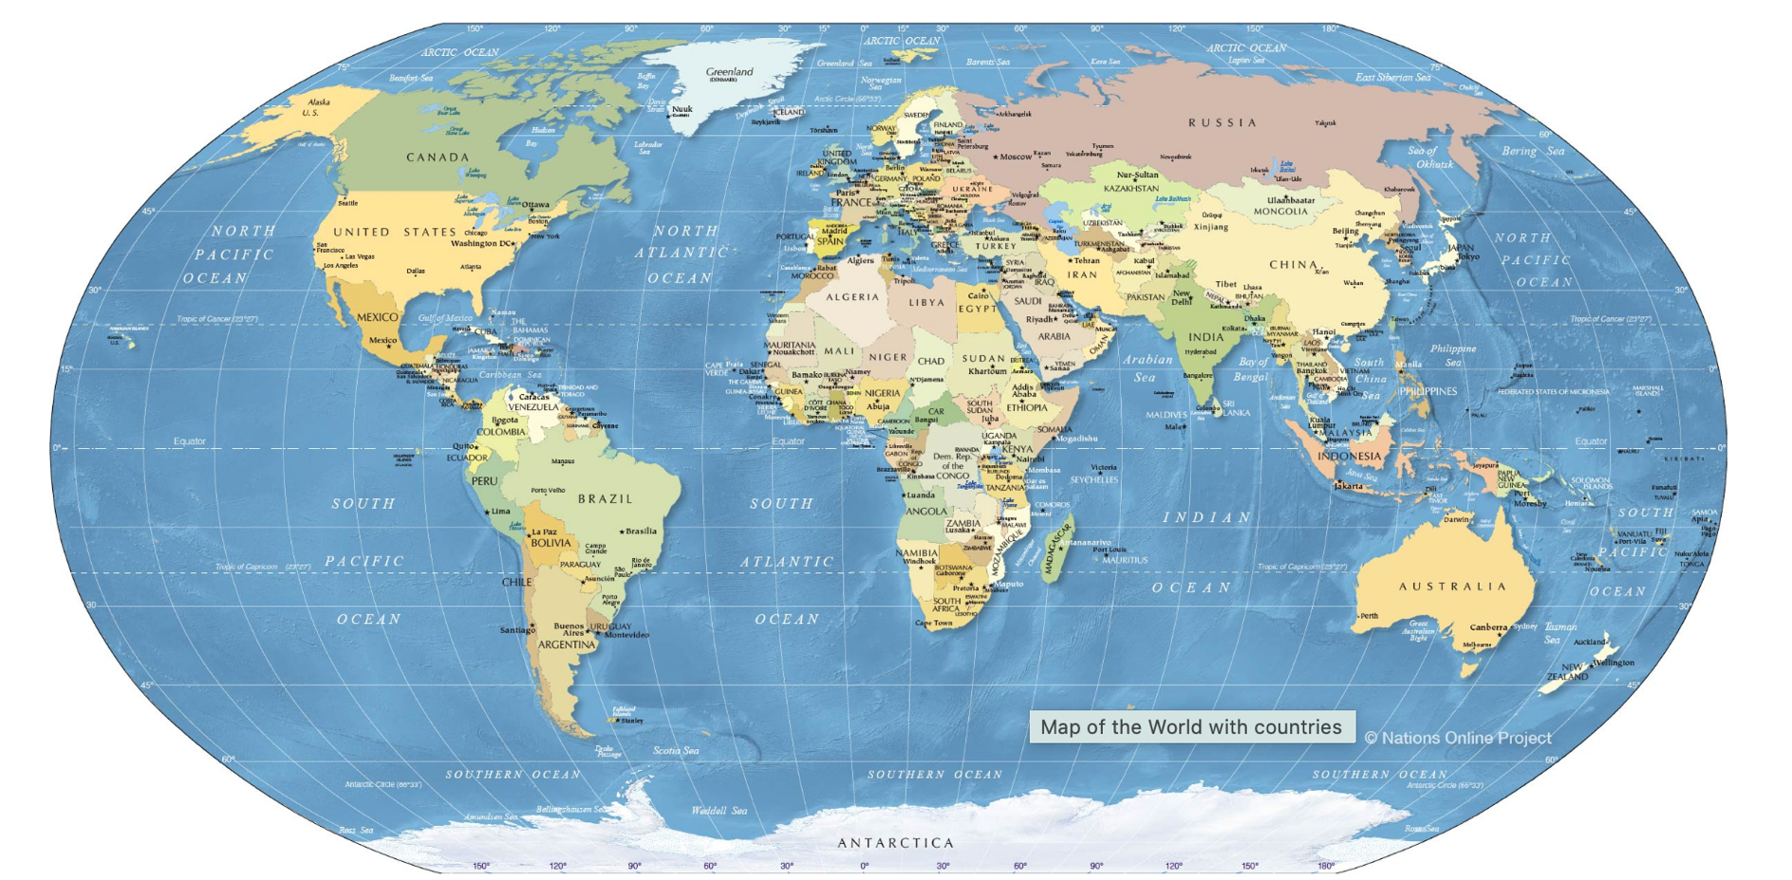

SI Solid State Players
Cryogenic Bolometers
CCD-based
Point Contact HPGe,
NaI Annual Modulation
Modane
EDELWEISS
DAMIC-M
SNOLAB: SuperCDMS
DAMIC, SENSEI, Oscura
JinPing
CDEX
Gran Sasso
CRESST
DAMA/LIBRASABRE North
COSINUS
Yangyang
COSINE-100
Canfranc
Anais
Stawell (SUPL) SABRE South

Slide 14
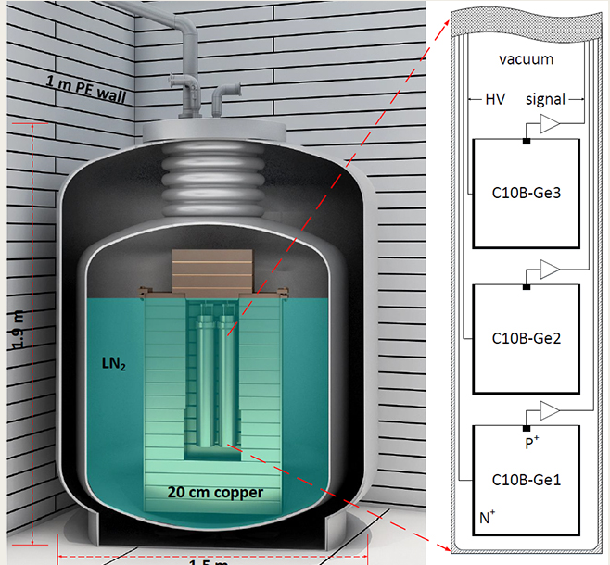
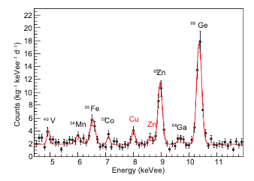
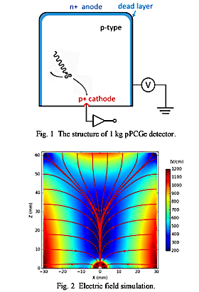
High Purity Germanium Detectors : CDEX at JinPing
Runs at liquid nitrogen temperatures
Excellent energy resolution
Doubles as a neutrinoless double beta decay detector
  Get the threshold low enough ➔ DM detector
Use energy resolution to beat down background
No evt by evt ER vs NR discrimination
Some pulse shape discrimination
CDEX-10 operating now
205 kg-d exposure with 10 kg array of 9 detectors
C10B-Ge1
E_{thresh} = 160 eVee,
σ_{E} = 219 eVee FWHM at 10.37 keV

Slide 15
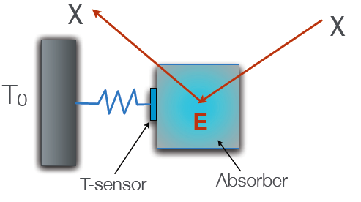
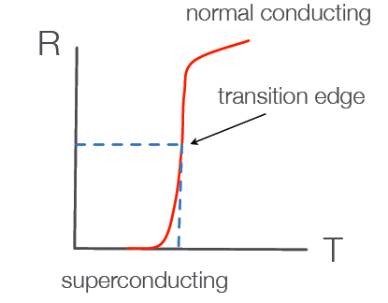
Principles of Cryogenic Solid State Phonon Detection
Small heat capacity is key!
Large sensitivity (big ΔT) for a tiny ΔE deposition.
Tens of mK ➔ dilution fridge infrastructure.
thermal bath
Energy deposition (temperature) is measured by
EDELWEISS
GeNTD: Neutron-transmutation-doped sensors. Ge wafer with T-dependent resistance
induced by neutron irradiation doping. Sensitive to thermal phonons.
TES: Transition-edge sensors. Tungsten film operated near Tc and read out by
SQUIDs. Dominated by athermal phonons. Sensitive to ΔT ~0.1 mK
QET: Quasiparticle-trap-assisted Electrothermal-feedback TES: Arrays of Al fins
transmit quasiparticles to the TES. Increases collection area without increasing
sensor capacitance and maintains athermal phonon properties.
CRESST
CDMS

Slide 16
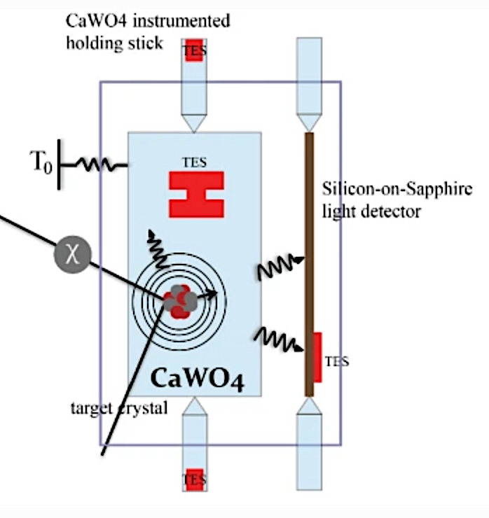
Phonons supplemented by a second channel
+ Ionization
+ Scintillation
CDMS and EDELWEISS
CRESST
Silicon or
V_{bias}

Slide 17
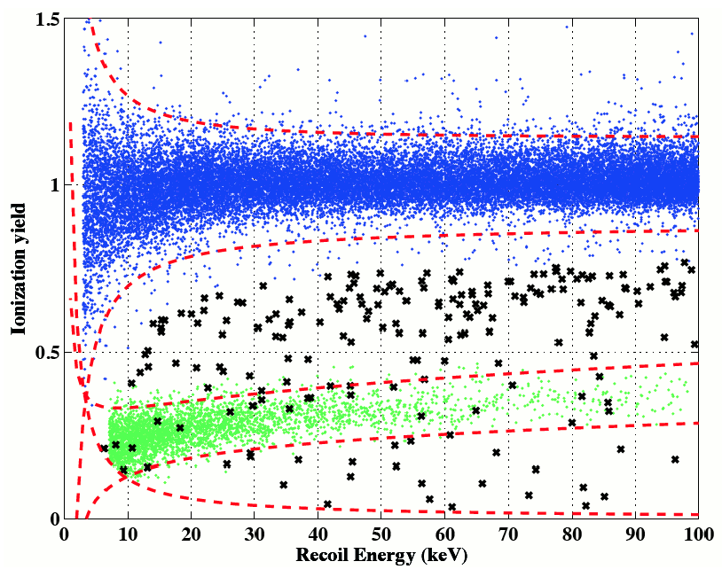
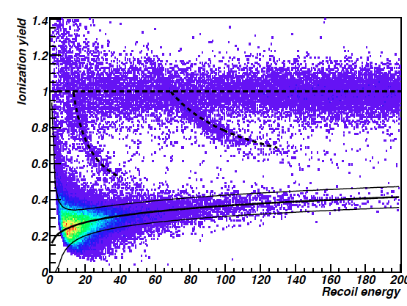
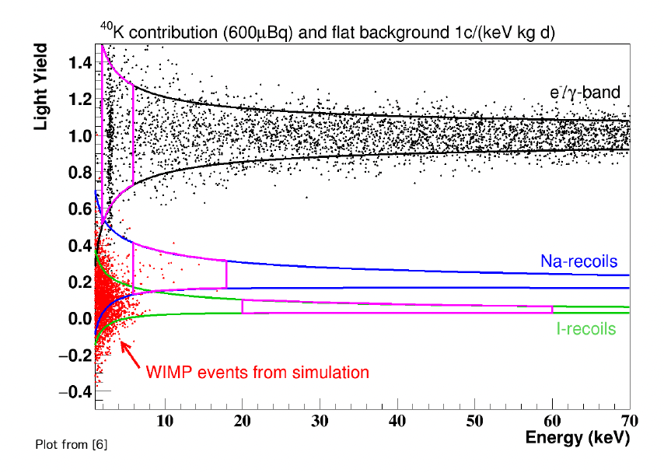
Yield-based Discrimination
Nuclear Recoil (NR)events are “quenched” relative to Electron Recoils (ER)
Charge to Heat ratio
Light to Heat ratio
COSINUS (welcome to the gang!)
SuperCDMS
EDELWEISS
CRESST
Q(Si) and Q(Ge): NR Quenched by factor ~ 3
Large quenching factors
Q(O) ~ 9; Q(W) ~ 40
Q(Na) ~ 3
Q(I) ~ 20
Small Q requires additional rejection of ER
using E-field shaping, timing, veto channels
Caution: Q is dependent on Energy. Tend to lose NR signal when moving to low mass DM ➔ Calibration required

Slide 18
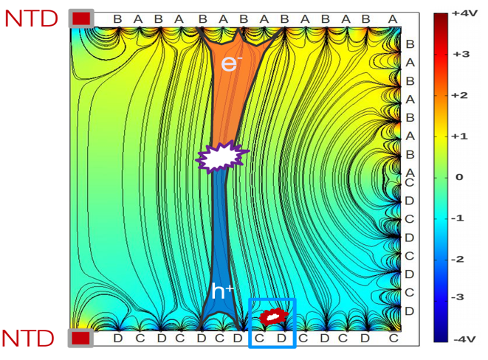
electrodes provide field shaping and surface rejection
Interdigitized
Interleaved
EDELWEISS FID800
EDELWEISS - III
SuperCDMS SNOLAB 1.4 Kg Ge iZIP

Slide 19
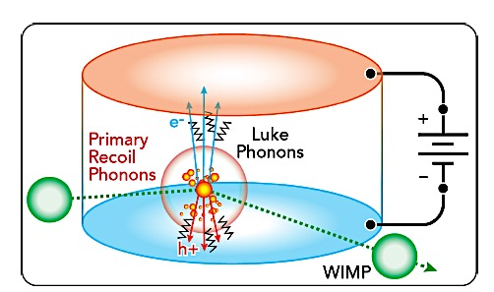
High Voltage Mode (SuperCDMS and EDELWEISS)
Work done by V_{b} in drifting electron-hole pairs
releases additional NTL phonons
NTL
phonons
E_{tot} = E_{r} + N_{eh} e V_{b} = E_{r} 1 + Y(E_{r}) e V_{b}
ε
Two different modes of operation
iZIP and FID: Low bias voltage (2-5 V) gives background-free mode ➔ NTL phonons negligible
Ratio of ionization to primary phonon signal is unambiguous
Interleaved phonon and charge sensors on both sides
Provides 10⁶ ER/NR discrimination and surface rejection
HV: High bias voltage (~ 100 V) pushes to lower thresholds ➔ NTL phonons dominate.
The total phonon signal is larger (amplification means lower thresholds),
but it is essentially a measure of the charge signal read out through the phonon channel
E_{tot} ~ E_{r} Y(E_{r}) e V_{b}
ε

Slide 20
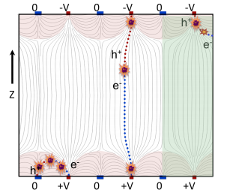
SuperCDMS SNOLAB Detectors
Two target materials Ge (1.4 kg) and Si (0.6 kg)
10 cm diameter and 3.3 cm thick
iZIP
Double-sided readout with E-field-shaping provides z-dependence and surface rejection
HV
No charge readout required.
Optimized for phonon energy resolution and collection efficiency (35% coverage)
Improved position resolution and double outer ring to sharpen fiducial cut.

Slide 21
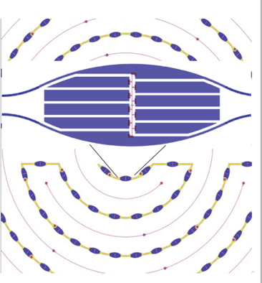
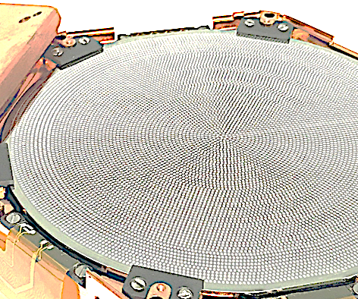
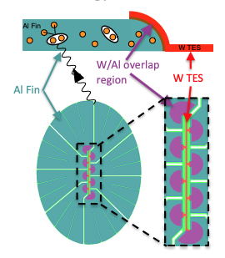
SuperCDMS TES and collection fin design follows function
Aluminum fins
iZIP
Double-sided readout with E-field-shaping provides z-dependence and surface rejection
TES
Charge collection
HV
No charge readout required.
Optimized for phonon energy resolution and collection efficiency (35% coverage)
Improved position resolution and double outer ring to sharpen fiducial cut.

Slide 22
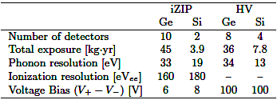
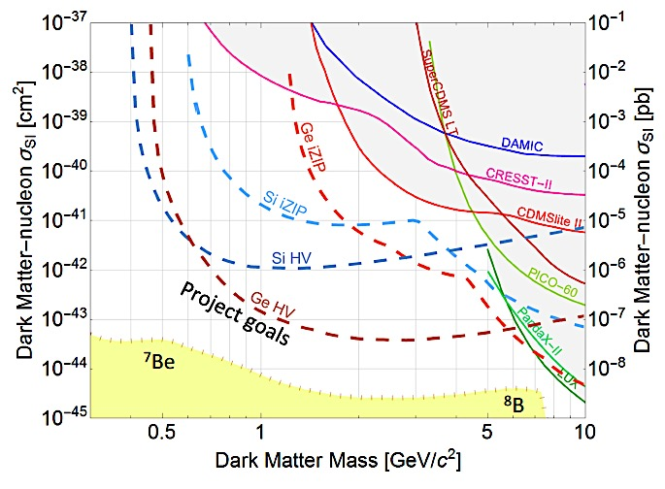
SuperCDMS Strategy
Complementary Targets and Multiple Functionality
Mode
HV
iZIP
Tower 1 (iZIP)
Tower 2 (HV)
Tower 3 (HV)
Tower 4 (iZIP)
22
profile likelihood
Project Goals assume Optimum Interval, no prior knowledge of
backgrounds. To reach full potential, a profile likelihood analysis
will use iZIP background data in the fit.

Slide 23
Pushing even deeper into the nucleon-coupled DM landscape
Arrays of small 0V
phonon-only detectors
Wide-open parameter space at low mass
Exposure is not the driving force
Smaller detectors achieve lower thresholds
Surface runs can provide world-leading results
Pushing down to the neutrino floor requires exposure and reduced bkgd
Improve ionization resolution and reduce leakage currents or
HV with eh sensitivity
driven by phonon resolution
σ_{pt} ~ 30 meV ➔ M ~ 50 MeV
High Voltage
Phonon + Ionization
driven by charge leakage and ionization resolution
Small HV detectors with e/h sensitivity
Plus new ideas in ER rejection
All of this can happen in the existing SNOLAB cryostat and shielding. Improvements in detector performance can be used to circumvent backgrounds.

Slide 24
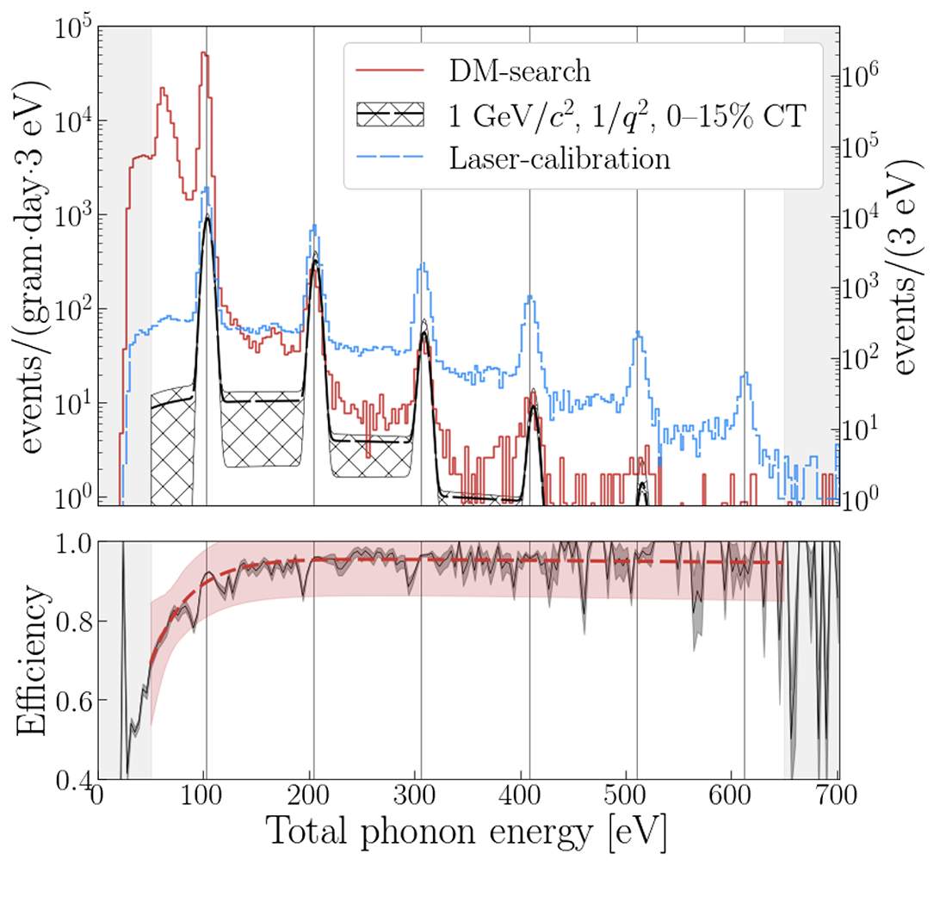
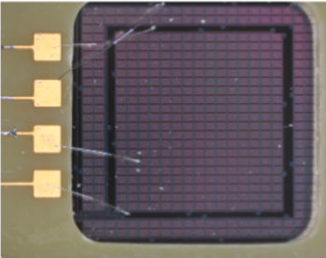

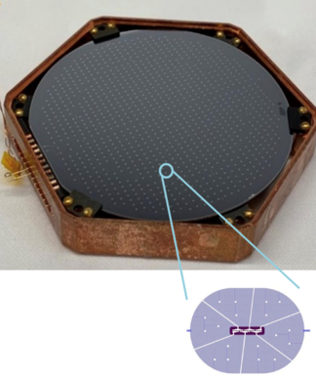
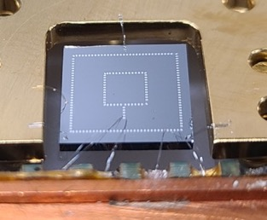
SuperCDMS is already using small 0 V and single eh-sensitive HV detectors
HVeV (Si or Ge, 1 cm² x 4 mm). Like a small HV detector with single e-h resolution.
ER events are in the peaks, NR fills in gaps
A mosaic of these on 2 SuperCDMS towers
can get to the ν-fog in 0.5 – 5 GeV range
0V (aka CPD). A thin, phonon-only device with SuperCDMS TES readout
Improving “environmental” phonon-only backgrounds
Phonon resolution in the σ_{pt} ~ 1 eV range now.
Advances in stress-related bkgds will get to 100 meV
A mosaic of sub-eV σ_{pt} CPDs on 2 towers can get to masses of 50 MeV

Slide 25

Will also push deep into Sub-GeV Electron Recoiling regime
cryogenic phonon detectors are well-suited for these searches.
sensitivity to 1–100 eV deposited energy
enabled by small bandgaps ~1 eV
and excellent energy resolution.
Light DM in the 1-100 MeV range
DM scattering off electrons or collective excitations
Extend cross section by 4 - 5 orders of magnitude.
Dark photon and ALPs in the 1-100 eV range.
Absorption by electrons or collective excitations
Improvements in leakage and resolution drives these limits.
  100 times better reach in kinetic-mixing parameter ϵ
  1000 times better reach in g_{ae}.

Slide 26
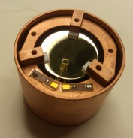
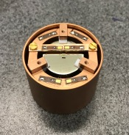
Same themes in the EDELWEISS program
EDELWEISS - III Large exposure underground for 5 – 30 GeV WIMPs
870 g Ge bolometers with 200 eV_{ee} threshold
24 detectors in low background cryostat operated at ~ 18 mK
EDELWEISS – sub-GeV (surface and underground)
33 g Ge bolometers exploring two modes:
LV detectors: Maintain yield discrimination at low energy.
Run above ground, collaboration with RICOCHET CEνNS
RED20 18 eV (RMS) heat resolution + 55 eV energy threshold
To get to 10 eV, need to move from FETs to HEMTs
HV detectors: NTL phonon amplification
RED30 Add top and bottom electrodes and run underground
σ = 1.8 eV_{ee} at 70 V

Slide 27
EDELWEISS goes athermal
NOW: new 100 nm thick, 20 mm diameter spiral
NbSi TES sensor lithographed on a 200 g Ge crystal
Run underground in NTL mode (data next pg)
Future Edelweiss sub-GeVProgram
Cryosel = Thermal Bolometer with NTD thermistor
running at 200 V with 20 eV phonon resolution
Can identify athermal phonons from heat-only
events using the NbSi TES
Superconducting Single Electron Device
NbSi TES

Slide 28
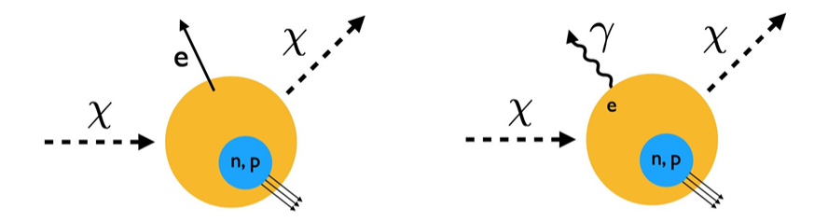
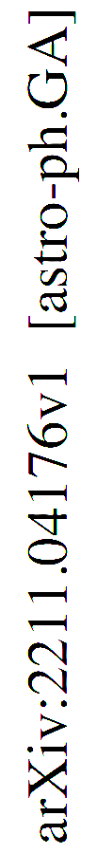
Inelastic scattering extends access to lower mass NR
An NR below threshold can be seen in the ER channel.
Migdal Effect
Readjustment of the electron cloud after NR
can spit out an electron
of a few hundred eV.
RED20
CRESST-III
NbSi
Xenon-1T

Slide 29
Inelastic scattering extends access to lower mass NR
An NR below threshold can be seen in the ER channel.
Migdal Effect
Readjustment of the electron cloud after NR
can spit out an electron
of a few hundred eV.
RED20
CRESST-III
NbSi
CDEX-10
CDMSLite
Xenon-1T

Slide 30
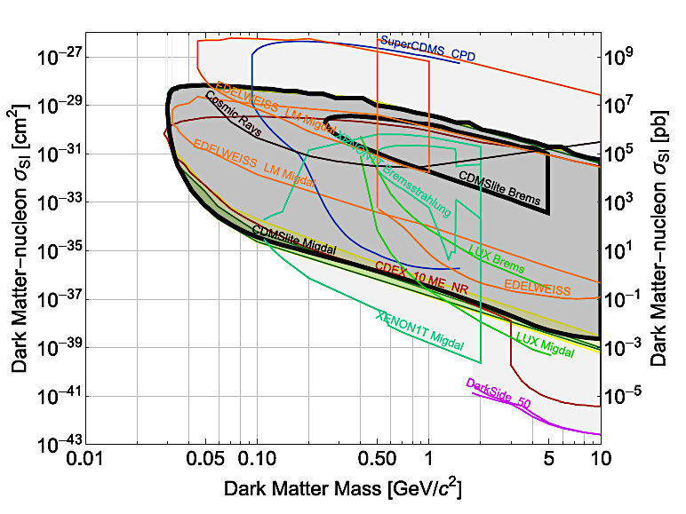
Inelastic scattering extends access to lower mass NR
An NR below threshold can be seen in the ER channel.
Migdal Effect
Readjustment of the electron cloud after NR
can spit out an electron
of a few hundred eV.
Bremsstrahlung
Probability is 3-4 orders of magnitude less
Surface runs (MIGDAL)
CPD (Si with TES readout)
CDMSLiteBrem
RED20
CRESST-III
NbSi
CDEX-10
CDMSLite
Xenon-1T
arxiv:2203.02594

Slide 31
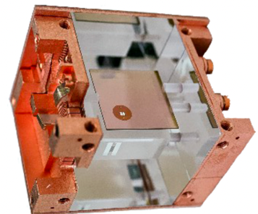
CRESST – III Program
CRESST has already moved to smaller
detectors for improved resolution
arXiv:1904.00498
Recent Spin Independent Limits
New Spin Dependent Limits
Two 10g LiAlOs crystals in LNGS
Lithium: 92.4% ⁷Li (p), 7.6% ⁶Li (p,n)
Planning for a 100 detector underground exposure
upgrade LNGS cryogenic infrastructure
Develop TES mass production
Continue to improve crystal purity

Slide 32
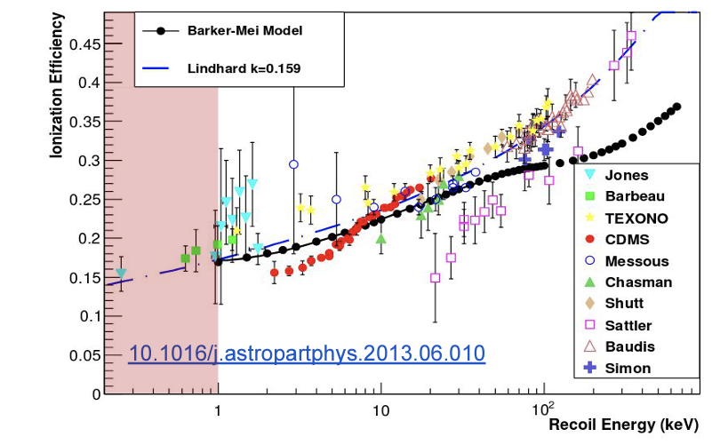
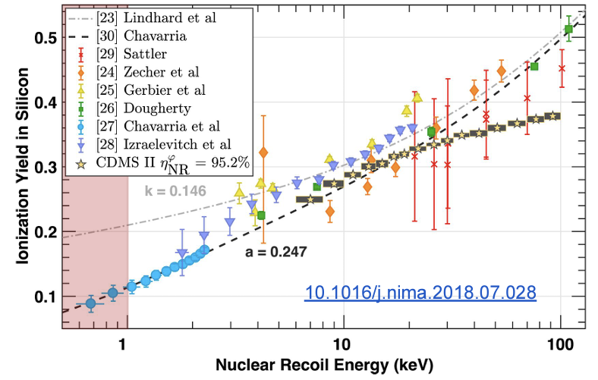
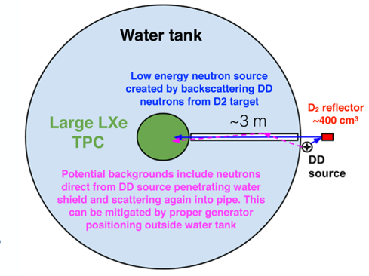
A Common challenge:
Understanding the Nuclear Recoil Scale at lower energies
Germanium
Silicon
?
?
D₂ reflector
LXe TPC style in-situ neutron scattering
is not an option for cryo bolometers
LUX in-situ
Calibration
DD generator

Slide 33
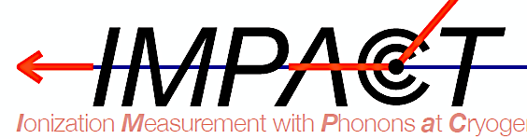
SuperCDMS Nuclear Recoil Scale Measurements at low energy
  Neutron beam at the TUNL facility
  Used a “portable” ADR fridge and a Silicon HVeV
  Next campaign in 2024 with a Germanium HVeV

Slide 34
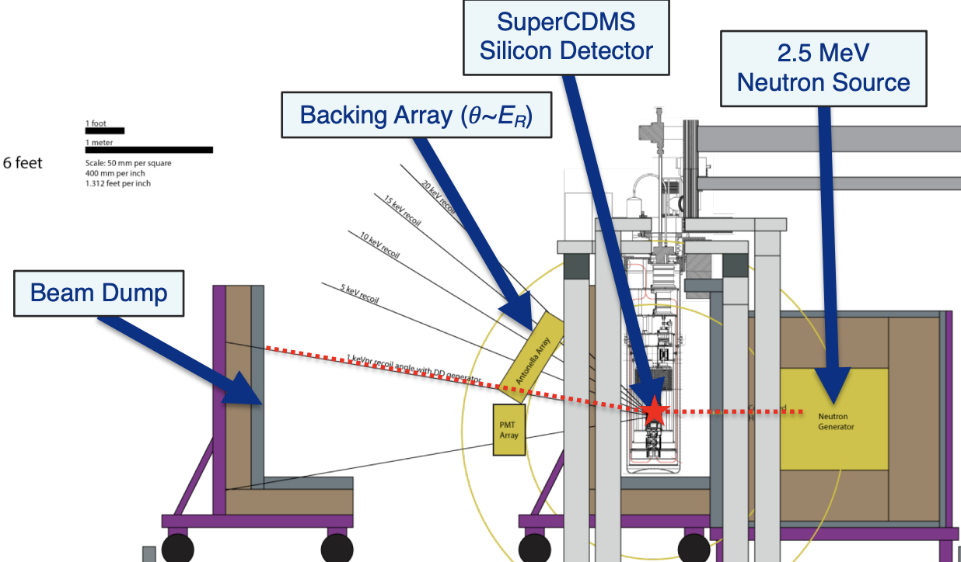
SuperCDMS Nuclear Recoil Scale Measurements at low energy
  Neutron beam at the TUNL facility
  Used a “portable” ADR fridge and a Silicon HVeV
  Next campaign in 2024 with a Germanium HVeV
DD generator at FNAL NUMI hall (~300 mwe)
Use the NEXUS fridge and backing array
Run both HVeV with full-scale SuperCDMS HV

Slide 35
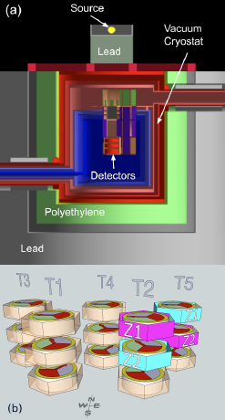
SuperCDMS Nuclear Recoil Scale Measurements at low energy
  Neutron beam at the TUNL facility
  Used a “portable” ADR fridge and a Silicon HVeV
  Next campaign in 2024 with a Germanium HVeV
DD generator at FNAL NUMI hall (~300 mwe)
Use the NEXUS fridge and backing array
Run both HVeV with full-scale SuperCDMS HV
Photo-neutron Source: (⁸⁸Y or ¹²⁴Sb) gammas on ⁹Be
Soudan Lab, Ge iZIP run in CDMSlite mode
Soudan

Slide 36
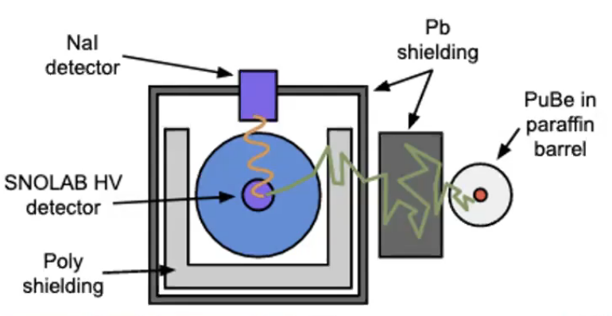
SuperCDMS Nuclear Recoil Scale Measurements at low energy
  Neutron beam at the TUNL facility
  Used a “portable” ADR fridge and a Silicon HVeV
  Next campaign in 2024 with a Germanium HVeV
DD generator at FNAL NUMI hall (~300 mwe)
Use the NEXUS fridge and backing array
Run both HVeV with full-scale SuperCDMS HV
Photo-neutron Source: (⁸⁸Y or ¹²⁴Sb) gammas on ⁹Be
Soudan Lab, Ge iZIP run in CDMSlite mode
Developing new neutron capture technique
SNOLAB Si HV in UMN cryo lab exposed to PuBe source of thermal neutrons
Measure nuclear recoil after neutron capture, tag de-excitation γ
Soudan

Slide 37
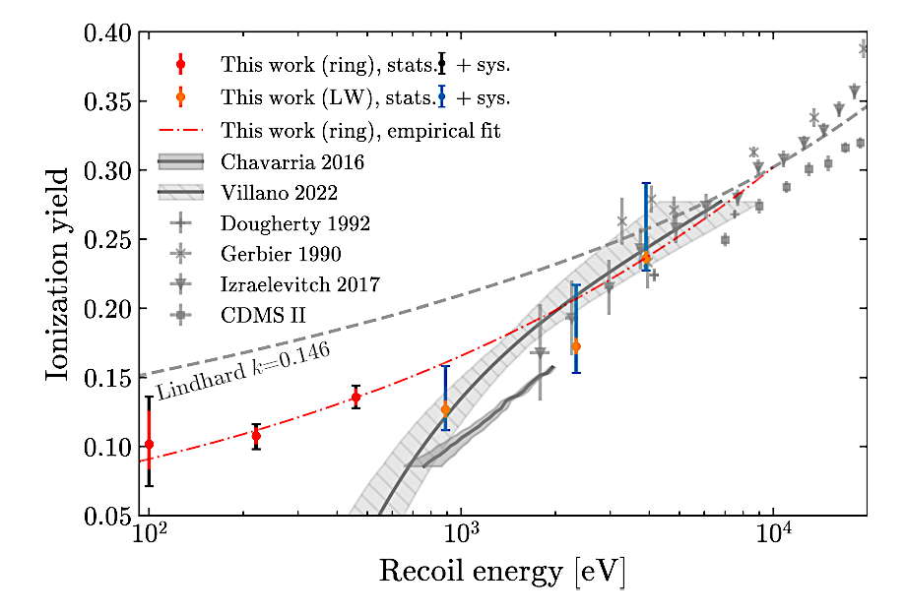
Good Progress, but further work is required to establish confident interpretation of low mass DM limits from Ge and Si
Silicon NR response
falls faster than Lindhard
Quenching in Germanium may depend on
temperature or internal electric field
n-capture
Ge CDMSlite photoneutron
IMPACT

Slide 38
Summary
A multi-experiment Strategy for the future based on “Delve Deep and Search Wide”
The strategy requires development of multiple targets and their readout technology in parallel
Not only because we don’t know where the DM is, but also
because understanding the nature of the interaction will require multiple targets
We have a program that can explore down to the neutrino fog in most scenarios
Not finding a signal (in a particular section of phase space) is as important as finding it.
There is no guarantee that there is only one type of dark matter
This decade has produced a wealth of candidates with arguments as compelling as the WIMP
The role of cryogenic bolometer experiments in this strategy
Near term, large exposure searches which probe NR DM at lower masses
Good sensitivity to inelastic NR (Migdal) and ER dark matter
Active R&D on small detectors which can push deep into ER dark matter
Improvements in the ionization yield discrimination (HEMTs, leakage current, charge resolution)
Coordinated effort to measure NR quenching in Ge, Si
Development of HV alternatives to access lowest energies down to single eh charge sensitivity
Improve phonon resolution without the complication of charge

Slide 39
Backup Slides

Slide 40
There are a lot of solutions consistent with the gravitational evidence
Search Wide

Slide 41
Not finding a vanilla WIMP is an incredible scientific accomplishment
Delve Deep

Slide 42
It puts any new signal in context
A signal! An eye fits into the theory of an animal.
Use its size and what you know about
animals to look for where the tail should be
check here!
The region without an animal now tells you which direction it is facing and its environment

Slide 43
The model may require you to look with a different sort of detector
A tail!

Slide 44
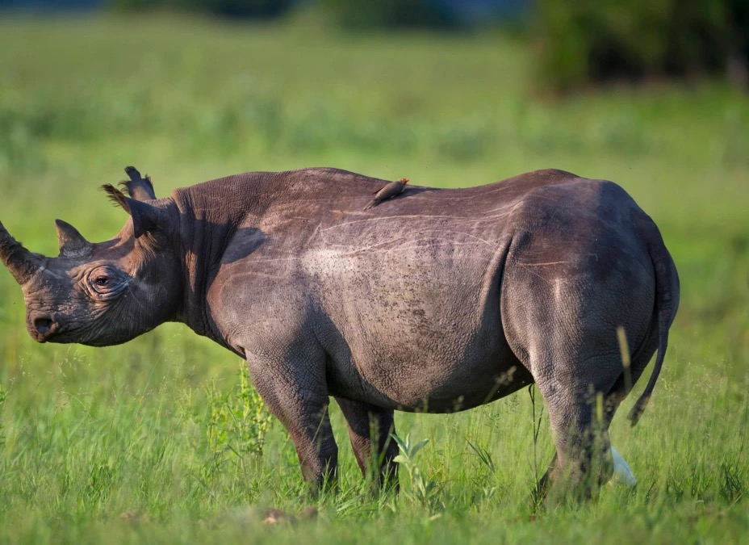
Iterate with a new round of active model-building
A signal!
An eye fits into the theory of an animal.
Use its size and what you know about animals to look
for where the tail should be
Check a distinguishing feature
?
check here!
And the region without an animal now tells you
which direction it is facing.

Slide 45
And hope there is a technology available to look there
An ear fits the elephant model
better than the rhino model

Slide 46
And this is still just one part of the jungle

Slide 47
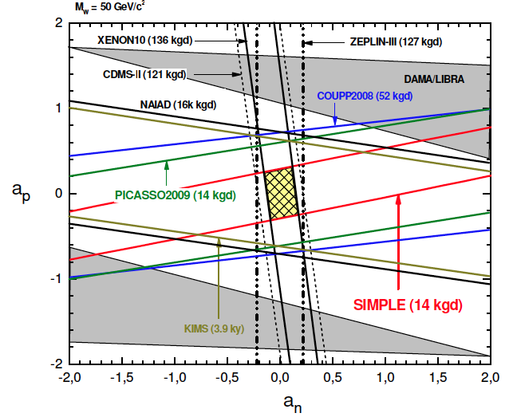
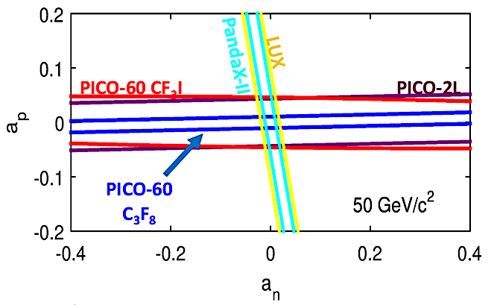
Multiple SD targets are necessary for best constraints
Example from 2010. Superheated droplet detectors
Using the n-coupled Xenon10 results improved
the SIMPLE (C₂ClF₅) p-coupled results.
Current constraints are an order of magnitude better. Note that the players are LXe TPCs and Freon bubble chambers
| a_{p}| < 0.32, |a_{n}| < 0.17
for 50 GeV/c² WIMP

Slide 48
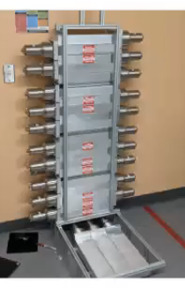
Develop new in situ technique
Nuclear Recoils induced by neutron capture (n,γ) of thermal neutrons
Use NaI to tag events
with escaped gammas:
these represent “pure” NR.
Running now with
large NaI array and new
Si HV detector with
better resolution
Capture spectrum depends on yield model and detector resolution. Here shown for
two yield models and two resolutions

Slide 49
Neutron capture observed
Yield again shows low energy suppression in silicon.
Fit data to simulated ER + NR
For NR, choose a yield model.
Data shows a clear (nγ) feature
Yield models all require a neutron capture component (by 25σ)
Best fit using the Sorenson yield model clearly indicates suppression and possible threshold.

Slide 50
Measure Y(E_{r}) in Germanium using a photo-neutron source
Last set of runs before disassembling Soudan Facility
Illuminated the SuperCDMS array of germanium iZIPs
For each run, one iZIP was in CDMSlite HV mode.

Slide 51
Measure Y(E_{r}) in Germanium using a photo-neutron source
Data without Be disk
Data with Be disk
Geant4 MC

Slide 52
Soudan CDMSlite photo-neutron source results for germanium
https://arxiv.org/abs/2202.07043
Likelihood fit to
modified Lindhard
Inconsistent with recent Collar measurement.
Is Yield T-dependent?
Or modified by internal field?
Uncertainty dominated by statistics and precision of neutron scattering cross sections
CDMSlite result

Slide 53



Measure Y(E_{r}) in Silicon
Neutron Beam Energy ➔ E_{n}
1.9 MeV pulsed (2.5 MHz) protons on LiF target
Tune to the ²⁸Si elastic scattering resonance (56 keV)
Neutron scattering angle ➔ E_{r}
Backing Array (26 PMTs) at 2 distances
3 “lone wolf” to reference large angles
Also measure TOF and γ backgrounds
Silicon Detector ➔ total phonon energy
HVeV (0.93 g) with 2 TES channels
Energy Resolution: σ_{p} ~ 3 eV
Charge Resolution: σ_{eh} ~ 0.03 e/h
E_{tot} = E_{r} + E_{NTL}
NTL
phonons
Liq. Scint.
EJ-301/309

Slide 54


Yield has significant consequences to our low mass reach in Silicon
..
Yield model previously used for SuperCDMS project limits
All our Si project limits were based on a modified Lindhard (green)that passes through Chavarria ‘16

Slide 55






The CEνNS Connection
CRESST➔
nu-cleus
SuperCDMS➔
MIνER
EDELWEISS➔
Ricochet
Two 3x3 arrays of
6g CaWO₄ + 4g Al₂O₃
read out by W TES
HV, iZIP
Al₂O₃ + QET
TRIGA research nuclear reactor at TAMU with moveable core

Slide 56



Recent Excess workshop identifies further clues
CPD (both underground and at surface)
EDELWEISS “heat only” events
Rate differs by x 10 in ”identical” Al₂O₃ detectors
Relaxing after cooldown is a feature consistent with microfracture stresses

Slide 57

A Strategy for Low-Mass Dark Matter Searches with Cryogenic Detectors
in the SuperCDMS SNOLAB Facility. https://arxiv.org/abs/2203.08463
Nucleon-coupled dark matter (50 MeV – 5 GeV)
Large = SNOLAB (260 cm³)
Medium = 10 cm³
Small = 1 cm³
small 0V
Large HV,
medium iZIP
dark matter mass (GeV/c²)
dark matter mass (GeV/c²)
Dark blue = SNOLAB limits with 4 Towers (in our 7-tower cryostat).
Light blue = In-hand small detector mosaics filling two towers running at 80% duty cycle for 4 yrs.
Dark Grey = Mosaics of upgraded detectors (see next slide) in two towers.
Three two-tower scenarios can fit in the the cryostat and run in parallel.

Slide 58


A Strategy for Low-Mass Dark Matter Searches with Cryogenic Detectors
in the SuperCDMS SNOLAB Facility. https://arxiv.org/abs/2203.08463
Dark photon kinetic mixing ALP effective coupling
Light DM coupled to dark photon
heavy mediator
light mediator
dark photon mass (keV/c²)
ALP mass (keV/c²)
dark matter mass (MeV/c²)
dark matter mass (MeV/c²)
Dark blue: SNOLAB limits with 4 Towers (in our 7-Tower cryostat)
Light blue: In-hand small detector mosaics filling two towers running at 80% duty cycle for 4 yrs.
Dark Grey: Mosaics of upgraded detectors in two towers.
Three two-tower scenarios can fit in the the cryostat and run in parallel.
yellow line: parameter space consistent with the hint from white dwarf cooling.
pink lines are sharp targets for M_{A’} = 3 M_{χ}
from 2017 cosmic visions workshop
J. Cosmo. Astro. Phys. 2016, 057

