Slide 1











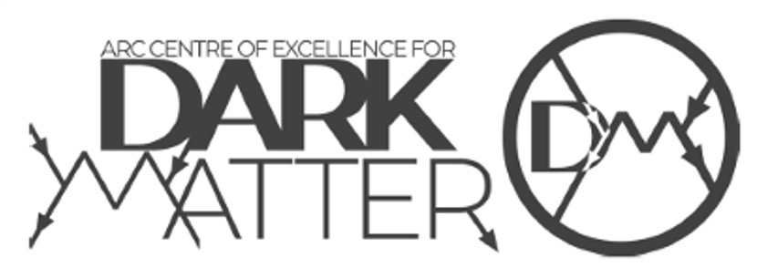


Status of the SABRE
Dark Matter experiment
Aldo Ianni
INFN – LNGS
on behalf of the SABRE Collaboration
UCLA Dark Matter, 2023

Slide 2
Motivation of SABRE
Sodium-iodide with Active Background RejEction
Probe DAMA/LIBRA model-independent finding with same target material and lower background
Observed annual modulation ~ 0.01 cpd/kg/keV (dru) in ROI [1,6]keV
Background ~ 1 dru in ROI
STRATEGY in SABRE
  Higher signal-to-background ratio by ultra-high purity NaI(Tl) crystals
    aim to 0.1 dru in ROI
  North-South «twin» experiments at LNGS(Italy) and SUPL(Australia)
    Rule out seasonal effects
  Proof-of-Principle (PoP) at LNGS
    Exploit active background rejection with a liquid scintillator
    Test crystals radio-purity

Slide 3
Ultra-high radio-purity NaI(Tl) detectors
At the time SABRE was conceived by Frank Calaprice (Princeton Univ) (~2010) the main background sources under consideration were mainly ⁴⁰K at DAMA/LIBRA level ~10-20ppb and ²³⁸U, ²³²Th, and ⁸⁷Rb
Two considerations were driving the project
  Grow crystals from a low potassium powder
  Improve ⁴⁰K rejection by a high radio-purity liquid scintillator veto
The effort made led to the following results
  the Astro Grade NaI powder was developed in collaboration between Princeton University and Sigma-Aldrich with potassium < 10ppb after fractional crystallization purification
  test crystals with potassium < 10ppb were grown
  a PoP with the Borexino liquid scintillator was designed and built at LNGS showing 84% efficiency in rejection of ⁴⁰K

Slide 4
NaI(Tl) crystal production for SABRE
Crystals are grown from Astro Grade
  a few ppt in U, Th and a few ppb in K and Rb
The Bridgman method has been selected to mitigate the risk of contamination during growth
  molten material is sealed inside a cleaned crucible
Crystal growth is performed by the industrial partner Radiation Monitoring Devices (RMD)
  some quality controls are performed prior to underground counting

Slide 5
ICP-MS screening of tip and tail samples after growth
NaI-33
black marker: data
blue marker: fit
k = 0.59_{-0.06}^{+0.05}
radio-purity characterization is performed after growth
on tip and tail samples to make a first assessment of the crystal
quality
³⁹K < 10ppb, ⁸⁵Rb ~ 1ppb, U/Th < 0.1ppb
These results to be compared with direct counting underground
NaI-35
k=0.52±0.04

Slide 6
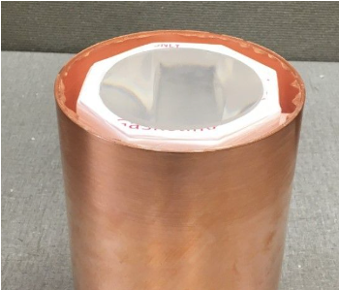
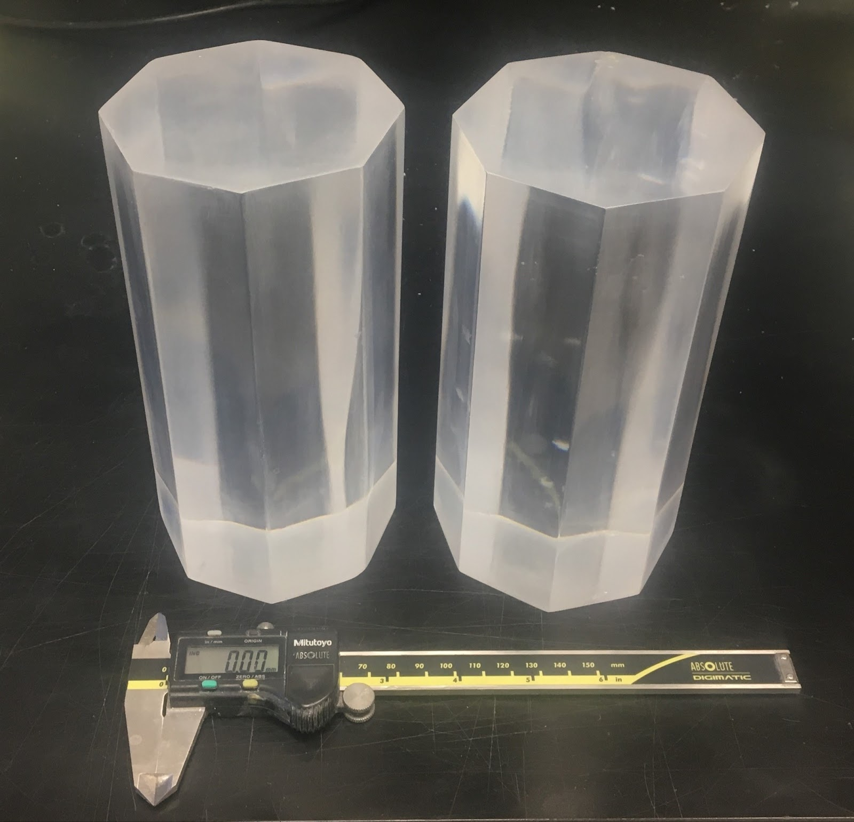
Grown crystals and underground at LNGS
NaI-35
encapsulated
NaI-31 at LNGS since April 2019
NaI-33 since August 2019, assembled in Princeton
NaI-35 since May 2022, assembled at RMD
NaI-37 since March 2022, naked and encapsulated at LNGS
NaI-35
NaI-37

Slide 7
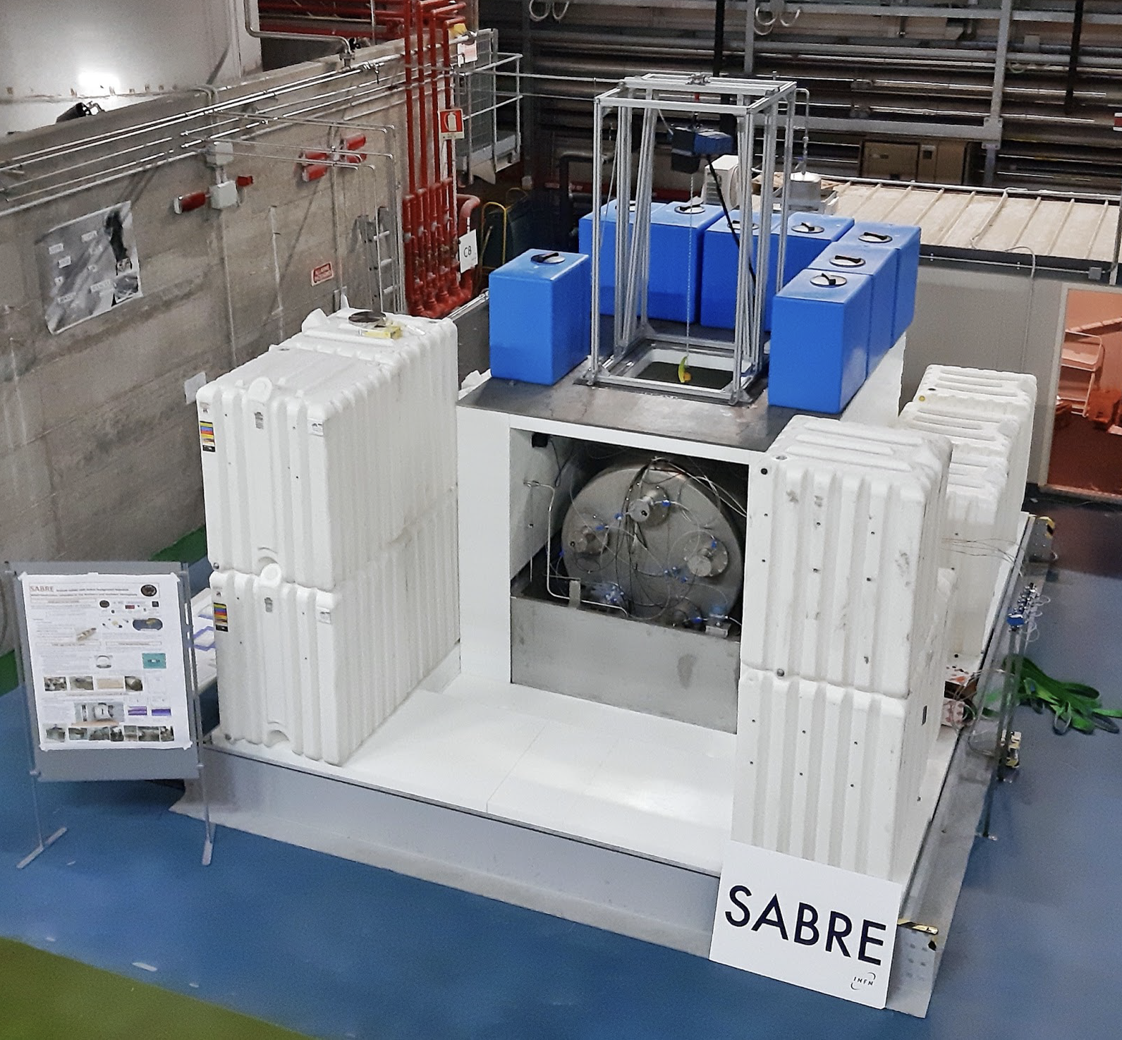
PoP at LNGS
Run in 2020 with Borexino liquid scintillator and NaI-33
  2 tons LS active veto with 10 8-inch PMTs + H₂O shielding
Exploited successfully ⁴⁰K tagging with sensitivity at the level of 1ppb
Demonstration by direct counting of first crystal production after DAMA/LIBRA with background in [1,6]keV of order 1dru
Identified main background sources:
  ²¹⁰Pb in crystal bulk equal to 0.51±0.02 mBq/kg
  Confirmed ICP-MS estimation for ⁴⁰K contamination

Slide 8
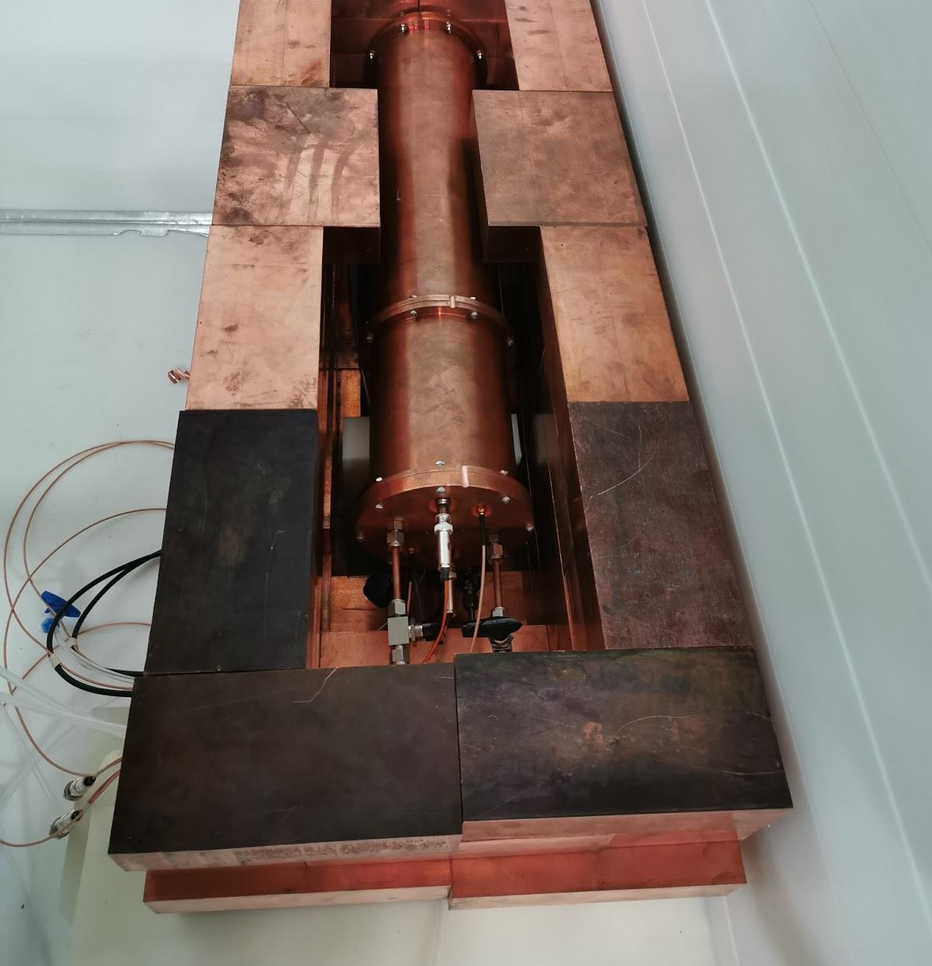
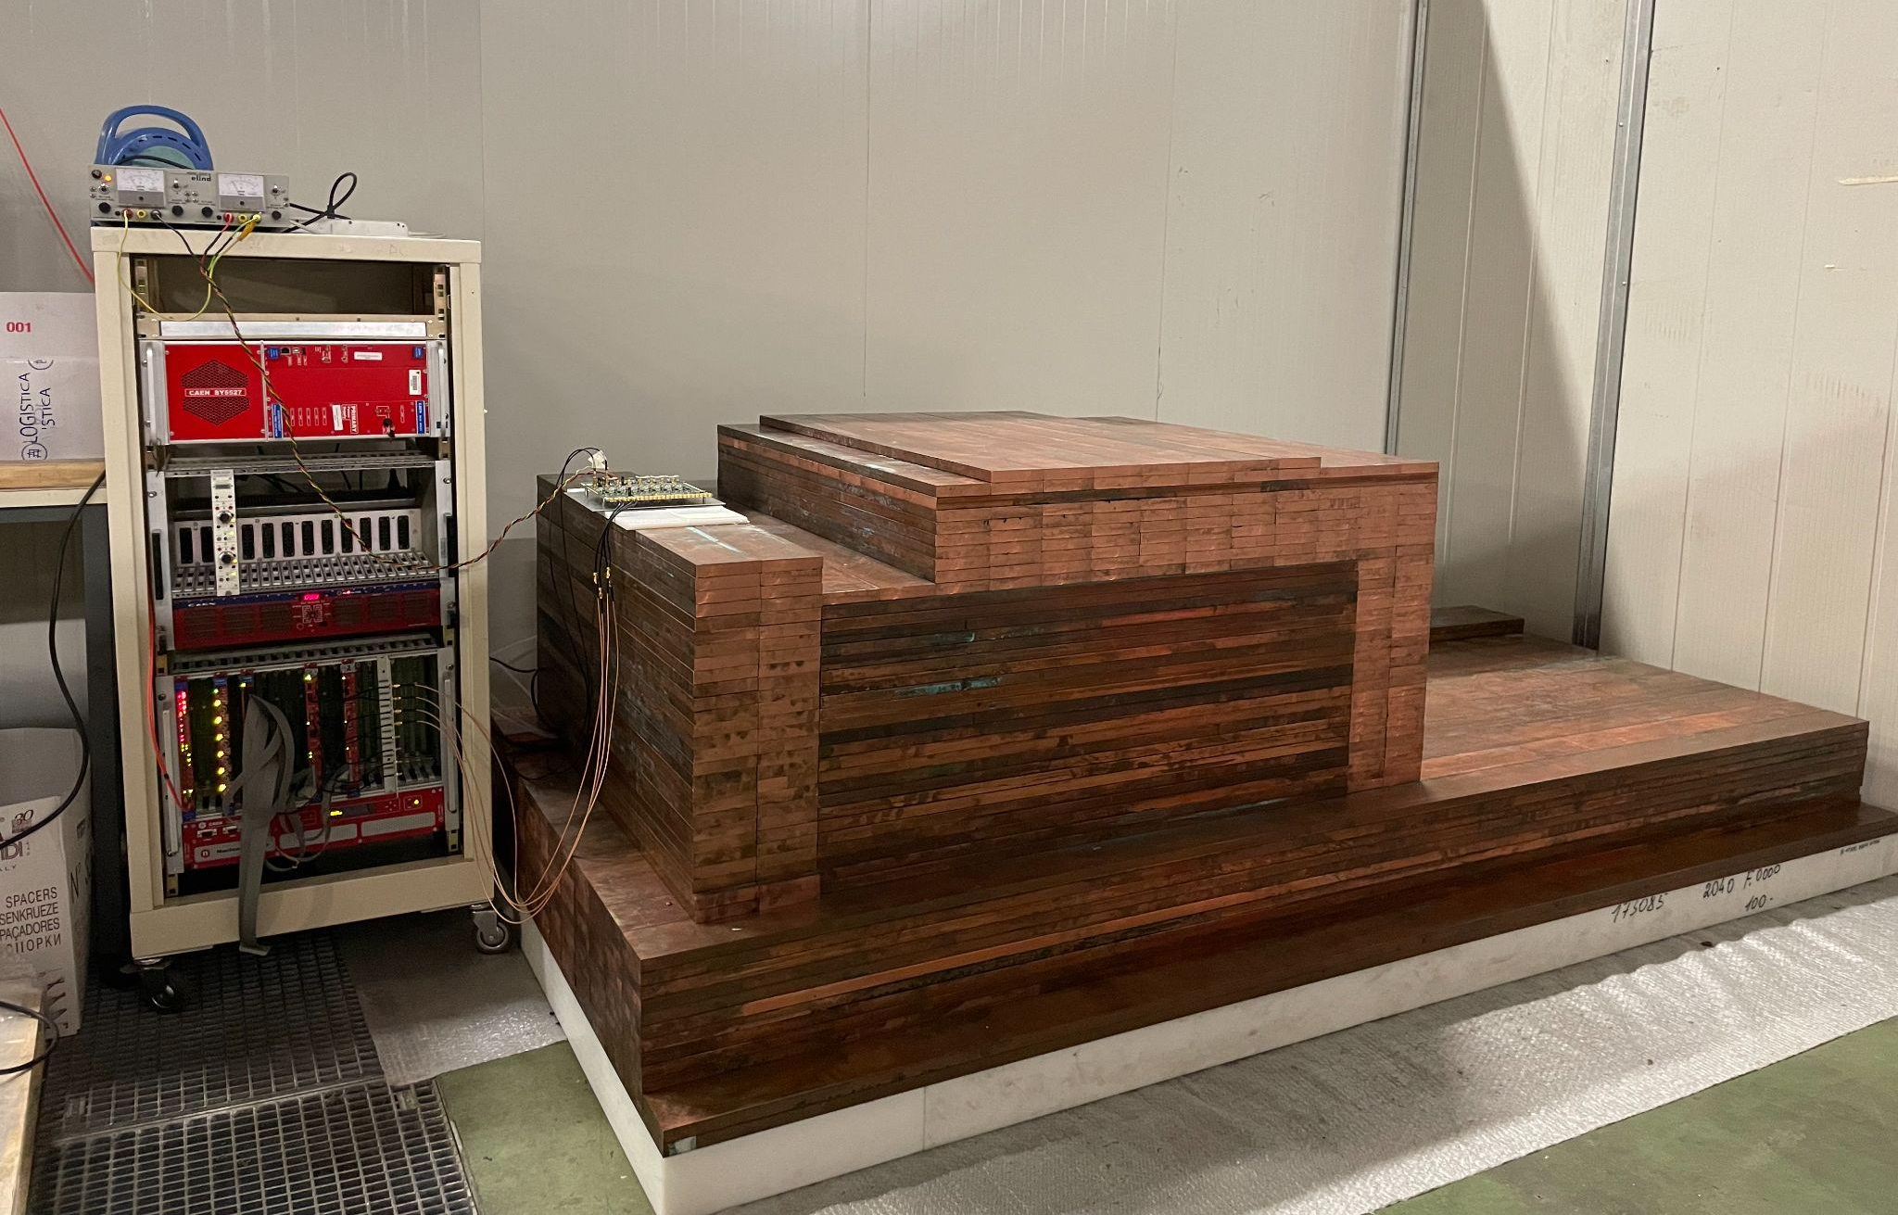
Beyond the PoP run
PoP-dry run
The low potassium level wrt to the original 10-20ppb assumed and restrictions at LNGS for LS use, led us to consider a passive shielding design for SABRE-North
To elaborate this idea we have taken data with NaI-33 inside the PoP w/o LS with an improved Cu shielding (PoP-dry run)
After PoP set-up desommissiong we have built a full low ²¹⁰Pb Cu shielding (30cm) set-up for crystal characterization
New Cu shielding for crystal characterizaion

Slide 9
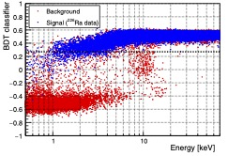
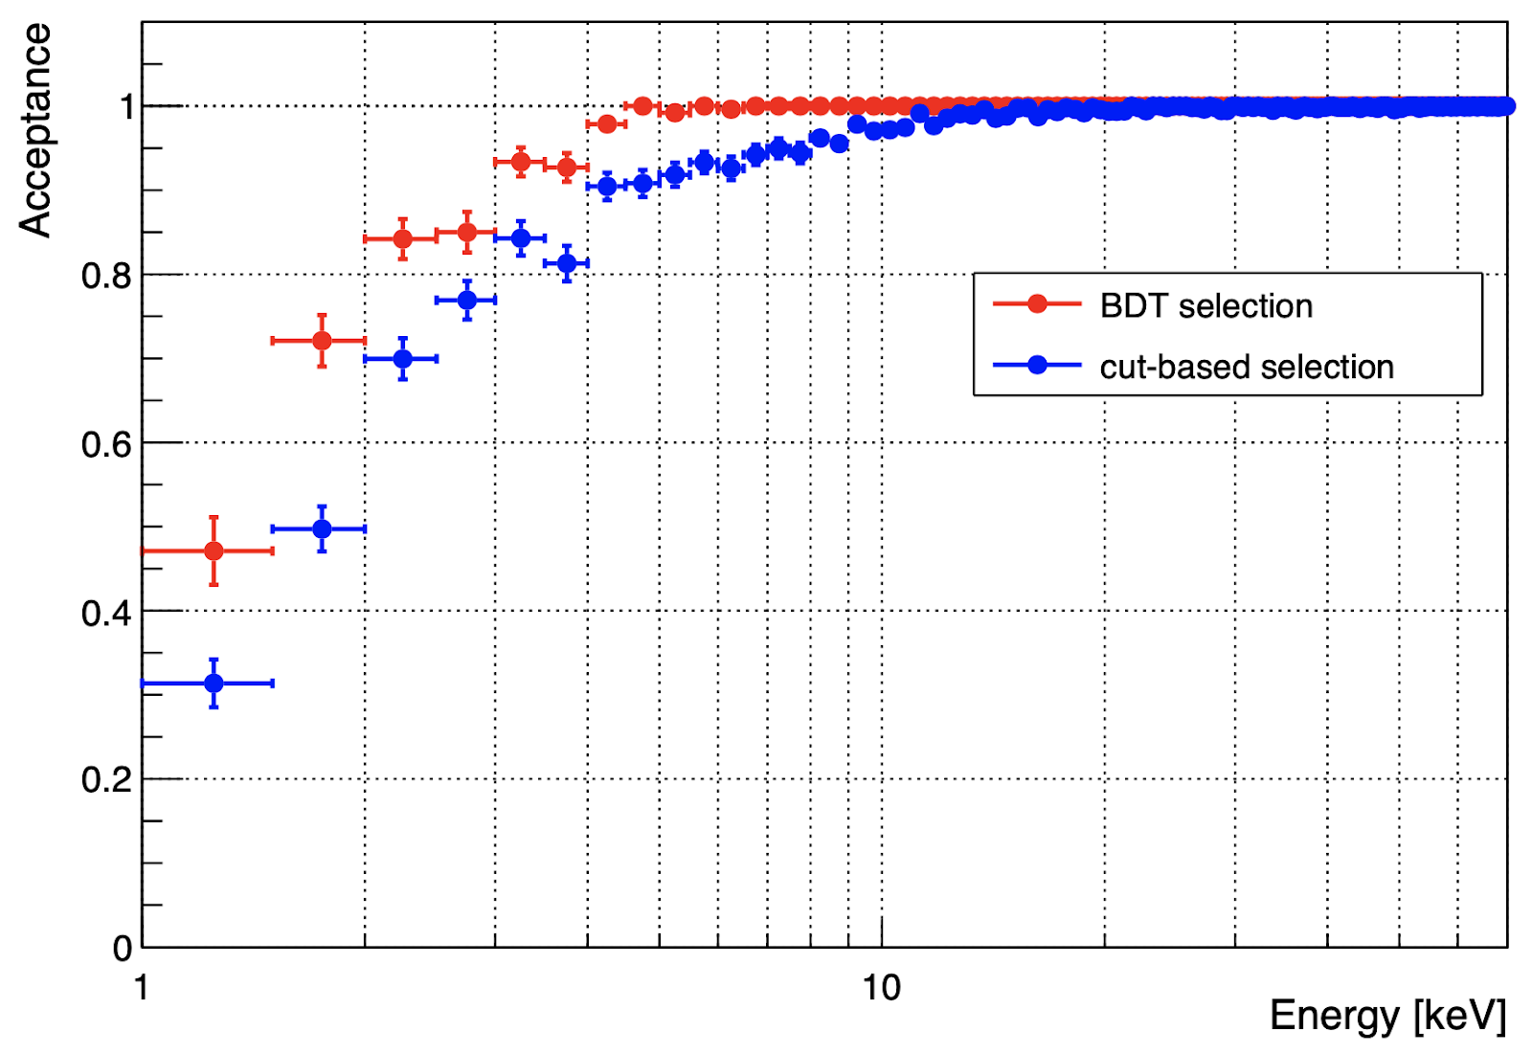
PoP-dry run
BDT cut
891 kg x day exposure with NaI-33
Noise reduction by BDT
Rate in ROI dominated (60%) by external background
⁴⁰K in ROI only 10% of total rate
Rate in ROI = 1.39±0.03 dru

Slide 10

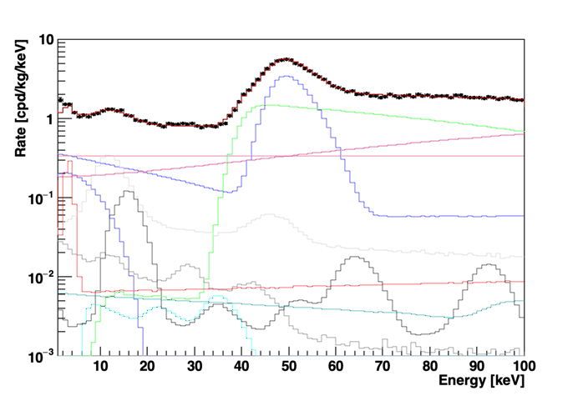
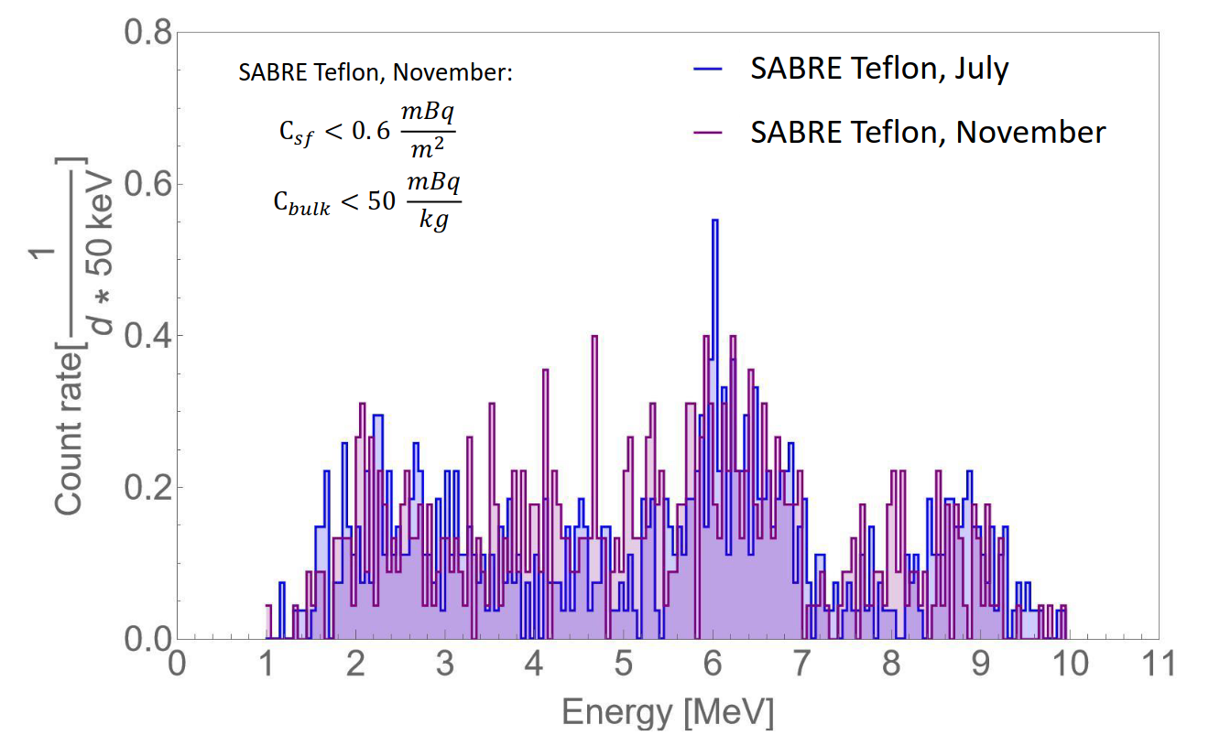
PoP-dry background breakdown
³H expected 37±10 μBq/kg for 10 months surface exposure and 24 months underground
  Possible reduction due to storage in B level below ground at Princeton
²¹⁰Pb in PTFE reflector within upper limits by α spectroscopy
²¹⁰Pb in bulk consisted with α tagging by PSD based on amplitude-weighed mean time
G. Zuzel

Slide 11
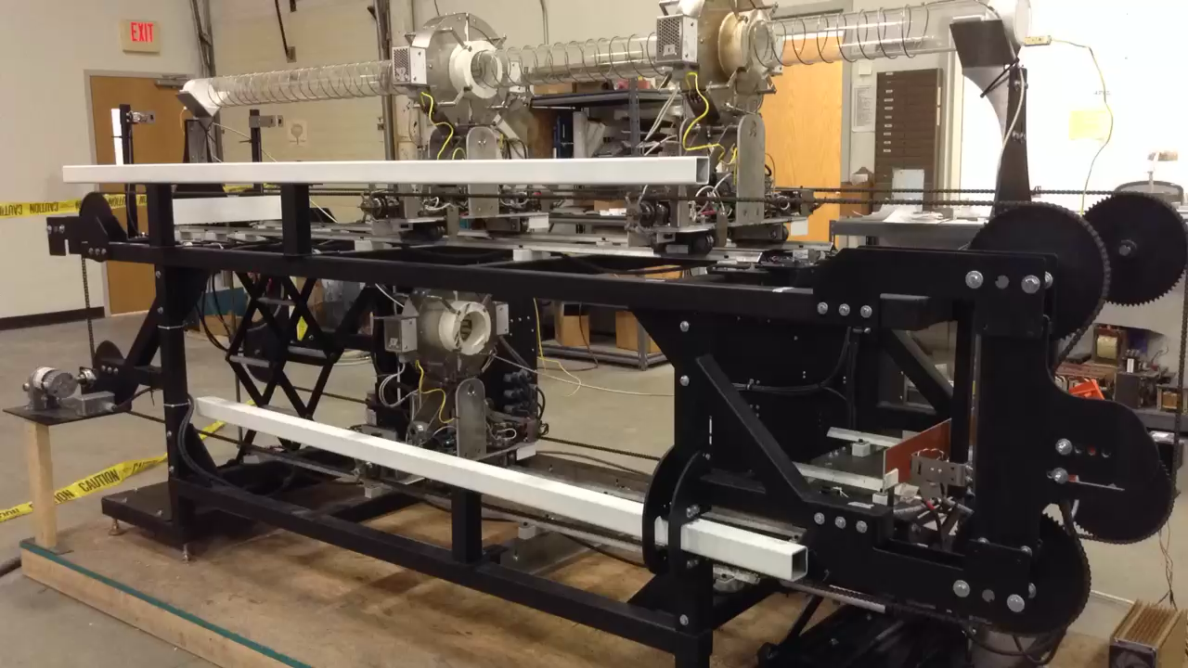
Zone refining purification in SABRE
Strategic and unique to the SABRE project is the idea to zone refine the powder prior to growth
A zone refiner suitable for order of 100 kg crystal production has been built in collaboration with MELLEN
The zone refiner is being moved to RMD for growing a test crystal by the end of the summer

Slide 12
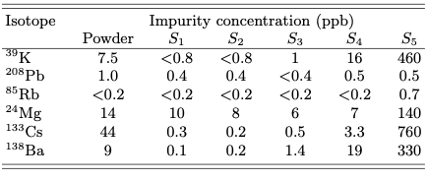
Performance of ZR purification
744 g of AG powder and 53 passes at ~ 6 cm/h
impurities are pushed to the end of the refining tube at different level and eliminated from the material selection before the growth
Different segregation coefficients (k<1) of impurities in molten vs solid phase

Slide 13
Data from tested crystals
preliminary
 | Mass [kg] | LY**** [pe/keV] | ³⁹K [ppb] | ²¹⁰Pb [mBq/kg] | Rate ROI [1,6]keV
NaI-31 | 3.00 | 9.1±0.1 | 16.5±1.1 | 1.02±0.07 | 2.74±0.03
NaI-33* | 3.40 | 12.1±0.2 | 4.3±0.6 | 0.51±0.02 | 1.20±0.05
NaI-33** | 3.40 | 11.1±0.2 | 4.3±0.6 | 0.51±0.02 | 1.39±0.03
NaI-33*** | 3.40 | 11.1±0.2 | 4.3±0.6 | 0.51±0.02 | 0.95±0.05
NaI-35 | 4.36 | ~9 | 8.3±0.6 | 0.49±0.2 | -
NaI-37 | 4.35 | ~8 | 8.0±0.6 | 0.80±0.01 | -
* PoP run
** PoP-dry run
*** NaI-33 in 30cm Cu shielding
**** from ²⁴¹Am (59.5 keV)

Slide 14
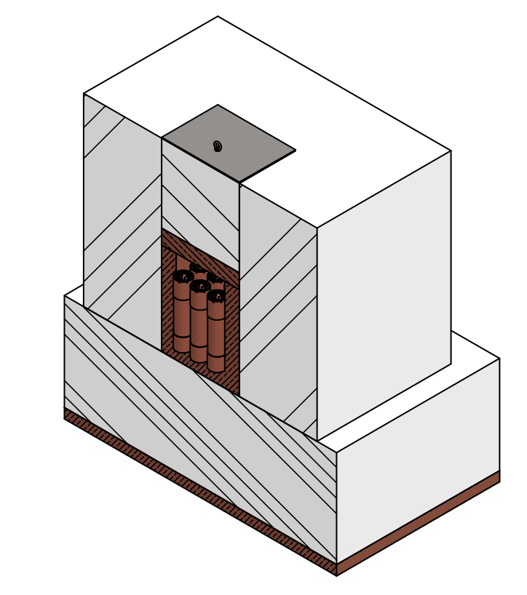
Preliminary design of
SABRE-North
3 x 3 matrix of ≈ 5 kg NaI detectors
Inner 5 mm thick Cu box
Vertical crystal deployment
15 cm Cu and 80 cm PE shielding structure
10 cm Cu basement
MC predicted background from environmental
gamma and neutrons ~0.01dru in the ROI
Overall shielding dimensions and mass:
3 x 3 x 3 m³, ≈30 t
Sensitivity to annual modulation

Slide 15
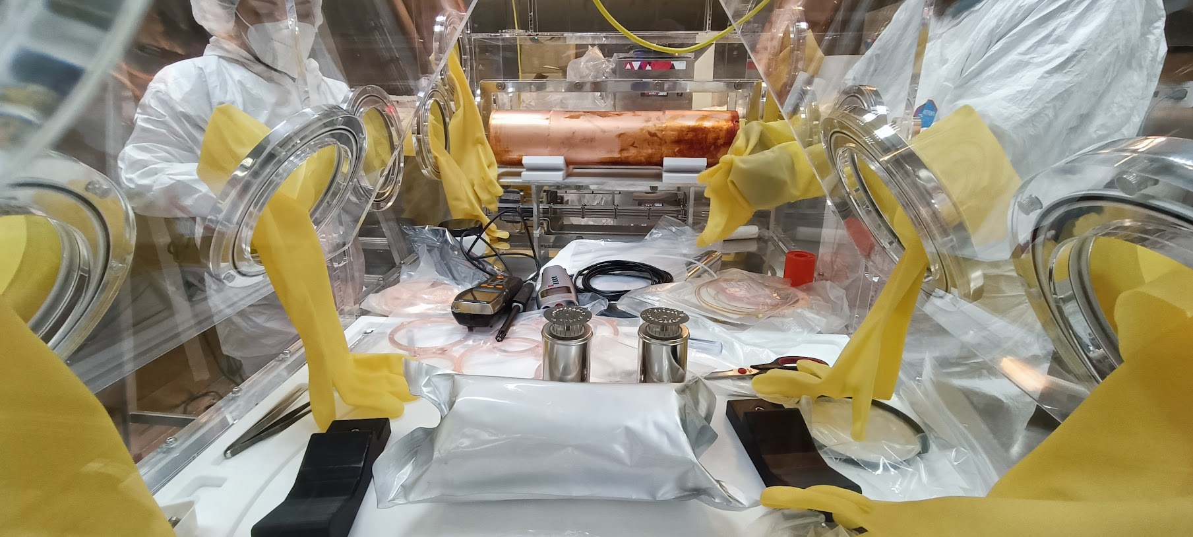
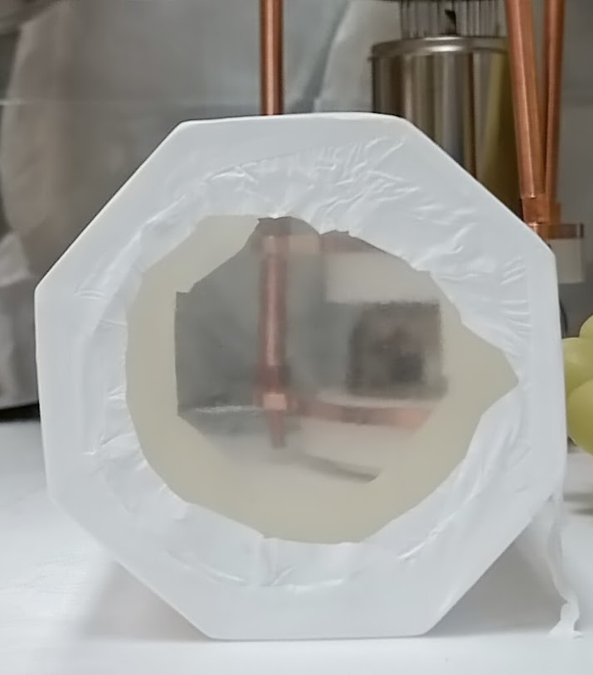
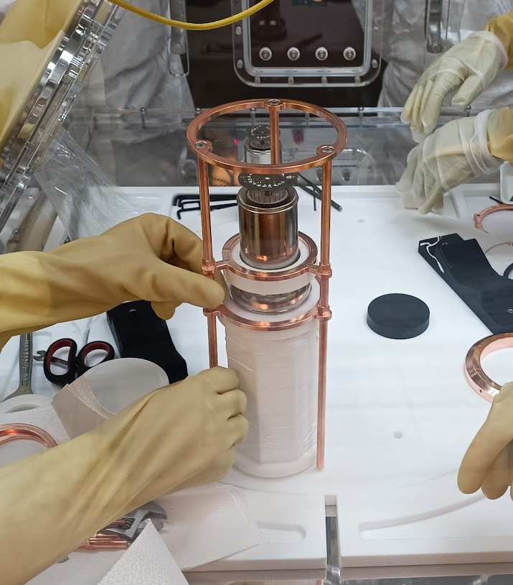
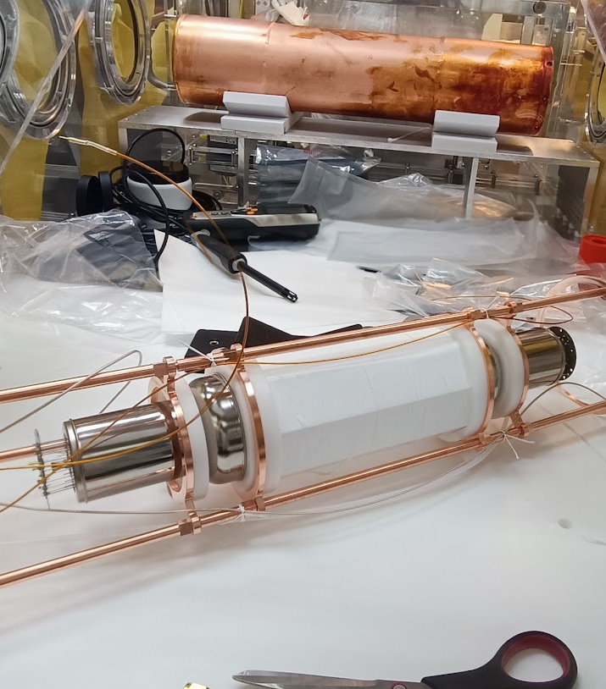
Operation for NaI-37 in underground Radon-free clear room (400mBq/m³) previously built for DarkSide-50

Slide 16
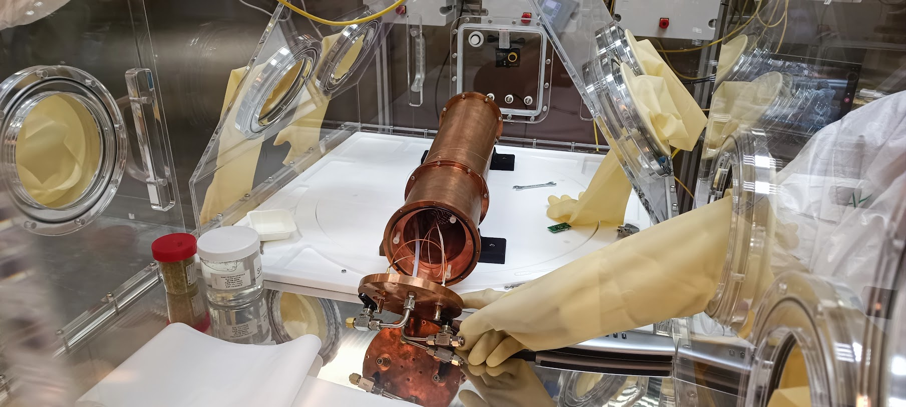
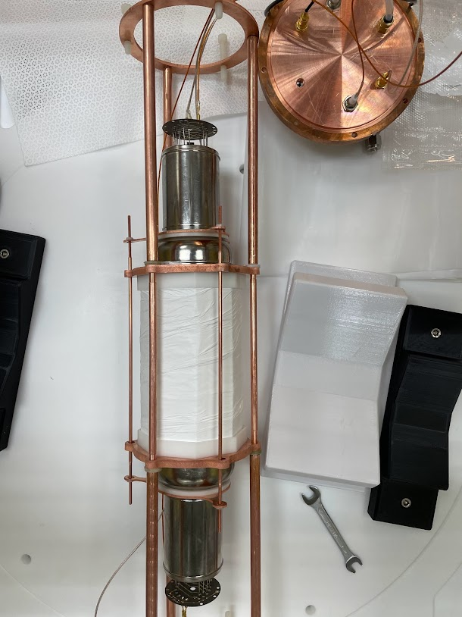
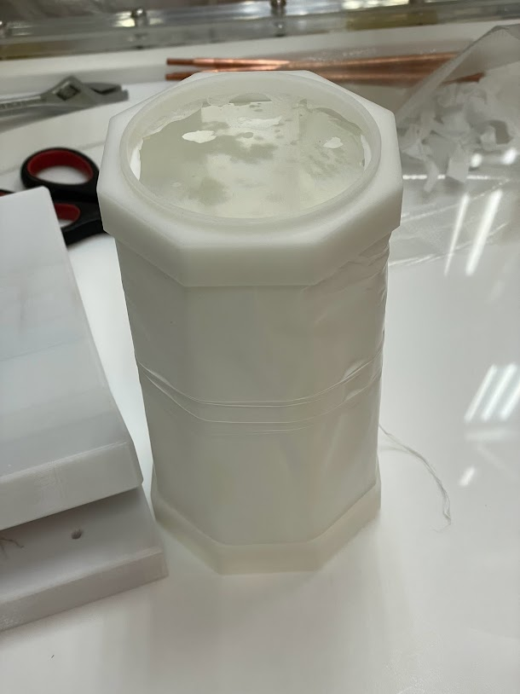
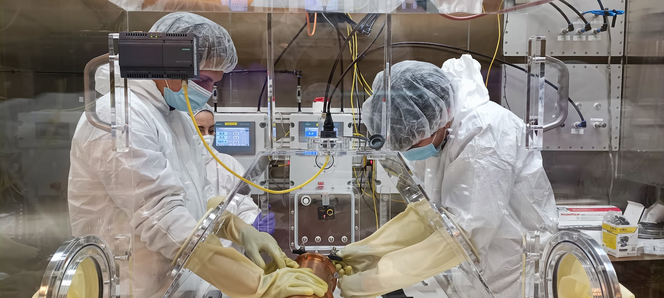

Slide 17
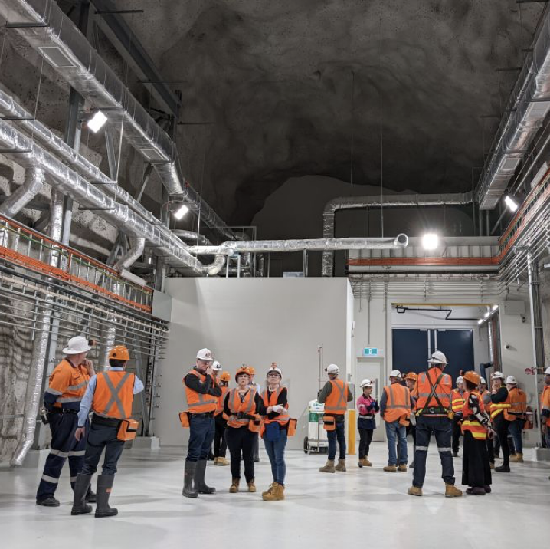
Stawell Underground Physics Laboratory (SUPL) and
SABRE-South
SUPL is in an advanced outfitting phase with 2900 m.w.e. overburden
SABRE-South
  Same detector module concept
  Common DAQ and simulations
  Same crystals
  Active veto with LAB from JUNO
    From MC simulations efficiency to reject ⁴⁰K is 85.4%
    <10% background from non-crystal sources in ROI

Slide 18
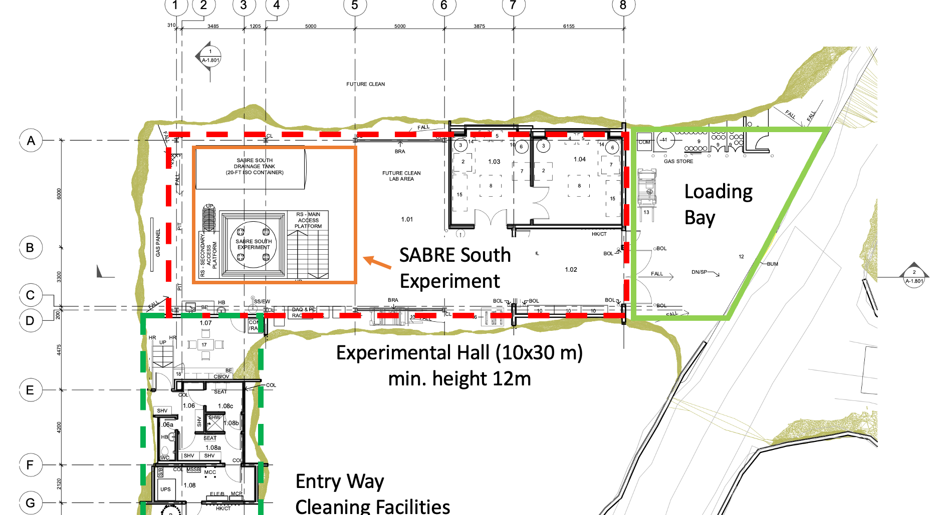
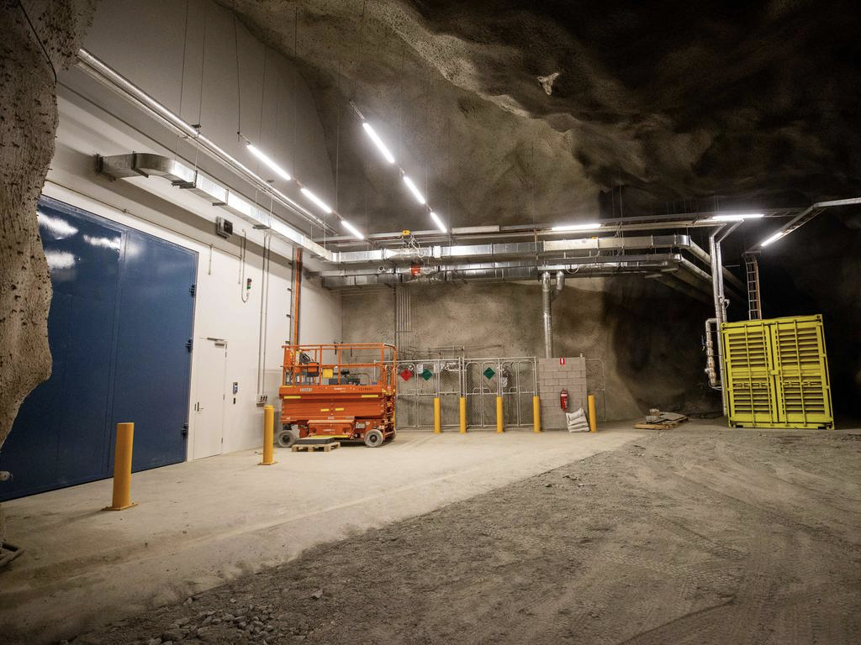
SUPL

Slide 19
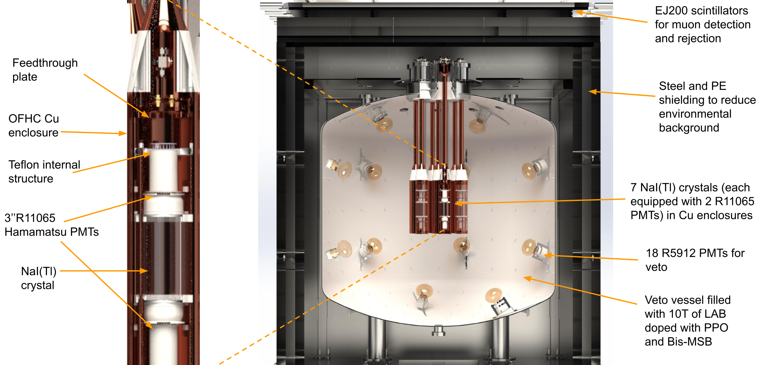
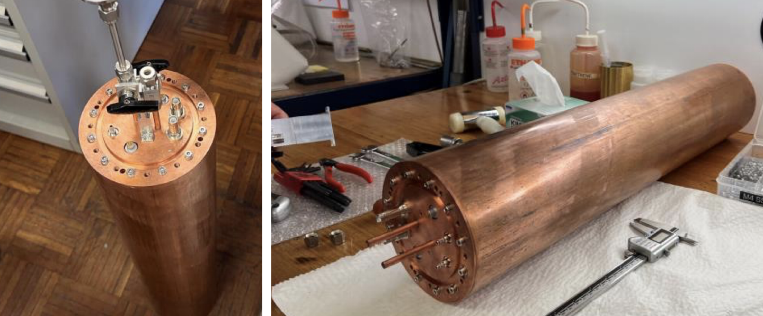
SABRE-South detector
50 kg x 3 yr

Slide 20
Conclusions
The main goal of SABRE is to deploy two nearly identical detectors in the Northern and Southern Hemispheres
SABRE aims to focus on ultra-high purity NaI(Tl) detectors (0.1-0.3 dru in the ROI)
  Currently, four crystals underground at LNGS
  Two more crystals foreseen by 2023 to complete crystal characterization prior to production
By 2023 finalize the strategy for crystals mass production for both SABRE-North and SABRE-South
  We aim to demonstrate that ZR is a key technique for ultra-high radio-purity NaI-based detectors
SABRE-South full detector deployment by mid 2024
SABRE-North new underground site outfitting by 2024

Slide 21
Publications
SABRE: A new NaI(Tl) dark matter direct detection experiment, Physics Procedia 61 ( 2015) 169 – 178
The SABRE project and the SABRE Proof-of-Principle, Eur.Phys.J.C 79 (2019) 4, 363
Monte Carlo simulation of the SABRE PoP background, Astropart.Phys. 106 (2019) 1-9
Growth of ultra-high purity NaI(Tl) crystals for dark matter searches, Phys.Rev.Res. 2 (2020) 1, 013223
Characterization of SABRE crystal NaI-33 with direct underground counting, Eur.Phys.J.C 81 (2021) 4, 299
Zone Refining of Ultrahigh-Purity Sodium Iodide for Low-Background Detectors, Phys.Rev.Applied 16 (2021) 1, 014060
High sensitivity characterization of an ultrahigh purity NaI(Tl) crystal scintillator with the SABRE proof-of-principle detector, Phys.Rev.D 104 (2021) 2, L021302
Performance of the SABRE detector module in a purely passive shielding, Eur.Phys.J.C 82 (2022) 12, 1158
SABRE-South simulation paper submitted to EPJC. https://arxiv.org/abs/2205.13849

Slide 22
Thank you!

Slide 23
Ongoing activities for 2023
Characterization of NaI-35 and NaI-37 at LNGS
Performed several assembly activities to test different PTFE reflectors
and enclosure design in an underground Radon-free clean room
Ugrade of zone refiner at MELLEN
Outfitting laboratory space at RMD for zone refining and tests for growth after zone refining
Start feasibility study with APL Engineered Materials, Inc. for high-purity powder production
Outfitting of SUPL and deployment of SABRE-South detector, almost completed
Fluid handling and shielding construction for SABRE-South

