Slide 1


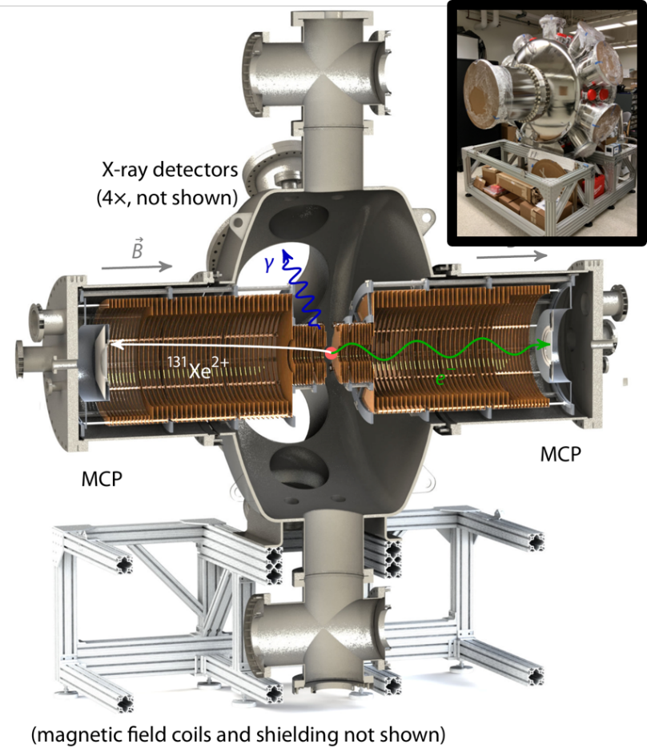


The HUNTER Sterile Neutrino Search
Temple University: C.J. Martoff, V. Palmaccio
UCLA: P. Hamilton, E. Hudson, P.F. Smith, E. Chang, S. Khamis, C. Schneider (now JPL)
Princeton U.: P. Meyers
Hebrew Univ. of Jerusalem: G. Ron, A. Prosnyakov
U. Houston: A. Renshaw, F. Malatino
Theory Collaborators:
UCLA: G. Gelmini, A. Kusenko;
UCI: K. Abazajian
See details in C. J. Martoff et al, Quantum Sci. Technol. 6, 024008 (2021)

Slide 2


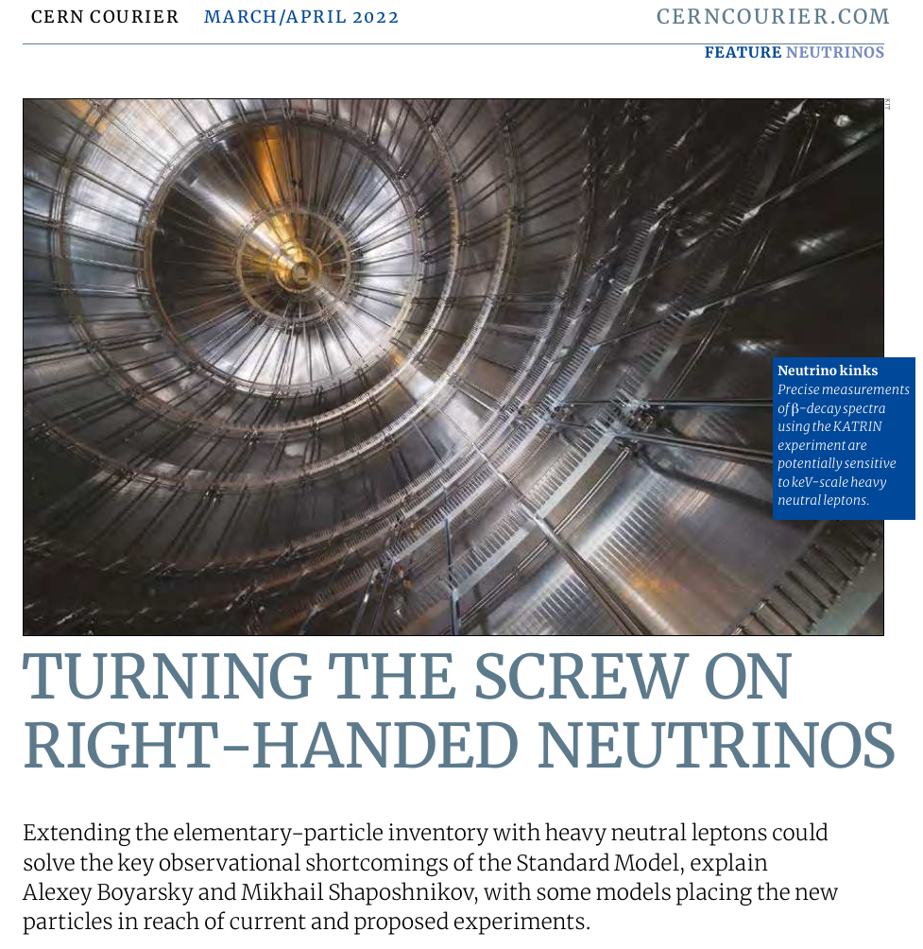
Outline
HUNTER
“... many astrophysical observatories, however,... will not be able to determine the particle origin of this signal. Thus, complementary laboratory searches are needed. One experimental proposal that claims a sufficient sensitivity to enter into the cosmologically relevant region is HUNTER, based on radioactive atom trapping and high-resolution decay-product spectrometry.”

Slide 3
Outline
Outline
Why heavy neutrinos?
HUNTER concept
Current status / future reach

Slide 4
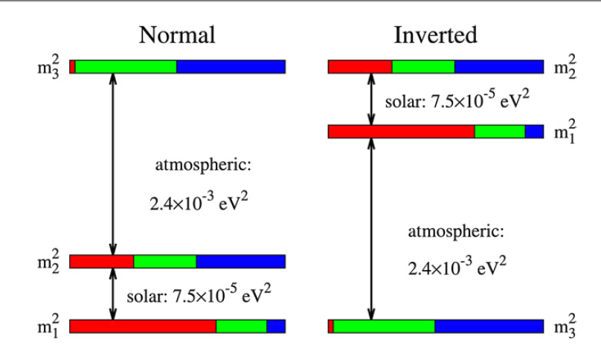

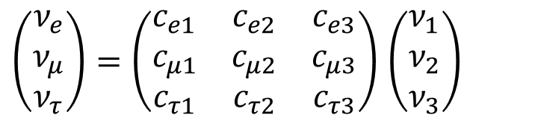
Outline
Two weird facts about neutrinos
Where art thou right-handed neutrinos?
Flavor eigenstates aren’t mass eigenstates
Left
handed
right
handed
$$e μ τ$$
“Mixing” matrix
MISSING
$\left(\begin{matrix}ν_{e} \\ ν_{μ} \\ ν_{τ}\end{matrix}\right)=\left(\begin{matrix}c_{e1} & c_{e2} & c_{e3} \\ c_{μ1} & c_{μ2} & c_{μ3} \\ c_{τ1} & c_{τ2} & c_{τ3}\end{matrix}\right)$ $\left(\begin{matrix}ν_{1} \\ ν_{2} \\ ν_{3}\end{matrix}\right)$
Unseen in existing neutrino interactions

Slide 5
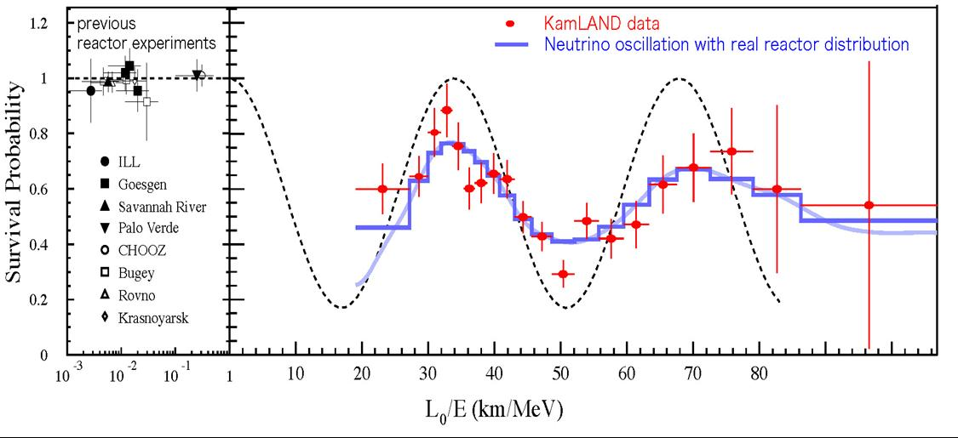
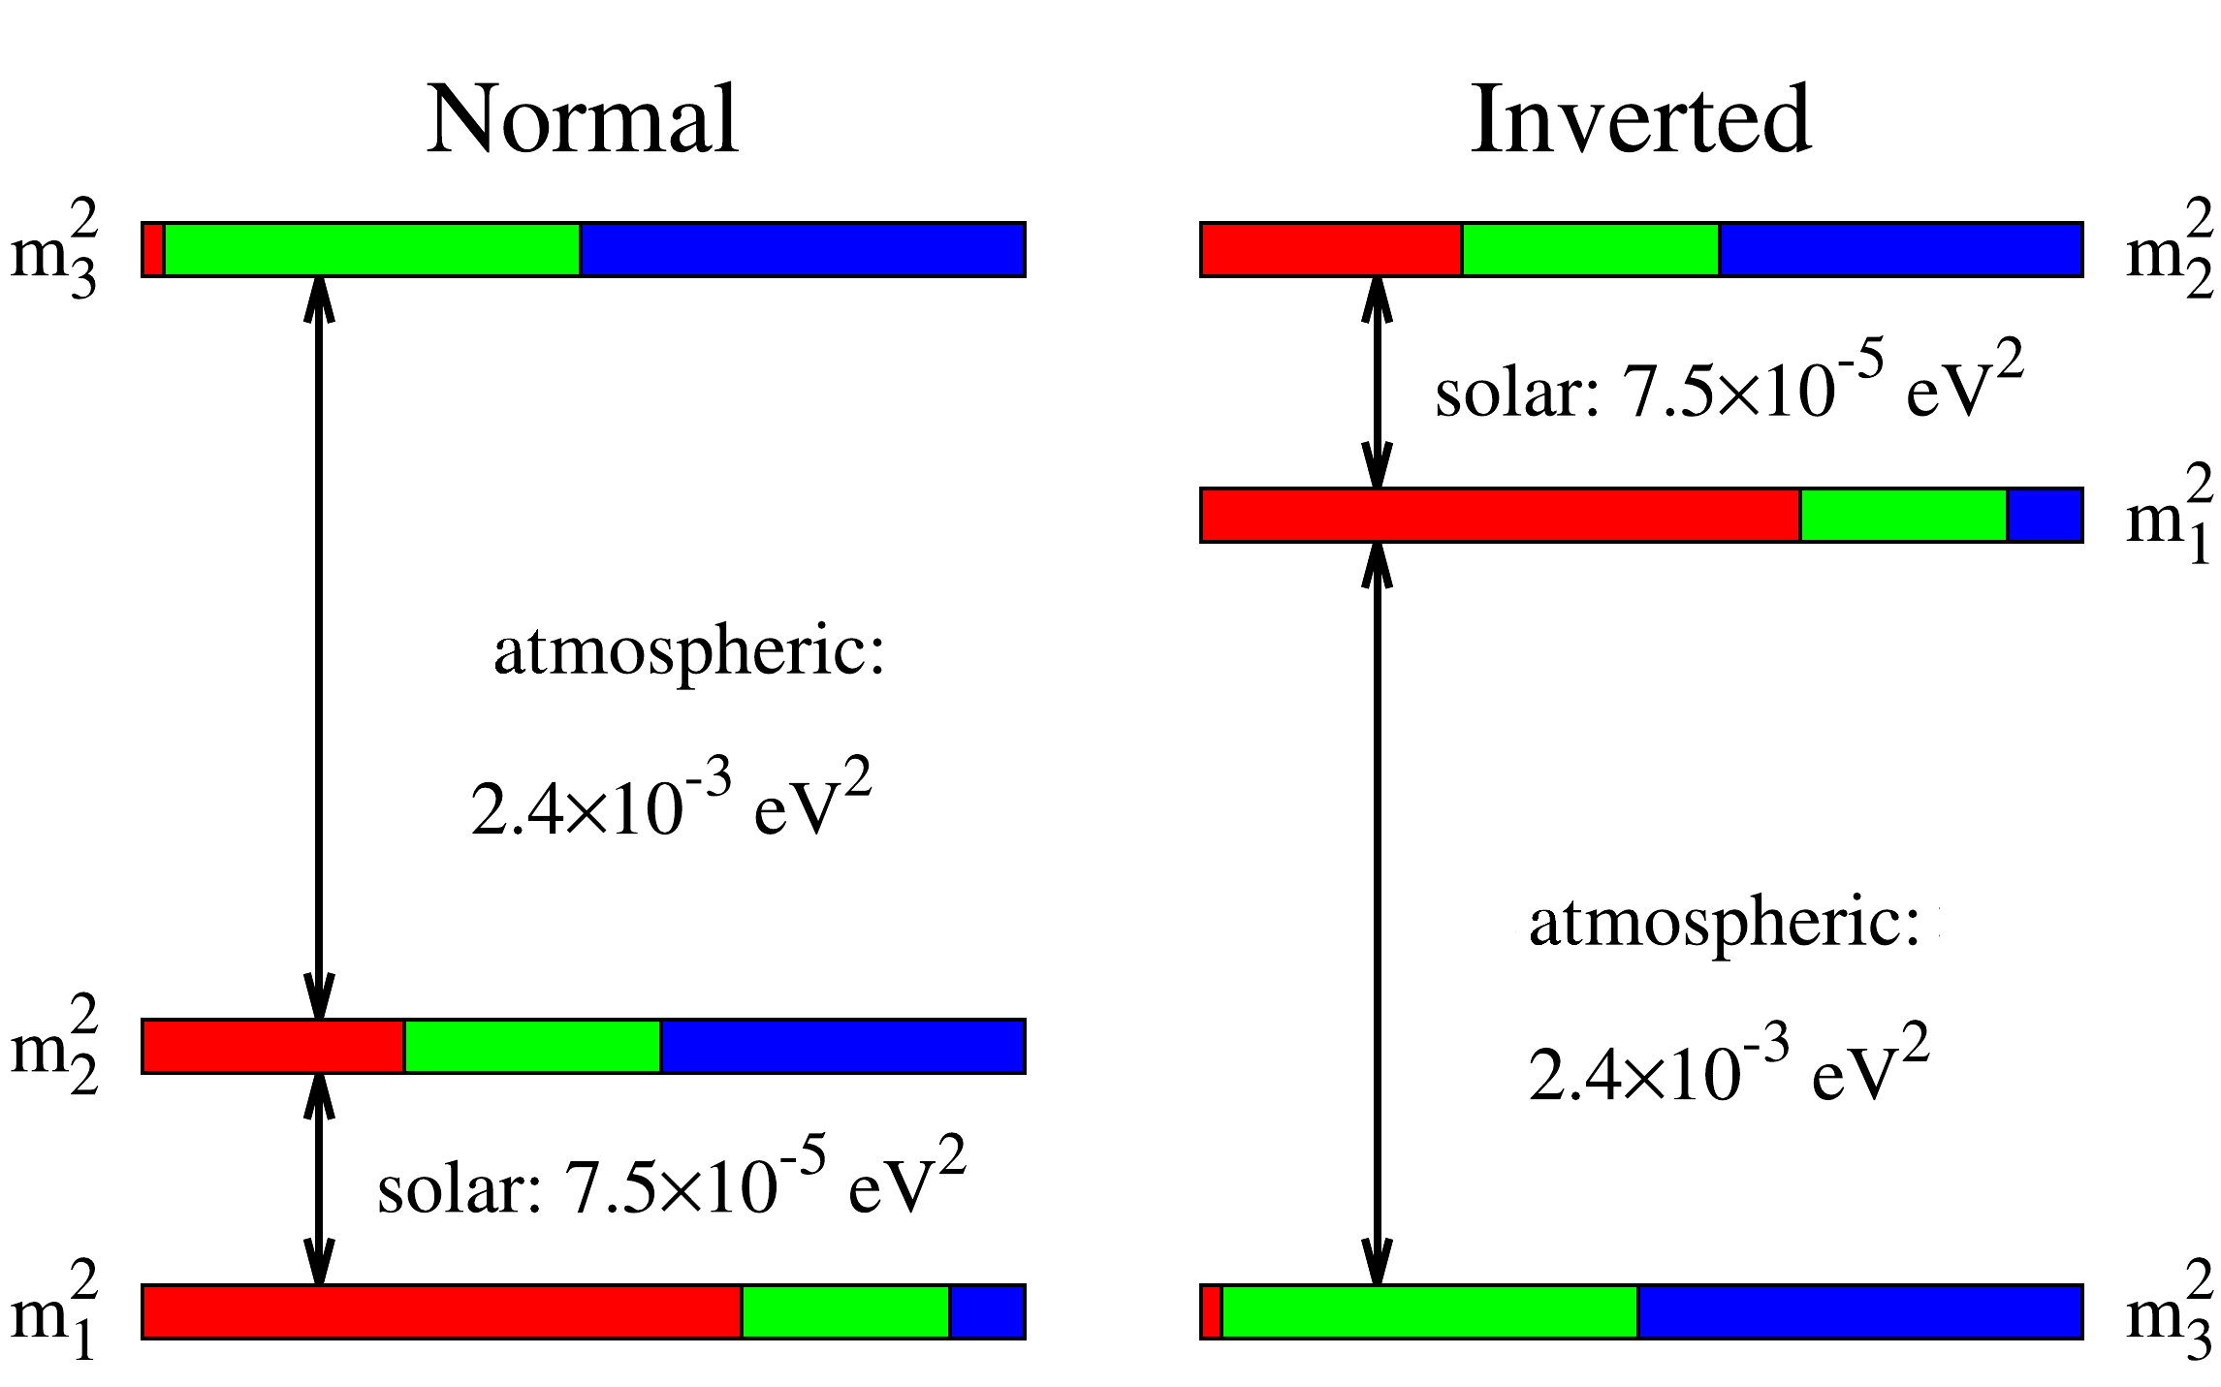
Outline
The problem of non-zero mass
Neutrino oscillation (flavor changing via mixing)
is the only firm laboratory observation of BSM physics.
amplitudes → mixing angles
periods → mass² differences
Known for 30 years, but the origin is still not explained.
HOWEVER...
PDG “Neutrino Masses, Mixing, and Oscillations”...
14.2 Extending the Standard Model to Introduce Massive Neutrinos; From the above discussion we conclude that it is not possible to construct a renormalizable mass term for the neutrinos with the fermionic content and gauge symmetry of the SM. The obvious consequence is that in order to introduce a neutrino mass in the theory one must extend the particle content of the model, depart from gauge invariance and/or do both.

Slide 6
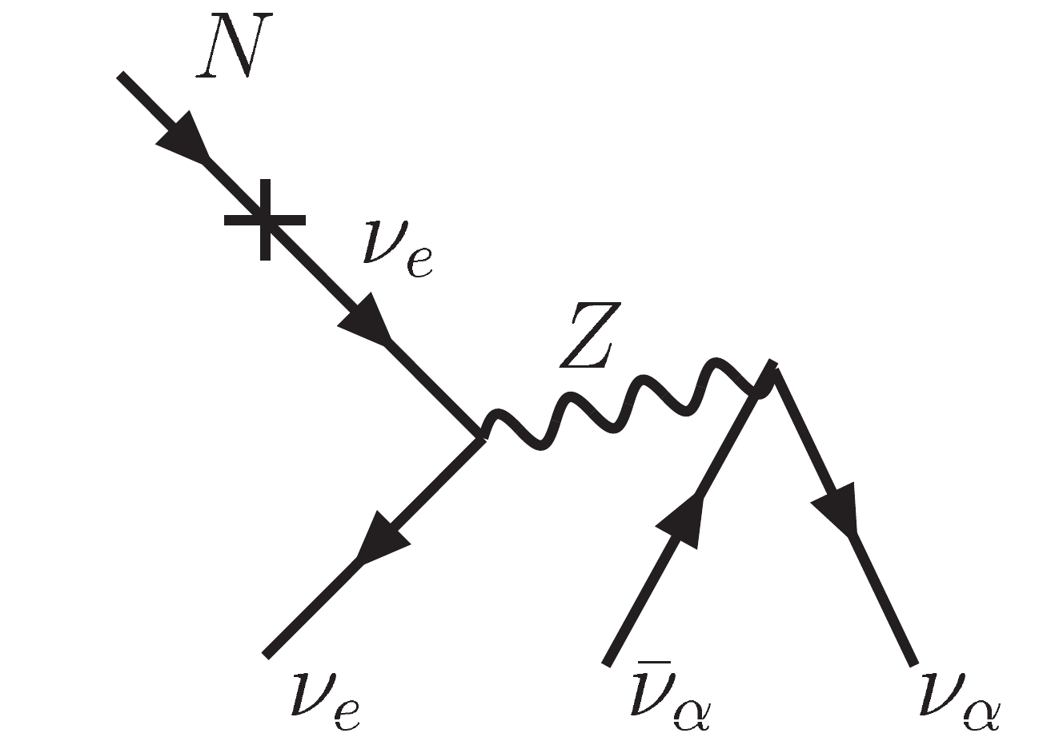

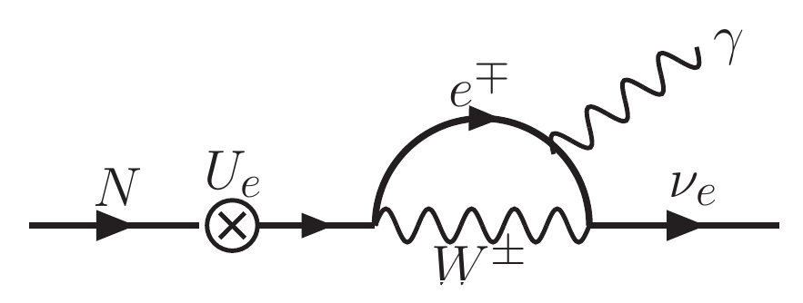
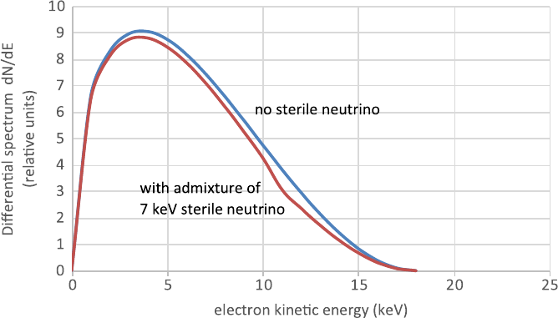
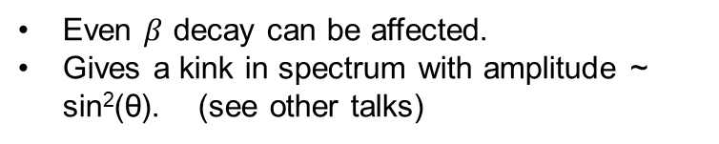
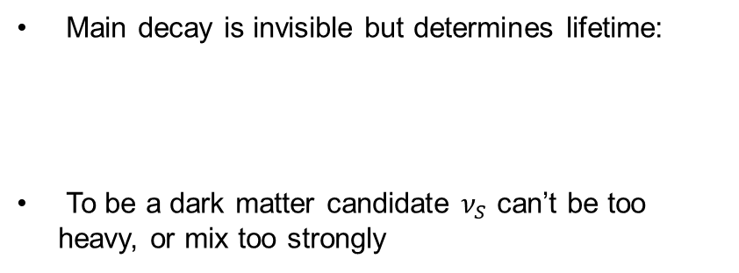
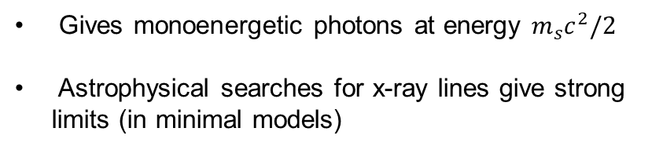
Outline
Sterile Neutrino Interactions
Main decay is invisible but determines lifetime:
To be a dark matter candidate $ν_{S}$ can’t be too heavy, or mix too strongly
Gives monoenergetic photons at energy $m_{s}c^{2}/2$
Astrophysical searches for x-ray lines give strong limits (in minimal models)
Even $β$ decay can be affected.
Gives a kink in spectrum with amplitude ~ sin²(θ). (see other talks)

Slide 7
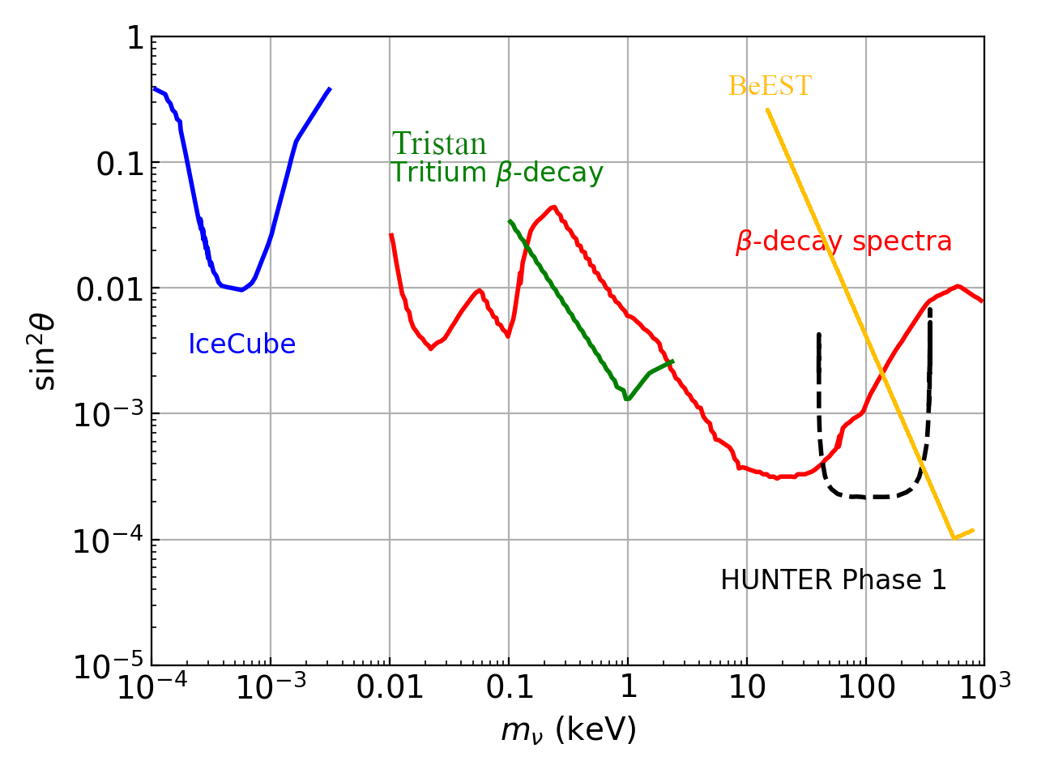
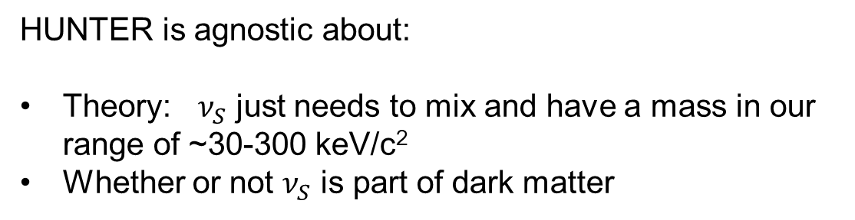
Outline
Summary of existing lab limits
HUNTER is agnostic about:
Theory: $ν_{S}$ just needs to mix and have a mass in our range of ~30-300 keV/c²
Whether or not $ν_{S}$ is part of dark matter

Slide 8
Outline
Outline
Why heavy neutrinos?
HUNTER concept
Current status / future reach

Slide 9
Outline
HUNTER concept
Heavy Unseen Neutrinos by Total Energy-momentum Reconstruction
Measure the mass of an unseen neutrino in K-capture decay
electron
neutrino
X-ray photon
Auger electron
K-shell
recoil
Proton in nucleus
absorbs K-shell
atomic electron
Neutrino emitted
Nucleus recoils
X-ray emitted
Auger electrons emitted
Measure momentum of ion, X-ray, and electron to calculate neutrino momentum and mass
Cloud of ¹³¹Cs atoms
laser cooled in vacuum
Sterile neutrinos can be produced up to
to Q value of decay (350 keV for ¹³¹Cs)
Fraction of heavy decays events gives coupling
1 mm

Slide 10
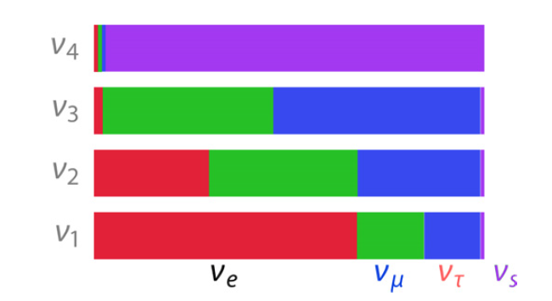
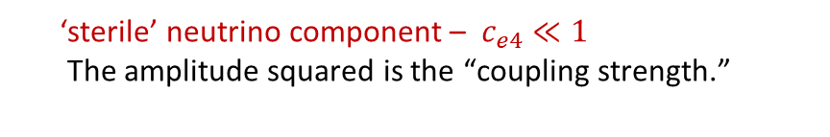
What does a sterile neutrino look like?
recoil
‘electron neutrino’
ν_{e} = c_{e1}ν₁ + c_{e2}ν₂ + c_{e3}ν₃ + c_{e4}ν₄
standard neutrino mass states
‘sterile’ neutrino component – $c_{e4}≪1$
The amplitude squared is the “coupling strength.”
The “normal” electron neutrino is a superposition of mass states including components of possible sterile neutrinos.

Slide 11
HUNTER concept
Reconstructed mass spectra:
trigger X-ray p_{γ}
electrons p_{e}
standard neutrino events
at zero mass
ion p_{N}
No of events
neutrino
keV sterile ν_{s} seen as
separated population(s)
Mass reconstruction formula:
m_{ν}² = [Q - E_{e} - E_{γ} - E_{N}]² - [ p_{γ} + p_{e} + p_{N}]²
0 50 100 200
missing energy missing momentum
reconstructed mass² (keV²)
• Separated population of sterile neutrino events
• Model independent
Kinematic reconstruction idea:
S. Cook et al., PRD 46 R6 (1992)
G. Finocchario and R.E. Schrock, PRD 46 R888 (1992)

Slide 12
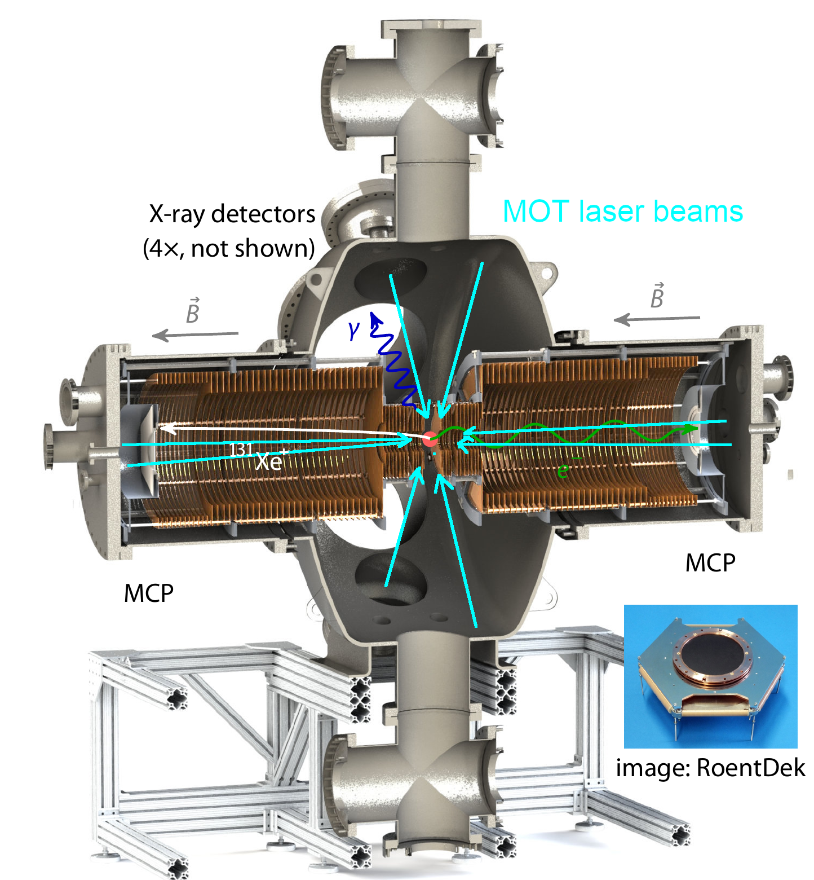
Outline
HUNTER spectrometer
Heavy Unseen Neutrinos by Total Energy-momentum Reconstruction
Kinematic reconstruction of “2-body” EC decay
  Measure all decay product momenta
  Reconstruct missing neutrino mass event-by-event
¹³¹Cs is held in a magneto-optical trap and laser cooled to 20 µK
Reaction Ion Microscopes measure recoil nucleus and Auger electron momenta with high efficiency & resolution 0.1-1%
3 m

Slide 13
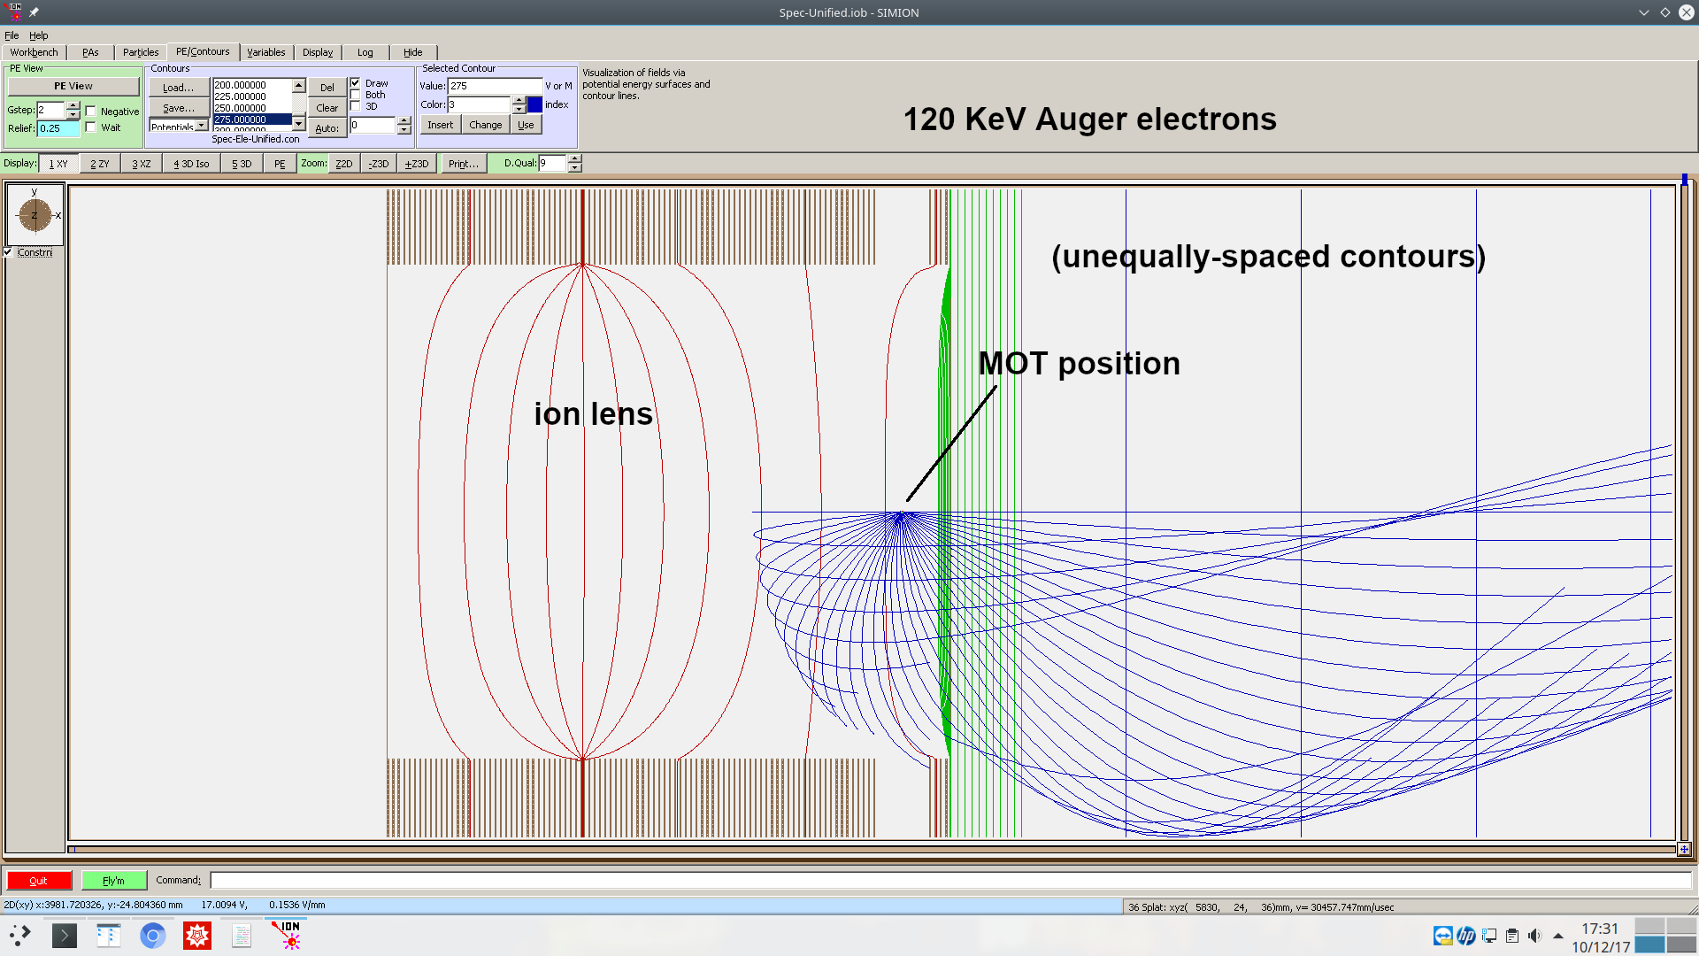
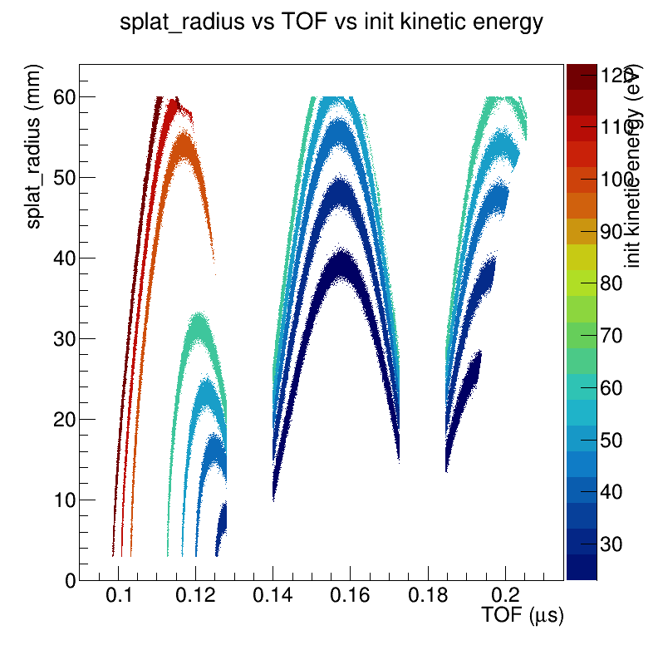
Outline
Spectrometer simulation
To satisfy resolution requirements,
HUNTER double-focusing RIMs
are perhaps the world’s largest.
Design process based on full 3-D
simulations done at Temple:
3-D E maps from SIMION
3-D B maps from COMSOL
Particle tracking by GEANT4
Analysis with ROOT

Slide 14
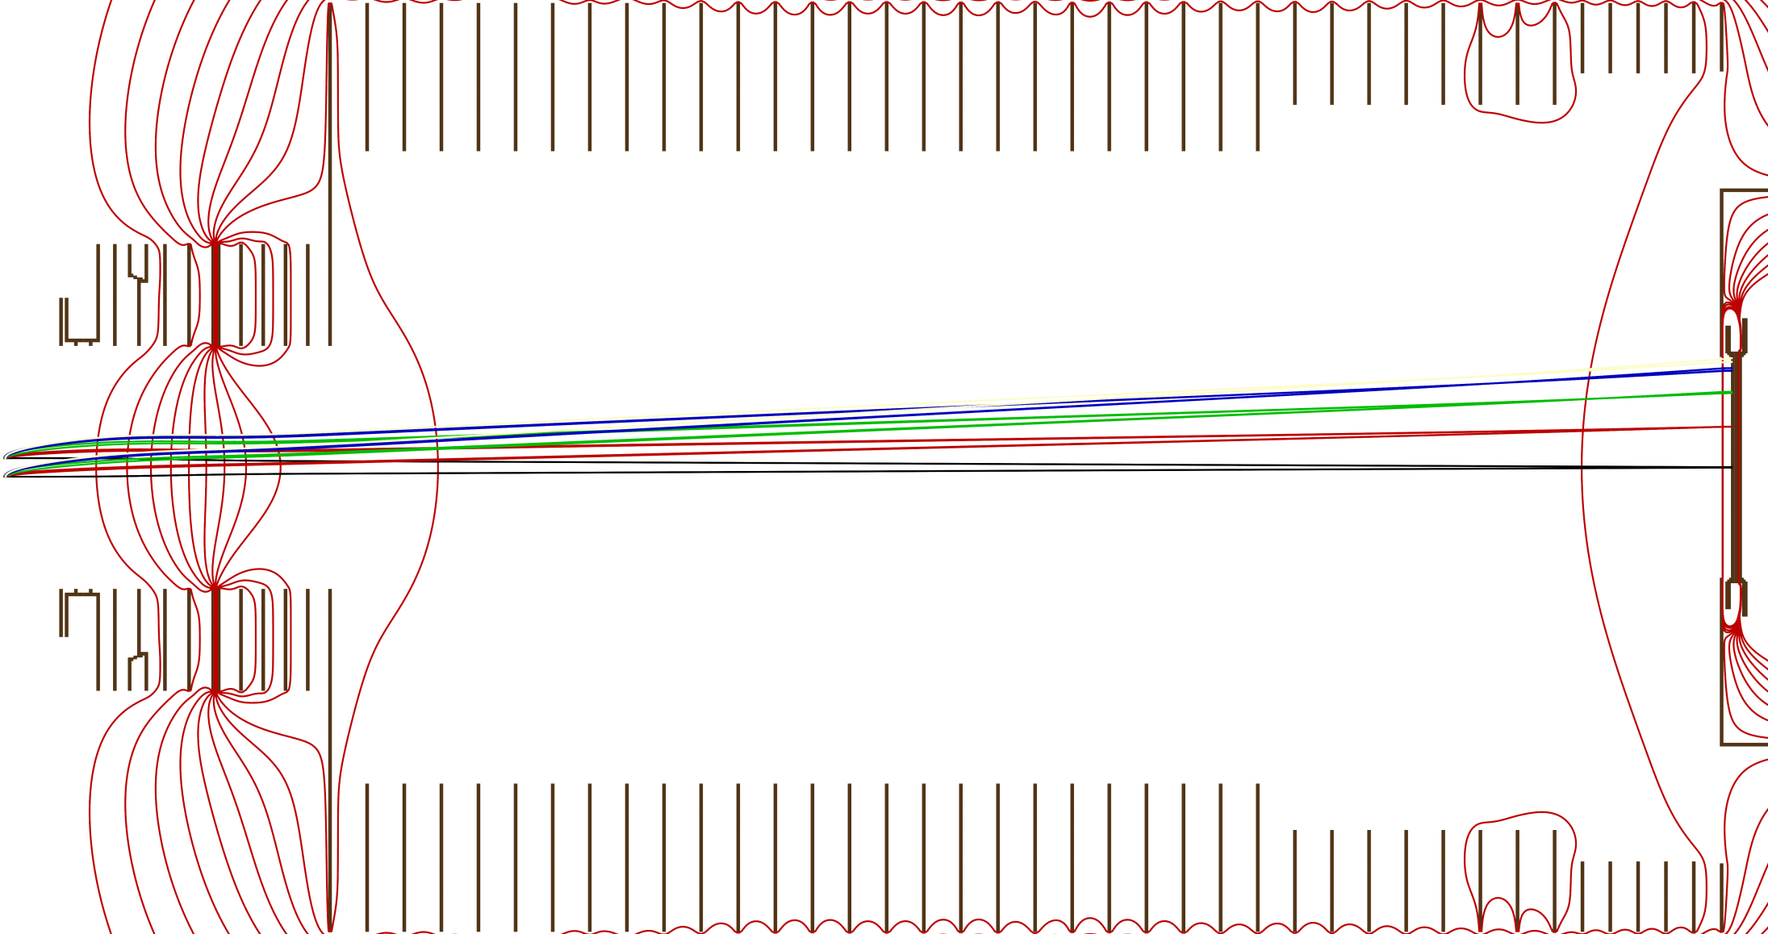
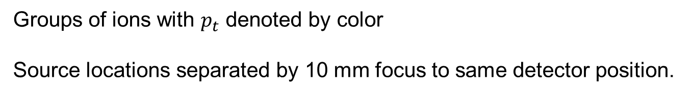
Outline
Example: Transverse focusing
Groups of ions with $p_{t}$ denoted by color
Source locations separated by 10 mm focus to same detector position.

Slide 15
Outline
Radioactive isotope choice
Desired properties of nuclear isotope:
  Electron capture: Simple kinematics allow reconstruction
  Laser coolable species: Low initial kinetic energy
  t_{1/2}> 1 day (no accelerator beam – for now)
  Isotope availability (medical – for now)
From >60 possible nuclides to essentially only one meets requirements:
¹³¹Cs
Ref: Peter F Smith 2019 New J. Phys. 21 053022

Slide 16
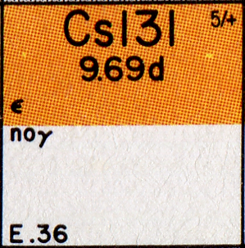
Outline
¹³¹Cs Decay
t_{1/2}=9.7 days, 100% electron capture,
Q_{EC}=355 keV
131-Cs -> 131-Xe (stable)
+ ν
+ x-rays (4-35 keV)
+ Auger e⁻'s (3-150 eV)
No penetrating radiation, no radioactive daughter.
Commercially available
$10K/order + $1K/Ci

Slide 17
Outline
Outline
Why heavy neutrinos?
HUNTER concept
Current status / future reach

Slide 18
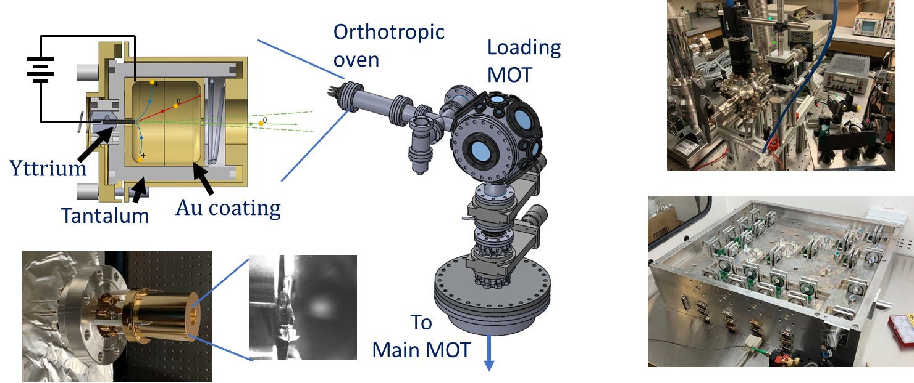
Outline
^{131,133}Cs magneto-optical trapping
Modular oven design complete for easy reloading.
Ultrastable laser system with complete amplitude / polarization control for MOT control.
Notes:
Three main challenges. First two have been solved by others, the last one we know how to use. Hudson’s group has been working with thorium-229 and barium-133. (In fact, three weeks ago we demonstrated the first-ever laser cooling of Ba-133, 10 yr half life).

Slide 19
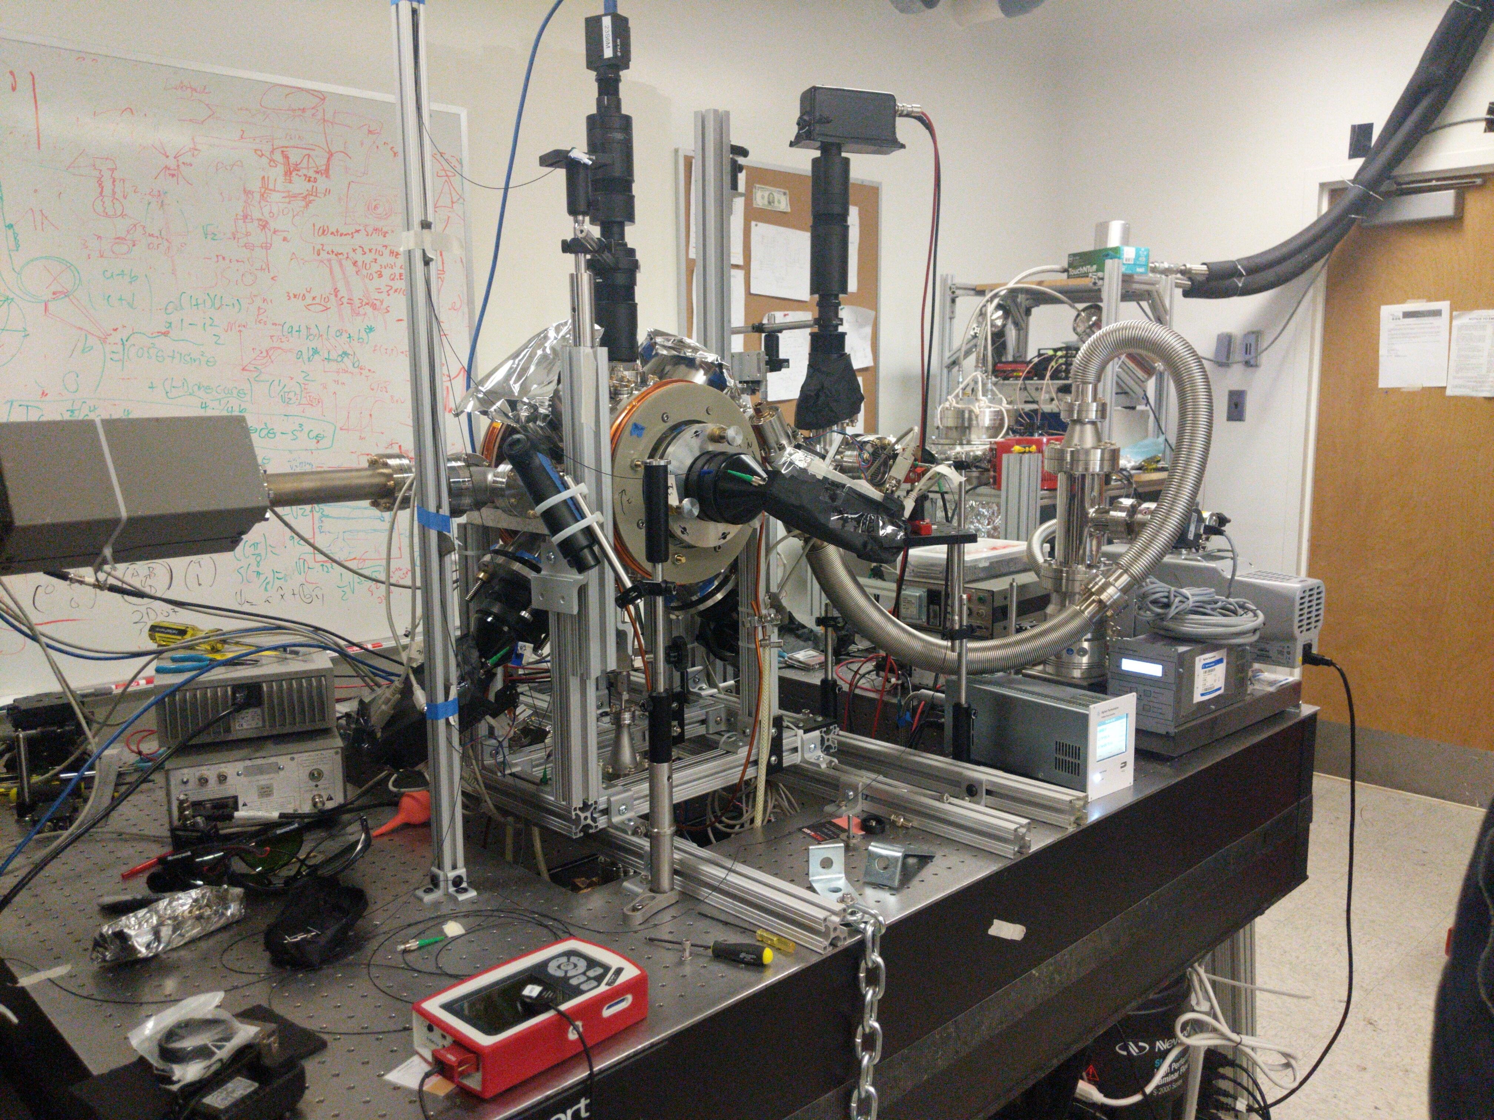
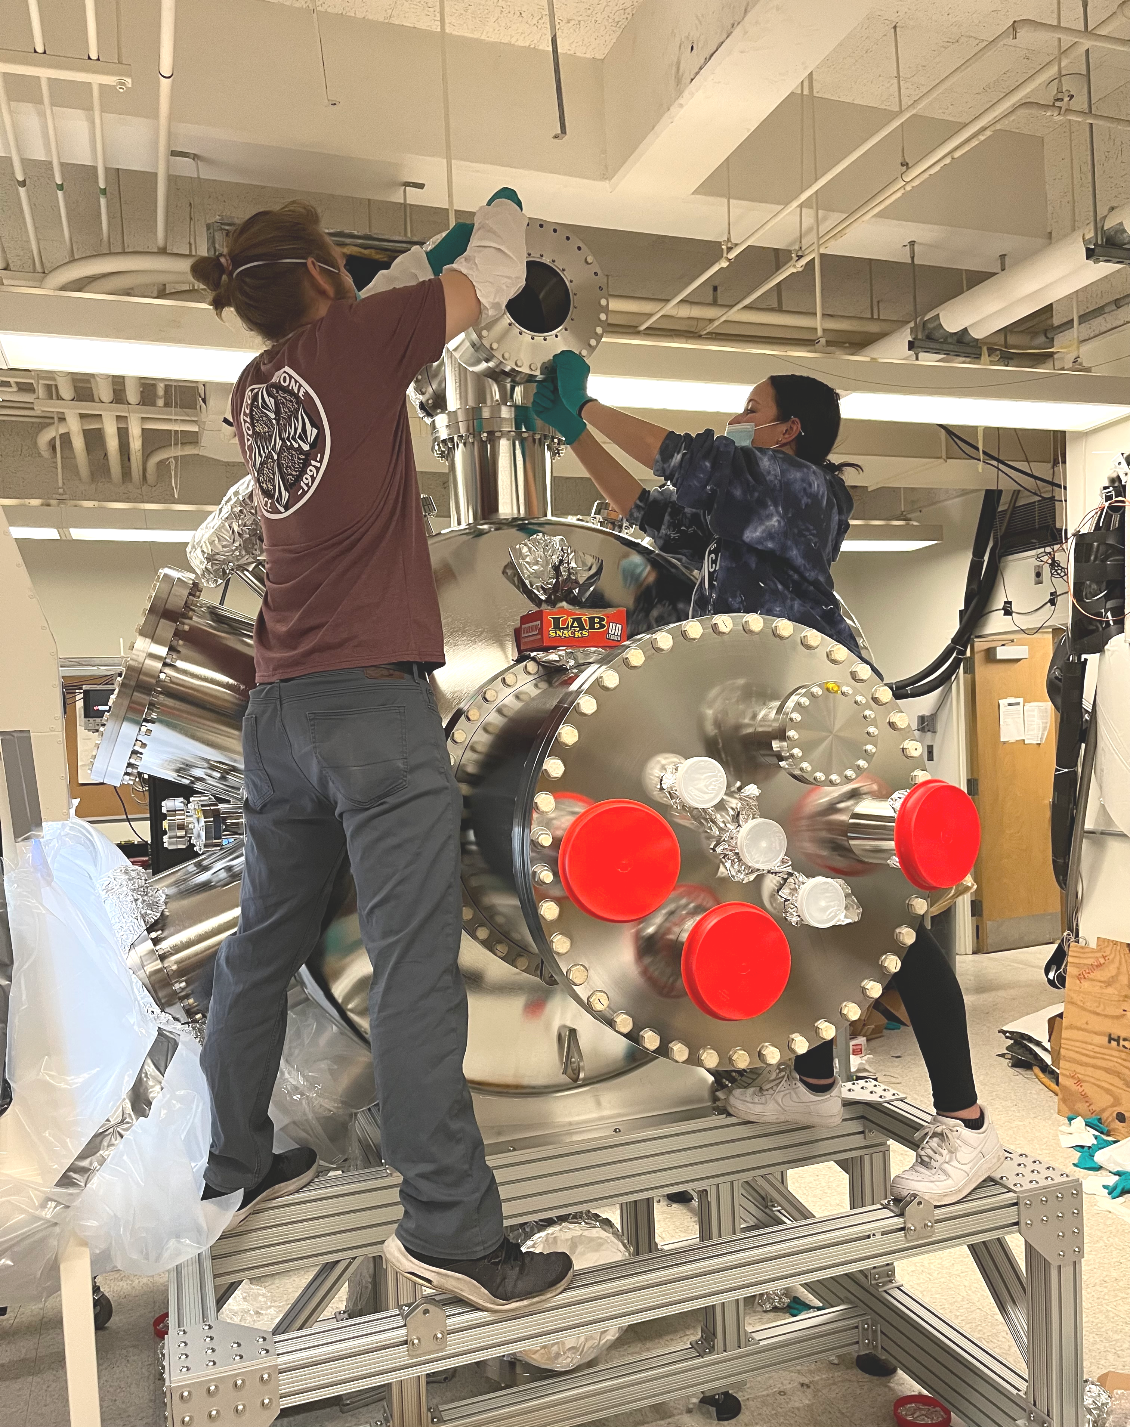
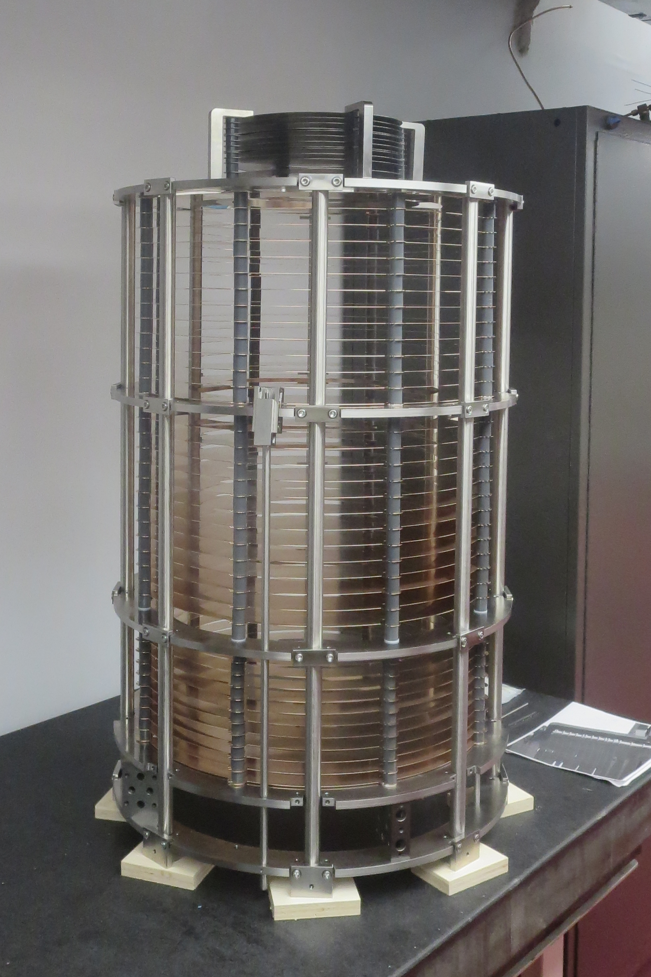
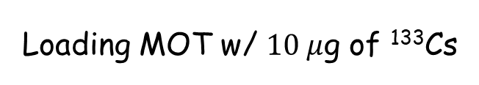
Outline
HUNTER assembly at UCLA
Loading MOT w/ $10 μ$g of ¹³³Cs
Spectrometer assembly
Vacuum vessel- now < 1e-8 mbar

Slide 20
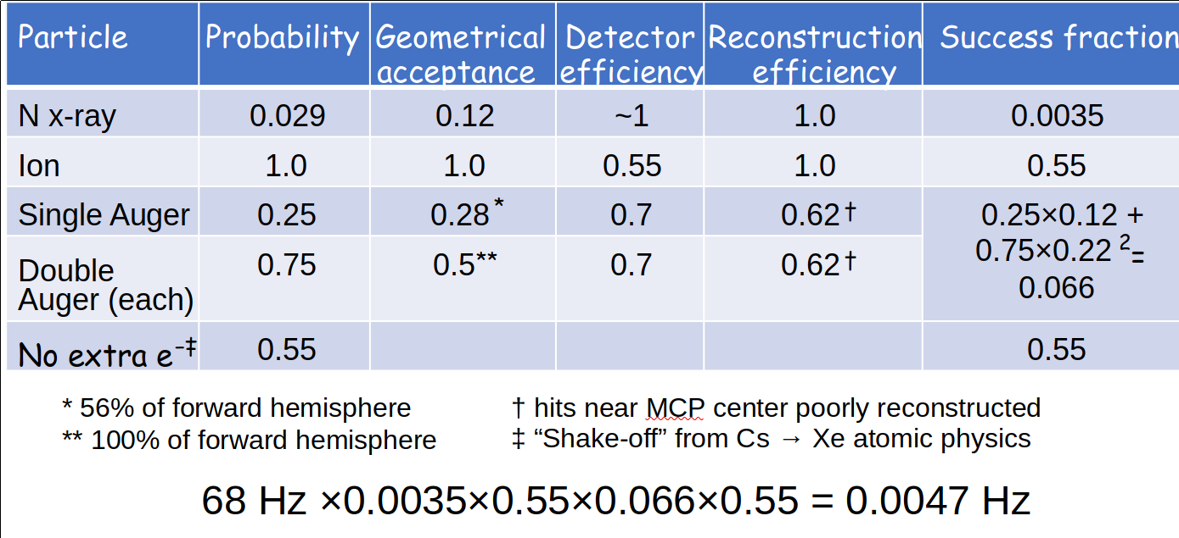
Outline
Projected ¹³¹Cs rates & efficiency
10⁸ trapped atoms, τ = 14 d → 80 Hz of decays => 0.85x80 = 68 Hz of K-captures
⟹ ~150,000 events per year of livetime

Slide 21
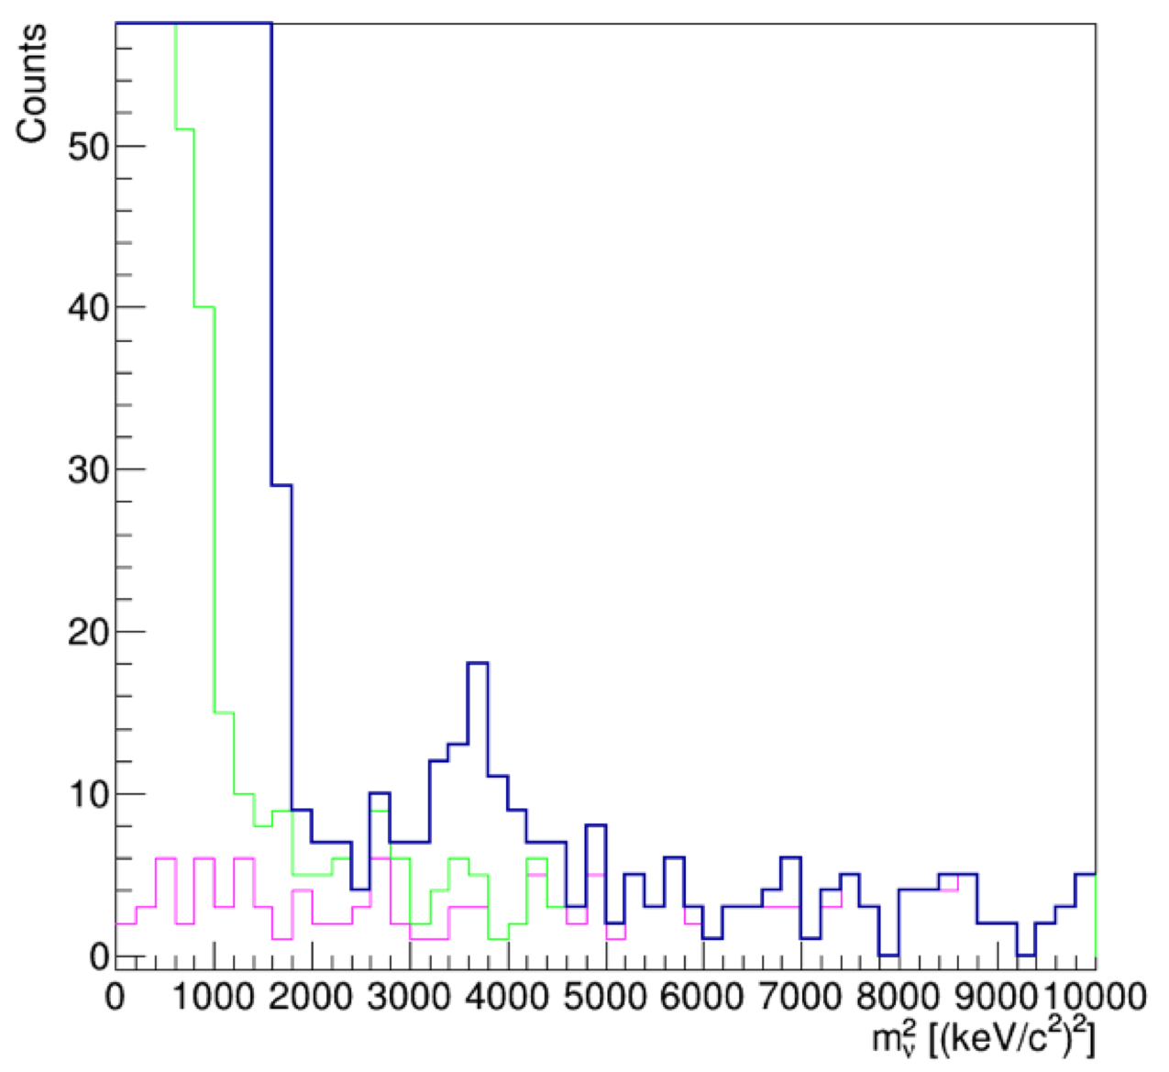
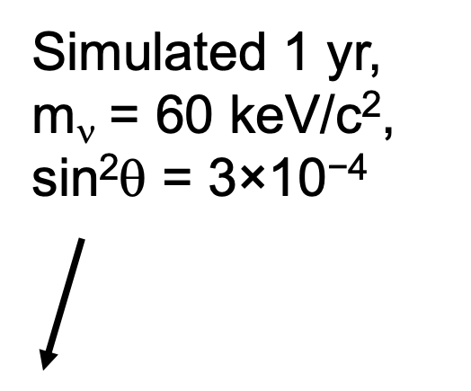
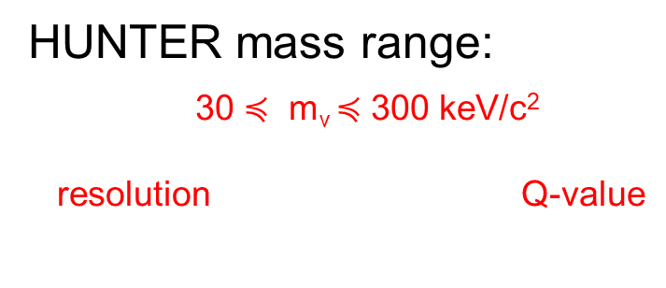
Outline
^{Projected HUNTER Reach}
Phase 1: Cost-limited Proof-of-principle and Science
40 sterile neutrino events gives 5σ peak
Using best estimates of backgrounds and a 1-year sample.
HUNTER mass range:
30 $≼$ m_{ν} $≼$ 300 keV/c²
resolution Q-value
Backgrounds discussed in Quantum Sci. Tech. 6, 024008 (2021)
Leading background: Scattering of Xe+ by Cs broadens zero-mass peak and contributes flat-ish background shown in green

Slide 22
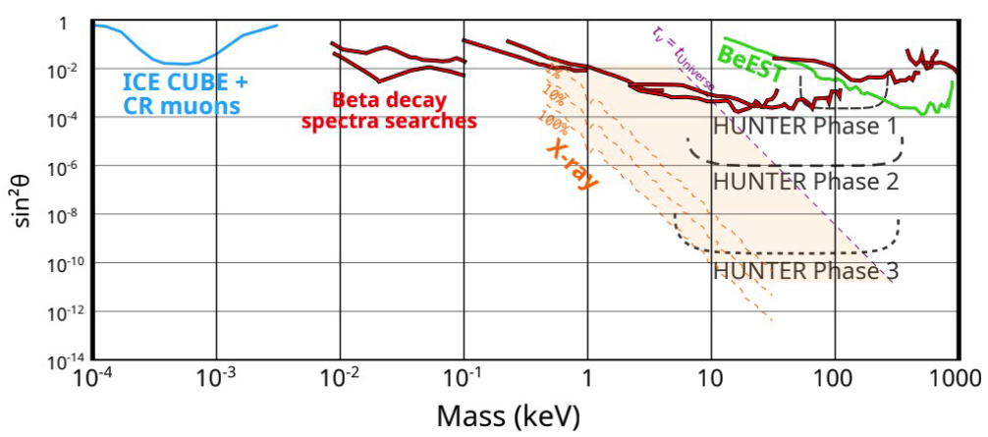
Outline
Projected sensitivity
Later phases increase acceptance with more detector coverage and progressive increases in trap population.
See: C J Martoff et al 2021 Quantum Sci. Technol. 6 024008

Slide 23
Outline
Other physics with HUNTER
HUNTER allows:
High resolution nuclear recoil detection
4π solid angle for angle-resolved detection of recoil ions
Large solid angle for low energy electrons
Nuclear polarization in the trap
Angle-resolved measurement of x-rays and electrons up to several hundred keV (energy range is upgradable)

Slide 24
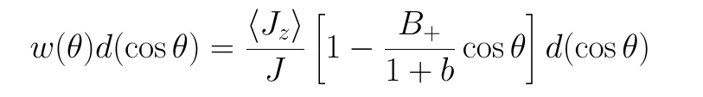
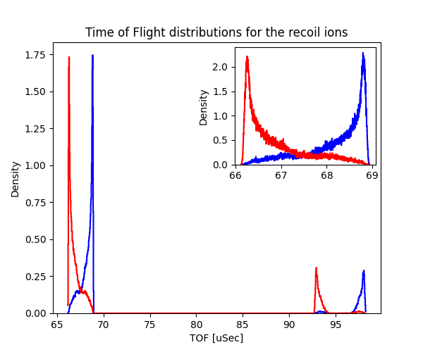
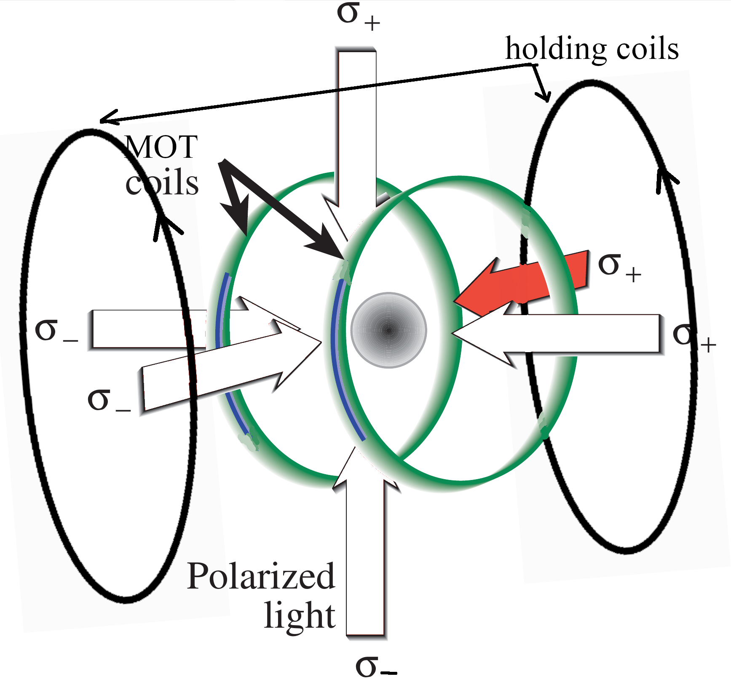
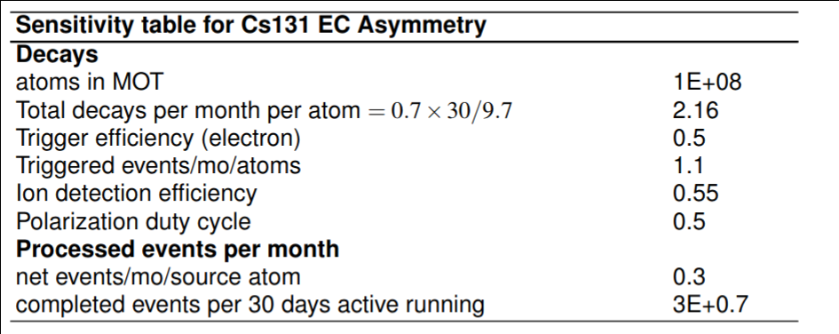
Outline
EC spin asymmetry
EC decay of polarized nuclei (Triemann 1958):
B₊ = beta decay spin asy. parameter
b = beta decay Fierz term
Polarize by optical pumping
Measure polarization optically
Shake-off e- trigger
Measure recoil nuclei only
Asymmetry by TOF or position
Alternate polarization axis/sense

Slide 25

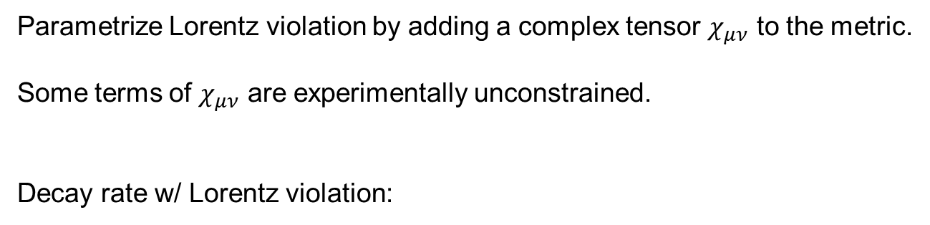
Outline
Lorentz violation in EC
(K. K. Vos, H. W. Wilschut, and R. G. E. Timmermans, Phys. Rev.C 91, 038501 (2015))
Parametrize Lorentz violation by adding a complex tensor $χ_{μν}$ to the metric.
Some terms of $χ_{μν}$ are experimentally unconstrained.
Decay rate w/ Lorentz violation:
s
k = neutrino momentum
I = nuclear spin
P ∝ polarization
Leads to an azimuthal asymmetry that rotates at sidereal rate!

Slide 26
Current Plan:
Source chamber:
Summer: MOT & precision hyperfine measurements of ¹³¹Cs
Fall: Decay asymmetry measurement
Main chamber:
Leak-check & pump-down complete
Summer: Mounting of spectrometers, x=ray detectors, coils & magnetic shield
End of year: first stable ¹³³Cs fill & calibration,
then ¹³¹Cs fill
This mounting & integration time is an exciting time for HUNTER.
We are always seeking additional collaborators with expertise and new ideas!

Slide 27
Outline
Improving Sensitivity
Increase detection efficiency (rate and coupling)
                Scale the number of detectors to increase surface coverage
        New detector technology to detect X-ray and Auger e⁻ in same device
        Increase number of atoms in MOT (higher radioactivity limits)
Improve timing resolution (mass resolution)
    Faster electronics: Digitize all channels with sub-nanosecond resolution, commercial device ($1,000s per channel)
    Or home-built DAQ system from UH, spin-off from ongoing PET scanner project (~$50 per channel!)
Improve position resolution (mass resolution)
    SiPM arrays with smaller individual SiPM sizes available
    Readout individual SiPMs instead of rows and channels
    Less effective than above, since limited by source size

Slide 28
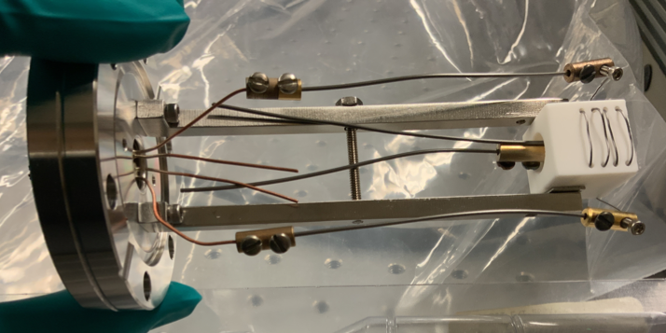
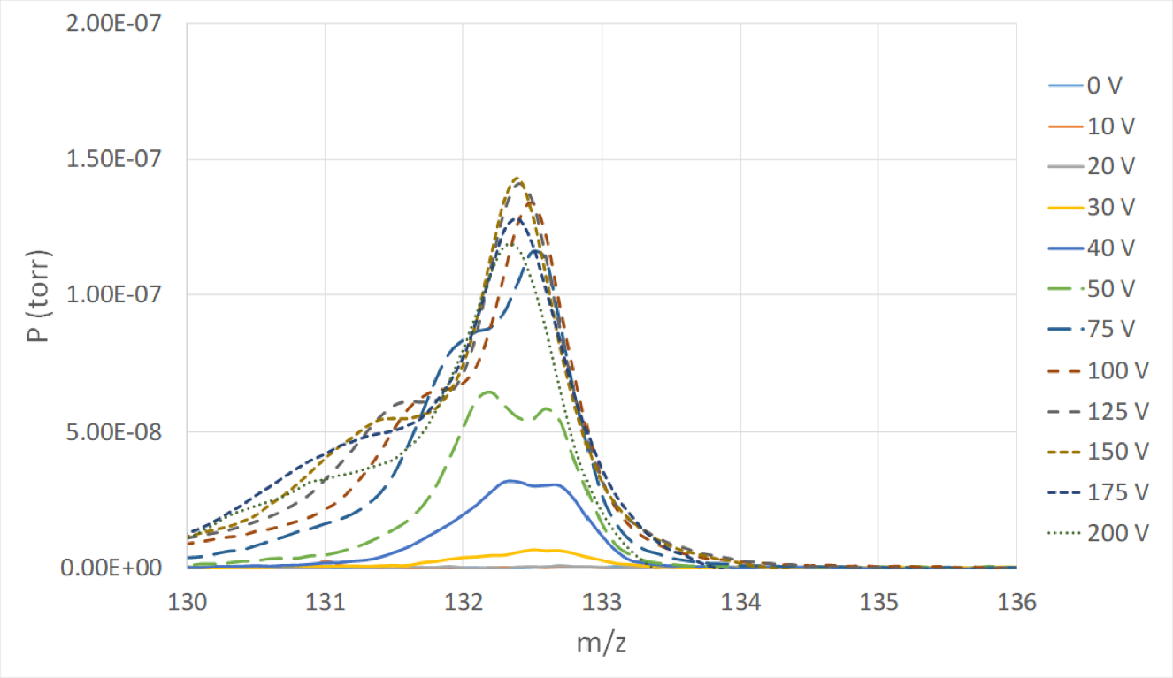
Cs-131 MOT: High Efficiency source
CsCl in H2O
Prototype oven:
Loaded with “Fake” radioactive solution
Atomic Cs flux measured w/RGA
Bias controls flux

