Slide 1
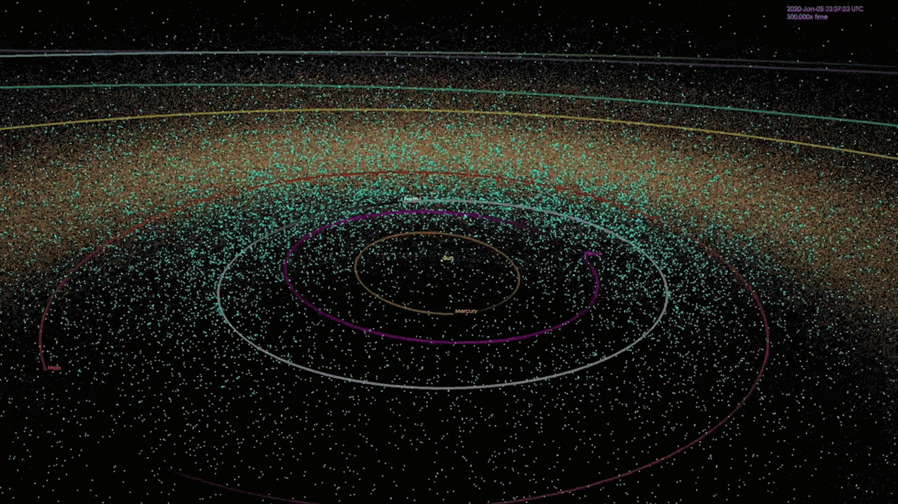
The Elusive Universe:
New Precision Frontiers
Credit: NASA/JPL-Caltech
Yu-Dai Tsai
University of California, Irvine (yudait1@uci.edu)
A recorded talk with more details at IAS [link]
2112.07674 (Nature Astronomy 22), 2107.04038 (JCAP 23), 2210.03749

Slide 2
The Elusive Universe
Underlying
Theory
Neutrino
Gravity
The rest of the
Standard Model
Particles
feeble interactions
Dark Matter
What I have been thinking
about for the past decade

Slide 3
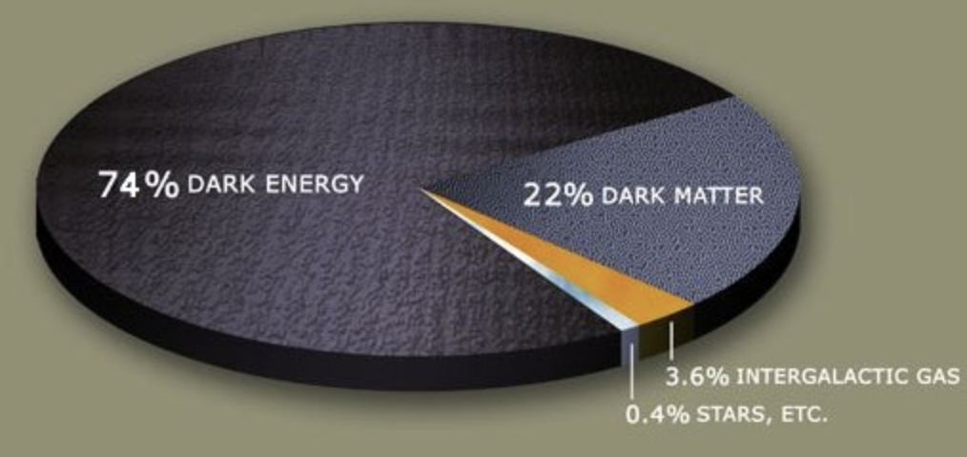
Explore the Elusive Universe
(Related to Gravity)
NASA/public domain
Most of the universe is not fully understood
We won’t stop until we understand all of it

Slide 4
Strong Probes of the Elusive Universe
Coupling Strength
Energy
The rest of the
Standard Model (SM)
String Theory,
Standard-Model Extension,
Grand Unification (GUT),
etc.
Higgs
Mass
Precision
Intensity
Planetary Data
Space Missions
Quantum Sensors
…
LHC Forward Physics Facility
FORMOSA, FerMINI, LongQuest
Neutrino Experiments
…
HEP Theory & Cosmology
DM Models, …
Gravity
(e.g., General Relativity
Gravitational waves)
Neutrino
HEP Theory
Cosmology
DM Models
…
Dark Matter
Yu-Dai Tsai (UC Irvine)

Slide 5
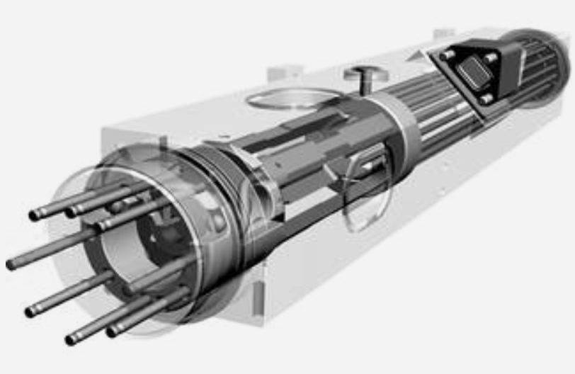
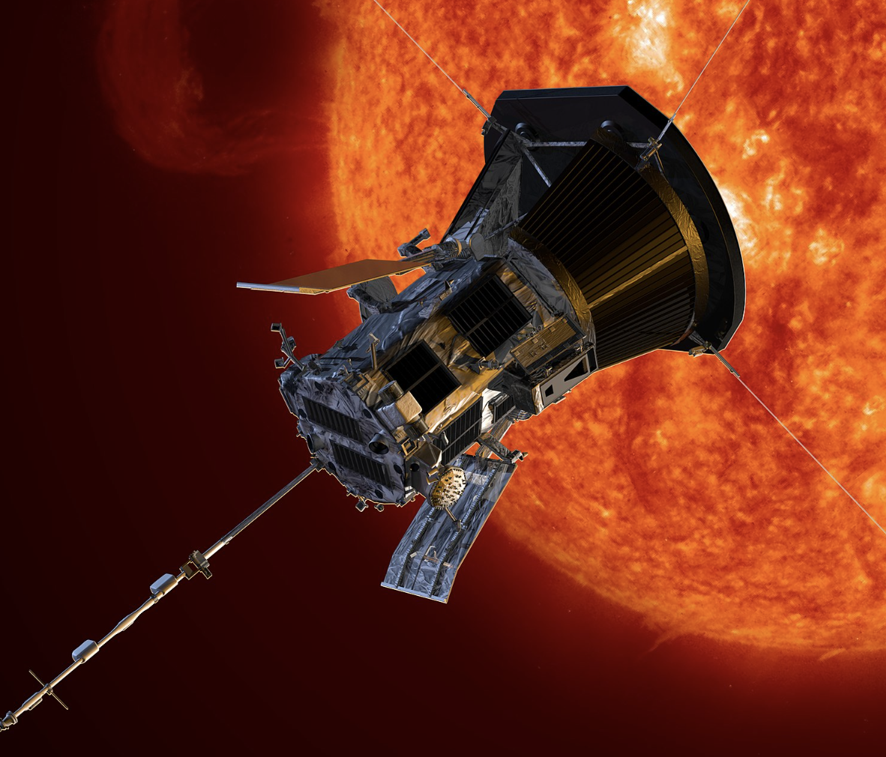

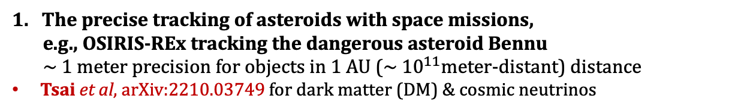
Novel Directions at the Precision Frontier
New technologies with many practical applications. Keep us safe & punctual!
1. The precise tracking of asteroids with space missions,
e.g., OSIRIS-REx tracking the dangerous asteroid Bennu
~ 1 meter precision for objects in 1 AU (~ ${10}^{11}$meter-distant) distance
Tsai et al, arXiv:2210.03749 for dark matter (DM) & cosmic neutrinos
2. The precise time keeping (e.g., NASA Deep Space Atomic Clock)
lose 1 second every 10 million years
Tsai, Eby, Safronova, Nature Astronomy (2022)
for ultralight dark matter (ULDM) searches
Searching for ultralight DM bound to Sun
NASA/Clare Skelly
Parker Solar Probe
Theme of this talk:
Bridging High Energy Theory, Precision Astronomy, & Space Quantum Technology!

Slide 6
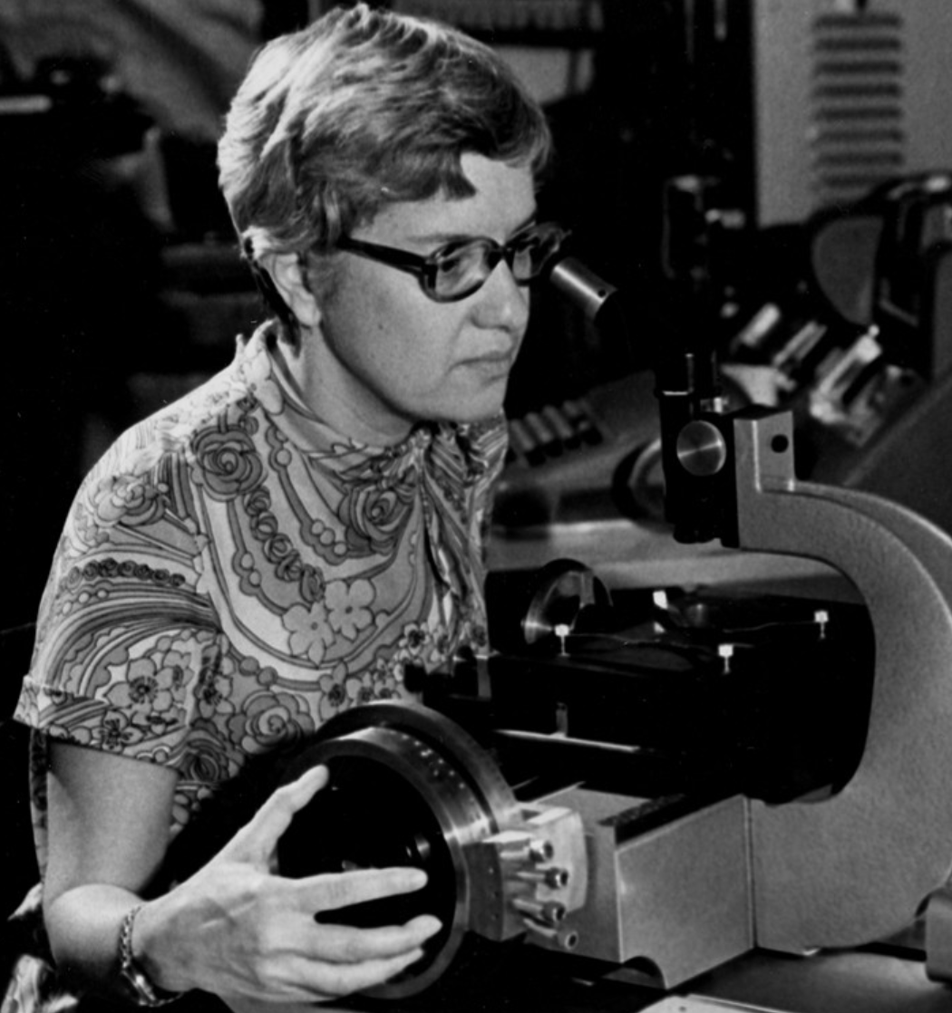
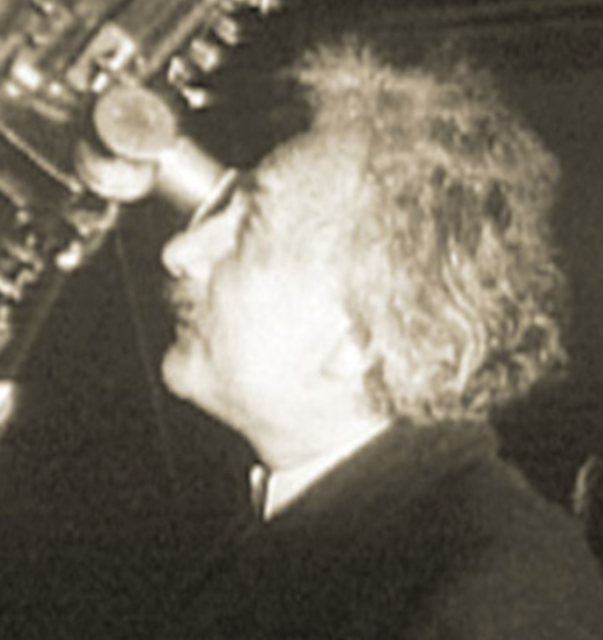
Outline
Precision Astrometry:
Dark Matter & Cosmic Neutrinos
Space Quantum Probe for Ultralight Dark Matter
Vera Rubin
Carnegie Institution for Science
Albert Einstein
Mount Wilson Observatory, California

Slide 7
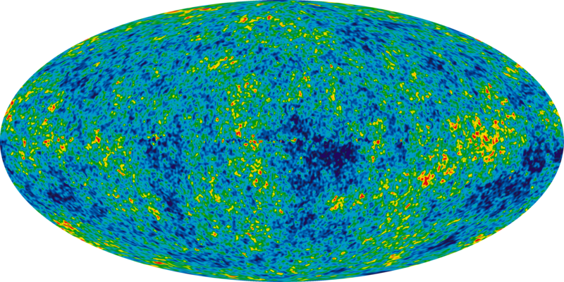
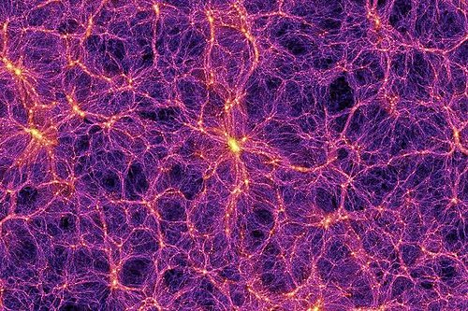
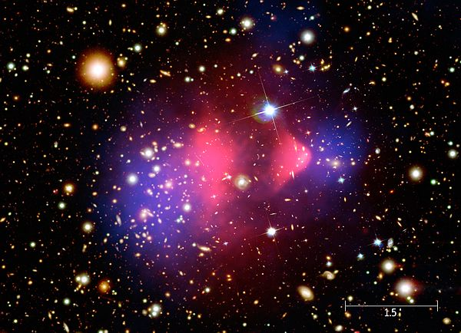
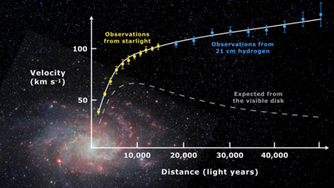
How do we know dark matter exist?
Size
Cosmic Microwave Background
Credit: NASA / WMAP
Large Scale Structure
Credit: Springel et al. 2015 (10-100 Gpc)
DM
Gravitational
Interactions
Bullet Cluster Merger
Credit: NASA/CXC/M. Weiss (Gpc)
Galactic Rotation Curves
Credit: De Leo-Winkler(10 kpc)
Modified from a slide from Tien-Tien Yu (U. of Oregon)

Slide 8
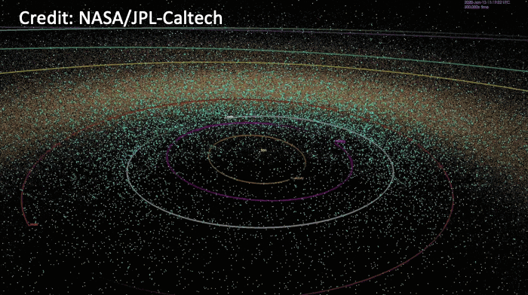
DM Gravity in Smaller Scale?
Size
DM Gravitational Interactions
Precision Astrometry
Mechanical Sensors
Tsai et al., arXiv:2210.03749
(under review by Nature Astronomy)
See, e.g., Carney, Lang et al.
Quantum Sci. Technol. 2021, Rafael’s talk on Saturday

Slide 9
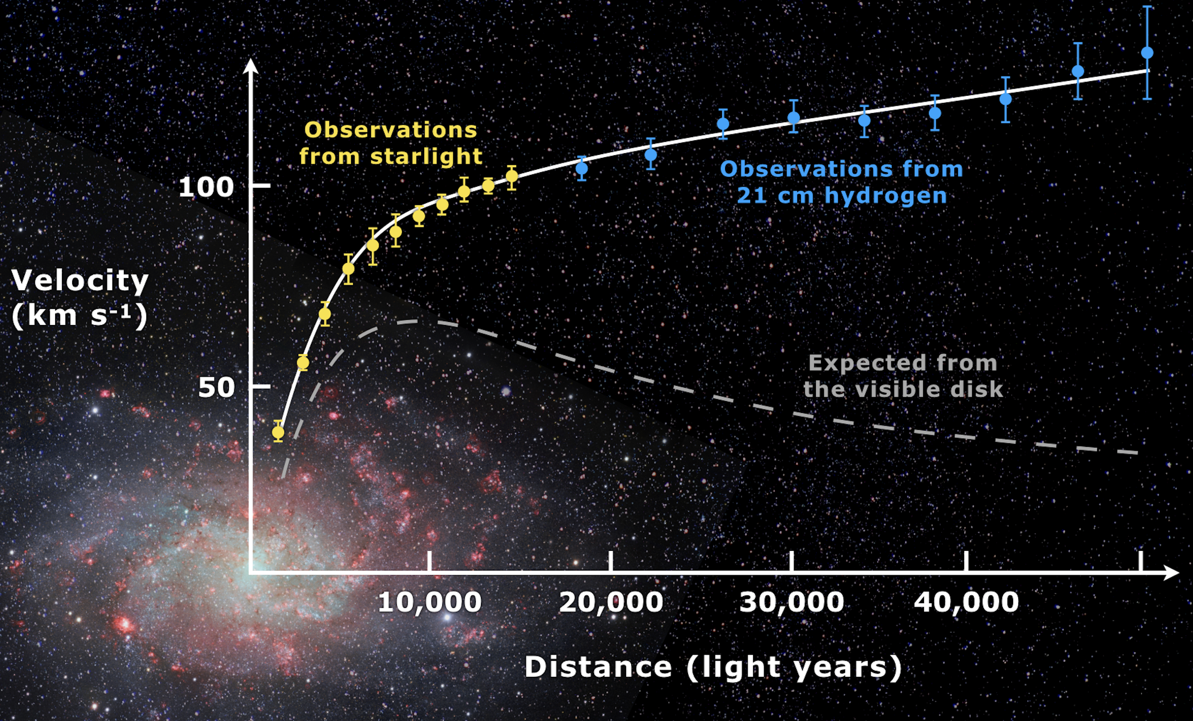

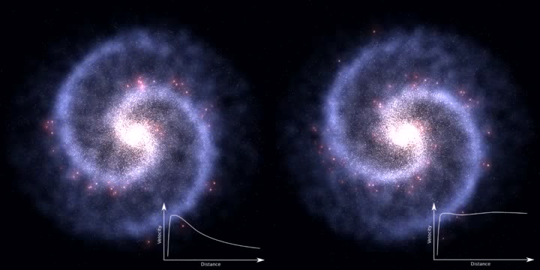
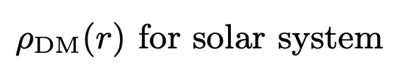
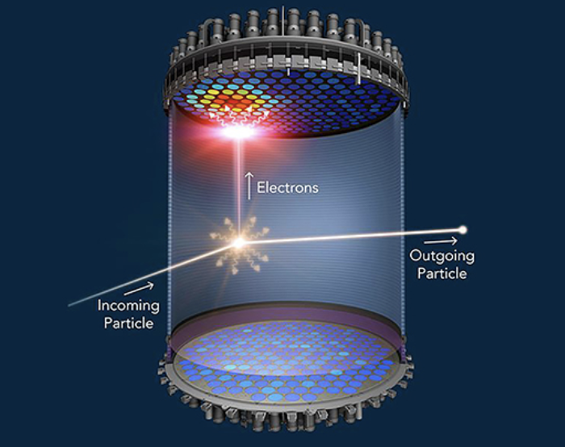
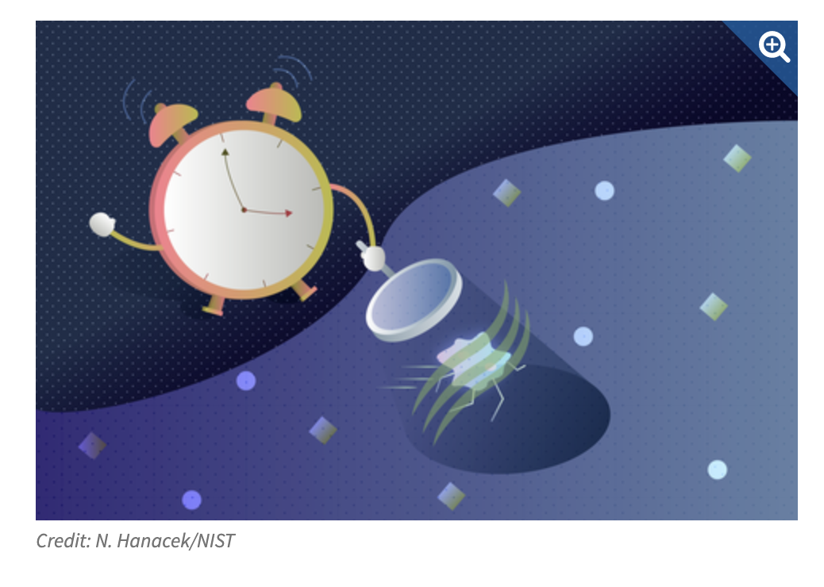
A question we asked
Mario De Leo-Winkler (University of California, Riverside)
Vera Rubin
From: https://en.wikipedia.org/wiki/File:Galaxy_rotation_under_the_influence_of_dark_matter.ogv
under the Creative Commons Attribution-Share Alike 3.0 Unported license.
Stars
Credit: NASA/JPL-Caltech
Crucial for Direct Detection of DM
Wave-like DM
Particle-like DM
Solar System Objects
N Hanacek/NIST
Credit: Xenon 1T Col.
Yu-Dai Tsai (UC Irvine)

Slide 10
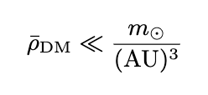

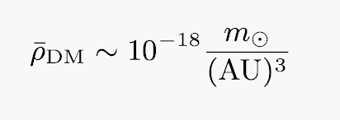

A question we asked
Mario De Leo-Winkler (University of California, Riverside)
Stars
Credit: NASA/JPL-Caltech
,
${\overline{ρ}}_{DM}$ = 0.3 GeV/${cm}^{3}$
Velocity measurements ineffective
We need to go beyond it!
Solar System Objects

Slide 11

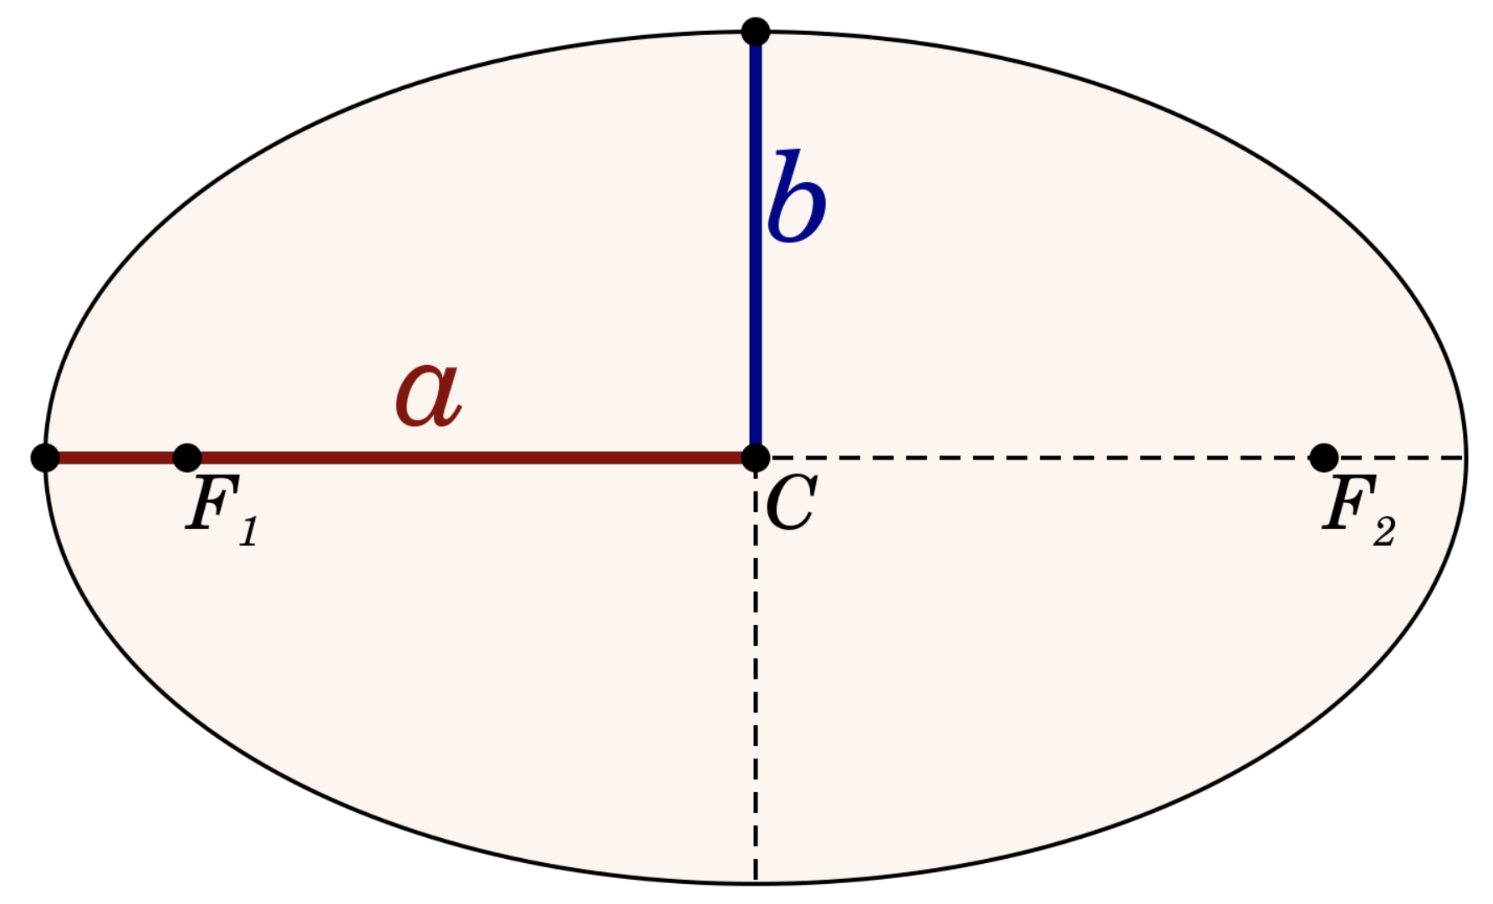
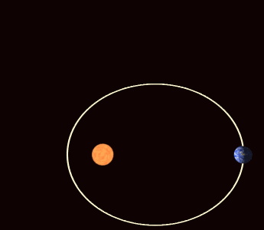
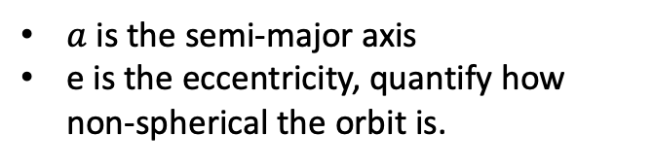
Beyond Velocity: Perihelion Precession
$a$ is the semi-major axis
e is the eccentricity, quantify how non-spherical the orbit is.
Credit: M. Toews
Credit: WilllowW under CC BY 3.0
“Anomalous” precession of Mercury's perihelion
One of the first ways to confirm General Relativity

Slide 12
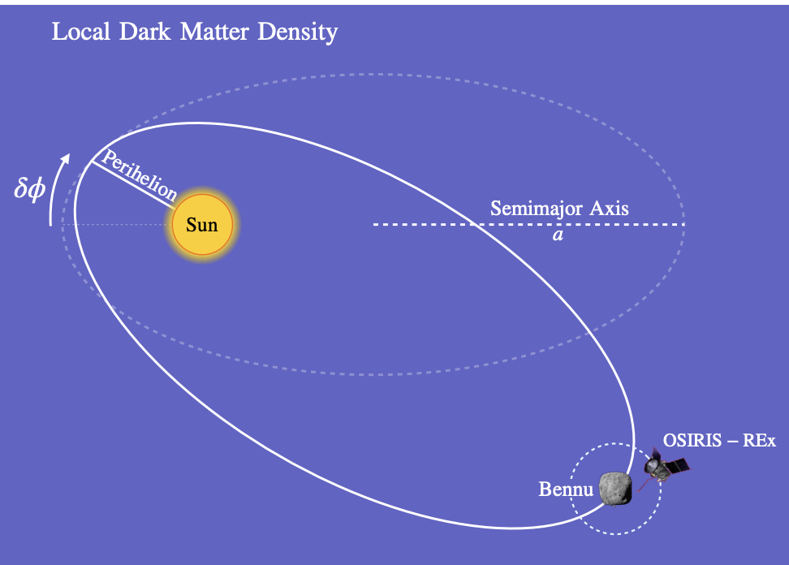
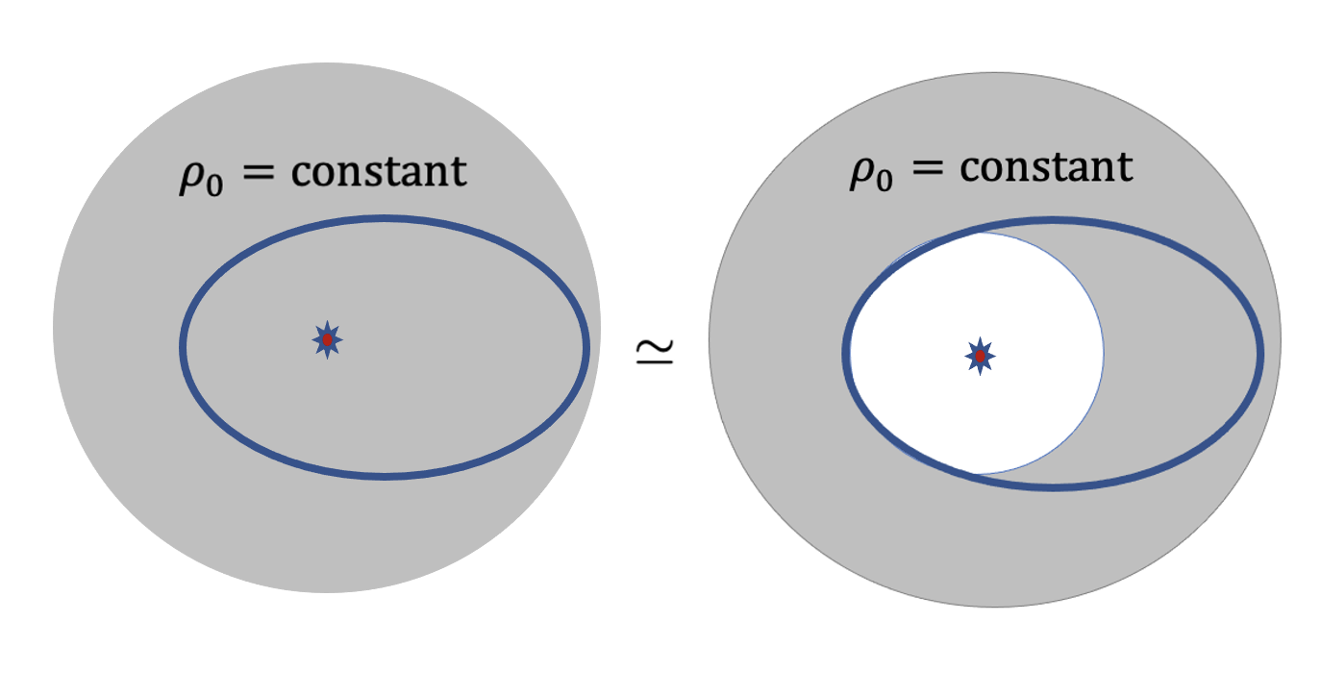

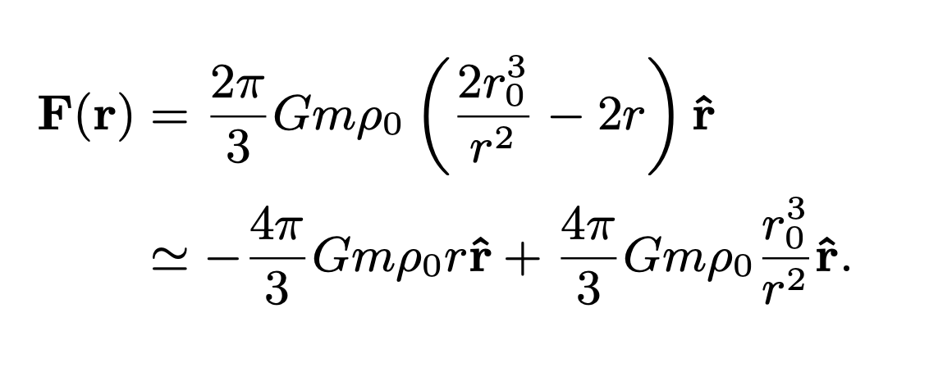
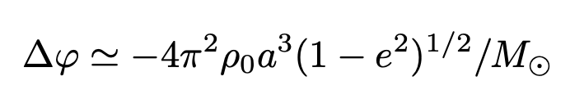
Our Project:
Local DM or Cosmic Neutrinos Induce Precessions
Tsai et al, arXiv:2210.03749
Dark Matter Gravity:
m is the mass of the object
Induced Precession:

Slide 13
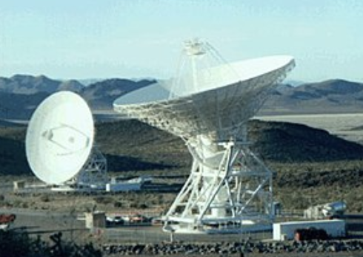
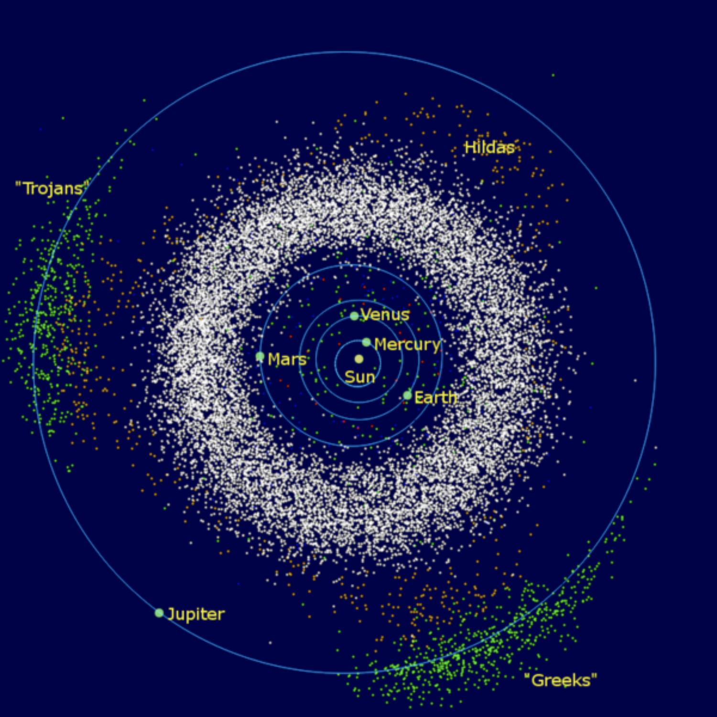
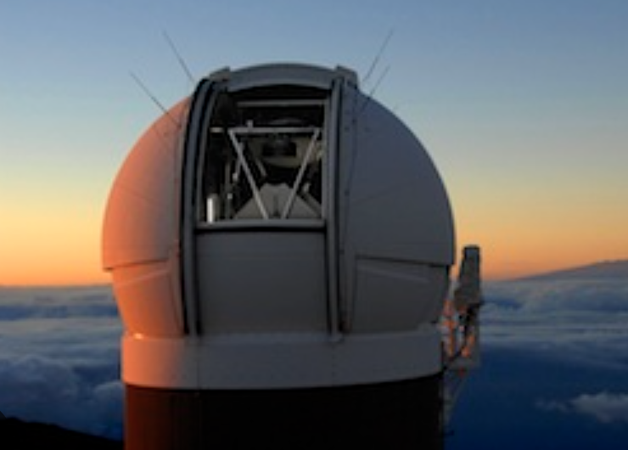
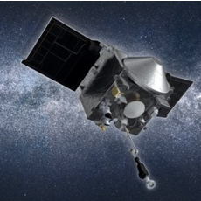
Asteroids & Other Solar System Objects
Credit: NASA
Radar (Goldstone)
Credit: UH IfA
Optical (Pan-STARRS, LSST)
Public Domain
Credit: NASA
Space Missions
Use millions of solar-system objects to study many fundamental physics topics.
Need theory & data expertise to realize the full potential of the dataset.

Slide 14
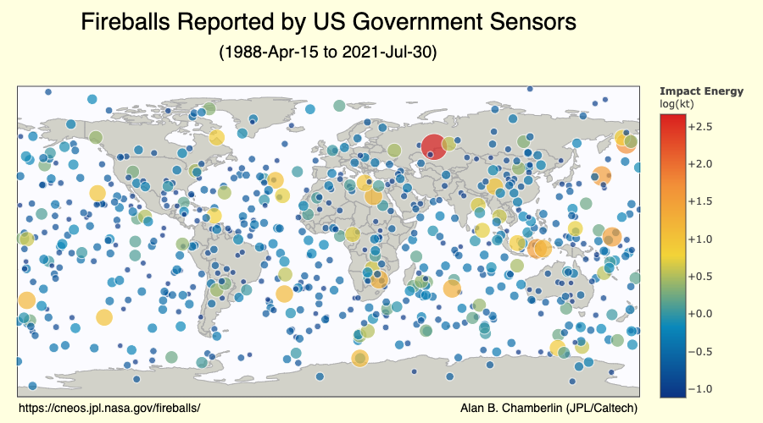
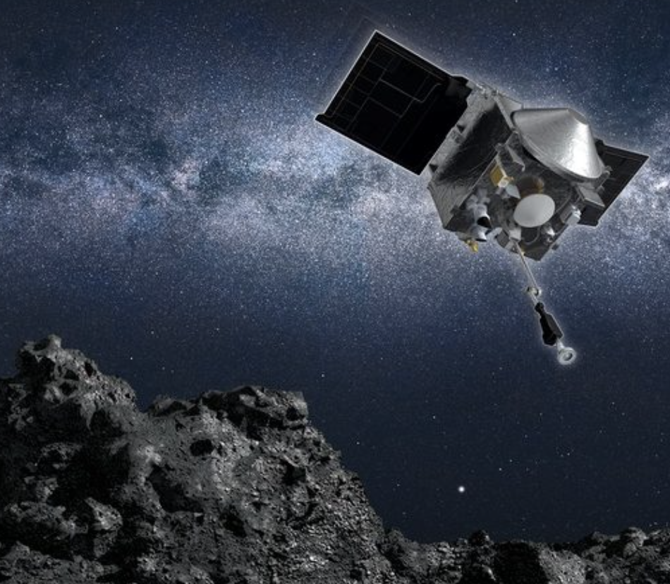
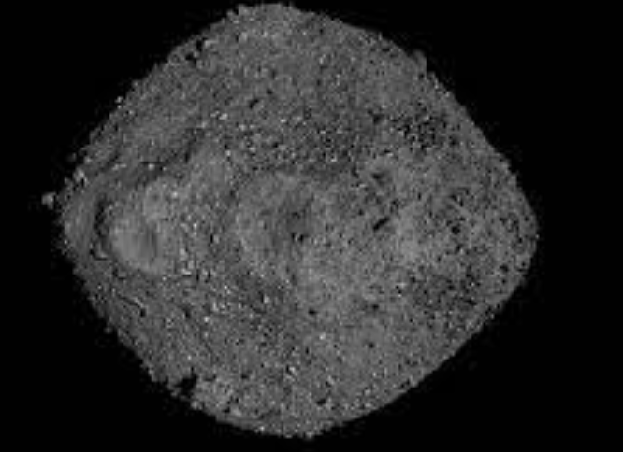
Asteroids & Planetary Defense
OSIRIS-REx
Credit: NASA
Bennu
Tracking asteroids is important to our safety
We have space missions, like OSIRIS-REx, to track dangerous asteroids like Bennu, return sample.
NASA Plan: OSIRIS-REx will track Apophis and become OSIRIS-APEX

Slide 15
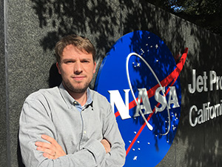
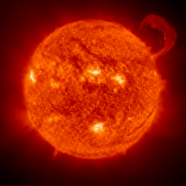
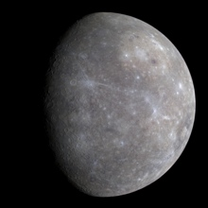
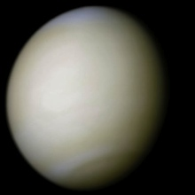
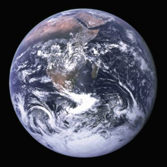
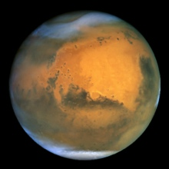
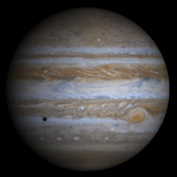
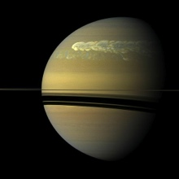
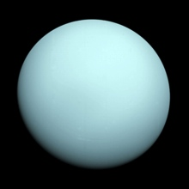
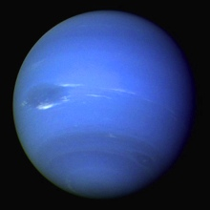
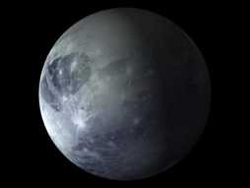
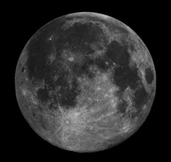
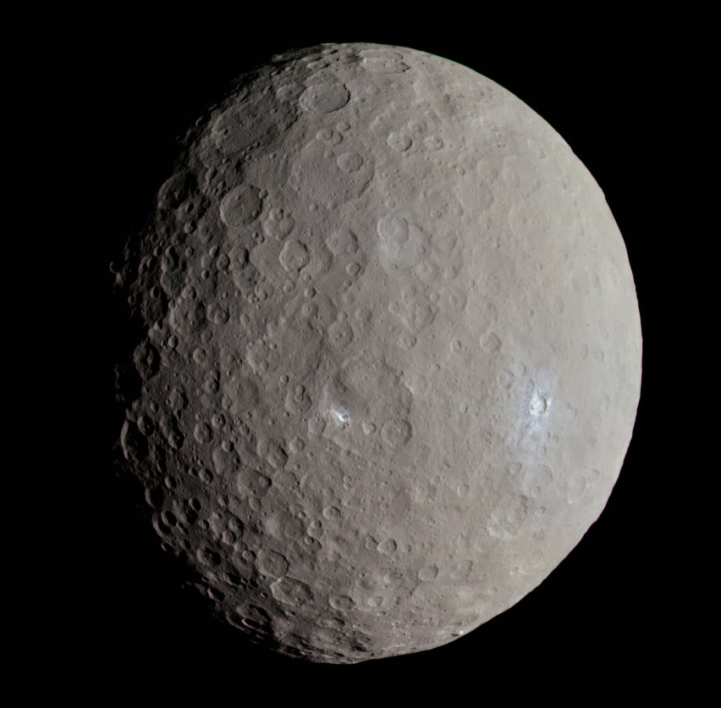
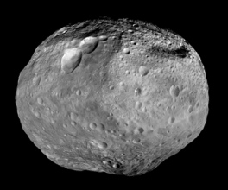

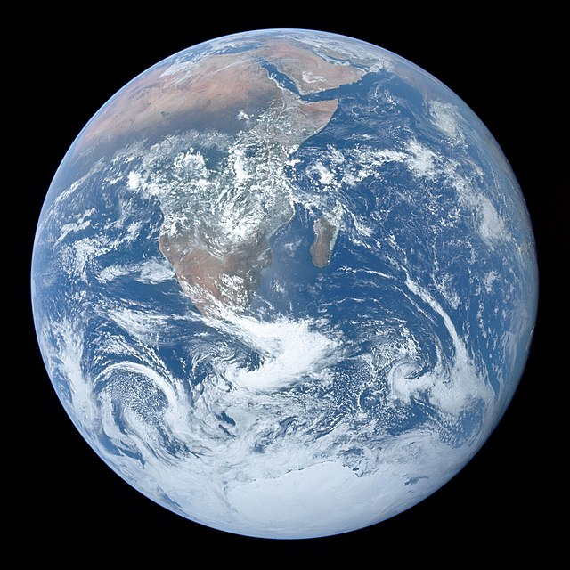
Robust Analysis: High-Fidelity Force Model
NASA JPL & OSIRIS-REx Expert
Davide Farnocchia
JPL Planetary Ephemerides DE441
343 Small-body Perturbers
Relativistic Effects
Oblateness
The Yarkovsky effect based on in-situ characterization,
solar radiation pressure, Poynting-Robertson drag, etc.

Slide 16
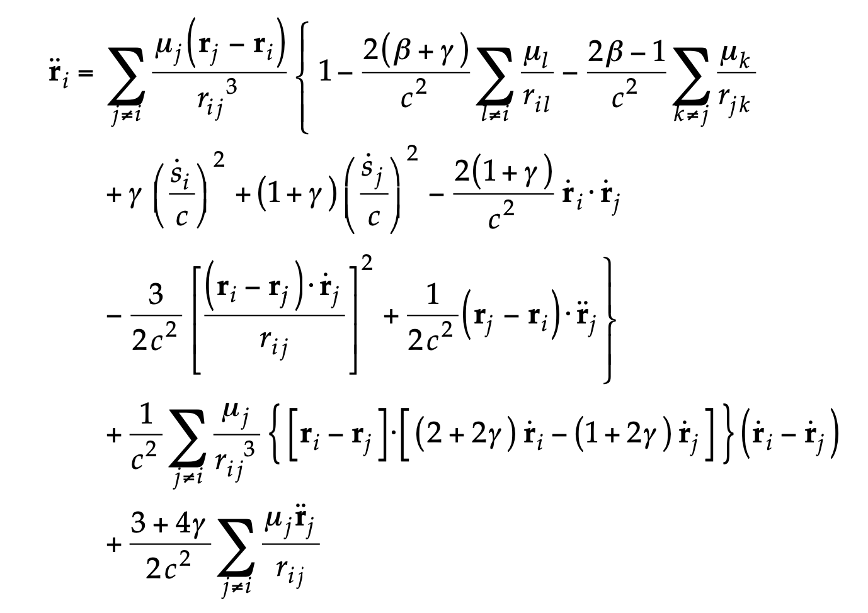
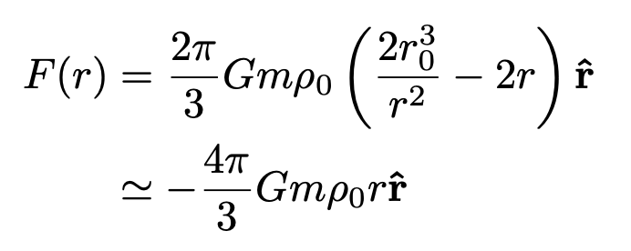
Adding Dark Matter to the Force Model
Force terms considered by
Davide Farnocchia
The dark matter contribution
List of uncertainties considered:
1) Errors in planetary trajectories and masses; 2) Errors in perturber masses & trajectories; 3) Higher order relativistic terms; 4) Higher order gravity terms; 5) Simplified assumptions in nongravitational force model (non-spherical effects, Yarkovsky, solar torque, physical parameter evolution, etc.); 7) Solar mass loss and solar wind; 8) Meteoroid impacts, Spacecraft interaction
Planetary constraints, see Pitjev, Pitjeva, Astronomy Letters (2013)

Slide 17



New Model-Independent Constraints on DM Profile
Tsai, Eby, Arakawa, Farnocchia, Safronova, arXiv:2210.03749
$ρ_{max}$(r) is the derived upper bound on DM
though only gravitational interaction
${\overline{ρ}}_{DM}$ = 0.3 GeV/${cm}^{3}$
NEO: Near-Earth Objects
r: Distance from the Sun
Astronomical unit (AU)
The horizontal lines are NOT error bars, but the coverage of the constraints.

Slide 18


The Implications of Our Constraints
Strong constraints on DM models predict local over-densities in solar system, including solar halo, axion mini-cluster, solar basin, etc.
Tsai, Eby, Safronova, Nature Astronomy (2022)
Tsai, et al, arXiv:2210.03749
r: Distance from the Sun
Astronomical unit (AU)

Slide 19




Implications of the Constraints: DM-SM Interaction
2. Strong constraints on DM-SM long-range interaction,
only ~ 4-6 order stronger than gravity: very strong bound
Constraints on particle physics and cosmology motivated models, Tsai et al, in progress

Slide 20


Implications of the Constraints: CvB
3. Close-to-leading constraints on
cosmic neutrino background (CvB)
over-density profile.
Dedicated search for CvB see, e.g., the PTOLEMY proposal, PTOLEMY collaboration, arXiv:1808.01892 (2022)
Other CvB phenomenology, see, e.g., Brdar et al, PLB (2022)

Slide 21



Summary of High-Energy Theory Targets
GR Test:
Fifth Forces:
, see Tsai et al arXiv:2107.04038
Dark Matter:
HEP theory inputs are crucial
Calling for modern data-analysis approaches

Slide 22

Millions of Objects of Interest
Tsai, Wu, Vagnozzi, Visinelli, Probing long-range fifth forces & ultralights, JCAP (2023), 2107.04038
Fedderke, Graham, and Rajendran, PRD (2022)
Study Gravitational Wave with Asteroids

Slide 23






Roadmap to Observe Local Dark Matter through Gravity
Up to around Saturn distance, we will see solar wind first
Credit:
Jason Oliver
Tsai, Aishik, Arakawa et al.
The “Asteroid Network” project for fundamental physics,
Increase precision (e.g., with quantum clocks onboard of space missions)
Consider more asteroids & minor planets (near Sun & far from Sun)

Slide 24


Outline
Precision Astrometry:
Dark Matter, Cosmic Neutrinos, Fifth Forces & GR
Space Quantum Probe for Ultralight Dark Matter
Schive, et. al., Nature Physics ‘14

Slide 25


NASA DSAC & Parker Solar Probe
NASA Deep Space Atomic Clock (DSAC)
loses one second every 10 million years
The clock has operated for more than 12 months in space;
long-term fractional frequency stability of 3 × ${\text{10}}^{−15}$,
Burt et al., Nature (2021)
Exceeds previous space clock performance by up to an order of magnitude
Clock-Comparison for CPT & Lorentz Violation, Kostelecký, Vargas, PRD ‘18
DSAC/JPL
29 × 26 × 23 cm (17.5 kg)
Parker Solar Probe (PSP)
see, e.g., “Probing the energetic particle environment near the Sun,”
McComas et al, Nature (2019)
Credit: NASA
Size of PSP ~ 1.0 × 3.0 × 2.3 m
(685 kg → 555 kg)
My Question: Why don’t we put a quantum clocks on a solar probe?
What fundamental physics can we study?

Slide 26




SpaceQ Mission Concept
Tsai, Eby, Safronova, Nature Astronomy (2022)
N. Hanacek/NIST
Aya Tsuboi (IPMU)
(Non-relativistic solution)
Oscillation frequency ~ dark matter mass
Propose a two-clock comparison experiment
onboard a future Solar Probe

Slide 27







Projected Sensitivity for ULDM
Tsai, Eby, Safronova, Nature Astronomy (2022)
(+ photon & gluon couplings)
AMO convention
Motivate
Nuclear Clocks!
Naturalness condition:
0.1 AU: motivated by the Parker Solar Probe

Slide 28




Spatial Variation of Fundamental Constants
Tsai, Eby, Safronova, Nature Astronomy (2022)
fine-structure constant
quark and QCD parameters
electron to proton mass ratio
δU: change in gravitational potential .
Safronova et al, Rev. Mod. Phys. (2018)
Lange et al, PRL (2021)
Earth variation
from Earth to Solar probe at 0.1 AU.
Achieve constraints on $k_{X}$ that are a factor of ∼ 300 stronger

Slide 29

My Understanding Before Our Projects
General Relativity
Modified Gravity
Planetary Defense & Solar Physics
Credit: Jake Weirick

Slide 30




New Precision Lab
for HEP Theories
Cosmology
and Astrophysics
Rubin Observatory/LSST
5 times more asteroids
Dark Matter & Cosmic Neutrinos
LSST: Large Synoptic Survey Telescope
Space Missions
Explore Jupiter’s Trojan asteroids
Many Other Topics
Planet 9?
LUCY/NASA
JWST
Leading GR & Fifth-Forces Constraints
Interstellar Object
(ʻOumuamua)
OSIRIS-REx
→ OSIRIS-APEX
NASA DSAC I
→ DSAC II
Planetary Defense & Solar Physics

Slide 31

Frederick Reines
Nobel Prize Laureate. Professor at UC Irvine
Utilized a nuclear reactor to study free neutrinos
The Elusive Universe is at the horizon
I presented a practical roadmap to explore it
wide & deep
Thank you for listening!
Credit:
Jason Oliver
Tsai et al, arXiv:2210.03749

Slide 32

Summary & Results & Plans
Precision Astrometry
Improved understanding of
Dark Matter Local Distribution
Tsai et al., arXiv:2210.03749
Cosmic Neutrino Local Distribution
Tsai et al., arXiv:2210.03749
Ultralight Dark Matter
Tsai+, Nature Astronomy (2022)
Fifth Force
Tsai et al., arXiv:2107.04038
Gravity Theories;
Many Other Topics
Space Missions
Precision Frontier:
HEP Theories &
New Precision Probes
Plan:
Study more HEP Theory & cosmology topics
Collaborate with particle theorists & cosmologists,
space scientists, astronomers, machine-Learners, and quantum experts
OSIRIS-REx → OSIRIS-APEX
Quantum Sensors
NASA DSAC I → DSAC II
Albert Einstein
Mount Wilson Observatory, California

Slide 33
Future Observations
Rubin Observatory/LSST
5 times more asteroids
Improved understanding of
Dark Matter Local Distribution
Tsai et al., arXiv:2210.03749
Cosmic Neutrino Local Distribution
Tsai et al., arXiv:2210.03749
Ultralight Dark Matter
Tsai+, Nature Astronomy (2022)
Fifth Force
Tsai et al., arXiv:2107.04038
Gravity Theories;
Many Other Topics
Credit: LSST/NSF/AURA
LSST: Large Synoptic Survey Telescope
Cosmic Frontier:
HEP Theories & New Data
Space Missions
Explore Jupiter’s Trojan asteroids
LUCY/NASA
Plan:
Study more HEP Theory & cosmology topics
Conduct robust analysis;
with data-intense techniques
James Webb Space Telescope (JWST)
NASA
Albert Einstein
Mount Wilson Observatory, California

