Slide 1

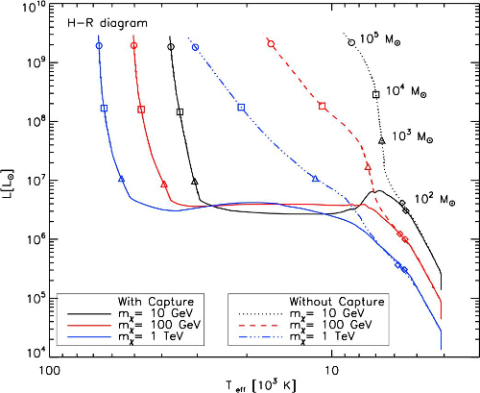
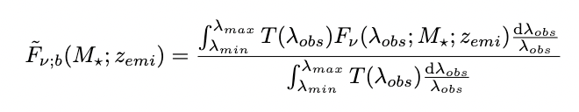
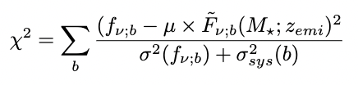
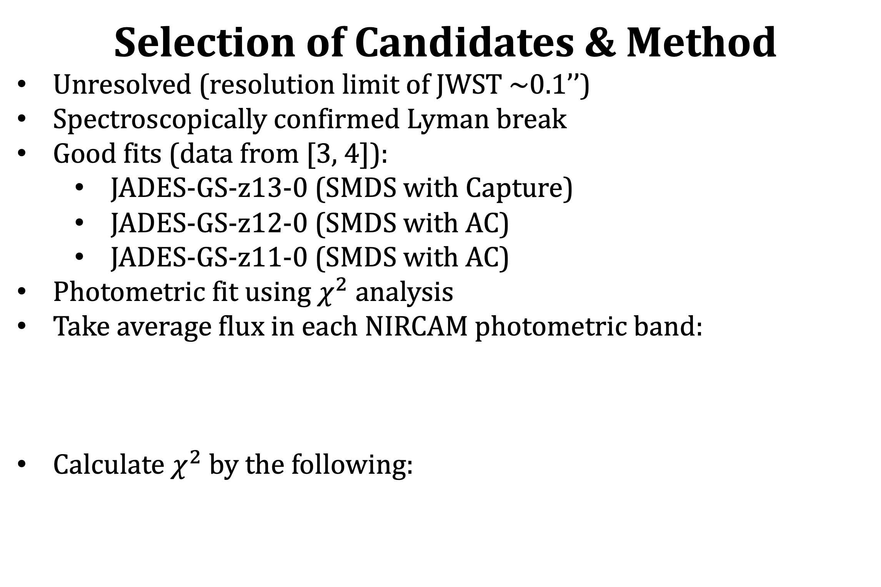
Analyzing High-Redshift Galaxy Candidates as Supermassive Dark Star Candidates with JWST Data
Jillian Paulin¹, Cosmin Ilie¹, and Katherine Freese²
¹Colgate University, ²University of Texas at Austin
Contact: jpaulin@colgate.edu
Introduction
Problem: too many galaxies, too early in the universe
What if some of these galaxies were Dark Stars?
Dark Stars (DS) [1, 2]:
    Theoretical; form in dark matter (DM) haloes
    Form via Extended Adiabatic Contraction (AC) or with DM capture
    Powered predominantly by DM annihilations rather than fusion
Selection of Candidates & Method
Unresolved (resolution limit of JWST ~0.1’’)
Spectroscopically confirmed Lyman break
Good fits (data from [3, 4]):
    JADES-GS-z13-0 (SMDS with Capture)
    JADES-GS-z12-0 (SMDS with AC)
    JADES-GS-z11-0 (SMDS with AC)
Photometric fit using $χ^{2}$ analysis
Take average flux in each NIRCAM photometric band:
Calculate $χ^{2}$ by the following:
Results
Discussion
There is a degeneracy between μ and M for SMDS with capture
In [3], the authors claim that JADES-z11 and JADES-z12 are resolved; they are actually unresolved (resolution limit of JWST is ~0.1’’)
Notice: μ<1 for our JADES-GS-z11-0 fit
  De-lensing is possible at very high redshift [5]
Follow-up spectroscopy is required to distinguish SMDS from galaxies
References
[1] D. Spolyar, K. Freese, and P. Gondolo, Dark matter and the first stars: a new phase of stellar evolution, Phys. Rev. Lett. 100, 051101 (2008), arXiv:0705.0521
[2] K. Freese, C. Ilie, D. Spolyar, M. Valluri, and P. Bodenheimer, Supermassive Dark Stars: Detectable in JWST, Astrophys. J. 716, 1397 (2010), arXiv:1002.2233
[3] B.E. Robertson et al, Discovery and properties of the earliest galaxies with confirmed distances, arXiv e-prints, arXiv:2212.04480 (2022)
[4] E. Curtis-Lake et al, Spectroscopic confirmation of four metal-poor galaxies at z=10.3-13.2, arXiv e-prints, arXiv:2212.04568 (2022)
[5] Y. Wang, D.E. Holz, and D. Munshi, A Universal Probability Distribution Function for Weak-lensing Amplification, Astrophys. J. 572 (2002)

