Slide 1
Part 1 Quick overview of Concave assembly option
Part 2 Corrado kindly made a list of pro and con which I try to address

Slide 2
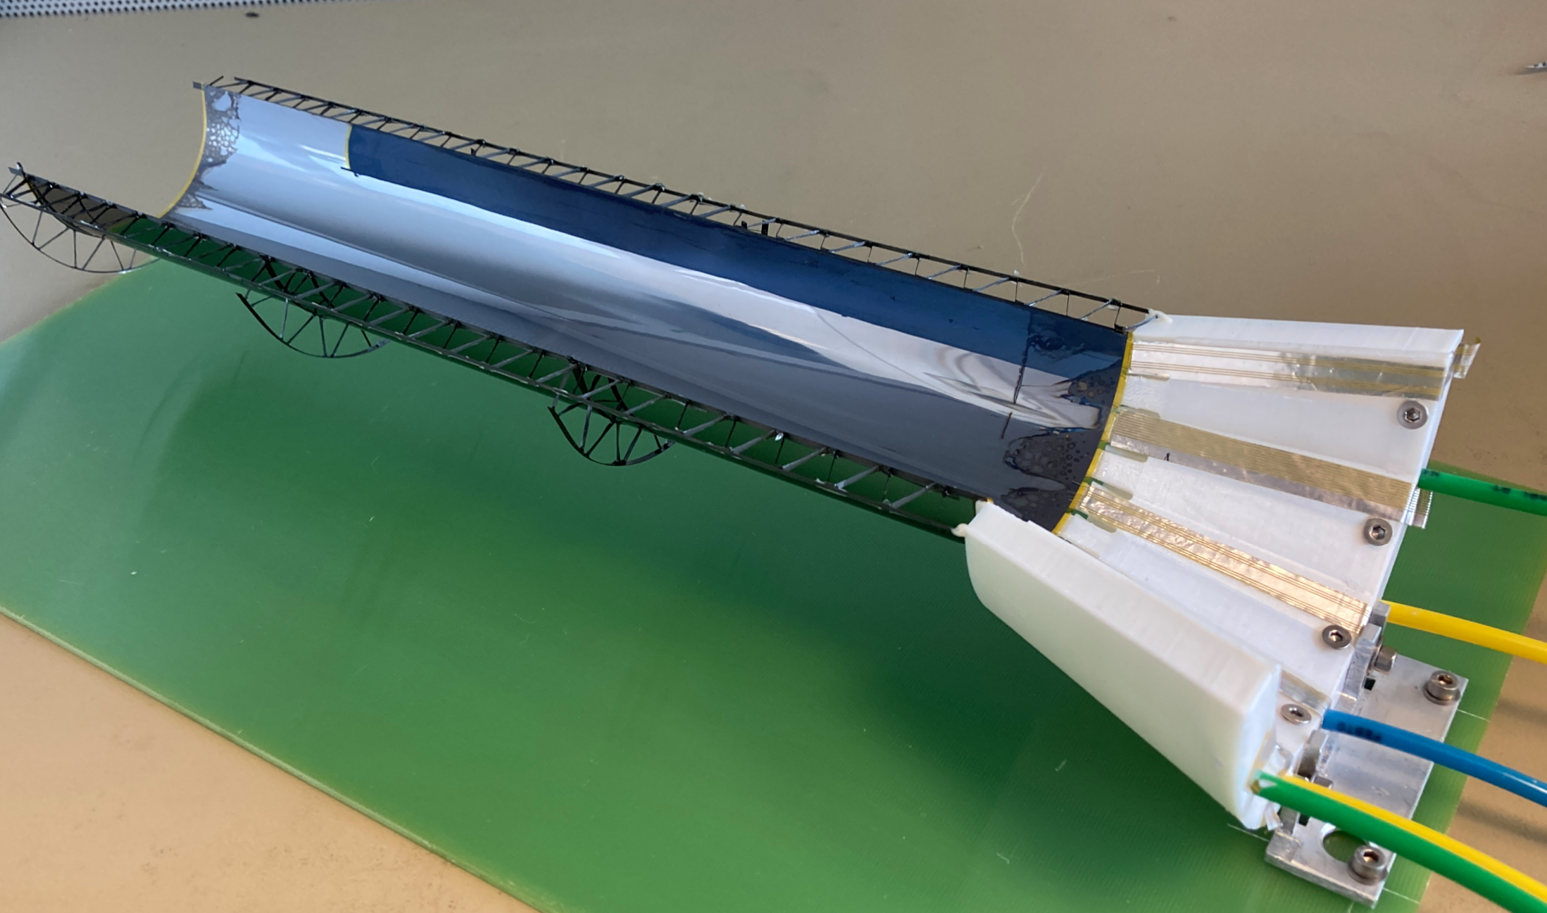
Wel thanks to marcel his question to bent silicon concave for the strain research and Grigory his suggestion
to make slots in a concave mandrel to glue from the outside we have a optional vacuum assembly strategy .

Slide 3
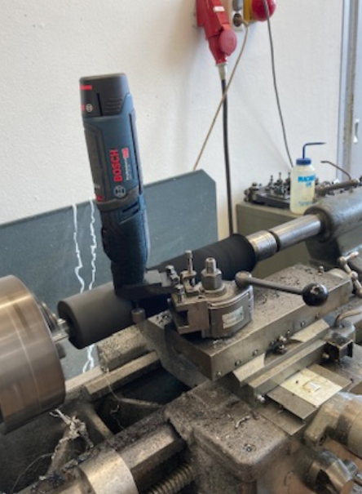
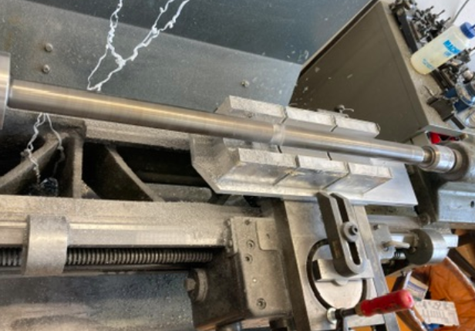
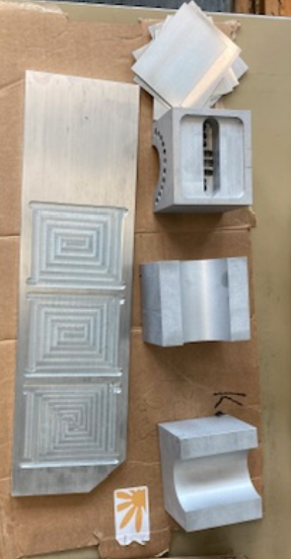
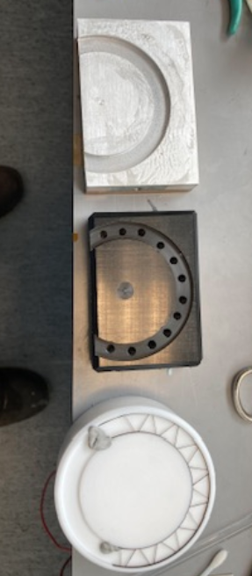
Tooling for first test made on conventional machines

Slide 4
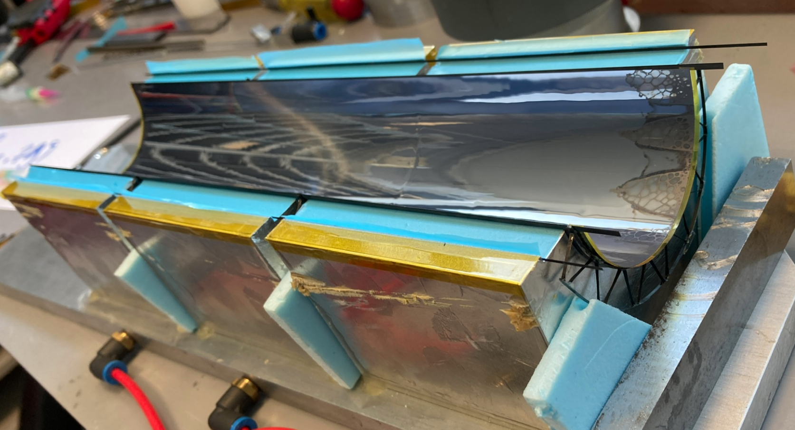

Slide 5
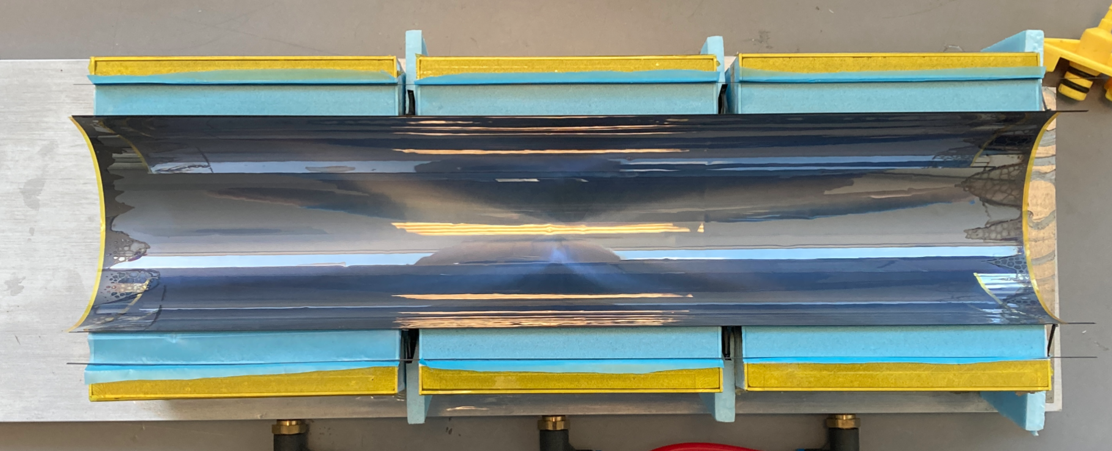

Slide 6
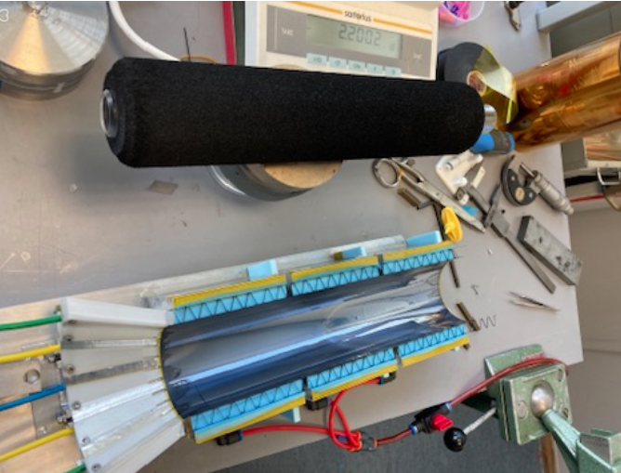
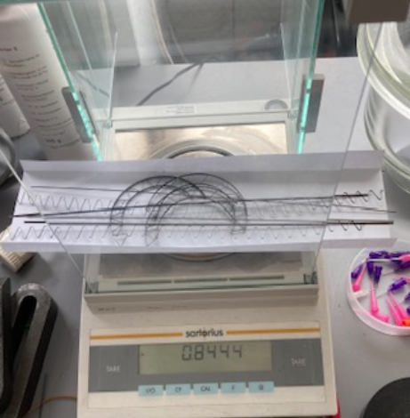
Assembly : push silicon in with rubber bar possible to position til you switch on vacum(slides on paper)

Slide 7
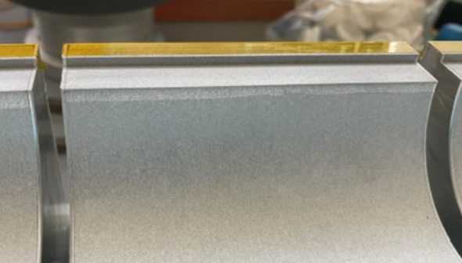
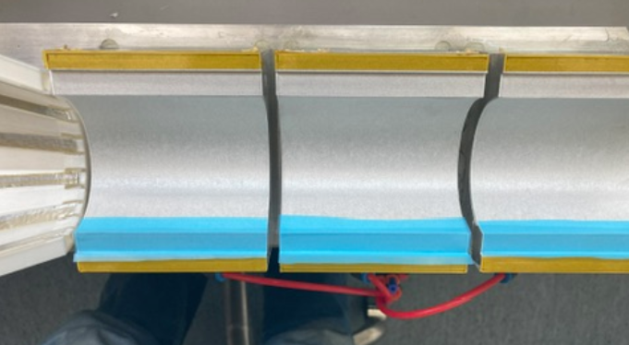
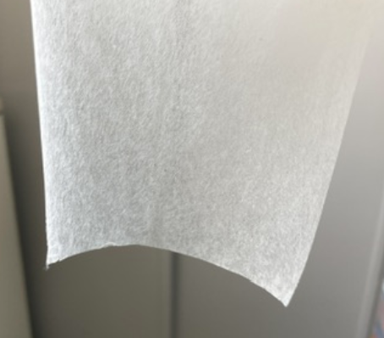
“Cheating part 1” current our cleanroom is not so clean and I suspect aluminum particles getting lose from the metaphor
Or left over from machining so I added a ca 30mu japanese tissue on the mandrel
After discussion with metaphor they advised light sanding with fine scotch bright cleaning ultrasonic and drying and
Possible finer structure metaphor (BF100-al) they don’t expect once cleaned that particles loosen

Slide 8
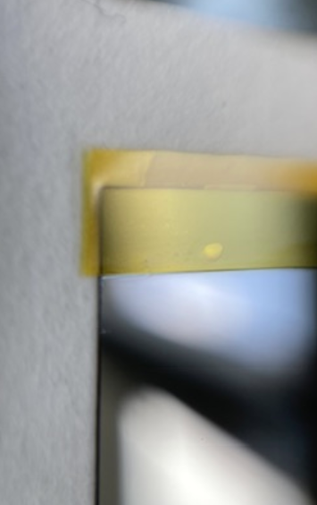
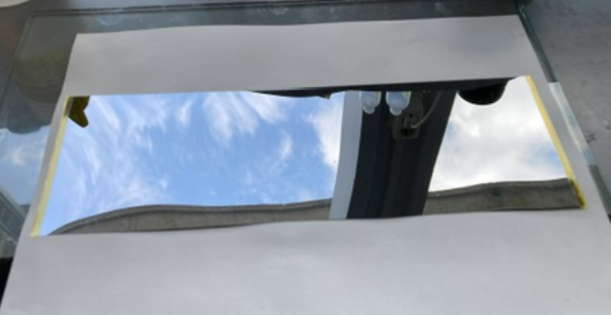
More cheating , as we saw already a lot broken silicon and this is last on at utrecht (2 set more at cern )
I added a 30 mu kapton strip on the silicon edge in the hope to move the neutral bending line in
to get a bit less tension in the silicon (need to do it different got glue stains on other side)
Once we understand the edge defects this might not be necessary

Slide 9
From the thorough comment of corrado, rene’s comment in blue
Concave assembly
Pro:
  It eliminates the need for Kapton at the chip side; however, Kapton solves of the electrical isolation issue.
  Kapton thickness can go down 25um. Therefore I do not consider the use of Kapton a big problem.
  As of first test, method seems easy to use needs to be assessed by other people (yes Im probably biasd….)

Slide 10
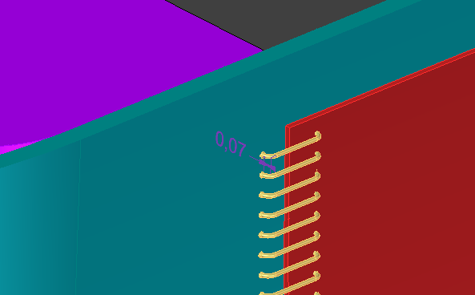
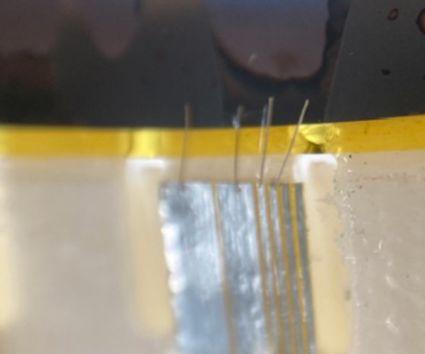
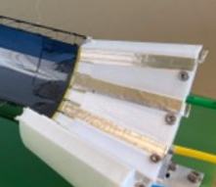
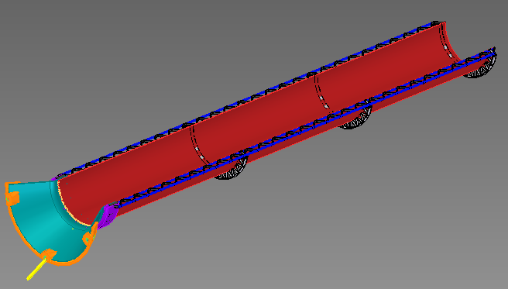
Concave assembly
Contra:
  LO electrical interconnection issue. As you said, it creates a problem with the electrical interconnection that
  can be solved by tab bonding or reversing the chip for the wire bonding. Up to now, we cannot base the ITS3
  development on tab bonding or another interconnection that differs from wire bonding (it must be demonstrated that you can bond 40um chips with them). Reversing the chips will complicate the assembly, but it could be feasible in principle.
  As of now wire bonding seems the way to go , according to NIKHEF bonding specialist at a distance of 300-500 mu Bond hight can be around 80 mu bonding (NOTE 1 WE GOT 1 MM TO BEAMPIPE) (Note 2 we did measurements on a concave bended alpide (analisis wil be continued round september) effects seem low but needs to be validated (wp3?)

Slide 11
Extra note on interconnect ,Pending on final data bitrate (2-5Gbit ???) Marcel Rossewij expects
2-5 cm pcb/flex no problem longer (30cm e.g.) Has to be tested
So it could wel be that we need firefly like connectors at a couple cm from edge of silicon
This would be a consideration in material budget of support cone desing

Slide 12
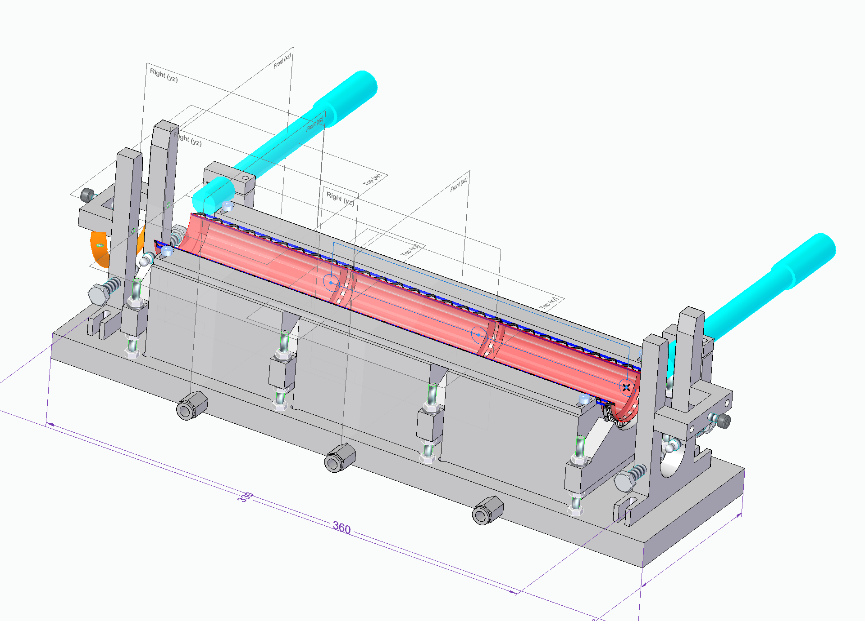
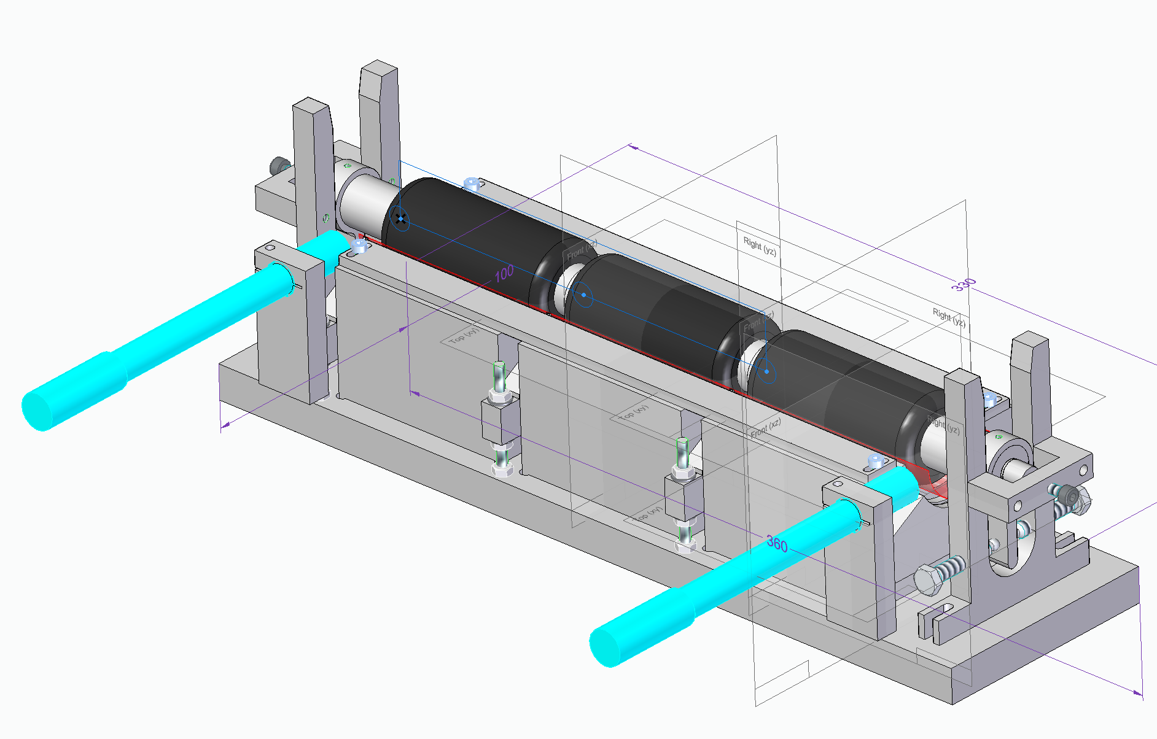
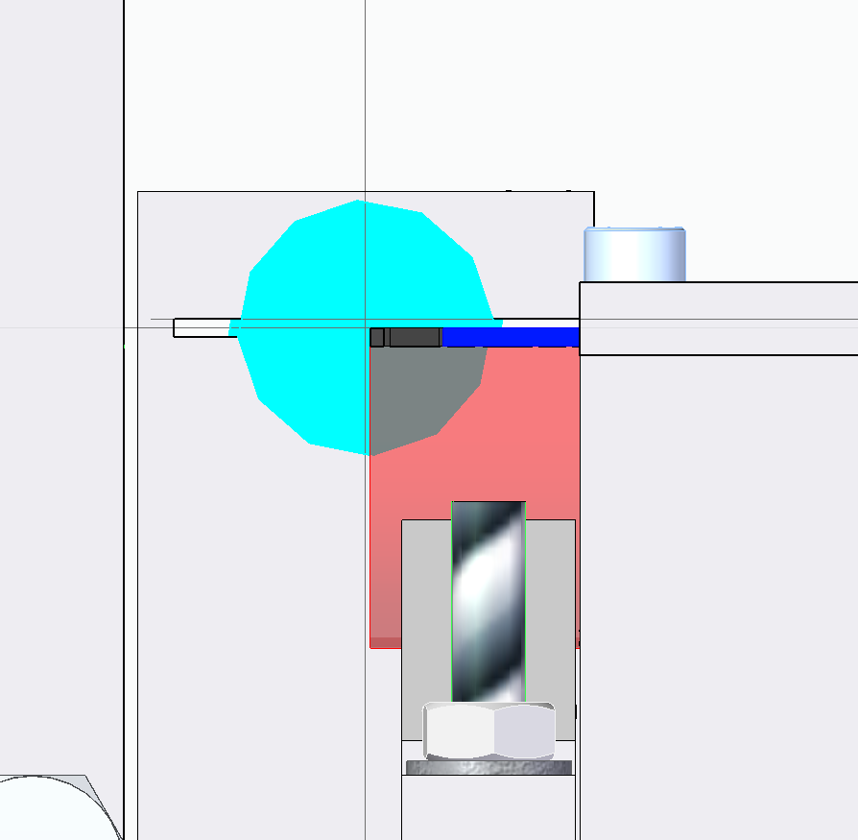
  Concave assembly
  Contra:
  Alignment control concerning the mechanics during bending/gluing. It is unclear how you can align the chip
  in the conclave mandrel.
  I noticed that before applying vacuum the silicon slides well in the “Japanese tissue” we can aling to the edges
  Of the silicon with cameras and use some adjustmetscrews to move the pressing roll wich we divide in 3 independent rotating sections , concept desing ready try to build one (L0) for demo

Slide 13
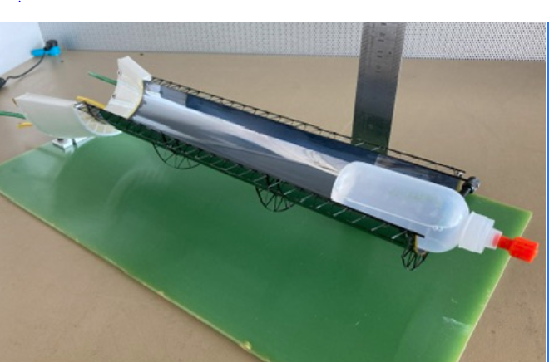
Self-support configuration
Pro:
  self supporting layer that can be reworked in case of problem without loosing the entire half barrel
  Eliminates the carbon support barrel “nicer for L4-5-6- should check with physics”
Contra:
  Self supporting layer requires that the supporting frame provide the right stiffness, the right shape and
  alignment features among layers. We considered the self-supporting concept, at the beginning, also for
  the carbon foam; and I discarded due to the complexity to fulfil these three requirements
  (stiffness, shape, alignment), based on the ITS2 experience. Nevertheless I am opened to reconsider.
  Note, on concave mandrel assy it has to be self supporting it can be fixed to a final assembly in a later stage
50 gram load at tip is no problem, note that silicon =aprox 3.3gr+1gram carbon. As far as I could see sag was mainly in printed Support and fixation.
Yes support is critical as anny error is “amplified” by the length Of the silicon

Slide 14
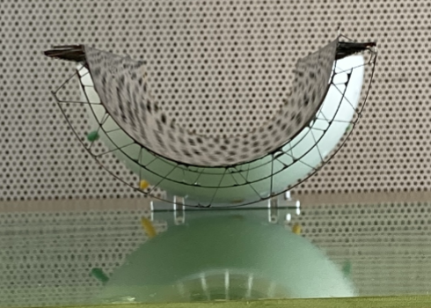
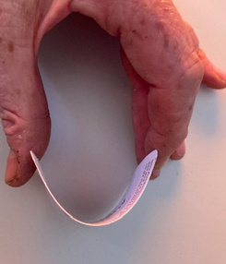
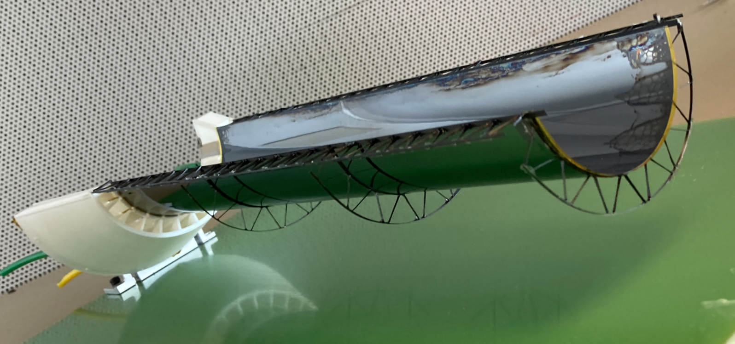
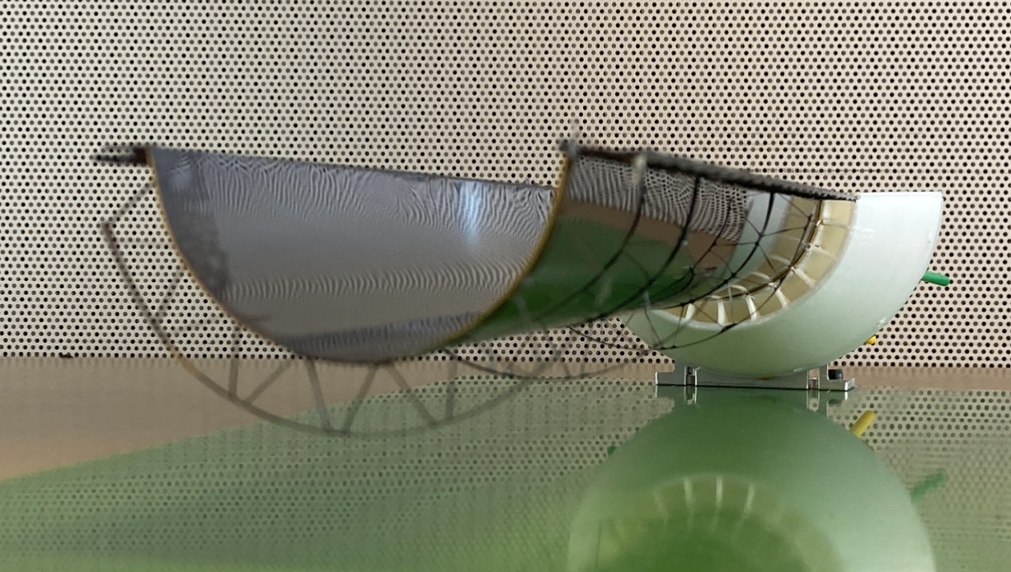
On support rings I don’t think with only longeron support You wil get a circle, or the side support Needs to be so strong to hold the Bending moment
I could try one ring close to free end
Say 5 to 10 cm assuming other side is fixed by cooler/cone ???
We could compare the ct of engineering module a and
Ring support also check with physics wat is the real requirement of roundness

Slide 15
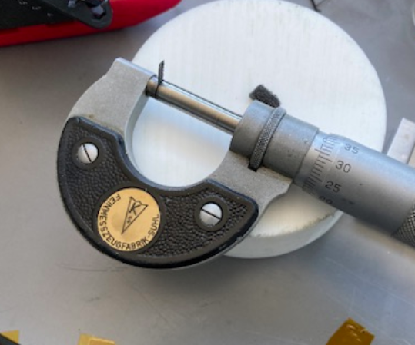
Carbon space frame structure
Pro:
  Material budget? Less? Must be reassessed considering glue
Contra:
  Non uniform material budget, One additional ring.
  In principle the concave assembly can be done also with c-foam longerons as long as its self supporting
Note we should take care with
realistic simulations !
I pealed off the fleece from a
Longeron scratched of foam
its including glue when forcing it
In micrometer 0.3mm wheight is
0.007 gram for 1 cm long pice
The carbon fibre is aprox0.1mm thik
And a cm weights 0.0026 gram current its
Zigzag + 2 straight strips so aproc same
weight as 1!! Side of fleece on longeron
So material weight is lower but less uniform this must be simulated .
Who did the simulations now ? Current I have only preliminary L0 in CAD is that enough as a base for simulations ? E.g. scale it for L1-L0 ?
We did some test with GDML export (KeithSloan / GDML with freecad) that seem to work but needs some more time. (current I rather focus on demonstrating the mechanics)
Could somebody be available to do the simulations ?

Slide 16
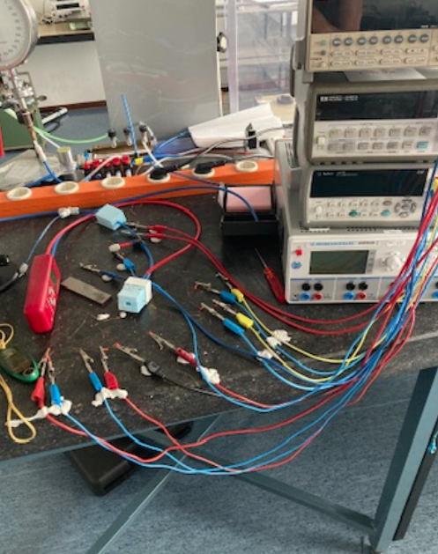
  Carbon space frame structure
  Contra:
  Lost the function of radiator at the periphery
  So with latest carbon foam mini windtunnel tests ……
  (spoiler carbon foam works fantastic as cooler
  As lon as you don’t have holes and a considerable
  Pressure drop 0.1 bar)

Slide 17
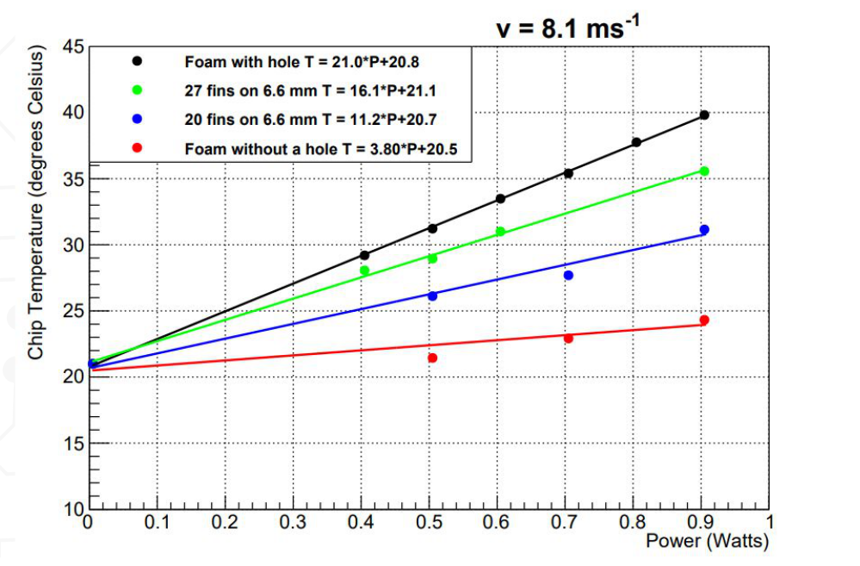

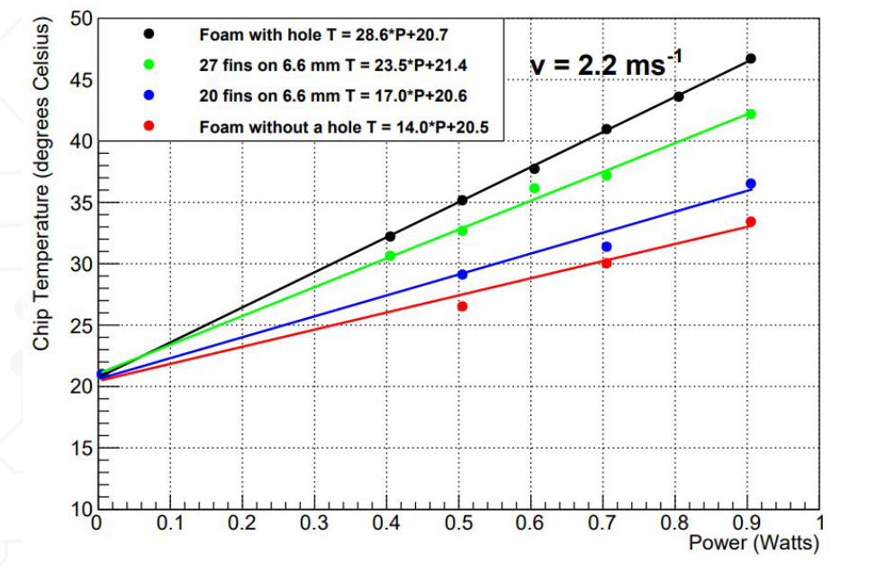
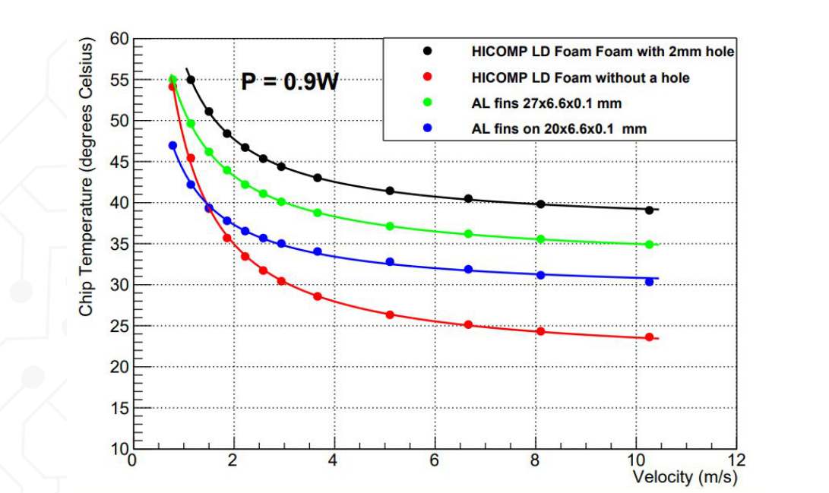
PRELIMINARY/IN PROGRESS wil be continued in
September by (interim)else + ???
Note pressure drop graph is being workd on some 0.1-0.2 bar at max flow

Slide 18
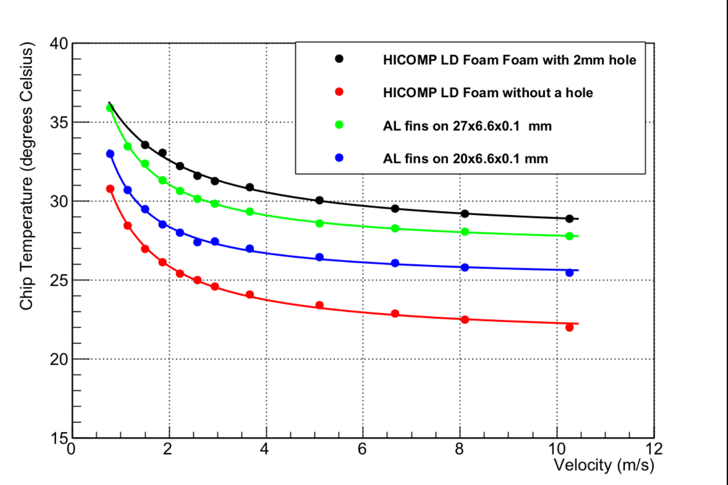
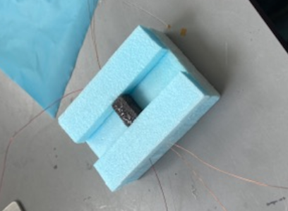
we are current testing a 3 mm high cooler preliminary looks good it seems most cooling happens
near chip and there is not so much conduction through the foam
Graph is 0.4 watt and cooler is 3mm high 10 wide and 6 long (haadi is working on rest of analasis/data)
Like this one but 3mm high

Slide 19
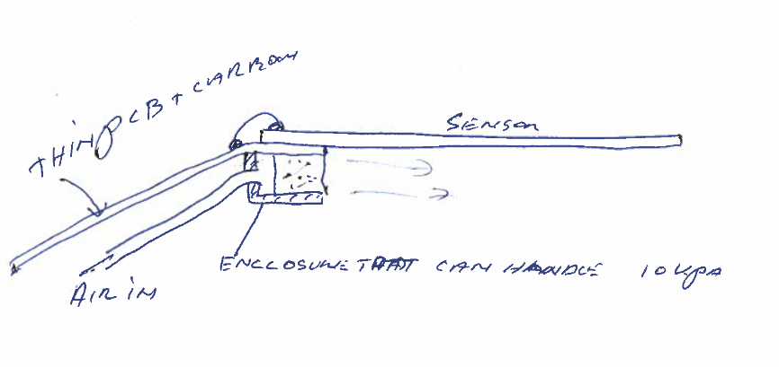
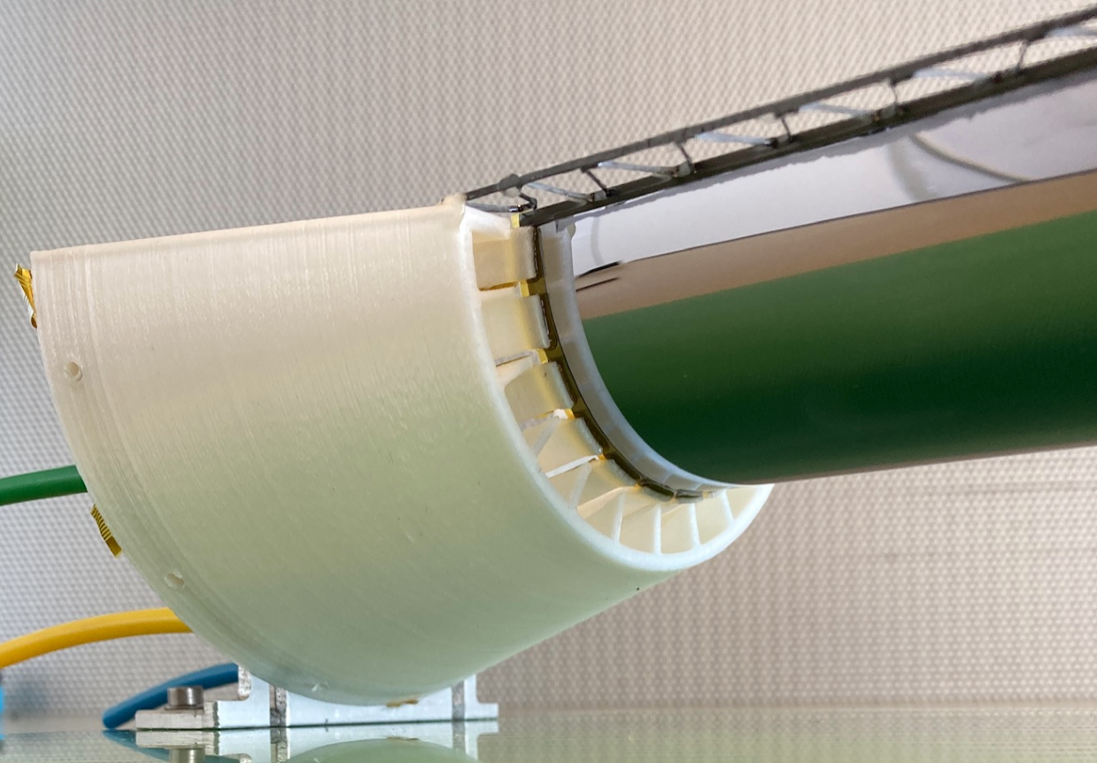
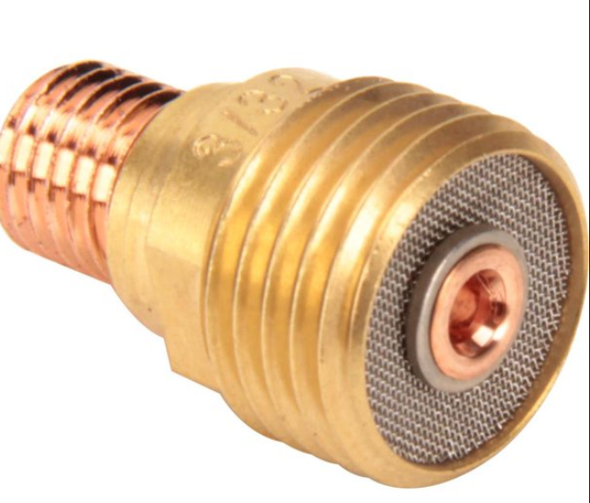
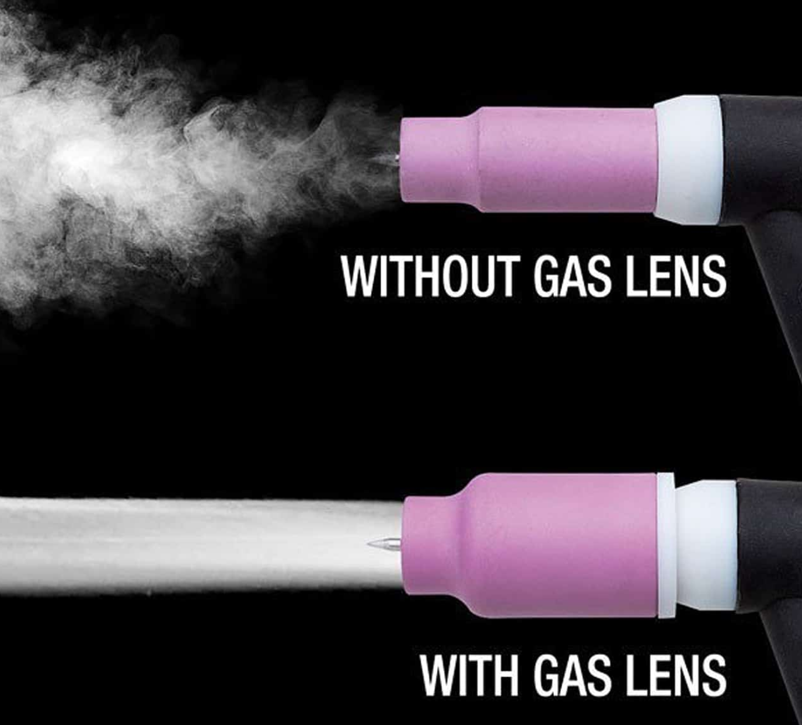
On cooling , so from sem,eline,haadi ther work it seems carbon foam works realy well to cool as long as you have a
Considerable pressure drop of some 10Kpa (0.1bar) that’s 1newton per cm2 so nothing you wana do to 40mu silicon
But if you can constrain the forces to the foam and have a free flow out it should work. Also the flow coming out of a
Restriction like a sieve or pourus medium is in general very laminar and smooth (principle used in gas lens for tig welding)
So this could be beneficial for vibrations on silicon. Not that if a 3 separate layer construction is accepted by the cooler
has to be lower (6>4 mm or so)
Want to make some small experiments
To se if carbon can hold the over pressure
cooling of 3 mm high e.t.c

Slide 20
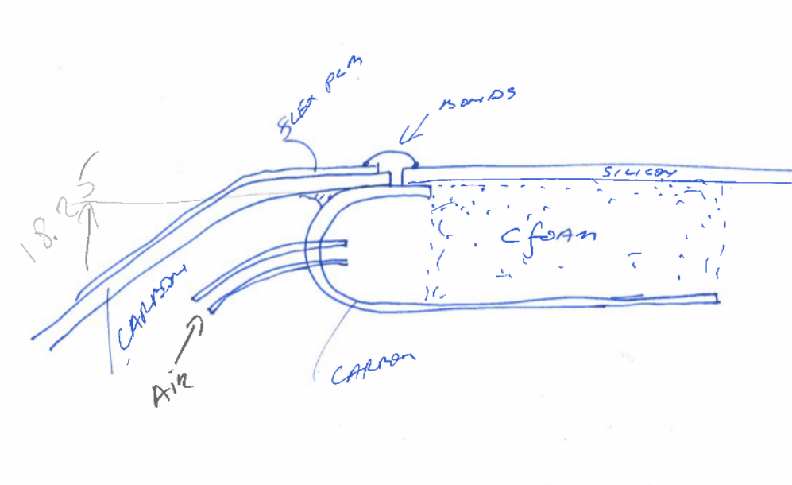

Slide 21
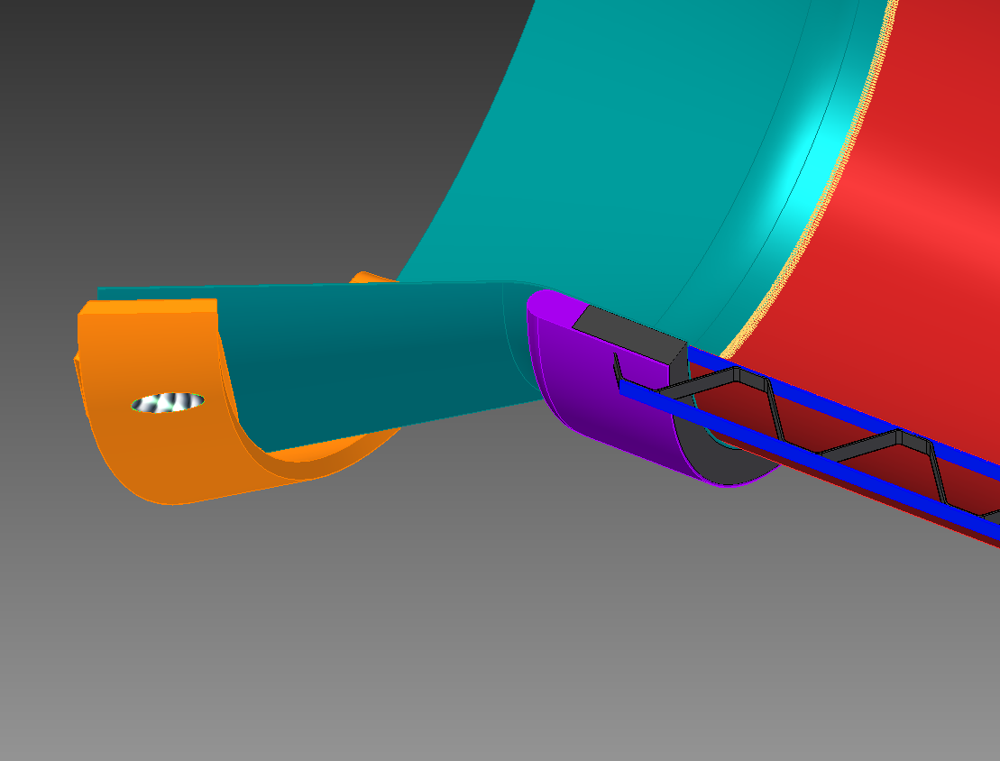
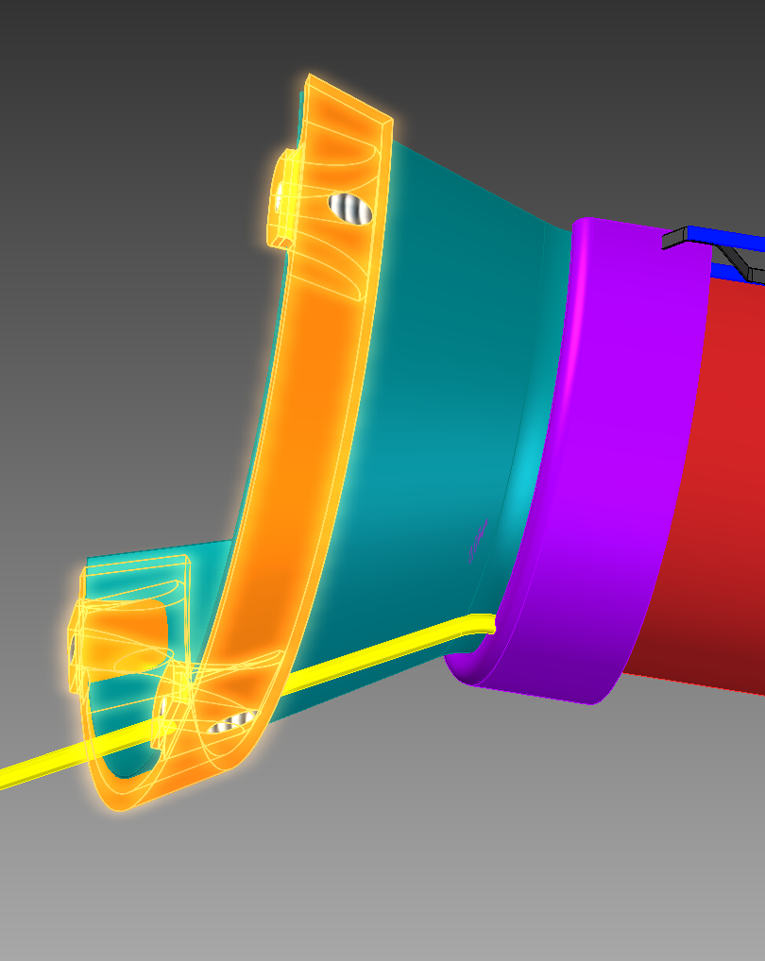
Close sides
Carbon foam out
Air in (1? Or a couple?)

Slide 22
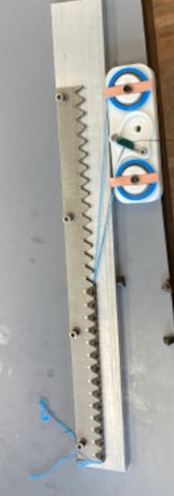
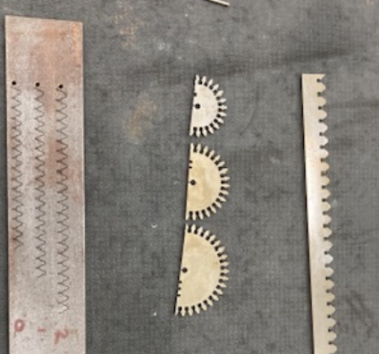
Next steps
* As discussed with corrado demo at cern after holliday season (who wants to join ?)
coming month prepare L2 I have need to build l1-l0 got still enough metapor (not enough for big mistakes☹) build protop alingmnet with cameraas(probably only l0)
There are stil 2 sets silicon at cern would be grate to use them for the demo
* Prepare carbon support 4 mm high improve tooling to make procedure better (new tooling mostly done)
* We stil have a set heated G10 layers test the no hole carbon cooler
(probably L0 first)

