Slide 1
TAXS and TAXN ABSORBERS - OVERVIEW
F. Sanchez Galan, HL-LHC WP8 leader
15-08-2022

Slide 2
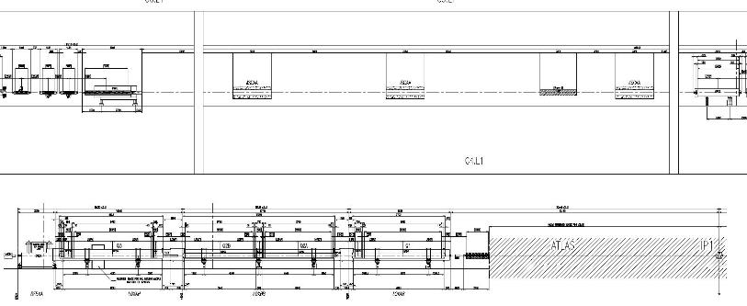
Scope Machine-experiment interface
Absorbers to protect the inner triplets and dipoles from the collision debris generated at the interaction point.
Target Absorber for Neutrals (TAN→TAXN)
Target Absorber for Secondary (TAS→TAXS)

Slide 3
Scope – from TAS to TAXS @ P1& P5
TAXS will replace TAS, which are embedded in the forward shielding, at the limit of the experimental cavern and LHC tunnel.
Functionality and design principles will be kept.
Dedicated water cooling to cope with the increased deposited energy, optimised engineering based on experience.
.

Slide 4

TAXS in CMS Forward Shielding
Fixed Iron nose
TAXS absorber (~3.5 T Cu)
Rotating shielding

Slide 5
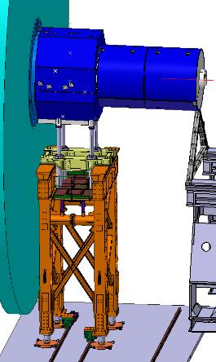
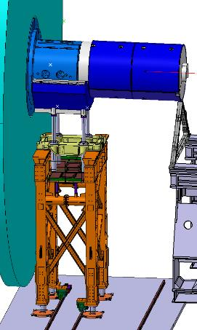
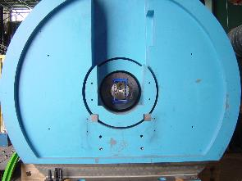
TAXS in ATLAS Forward Shielding
Movable: Octagonal shielding (JFS), cylindrical shielding (JFC)
TAXS absorber
and shielding (cradle)
TAXS
Courtesy of M. Raymond

Slide 6
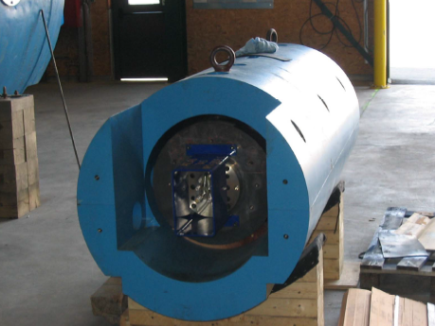
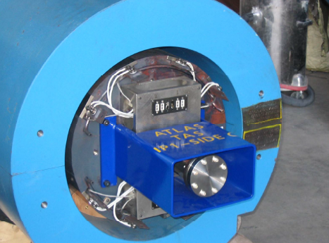
TAXS
4 TAXS (Cu absorbers) 2 Iron shieldings
Cooling (piping), temperature monitoring system (thermocouples) & inserts for supporting rods integrated

Slide 7
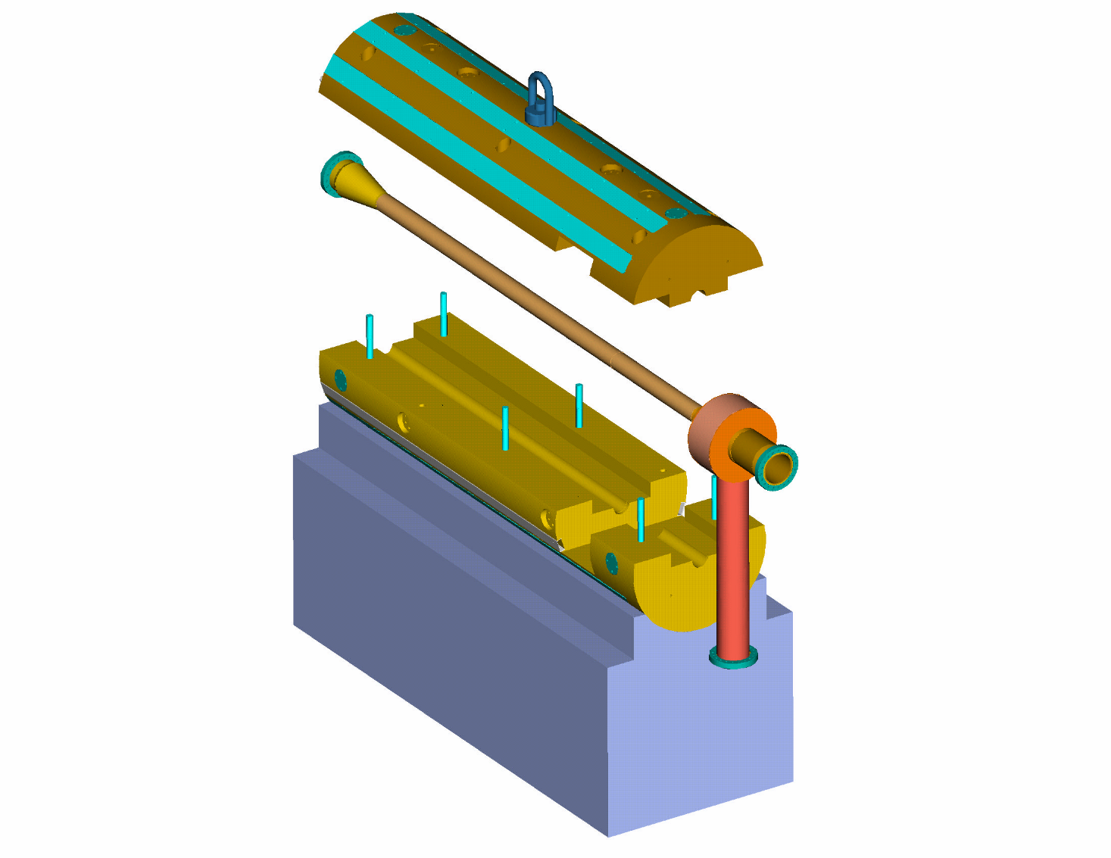
TAXS ASSEMBLY
UPPER COPPER (no OHFC) CLAMSHELL
THERMOCOUPLES,
PIPING
BEAM TUBE
COPPER (OHFC)
60 mm ID
LOWER COPPER (no OHFC) CLAMSHELL
SUPPORT CRADLE (only for assembly purposes)
Engineering and detailed drawings will be provided by CERN.
7

Slide 8
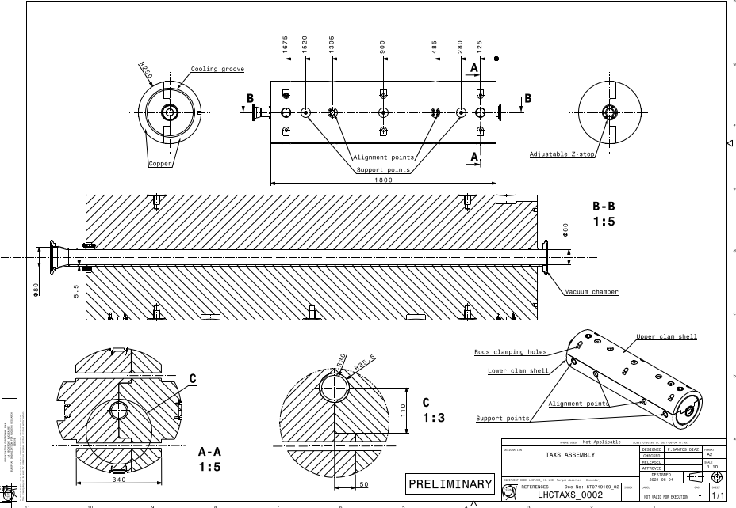
TAXS (4 units)

Slide 9
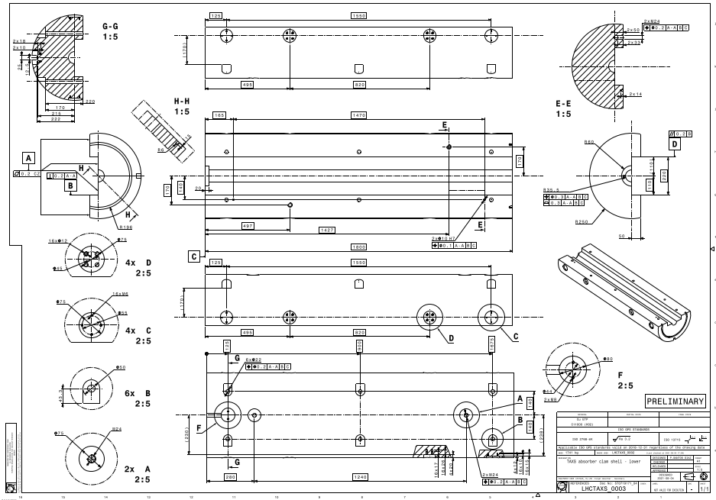
TAXS (4 units)

Slide 10
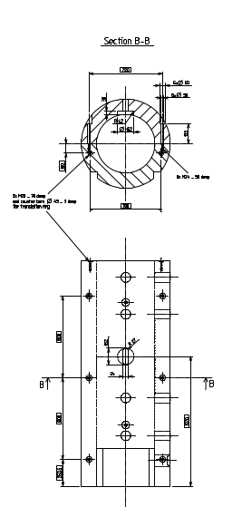
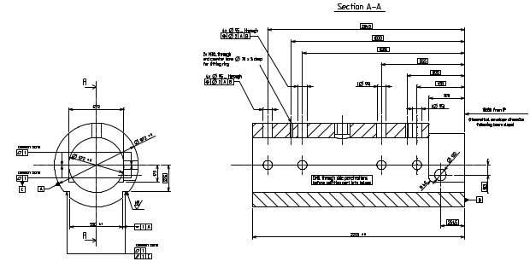
TAXS shielding/cradle (2 units)
Precise positioning of TAXS via supports/rails

Slide 11
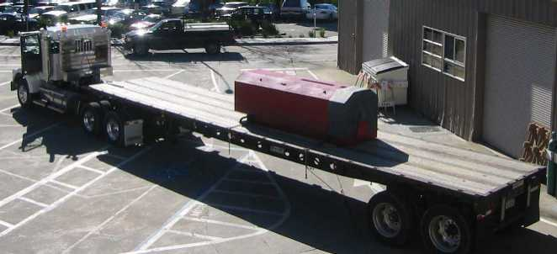
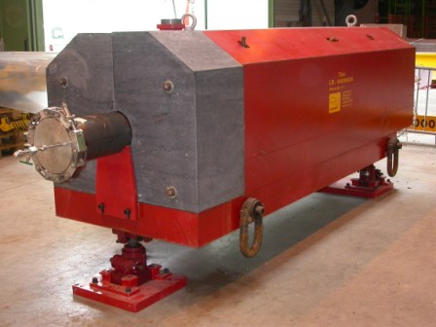
Scope – from TAN to TAXN @ P1& P5
A new absorber will replace the LHC inside the TAN to protect D2.
External St36 shielding will be kept

Slide 12
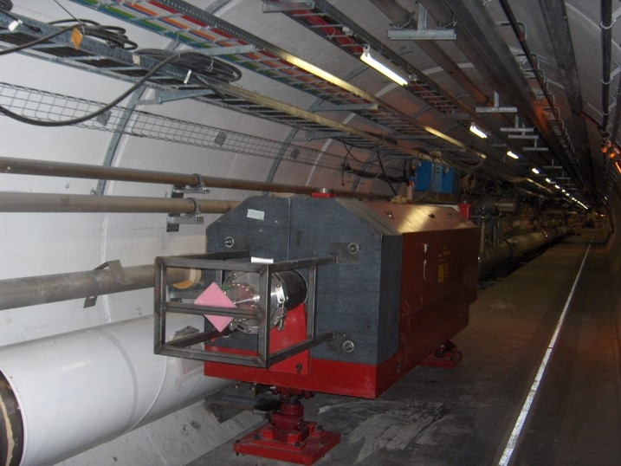
TAXN
Engineering and detailed drawings will be provided by CERN.
Alignment supports provided by CERN.

Slide 13
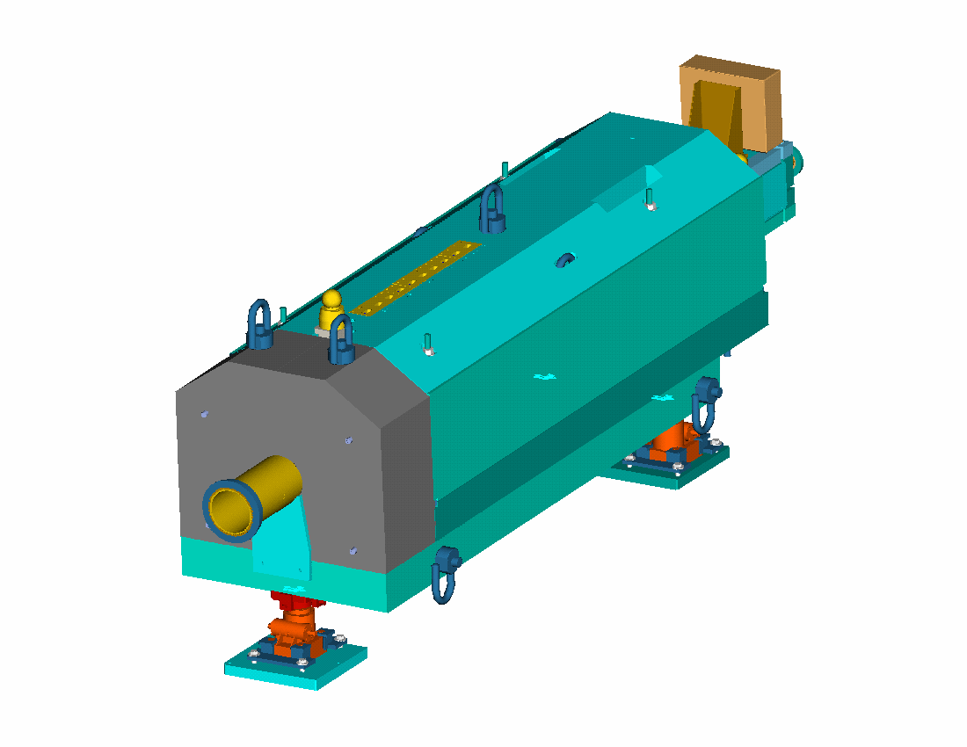
TAN ASSEMBLY
The TAN consists of two major sub-assemblies:
- Absorber Box
- Steel Shielding.
Upper shielding
Junction box
Absorber box
Side shielding (2)
Marble
Upper base plate
Beam tube
vacuum chamber
Lower base plate
Jacks (3)
13

Slide 14
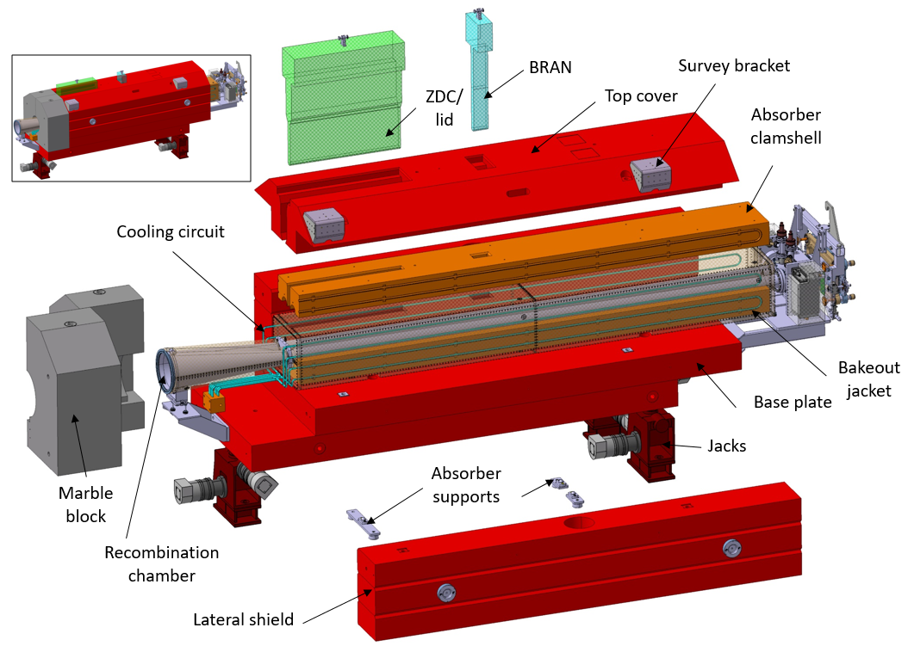

Slide 15
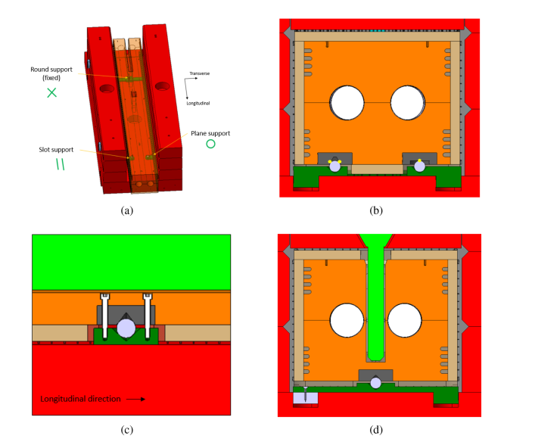
Details of the Cu absorber top slot, ancillaries, supports, slots for cooling pipes and thermocouples

Slide 16
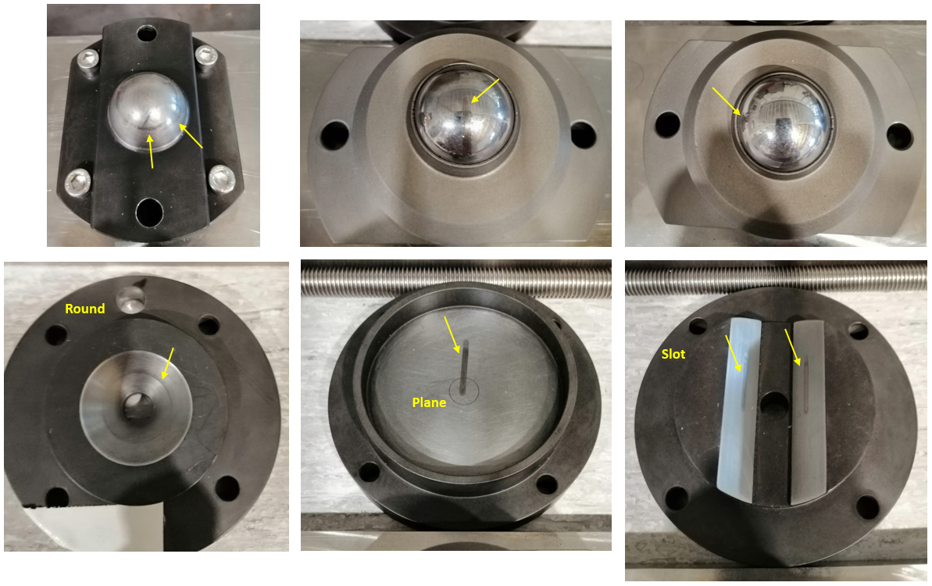
Absorber supports: Round, plane and slot assembly (sphere and steel 100Cr6 tempered part > 60HRC )

Slide 17
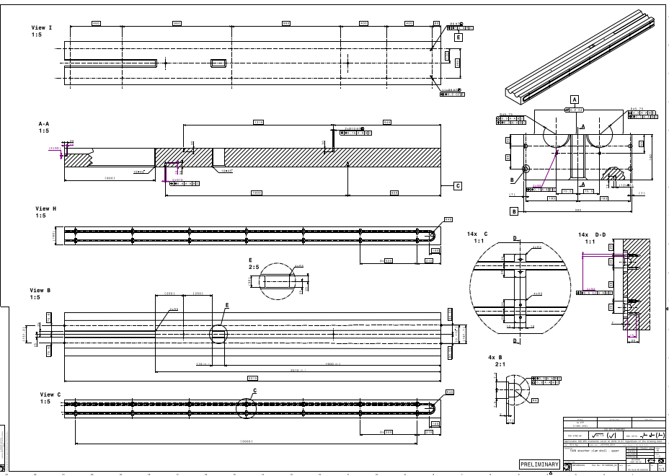

Slide 18
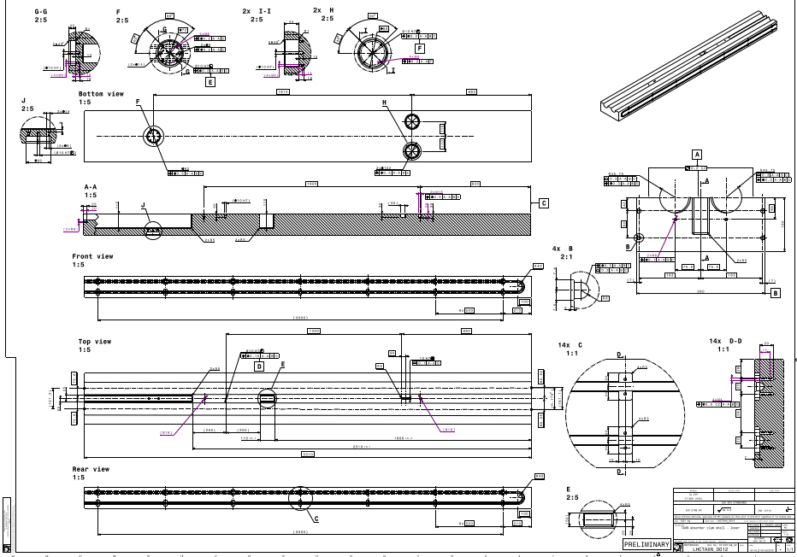

Slide 19
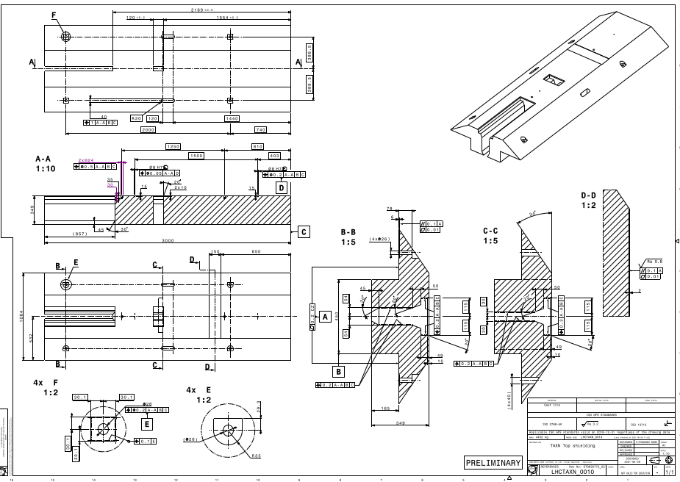

Slide 20
Material deliverables
TAXN absorber (4 units, Cu)
TAXS absorber (4 units, Cu)
Ancillaries (absorber supports/piping, manifolds)
Cradle/Shielding (2 units, cast iron)
Marble shielding (4 units)
Sarcophagui (6-8 units)
TAXN top cover (2 units)

Slide 21
Non- material deliverables
FABRICATION/ASSEMBLY PLAN (Q/A)→ To be prepared by the manufacturer and accepted in a Production Readiness Review
  Lead technician, single contact point for technical discussions.
  Testing & metrology resources.

Slide 22
Acceptance criteria
The major components of the Acceptance Criteria include the following:
Dimensional checks (Fiducialization measurements). Fitting of the absorbers around the beampipe is key factor for the performance.
Manufacturing record, material certificates
Pressure tests (piping)
Continuity checks for thermocouples
Ancillaries and special tooling needed for handling will be delivered with the absorbers

Slide 23
Summary:
Design done at CERN
Procurement/manufacturing of components according to CERN drawings and detailed specifications.
Assembly & acceptance tests at factory and and reception tests at CERN with on-site support of industrial contractors (ex.: mechanical assembly, welding, quality control)

Slide 24
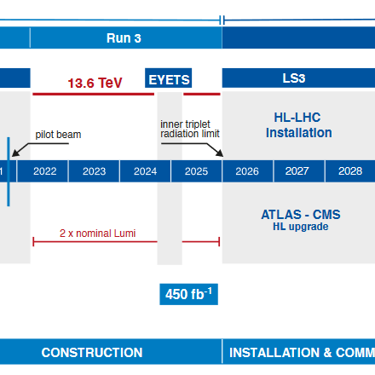
Deliverables
Q3 2024 - Q1 2025

Slide 25
Thanks

